Slide 1
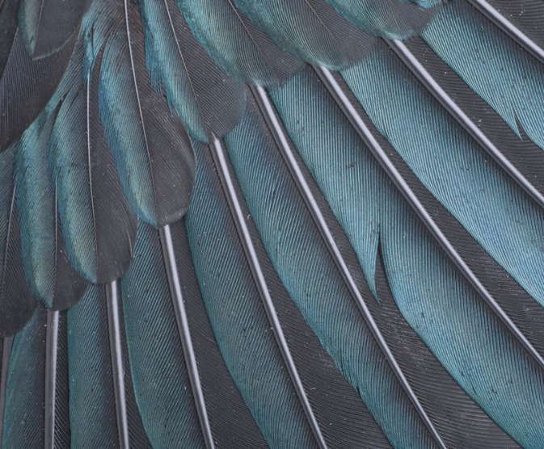
Opportunities for using
te reo Māori
Professor
Rangi Matamua and
Greta Dromgool
Thursday 22 November 2018
Tui, Prosthemadera novaeseelandiae, collected 18 April 2001, Dunedin, New Zealand. Gift of the Department of Conservation via Massey University, 2008-2010. CC BY-NC-ND 4.0. Te Papa (OR.029126)
© Copyright. University of Waikato. All Rights Reserved | www.sciencelearn.org.nz
All images are copyrighted. For further information, please refer to enquiries@sciencelearn.org.nz
Notes:
Image: https://collections.tepapa.govt.nz/object/1109638

Slide 2

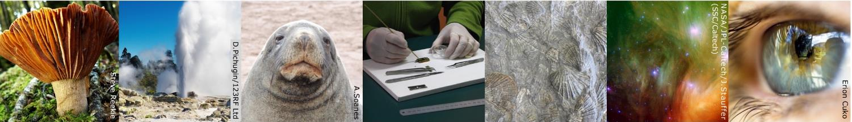
Pokapū Akoranga Pūtaiao
A trustworthy online resource – produced by educators and scientists
Based on world-class New Zealand science research
Supported by learning activities, information about the key science ideas and concepts, multimedia tools and other resources
Written for New Zealand teachers and students
Notes:
The Science Learning Hub (SLH) is funded by the NZ Government - MBIE Ministry of Business, Innovation and Employment - under the Curious Minds fund
www.sciencelearn.org.nz

Slide 3
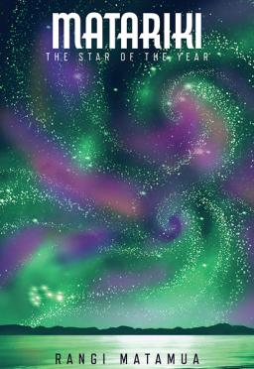
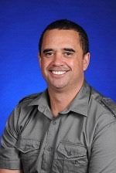
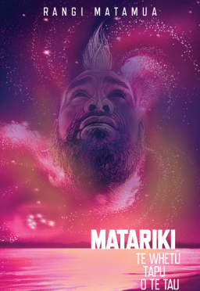
Professor Rangi Matamua
Image of Prof.Matamua © Rangi Matamua/UOW
Book images, Huia Publishers
Notes:
Matariki: star of the year: www.huia.co.nz/huia-bookshop/authors/author/201 - Book images are used under editorial use
Professor Rangi Matamua’s Facebook page: www.facebook.com/Livingbythestars

Slide 4
Purpose
In this webinar we will:
Share our thoughts about why we want to use Te reo Māori in the science classroom.
Discuss what opportunities there might be to use Te reo Māori when teaching science.
Share high quality resources and inspiring ideas to support your use of Te reo Māori.
© Copyright. University of Waikato. All Rights Reserved | www.sciencelearn.org.nz
All images are copyrighted. For further information, please refer to enquiries@sciencelearn.org.nz

Slide 5
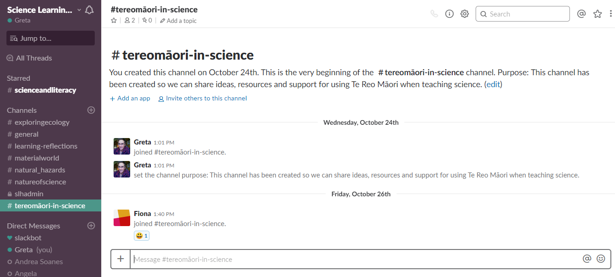
Slack
Continue the discussions
© Copyright. University of Waikato. All Rights Reserved | www.sciencelearn.org.nz
All images are copyrighted. For further information, please refer to enquiries@sciencelearn.org.nz
Notes:
Image: https://slh-talk.slack.com/messages/CDL529ERW/

Slide 6
Index
Topic | Slide show number(s) | Video timecode
Introducing the Science Learning Hub and presenters | 1–5 | 00:00
Index | 6 | 3:32
Why are we wanting to increase the amount of te reo Māori in the classroom? | 7–13 | 3:46
How can we do this? | 14–16 | 15:13
People | 17 | 20:22
Environment | 18–19 | 22:25
Teacher resources | 20–23 | 24:00
Student resources | 24–34 | 26:17
Adapting resources | 35–38 | 36:16
Setting goals | 39–41 | 37:27
SLH links, keep in touch and thanks | 42 | 39:24
© Copyright. University of Waikato. All Rights Reserved | www.sciencelearn.org.nz
All images are copyrighted. For further information, please refer to enquiries@sciencelearn.org.nz

Slide 7
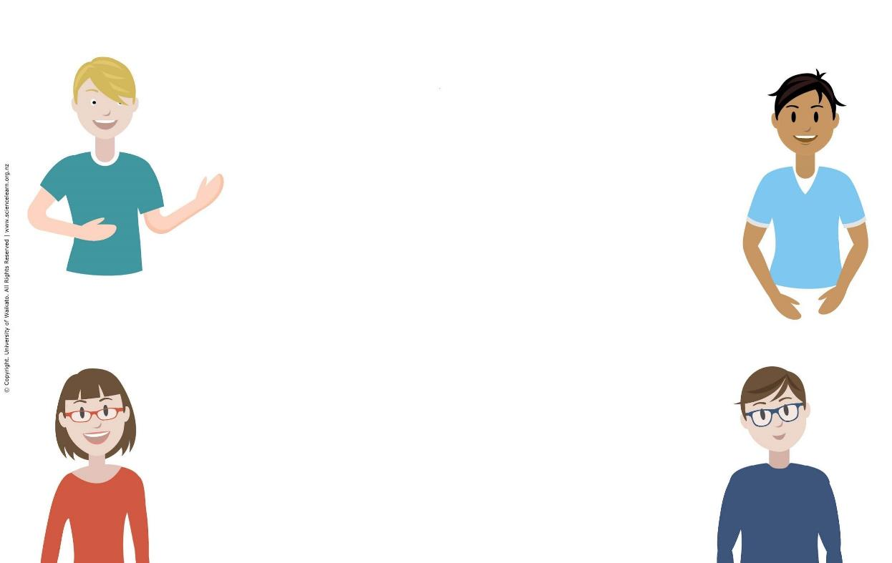
Why
© Steve Hathaway
© Copyright. University of Waikato. All Rights Reserved | www.sciencelearn.org.nz
All images are copyrighted. For further information, please refer to enquiries@sciencelearn.org.nz
Notes:
Why are you here?
Want to learn more about te reo Māori statistics in Primary and Intermediate schools - NZCER survey: www.nzcer.org.nz/system/files/National%20Survey_A%CC%84konga%20Ma%CC%84ori.pdf

Slide 8

Participant responses
Culturally responsive teaching – making all students feel they belong in my class. Building better relationships with Māori students.
Broaden my worldview; hear about other perspectives. Creating opportunities to connect to our unique indigenous culture.To add to my kete.
To engage students in science in a way that connects with who they are, their identity as Māori and cultural knowledge.
I think that ‘science’ is seen as a western construct and that using Māori, or other languages in the science classroom, quickly shifts us out of being in a "white western space" to a space for all of our students' and that ‘science’ is not something that has only being carried out and constructed by "white/western culture”.
It's one of our national languages so that along with NZ sign language should be spoken equally in the classroom so all New Zealanders can communicate and feel included.
© Steve Hathaway
© Copyright. University of Waikato. All Rights Reserved | www.sciencelearn.org.nz
All images are copyrighted. For further information, please refer to enquiries@sciencelearn.org.nz
Notes:
Why are you here?

Slide 9
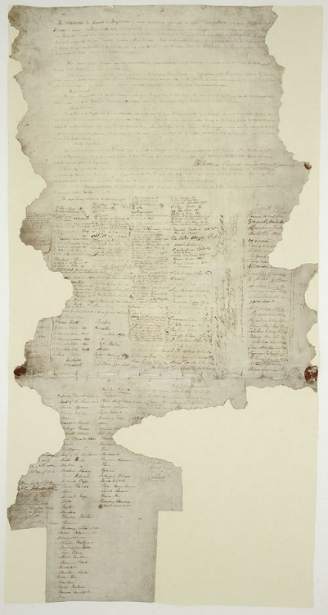
Te Tiriti o Waitangi
Image Public Domain: https://commons.wikimedia.org/wiki/File:Treatyofwaitangi.jpg
© Copyright. University of Waikato. All Rights Reserved | www.sciencelearn.org.nz
All images are copyrighted. For further information, please refer to enquiries@sciencelearn.org.nz
Notes:
Image: https://en.wikipedia.org/wiki/Treaty_of_Waitangi
https://upload.wikimedia.org/wikipedia/commons/thumb/8/87/Treatyofwaitangi.jpg/500px-Treatyofwaitangi.jpg
TKI: http://nzcurriculum.tki.org.nz/Principles/Treaty-of-Waitangi/Resources#collapsible6
Hana O’Regan’s 2018 speech:
https://edtalks.org/#/video/hana-oregan-to-reo-ki-te-raki-to-mana-ki-te-whenua
Easy to read: www.schoolnews.co.nz/2016/11/te-tiriti-o-waitangi-living-the-values/

Slide 10
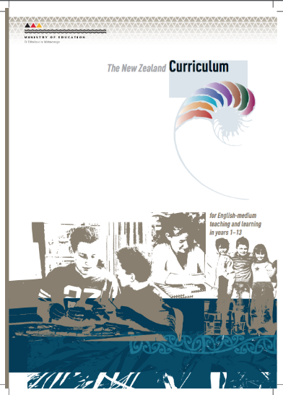




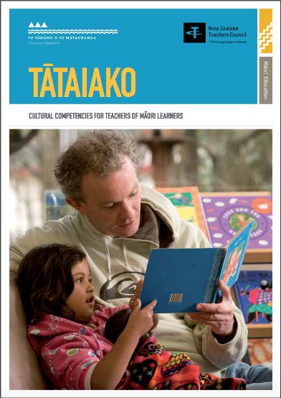
© Copyright. University of Waikato. All Rights Reserved | www.sciencelearn.org.nz
All images are copyrighted. For further information, please refer to enquiries@sciencelearn.org.nz
Notes:
NZC: http://nzcurriculum.tki.org.nz/The-New-Zealand-Curriculum#collapsible8
Te Marautanga o Aotearoa: http://tmoa.tki.org.nz/Te-Marautanga-o-Aotearoa/Te-Marautanga-o-Aotearoa
Te Whāriki: https://tewhariki.tki.org.nz/
Ka Hikitia: https://www.education.govt.nz/assets/Documents/Ministry/Strategies-and-policies/Ka-Hikitia/KaHikitiaAcceleratingSuccessEnglish.pdf
Our Code, Our Standards: https://educationcouncil.org.nz/sites/default/files/Our%20Code%20Our%20Standards%20web%20booklet%20FINAL.pdf
Tātaiako: https://educationcouncil.org.nz/sites/default/files/Tataiako_FINAL_web_mar16.pdf
NZC: The curriculum acknowledges the principles of the Treaty of Waitangi and the bicultural foundations of Aotearoa New Zealand. All students have the opportunity to acquire knowledge of te reo Māori me ōna tikanga. p9

Slide 11
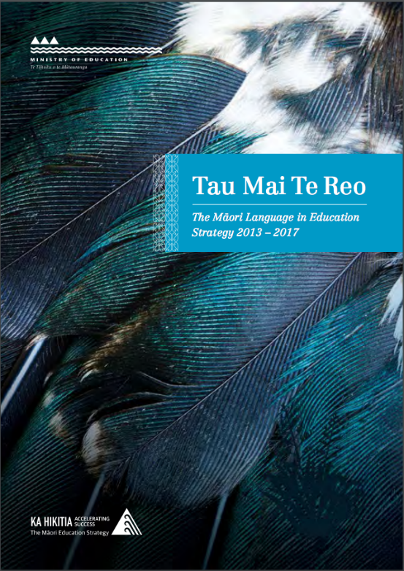
Tau Mai Te Reo
The Māori Language in Education Strategy
© Copyright. University of Waikato. All Rights Reserved | www.sciencelearn.org.nz
Slide image: Ministry of Education, Crown Copyright.
Notes:
Tau mai Te Reo: www.education.govt.nz/assets/Documents/Ministry/Strategies-and-policies/TauMaiTeReoFullStrategy-English.pdf
High quality Māori language in education is important because it: supports identity, language and culture, provides all Māori students with the opportunity to realise their unique potential and to succeed as Māori , gives expression to the national curriculum documents, supports community and iwi commitments to Māori language intergenerational transmission and language survival.

Slide 12
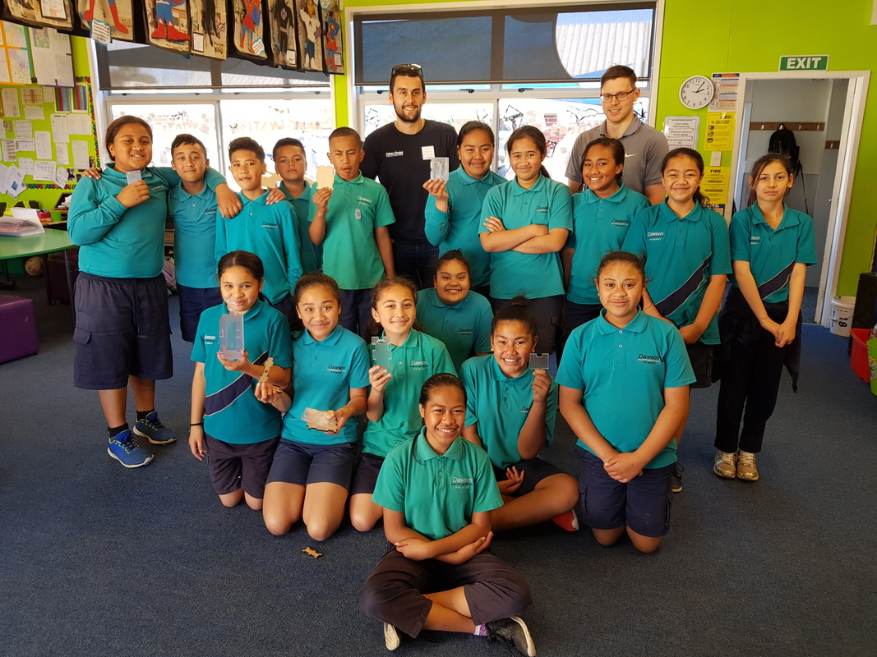
©Dawson Primary School
© Copyright. University of Waikato. All Rights Reserved | www.sciencelearn.org.nz
All images are copyrighted. For further information, please refer to enquiries@sciencelearn.org.nz
Notes:
Image: www.sciencelearn.org.nz/images/3572-engineers-working-with-dawson-primary-school-students

Slide 13
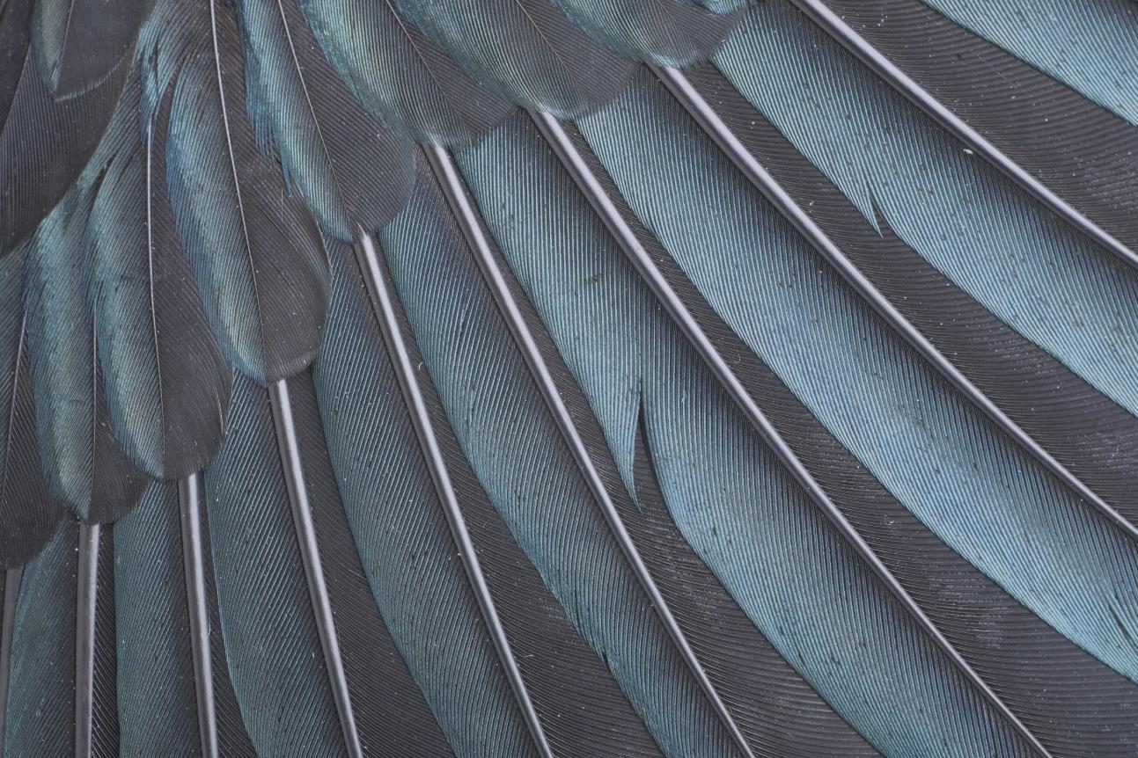
Every contribution that we make, no matter the size, makes an important contribution to the growth and development of our language.
© Copyright. University of Waikato. All Rights Reserved | www.sciencelearn.org.nz
Background image Tui, Prosthemadera novaeseelandiae, collected 18 April 2001, Dunedin, New Zealand. Gift of the Department of Conservation via Massey University, 2008-2010. CC BY-NC-ND 4.0. Te Papa (OR.029126)
Notes:
Promoting positive attitudes to the Māori language in the classroom
Māori Language commision, 2000.

Slide 14
How
© Steve Hathaway
© Copyright. University of Waikato. All Rights Reserved | www.sciencelearn.org.nz
All images are copyrighted. For further information, please refer to enquiries@sciencelearn.org.nz
Notes:
What are you already doing in your classrooms

Slide 15
Participant responses
For greetings, requests to listen or look, name of month on the whiteboard, te reo names of native plant and animal species.
I try to use common classroom commands but this can be hard at times with no Māori students in front of you.
We speak Māori every day in conversations and instruction in lessons. About 50% of the time. Sometimes it's hard to know the right kupu to choose.
I have a whakataukī displayed and dates in te reo Māori. I have taught navigation with Māori compass and some Matariki myths and legends.
© Steve Hathaway
Karakia; greetings; correct pronunciation of student names; key kupu.
Using Paekupu http://paekupu.co.nz to examine the tikanga of sciency words.
I'm still just at the greetings stage!
© Copyright. University of Waikato. All Rights Reserved | www.sciencelearn.org.nz
All images are copyrighted. For further information, please refer to enquiries@sciencelearn.org.nz
Notes:
These are a selection of the contributions made to the webinar.

Slide 16
So what can teachers do?
Examine what we really think about te reo Māori in the classroom and what we believe we should do about it.
Utilise available resources.
Te reo Māori in classrooms, current policy, future practice, by Georgina Stewart.
© Steve Hathaway
© Copyright. University of Waikato. All Rights Reserved | www.sciencelearn.org.nz
All images are copyrighted. For further information, please refer to enquiries@sciencelearn.org.nz
Notes:
Georgina Stewart’s article: www.nzcer.org.nz/system/files/journals/set/downloads/set2014_3_003.pdf
Resources:
People, the environment, Teacher reference books and articles
Prepared resources
Teacher/student developed resources
Q: How does what you already do match these categories?

Slide 17
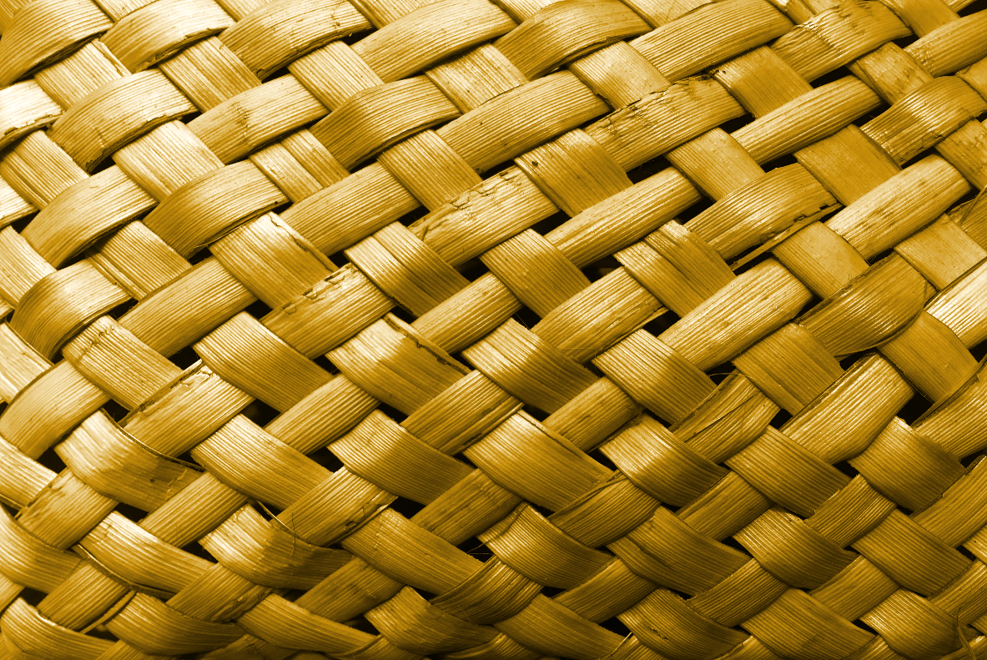
People
He tangata, he tangata, he tangata
Whānau
Community
Students
Colleagues
You
© Copyright. University of Waikato. All Rights Reserved | www.sciencelearn.org.nz
All images are copyrighted. For further information, please refer to enquiries@sciencelearn.org.nz
Notes:
TKI on partnerships: http://nzcurriculum.tki.org.nz/Principles/Community-engagement
http://partnerships.ruia.educationalleaders.govt.nz/Educationally-powerful-partnerships
Māori Maps: https://maorimaps.com/node/14479

Slide 18
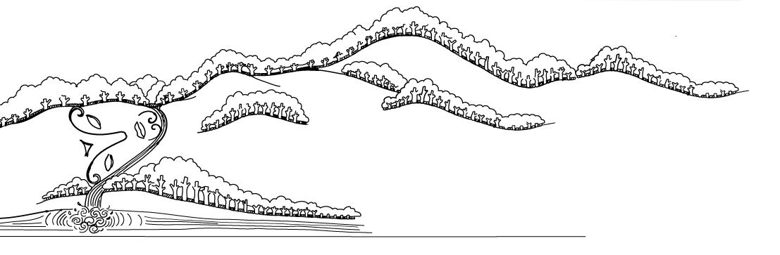
The environment
© Copyright. University of Waikato. All Rights Reserved | www.sciencelearn.org.nz
All images are copyrighted. For further information, please refer to enquiries@sciencelearn.org.nz
Notes:
www.enviroschools.org.nz/
Enviroschools: www.enviroschools.org.nz/members_area/maori-perspectives

Slide 19
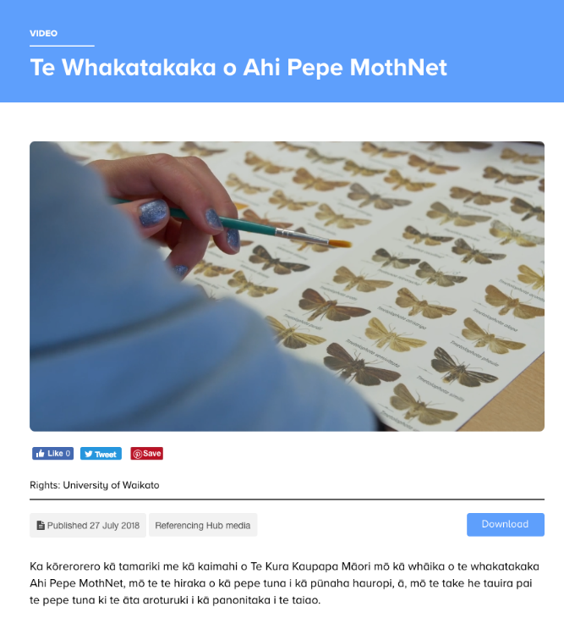
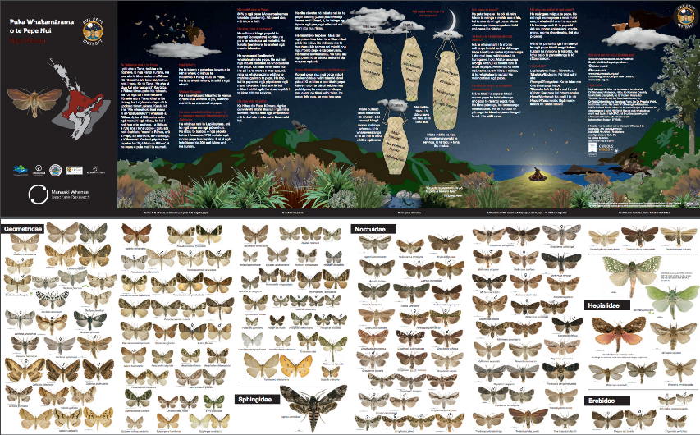
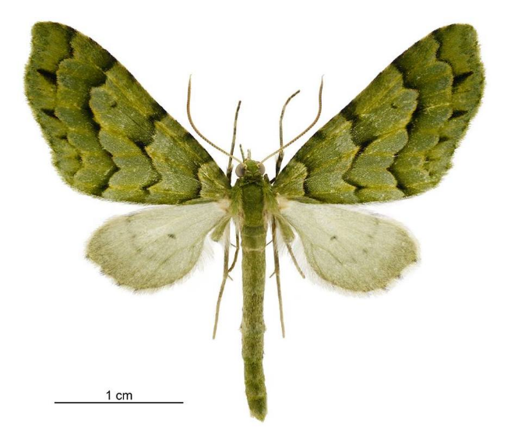
Science learning hub resources
Ahi Pepe Mothnet
© Steve Hathaway
© Copyright. f Waikato. All Rights Reserved | www.sciencelearn.org.nz
Moth guide and specimeUniversity on image © Manaaki Whenua – Landcare Research. Video still © UOW.
Notes:
www.sciencelearn.org.nz/videos/1834-te-whakatakaka-o-ahi-pepe-mothnet
Puka Whakamārama o Te Pepe Nui – moth identification guides – have been sent to New Zealand schools and are available for download.

Slide 20
Teacher resources
Revisit curriculum documents
Government strategies
Researchers
Reading lists e.g. end of Te reo Māori in classrooms, current policy, future practice, by Georgina Stewart
Blogs and podcasts
Te Tiriti o Waitangi Workshops
Professional Learning Development
Science Learning Hub
© Copyright. University of Waikato. All Rights Reserved | www.sciencelearn.org.nz
All images are copyrighted. For further information, please refer to enquiries@sciencelearn.org.nz

Slide 21
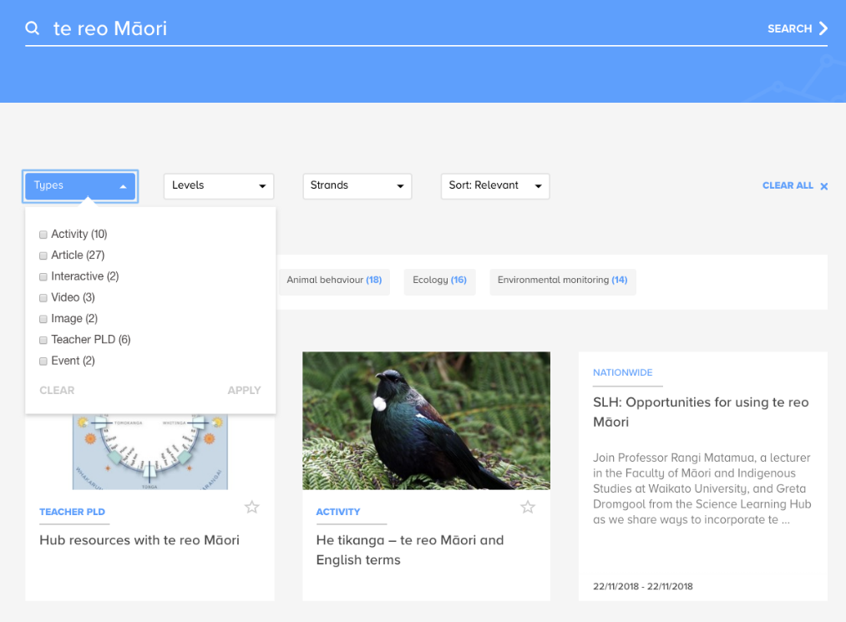
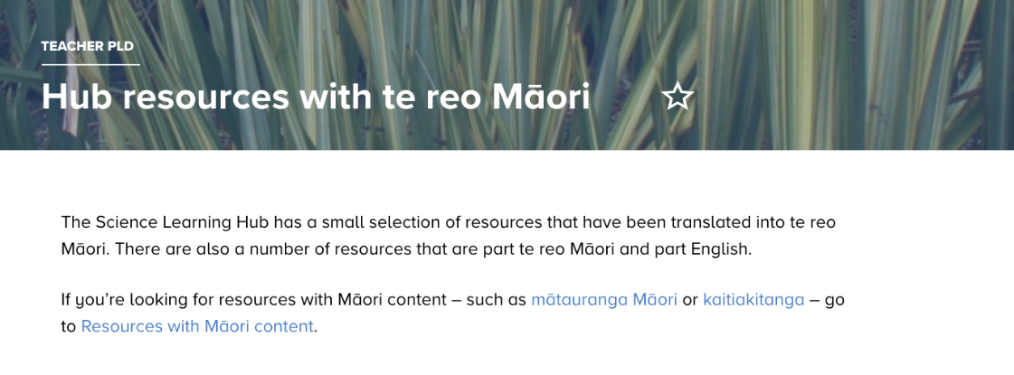
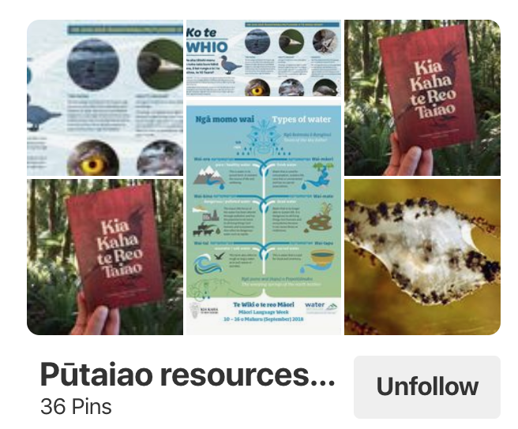
Teacher resources
Science learning hub resources
© Steve Hathaway
© Copyright. University of Waikato. All Rights Reserved | www.sciencelearn.org.nz
All images are copyrighted. For further information, please refer to enquiries@sciencelearn.org.nz
Notes:
Hub resources with te reo Māori: www.sciencelearn.org.nz/resources/2595-hub-resources-with-te-reo-maori
Pinterest image: www.pinterest.nz/nzsciencelearn/boards/
Search image: www.sciencelearn.org.nz/search?term=te%20reo%20M%C4%81ori

Slide 22
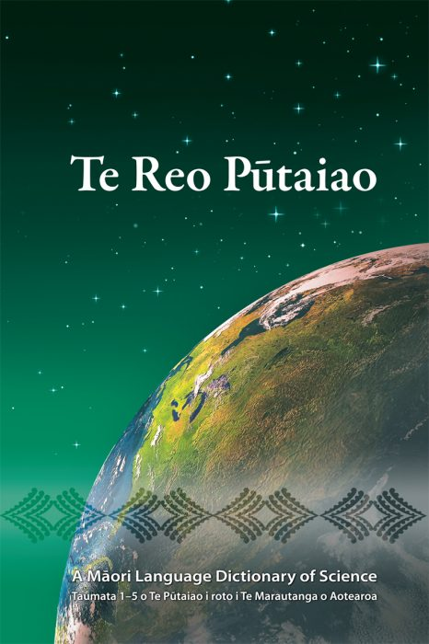
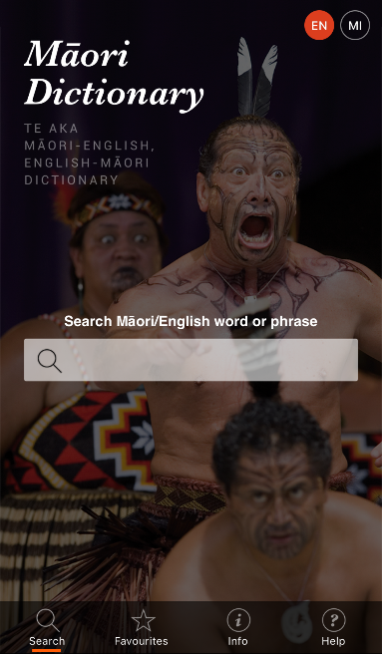
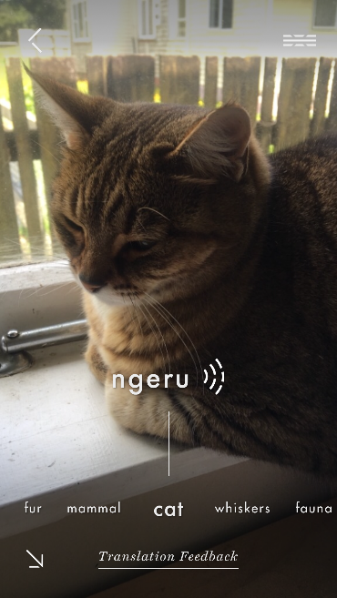
Teacher resources
Dictionaries
© Steve Hathaway
© Copyright. University of Waikato. All Rights Reserved | www.sciencelearn.org.nz
Māori Dictionary app, ©AUT; Te Reo Te Reo Pūtaiao cover ©He Kupenga Hao i te Reo Ltd; and Kupu app ©Spark.
Notes:
Image:Te Reo Pūtaiao: www.kupengahao.co.nz/product/te-reo-putaiao/
www.youtube.com/watch?v=BI0ST3CtIkE
Places to Learn Te reo Māori:
Mentioned by Rangi: www.kurareo.com/rehita
Others:
https://thespinoff.co.nz/atea/12-09-2017/where-to-learn-te-reo-maori-anywhere-in-aotearoa-for-free-or-next-to-nothing/

Slide 23
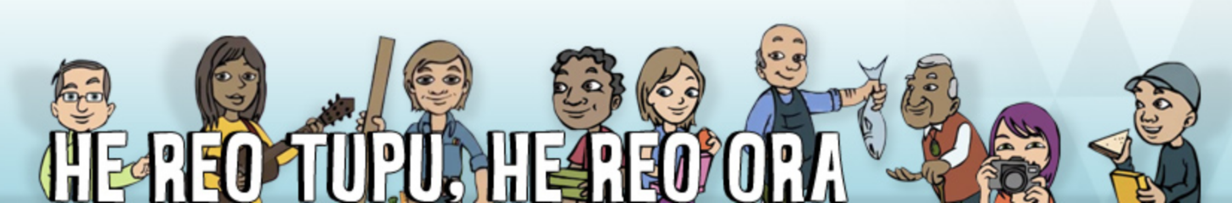
Teacher resources
Te Kete Ipurangi
A growing language is a living language
Te reo Māori and tikanga Māori are intertwined, and so learning te reo Māori gives students access to te ao Māori (the Māori world) and to Māori world views.
http://hereoora.tki.org.nz/Teachers-notes/Teaching-te-reo-Maori-effectively
© Steve Hathaway
© Copyright. University of Waikato. All Rights Reserved | www.sciencelearn.org.nz
Image from Te Kete Ipurangi, ©Ministry of Education, Crown Copyright.
Notes:
Editorial use covers this
http://hereoora.tki.org.nz/Teachers-notes/Teaching-te-reo-Maori-effectively

Slide 24

Student resources
Receptive modes:
Listening
Viewing
Reading
Productive modes:
Speaking
Presenting
Writing
© Steve Hathaway
© Copyright. University of Waikato. All Rights Reserved | www.sciencelearn.org.nz
All images are copyrighted. For further information, please refer to enquiries@sciencelearn.org.nz
Notes:
www.tewikiotereomaori.co.nz/te-wiki-rauemi/postcard-ako/
Modes: http://tereomaori.tki.org.nz/Curriculum-guidelines/Teaching-and-learning-te-reo-Maori/Key-understandings-about-effective-language-learning/Language-knowledge

Slide 25
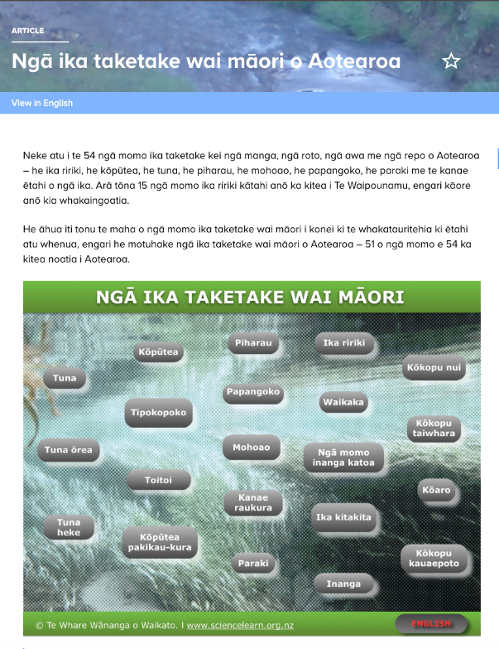
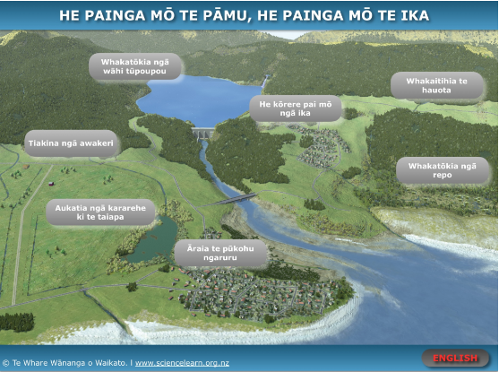
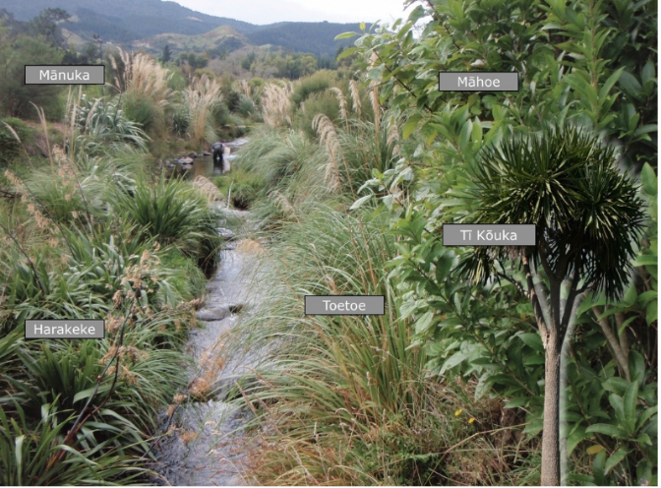
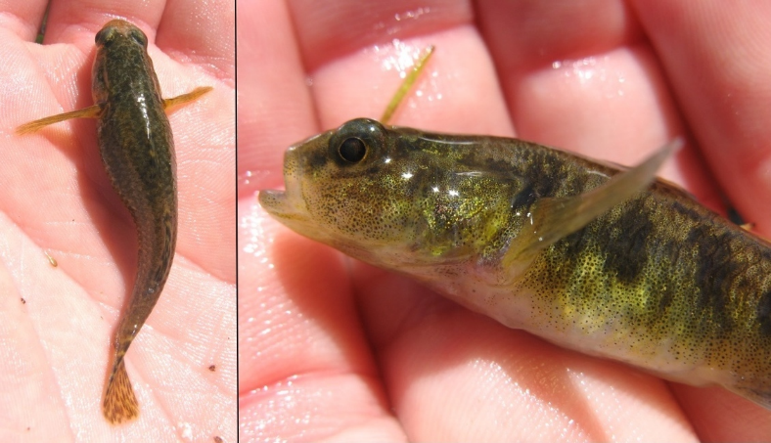
Science learning hub resources
The environment
© Steve Hathaway
© Copyright. University of Waikato. All Rights Reserved | www.sciencelearn.org.nz
All images are copyrighted. Bullies image Stella McQueen, Creative Commons 4.0; stream image, Rob Davies-Colley, NIWA. For further information, please refer to enquiries@sciencelearn.org.nz
Notes:
Article: www.sciencelearn.org.nz/resources/2573-nga-ika-taketake-wai-maori-o-aotearoa
Fish: www.sciencelearn.org.nz/images/3465-koputea
Interactive: www.sciencelearn.org.nz/image_maps/64-he-painga-mo-te-pamu-he-painga-mo-te-ika
Trees image: www.sciencelearn.org.nz/images/3427-te-koawa-o-waitete

Slide 26
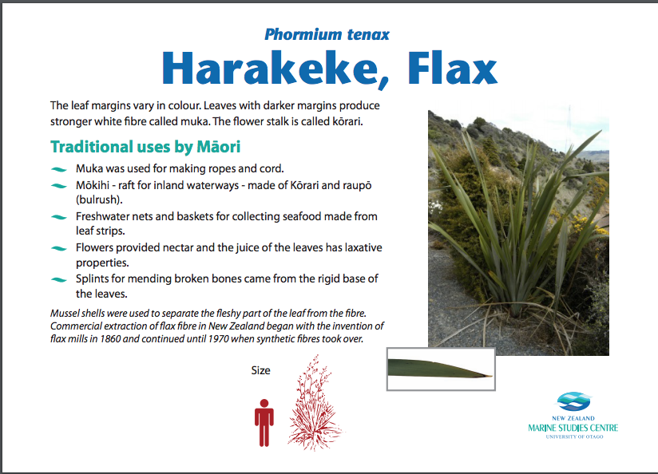

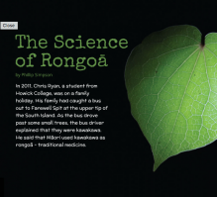
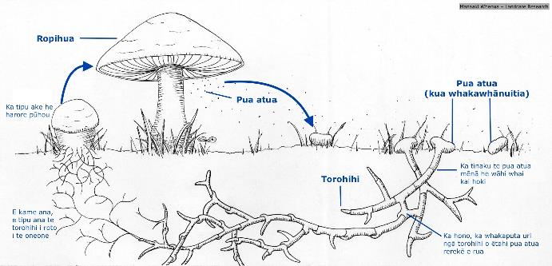
Student resources
© Steve Hathaway
© Copyright. University of Waikato. All Rights Reserved | www.sciencelearn.org.nz
Ngā Hekaheka o Aotearoa cover ©Manaaki Whenua - Landcare Research; Science of Rongoā ©Ministry of Education, Crown Copyright; and Harakeke, Flax resources, ©New Zealand Marine Studies, University of Otago. For further information, please refer to enquiries@sciencelearn.org.nz
Notes:
www.otago.ac.nz/marine-studies/resources/download/otago062823.pdf
Rongoa: http://instructionalseries.tki.org.nz/Instructional-Series/Connected/Connected-2015-level-3-Fact-or-Fiction/The-Science-of-Rongoa
Other Rongoa links: www.tepapa.govt.nz/discover-collections/read-watch-play/maori/maori-medicine
Ngā Hekaheka on the Hub: www.sciencelearn.org.nz/resources/2673-nga-hekaheka-o-aotearoa-kuputaka
Ngā Hekaheka: www.huia.co.nz/huia-services/resources-for-teachers/nga-hekaheka-o-aotearoa/

Slide 27
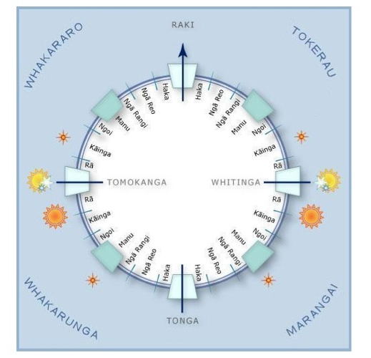
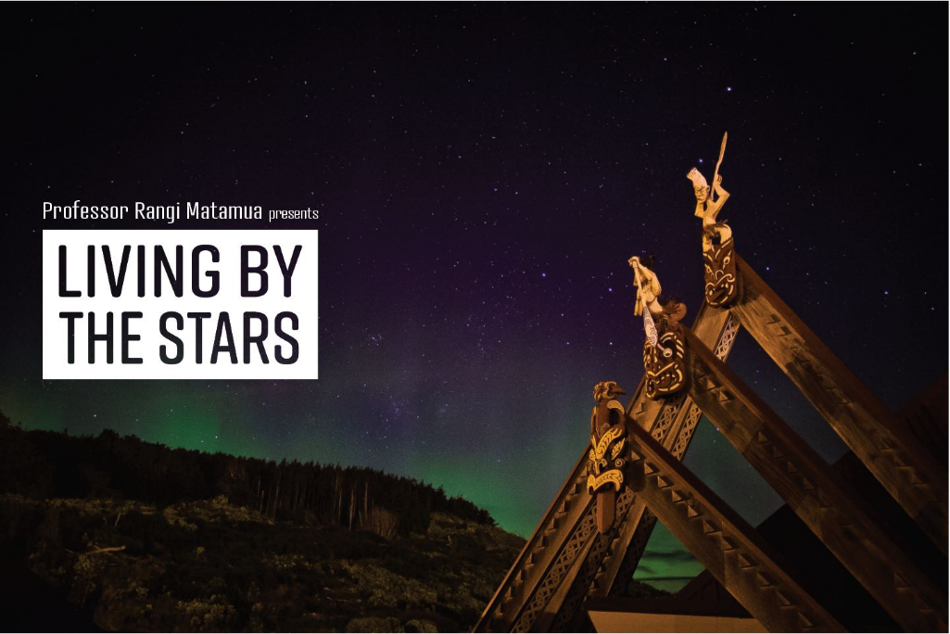
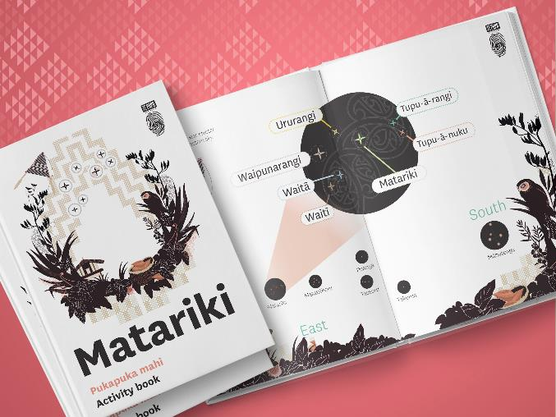
Student resources
Astronomy and the stars
© Copyright. University of Waikato. All Rights Reserved | www.sciencelearn.org.nz
All images are copyrighted. Star compass ©Te Aurere; Matariki activity book images ©Te Papa; Matariki book covers ©Huia Publishers. Living by the Stars image © Rangi Matamua. For further information, please refer to enquiries@sciencelearn.org.nz
Notes:
Star compass: www.sciencelearn.org.nz/images/676-star-compass
Rangi’s Facebok page: www.facebook.com/Livingbythestars/photos/a.2008011096119859/2008110506109918/?type=1&theater
Rangi’s books: www.huia.co.nz/huia-bookshop/authors/author/201
Te Papa Matariki resources: www.tepapa.govt.nz/learn/for-educators/teaching-resources/matariki-activity-book

Slide 28

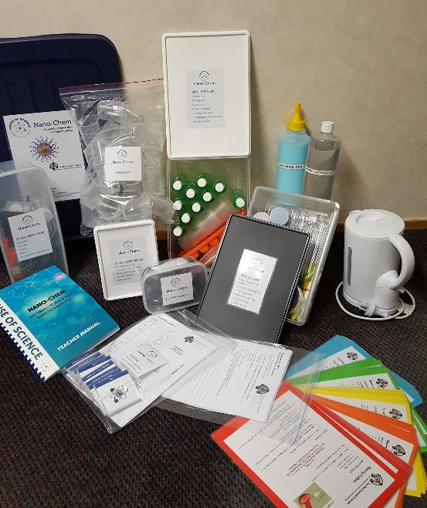
House of Science kits
Hands-on experiments
Year 1-8
Range of topics
Include bi-lingual student and teacher instructions
©House of Science
https://houseofscience.nz/resources/
© Copyright. University of Waikato. All Rights Reserved | www.sciencelearn.org.nz
All images are copyrighted. For further information, please refer to enquiries@sciencelearn.org.nz
Notes:
https://houseofscience.nz/resources

Slide 29
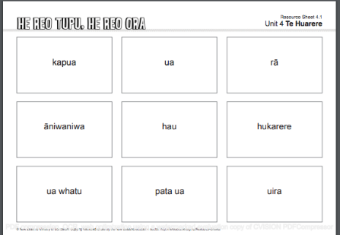
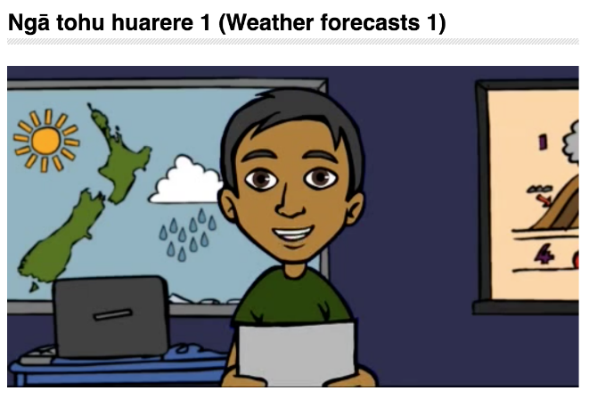
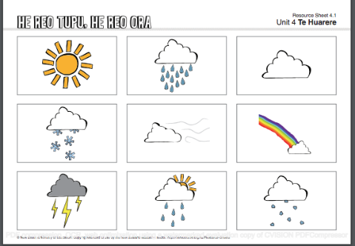
Te Kete Ipurangi
© Steve Hathaway
© Copyright. University of Waikato. All Rights Reserved | www.sciencelearn.org.nz
Images from Te Kete Ipurangi, ©Ministry of Education, Crown Copyright.
Notes:
TKI He reo tupu, he reo ora:
Unit Plans: http://hereoora.tki.org.nz/Unit-plans for example: Te huarere (The weather)
Flash cards: http://hereoora.tki.org.nz/Unit-plans/Unit-4-Te-huarere/Tasks-and-activities/Flashcards-2
Video: http://hereoora.tki.org.nz/Unit-plans/Unit-4-Te-huarere/Reomations/Nga-tohu-huarere-1-Weather-forecasts-1

Slide 30
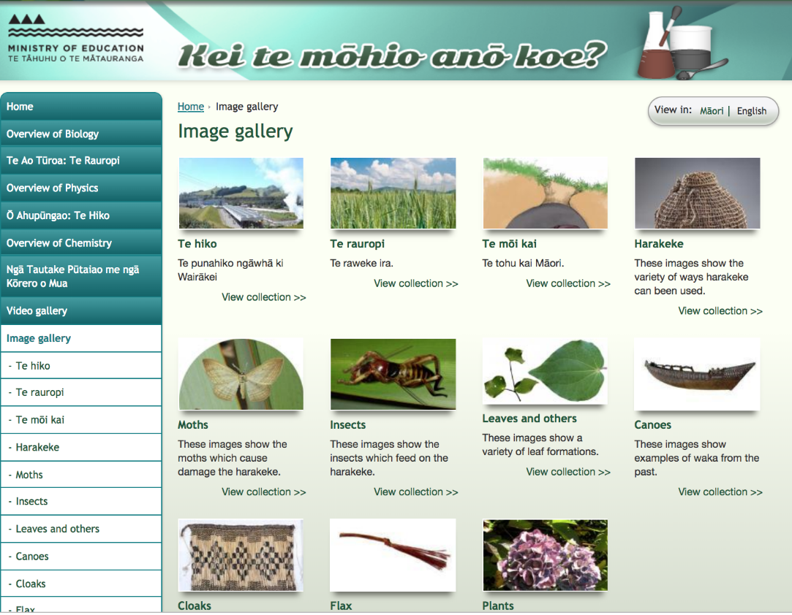
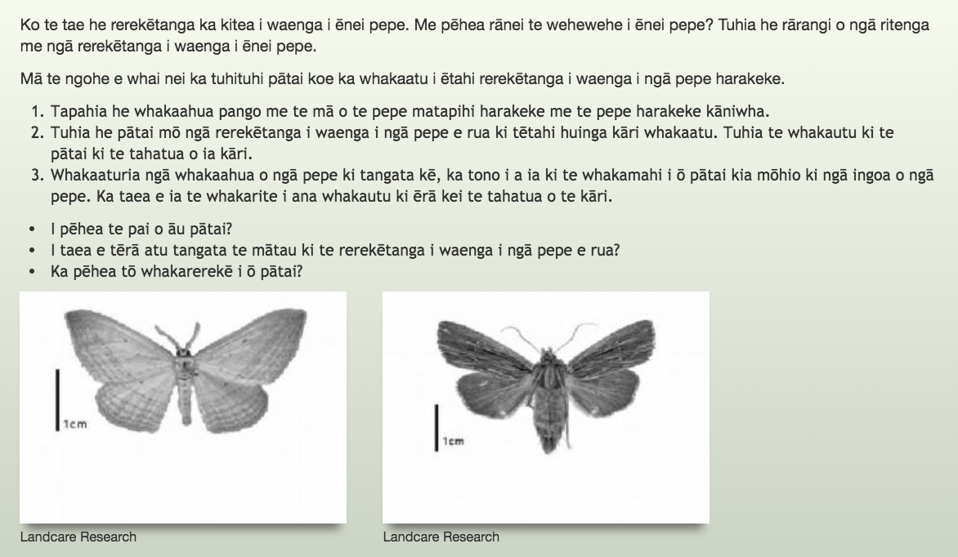
Te Kete Ipurangi
© Steve Hathaway
© Copyright. University of Waikato. All Rights Reserved | www.sciencelearn.org.nz
All images are copyrighted. For further information, please refer to enquiries@sciencelearn.org.nz
Notes:
http://eng.keitemohiokoe.tki.org.nz/Image-gallery
http://eng.keitemohiokoe.tki.org.nz/
http://eng.keitemohiokoe.tki.org.nz/Te-Ao-Turoa-Koiora/Te-tautuhi-tipu-me-nga-kararehe/Te-Ngohe-Me-pehea-te-wehewehe-i-nga-momo-pepe-Nga-Taumata-3-me-4

Slide 31
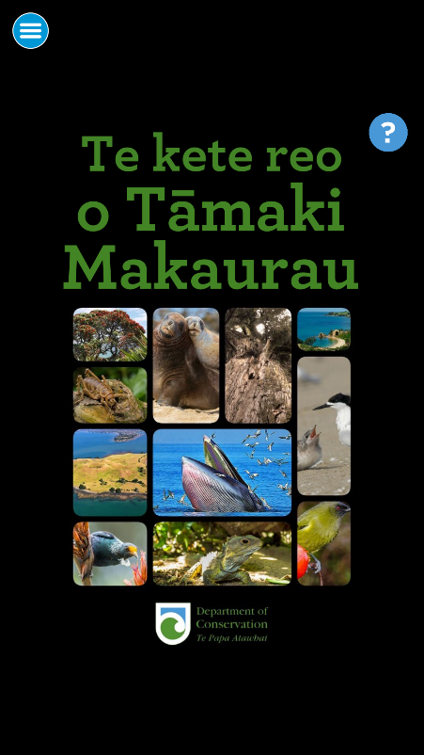
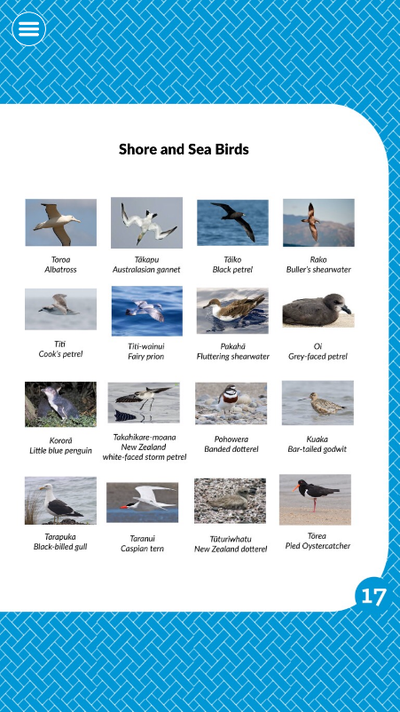

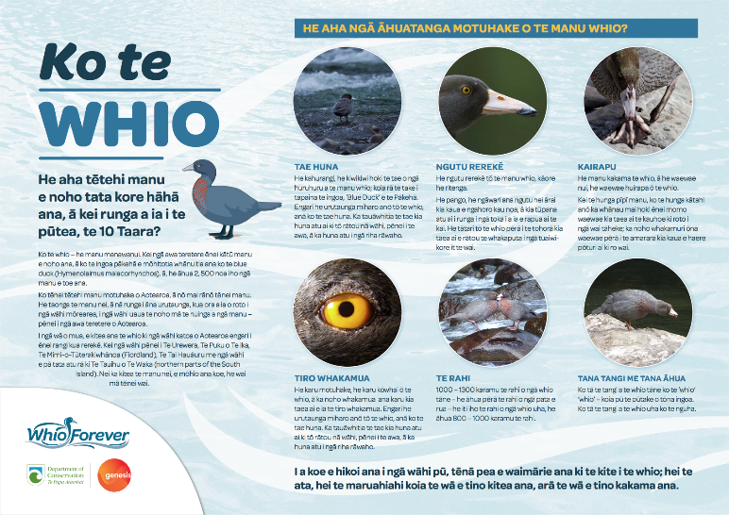
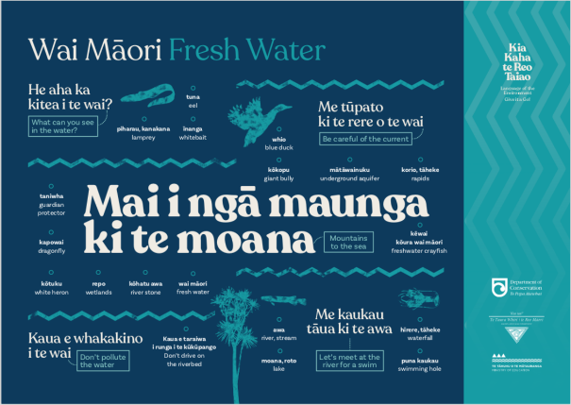
Department of Conservation resources
© Copyright. University of Waikato. All Rights Reserved | www.sciencelearn.org.nz
Kia Kaha te Reo Taiao cover ©Te Taura Whiri i te Reo Māori. All other images ©Department of Conservation. For further information, please refer to enquiries@sciencelearn.org.nz
Notes:
Taiao Poster Images from: www.tewikiotereomaori.co.nz/te-wiki-rauemi/taiao/
Whio poster Image: www.doc.govt.nz/globalassets/documents/conservation/native-animals/birds/whio/ko-te-whio.pdf

Slide 32
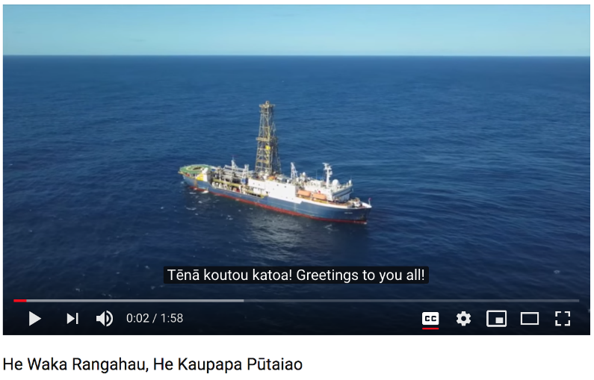
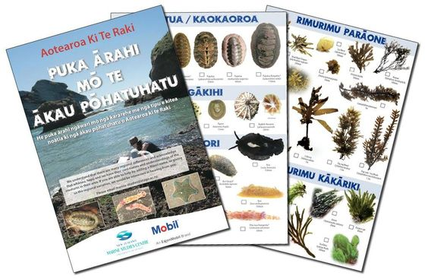
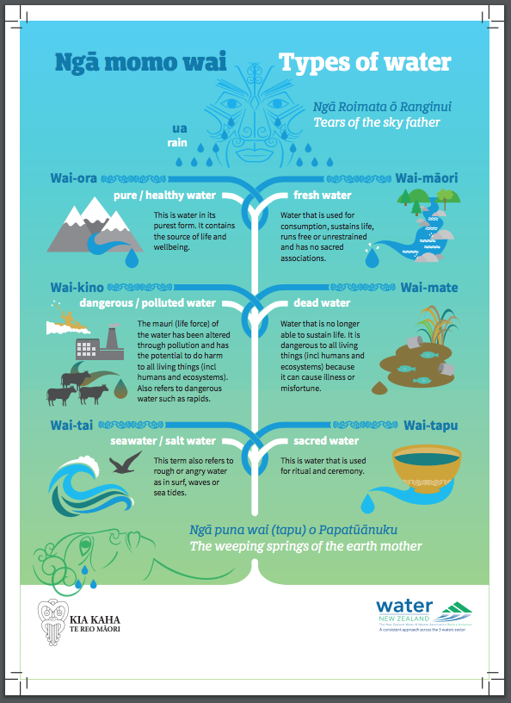
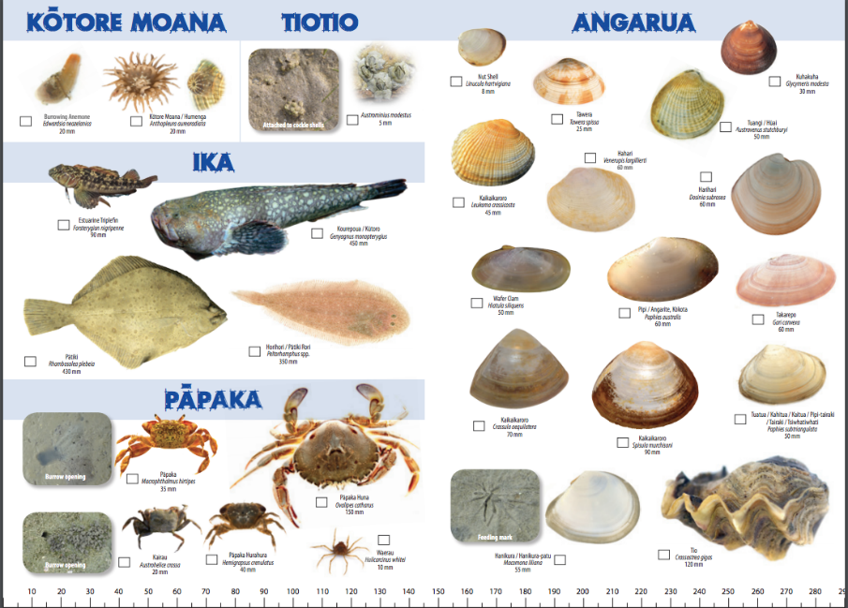
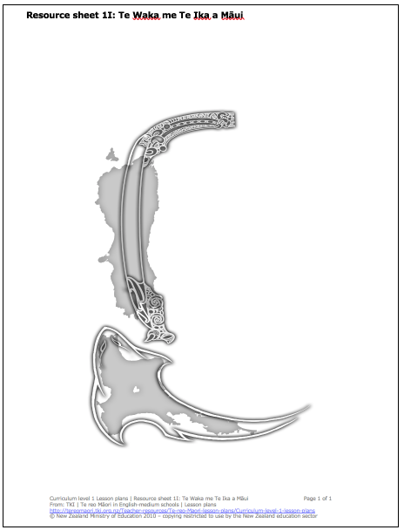

Student resources
© Copyright. University of Waikato. All Rights Reserved | www.sciencelearn.org.nz
Ngā Momo Wai ©Water NZ; Te Ika a Māui - Māui’s fish ©Ministry of Education, Crown Copyright.; He Waka Rangahau, He Kaupapa Pūtaiao video, ©IODP/ Joides Resolution; and screengrabs of all other resources, ©New Zealand Marine Studies, University of Otago. For further information, please refer to enquiries@sciencelearn.org.
Notes:
Video: www.youtube.com/watch?v=H85_uOilGIc
Marine resources: www.otago.ac.nz/marine-studies/resources/download/otago057316.html#maori
Map: http://tereomaori.tki.org.nz/Teacher-tools/Te-reo-Maori-lesson-plans/Curriculum-level-1/Te-Ika-a-Maui-Maui-s-fish
Water poster: www.waternz.org.nz/Attachment?Action=Download&Attachment_id=3347

Slide 33




Student resources
Physics
© Steve Hathaway
© Copyright. University of Waikato. All Rights Reserved | www.sciencelearn.org.nz
All images are copyrighted. Pukuhiko Paihikara video and Te Reo Physics Resources, ©Victoria University of Wellington; and SI Units, ©Measurement Standards Laboratory of New Zealand. For further information, please refer to enquiries@sciencelearn.org.nz
Notes:
Measurement: www.measurement.govt.nz/metrology/si-units/
Te reo Physics resources: http://ecs.victoria.ac.nz/technical/TeReoPhysics/

Slide 34




Student resources
© Steve Hathaway
© Copyright. University of Waikato. All Rights Reserved | www.sciencelearn.org.nz
All images are copyrighted. Pōtae Pai ©Maori Television; Koha - a Gift of Knowledge and Kīwaha - Kēreru Cards, ©Core Education; and stamp, ©Creative Classrooms. For further information, please refer to enquiries@sciencelearn.org.nz
Notes:
www.maoritelevision.com/shows/potae-pai/tips-tricks
www.core-ed.org/shop/te-reo-maori-resources/koha-a-gift-of-knowledge/
www.core-ed.org/shop/te-reo-maori-resources/kiwaha-kereru-set/
www.creativeclassrooms.co.nz/personalised-stamps.html?gclid=EAIaIQobChMI58GAgoa83gIVyKuWCh1XCAPnEAYYASABEgJj8PD_BwE

Slide 35
Teacher-developed resources
How could you adapt a resource to meet the needs of your students?
© Copyright. University of Waikato. All Rights Reserved | www.sciencelearn.org.nz
All images are copyrighted. For further information, please refer to enquiries@sciencelearn.org.nz
Notes:
Signs
Tangram activity
Example from the hub – an adaptive expertise resource: www.sciencelearn.org.nz/resources/2400-adapting-slh-materials-an-overview

Slide 36

Adapting and creating resources
© Steve Hathaway
© Copyright. University of Waikato. All Rights Reserved | www.sciencelearn.org.nz
All images are copyrighted. For further information, please refer to enquiries@sciencelearn.org.nz
Notes:
Discuss with colleagues
Idea – consider Māori ideas for cross-cutting concepts, e.g. whakapapa, manaakitanga.
Use analogies

Slide 37

Adapting and creating resources
© Steve Hathaway
Rob Davies-Colley, NIWA
© Copyright. University of Waikato. All Rights Reserved | www.sciencelearn.org.nz
All images are copyrighted. For further information, please refer to enquiries@sciencelearn.org.nz
Notes:
Trees image: www.sciencelearn.org.nz/images/3427-te-koawa-o-waitete

Slide 38
Adapting and creating resources
I notice Ōku kītenga
I think Ki ōku nei whakaaro
I wonder He pātai tāku
© Copyright. University of Waikato. All Rights Reserved | www.sciencelearn.org.nz
All images are copyrighted. For further information, please refer to enquiries@sciencelearn.org.nz

Slide 39
Every contribution that we make, no matter the size, makes an important contribution to the growth and development of our language.
© Copyright. University of Waikato. All Rights Reserved | www.sciencelearn.org.nz
Background image Tui, Prosthemadera novaeseelandiae, collected 18 April 2001, Dunedin, New Zealand. Gift of the Department of Conservation via Massey University, 2008-2010. CC BY-NC-ND 4.0. Te Papa (OR.029126)
Notes:
Promoting positive attitudes to the Māori language in the classroom
Māori Language commision, 2000.

Slide 40
Goals
© Steve Hathaway
© Copyright. University of Waikato. All Rights Reserved | www.sciencelearn.org.nz
All images are copyrighted. For further information, please refer to enquiries@sciencelearn.org.nz
Notes:
Setting goals for Te Reo Māori: http://tereomaori.tki.org.nz/Professional-learning/National-Reo-Maori-Workshops-Video-archives/Part-4-Te-Whakarite-Hotaka/Setting-Goals-Providing-for-Te-Reo-Maori-Students (powerpoint)

Slide 41
Participant goals
Have a go at bringing more te reo and te ao Māori into the classroom.
First goal to have a look at these links and find one thing to incorporate.
Follow up on the resources shared here and bring them to the attention of others in my department. Have a go at bringing more te reo and te ao Māori into the classroom.
Getting the Māori Science dictionary to help bring te reo into the classroom.
My Goal: Learn more about the lunar calendar. Moon phases helping students to see the relevance of this phenomenon in relation to patterns on the earth and in people.
© Steve Hathaway
© Copyright. University of Waikato. All Rights Reserved | www.sciencelearn.org.nz
All images are copyrighted. For further information, please refer to enquiries@sciencelearn.org.nz
Notes:
Setting goals for Te Reo Māori: http://tereomaori.tki.org.nz/Professional-learning/National-Reo-Maori-Workshops-Video-archives/Part-4-Te-Whakarite-Hotaka/Setting-Goals-Providing-for-Te-Reo-Maori-Students (powerpoint)

Slide 42






Thanks
Pokapū Akoranga Pūtaiao
Email us on enquiries@sciencelearn.org.nz
https://twitter.com/NZScienceLearn
www.facebook.com/nzsciencelearn
https://nz.pinterest.com/nzsciencelearn
www.pond.co.nz/community/214015/science-learning-hub/1
www.instagram.com/sciencelearninghubnz
Join us in our discussion channel on Slack.
(Any problems accessing Slack, please contact us via our enquiries email, enquiries@sciencelearn.org.nz.)
Notes:
SLACK: https://slh-talk.slack.com/messages/CDL529ERW/

