Slide 1
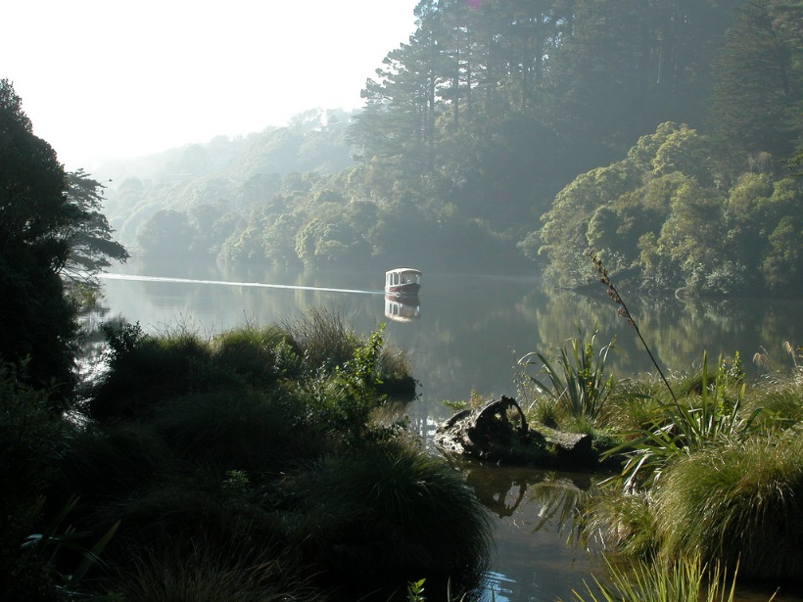
Photo Credit: Chris Moore
Takahē Community Study
2020

Slide 2
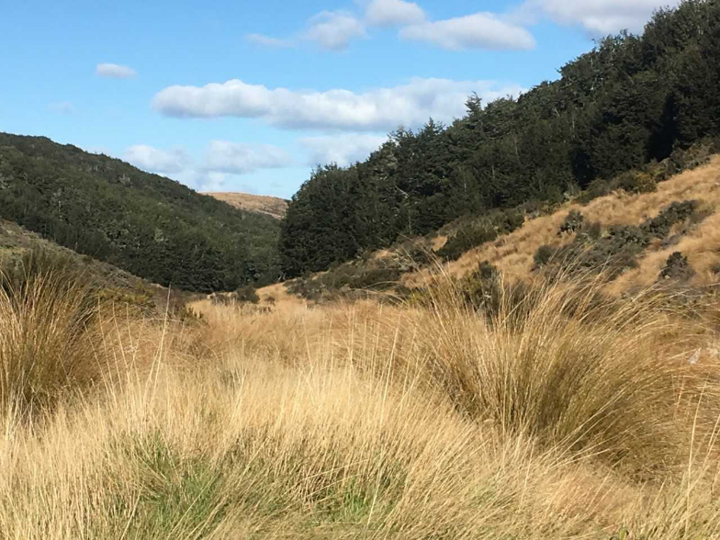
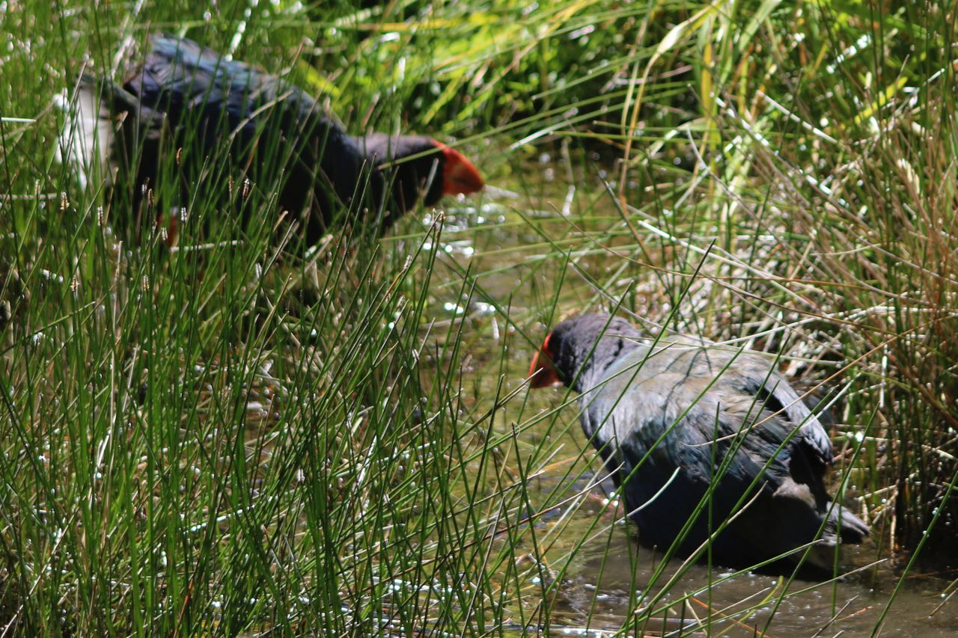
A.S. 91158 Biology 2.6
Investigate a pattern in an ecological community
  Context: An investigation into the impact of introduced mammals on the distribution of takahē in New Zealand.
Photo Credit: Sue Lum
Photo Credit: Andrew Hawke
Notes:
Set up context of study:
Work on part 1 of seminar – focus on environmental factors, ecological niches and adaptations, and interspecific relationships.
Go for walk out in the Valley, spend some time observing Takahē, one of the species in your study.
If at ZEALANDIA, spend some time in the exhibition to gather additional information as per booklet
After lunch, part 2 of seminar, unpacking the standard.

Slide 3
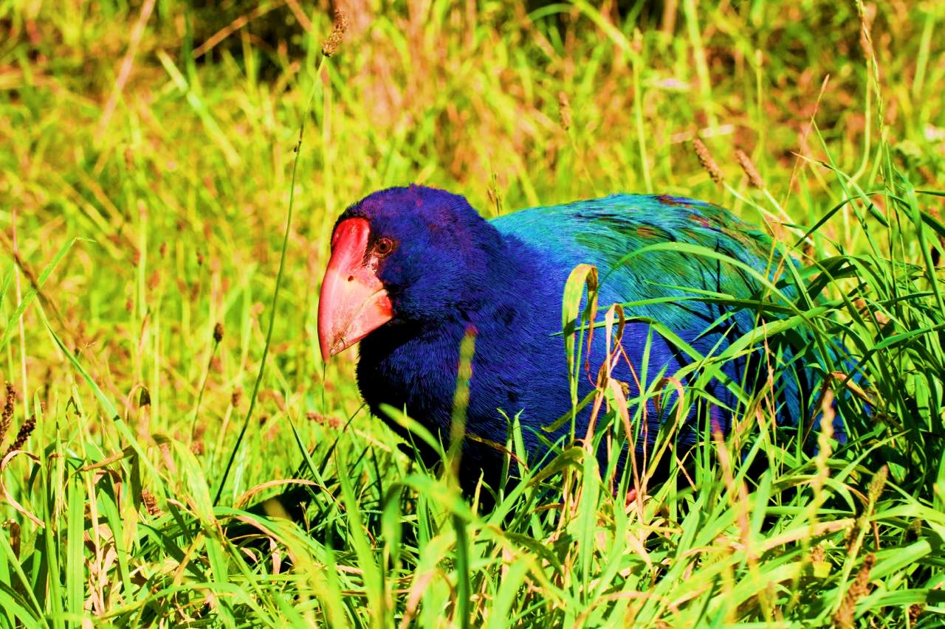
Learning Outcomes
To understand the uniqueness of New Zealand’s endemic species
To observe takahē (Porphyrio hochstetteri) and make links to adaptations
To think about some aspects of interrelationships between species in the communities in which takahē live
Photo Credit: Andrew Hawke
Notes:
Introduce term ‘endemic’ and emphasise why extinction is so final for these species.(spp) (not found anywhere else in the world).
The context for this standard is centered around the impact of introduced species but needs to include a number of interrelationships, hence need to look at several species present – takahē, stoat, red deer, snow tussock.

Slide 4
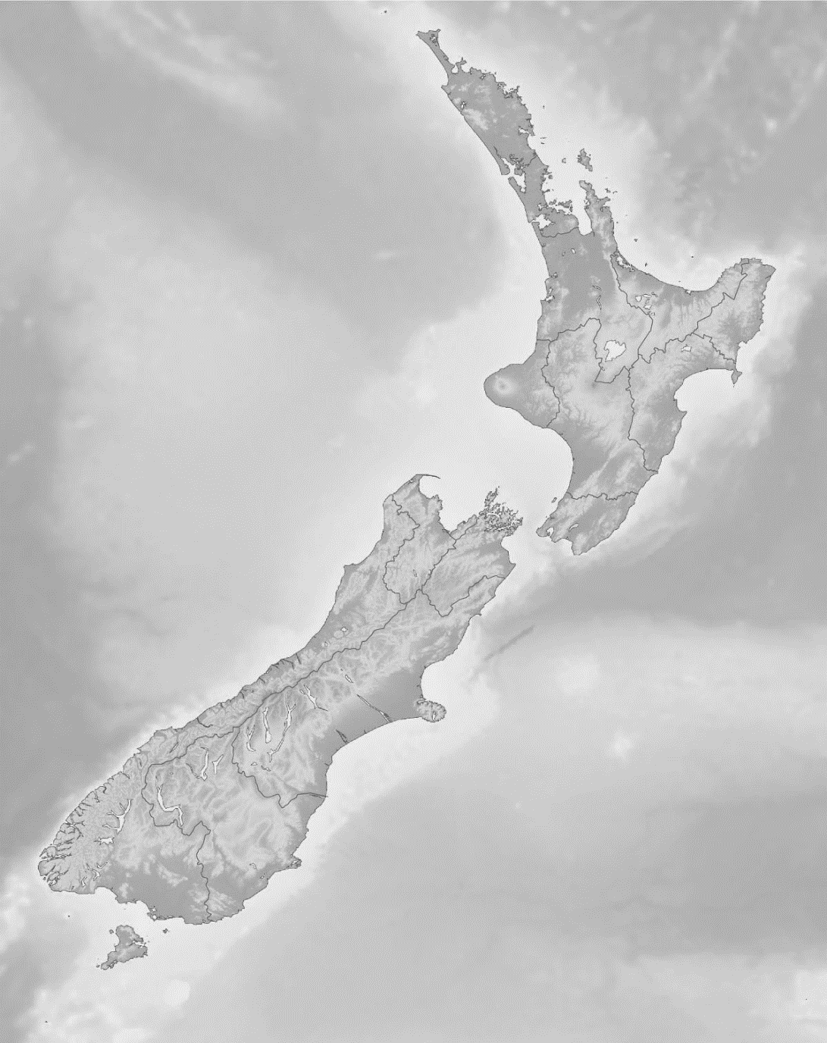
“New Zealand is as close as we will get to the opportunity to study life on another planet.”
Jared Diamond
Source: Wikimedia Commons
Notes:
Context for conservation in New Zealand. New Zealand has unique environment/ecosystems due to separation from Gondwana prior to evolution of mammals. The flora and fauna found here is not present anywhere else in the world. Therefore the impact of introduced mammals has been greater owing to lack of adaptation to the predation and competition brought by these introduced species.

Slide 5
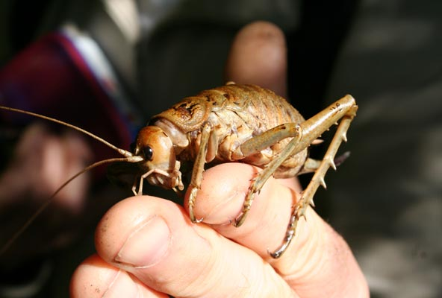
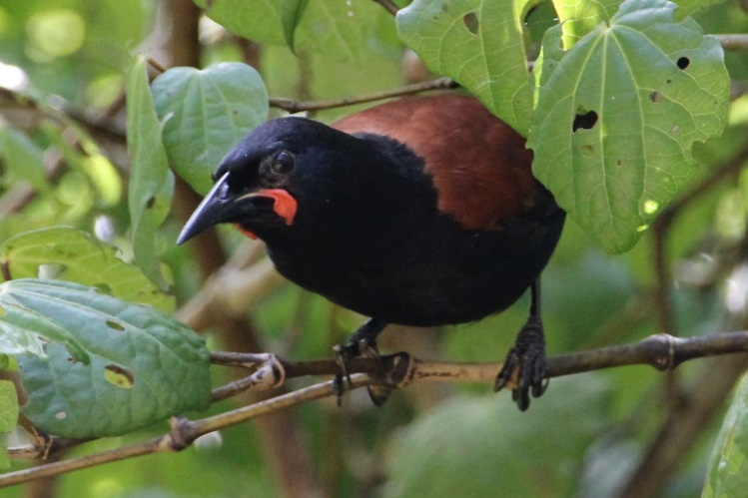
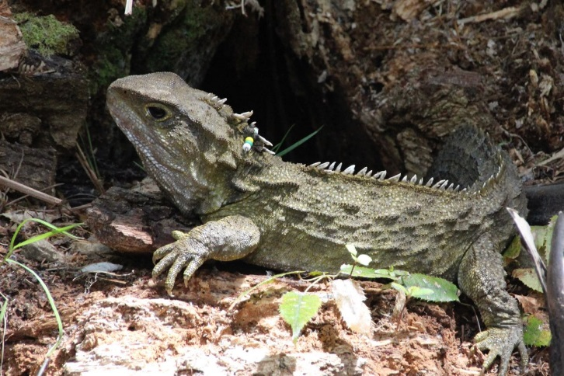
New Zealand Endemism
(species found only in
New Zealand)
Photo Credit: Tom Lynch
70 % of birds
80 % of trees
90 % of fish / insects
100 % of frogs / reptiles / bats
Photo Credit: Andrew Hawke
Photo Credit: Andrew Hawke
Notes:
Extremely high rates of endemism, not seen elsewhere in the world. Look at bird %. Linked to ability to fly and self-introduced birds → native over time.

Slide 6
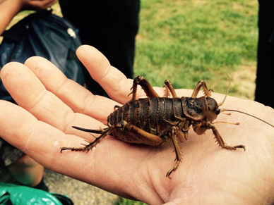
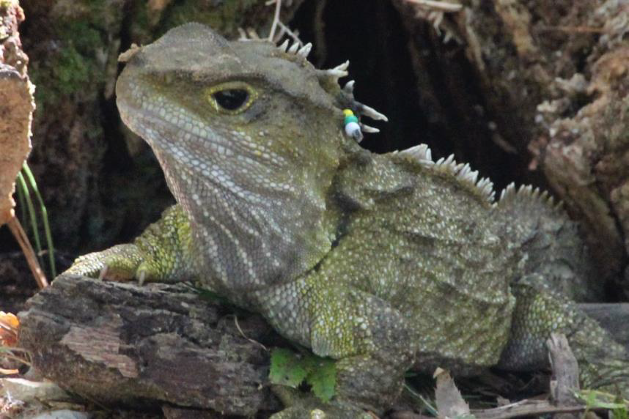
Unique NZ Species
Flightless birds
Giant insects
Living fossils
Trees that change shape
Photo Credit: Sue Lum
Photo Credit: Andrew Digby
Photo Credit: Andrew Hawke
Photo Credit: Akos Kokai (Some right reserved) Attribution 2.0 CC
Notes:
All the above characteristics link to isolation of Zealandia continent and relate to absence of mammals and lack of adaptations to deal with mammalian predators and competitors.

Slide 7
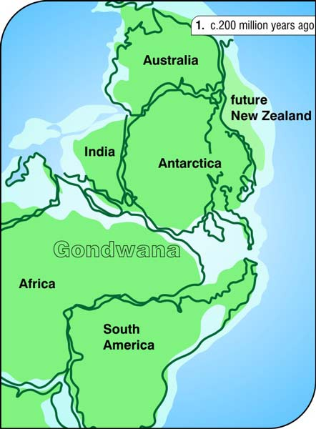
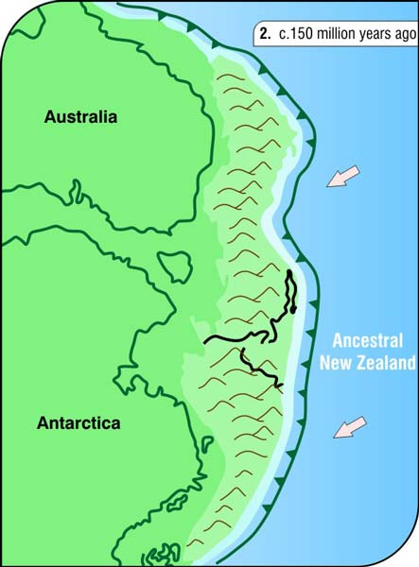
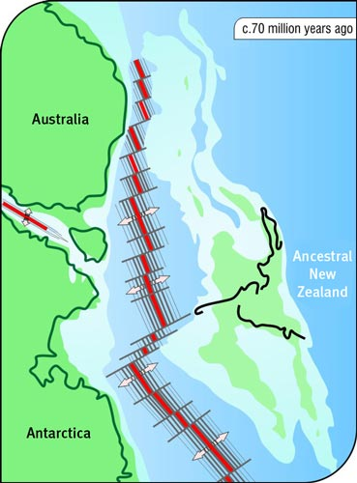
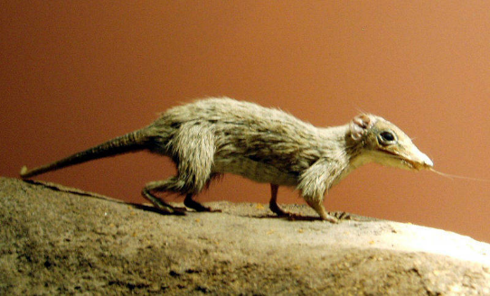
Separation from Gondwana and subsequent isolation
https://evolutionofnewzealand.weebly.com/gondwanaland.html
Photo Credit: Natural History Museum, London
Notes:
Fauna species present in NZ limited to birds, insects, reptiles and amphibians. Photo of Megazostradon from NHM, thought to be early mammal ancestral sp. Emphasise early mammal development NOT present in NZ (only three known mammals – bats).

Slide 8
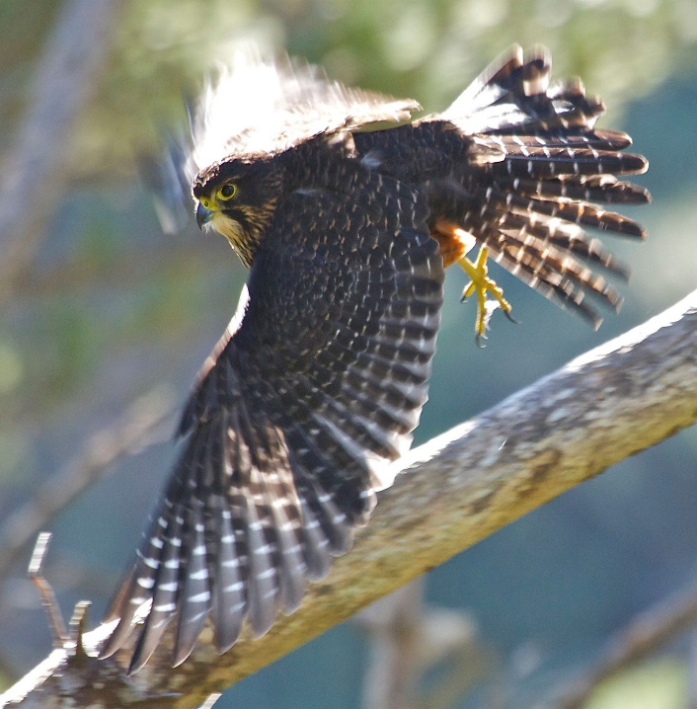
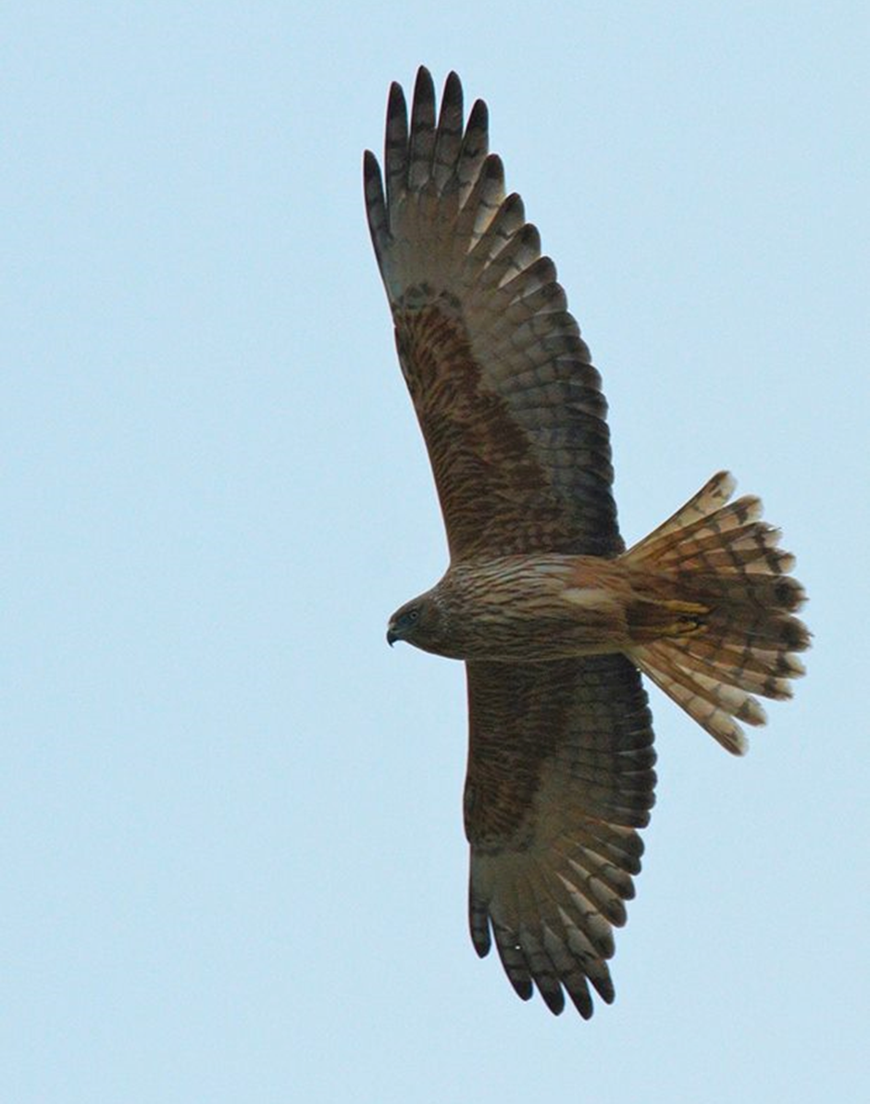
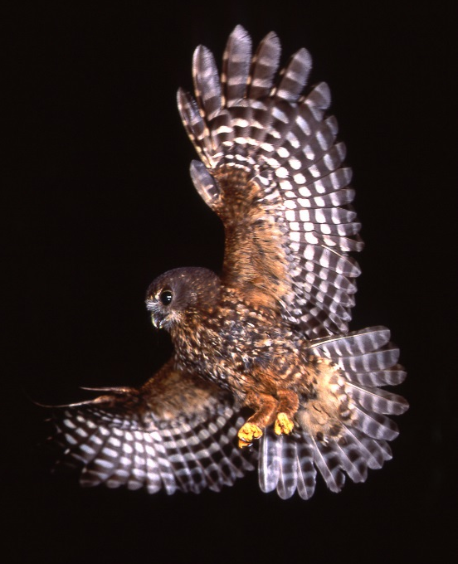
NO mammalian predators…
Photo Credit: Steve Attwood
…only eyes in the sky
Photo Credit: Nga Manu Images ©
Photo Credit: Steve Attwood
Notes:
KEY idea! Kārearea and kāhu, ruru and Haast eagle. Aerial predators only, so spp adapted to avoid these by camouflage, freezing, burrowing and nocturnal habits.
No ground-based predators so ‘smelliness’ (e.g. kiwi) , ground feeding or ground nesting not a problem. Can give example of European spp that ‘turn off’ their scent during nesting/breeding to avoid mammalian predators.

Slide 9
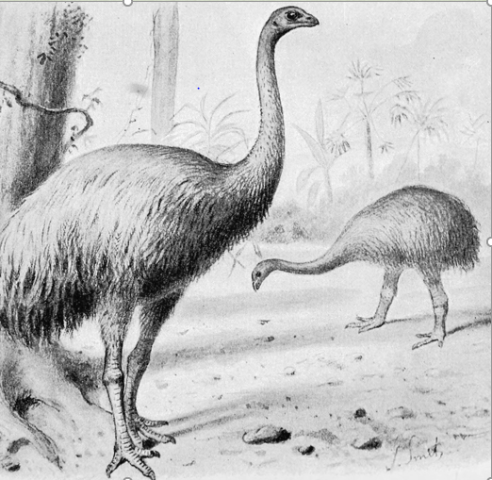
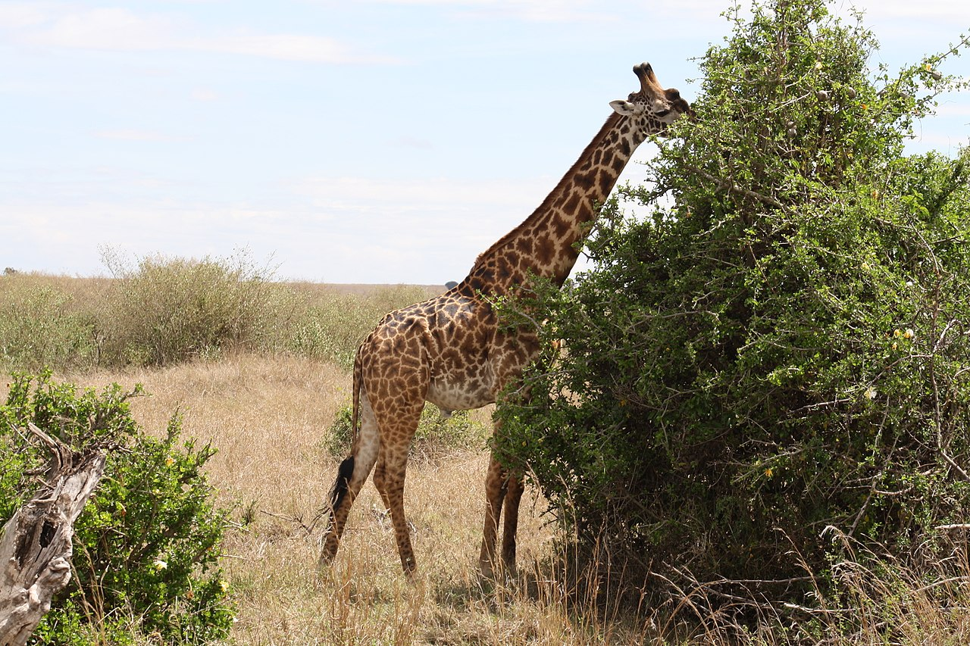
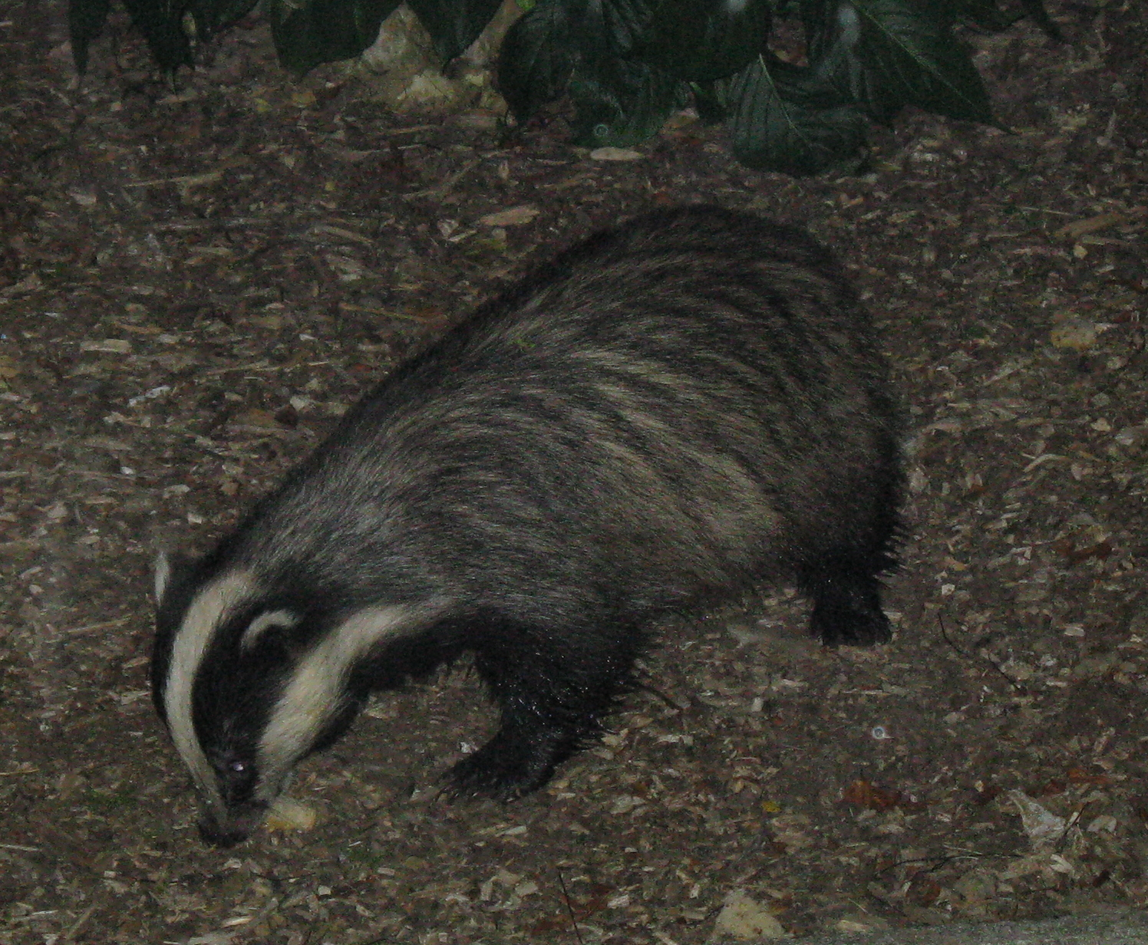
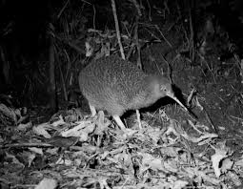

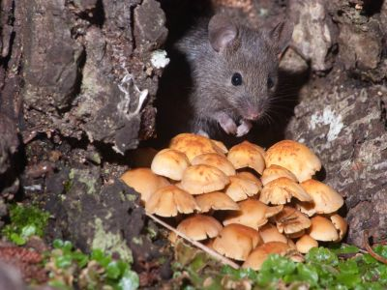
Ecological Niche equivalents
Artist Credit: Joseph Smit Public Domain
Photo Credit: Shankar S CC BY 2.0
Mammals overseas occupy a range of ecological niches.
Photo Credit: Jo Moore
Photo Credit: Creative Commons Attribution-ShareAlike 3.0 Unported
Which animals here in pre-human New Zealand occupied similar ecological niches to these overseas ones?
Photo Credit: Sue Lum
Photo Credit: Ngā Manu Images ©
Notes:
Look at examples of spp and what e. niches they fill. Compare these niches in other countries and what opportunities were available for NZ spp to fill here
Ecological niche = their role in a community e.g badger – nocturnal carnivore – burrows, eats grubs, snails etc

Slide 10
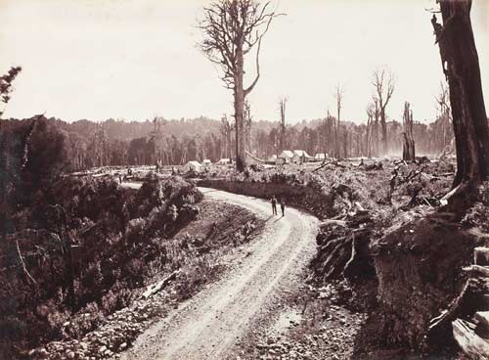
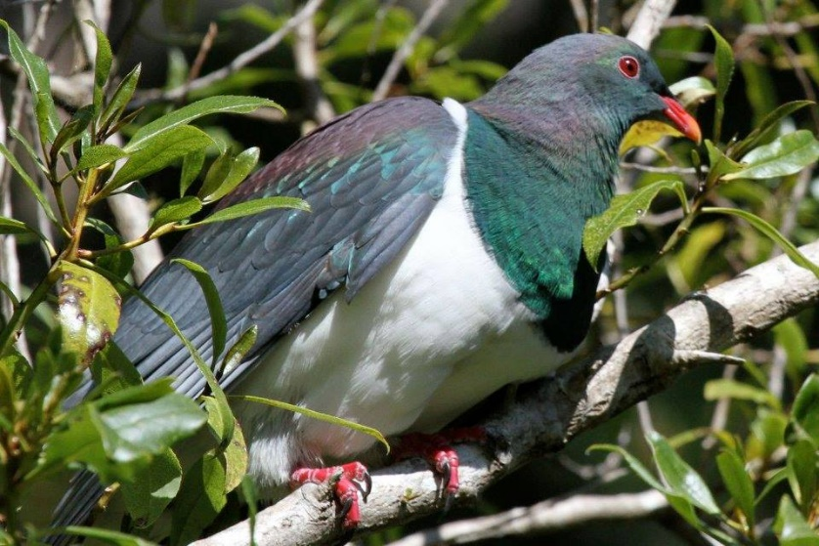
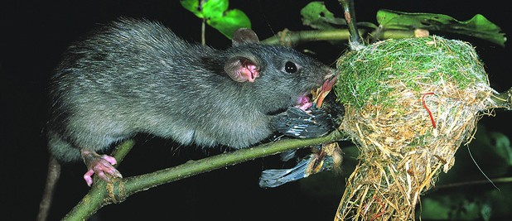
But then…
Photo Credit: Andrew Hawke
Photo Credit: Museum of New Zealand Te Papa Tongarewa Collections
Photo Credit: Nga Manu Images ©
Notes:
Human impact → ecosystem out of balance → extinction, mass loss of species due to habitat loss, introduced spp, hunting.

Slide 11
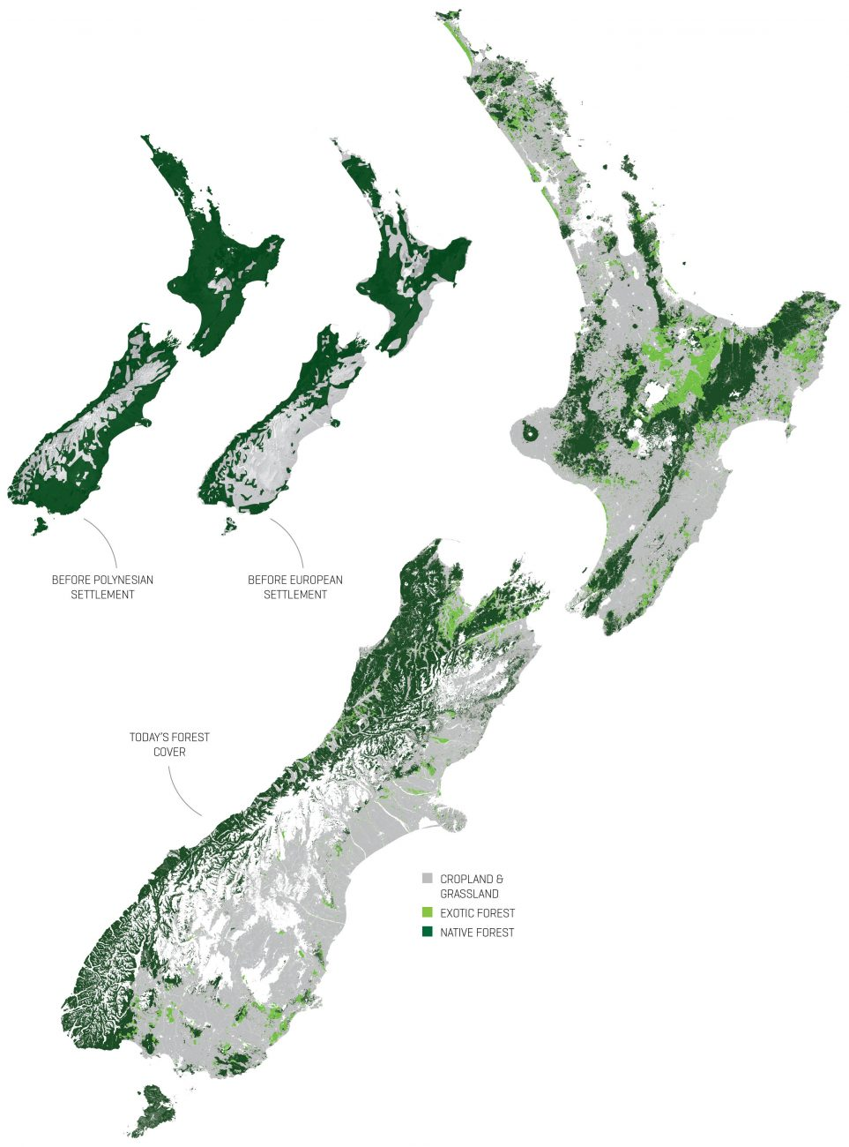
Human Impact
Since Polynesian and later European settlement, native forests have been reduced to under 30% of the original bush cover.
As a result of this habitat loss, a number of endemic species have become extinct.
1000 AD
1800 AD
2000 AD
Source: New Zealand Geographic (2014)
Notes:
Reduction in forest cover and loss of endemic spp – compare loss of forest even since early Maori arrival (South Island). Talk about why fire might have been used – e.g. hunting tool to flush animals out, safety.

Slide 12
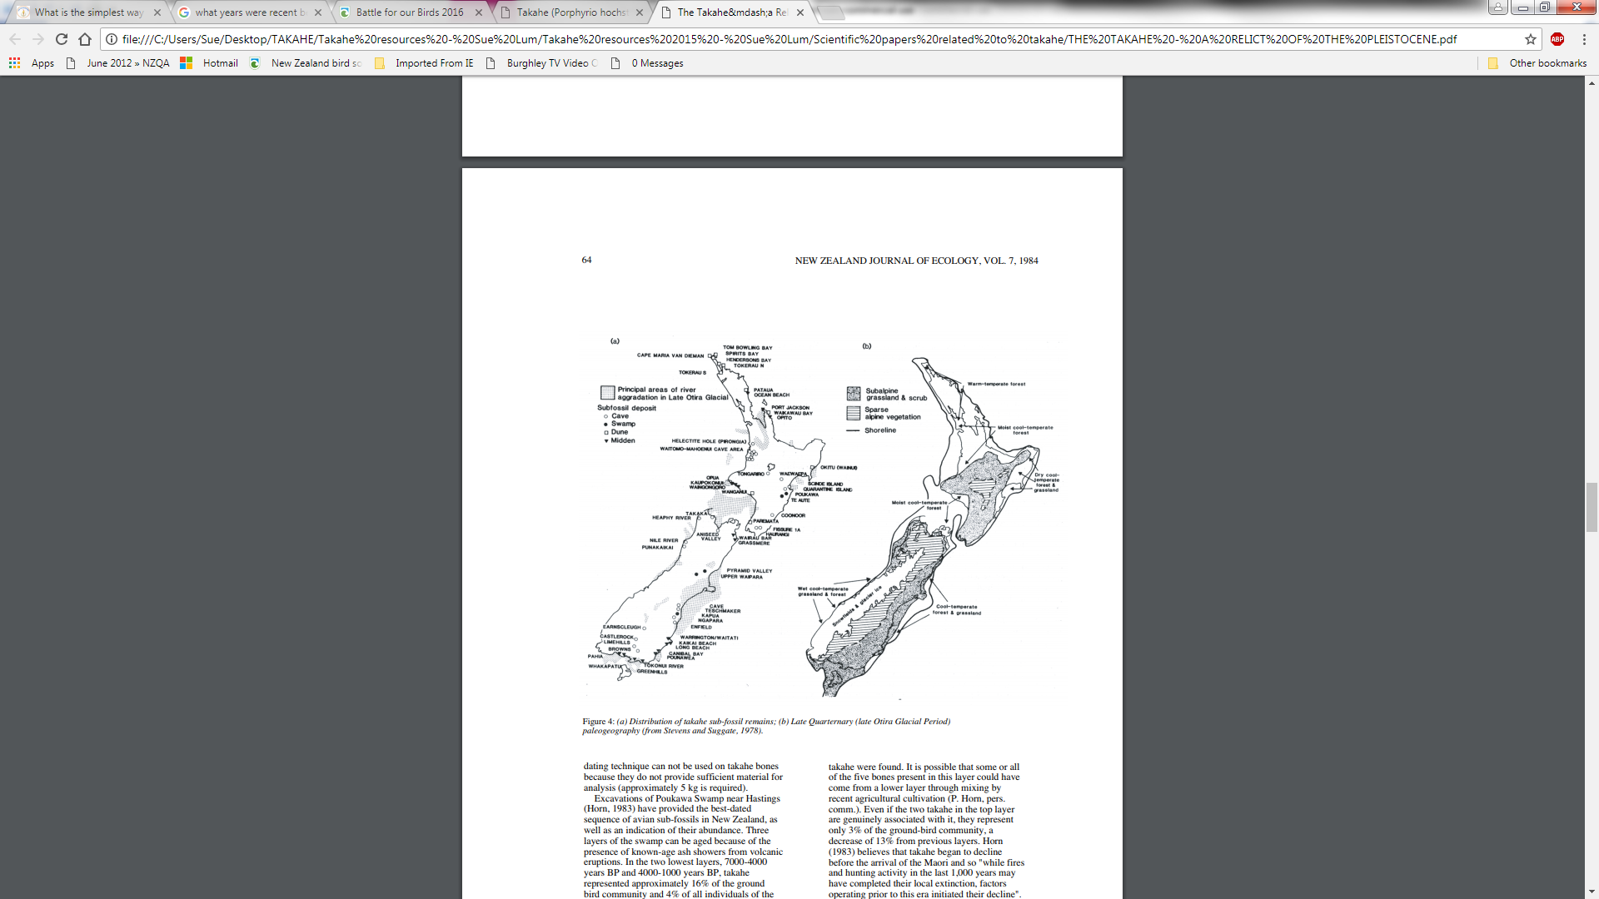
Prehistoric distribution of takahē from fossil remains
Impact of climate changes
Notes:
Evidence of takahē and moho distribution throughout NZ, linked to human impacts and potentially climate change.

Slide 13
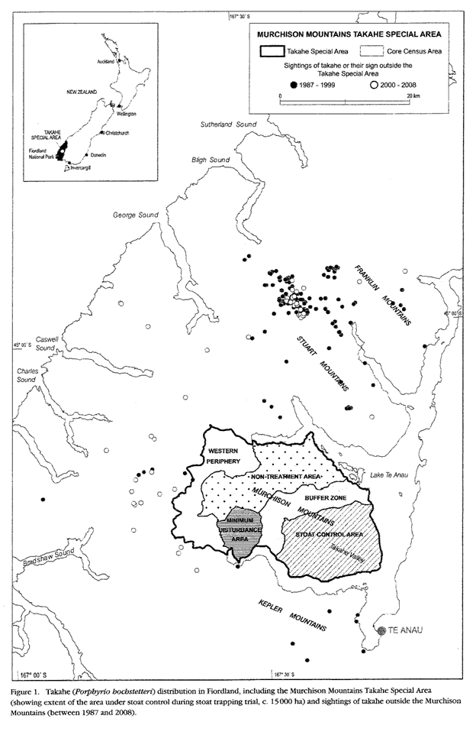
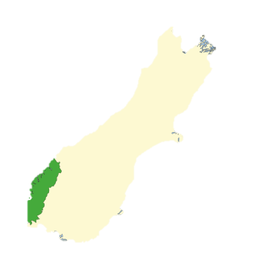
Sightings of wild takahē outside the takahē ‘special area’ between 1987 and 2008
New location - Kahurangi National Park
Source: By Costello - self-made, based on Image: NZ Locator Blank.png, CC BY-SA 3.0,
Source: Takahē Recovery Plan 2007-2012 Department of Conservation Te Anau Area Office
Notes:
Where are takahē found now? – ensure students understand that current location is not ‘where they prefer’ but simply where they can now exist.
Some evidence suggests that takahē were once found throughout South Island, down to sea level. The loss of habitat and hunting/predation has resulted in them dying out in these areas, rather than ‘moving to the mountains where they would be safe’. Fiordland is currently the last bastion (not counting the newly established Gouland Downs group) where they have survived.

Slide 14
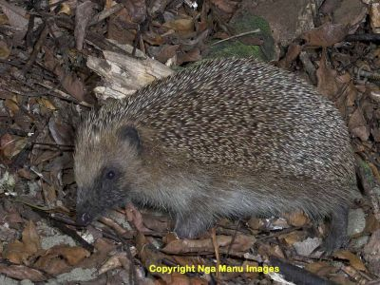
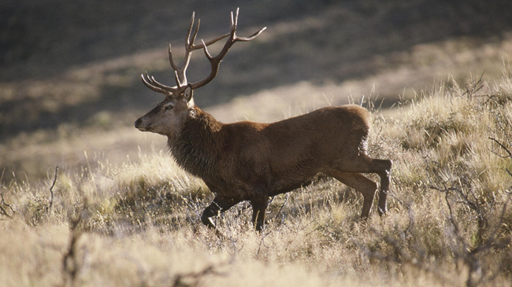
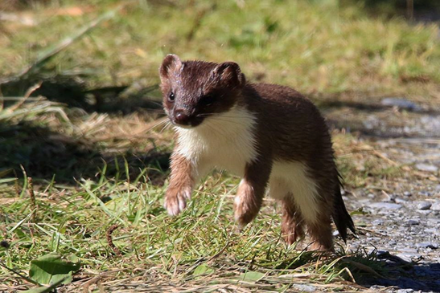
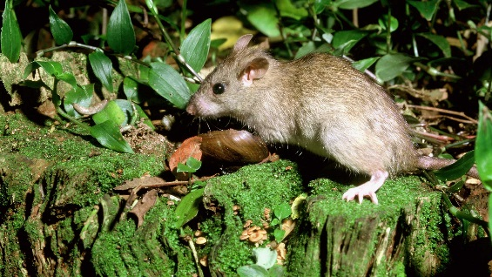
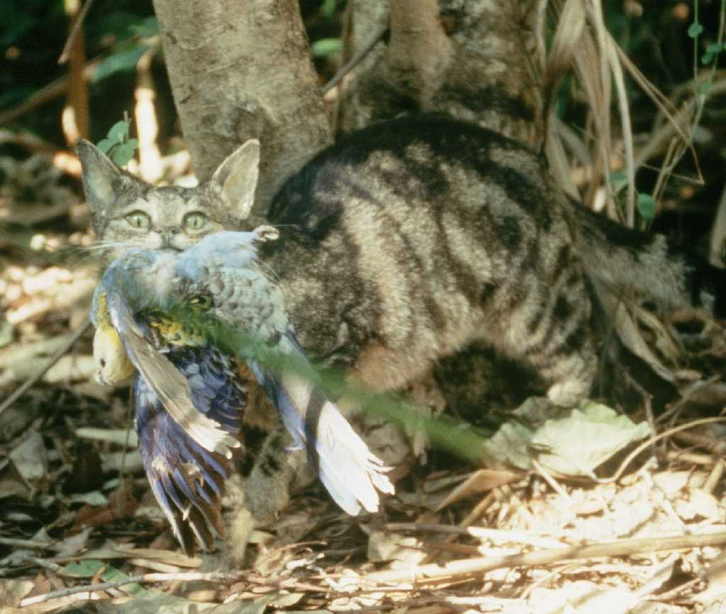
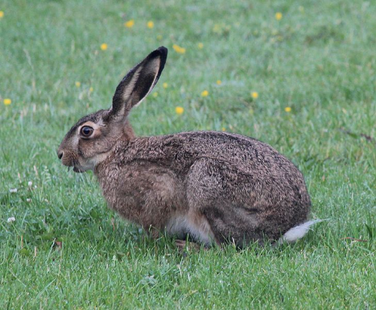
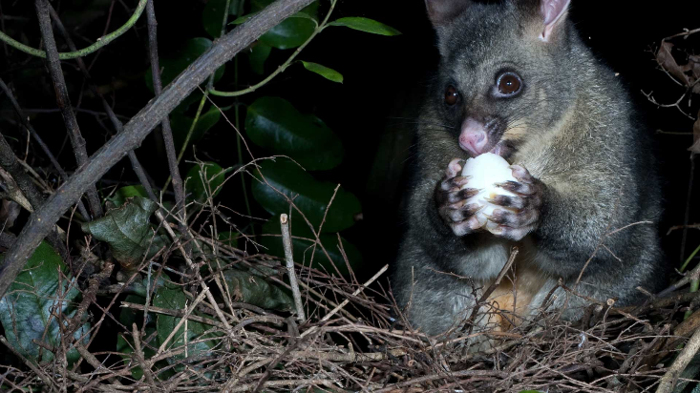
Mammalian pests in New Zealand
Photo Credit: Nga Manu Images ©
Photo Credit: Steve Attwood
Photo Credit: Gordon Roberts Department of Conservation
Photo Credit: Nga Manu Images ©
Photo Credit: Kim Hansen Creative Commons Attribution-ShareAlike 3.0 Unported
Photo Credit: Nga Manu Images ©
Photo Credit: Brisbane City Council
Notes:
Impact of mammalian predators is huge as NZ spp not adapted to them. Mammalian predators hunt by nose – sense of smell, so ground dwelling / nesting spp now hugely at risk (compared to endemic aerial predators which are hunt by sight)

Slide 15
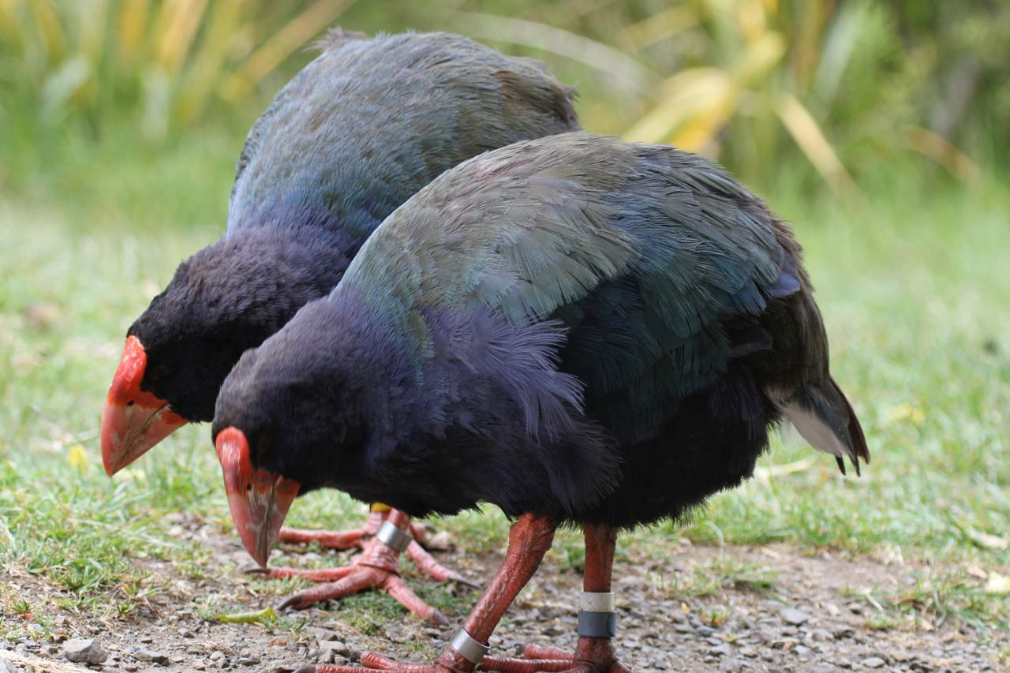

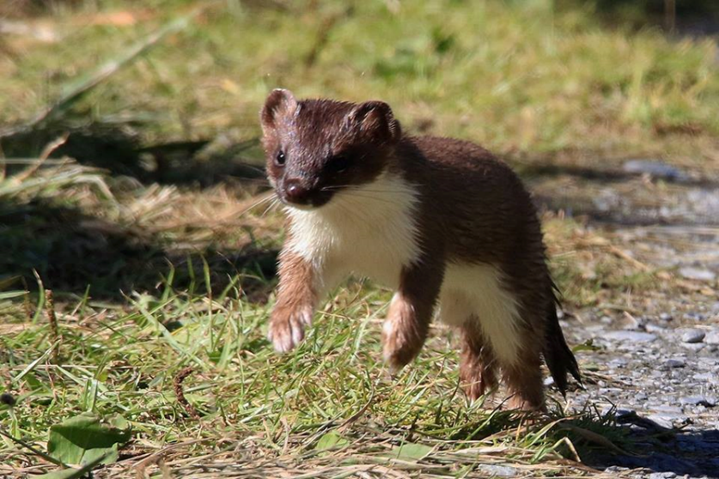
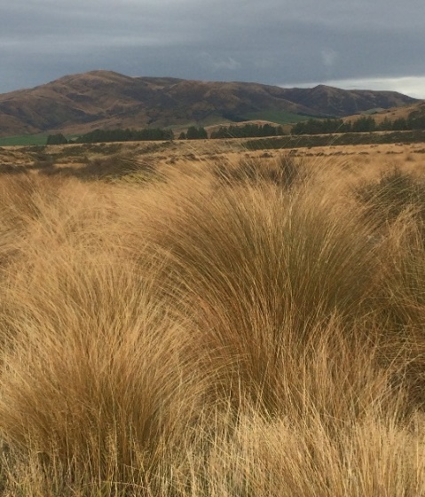
Consider the ecological niches of these species in the Murchison Mountains
Photo Credit: Andrew Hawke
Photo Credit: Gordon Roberts Department of Conservation
Photo Credit: Steve Attwood
Photo Credit: Sue Lum
Notes:
Talk about e.niches in Murchison Mountains. Describe e.niche for each (HAFA) - Habitat, Adaptations, Feeding, Activity (behaviour)
Get students to write down on the worksheet, as many aspects of the ecological niches as they can. Emphasise that while this is not required for their assessment, the understanding is critical to their getting a good grasp on the interrelationships and biology (including adaptations) for the species they are studying.

Slide 16
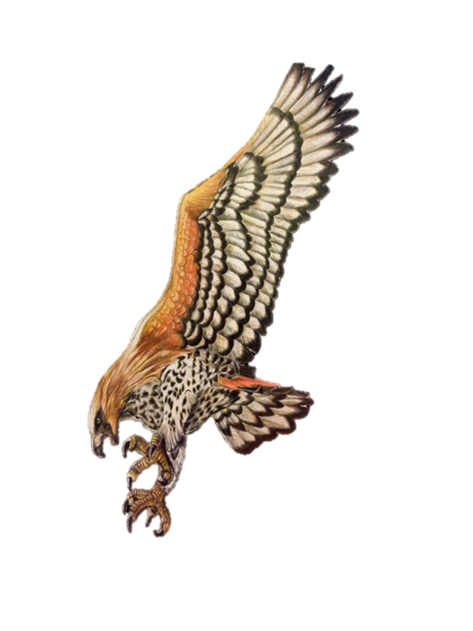
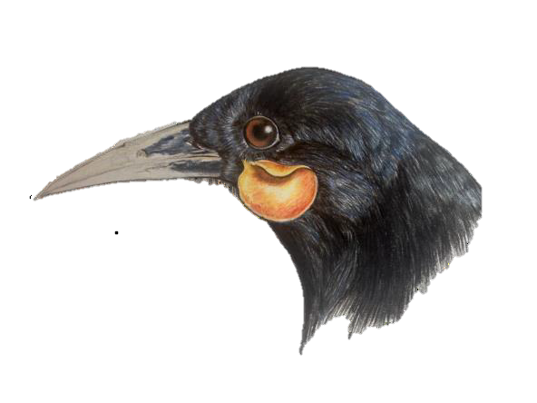
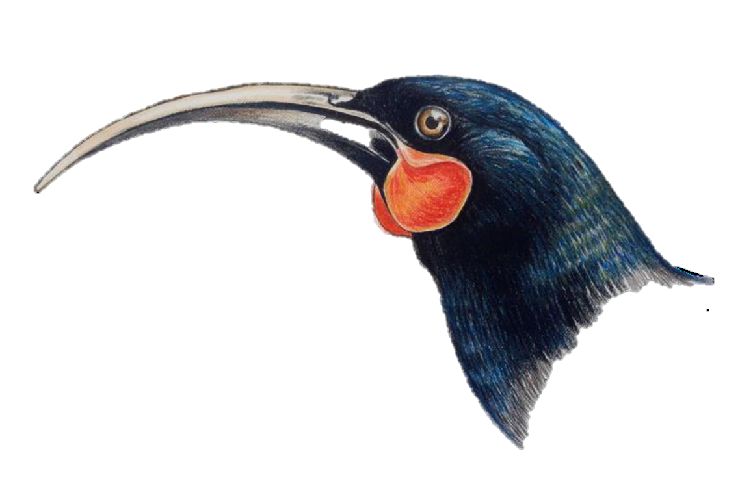
Endemism and Extinction
Extinction is forever.
Does it matter?
Artwork by Emma Rowell
Notes:
Link concept of endemism – only found in one place with the inability to replace something once lost. Extinction of spp link to not only to poor biodiversity and ecosystem disruption but also cultural loss

Slide 17
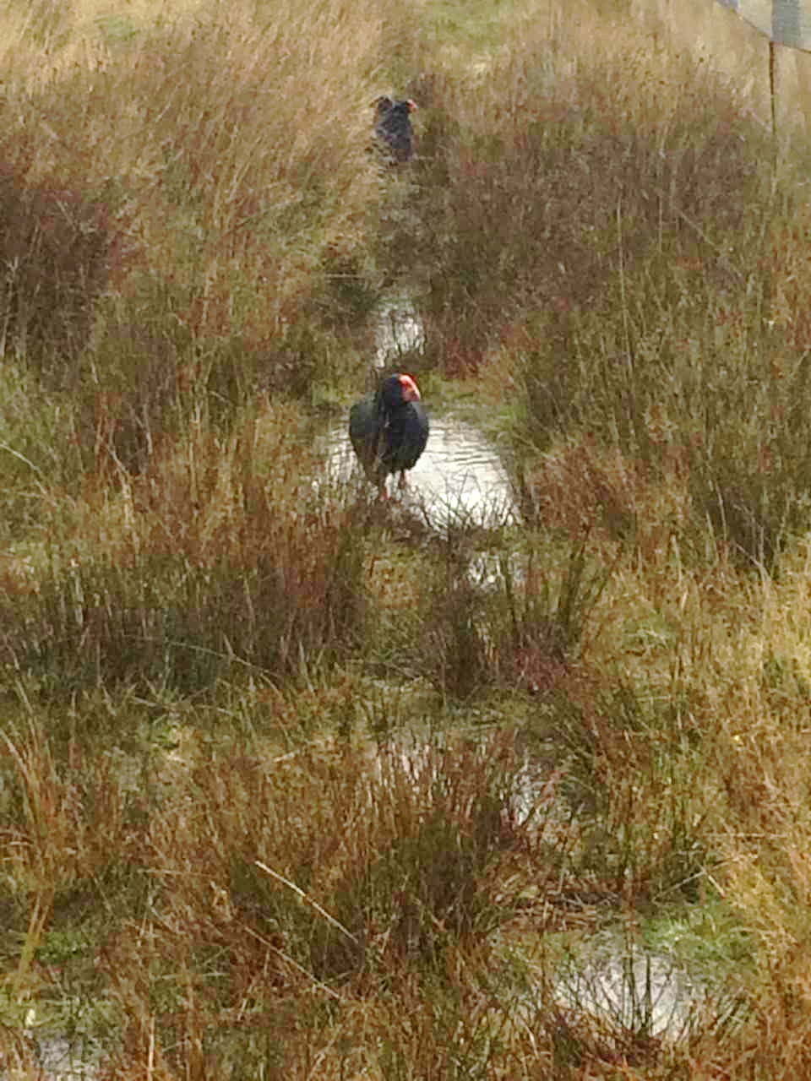
Takahē
Takahē are the world’s largest flightless rail species.
Previously thought to be extinct, they were rediscovered in 1948.
The Department of Conservation and Ngāi Tahu have been working together to bring takahē ‘back from the brink’.
Photo Credit: Sue Lum
Notes:
Previously at Burwood:
Captive reared ‘wild’ eggs - eggs collected form the wild, incubated at Burwood and hand-reared using puppets. Young takahē released back into the wild, but survival rate not so good as wild reared birds.
Yearlings released into wild
Problems with this. Why? Did not have the necessary skills for survival. E.g. tussock and Hypolepis training or ability communicate/rear young – initially imprinted on a limited 30 sec sound bite of calls and not well ‘tuned – in’.
Role of Ngāi Tahu as kaitiaki
Recently, don’t collect wild eggs (since 2011)
At Burwood in 2017, 25 breeding pairs. These birds breed and rear their own young. Eggs from ‘high value’ birds are sometimes swapped into other nests to encourage these birds to lay again, thus increasing their productivity and improve the genetic diversity of the takahē.
The ‘harvested’ eggs are put into another pair’s nest where they are reared by them. Juveniles are also sometimes fostered onto parents at Burwood to get training in feeding on tussock and how to forage Hypolepis (summer green) fern rhizomes which is a winter food.
Some background to old methods of takahē husbandry:
http://www.tiritirimatangi.org.nz/dawn%20chorus/Dawn%20Chorus%2091.pdf

Slide 18
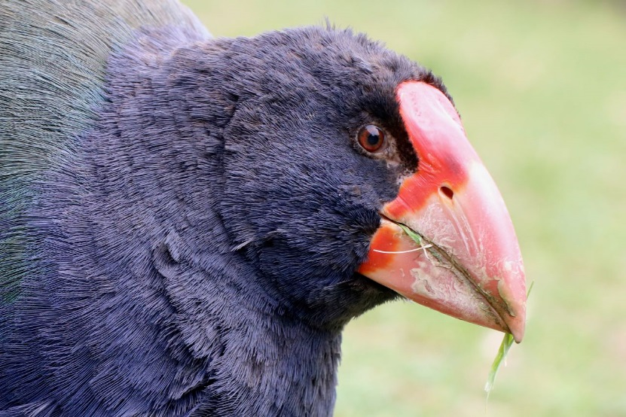
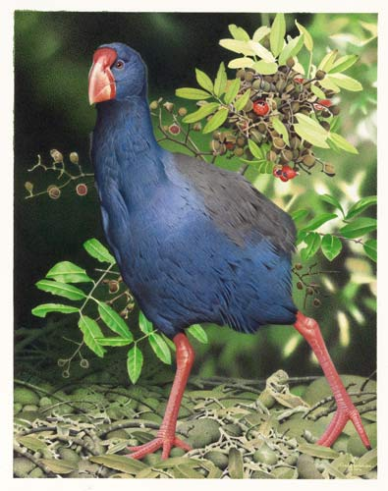
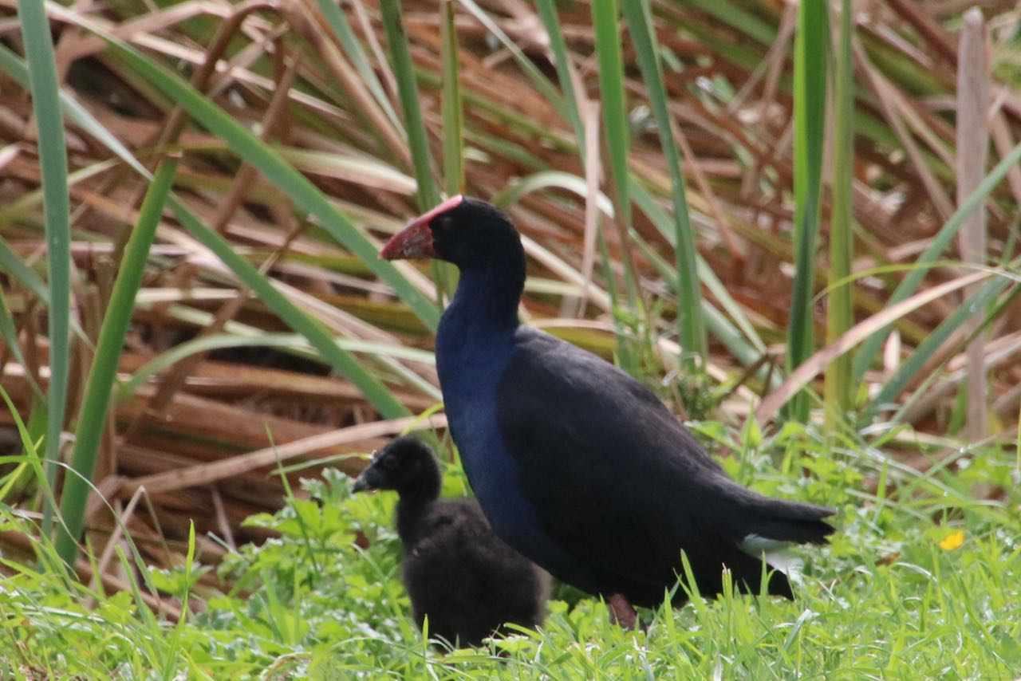
Takahē and their cousins
Takahē are thought to have arisen from an ancestral pūkeko-type bird which flew to New Zealand from South Africa
Photo Credit: Andrew Hawke
Pūkeko are a much later arrival via Australia and are much more closely related to Moho (the extinct North Island takahē) than South Island takahē
Photo Credit: Andrew Hawke
Notes:
Takahē ancestors flew to New Zealand, ~5-20mya from SA, shares DNA with SA swamphens
Moho and pūkeko (arrived <400 ya, more closely related.
Adaptations of takahē:
Large frame – reduces heat loss, insulating feathers
Strong beak and claws
Colouration – camouflage against tussocks
Vulnerable to predation due to low reproductive rate
Pair bonding
Hi parental input
Nest sites
Flightless
Competition
Selective browser
Eat meristem
Poor digestion of cellulose
Rostrum – protective against tangled shrubs such as Matagouri
Comparison of takahē and pūkeko on sheet.
Pūkeko: a complex social life. In many areas, pūkeko live in permanent social groups and defend a shared territory that is used for both feeding and breeding. Social groups can have multiple breeding males and females, but all eggs are laid in a single nest and the group offspring are raised by all group members.
They are typically found near sheltered fresh or brackish water (e.g. vegetated swamps, streams or lagoons), especially adjacent to open grassy areas and pastures.
Pūkeko are very abundant and widespread, with high population densities in areas of the North Island and west coast of South Island.
Pūkeko are commonly seen foraging in paddocks and along roadsides. When disturbed, they prefer to run or hide rather than fly, but once airborne, they are capable fliers and can fly long distances (e.g. to offshore islands). Despite not having webbed feet, they are also strong swimmers. Adult pūkeko have few natural predators. Juvenile birds are often targeted by swamp harriers, but adult birds will fight vigorously to defend their offspring. pūkeko have been observed attacking cats and stoats. pūkeko are primarily vegetarian, but animal foods make up a small proportion of the diet. Most common foods are the stems, shoots, leaves and seeds of grasses (e.g. Poa, Glyceria, and Anthoxanthum spp.), sedges (e.g. Carex and Scirpus spp.), rushes (Juncus spp.), clover (Trifolium spp.) and bullrush (Typha spp.). They also eat garden vegetables and crop plants. Animal foods consist mostly of insects, spiders and earthworms however there are rare reports of pūkeko taking larger prey such as frogs, lizards, fish and nestling birds. The bill is used to cut, rip or dig up plants which are typically held and manipulated in the foot (i.e. ‘parrot style’) as they are eaten. (http://nzbirdsonline.org.nz/species/pūkeko)
https://www.nzgeo.com/stories/pūkeko-the-indomitable-swamphen
http://www.doc.govt.nz/nature/native-animals/birds/birds-a-z/pūkeko

Slide 19
Adaptations
Adaptations can be described in a number of ways.
We can group them as:
structural
physiological
behavioural
Use the ‘Adaptations’ sheet to help you think about these for each of your chosen species
Notes:
Deal with these in detail while down at the takahē lawn.

Slide 20
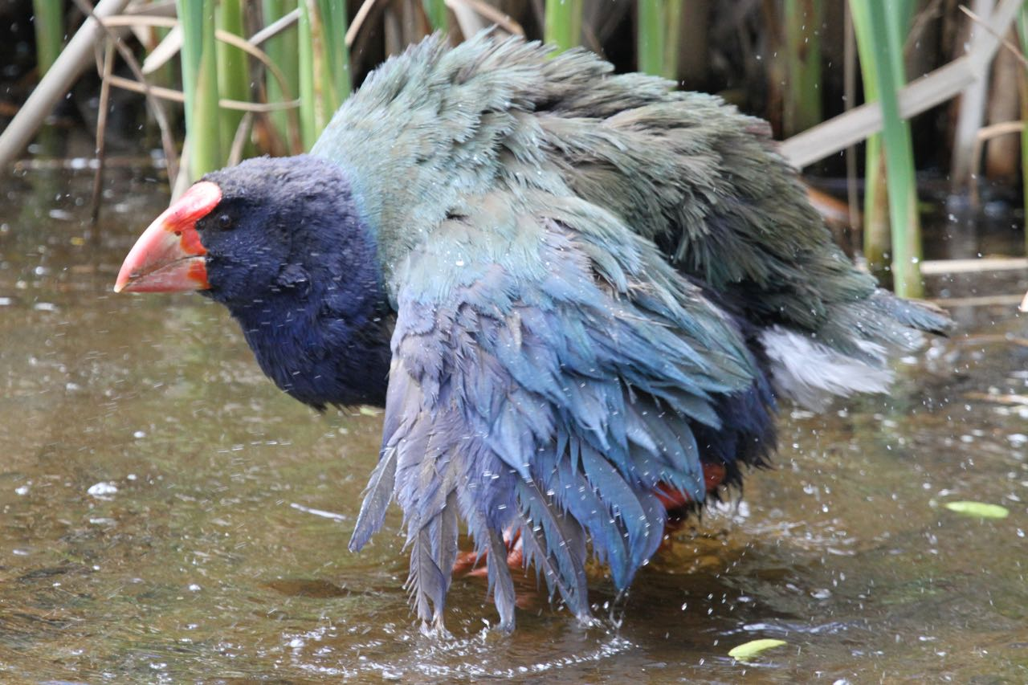
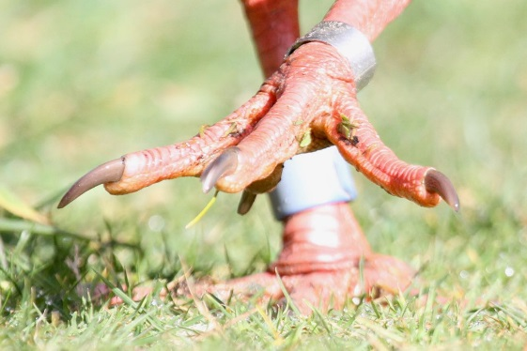
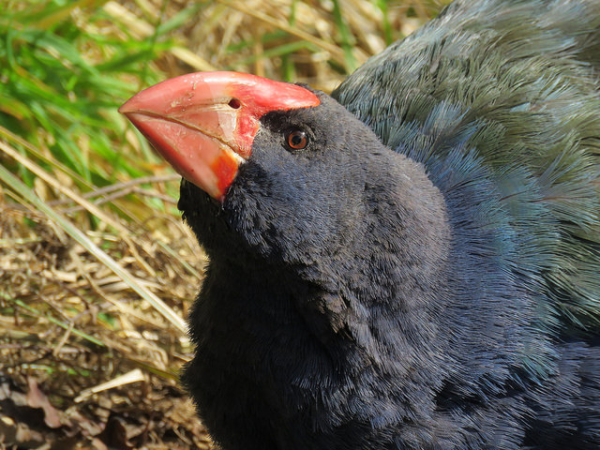
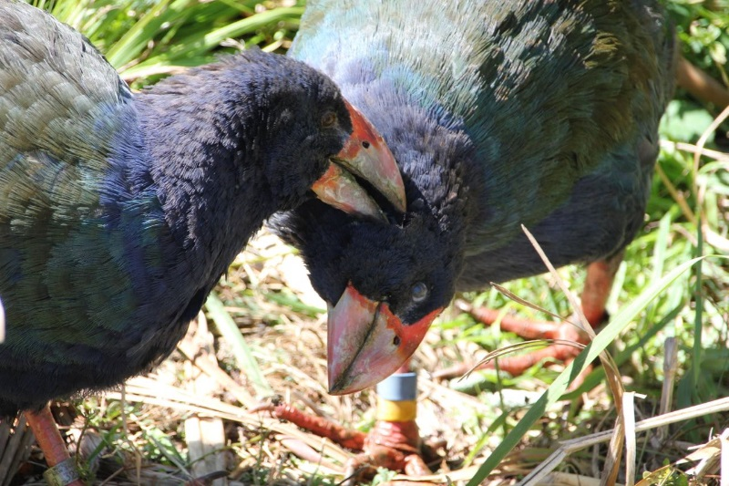



Photo Credit: Andrew Hawke
Photo Credit: Emma Rowell
Photo Credit: Andrew Hawke
Photo Credit: Andrew Hawke
Photo Credit: Sue Lum
#imnotapukeko
Photo Credit: Dave Jenkins Department of Conservation
Photo Credit: Andrew Hawke
Notes:
Worksheet – can print off this page and use with the compare and contrast worksheet ‘Takahē v Pūkeko’
Some key ideas:
Flightless
Pair bonding, tight family structure, both male and female incubate 1-3 eggs and rear young (1-2 chicks). Occasionally additional females may assist with egg incubation/chick rearing. Juveniles may stay with parents into next breeding season.
Diet predominantly herbivorous (chicks are fed a more varied diet, including moths and other insects).
Larger size – helps with avoiding heat loss in cold environment.
Colouration – camouflage against tussocks etc.
Robust beak and claws – needed for ‘tillering’ (15.5kg of force needed to pull out tussock tiller), ‘stripping’ seeds and ‘snipping’ softer grasses and alpine herbs, used also for grubbing for fern rhizomes in winter. Use of feet to hold food while eating.
Nest often enclosed in tussock.
Old but comprehensive reference
http://nzbirdsonline.org.nz/sites/all/files/180_South%20Island%20Takahe.pdf

Slide 21






Same or different?
Photo Credit: Tony Fluerty (Boney Whitefoot Photography)
Photo Credit: Bernard Spraggs NZ
Photo Credit: Bernard Spraggs NZ
Photo Credit: Bernard Spraggs NZ
Photo Credit: Nga Manu Images ©
Photo Credit: Nga Manu Images ©
Notes:
Key ideas:
Able to fly
Wetland / pasture habitat
Colour does not provide camouflage - conspicuous
Polygynandrous – multiple male and female partners – complex social structure.
May have multiple clutches laid in a nest, (4-6 eggs per female) related birds take part in incubating and rearing young
Birds congregate together – shared territories for breeding and feeding
http://nzbirdsonline.org.nz/species/pukeko

Slide 22

Bahavioural adaptations - Family relationships
Takahēs feeding
Photo credit: Sue Lum

Slide 23



Behavioural adaptations - Tillering
Photo credit: Sue Lum
Photo credit: Sue Lum
Photo credit: Sue Lum

Slide 24


Where in the world are they?
Until recently takahē were only found in the wild in the remote alpine valleys of Fiordland.
Photo Credit: Helen Dodson Department of Conservation
Their rediscovery kickstarted one of the longest standing species conservation programmes in New Zealand.

Slide 25



Abiotic factors
Photo Credits: Department of Conservation
Notes:
Abiotic factors include severe winters, avalanche, drowning hazards in kettle hole lakes, poor soil nutrient levels due to ‘young soils’ affecting food quality, mast years caused by climate

Slide 26



Burwood Takahē Centre June 2018
Photo Credit: Sue Lum
Photo Credit: Department of Conservation
Photo Credit: Sam Haultain Department of Conservation
Notes:
Snow (harsh winters) impacts the ability of takahē to access tussock for food, drives them to bush edge to grub for Hypolepis sp
Burwood Takahē Centre is the New Zealand centre for the Takahē Recovery Programme.
https://www.doc.govt.nz/our-work/takahe-recovery-programme

Slide 27

Where in the world are they?
As at 31st September 2018 population numbers was estimated at 376 and as a result, takahē are now considered ‘threatened - nationally vulnerable’.
In March 2018, the first small group of takahē were translocated to Gouland Downs in Kahurangi National Park from where they have been absent for over 100 years.
Why are they not found elsewhere?
Habitat destruction
Presence of introduced mammals
        Photo Credit: Martin Genet Department of Conservation
Notes:
The Gouland Downs group are doing well. In their new habitat they are exploring other food sources not found in Fiordland.
Recent breeding success in 2018/19 season with chicks sighted – 30 birds translocated , 7 breeding pairs
About 130 birds in the Murchies
See DOC’s ‘New Zealand Threat Classification - Conservation Status of New Zealand Birds, 2016’
Nationally Vulnerable Criteria for Nationally Vulnerable:
A—small, increasing population (unnatural)
A(1/1) 250–1000 mature individuals, predicted increase > 10%
A(2/1) ≤ 5 subpopulations, ≤ 300 mature individuals in the largest subpopulation, predicted increase > 10%
A(3/1) Total area of occupancy ≤ 10 ha (0.1 km2), predicted increase > 10%
The takahē fall within this population as although their numbers are still small, the population is predicted to continue increasing.

Slide 28

Monitoring
Sky Ranger™
Smart transmitters allow remote monitoring via aircraft with receiver
About half the wild birds carry transmitters
GPS recorder logs location and ‘state’ of each bird
‘Ground truthing’ by small groups of rangers
Photo Credit: Jo Ledington Department of Conservation
Notes:
Transmitters attached to wild birds in the Murchison Mountains allow rangers to get population data for takahē, by recording distribution, range and activity levels.
Harnesses can drop off from time to time and need to be replaced. Groups of rangers working out in the field help to validate Sky Ranger™ data.

Slide 29

Your task with the takahē today
Spend some time observing the takahē
Think about adaptations which fit them for living in their current wild environment
Think about which factors / relationships affect this species
Think about what makes takahē vulnerable to predation and competition
Photo Credit: Andrew Hawke
Notes:
As students are walking up to the Takahē Lawn, encourage them to look for kākā, tīeke and toutouwai, and focusing on adaptations and vulnerability of New Zealand species to competition and predation by introduced mammals.

Slide 30


Takahē observations (in person or on film)
Sit quietly and watch the birds.
Note down what they are doing, how they interact with each other.
How do they use their beak and feet for feeding?
What do you notice about their colouration, their feathers, their size?
Photo Credit: Andrew Hawke
Photo Credit: Andrew Hawke
Note down anything else interesting you observe.
Notes:
Encourage students to write done ALL and ANY observations – these can be discussed later

Slide 31

Unpacking the Standard
Once you understand what is required, and have:
done your research,
made your observations
and analysed your data,
you need to communicate your findings clearly and succinctly.
To do this you need to connect your ideas logically and present them concisely, using correct scientific names and terminology

Slide 32
Investigating a pattern in an ecological community (A)
Investigate a pattern means you need to:
Identify a pattern in an ecological community
Relate the pattern to an environmental factor - abiotic (e.g. climate) or biotic (e.g. presence or absence of introduced mammals)
Describe how the environmental factor might affect the chosen species (e.g. takahē, stoat, deer, snow tussock)
Notes:
This is AS 91158 - read out slide
Basic level of understanding – need to relate data to environmental factor – what is the pattern?
Pattern: change in numbers over time, comparison with another area. – a trend A pattern should be quantitative and comparative.
Change in distribution
Environmental factors: abiotic (temp, climate, soil quality)/biotic (presence of introduced mammals and other interrelationships within community)

Slide 33


Linking observations and data or findings to describe a pattern
Have sufficient data about your chosen species to be able to describe a pattern or trend
Research and make observations about the biology of your chosen species
Photo Credit: Andrew Hawke
Source: Takahē Recovery programme –Department of Conservation Te Anau Area Office 2012
Notes:
A range of graphs and data are available in the resource.

Slide 34


Important ideas to think about!
Source: Takahē Recovery programme Department of Conservation Te Anau Area Office 2012
Photo Credit: Sue Lum
What are the communities you are studying and what species do you have data for?
What is a pattern? What does your data show? Your pattern needs to be able to be described quantitatively and show a comparison between different communities.
What environmental factors are present or absent in your communities? (clue: there are biotic and abiotic factors).
How could the environmental factor(s) explain the pattern in your data?
Notes:
Alpine tussockland community – what spp are present?
Links between sets of data suggesting reasons for pattern

Slide 35

Appendix 3: Takahē population trends (1981–2009)
Source: Takahē Recovery programme – Department of Conservation Te Anau Area Office 2012
Notes:
More up to date info available but good to see trends in this graph
Pattern seeking – talk about how to describe pattern:
e.g. ‘Between _____ and _____, there is a ___________ in takahē numbers of ______ to __________ in ______________. This is due to ______________.
In comparison the number of takahē on ___________, has changed from ________ to __________ during the same time period. This can be attributed to __________ ________________________’

Slide 36

Appendix 4: Impact of temperature on adult takahē (1981–1994)
Source: Maxwell, J. M. and Jamieson, I. G. (1997) Survival and recruitment of captive-reared and wild-reared takahē in Fiordland, New Zealand https://www.otago.ac.nz/threatenedbirdgroup/Publications_files/Maxwell&Jamieson_1997.pdf
Notes:
Can use this graph to link to earlier graph to demonstrate the impact of very cold winters on takahē

Slide 37
Appendix 5: Impact of deer culling operations in the Murchison Mountains (1963–2008)
Source: Kill data: Department of Conservation Te Anau Area Office 2012
MNA = Minimum Number Alive, estimate derived from Fraser & Nugent Landcare Research, report number LC 0203/178
Notes:
This demonstrates impact of deer on the population

Slide 38

Appendix 6: Stoat and rat trap kills (2003–2019) updated
Beech/snow tussock masts 2007/8, 2012, 2014, 2016, 2019. Normally every 5 years
Source: Takahē Recovery Programme – Department of Conservation Te Anau Area Office 2019
/100 CTN = corrected trap nights. A measure of abundance
Notes:
Clear links between stoat population and rats AND takahe numbers over this period.
Can discuss potential prey switching and /or impact of trapping

Slide 39
Investigate a pattern in an ecological community (M)
Investigate in depth (i.e. Achieved PLUS) means you need to:
Give reasons how or why the biology of ONE of the chosen species relates to the pattern
Note: The biology involves adaptations related to the environmental factor and to an interrelationship with an organism of another species
Notes:
Investigate in depth means:
Linking adaptation to pattern
If stoats impacting takahe populations, why?
Predation – stoats, what adaptations do they have to make them successful? Hunt by smell, fast, high reproductive rate etc.
Why are takahe susceptible to predation by stoats?
Link adaptations of takahe to pre-human times – lack of flight, ground nesting, low reproductive rate etc.

Slide 40

Appendix 7: Latest takahē population trends (2000–2018) updated
Source: Takahē Recovery Programme – Department of Conservation Te Anau Area Office 2019
Notes:
Highest numbers since rediscovered in 1948.
What patterns can you see?
Link to ?
Stoat plague
Presence of introduced mammals

Slide 41

Appendix 9: Takahē Population Recruitment versus Mortality (2006 – 2018) updated
Source: Takahē Recovery Programme – Department of Conservation Te Anau Area Office 2019
Notes:
Link between number of chicks born and recruitment – not all survive.
However, increased recruitment very noticeable in 2014-16 due to successful rearing and translocations from Burwood

Slide 42

Appendix 10: Takahē Census Results – Murchison Mountains 2014
Figure 9. 2014 Murchison Mountains takahē census results. Pair. Single bird.
Source: Takahē Recovery Programme Annual Report (2014-15) DOC Te Anau Area Office

Slide 43

Appendix 11: Deer Kills and Helicopter Hunting Tracks in the Murchison Mountains
Figure 9: Murchison Mountains deer kills and helicopter hunting tracks for 2016/2017
Source: Takahē Recovery Programme Annual Report (2017-18) DOC Te Anau Area Office

Slide 44

Appendix 11a: Deer Kills in the Murchison Mountains 2017/2018 (new)
Source: Takahē Recovery Programme DOC Te Anau Area Office 2019

Slide 45

Appendix 18: Murchison Mountains 2017 Census results showing takahē territories
Source: Takahē Recovery Programme DOC Te Anau Area Office 2019

Slide 46


Important ideas – the biology...
What are your chosen species’ ecological niches?
What adaptations (structural, behavioural and / or physiological) can you describe and relate to the advantage/disadvantage these brings to your species?
What interrelationships exist in the community? (including competition, predation and herbivory)
Photo Credit: Steve Attwood
Photo Credit: Gordon Roberts Department of Conservation
Notes:
Investigate in depth means:
Linking adaptation to pattern
If stoats impacting takahe populations, why?
Predation – stoats, what adaptations do they have to make them successful? Hunt by smell, fast, high reproductive rate etc.
Why are takahe susceptible to predation by stoats?
Link adaptations of takahe to pre-human times – lack of flight, ground nesting, low reproductive rate etc.

Slide 47
Investigate a pattern in an ecological community (E)
Comprehensively investigate (i.e. Merit PLUS) means you need to be able to:
Explain the pattern by using an environmental factor AND the biology of interrelated organisms of different species
This requires in-depth analysis of your data, comparing and contrasting data, evaluating and justifying your explanations.
Notes:
To achieve at this level, students must make multiple links and have analysed data as well as demonstrating their understanding of the biology of several spp.

Slide 48


How do these graphs relate?
Notes:
More up to date data available. Include links to environmental abiotic factors data e.g. temp as well as trends in numbers for biotic factors.
‘Think outside the square’

Slide 49




Or these?
What correlations can you see?
Notes:
More up to date data available. Include links to environmental abiotic factors data e.g. temp as well as trends in numbers for biotic factors.
‘Think outside the square’ – encourage students to make links – important for ‘excellence’ level discussion (which should not just be a brain dump of all available research!)

Slide 50
Your tasks to complete
Analyse the data provided or researched
Describe adaptations from your observations
Research the biology of your chosen species
Look at the interrelationships between the species present in the community(ies) you are studying

Slide 51

Food for thought?
“Stoats, avalanches, unforgiving habitat and food of poor nutritional value, in addition to a natural mortality estimated at eight percent per year –little wonder that some ecologists have been questioning whether the takahē belong in the Murchison Mountains at all”
Derek Grezelwski,NZ Geographic (2012)

Slide 52

Extra for experts!
Photo Credit: Sue Lum
If takahē are naturally found in alpine environments, why are they not normally found at sea level? How do they cope in island environments?
Why are the off shore island populations not growing exponentially in the absence of predators?
What factors might limit their potential?
Notes:
Think about what other limiting factors might impact the species present on the islands.
If no mammals present, what else could limit their productivity and existence? e.g. diet, temperature, nesting sites, territory sizes (intraspecific competition).

Slide 53

What happens on the islands?
In island populations, relatively low numbers in a population can mean there is low genetic variation.
This may lead to inbreeding depression, expressed in infertile eggs, failure to hatch and poor chick survival.
Low population numbers and endemism make it difficult to increase genetic diversity.
Photo Credit: Sue Lum
Notes:
More able students can investigate lack of ‘exponential’ growth of populations on predator free islands – what other limiting factors may be involved? E.g. is there an optimal temperature – warmer may not be ‘better’.

Slide 54

How does DOC manage the problems associated with small populations?
Records are kept for all managed breeding pairs
Restrictions are made on the ‘types’ of pairings and the number of offspring from a particular ‘line’ or parentage
Birds are translocated around the country to different breeding sites, to ‘mix things up’
Photo Credit: Minnie Clark Department of Conservation

Slide 55

Appendix 22: Genetic diversity and kinship within the takahē populations (2012–2018)
Source: Takahē Recovery Programme DOC Te Anau Area Office 2019

Slide 56
Infographics from
Takahē recovery Programme
www.doc.govt.nz/our-work/takahe-recovery-programme/takahe-story-visualisation/

Slide 57
Acknowledgments
This resource was developed by ZEALANDIA educator and senior biology teacher Sue Lum.
It would not have been possible without the support of the Department of Conservation’s Takahē Recovery Programme, and in particular the Te Anau Area Office for their generosity in sharing their time, expertise and resources.
Thank you also to the education staff and volunteers at ZEALANDIA for their support and encouragement.
Wellington biology teachers Rebecca Rapira-Davies from St Catherine’s College, Emma Stoddart from Chilton St James School, Jan Szydlowski from Onslow College, and Joanne Lowe from Wellington High School generously gave their time to provide feedback and student exemplars.

