Slide 1

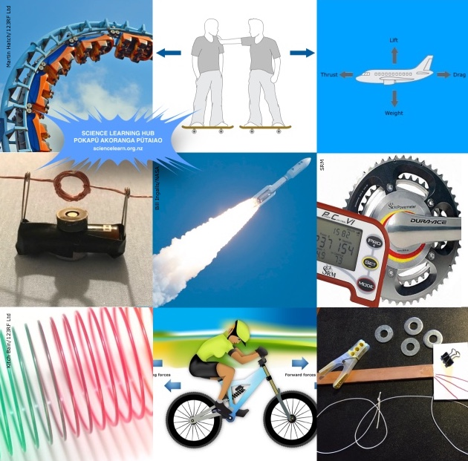
Physics made simple – force and motion
© Steve Hathaway
Greta Dromgool and Ted Cizadlo
4–4.45pm Thursday 21 February
© The University of Waikato Te Whare Wānanga o Waikato. All Rights Reserved | www.sciencelearn.org.nz
All images are copyrighted. For further information, please refer to enquiries@sciencelearn.org.nz
Collage acknowledgements:: Rollercoaster image, Martin Hatch/123RF Ltd; rocket image, Bill Ingalls/NASA; cycling power meter, SRM; and slinky image, Kitch Bain/123RF Ltd.

Slide 2


Pokapū Akoranga Pūtaiao
The Science Learning Hub
A trustworthy online resource – produced by educators and scientists for New Zealand teachers and students.
Based on world-class New Zealand science research.
Supported by learning activities, information about the key science ideas and concepts, multimedia tools and other resources.
© The University of Waikato Te Whare Wānanga o Waikato. All Rights Reserved | www.sciencelearn.org.nz
All images are copyrighted. For further information, please refer to enquiries@sciencelearn.org.nz
Notes:
The SLH is funded by the New Zealand Government – MBIE Ministry of Business, Innovation and Employment – under the Curious Minds fund

Slide 3
Index
Topic | Slideshow number(s ) | Video timecode
Introducing the Science Learning Hub and presenters | 1–2 | 00:00
Index | 3 | 00:52
Purpose | 4 | 01:40
NZ Curriculum | 5–7 | 06:12
Word map: motion and forces | 8–9 | 09:11
Speed | 10–11 | 11:37
Acceleration | 12 | 21:11
Forces | 13 | 26:45
Contexts and other resources | 14–16 | 37:15
SLH links, keep in touch and thanks | 17 | 38:25
© The University of Waikato Te Whare Wānanga o Waikato. All Rights Reserved | www.sciencelearn.org.nz
All images are copyrighted. For further information, please refer to enquiries@sciencelearn.org.nz

Slide 4
Purpose
In this webinar, we will:
build confidence to teach the Physical World by:
explaining key physics concepts
sharing simple activities to demonstrate concepts.
© The University of Waikato Te Whare Wānanga o Waikato. All Rights Reserved | www.sciencelearn.org.nz
All images are copyrighted. For further information, please refer to enquiries@sciencelearn.org.nz

Slide 5
What does the curriculum say?
Level 1 & 2
Explore everyday examples of physical phenomena, such as movement, forces, electricity and magnetism, light, sound, waves, and heat.
Seek and describe simple patterns in physical phenomena.
© The University of Waikato Te Whare Wānanga o Waikato. All Rights Reserved | www.sciencelearn.org.nz
All images are copyrighted. For further information, please refer to enquiries@sciencelearn.org.nz

Slide 6
What does the curriculum say?
Level 3 & 4
Explore, describe, and represent patterns and trends for everyday examples of physical phenomena, such as movement, forces, electricity and magnetism, light, sound, waves, and heat.
For example, identify and describe the effect of forces (contact and non-contact) on the motion of objects ...
© The University of Waikato Te Whare Wānanga o Waikato. All Rights Reserved | www.sciencelearn.org.nz
All images are copyrighted. For further information, please refer to enquiries@sciencelearn.org.nz

Slide 7
What does the curriculum say?
Level 5
Identify and describe the patterns associated with physical phenomena found in simple everyday situations involving movement, forces ...
For example, identify and describe the effect of contact and non-contact on the motion of objects.
Using physics: Explore a technological or biological application of physics.
© The University of Waikato Te Whare Wānanga o Waikato. All Rights Reserved | www.sciencelearn.org.nz
All images are copyrighted. For further information, please refer to enquiries@sciencelearn.org.nz

Slide 8

Participant ideas
Velocity. Is it the same as speed?
Balanced and unbalanced forces
Acceleration
Contact and non-contact forces
Weight
Gravity
© The University of Waikato Te Whare Wānanga o Waikato. All Rights Reserved | www.sciencelearn.org.nz
All images are copyrighted. For further information, please refer to enquiries@sciencelearn.org.nz

Slide 9
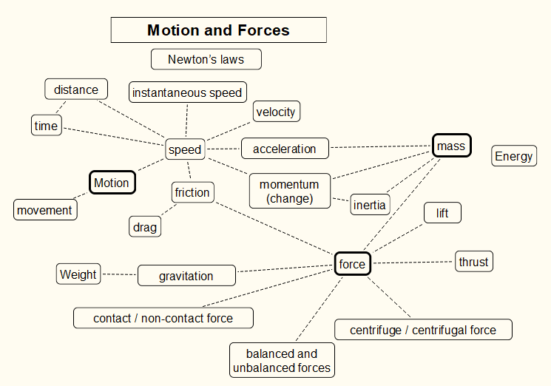
Word map
Try creating your own map, or do this as an activity with students. It is important to try and explain why you have made a connection between two words.
© The University of Waikato Te Whare Wānanga o Waikato. All Rights Reserved | www.sciencelearn.org.nz
All images are copyrighted. For further information, please refer to enquiries@sciencelearn.org.nz

Slide 10
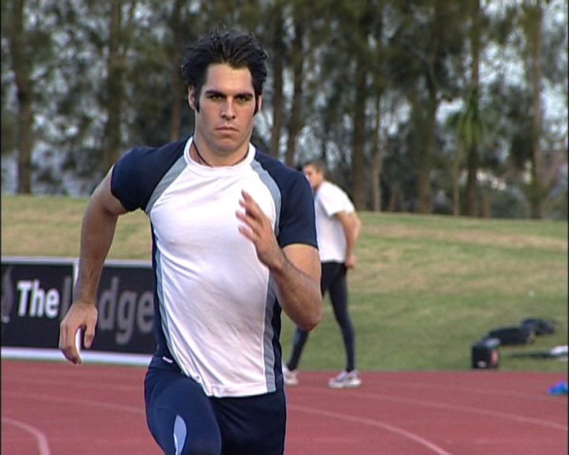
Speed
Speed is a measurement of movement.
How do you measure speed?
To measure speed we need to know the distance an object has moved and the time it took to get there.
© The University of Waikato Te Whare Wānanga o Waikato. All Rights Reserved | www.sciencelearn.org.nz
All images are copyrighted. For further information, please refer to enquiries@sciencelearn.org.nz
Notes:
https://www.sciencelearn.org.nz/images/2348-sprinter-james-dolphin

Slide 11
Speed
Speed is a measurement of movement.
How do you measure speed?
To measure speed we need to know the distance an object has moved and the time it took to get there.
See the activity An investigation of motion
Spend time discussing, predicting and measuring the speeds of everyday objects.
© The University of Waikato Te Whare Wānanga o Waikato. All Rights Reserved | www.sciencelearn.org.nz
All images are copyrighted. For further information, please refer to enquiries@sciencelearn.org.nz
Notes:
https://www.sciencelearn.org.nz/images/2348-sprinter-james-dolphin

Slide 12
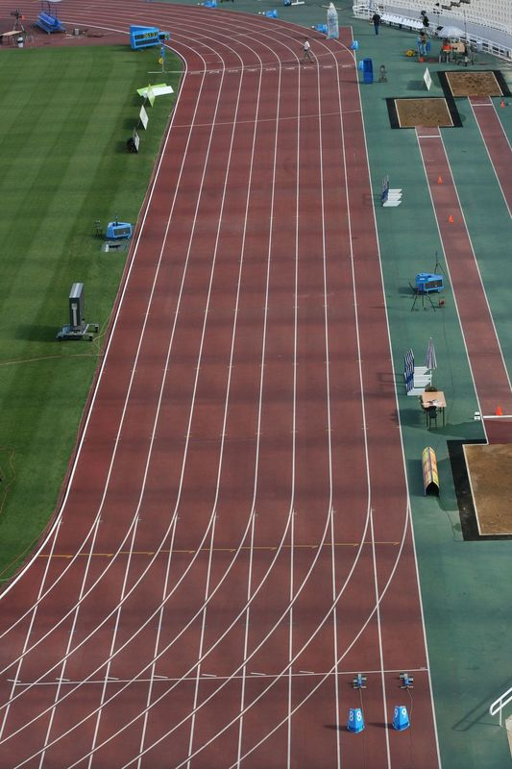
Calculating speed
Speed can be calculated by dividing distance time.
100 meters in 12 seconds
= 100m/12s
= 8.3m/s
This gives is an average speed. During this time the object may have changed speed.
The speed something is travelling at a particular moment in time is called instantaneous speed.
Evangelos Thomaidis, licensed through 123RF Ltd
© The University of Waikato Te Whare Wānanga o Waikato. All Rights Reserved | www.sciencelearn.org.nz
All images are copyrighted. For further information, please refer to enquiries@sciencelearn.org.nz
Notes:
https://www.sciencelearn.org.nz/images/2347-race-track

Slide 13
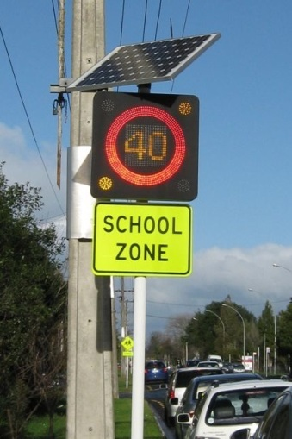
Acceleration
Acceleration is a change in speed.
What makes things speed up and slow down?
Acceleration is related to the mass of an object and the amount of force applied to that object.
© The University of Waikato Te Whare Wānanga o Waikato. All Rights Reserved | www.sciencelearn.org.nz
All images are copyrighted. For further information, please refer to enquiries@sciencelearn.org.nz
Notes:
https://www.sciencelearn.org.nz/images/2178-photovoltaic-road-sign

Slide 14
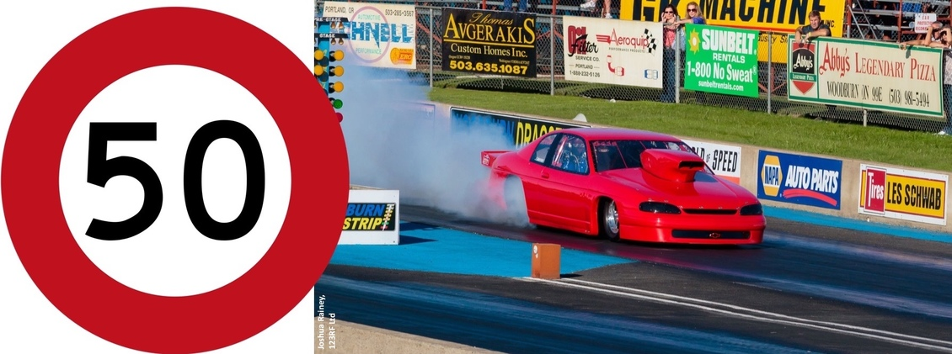
Forces
Forces change the speed of an object.
Drag racing car, Joshua Rainey, 123RF Ltd.
© The University of Waikato Te Whare Wānanga o Waikato. All Rights Reserved | www.sciencelearn.org.nz
All images are copyrighted. For further information, please refer to enquiries@sciencelearn.org.nz

Slide 15
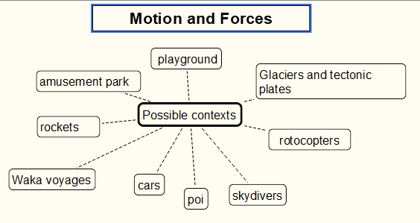
Context ideas
Which contexts would be relevant and engaging to your students?
© The University of Waikato Te Whare Wānanga o Waikato. All Rights Reserved | www.sciencelearn.org.nz
All images are copyrighted. For further information, please refer to enquiries@sciencelearn.org.nz
Notes:
https://www.sciencelearn.org.nz/images/3410-bar-magnets

Slide 16
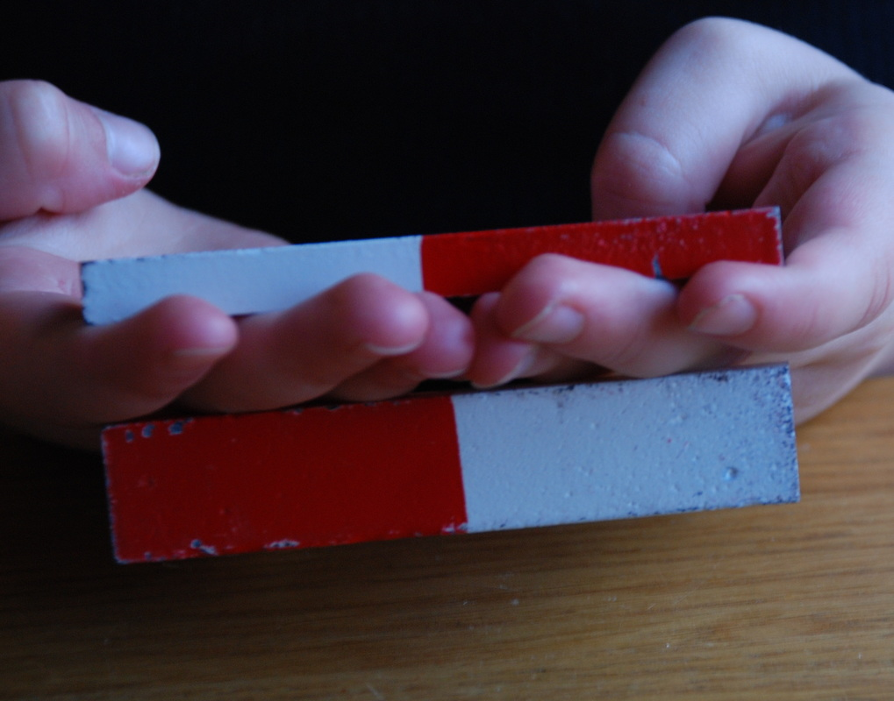
Other forces
Magnetism
Concept: www.sciencelearn.org.nz/concepts/magnetism
Webinar: www.sciencelearn.org.nz/resources/2549-exploring-magnetism
© The University of Waikato Te Whare Wānanga o Waikato. All Rights Reserved | www.sciencelearn.org.nz
All images are copyrighted. For further information, please refer to enquiries@sciencelearn.org.nz
Notes:
https://www.sciencelearn.org.nz/images/3410-bar-magnets

Slide 17
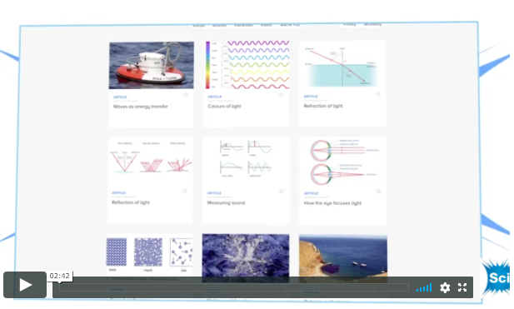
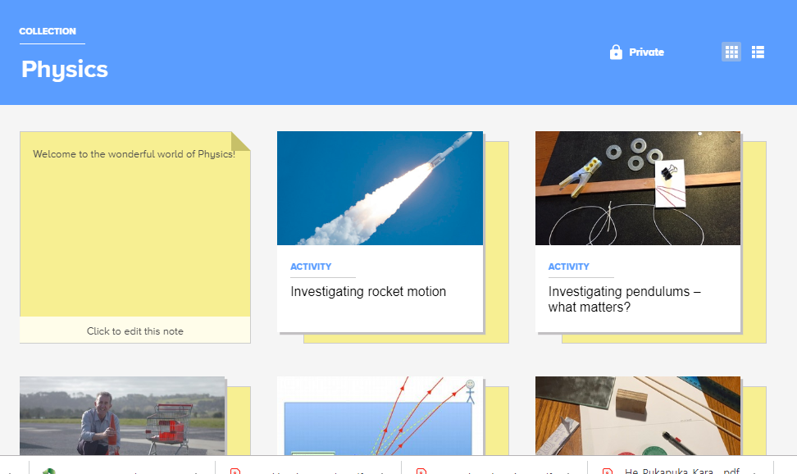
Want more?
Help I’m teaching physics!
www.sciencelearn.org.nz/videos/1859-help-i-m-teaching-physics
Physics collection www.sciencelearn.org.nz/collections/shared/1f59bd69f25768cafbc94102f2908c8a
© The University of Waikato Te Whare Wānanga o Waikato. All Rights Reserved | www.sciencelearn.org.nz
All images are copyrighted. For further information, please refer to enquiries@sciencelearn.org.nz

Slide 18






Thanks
Pokapū Akoranga Pūtaiao
Email us on enquiries@sciencelearn.org.nz
https://twitter.com/NZScienceLearn
www.facebook.com/nzsciencelearn
https://nz.pinterest.com/nzsciencelearn
www.pond.co.nz/community/214015/science-learning-hub/1
www.instagram.com/sciencelearninghubnz
Join us in our discussion channel on Slack.
(Any problems accessing Slack, please contact us via our enquiries email, enquiries@sciencelearn.org.nz.)
Notes:
SLACK: https://slh-talk.slack.com/messages/CDL529ERW/

