Slide 1
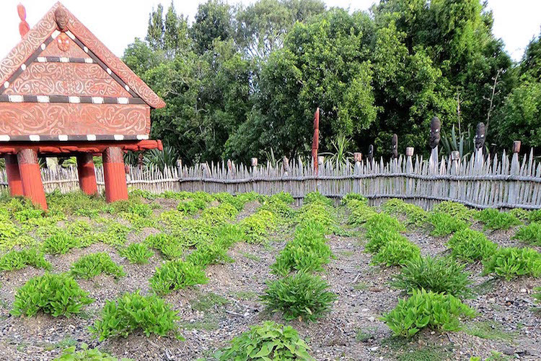
Mātauranga Māori
Associate Professor Hēmi Whaanga
and
Greta Dromgool
June 2019
Megan Balks
© Copyright. The University of Waikato Te Whare Wānanga o Waikato. All Rights Reserved | www.sciencelearn.org.nz
All images are copyrighted. For further information, please refer to enquiries@sciencelearn.org.nz

Slide 2
Pokapū Akoranga Pūtaiao
The Science Learning Hub
A trustworthy online resource – produced by educators and scientists for New Zealand teachers and students.
Based on world-class New Zealand science research.
Supported by learning activities, information about the key science ideas and concepts, multimedia tools and other resources.
© Copyright. The University of Waikato Te Whare Wānanga o Waikato. All Rights Reserved | www.sciencelearn.org.nz
All images are copyrighted. For further information, please refer to enquiries@sciencelearn.org.nz
Notes:
The SLH is funded by the NZ Government – MBIE Ministry of Business, Innovation and Employment – under the Curious Minds fund

Slide 3
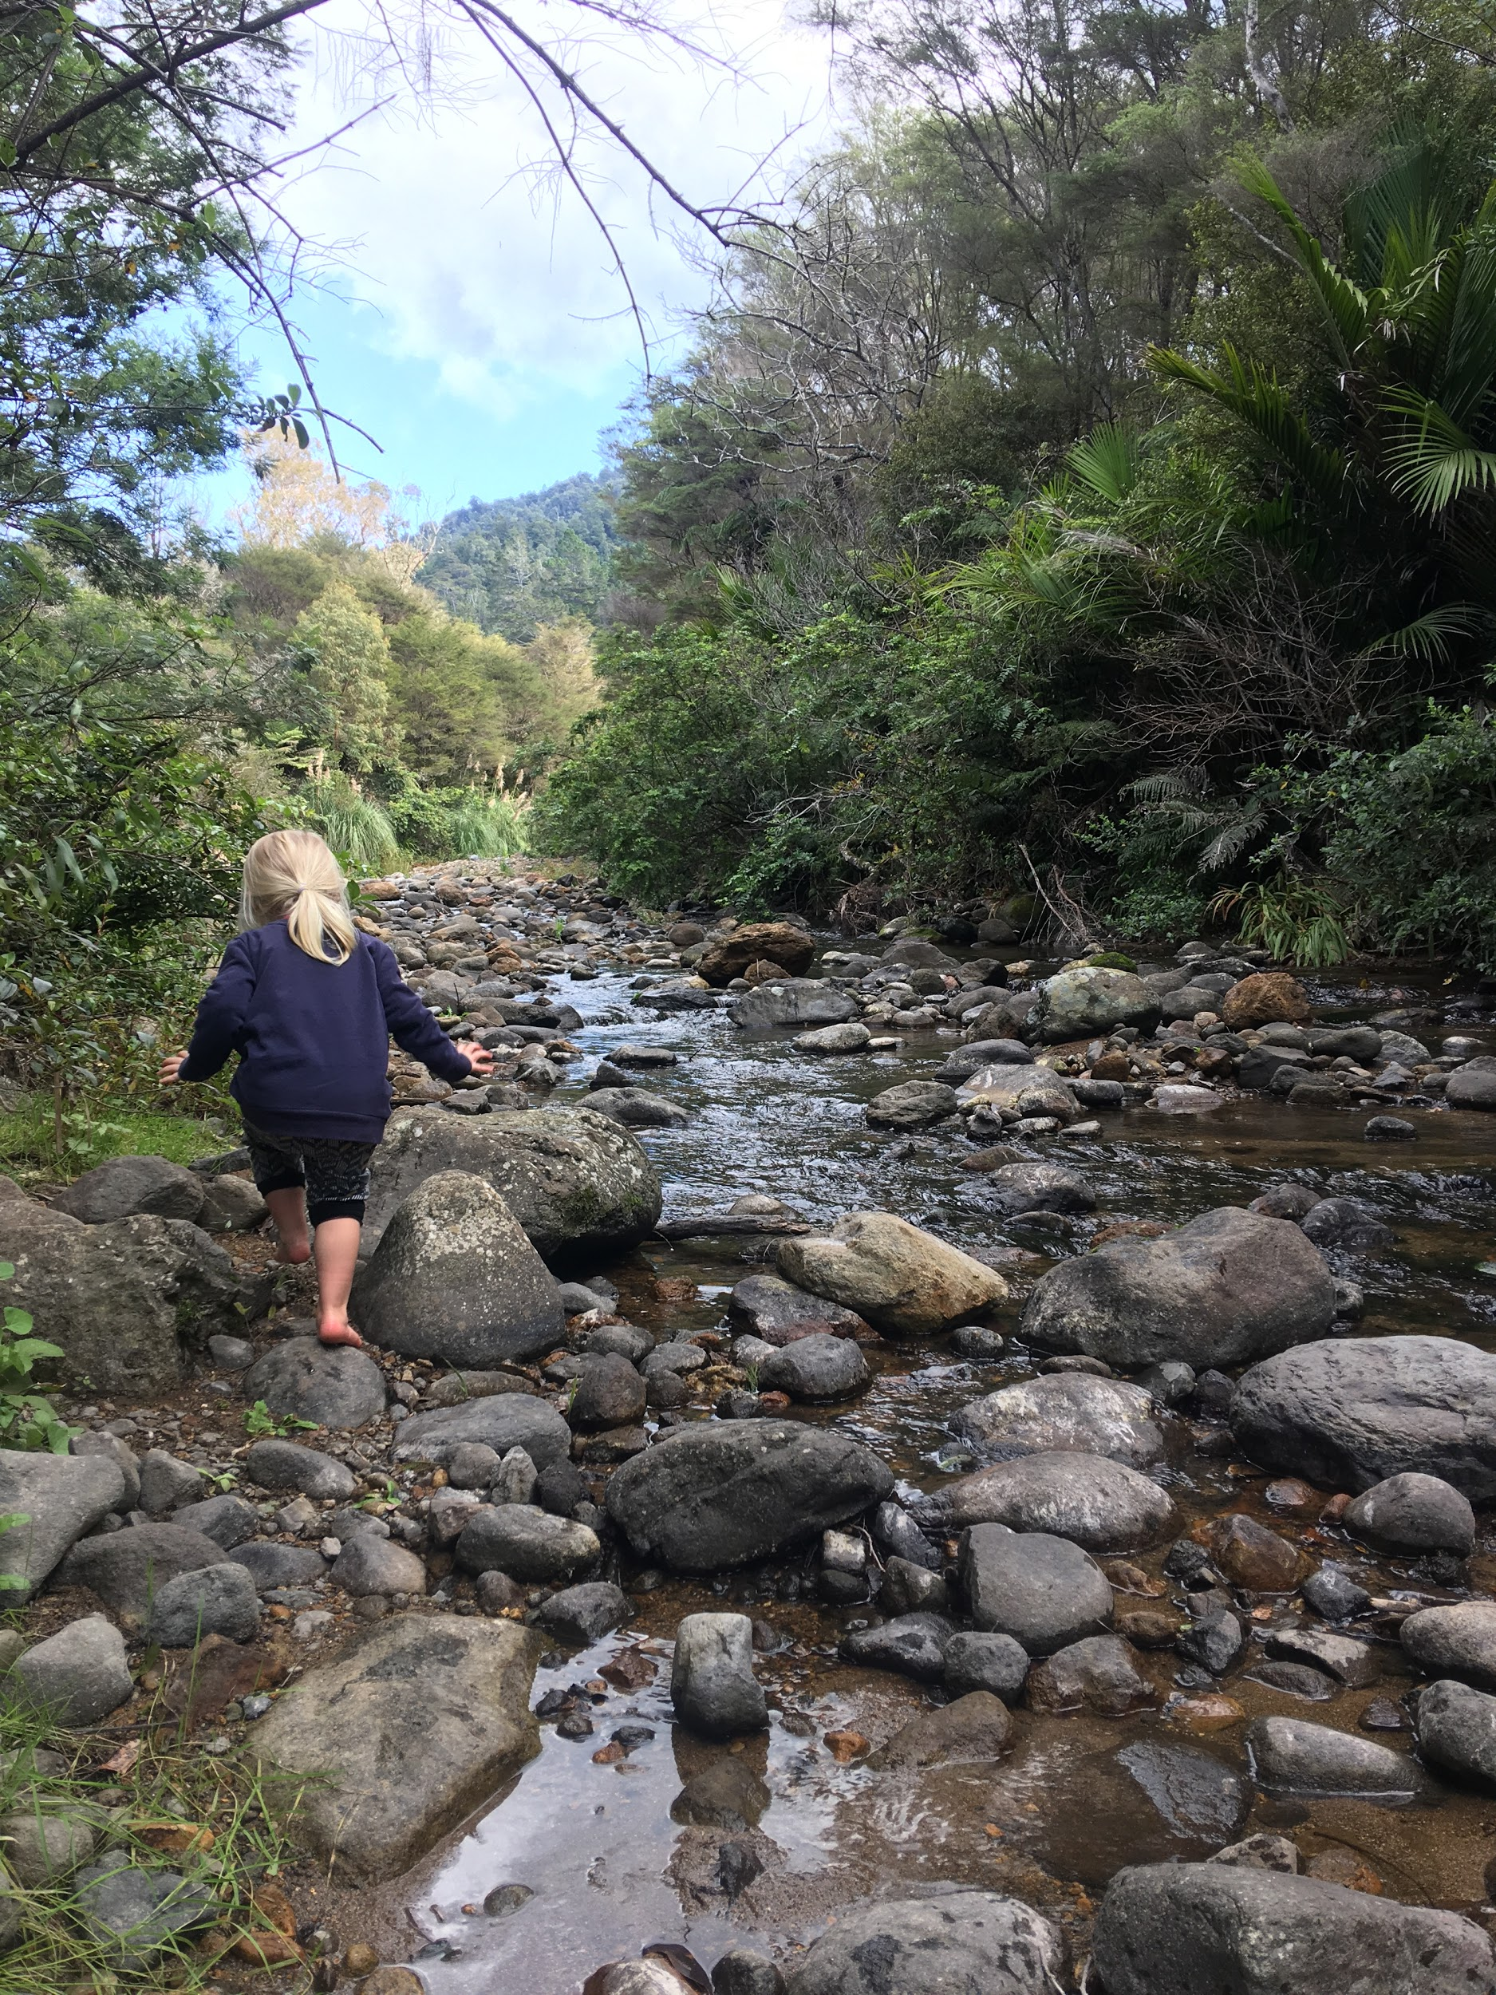
Private collection
© Copyright. The University of Waikato Te Whare Wānanga o Waikato. All Rights Reserved | www.sciencelearn.org.nz
All images are copyrighted. For further information, please refer to enquiries@sciencelearn.org.nz
Notes:
Copyright Greta Dromgool

Slide 4
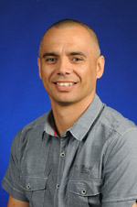
Hēmi Whaanga
Associate Professor at Te Pua Wānanga ki te Ao (Faculty of Māori and Indigenous Studies), Waikato University.
Hēmi is involved in the areas of mātauranga Māori, traditional ecological knowledge, digitisation of indigenous knowledge, language revitalisation, linguistics, language teaching and curriculum development.
© Copyright. The University of Waikato Te Whare Wānanga o Waikato. All Rights Reserved | www.sciencelearn.org.nz
All images are copyrighted. For further information, please refer to enquiries@sciencelearn.org.nz
Notes:
https://www.waikato.ac.nz/fmis/about/staff/hemi
Hēmi’s work on the Science Learning Hub
Moa article: https://www.sciencelearn.org.nz/resources/2654-dead-as-the-moa-oral-traditions-show-that-early-maori-recognised-extinction

Slide 5
Index
Topic | Slide show number(s) | Video timecode
Welcome | 1 | 00:00
Introducing the Science Learning Hub and presenters | 2-4 | 00:19
Index | 5 | 2:25
Exploring mātauranga Māori – teacher ideas | 6 –7 | 2:36
Exploring mātauranga Māori – perspectives | 8 – 13 | 4:03
Science and mātauranga | 14 | 12:38
Maramataka, weather and fresh water | 15–17 | 15:16
Students, making connections and whakapapa | 18 – 22 | 21:19
Tātai arorangi and Matariki | 23 – 27 | 28:19
Navigation | 28 – 29 | 38:12
SLH links, keep in touch and thanks | 30 – 31 | 39:41
© Copyright. University of Waikato. All Rights Reserved | www.sciencelearn.org.nz
All images are copyrighted. For further information, please refer to enquiries@sciencelearn.org.nz

Slide 6
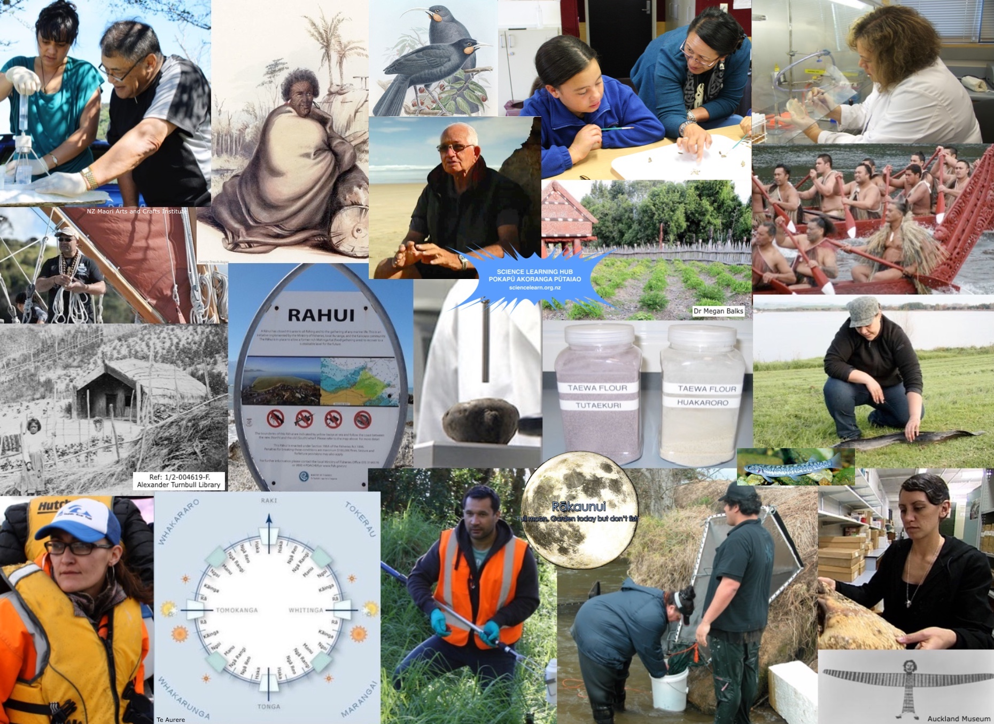
Exploring
mātauranga Māori
© Copyright. The University of Waikato Te Whare Wānanga o Waikato. All Rights Reserved | www.sciencelearn.org.nz
All images are copyrighted. For further information, please refer to enquiries@sciencelearn.org.nz
Notes:
Mātauranga and Māori scientist Pinterest collection: https://www.pinterest.nz/nzsciencelearn/m%C4%81tauranga-m%C4%81ori/

Slide 7
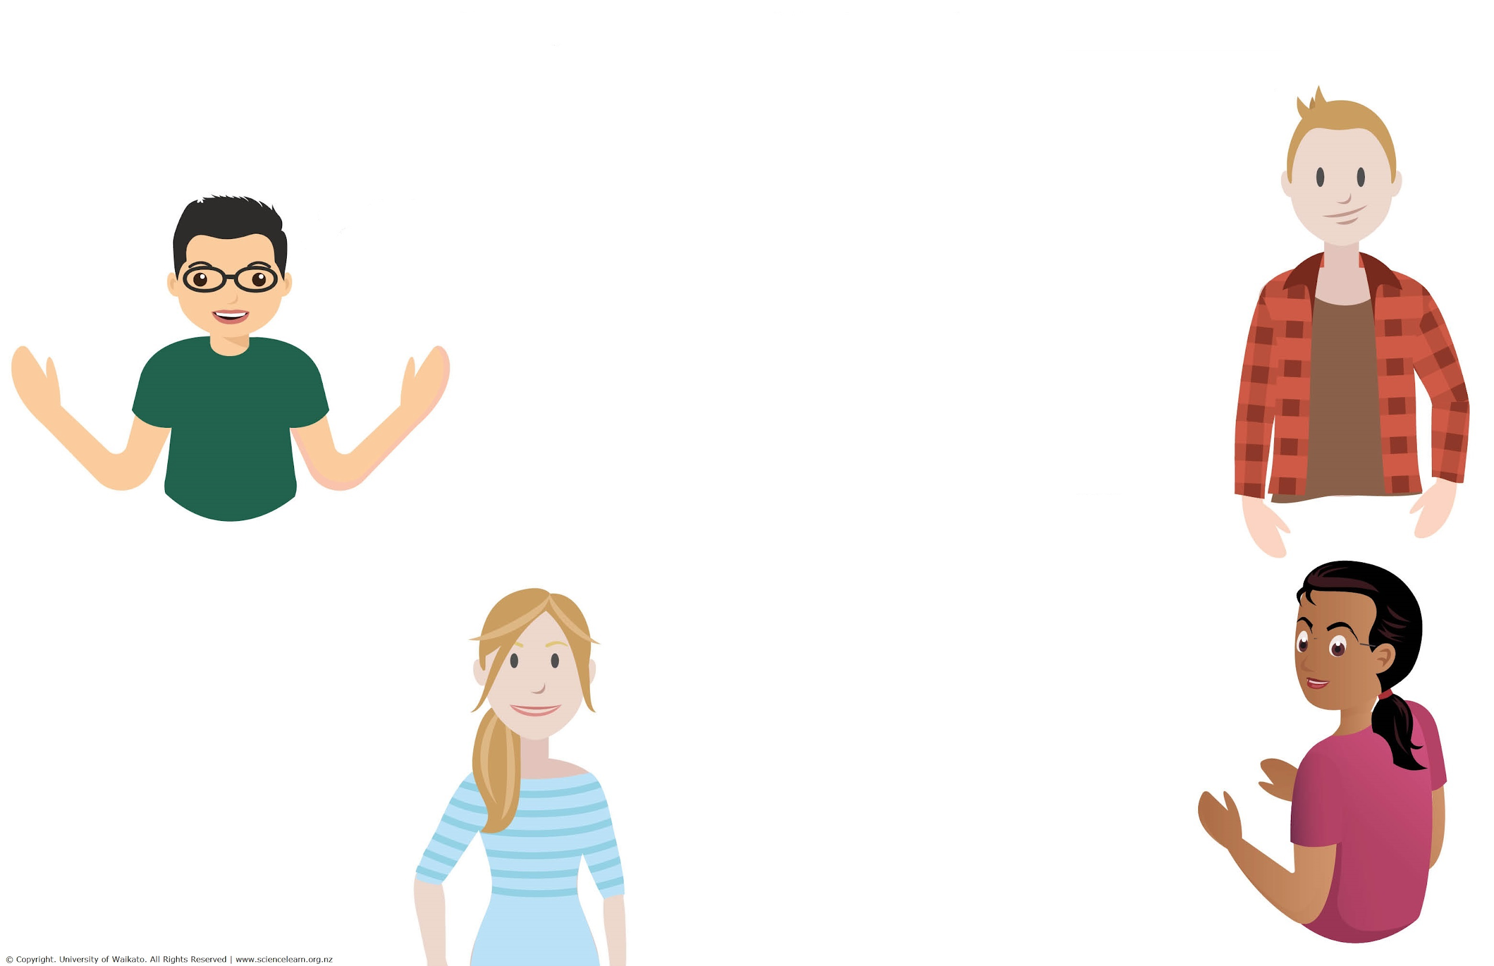
Exploring mātauranga Māori
What does it mean to you?
Science with a Māori context and perspectives
Traditional knowledge – connection with land, flora, fauna and natural cycles
Māori way of living, seeing and doing
A body of knowledge gathered by careful observation/analysis, often explained by a spiritual/ holistic world view
Knowledge, concepts – mauri in biology – life force, health of an environment like a stream
© Copyright. The University of Waikato Te Whare Wānanga o Waikato. All Rights Reserved | www.sciencelearn.org.nz
All images are copyrighted. For further information, please refer to enquiries@sciencelearn.org.nz
Notes:
What is mātauranga Māori to you? Ideas collection from webinar participants.

Slide 8
Exploring
mātauranga Māori
“… Mātauranga Māori is something that incorporates all aspects of Māori world view, traditional knowledge, cultural knowledge, spiritual knowledge, values, all those systems that interrelate with each other to create a knowledge system …”
© Copyright. The University of Waikato Te Whare Wānanga o Waikato. All Rights Reserved | www.sciencelearn.org.nz
All images are copyrighted. For further information, please refer to enquiries@sciencelearn.org.nz
Notes:
Quote from Hēmi Whaanga

Slide 9
Is mātauranga a science?
“Saying mātauranga Māori is a science, well, science is involved in mātauranga, but it is a holistic system that we have to describe everything, how we interact with the environment, with each other, with all those different aspects of Māoridom.”
© Copyright. The University of Waikato Te Whare Wānanga o Waikato. All Rights Reserved | www.sciencelearn.org.nz
All images are copyrighted. For further information, please refer to enquiries@sciencelearn.org.nz
Notes:
Quote from Hēmi Whaanga

Slide 10
A place-based knowledge system
“For example, knowledge relating to fishing may be very place based depending on where you are, what side of the island you are on. Knowledge about harvesting and forests, they will be very different from that knowledge.
They are very much different systems within a whole system of Māori knowledge.”
© Copyright. The University of Waikato Te Whare Wānanga o Waikato. All Rights Reserved | www.sciencelearn.org.nz
All images are copyrighted. For further information, please refer to enquiries@sciencelearn.org.nz
Notes:
Quote from Hēmi Whaanga

Slide 11
Exploring mātauranga Māori
… Mātauranga Māori can’t be translated or defined in a simple, two-dimensional way: it is multifaceted. There are many aspects to it. From my understanding, Mātauranga Māori not only refers to the knowledge that Māori have, but encompasses the Māori way of knowing – and the connectedness that knowledge has with the environment out of which it was derived.
What is Mātauranga Māori?
Laura Goodall Sciblogs 26/02/2016
Mātauranga Māori – the ūkaipō of knowledge in New Zealand
RSNZ Journal 2016
… mātauranga Māori includes knowledge generated using techniques consistent with the scientific method, but explained according to a Māori world view.
© Copyright. The University of Waikato Te Whare Wānanga o Waikato. All Rights Reserved | www.sciencelearn.org.nz
All images are copyrighted. For further information, please refer to enquiries@sciencelearn.org.nz
Notes:
Mātauranga Māori – the ūkaipō of knowledge in New Zealand: https://www.tandfonline.com/doi/abs/10.1080/03036758.2016.1252407
What is Mātauranga Māori?: https://sciblogs.co.nz/matau-taiao/2016/02/26/what-is-matauranga-maori/

Slide 12
“One of the important things when trying to incorporate it into your own classroom and learning is that there are resources and people within your community that have expertise in this area.”
© Copyright. The University of Waikato Te Whare Wānanga o Waikato. All Rights Reserved | www.sciencelearn.org.nz
All images are copyrighted. For further information, please refer to enquiries@sciencelearn.org.nz
Notes:
There is support out there for connecting to experts:
Enviroschools - contact them to find out more: https://enviroschools.org.nz/
Great chapter on cross-cultural conversations here: https://www.landcareresearch.co.nz/__data/assets/pdf_file/0004/134932/1-Kapu-Ti-101.pdf
And don’t forget you can always contact the Science Learning Hub and we can connect you.

Slide 13
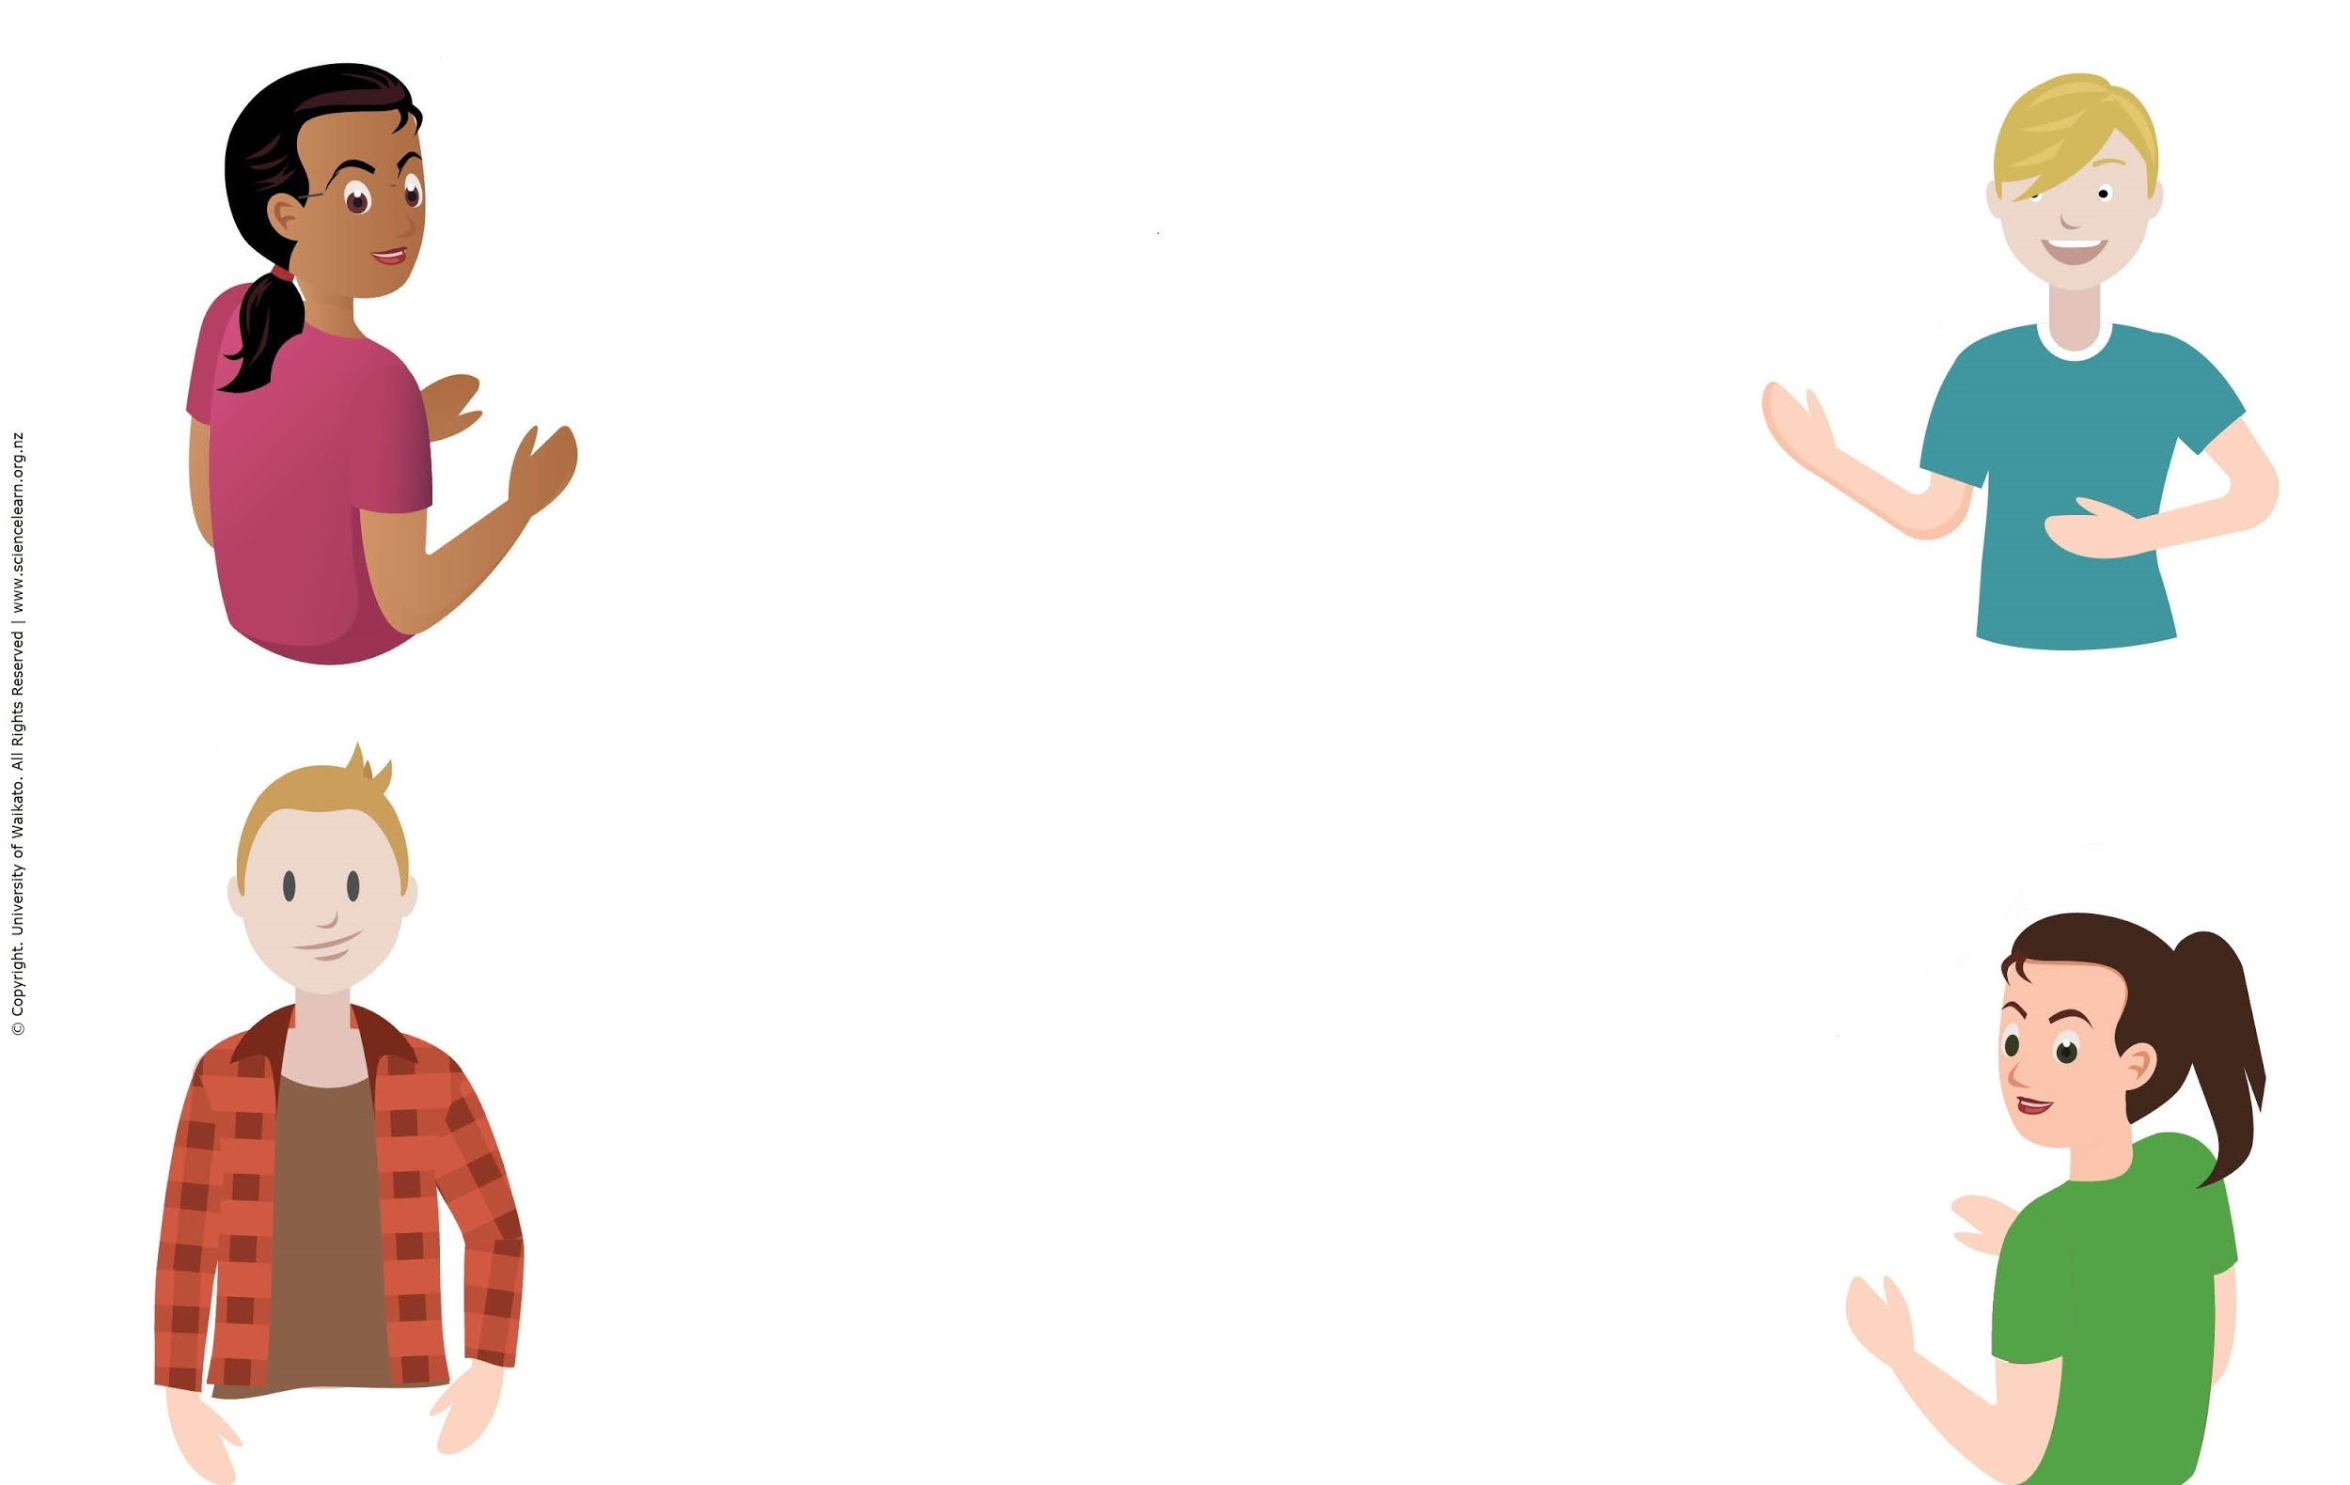
Exploring mātauranga continued
Traditions, beliefs, culture
When harvesting kawa kawa leaves for rongoā, does the tikanga of when/where/how to harvest count as mātauranga?
Kaitiaki/guardianship of the living and non-living world
Ko mātauranga Māori te korowai, tūāpapa rānei o ngā mea Māori katoa ... o te ao Māori.
Mātauranga kua tuku iho mai i o tātou tīpuna
Traditional knowledge, cultural, spiritual world view of Māori and expression of values (kaitiakitanga)
© Copyright. The University of Waikato Te Whare Wānanga o Waikato. All Rights Reserved | www.sciencelearn.org.nz
All images are copyrighted. For further information, please refer to enquiries@sciencelearn.org.nz
Notes:
Moa article: https://www.sciencelearn.org.nz/resources/2654-dead-as-the-moa-oral-traditions-show-that-early-maori-recognised-extinction

Slide 14
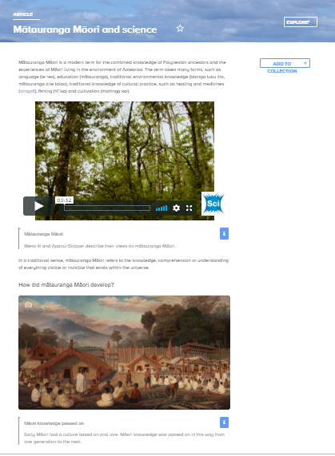
Science and mātauranga
Auckland Art Gallery – Toi o Tāmaki Reference: 1923/3 Oil on canvas by Sam Stuart
© Copyright. The University of Waikato Te Whare Wānanga o Waikato. All Rights Reserved | www.sciencelearn.org.nz
All images are copyrighted. For further information, please refer to enquiries@sciencelearn.org.nz
Notes:
Article: https://www.sciencelearn.org.nz/resources/2545-matauranga-maori-and-science

Slide 15
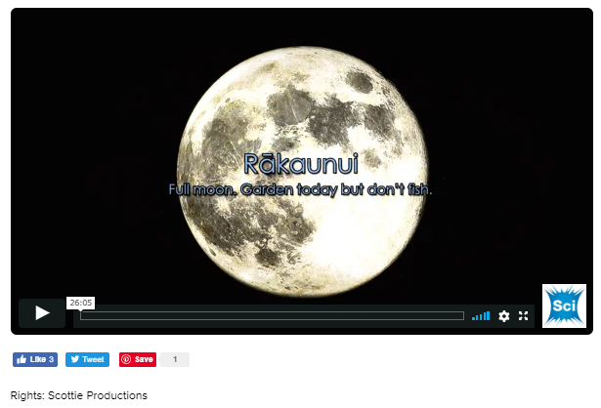
Maramataka
© Copyright. The University of Waikato Te Whare Wānanga o Waikato. All Rights Reserved | www.sciencelearn.org.nz
All images are copyrighted. For further information, please refer to enquiries@sciencelearn.org.nz
Notes:
Tātai arorangi video: https://www.sciencelearn.org.nz/videos/563-tatai-arorangi
Te Papa link to Maramataka: https://www.tepapa.govt.nz/discover-collections/read-watch-play/maori/matariki-maori-new-year/maramataka/nights-maramataka

Slide 16
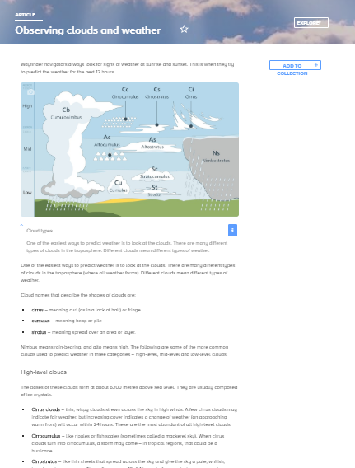
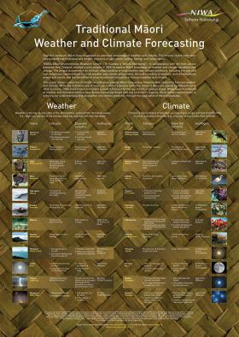
Weather
Valentin de Bruyn/Coton
NIWA
© Copyright. The University of Waikato Te Whare Wānanga o Waikato. All Rights Reserved | www.sciencelearn.org.nz
All images are copyrighted. For further information, please refer to enquiries@sciencelearn.org.nz
Notes:
Weather links and resources
Observing clouds and weather: https://www.sciencelearn.org.nz/resources/628-observing-clouds-and-weather
NIWA posters: https://www.niwa.co.nz/publications/posters
Royal Society Crest Awards: https://royalsociety.org.nz/what-we-do/funds-and-opportunities/crest-awards/primary-crest/primary-crest-niwa-what-is-climate-2/
https://royalsociety.org.nz/assets/documents/PRIMARY-CREST-NIWA-What-is-Weather.pdf
Metservice cloud posters: https://about.metservice.com/our-company/learning-centre/poster-downloads/

Slide 17
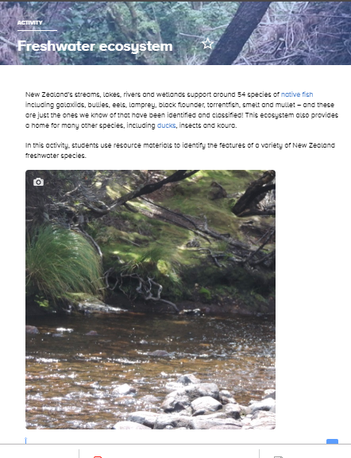
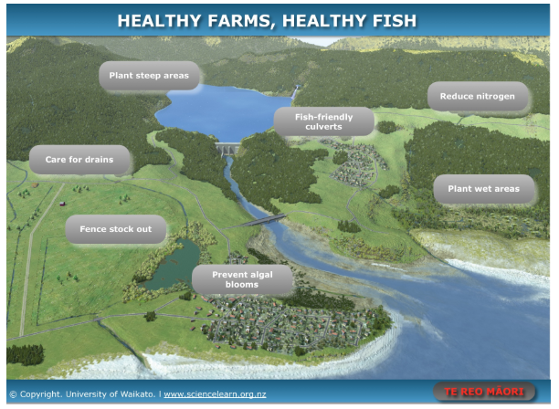
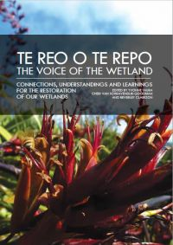
Freshwater
Identifying a gap in regards to information, Waikato-Tainui approached and then collaborated with Manaaki Whenua on this publication — Te reo o te repo - The voice of the wetland: connections, understandings and learnings for the restoration of our wetlands / edited by Yvonne Taura, Cheri van Schravendijk-Goodman, Beverley Clarkson. -- Hamilton, NZ: Manaaki Whenua – Landcare Research and Waikato Raupatu River Trust, 2017.
© Copyright. The University of Waikato Te Whare Wānanga o Waikato. All Rights Reserved | www.sciencelearn.org.nz
All images are copyrighted. For further information, please refer to enquiries@sciencelearn.org.nz
Notes:
Freshwater interactive – includes te reo: https://www.sciencelearn.org.nz/image_maps/54-healthy-farms-healthy-fish
Freshwater ecosystem activity: https://www.sciencelearn.org.nz/resources/2591-freshwater-ecosystem
Waikato Raupatu River Trust and Manaaki Whenua – Landcare Research: https://www.landcareresearch.co.nz/publications/books/te-reo-o-te-repo

Slide 18
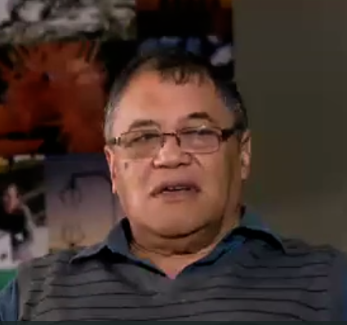
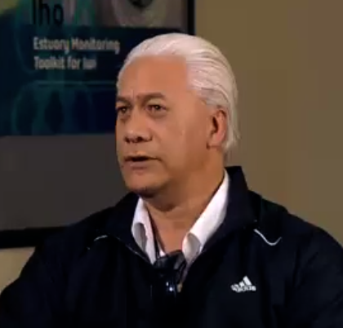
Exploring mātauranga Māori
Mātauranga Māori is, I believe, the knowledge of the Māori. And in a lot of cases, you have to look at what the mātauranga is about because some mātauranga is not for the common person.
WENO ITI
There’s no general sort of thing in regards to Māori because we’re all different. Some are located on the coast, so they have knowledge that’s pertaining to the sea and the ocean. Some are located along the rivers, so they have an in-depth knowledge and understanding around the river.
APANUI SKIPPER
© Copyright. The University of Waikato Te Whare Wānanga o Waikato. All Rights Reserved | www.sciencelearn.org.nz
All images are copyrighted. For further information, please refer to enquiries@sciencelearn.org.nz
Notes:
Images of Weno Iti and Apanui Skipper from https://www.sciencelearn.org.nz/videos/652-matauranga-maori

Slide 19
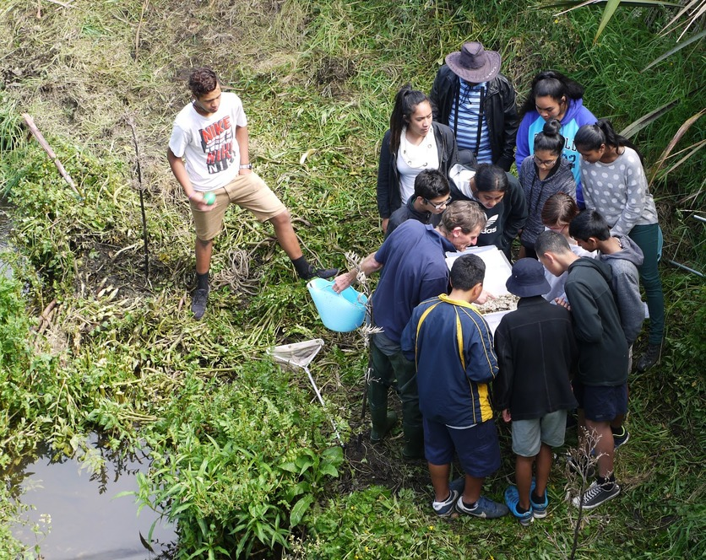
Student knowledge
Dr Sarah Morgan, Comet Auckland
© Copyright. The University of Waikato Te Whare Wānanga o Waikato. All Rights Reserved | www.sciencelearn.org.nz
All images are copyrighted. For further information, please refer to enquiries@sciencelearn.org.nz
Notes:
Image of students: https://www.sciencelearn.org.nz/images/2099-species-count-at-city-stream
Curious Minds stories: https://www.curiousminds.nz/stories/?subject=matauranga-maori

Slide 20
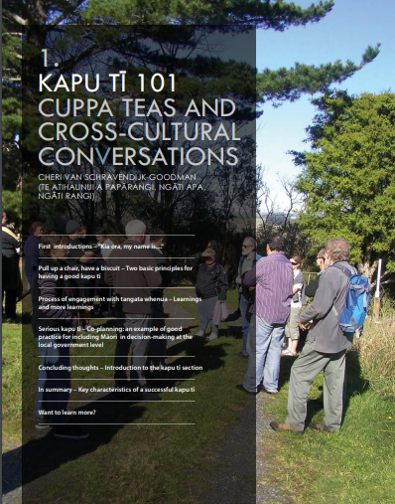
Making connections
Identifying a gap in regards to information, Waikato-Tainui approached and then collaborated with Manaaki Whenua on this publication — Te reo o te repo - The voice of the wetland: connections, understandings and learnings for the restoration of our wetlands / edited by Yvonne Taura, Cheri van Schravendijk-Goodman, Beverley Clarkson. -- Hamilton, NZ: Manaaki Whenua – Landcare Research and Waikato Raupatu River Trust, 2017.
© Copyright. The University of Waikato Te Whare Wānanga o Waikato. All Rights Reserved | www.sciencelearn.org.nz
All images are copyrighted. For further information, please refer to enquiries@sciencelearn.org.nz
Notes:
There is support out there for connecting to experts:
Enviroschools – contact them to find out more: https://enviroschools.org.nz/
Great chapter on cross-cultural conversations here: https://www.landcareresearch.co.nz/__data/assets/pdf_file/0004/134932/1-Kapu-Ti-101.pdf
And don’t forget you can always contact the Science Learning Hub and we can connect you.

Slide 21
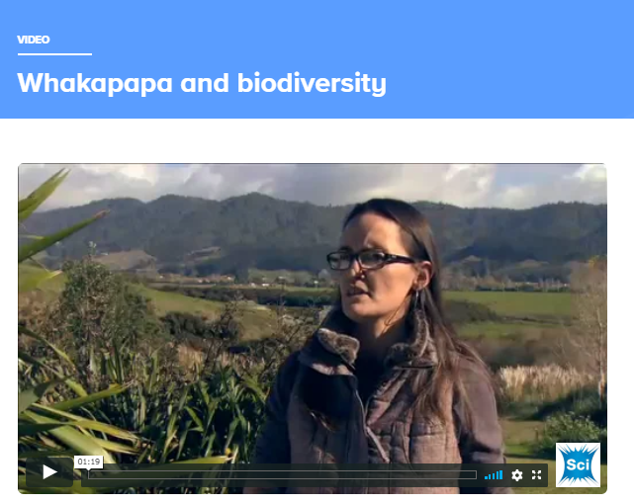
Whakapapa
© Copyright. The University of Waikato Te Whare Wānanga o Waikato. All Rights Reserved | www.sciencelearn.org.nz
All images are copyrighted. For further information, please refer to enquiries@sciencelearn.org.nz
Notes:
Whakapapa and biodiversity: https://www.sciencelearn.org.nz/videos/258-whakapapa-and-biodiversity
Good Ancestors podcast: Mātauranga and conservation: https://thespinoff.co.nz/partner/auckland-zoo/25-03-2019/matauranga-maori-and-western-science-two-worlds-meet-to-save-the-one-we-have/
Mere Roberts “Ways of seeing”:
https://www.semanticscholar.org/paper/Whakapapa-as-a-Maori-Mental-Construct%3A-Some-for-the-Roberts-Haami/fffdb929c577a30395258132126c4085d7b1f481

Slide 22
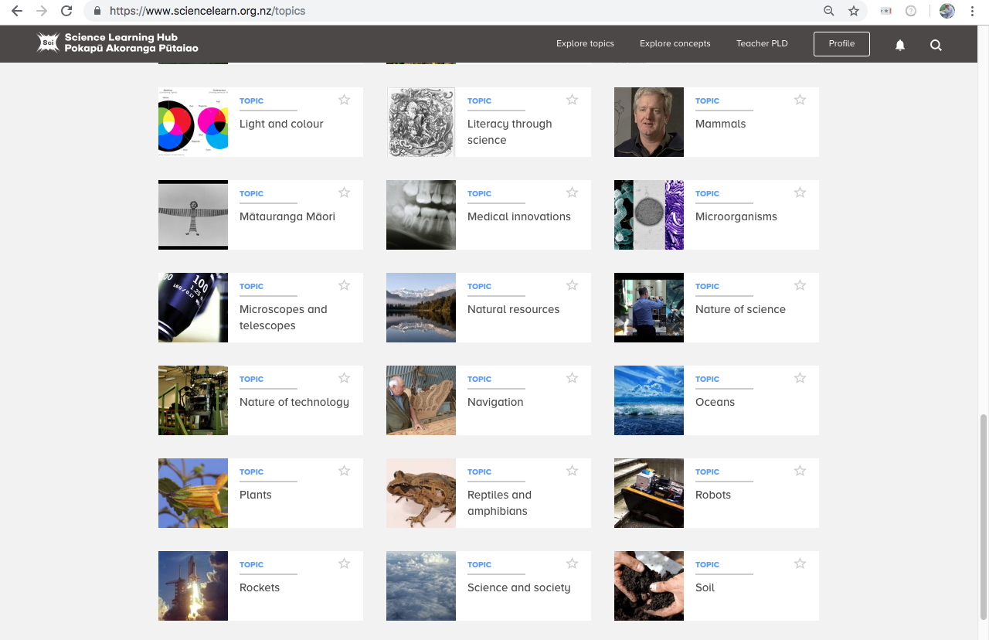
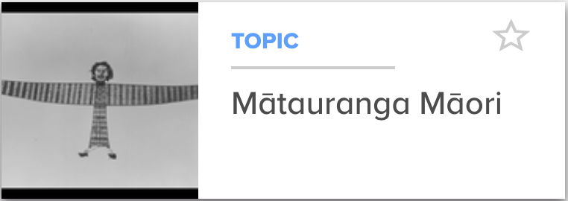
Auckland Museum
© Copyright. The University of Waikato Te Whare Wānanga o Waikato. All Rights Reserved | www.sciencelearn.org.nz
All images are copyrighted. For further information, please refer to enquiries@sciencelearn.org.nz
Notes:
Topic: https://www.sciencelearn.org.nz/topics/m%C4%81tauranga-m%C4% 81ori
Article: https://www.sciencelearn.org.nz/resources/2545-matauranga-maori-and-science

Slide 23
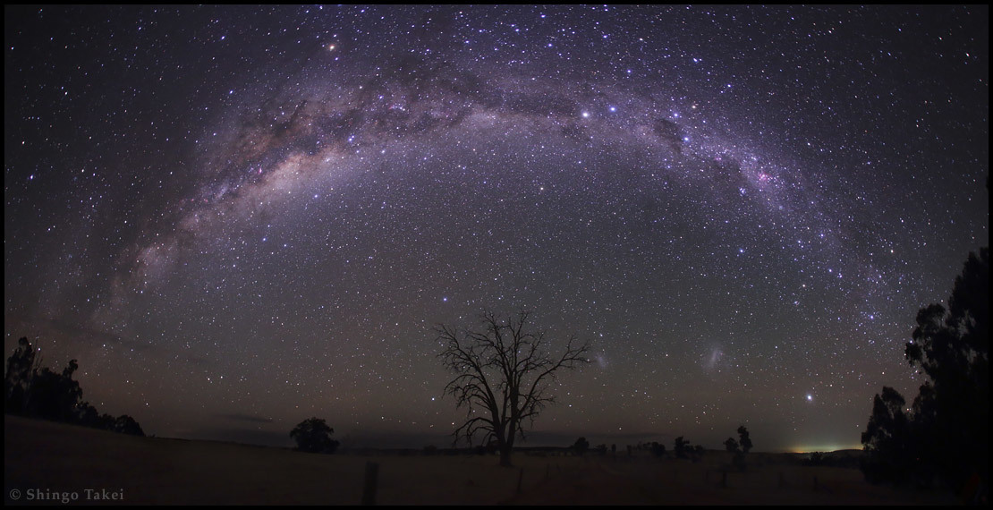
Tātai arorangi
Māori astronomy
Shingo Takei
© Copyright. The University of Waikato Te Whare Wānanga o Waikato. All Rights Reserved | www.sciencelearn.org.nz
All images are copyrighted. For further information, please refer to enquiries@sciencelearn.org.nz
Notes:
SMART: Society of Maori Astronomy Research and Traditions: https://www.maoriastronomy.co.nz/publications
Image: https://www.sciencelearn.org.nz/images/603-stars

Slide 24
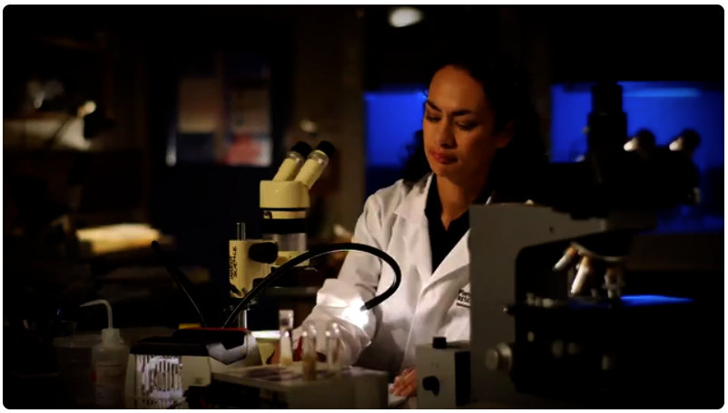
Tātai arorangi
Māori astronomy
Scottie Productions
© Copyright. The University of Waikato Te Whare Wānanga o Waikato. All Rights Reserved | www.sciencelearn.org.nz
All images are copyrighted. For further information, please refer to enquiries@sciencelearn.org.nz
Notes:
Image: Still from https://www.sciencelearn.org.nz/videos/563-tatai-arorangi
Article: https://www.sciencelearn.org.nz/resources/1274-revitalising-maori-astronomy

Slide 25
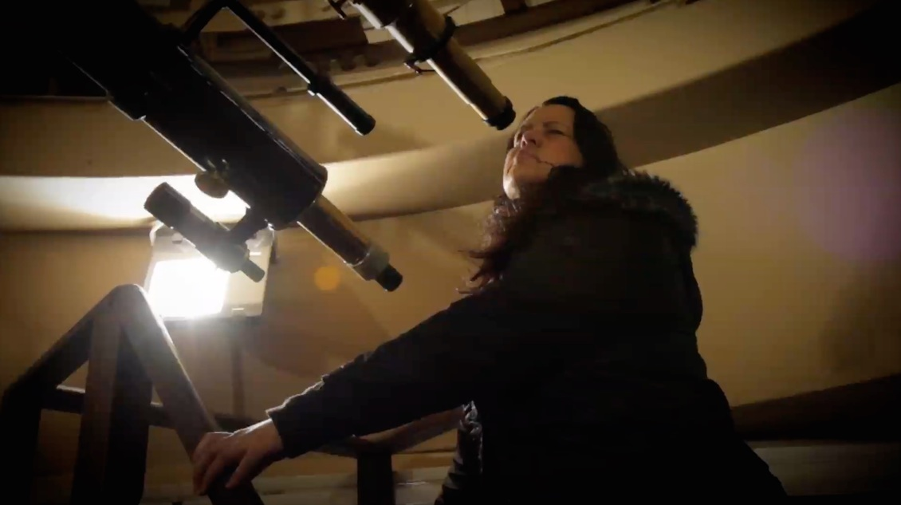
Tātai arorangi
Māori astronomy
Scottie Productions
© Copyright. The University of Waikato Te Whare Wānanga o Waikato. All Rights Reserved | www.sciencelearn.org.nz
All images are copyrighted. For further information, please refer to enquiries@sciencelearn.org.nz
Notes:
Image: https://www.sciencelearn.org.nz/images/1171-dr-pauline-harris
Article: https://www.sciencelearn.org.nz/resources/1274-revitalising-maori-astronomy

Slide 26
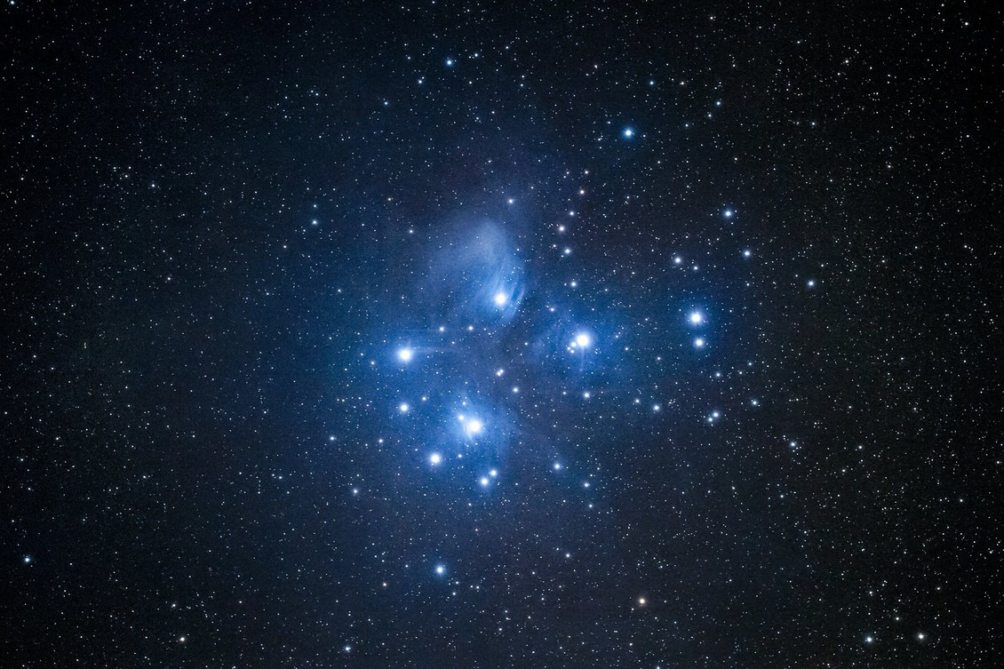
Matariki
Fraser Gunn, www.astroimage.co.nz
© Copyright. The University of Waikato Te Whare Wānanga o Waikato. All Rights Reserved | www.sciencelearn.org.nz
All images are copyrighted. For further information, please refer to enquiries@sciencelearn.org.nz
Notes:
https://www.sciencelearn.org.nz/images/697-matariki-pleiades-star-cluster
Matariki article: https://www.sciencelearn.org.nz/resources/2322-the-matariki-star-cluster

Slide 27
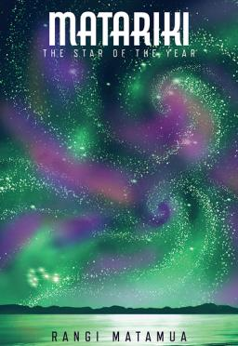
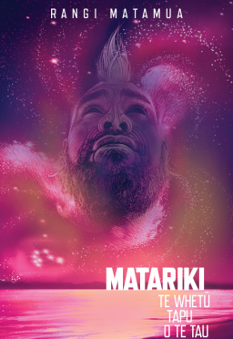
Matariki
Living by the Stars image © Rangi Matamua.
Book images, Huia Publishers
© Copyright. The University of Waikato Te Whare Wānanga o Waikato. All Rights Reserved | www.sciencelearn.org.nz
All images are copyrighted. For further information, please refer to enquiries@sciencelearn.org.nz
Notes:
Rangi Matamua’s Facebook page, Living by the stars: https://www.facebook.com/Livingbythestars/
Matariki, star of the year book: https://www.huia.co.nz/huia-bookshop/bookshop/matariki-the-star-of-the-year/

Slide 28
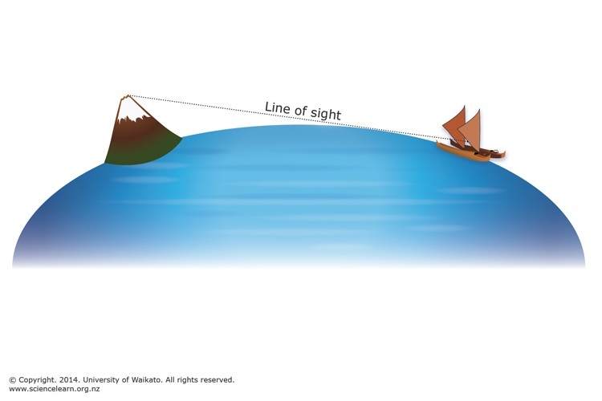
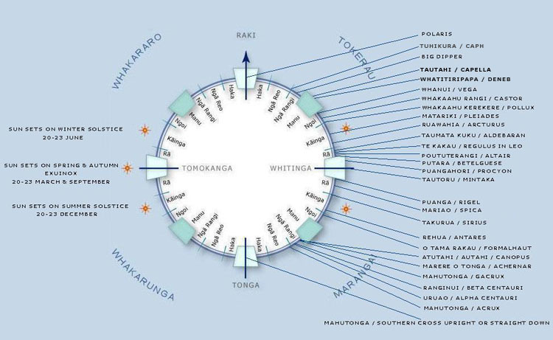
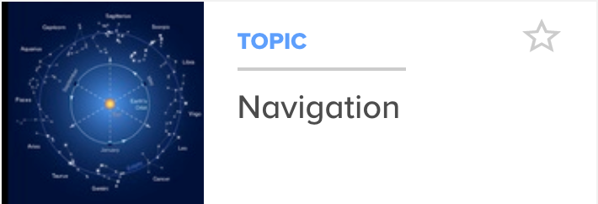
Navigation
© Copyright. The University of Waikato Te Whare Wānanga o Waikato. All Rights Reserved | www.sciencelearn.org.nz
All images are copyrighted. For further information, please refer to enquiries@sciencelearn.org.nz
Notes:
https://www.sciencelearn.org.nz/images/679-star-compass-and-star-positions
Article on wayfinding; https://www.sciencelearn.org.nz/resources/630-wayfinding
Image, line of sight: https://www.sciencelearn.org.nz/images/695-sighting-land

Slide 29
Navigation
I’d be doing things like: “Let’s figure out how fast we’re going. Without using any instruments.”
Then, I’d show them how to do that. Really, it’s all physics and maths.
And they’d say: “But our tūpuna didn’t do any of that stuff.”
And I’d say: “Yeah, they did. They just didn’t call it physics and maths. They called it living.”
Hoturoa Barclay-Kerr
© Copyright. The University of Waikato Te Whare Wānanga o Waikato. All Rights Reserved | www.sciencelearn.org.nz
All images are copyrighted. For further information, please refer to enquiries@sciencelearn.org.nz
Notes:
Quote from: https://e-tangata.co.nz/korero/hoturoa-and-the-waka-legacy/?fbclid=IwAR0qnY-LhDtqvJhRytKV9LivB7_3vcTZHwMWICSY8ZNytvyN5WXLvro_U4Y

Slide 30
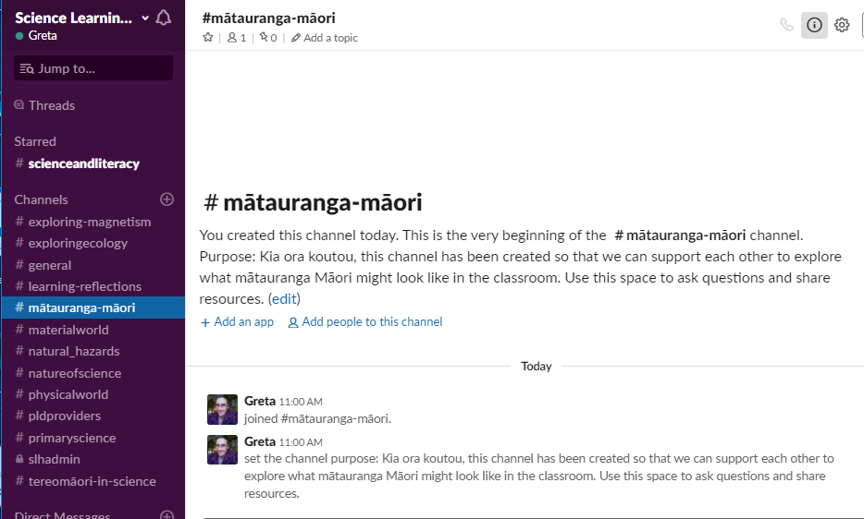
Slack discussion forum
SLACK
© Copyright. The University of Waikato Te Whare Wānanga o Waikato. All Rights Reserved | www.sciencelearn.org.nz
All images are copyrighted. For further information, please refer to enquiries@sciencelearn.org.nz
Notes:
Slack link: https://slh-talk.slack.com/messages/CKG84HB0Q/details/

Slide 31
Thanks
Pokapū Akoranga Pūtaiao
Email us on enquiries@sciencelearn.org.nz
https://twitter.com/NZScienceLearn
www.facebook.com/nzsciencelearn
https://nz.pinterest.com/nzsciencelearn
www.instagram.com/sciencelearninghubnz
Join us in our discussion channel on Slack.
(Any problems accessing Slack, please contact us via our enquiries email, enquiries@sciencelearn.org.nz.)
Notes:
Slack: https://slh-talk.slack.com/messages/CDL529ERW/
Mātauranga and Māori scientist Pinterest collection: https://www.pinterest.nz/nzsciencelearn/m%C4%81tauranga-m%C4%81ori/

