Slide 1
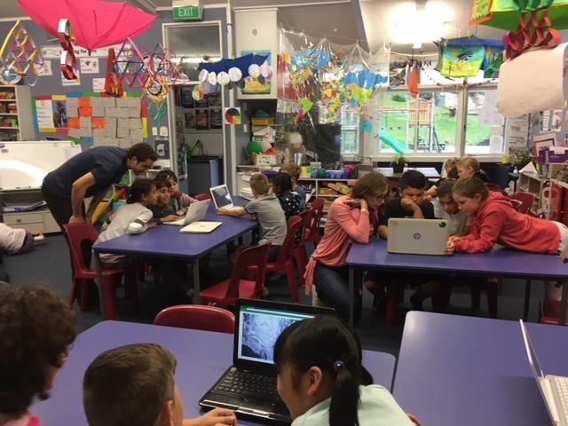
Online citizen science
Carol Brieseman, Hampton Hill School
Greta Dromgool & Carol Brieseman
4–4.45pm Thursday 12 September
© Copyright. Science Learning Hub – Pokapū Akoranga Pūtaiao The University of Waikato Te Whare Wananga o Waikato.
All Rights Reserved | www.sciencelearn.org.nz. All images are copyrighted. For further information, please refer to enquiries@sciencelearn.org.nz

Slide 2
Pokapū Akoranga Pūtaiao
The Science Learning Hub
A trustworthy online resource – produced by educators and scientists for New Zealand teachers and students.
Based on world-class New Zealand science research.
Supported by learning activities, information about the key science ideas and concepts, multimedia tools and other resources.
© Copyright. Science Learning Hub – Pokapū Akoranga Pūtaiao The University of Waikato Te Whare Wananga o Waikato.
All Rights Reserved | www.sciencelearn.org.nz. All images are copyrighted. For further information, please refer to enquiries@sciencelearn.org.nz
Notes:
The SLH is funded by the NZ Government – MBIE Ministry of Business, Innovation and Employment – under the Curious Minds fund

Slide 3
Carol Brieseman
Primary teacher
STLP
New Zealand Association of Primary Science Educators
Prime Minister’s Science Teacher Prize winner
Prime Minister’s
Science Prizes
Crown Copyright 2018
© Copyright. Science Learning Hub – Pokapū Akoranga Pūtaiao The University of Waikato Te Whare Wananga o Waikato.
All Rights Reserved | www.sciencelearn.org.nz. All images are copyrighted. For further information, please refer to enquiries@sciencelearn.org.nz
Notes:
Image from: https://www.stuff.co.nz/national/education/111177495/wellington-primary-school-teacher-wins-prime-ministers-science-teacher-prize

Slide 4
Index
Topic | Slideshow number(s ) | Video timecode
Introducing the Science Learning Hub and presenters | 1–3 | 00:00
Index | 4 | 04:40
Purpose | 5 | 04:48
What is online citizen science? | 6–7 | 05:15
The Online Citizen Science (OCS) research project | 8–10 | 09:43
Why use online citizen science? | 11–12 | 16:23
Science capabilities | 13–14 | 17:23
Choosing a project | 15–16 | 19:43
Finding OCS resources on the Hub | 17 | 30:00
SLH links, keep in touch and thanks | 18 | 31:23
© Copyright. University of Waikato. All Rights Reserved | www.sciencelearn.org.nz
All images are copyrighted. For further information, please refer to enquiries@sciencelearn.org.nz

Slide 5
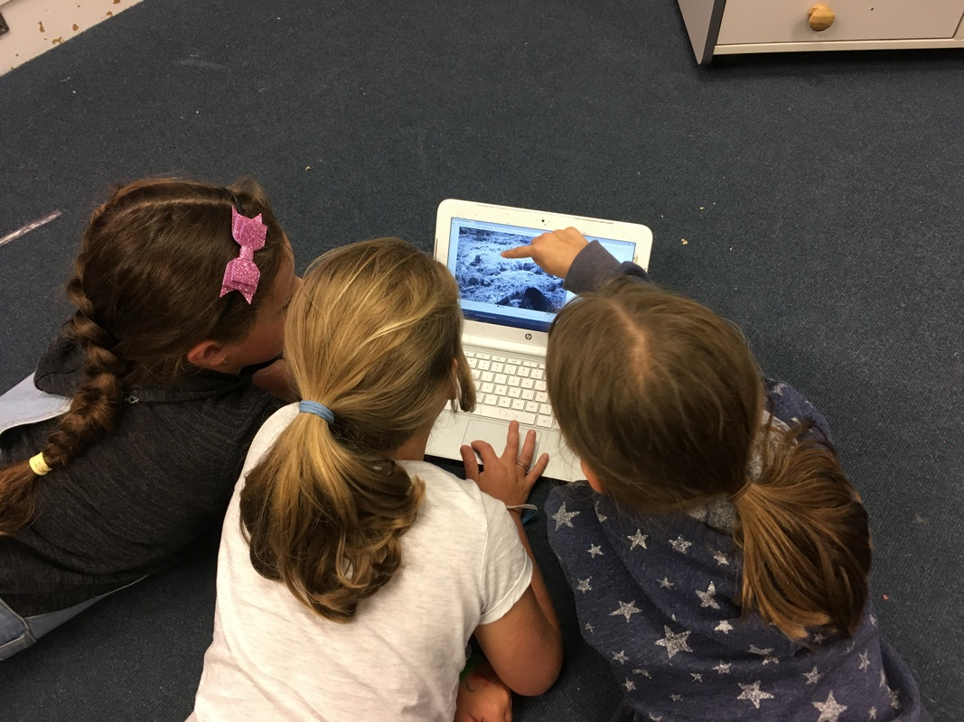
Purpose
In this webinar, we will:
explore what we mean by online citizen science (OCS) and why you might want to give it a go
give you some useful tips for getting the most out of the experience
share examples of teachers using citizen science to enhance their science programme.
Carol Brieseman
Hampton Hill School
© Copyright. Science Learning Hub – Pokapū Akoranga Pūtaiao The University of Waikato Te Whare Wananga o Waikato.
All Rights Reserved | www.sciencelearn.org.nz. All images are copyrighted. For further information, please refer to enquiries@sciencelearn.org.nz
Notes:
Image: https://www.sciencelearn.org.nz/images/1300-students-with-dr-peter-buchanan

Slide 6
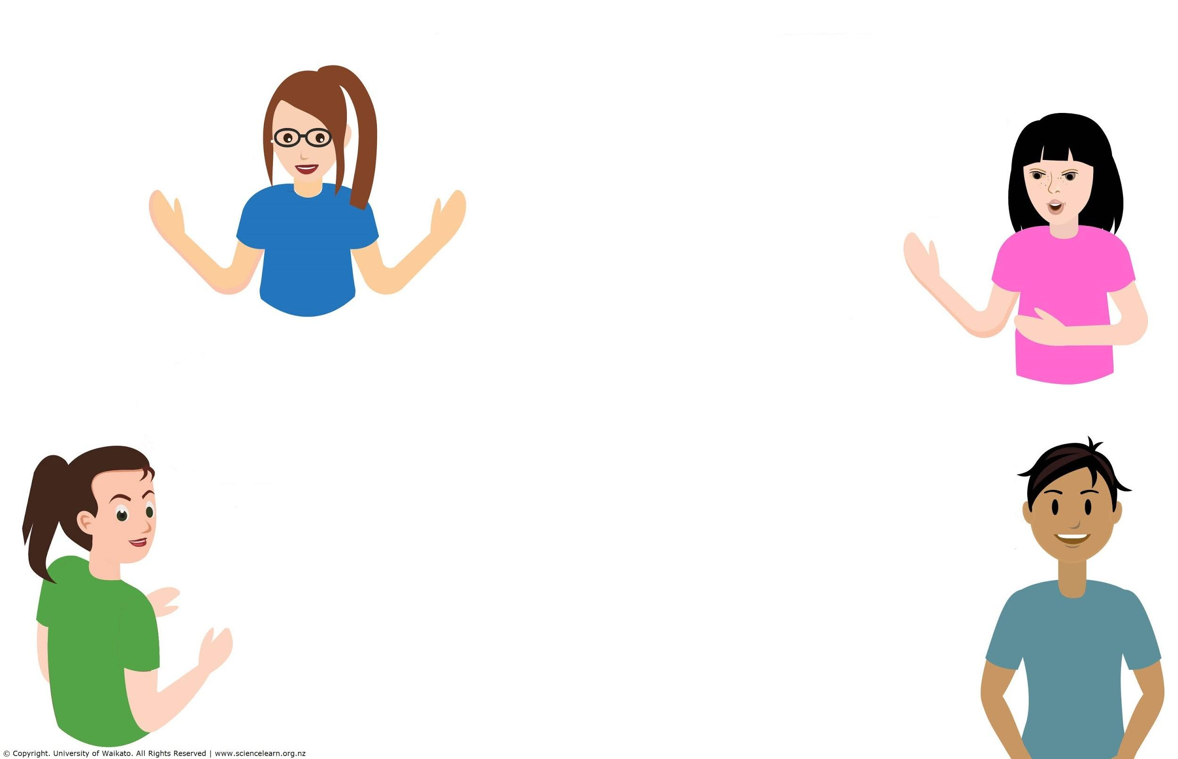
What is online citizen science?
© Copyright. Science Learning Hub – Pokapū Akoranga Pūtaiao The University of Waikato Te Whare Wananga o Waikato.
All Rights Reserved | www.sciencelearn.org.nz. All images are copyrighted. For further information, please refer to enquiries@sciencelearn.org.nz
Notes:
https://www.landcare.org.nz/file/citizen-science-inventory-updated-may-2018-lr/open

Slide 7
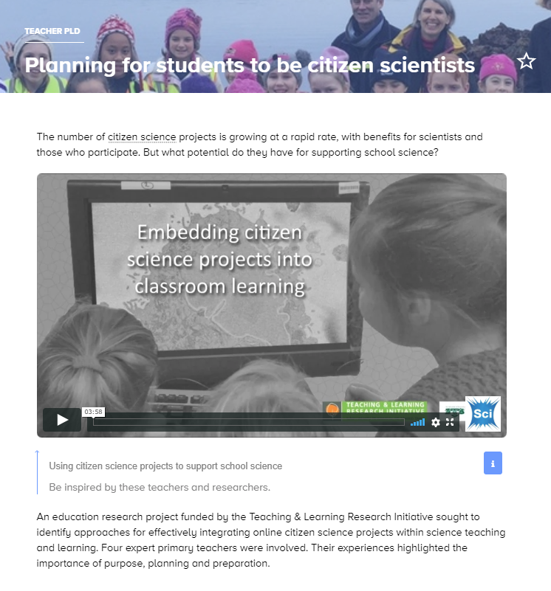
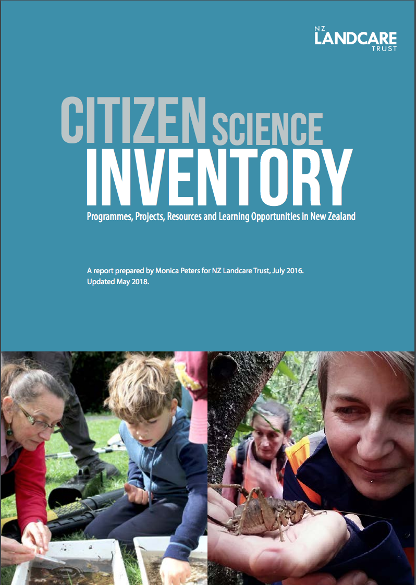
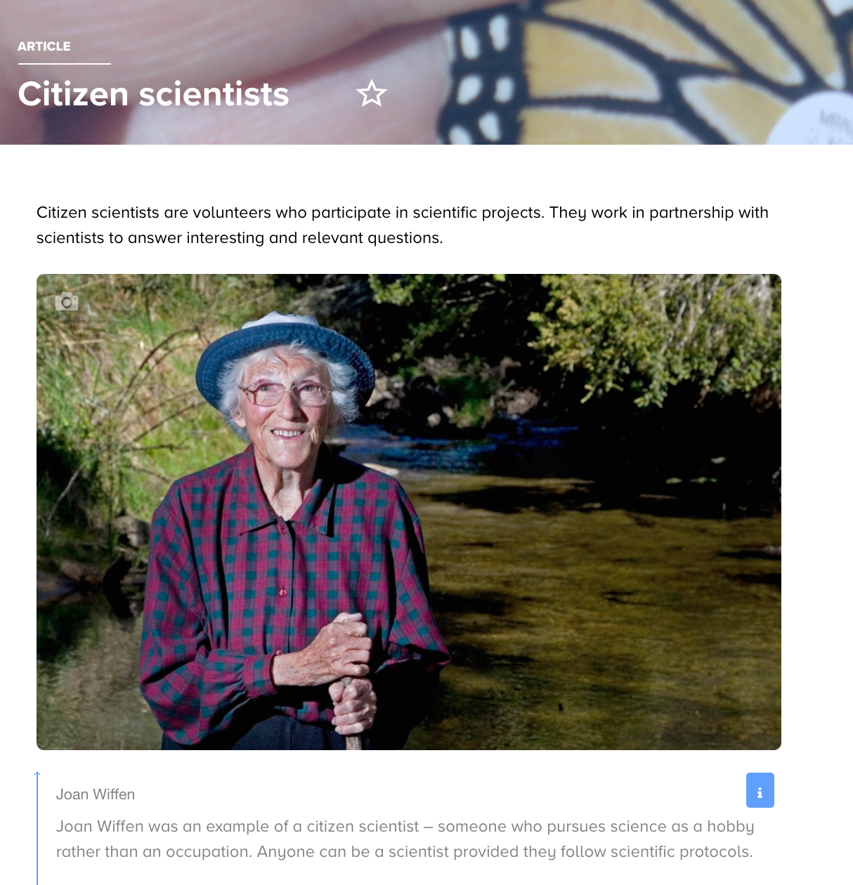
What is online citizen science?
Citizen science projects invite citizens (including school students) to contribute to a real-world science project.
In OCS projects, tasks require using the internet. This means that participants can contribute from different locations.
NZPA/John Cowpland
NZ Landcare Trust
© Copyright. Science Learning Hub – Pokapū Akoranga Pūtaiao The University of Waikato Te Whare Wananga o Waikato.
All Rights Reserved | www.sciencelearn.org.nz. All images are copyrighted. For further information, please refer to enquiries@sciencelearn.org.nz
Notes:
Planning article: https://www.sciencelearn.org.nz/resources/2740-planning-for-students-to-be-citizen-scientist
Inventory: https://www.landcare.org.nz/file/citizen-science-inventory-updated-may-2018-lr/open
SLH article on citizen science: https://www.sciencelearn.org.nz/resources/512-citizen-scientists
SLH topic: https://www.sciencelearn.org.nz/topics/citizen-science

Slide 8
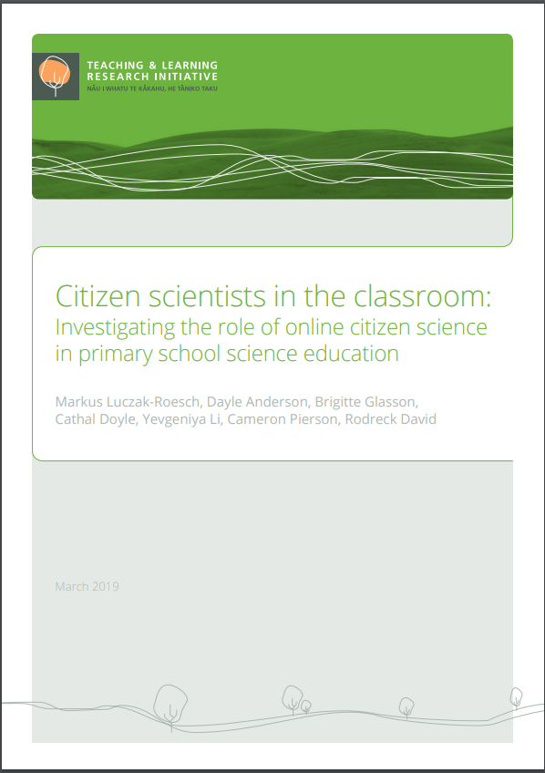
Online citizen science research
Teaching & Learning Research Initiative
Victoria University of Wellington
© Copyright. Science Learning Hub – Pokapū Akoranga Pūtaiao The University of Waikato Te Whare Wananga o Waikato.
All Rights Reserved | www.sciencelearn.org.nz. All images are copyrighted. For further information, please refer to enquiries@sciencelearn.org.nz
Notes:
https://osf.io/n953p/
http://www.tlri.org.nz/sites/default/files/projects/Final%20Summary%20Report_Lukacz%20for%20web.pdf

Slide 9
Online citizen science research
... the embedding of OCS is crucial for its effectiveness.
While participation in the OCS provided potential for science learning, each teacher used their knowledge of the capabilities and science to firstly recognise these opportunities, and then to shape and add to them to make them relevant and accessible to their students to promote productive learning.
Quote from summary report (conclusion)
© Copyright. Science Learning Hub – Pokapū Akoranga Pūtaiao The University of Waikato Te Whare Wananga o Waikato.
All Rights Reserved | www.sciencelearn.org.nz. All images are copyrighted. For further information, please refer to enquiries@sciencelearn.org.nz
Notes:
http://www.tlri.org.nz/sites/default/files/projects/Final%20Summary%20Report_Lukacz%20for%20web.pdf

Slide 10
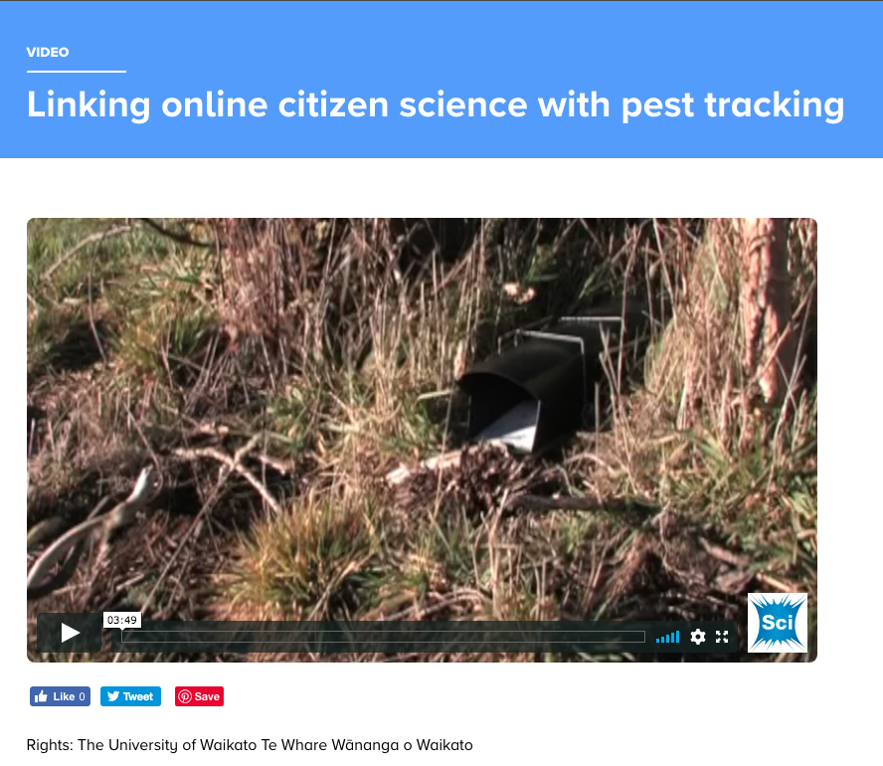
Online citizen science research
© Copyright. Science Learning Hub – Pokapū Akoranga Pūtaiao The University of Waikato Te Whare Wananga o Waikato.
All Rights Reserved | www.sciencelearn.org.nz. All images are copyrighted. For further information, please refer to enquiries@sciencelearn.org.nz
Notes:
https://www.sciencelearn.org.nz/videos/1886-linking-online-citizen-science-with-pest-tracking

Slide 11
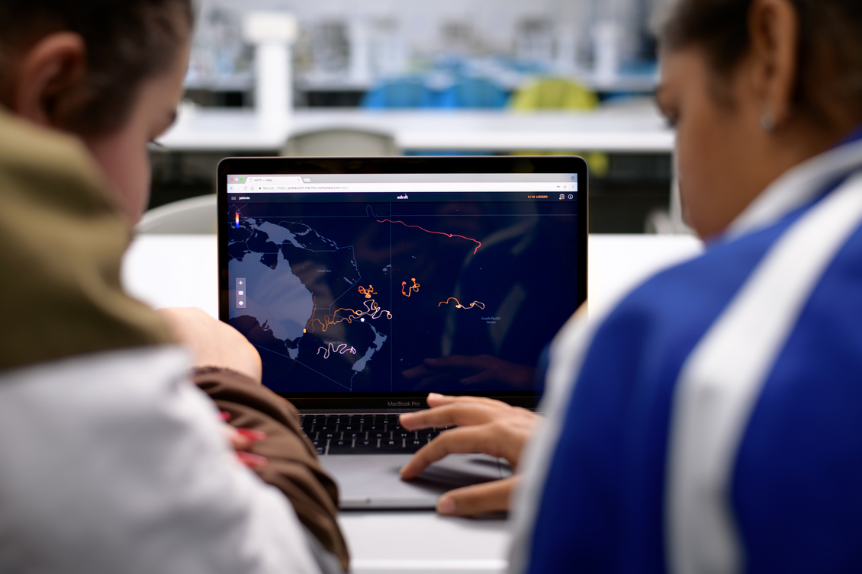
Why use online citizen science?
UTS Adrift Project
Adrift allows citizen scientists to virtually ‘drop’ microbes into the global ocean and provides an entry point for students to begin to understand the challenges of living in the ocean today.
© Copyright. Science Learning Hub – Pokapū Akoranga Pūtaiao The University of Waikato Te Whare Wananga o Waikato.
All Rights Reserved | www.sciencelearn.org.nz. All images are copyrighted. For further information, please refer to enquiries@sciencelearn.org.nz
Notes:
Image: https://www.sciencelearn.org.nz/images/4035-using-adrift

Slide 12
What are we trying to achieve in our science programmes?
© Copyright. Science Learning Hub – Pokapū Akoranga Pūtaiao The University of Waikato Te Whare Wananga o Waikato.
All Rights Reserved | www.sciencelearn.org.nz. All images are copyrighted. For further information, please refer to enquiries@sciencelearn.org.nz

Slide 13
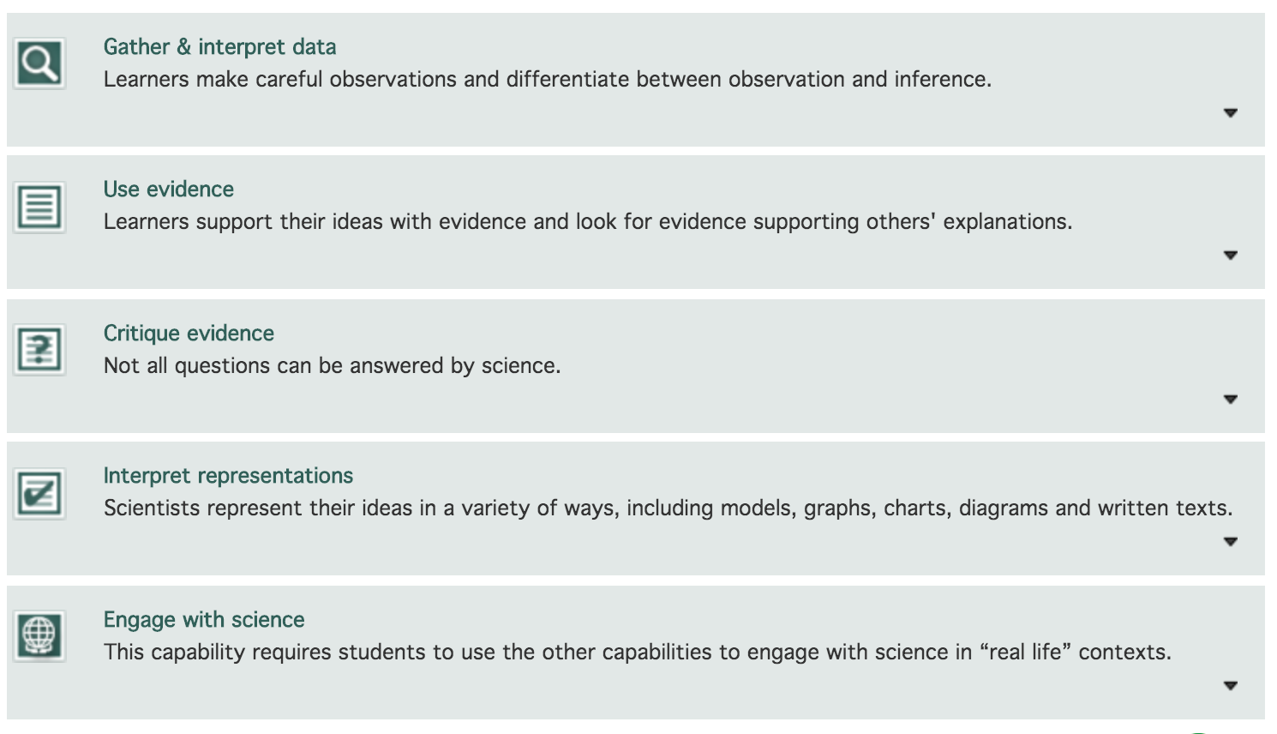
What are science capabilities?
https://scienceonline.tki.org.nz/Science-capabilities-for-citizenship
Crown Copyright
© Copyright. Science Learning Hub – Pokapū Akoranga Pūtaiao The University of Waikato Te Whare Wananga o Waikato.
All Rights Reserved | www.sciencelearn.org.nz. All images are copyrighted. For further information, please refer to enquiries@sciencelearn.org.nz
Notes:
Image from: https://scienceonline.tki.org.nz/Science-capabilities-for-citizenship/Introducing-five-science-capabilities

Slide 14
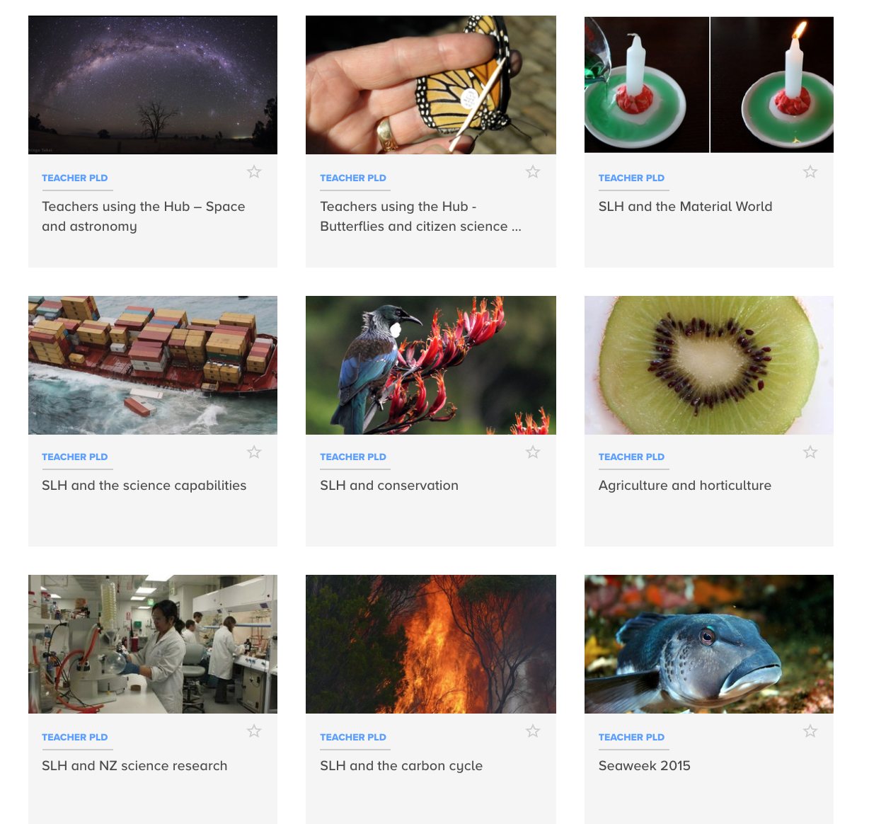
Science capabilities
Link content and Nature of Science strands, NZC statement and key competencies.
© Copyright. Science Learning Hub – Pokapū Akoranga Pūtaiao The University of Waikato Te Whare Wananga o Waikato.
All Rights Reserved | www.sciencelearn.org.nz. All images are copyrighted. For further information, please refer to enquiries@sciencelearn.org.nz
Notes:
https://www.sciencelearn.org.nz/resources/2245-slh-and-the-science-capabilities

Slide 15
Choosing an online citizen
science project
© Copyright. Science Learning Hub – Pokapū Akoranga Pūtaiao The University of Waikato Te Whare Wananga o Waikato.
All Rights Reserved | www.sciencelearn.org.nz. All images are copyrighted. For further information, please refer to enquiries@sciencelearn.org.nz

Slide 16
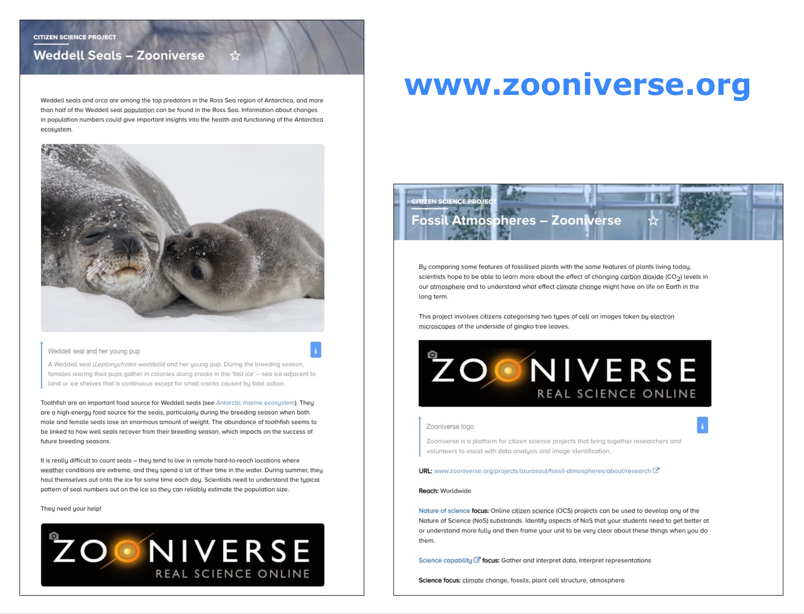
Choosing an online citizen
science project
© Copyright. Science Learning Hub – Pokapū Akoranga Pūtaiao The University of Waikato Te Whare Wananga o Waikato.
All Rights Reserved | www.sciencelearn.org.nz. All images are copyrighted. For further information, please refer to enquiries@sciencelearn.org.nz
Notes:
https://www.sciencelearn.org.nz/citizen_science

Slide 17
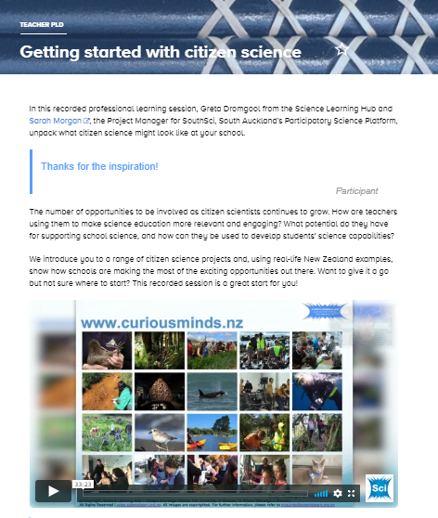
Find out more
© Copyright. Science Learning Hub – Pokapū Akoranga Pūtaiao The University of Waikato Te Whare Wananga o Waikato.
All Rights Reserved | www.sciencelearn.org.nz. All images are copyrighted. For further information, please refer to enquiries@sciencelearn.org.nz
Notes:
https://www.sciencelearn.org.nz/resources/2804-getting-started-with-citizen-science

Slide 18
Keep in touch
Email us enquiries@sciencelearn.org.nz
https://twitter.com/NZScienceLearn
www.facebook.com/nzsciencelearn
https://nz.pinterest.com/nzsciencelearn
www.instagram.com/sciencelearninghubnz
Join us in our discussion channel on Slack.
(Any problems accessing Slack, please contact us via our enquiries email, enquiries@sciencelearn.org.nz.)
Notes:
Don’t forget the SLH can help
SLACK: https://slh-talk.slack.com/messages/CDL529ERW/

