Slide 1

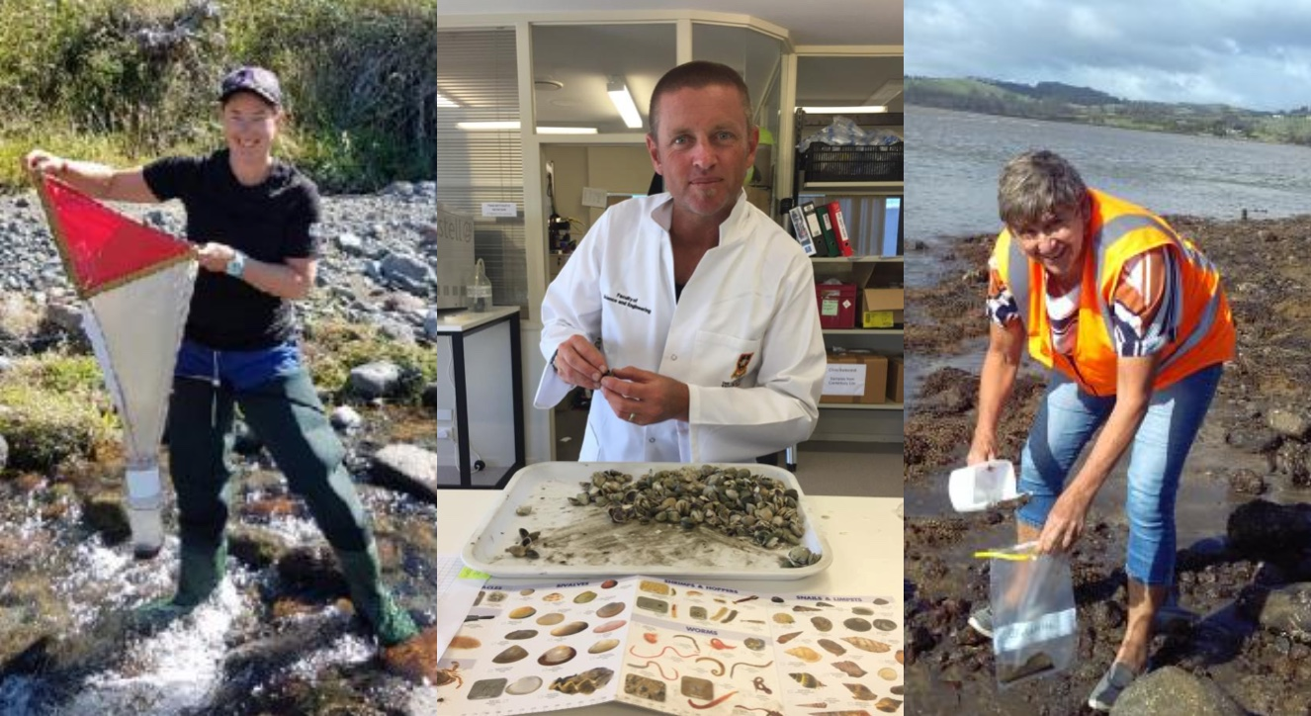

Science capabilities
in action
© Royal Society Te Apārangi
4–4:45 pm Thursday 31 October
© Copyright. Science Learning Hub – Pokapū Akoranga Pūtaiao The University of Waikato Te Whare Wananga o Waikato.
All Rights Reserved | www.sciencelearn.org.nz. All images are copyrighted. For further information, please refer to enquiries@sciencelearn.org.nz

Slide 2
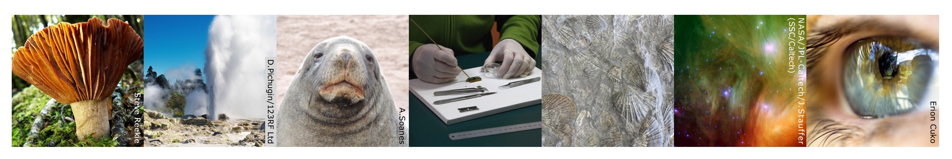

Pokapū Akoranga Pūtaiao
The Science Learning Hub
A trustworthy online resource – produced by educators and scientists for New Zealand teachers and students.
Based on world-class New Zealand science research.
Supported by learning activities, information about the key science ideas and concepts, multimedia tools and other resources.
© Copyright. Science Learning Hub – Pokapū Akoranga Pūtaiao The University of Waikato Te Whare Wananga o Waikato.
All Rights Reserved | www.sciencelearn.org.nz. All images are copyrighted. For further information, please refer to enquiries@sciencelearn.org.nz
Notes:
The SLH is funded by the NZ Government – MBIE Ministry of Business, Innovation and Employment – under the Curious Minds fund

Slide 3
Index
Topic | PowerPoint slide number(s ) | Video timecode
Introducing the Science Learning Hub | 1–2 | 00:00
Index | 3 | 01:04
Purpose | 4 | 01:12
What are the science capabilities | 5–7 | 01:30
Science capabilities resources | 8–10 | 02:50
Helen Moore – gathering data | 11–18 | 05:21
Meredith Wilson – representing data | 19–25 | 17:45
Roger Colquhoun – engaging in science | 26–32 | 25:06
SLH links, keep in touch and thanks | 33–34 | 32:19
© Copyright. University of Waikato. All Rights Reserved | www.sciencelearn.org.nz
All images are copyrighted. For further information, please refer to enquiries@sciencelearn.org.nz

Slide 4
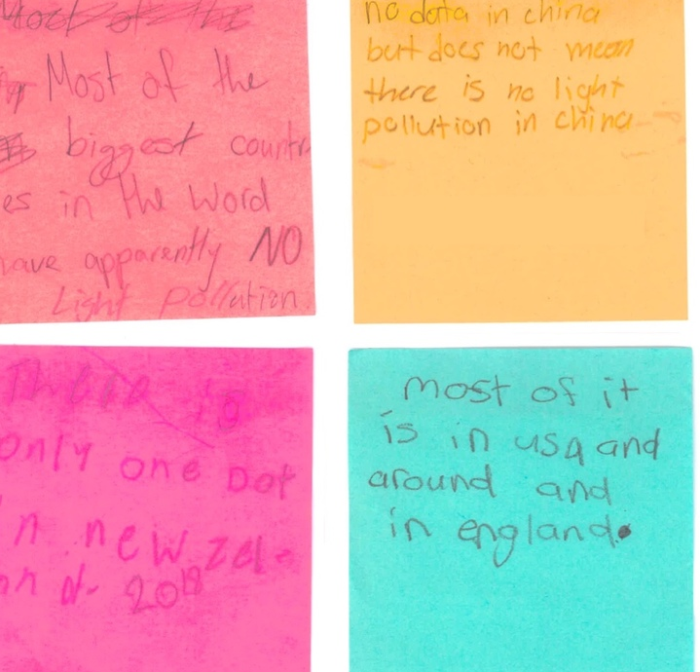
Purpose
In this webinar, we will:
outline the science capabilities
share examples of the science capabilities in action
share resources you can use in your classroom.
© Boulcott School
© Copyright. Science Learning Hub – Pokapū Akoranga Pūtaiao The University of Waikato Te Whare Wananga o Waikato.
All Rights Reserved | www.sciencelearn.org.nz. All images are copyrighted. For further information, please refer to enquiries@sciencelearn.org.nz

Slide 5
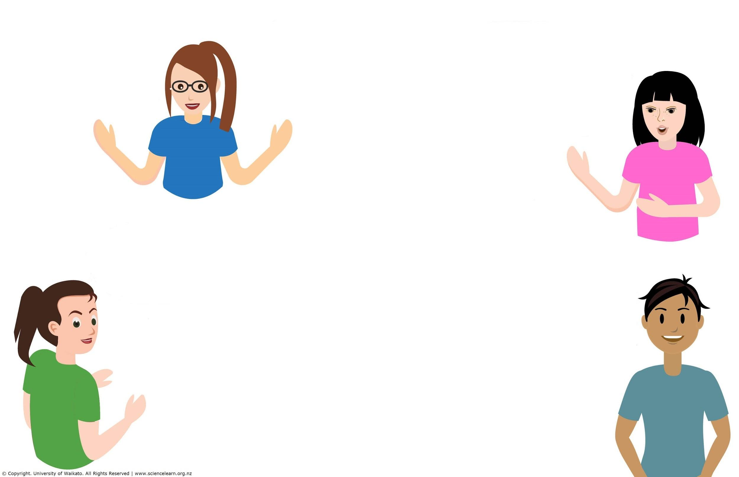
What are the science capabilities?
© Copyright. Science Learning Hub – Pokapū Akoranga Pūtaiao The University of Waikato Te Whare Wananga o Waikato.
All Rights Reserved | www.sciencelearn.org.nz. All images are copyrighted. For further information, please refer to enquiries@sciencelearn.org.nz

Slide 6
What are the science capabilities?
They connect to the Nature of science strand and bring it to life.
Gathering, understanding and critiquing data.
They involve working like scientists and working in context.
They are important knowledge and skills and attitudes for scientific citizenship and literacy.
They help to connect content, the Nature of science strand and the key competencies.
They are part of a functional knowledge of science. What students’ might need to say and be able to do.
They can support teachers to make sure teaching science isn’t just about knowing more stuff.
© Copyright. Science Learning Hub – Pokapū Akoranga Pūtaiao The University of Waikato Te Whare Wananga o Waikato.
All Rights Reserved | www.sciencelearn.org.nz. All images are copyrighted. For further information, please refer to enquiries@sciencelearn.org.nz

Slide 7
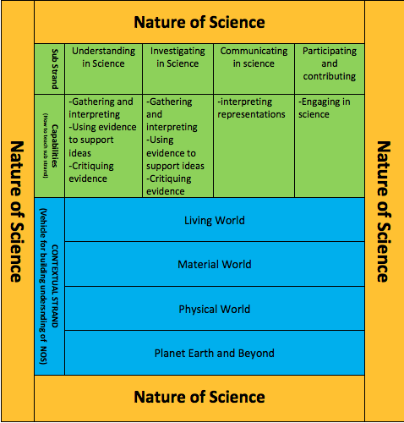

Slide 8
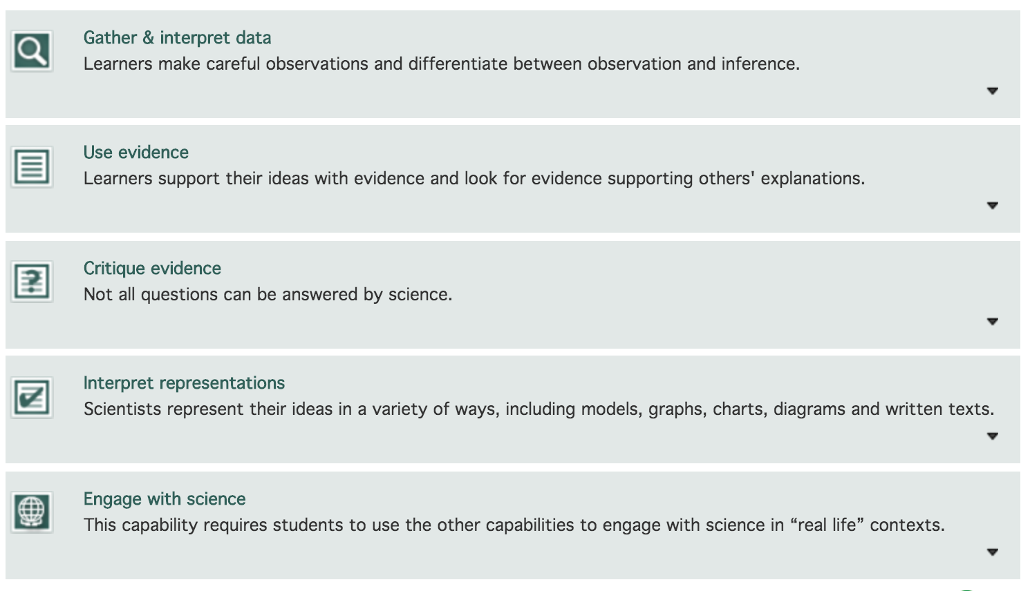
What are science capabilities?
https://scienceonline.tki.org.nz/Science-capabilities-for-citizenship
Crown Copyright
© Copyright. Science Learning Hub – Pokapū Akoranga Pūtaiao The University of Waikato Te Whare Wananga o Waikato.
All Rights Reserved | www.sciencelearn.org.nz. All images are copyrighted. For further information, please refer to enquiries@sciencelearn.org.nz
Notes:
Image from: https://scienceonline.tki.org.nz/Science-capabilities-for-citizenship/Introducing-five-science-capabilities

Slide 9
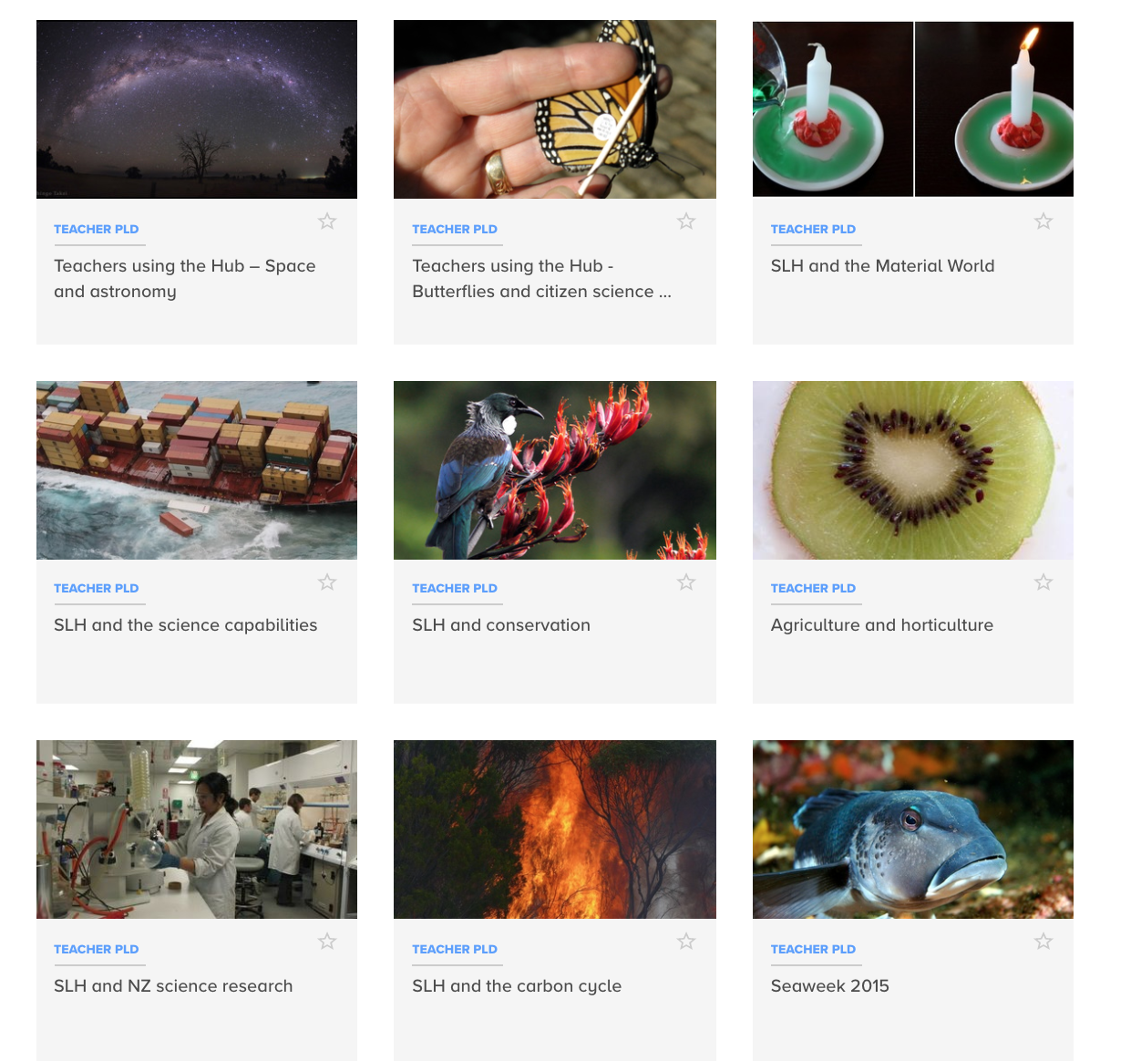
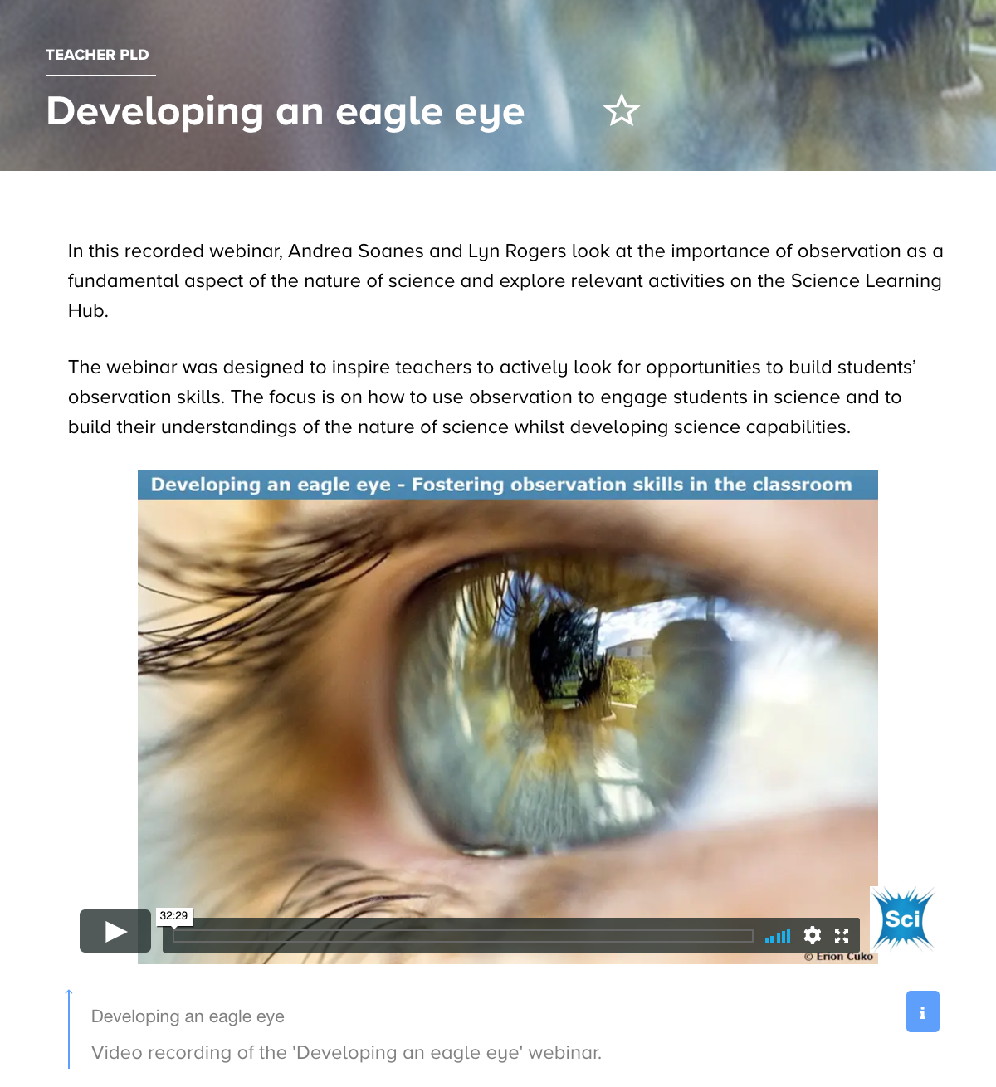
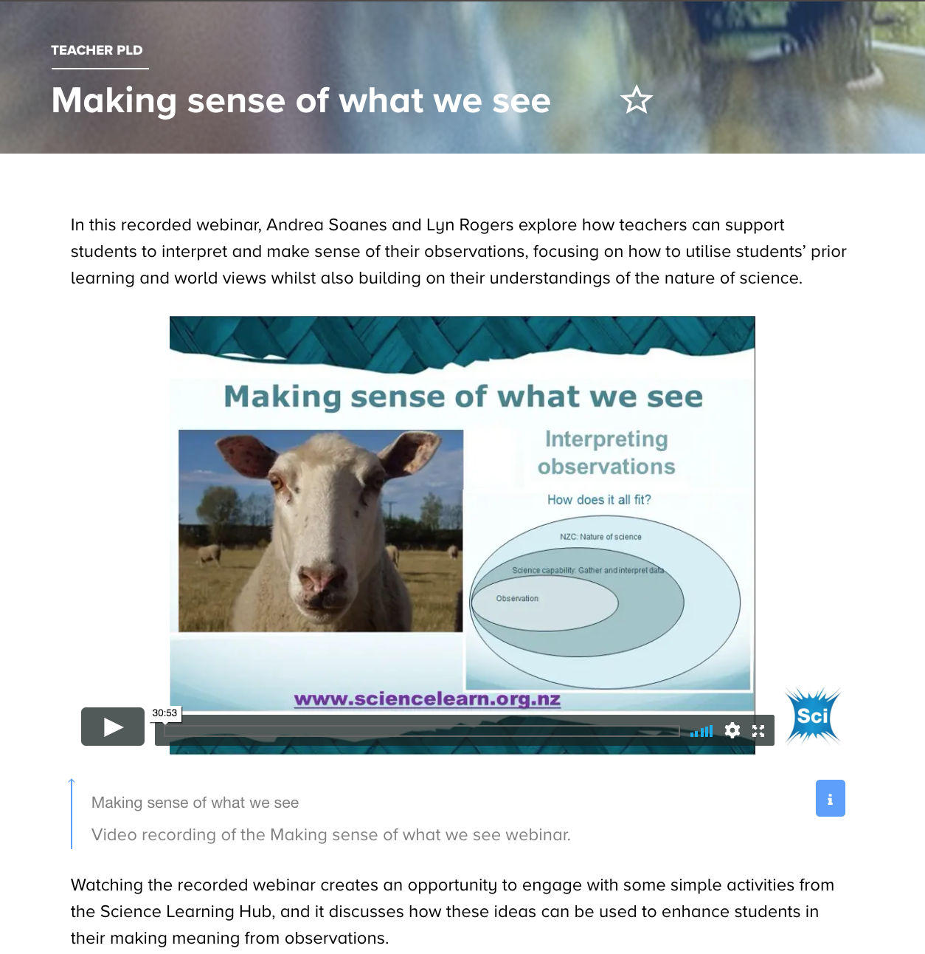
Science capabilities
Link content and Nature of Science strands, NZC statement and key competencies.
© Copyright. Science Learning Hub – Pokapū Akoranga Pūtaiao The University of Waikato Te Whare Wananga o Waikato.
All Rights Reserved | www.sciencelearn.org.nz. All images are copyrighted. For further information, please refer to enquiries@sciencelearn.org.nz
Notes:
www.sciencelearn.org.nz/resources/2245-slh-and-the-science-capabilities

Slide 10
What do the science capabilities look like in action?
© Copyright. Science Learning Hub – Pokapū Akoranga Pūtaiao The University of Waikato Te Whare Wananga o Waikato.
All Rights Reserved | www.sciencelearn.org.nz. All images are copyrighted. For further information, please refer to enquiries@sciencelearn.org.nz

Slide 11
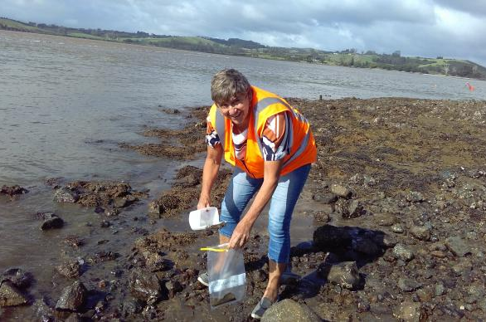
Helen Moore
© Royal Society Te Apārangi
© Copyright. Science Learning Hub – Pokapū Akoranga Pūtaiao The University of Waikato Te Whare Wananga o Waikato.
All Rights Reserved | www.sciencelearn.org.nz. All images are copyrighted. For further information, please refer to enquiries@sciencelearn.org.nz

Slide 12
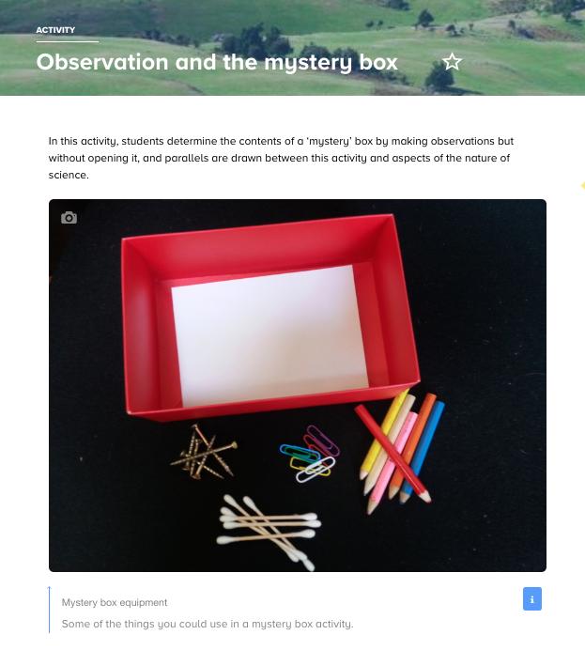
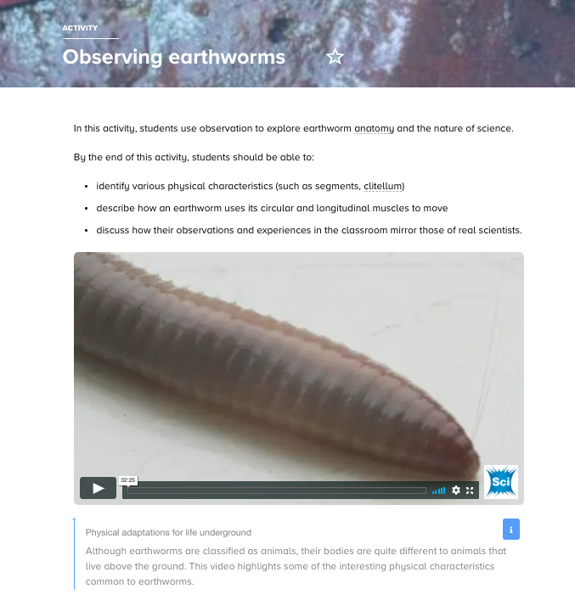
Gather and interpret data
Learners make careful observations and differentiate between observation and inference.
Notes:
www.sciencelearn.org.nz/resources/430-observation-and-the-mystery-box
www.sciencelearn.org.nz/resources/28-observing-earthworms

Slide 13
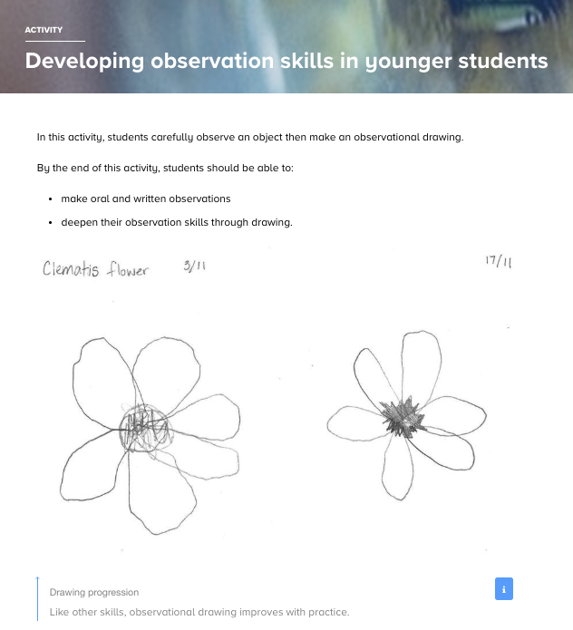
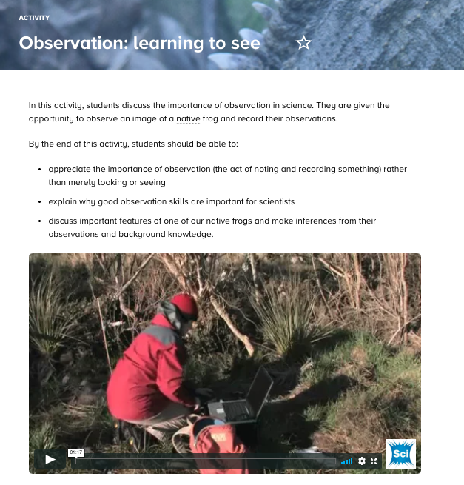
Gather and interpret data
Learners make careful observations and differentiate between observation and inference.
Notes:
www.sciencelearn.org.nz/resources/2071-developing-observation-skills-in-younger-students
www.sciencelearn.org.nz/resources/1400-observation-learning-to-see

Slide 14
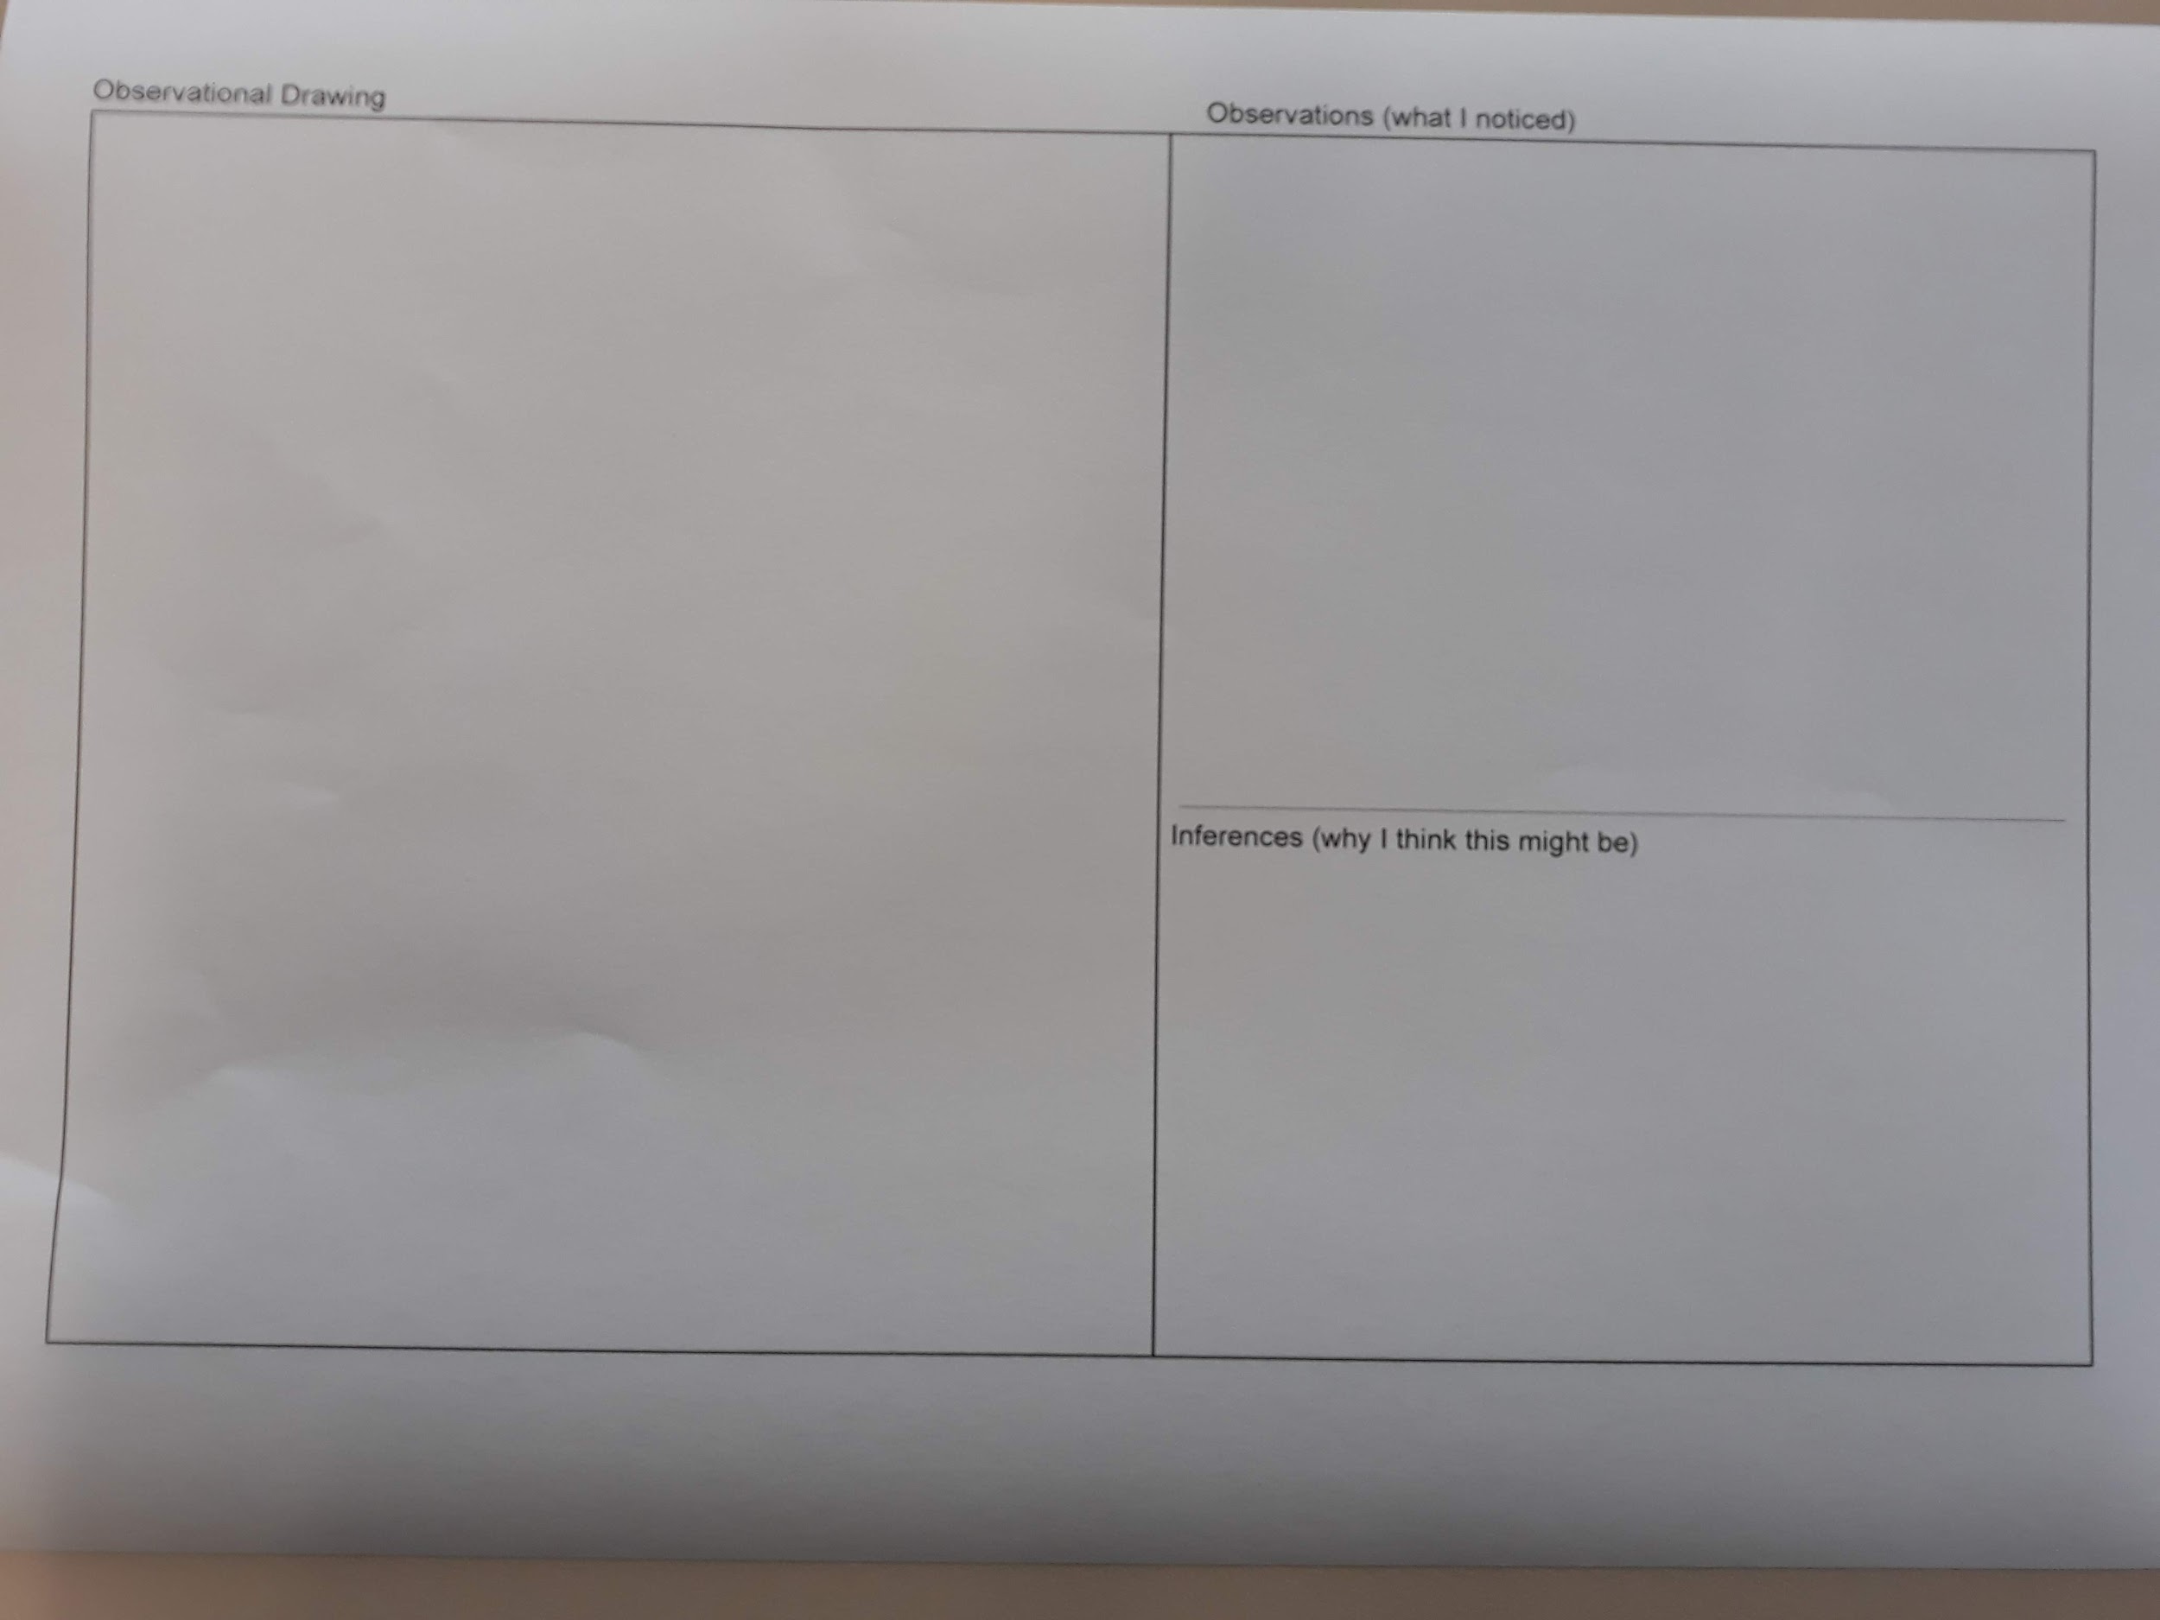
Photo by Helen Moore © Hikurangi School

Slide 15
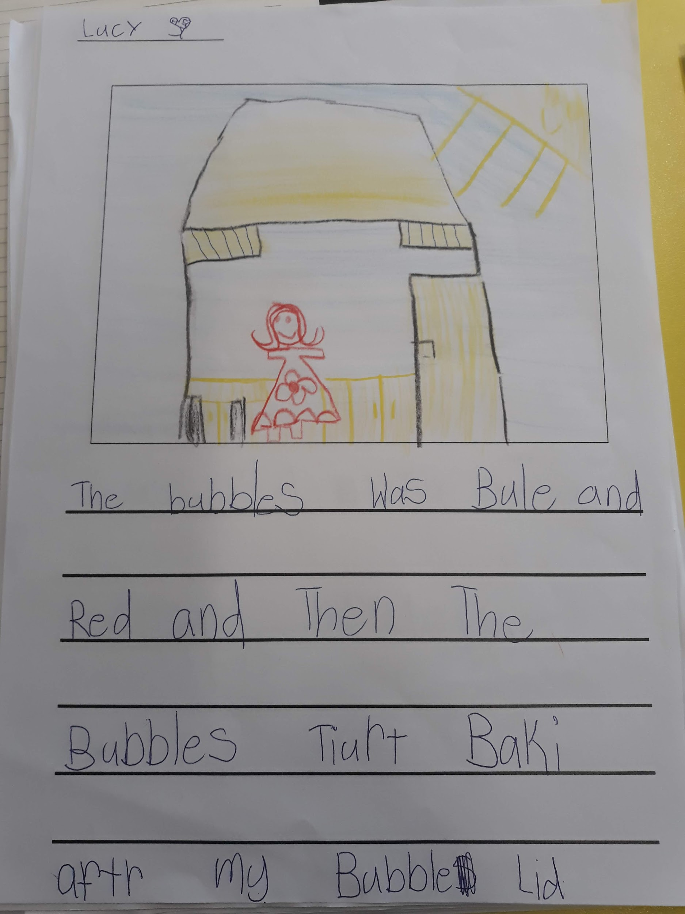
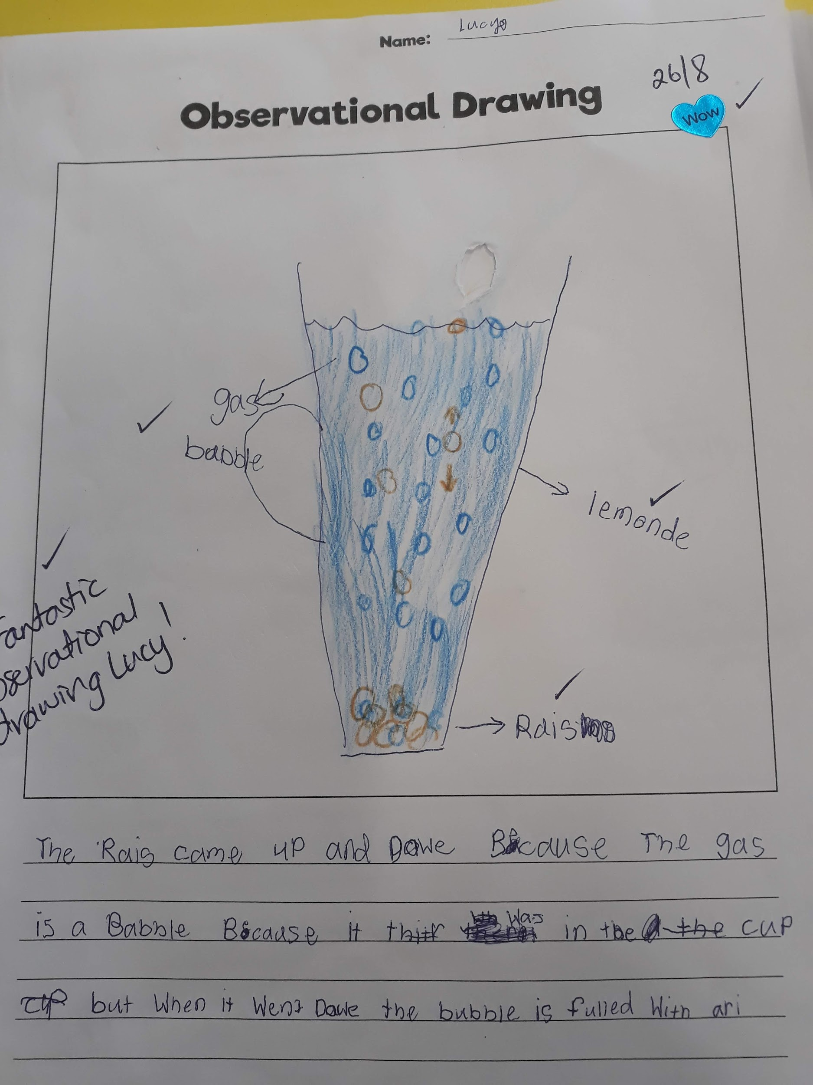
Photos by Helen Moore © Hikurangi School

Slide 16
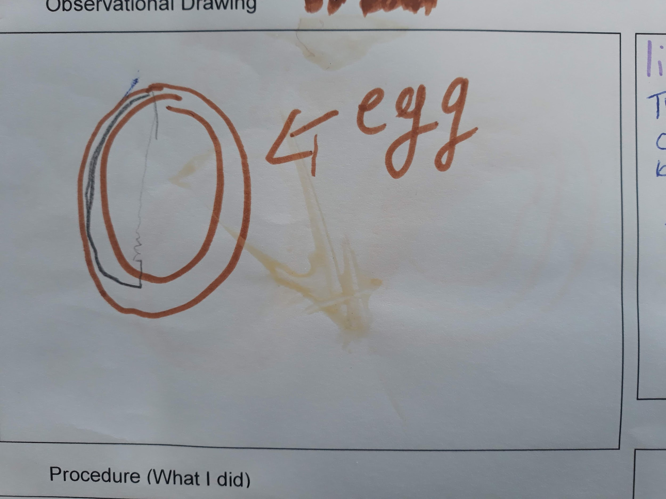
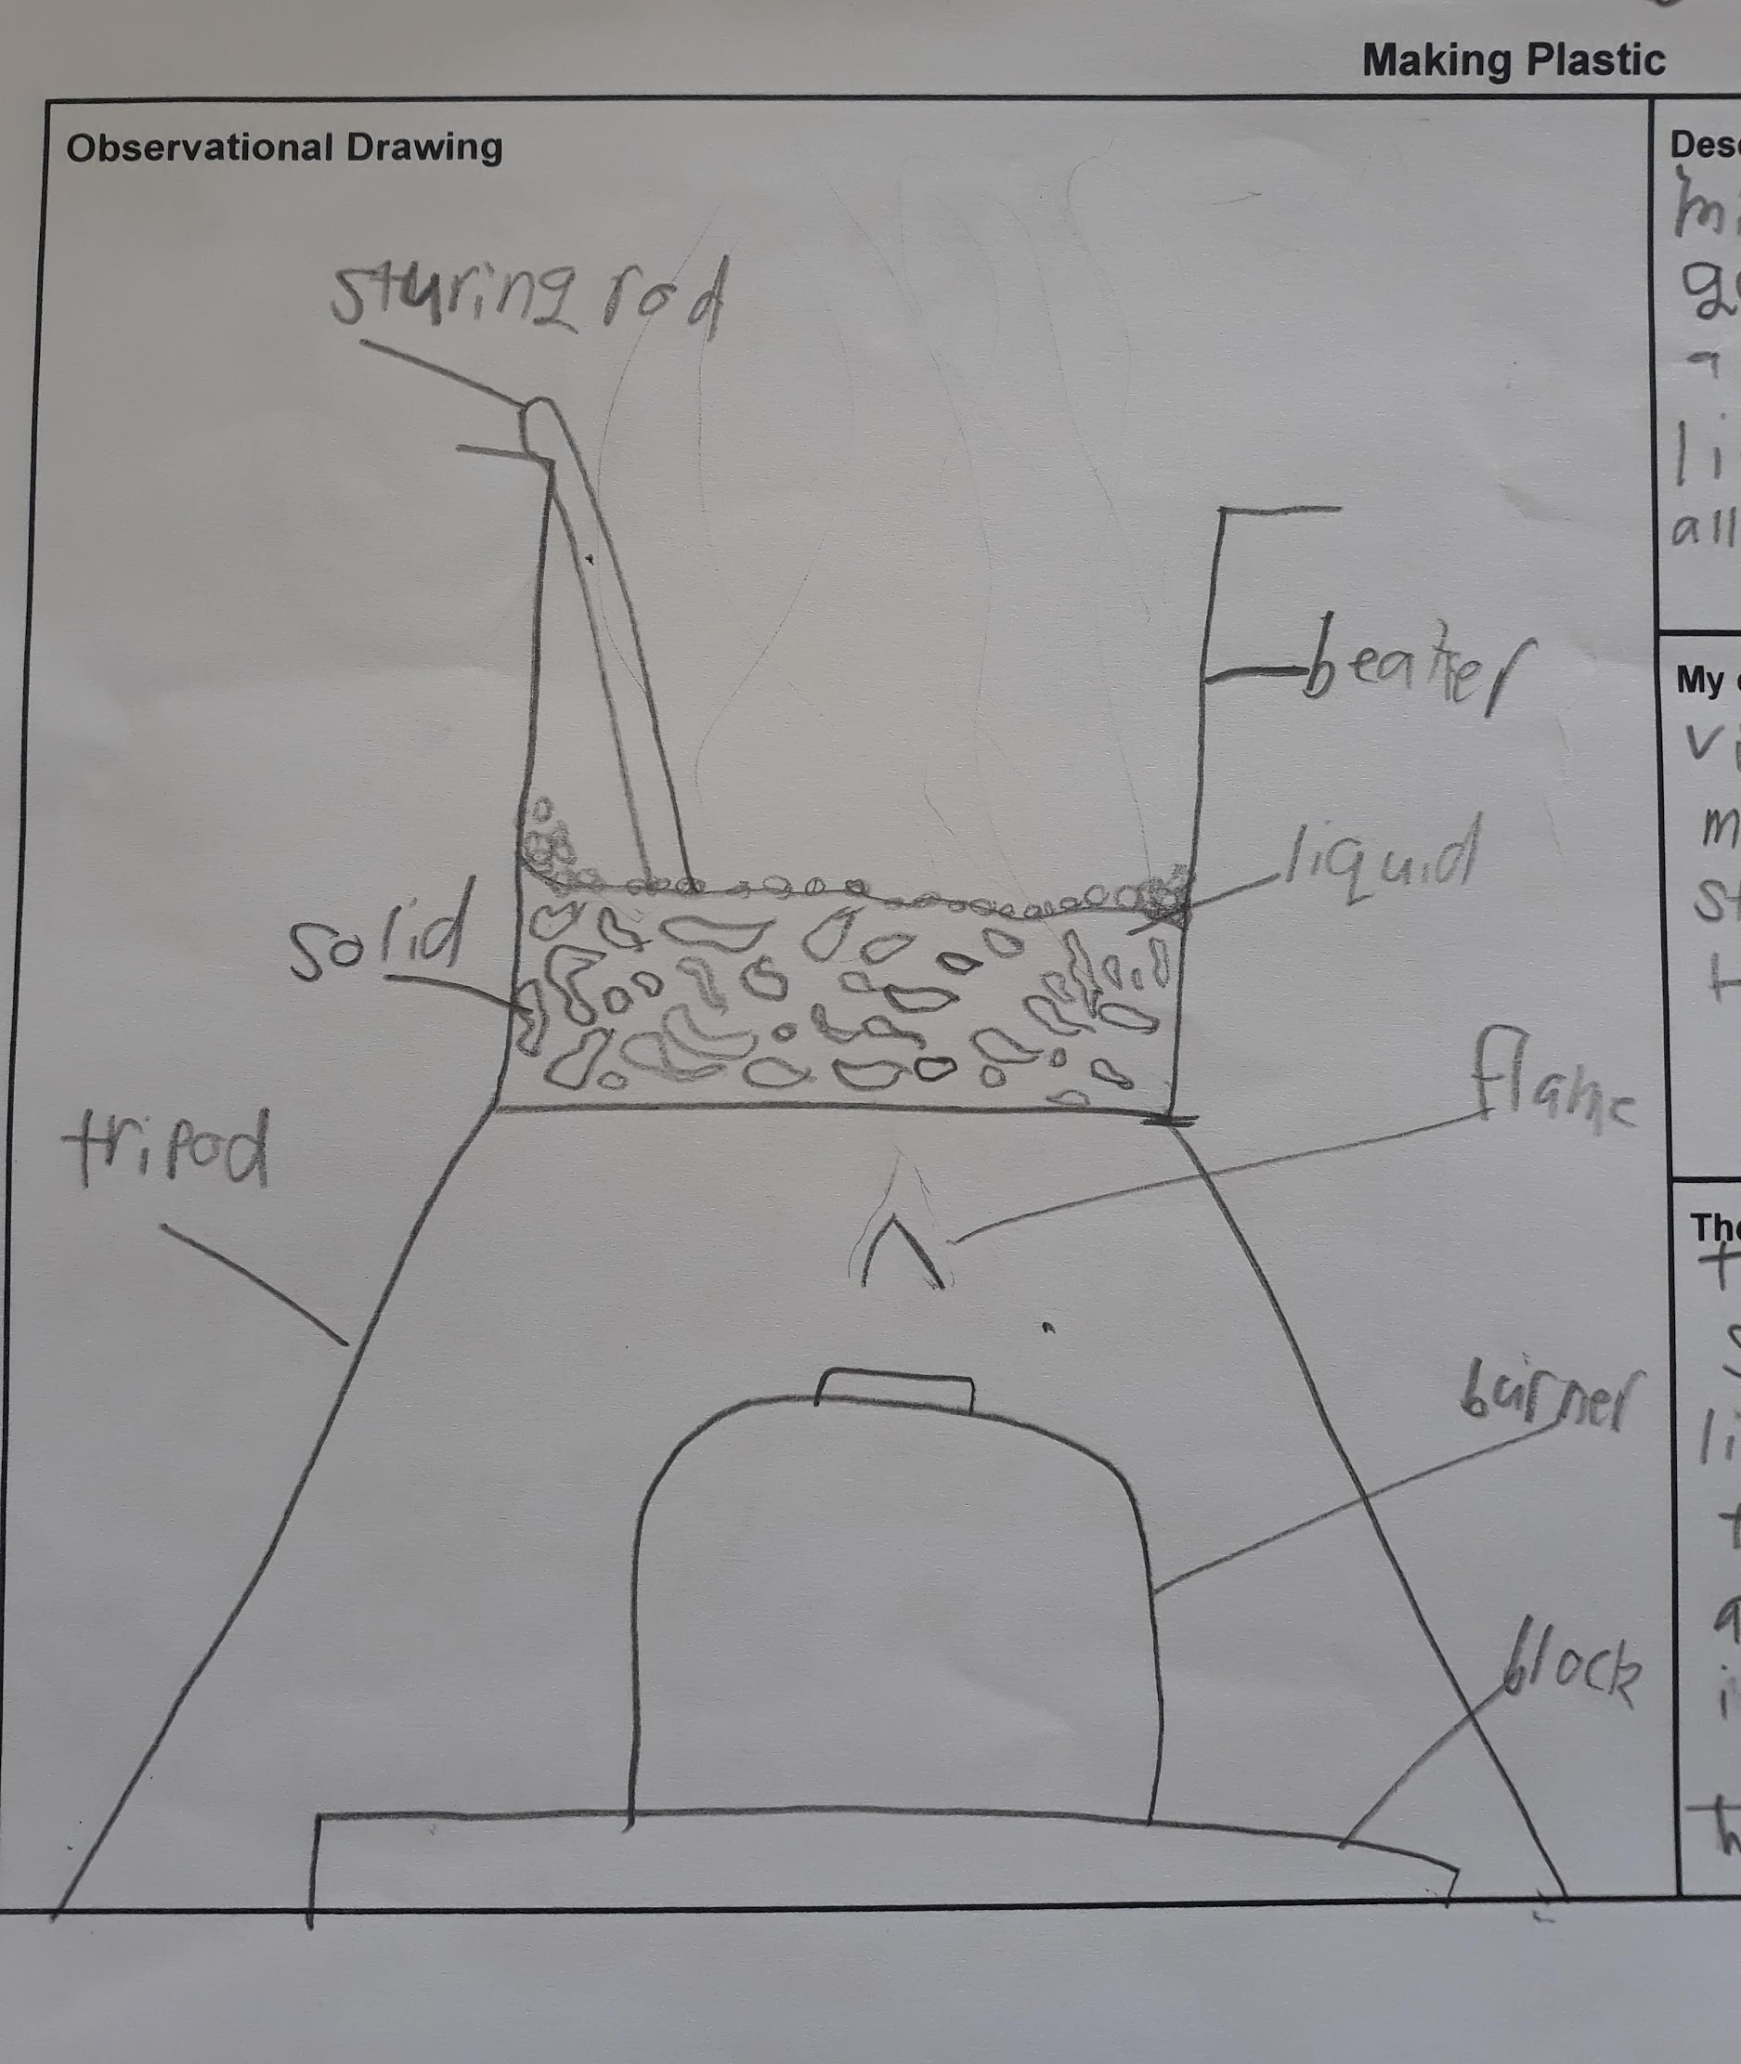
Photos by Helen Moore © Hikurangi School

Slide 17
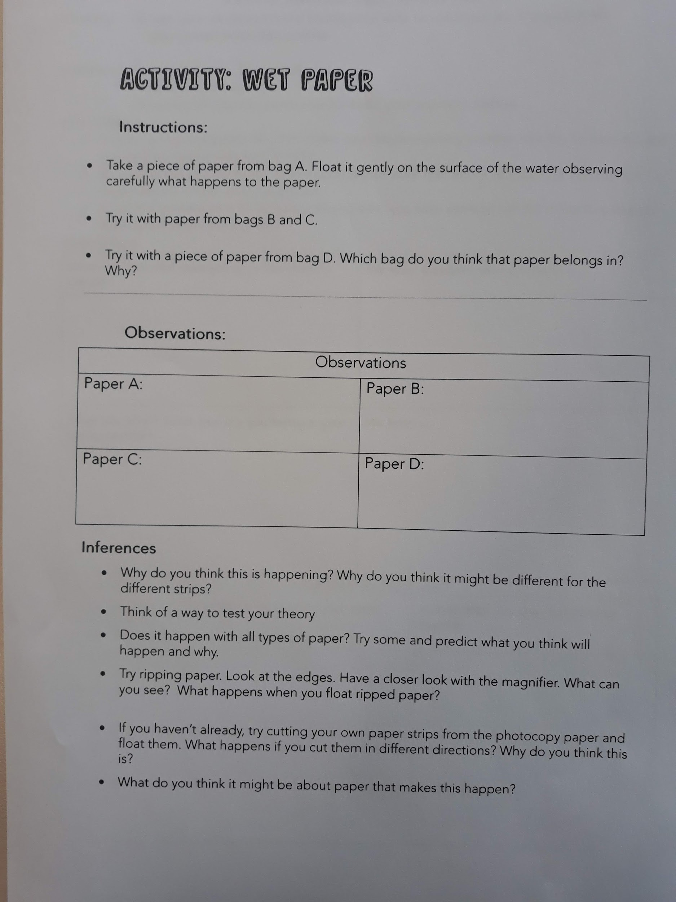
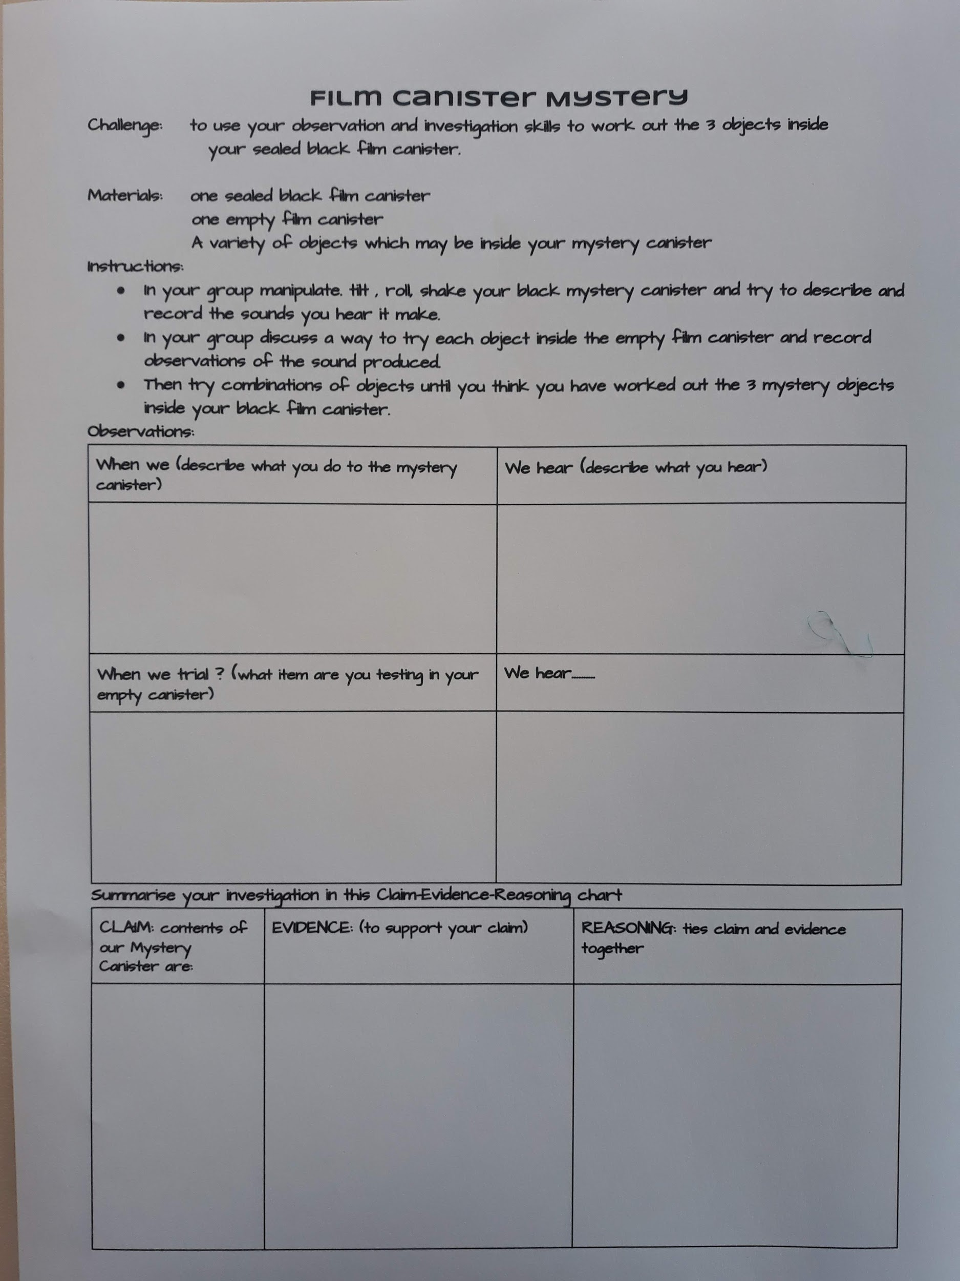
Photos by Helen Moore © Hikurangi School

Slide 18
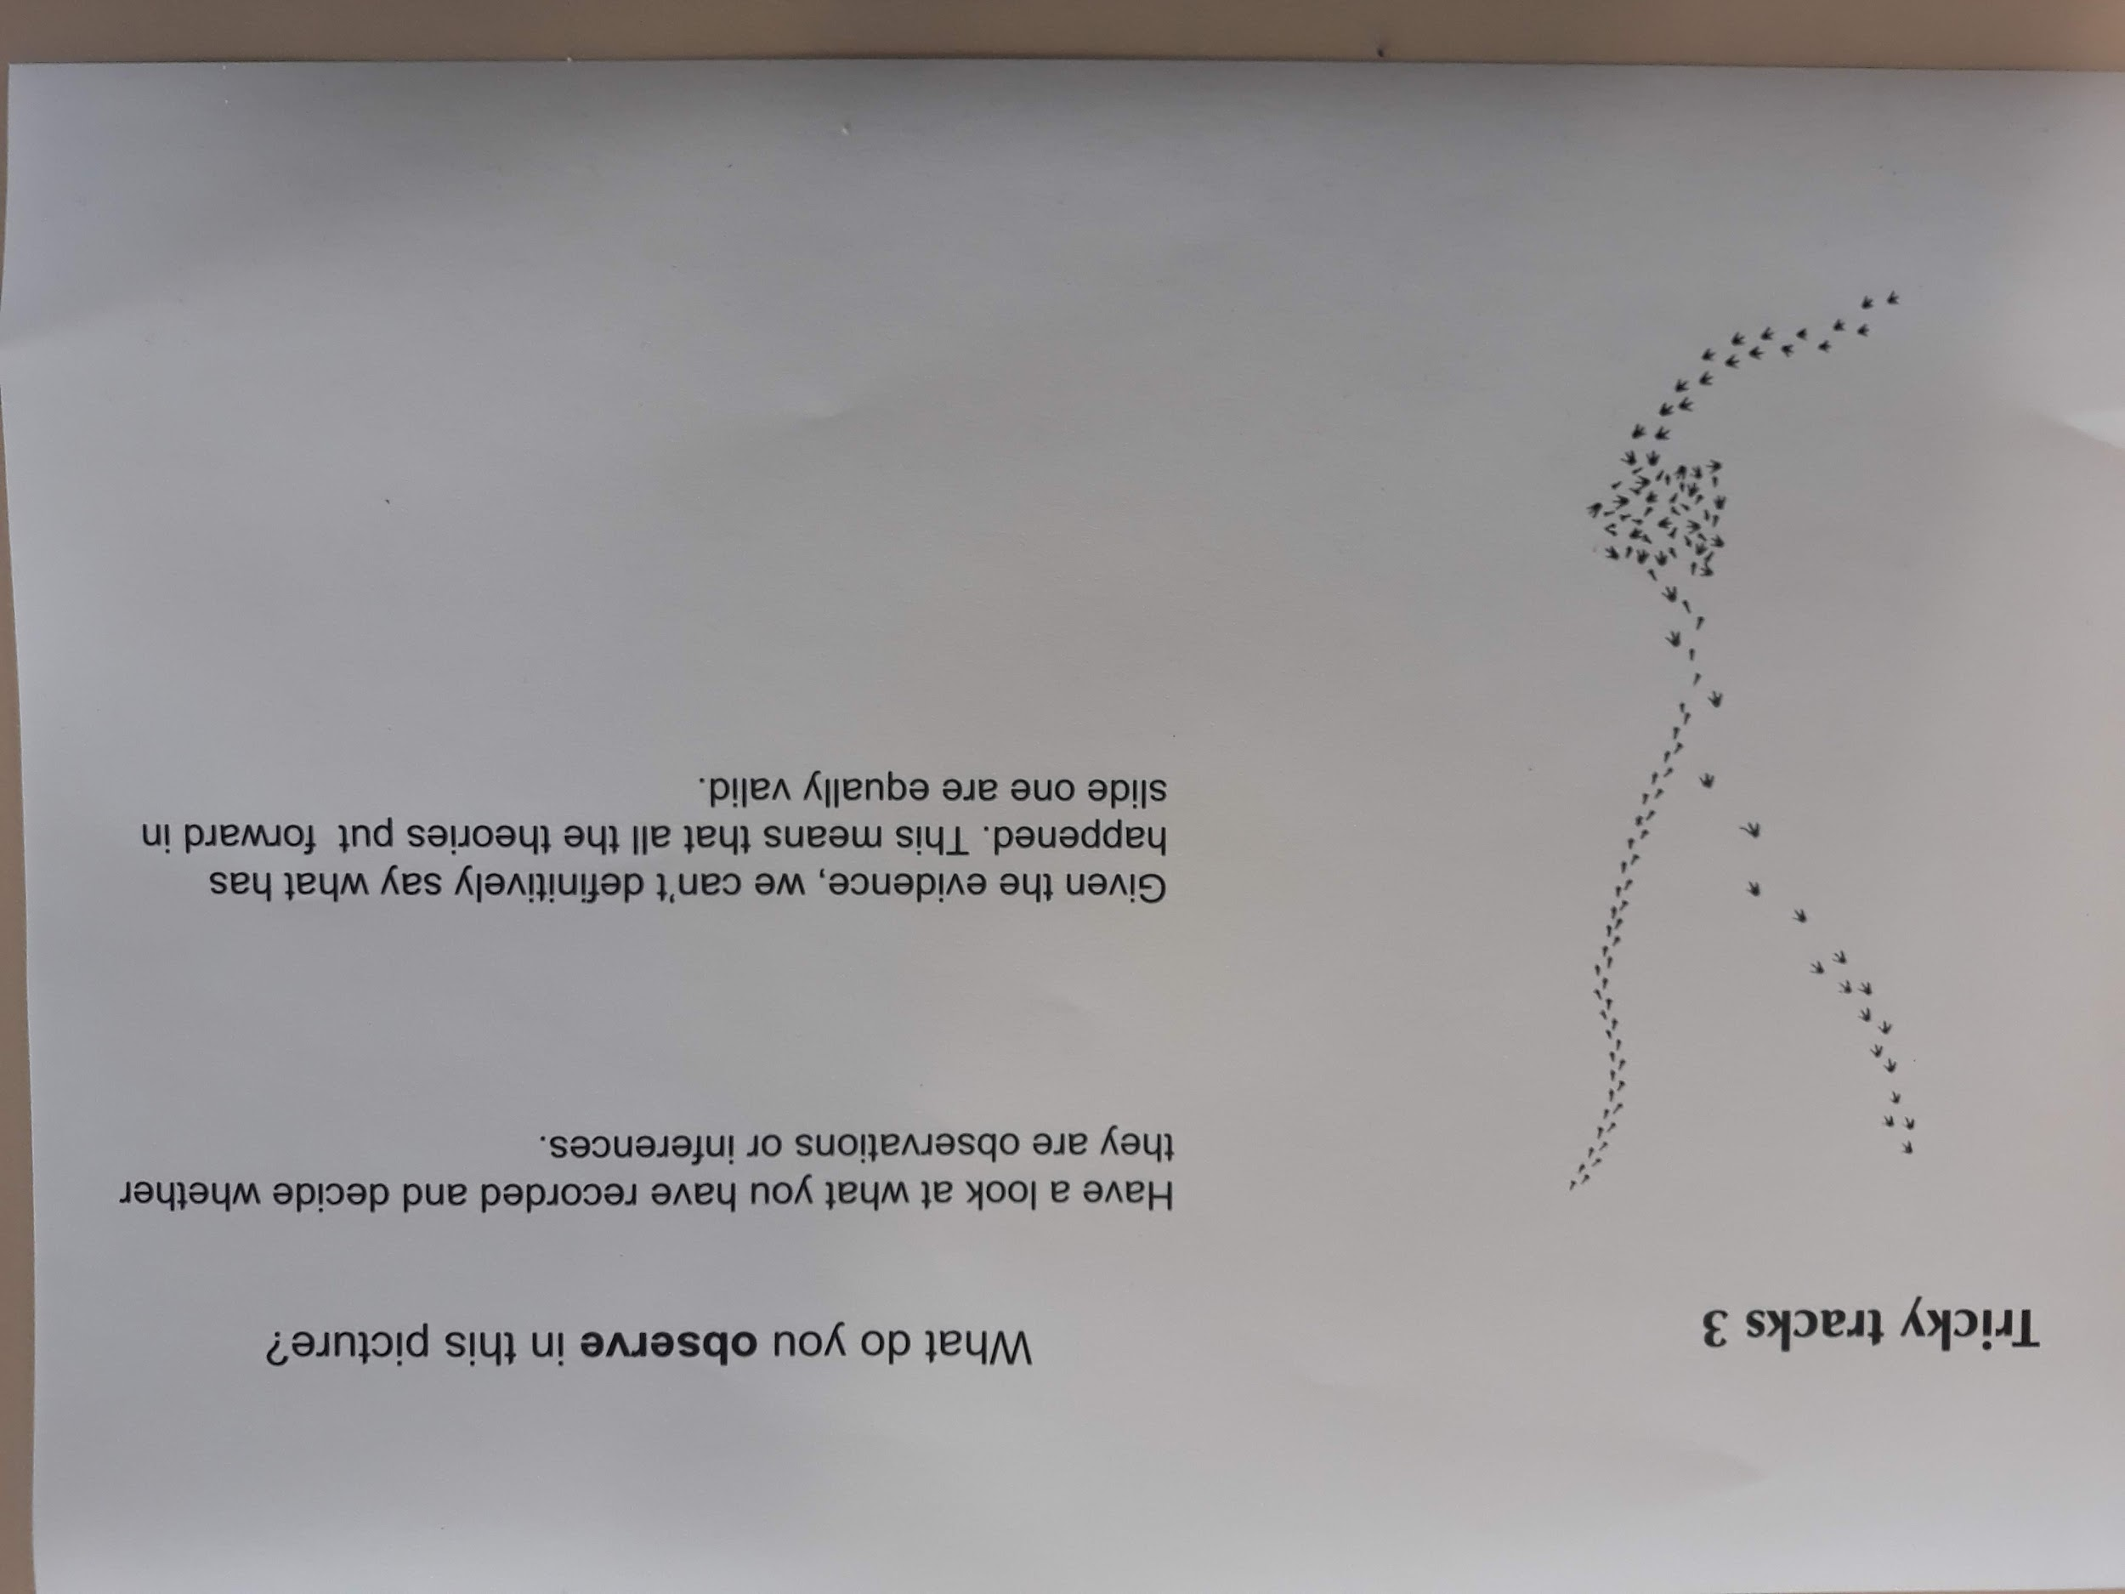
Photo by Helen Moore © Hikurangi School

Slide 19
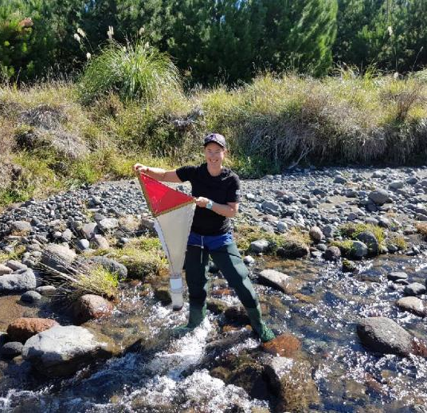
Meredith Wilson
© Royal Society Te Apārangi
© Copyright. Science Learning Hub – Pokapū Akoranga Pūtaiao The University of Waikato Te Whare Wananga o Waikato.
All Rights Reserved | www.sciencelearn.org.nz. All images are copyrighted. For further information, please refer to enquiries@sciencelearn.org.nz

Slide 20
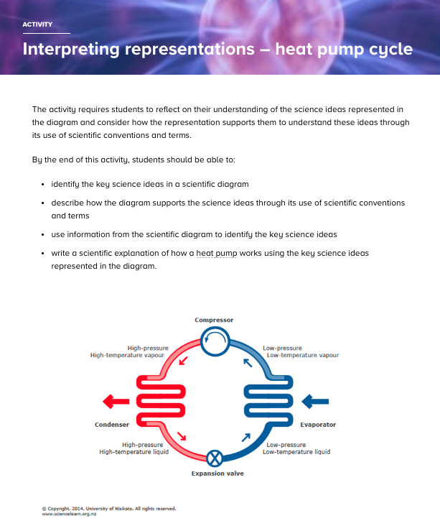
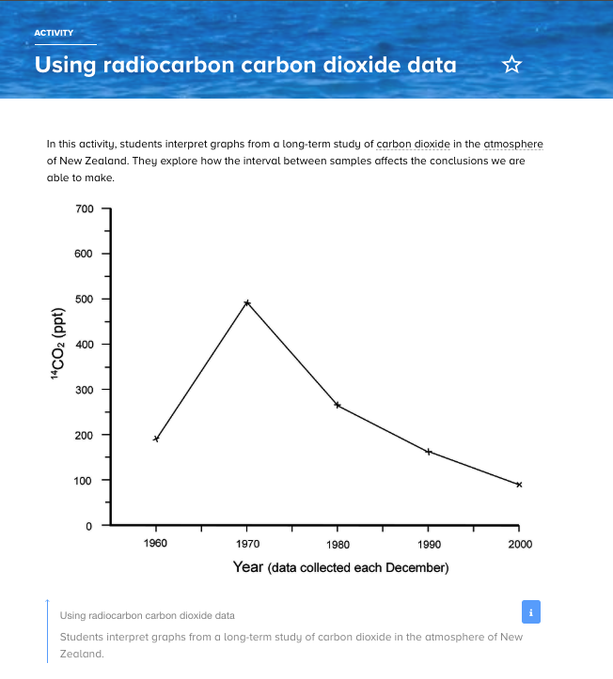
Interpret representations
Scientists represent their ideas in a variety of ways, including models, graphs, charts, diagrams and written texts.
Notes:
www.sciencelearn.org.nz/resources/259-interpreting-representations-heat-pump-cycle
www.sciencelearn.org.nz/resources/711-using-radiocarbon-carbon-dioxide-data

Slide 21
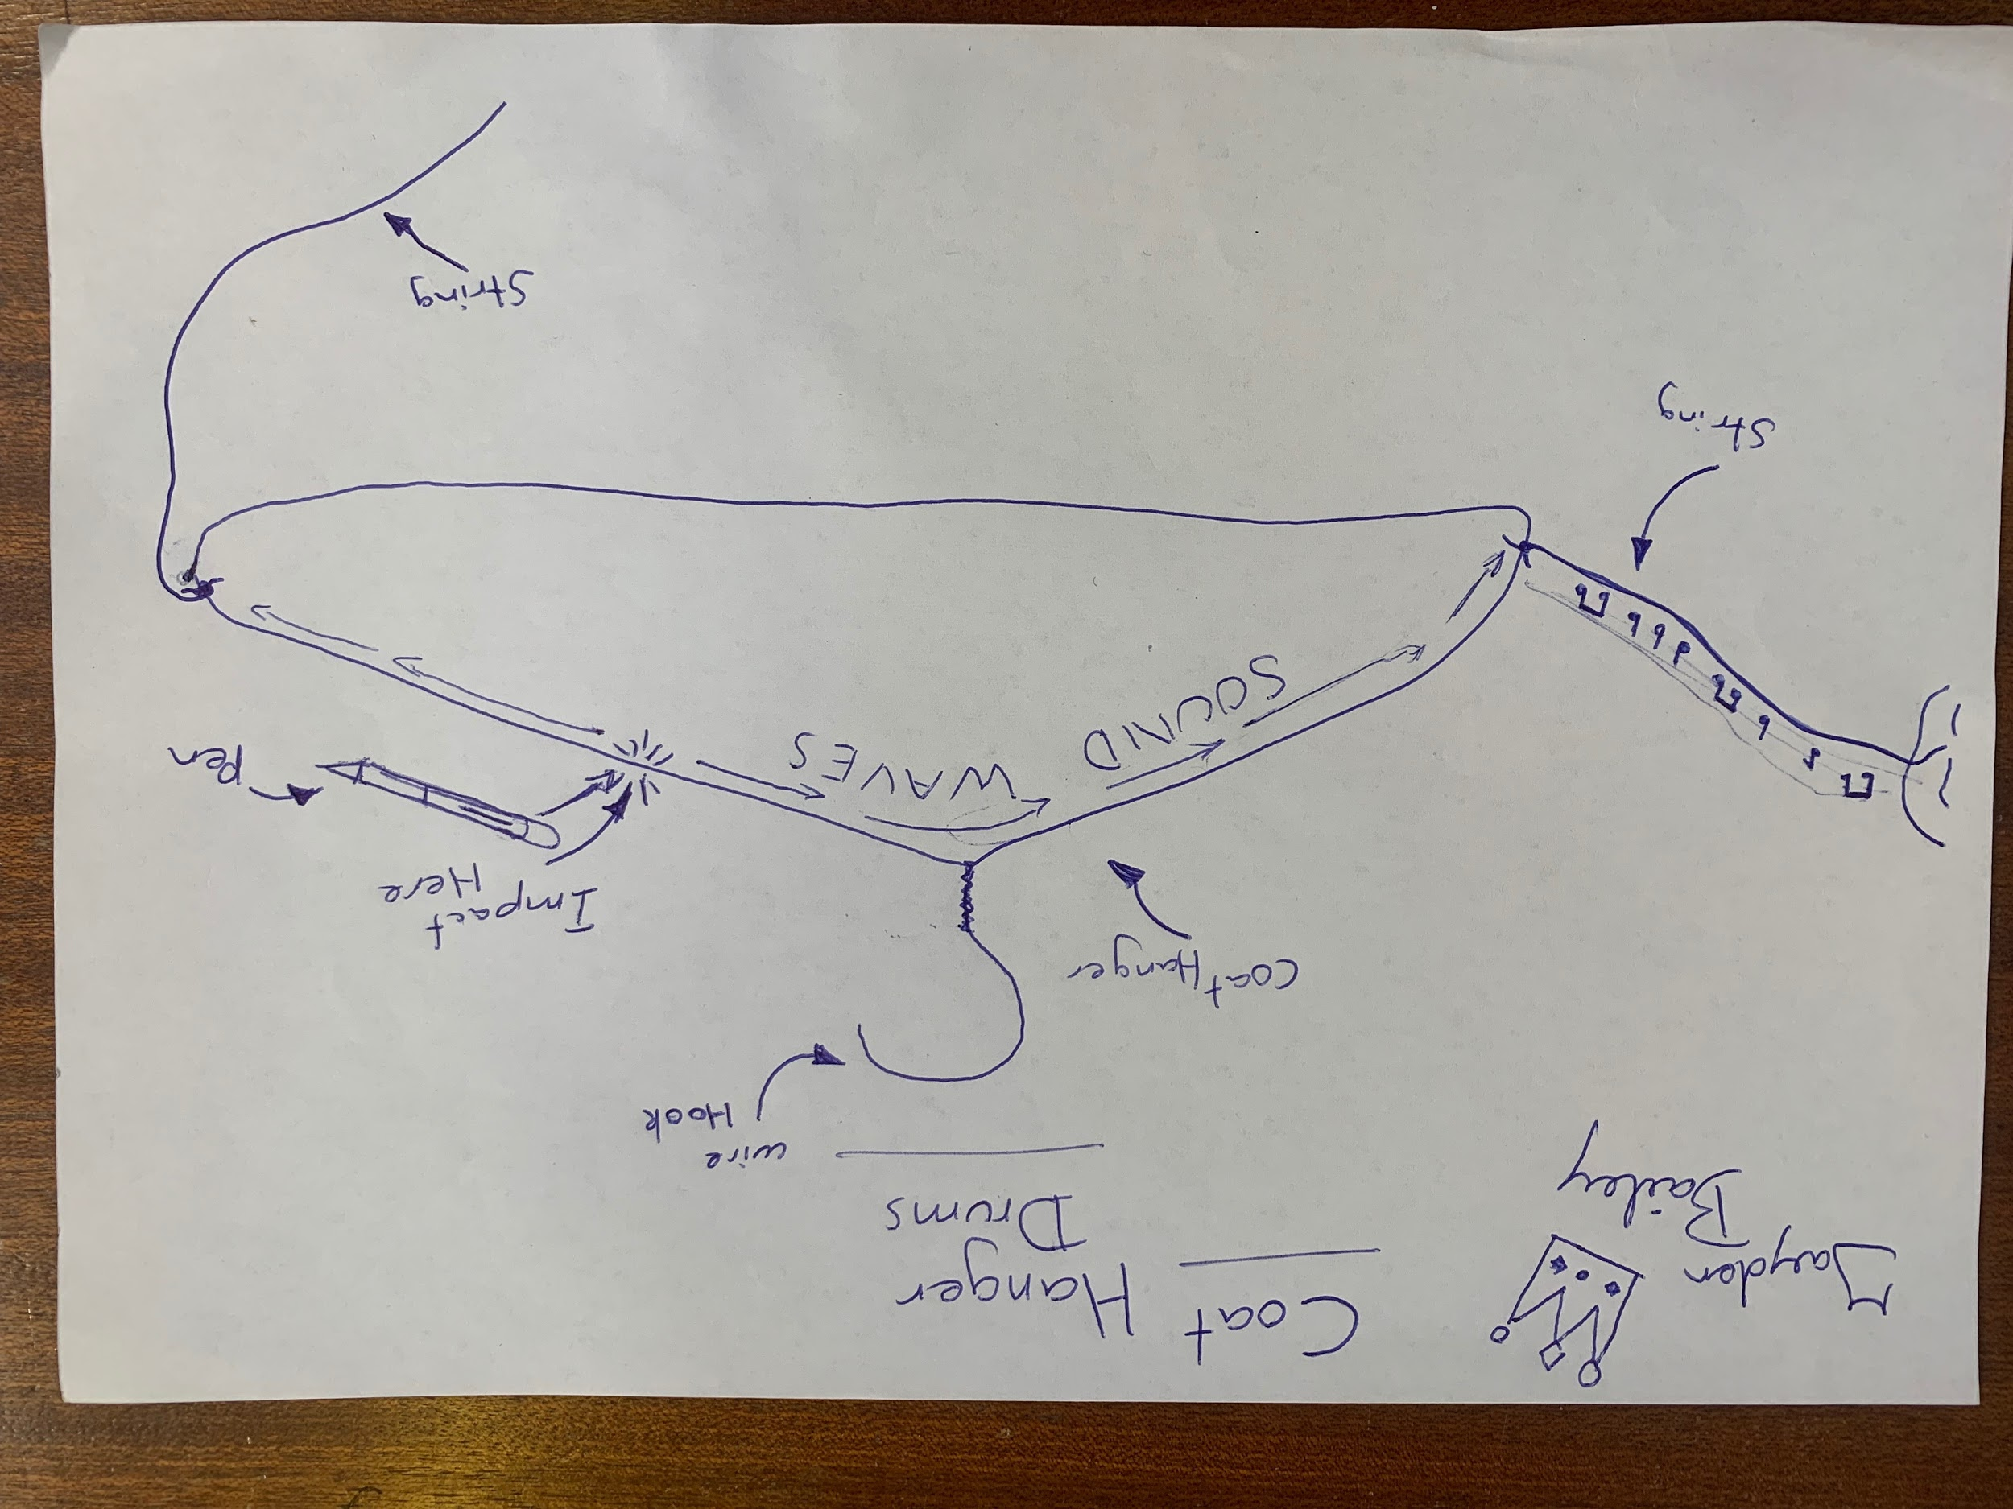
Interpret representations
Photo by Meredith Wilson © Ruapehu College
© Copyright. Science Learning Hub – Pokapū Akoranga Pūtaiao The University of Waikato Te Whare Wananga o Waikato.
All Rights Reserved | www.sciencelearn.org.nz. All images are copyrighted. For further information, please refer to enquiries@sciencelearn.org.nz

Slide 22
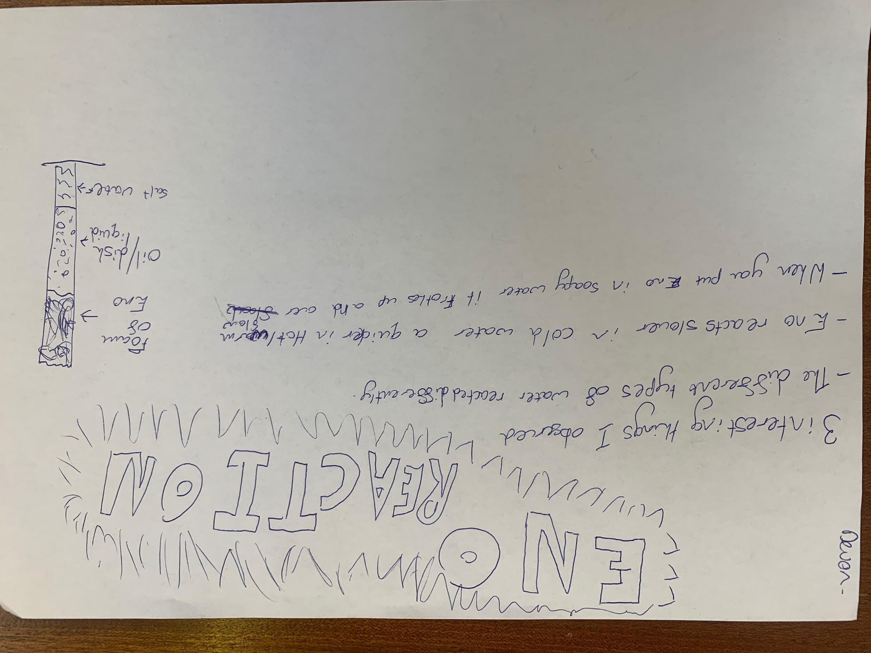
Interpret representations
Photo by Meredith Wilson © Ruapehu College
© Copyright. Science Learning Hub – Pokapū Akoranga Pūtaiao The University of Waikato Te Whare Wananga o Waikato.
All Rights Reserved | www.sciencelearn.org.nz. All images are copyrighted. For further information, please refer to enquiries@sciencelearn.org.nz

Slide 23
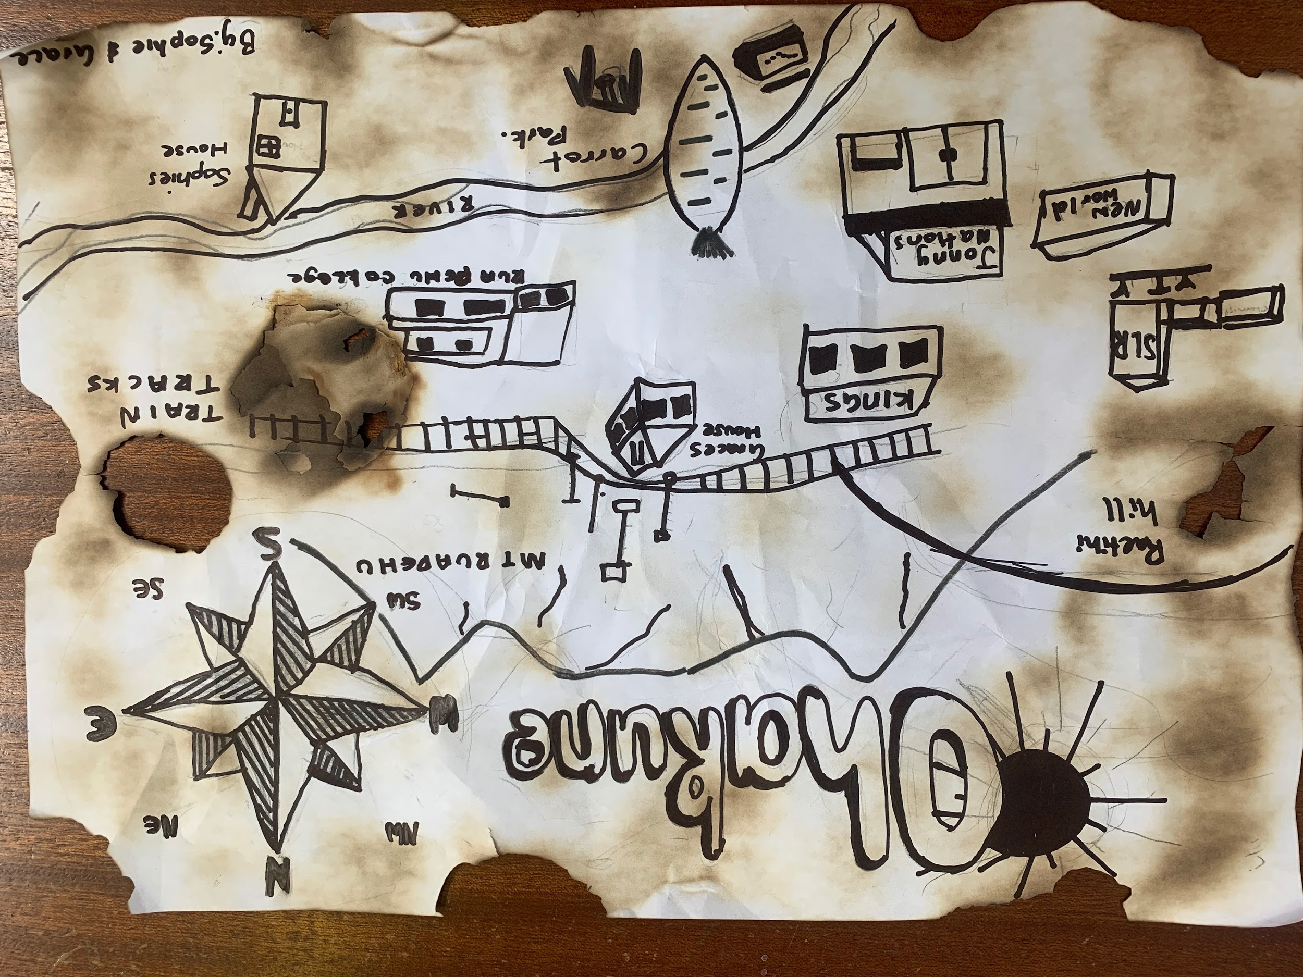
Interpret representations
Photo by Meredith Wilson © Ruapehu College
© Copyright. Science Learning Hub – Pokapū Akoranga Pūtaiao The University of Waikato Te Whare Wananga o Waikato.
All Rights Reserved | www.sciencelearn.org.nz. All images are copyrighted. For further information, please refer to enquiries@sciencelearn.org.nz

Slide 24
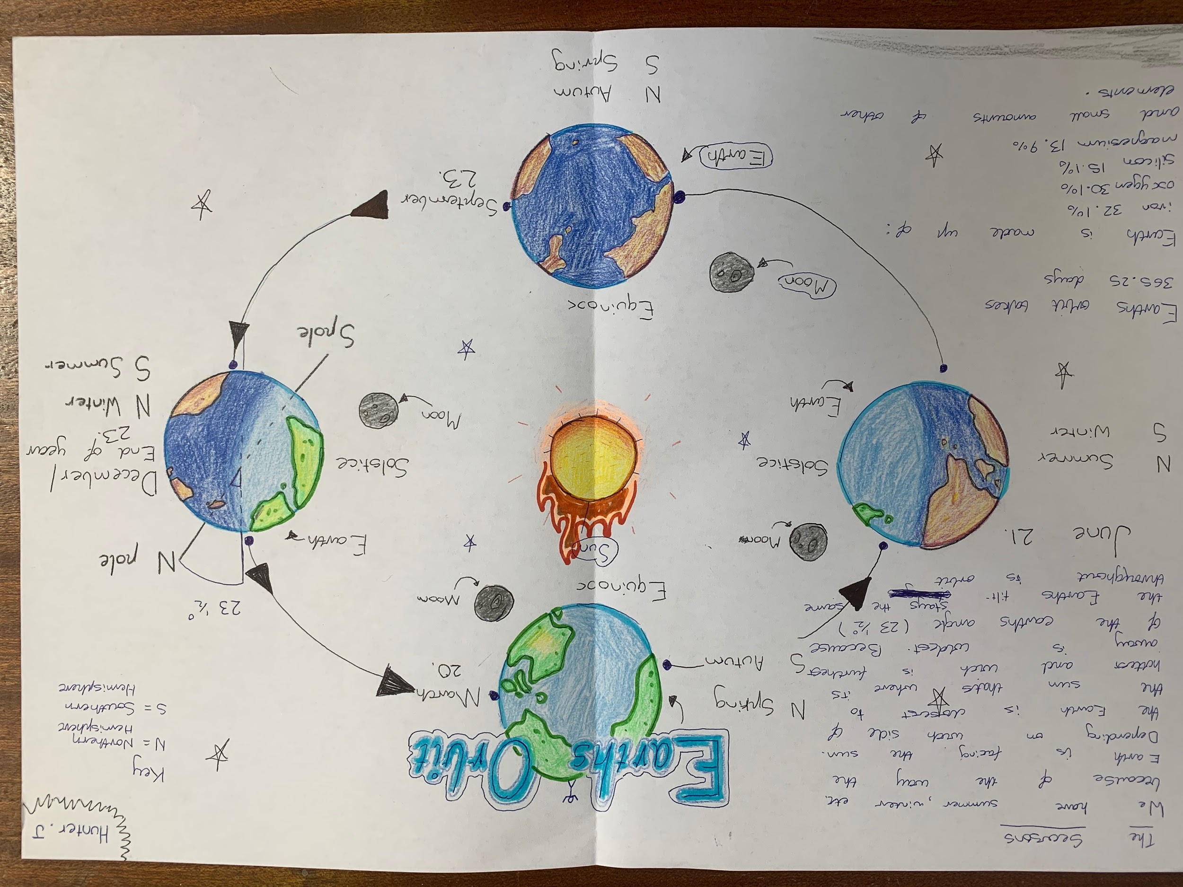
Interpret representations
Photo by Meredith Wilson © Ruapehu College
© Copyright. Science Learning Hub – Pokapū Akoranga Pūtaiao The University of Waikato Te Whare Wananga o Waikato.
All Rights Reserved | www.sciencelearn.org.nz. All images are copyrighted. For further information, please refer to enquiries@sciencelearn.org.nz

Slide 25
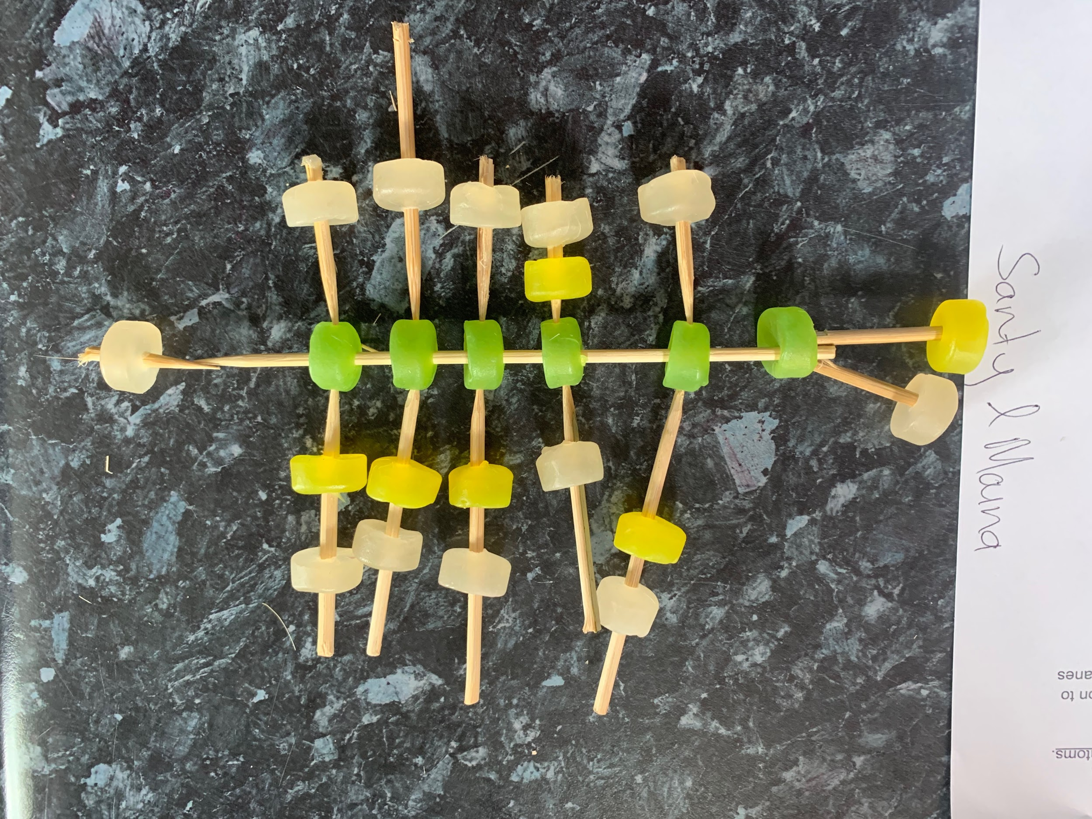
Interpret representations
Photo by Meredith Wilson © Ruapehu College
© Copyright. Science Learning Hub – Pokapū Akoranga Pūtaiao The University of Waikato Te Whare Wananga o Waikato.
All Rights Reserved | www.sciencelearn.org.nz. All images are copyrighted. For further information, please refer to enquiries@sciencelearn.org.nz

Slide 26
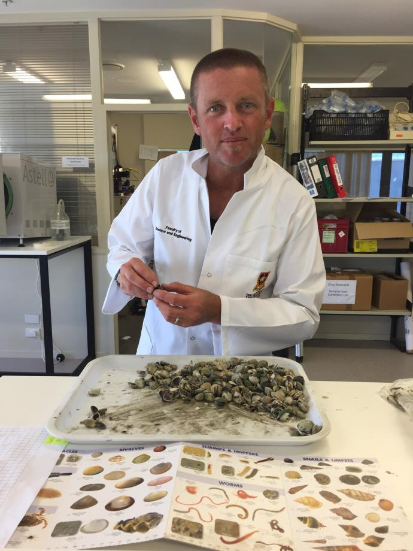
Roger Colquhoun
© Royal Society Te Apārangi
© Copyright. Science Learning Hub – Pokapū Akoranga Pūtaiao The University of Waikato Te Whare Wananga o Waikato.
All Rights Reserved | www.sciencelearn.org.nz. All images are copyrighted. For further information, please refer to enquiries@sciencelearn.org.nz

Slide 27
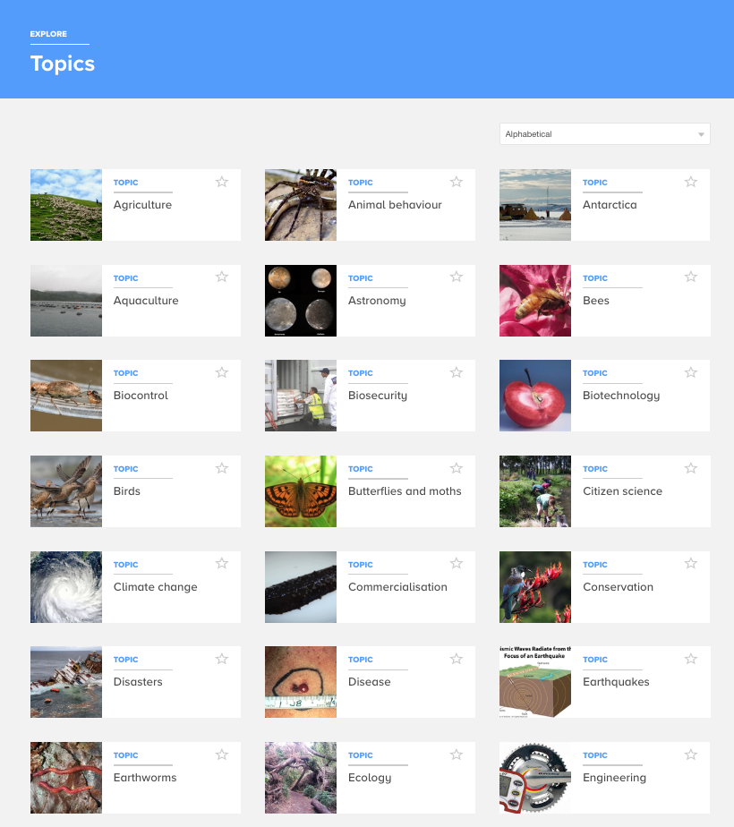
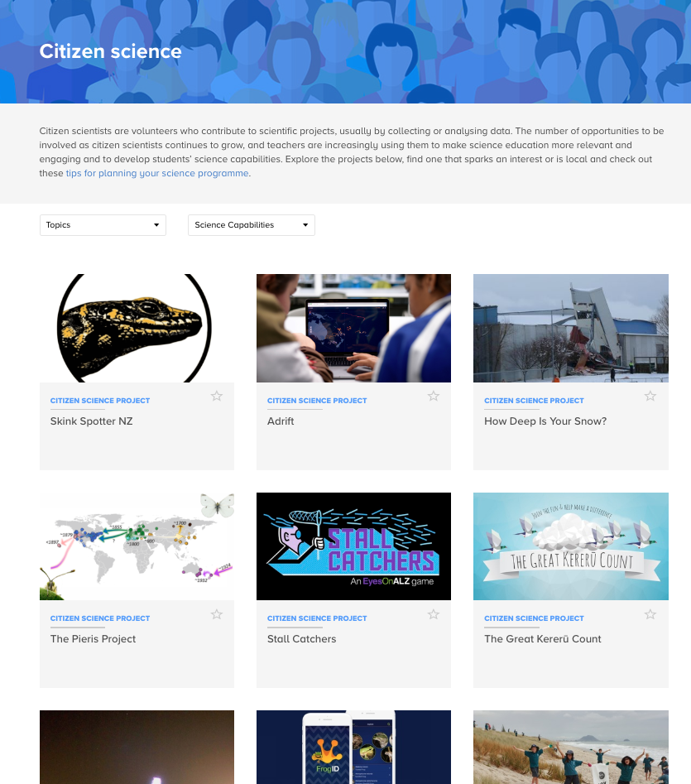
Engaging in science
This capability requires students to use the other capabilities to engage with science in ‘real life’ contexts.
Notes:
www.sciencelearn.org.nz/topics
www.sciencelearn.org.nz/citizen_science

Slide 28
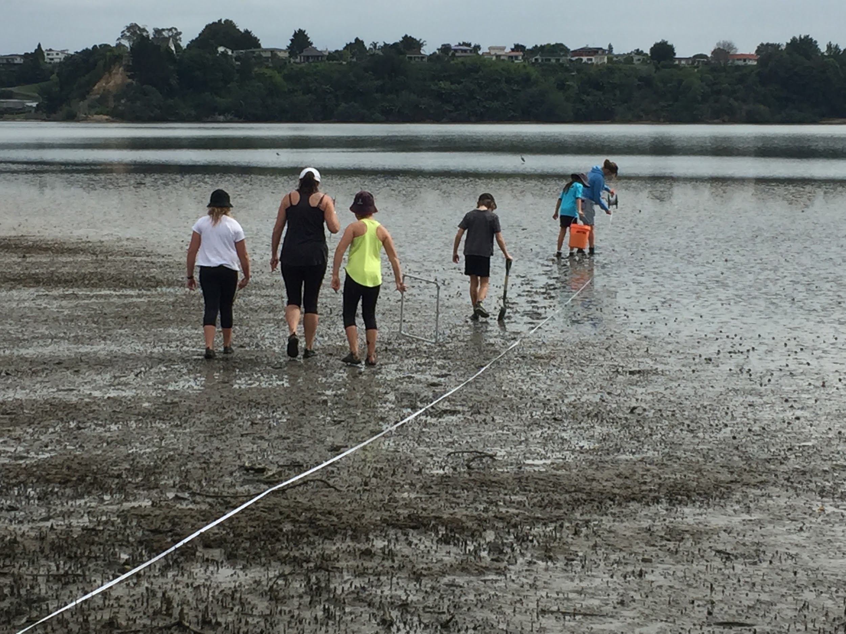
Photo by R. Colquhoun © Selwyn Ridge School

Slide 29
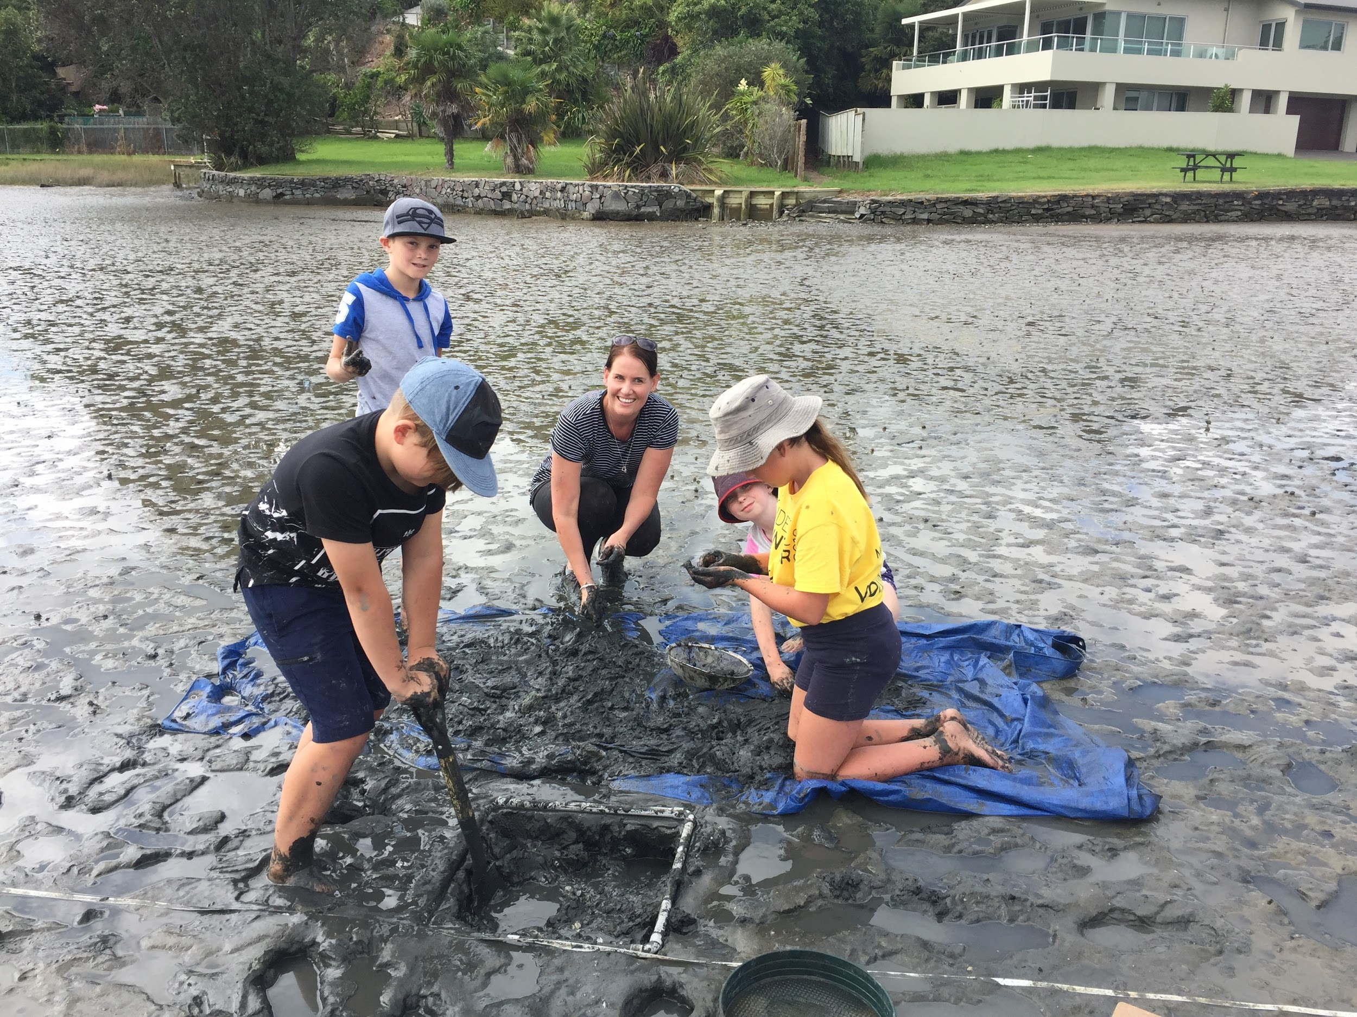
Photo by R. Colquhoun © Selwyn Ridge School

Slide 30
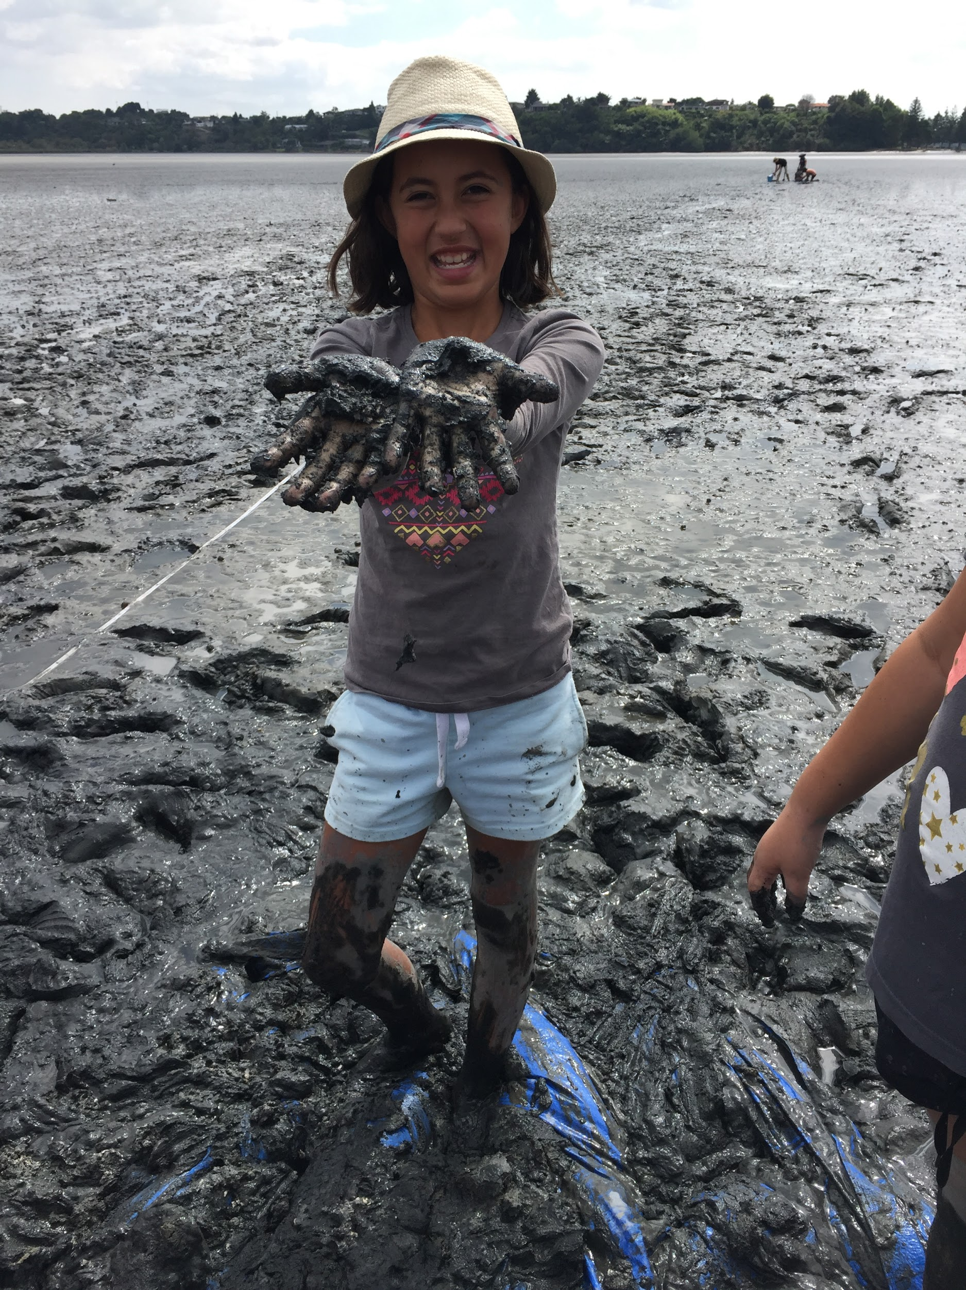
Photo by R. Colquhoun © Selwyn Ridge School

Slide 31
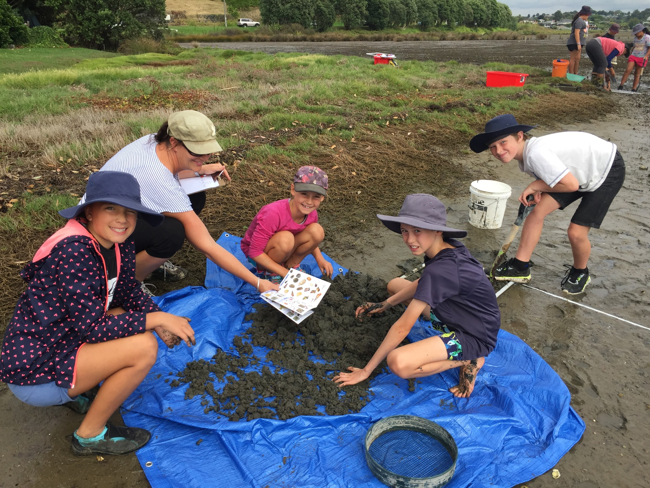
Photo by R. Colquhoun © Selwyn Ridge School

Slide 32
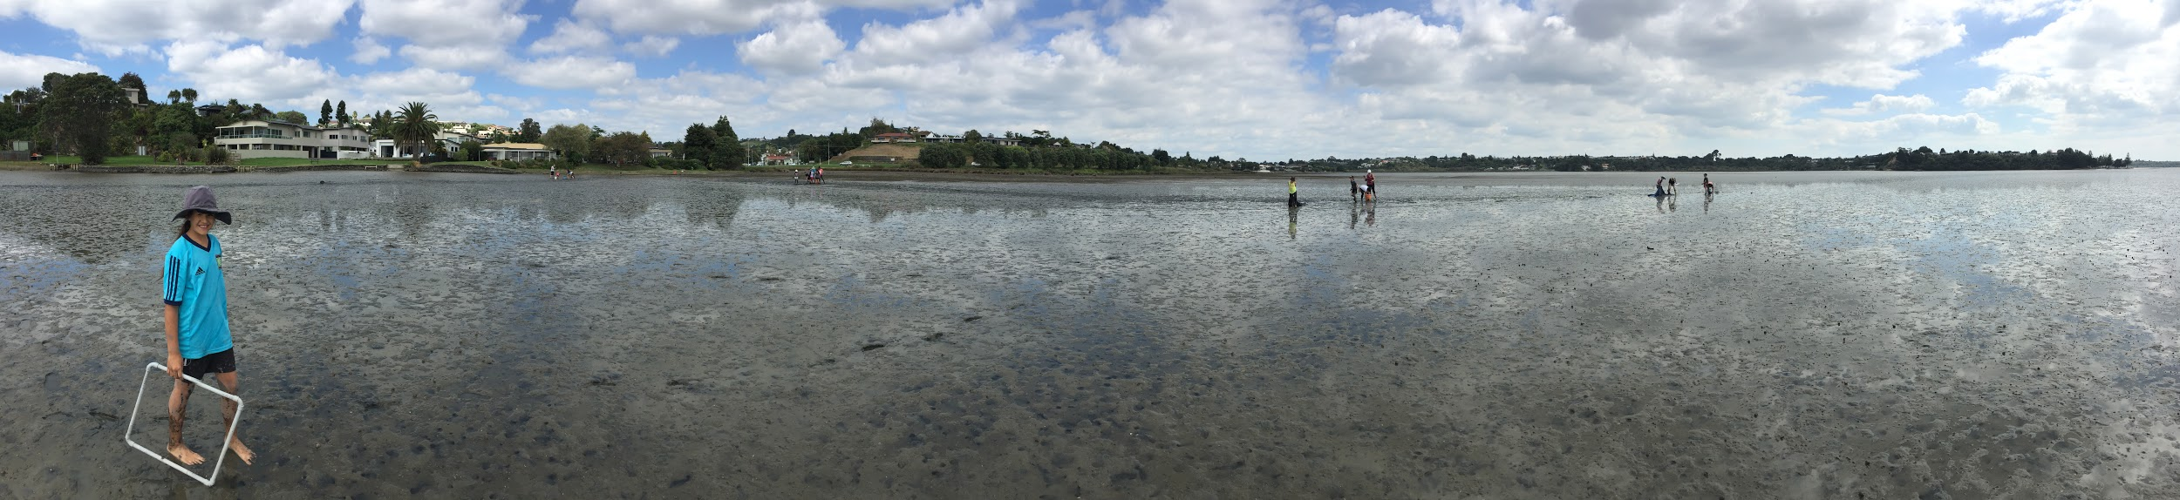
Photo by R. Colquhoun © Selwyn Ridge School

Slide 33





Keep in touch
Email us enquiries@sciencelearn.org.nz
https://twitter.com/NZScienceLearn
www.facebook.com/nzsciencelearn
https://nz.pinterest.com/nzsciencelearn
www.instagram.com/sciencelearninghubnz
Join us in our discussion channel on Slack.
(Any problems accessing Slack, please contact us via our enquiries email, enquiries@sciencelearn.org.nz.)
Notes:
Don’t forget that SLH can help, SLACK: https://slh-talk.slack.com

Slide 34
The Science Learning Hub
would like to thank Helen Moore, Meredith Wilson, Roger Colquhoun and the Royal Society of New Zealand.

