Slide 1
Electron microscopes
Electron microscopes enable us to look in far more detail at objects than is possible with a light microscope. Some electron microscopes can detect objects that are approximately one-twentieth of a nanometre (10-9 m).
Electron microscopes can’t be used to look directly at living things. Instead, electron microscopes aim to provide a high-resolution ‘snapshot’ of a moment in time.
I think the electron microscope has contributed more to science than any other scientific instrument that’s ever been invented.
Allan Mitchell, Microscopy Otago
© Copyright. The University of Waikato Te Whare Wananga o Waikato l Science Learning Hub – Pokapū Akoranga Pūtaiao. All Rights Reserved
All images are copyrighted. For further information, please refer to enquiries@sciencelearn.org.nz

Slide 2
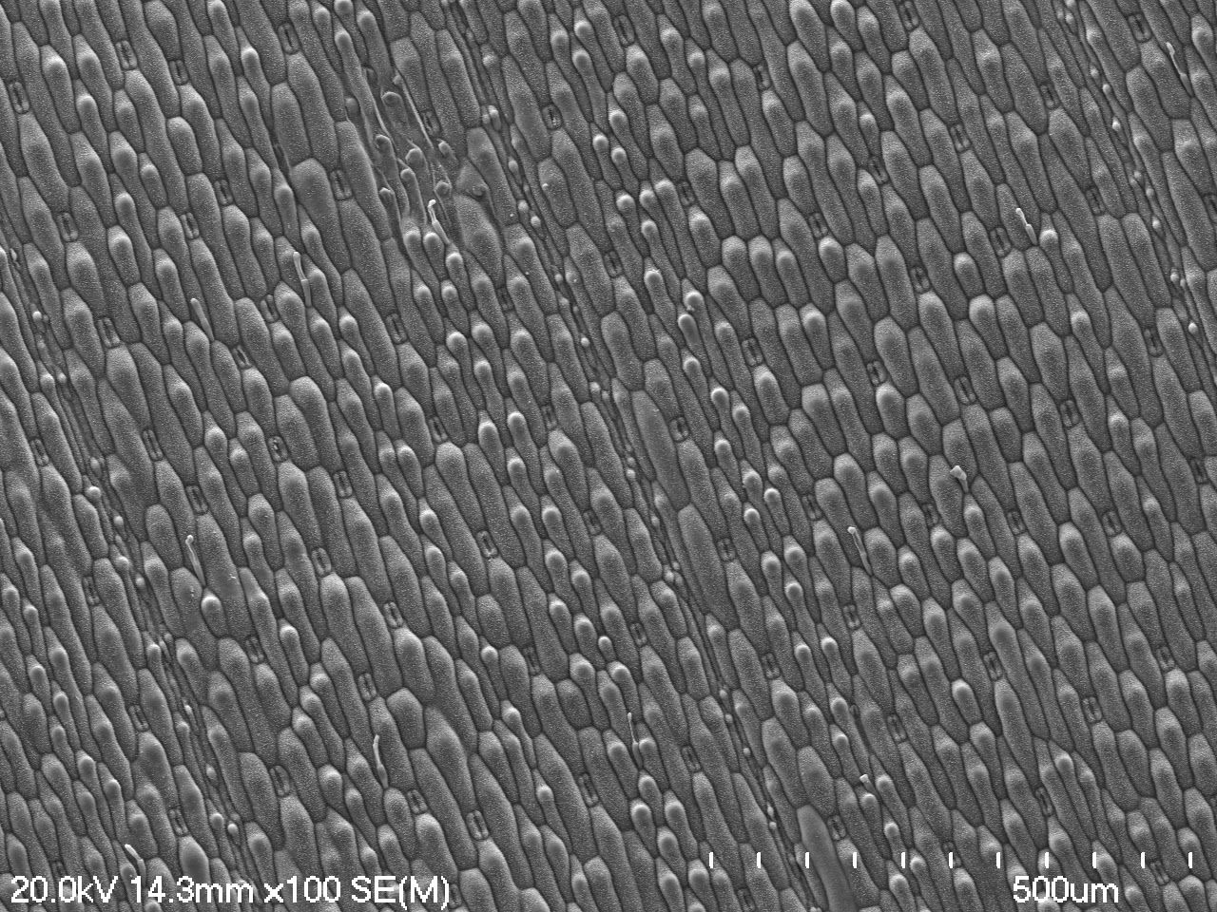
© Helen Turner, University of Waikato Te Whare Wānanga o Waikato
Notes:
Barnyard grass

Slide 3
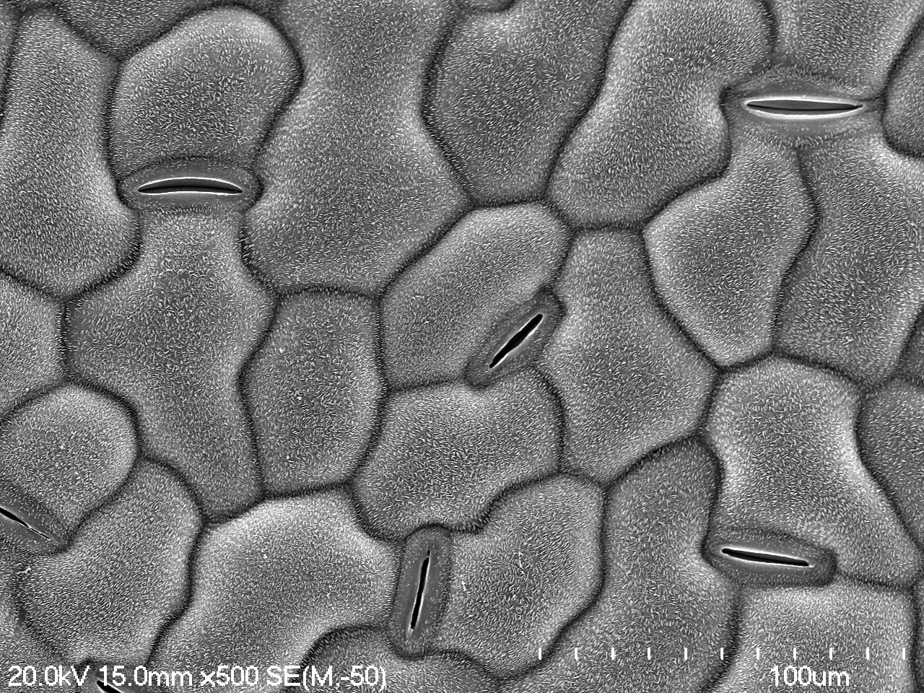
© Helen Turner, University of Waikato Te Whare Wānanga o Waikato
Notes:
Grass surface

Slide 4
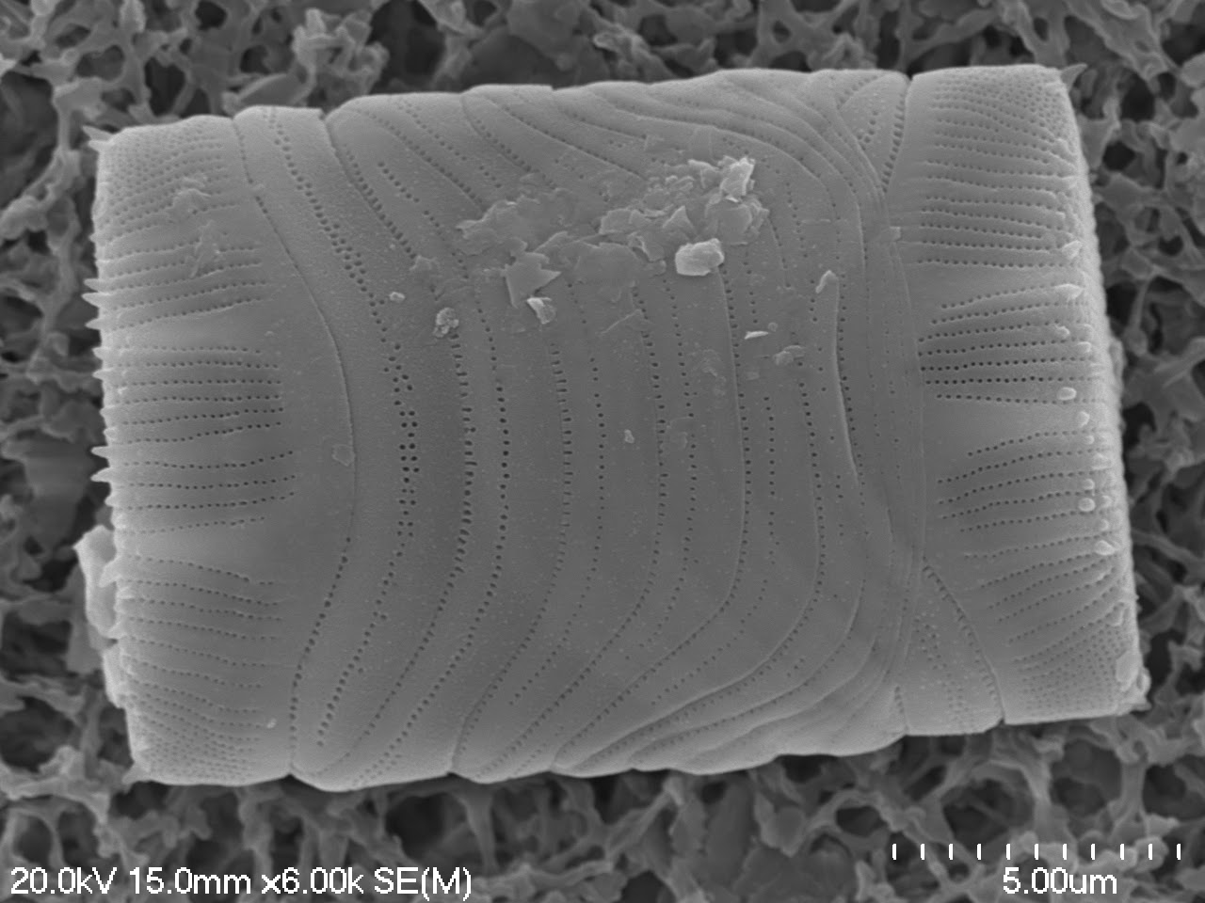
© Helen Turner, University of Waikato Te Whare Wānanga o Waikato
Notes:
Diatom

Slide 5
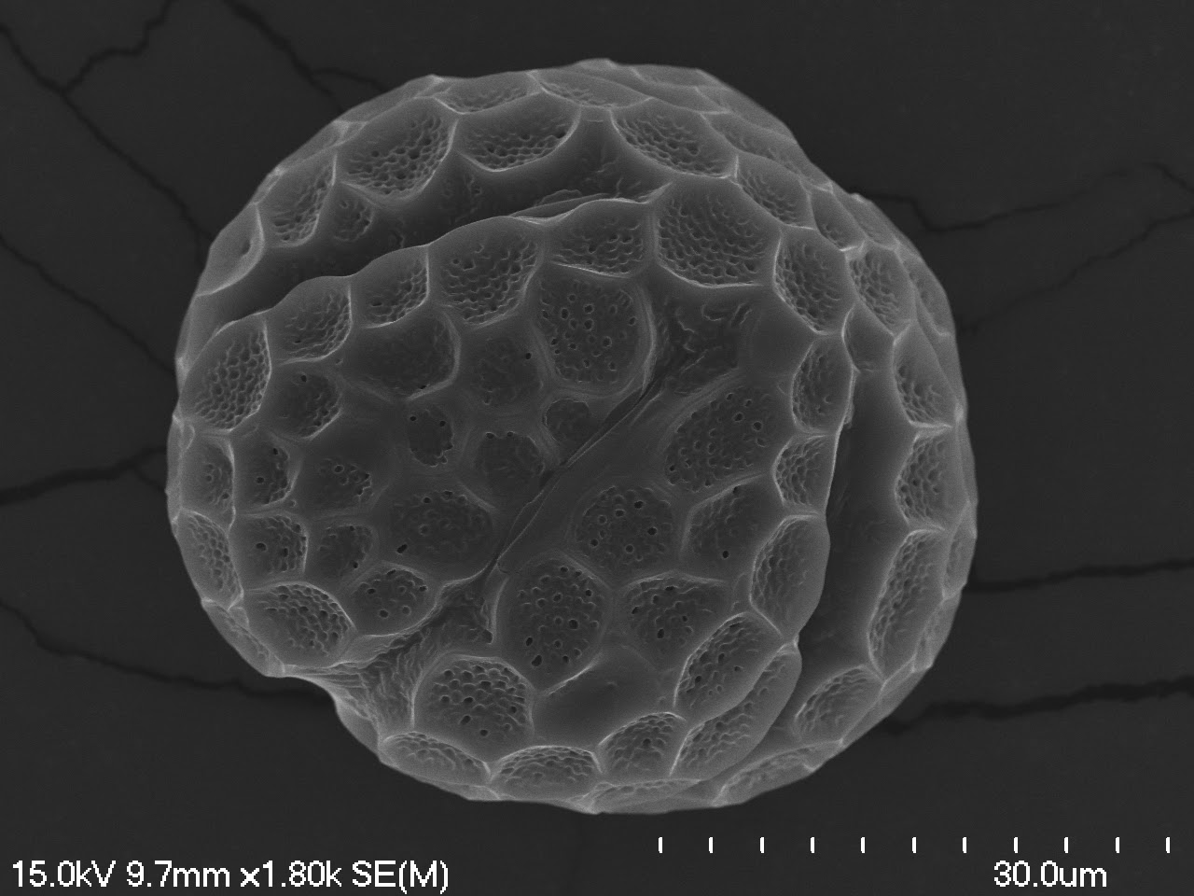
© Helen Turner, University of Waikato Te Whare Wānanga o Waikato
Notes:
Basil pollen

Slide 6
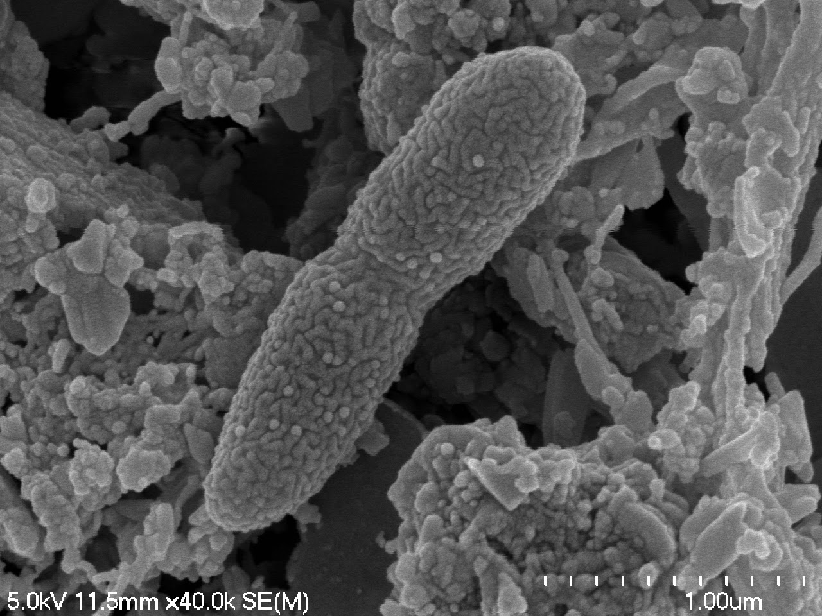
© Helen Turner, University of Waikato Te Whare Wānanga o Waikato
Notes:
Soil bacteria

Slide 7
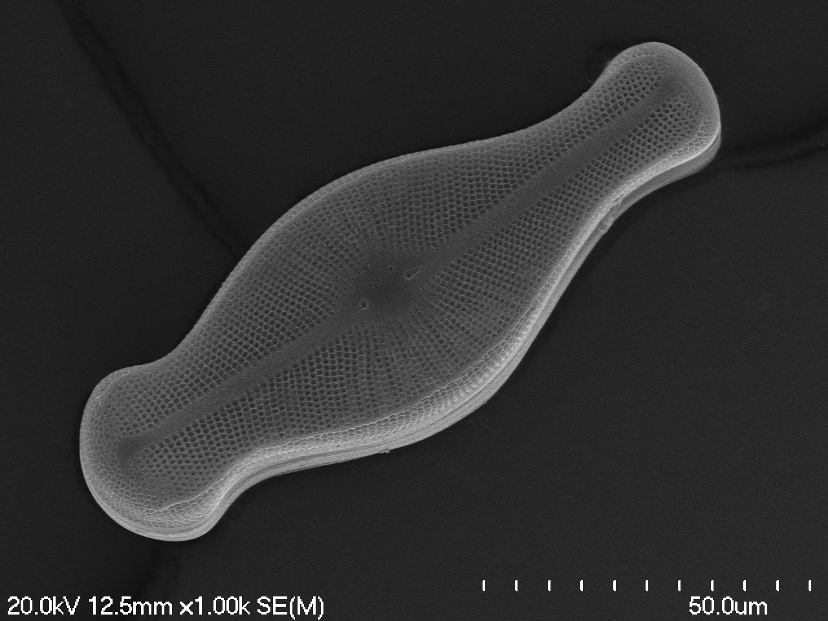
© Helen Turner, University of Waikato Te Whare Wānanga o Waikato
Notes:
Didymo

Slide 8
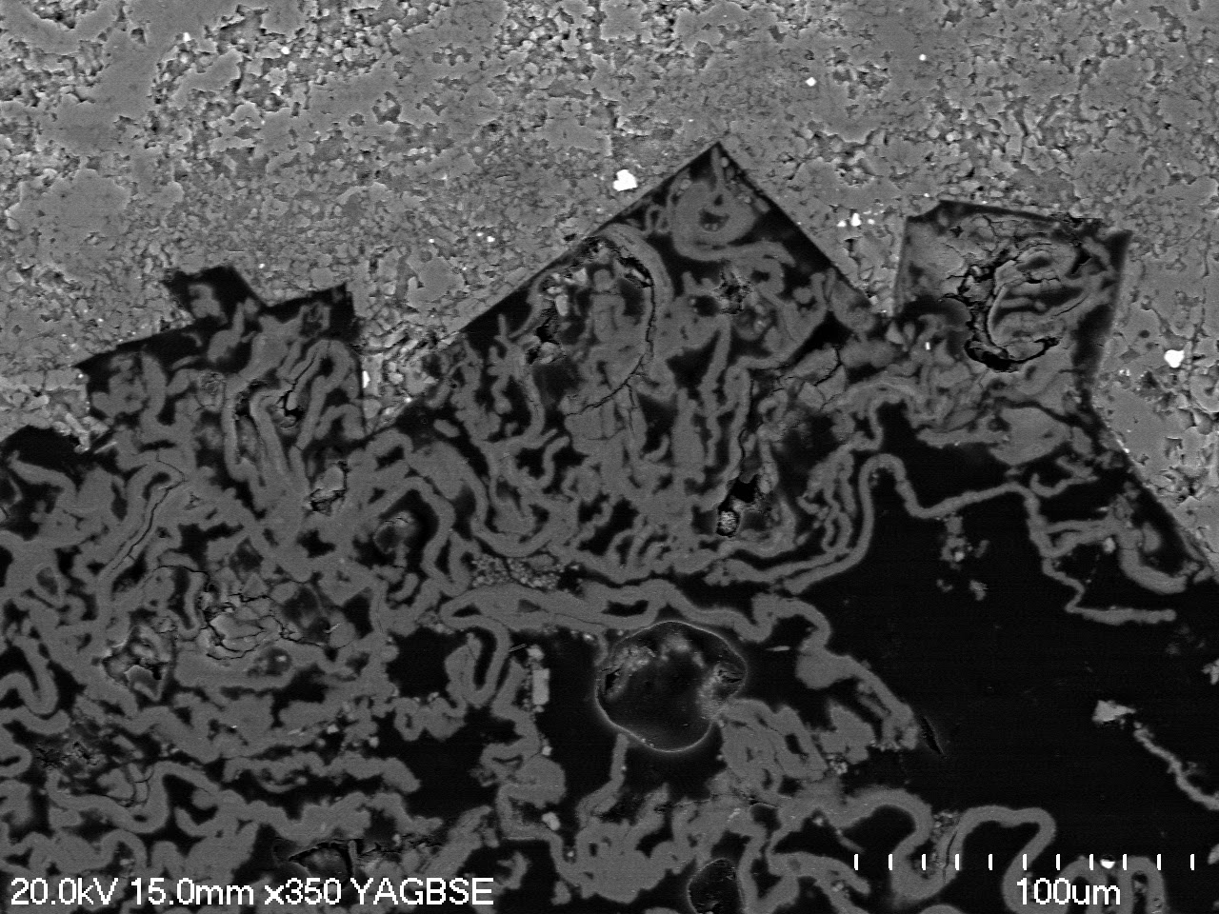
© Helen Turner, University of Waikato Te Whare Wānanga o Waikato
Notes:
Rock (thin section)

Slide 9
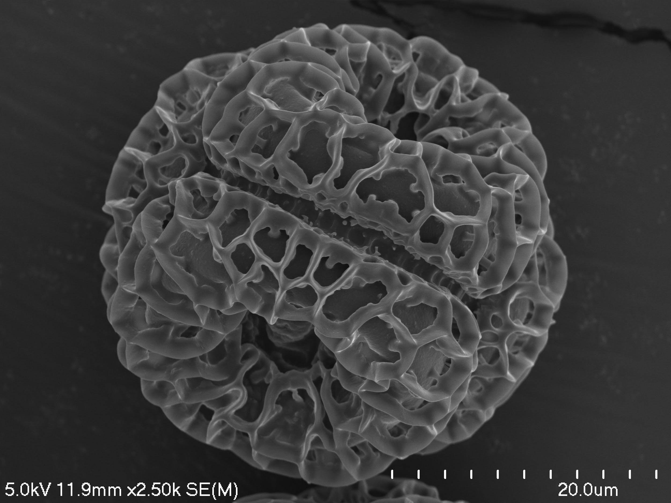
© Helen Turner, University of Waikato Te Whare Wānanga o Waikato
Notes:
Horopito pollen

Slide 10
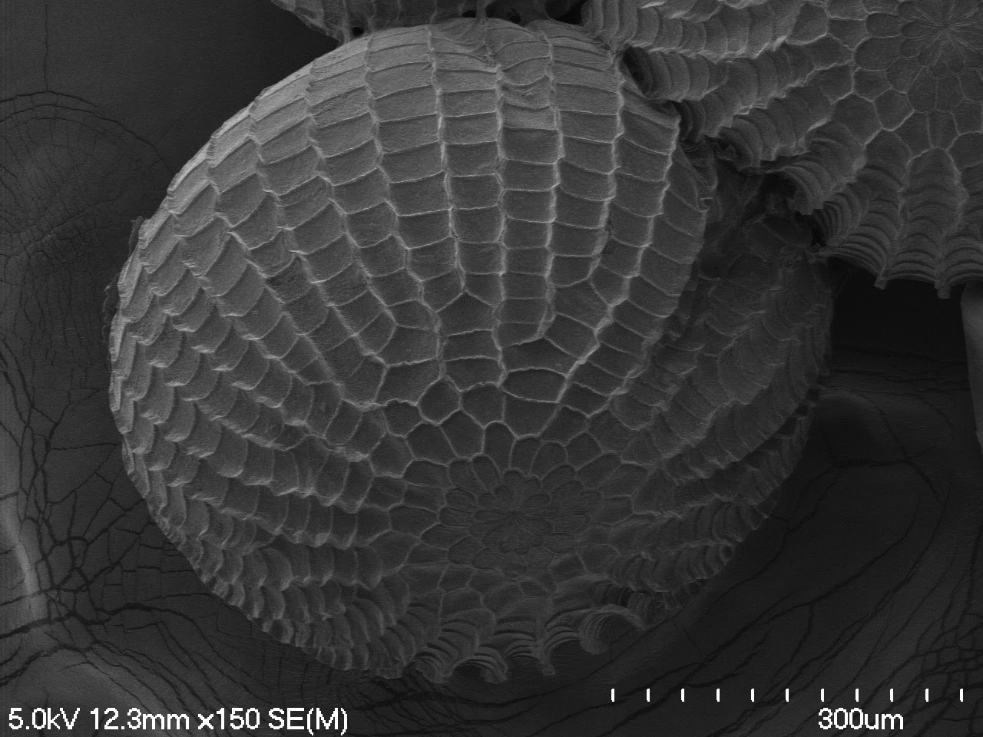
© Helen Turner, University of Waikato Te Whare Wānanga o Waikato
Notes:
Moth egg

Slide 11
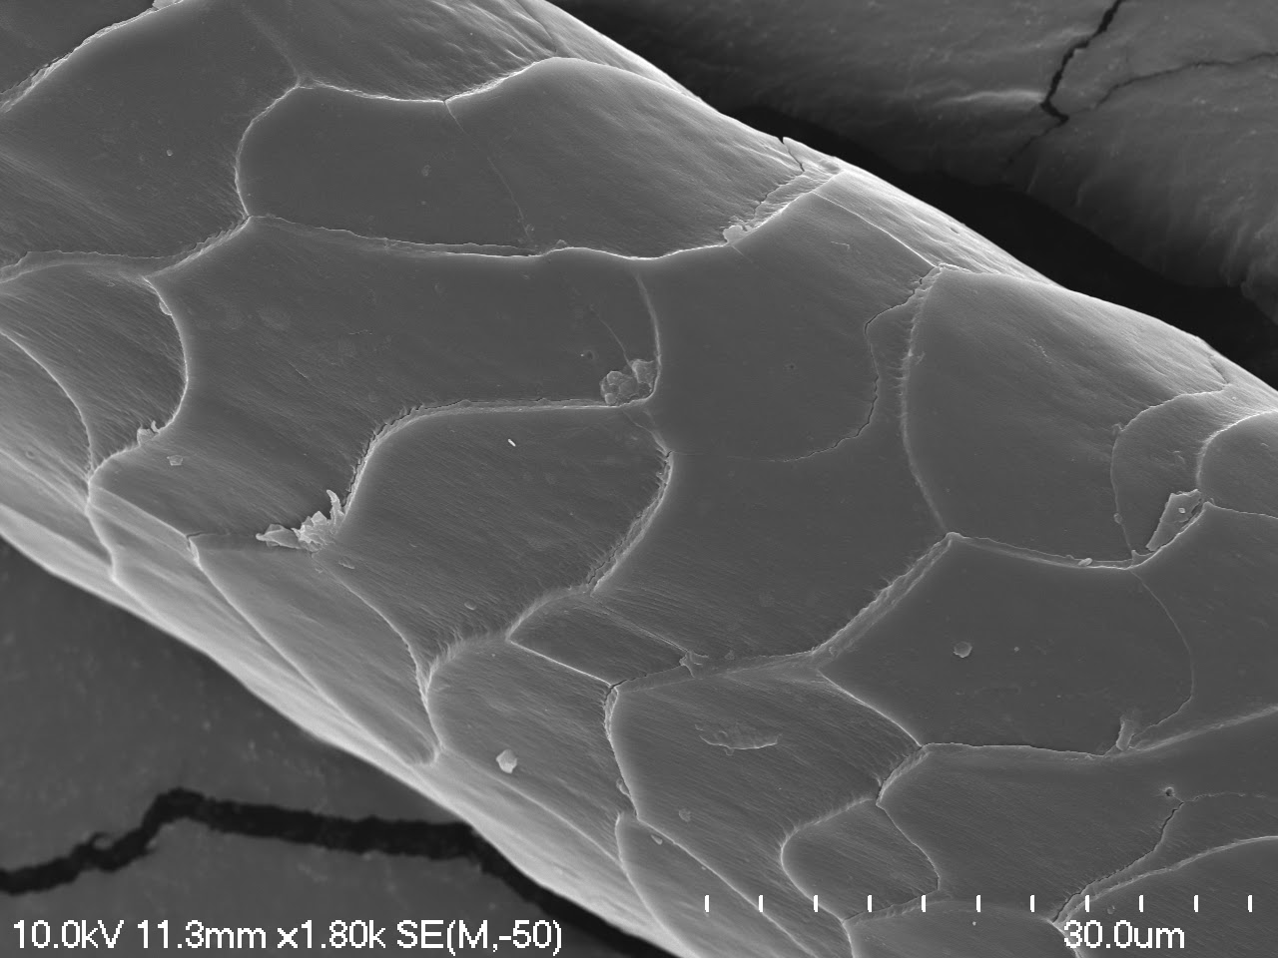
© Helen Turner, University of Waikato Te Whare Wānanga o Waikato
Notes:
Wool fibre

Slide 12
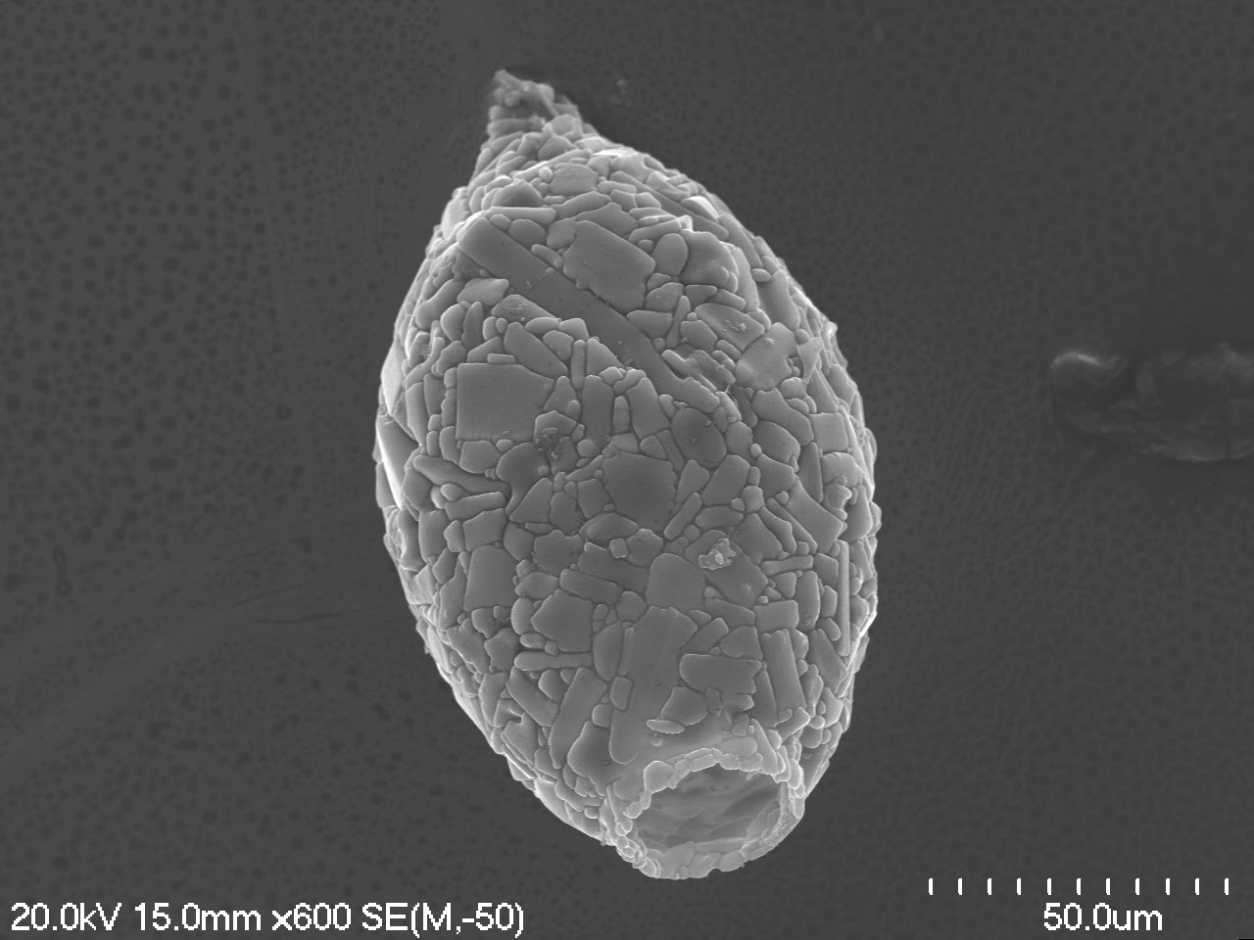
© Helen Turner, University of Waikato Te Whare Wānanga o Waikato
Notes:
Testae amoeba

Slide 13
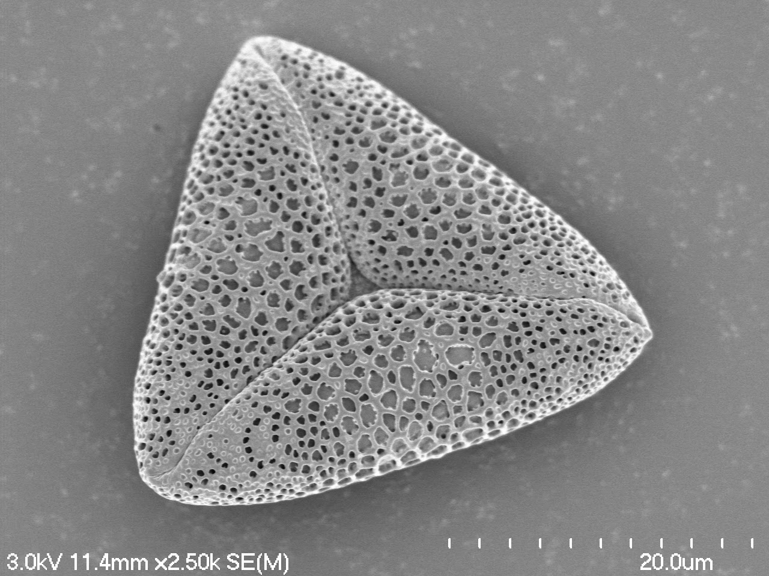
© Helen Turner, University of Waikato Te Whare Wānanga o Waikato
Notes:
Flax pollen

Slide 14
Images
Barnyard grass
Grass surface
Diatom
Basil pollen
Soil bacteria
Didymo
Rock (thin section)
Horopito pollen
Moth egg
Wool fibre
Testate amoeba
Flax pollen
© Copyright. The University of Waikato Te Whare Wananga o Waikato l Science Learning Hub – Pokapū Akoranga Pūtaiao. All Rights Reserved
All images are copyrighted. For further information, please refer to enquiries@sciencelearn.org.nz

Slide 15
The Science Learning Hub would like to thank Helen Turner,
The University of Waikato Te Whare Wānanga o Waikato
for the use of the images in this slideshow.
© Copyright. The University of Waikato Te Whare Wananga o Waikato l Science Learning Hub – Pokapū Akoranga Pūtaiao. All Rights Reserved
All images are copyrighted. For further information, please refer to enquiries@sciencelearn.org.nz

