Slide 1
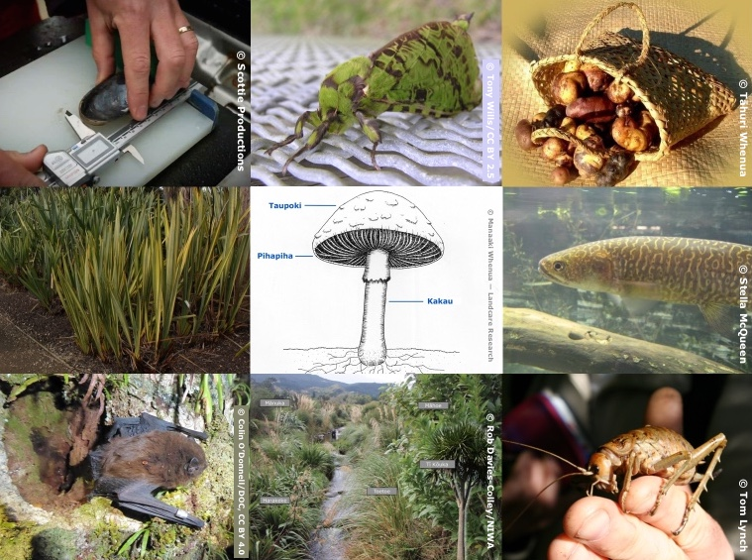
Mātauranga and the
Living World
4–4:45 pm Thursday 21 November
© Copyright. The University of Waikato Te Whare Wananga o Waikato l Science Learning Hub – Pokapū Akoranga Pūtaiao. All Rights Reserved
All images are copyrighted. For further information, please refer to enquiries@sciencelearn.org.nz

Slide 2
Pokapū Akoranga Pūtaiao
The Science Learning Hub
A trustworthy online resource – produced by educators and scientists for New Zealand teachers and students.
Based on world-class New Zealand science research.
Supported by learning activities, information about the key science ideas and concepts, multimedia tools and other resources.
© Copyright. The University of Waikato Te Whare Wananga o Waikato l Science Learning Hub – Pokapū Akoranga Pūtaiao. All Rights Reserved
All images are copyrighted. For further information, please refer to enquiries@sciencelearn.org.nz
Notes:
The SLH is funded by the NZ Government – MBIE Ministry of Business, Innovation and Employment – under the Curious Minds fund

Slide 3
Index
Topic | Slideshow number(s) | Video timecode
Introducing the Science Learning Hub | 1–2 | 00:00
Index | 3 | 1:04
Introducing Yvonne Taura and our purpose | 4–6 | 1:28
Mātauranga on the Hub | 7–13 | 6:02
Whakapapa | 14 | 12:03
Kaitiakitanga | 15 | 14:31
Harakeke | 16–18 | 19:02
Rongoā | 19–22 | 24:00
Ngā Hekeheka/Fungi | 23–25 | 27:17
Ahi Pepe/Mothnet | 26 | 29:27
SLH links, keep in touch and thanks | 27–29 | 33:23
© Copyright. The University of Waikato Te Whare Wananga o Waikato l Science Learning Hub – Pokapū Akoranga Pūtaiao. All Rights Reserved
All images are copyrighted. For further information, please refer to enquiries@sciencelearn.org.nz

Slide 4
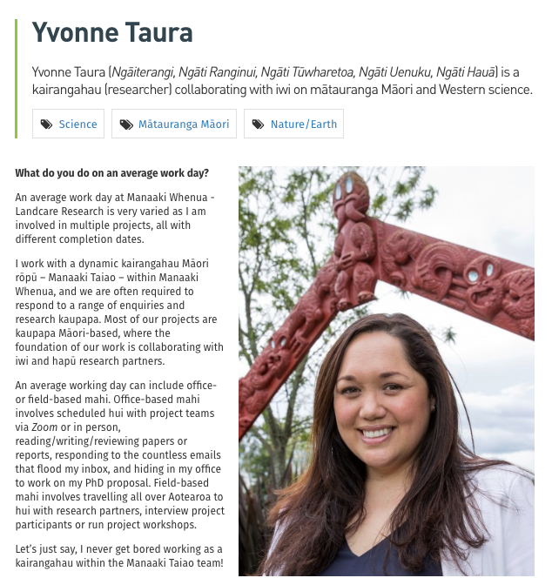
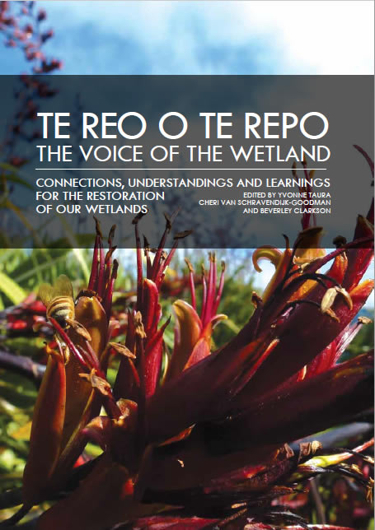
Yvonne Taura
Identifying a gap in regards to information, Waikato-Tainui approached and then collaborated with Manaaki Whenua on this publication — Te reo o te repo - The voice of the wetland: connections, understandings and learnings for the restoration of our wetlands / edited by Yvonne Taura, Cheri van Schravendijk-Goodman, Beverley Clarkson. -- Hamilton, NZ: Manaaki Whenua – Landcare Research and Waikato Raupatu River Trust, 2017.
Curious Minds He Hihiri i te Mahara/Crown Copyright
www.curiousminds.nz/profiles
© Copyright. The University of Waikato Te Whare Wananga o Waikato l Science Learning Hub – Pokapū Akoranga Pūtaiao. All Rights Reserved
All images are copyrighted. For further information, please refer to enquiries@sciencelearn.org.nz
Notes:
Yvonne Taura: www.curiousminds.nz/profiles/yvonne-taura/
Te Reo o te Repo: www.landcareresearch.co.nz/publications/books/te-reo-o-te-repo

Slide 5
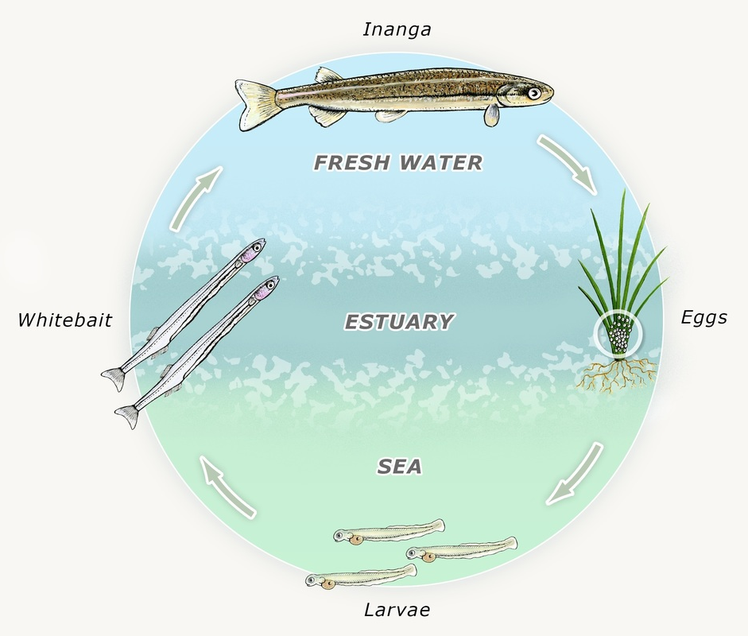
Purpose
In this webinar, we will:
highlight some important ideas about including mātauranga in the classroom
share mātauranga informed resources you can use in the classroom.
© Copyright. The University of Waikato Te Whare Wananga o Waikato l Science Learning Hub – Pokapū Akoranga Pūtaiao. All Rights Reserved
All images are copyrighted. For further information, please refer to enquiries@sciencelearn.org.nz
Notes:
www.sciencelearn.org.nz/images/463-inanga-life-cycle

Slide 6
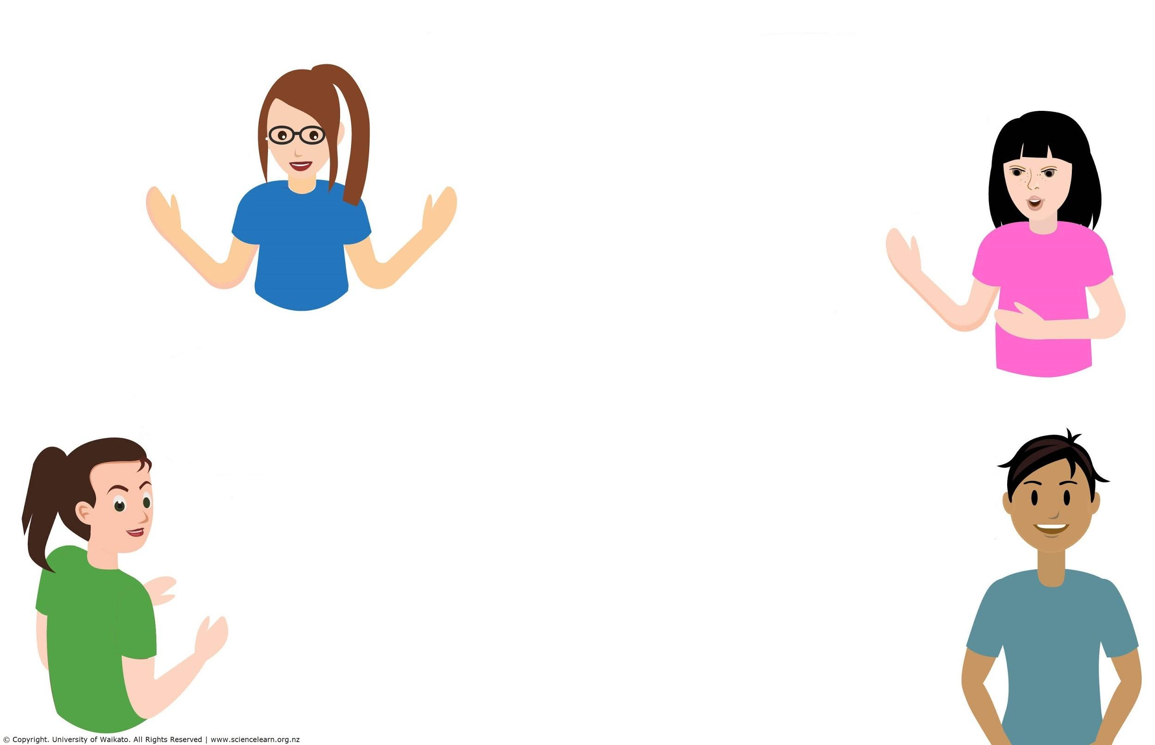
Participant questions
What resources are available?
How can we access local knowledge and stories?
I’m developing a rongoā unit – what are some of the things I should include?
How can I best help and encourage other science department members to have the confidence to go into this area. What resources could help me learn and deliver science from a Māori perspective?
What are some practical ways that mātautanga māori can be included in primary classroom programmes?
How do I include it with Environmental Education as an Enviro school?
I wish to know more about flora and fauna in Hauraki Plains, Hunuas, and Coromandel.
What themes can we use to engage children in Year 3 and 4?
How to work this in at ECE and new entrant levels.
© Copyright. The University of Waikato Te Whare Wananga o Waikato l Science Learning Hub – Pokapū Akoranga Pūtaiao. All Rights Reserved
All images are copyrighted. For further information, please refer to enquiries@sciencelearn.org.nz

Slide 7
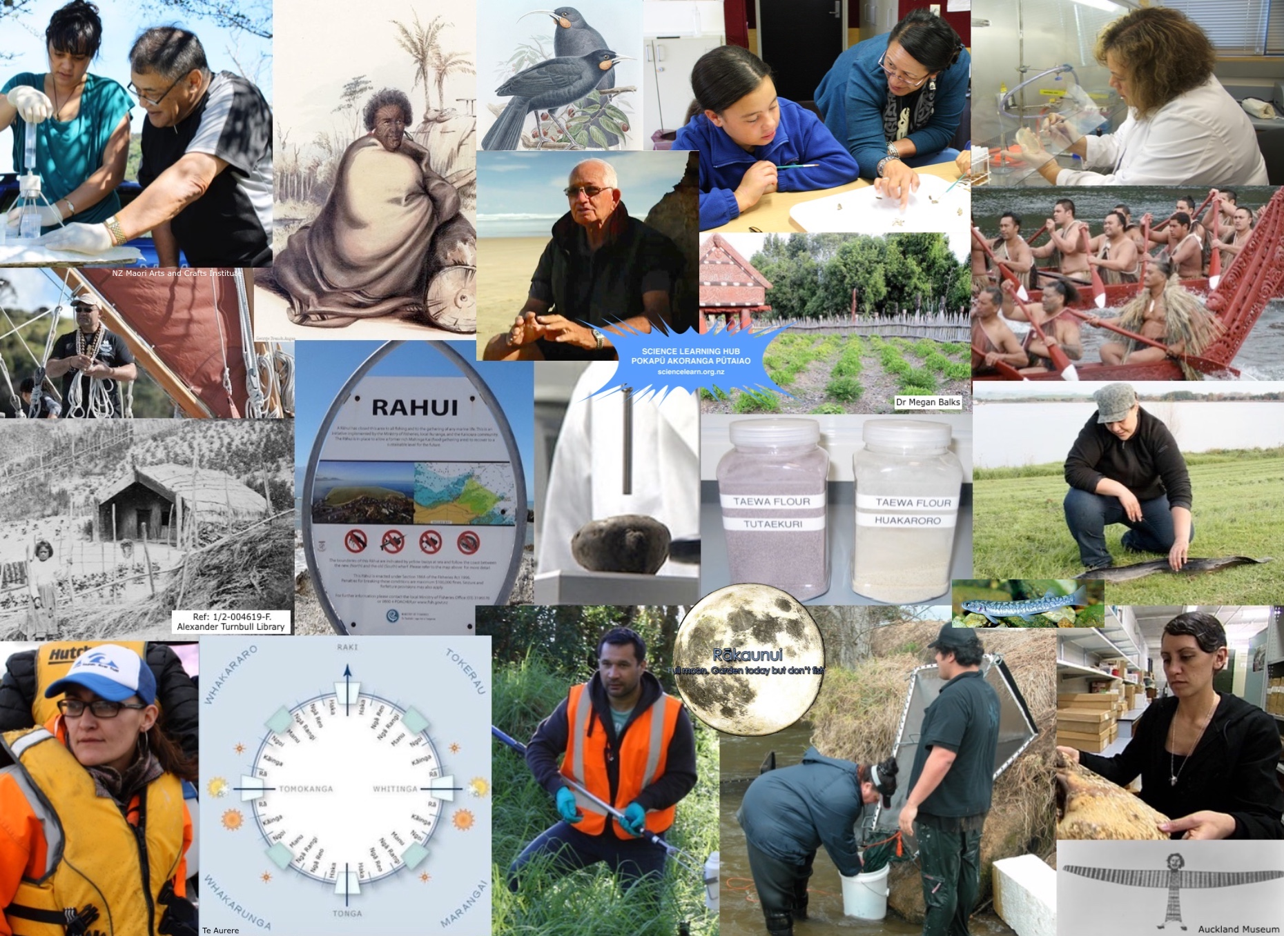
Exploring
mātauranga Māori
How can I best help and encourage other science department members to have the confidence to go into this area?
What resources could help me learn and deliver science from a Māori perspective?
© Copyright. The University of Waikato Te Whare Wananga o Waikato l Science Learning Hub – Pokapū Akoranga Pūtaiao. All Rights Reserved
All images are copyrighted. For further information, please refer to enquiries@sciencelearn.org.nz
Notes:
Mātauranga and Māori scientist Pinterest collection: www.pinterest.nz/nzsciencelearn/mātauranga-māori

Slide 8
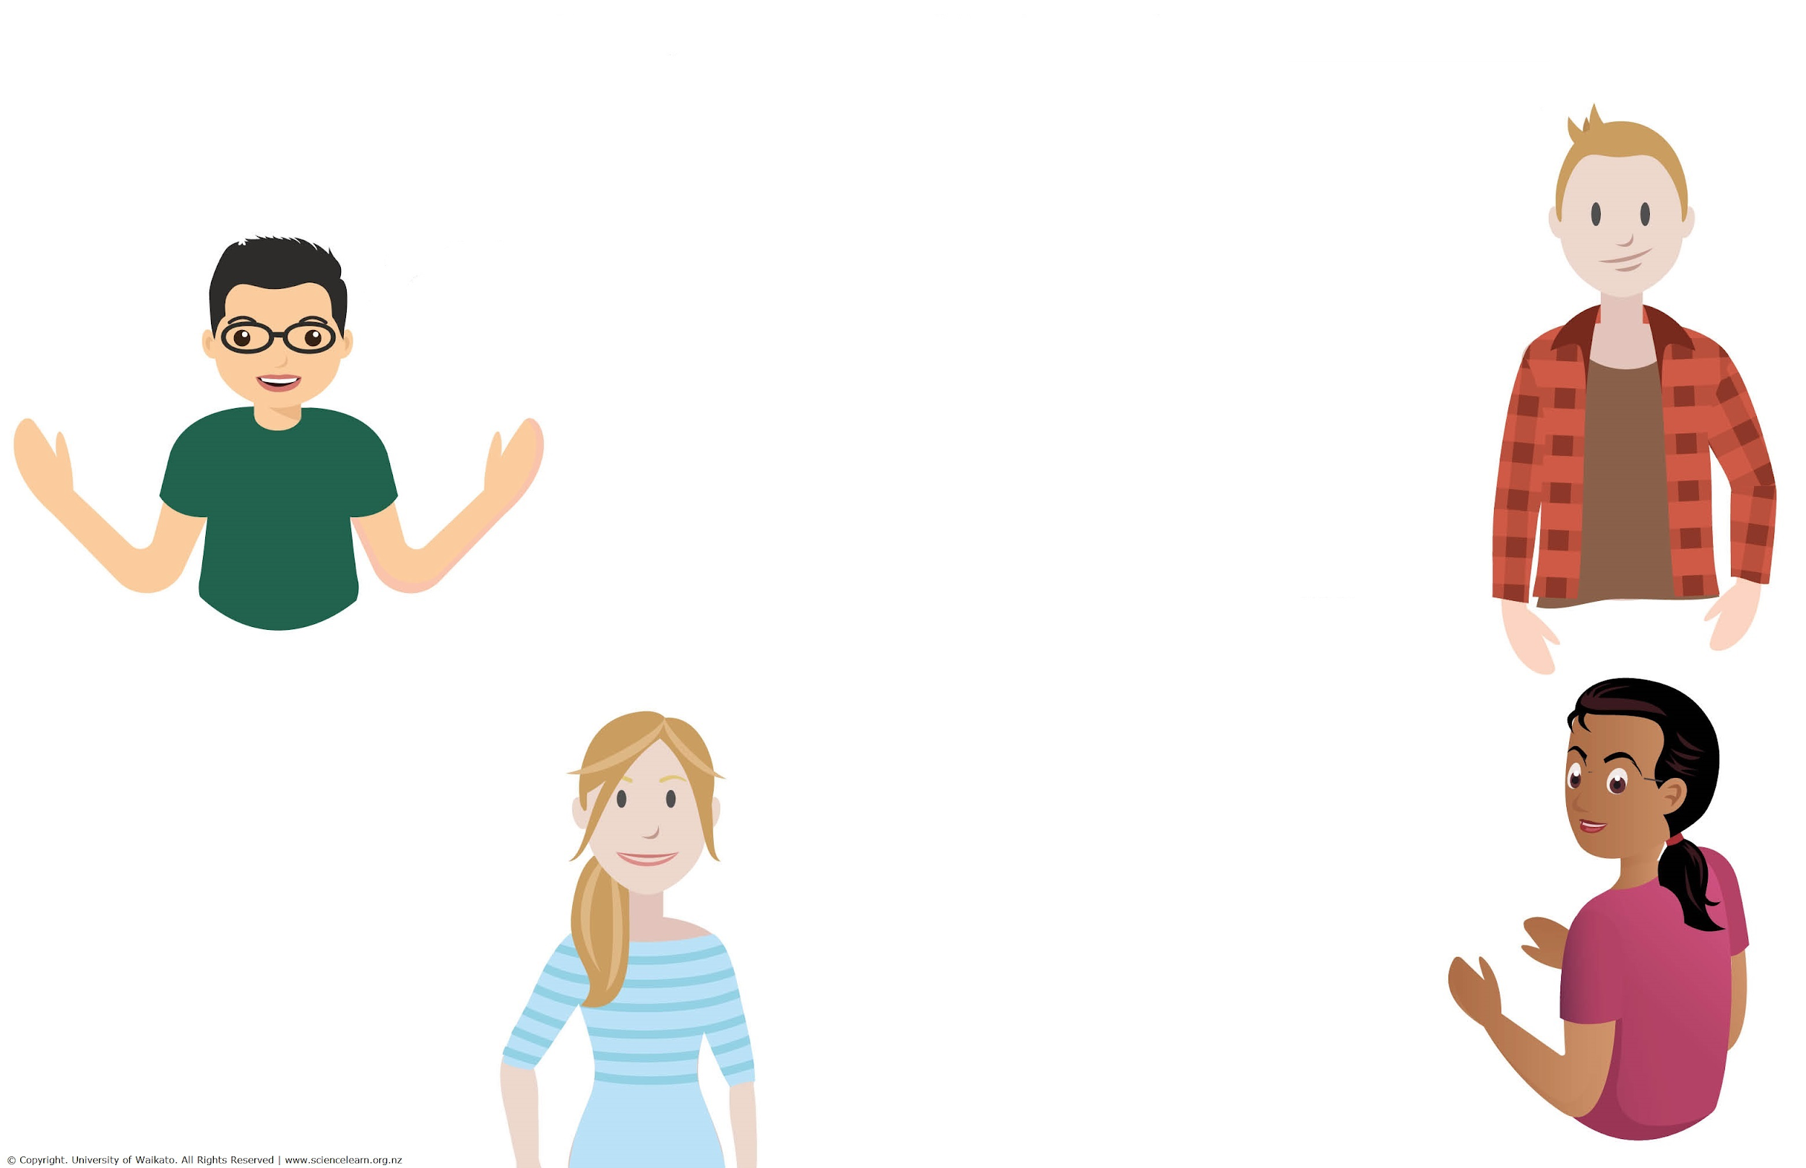
Exploring mātauranga Māori
What does it mean to you?
Science with a Māori context and perspectives
Traditional knowledge – connection with land, flora, fauna and natural cycles
Māori way of living, seeing and doing
A body of knowledge gathered by careful observation/analysis, often explained by a spiritual/holistic world view
Knowledge, concepts – mauri in biology – life force, health of an environment like a stream
© Copyright. The University of Waikato Te Whare Wananga o Waikato l Science Learning Hub – Pokapū Akoranga Pūtaiao. All Rights Reserved
All images are copyrighted. For further information, please refer to enquiries@sciencelearn.org.nz
Notes:
What is mātauranga Māori to you? Ideas collection from webinar participants.
This can be found at 3:35min in our webinar Mātauranga Māori www.sciencelearn.org.nz/resources/2801-matauranga-maori

Slide 9
Exploring
mātauranga Māori
“… Mātauranga Māori is something that incorporates all aspects of Māori world view, traditional knowledge, cultural knowledge, spiritual knowledge, values, all those systems that interrelate with each other to create a knowledge system …”
© Copyright. The University of Waikato Te Whare Wananga o Waikato l Science Learning Hub – Pokapū Akoranga Pūtaiao. All Rights Reserved
All images are copyrighted. For further information, please refer to enquiries@sciencelearn.org.nz
Notes:
Quote from Hēmi Whaanga

Slide 10
Yvonne Taura
Identifying a gap in regards to information, Waikato-Tainui approached and then collaborated with Manaaki Whenua on this publication — Te reo o te repo - The voice of the wetland: connections, understandings and learnings for the restoration of our wetlands / edited by Yvonne Taura, Cheri van Schravendijk-Goodman, Beverley Clarkson. -- Hamilton, NZ: Manaaki Whenua – Landcare Research and Waikato Raupatu River Trust, 2017.
Curious Minds He Hihiri i te Mahara/Crown Copyright
www.curiousminds.nz/profiles
© Copyright. The University of Waikato Te Whare Wananga o Waikato l Science Learning Hub – Pokapū Akoranga Pūtaiao. All Rights Reserved
All images are copyrighted. For further information, please refer to enquiries@sciencelearn.org.nz
Notes:
Yvonne Taura: www.curiousminds.nz/profiles/yvonne-taura/
Te Reo o te Repo: www.landcareresearch.co.nz/publications/books/te-reo-o-te-repo

Slide 11
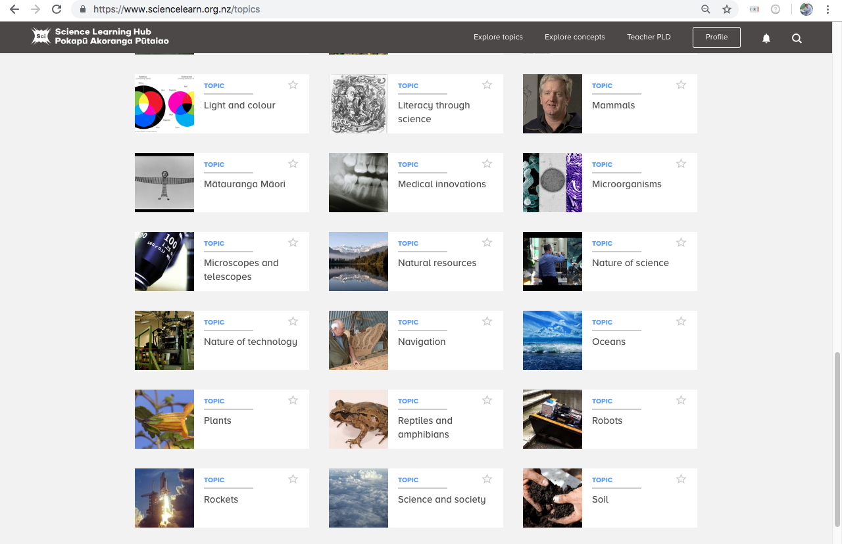
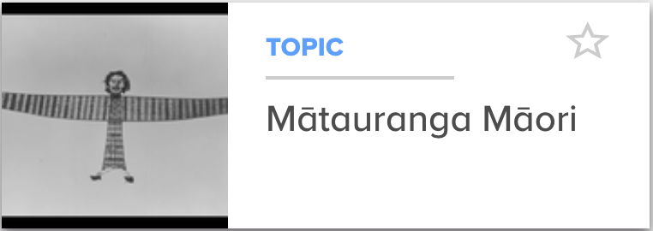
Mātauranga on the Hub
Auckland Museum
© Copyright. The University of Waikato Te Whare Wananga o Waikato l Science Learning Hub – Pokapū Akoranga Pūtaiao. All Rights Reserved
All images are copyrighted. For further information, please refer to enquiries@sciencelearn.org.nz
Notes:
Topic: www.sciencelearn.org.nz/topics/mātauranga-māori
Article: www.sciencelearn.org.nz/resources/2545-matauranga-maori-and-science

Slide 12
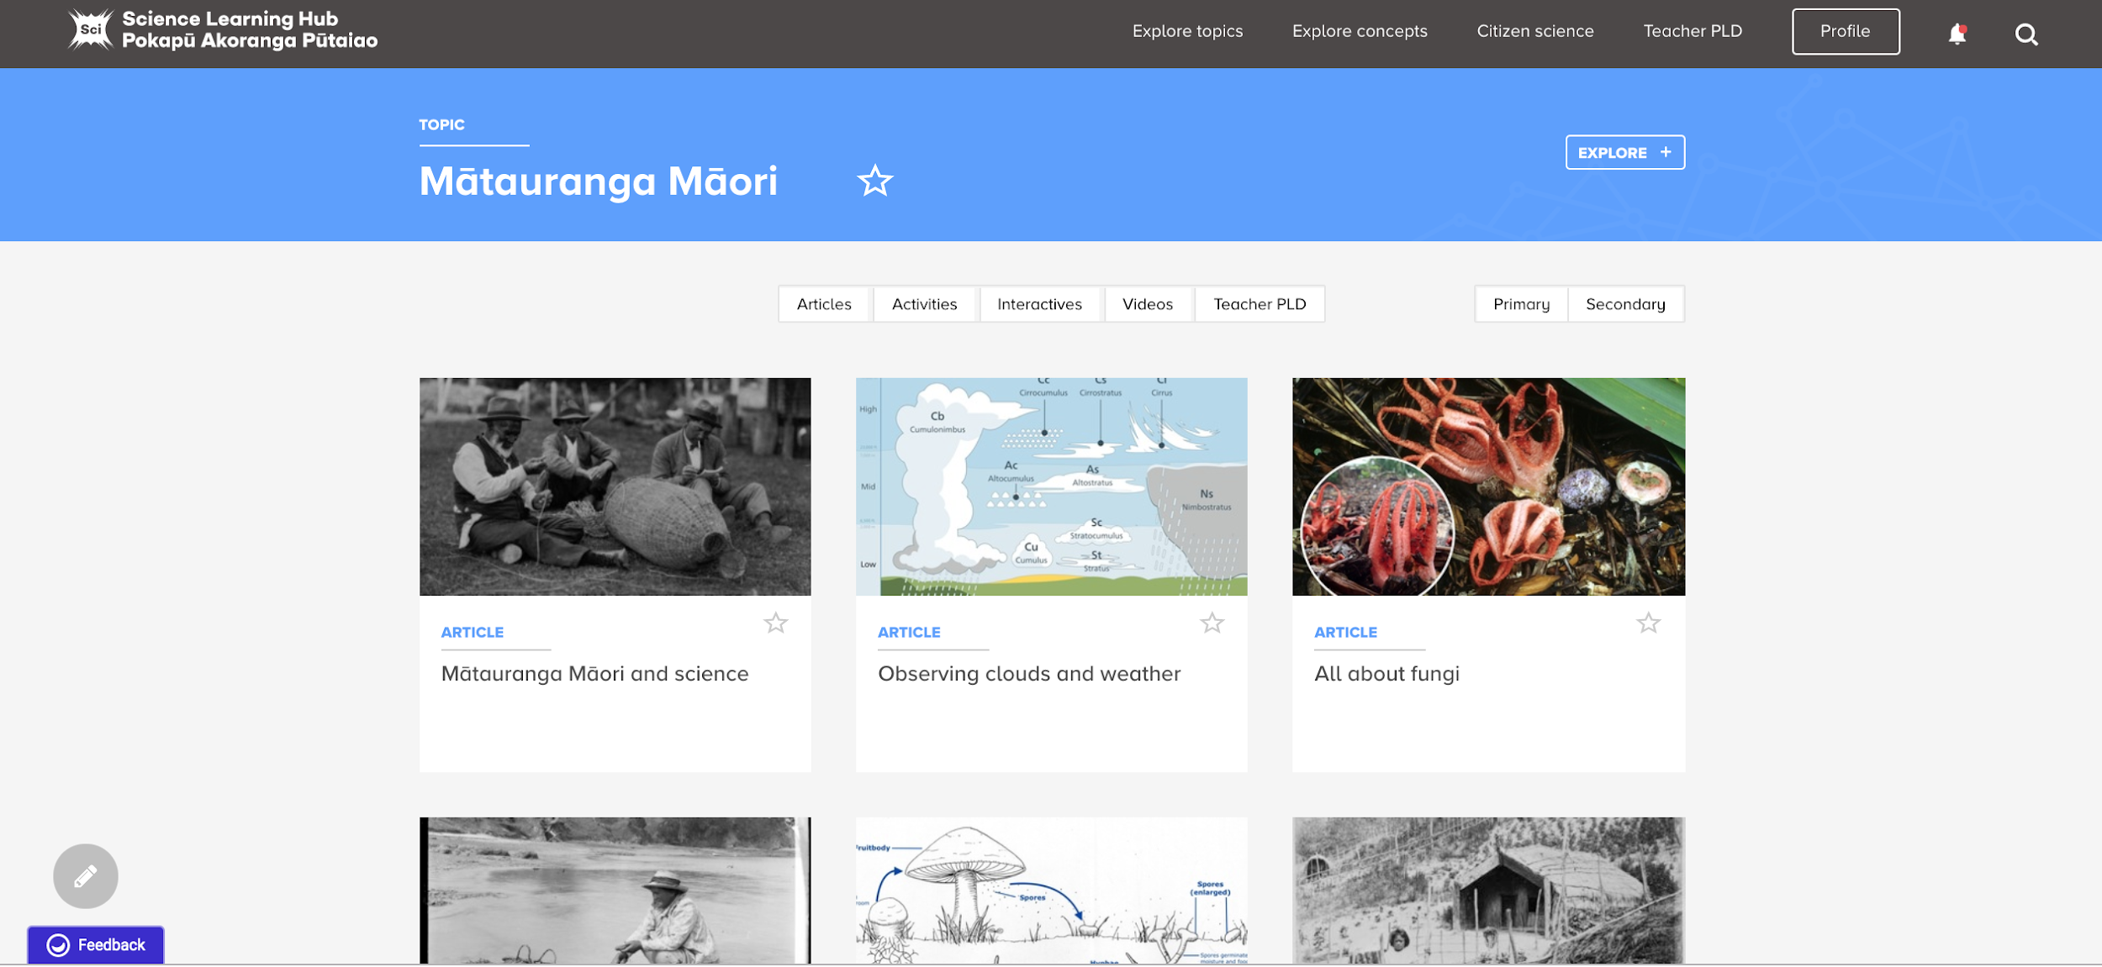
Mātauranga on the Hub
© Copyright. The University of Waikato Te Whare Wananga o Waikato l Science Learning Hub – Pokapū Akoranga Pūtaiao. All Rights Reserved
All images are copyrighted. For further information, please refer to enquiries@sciencelearn.org.nz

Slide 13
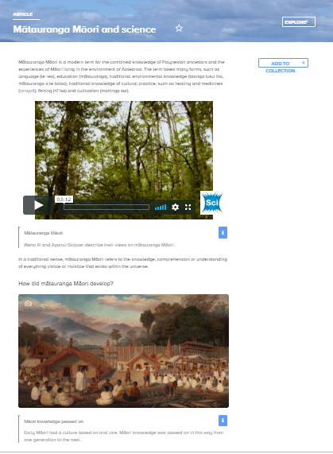
Science and mātauranga
Auckland Art Gallery – Toi o Tāmaki Reference: 1923/3 Oil on canvas by Sam Stuart
© Copyright. The University of Waikato Te Whare Wananga o Waikato l Science Learning Hub – Pokapū Akoranga Pūtaiao. All Rights Reserved
All images are copyrighted. For further information, please refer to enquiries@sciencelearn.org.nz
Notes:
Article: www.sciencelearn.org.nz/resources/2545-matauranga-maori-and-science

Slide 14
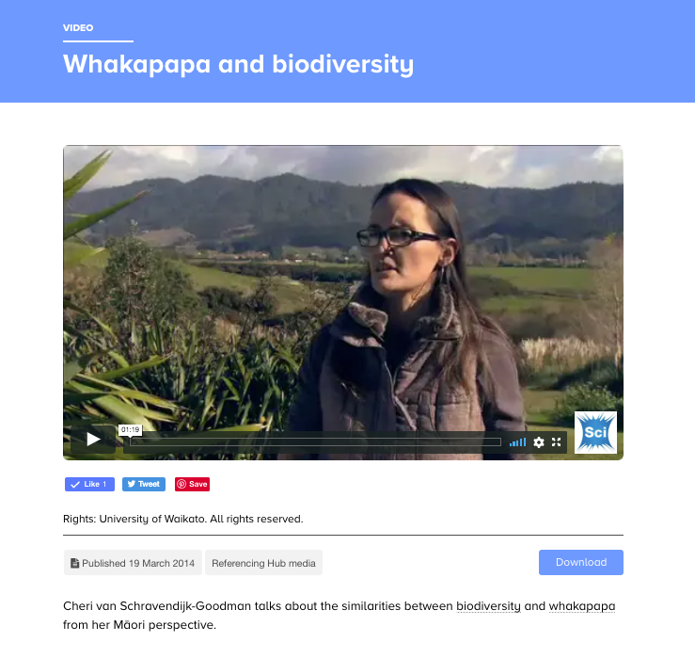
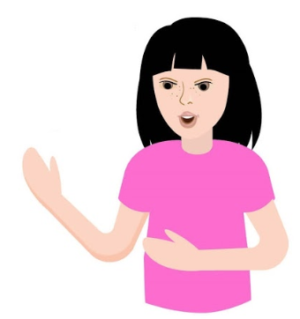
Whakapapa
What themes can we use to engage children in Year 3 & 4?
How to work this in at ECE and new entrant levels.
© Copyright. The University of Waikato Te Whare Wananga o Waikato l Science Learning Hub – Pokapū Akoranga Pūtaiao. All Rights Reserved
All images are copyrighted. For further information, please refer to enquiries@sciencelearn.org.nz
Notes:
Video: www.sciencelearn.org.nz/videos/258-whakapapa-and-biodiversity

Slide 15
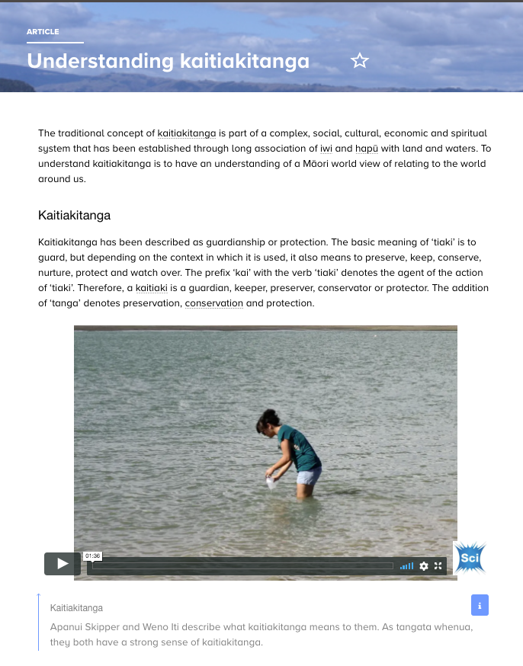
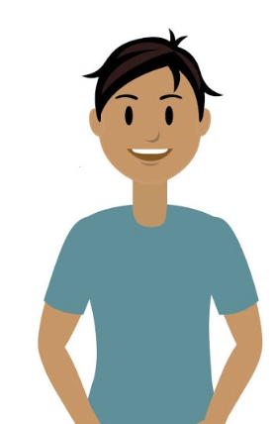
Kaitiakitanga
How do I include it with Environmental Education as an Enviro school?
© Copyright. The University of Waikato Te Whare Wananga o Waikato l Science Learning Hub – Pokapū Akoranga Pūtaiao. All Rights Reserved
All images are copyrighted. For further information, please refer to enquiries@sciencelearn.org.nz
Notes:
Article: www.sciencelearn.org.nz/resources/2544-understanding-kaitiakitanga

Slide 16
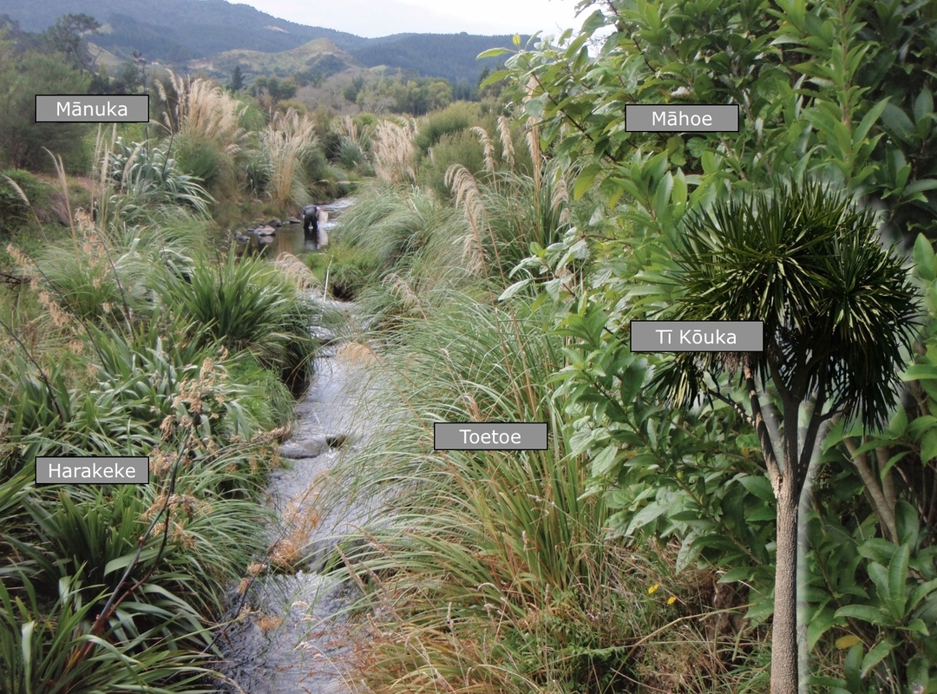
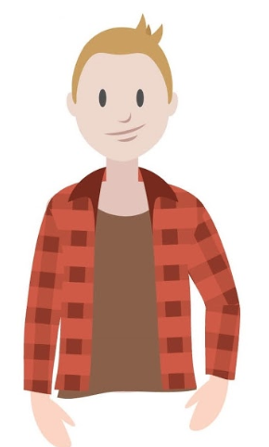
I wish to know more about flora and fauna in Hauraki Plains, Hunuas, and Coromandel
© Rob Davies-Colley, NIWA
© Copyright. The University of Waikato Te Whare Wananga o Waikato l Science Learning Hub – Pokapū Akoranga Pūtaiao. All Rights Reserved
All images are copyrighted. For further information, please refer to enquiries@sciencelearn.org.nz
Notes:
www.waikatoregion.govt.nz/assets/PageFiles/20481/TR%202010-36.pdf
Te Ara: https://teara.govt.nz/en/hauraki-coromandel-region/page-3
https://teara.govt.nz/en/interactive/30365/vegetation-in-the-lower-waihou-valley-before-human-settlement
Manaaki Whenua
Fungi: www.landcareresearch.co.nz/science/portfolios/defining-land-biota/fungi/distribution-and-ecology/site-restoration
Landcare Trust: www.landcare.org.nz/region-item/waikato
What to plant: www.waikatoregion.govt.nz/assets/WRC/Environment/Natural-Resources/Biodiversity/planting-guides/WRC-Coromandel-planting-guide-part1.pdf

Slide 17
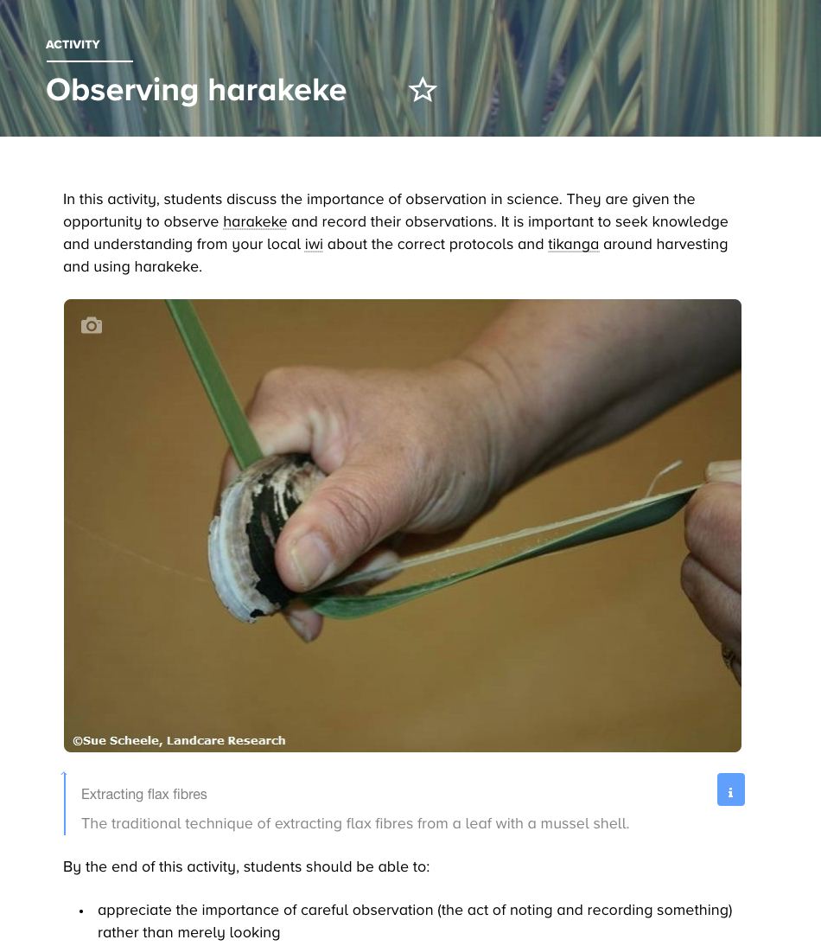
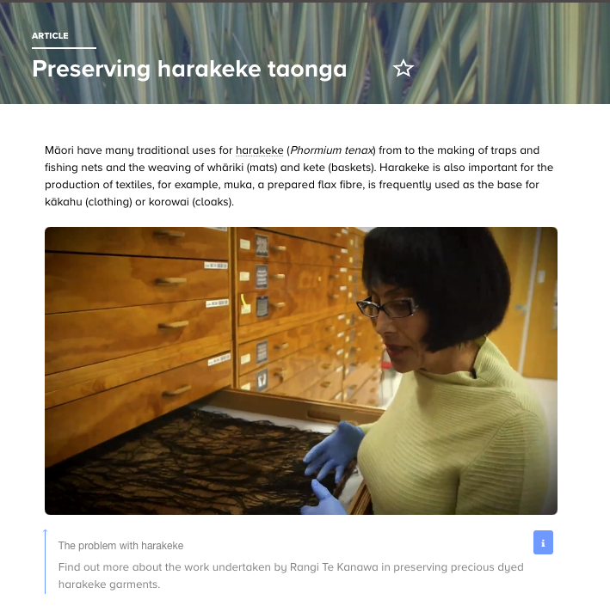
Harakeke
© Scottie Productions
© Copyright. The University of Waikato Te Whare Wananga o Waikato l Science Learning Hub – Pokapū Akoranga Pūtaiao. All Rights Reserved
All images are copyrighted. For further information, please refer to enquiries@sciencelearn.org.nz
Notes:
www.sciencelearn.org.nz/resources/519-observing-harakeke
www.sciencelearn.org.nz/videos/295-exploring-harakeke-on-the-sem
www.sciencelearn.org.nz/videos/659-the-problem-with-harakeke
www.sciencelearn.org.nz/resources/1271-preserving-harakeke-taonga

Slide 18
Yvonne Taura
Identifying a gap in regards to information, Waikato-Tainui approached and then collaborated with Manaaki Whenua on this publication — Te reo o te repo - The voice of the wetland: connections, understandings and learnings for the restoration of our wetlands / edited by Yvonne Taura, Cheri van Schravendijk-Goodman, Beverley Clarkson. -- Hamilton, NZ: Manaaki Whenua – Landcare Research and Waikato Raupatu River Trust, 2017.
Curious Minds He Hihiri i te Mahara/Crown Copyright
www.curiousminds.nz/profiles
© Copyright. The University of Waikato Te Whare Wananga o Waikato l Science Learning Hub – Pokapū Akoranga Pūtaiao. All Rights Reserved
All images are copyrighted. For further information, please refer to enquiries@sciencelearn.org.nz
Notes:
Yvonne Taura: www.curiousminds.nz/profiles/yvonne-taura/
Te Reo o te Repo: www.landcareresearch.co.nz/publications/books/te-reo-o-te-repo

Slide 19
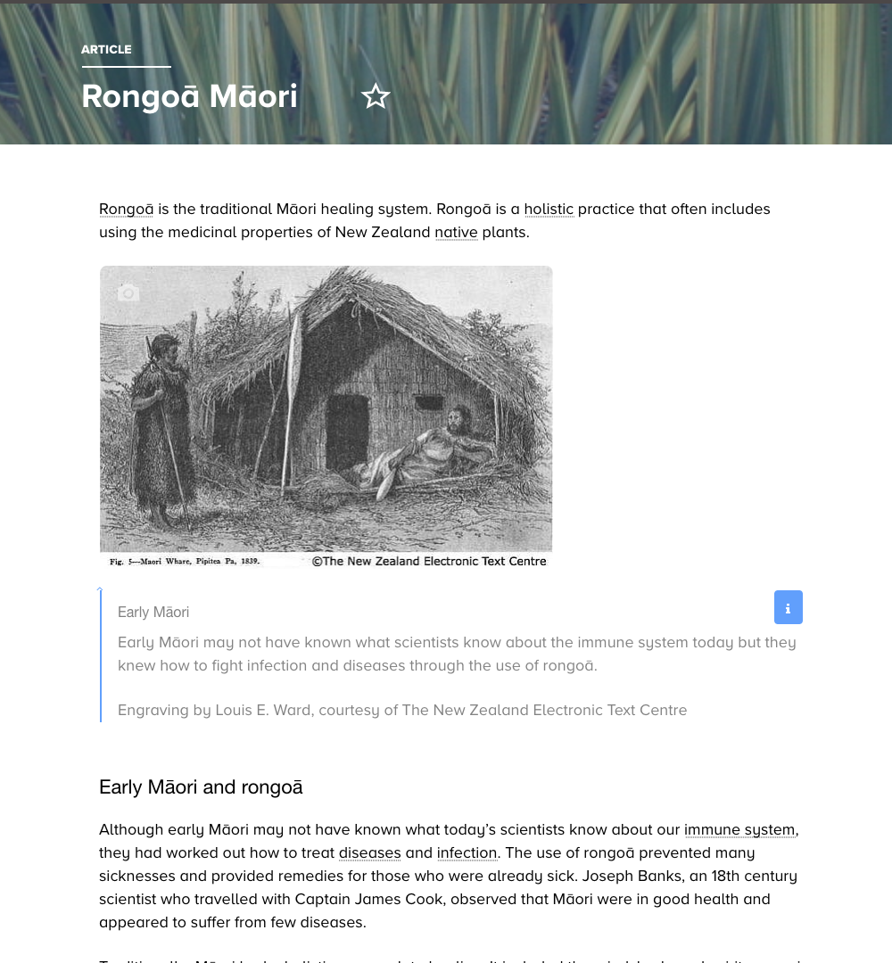
Science Learning Hub resources
Rongoā
I’m developing a rongoā unit – what are some of the things I should include?
© Copyright. The University of Waikato Te Whare Wananga o Waikato l Science Learning Hub – Pokapū Akoranga Pūtaiao. All Rights Reserved
All images are copyrighted. For further information, please refer to enquiries@sciencelearn.org.nz
Notes:
Article: www.sciencelearn.org.nz/resources/185-rongoa-maori
Manaaki Whenua: https://maoriplantuse.landcareresearch.co.nz/WebForms/default.aspx

Slide 20
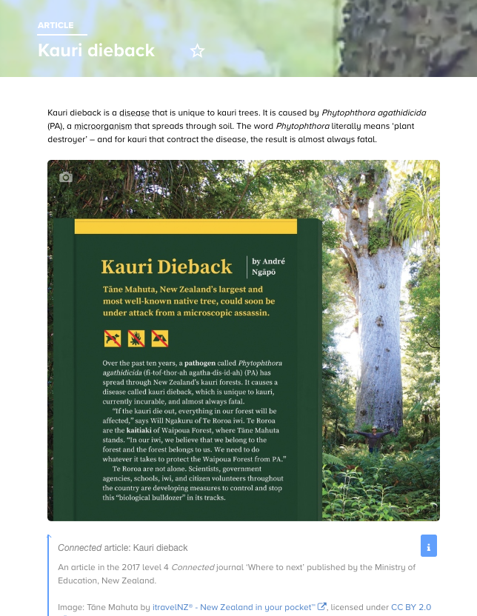
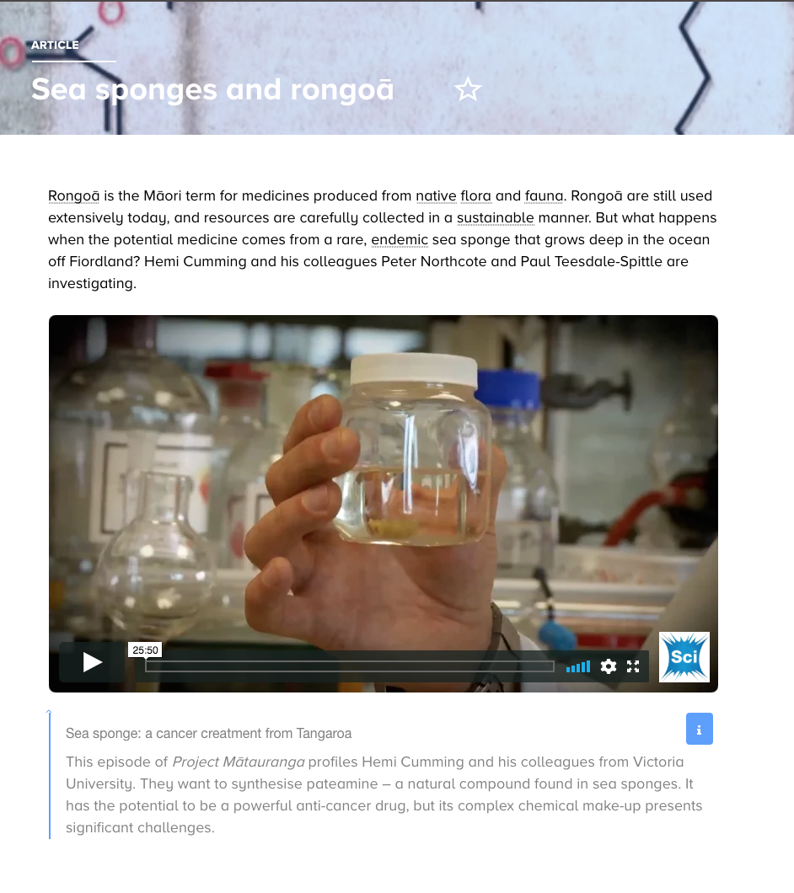
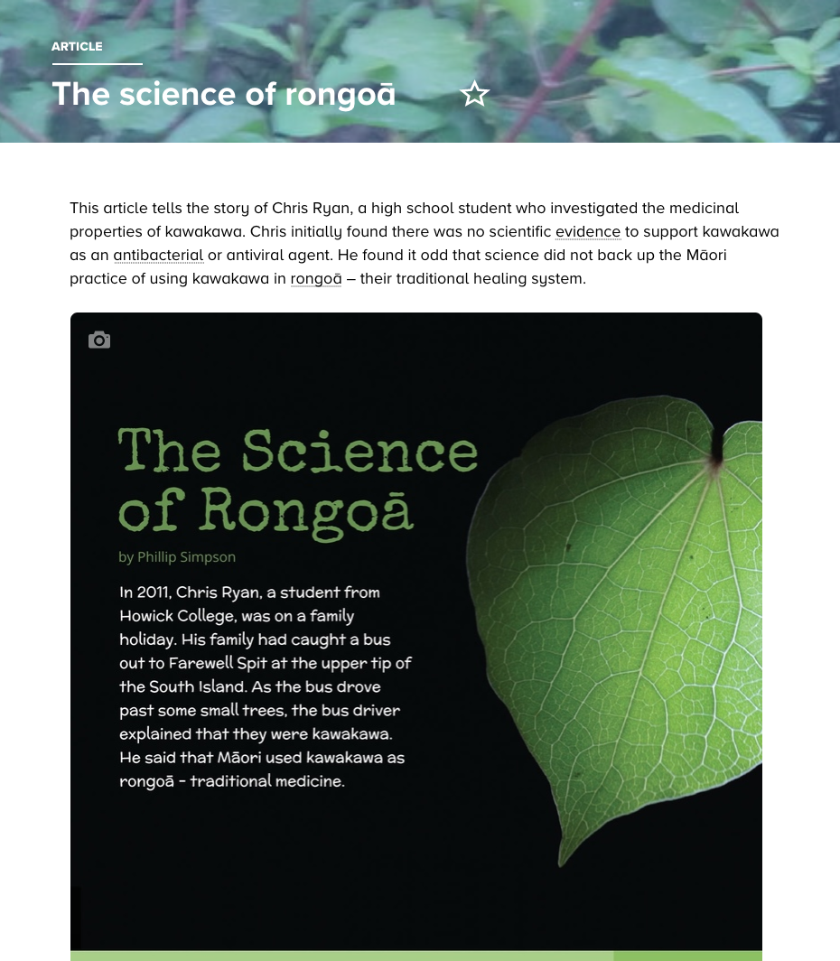
Science Learning Hub resources
Rongoā
© Scottie Productions
Photograph by Simon Waterfield/Crown Copyright
© Copyright. The University of Waikato Te Whare Wananga o Waikato l Science Learning Hub – Pokapū Akoranga Pūtaiao. All Rights Reserved
All images are copyrighted. For further information, please refer to enquiries@sciencelearn.org.nz
Notes:
Kauri dieback and mātauanga: www.sciencelearn.org.nz/resources/2831-kauri-dieback-and-matauranga-maori
Sea sponges: www.sciencelearn.org.nz/resources/1593-sea-sponges-and-rongoa
Connected journal: www.sciencelearn.org.nz/resources/2822-the-science-of-rongoa

Slide 21
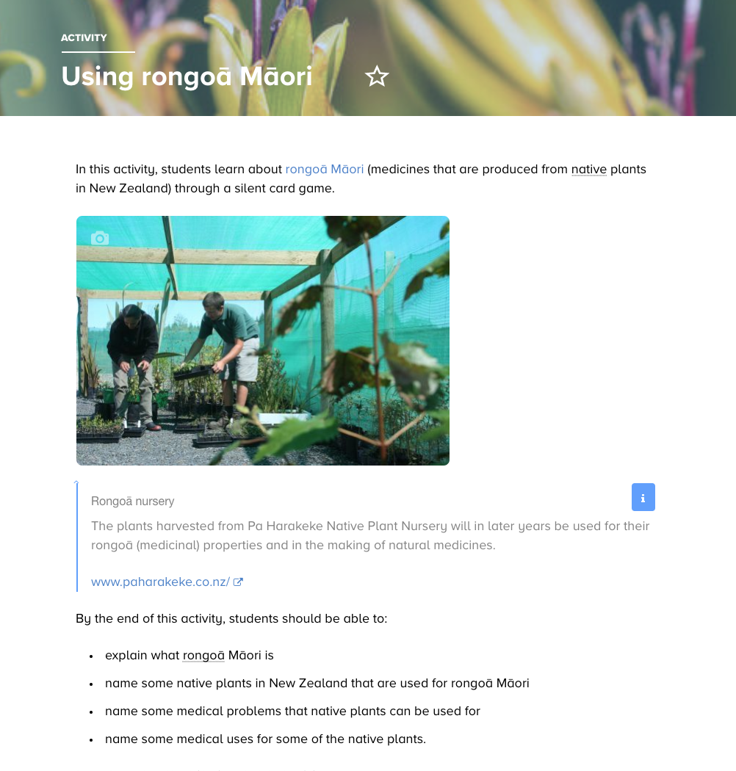
© Copyright. The University of Waikato Te Whare Wananga o Waikato l Science Learning Hub – Pokapū Akoranga Pūtaiao. All Rights Reserved
All images are copyrighted. For further information, please refer to enquiries@sciencelearn.org.nz
Notes:
Activity: www.sciencelearn.org.nz/resources/197-using-rongoa-maori

Slide 22
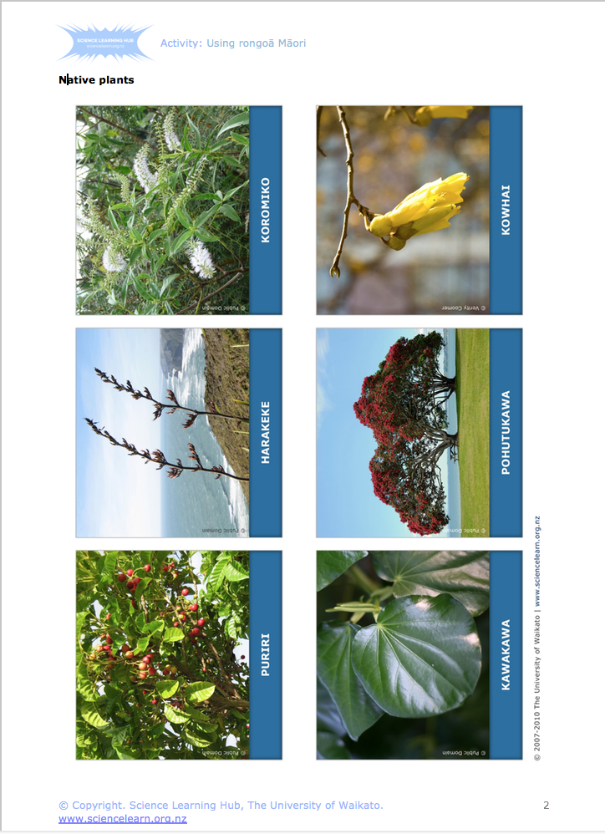
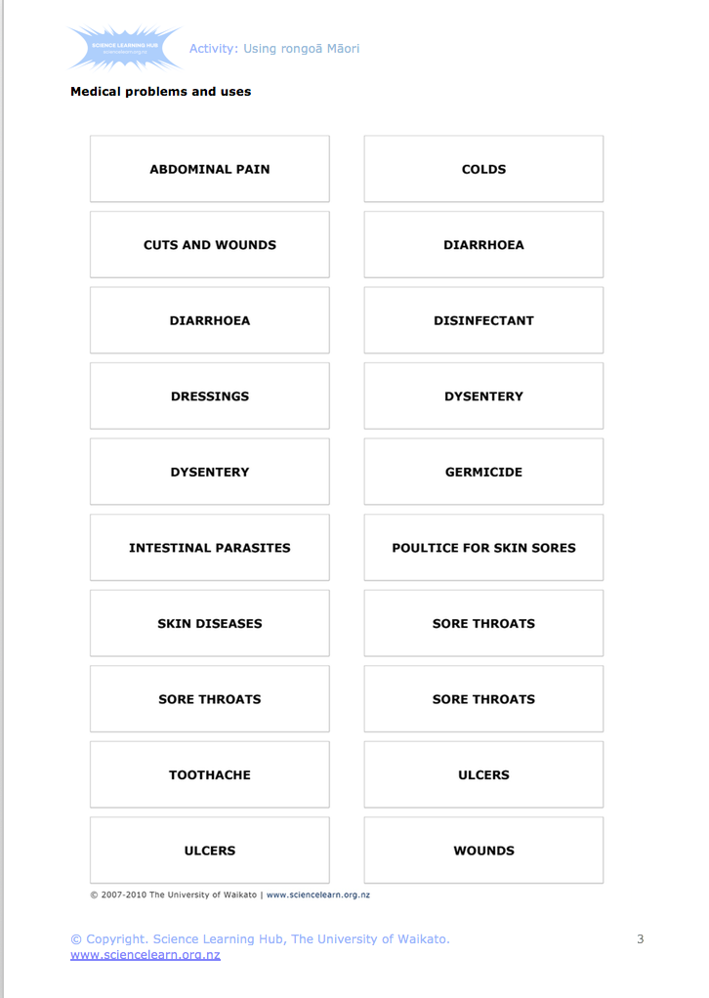
Science Learning Hub resources
Rongoā
© Copyright. The University of Waikato Te Whare Wananga o Waikato l Science Learning Hub – Pokapū Akoranga Pūtaiao. All Rights Reserved
All images are copyrighted. For further information, please refer to enquiries@sciencelearn.org.nz
Notes:
Activity: www.sciencelearn.org.nz/resources/197-using-rongoa-maori

Slide 23
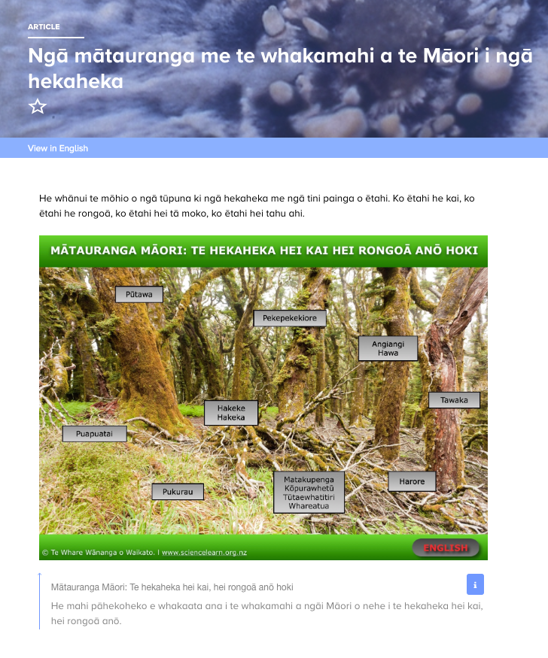
Science Learning Hub resources
Ngā Hekaheka o Aotearoa
© Manaaki Whenua – Landcare Research
© Copyright. The University of Waikato Te Whare Wananga o Waikato l Science Learning Hub – Pokapū Akoranga Pūtaiao. All Rights Reserved
All images are copyrighted. For further information, please refer to enquiries@sciencelearn.org.nz
Notes:
www.sciencelearn.org.nz/images/3711-nga-hekaheka-o-aotearoa
www.sciencelearn.org.nz/resources/2669-nga-matauranga-me-te-whakamahi-a-te-maori-i-nga-hekaheka

Slide 24
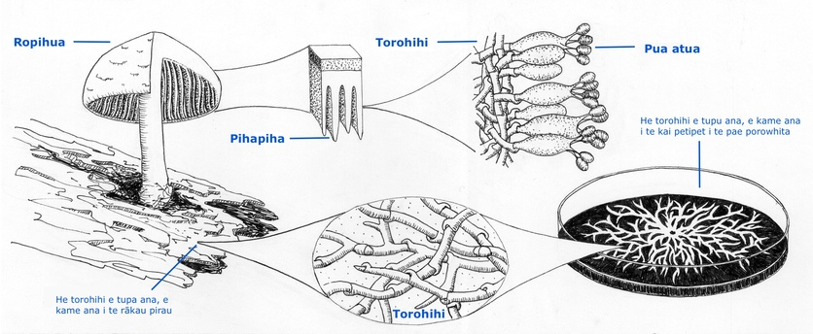
Science Learning Hub resources
Ngā Hekaheka o Aotearoa
© Manaaki Whenua – Landcare Research
© Copyright. The University of Waikato Te Whare Wananga o Waikato l Science Learning Hub – Pokapū Akoranga Pūtaiao. All Rights Reserved
All images are copyrighted. For further information, please refer to enquiries@sciencelearn.org.nz
Notes:
Image: www.sciencelearn.org.nz/images/3688-torohihi

Slide 25
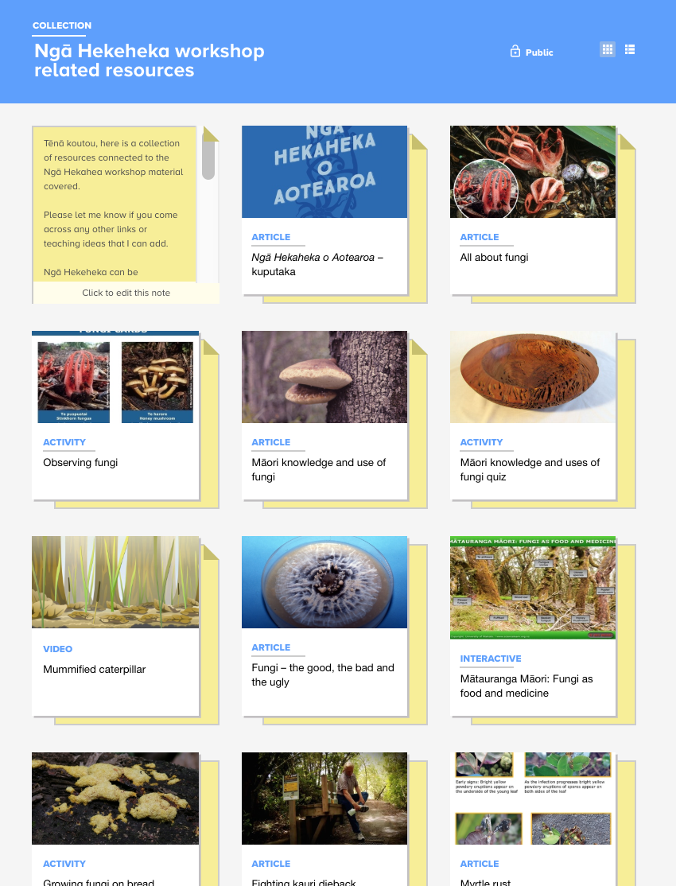
Science Learning Hub resources
Ngā Hekaheka o Aotearoa
© Copyright. The University of Waikato Te Whare Wananga o Waikato l Science Learning Hub – Pokapū Akoranga Pūtaiao. All Rights Reserved
All images are copyrighted. For further information, please refer to enquiries@sciencelearn.org.nz
Notes:
https://www.sciencelearn.org.nz/collections/shared/0159ae30e9e27cf5b67eb1f096073898

Slide 26
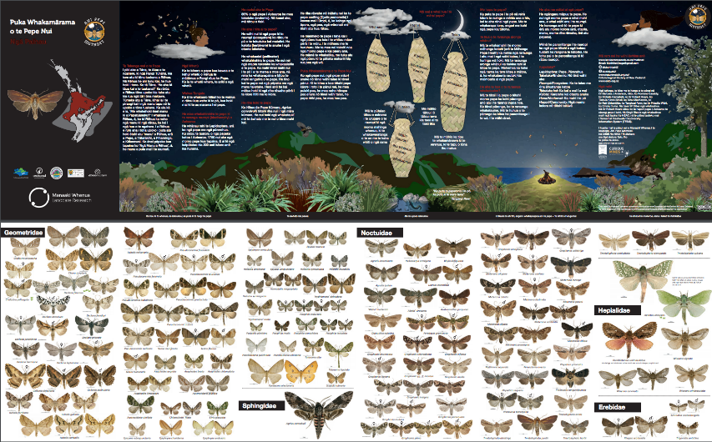
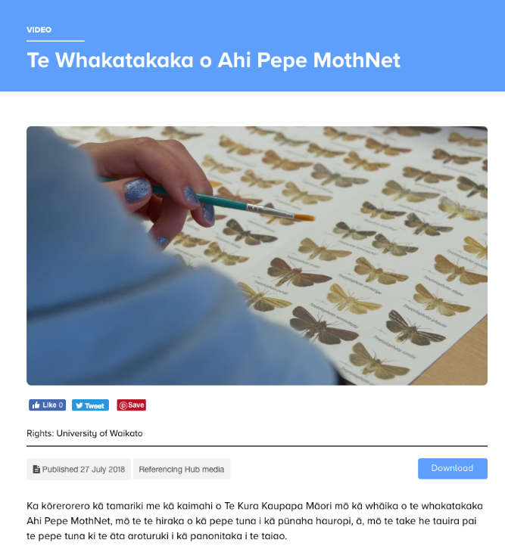
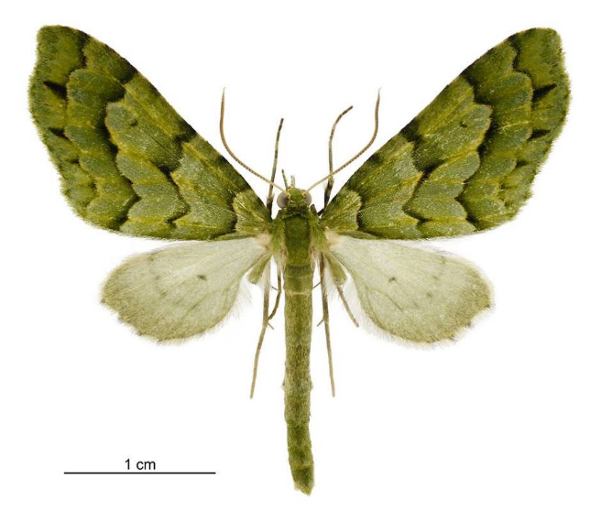
Science Learning Hub resources
Ahi Pepe Mothnet
© Manaaki Whenua – Landcare Research
© Steve Hathaway
© Manaaki Whenua — Landcare Research
© Copyright. The University of Waikato Te Whare Wananga o Waikato l Science Learning Hub – Pokapū Akoranga Pūtaiao. All Rights Reserved
All images are copyrighted. For further information, please refer to enquiries@sciencelearn.org.nz
Notes:
www.sciencelearn.org.nz/videos/1834-te-whakatakaka-o-ahi-pepe-mothnet
Puka Whakamārama o Te Pepe Nui – moth identification guides – have been sent to New Zealand schools and are available for download.

Slide 27
Classroom ideas
© Copyright. The University of Waikato Te Whare Wananga o Waikato l Science Learning Hub – Pokapū Akoranga Pūtaiao. All Rights Reserved
All images are copyrighted. For further information, please refer to enquiries@sciencelearn.org.nz

Slide 28
Keep in touch
Email us enquiries@sciencelearn.org.nz
https://twitter.com/NZScienceLearn
www.facebook.com/nzsciencelearn
https://nz.pinterest.com/nzsciencelearn
www.instagram.com/sciencelearninghubnz
Join us in our discussion channel on Slack.
(Any problems accessing Slack, please contact us via our enquiries email, enquiries@sciencelearn.org.nz.)
© Copyright. The University of Waikato Te Whare Wananga o Waikato l Science Learning Hub – Pokapū Akoranga Pūtaiao. All Rights Reserved
All images are copyrighted. For further information, please refer to enquiries@sciencelearn.org.nz
Notes:
Don’t forget the SLH can help
SLACK: https://slh-talk.slack.com/messages/CDL529ERW/

Slide 29
The Science Learning Hub
would like to Yvonne Taura from
Manaaki Whenua.
© Copyright. The University of Waikato Te Whare Wananga o Waikato l Science Learning Hub – Pokapū Akoranga Pūtaiao. All Rights Reserved
All images are copyrighted. For further information, please refer to enquiries@sciencelearn.org.nz

