Slide 1
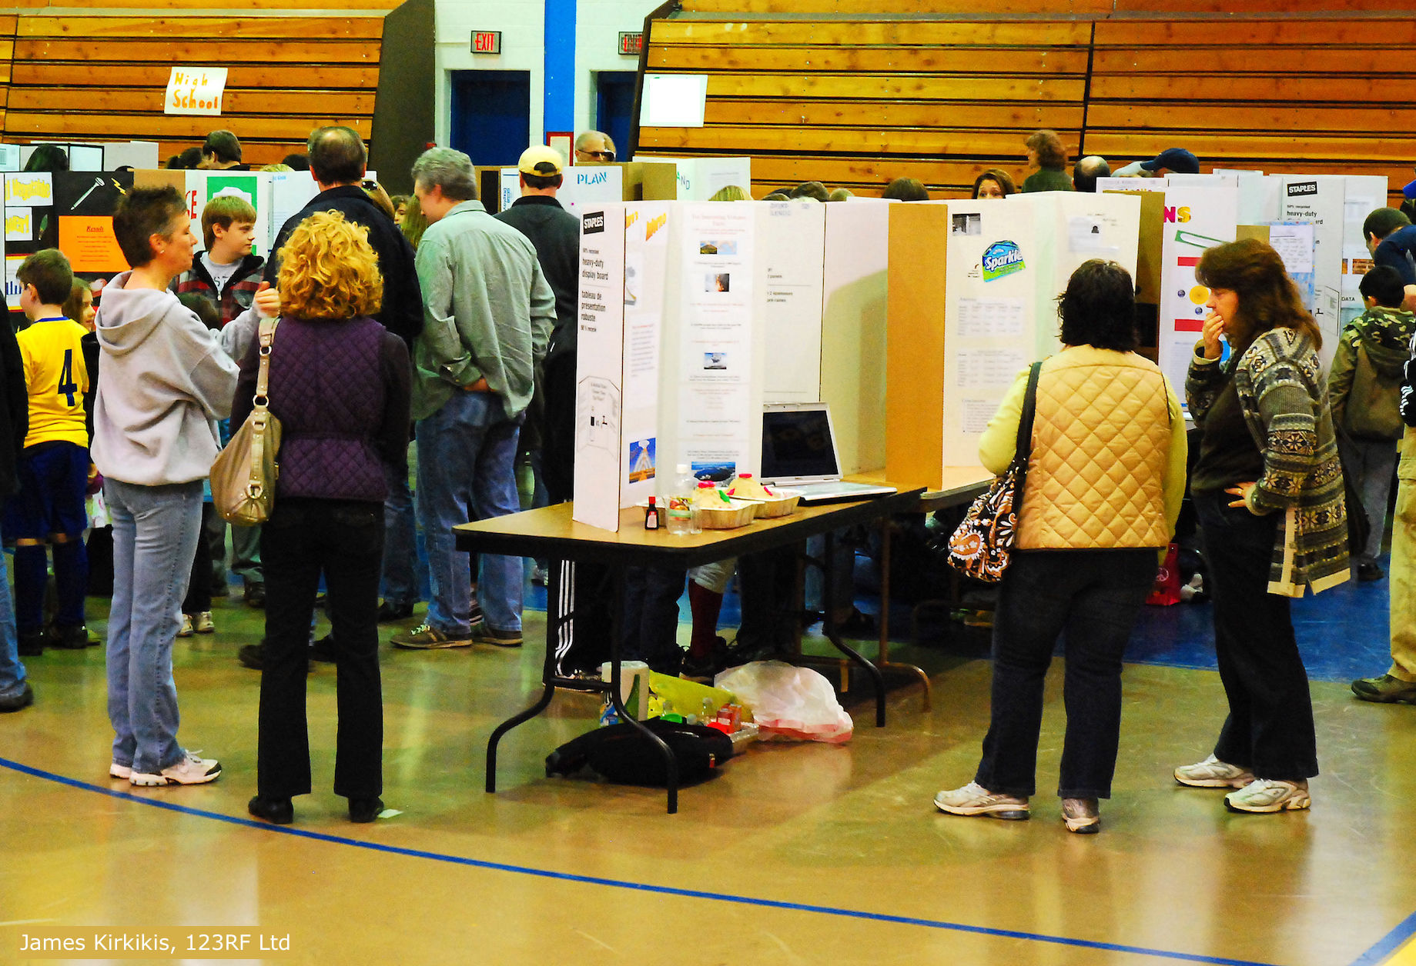
Flipping science fairs
4–4:45 pm Thursday 20 February
© Copyright. The University of Waikato Te Whare Wananga o Waikato l Science Learning Hub – Pokapū Akoranga Pūtaiao. All Rights Reserved
All images are copyrighted. For further information, please refer to enquiries@sciencelearn.org.nz

Slide 2
Pokapū Akoranga Pūtaiao
The Science Learning Hub
A trustworthy online resource – produced by educators and scientists for New Zealand teachers and students.
Based on world-class New Zealand science research.
Supported by learning activities, information about the key science ideas and concepts, multimedia tools and other resources.
© Copyright. The University of Waikato Te Whare Wananga o Waikato l Science Learning Hub – Pokapū Akoranga Pūtaiao. All Rights Reserved
All images are copyrighted. For further information, please refer to enquiries@sciencelearn.org.nz
Notes:
The SLH is funded by the New Zealand Government – MBIE Ministry of Business, Innovation and Employment – under the Curious Minds fund

Slide 3
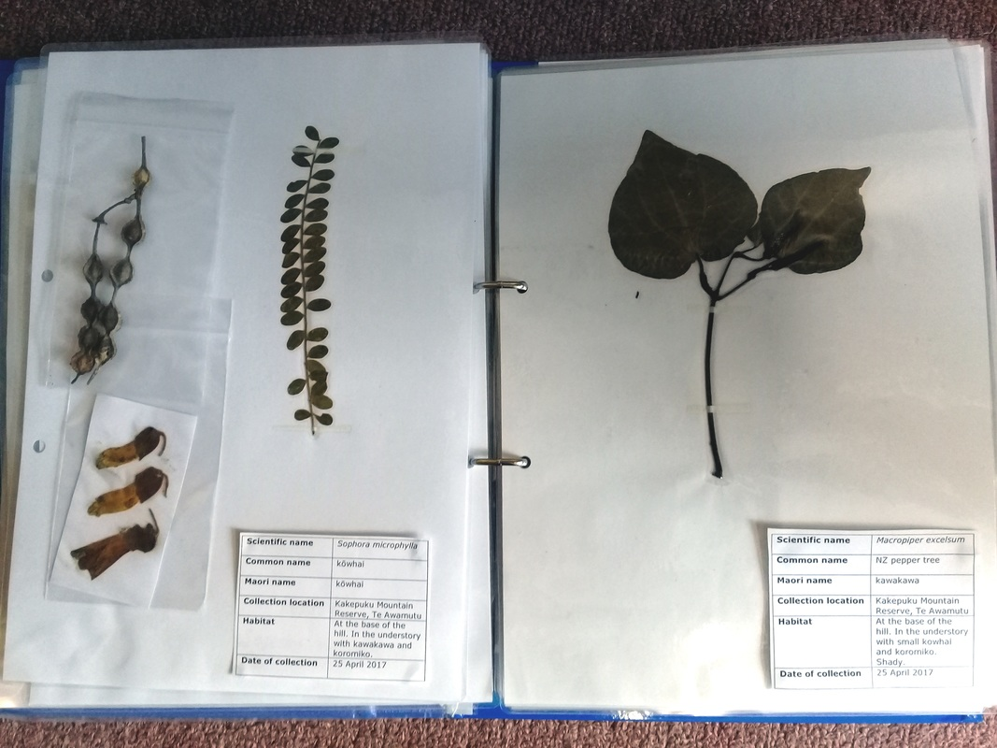
Purpose
In this webinar, we will:
share ideas on how to flip science fairs
explore important components for ensuring quality learning
link to the science capabilities and nature of science
share inspiring outcomes.
© Copyright. The University of Waikato Te Whare Wananga o Waikato l Science Learning Hub – Pokapū Akoranga Pūtaiao. All Rights Reserved
All images are copyrighted. For further information, please refer to enquiries@sciencelearn.org.nz
Notes:
Image: www.sciencelearn.org.nz/images/3551-life-size-leaf-collection

Slide 4
Index
Topic | Slideshow number(s) | Video timecode
Introducing the Science Learning Hub and presenters | 1–2 | 00:00
Purpose | 3 | 01:49
Index | 4 | 02:29
What is the purpose of science fair? | 5–7 | 02:41
Health, safety and ethics | 8 | 08:55
Finding a good fit | 9 | 12:29
What’s in a name? | 10 | 25:31
Figuring out what project to do | 11–13 | 28:14
Planning and useful tools | 14–17 | 36:36
Get inspired | 18–19 | 41:28
SLH links, keep in touch and thanks | 20 | 41:40
© Copyright. The University of Waikato Te Whare Wananga o Waikato l Science Learning Hub – Pokapū Akoranga Pūtaiao. All Rights Reserved
All images are copyrighted. For further information, please refer to enquiries@sciencelearn.org.nz

Slide 5
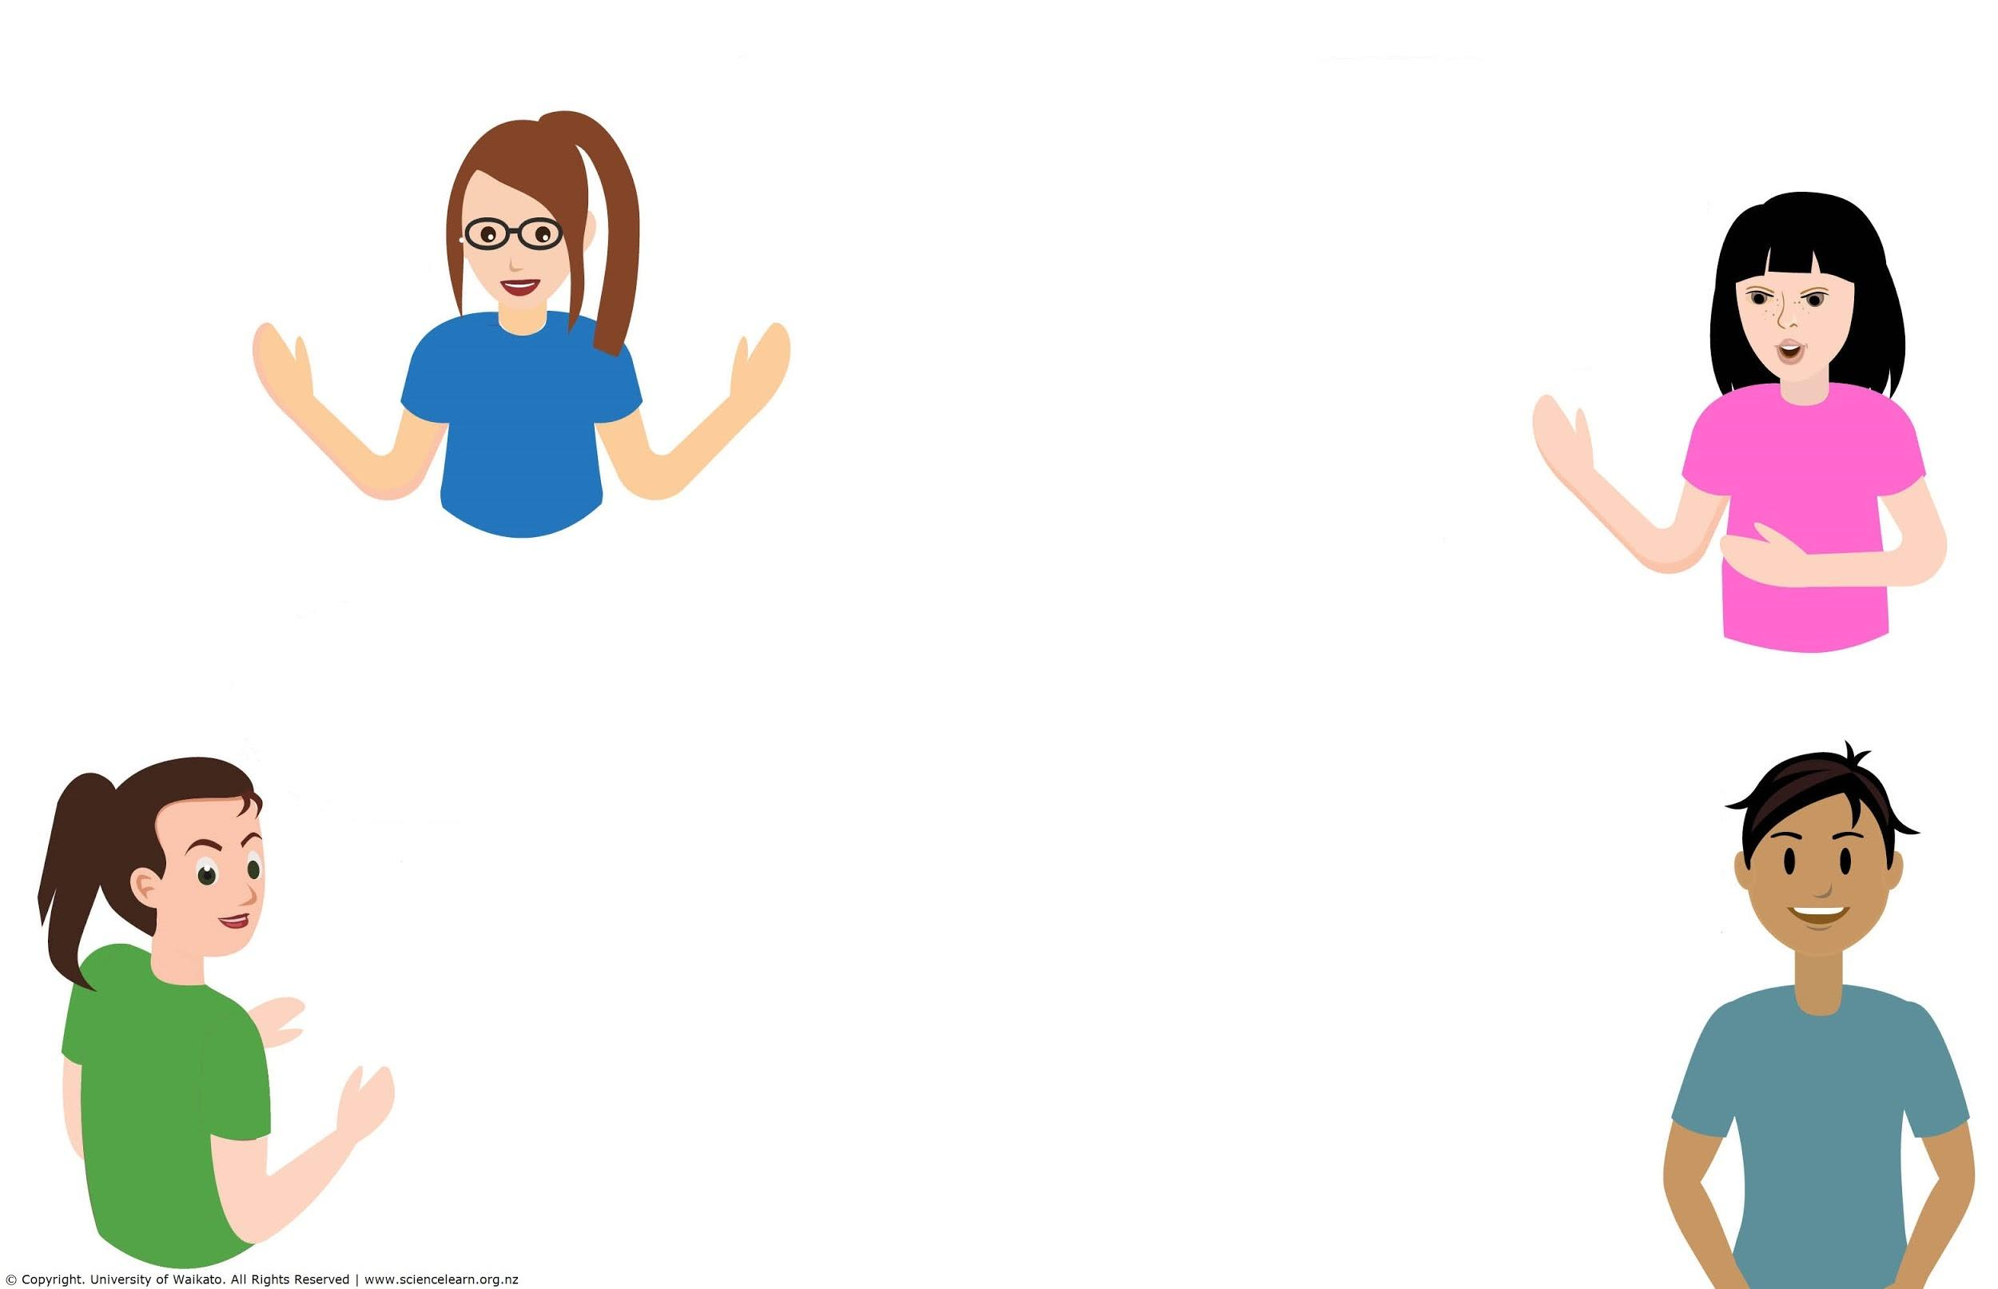
Questions
How do you ensure authenticity?
Ways to help students follow their own interests in the questions they set themselves while still scaffolding rich and genuine development of scientific skills and techniques.
What do we really want the students to ‘get’ from completing science fair projects.
What degree of parental involvement is acceptable?
Ideas for lower ability students.
In what depth, should students be pre-researching their ideas for a science fair? Is it better for them to discover for themselves things that already ‘known’ or to try and be innovative, and potentially discover little within the time frames they have available?
Ideas for supporting students who are not able to do any of their science fair work at home.
© Copyright. The University of Waikato Te Whare Wananga o Waikato l Science Learning Hub – Pokapū Akoranga Pūtaiao. All Rights Reserved
All images are copyrighted. For further information, please refer to enquiries@sciencelearn.org.nz
Notes:
See themselves as scientists to be in awe and wonder about the world around them to understand the Nature of Science (NOS)

Slide 6
Why science fair?
What is the purpose?
Excitement!
Inquiry learning
Get to identify as scientists and experience the science capabilities
Working with their community
Students learn from mistakes as well as successes
Students can follow their passions and see how science is important in their lives
© Copyright. The University of Waikato Te Whare Wananga o Waikato l Science Learning Hub – Pokapū Akoranga Pūtaiao. All Rights Reserved
All images are copyrighted. For further information, please refer to enquiries@sciencelearn.org.nz
Notes:
What are you wanting to achieve?
What learning are you wanting to support?
Excitement/passion/engagement a sense of achievement pride in their work and building on those skills.
Could be a storytelling exercise – it could be just made of pictures it could be a recorded rap or a poem that comes from a small project ….
NIWA: What is the Fair – Science projects: Study the world to find out something new. Is there a question that you can answer by doing a test or making observations? Technology projects: Can you put something together from things that already exist to make life better? www.scifair.org.nz/assets/files/Intro%20to%20the%20Science%20Fair.pdf

Slide 7
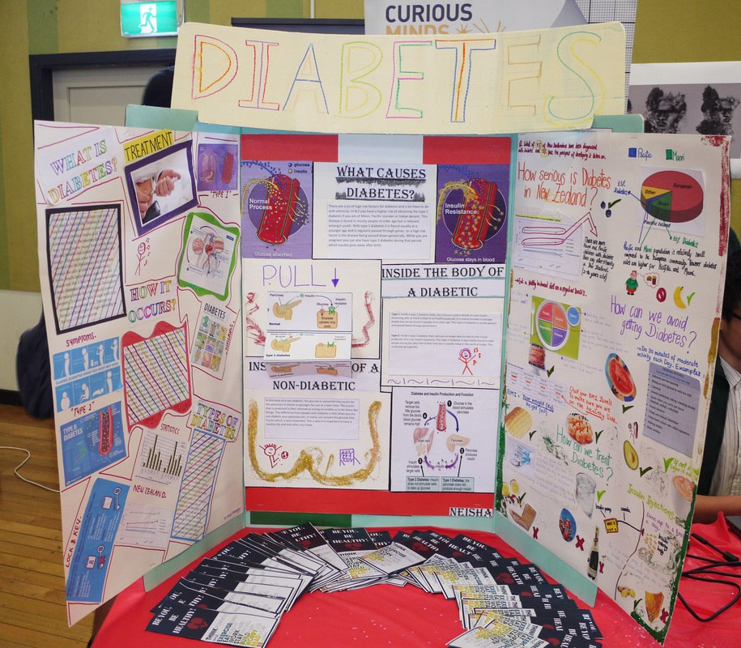
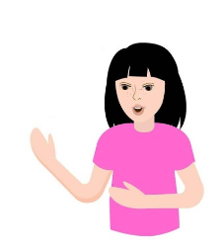
Why science fair?
What is the purpose?
What do we really want the students to ‘get’ from completing science fair projects?
Sarah Morgan, Comet Auckland
© Copyright. The University of Waikato Te Whare Wananga o Waikato l Science Learning Hub – Pokapū Akoranga Pūtaiao. All Rights Reserved
All images are copyrighted. For further information, please refer to enquiries@sciencelearn.org.nz
Notes:
Image: www.sciencelearn.org.nz/images/2674-manurewa-high-school-s-health-expo
developing Nature of science and science capabilities
bringing together STEAM subjects
promoting hands-on science
see themselves as scientists
understand about fair testing (but not the be all)
scientific process
but what do YOU as a school want them to get out of it? That then that drives how you go about doing it.

Slide 8
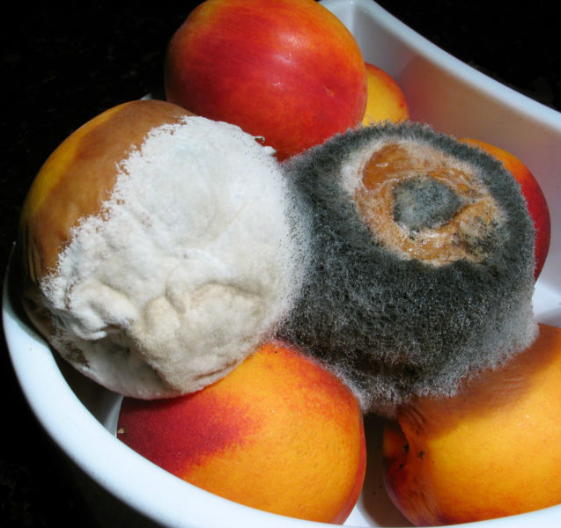
Health, safety & ethics
Find out early
New Zealand Association for Science Educators (NZASE)
CREST – Human ethics
If in doubt – ask
Roger McLassus, CC BY-SA 3.0
© Copyright. The University of Waikato Te Whare Wananga o Waikato l Science Learning Hub – Pokapū Akoranga Pūtaiao. All Rights Reserved
All images are copyrighted. For further information, please refer to enquiries@sciencelearn.org.nz
Notes:
New Zealand Association of Science Educators (NZASE): https://nzase.org.nz/animal-ethics/
Australian and New Zealand Council for the Care of Animals in Research and Teaching: https://anzccart.org.nz/schools/information-for-new-zealand-teachers/
Human ethics: www.royalsociety.org.nz/what-we-do/funds-and-opportunities/crest-awards/crest-and-ethical-practice/crest-and-ethics/

Slide 9
Finding a good fit
School synergies
Students’ science capabilities
Scale – classroom, school, region and timing
Compulsory or voluntary
Judging and parental involvement
Making sure the fair is fair – access to resources
Mātauranga and te reo Māori
Ideas for lower ability students.
In what depth, should students be pre-researching their ideas for a science fair? Is it better for them to discover for themselves things that already ‘known’ or to try and be innovative, and potentially discover little within the time frames they have available?
© Copyright. The University of Waikato Te Whare Wananga o Waikato l Science Learning Hub – Pokapū Akoranga Pūtaiao. All Rights Reserved
All images are copyrighted. For further information, please refer to enquiries@sciencelearn.org.nz
Notes:
Regional fairs: https://niwa.co.nz/education-and-training/science-and-technology-fairs
Crest: www.royalsociety.org.nz/what-we-do/funds-and-opportunities/crest-awards/
Brightsparks: www.brightsparks.org.nz/

Slide 10
What’s in a name?
Science exhibition
Science talent search
Interest fair
Science celebration/festival/expo
Science stories
Science and space festival
We are changing from Science Fair to a Science Expo where all investigations are publicly displayed.
You could also run a STEAM circus!
© Copyright. The University of Waikato Te Whare Wananga o Waikato l Science Learning Hub – Pokapū Akoranga Pūtaiao. All Rights Reserved
All images are copyrighted. For further information, please refer to enquiries@sciencelearn.org.nz
Notes:
Science Expo – students choose an experiment to teach to other students

Slide 11
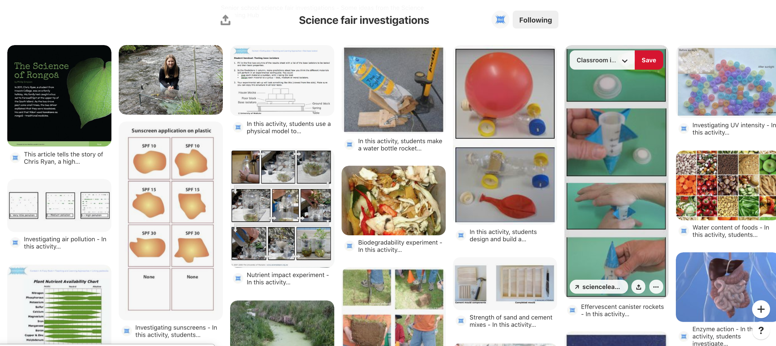
Figuring out what project to do
Ways to help students follow their own interests in the questions they set themselves while still scaffolding rich and genuine development of scientific skills and techniques.
© Copyright. The University of Waikato Te Whare Wananga o Waikato l Science Learning Hub – Pokapū Akoranga Pūtaiao. All Rights Reserved
All images are copyrighted. For further information, please refer to enquiries@sciencelearn.org.nz
Notes:
www.pinterest.co.uk/nzsciencelearn/science-fair-investigations/
National Library: https://natlib.govt.nz/schools/topics/57eae64d1257570f70004715/science-fairs-and-projects

Slide 12
Real-life contexts
Creating a science identity
Rather than focusing on competition and a final product – what if we shifted the focus of science fairs to students participating in a science community?
(Ally Bull, 2016)
© Copyright. The University of Waikato Te Whare Wananga o Waikato l Science Learning Hub – Pokapū Akoranga Pūtaiao. All Rights Reserved
All images are copyrighted. For further information, please refer to enquiries@sciencelearn.org.nz
Notes:
www.nzcer.org.nz/blogs/science-fairs

Slide 13
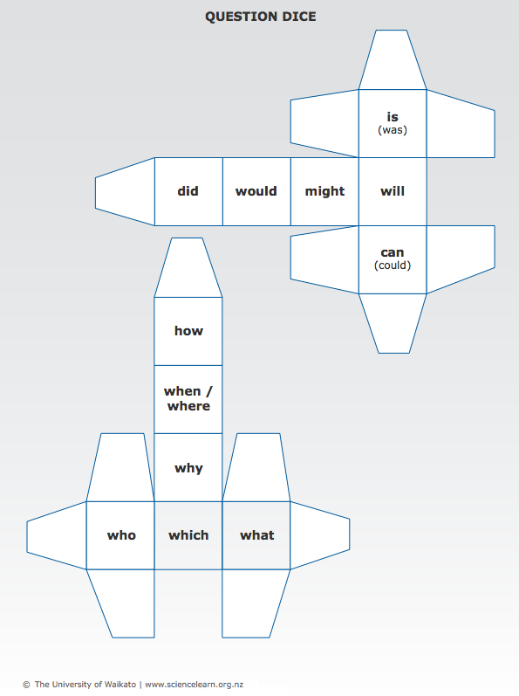
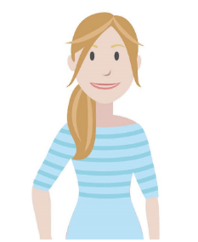
Figuring out what project to do
Practise asking questions
View a scene
What parts interest you?
Use question dice
Ways to help students follow their own interests in the questions they set themselves.
© Copyright. The University of Waikato Te Whare Wananga o Waikato l Science Learning Hub – Pokapū Akoranga Pūtaiao. All Rights Reserved
All images are copyrighted. For further information, please refer to enquiries@sciencelearn.org.nz
Notes:
Brainstorming and mindmapping interests
Diamond ordering activity
Scene prompt activity – next slide
Image: www.sciencelearn.org.nz/images/590-question-dice-template
Idea from: www.jpl.nasa.gov/edu/learn/activities/science-fair-project/
Activity: www.sciencelearn.org.nz/resources/61-question-dice-game

Slide 14
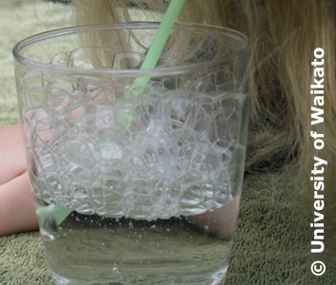
Teacher planning
Keep purpose in front of mind
Allow time
© Copyright. The University of Waikato Te Whare Wananga o Waikato l Science Learning Hub – Pokapū Akoranga Pūtaiao. All Rights Reserved
All images are copyrighted. For further information, please refer to enquiries@sciencelearn.org.nz
Notes:
www.googlesciencefair.com/educator-resources
Image: www.sciencelearn.org.nz/images/665-investigating-bubbles

Slide 15
What level of support do
your students need?
At our school some students work in a group with learning support staff.
We run a fair at the end of year 10, that way students have had at least two years learning the knowledge and skills needed to work independently.
My class has not done much science, so we all worked through an investigation together. Next time we will try working groups.
Some students need ideas on how to get started.
© Copyright. The University of Waikato Te Whare Wananga o Waikato l Science Learning Hub – Pokapū Akoranga Pūtaiao. All Rights Reserved
All images are copyrighted. For further information, please refer to enquiries@sciencelearn.org.nz

Slide 16
Tools
Journals
handwritten or digital
Planning sheets/templates
Mentoring
other schools
grandparents
How do you ensure authenticity?
Primary and secondary schools could connect to develop science and communication skills.
© Copyright. The University of Waikato Te Whare Wananga o Waikato l Science Learning Hub – Pokapū Akoranga Pūtaiao. All Rights Reserved
All images are copyrighted. For further information, please refer to enquiries@sciencelearn.org.nz

Slide 17
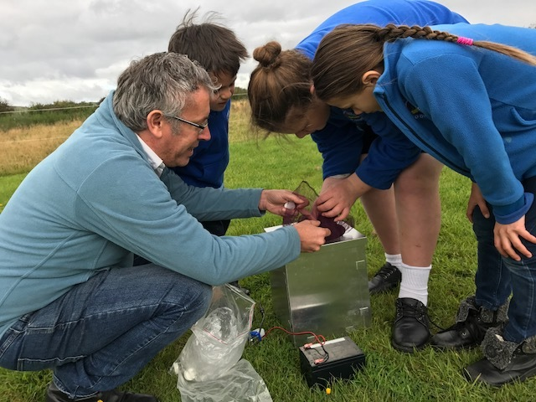
Whānau and community involvement
© Copyright. The University of Waikato Te Whare Wananga o Waikato l Science Learning Hub – Pokapū Akoranga Pūtaiao. All Rights Reserved
All images are copyrighted. For further information, please refer to enquiries@sciencelearn.org.nz
Notes:
Image: www.sciencelearn.org.nz/images/3181-using-a-heath-moth-trap – Lepidopterist Dr Robert Hoare and students from Te Kura Kaupapa Māori o Ōtepoti check the contents of a Heath moth trap. Heath moth traps attract and trap moths. (part of the mothnet/PSP mahi)

Slide 18
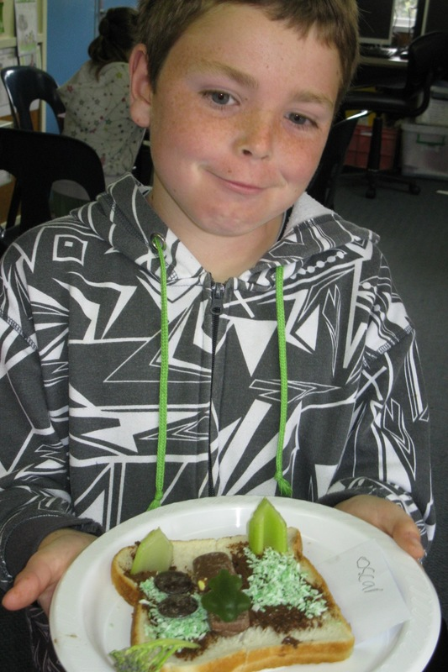
Science communication
Also see the Connected article Winning ways: presenting scientific data
Illustration by Katie O’Neill
Crown Copyright 2016
© Copyright. The University of Waikato Te Whare Wananga o Waikato l Science Learning Hub – Pokapū Akoranga Pūtaiao. All Rights Reserved
All images are copyrighted. For further information, please refer to enquiries@sciencelearn.org.nz
Notes:
Image: www.sciencelearn.org.nz/images/1041-modelling-tectonic-plates
What is your purpose – what form of communication meets this best?
Image: www.sciencelearn.org.nz/resources/2868-winning-ways-presenting-scientific-data
Article: www.sciencelearn.org.nz/resources/2868-winning-ways-presenting-scientific-data

Slide 19
Get inspired
Stories of some previous New Zealand science fair winners.
Kindling cracker
Oobleck versus flubber
Science project measures noise levels
Questions?
© Copyright. The University of Waikato Te Whare Wananga o Waikato l Science Learning Hub – Pokapū Akoranga Pūtaiao. All Rights Reserved
All images are copyrighted. For further information, please refer to enquiries@sciencelearn.org.nz

Slide 20
Keep in touch
Email us enquiries@sciencelearn.org.nz
https://twitter.com/NZScienceLearn
www.facebook.com/nzsciencelearn
https://nz.pinterest.com/nzsciencelearn
www.instagram.com/sciencelearninghubnz
Join us in our discussion channel on Slack.
(Any problems accessing Slack, please contact us via our enquiries email, enquiries@sciencelearn.org.nz.)
© Copyright. The University of Waikato Te Whare Wananga o Waikato l Science Learning Hub – Pokapū Akoranga Pūtaiao. All Rights Reserved
All images are copyrighted. For further information, please refer to enquiries@sciencelearn.org.nz
Notes:
Don’t forget the SLH can help
SLACK: https://slh-talk.slack.com/messages/CDL529ERW/

