Slide 1

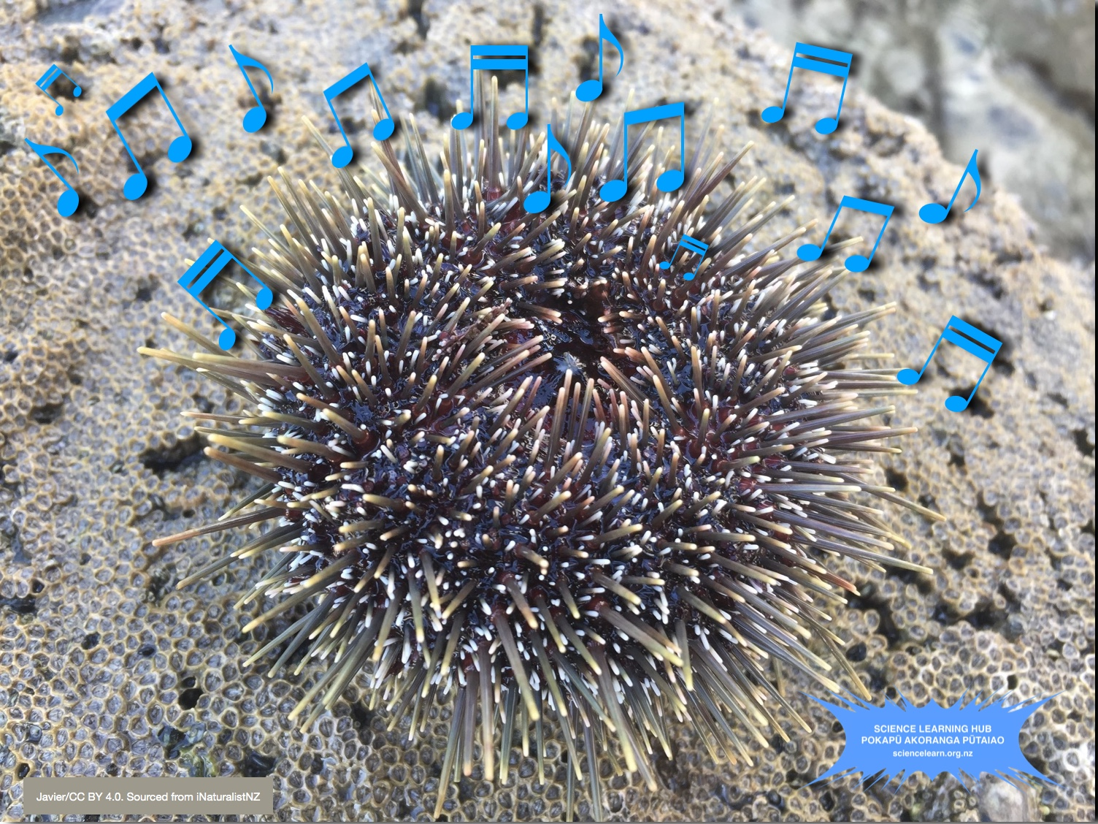
Sounds of Aotearoa
4–4:45 pm Thursday 7 May
© Copyright. The University of Waikato Te Whare Wananga o Waikato l Science Learning Hub – Pokapū Akoranga Pūtaiao. All Rights Reserved
All images are copyrighted. For further information, please refer to enquiries@sciencelearn.org.nz

Slide 2
Index
Topic | Slideshow number(s) | Video timecode
Welcome | 1 | 00:00
Index | 2 | 00:10
Introducing NZAPSE, The Science Learning Hub and purpose | 3–6 | 02:35
Sound resources | 7–9 | 03:36
Sandy Jackson: musical sounds activity | 10 | 04:29
Chris Duggan: seeing sounds activity | 11 | 12:11
Sterling Cathman: pump up the volume activity | 12 | 18:07
John Marsh: grass sax, oboe and clucking chicken activities | 13 | 29:30
SLH links, keep in touch and thanks | 14–15 | 37:10
© Copyright. The University of Waikato Te Whare Wananga o Waikato l Science Learning Hub – Pokapū Akoranga Pūtaiao. All Rights Reserved
All images are copyrighted. For further information, please refer to enquiries@sciencelearn.org.nz

Slide 3
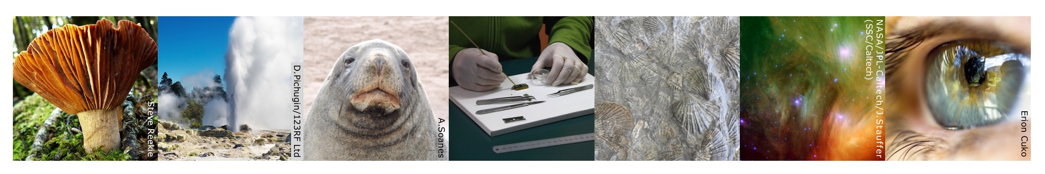

Pokapū Akoranga Pūtaiao
The Science Learning Hub
A trustworthy online resource – produced by educators and scientists for New Zealand teachers and students.
Based on world-class New Zealand science research.
Supported by learning activities, information about the key science ideas and concepts, multimedia tools and other resources.
© Copyright. The University of Waikato Te Whare Wananga o Waikato l Science Learning Hub – Pokapū Akoranga Pūtaiao. All Rights Reserved
All images are copyrighted. For further information, please refer to enquiries@sciencelearn.org.nz
Notes:
The SLH is funded by the New Zealand Government – MBIE Ministry of Business, Innovation and Employment – under the Curious Minds fund

Slide 4

https://nzapse.nzase.org.nz/
© Copyright. The University of Waikato Te Whare Wananga o Waikato l Science Learning Hub – Pokapū Akoranga Pūtaiao. All Rights Reserved
All images are copyrighted. For further information, please refer to enquiries@sciencelearn.org.nz
Notes:
Image: https://nzapse.nzase.org.nz/

Slide 5

© Copyright. The University of Waikato Te Whare Wananga o Waikato l Science Learning Hub – Pokapū Akoranga Pūtaiao. All Rights Reserved
All images are copyrighted. For further information, please refer to enquiries@sciencelearn.org.nz
Notes:
Image: https://nzapse.nzase.org.nz/

Slide 6

Purpose
In this webinar, we will:
Demonstrate some simple activities to support learning about sound.
Share a range of resources designed to support primary teachers with science.
© Copyright. The University of Waikato Te Whare Wananga o Waikato l Science Learning Hub – Pokapū Akoranga Pūtaiao. All Rights Reserved
All images are copyrighted. For further information, please refer to enquiries@sciencelearn.org.nz

Slide 7
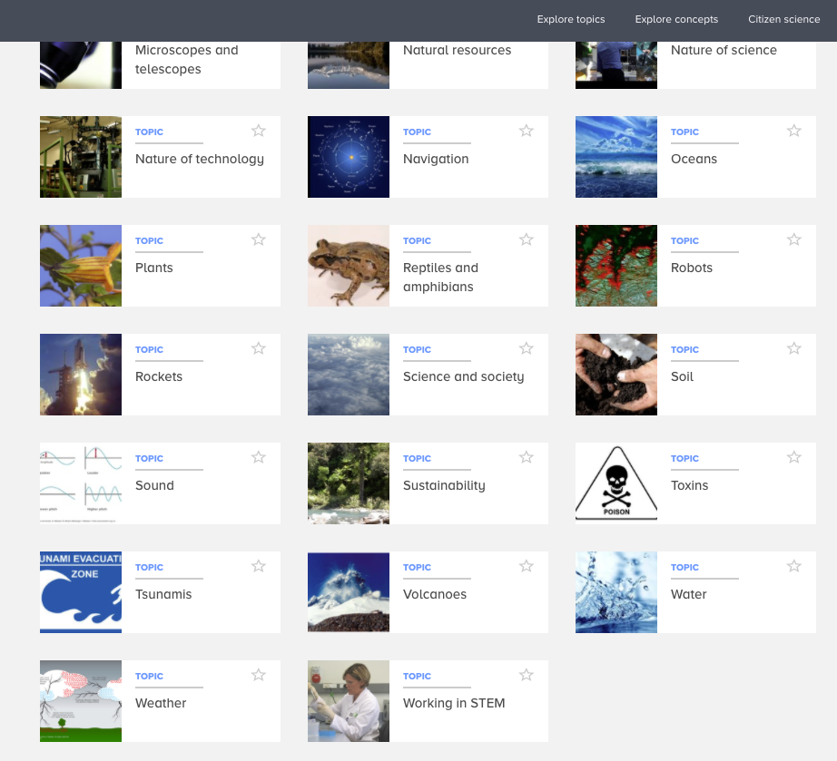
Sound on the Hub
© Copyright. The University of Waikato Te Whare Wananga o Waikato l Science Learning Hub – Pokapū Akoranga Pūtaiao. All Rights Reserved
All images are copyrighted. For further information, please refer to enquiries@sciencelearn.org.nz
Notes:
Image: https://www.sciencelearn.org.nz/topics/sound

Slide 8
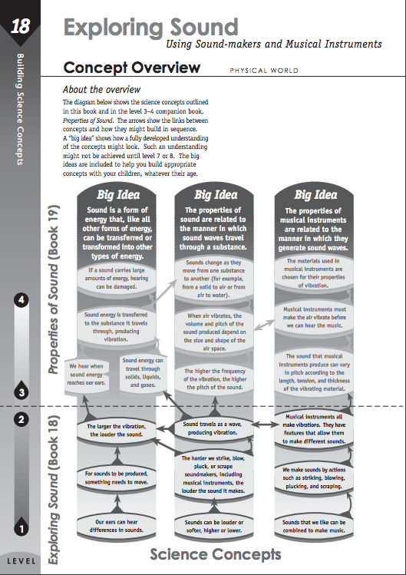
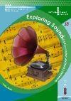
Introducing sound
scienceonline.tki.org.nz
© Copyright. The University of Waikato Te Whare Wananga o Waikato l Science Learning Hub – Pokapū Akoranga Pūtaiao. All Rights Reserved
All images are copyrighted. For further information, please refer to enquiries@sciencelearn.org.nz
Notes:
Image: https://scienceonline.tki.org.nz/What-do-my-students-need-to-learn/Building-Science-Concepts/Titles-and-concept-overviews/Exploring-Sound

Slide 9
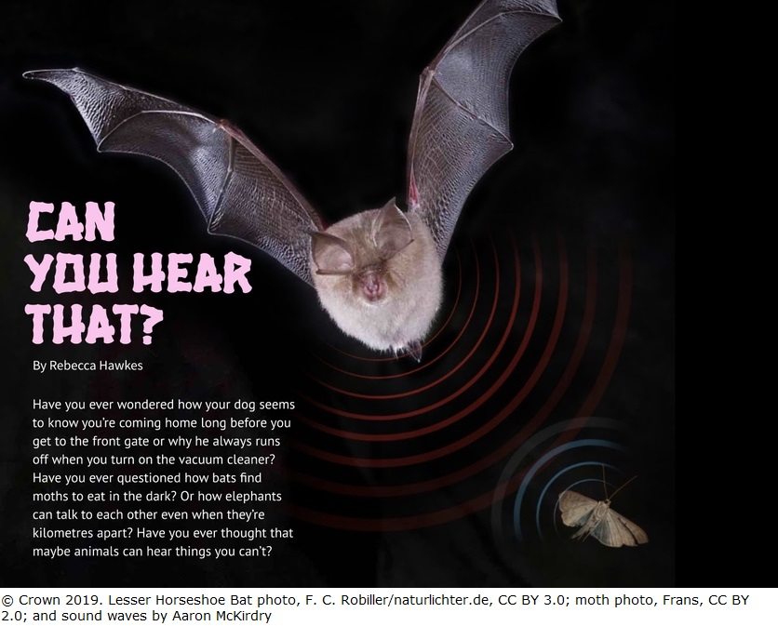
Sounds of Aotearoa
© Copyright. The University of Waikato Te Whare Wananga o Waikato l Science Learning Hub – Pokapū Akoranga Pūtaiao. All Rights Reserved
All images are copyrighted. For further information, please refer to enquiries@sciencelearn.org.nz
Notes:
Image: www.sciencelearn.org.nz/images/4240-connected-article-can-you-hear-that
Article: www.sciencelearn.org.nz/resources/2870-can-you-hear-that
Echolocation – discover more New Zealand bats – pekapeka (www.sciencelearn.org.nz/resources/2837-new-zealand-bats-pekapeka) and how they use sound.

Slide 10
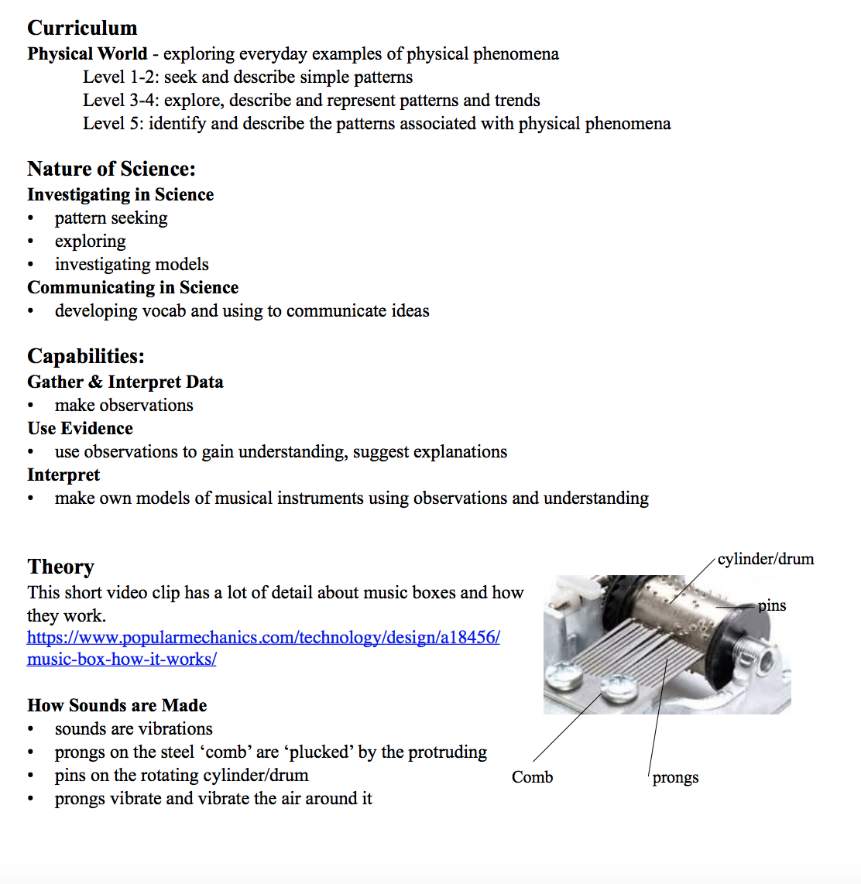
Musical sounds
Activity courtesy of Sandy Jackson
© Copyright. The University of Waikato Te Whare Wananga o Waikato l Science Learning Hub – Pokapū Akoranga Pūtaiao. All Rights Reserved
All images are copyrighted. For further information, please refer to enquiries@sciencelearn.org.nz

Slide 11
See a sound
Activity courtesy of Chris Duggan
Level: any
Gear needed: smartphone or other device with a microphone that can download apps
Safety requirements: none
Link to NZ Curriculum/Capabilities: Physical world, introduce simple wave terminology with respect to sound (amplitude, wavelength, frequency), Gather and interpret data, use evidence, interpret representations (models)
Discussion questions:
How does the display change when a sound is made louder / increases in pitch / is made with your mouth open or closed?
For older students you can introduce some of the wave terminology like amplitude and frequency.
How ‘pure’ is the sound you can make? (how smooth is the pattern?)
Can you find some unique New Zealand sounds like a native bird? What does their sound ‘look like’ on the oscilloscope?
© Copyright. The University of Waikato Te Whare Wananga o Waikato l Science Learning Hub – Pokapū Akoranga Pūtaiao. All Rights Reserved
All images are copyrighted. For further information, please refer to enquiries@sciencelearn.org.nz
Notes:
Chris

Slide 12
Pump up the volume
Activity courtesy of Sterling Cathman (Mr Science)
Level: 1–8
Gear needed: TBA
Safety requirements: ear muffs, could be LOUD!!
Link to NZ Curriculum/Capabilities: Science Physical World. Explore everyday examples of physical phenomena, such as movement, forces, electricity and magnetism, light, sound, waves and heat.
http://scienceonline.tki.org.nz/Introducing-five-science-capabilities/Use-evidence/Super-Senses
One idea for getting students using capabilities/Nature of Science.
Questions
What is sound? (a form of energy, vibration)
How does it change as it gets louder?
How does sound get from its source to our ear? (waves)
Does sound travel better through water? Why?
© Copyright. The University of Waikato Te Whare Wananga o Waikato l Science Learning Hub – Pokapū Akoranga Pūtaiao. All Rights Reserved
All images are copyrighted. For further information, please refer to enquiries@sciencelearn.org.nz

Slide 13
Grass saxophone
Activity courtesy of John Marsh
Levels: Year 2–8
Gear needed: thick pieces of grass 8–10 cm long and two hands
Safety issues: be careful of cutty grass
NZ Curriculum/Capability links: Physical World
Science Capabilities: Gather and interpret data, Use evidence and engage with science
Things to investigate:
width of grass and sound
thickness of grass and sound
tension on grass and sound
how hand cupping shape affect
sound
speed of wind and sound.
Links to everyday:
guitar/violin tuning
stringed instrument string thickness and music/sound
how a saxophone reed is made and works
how vocal cords work
how the vibration can be amplified in musical instruments.
© Copyright. The University of Waikato Te Whare Wananga o Waikato l Science Learning Hub – Pokapū Akoranga Pūtaiao. All Rights Reserved
All images are copyrighted. For further information, please refer to enquiries@sciencelearn.org.nz

Slide 14
Thank you to the amazing NZAPSE team
Sandy Jackson
Chris Duggan (House of Science)
Sterling Cathman (Mr Science)
John Marsh
© Copyright. The University of Waikato Te Whare Wananga o Waikato l Science Learning Hub – Pokapū Akoranga Pūtaiao. All Rights Reserved
All images are copyrighted. For further information, please refer to enquiries@sciencelearn.org.nz
Notes:
Don’t forget the SLH can help
SLACK: https://slh-talk.slack.com/messages/CDL529ERW/

Slide 15





Keep in touch
Email us enquiries@sciencelearn.org.nz
https://twitter.com/NZScienceLearn
www.facebook.com/nzsciencelearn
https://nz.pinterest.com/nzsciencelearn
www.instagram.com/sciencelearninghubnz
Join us in our discussion channel on Slack.
(Any problems accessing Slack, please contact us via our enquiries email, enquiries@sciencelearn.org.nz.)
© Copyright. The University of Waikato Te Whare Wananga o Waikato l Science Learning Hub – Pokapū Akoranga Pūtaiao. All Rights Reserved
All images are copyrighted. For further information, please refer to enquiries@sciencelearn.org.nz
Notes:
Don’t forget the SLH can help
SLACK: https://slh-talk.slack.com/messages/CDL529ERW/

