Slide 1
Earth and Space Science Scholarship – Introduction For further information or help, contact earthspacenz@gmail.com, putting ESS Scholarship in the subject line.

Slide 2
The ESS Scholarship exam
The ESS Scholarship exam consists of three open-ended questions. ALL three questions must be answered.
You will be given two booklets. One will contain the questions and plenty of space for you to write your answers. Extra pages will be available during the exam.
The other booklet will have resource material for each question.
Each question is worth 8 marks. The highest mark possible for the exam is 24.
A scholarship level answer for a question will score 5 or 6 marks. An outstanding level answer will gain 7 or 8 marks.
Questions will be asked about unfamiliar contexts, and will have links to more than one ESS aspect. When answering, link your own knowledge and understanding with resource material and then demonstrate high level critical thinking by analysing and evaluating scientific information, and by adding new thoughts and realisations when you can.

Slide 3
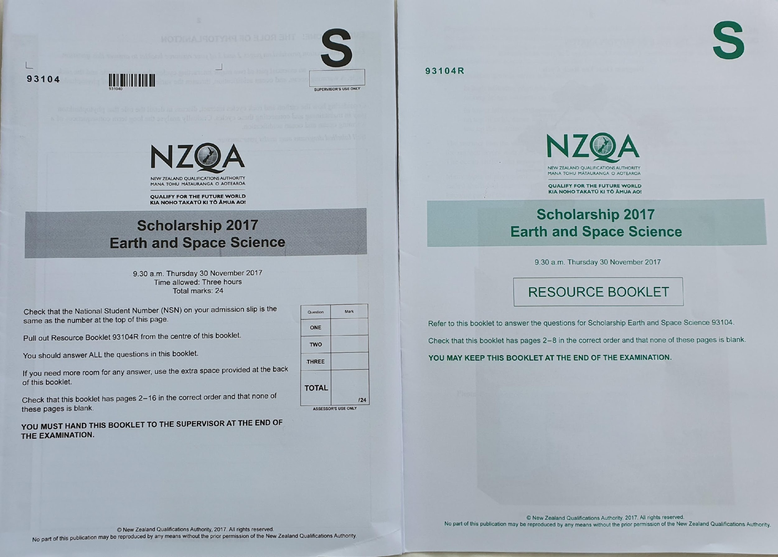
There is a lot to read and to think about. Spend 5-10 minutes at the beginning of the exam reading through the questions.
Then plan your time carefully and stick to your plan.

Slide 4
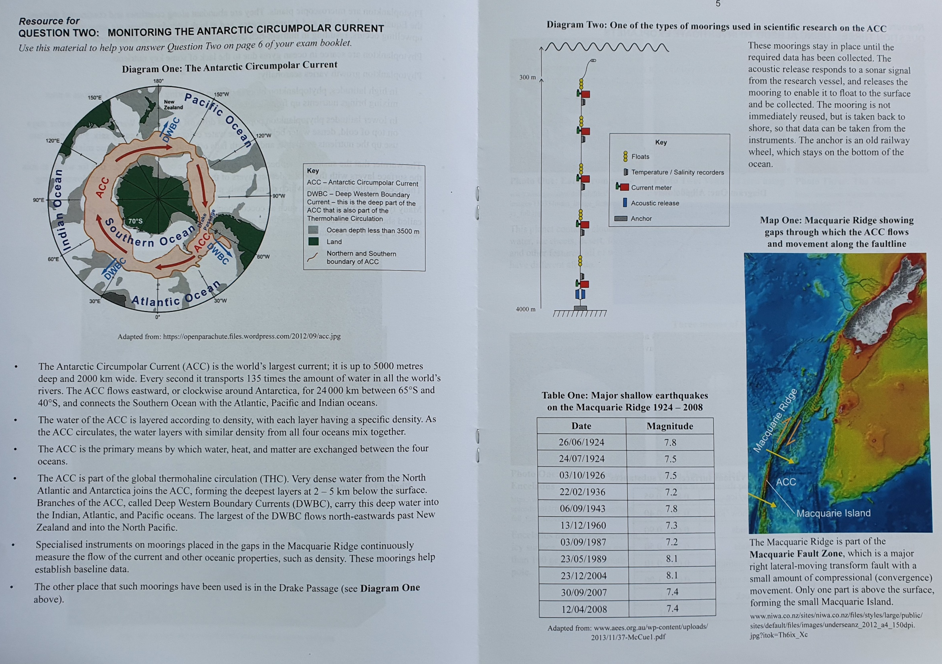
Here is an example of a question and the resource book material.
Note that this question requires you to integrate understanding of the importance of a major ocean current with aspects of geology, considering why and how ESS scientists do research in challenging environments.

Slide 5
Hints for the actual exam
DO read the question and the resources very carefully. Highlight key aspects but remember that every word and diagram is there for a reason
DO start the exam with a question that you are confident about answering.
DO write down quick notes to help you get started.
DO draw and annotate diagrams if you can express some knowledge and understanding better that way
DON’T just reword the question or resource material. You must say something new!
DON’T just regurgitate class/tutorial notes in your answer. Draw on your knowledge and the information in the RB to reach conclusions and to demonstrate high level critical thinking by analysing and evaluating scientific information.

Slide 6
The ESS Scholarship performance standard
The ESS Scholarship standard sets out the skills that are needed for a student to gain a Scholarship. The skills are the same for all scholarship subjects.
The standard has:
A number, ESS is 93104
Descriptions of what skills are required for the two possible types of pass, Scholarship and Outstanding.
Explanatory notes which describe the scholarship and outstanding skills that are required.
For ESS this important statement: This standard is derived from the Science learning area in The New Zealand Curriculum Nature of Science and Planet Earth and Beyond strands up to and including Curriculum Level 8. (This is a very broad statement and is explained soon.)

Slide 7
Assessment specifications are also available which clarify the nature of the exam.
ESS Scholarship resources including the standard, assessment specifications, past papers and exemplars can be found at https://www.nzqa.govt.nz/qualifications-standards/awards/new-zealand-scholarship/scholarship-subjects/earth-and-space-science/.
They can also be found in the ESS Scholarship folder in Google Drive. Both teachers and students can have access to this folder.
Contact earthspacenz@gmail.com for access (recommended) or go to https://drive.google.com/drive/u/0/folders/1VWpuu3aRuTN29aGo_kJUYKyNwNm6fvje sub-folder – 2020 updated ESS scholarship resources.

Slide 8
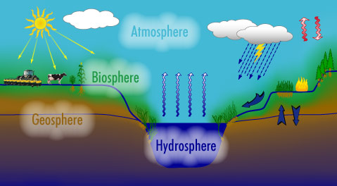
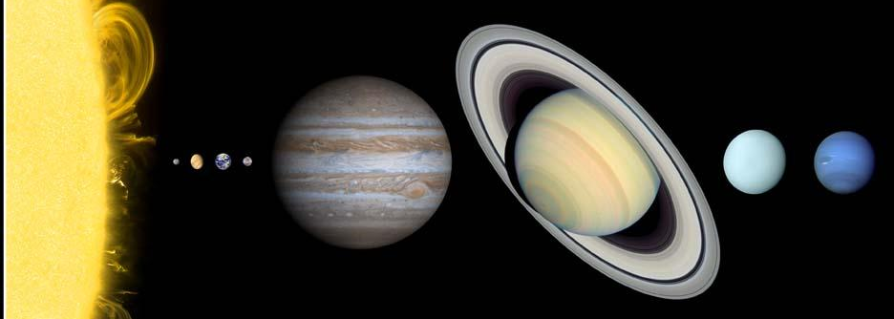
Relevant curriculum links – Planet Earth and Beyond
This is the science learning area in the New Zealand curriculum (NZC) that Earth and Space Science is derived from. The relevant ESS scholarship aspects are:
Earth systems and interacting systems: the interactions and cycles of the geosphere (geology), hydrosphere (any water anywhere), atmosphere and biosphere (relevant aspects of life including humans).
Astronomical systems: Planetary Science and relevant Astronomy such as the features and life cycles of stars and planetary systems.

Slide 9
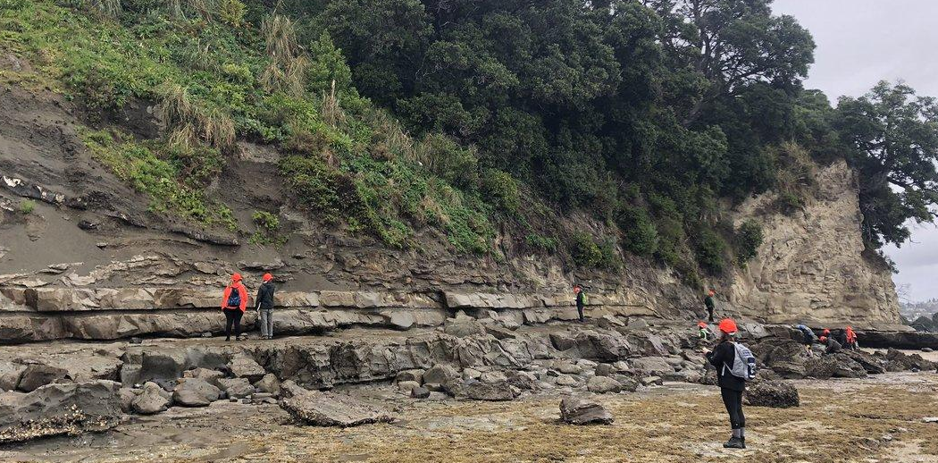
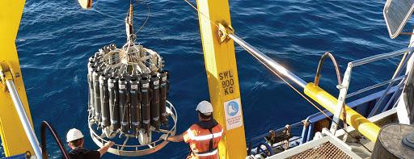
Relevant curriculum links – Nature of Science
This is the curriculum area that presents the concepts and skills that underpin all scientific work:
Understanding about science: What is scientific knowledge, how it develops and interacts with society.
Investigating in science: Carrying out science investigations using a variety of approaches.
Communicating in science: Communicating scientific knowledge by using relevant vocabulary, numeracy and symbols.
Participating and contributing: Bringing a scientific perspective to decisions and actions appropriate to socio-scientific issues.

Slide 10
What to learn and understand: The ESS knowledge that needs to be learnt and understood has been divided up into six different sections that can be found in the subfolder ‘ESS Sections’. Each folder contains specific resources and practice questions. You may find the L2 ESA workbook useful too, but it isn’t essential. .
The six sections are:
Astronomy
Geology
Oceans and Atmosphere
The water, carbon and rock cycles
Extra background information
Nature of Science
In each ESS section you will find a document titled ‘Read this first’. These contain hints and recommendations about how to approach each section of learning.

Slide 11
Also:
Go over the questions in the past papers including the 2013 sample paper (2013S). If you can’t work out how to answer a question look through the answer and work backwards from there. These and the exemplars will show you how knowledge can be integrated and what critical thinking looks like.
Also go over the old questions (OQ) from old Science Scholarship exams.
When you are learning this work think about how certain aspects link – e.g. geology and the surface features of Mars, interaction of ocean and atmosphere.
Read the online exemplars to see what Outstanding and Scholarship looks like – see ‘National exams’ folder.
The last four recommendations are as important as anything you will learn.

Slide 12
Content, skills and concepts to learn | Where to get information | Good relevant questions
Astronomy | Summary ppts and revision notes especially key features of solar system objects. L2 ESA workbook, AS 91192, p173-208 | 2013S Q3 KBOs 2013 Q2 Tectonics on Mars 2014 Q1 Io and Europa | 2015 Q3 Red dwarfs 2016 Q2 Liquid water Mars 2017 Q3 Albedo exoplanets
Geology | Ppts: Tectonics for Scholarship, Erosion and Weathering ppts plus revision notes. L2 ESA workbook: AS 91191, p129-172 | 2013S Q1 Kaikoura canyon 2013 Q3 The Anthropocene Q2 Tectonics on Mars 2014 Q3 Volcanoes mining 2015 Q1 ocean sediments | 2016 Q1 Methane gas seeps 2017 Q2 Monitoring ACC OQ Sediments and Volcanoes
Ocean and Atmosphere | Summary ppts and sheets, anything on Climate Change and Ocean Acidification | 2013 Q1 NZ and C cycle 2014 Q2 Polynyas 2015 Q1 Ocean sediments Q2 SH atmosphere | 2016 Q1 Methane gas seeps Q3 Warming ocean 2017 Q1 Phytoplankton

Slide 13
Water, carbon and rock cycles | Notes and ppts | 2013 Q1 NZ and C cycle 2015 Q1 Ocean sediments 2016 Q2 Liquid water Mars |  | 2017 Q1 Phytoplankton
Extra background information | Relevant powerpoint and revision notes. L2 ESA workbook: AS 91193, p209-256 | Important for many questions
Nature of Science | ‘How ESS scientists work’ Powerpoint – this will help you with the Nature of Science concepts | 2013S Q3 Anthropogenic noise 2014 Q3 Volcanoes and mining 2015 Q1 ocean sediments | 2016 Q1 Methane gas seeps 2017 Q2 Monitoring ACC OQ: C isotopes Water turbidity

