Slide 1

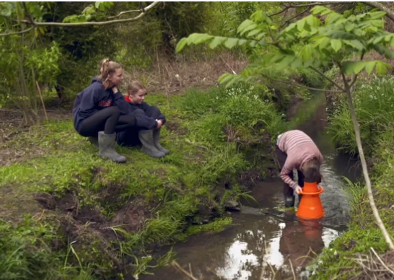
Rivers and Us
© The University of Waikato Te Whare Wananga o Waikato and Waikato Regional Council
4–4:45 pm Thursday 6 August
© Copyright. The University of Waikato Te Whare Wananga o Waikato l Science Learning Hub – Pokapū Akoranga Pūtaiao. All Rights Reserved
All images are copyrighted. For further information, please refer to enquiries@sciencelearn.org.nz
Notes:
Image: screenshot from video: Benefits of environmental education

Slide 2
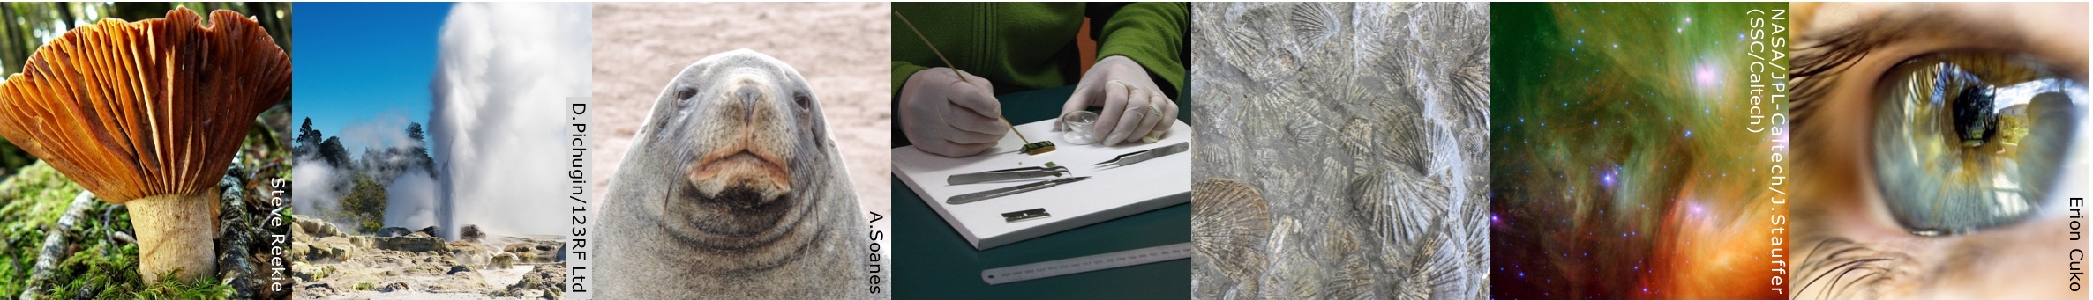

Pokapū Akoranga Pūtaiao
The Science Learning Hub
A trustworthy online resource – produced by educators and scientists for New Zealand teachers and students.
Based on world-class New Zealand science research.
Supported by learning activities, information about the key science ideas and concepts, multimedia tools and other resources.
© Copyright. The University of Waikato Te Whare Wananga o Waikato l Science Learning Hub – Pokapū Akoranga Pūtaiao. All Rights Reserved
All images are copyrighted. For further information, please refer to enquiries@sciencelearn.org.nz
Notes:
The Science Learning Hub is funded by the New Zealand Government – MBIE Ministry of Business, Innovation and Employment – under the Curious Minds fund

Slide 3
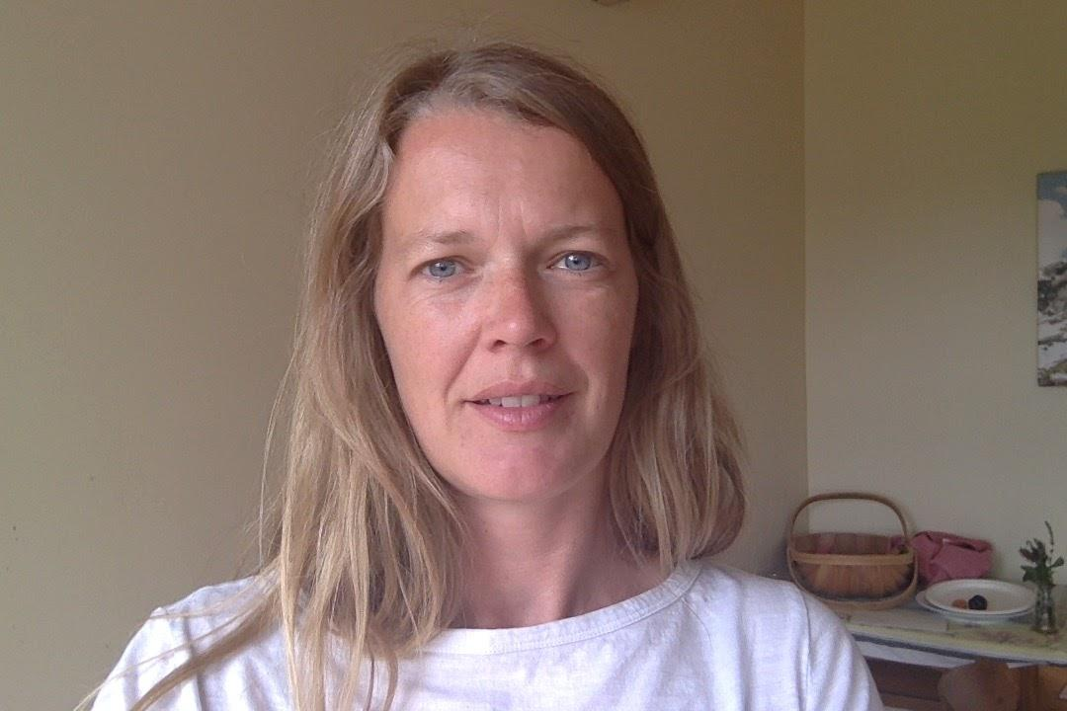
Alex Daniel
Environmental Educator – Enviroschools Facilitator
Waikato Regional Council
Currently working with schools in
Taupo
Waipa
Hamilton City
“When tamariki/students connect with their place and its people, and then plan, design and take action, they are creating change.
Caring for our place and the whole planet becomes a living curriculum where skills and competencies are gained through experience and mahi within meaningful community settings.”
Creating Change, Enviroschools.

Slide 4
Index
Topic | Slideshow number(s ) | Video timecode
Introducing the Science Learning Hub and presenters | 1–3 | 00:00
Index | 4 | 1:40
Purpose | 5 | 2:01
Rivers and Us background | 6 | 2:39
Getting started, curriculum links and the Inquiry and action learning process | 7–9 | 5:38
Participant questions | 10–11 | 11:43
Planning – where to go and what to do | 12–15 | 14:26
What gear do you need and how do you use it? | 16–18 | 31:27
Macroinvertebrates | 19–20 | 34:04
Other useful links and support | 21 | 40:54
SLH links, keep in touch and thanks | 22 | 41:19
© Copyright. The University of Waikato Te Whare Wananga o Waikato l Science Learning Hub – Pokapū Akoranga Pūtaiao. All Rights Reserved
All images are copyrighted. For further information, please refer to enquiries@sciencelearn.org.nz.

Slide 5
Purpose
Get you excited and engaged about this wonderful thing called experiential learning!
Guide you on how to use a variety of water quality indicators.
Share resources such as recording sheets and videos.
Make links to the New Zealand curriculum and teaching strategies.
© Copyright. The University of Waikato Te Whare Wananga o Waikato l Science Learning Hub – Pokapū Akoranga Pūtaiao. All Rights Reserved
All images are copyrighted. For further information, please refer to enquiries@sciencelearn.org.nz

Slide 6
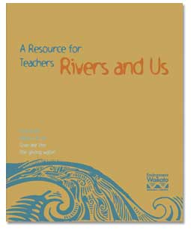

Rivers and Us
Background
© Copyright. The University of Waikato Te Whare Wananga o Waikato l Science Learning Hub – Pokapū Akoranga Pūtaiao. All Rights Reserved
Images © Waikato Regional Council
Notes:
Waikato based but can be used all over Aotearoa, check out other Council resources.

Slide 7
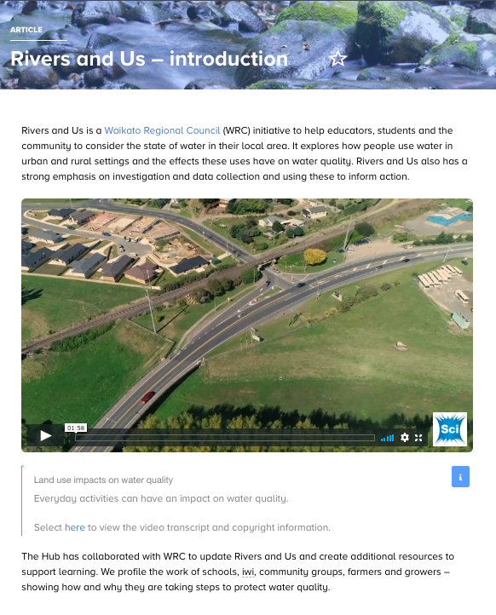
© The University of Waikato Te Whare Wananga o Waikato and Waikato Regional Council
Notes:
Rivers and Us – introduction – a good place to start exploring the Rivers and Us resources

Slide 8
Curriculum links
The resources featured in Rivers and Us explore Planet Earth and Beyond and Living World concepts:
River catchments are part of the water cycle.
The Earth has a limited amount of freshwater and it is continuously recycled.
Water goes through physical changes as it moves through the water cycle. The changes are powered by heat from the Sun.
Earth’s resources and natural features are affected by human actions.
Living things are suited to their particular environment.
Living things depend on each other and on the environment in which they live.
Changes in any part of an environment affect the relationships between the plants and animals that live there.
Changes in any part of an environment can hinder or improve the chances of some species surviving.

Slide 9
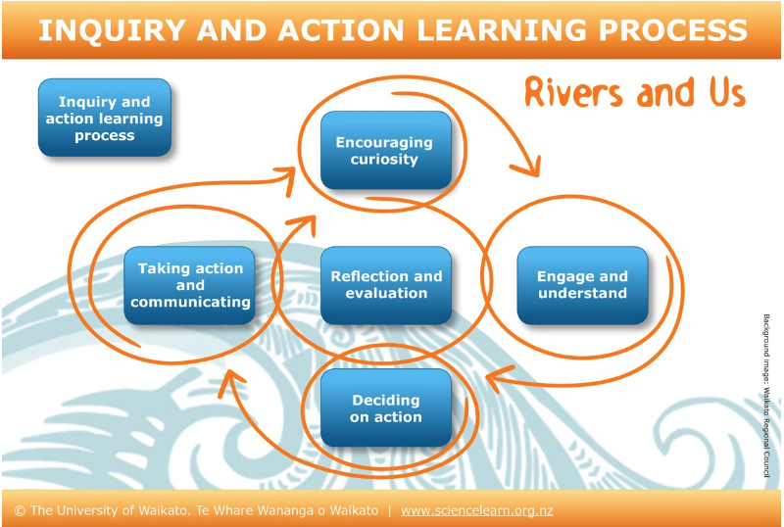
© Copyright. The University of Waikato Te Whare Wananga o Waikato l Science Learning Hub – Pokapū Akoranga Pūtaiao. All Rights Reserved
All images are copyrighted. For further information, please refer to enquiries@sciencelearn.org.nz
Notes:
Inquiry and action learning process
Q: It’s a lot of effort getting outdoors for learning – why bother?
Add a stream study to your programme, camping, tree planting …
Think about whether you will return/monitor over time or is it a one off.

Slide 10
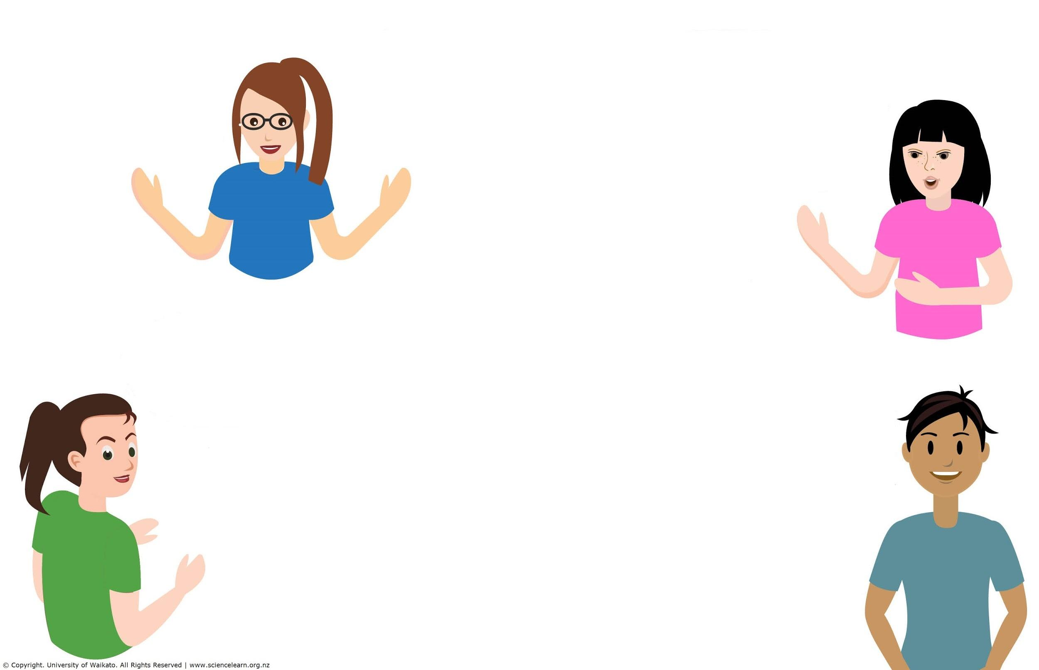
Questions
© Copyright. The University of Waikato Te Whare Wananga o Waikato l Science Learning Hub – Pokapū Akoranga Pūtaiao. All Rights Reserved
All images are copyrighted. For further information, please refer to enquiries@sciencelearn.org.nz
Notes:
What questions or barriers or concerns do you have about embarking on this type of learning??

Slide 11
Questions
How? Where? When? How often?
Our main river is boring to assess – silt laden, large flow, saline zone in town – question whether it's worth studying given than we cannot assess E.coli etc. Any comments? Only find small snails and a few worms.
What equipment is required for this? Do I need to buy anything?
How do I gain access to a stream?
What kit do you use?
Is it worth revisiting a stream or river regardless of season or different weather.
Often not possible to replicate the original conditions with the organisational restrictions.
How can I test the Waikato River and other water sources with my students?
© Copyright. The University of Waikato Te Whare Wananga o Waikato l Science Learning Hub – Pokapū Akoranga Pūtaiao. All Rights Reserved
All images are copyrighted. For further information, please refer to enquiries@sciencelearn.org.nz
Notes:
What questions or barriers or concerns do you have about embarking on this type of learning??

Slide 12
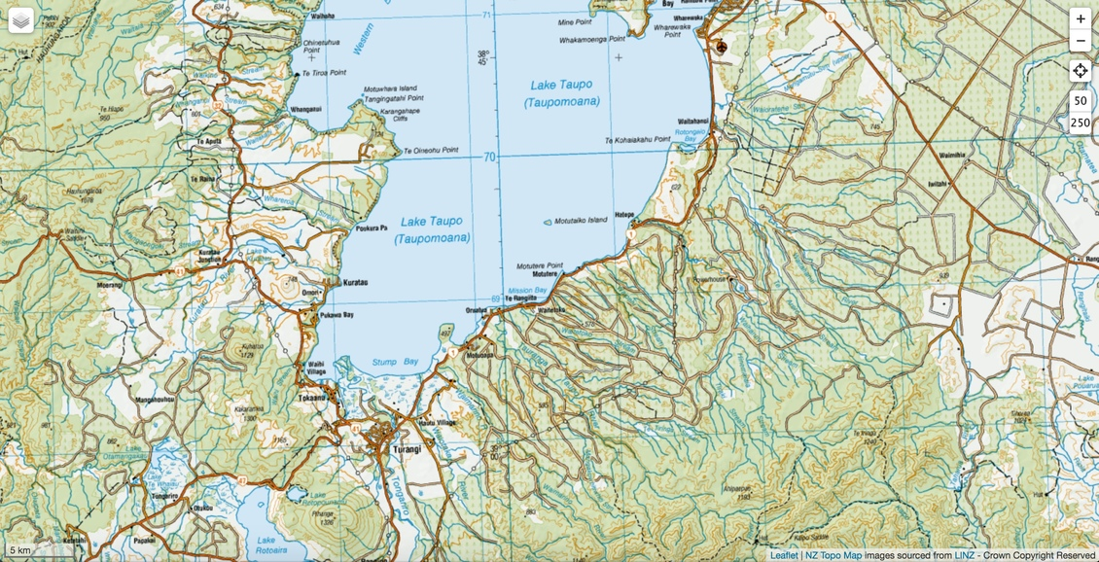
Where to go

Slide 13
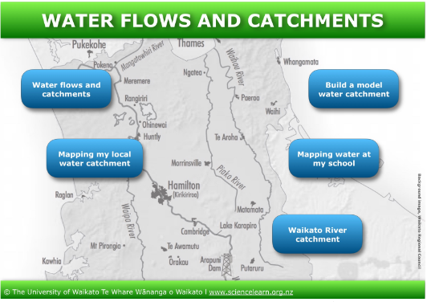
© Copyright. The University of Waikato Te Whare Wananga o Waikato l Science Learning Hub – Pokapū Akoranga Pūtaiao. All Rights Reserved
All images are copyrighted. For further information, please refer to enquiries@sciencelearn.org.nz
Notes:
Supportive resources: Water flows and catchments

Slide 14
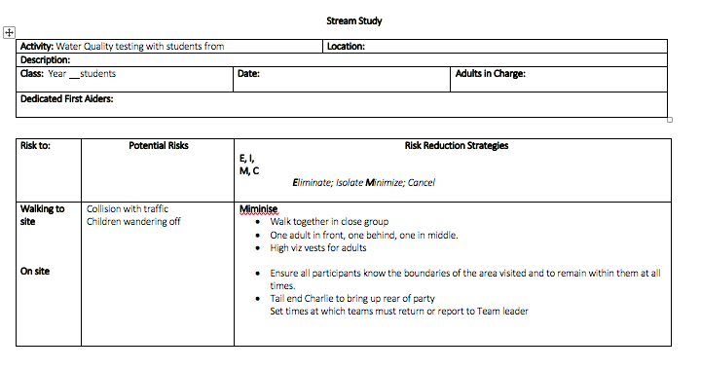
Health and safety
Notes:
Available on our SLACK forum: https://slh-talk.slack.com/archives/CA48YSVRS

Slide 15
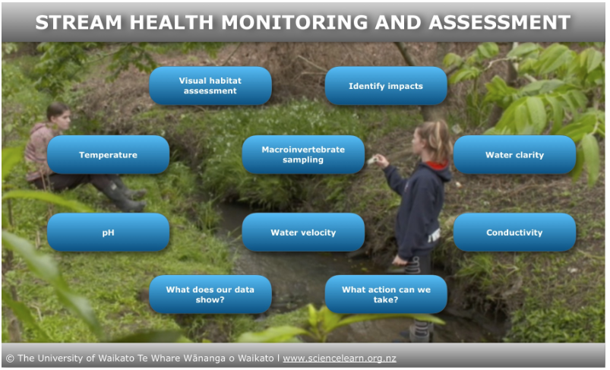
Background image © The University of Waikato Te Whare Wananga o Waikato and Waikato Regional Council
© Copyright. The University of Waikato Te Whare Wananga o Waikato l Science Learning Hub – Pokapū Akoranga Pūtaiao. All Rights Reserved
All images are copyrighted. For further information, please refer to enquiries@sciencelearn.org.nz
Notes:
Stream health monitoring and assessment

Slide 16
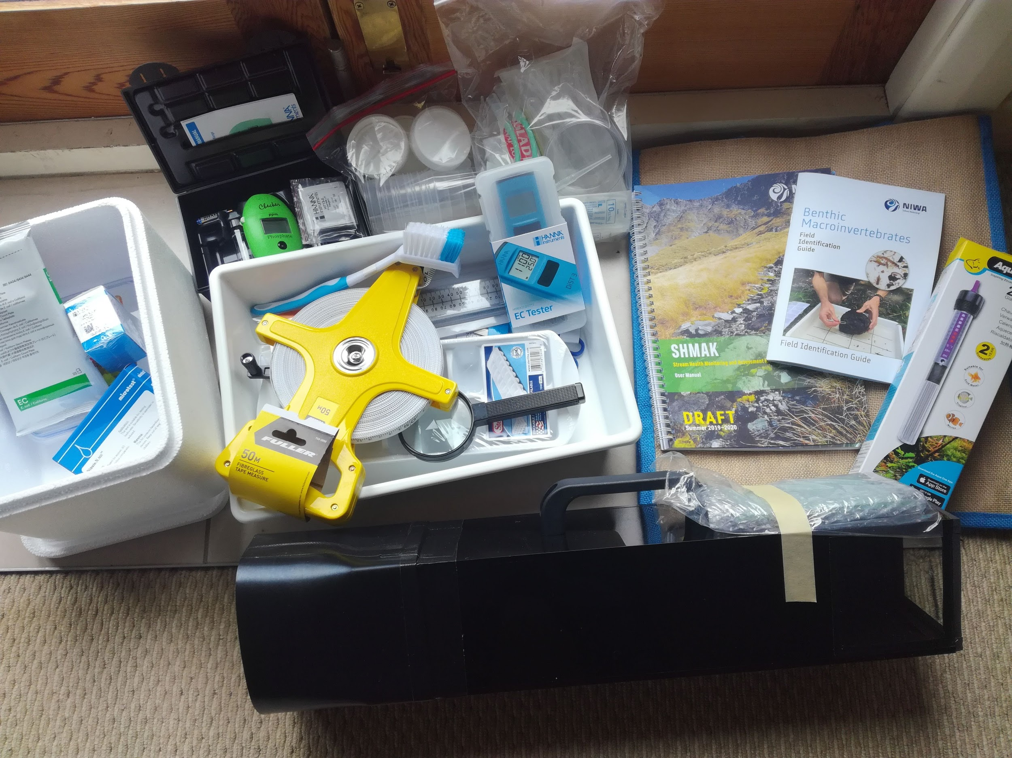
What gear do you need?
© Alex Daniel 2020
© Copyright. The University of Waikato Te Whare Wananga o Waikato l Science Learning Hub – Pokapū Akoranga Pūtaiao. All Rights Reserved
All images are copyrighted. For further information, please refer to enquiries@sciencelearn.org.nz

Slide 17
How do you use the gear?
© Copyright. The University of Waikato Te Whare Wananga o Waikato l Science Learning Hub – Pokapū Akoranga Pūtaiao. All Rights Reserved
All images are copyrighted. For further information, please refer to enquiries@sciencelearn.org.nz
Notes:
Stream health monitoring and assessment

Slide 18
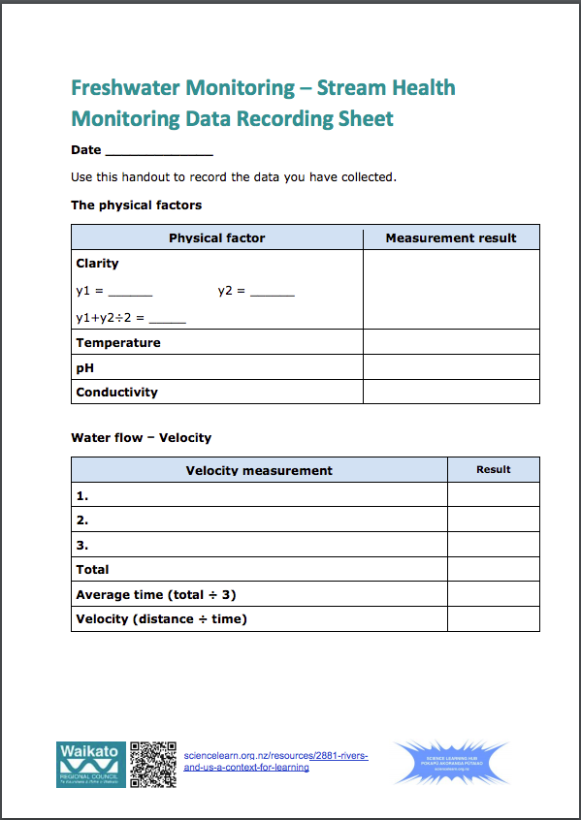
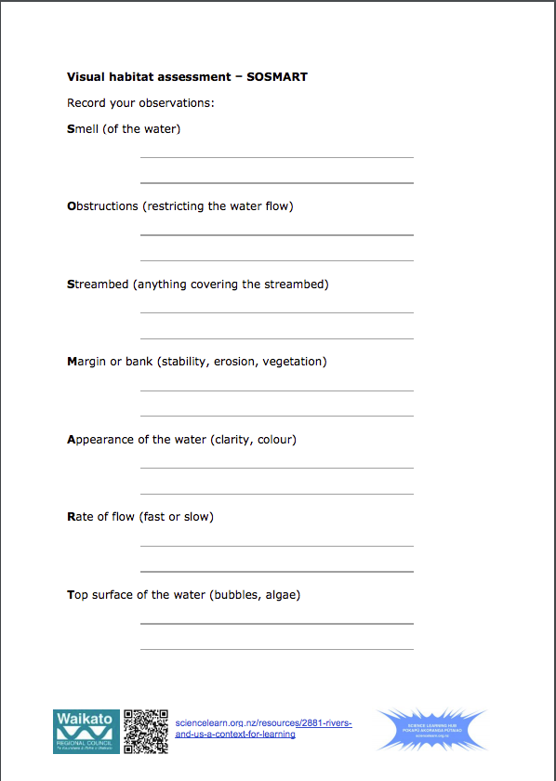
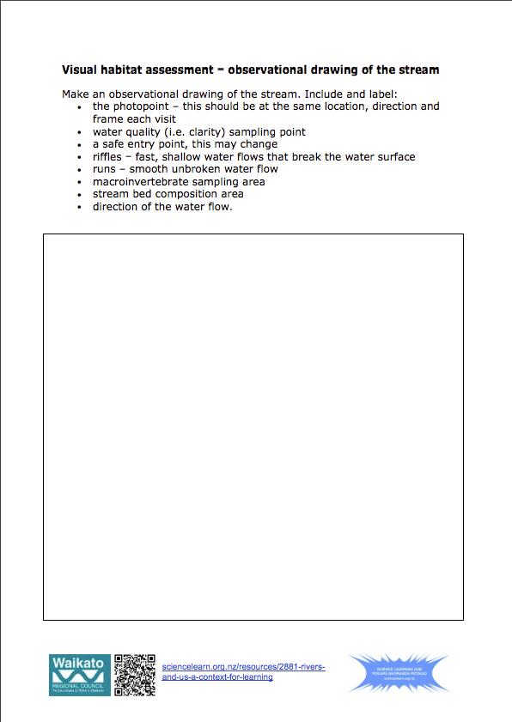
Recording data
Notes:
Freshwater Monitoring – Stream Health Monitoring Data Recording Sheet (PDF download)

Slide 19
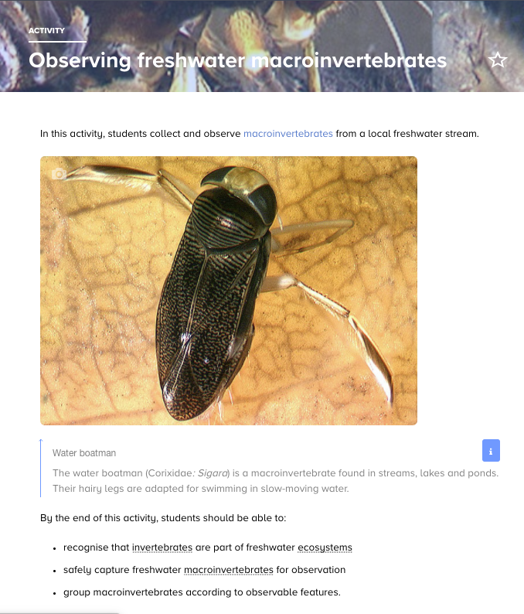
Macroinvertebrates
Notes:
Observing freshwater macroinvertebrates

Slide 20
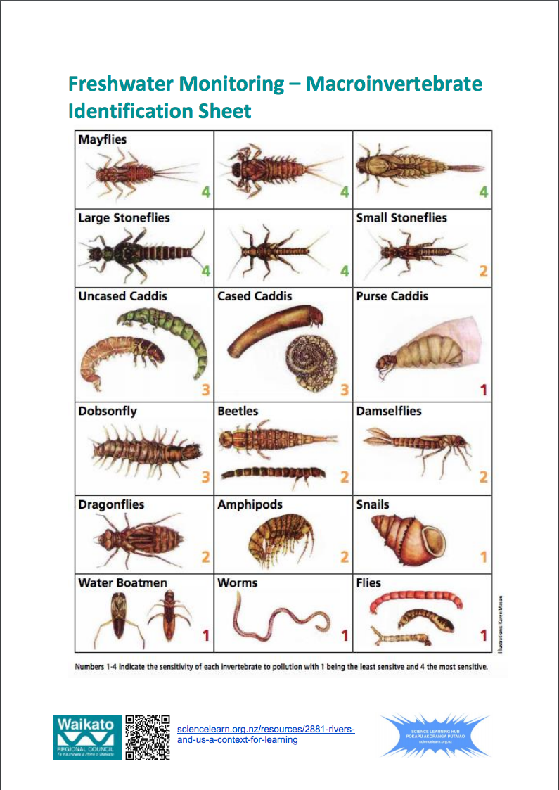
Macroinvertebrates
Notes:
Freshwater Monitoring – Macroinvertebrate Identification Sheet (PDF download)

Slide 21
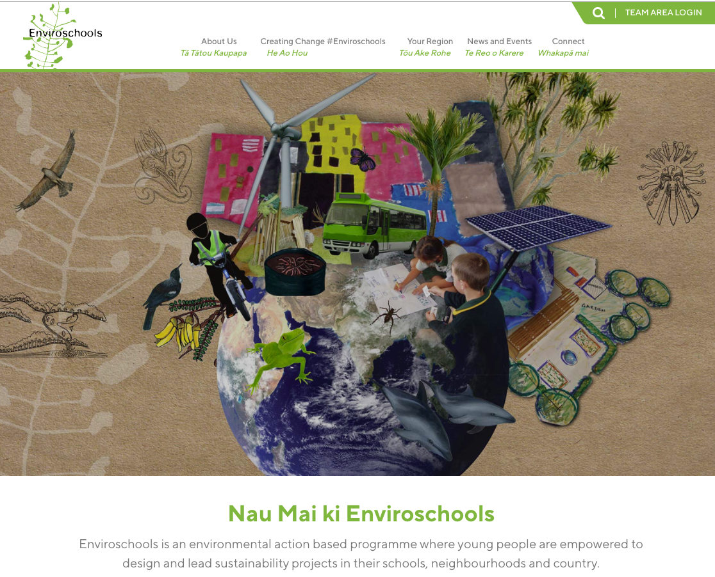
Enviroschools
Notes:
https://enviroschools.org.nz/

Slide 22





Keep in touch
Email us enquiries@sciencelearn.org.nz
https://twitter.com/NZScienceLearn
www.facebook.com/nzsciencelearn
https://nz.pinterest.com/nzsciencelearn
www.instagram.com/sciencelearninghubnz
Join us in our discussion channel on Slack.
(Any problems accessing Slack, please contact us via our enquiries email, enquiries@sciencelearn.org.nz.)
© Copyright. The University of Waikato Te Whare Wananga o Waikato l Science Learning Hub – Pokapū Akoranga Pūtaiao. All Rights Reserved
All images are copyrighted. For further information, please refer to enquiries@sciencelearn.org.nz
Notes:
Don’t forget the SLH can help
SLACK: https://slh-talk.slack.com/messages/CDL529ERW/

