Slide 1
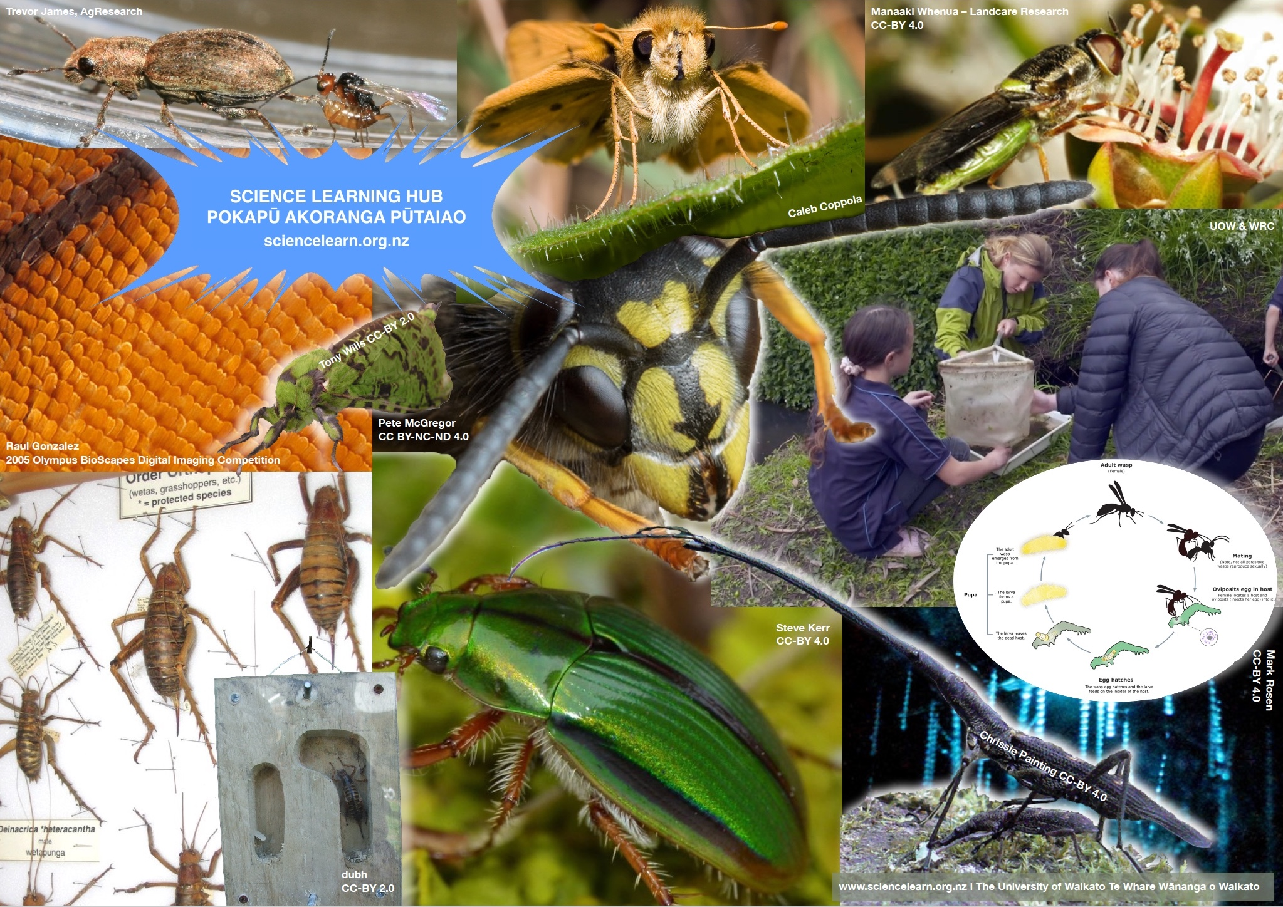
All about insects
© The University of Waikato Te Whare Wananga o Waikato
4–4:45 pm Thursday 22 October
© Copyright. The University of Waikato Te Whare Wananga o Waikato l Science Learning Hub – Pokapū Akoranga Pūtaiao. All Rights Reserved
All images are copyrighted. For further information, please refer to enquiries@sciencelearn.org.nz

Slide 2
Index
Topic | Slideshow number(s ) | Video timecode
Introducing the Science Learning Hub and presenters | 1–7 | 00:00
Index | 2 | 00:23
Weird and wonderful insects | 8 | 02:50
What is an insect? | 9–12 | 07:10
Insect senses | 13–14 | 12:05
Life cycles | 15–16 | 17:20
Why learn about insects? | 17–18 | 22:12
Biodiversity | 19–20 | 23:27
The roles of insects | 21–24 | 27:01
Getting hands-on | 25–28 | 35:56
Insects and other learning areas | 29–33 | 39:23
SLH links, keep in touch and thanks | 34–36 | 40:56
© Copyright. The University of Waikato Te Whare Wananga o Waikato l Science Learning Hub – Pokapū Akoranga Pūtaiao. All Rights Reserved
All images are copyrighted. For further information, please refer to enquiries@sciencelearn.org.nz.
Notes:
Greta

Slide 3
Pokapū Akoranga Pūtaiao
The Science Learning Hub
A trustworthy online resource – produced by educators and scientists for New Zealand teachers and students.
Based on world-class New Zealand science research.
Supported by learning activities, information about the key science ideas and concepts, multimedia tools and other resources.
© Copyright. The University of Waikato Te Whare Wananga o Waikato l Science Learning Hub – Pokapū Akoranga Pūtaiao. All Rights Reserved
All images are copyrighted. For further information, please refer to enquiries@sciencelearn.org.nz
Notes:
The Science Learning Hub is funded by the New Zealand Government – MBIE Ministry of Business, Innovation and Employment – under the Curious Minds fund

Slide 4
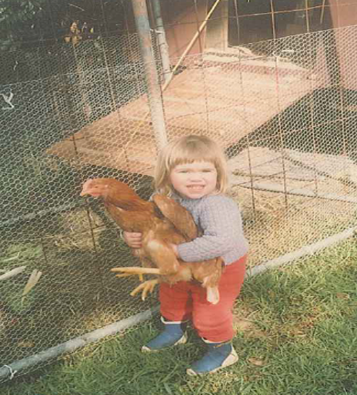
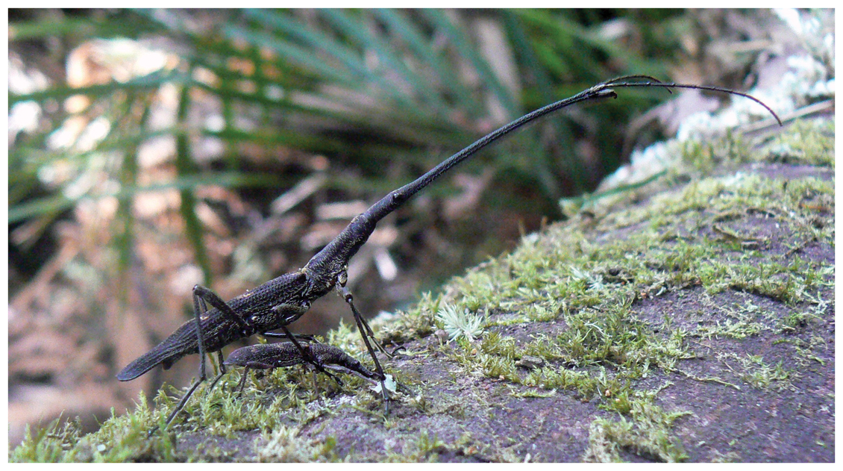
Chrissie Painting
Lecturer at the University of Waikato
© Dr Chrissie Painting
CC BY 3.0
© Dr Chrissie Painting
evolutionary ecologist
interested in invertebrate behaviour and conservation
Contact me:
@cpaintingnz
http://chrissiepainting.com
chrissie.painting@waikato.ac.nz
© Copyright. The University of Waikato Te Whare Wananga o Waikato l Science Learning Hub – Pokapū Akoranga Pūtaiao. All Rights Reserved
All images are copyrighted. For further information, please refer to enquiries@sciencelearn.org.nz
Notes:
https://chrissiepainting.com/
www.sciencelearn.org.nz/images/4171-new-zealand-giraffe-weevil

Slide 5
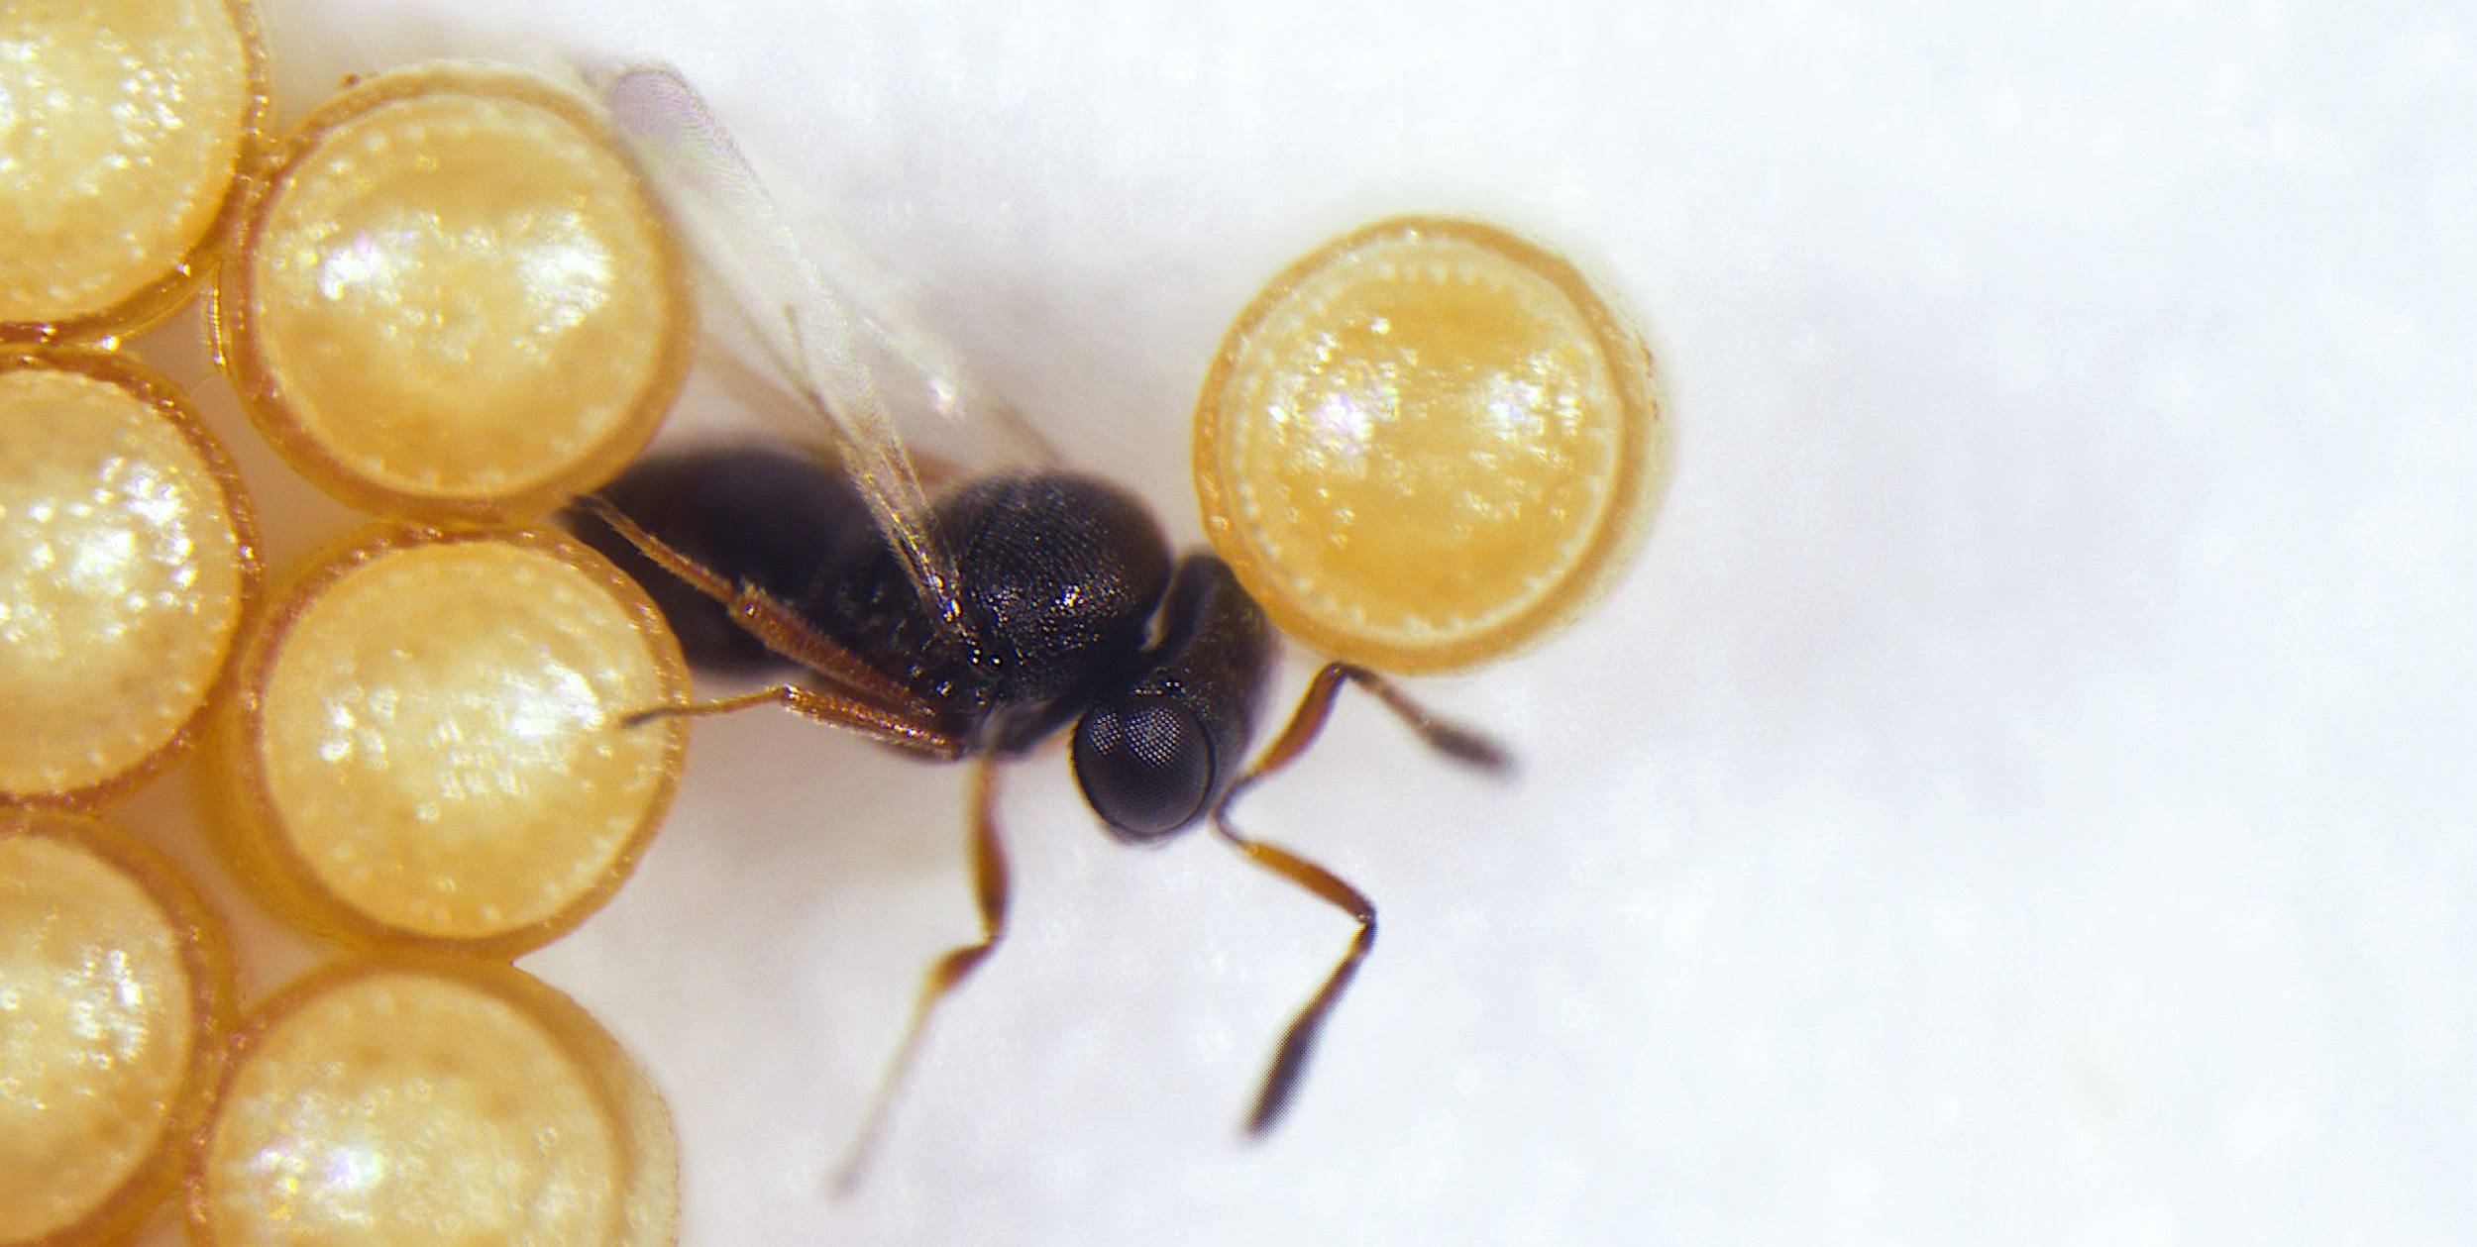
Tom Saunders
PhD candidate, biological control
loves parasitoids
Contact me:
TomSaunders.co.nz
@TomSaundersNZ
tsau017@aucklanduni.ac.nz
© Tom Saunders
© Copyright. The University of Waikato Te Whare Wananga o Waikato l Science Learning Hub – Pokapū Akoranga Pūtaiao. All Rights Reserved
All images are copyrighted. For further information, please refer to enquiries@sciencelearn.org.nz
Notes:
https://tomsaunders.co.nz/

Slide 6
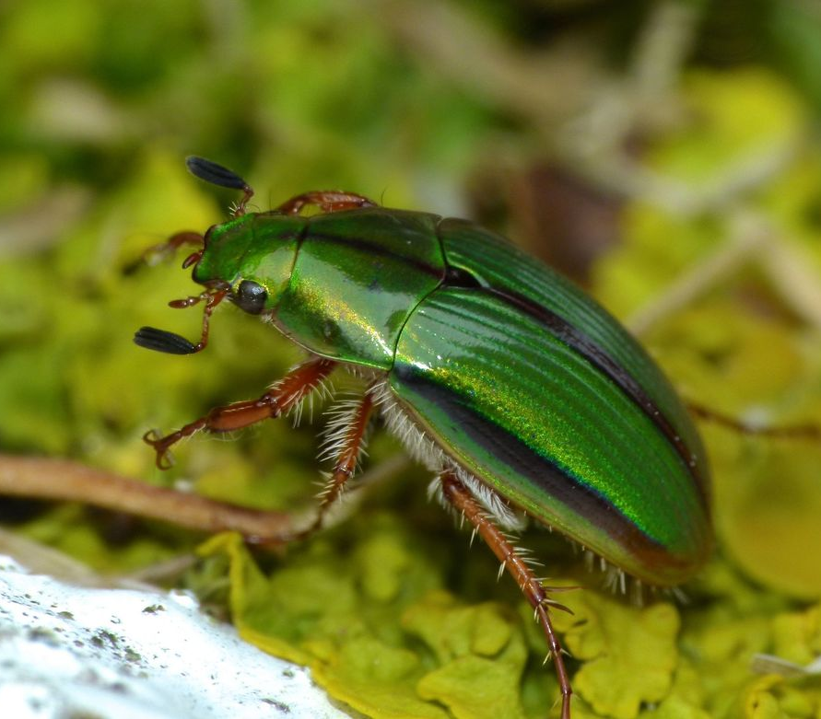
Purpose
To get you excited about teaching with insects
To share ideas and resources to support you in (or out of) the classroom
Answer your questions about teaching with insects
© Steve Kerr, CC BY 4.0
© Copyright. The University of Waikato Te Whare Wananga o Waikato l Science Learning Hub – Pokapū Akoranga Pūtaiao. All Rights Reserved
All images are copyrighted. For further information, please refer to enquiries@sciencelearn.org.nz
Notes:
Greta
Image: Mānuka beetle (Pyronota festiva), https://www.sciencelearn.org.nz/images/4178-manuka-beetle-pyronota-festiva

Slide 7
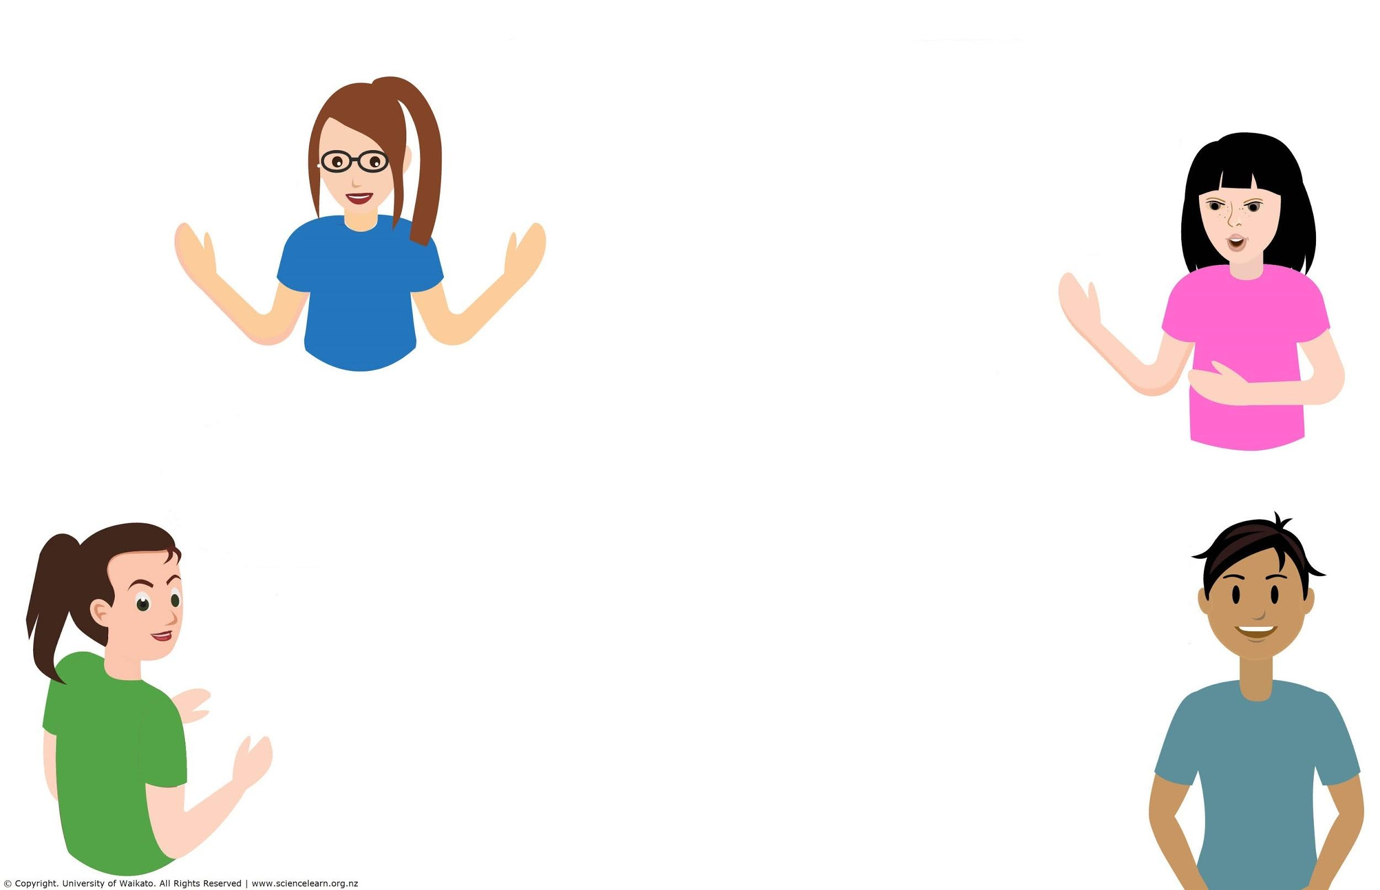
Questions from registration
Taxonomy?
Do the benefits of insects existence outweigh the negatives?
Best tools for students to use to encourage accurate identification?
Why is it important to learn about insects ?
Do you allow students to touch insects?
Can they be used to determine changes to the environment due to deforestation, dairy farming, climate change, etc?
Is there a way of keeping an already dead insect in class for observation without it smelling, in other words a way of preserving it?
© Copyright. The University of Waikato Te Whare Wananga o Waikato l Science Learning Hub – Pokapū Akoranga Pūtaiao. All Rights Reserved
All images are copyrighted. For further information, please refer to enquiries@sciencelearn.org.nz
Notes:
Greta

Slide 8
Weird and wonderful insects
© Copyright. The University of Waikato Te Whare Wananga o Waikato l Science Learning Hub – Pokapū Akoranga Pūtaiao. All Rights Reserved
All images are copyrighted. For further information, please refer to enquiries@sciencelearn.org.nz
Notes:
www.sciencelearn.org.nz/resources/1196-angry-wasp-versus-hungry-ant

Slide 9
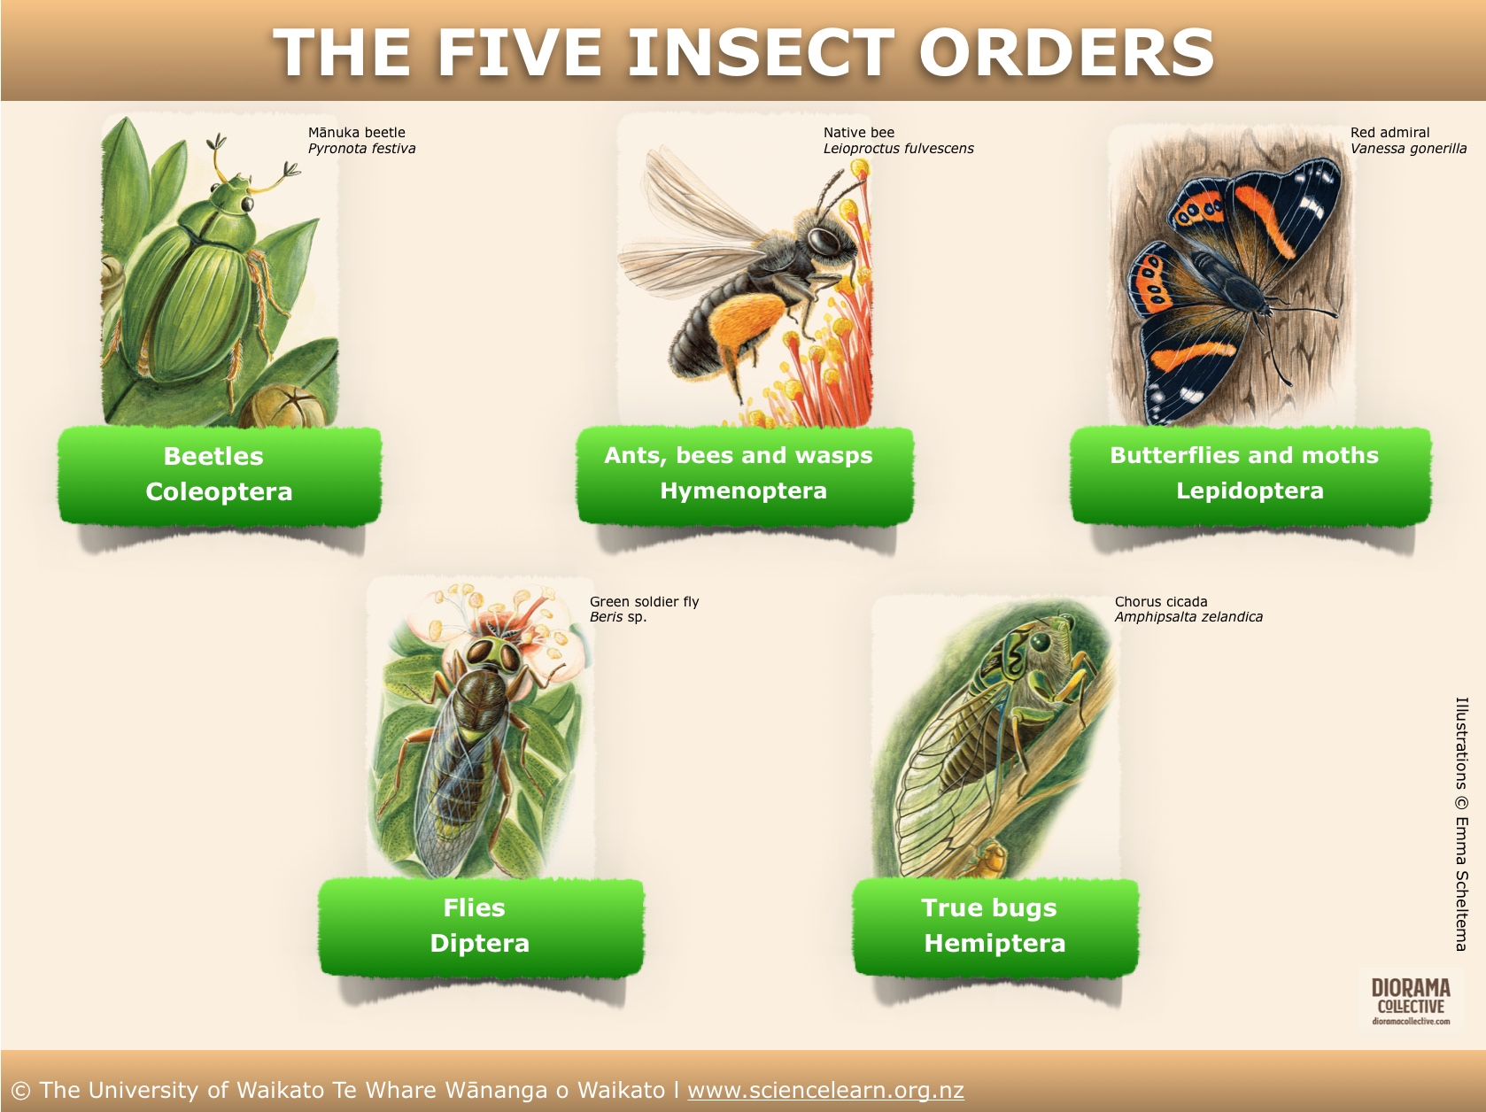
What is an insect?
© Copyright. The University of Waikato Te Whare Wananga o Waikato l Science Learning Hub – Pokapū Akoranga Pūtaiao. All Rights Reserved
All images are copyrighted. For further information, please refer to enquiries@sciencelearn.org.nz
Notes:
5 MOST DIVERSE insect orders
www.sciencelearn.org.nz/resources/2840-insect-taxonomy
https://static.sciencelearn.org.nz/documents/files/000/000/807/original/Which_insect_is_that.pdf?1573008211

Slide 10
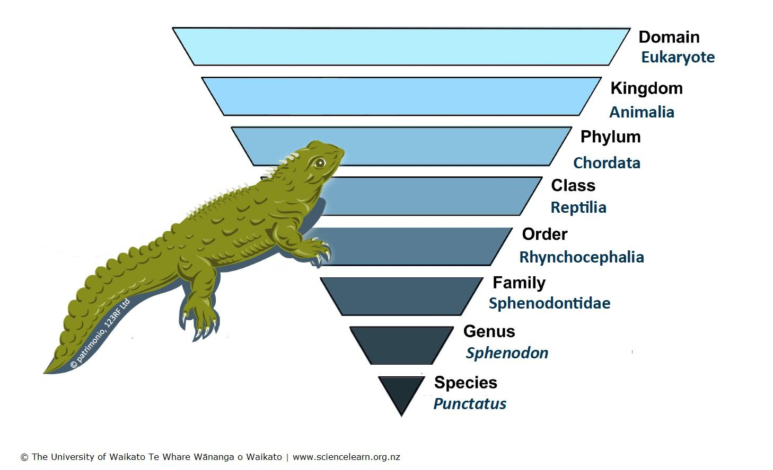
Classification
https://nzacfactsheets.landcareresearch.co.nz
www.landcareresearch.co.nz
© Copyright. The University of Waikato Te Whare Wananga o Waikato l Science Learning Hub – Pokapū Akoranga Pūtaiao. All Rights Reserved
All images are copyrighted. For further information, please refer to enquiries@sciencelearn.org.nz
Notes:
Taxonomic diagram www.sciencelearn.org.nz/images/4445-tuatara-classification
2. Permission for the MWLR images/logo from parkdj@landcareresearch.co.nz

Slide 11
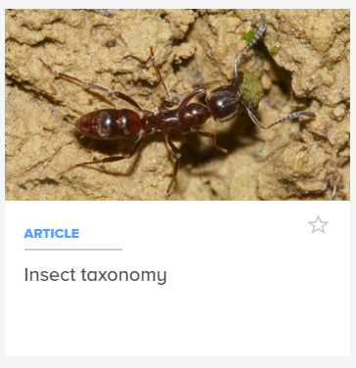
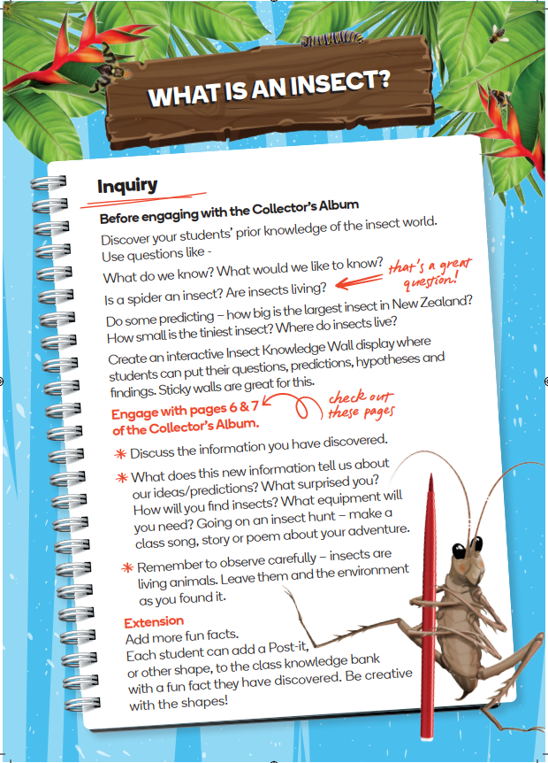
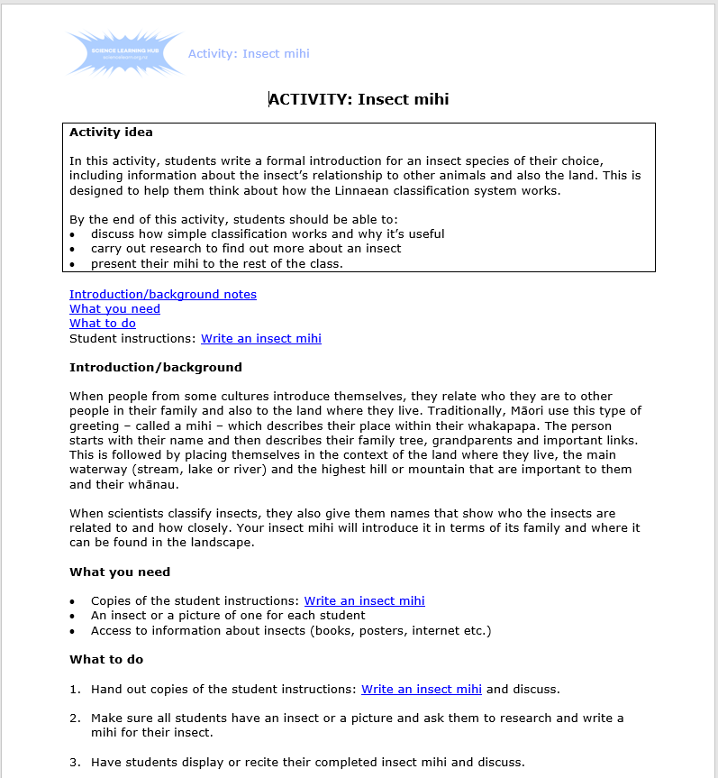
What is an insect?
Taxonomy?
What are the best tools for students to use to encourage accurate identification?
© Uwe Schneehagen/CC BY-NC 4.0
Sourced from iNaturalistNZ
© Copyright. The University of Waikato Te Whare Wananga o Waikato l Science Learning Hub – Pokapū Akoranga Pūtaiao. All Rights Reserved
All images are copyrighted. For further information, please refer to enquiries@sciencelearn.org.nz
Notes:
Article: www.sciencelearn.org.nz/resources/2840-insect-taxonomy
Super insect cards: www.sciencelearn.org.nz/resources/2953-super-insects
Insect mihi: www.sciencelearn.org.nz/resources/1447-insect-mihi
What is this bug? » Manaaki Whenua
iNaturalist?

Slide 12
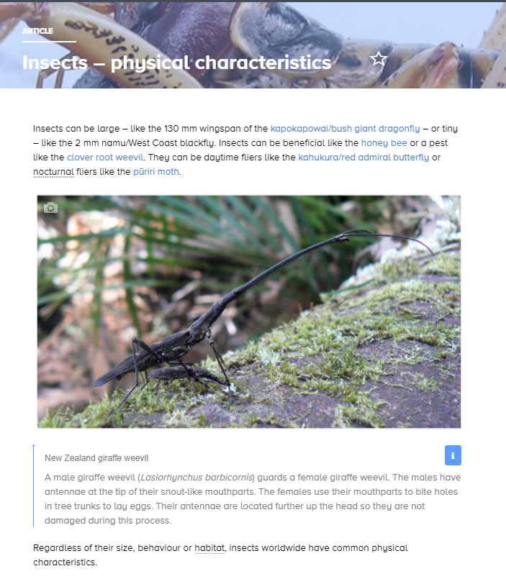
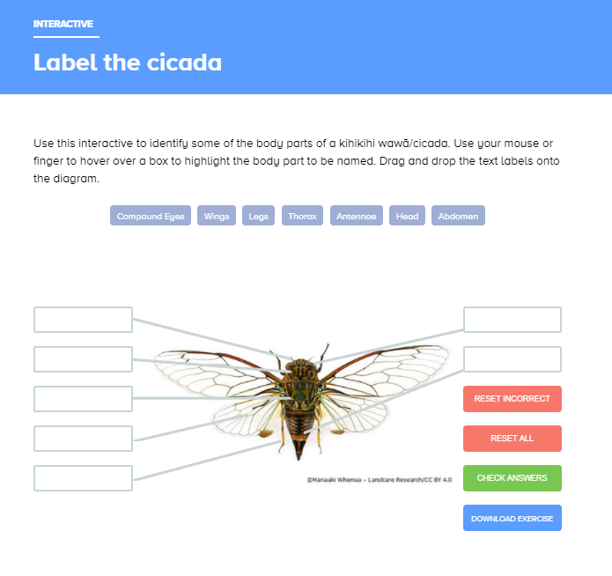
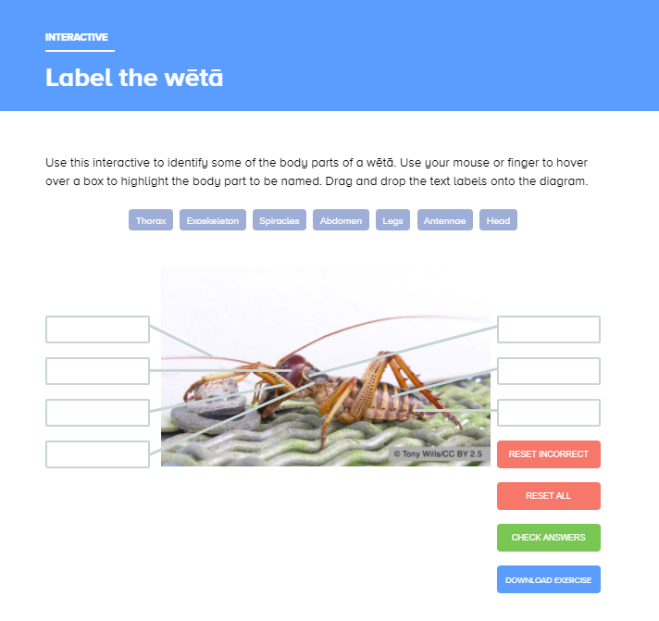
Body bits
© Dr Chrissie Painting
© Copyright. The University of Waikato Te Whare Wananga o Waikato l Science Learning Hub – Pokapū Akoranga Pūtaiao. All Rights Reserved
All images are copyrighted. For further information, please refer to enquiries@sciencelearn.org.nz
Notes:
www.sciencelearn.org.nz/resources/2842-insects-physical-characteristics
www.sciencelearn.org.nz/resources/2843-label-the-insect

Slide 13
Insect senses
© UOW/Manaaki Whenua — Landcare Research
Photographs by Birgit Rhodes
© Copyright. The University of Waikato Te Whare Wananga o Waikato l Science Learning Hub – Pokapū Akoranga Pūtaiao. All Rights Reserved
All images are copyrighted. For further information, please refer to enquiries@sciencelearn.org.nz
Notes:
www.sciencelearn.org.nz/resources/2756-insect-antennae

Slide 14
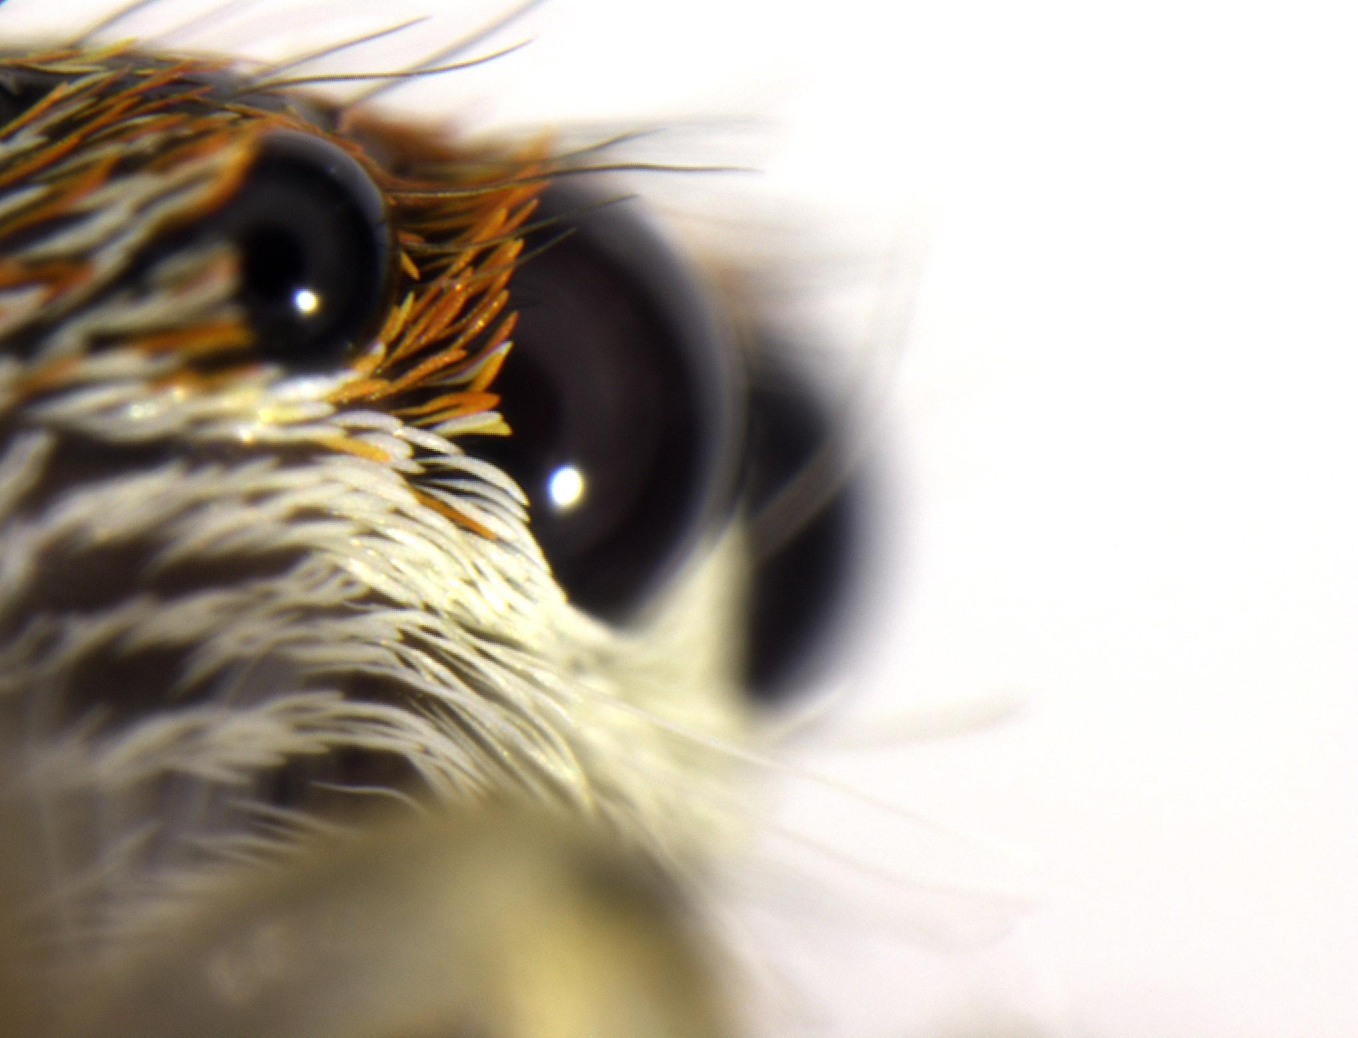
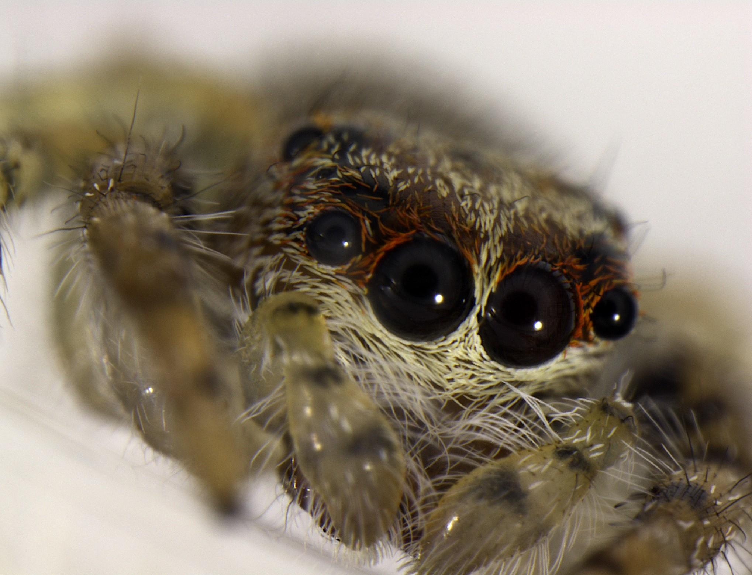
Insect senses
© Tom Saunders
© Copyright. The University of Waikato Te Whare Wananga o Waikato l Science Learning Hub – Pokapū Akoranga Pūtaiao. All Rights Reserved
All images are copyrighted. For further information, please refer to enquiries@sciencelearn.org.nz

Slide 15
Insect life cycles
Notes:
www.sciencelearn.org.nz/image_maps/48-monarch-butterfly-life-cycle
www.sciencelearn.org.nz/resources/2770-parasitoid-wasp-life-cycle

Slide 16
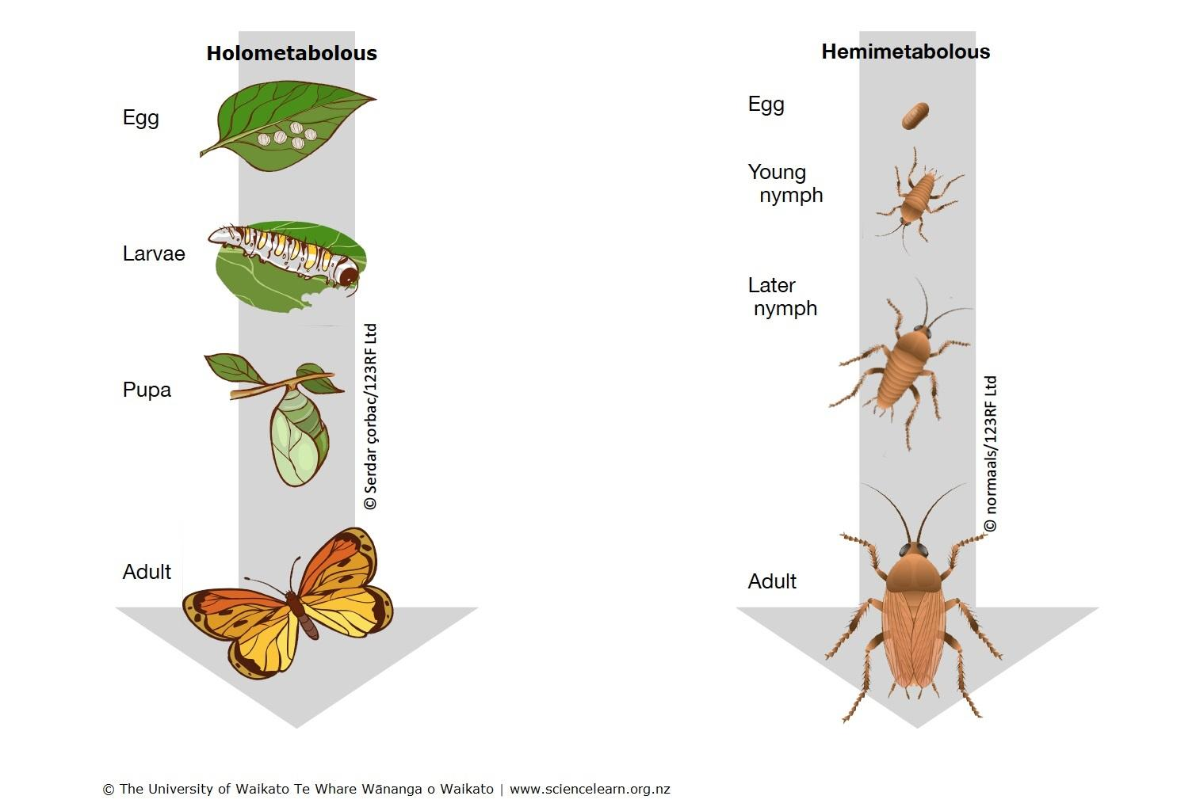
Insect life cycles
Username1927 (CC BY-SA) / Wikimedia Commons
Notes:
Images: www.sciencelearn.org.nz/images/4446-insect-metamorphosis

Slide 17
Why learn about insects
Why is it important to learn about insects?
Photo: James Gathany
© Copyright. The University of Waikato Te Whare Wananga o Waikato l Science Learning Hub – Pokapū Akoranga Pūtaiao. All Rights Reserved
All images are copyrighted. For further information, please refer to enquiries@sciencelearn.org.nz
Notes:
Article: www.sciencelearn.org.nz/resources/2839-what-s-so-special-about-insects

Slide 18
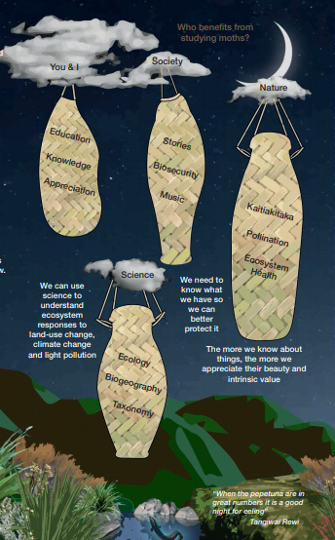
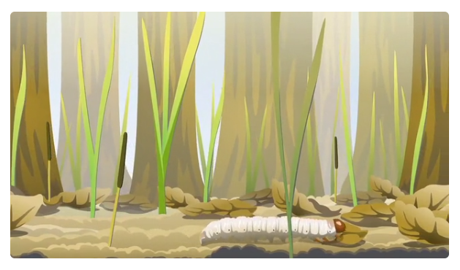
Insects and te ao Māori
© Ahi Pepe MothNet
© Copyright. The University of Waikato Te Whare Wananga o Waikato l Science Learning Hub – Pokapū Akoranga Pūtaiao. All Rights Reserved
All images are copyrighted. For further information, please refer to enquiries@sciencelearn.org.nz
Notes:
Mothnet guides: https://mothnet.org/assets/Guides/Guide-Downloads/Beginners-Guide-to-Macro-Moths-Te-Taurapa.pdf
www.sciencelearn.org.nz/videos/1840-mummified-caterpillar
What is te aitanga pepeke?
Origin of Insects

Slide 19
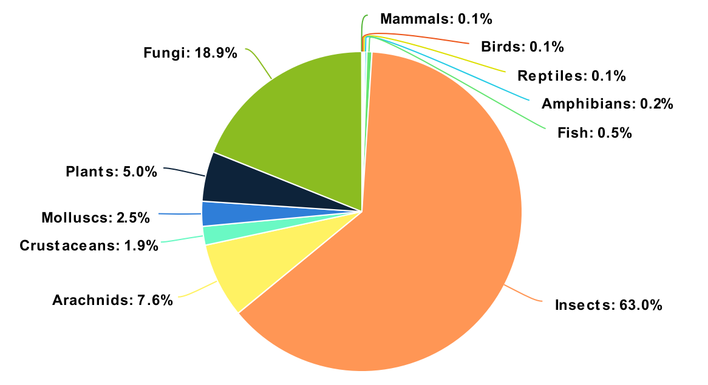
Biodiversity
Total estimated diversity:
© Tom Saunders
© Copyright. The University of Waikato Te Whare Wananga o Waikato l Science Learning Hub – Pokapū Akoranga Pūtaiao. All Rights Reserved
All images are copyrighted. For further information, please refer to enquiries@sciencelearn.org.nz

Slide 20
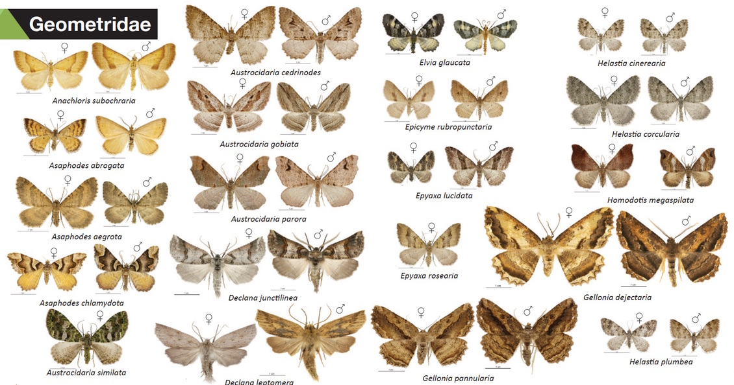
Biodiversity
© Ahi Pepe MothNet
© Copyright. The University of Waikato Te Whare Wananga o Waikato l Science Learning Hub – Pokapū Akoranga Pūtaiao. All Rights Reserved
All images are copyrighted. For further information, please refer to enquiries@sciencelearn.org.nz

Slide 21
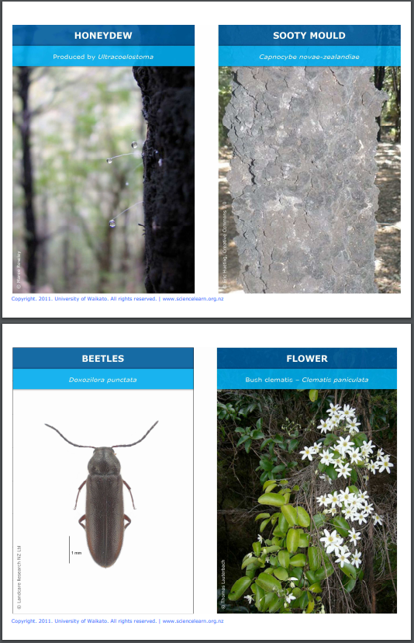
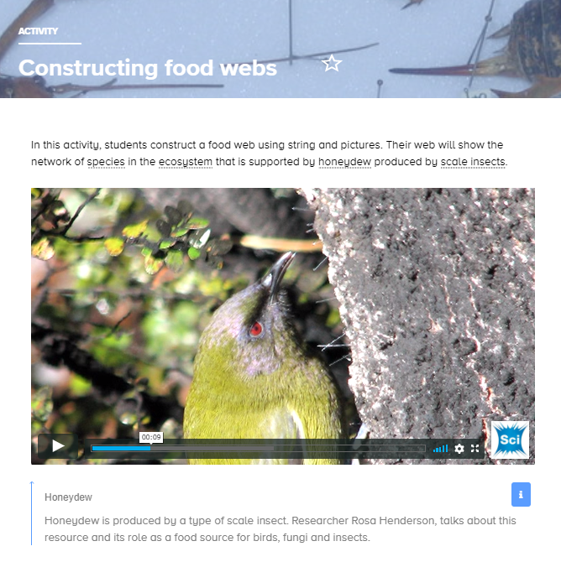
What roles do insects play?
Do the benefits of insects existence outweigh the negatives?
Can they be used to determine changes to the environment due to deforestation, dairy farming, climate change, etc?
© Copyright. The University of Waikato Te Whare Wananga o Waikato l Science Learning Hub – Pokapū Akoranga Pūtaiao. All Rights Reserved
All images are copyrighted. For further information, please refer to enquiries@sciencelearn.org.nz
Notes:
www.sciencelearn.org.nz/resources/1453-constructing-food-webs
https://commons.wikimedia.org/wiki/File:Bellbird_feeding_on_mountain_beech_honeydew.jpg

Slide 22
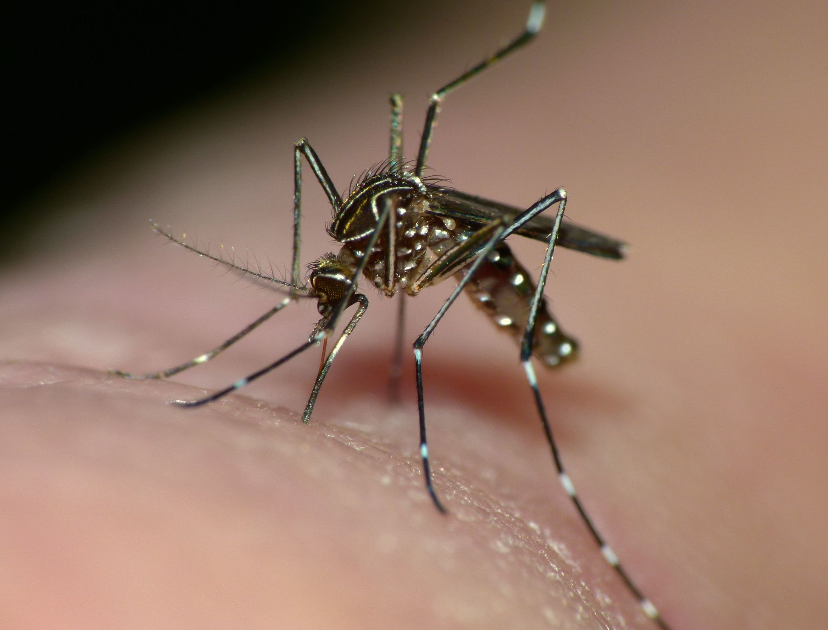
Problems with insects
disease vectors
malaria
typhus
dengue fever
sleeping sickness
crop pests
bites and stings
damage property
Steve Kerr (CC BY) / iNaturalist
© Copyright. The University of Waikato Te Whare Wananga o Waikato l Science Learning Hub – Pokapū Akoranga Pūtaiao. All Rights Reserved
All images are copyrighted. For further information, please refer to enquiries@sciencelearn.org.nz

Slide 23
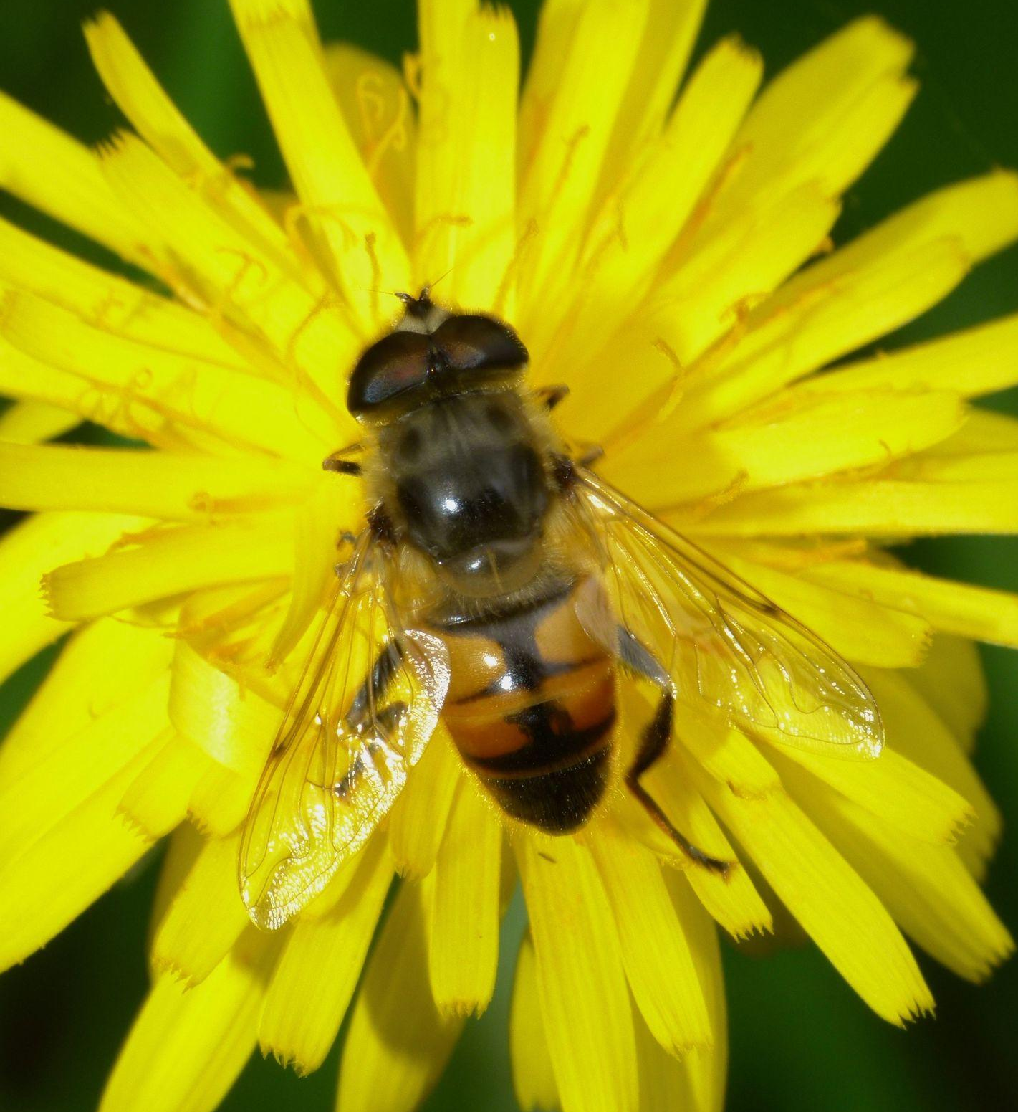
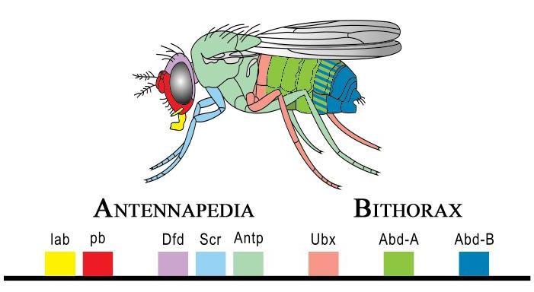
Benefits of insects
pollination
honey, shellac, edible insects
recycle nutrients
biological control of pests
research
forensics
medicine
Steve Kerr (CC BY) / iNaturalist
Public domain / Wikimedia Commons
© Copyright. The University of Waikato Te Whare Wananga o Waikato l Science Learning Hub – Pokapū Akoranga Pūtaiao. All Rights Reserved
All images are copyrighted. For further information, please refer to enquiries@sciencelearn.org.nz

Slide 24
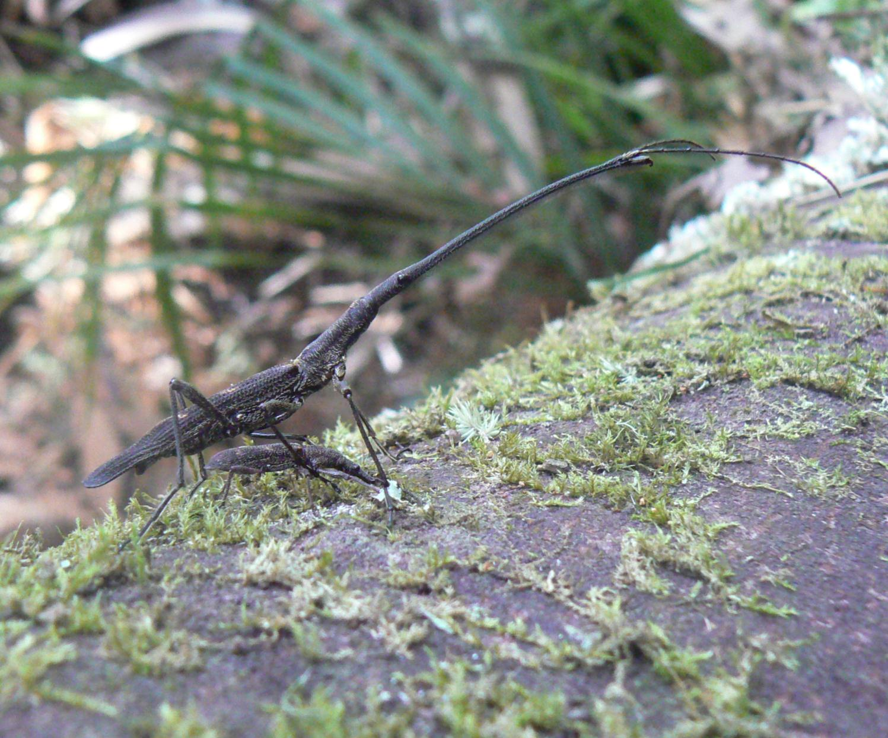
Insects in New Zealand
© Dr Chrissie Painting
© Copyright. The University of Waikato Te Whare Wananga o Waikato l Science Learning Hub – Pokapū Akoranga Pūtaiao. All Rights Reserved
All images are copyrighted. For further information, please refer to enquiries@sciencelearn.org.nz

Slide 25
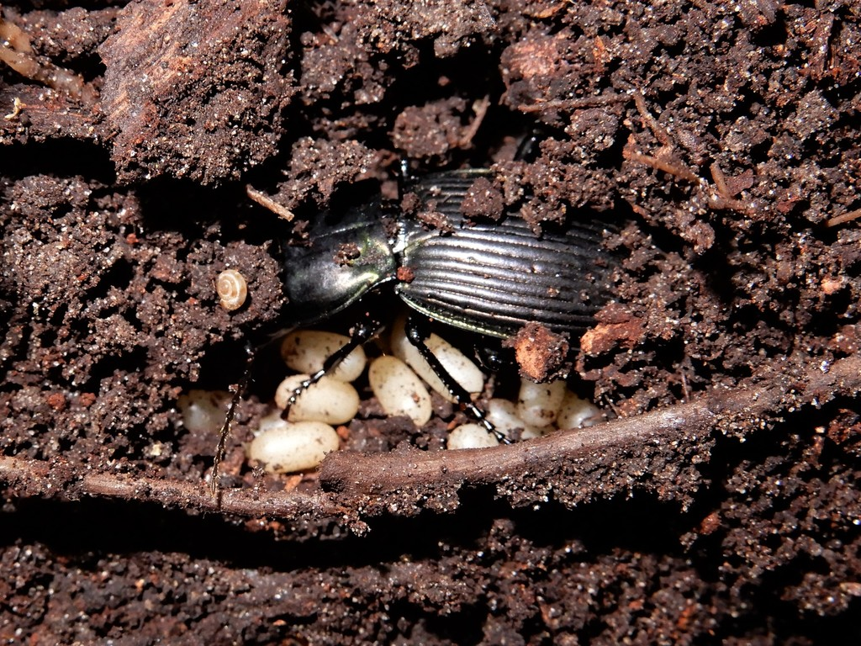
Finding and catching
check flowers/fruits in summer for pollinators or herbivores
under rocks, rotten logs
window sills, fences, attracted to light at night
simple pan trap
© Grey Smith CC BY-NC / iNaturlist
© Copyright. The University of Waikato Te Whare Wananga o Waikato l Science Learning Hub – Pokapū Akoranga Pūtaiao. All Rights Reserved
All images are copyrighted. For further information, please refer to enquiries@sciencelearn.org.nz

Slide 26
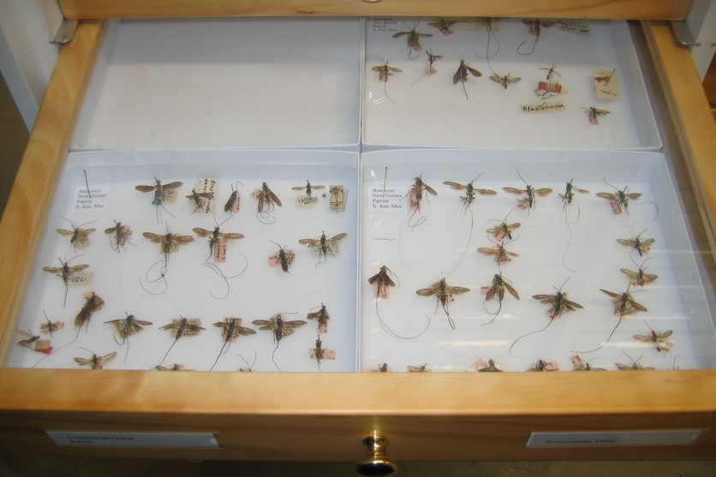
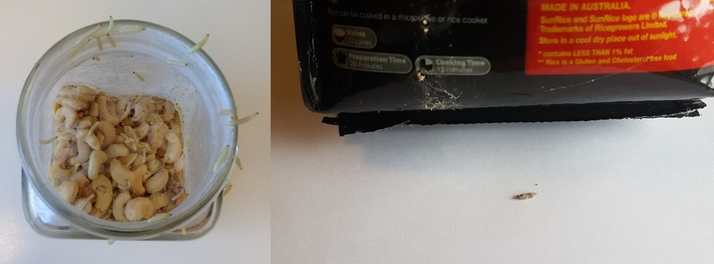
Getting hands-on
Do you allow students to touch insects?
Is there a way of keeping an already dead insect in class for observation without it smelling, in other words a way of preserving it?
rearing or caring for
preserving
© Copyright. The University of Waikato Te Whare Wananga o Waikato l Science Learning Hub – Pokapū Akoranga Pūtaiao. All Rights Reserved
All images are copyrighted. For further information, please refer to enquiries@sciencelearn.org.nz
Notes:
www.sciencelearn.org.nz/resources/2443-rearing-moths-to-observe-life-cycles

Slide 27
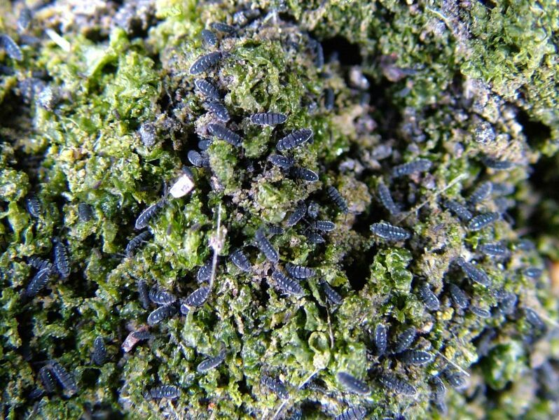
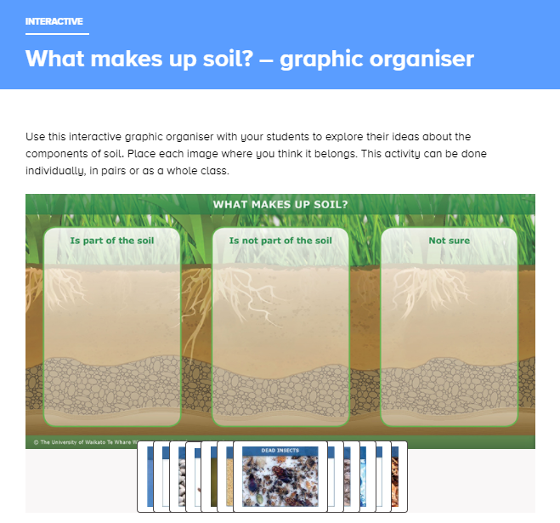
Soil insects
(and other arthropods)
C Beard, Antarctica NZ Pictorial Collection K002 04/05
© Copyright. The University of Waikato Te Whare Wananga o Waikato l Science Learning Hub – Pokapū Akoranga Pūtaiao. All Rights Reserved
All images are copyrighted. For further information, please refer to enquiries@sciencelearn.org.nz
Notes:
Image: Springtails www.sciencelearn.org.nz/images/1056-springtails
Interactive: www.sciencelearn.org.nz/drag_and_drops/9-what-makes-up-soil-graphic-organiser
http://soilbugs.massey.ac.nz/insecta.php

Slide 28
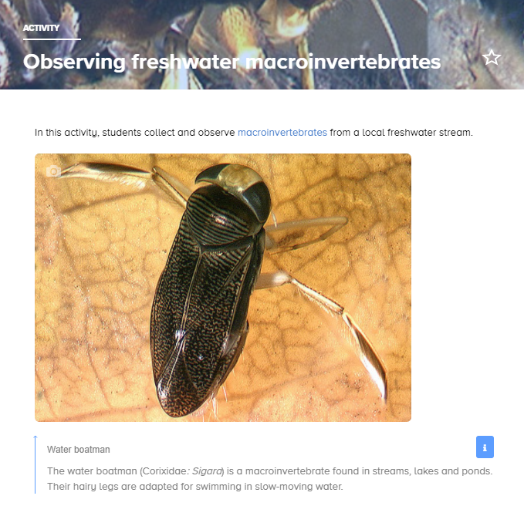
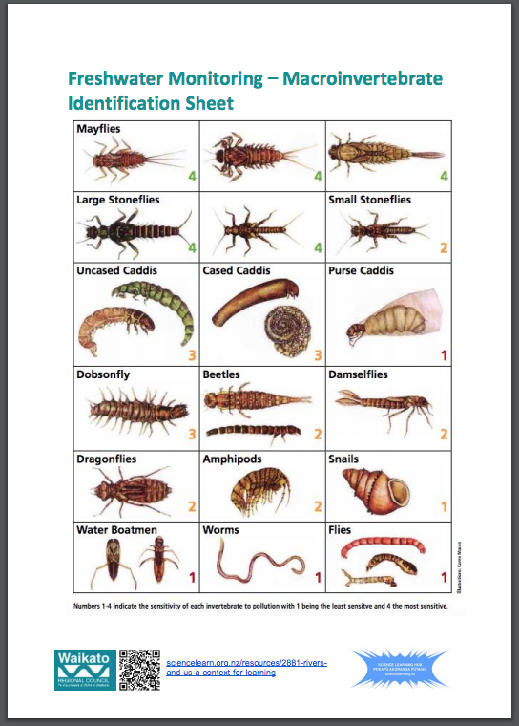
Aquatic insects
Manaaki Whenua – Landcare Research
CC BY 4.0
© Copyright. The University of Waikato Te Whare Wananga o Waikato l Science Learning Hub – Pokapū Akoranga Pūtaiao. All Rights Reserved
All images are copyrighted. For further information, please refer to enquiries@sciencelearn.org.nz
Notes:
https://static.sciencelearn.org.nz/documents/files/000/000/814/original/Freshwater_monitoring_%E2%80%93_Macroinvertebrate_Identification_Sheet_v2.pdf?1598846812
www.sciencelearn.org.nz/image_maps/85-new-zealand-aquatic-insects
Poster: https://www.sciencelearn.org.nz/system/documents/files/000/000/806/original/Aquatic_insect_life.pdf?1573008110

Slide 29
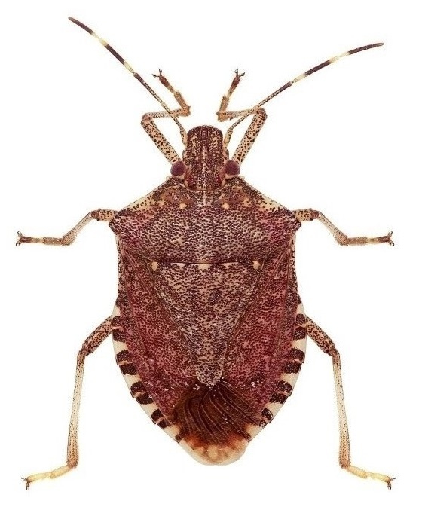
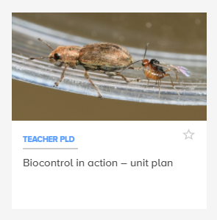
Biosecurity
© Dr Trevor James, AgResearch
© Copyright. The University of Waikato Te Whare Wananga o Waikato l Science Learning Hub – Pokapū Akoranga Pūtaiao. All Rights Reserved
All images are copyrighted. For further information, please refer to enquiries@sciencelearn.org.nz
Notes:
www.sciencelearn.org.nz/images/4141-brown-marmorated-stink-bug
www.sciencelearn.org.nz/resources/1742-biocontrol-in-action-unit-plan

Slide 30
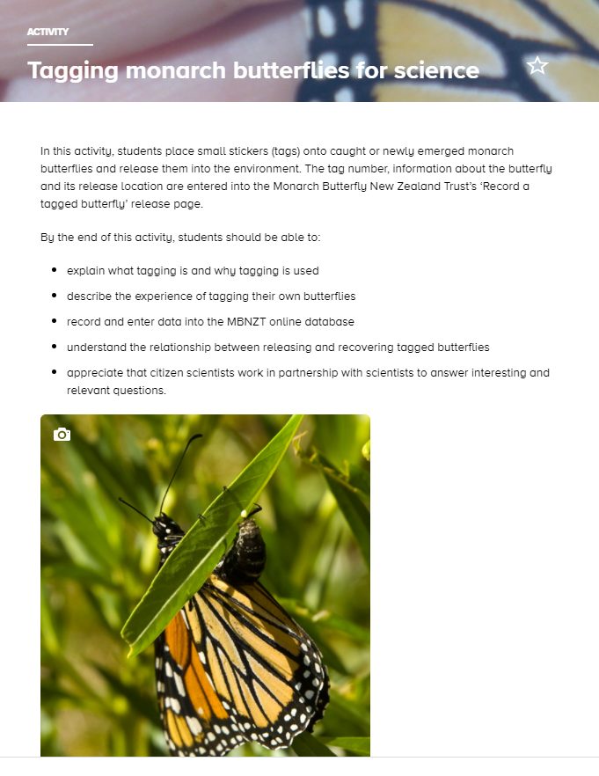
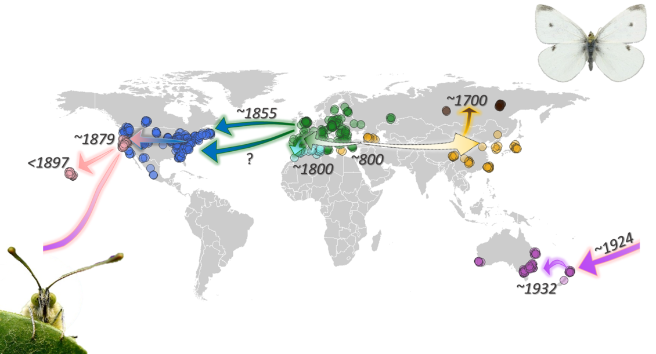
Citizen science projects
© Keith Moore
Monarch Butterfly NZ Trust
© The Pieris Project
© Copyright. The University of Waikato Te Whare Wananga o Waikato l Science Learning Hub – Pokapū Akoranga Pūtaiao. All Rights Reserved
All images are copyrighted. For further information, please refer to enquiries@sciencelearn.org.nz
Notes:
www.sciencelearn.org.nz/resources/700-tagging-monarch-butterflies-for-science
www.nzbutterflies.org.nz/introduction-to-research/taggingtransects/
www.sciencelearn.org.nz/resources/2793-the-pieris-project

Slide 31
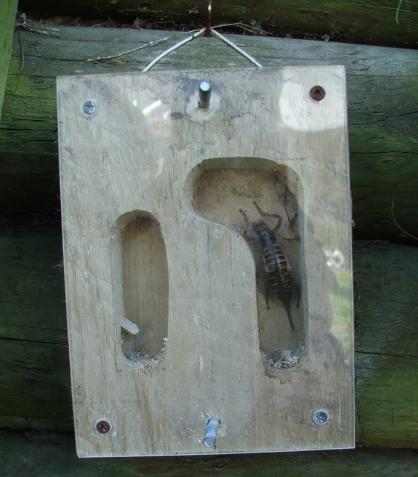
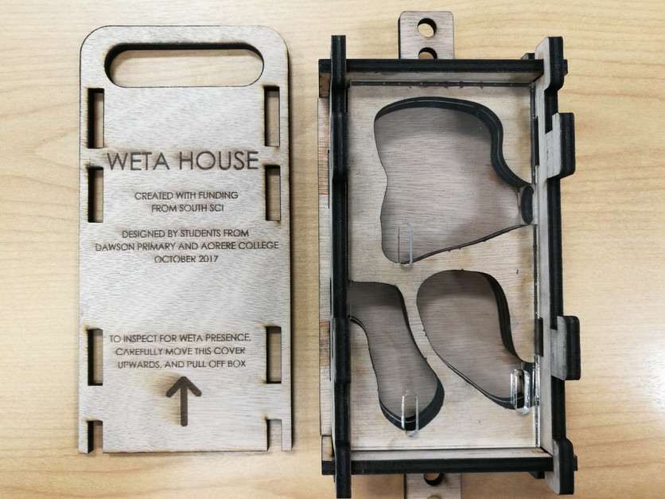
Insects and technology
© Dawson Primary School
© dubd, CC BY 2.0
© Copyright. The University of Waikato Te Whare Wananga o Waikato l Science Learning Hub – Pokapū Akoranga Pūtaiao. All Rights Reserved
All images are copyrighted. For further information, please refer to enquiries@sciencelearn.org.nz
Notes:
www.sciencelearn.org.nz/resources/1964-building-homes-for-tree-weta
www.sciencelearn.org.nz/resources/2622-redesigning-weta-houses

Slide 32
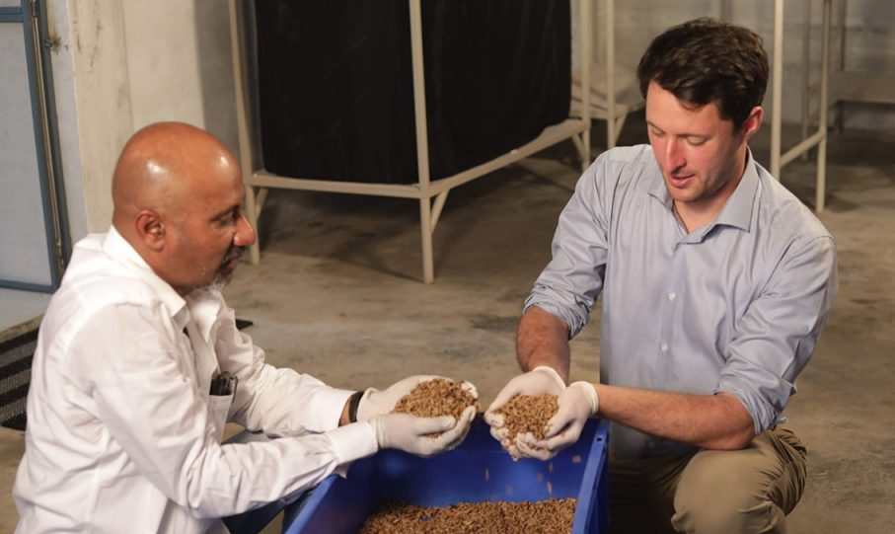
Insects and waste
© Neil Birrell
© Copyright. The University of Waikato Te Whare Wananga o Waikato l Science Learning Hub – Pokapū Akoranga Pūtaiao. All Rights Reserved
All images are copyrighted. For further information, please refer to enquiries@sciencelearn.org.nz

Slide 33
Art and insects
© Copyright. The University of Waikato Te Whare Wananga o Waikato l Science Learning Hub – Pokapū Akoranga Pūtaiao. All Rights Reserved
All images are copyrighted. For further information, please refer to enquiries@sciencelearn.org.nz
Notes:
Insect photography
www.123rf.com/stock-photo/clay_insect.html?oriSearch=children+insect+drawing&sti=lns0mebzi66avppsm3|&mediapopup=116277860
Diorama collective: https://static.sciencelearn.org.nz/documents/files/000/000/807/original/Which_insect_is_that.pdf?1573008211
www.eventfinda.co.nz/2019/holiday-craft-workshop-create-your-own-imaginary-insects/auckland/kohimarama
https://thekidshouldseethis.com/post/soil-ecology-claymation-maxwell-helmberger
https://www.tepapa.govt.nz/sites/default/files/buglab-brochure.pdf

Slide 34
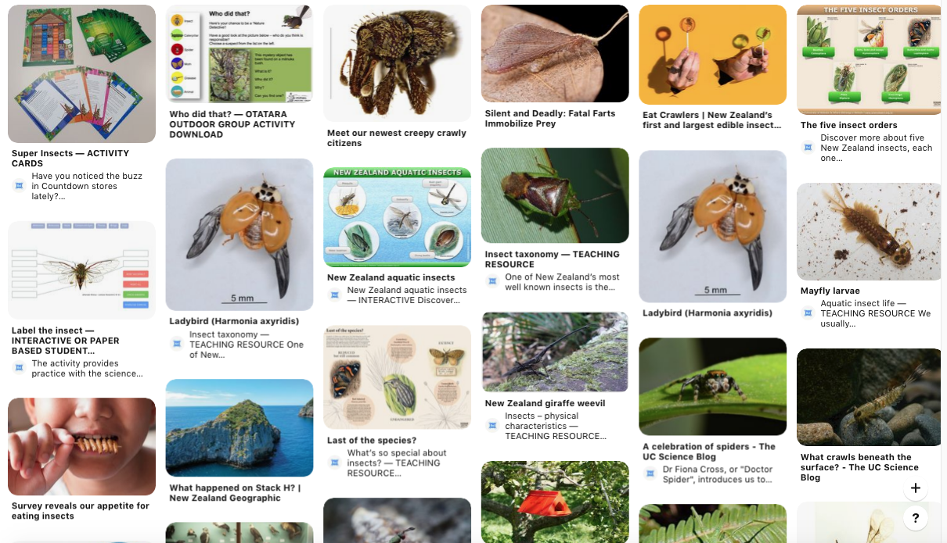
Useful links
Notes:
https://www.pinterest.co.uk/nzsciencelearn/we-bugs/?autologin=true

Slide 35
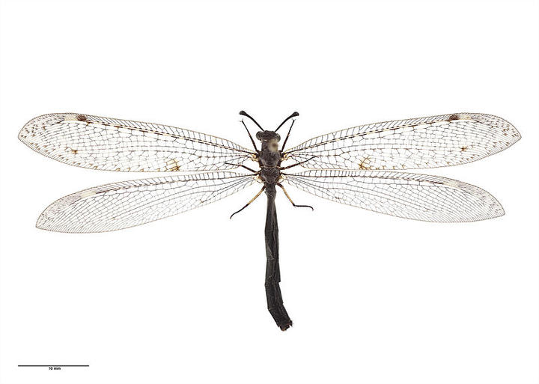
Useful links
Living World – Insects
National Library: Topic Explorer - Insects and Minibeasts | Services to Schools
Te Papa: It's a Bug's Life science resource for ECE and Primary
The genius of bugs
DOC Minibeasts
Te Ara – Māori narratives
https://www.youtube.com/watch?v=YjOFjzLgY0M
Critter of the Week New Zealand Antlion
Auckland War Memorial Museum
CC BY 4.0
© Copyright. The University of Waikato Te Whare Wananga o Waikato l Science Learning Hub – Pokapū Akoranga Pūtaiao. All Rights Reserved
Images © Waikato Regional Council
Notes:
Image: Adult_Auckland War Memorial Museum_ Photo: CC BY [httpscreativecommons.orglicensesby4.0]

Slide 36
Keep in touch
Email us enquiries@sciencelearn.org.nz
https://twitter.com/NZScienceLearn
www.facebook.com/nzsciencelearn
https://nz.pinterest.com/nzsciencelearn
www.instagram.com/sciencelearninghubnz
Join us in our discussion channel on Slack.
(Any problems accessing Slack, please contact us via our enquiries email, enquiries@sciencelearn.org.nz.)
© Copyright. The University of Waikato Te Whare Wananga o Waikato l Science Learning Hub – Pokapū Akoranga Pūtaiao. All Rights Reserved
All images are copyrighted. For further information, please refer to enquiries@sciencelearn.org.nz
Notes:
Don’t forget the SLH can help
SLACK: https://slh-talk.slack.com/messages/CDL529ERW/

