Slide 1
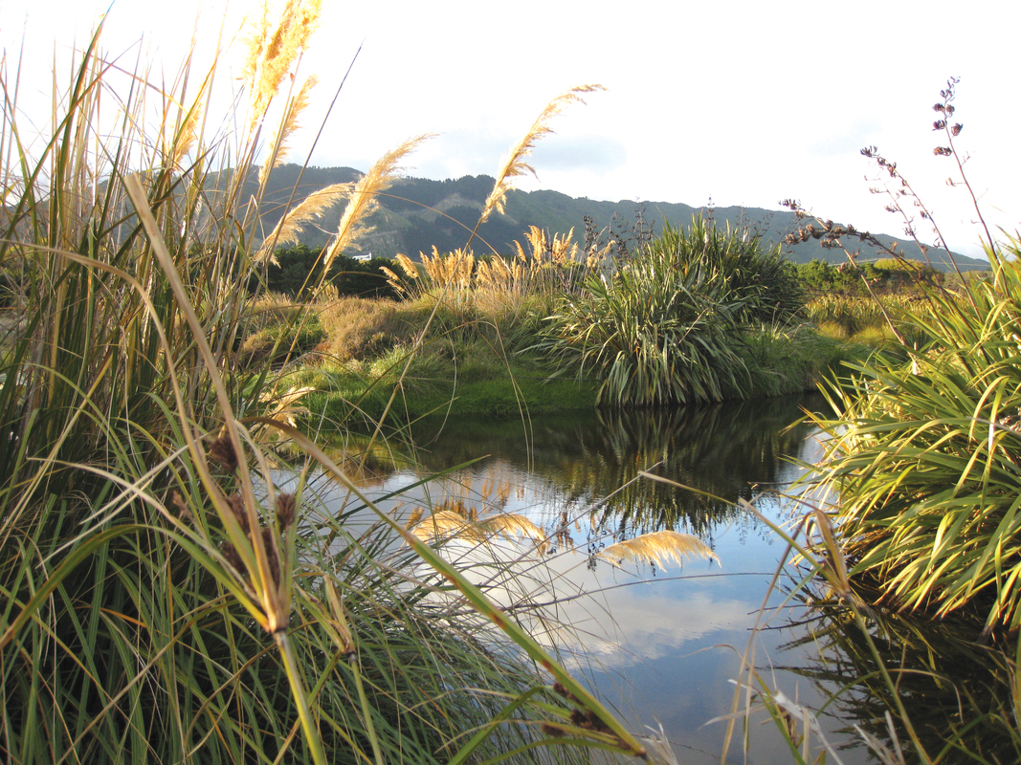
Repo
wetlands as a context for learning
Rights: Monica Peters. Sourced from Te Reo o Te Repo – The Voice of the Wetland.
4–4:45 pm Thursday 22 October
© Copyright. Science Learning Hub – Pokapū Akoranga Pūtaiao The University of Waikato Te Whare Wananga o Waikato.
All Rights Reserved | www.sciencelearn.org.nz. All images are copyrighted. For further information, please refer to enquiries@sciencelearn.org.nz

Slide 2
Index
Topic | Slideshow number(s) | Video timecode
Video: Te ao Māori and repo | 1 | 00:00
Index | 2 | 03:45
Introducing the Science Learning Hub and purpose | 3–4 | 04:00
What are repo/wetlands Video: Wetlands in Aotearoa | 5 | 05:47
Background of Tuia o ngā repo me ngā tāngata | 6 | 09:09
Finding the resources on the Hub | 7–9 | 12:10
Where to start – articles and interactive image maps | 10–13 | 13:41
Wetland ecosystem connections Video: Ruru | 14–15 | 21:45
Wetland restoration Video: Healing the repo | 16 | 27:09
Cultural indicators | 17 | 29:47
Kōura resources | 18–19 | 30:41
Activity: Titiro – observing my environment | 20 | 31:12
SLH links, keep in touch and thanks | 21 | 32:08
© Copyright. The University of Waikato Te Whare Wananga o Waikato l Science Learning Hub – Pokapū Akoranga Pūtaiao. All Rights Reserved
All images are copyrighted. For further information, please refer to enquiries@sciencelearn.org.nz.

Slide 3
The Science Learning Hub
A trustworthy online resource – produced by educators and scientists
Based on world-class New Zealand science research
Supported by learning activities, information about the key science ideas and concepts, multimedia tools and other resources
Written for New Zealand teachers and students
© Copyright. Science Learning Hub – Pokapū Akoranga Pūtaiao The University of Waikato Te Whare Wananga o Waikato.
All Rights Reserved | www.sciencelearn.org.nz. All images are copyrighted. For further information, please refer to enquiries@sciencelearn.org.nz
Notes:
The SLH is funded by the NZ government – MBIE Ministry of Business, Innovation and Employment – under the Curious Minds fund

Slide 4
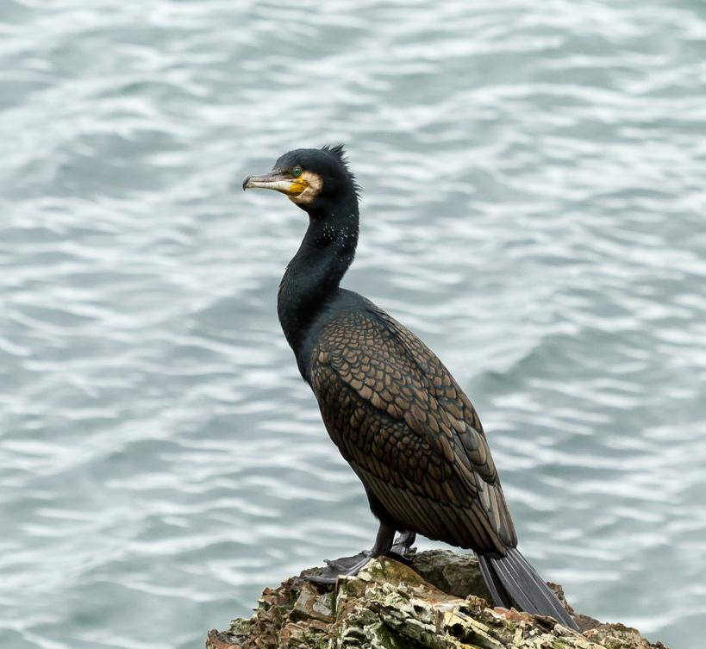
Purpose
To get you excited about teaching in, for and about repo
To share ideas and resources to support you in and out of the classroom
Highlight indigenous research connected to repo
Manatārua: Janice McKenna. Nō roto mai i
Te Reo o Te Repo – The Voice of the Wetland.
Notes:
Image: www.sciencelearn.org.nz/images/4372-te-kawau
Rights: Manatārua: Janice McKenna. Nō roto mai i Te Reo o Te Repo – The Voice of the Wetland.

Slide 5
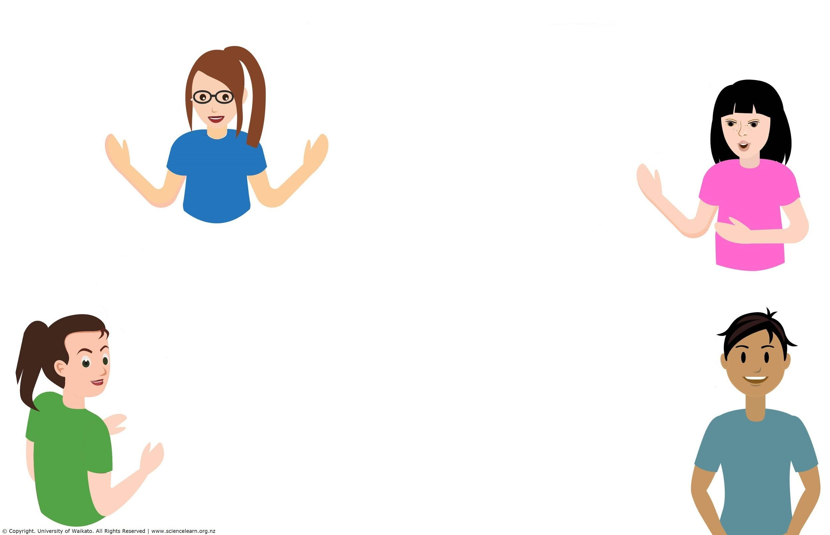
What are repo/wetlands?
Why should we care?
Food source
A habitat for flora and fauna
Filters
Outdoor classrooms
Traditionally the pātaka kai of our tīpuna
Kidneys of the whenua, wai. We need to care for them to stay healthy. Ko au te whenua.
Unique biodiverse ecosystems
Notes:
www.sciencelearn.org.nz/videos/2013-wetlands-in-aotearoa

Slide 6
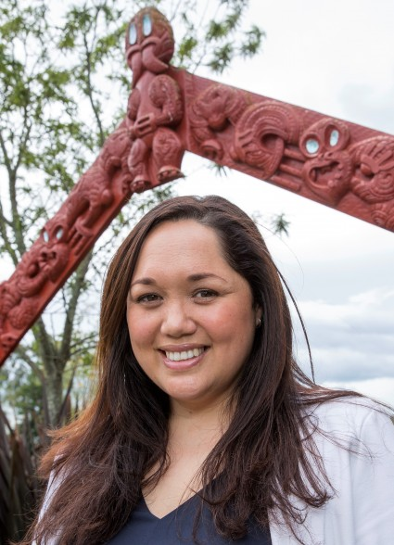
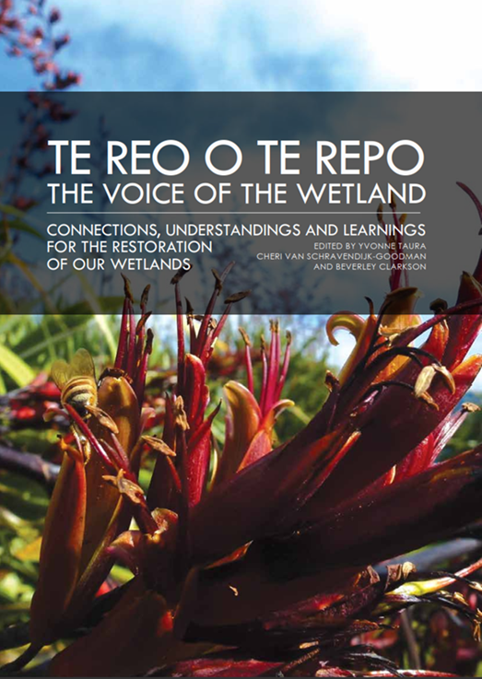
Tuia o ngā repo me ngā tāngata
Yvonne Taura from Manaaki Whenua
Te Reo o Te Repo – The Voice of the Wetland
Stakeholder Hui
Pauline Waiti & Hēni Jacob
Support from kura
© Manaaki Whenua – Landcare Research
Notes:
Image and link for Yvonne Taura: www.landcareresearch.co.nz/about-us/our-people/yvonne-taura
Curious Minds profile
Yvonne Taura (Ngāiterangi, Ngāti Ranginui, Ngāti Hauā, Ngāti Uenuku, Ngāti Tūwharetoa) is a kairangahau Māori (researcher) in the Manaaki Taiao rōpū (Māori research team)
Te reo o te repo: The voice of the wetland

Slide 7
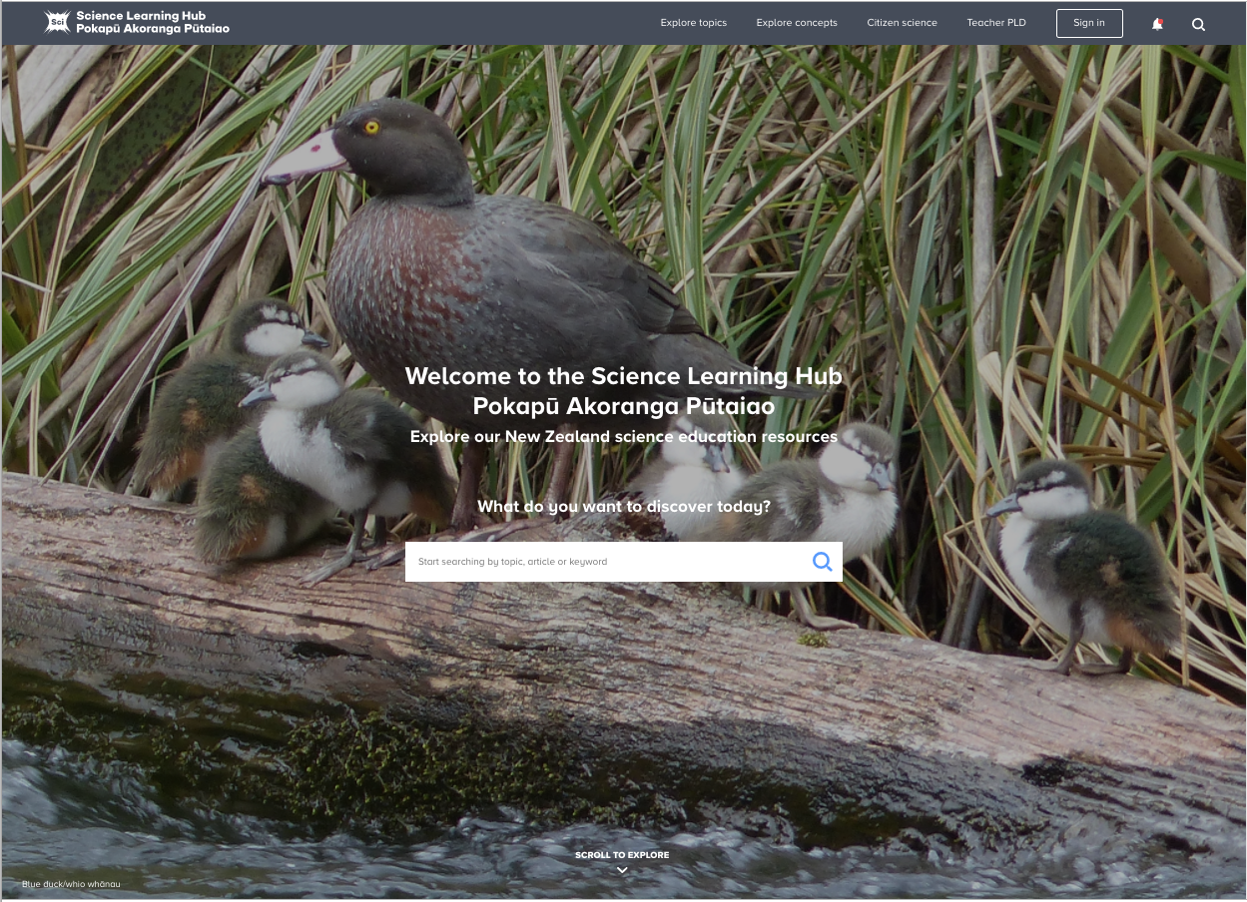
Finding the resources
© Copyright. Science Learning Hub – Pokapū Akoranga Pūtaiao The University of Waikato Te Whare Wananga o Waikato.
All Rights Reserved | www.sciencelearn.org.nz. All images are copyrighted. For further information, please refer to enquiries@sciencelearn.org.nz

Slide 8
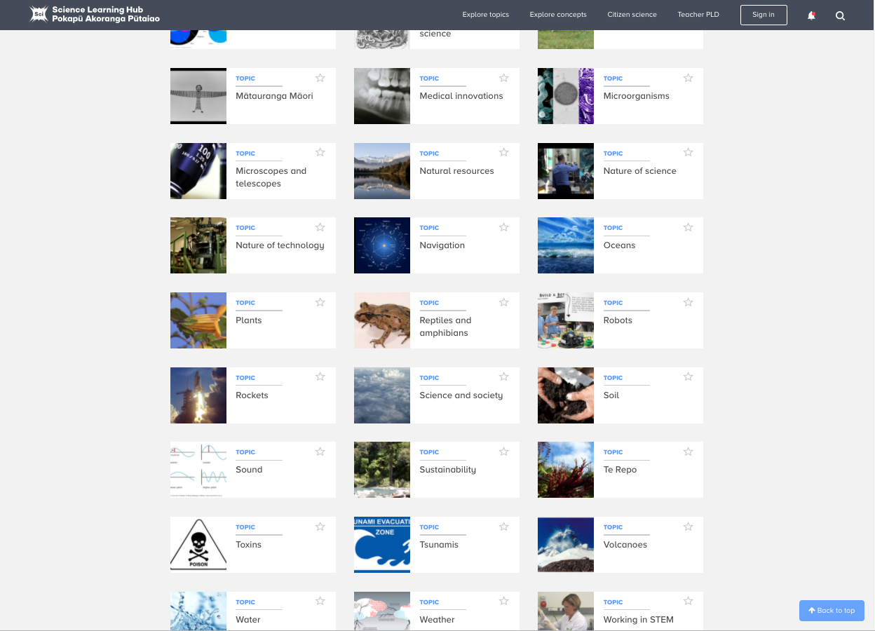
Finding the resources
© Copyright. Science Learning Hub – Pokapū Akoranga Pūtaiao The University of Waikato Te Whare Wananga o Waikato.
All Rights Reserved | www.sciencelearn.org.nz. All images are copyrighted. For further information, please refer to enquiries@sciencelearn.org.nz

Slide 9
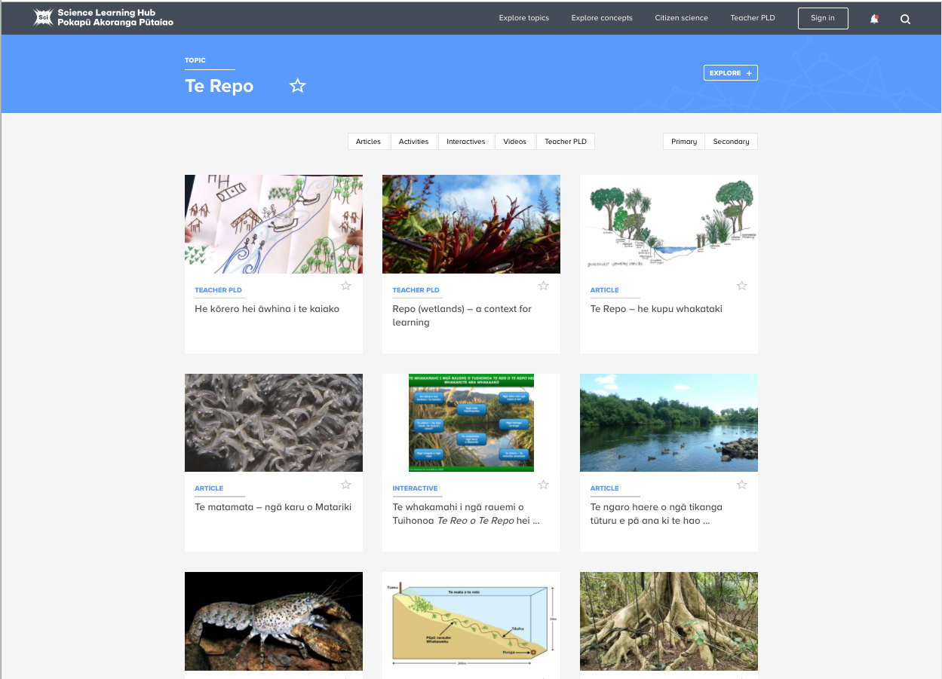
Finding the resources
© Copyright. Science Learning Hub – Pokapū Akoranga Pūtaiao The University of Waikato Te Whare Wananga o Waikato.
All Rights Reserved | www.sciencelearn.org.nz. All images are copyrighted. For further information, please refer to enquiries@sciencelearn.org.nz
Notes:
www.sciencelearn.org.nz/topics/te-repo

Slide 10
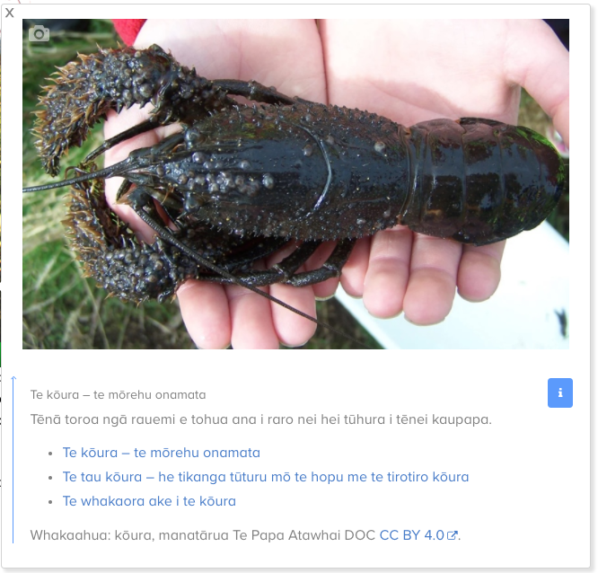
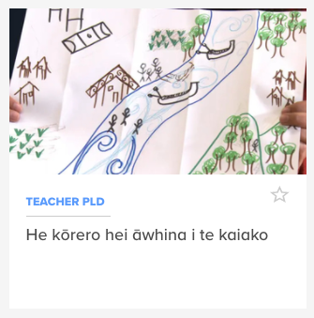
Where to start
He kōrero hei āwhina i te kaiako
© Copyright. Science Learning Hub – Pokapū Akoranga Pūtaiao The University of Waikato Te Whare Wananga o Waikato.
All Rights Reserved | www.sciencelearn.org.nz. All images are copyrighted. For further information, please refer to enquiries@sciencelearn.org.nz
Notes:
www.sciencelearn.org.nz/resources/2983-he-korero-hei-awhina-i-te-kaiako
www.sciencelearn.org.nz/image_maps/96-te-whakamahi-i-nga-rauemi-o-tuihonoa-te-reo-o-te-repo-hei-whakarite-ara-whakaako

Slide 11
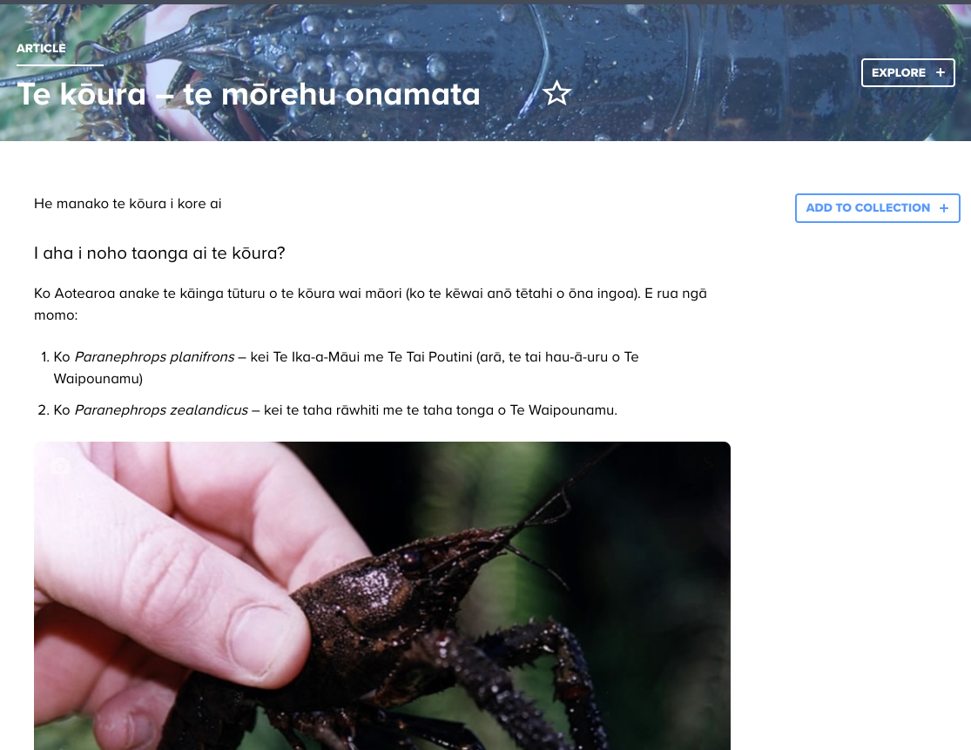
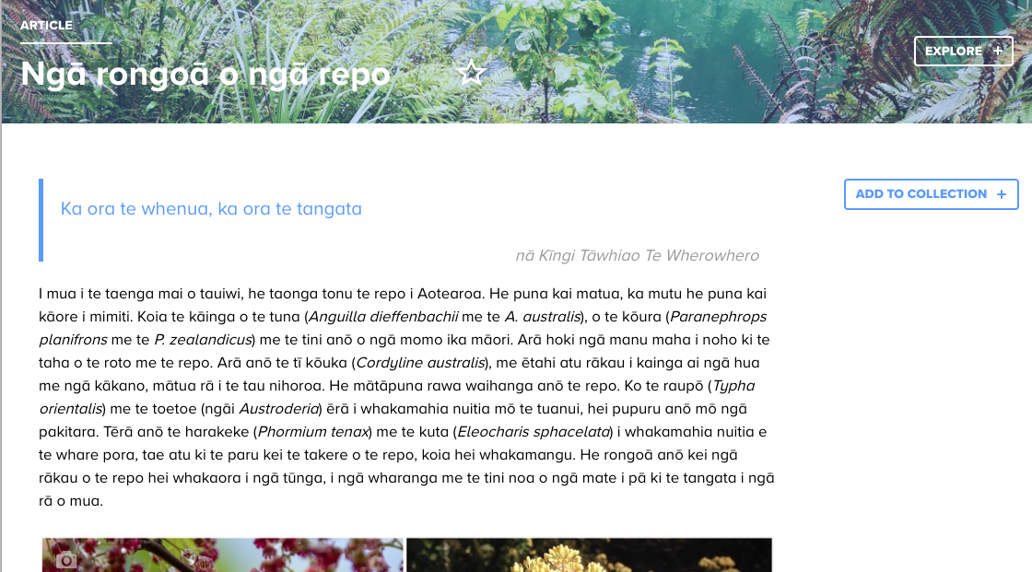
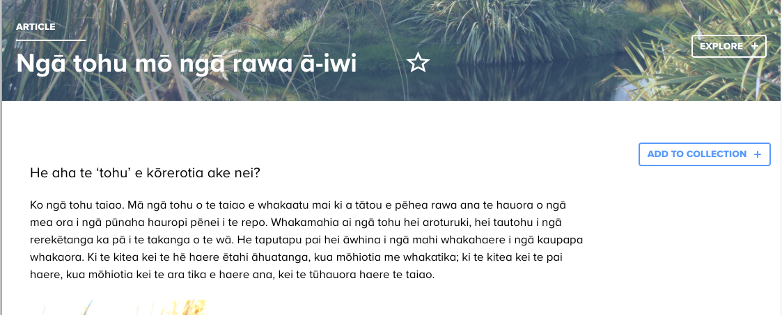
© Copyright. Science Learning Hub – Pokapū Akoranga Pūtaiao The University of Waikato Te Whare Wananga o Waikato.
All Rights Reserved | www.sciencelearn.org.nz. All images are copyrighted. For further information, please refer to enquiries@sciencelearn.org.nz
Notes:
www.sciencelearn.org.nz/resources/2936-te-koura-te-morehu-onamata

Slide 12
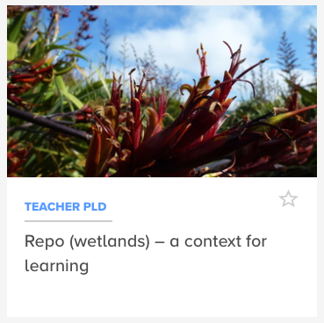
Where to start
Repo (wetlands) – a context for learning
Illustration of Papatūānuku embracing Ranginui, from the graphic novella Te Orokotimatanga o te Ao, story by Rewi Spraggon, and artwork by Munro Te Whata. Courtesy of Kiwa Digital. Downloads available on Appstore for Apple or Google Play for Android.
Video: © Crown Copyright
© Copyright. Science Learning Hub – Pokapū Akoranga Pūtaiao The University of Waikato Te Whare Wananga o Waikato.
All Rights Reserved | www.sciencelearn.org.nz. All images are copyrighted. For further information, please refer to enquiries@sciencelearn.org.nz
Notes:
www.sciencelearn.org.nz/resources/3001-repo-wetlands-a-context-for-learning

Slide 13
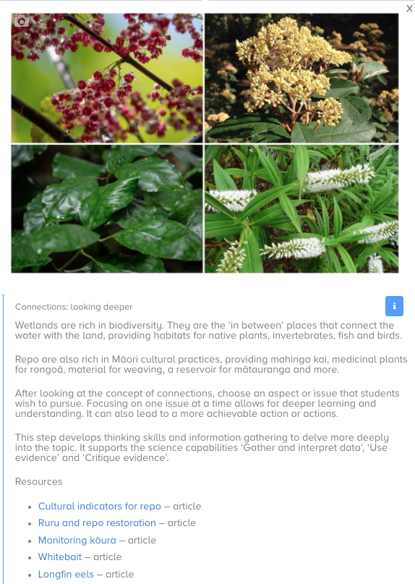
Where to start
Wetlands – inquiry and action learning process
© Copyright. Science Learning Hub – Pokapū Akoranga Pūtaiao The University of Waikato Te Whare Wananga o Waikato.
All Rights Reserved | www.sciencelearn.org.nz. All images are copyrighted. For further information, please refer to enquiries@sciencelearn.org.nz
Notes:
www.sciencelearn.org.nz/image_maps/98-wetlands-inquiry-and-action-learning-process

Slide 14
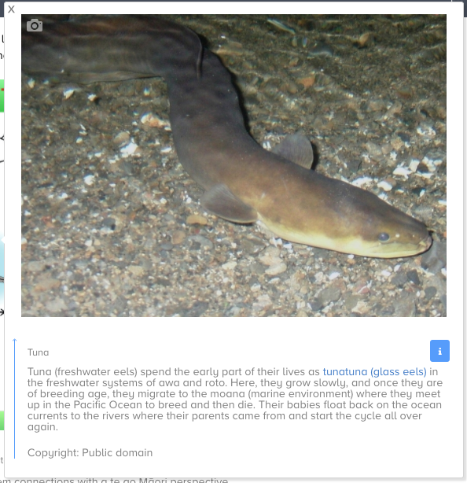
© Copyright. Science Learning Hub – Pokapū Akoranga Pūtaiao The University of Waikato Te Whare Wananga o Waikato.
All Rights Reserved | www.sciencelearn.org.nz. All images are copyrighted. For further information, please refer to enquiries@sciencelearn.org.nz
Notes:
Q: What other species do you associate with repo?
www.sciencelearn.org.nz/image_maps/97-wetland-ecosystem-connections

Slide 15
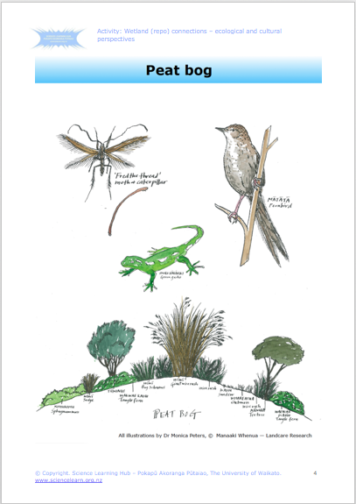
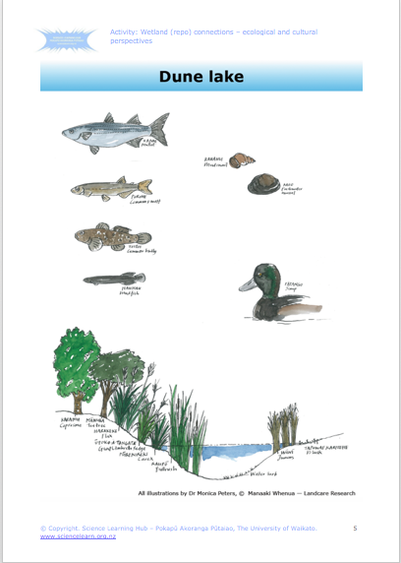
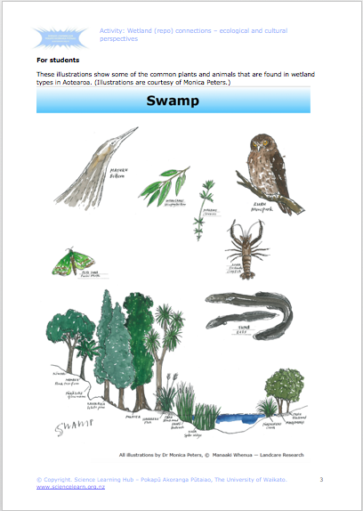
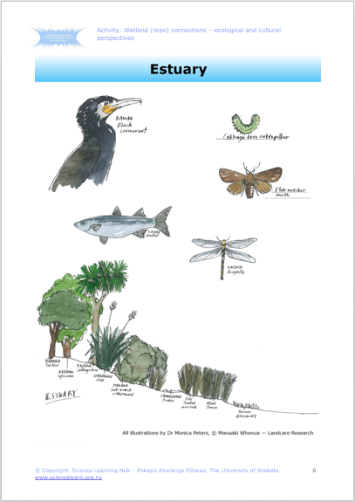
© Copyright. Science Learning Hub – Pokapū Akoranga Pūtaiao The University of Waikato Te Whare Wananga o Waikato.
All Rights Reserved | www.sciencelearn.org.nz. All images are copyrighted. For further information, please refer to enquiries@sciencelearn.org.nz
Notes:
www.sciencelearn.org.nz/resources/3000-wetland-repo-connections-ecological-and-cultural-perspectives

Slide 16
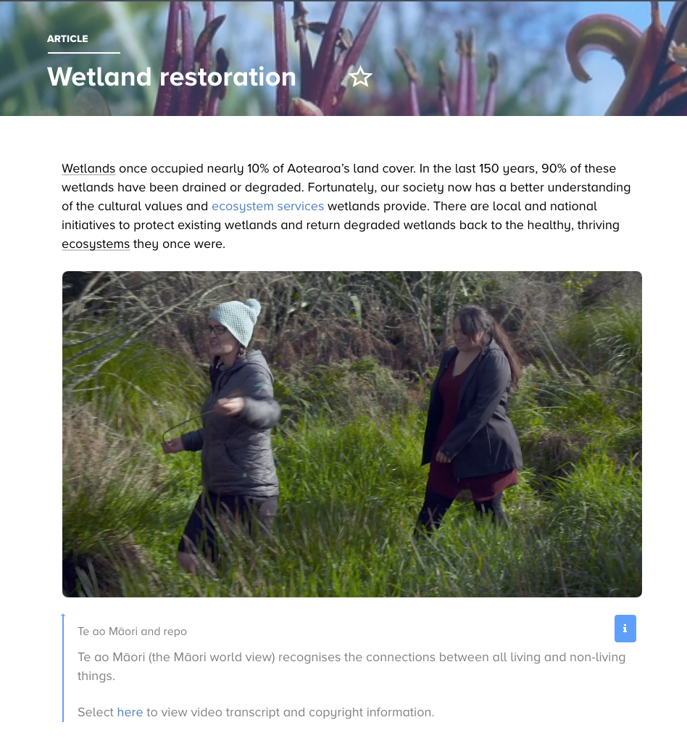
Wetland restoration
© Copyright. Science Learning Hub – Pokapū Akoranga Pūtaiao The University of Waikato Te Whare Wananga o Waikato.
All Rights Reserved | www.sciencelearn.org.nz. All images are copyrighted. For further information, please refer to enquiries@sciencelearn.org.nz
Notes:
www.sciencelearn.org.nz/resources/2991-wetland-restoration

Slide 17
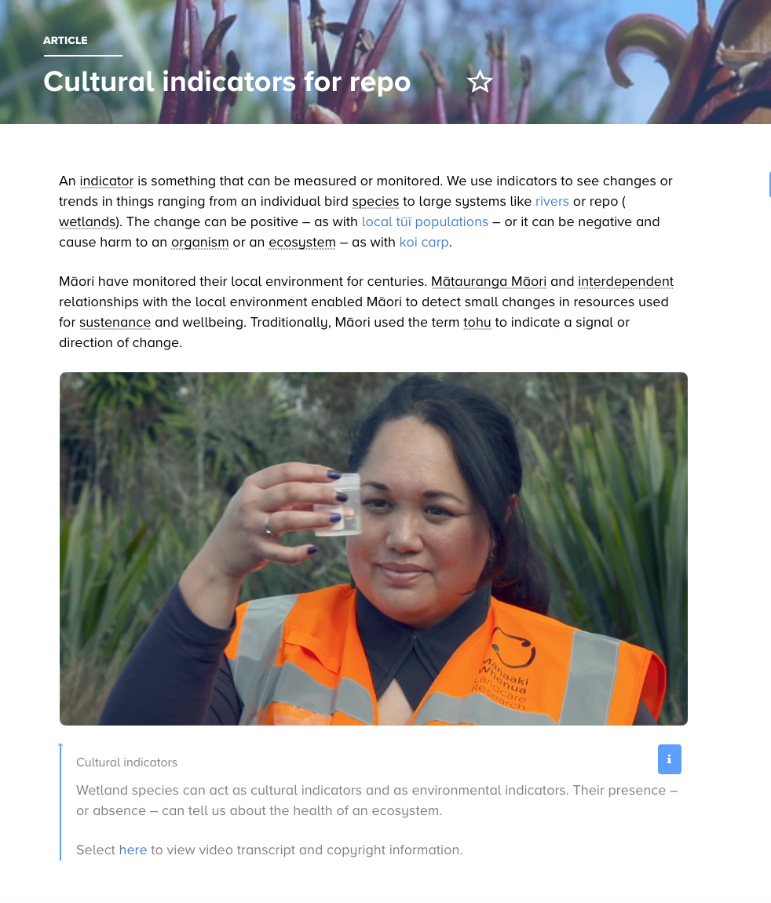
© Copyright. Science Learning Hub – Pokapū Akoranga Pūtaiao The University of Waikato Te Whare Wananga o Waikato.
All Rights Reserved | www.sciencelearn.org.nz. All images are copyrighted. For further information, please refer to enquiries@sciencelearn.org.nz
Notes:
www.sciencelearn.org.nz/resources/2992-cultural-indicators-for-repo

Slide 18
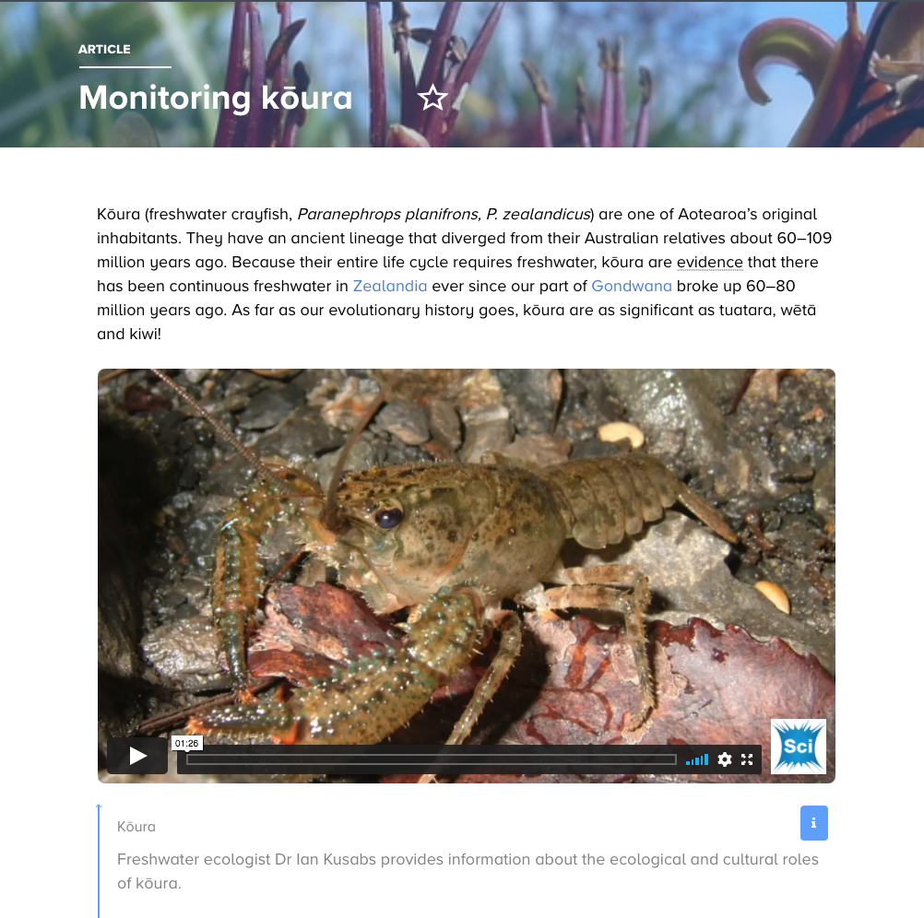
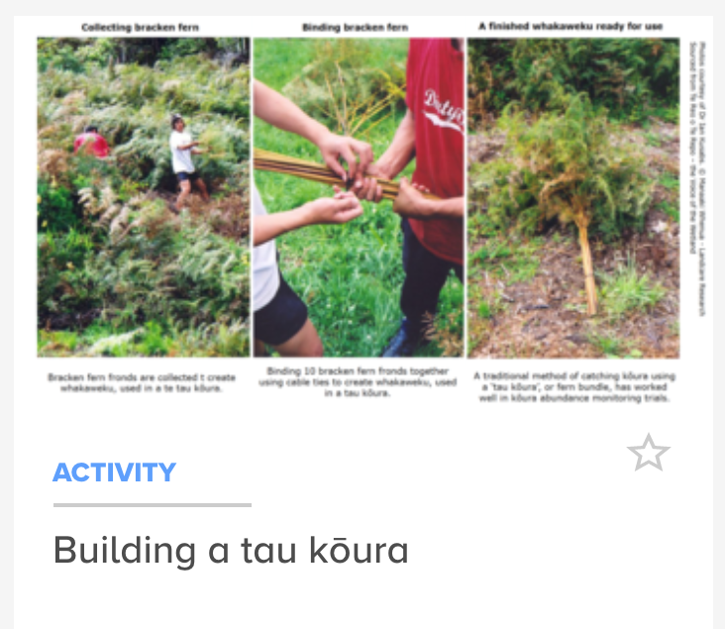
© Copyright. Science Learning Hub – Pokapū Akoranga Pūtaiao The University of Waikato Te Whare Wananga o Waikato.
All Rights Reserved | www.sciencelearn.org.nz. All images are copyrighted. For further information, please refer to enquiries@sciencelearn.org.nz
Notes:
www.sciencelearn.org.nz/resources/2994-monitoring-koura
www.sciencelearn.org.nz/resources/2999-building-a-tau-koura

Slide 19
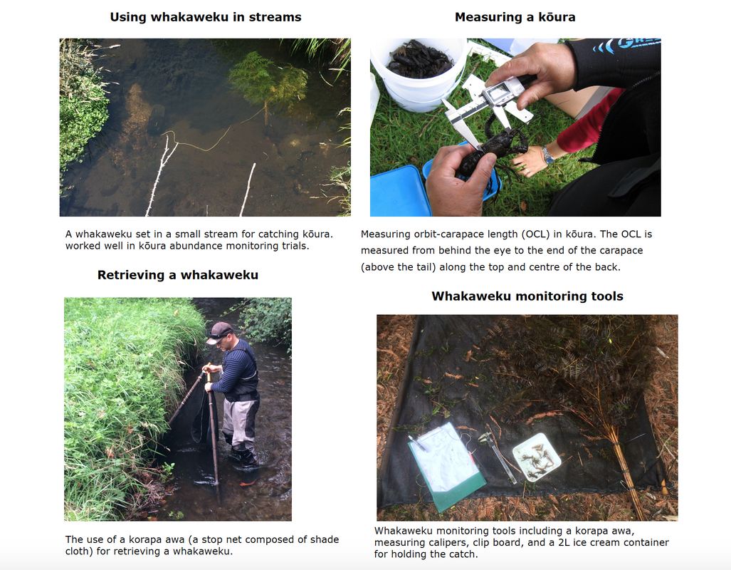
© Dr Ian Kusabs. Nō roto mai i Te Reo o Te Repo – The Voice of the Wetland.

Slide 20
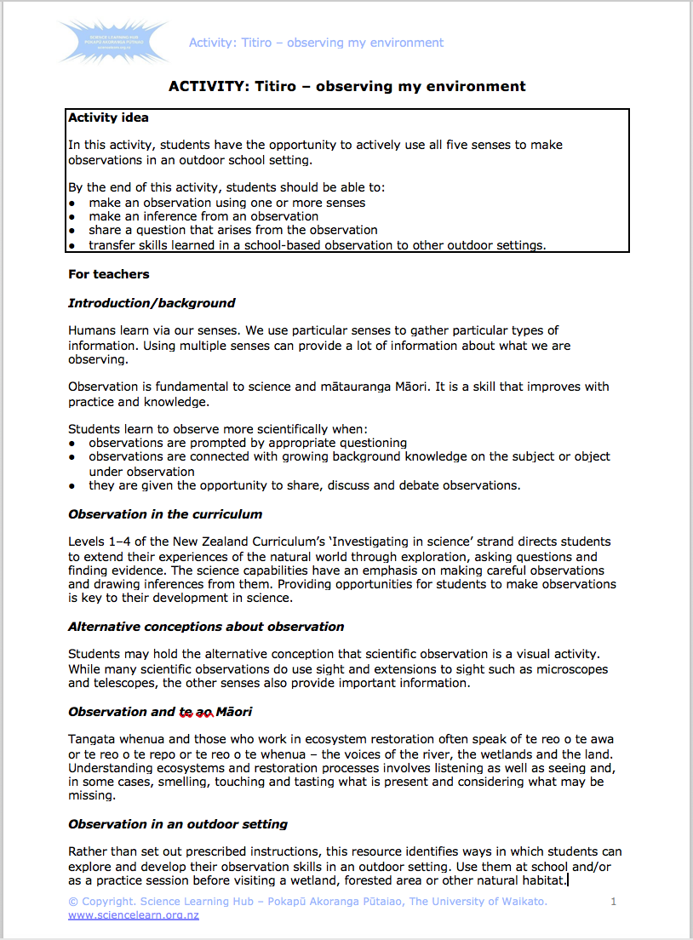
Possibly the most powerful model of inspiration that we can draw from our ancestors is that of careful, purposeful care and observation. Through approaches informed by time-honoured holistic observations, and enhanced by technological advancements, our fluency in the reo of the awa can be renewed
Tina Ngata, Ngāti Porou, on the whakapapa of life-giving freshwater
© Copyright. Science Learning Hub – Pokapū Akoranga Pūtaiao The University of Waikato Te Whare Wananga o Waikato.
All Rights Reserved | www.sciencelearn.org.nz. All images are copyrighted. For further information, please refer to enquiries@sciencelearn.org.nz
Notes:
www.sciencelearn.org.nz/resources/2997-titiro-observing-my-environment

Slide 21
Thanks – want to learn more?
Keep in touch
Email us on enquiries@sciencelearn.org.nz
https://twitter.com/NZScienceLearn
www.facebook.com/nzsciencelearn
https://nz.pinterest.com/nzsciencelearn
www.instagram.com/sciencelearninghubnz
Join us in our discussion channel on Slack (http://slh-talk.slack.com).
(Any problems accessing Slack, please contact us via our enquiries email, enquiries@sciencelearn.org.nz.)
© Copyright. Science Learning Hub – Pokapū Akoranga Pūtaiao The University of Waikato Te Whare Wananga o Waikato.
All Rights Reserved | www.sciencelearn.org.nz. All images are copyrighted. For further information, please refer to enquiries@sciencelearn.org.nz
Notes:
Collection: Te repo / wetlands – collection

