Slide 1
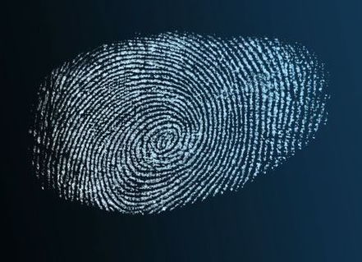
A crime has been committed.
It’s up to you to try and solve it.
In this activity you will take a closer look at a crime scene, decide what evidence to collect and how to get it back safely to the lab.
Learn more about DNA profiling and compare different profiles to see if you can help to solve the crime.
Good luck!
© Kitchener Bain/123RF Ltd
© Copyright. The University of Waikato Te Whare Wananga o Waikato l Science Learning Hub – Pokapū Akoranga Pūtaiao. All Rights Reserved
All images are copyrighted. For further information, please refer to enquiries@sciencelearn.org.nz

Slide 2
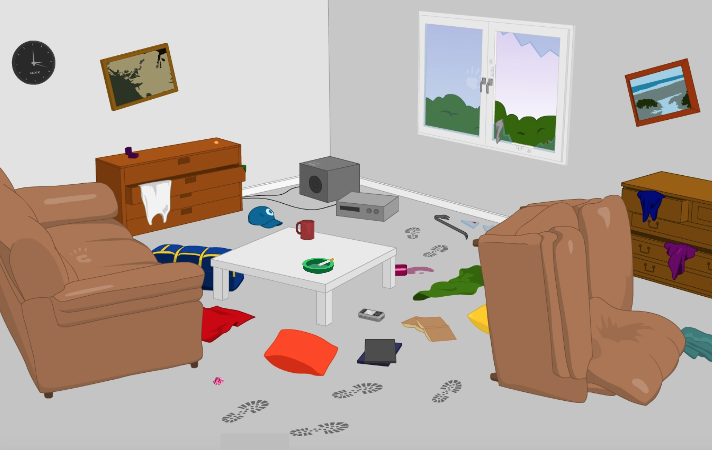
The crime scene
Look closely at this crime scene.
What do you think has happened here?
What could you collect as evidence?
Make a list of samples you would like to take back to the lab.
© Copyright. The University of Waikato Te Whare Wananga o Waikato l Science Learning Hub – Pokapū Akoranga Pūtaiao. All Rights Reserved
All images are copyrighted. For further information, please refer to enquiries@sciencelearn.org.nz

Slide 3
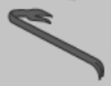
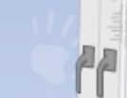
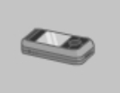
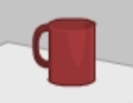
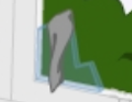
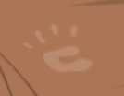
Looking for DNA evidence
Think about the samples on your list. Which of these do you think contain DNA? Write down your ideas.
© Copyright. The University of Waikato Te Whare Wananga o Waikato l Science Learning Hub – Pokapū Akoranga Pūtaiao. All Rights Reserved
All images are copyrighted. For further information, please refer to enquiries@sciencelearn.org.nz

Slide 4
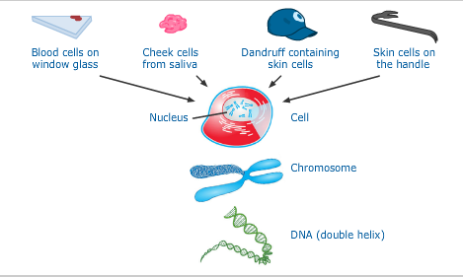
How do you ‘leave DNA behind’?
We all leave DNA behind wherever we go. DNA is a molecule found in the nucleus of nearly every cell in your body. Therefore, any sample containing cells will contain DNA.
Think about the samples on the previous slide. Would you like to change any of your answers?
© Copyright. The University of Waikato Te Whare Wananga o Waikato l Science Learning Hub – Pokapū Akoranga Pūtaiao. All Rights Reserved
All images are copyrighted. For further information, please refer to enquiries@sciencelearn.org.nz

Slide 5
Collecting a sample
Forward to the ESR lab as soon as possible.
Photograph the sample.
Allow the sample to air dry before packaging into a paper bag or collecting into a test tube if liquid.
Provide information that you think may be important, for example, an unusual location or any possible contaminants.
Carefully label and seal the sample bag/container.
Put on protective clothing including gloves to prevent sweat, hair etc. from contaminating the sample.
Carefully swab the sample.
Protect the sample from any external factors including the weather, animals and traffic.
Personnel collecting DNA samples at a crime scene need to be very careful not to contaminate the evidence with their own biological material containing cells (and therefore DNA).
Think about the following steps and write them in the correct order.
© Copyright. The University of Waikato Te Whare Wananga o Waikato l Science Learning Hub – Pokapū Akoranga Pūtaiao. All Rights Reserved
All images are copyrighted. For further information, please refer to enquiries@sciencelearn.org.nz

Slide 6
Polymerase chain reaction (PCR) is a method that rapidly
increases the number of copies of a target DNA sequence enabling it to be visualised. This is used for detecting small amounts of DNA material.
This animation explains the steps involved in the PCR process.
© Copyright. The University of Waikato Te Whare Wananga o Waikato l Science Learning Hub – Pokapū Akoranga Pūtaiao. All Rights Reserved
All images are copyrighted. For further information, please refer to enquiries@sciencelearn.org.nz

Slide 7
Creating a DNA profile
©ESR
© Copyright. The University of Waikato Te Whare Wananga o Waikato l Science Learning Hub – Pokapū Akoranga Pūtaiao. All Rights Reserved
All images are copyrighted. For further information, please refer to enquiries@sciencelearn.org.nz

Slide 8
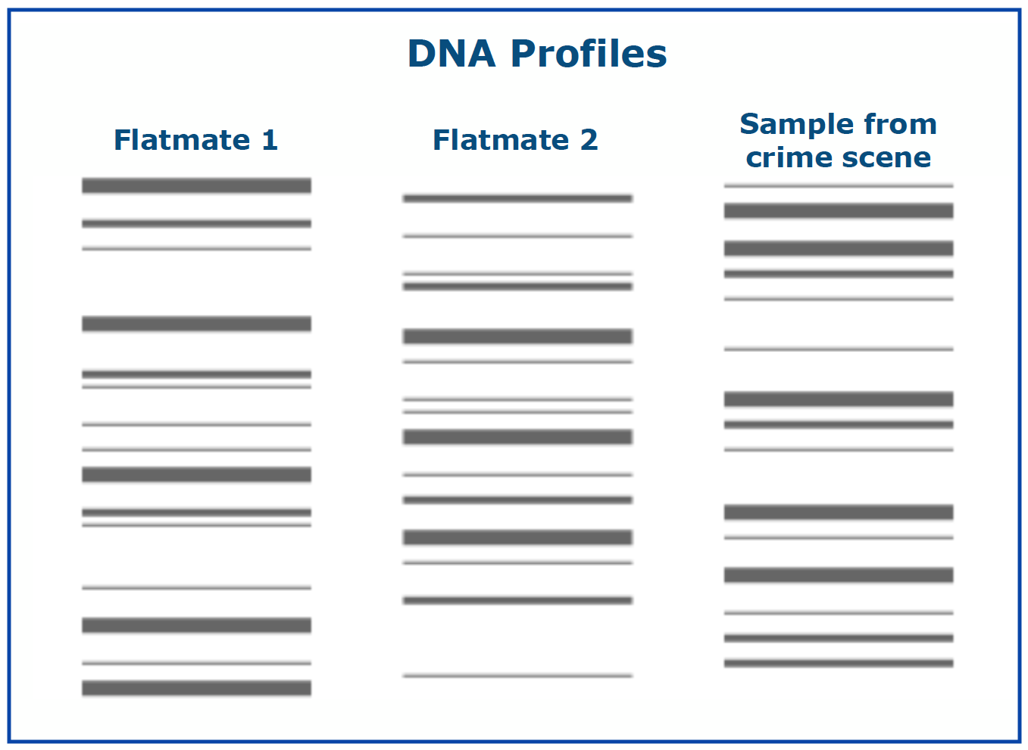
The suspect or the victim?
The first step is to compare the DNA from the blood at the scene with the two people that live at the house. Why do you think this is necessary?
Look at the DNA profiles. Does the sample match either of the of flatmates? What does this information tell us? Discuss or record your ideas.
© Copyright. The University of Waikato Te Whare Wananga o Waikato l Science Learning Hub – Pokapū Akoranga Pūtaiao. All Rights Reserved
All images are copyrighted. For further information, please refer to enquiries@sciencelearn.org.nz

Slide 9
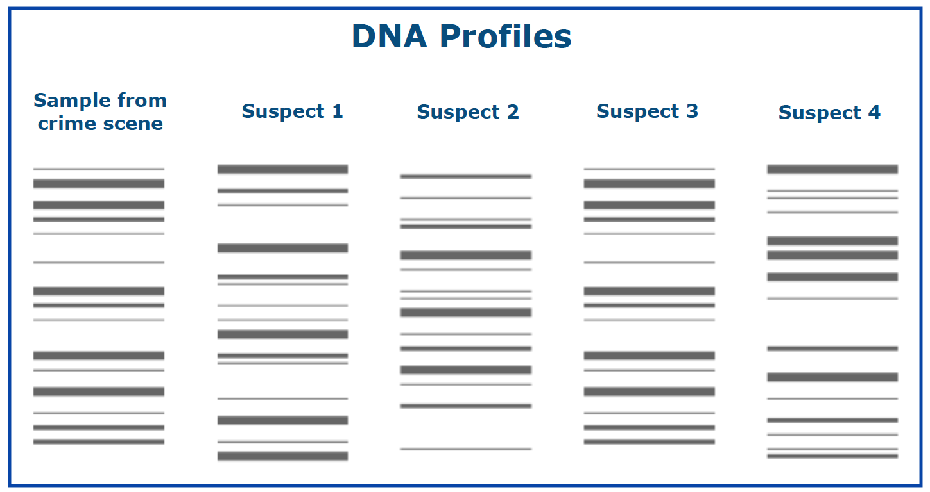
Who did it?
After the burglary, the police interviewed neighbours and eye-witnesses who saw the burglar run away from the house. Based on this information and some previous burglaries in the area they have four suspects. Compare the DNA profile from the crime scene with the suspects.
Is there a match?
What does this tell us?
Discuss or record your
ideas.
© Copyright. The University of Waikato Te Whare Wananga o Waikato l Science Learning Hub – Pokapū Akoranga Pūtaiao. All Rights Reserved
All images are copyrighted. For further information, please refer to enquiries@sciencelearn.org.nz

Slide 10
Can we trust the evidence?
The probability of two random individuals having the same DNA profile decreases with each additional locus:
For example, comparing alleles at:
1 locus approximately one in 10
4 loci one in 7000
10 loci less than one in 1000 million (a US billion)
15 loci less than one in 10¹² (an English billion)
ESR tests 15 loci. In the UK and Europe 10 loci are tested. In the USA 13 loci are tested.
© Copyright. The University of Waikato Te Whare Wananga o Waikato l Science Learning Hub – Pokapū Akoranga Pūtaiao. All Rights Reserved
All images are copyrighted. For further information, please refer to enquiries@sciencelearn.org.nz

Slide 11
Going to court – what do you think?
What does a matching DNA profile actually prove?
What other evidence could be used in court in addition to a DNA match?
© Copyright. The University of Waikato Te Whare Wananga o Waikato l Science Learning Hub – Pokapū Akoranga Pūtaiao. All Rights Reserved
All images are copyrighted. For further information, please refer to enquiries@sciencelearn.org.nz

