Slide 1
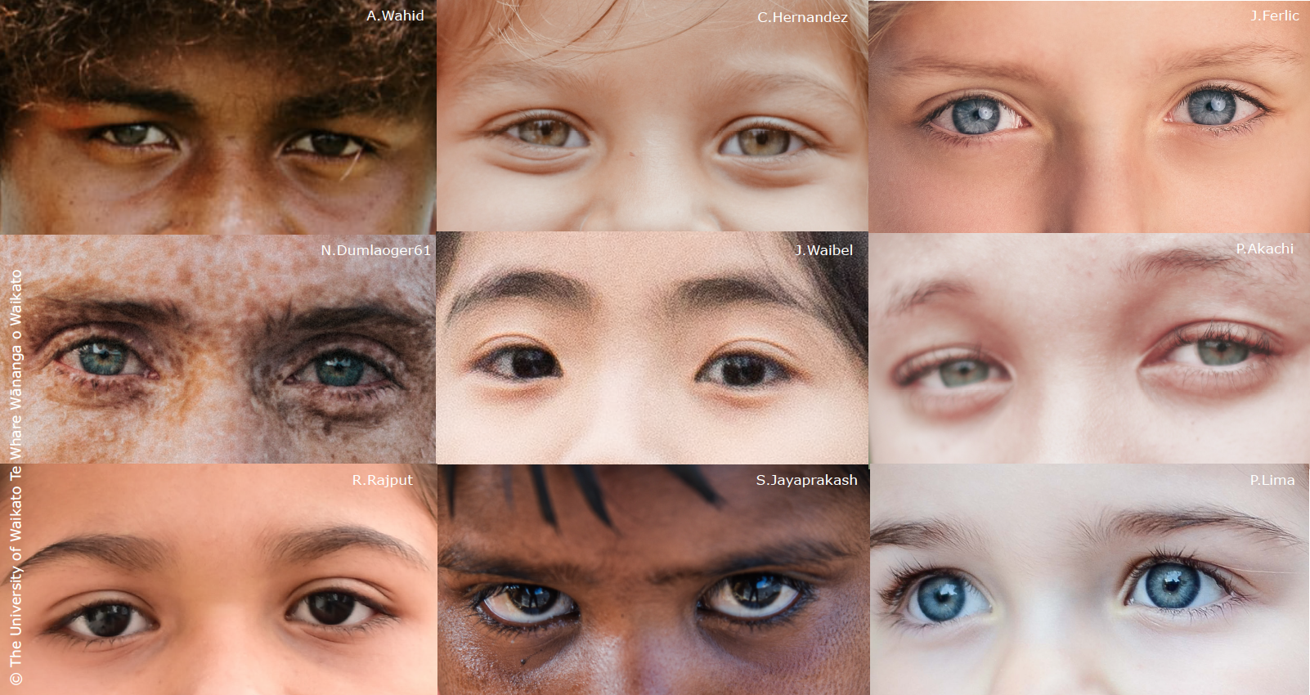
Vision 20/20
child to child vision testing
4–4:45 pm Thursday 25 March
© Copyright. Science Learning Hub – Pokapū Akoranga Pūtaiao The University of Waikato Te Whare Wananga o Waikato.
All Rights Reserved | www.sciencelearn.org.nz. All images are copyrighted. For further information, please refer to enquiries@sciencelearn.org.nz
Notes:
www.sciencelearn.org.nz/images/4497-human-eyes-similar-but-different

Slide 2
The Science Learning Hub
A trustworthy online resource – produced by educators and scientists
Based on world-class New Zealand science research
Supported by learning activities, information about the key science ideas and concepts, multimedia tools and other resources
Written for New Zealand teachers and students
© Copyright. Science Learning Hub – Pokapū Akoranga Pūtaiao The University of Waikato Te Whare Wananga o Waikato.
All Rights Reserved | www.sciencelearn.org.nz. All images are copyrighted. For further information, please refer to enquiries@sciencelearn.org.nz
Notes:
The SLH is funded by the New Zealand government – Ministry of Business, Innovation and Employment (MBIE) – under the Curious Minds fund

Slide 3
Index
Topic | Slideshow number(s ) | Video timecode
Introducing the Science Learning Hub and presenters | 1–2 | 00:00
Index | 3 | 00:27
Purpose | 4 | 00:42
Guest – Karen Parker | 5 | 00:58
Project background | 6–8 | 2:12
The testing process and teacher reflections | 9–16 | 5:22
Specific learning and curriculum links | 17–19 | 24:45
Participant questions | 20–21 | 31:25
Supporting resources | 22–25 | 37:42
SLH links, keep in touch and thanks | 26 | 38:09
© Copyright. The University of Waikato Te Whare Wananga o Waikato l Science Learning Hub – Pokapū Akoranga Pūtaiao. All Rights Reserved
All images are copyrighted. For further information, please refer to enquiries@sciencelearn.org.nz.

Slide 4
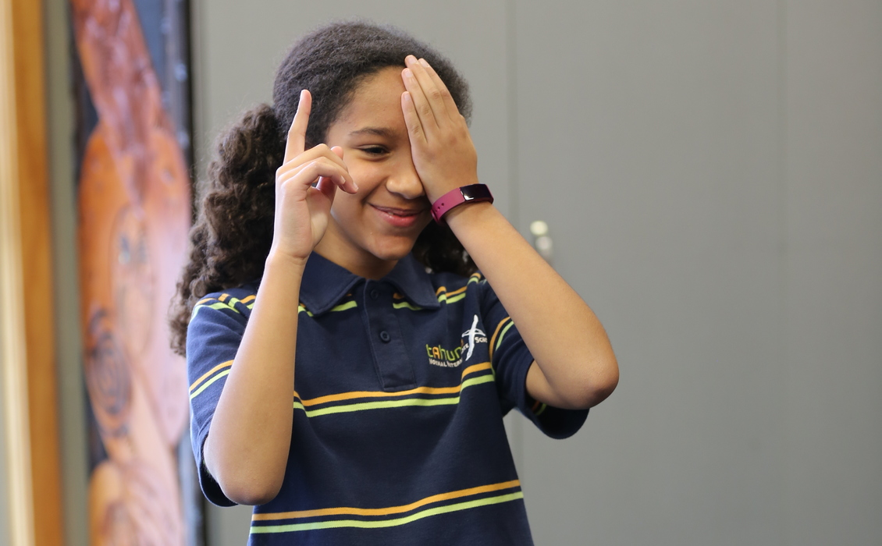
Purpose
To share with you how to include vision testing in your programme
Take you through the testing process
Make clear connections to the NZ curriculum and science capabilities
Rights: Photograph by Grant Philip, © Tahuna Normal Intermediate School.
© Copyright. Science Learning Hub – Pokapū Akoranga Pūtaiao The University of Waikato Te Whare Wananga o Waikato.
All Rights Reserved | www.sciencelearn.org.nz. All images are copyrighted. For further information, please refer to enquiries@sciencelearn.org.nz
Notes:
Image: www.sciencelearn.org.nz/images/4499-being-eye-tested
Share collection: www.sciencelearn.org.nz/collections/shared/88281a8a9daf3c705b2d7ab29a3c7272

Slide 5
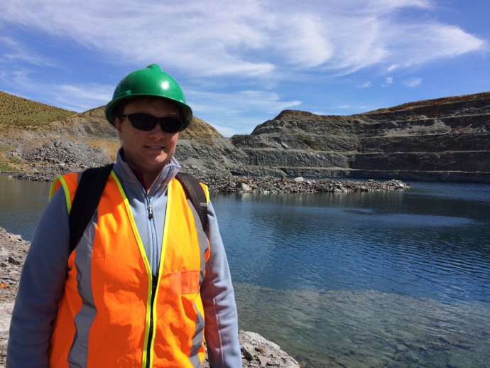
Karen Parker
Rights: Photograph by Karen Parker
© Copyright. Science Learning Hub – Pokapū Akoranga Pūtaiao The University of Waikato Te Whare Wananga o Waikato.
All Rights Reserved | www.sciencelearn.org.nz. All images are copyrighted. For further information, please refer to enquiries@sciencelearn.org.nz
Notes:
www.royalsociety.org.nz/what-we-do/funds-and-opportunities/science-teaching-leadership-programme/teacher-profiles/2015-teacher-profiles/arthur-street-school-karen-parker/
https://tahuna.school.nz/about/our-staff/karen-parker/

Slide 6
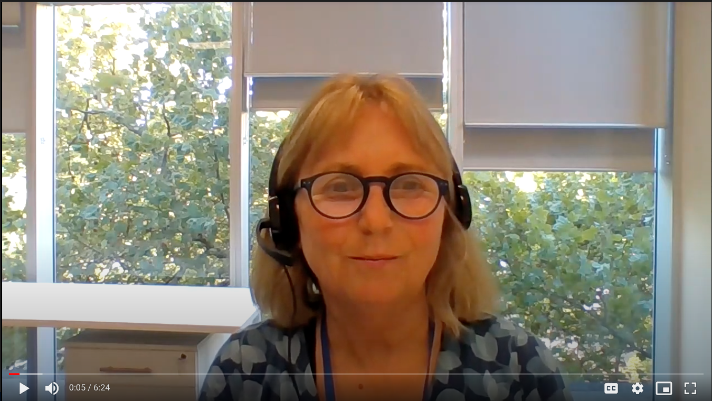
Project background
I want to create awareness of the need for vision screening in children. As we have unpacked this, we have realised the issue is huge. It gets harder and harder for children with untreated low vision as they go through the education system as more and more reading is required.
Mary Butler, Vision 20/20 Project lead
© Copyright. Science Learning Hub – Pokapū Akoranga Pūtaiao The University of Waikato Te Whare Wananga o Waikato.
All Rights Reserved | www.sciencelearn.org.nz. All images are copyrighted. For further information, please refer to enquiries@sciencelearn.org.nz

Slide 7
Project background
The primary outcome was to integrate a child-to-child vision testing toolkit that gives students the opportunity to test their peers’ eyesight through fair testing.
© Copyright. Science Learning Hub – Pokapū Akoranga Pūtaiao The University of Waikato Te Whare Wananga o Waikato.
All Rights Reserved | www.sciencelearn.org.nz. All images are copyrighted. For further information, please refer to enquiries@sciencelearn.org.nz
Notes:
www.sciencelearn.org.nz/resources/3006-our-eyes-our-vision
www.sciencelearn.org.nz/resources/3009-improving-vision-screening-for-children

Slide 8
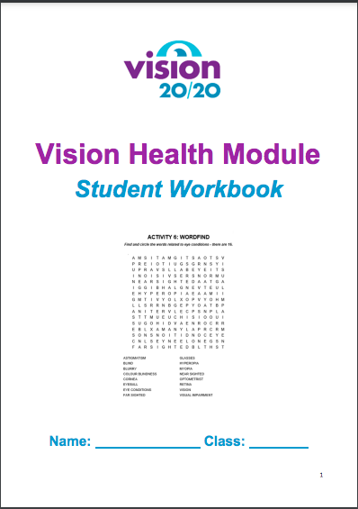
Project background
The secondary outcome was to develop teaching and learning opportunities for students to understand about the eye and the importance of good eye health in relation to wellbeing.
© Vision 20/20 Project
© Copyright. Science Learning Hub – Pokapū Akoranga Pūtaiao The University of Waikato Te Whare Wananga o Waikato.
All Rights Reserved | www.sciencelearn.org.nz. All images are copyrighted. For further information, please refer to enquiries@sciencelearn.org.nz
Notes:
www.sciencelearn.org.nz/resources/3006-our-eyes-our-vision
www.sciencelearn.org.nz/resources/3009-improving-vision-screening-for-children

Slide 9
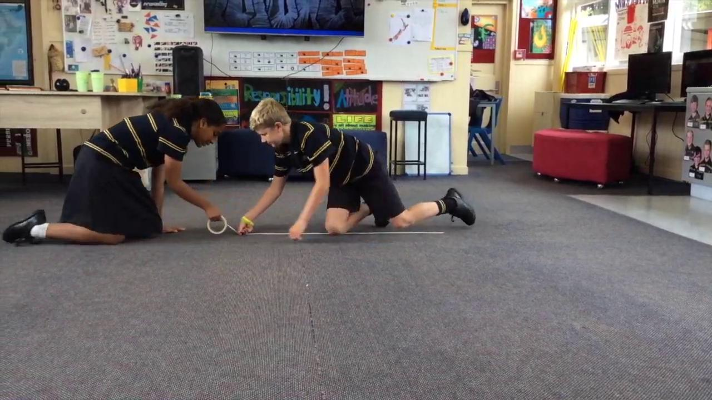
Child to child vision testing
© Tahuna Normal Intermediate School.
© Copyright. Science Learning Hub – Pokapū Akoranga Pūtaiao The University of Waikato Te Whare Wananga o Waikato.
All Rights Reserved | www.sciencelearn.org.nz. All images are copyrighted. For further information, please refer to enquiries@sciencelearn.org.nz

Slide 10
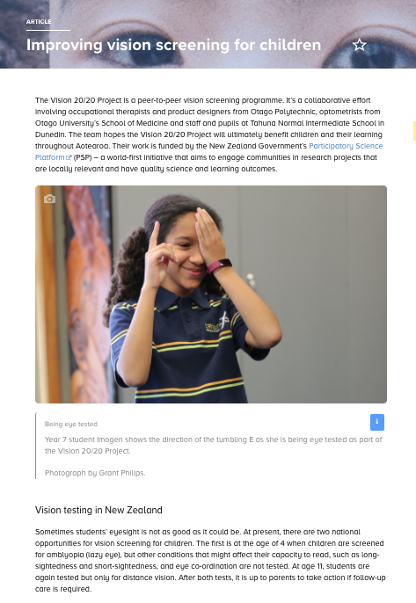
You can find the testing manual and other Vision 20/20 classroom resources in the article: Improving vision screening for children.
www.sciencelearn.org.nz/resources/3009-improving-vision-screening-for-children
© Copyright. Science Learning Hub – Pokapū Akoranga Pūtaiao The University of Waikato Te Whare Wananga o Waikato.
All Rights Reserved | www.sciencelearn.org.nz. All images are copyrighted. For further information, please refer to enquiries@sciencelearn.org.nz
Notes:
www.sciencelearn.org.nz/resources/3009-improving-vision-screening-for-children

Slide 11
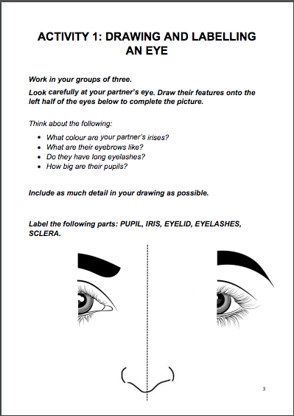
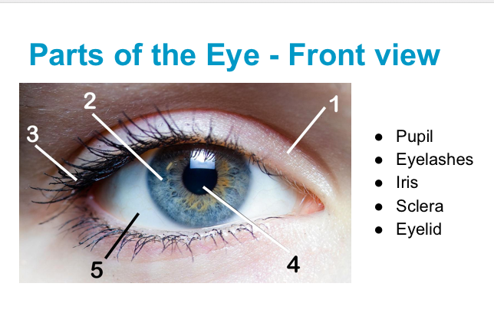
All images,
© Vision 20/20 Project
© Copyright. Science Learning Hub – Pokapū Akoranga Pūtaiao The University of Waikato Te Whare Wananga o Waikato.
All Rights Reserved | www.sciencelearn.org.nz. All images are copyrighted. For further information, please refer to enquiries@sciencelearn.org.nz

Slide 12
© Alex Gilks, 2020
© Copyright. Science Learning Hub – Pokapū Akoranga Pūtaiao The University of Waikato Te Whare Wananga o Waikato.
All Rights Reserved | www.sciencelearn.org.nz. All images are copyrighted. For further information, please refer to enquiries@sciencelearn.org.nz

Slide 13
© Vision 20/20 Project
© Copyright. Science Learning Hub – Pokapū Akoranga Pūtaiao The University of Waikato Te Whare Wananga o Waikato.
All Rights Reserved | www.sciencelearn.org.nz. All images are copyrighted. For further information, please refer to enquiries@sciencelearn.org.nz

Slide 14
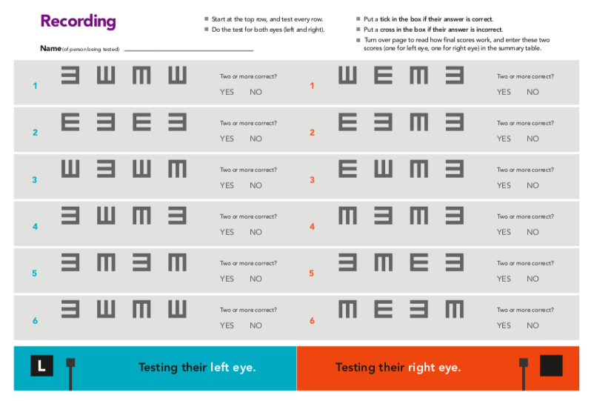
© Vision 20/20 Project
© Copyright. Science Learning Hub – Pokapū Akoranga Pūtaiao The University of Waikato Te Whare Wananga o Waikato.
All Rights Reserved | www.sciencelearn.org.nz. All images are copyrighted. For further information, please refer to enquiries@sciencelearn.org.nz

Slide 15
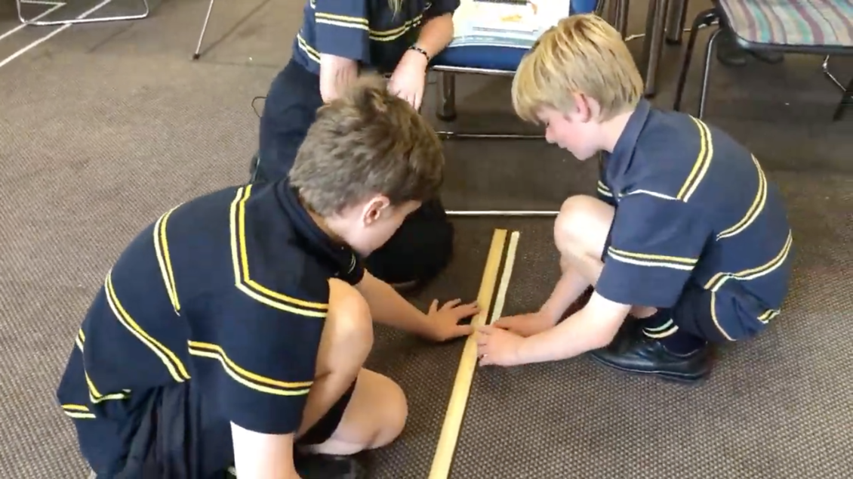
The testing
Photographs by Grant Philip, © Tahuna Normal Intermediate School.
© Copyright. Science Learning Hub – Pokapū Akoranga Pūtaiao The University of Waikato Te Whare Wananga o Waikato.
All Rights Reserved | www.sciencelearn.org.nz. All images are copyrighted. For further information, please refer to enquiries@sciencelearn.org.nz
Notes:
www.sciencelearn.org.nz/images/4503-setting-up-for-testing
www.sciencelearn.org.nz/images/4500-helping-to-run-the-eye-test
www.sciencelearn.org.nz/images/4499-being-eye-tested

Slide 16
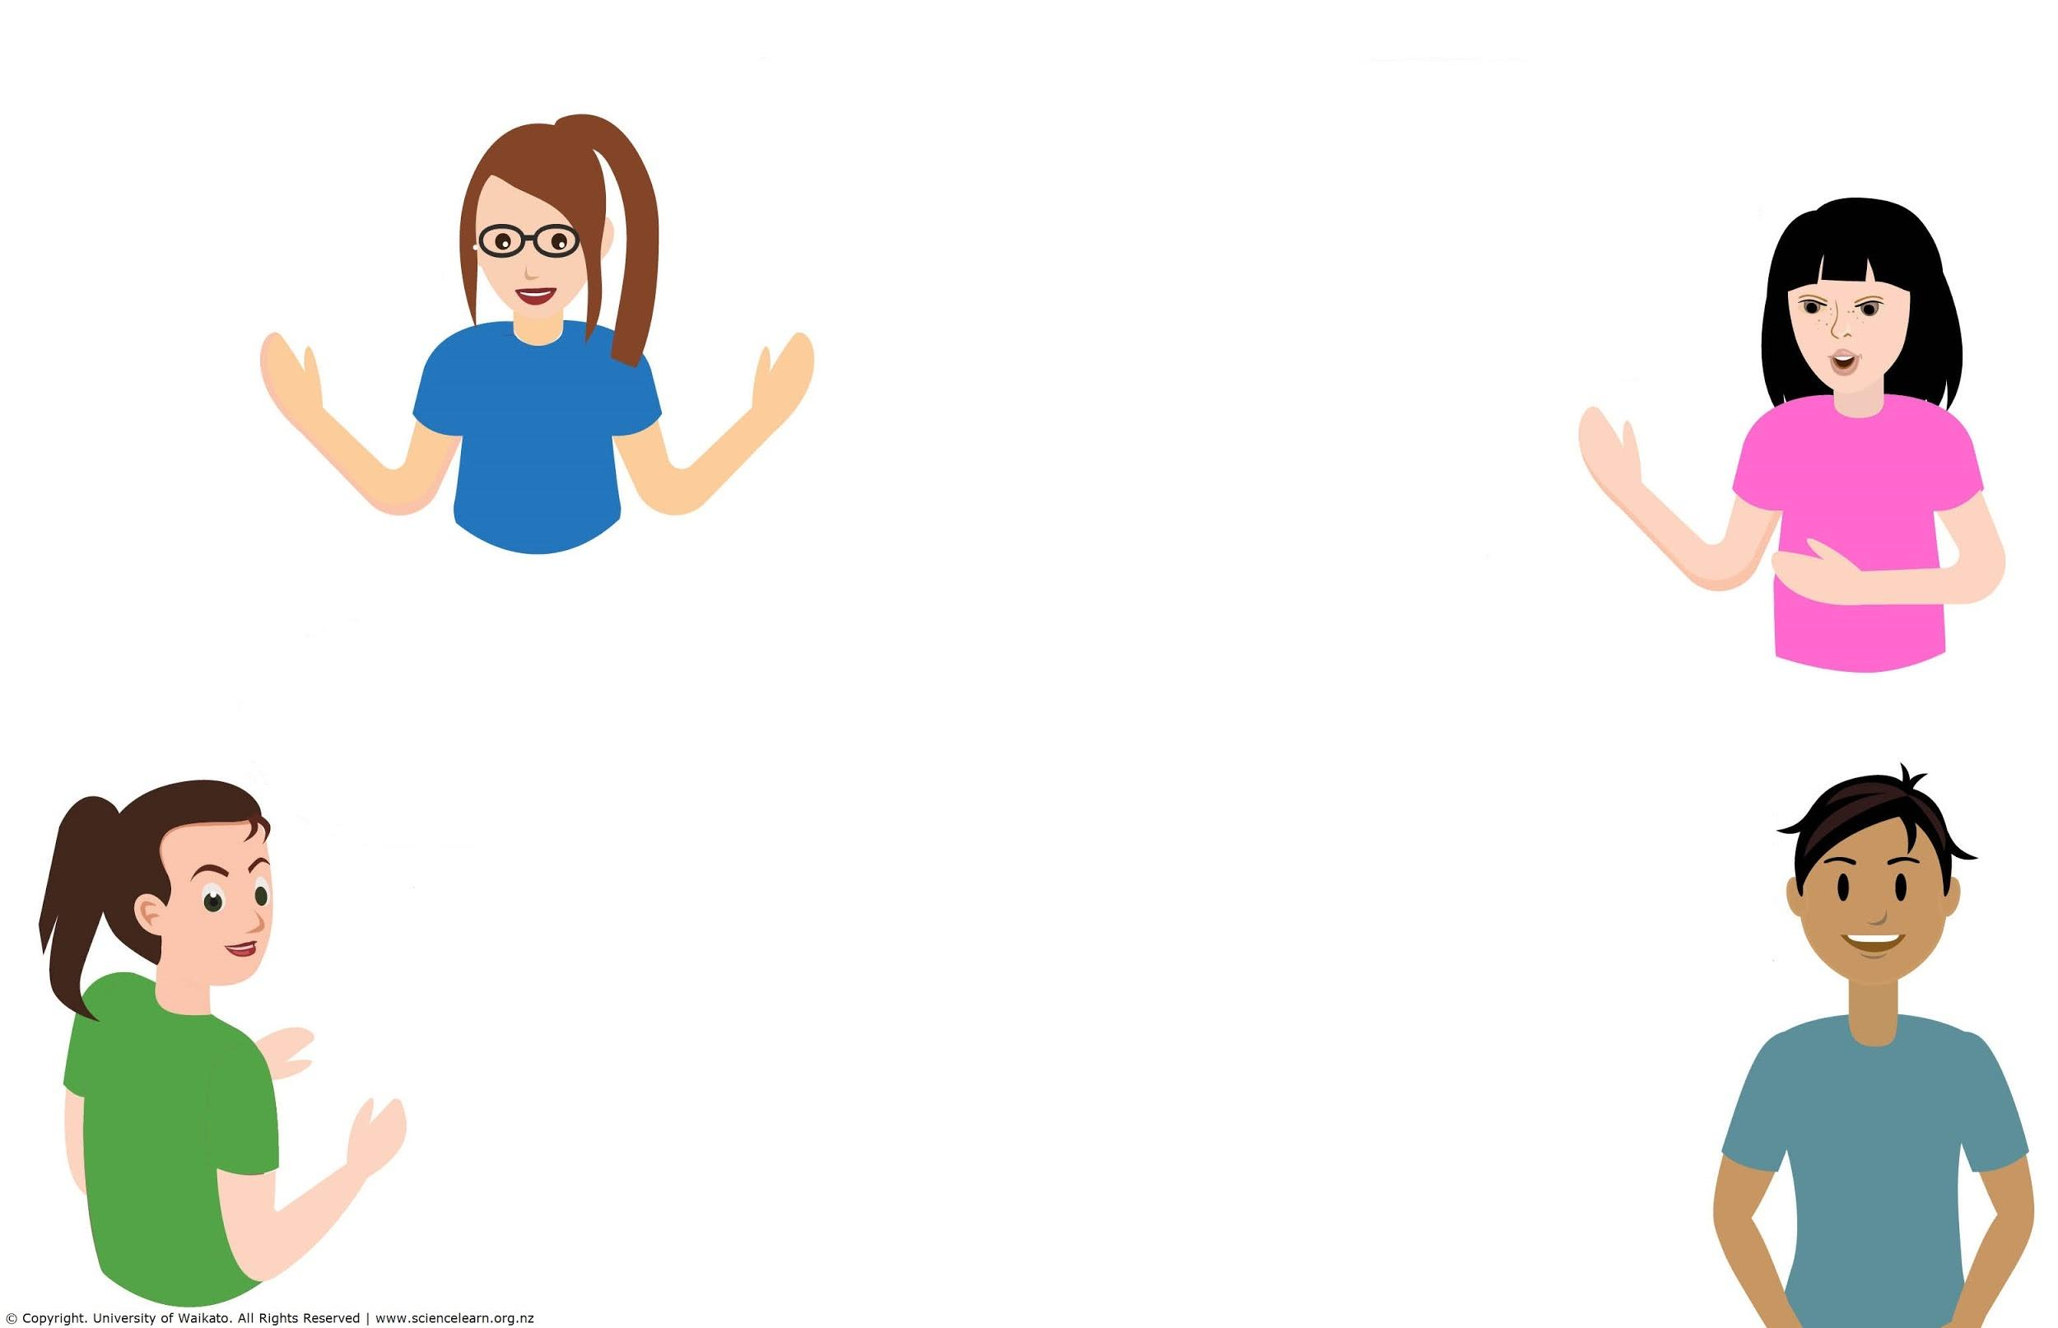
Questions about the process?
© Copyright. Science Learning Hub – Pokapū Akoranga Pūtaiao The University of Waikato Te Whare Wananga o Waikato.
All Rights Reserved | www.sciencelearn.org.nz. All images are copyrighted. For further information, please refer to enquiries@sciencelearn.org.nz

Slide 17
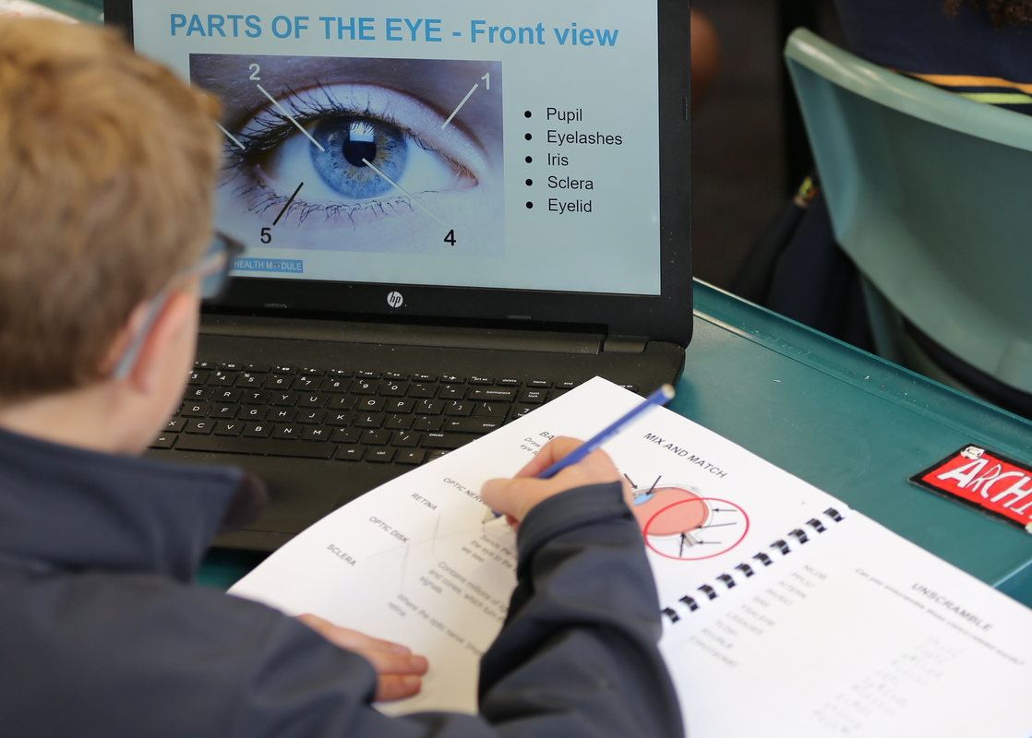
What was the learning?
Photograph by Grant Philip, © Tahuna Normal Intermediate School.
© Copyright. Science Learning Hub – Pokapū Akoranga Pūtaiao The University of Waikato Te Whare Wananga o Waikato.
All Rights Reserved | www.sciencelearn.org.nz. All images are copyrighted. For further information, please refer to enquiries@sciencelearn.org.nz
Notes:
www.sciencelearn.org.nz/images/4501-vision-health-module

Slide 18
Curriculum links
Level 4 science concepts
Investigating in science
Build on prior experiences, working together to share and examine their own and others’ knowledge.
Ask questions, find evidence, explore simple models and carry out appropriate investigations to develop simple explanations.
Participating and contributing
Use their growing science knowledge when considering issues of concern to them.
Explore various aspects of an issue and make decisions about possible actions.
Level 4 health concepts
D1 Societal attitudes and values
Investigate and describe lifestyle factors and media influences that contribute to the wellbeing of people in New Zealand.
D2 Community resources
Investigate and/or access a range of community resources that support wellbeing and evaluate the contribution made by each to the wellbeing of community members
© Copyright. Science Learning Hub – Pokapū Akoranga Pūtaiao The University of Waikato Te Whare Wananga o Waikato.
All Rights Reserved | www.sciencelearn.org.nz. All images are copyrighted. For further information, please refer to enquiries@sciencelearn.org.nz
Notes:
Level 4 science concepts
Investigating in science
Build on prior experiences, working together to share and examine their own and others’ knowledge.
Ask questions, find evidence, explore simple models and carry out appropriate investigations to develop simple explanations.
Participating and contributing
Use their growing science knowledge when considering issues of concern to them.
Explore various aspects of an issue and make decisions about possible actions.
Level 4 health concepts
D1 Societal attitudes and values
Investigate and describe lifestyle factors and media influences that contribute to the wellbeing of people in New Zealand.
D2 Community resources
Investigate and/or access a range of community resources that support wellbeing and evaluate the contribution made by each to the wellbeing of community members

Slide 19
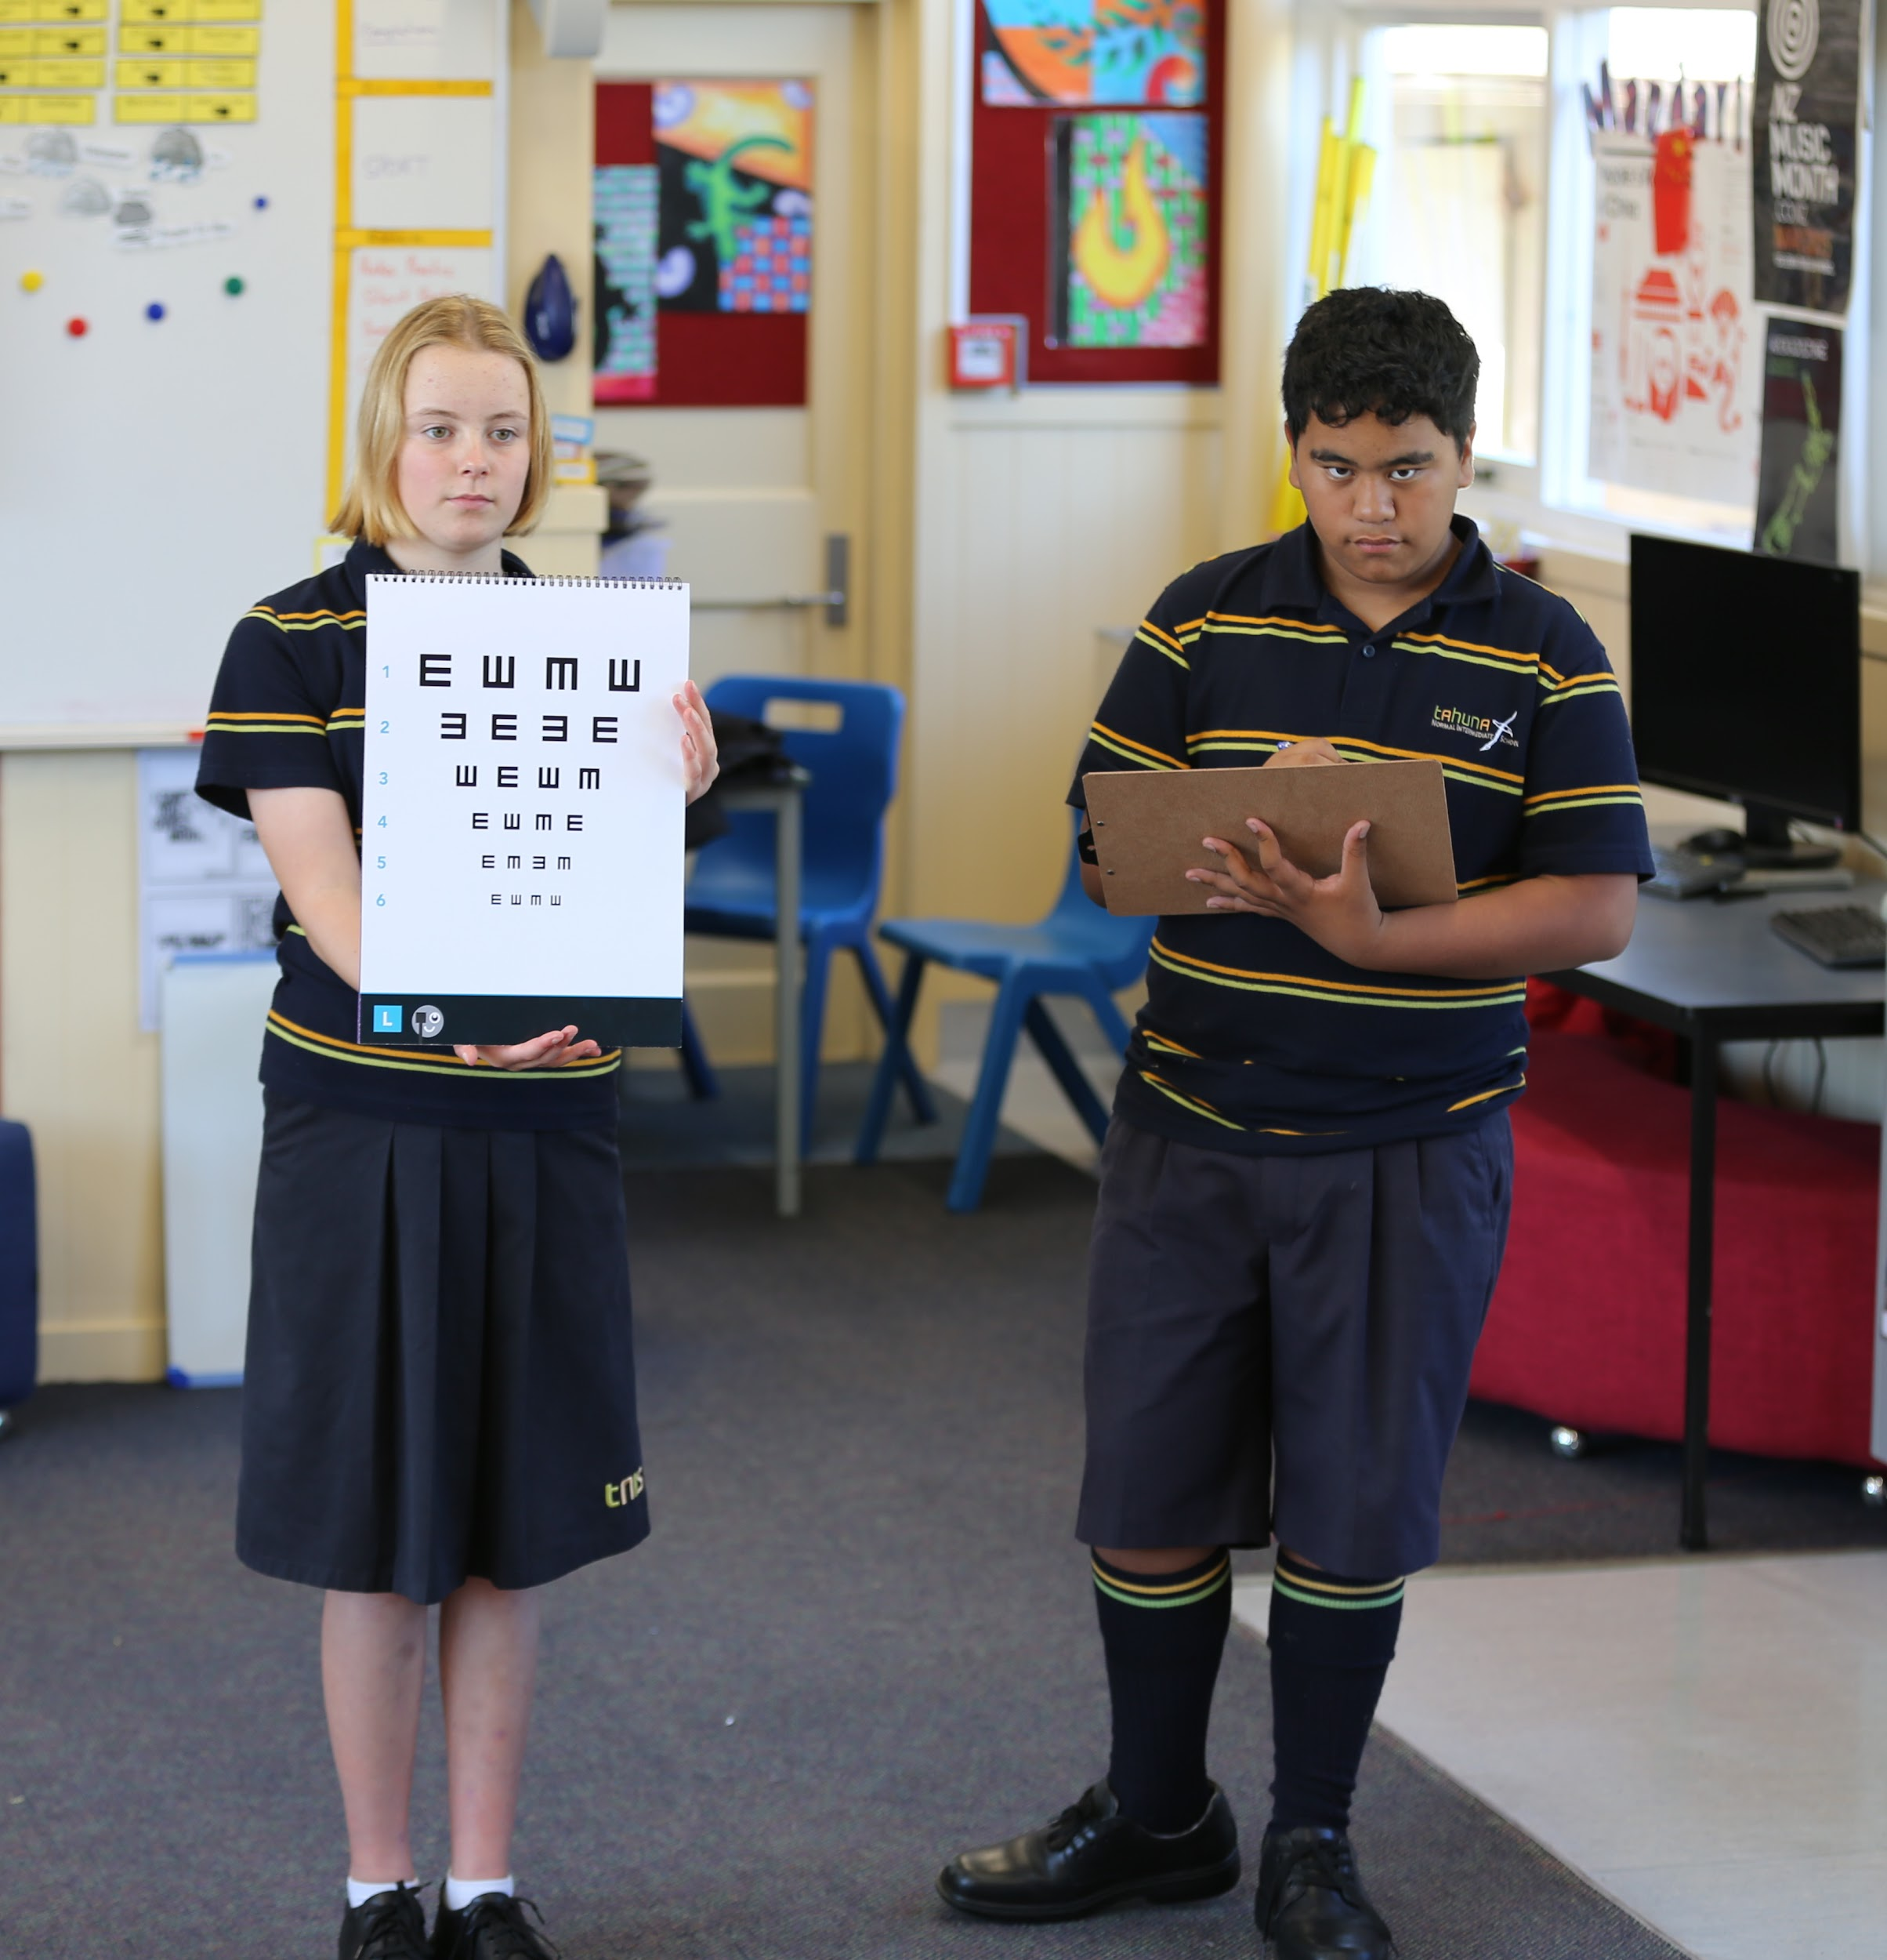
Science capabilities
Photograph by Grant Philip, © Tahuna Normal Intermediate School.
Human ethics resource: https://www.royalsociety.org.nz/what-we-do/funds-and-opportunities/crest-awards/crest-and-ethical-practice/crest-and-ethics/
© Copyright. Science Learning Hub – Pokapū Akoranga Pūtaiao The University of Waikato Te Whare Wananga o Waikato.
All Rights Reserved | www.sciencelearn.org.nz. All images are copyrighted. For further information, please refer to enquiries@sciencelearn.org.nz

Slide 20
Questions for Karen?
© Copyright. Science Learning Hub – Pokapū Akoranga Pūtaiao The University of Waikato Te Whare Wananga o Waikato.
All Rights Reserved | www.sciencelearn.org.nz. All images are copyrighted. For further information, please refer to enquiries@sciencelearn.org.nz

Slide 21
Feedback and eye testing chart
© Copyright. Science Learning Hub – Pokapū Akoranga Pūtaiao The University of Waikato Te Whare Wananga o Waikato.
All Rights Reserved | www.sciencelearn.org.nz. All images are copyrighted. For further information, please refer to enquiries@sciencelearn.org.nz
Notes:
Add how to get a chart.
Form: https://docs.google.com/forms/d/e/1FAIpQLScTwNNYeVrUSXXBStU9MA8j5vnT8wH8Hq1fxL5ThkJQIGDFNA/viewform?usp=sf_link

Slide 22
Resources on the Hub
The project team have created classroom resources:
The Vision Health Module (PDF, 2.4 MB) is a ready-made teaching package for year 7 teachers to implement in their classrooms, over six separate sessions.
The Child to Child Vision Screening Manual (PDF, 660 KB) outlines the process of carrying out child-to-child vision screening. If you are interested in this project and would like a flip chart please email us.
The following resources are designed to be used alongside the Vision Health Module:
How do our eyes work – Part 1 (PPT, 2.8 MB)
How do our eyes work – Part 2 (PPT, 2.4 MB)
Looking after our eyes (PPT, 3.7 MB)
We all see differently (PPT, 4.4 MB)
Technology and vision (PPT, 5.8 MB)
Child-to-child vision screening (PPT, 960 KB)
Vision Health Module – Student Workbook (PDF, 1 MB)
Vision Health Module – Workbook Answers (PDF, 950 KB)
Template for recording class vision screening results (XLS, 10 KB)
© Copyright. Science Learning Hub – Pokapū Akoranga Pūtaiao The University of Waikato Te Whare Wananga o Waikato.
All Rights Reserved | www.sciencelearn.org.nz. All images are copyrighted. For further information, please refer to enquiries@sciencelearn.org.nz
Notes:
www.sciencelearn.org.nz/resources/3009-improving-vision-screening-for-children (down the bottom in related content)
See these videos for additional information about the Vision 20/20 project.
Introduction to the Vision 20/20 toolkit
The design process for the Vision 20/20 toolkit

Slide 23
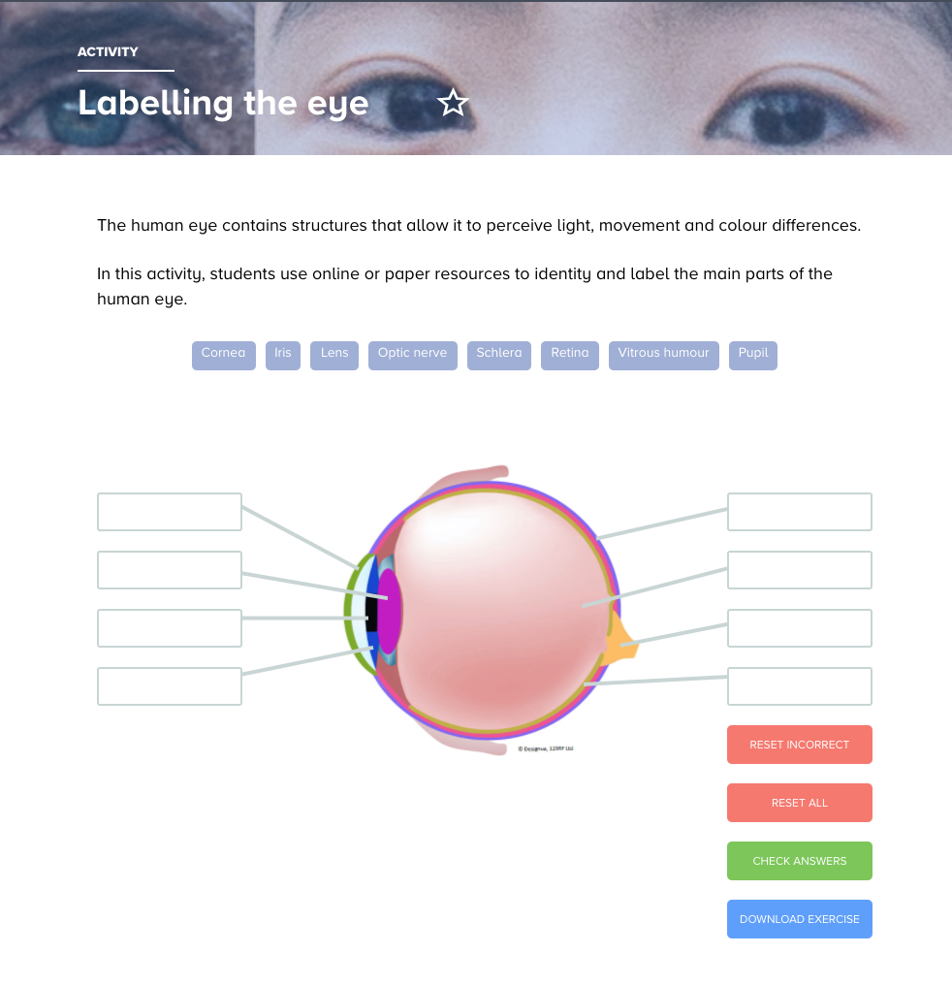
Resources on the Hub
© Copyright. Science Learning Hub – Pokapū Akoranga Pūtaiao The University of Waikato Te Whare Wananga o Waikato.
All Rights Reserved | www.sciencelearn.org.nz. All images are copyrighted. For further information, please refer to enquiries@sciencelearn.org.nz
Notes:
Interactive activity www.sciencelearn.org.nz/resources/3007-labelling-the-eye

Slide 24
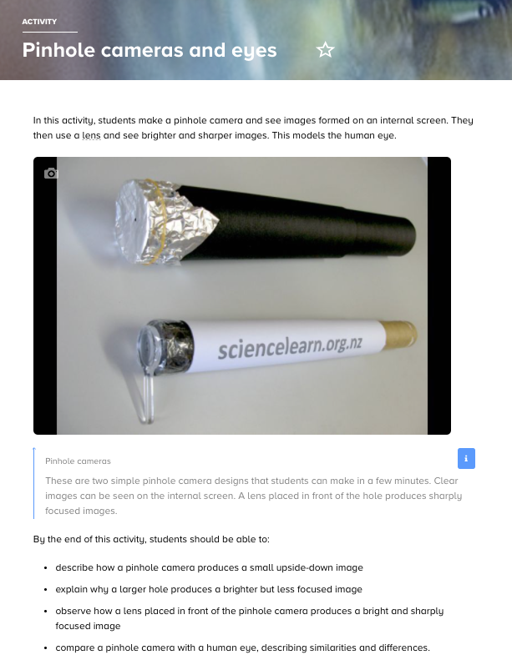
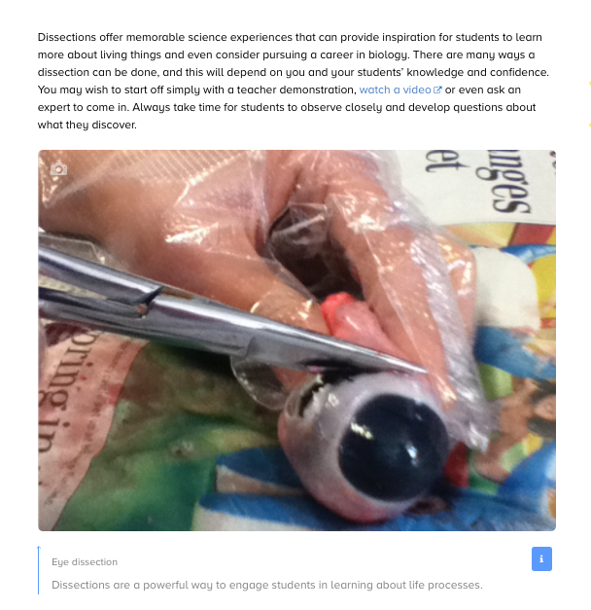
Resources on the Hub
Eye dissection
© Copyright. Science Learning Hub – Pokapū Akoranga Pūtaiao The University of Waikato Te Whare Wananga o Waikato.
All Rights Reserved | www.sciencelearn.org.nz. All images are copyrighted. For further information, please refer to enquiries@sciencelearn.org.nz
Notes:
www.sciencelearn.org.nz/resources/3008-eye-dissection
www.sciencelearn.org.nz/resources/58-pinhole-cameras-and-eyes

Slide 25
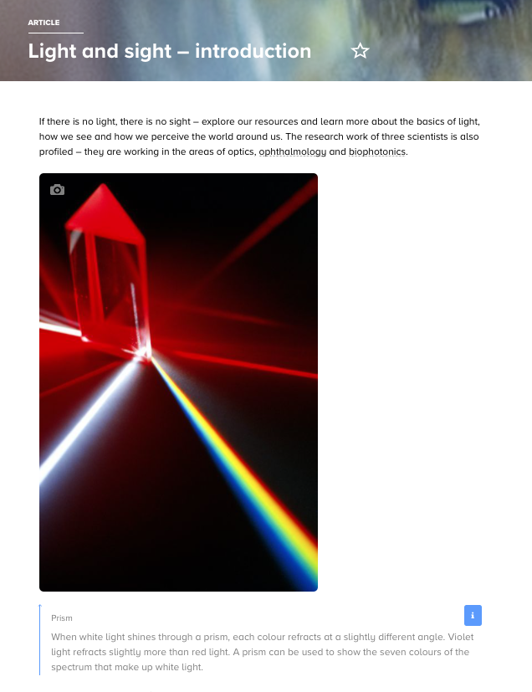
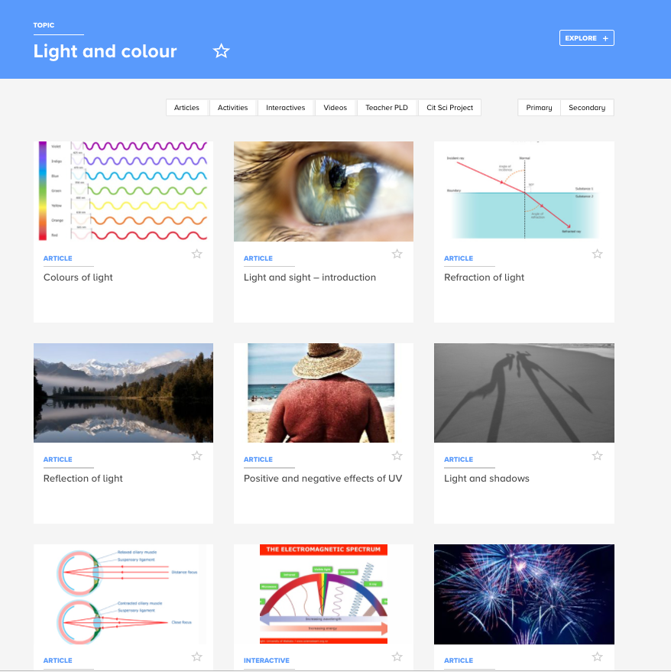
Resources on the Hub
© Copyright. Science Learning Hub – Pokapū Akoranga Pūtaiao The University of Waikato Te Whare Wananga o Waikato.
All Rights Reserved | www.sciencelearn.org.nz. All images are copyrighted. For further information, please refer to enquiries@sciencelearn.org.nz
Notes:
www.sciencelearn.org.nz/topics/light-and-colour
www.sciencelearn.org.nz/resources/39-light-and-sight-introduction
www.sciencelearn.org.nz/resources/1887-sight
www.sciencelearn.org.nz/resources/42-ophthalmology-research
www.sciencelearn.org.nz/resources/2771-light-and-shadows – for younger children

Slide 26
Thanks – want to keep in touch?
Email us on enquiries@sciencelearn.org.nz
https://twitter.com/NZScienceLearn
www.facebook.com/nzsciencelearn
https://nz.pinterest.com/nzsciencelearn
www.instagram.com/sciencelearninghubnz
Join us in our discussion channel on Slack (http://slh-talk.slack.com).
(Any problems accessing Slack, please contact us via our enquiries email, enquiries@sciencelearn.org.nz.)

