Slide 1
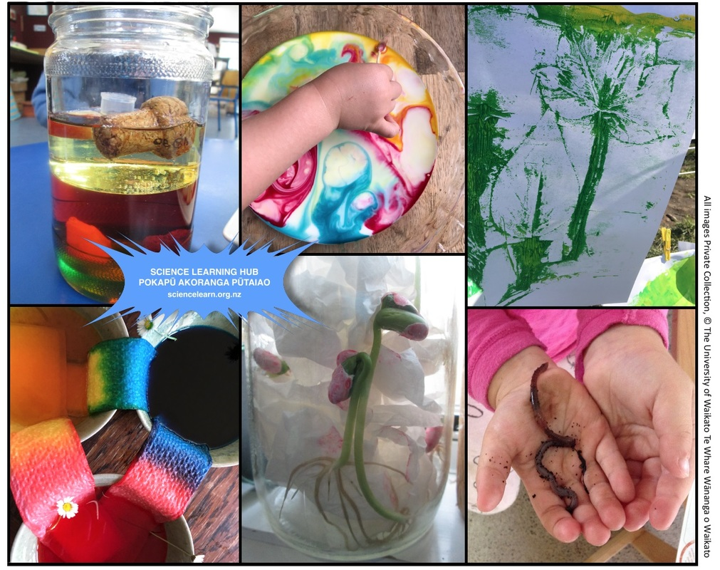
Exploring science in
the early years
4–4:45 pm Thursday 29 April
© Copyright. Science Learning Hub – Pokapū Akoranga Pūtaiao The University of Waikato Te Whare Wananga o Waikato.
All Rights Reserved | www.sciencelearn.org.nz. All images are copyrighted. For further information, please refer to enquiries@sciencelearn.org.nz

Slide 2
The Science Learning Hub
A trustworthy online resource – produced by educators and scientists
Based on world-class New Zealand science research
Supported by learning activities, information about the key science ideas and concepts, multimedia tools and other resources
Written for New Zealand teachers and students
Notes:
The SLH is funded by the NZ government – MBIE Ministry of Business, Innovation and Employment – under the Curious Minds fund

Slide 3
Index
Topic | Slideshow number(s ) | Video timecode
Introducing the Science Learning Hub | 1–2 | 00:00
Index and purpose | 3–5 | 0:31
Introducing Cathy Upton | 6 | 1:56
Participant ideas about science | 7–8 | 4:22
Why do science? | 9–11 | 4:36
Science at different centres | 12–14 | 11:29
Science capabilities and assessment | 15–17 | 22:13
Including diverse ways of knowing | 18 | 24:22
Activity ideas | 19 | 25:38
SLH links, keep in touch and thanks | 20–21 | 27:22
© Copyright. The University of Waikato Te Whare Wananga o Waikato l Science Learning Hub – Pokapū Akoranga Pūtaiao. All Rights Reserved
All images are copyrighted. For further information, please refer to enquiries@sciencelearn.org.nz.

Slide 4
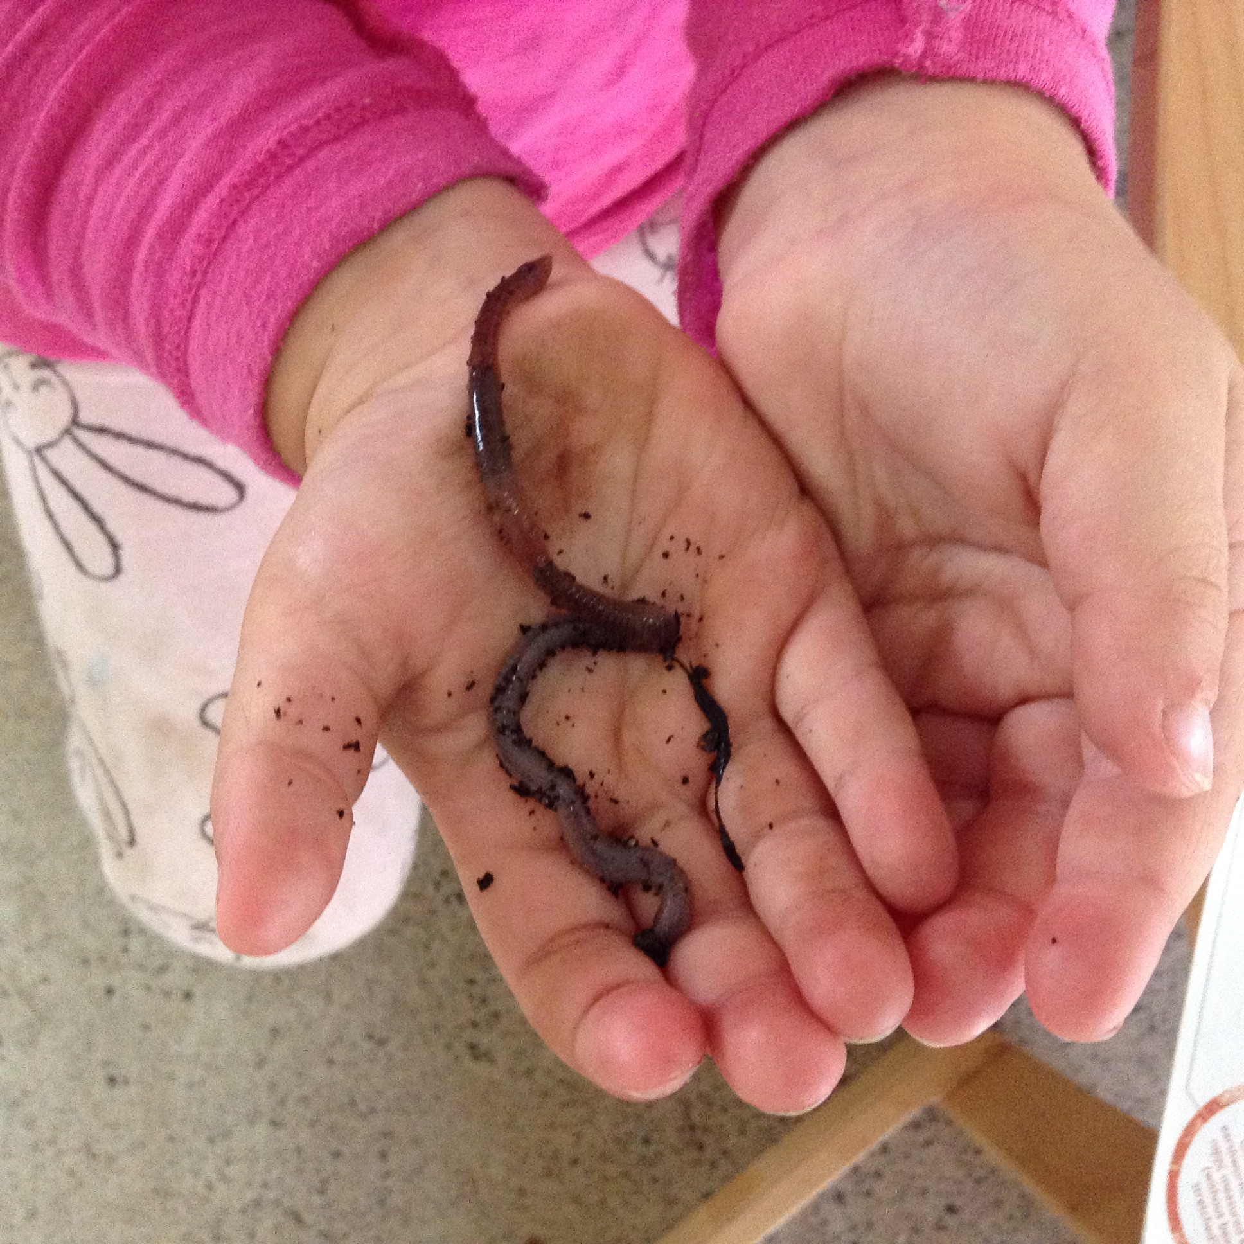
Purpose
To share with you how one centre has included science into their programme and the approaches and activities they found successful.
Provide support for a community of educators to explore how science might be strengthened for their tamariki.
Private Collection
© Copyright. Science Learning Hub – Pokapū Akoranga Pūtaiao The University of Waikato Te Whare Wananga o Waikato.
All Rights Reserved | www.sciencelearn.org.nz. All images are copyrighted. For further information, please refer to enquiries@sciencelearn.org.nz

Slide 5
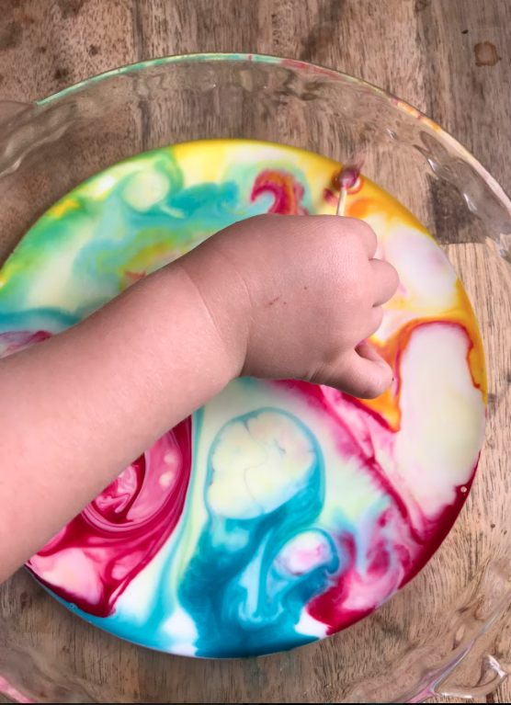
My friends love science,
I love science too.
(4 year old)
Private Collection

Slide 6
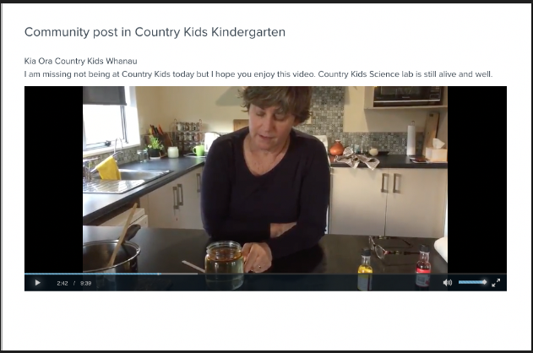
Introducing Cathy
© Country Kids Kindergarten
© Copyright. Science Learning Hub – Pokapū Akoranga Pūtaiao The University of Waikato Te Whare Wananga o Waikato.
All Rights Reserved | www.sciencelearn.org.nz. All images are copyrighted. For further information, please refer to enquiries@sciencelearn.org.nz

Slide 7
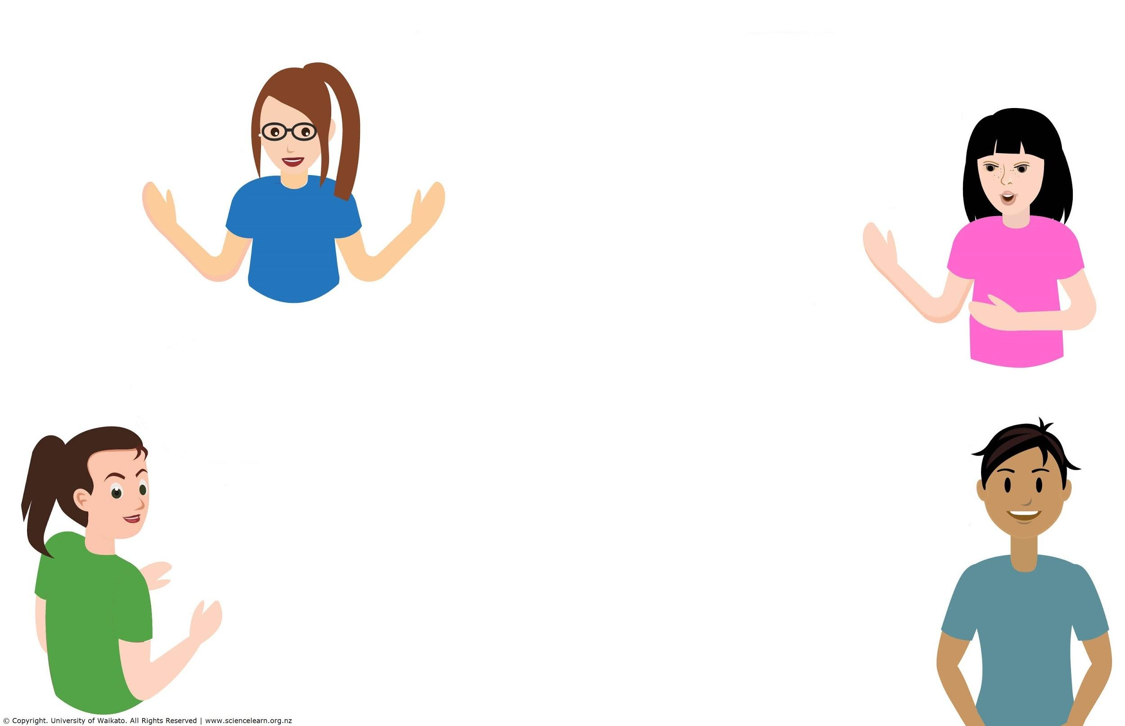
Ko wai tō ingoa?
Whos’ in the Zoom room?
Who you are, your connection to ECE, and an idea about what science is (e.g. favourite science area, idea or activity)
© Copyright. Science Learning Hub – Pokapū Akoranga Pūtaiao The University of Waikato Te Whare Wananga o Waikato.
All Rights Reserved | www.sciencelearn.org.nz. All images are copyrighted. For further information, please refer to enquiries@sciencelearn.org.nz

Slide 8
Participant ideas
about science
Science is everything.
Science is a great context for all kinds of learning.
The biggest resource is nature.
I really enjoy science. I get to see the world through children’s eyes and experience their awe and wonder.
Kids love it the most. It engages children.
Time and organising resources can be a challenge. Having kits ready to use helps a lot.
It’s really important to support teachers who are feeling less confident about science.
© Copyright. Science Learning Hub – Pokapū Akoranga Pūtaiao The University of Waikato Te Whare Wananga o Waikato.
All Rights Reserved | www.sciencelearn.org.nz. All images are copyrighted. For further information, please refer to enquiries@sciencelearn.org.nz

Slide 9
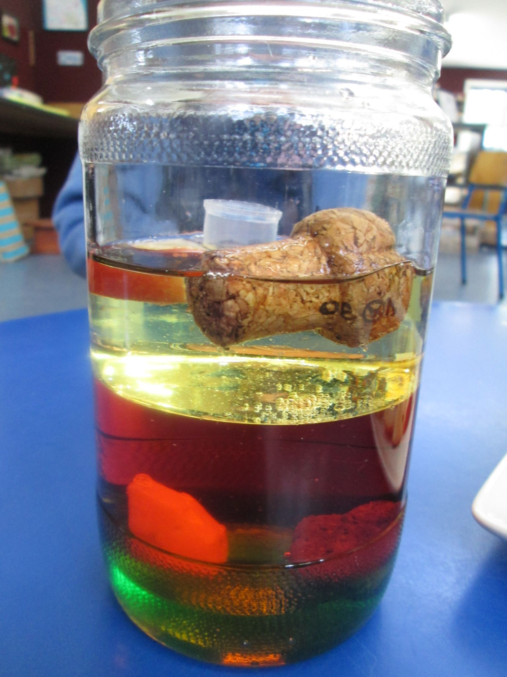
Why do science?
Private Collection
© Copyright. Science Learning Hub – Pokapū Akoranga Pūtaiao The University of Waikato Te Whare Wananga o Waikato.
All Rights Reserved | www.sciencelearn.org.nz. All images are copyrighted. For further information, please refer to enquiries@sciencelearn.org.nz

Slide 10
Why do science?
Encouraging deeper questioning.
I’ve noticed increased engagement. Science engages learners that were often hesitant in other learning areas.
Connections to ourselves and others. Developing a sense of belonging.
I feel science is so much fun! Seeing the wonder on tamariki's faces, the joy, curiosity and drive to learn is just awesome.
Transferable capabilities, making sense of the world, being curious. You can’t be wrong, we’re all making sense.
What is/are your reason(s) for wanting to include science in your programme?
© Copyright. Science Learning Hub – Pokapū Akoranga Pūtaiao The University of Waikato Te Whare Wananga o Waikato.
All Rights Reserved | www.sciencelearn.org.nz. All images are copyrighted. For further information, please refer to enquiries@sciencelearn.org.nz

Slide 11
Why focus on science?
Some findings:
plan for children’s learning and progress in science
use of assessment to describe and understand children’s learning, and inform next steps for their learning
bicultural practice
partnerships with parents, whānau, and the community
© Crown Copyright, CC BY 3.0
© Copyright. Science Learning Hub – Pokapū Akoranga Pūtaiao The University of Waikato Te Whare Wananga o Waikato.
All Rights Reserved | www.sciencelearn.org.nz. All images are copyrighted. For further information, please refer to enquiries@sciencelearn.org.nz
Notes:
https://ero.govt.nz/our-research/science-in-the-early-years-early-childhood-and-years-1-4

Slide 12
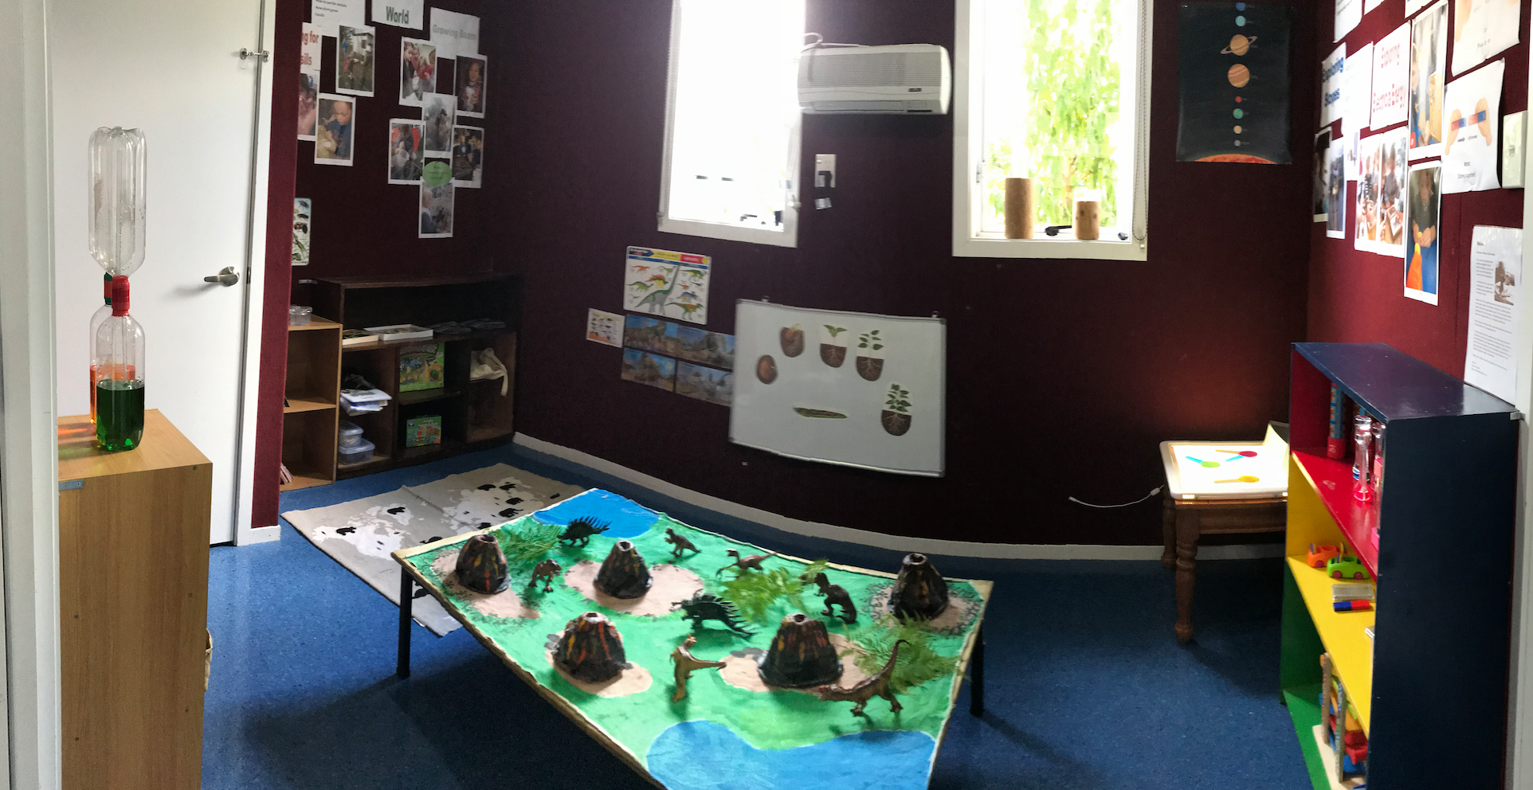
How Cathy started integrating
more science at her centre
Private Collection
© Copyright. Science Learning Hub – Pokapū Akoranga Pūtaiao The University of Waikato Te Whare Wananga o Waikato.
All Rights Reserved | www.sciencelearn.org.nz. All images are copyrighted. For further information, please refer to enquiries@sciencelearn.org.nz

Slide 13
Science at your centre?
What science is already happening?
What possibilities are there to use your environment?
© Copyright. Science Learning Hub – Pokapū Akoranga Pūtaiao The University of Waikato Te Whare Wananga o Waikato.
All Rights Reserved | www.sciencelearn.org.nz. All images are copyrighted. For further information, please refer to enquiries@sciencelearn.org.nz

Slide 14
Science at your centre?
A lot of the science we do has happened because of what children have brought in (e.g. insects, seeds, birds nests), and the questions they had.
We have lots of opportunities to explore science through the natural world at our centre and we’ve identified we would like more chemical and physical world experiences for our children.
We use language, for example “oh you're thinking/taking/observing like a scientist”. The children will say “I’m using my scientist eyes”.
We have an old sunflower that children can observe the changes over time.
Science for us is integrated naturally, it happens all around us.
We’ve had children passionate about floating boats – exploring water and density. They’ve been interested in flight, looking at wings and speed, and they always love colour and rainbows.
What science is already happening?
What possibilities are there to use your environment?
© Copyright. Science Learning Hub – Pokapū Akoranga Pūtaiao The University of Waikato Te Whare Wananga o Waikato.
All Rights Reserved | www.sciencelearn.org.nz. All images are copyrighted. For further information, please refer to enquiries@sciencelearn.org.nz

Slide 15
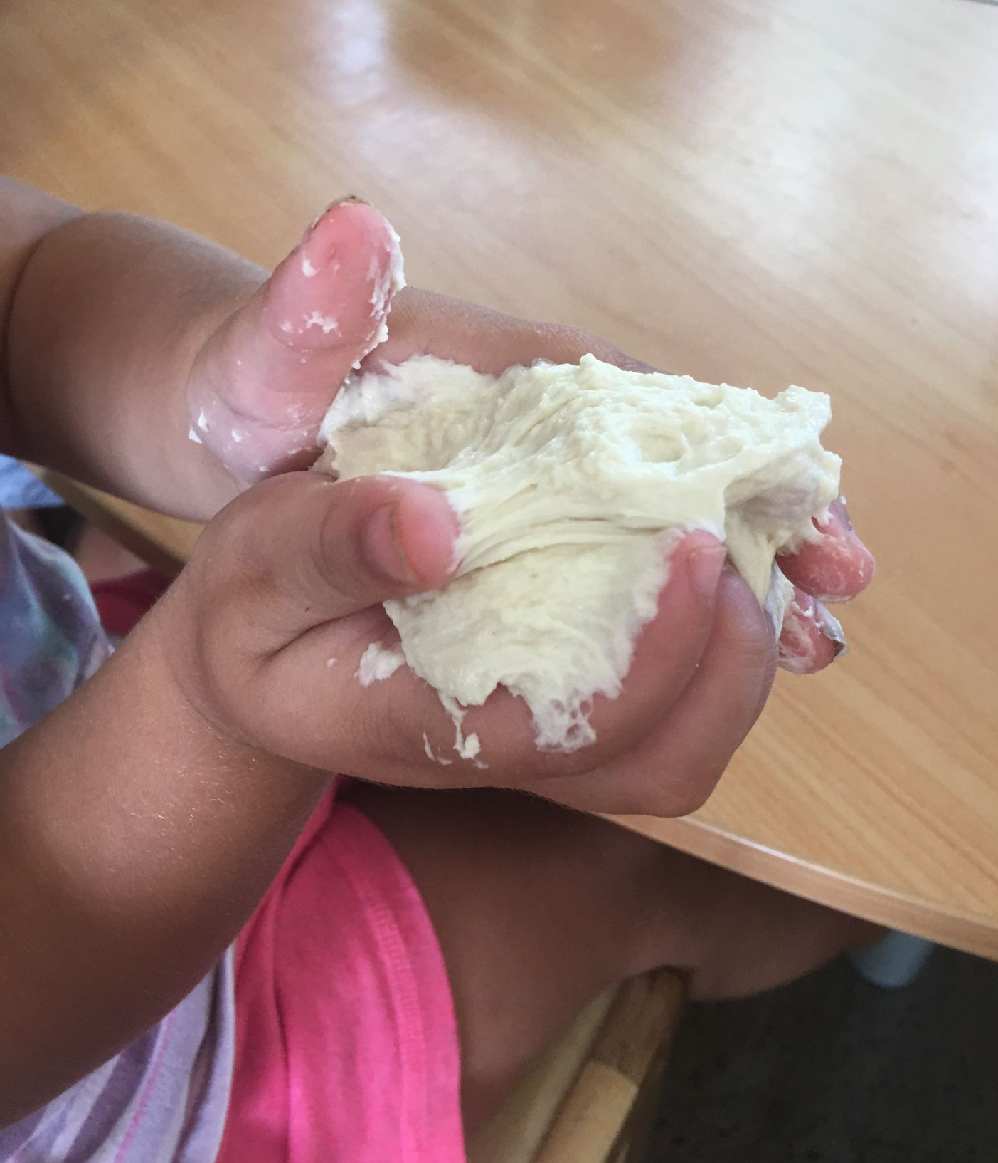
Doing science
Private Collection
© Copyright. Science Learning Hub – Pokapū Akoranga Pūtaiao The University of Waikato Te Whare Wananga o Waikato.
All Rights Reserved | www.sciencelearn.org.nz. All images are copyrighted. For further information, please refer to enquiries@sciencelearn.org.nz

Slide 16
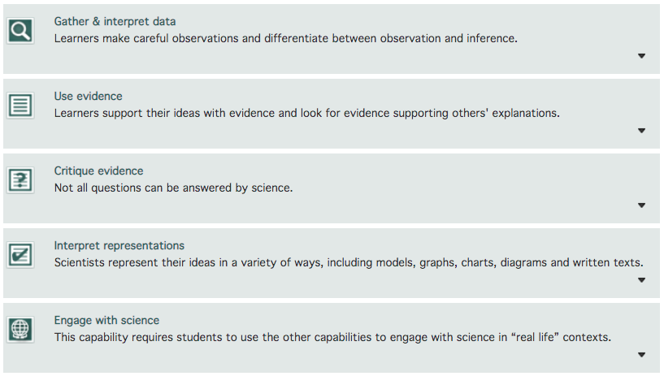
Science capabilities
Allow kaiako to support children’s progress in science across contexts
© Copyright. Science Learning Hub – Pokapū Akoranga Pūtaiao The University of Waikato Te Whare Wananga o Waikato.
All Rights Reserved | www.sciencelearn.org.nz. All images are copyrighted. For further information, please refer to enquiries@sciencelearn.org.nz
Notes:
https://scienceonline.tki.org.nz/Science-capabilities-for-citizenship/Introducing-five-science-capabilities

Slide 17
Assessing science?
We include science skills in our learning stories.
We’re using the science progressions so we can look at the students’ progress over time. They are based on the science capabilities, so are Nature of Science focussed.
We use the conversations we have with children to understand where they are at and what we need to do to scaffold them.
Our centre uses a version of Bloom’s taxonomy.
© Copyright. Science Learning Hub – Pokapū Akoranga Pūtaiao The University of Waikato Te Whare Wananga o Waikato.
All Rights Reserved | www.sciencelearn.org.nz. All images are copyrighted. For further information, please refer to enquiries@sciencelearn.org.nz

Slide 18
Including diverse ways of knowing
One idea: Observation and pattern seeking - observing weather, seasons...
© Copyright. Science Learning Hub – Pokapū Akoranga Pūtaiao The University of Waikato Te Whare Wananga o Waikato.
All Rights Reserved | www.sciencelearn.org.nz. All images are copyrighted. For further information, please refer to enquiries@sciencelearn.org.nz
Notes:
https://www.sciencelearn.org.nz/resources/2940-listening-to-the-land

Slide 19
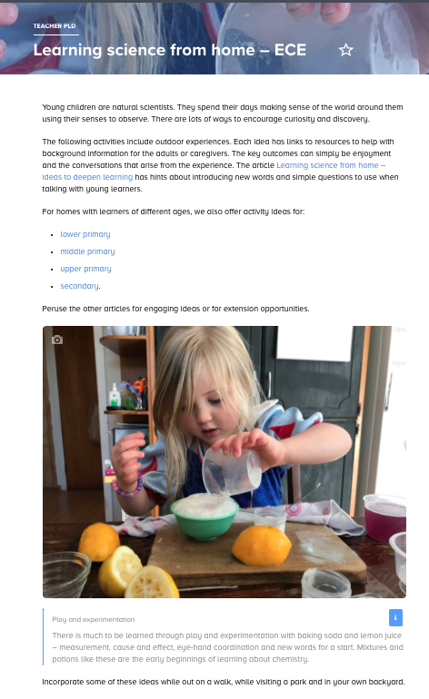
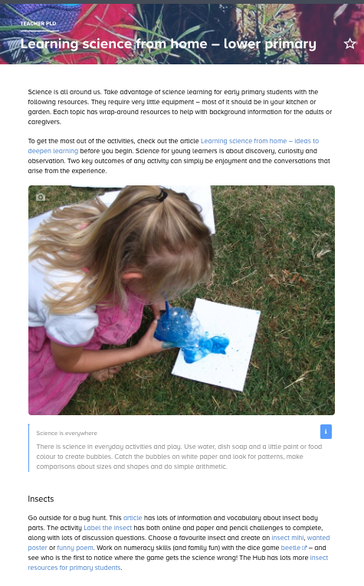
Activity ideas
© Copyright. Science Learning Hub – Pokapū Akoranga Pūtaiao The University of Waikato Te Whare Wananga o Waikato.
All Rights Reserved | www.sciencelearn.org.nz. All images are copyrighted. For further information, please refer to enquiries@sciencelearn.org.nz
Notes:
https://www.sciencelearn.org.nz/resources/2903-learning-science-from-home-ece
https://www.kitchensciencecookbook.com/

Slide 20
Thoughts, ideas, questions...
© Copyright. Science Learning Hub – Pokapū Akoranga Pūtaiao The University of Waikato Te Whare Wananga o Waikato.
All Rights Reserved | www.sciencelearn.org.nz. All images are copyrighted. For further information, please refer to enquiries@sciencelearn.org.nz
Notes:
https://gazette.education.govt.nz/articles/learning-the-wonder-of-science-together

Slide 21
Thanks – want to keep in touch?
Email us on enquiries@sciencelearn.org.nz
https://twitter.com/NZScienceLearn
www.facebook.com/nzsciencelearn
https://nz.pinterest.com/nzsciencelearn
www.instagram.com/sciencelearninghubnz
Join us in our discussion channel on Slack (http://slh-talk.slack.com).
(Any problems accessing Slack, please contact us via our enquiries email, enquiries@sciencelearn.org.nz.)

