Slide 1
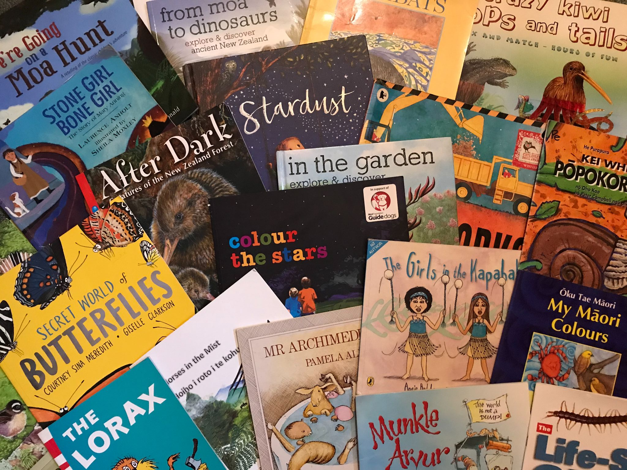
Science through
picture books
Thursday 17 June 2021
© Copyright. Science Learning Hub – Pokapū Akoranga Pūtaiao The University of Waikato Te Whare Wananga o Waikato.
All Rights Reserved | www.sciencelearn.org.nz. All images are copyrighted. For further information, please refer to enquiries@sciencelearn.org.nz

Slide 2
The Science Learning Hub
A trustworthy online resource – produced by educators and scientists
Based on world-class New Zealand science research
Supported by learning activities, information about the key science ideas and concepts, multimedia tools and other resources
Written for New Zealand teachers and students
Notes:
The SLH is funded by the New Zealand government – MBIE Ministry of Business, Innovation and Employment – under the Curious Minds fund

Slide 3
Index
Topic | Slideshow number(s) | Video timecode
Introducing the Science Learning Hub | 1–2 | 00:00
Index | 2 | 00:26
Introducing Dr Nicola Daly | 4 | 00:35
Participants ideas – favourite picture books | 5 | 01:55
Why use picture books in the classroom? | 6 | 02:16
Koro’s medicine – reading by Nicola | 7 | 09:40
Curriculum links | 8 | 19:04
Plant identification and classification | 9 | 20:08
Language | 10 | 22:30
Ways of knowing | 11 | 25:52
Participant ideas – picture books and science concepts | 12 | 29:19
SLH links, keep in touch and thanks | 13 | 31:43
© Copyright. Science Learning Hub – Pokapū Akoranga Pūtaiao The University of Waikato Te Whare Wananga o Waikato.

Slide 4
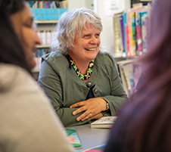
Nicola Daly
Associate Professor, Division of Education, University of Waikato
Teaches children’s literature and language-related courses
Researches bilingual picture books
© University of Waikato
© Copyright. Science Learning Hub – Pokapū Akoranga Pūtaiao The University of Waikato Te Whare Wananga o Waikato.
All Rights Reserved | www.sciencelearn.org.nz. All images are copyrighted. For further information, please refer to enquiries@sciencelearn.org.nz

Slide 5
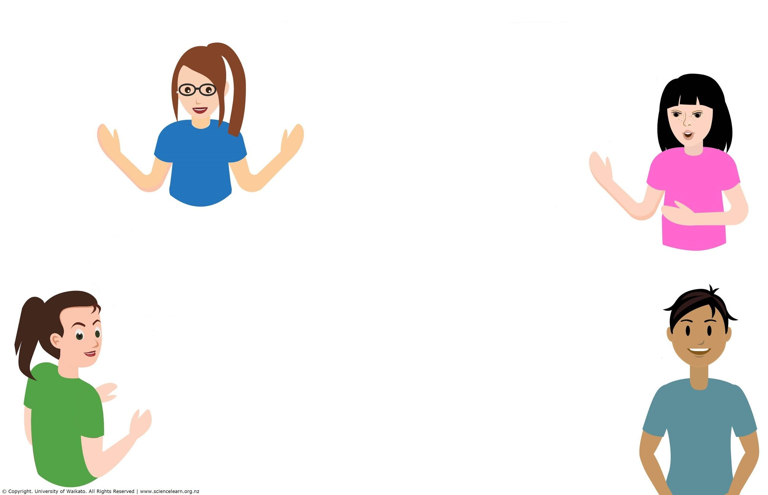
Participants favourite picture books
Greedy Cat by Joy Cowley
Red: A Crayon’s Story by Michael Hall and Things in the Sea are Touching Me by Linda Jane Keegan are both really cool.
My favourite picture book is Whose Beak is This?
You Are Stardust by Elin Kelsey, illustrated by Soyeon Kim
Fave picture book from me = I Need a New Bum!
Pig the Pug and
Giraffes Can't Dance
Owl Babies
I am Jellyfish by Ruth Paul
Iggy Peck, Architect
Bad Kitty and Here We Are: Notes For Living on Planet Earth by Oliver Jeffers
What Makes a Baby?
LOVE Where the Wild Things are and The Wild Girl
Who Sank the Boat, Pamela Allen
Love Little Blue about Don Mertens and his work to save the black robin.
Aura Parker's Twig and Cocoon
© Copyright. Science Learning Hub – Pokapū Akoranga Pūtaiao The University of Waikato Te Whare Wananga o Waikato.
All Rights Reserved | www.sciencelearn.org.nz. All images are copyrighted. For further information, please refer to enquiries@sciencelearn.org.nz

Slide 6
Why picture books?
© Copyright. Science Learning Hub – Pokapū Akoranga Pūtaiao The University of Waikato Te Whare Wananga o Waikato.
All Rights Reserved | www.sciencelearn.org.nz. All images are copyrighted. For further information, please refer to enquiries@sciencelearn.org.nz
Notes:
For example
Engaging
Discussion starters
Provide a context for contexts
Introduce science language
Identify alternative conceptions
Mix of image and text
Need to be aware that the science concepts are not necessarily accurate – therefore it can be important to find other sources of information (such as the SLH)
Reading a picture book is not doing science – HOWEVER it does provide a way into science conversations and provide an interest and purpose for doing science.

Slide 7
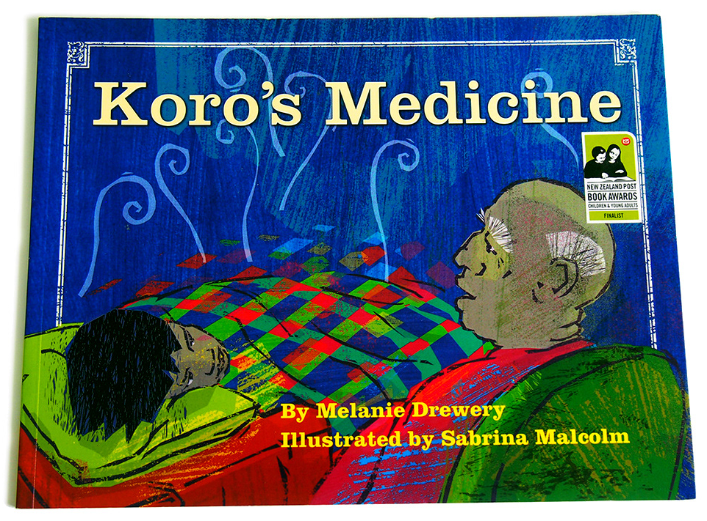
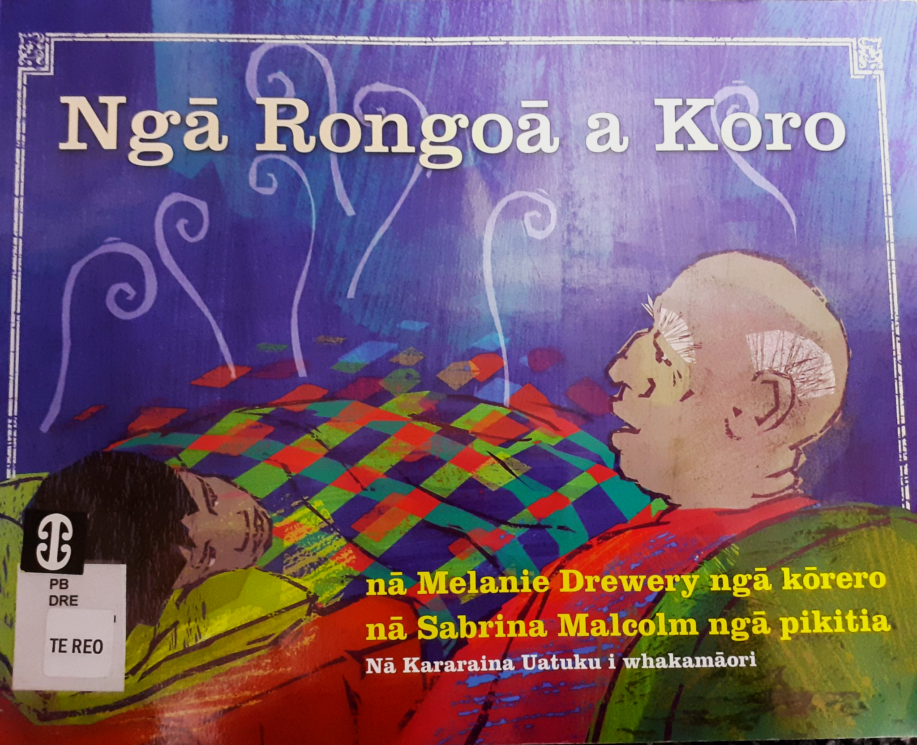
Koro’s Medicine and Ngā Rongoa a Koro, by Melanie Drewery, illustrations by Sabrina Malcolm.
With permission of Huia Publishers.
Notes:
Written by Melanie Drewery (Ngāti Mahanga) because she couldn’t see any children’s books about rongoā: A boy visits his koro, has a few minor scrapes and is introduced to rongoā, suitable for ages 8–12 according to Huia.
Two versions published simultaneously in 2005. Translation by Kararaina Uetuku (Tuhoe)
Melanie Drewery also wrote Dad's Takeaways which has got great science possibilities
Illustrations by Sabrina Malcolm
Ngā Rongoā a Koro won Te Kura Pounamu award in 2005
Author: Melanie Drewery
Illustrator: Sabrina Malcolm
Translator: Kararaina Uatuku

Slide 8
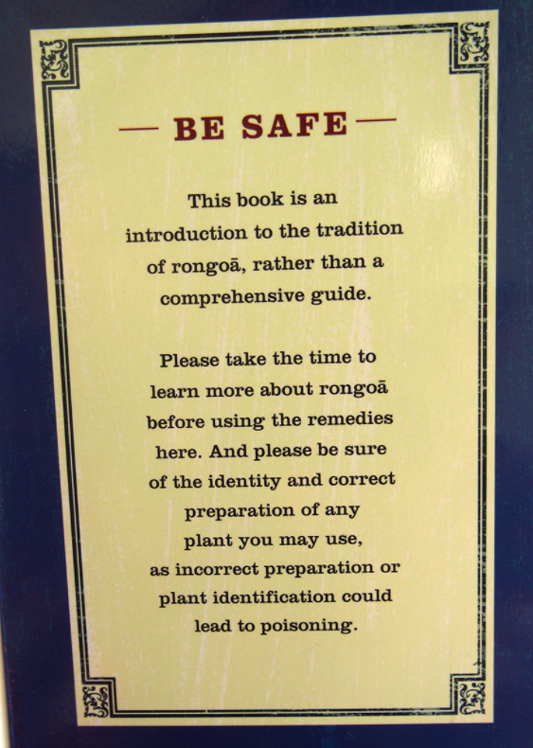
Plant identification
Koro’s Medicine, by Melanie Drewery, illustrations by Sabrina Malcolm.
With permission of Huia Publishers.

Slide 9
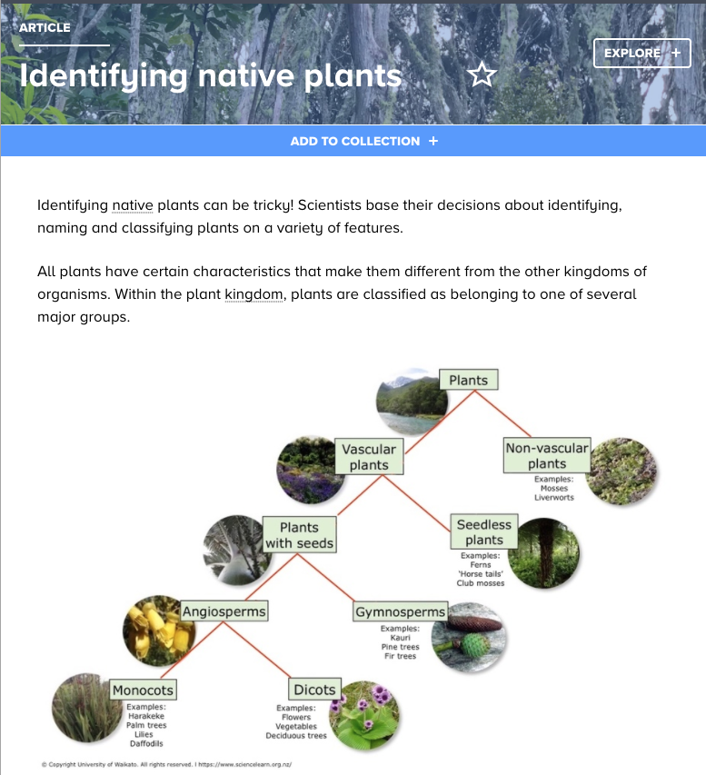
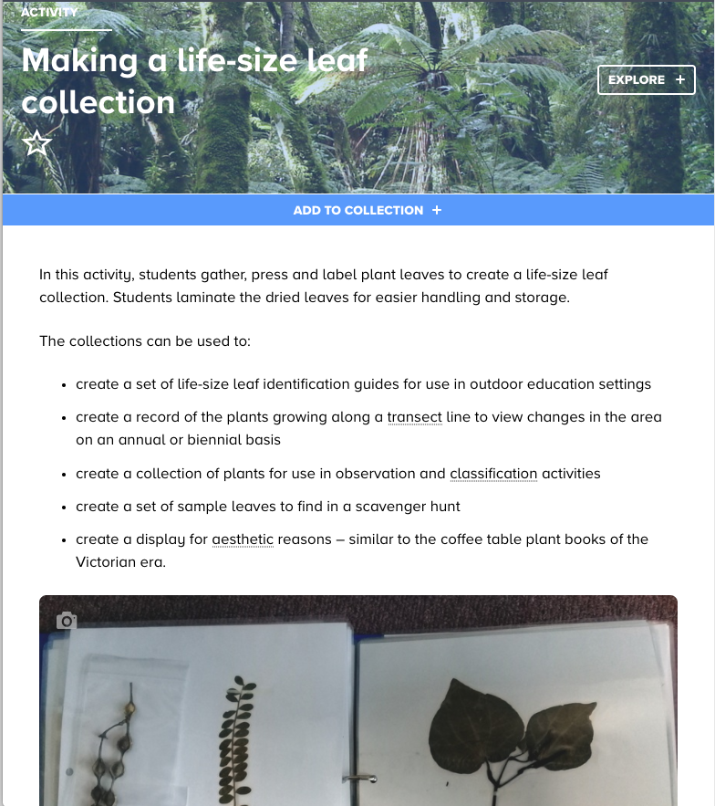
Plant identification
Notes:
https://www.sciencelearn.org.nz/resources/2634-identifying-native-plants
https://www.sciencelearn.org.nz/resources/2609-making-a-life-size-leaf-collection

Slide 10
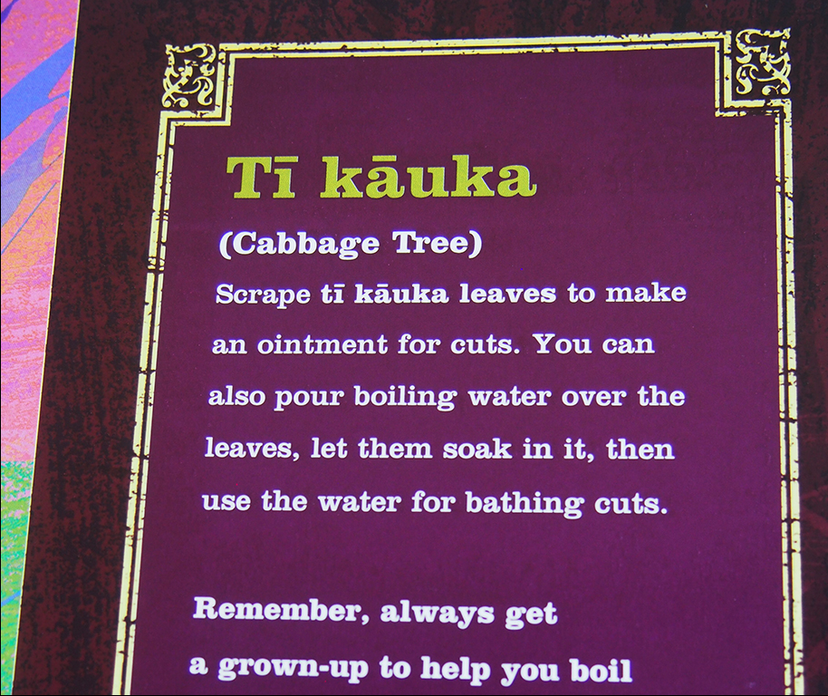
Language
Māori names for all plants used with macrons:
Harakeke
Tī kāuka
Kānuka
Karaka
Koromiko
Mānuka
Ngaio
Koro’s Medicine, by Melanie Drewery, illustrations by Sabrina Malcolm.
With permission of Huia Publishers.

Slide 11
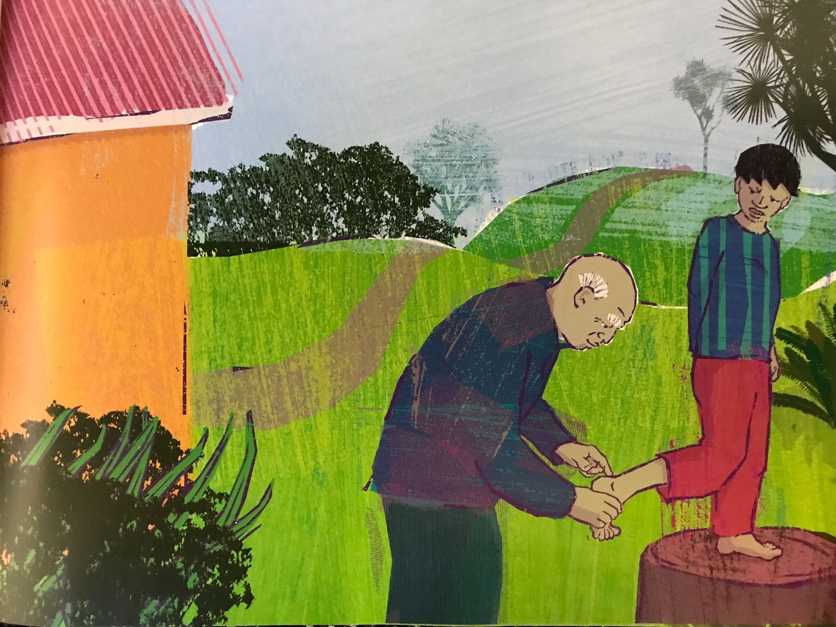
Mātauranga – ways of knowing
‘Don’t I need proper medicine?’ I said.
‘Āe, this is proper medicine,’ said Koro. ‘It’s rongoā – Māori medicine.’
Koro’s Medicine, by Melanie Drewery, illustrations by Sabrina Malcolm. With permission of Huia Publishers.

Slide 12
Participant ideas: picture books
and science concepts
Any story featuring Māui will bring science! :-)
River Story by Meredith Hooper
Granny McFlitter the Champion Knitter (Heather Haylock/ Lael Chisholm) – oil spills, penguin feathers, adaptations of different animals for their environments.
The Kuia and the Spider by Patricia Grace. Nature of Science, observation, noticing, wonderings, Mātauranga Māori, Kaitiakitanga.
Who Stole the Rainbow? – exploring the science of rainbows.
Let's Go Eels by Robin Kermode
Who Sank the Boat? – links to floating/sinking, weight, volume, size of different animals … Also Mr Archimedes’ Bath – has similar themes.
We're Going on a Bear Hunt – so many science concepts and properties
The Bomb by Sacha Cotter and Josh Morgan. Not a science book but could be an interesting/fun way to approach physics.
Lorax, Dr Seuss – enviro sustainability class, used the book to learn about aspects of sustainability. "What happened next", future thinking ...
Books by Peter Gossage – many are on Māori myths, i.e. Battle of the Mountains – links to geology, agriculture ...
Notes:
Other examples:
Gruffalo – food webs, identification
Hairy MacLary – breeds of dogs
Where the Wild Things Are – how long things stay hot
Dad’s Takeaways – sustainability in gathering kaimoana

Slide 13
Thanks – keep in touch!
Email us on enquiries@sciencelearn.org.nz
https://twitter.com/NZScienceLearn
www.facebook.com/nzsciencelearn
https://nz.pinterest.com/nzsciencelearn
www.instagram.com/sciencelearninghubnz
Join us in our discussion channel on Slack (http://slh-talk.slack.com).
(Any problems accessing Slack, please contact us via our enquiries email, enquiries@sciencelearn.org.nz.)

