Slide 1
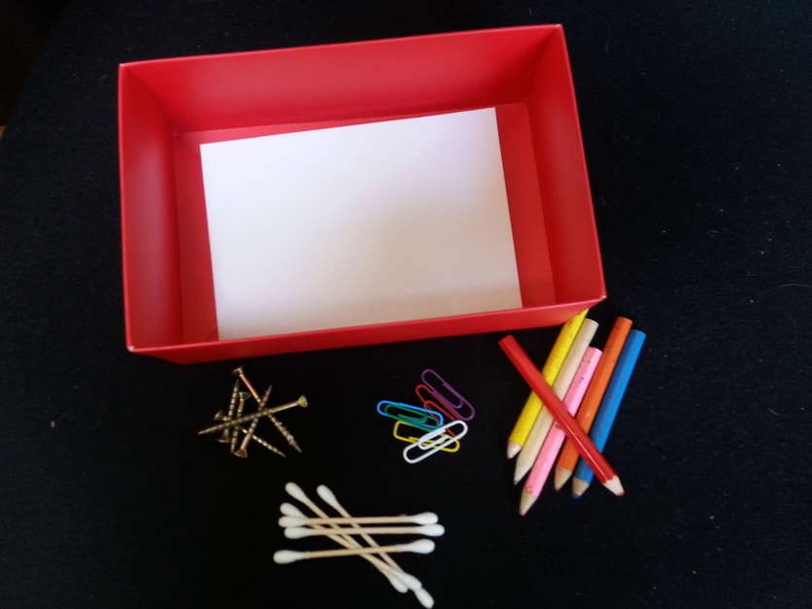
Having fun with the
science capabilities
4–4:45 pm Thursday 17 August
© Copyright. Science Learning Hub – Pokapū Akoranga Pūtaiao The University of Waikato Te Whare Wananga o Waikato.
All Rights Reserved | www.sciencelearn.org.nz. All images are copyrighted. For further information, please refer to enquiries@sciencelearn.org.nz

Slide 2
Index
Topic | Slideshow number(s ) | Video timecode
Index | 2 | 00:17
Introducing the Science Learning Hub and presenters | 3–4 | 00:26
Purpose | 5 | 02:37
What are the science capabilities? | 6 | 03:43
NMSSA and NZCER Progression resources | 7–11 | 07:44
Sandpit science | 12 | 11:37
Activity 1: Mystery boxes | 13 | 17:22
Activity 2: Observing hair | 14 | 24:19
Activity 3: Exploring liquids | 15–16 | 29:36
SLH links, keep in touch and thanks | 17–18 | 37:35
© Copyright. The University of Waikato Te Whare Wananga o Waikato l Science Learning Hub – Pokapū Akoranga Pūtaiao. All Rights Reserved
All images are copyrighted. For further information, please refer to enquiries@sciencelearn.org.nz.

Slide 3

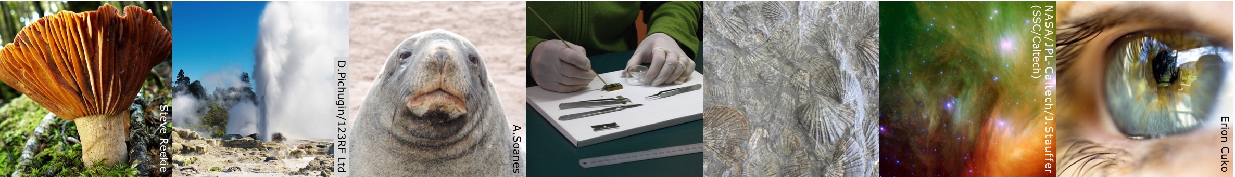
The Science Learning Hub
A trustworthy online resource – produced by educators and scientists
Based on world-class New Zealand science research
Supported by learning activities, information about the key science ideas and concepts, multimedia tools and other resources
Written for New Zealand teachers and students
Notes:
The SLH is funded by the NZ government – Ministry of Business, Innovation and Employment (MBIE) – under the Curious Minds fund

Slide 4
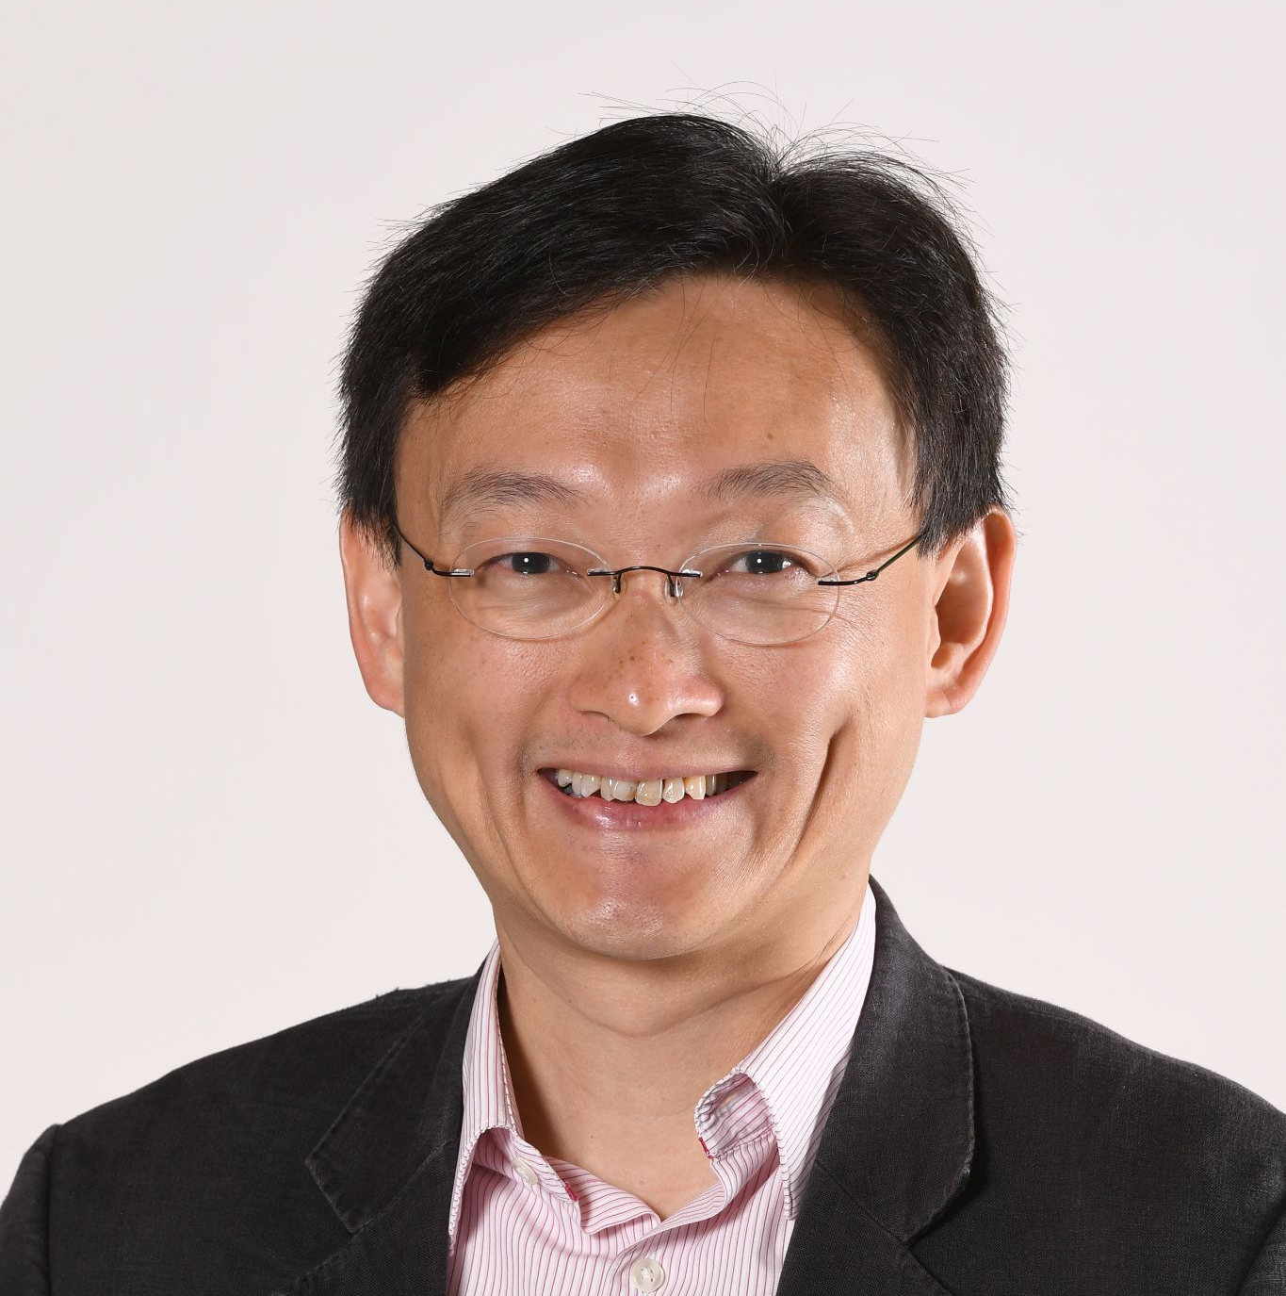
Dr Maurice Cheng
B.Pharm., P.C.Ed., M.Ed. (H.K.), PhD (Lond.)
Teaching and learning of science; drawing and diagrams for science learning; socioscientific issues; conceptual change; visual and verbal representations
The University of Waikato Te Whare Wananga o Waikato
© Copyright. Science Learning Hub – Pokapū Akoranga Pūtaiao The University of Waikato Te Whare Wananga o Waikato.
All Rights Reserved | www.sciencelearn.org.nz. All images are copyrighted. For further information, please refer to enquiries@sciencelearn.org.nz
Notes:
Image from: https://www.waikato.ac.nz/wmier/aray/our-people

Slide 5
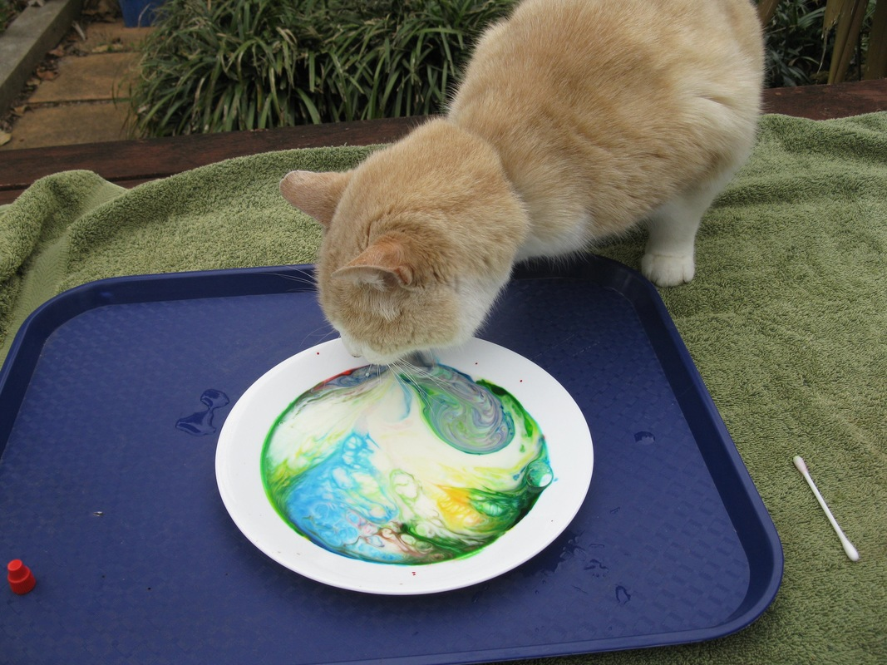
Purpose
To share nature of science/science capability activities you can easily use in the classroom
Provide examples for learner responses and link these to progress in the science capabilities
Rights: The University of Waikato Te Whare Wānanga o Waikato
© Copyright. Science Learning Hub – Pokapū Akoranga Pūtaiao The University of Waikato Te Whare Wananga o Waikato.
All Rights Reserved | www.sciencelearn.org.nz. All images are copyrighted. For further information, please refer to enquiries@sciencelearn.org.nz
Notes:
Image from: https://www.sciencelearn.org.nz/images/1706-help-with-activities

Slide 6
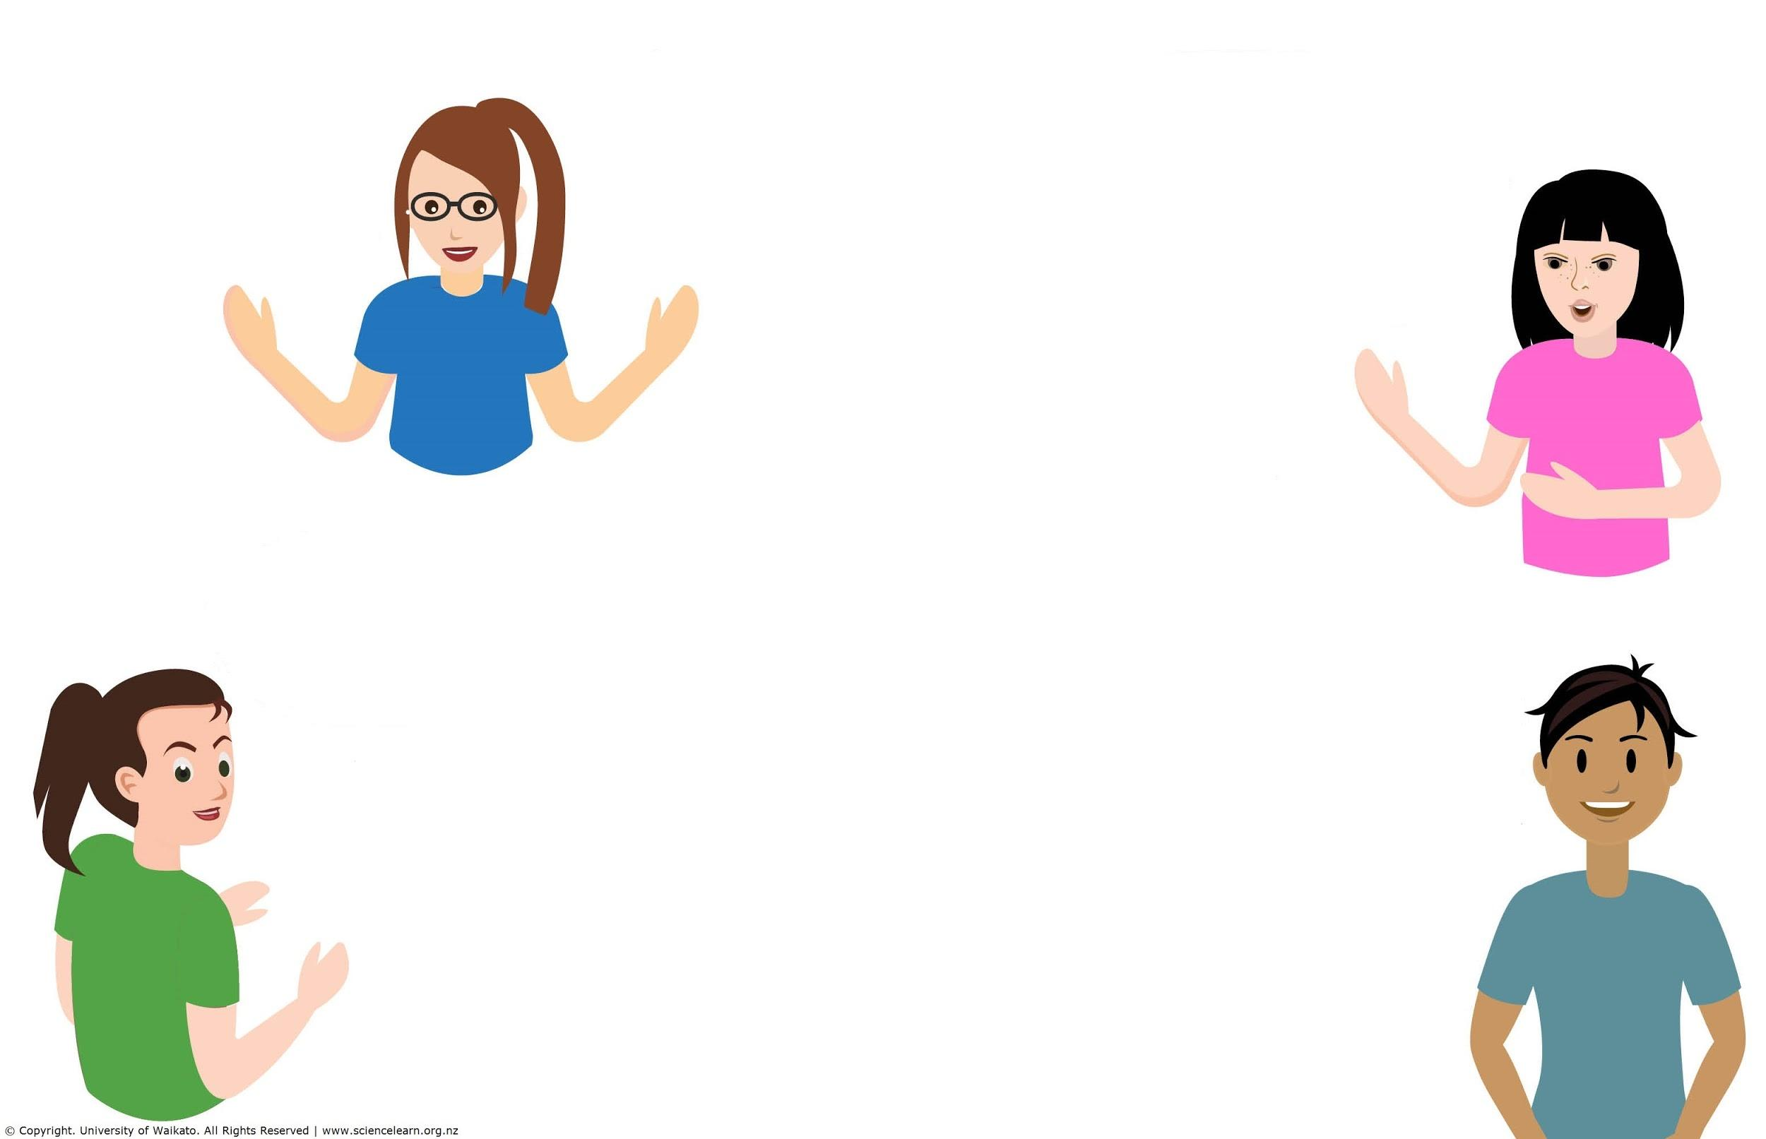
Participant responses:
What are the science capabilities?
There are 5 capabilities and they are a great avenue to teach the skills for Science and helps students grow from Primary through the rest of their science learning.
A list of skills that we want all students to be capable in as science citizens.
I use the acronym GUCIE to remind me of the 5 capabilities!
Gather and interpret data
Use and Critique data
Interpret representations
Engage in science
Observe, test,
Communication.
A simple and easy way to incorporate the nature of science into science lessons.
Observation and inference.
Skills that scientists use.
They fit under the NOS strand and are learnt/taught through contextual strands.
© Copyright. Science Learning Hub – Pokapū Akoranga Pūtaiao The University of Waikato Te Whare Wananga o Waikato.
All Rights Reserved | www.sciencelearn.org.nz. All images are copyrighted. For further information, please refer to enquiries@sciencelearn.org.nz

Slide 7
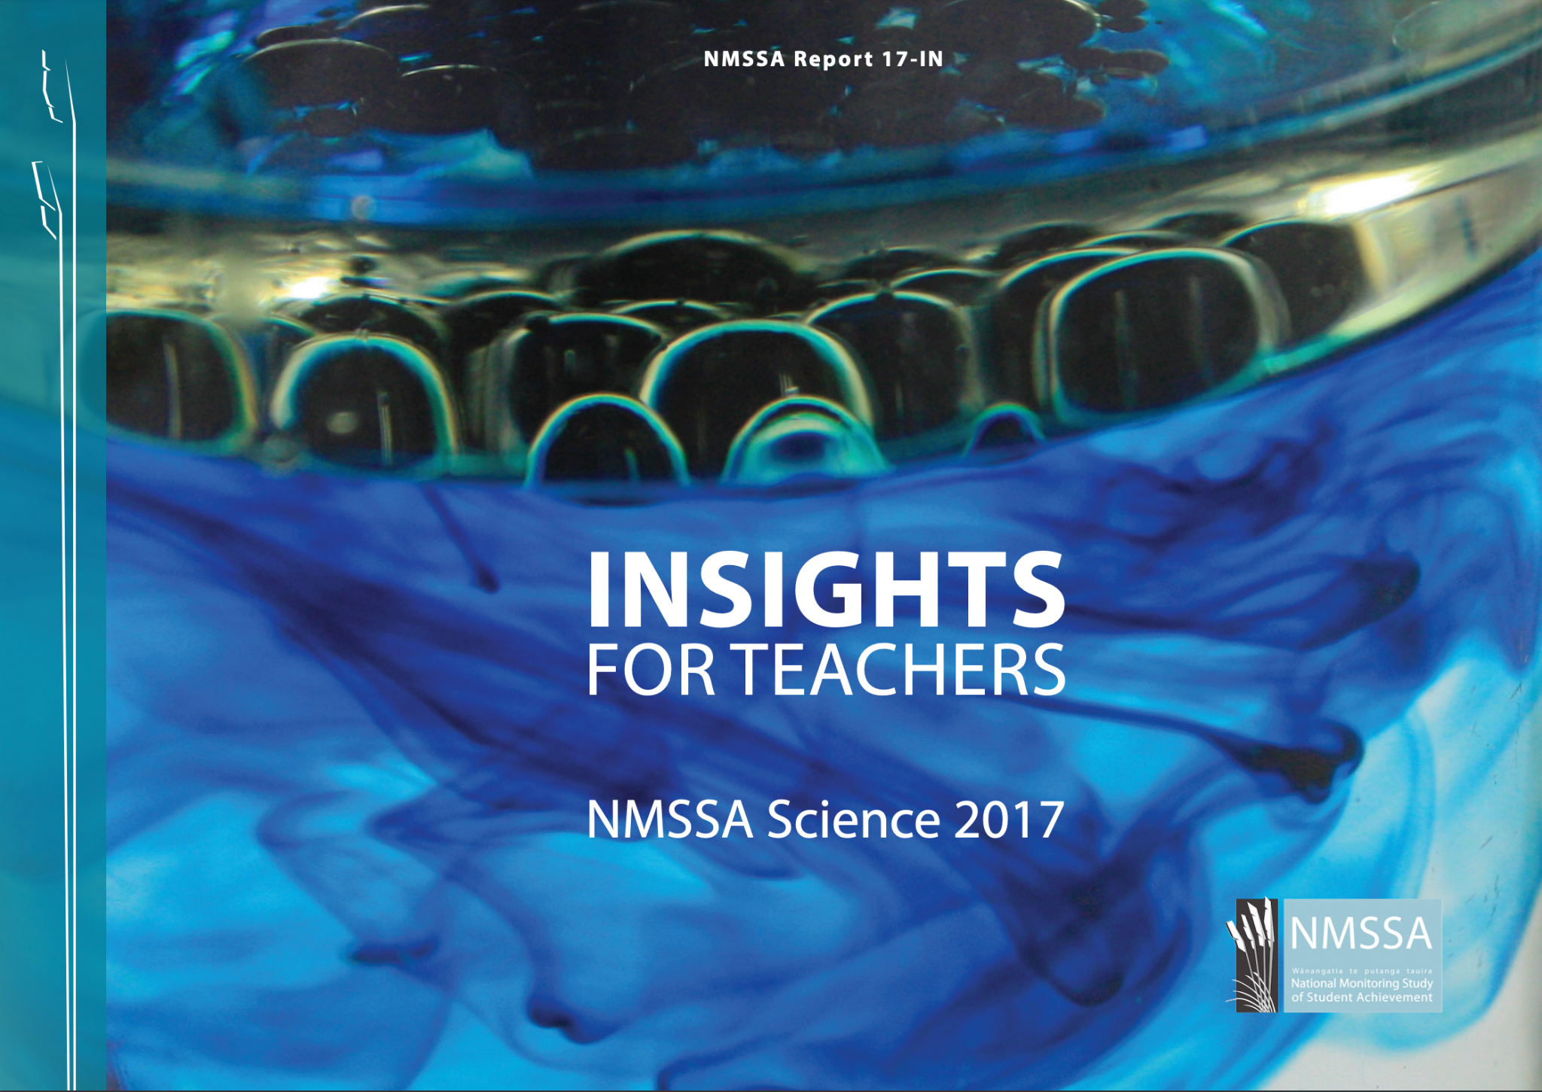
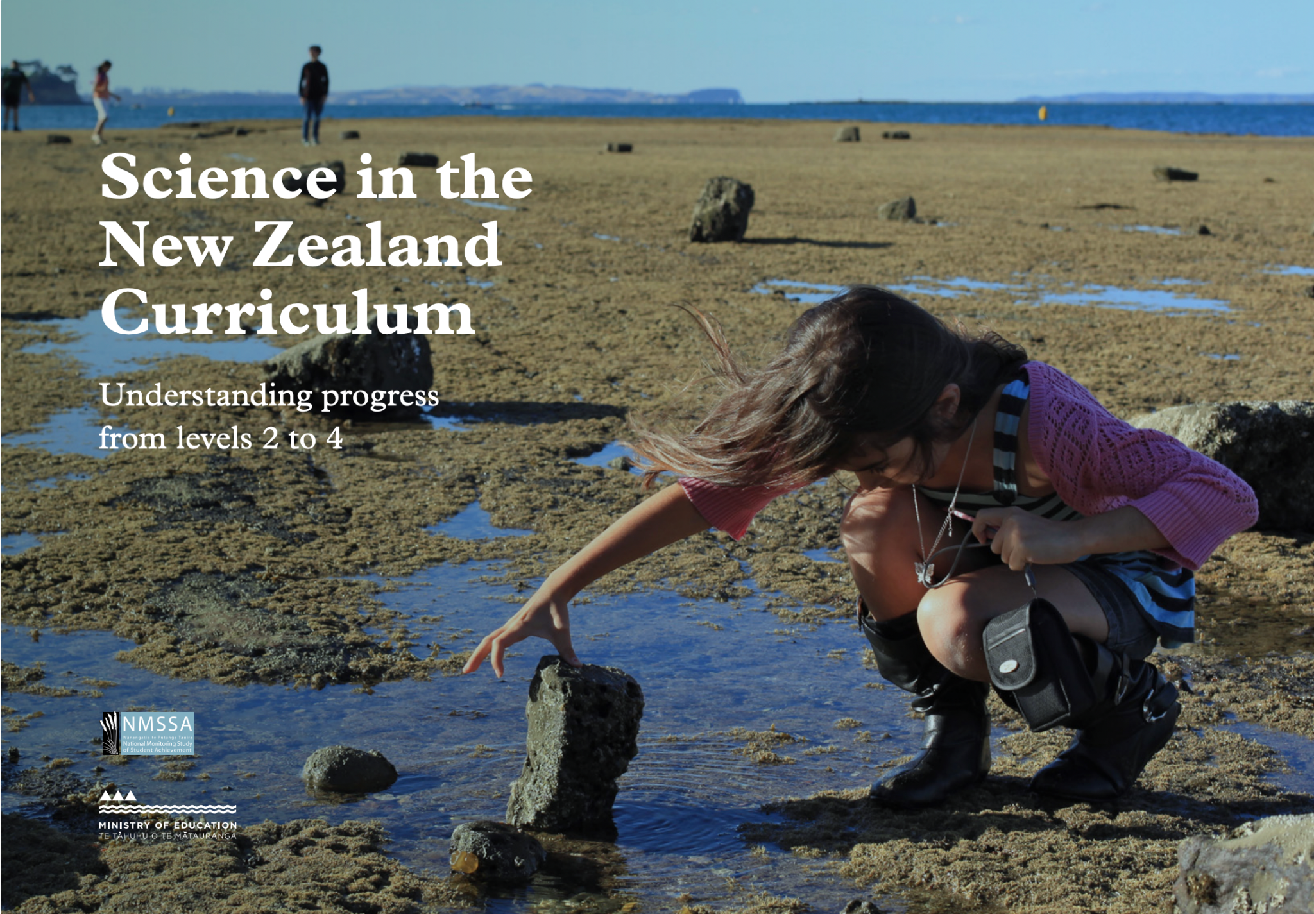
Progressions
© National Monitoring Study of Student Achievement
Crown Copyright
Notes:
https://scienceonline.tki.org.nz/Science-in-the-NZ-Curriculum

Slide 8
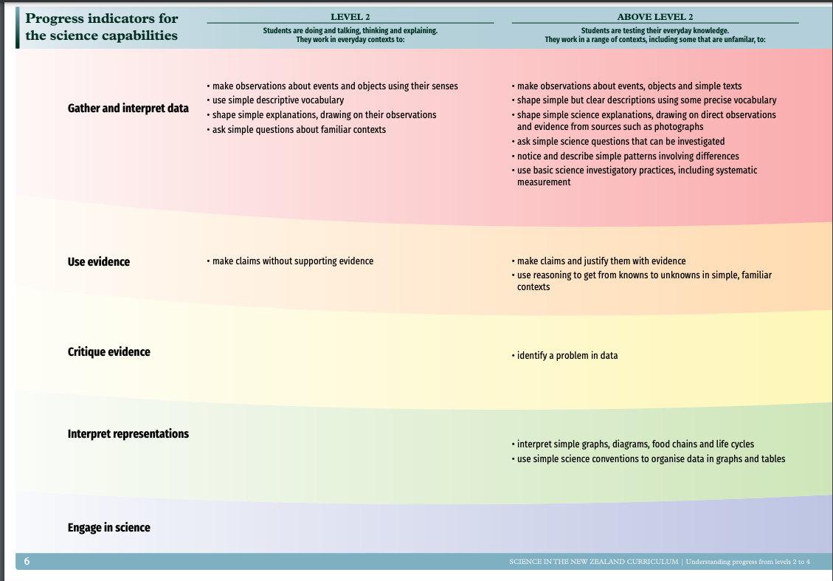
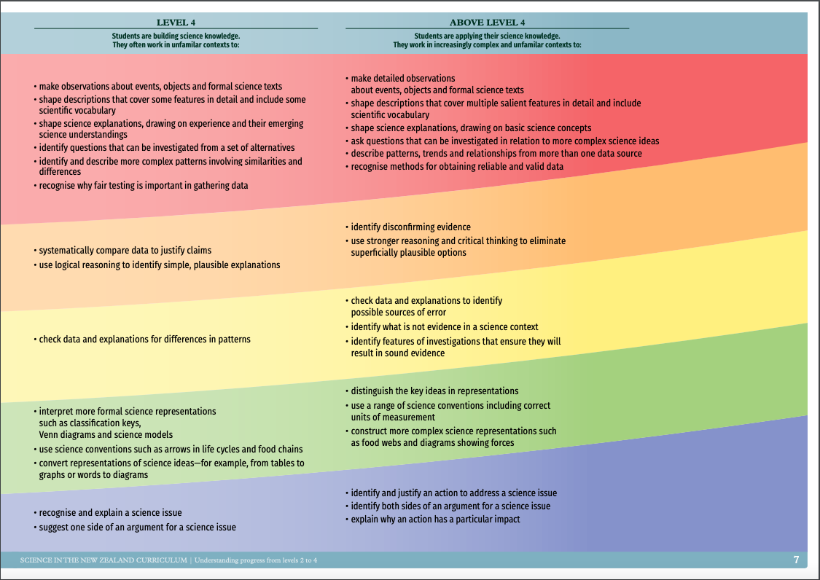
Progressions
© National Monitoring Study of Student Achievement
Level 2:
make observations about events and objects using their senses
use simple descriptive vocabulary
Level 4:
make detailed observations about events, objects and formal science texts
shape descriptions that cover multiple salient features in detail and include scientific vocabulary

Slide 9
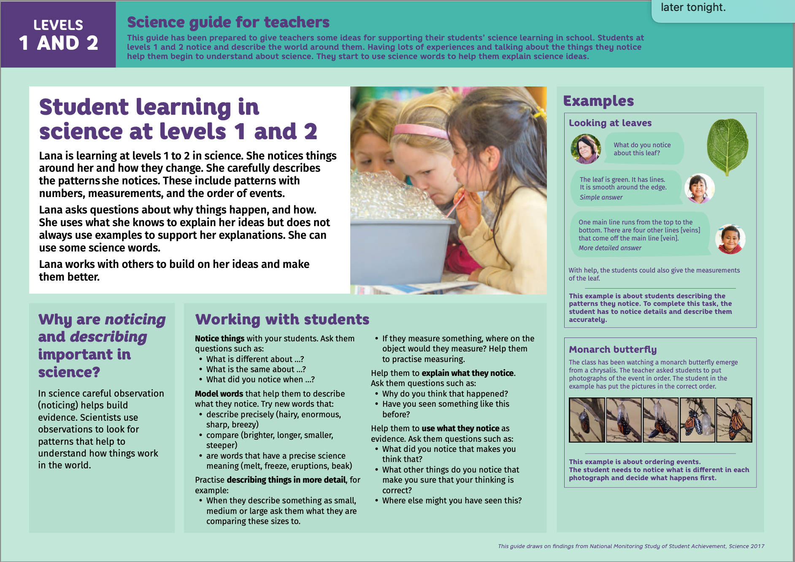
Progressions
© National Monitoring Study of Student Achievement
Notes:
https://nmssa.otago.ac.nz/science.htm

Slide 10
© National Monitoring Study of Student Achievement

Slide 11
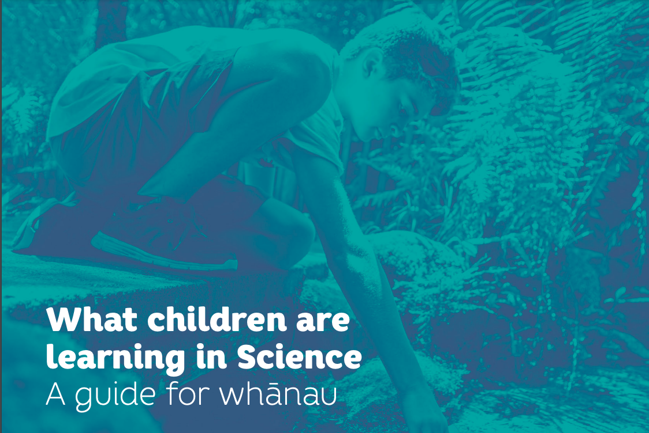
Progressions
© National Monitoring Study of Student Achievement

Slide 12
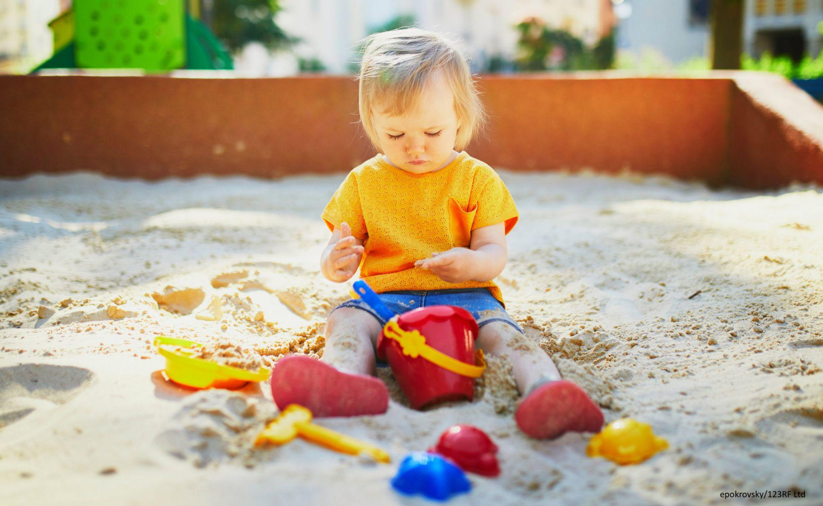
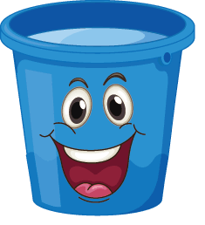
Material world: Properties and changes of matter (Level 1-2)
Observe, describe, and compare… properties of common materials and changes that occur when materials are mixed, heated, or cooled.
Some questions on observation:
What does the sand feel?
What does the sand look?
Can you hold the sand well? Why?
http://clipart-library.com/clipart/bucket-clip-art-15.htm

Slide 13
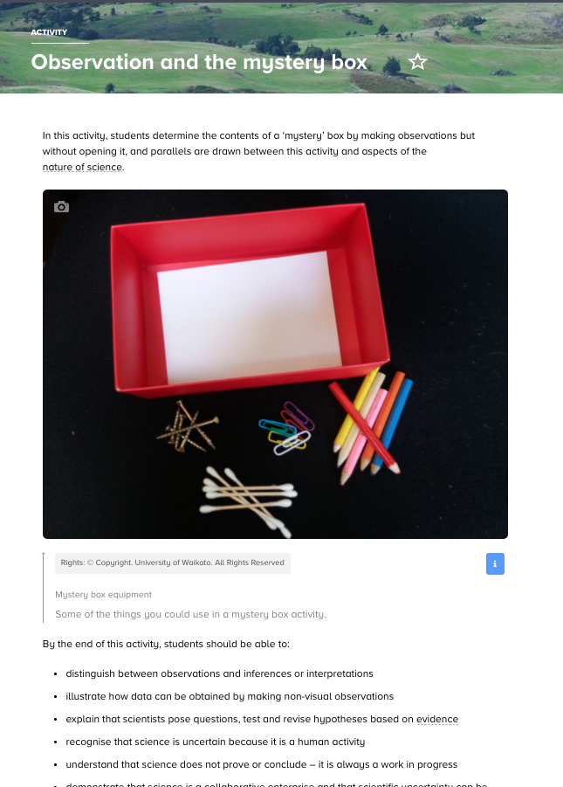
Activity 1: Mystery boxes
Notes:
Activity: https://www.sciencelearn.org.nz/resources/430-observation-and-the-mystery-box

Slide 14
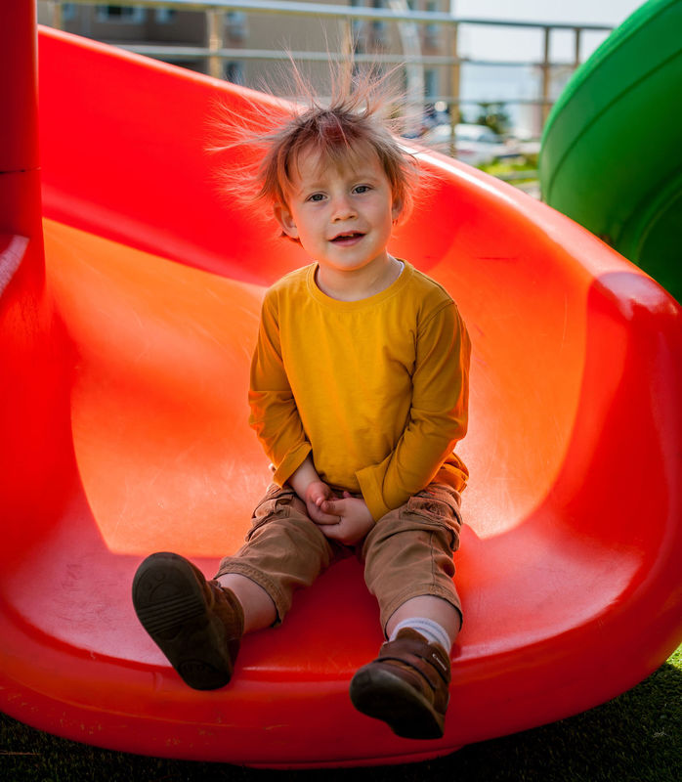
Activity 2: Observing hair
Elizaveta Galitckaia, 123RF Ltd
Notes:
Image from: https://www.sciencelearn.org.nz/images/3877-hair-raising-static-electricity

Slide 15
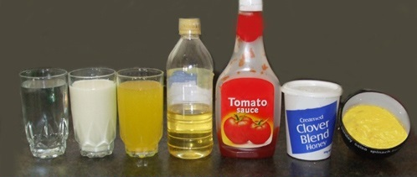
Activity 3: Exploring liquids
Science Learning Hub – Pokapū Akoranga Pūtaiao © The University of Waikato Te Whare Wananga o Waikato
Notes:
Image from: https://www.sciencelearn.org.nz/images/1843-different-liquids

Slide 16
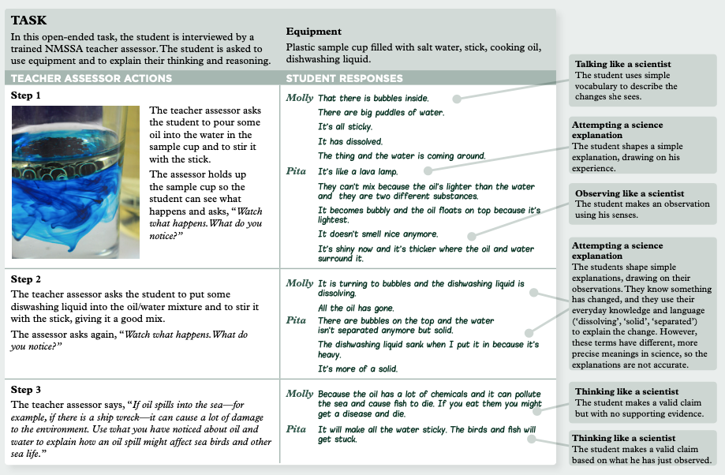
Activity 3: Exploring liquids
Page 9, Science in the New Zealand Curriculum: Understanding progress from levels 2 to 4. Crown Copyright 2019
Notes:
From: https://scienceonline.tki.org.nz/Science-in-the-NZ-Curriculum page 9

Slide 17
Science capabilities in the context of Material World: Properties and changes of matter

Slide 18

Participant questions and responses...
How do most teachers capture these observations in a time efficient, feasible, meaningful way?
We could use drawings, post-it notes on a content wall, evidence from home, simple video recording.
Are there any mātauranga Māori aspects that can be looked into?
Look at changing seasons or signs.
Stories of observation of river flow and how these observations over time allowed people to know the safest places to build.
Some more ideas here: www.sciencelearn.org.nz/resources/3049-whakanui-putaiao.
© Copyright. Science Learning Hub – Pokapū Akoranga Pūtaiao The University of Waikato Te Whare Wananga o Waikato.
All Rights Reserved | www.sciencelearn.org.nz. All images are copyrighted. For further information, please refer to enquiries@sciencelearn.org.nz

Slide 19





Thanks – want to keep in touch?
Email us on enquiries@sciencelearn.org.nz
https://twitter.com/NZScienceLearn
www.facebook.com/nzsciencelearn
https://nz.pinterest.com/nzsciencelearn
www.instagram.com/sciencelearninghubnz
Join us in our discussion channel on Slack (http://slh-talk.slack.com).
(Any problems accessing Slack, please contact us via our enquiries email, enquiries@sciencelearn.org.nz.)

