Slide 1

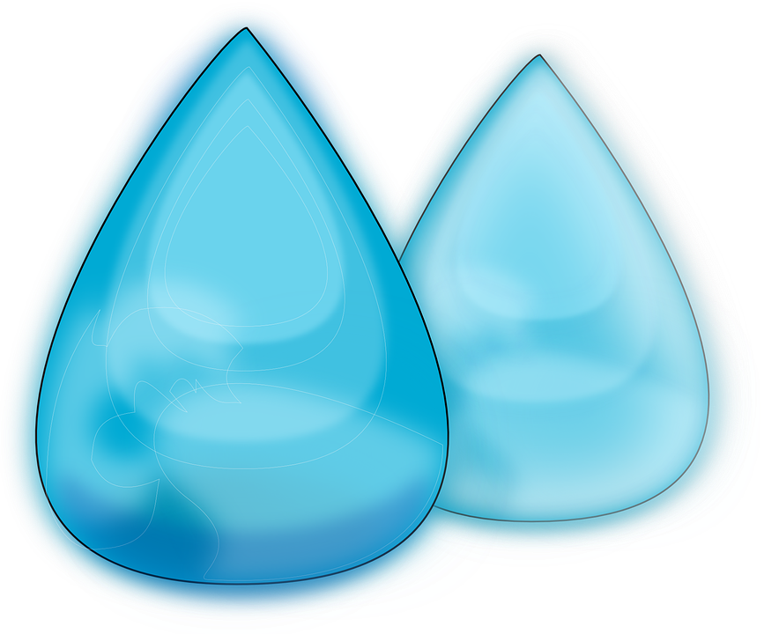



Smart Water
Inquiry plan and student reflection
Notes:
Water droplet image: Pixabay

Slide 2
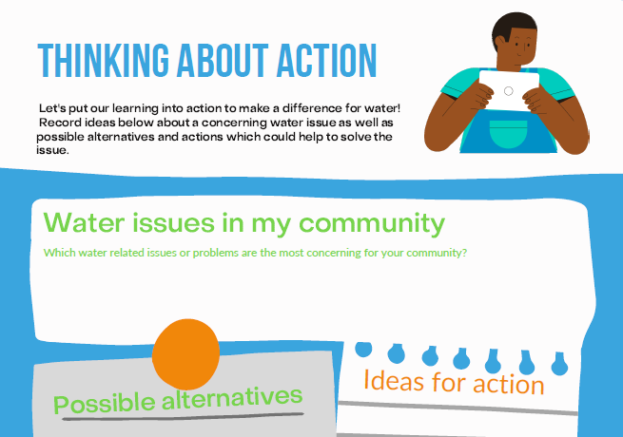
About this inquiry plan and reflection
This slideshow is part of a larger inquiry unit about freshwater by Smart Water and the Science Learning Hub.
Smart Water – a context for learning provides pedagogical information and links to all of the Smart Water resources on the Science Learning Hub.
Notes:
Image: Smart Water

Slide 3
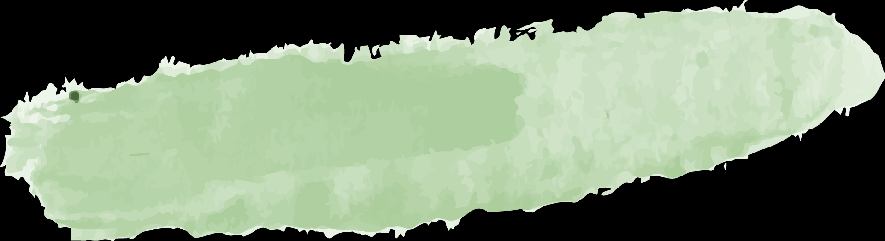

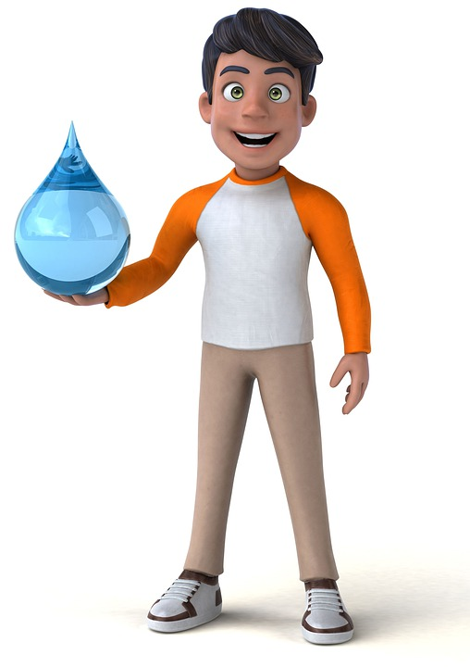
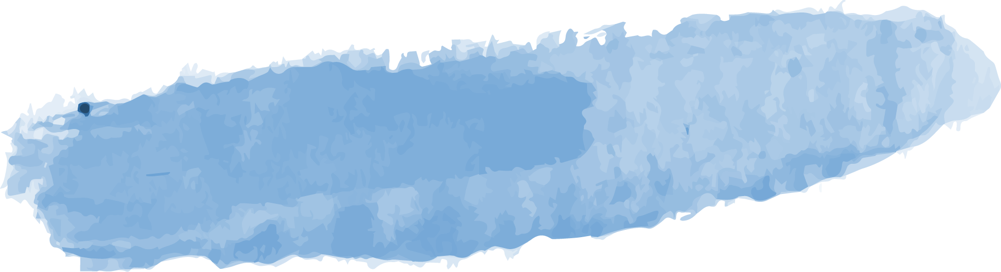

Slideshow learning intentions
1
3
2
4
We are learning to:
Plan a learning inquiry and reflect on our inquiry
Reflect on our water use
Describe next steps for learning and ideas for smart water use
Summarise the main points of our findings
Notes:
Image free Pixabay (no credit required) https://pixabay.com/illustrations/indian-teenager-water-adolescent-4724779/

Slide 4
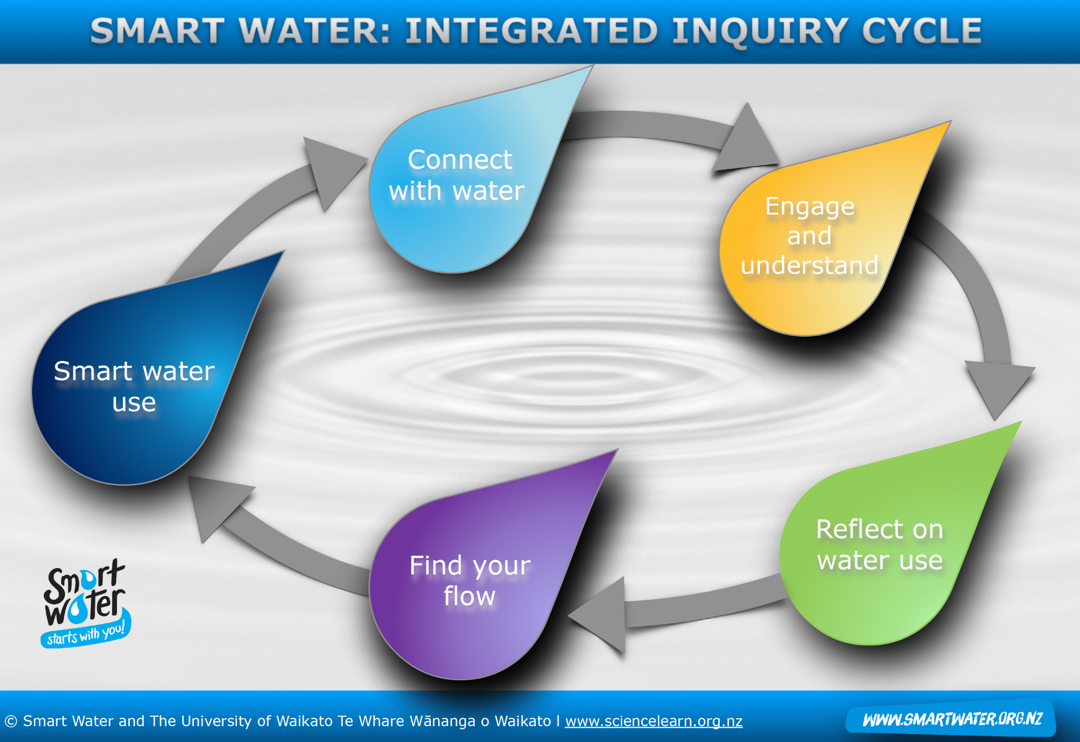
Smart Water inquiry cycle
Notes:
The interactive Smart Water – integrated inquiry cycle groups Smart Water and Science Learning Hub resources within the stages of an inquiry cycle.

Slide 5
Stage One: Connect with water
Record your ideas and knowledge about water
What do you already know about water?
Where can you find healthy freshwater in your community?
Why is clean, healthy freshwater important?

Slide 6
Stage One: Connect with water
What do you want to know about freshwater?

Slide 7
Stage Two: Engage and understand
It’s time to dive deeper into learning about freshwater!
What else would you like to know about freshwater sources and drinking water? | How can you find out the answers to your questions? Who could help you?

Slide 8
Stage Two: Engage and understand
Let’s keep being curious about freshwater!
What else would you like to know about te mana o te wai and Waikato’s freshwater features? | How can you find out the answers to your questions?

Slide 9
Stage Two: Engage and understand
Findings
Use this page to record your findings about water in your local area.

Slide 10
Stage Three: Reflect on water use
Water use summary
 | Average water use (L – litres)
Water use at home
Water use at school
Total water use per day
Other comments
Notes:
As an extension to this summary, consider water use linked to the products we consume.
The Guardian: Typical volume of water required to produce common foodstuffs
The Conscious Challenge: water and clothing
It takes up to 3-7 litres of water and one litre of oil to produce one litre of bottled water.

Slide 11
Stage Four: Find your flow
Summarising information: sum up your main findings in two paragraphs

Slide 12
Stage Four: Find your flow
Were there any issues of concern that came up during your inquiry?
What could be done to help?

Slide 13
Stage Five: Smart water use
How can we be smarter with our water use?

Slide 14
Stage Five: Smart water use
Next steps for learning

