Slide 1
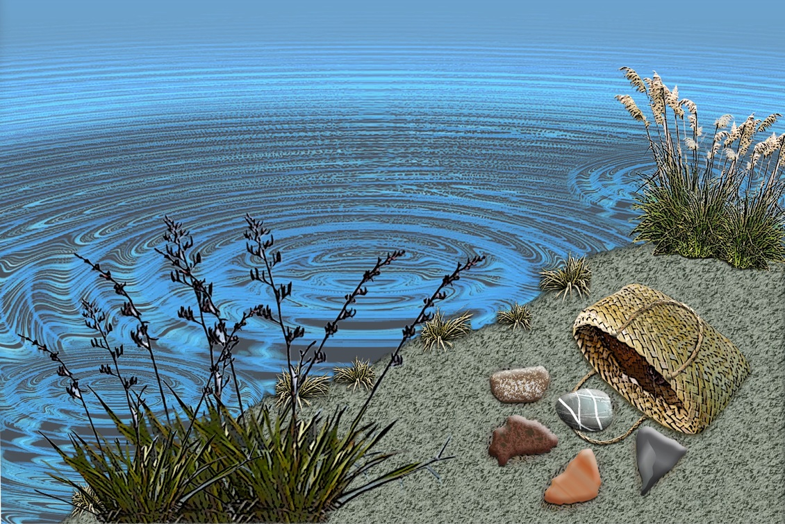
Science support at
your fingertips
4–4:45 pm Thursday 17 February 2022
© Copyright. Science Learning Hub – Pokapū Akoranga Pūtaiao The University of Waikato Te Whare Wananga o Waikato.
All Rights Reserved | www.sciencelearn.org.nz. All images are copyrighted. For further information, please refer to enquiries@sciencelearn.org.nz

Slide 2
Index
Topic | Slideshow number(s ) | Video timecode
Introducing the presenters | 1 | 00:00
Index | 2 | 00:07
Purpose | 3 | 00:38
Introducing the Science Learning Hub | 4–5 | 01:22
Collections tool | 6–11 | 02:18
Using our glossary | 12–17 | 10:02
Google classroom | 18–23 | 14:36
Teacher PLD | 24–25 | 18:20
SLH links, keep in touch and thanks | 26 | 29:51
© Copyright. The University of Waikato Te Whare Wananga o Waikato l Science Learning Hub – Pokapū Akoranga Pūtaiao. All Rights Reserved
All images are copyrighted. For further information, please refer to enquiries@sciencelearn.org.nz.

Slide 3
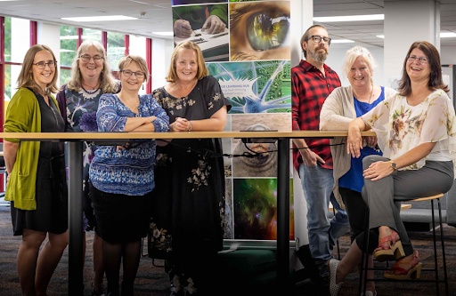
Purpose
To share new website developments
Provide lots of examples of resources for primary and secondary teaching
Opportunities to ask an answer questions
© Copyright. Science Learning Hub – Pokapū Akoranga Pūtaiao The University of Waikato Te Whare Wananga o Waikato.
All Rights Reserved | www.sciencelearn.org.nz. All images are copyrighted. For further information, please refer to enquiries@sciencelearn.org.nz

Slide 4
The Science Learning Hub
A trustworthy online resource – produced by educators and scientists
Based on world-class New Zealand science research
Supported by learning activities, information about the key science ideas and concepts, multimedia tools and other resources
Written for New Zealand teachers and students
Notes:
The SLH is funded by the New Zealand government – MBIE Ministry of Business, Innovation and Employment – under the Curious Minds fund

Slide 5
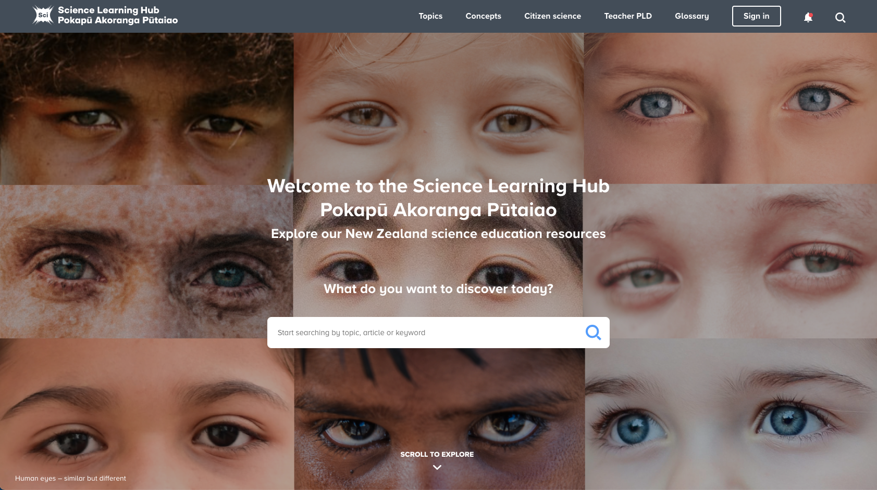
Our collections tool
C.Hernandez
sciencelearn.org.nz
A.Wahid
J.Ferlic
A.Wahid
N.Dunlaoger61
P.Akachi
J.Waibel
R.Rajput
S.Jayaprakash
P.Lima
© Copyright. Science Learning Hub – Pokapū Akoranga Pūtaiao The University of Waikato Te Whare Wananga o Waikato.
All Rights Reserved | www.sciencelearn.org.nz. All images are copyrighted. For further information, please refer to enquiries@sciencelearn.org.nz
Notes:
Home page: https://www.sciencelearn.org.nz/images
Background image: https://www.sciencelearn.org.nz/images/4497-human-eyes-similar-but-different

Slide 6
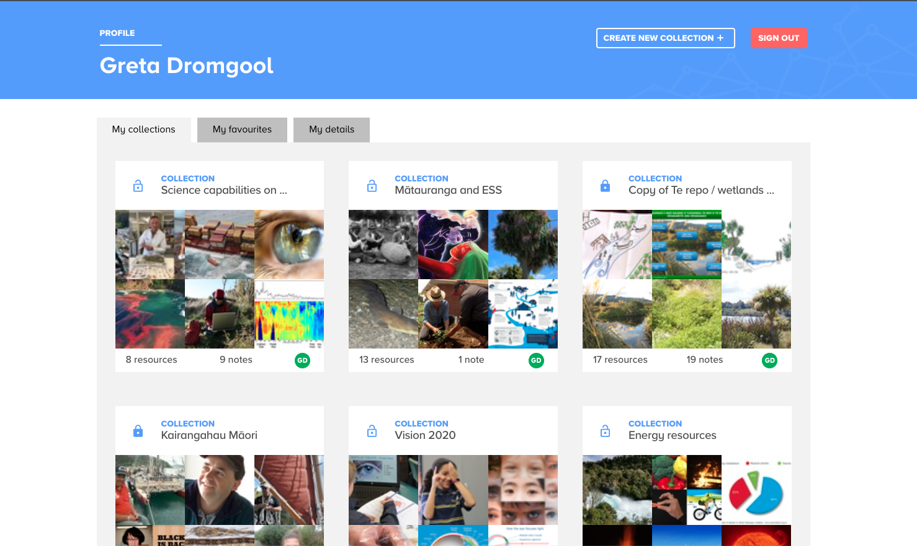
Our collections tool
© Copyright. Science Learning Hub – Pokapū Akoranga Pūtaiao The University of Waikato Te Whare Wananga o Waikato.
All Rights Reserved | www.sciencelearn.org.nz. All images are copyrighted. For further information, please refer to enquiries@sciencelearn.org.nz
Notes:
Greta

Slide 7
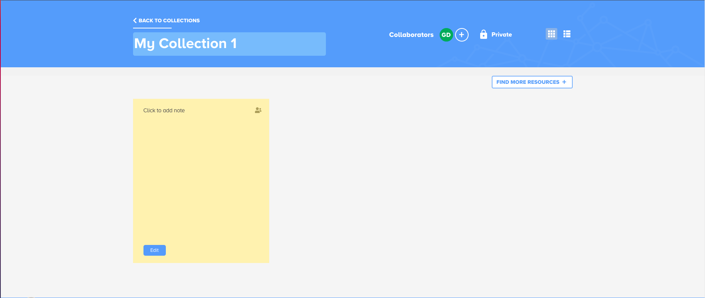
Our collections tool
© Copyright. Science Learning Hub – Pokapū Akoranga Pūtaiao The University of Waikato Te Whare Wananga o Waikato.
All Rights Reserved | www.sciencelearn.org.nz. All images are copyrighted. For further information, please refer to enquiries@sciencelearn.org.nz

Slide 8
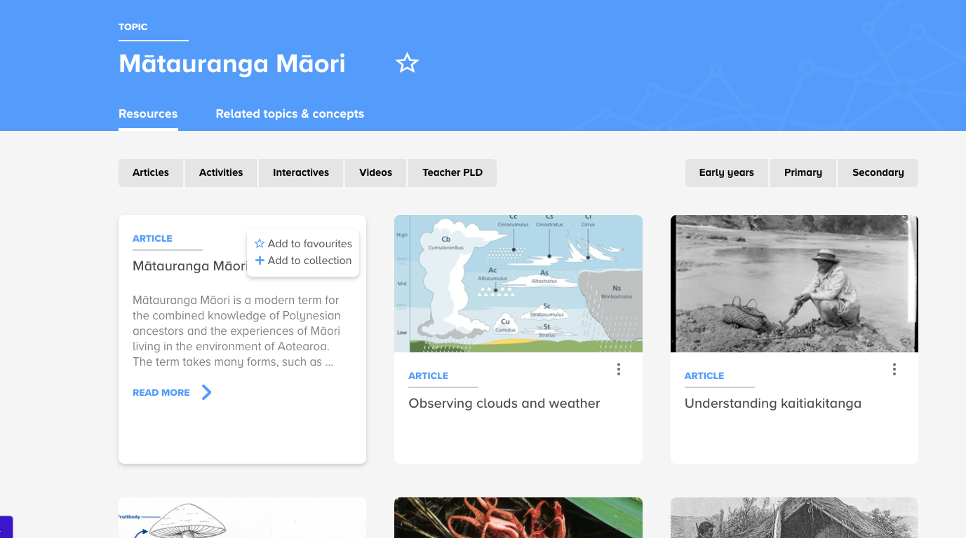
Our collections tool
Gathering sea food, possibly in Paihia. Denton, Frank J, 1869-1963 :Collection of negatives, prints and albums. Ref: 1/2-008468-G. Alexander Turnbull Library, Wellington, New Zealand. http://natlib.govt.nz/records/22628945
© Copyright. Science Learning Hub – Pokapū Akoranga Pūtaiao The University of Waikato Te Whare Wananga o Waikato.
All Rights Reserved | www.sciencelearn.org.nz. All images are copyrighted. For further information, please refer to enquiries@sciencelearn.org.nz

Slide 9
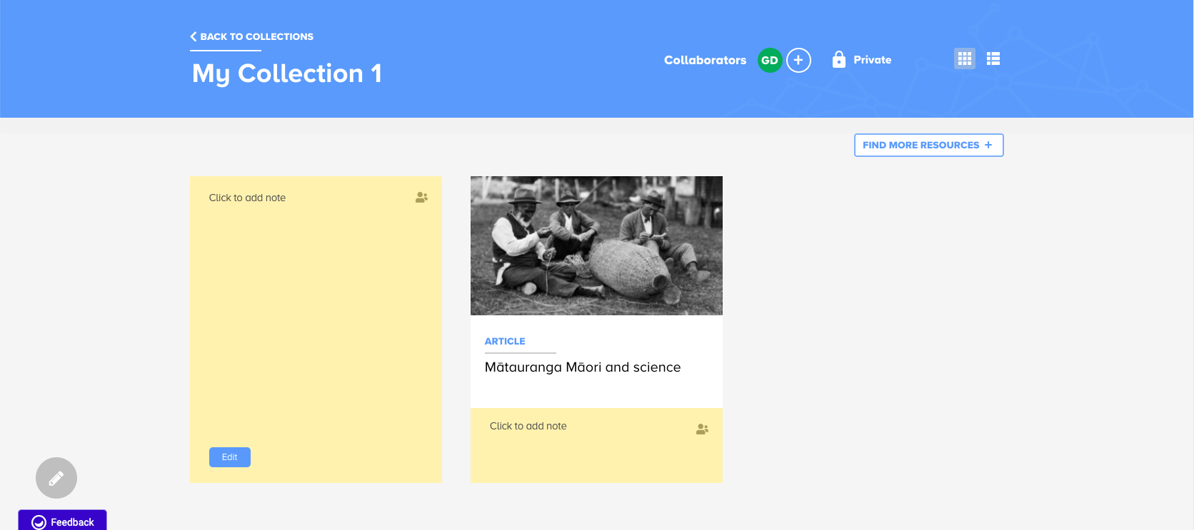
Our collections tool
Peter Buck studying Paratene Ngata making an eel basket. Ramsden, Eric: Photographs relating to Ramsden and his family and Maori subjects. Ref: 1/2-037930-F. Alexander Turnbull Library, Wellington, New Zealand.http://natlib.govt.nz/records/22495223
© Copyright. Science Learning Hub – Pokapū Akoranga Pūtaiao The University of Waikato Te Whare Wananga o Waikato.
All Rights Reserved | www.sciencelearn.org.nz. All images are copyrighted. For further information, please refer to enquiries@sciencelearn.org.nz

Slide 10
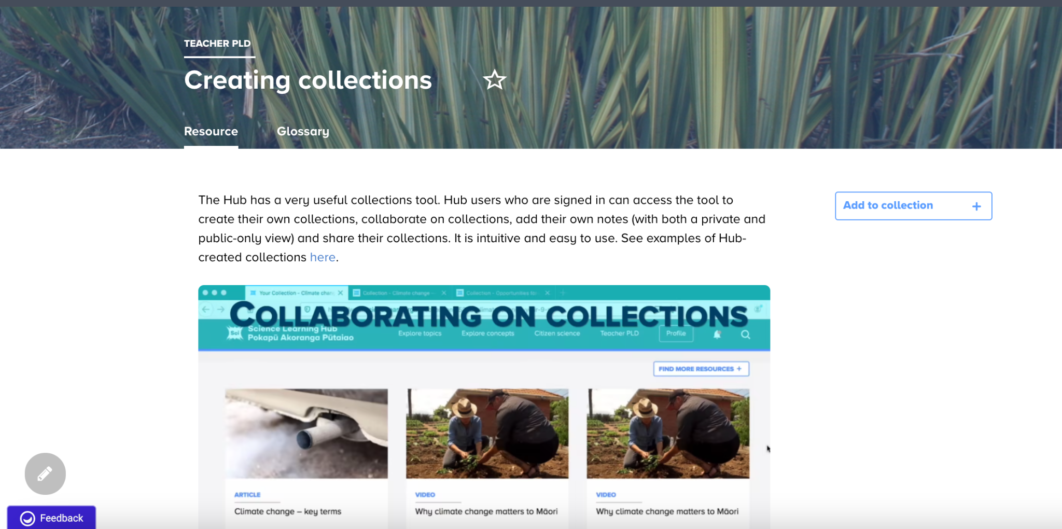
Our collections tool
Video thumbnail: Waimarie McFarland of Te Pane O Mataoho and Nicola Kawana planting kumara with traditional tools. Whānau Living, Adrenalin Group
© Copyright. Science Learning Hub – Pokapū Akoranga Pūtaiao The University of Waikato Te Whare Wananga o Waikato.
All Rights Reserved | www.sciencelearn.org.nz. All images are copyrighted. For further information, please refer to enquiries@sciencelearn.org.nz
Notes:
https://www.sciencelearn.org.nz/resources/2762-creating-collections

Slide 11
Collections to copy
1080 and the wicked problem of predator control
3, 2, 1 . . . Lift off!
The air around us
Autumn science
Big Blue Future
Biodiversity – estuaries and marine ecosystems
Biosecurity
Birds
Bringing back the birdsong
Clean water and sanitation
Climate change
Discovering new species
Our atmosphere and climate 2020
The periodic table of elements
Physics – force and motion
Simple machines Sound – lower primary
eDNA
Exploring space – resources for years 5/6
Flight and the science capabilities Gardens
Learning at home – Galileo
Learning at home – river catchments and connections
Light and shadows
Mighty microbes
Moo to You
Opportunities for using te reo Māori
Te repo/wetlands
Takahē – conservation and ecology
Takahē – science capabilities
Water analysis Water quality
Waves PLD resources
Summer science
Rongoā Māori
© Copyright. Science Learning Hub – Pokapū Akoranga Pūtaiao The University of Waikato Te Whare Wananga o Waikato.
All Rights Reserved | www.sciencelearn.org.nz. All images are copyrighted. For further information, please refer to enquiries@sciencelearn.org.nz
Notes:
https://www.sciencelearn.org.nz/resources/2762-creating-collections#public

Slide 12
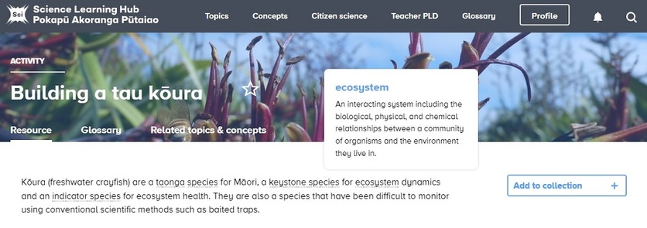
Glossary
© Copyright. Science Learning Hub – Pokapū Akoranga Pūtaiao The University of Waikato Te Whare Wananga o Waikato.
All Rights Reserved | www.sciencelearn.org.nz. All images are copyrighted. For further information, please refer to enquiries@sciencelearn.org.nz
Notes:
Greta

Slide 13
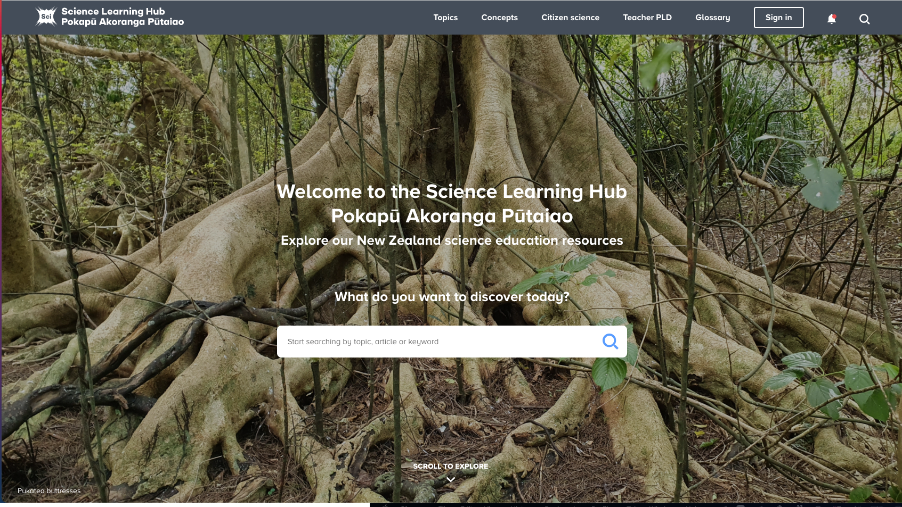
Glossary
© Copyright. Science Learning Hub – Pokapū Akoranga Pūtaiao The University of Waikato Te Whare Wananga o Waikato.
All Rights Reserved | www.sciencelearn.org.nz. All images are copyrighted. For further information, please refer to enquiries@sciencelearn.org.nz

Slide 14
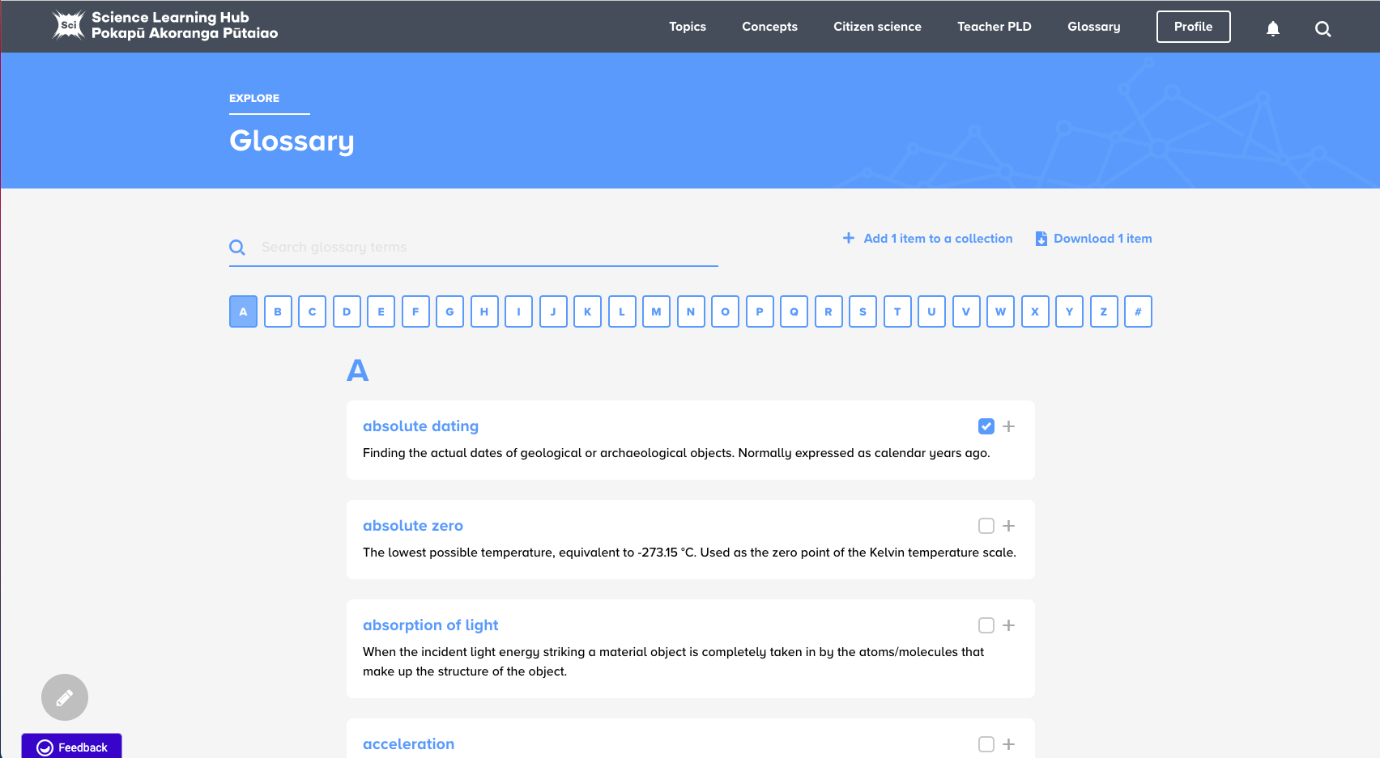
Glossary
© Copyright. Science Learning Hub – Pokapū Akoranga Pūtaiao The University of Waikato Te Whare Wananga o Waikato.
All Rights Reserved | www.sciencelearn.org.nz. All images are copyrighted. For further information, please refer to enquiries@sciencelearn.org.nz
Notes:
https://www.sciencelearn.org.nz/glossary

Slide 15
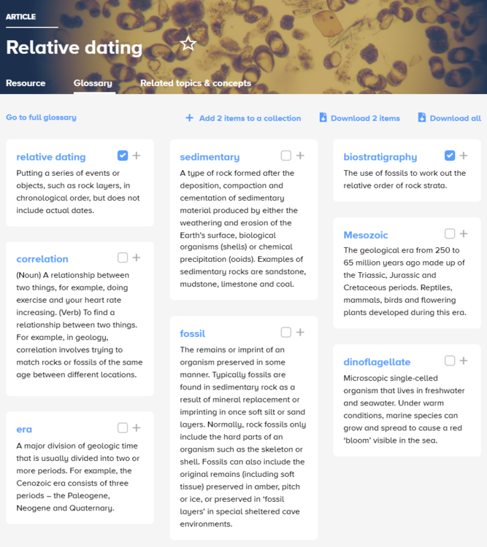
Glossary
© Copyright. Science Learning Hub – Pokapū Akoranga Pūtaiao The University of Waikato Te Whare Wananga o Waikato.
All Rights Reserved | www.sciencelearn.org.nz. All images are copyrighted. For further information, please refer to enquiries@sciencelearn.org.nz
Notes:
Add yellow

Slide 16
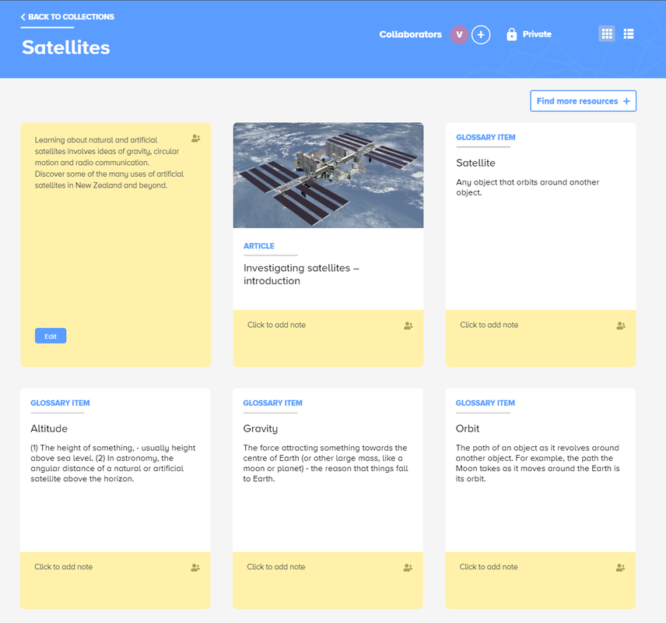
© Copyright. Science Learning Hub – Pokapū Akoranga Pūtaiao The University of Waikato Te Whare Wananga o Waikato.
All Rights Reserved | www.sciencelearn.org.nz. All images are copyrighted. For further information, please refer to enquiries@sciencelearn.org.nz
Notes:
https://www.sciencelearn.org.nz/resources/3074-using-our-glossary

Slide 17
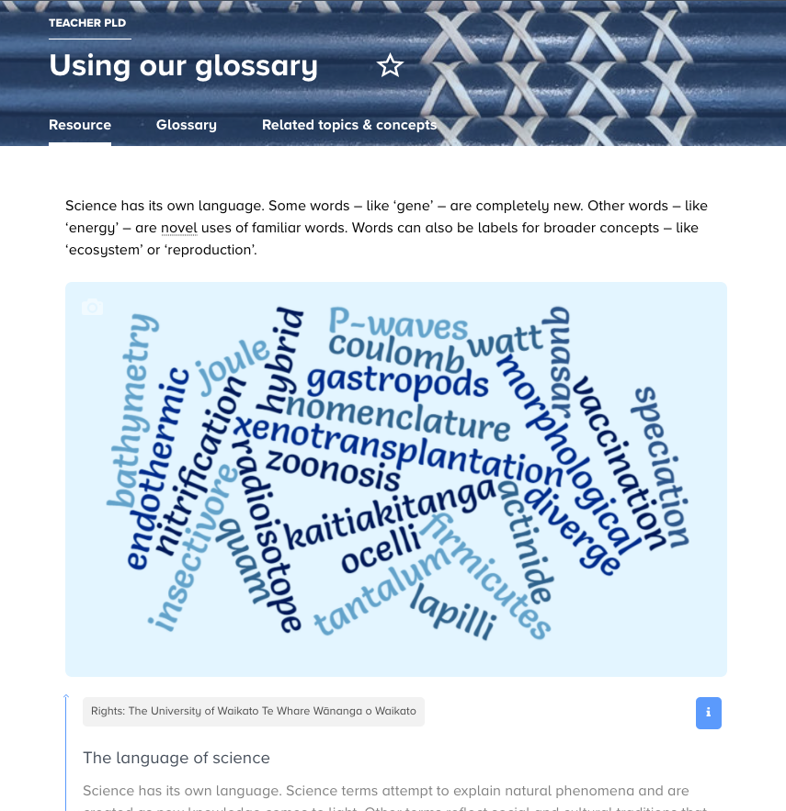
© Copyright. Science Learning Hub – Pokapū Akoranga Pūtaiao The University of Waikato Te Whare Wananga o Waikato.
All Rights Reserved | www.sciencelearn.org.nz. All images are copyrighted. For further information, please refer to enquiries@sciencelearn.org.nz
Notes:
https://www.sciencelearn.org.nz/resources/3074-using-our-glossary

Slide 18
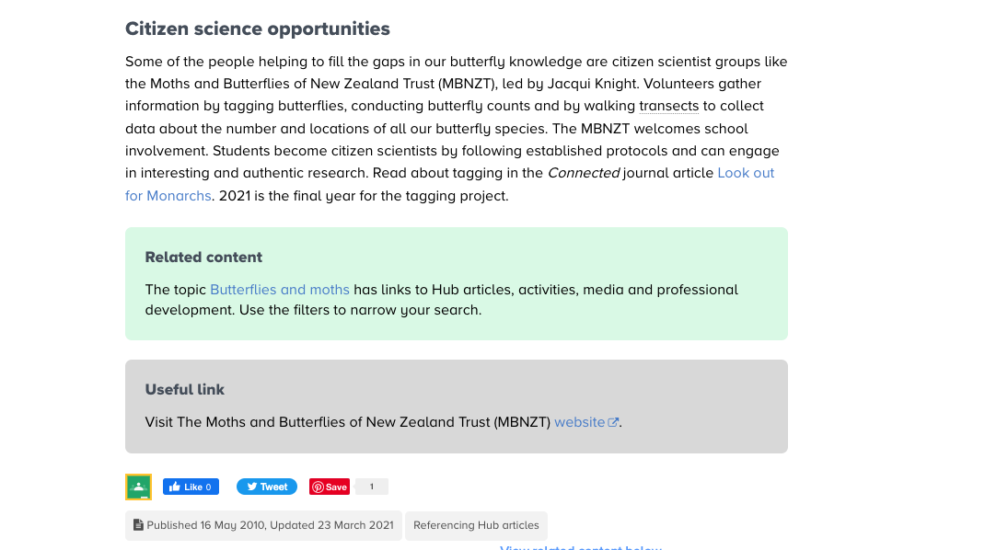
Google classrooms
© Copyright. Science Learning Hub – Pokapū Akoranga Pūtaiao The University of Waikato Te Whare Wananga o Waikato.
All Rights Reserved | www.sciencelearn.org.nz. All images are copyrighted. For further information, please refer to enquiries@sciencelearn.org.nz
Notes:
Used on https://www.sciencelearn.org.nz/resources/503-investigating-butterflies-an-introduction

Slide 19
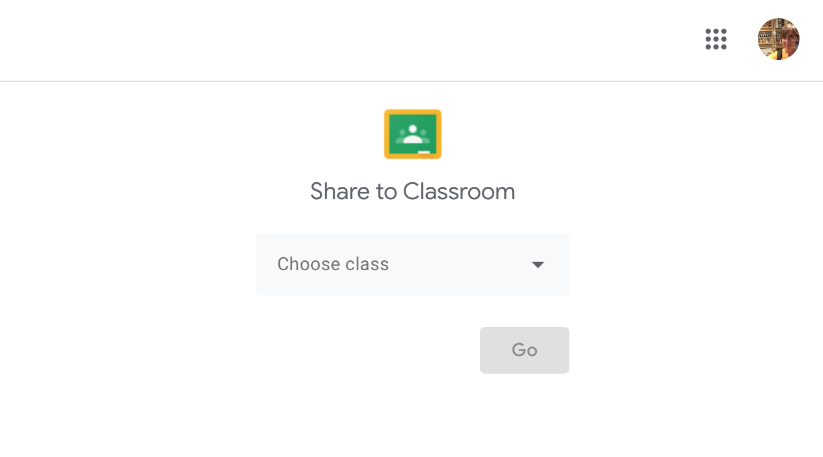
Google classrooms
© Copyright. Science Learning Hub – Pokapū Akoranga Pūtaiao The University of Waikato Te Whare Wananga o Waikato.
All Rights Reserved | www.sciencelearn.org.nz. All images are copyrighted. For further information, please refer to enquiries@sciencelearn.org.nz
Notes:
Used on https://www.sciencelearn.org.nz/resources/503-investigating-butterflies-an-introduction

Slide 20
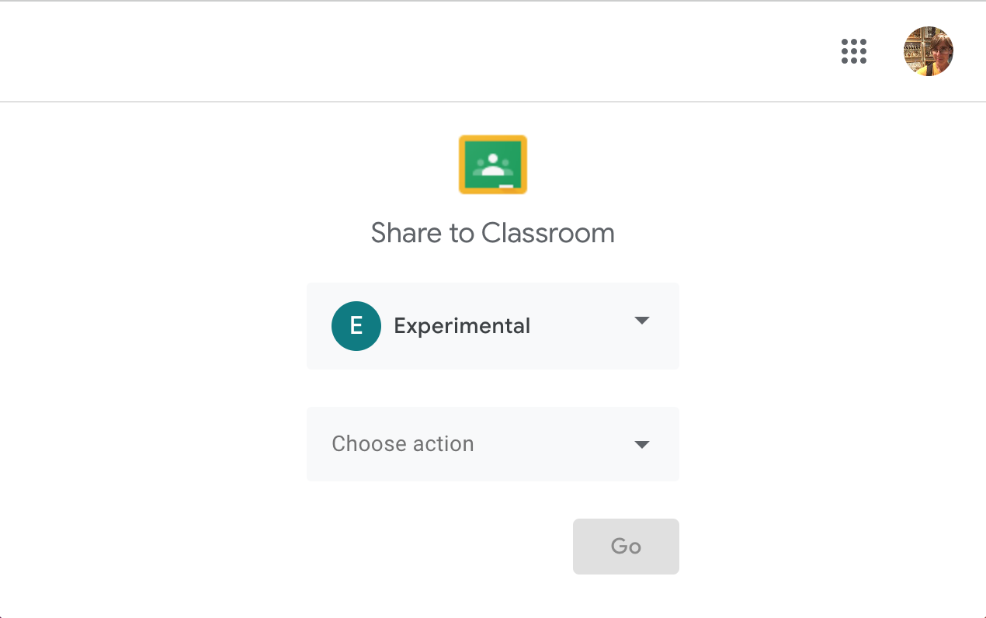
Google classrooms
© Copyright. Science Learning Hub – Pokapū Akoranga Pūtaiao The University of Waikato Te Whare Wananga o Waikato.
All Rights Reserved | www.sciencelearn.org.nz. All images are copyrighted. For further information, please refer to enquiries@sciencelearn.org.nz
Notes:
Used on https://www.sciencelearn.org.nz/resources/503-investigating-butterflies-an-introduction

Slide 21
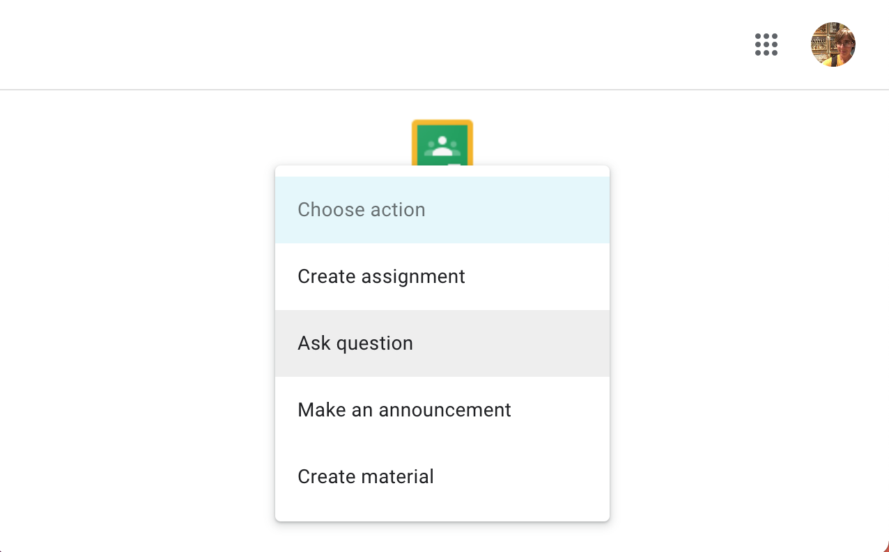
Google classrooms
© Copyright. Science Learning Hub – Pokapū Akoranga Pūtaiao The University of Waikato Te Whare Wananga o Waikato.
All Rights Reserved | www.sciencelearn.org.nz. All images are copyrighted. For further information, please refer to enquiries@sciencelearn.org.nz
Notes:
Used on https://www.sciencelearn.org.nz/resources/503-investigating-butterflies-an-introduction

Slide 22
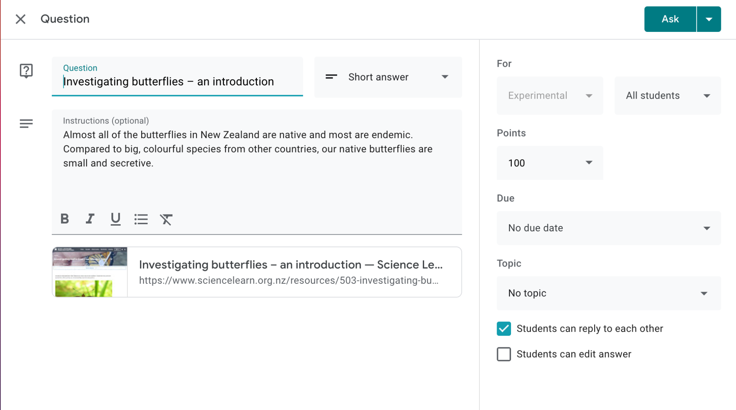
Google classrooms
© Copyright. Science Learning Hub – Pokapū Akoranga Pūtaiao The University of Waikato Te Whare Wananga o Waikato.
All Rights Reserved | www.sciencelearn.org.nz. All images are copyrighted. For further information, please refer to enquiries@sciencelearn.org.nz

Slide 23
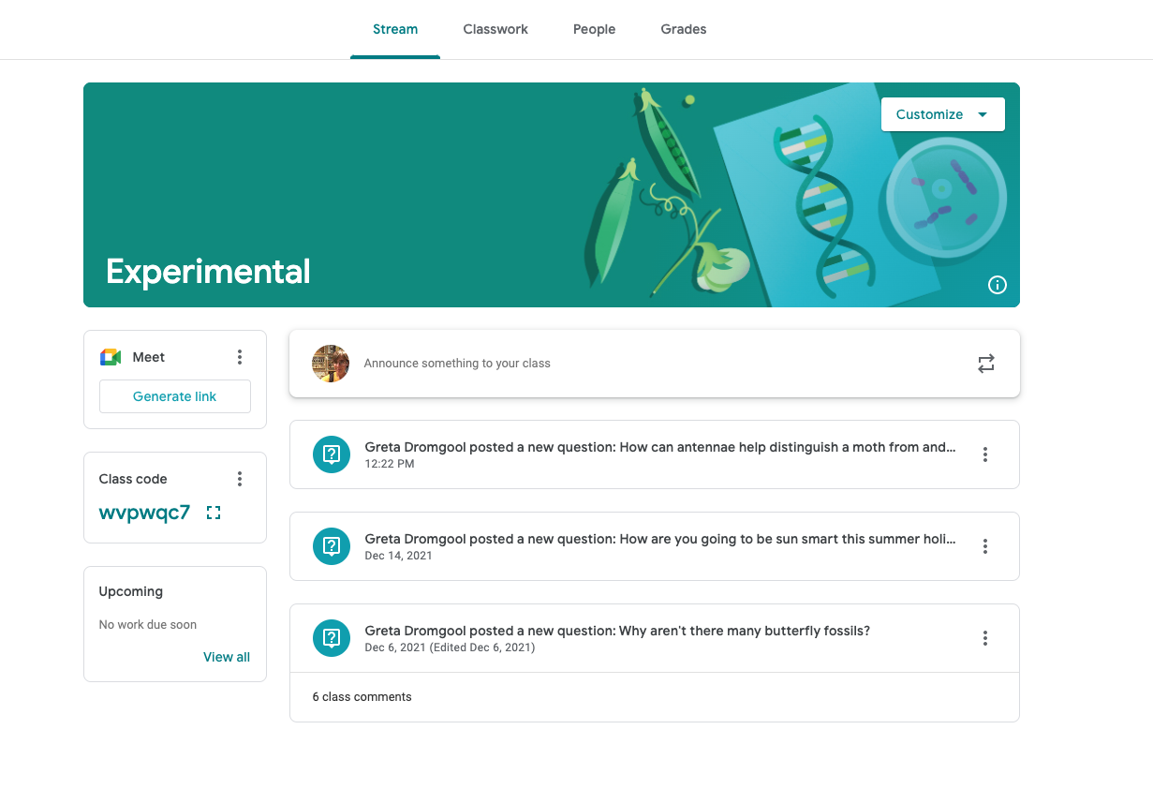
Google classrooms
© Copyright. Science Learning Hub – Pokapū Akoranga Pūtaiao The University of Waikato Te Whare Wananga o Waikato.
All Rights Reserved | www.sciencelearn.org.nz. All images are copyrighted. For further information, please refer to enquiries@sciencelearn.org.nz

Slide 24
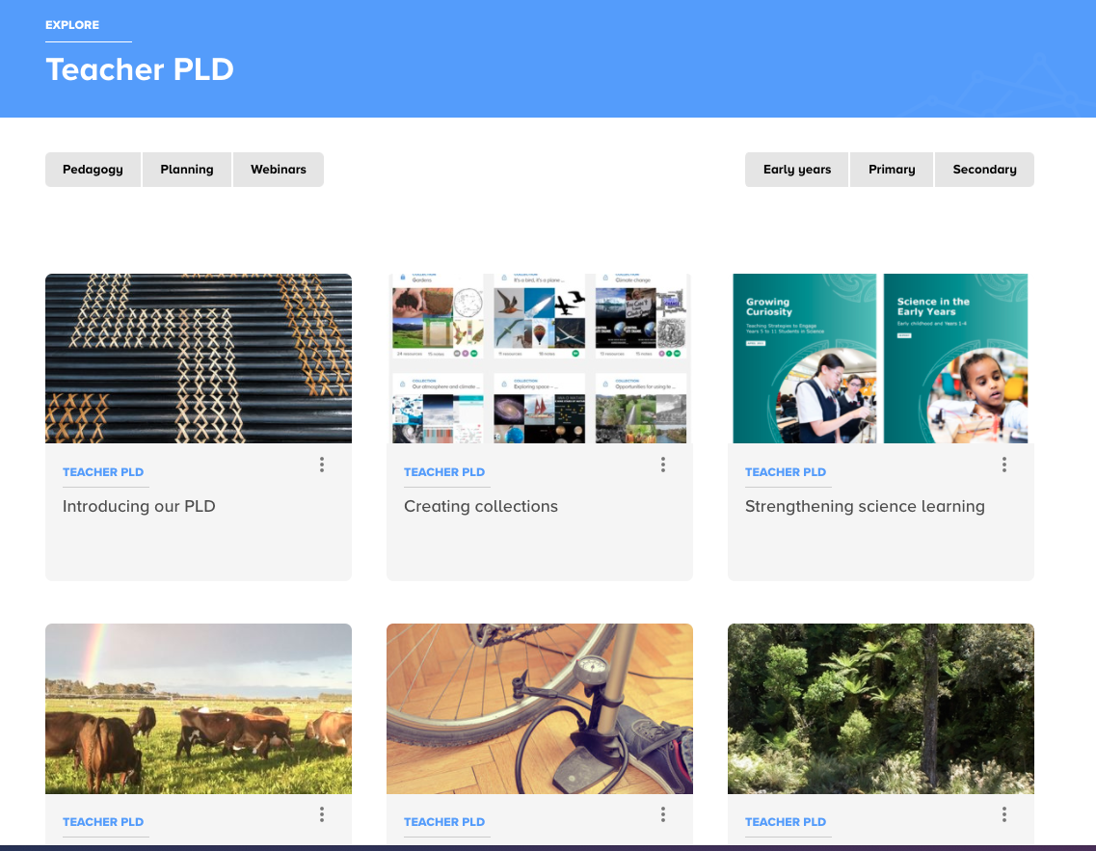
Teacher PLD
© Copyright. Science Learning Hub – Pokapū Akoranga Pūtaiao The University of Waikato Te Whare Wananga o Waikato.
All Rights Reserved | www.sciencelearn.org.nz. All images are copyrighted. For further information, please refer to enquiries@sciencelearn.org.nz
Notes:
https://www.sciencelearn.org.nz/teacher_pld

Slide 25
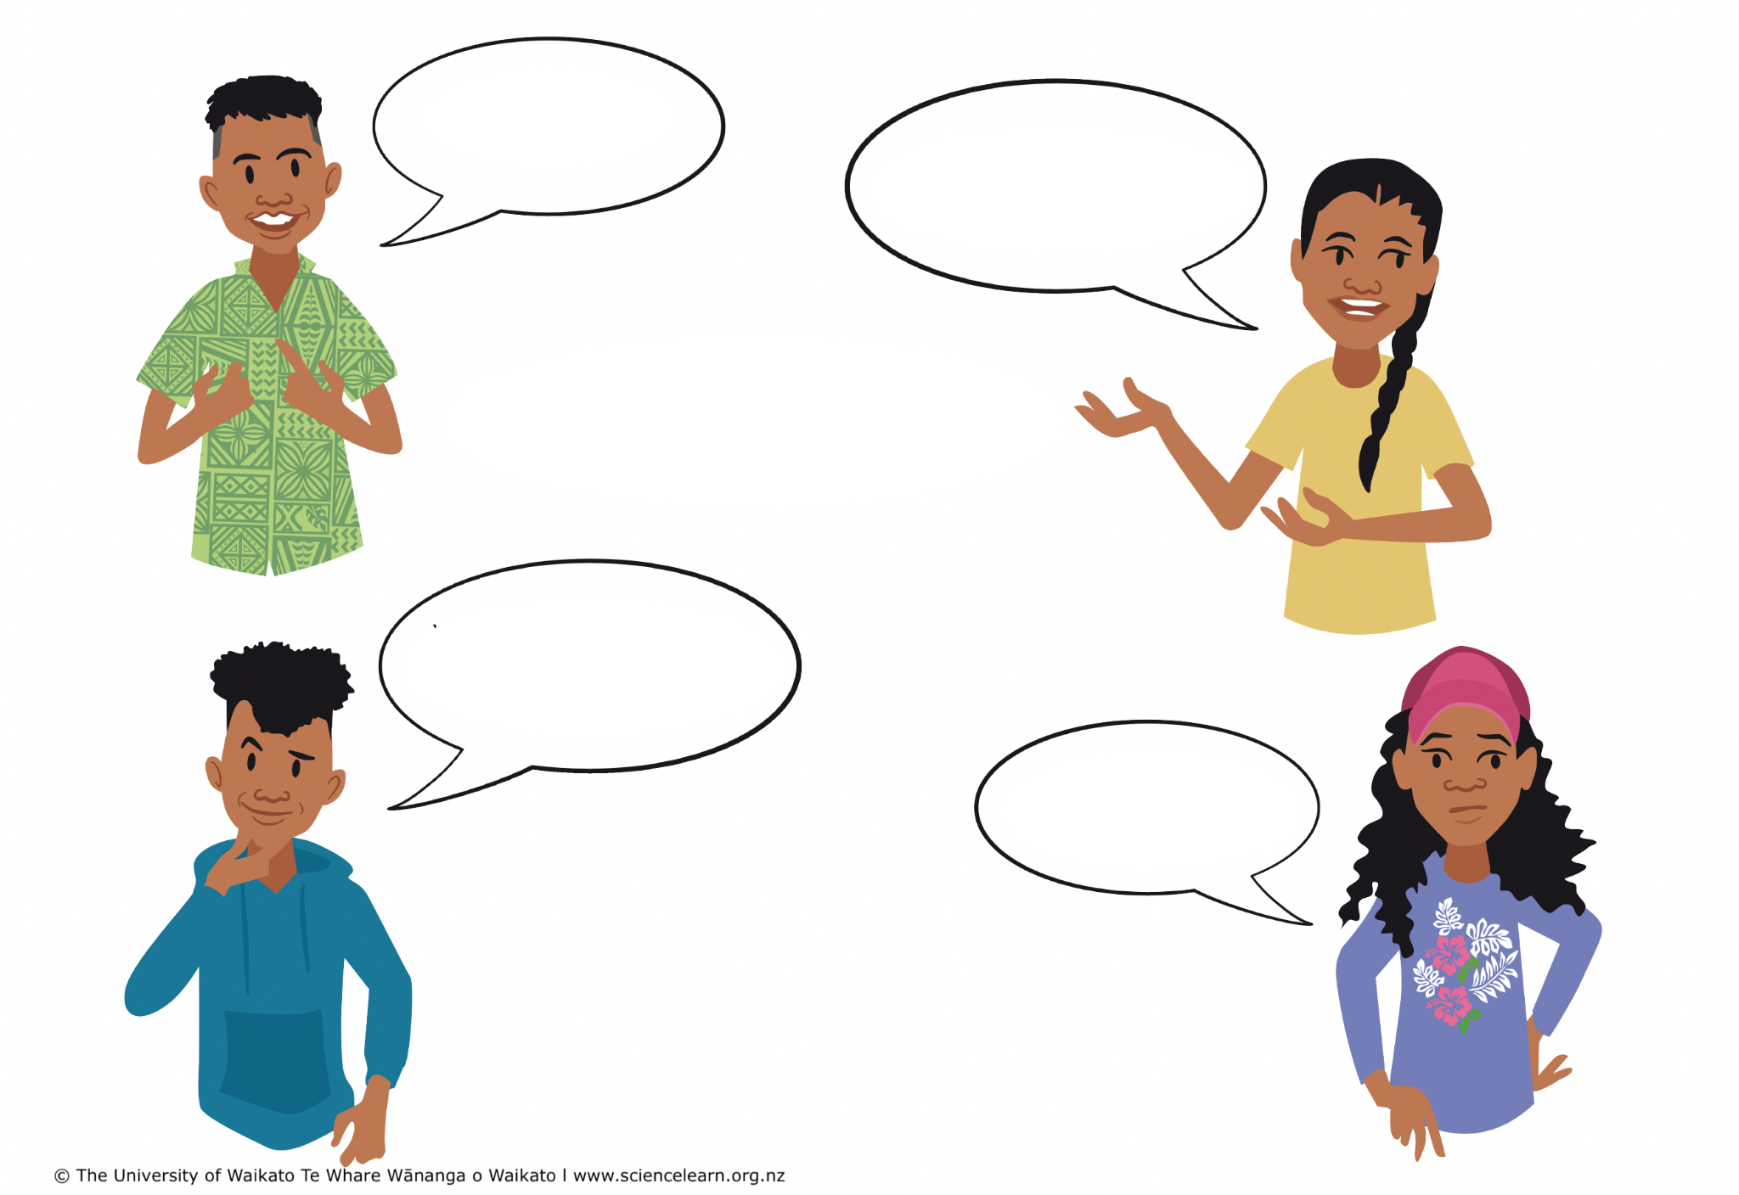
Thoughts, ideas, questions, feedback...
© Copyright. Science Learning Hub – Pokapū Akoranga Pūtaiao The University of Waikato Te Whare Wananga o Waikato.
All Rights Reserved | www.sciencelearn.org.nz. All images are copyrighted. For further information, please refer to enquiries@sciencelearn.org.nz

Slide 26
Thanks – want to keep in touch?
Email us on enquiries@sciencelearn.org.nz
https://twitter.com/NZScienceLearn
www.facebook.com/nzsciencelearn
https://nz.pinterest.com/nzsciencelearn
www.instagram.com/sciencelearninghubnz
Join us in our discussion channel on Slack (http://slh-talk.slack.com).
(Any problems accessing Slack, please contact us via our enquiries email, enquiries@sciencelearn.org.nz.)

