Slide 1
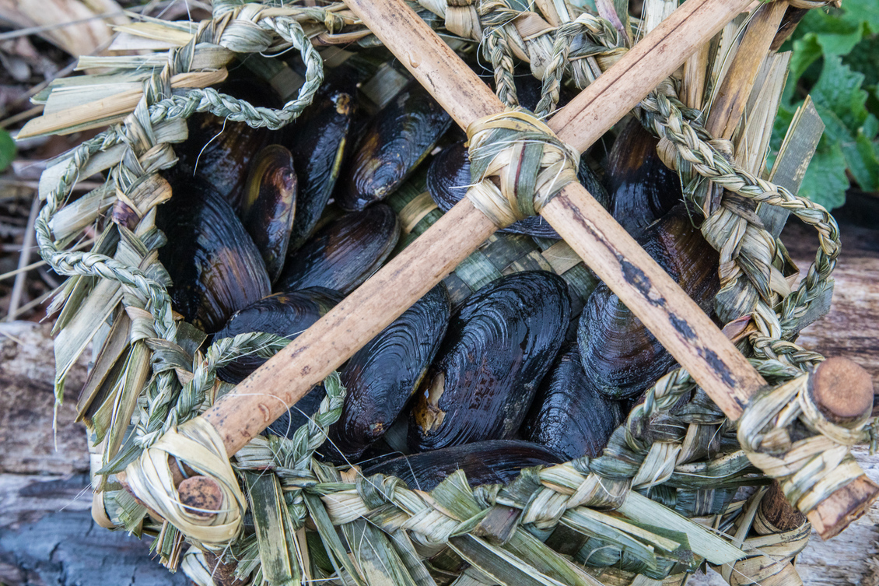
Local curriculum, mātauranga and science
Pete Monk Photography
4–4:45 pm Thursday
© Copyright. Science Learning Hub – Pokapū Akoranga Pūtaiao The University of Waikato Te Whare Wananga o Waikato.
All Rights Reserved | www.sciencelearn.org.nz. All images are copyrighted. For further information, please refer to enquiries@sciencelearn.org.nz

Slide 2

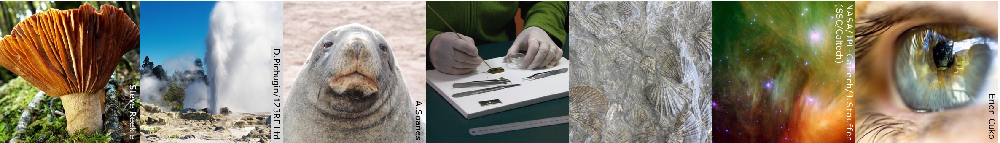
The Science Learning Hub
A trustworthy online resource – produced by educators and scientists
Based on world-class New Zealand science research
Supported by learning activities, information about the key science ideas and concepts, multimedia tools and other resources
Written for New Zealand teachers and students

Slide 3
Index
Topic | Slideshow number(s ) | Video timecode
Introducing the Science Learning Hub | 1–2 | 00:00
Index | 3 | 00:36
Introducing Shawn Cooper | 4–5 | 00:48
Purpose | 6 | 03:30
This is scary. Where do I start? | 7–10 | 04:41
How do I avoid being tokenistic? | 11–16 | 11:44
Connecting to mana whenua | 17–19 | 17:19
Am I being asked to teach religion in my science class? | 20–23 | 23:27
What if there’s no mātauranga to fit the context? | 24–31 | 33:46
SLH links, keep in touch and thanks | 32–35 | 42:22
© Copyright. The University of Waikato Te Whare Wananga o Waikato l Science Learning Hub – Pokapū Akoranga Pūtaiao. All Rights Reserved
All images are copyrighted. For further information, please refer to enquiries@sciencelearn.org.nz.

Slide 4
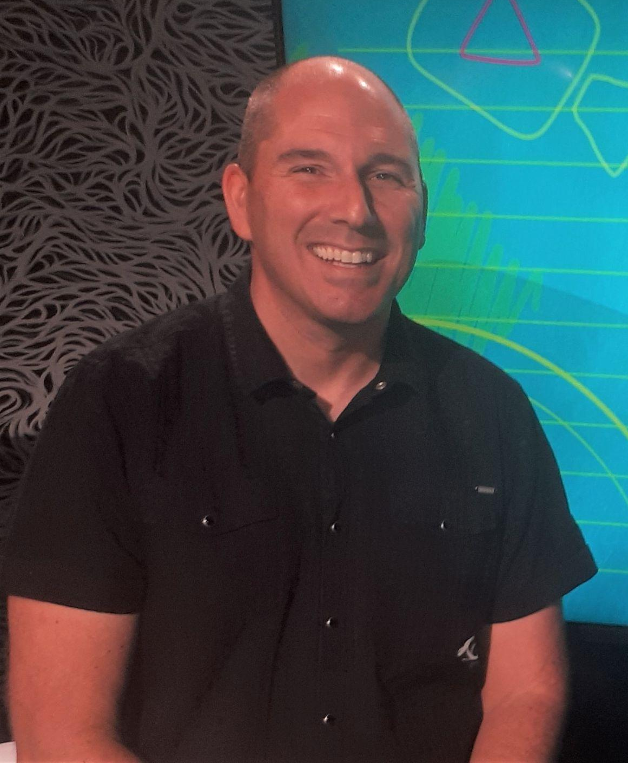

Shawn Cooper
Senior Curriculum Lead / Kaihautū Mātauranga
Ministry of Education / Te Tāhuhu o te Mātauranga
© Shawn Cooper
© Copyright. Science Learning Hub – Pokapū Akoranga Pūtaiao The University of Waikato Te Whare Wananga o Waikato.
All Rights Reserved | www.sciencelearn.org.nz. All images are copyrighted. For further information, please refer to enquiries@sciencelearn.org.nz

Slide 5
Karakia – Ka hikitia
Ka hikitia! Ka hikitia!
Hiki, hikitia!
Whakarewa ki runga rawa.
Herea kia kore e hoki whakamuri mai.
Poua atu te pūmananawa Māori. He mana tikanga. Me te uri o māia.
Poipoia ngā mokopuna. Ngā rangatira mo āpōpō.
Ka tihei! Tihei mauriora!
Managing Success! Encourage and Support!
And raise it to its highest level.
Ensure that high achievement is maintained.
Holdfast to our Māori Potential. Our Cultural Advantage. And our Inherent Capability.
Nurture our mokopuna. The leaders of the future.
Behold, we move onwards and upwards.

Slide 6
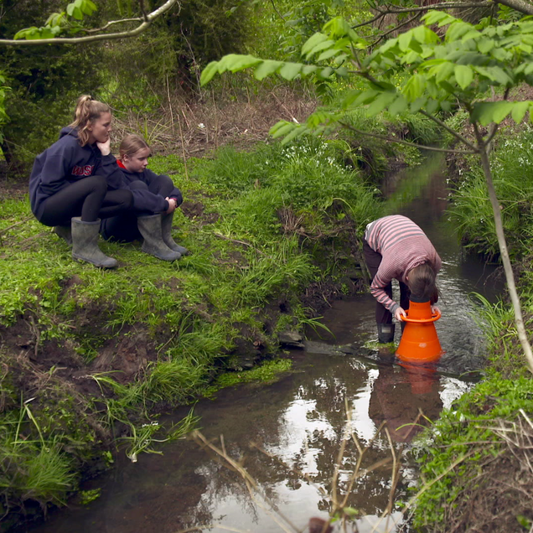
Purpose
To reflect on our role as Science educators within the context of Aotearoa New Zealand
To unpack ideas about local curriculum and mātauranga Māori in relation to teaching science
The University of Waikato Te Whare Wānanga o Waikato and Waikato Regional Council
© Copyright. Science Learning Hub – Pokapū Akoranga Pūtaiao The University of Waikato Te Whare Wananga o Waikato.
All Rights Reserved | www.sciencelearn.org.nz. All images are copyrighted. For further information, please refer to enquiries@sciencelearn.org.nz

Slide 7
He pātai taku
This is scary. Where do I start?
© Copyright. Science Learning Hub – Pokapū Akoranga Pūtaiao The University of Waikato Te Whare Wananga o Waikato.
All Rights Reserved | www.sciencelearn.org.nz. All images are copyrighted. For further information, please refer to enquiries@sciencelearn.org.nz

Slide 8
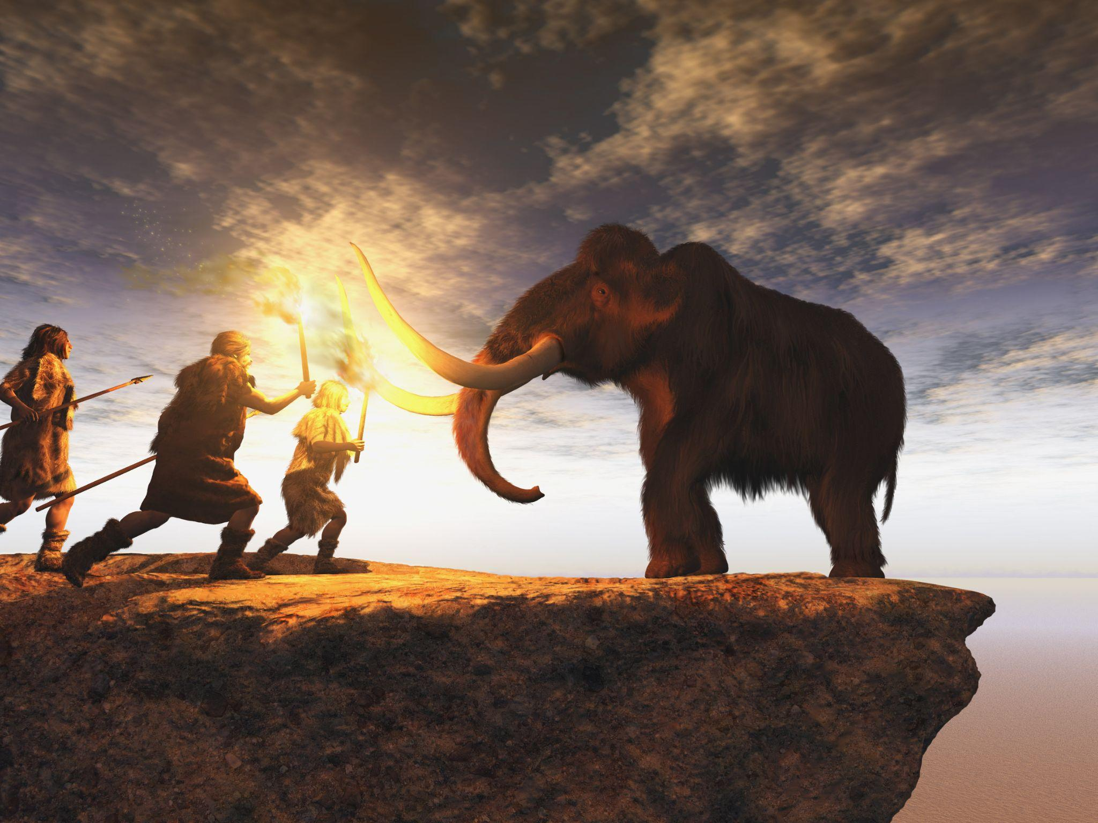
Educational Change
NCEA change
Literacy and numeracy
Local curriculum
Mātauranga Māori
© Estt/123RF Ltd
How do you eat an elephant?
© Copyright. Science Learning Hub – Pokapū Akoranga Pūtaiao The University of Waikato Te Whare Wananga o Waikato.
All Rights Reserved | www.sciencelearn.org.nz. All images are copyrighted. For further information, please refer to enquiries@sciencelearn.org.nz

Slide 9
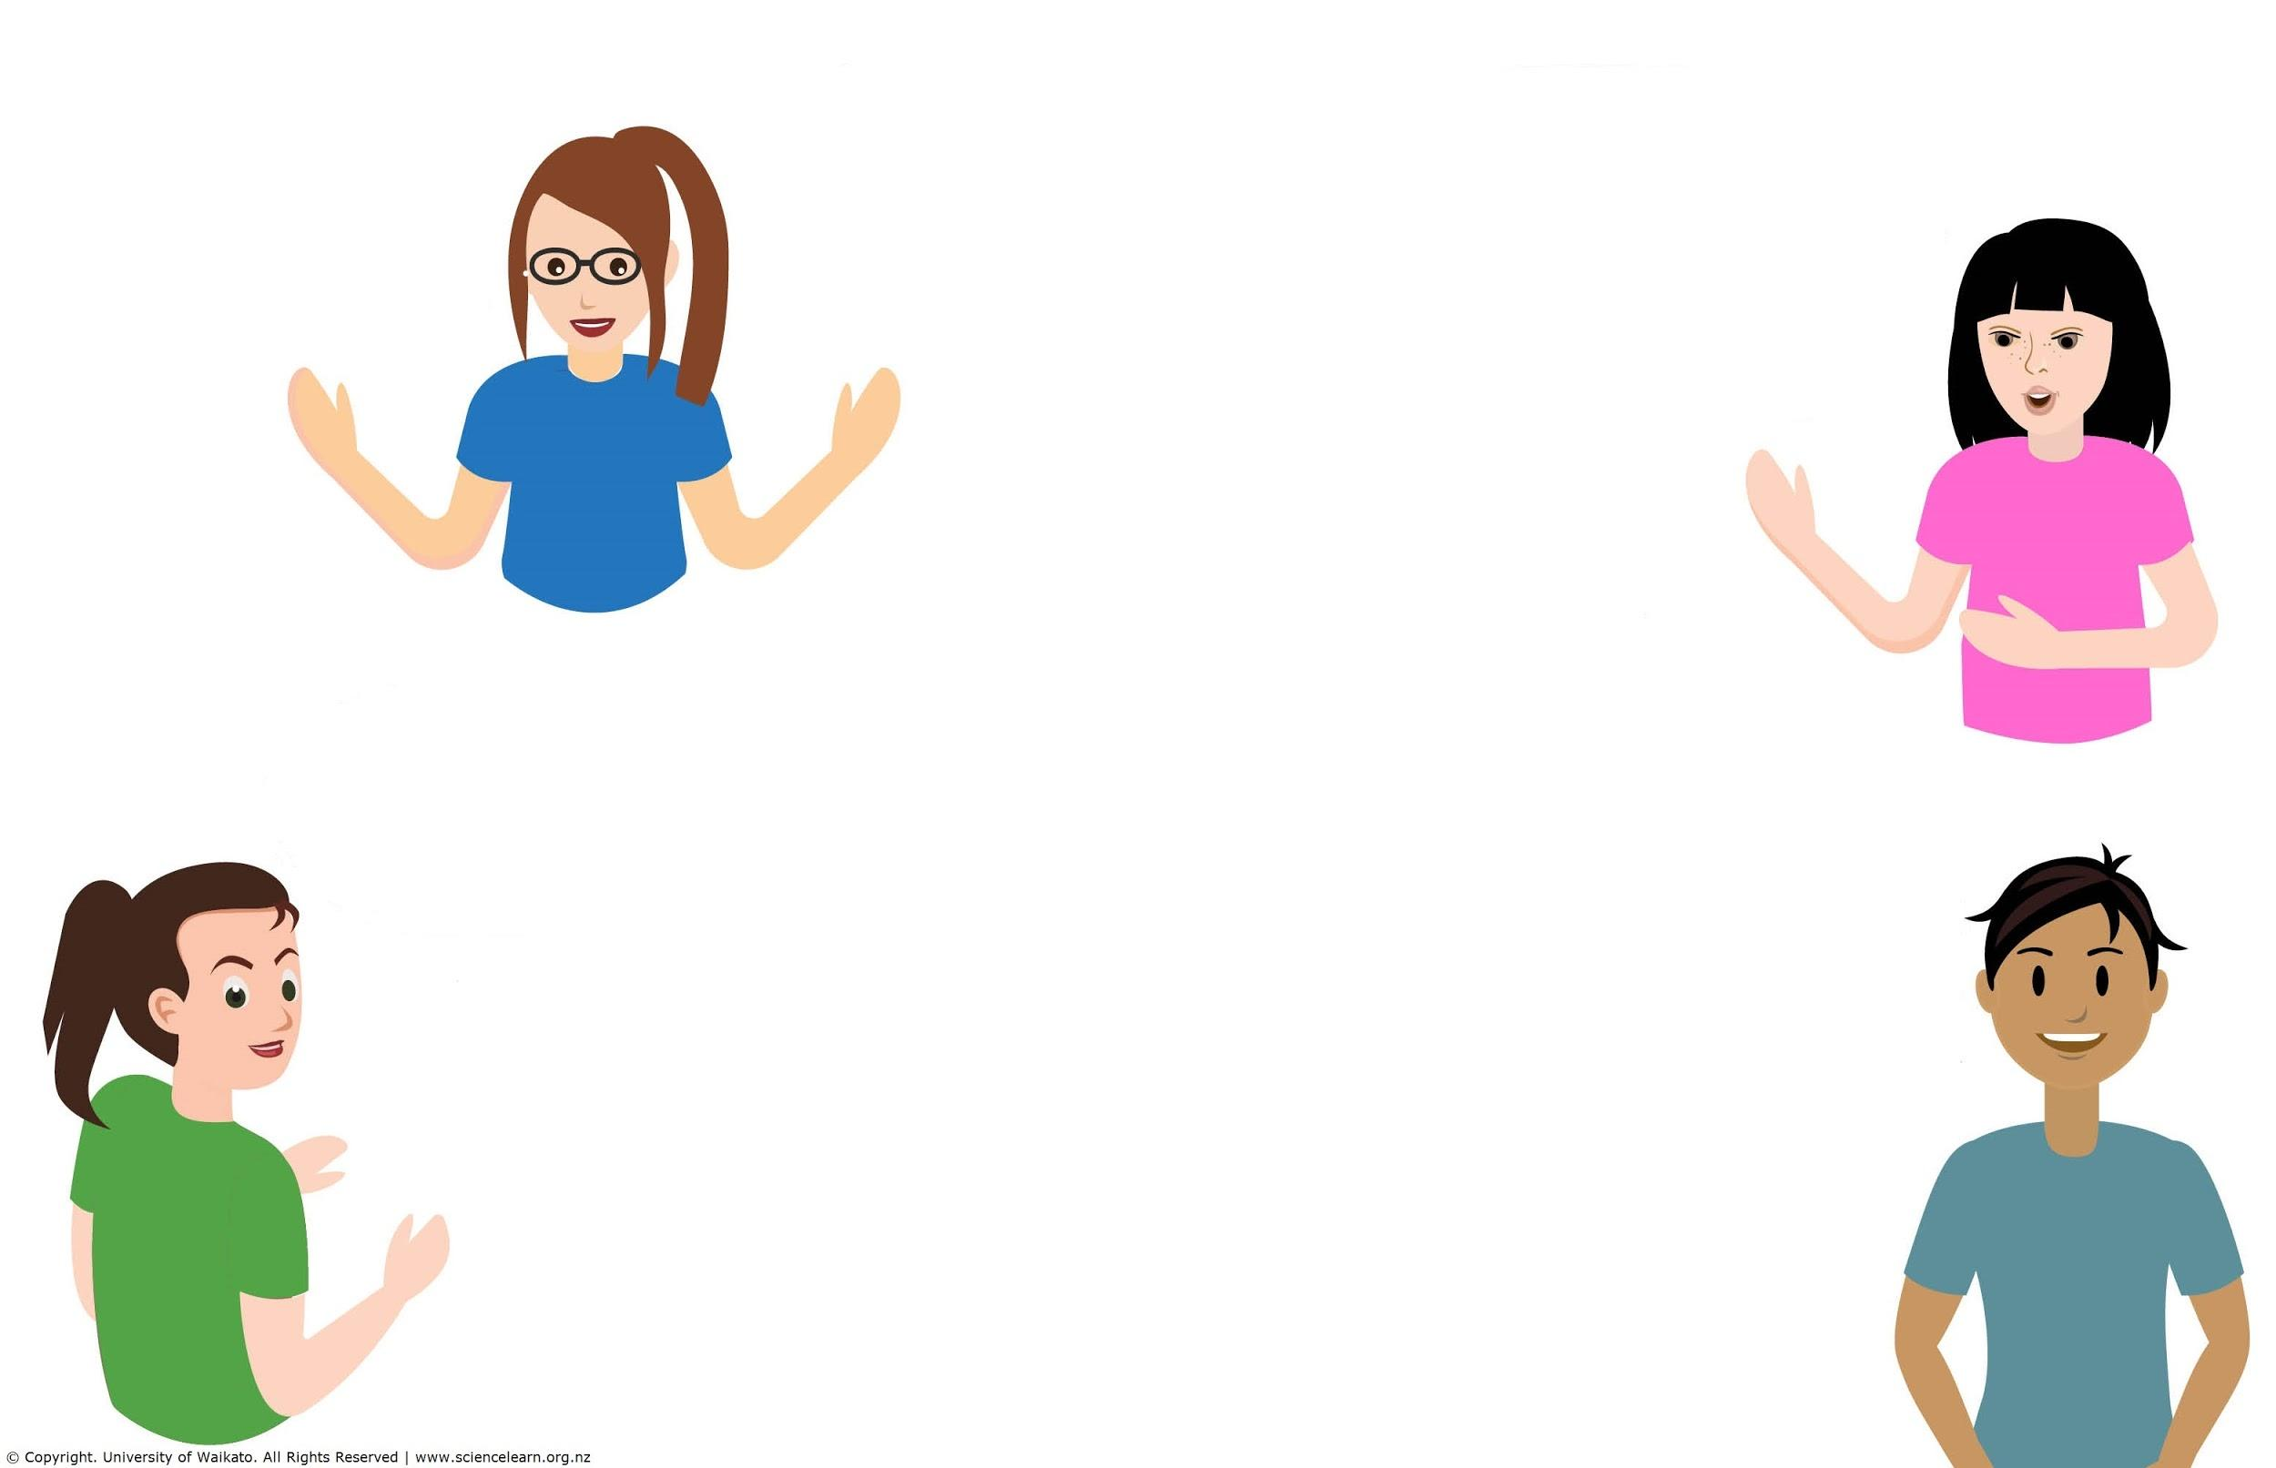
Participants ideas about
local curriculum
Learning motivated/driven by the physical and social environment of your school.
I have participated in walking through our local awa that the syndicate is named after. We looked into the history and the impact humans have had on the awa.
Using local restoration projects and parks to kickstart learning.
At Western Springs College, Mt Eden and its link to the springs at Western Springs, and the purakau linking lava flows in the local area/Tāmaki Makaurau, and the local basalt used in walls and roading edges on Motion Road.
Predator control in our school bush, looking to widen that to whole community.
Removal of catfish (pests) from our lakes.
Do you or your school have a relationships with mana whenua, community?
© Copyright. Science Learning Hub – Pokapū Akoranga Pūtaiao The University of Waikato Te Whare Wananga o Waikato.
All Rights Reserved | www.sciencelearn.org.nz. All images are copyrighted. For further information, please refer to enquiries@sciencelearn.org.nz

Slide 10
Local Curriculum and the NZC
Understand, Know, Do framework of the NZC Refresh
Vision for Young People (Be)
Mātauranga Māori
Indigenous knowledge systems
Place-based, iwi-based (sometimes competing/contradictory)
Dynamic, evolving and growing
Te Ahukaramū Charles Royal
MĀTAURANGA MĀORI An Introduction – A ‘think piece’ report
written for the Ministry of Education
© Copyright. Science Learning Hub – Pokapū Akoranga Pūtaiao The University of Waikato Te Whare Wananga o Waikato.
All Rights Reserved | www.sciencelearn.org.nz. All images are copyrighted. For further information, please refer to enquiries@sciencelearn.org.nz

Slide 11
He pātai taku
How do I avoid being tokenistic?
© Copyright. Science Learning Hub – Pokapū Akoranga Pūtaiao The University of Waikato Te Whare Wananga o Waikato.
All Rights Reserved | www.sciencelearn.org.nz. All images are copyrighted. For further information, please refer to enquiries@sciencelearn.org.nz

Slide 12
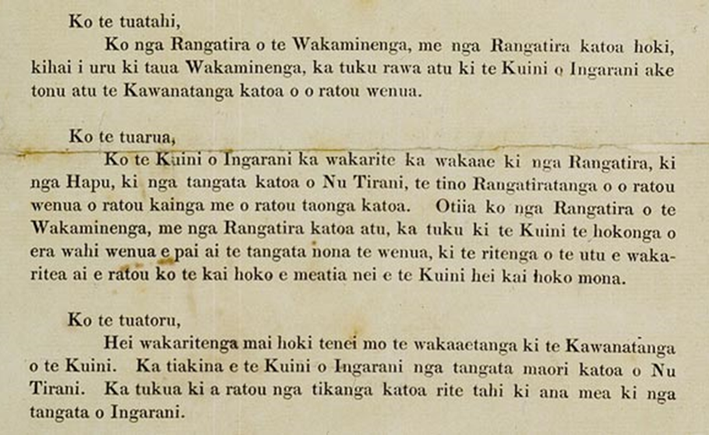
Bigger picture
Printed Sheet, Te Tiriti o Waitangi
Author | Archives New Zealand
Printed sheet, Tiriti o Waitangi, New Zealand Archives. CC BY 2.0
Educational Inequity and Rangatiratanga
© Copyright. Science Learning Hub – Pokapū Akoranga Pūtaiao The University of Waikato Te Whare Wananga o Waikato.
All Rights Reserved | www.sciencelearn.org.nz. All images are copyrighted. For further information, please refer to enquiries@sciencelearn.org.nz

Slide 13
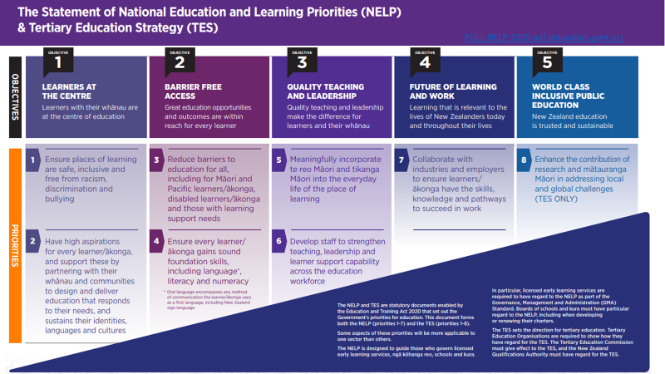
NELPS
Tau Mai Te Reo by the Ministry of Education from The Statement of National Education and Learning Priorities (NELP) and the Tertiary Education Strategy (TES) – Education in New Zealand is licensed under CC BY 3.0 New Zealand.

Slide 14
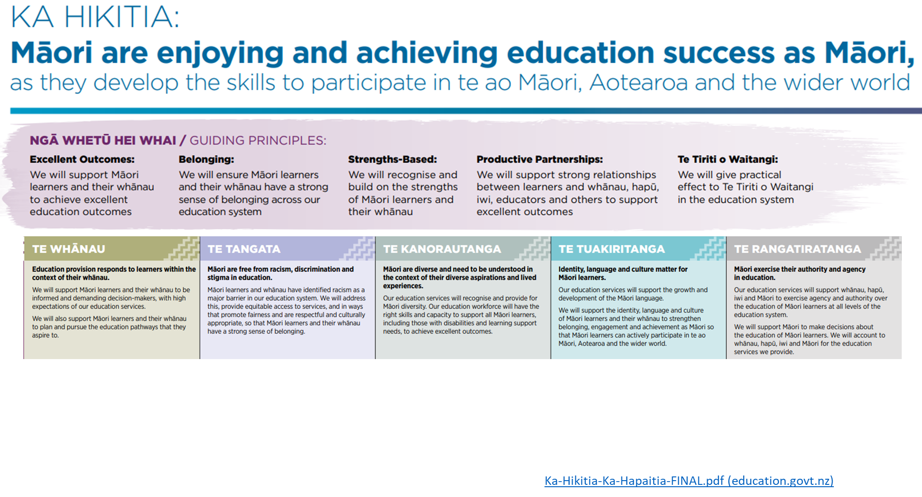
Ka Hikitia, Ka Hāpaitia
Tau Mai Te Reo by the Ministry of Education from Ka Hikitia – Ka Hāpaitia | The Māori Education Strategy (English) – Education in New Zealand is licensed under CC BY 3.0 New Zealand.
How do we develop a mana inspired approach to education?
© Copyright. Science Learning Hub – Pokapū Akoranga Pūtaiao The University of Waikato Te Whare Wananga o Waikato.
All Rights Reserved | www.sciencelearn.org.nz. All images are copyrighted. For further information, please refer to enquiries@sciencelearn.org.nz

Slide 15
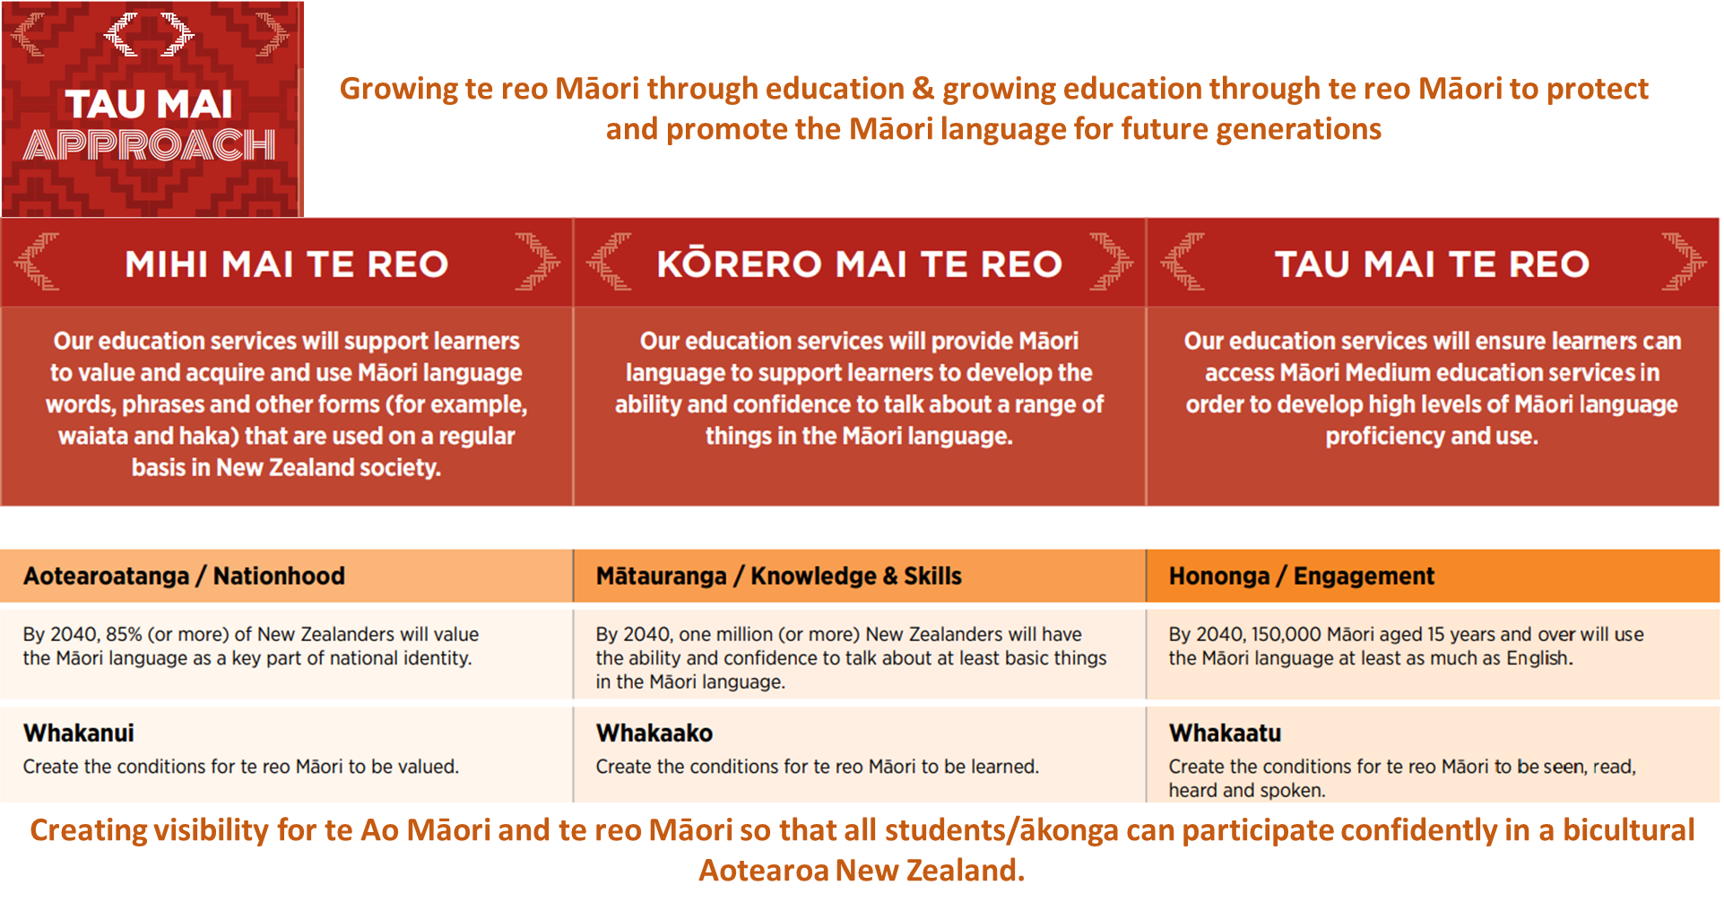
Tau Mai Te Reo
Tau Mai Te Reo by the Ministry of Education from Tau Mai Te Reo – Education in New Zealand is licensed under CC BY 3.0 New Zealand.
https://assets.education.govt.nz/public/Uploads/Tau-Mai-Te-Reo-FINAL.pdf
© Copyright. Science Learning Hub – Pokapū Akoranga Pūtaiao The University of Waikato Te Whare Wananga o Waikato.
All Rights Reserved | www.sciencelearn.org.nz. All images are copyrighted. For further information, please refer to enquiries@sciencelearn.org.nz

Slide 16
‘He waka eke noa’ and ‘Ako’
Start with the reo
Build a foundation upon which more complex understanding can be made
Intent: Culturally competent teachers help ākonga see their culture as a strength and draw on their cultural capital.
Create an authentic culture of learning
Teaching as inquiry and Ako
© Copyright. Science Learning Hub – Pokapū Akoranga Pūtaiao The University of Waikato Te Whare Wananga o Waikato.
All Rights Reserved | www.sciencelearn.org.nz. All images are copyrighted. For further information, please refer to enquiries@sciencelearn.org.nz

Slide 17
He pātai taku
Everyone says to connect to
mana whenua
– how do you actually do this?
© Copyright. Science Learning Hub – Pokapū Akoranga Pūtaiao The University of Waikato Te Whare Wananga o Waikato.
All Rights Reserved | www.sciencelearn.org.nz. All images are copyrighted. For further information, please refer to enquiries@sciencelearn.org.nz

Slide 18
Everyone says to connect to
mana whenua
How do you actually do this?
Relationships are essential (build the relationship before asking for support)
Mātauranga is a taonga
Start with those in front of you: ākonga, parents, BoT
Keeping yourself and ākonga safe
© Copyright. Science Learning Hub – Pokapū Akoranga Pūtaiao The University of Waikato Te Whare Wananga o Waikato.
All Rights Reserved | www.sciencelearn.org.nz. All images are copyrighted. For further information, please refer to enquiries@sciencelearn.org.nz

Slide 19
Indigenous knowledge and mana whenua
CARE principles for indigenous data governance
Collective Benefit
For inclusive development and innovation, for improved engagement, for equitable outcomes (mana ōrite)
Authority
Recognising rights and interests (consider sources)
Responsibility
For positive relationships, for expanding capability and capacity, for indigenous languages and worldviews
Ethics
For minimising harm and maximising benefit, for justice, for future use.
He Pou Hiringa – Grounding Science and Technology in Te Ao Maori
© Copyright. Science Learning Hub – Pokapū Akoranga Pūtaiao The University of Waikato Te Whare Wananga o Waikato.
All Rights Reserved | www.sciencelearn.org.nz. All images are copyrighted. For further information, please refer to enquiries@sciencelearn.org.nz

Slide 20
He pātai taku
Am I being asked to teach religion in my science class?
© Copyright. Science Learning Hub – Pokapū Akoranga Pūtaiao The University of Waikato Te Whare Wananga o Waikato.
All Rights Reserved | www.sciencelearn.org.nz. All images are copyrighted. For further information, please refer to enquiries@sciencelearn.org.nz

Slide 21
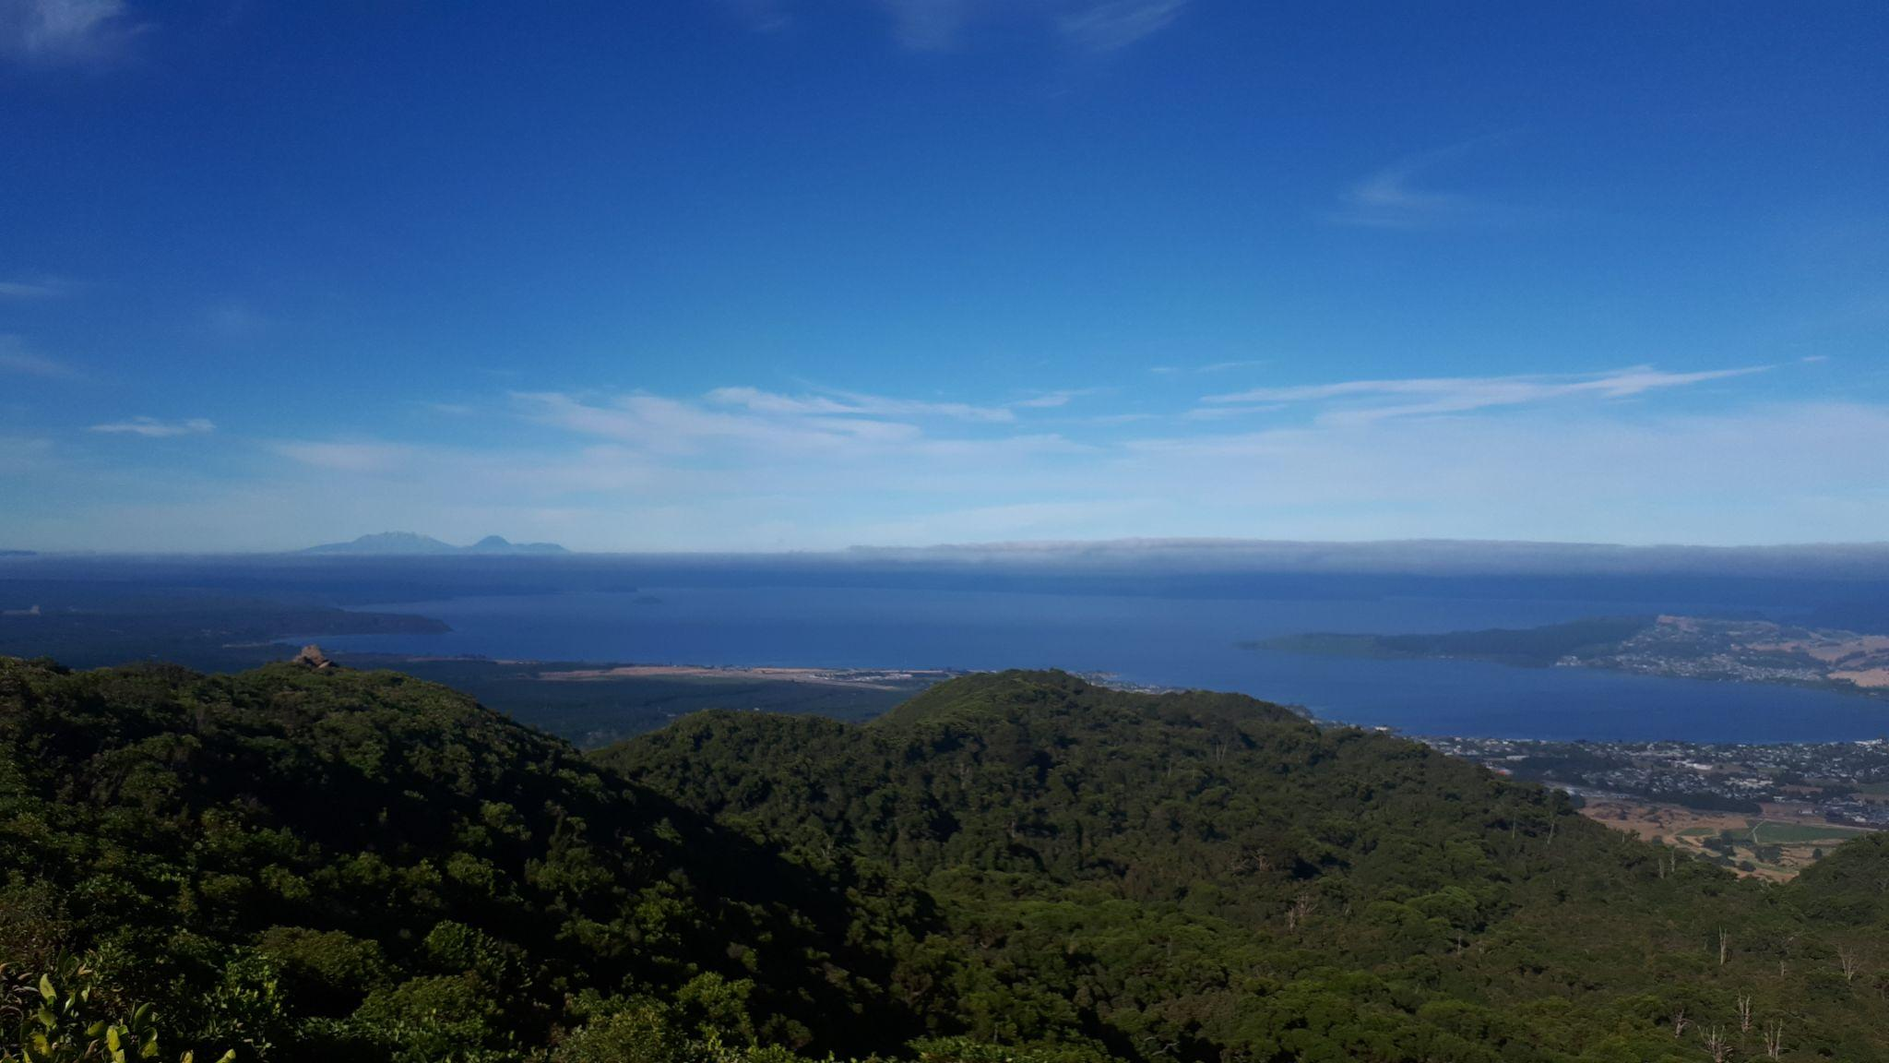
Am I being asked to teach religion in my science class?
Codification and oral transmission of knowledge
Pūrākau (narratives): Te Puia, Te Ika a Maui;
Analogies/Models: atomic, electricity
© Shawn Cooper
© Copyright. Science Learning Hub – Pokapū Akoranga Pūtaiao The University of Waikato Te Whare Wananga o Waikato.
All Rights Reserved | www.sciencelearn.org.nz. All images are copyrighted. For further information, please refer to enquiries@sciencelearn.org.nz

Slide 22
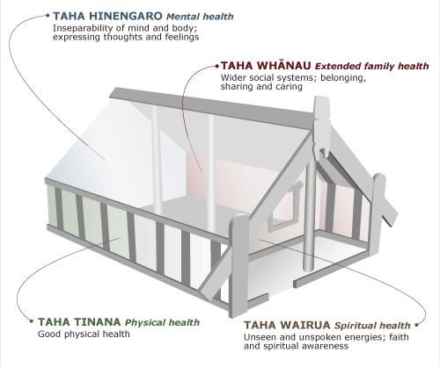
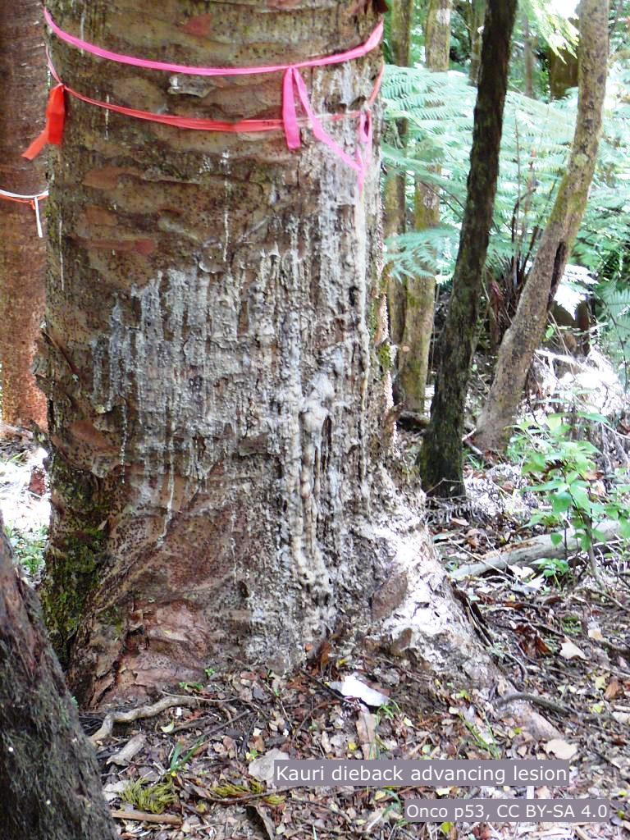
Am I being asked to teach religion in my science class?
2) Values and culturally grounded ways of doing, knowing, and/or applying science are embedded in mātauranga.
hauora (te whare tapa whā), climate change (rahui)
karakia and whakataukī
Te Ara The Encyclopedia of New Zealand
Source: Sir Mason Durie, Whaiora: Maori health development. Auckland: Oxford University Press, 1998, pp. 68–74
© Copyright. Science Learning Hub – Pokapū Akoranga Pūtaiao The University of Waikato Te Whare Wananga o Waikato.
All Rights Reserved | www.sciencelearn.org.nz. All images are copyrighted. For further information, please refer to enquiries@sciencelearn.org.nz

Slide 23

Am I being asked to teach religion in my science class?
3) Socio-scientific issues
Inclusion of mātauranga Māori and other knowledge systems promotes critical thinking
Ethical considerations to Science application
© Copyright. Science Learning Hub – Pokapū Akoranga Pūtaiao The University of Waikato Te Whare Wananga o Waikato.
All Rights Reserved | www.sciencelearn.org.nz. All images are copyrighted. For further information, please refer to enquiries@sciencelearn.org.nz

Slide 24
He pātai taku
What if there’s no mātauranga
to fit the context?
© Copyright. Science Learning Hub – Pokapū Akoranga Pūtaiao The University of Waikato Te Whare Wananga o Waikato.
All Rights Reserved | www.sciencelearn.org.nz. All images are copyrighted. For further information, please refer to enquiries@sciencelearn.org.nz

Slide 25
What if there’s not mātauranga
to fit the context?
Whakapapa
Ecology, Genealogy, Evolution, Geology, Astronomy
Kaitiakitanga
Ecology, Natural Cycles, Climate Change, Conservation
Maramataka
Astronomy, Navigation, Survival Skills, Ecology and Evolution
© Copyright. Science Learning Hub – Pokapū Akoranga Pūtaiao The University of Waikato Te Whare Wananga o Waikato.
All Rights Reserved | www.sciencelearn.org.nz. All images are copyrighted. For further information, please refer to enquiries@sciencelearn.org.nz

Slide 26
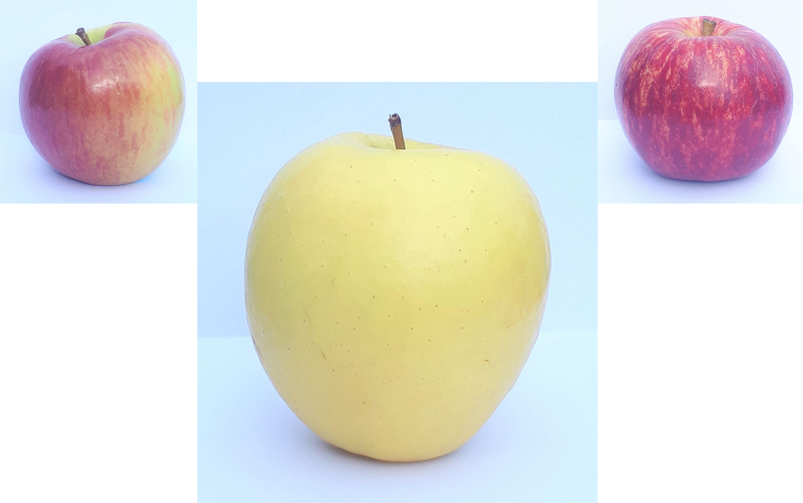
Whakapapa
© Shawn Cooper
© Copyright. Science Learning Hub – Pokapū Akoranga Pūtaiao The University of Waikato Te Whare Wananga o Waikato.
All Rights Reserved | www.sciencelearn.org.nz. All images are copyrighted. For further information, please refer to enquiries@sciencelearn.org.nz

Slide 27
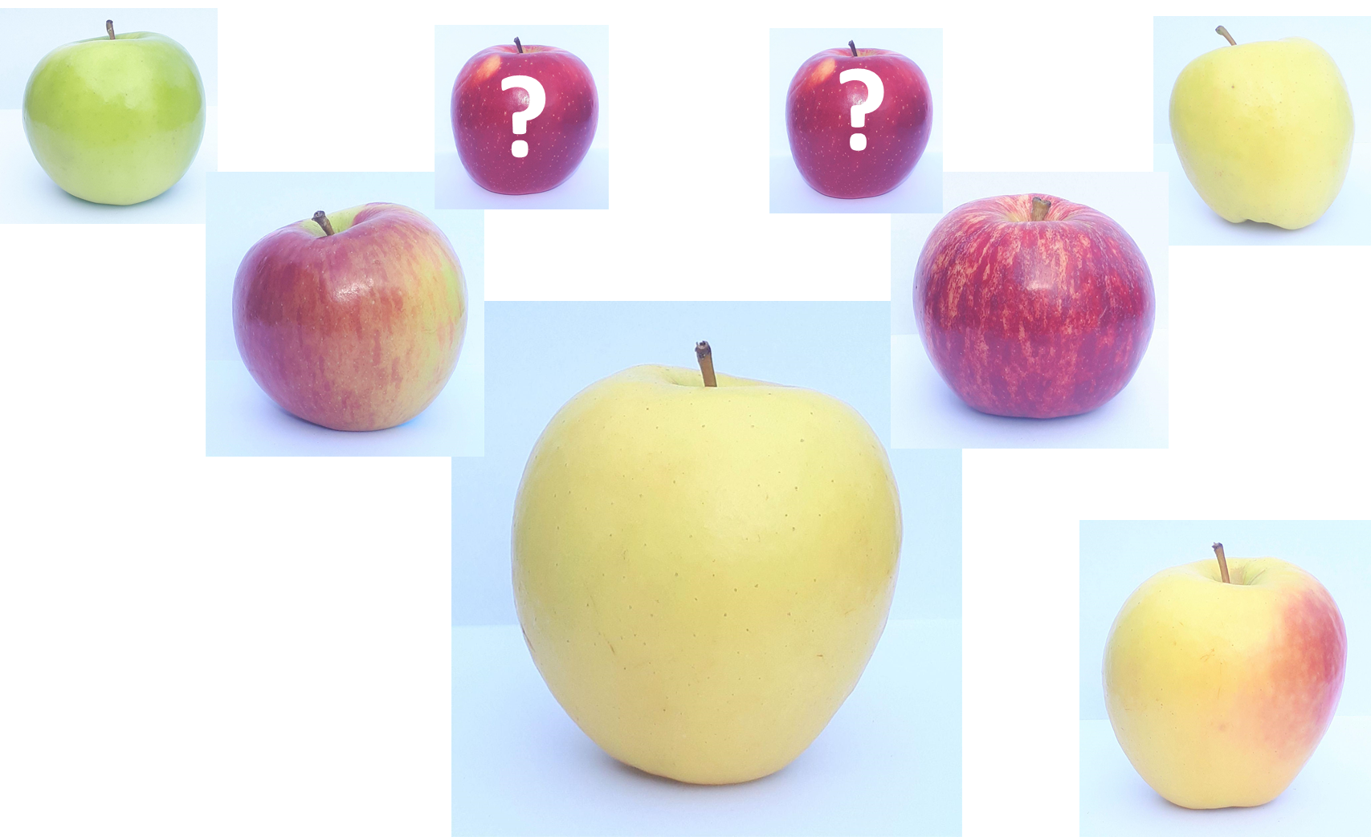
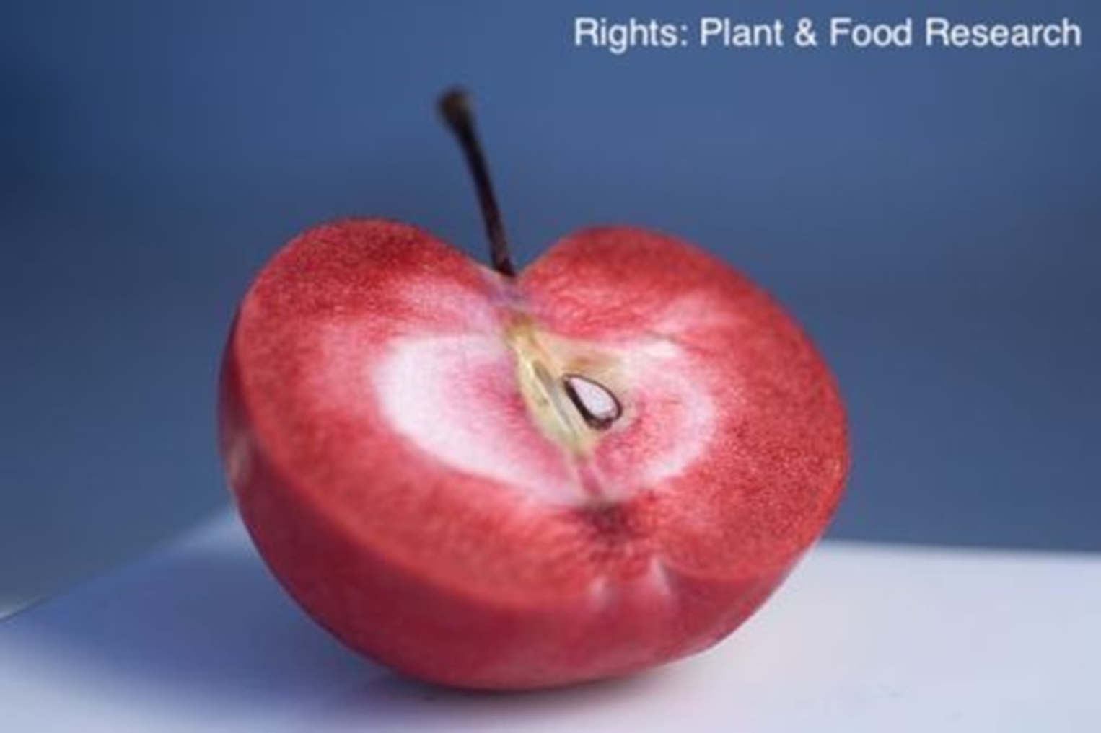
Whakapapa
© Copyright. Science Learning Hub – Pokapū Akoranga Pūtaiao The University of Waikato Te Whare Wananga o Waikato.
All Rights Reserved | www.sciencelearn.org.nz. All images are copyrighted. Red flesh apple, © Plant & Food Research, and all others © Shawn Cooper.
Notes:
Photo credit: Shawn Cooper
Red flesh Apple:Filename: MS_09_red_fleshed_apple.jpg
Copyright: Plant & Food Research
Acknowledgement: Rights: Plant & Food Research
Source: https://www.sciencelearn.org.nz/images/944-red-fleshed-apple

Slide 28
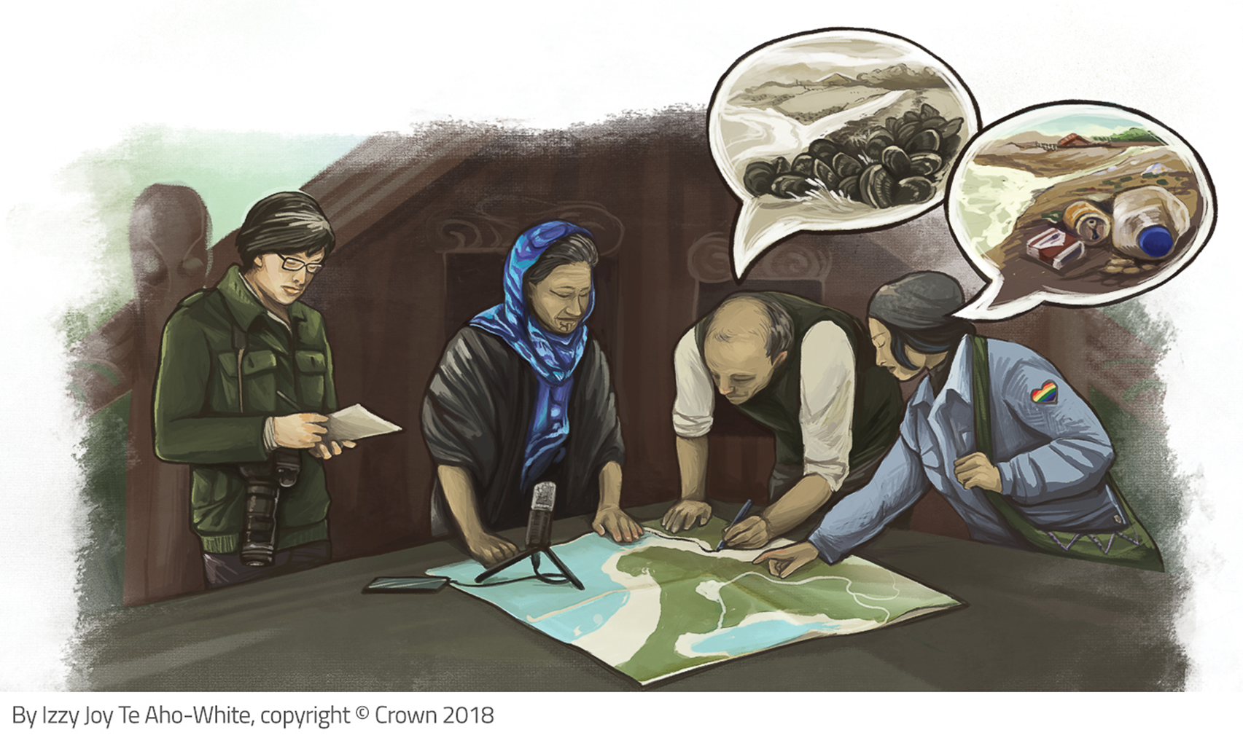
Kaitiakitanga
Used with permission.
© Copyright. Science Learning Hub – Pokapū Akoranga Pūtaiao The University of Waikato Te Whare Wananga o Waikato.
All Rights Reserved | www.sciencelearn.org.nz. All images are copyrighted. For further information, please refer to enquiries@sciencelearn.org.nz

Slide 29
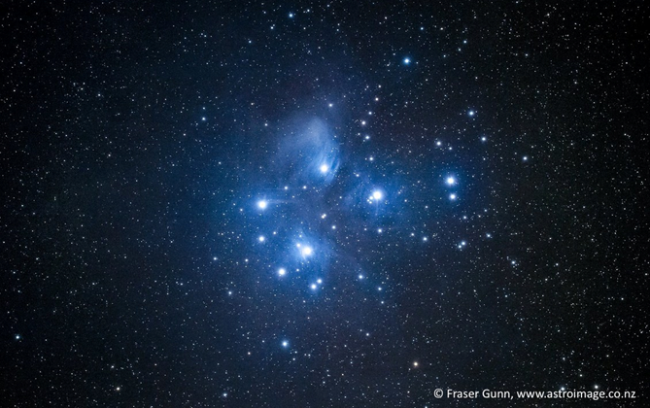
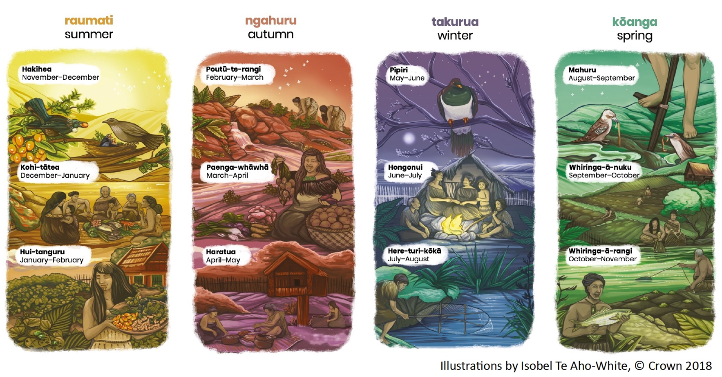
Maramataka
Used with permission. From Listening to the Land - Google Slides
© Copyright. Science Learning Hub – Pokapū Akoranga Pūtaiao The University of Waikato Te Whare Wananga o Waikato.
All Rights Reserved | www.sciencelearn.org.nz. All images are copyrighted. For further information, please refer to enquiries@sciencelearn.org.nz

Slide 30
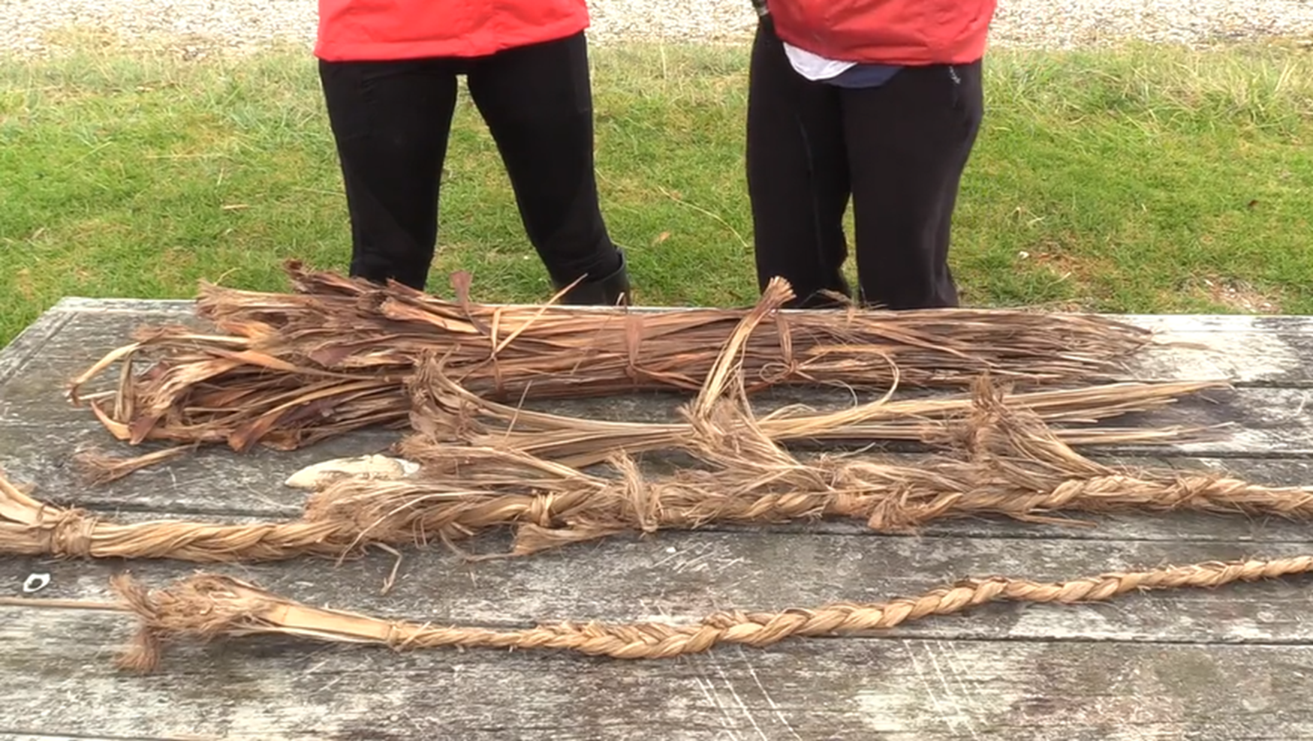
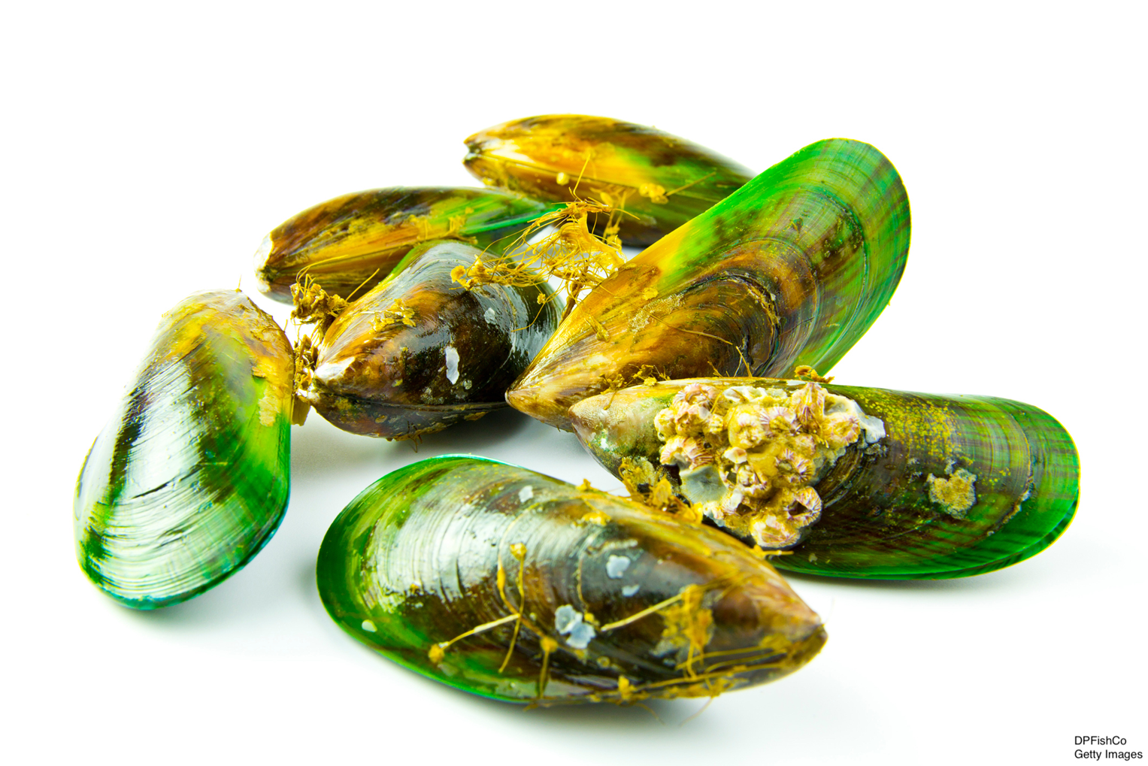
What if there’s no mātauranga to fit the context?
Challenge Misconceptions:
Mātauranga is not simply a library of historic knowledge
Mātauranga relates to a framework of knowing and discovering
Technology and Innovation:
LEARNZ, CC BY-NC
© Copyright. Science Learning Hub – Pokapū Akoranga Pūtaiao The University of Waikato Te Whare Wananga o Waikato.
All Rights Reserved | www.sciencelearn.org.nz. All images are copyrighted. For further information, please refer to enquiries@sciencelearn.org.nz

Slide 31
What if there’s no mātauranga to fit the context?
Reach out to those who can help:
Seek organisations that include iwi/hapū
Learning Area Leads (TOD3)
Networks of Expertise, Subject Associations
Science Learning Hub
NCEA.education.govt.nz
© Copyright. Science Learning Hub – Pokapū Akoranga Pūtaiao The University of Waikato Te Whare Wananga o Waikato.
All Rights Reserved | www.sciencelearn.org.nz. All images are copyrighted. For further information, please refer to enquiries@sciencelearn.org.nz

Slide 32
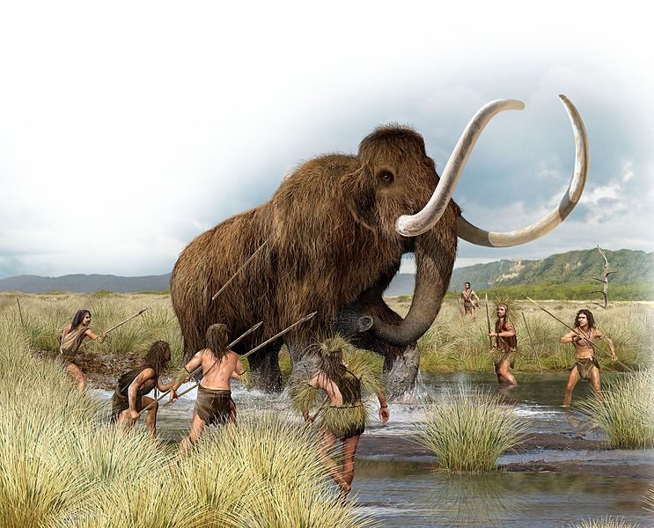
How do you eat…?
© Estt/123RF Ltd
© Copyright. Science Learning Hub – Pokapū Akoranga Pūtaiao The University of Waikato Te Whare Wananga o Waikato.
All Rights Reserved | www.sciencelearn.org.nz. All images are copyrighted. For further information, please refer to enquiries@sciencelearn.org.nz

Slide 33
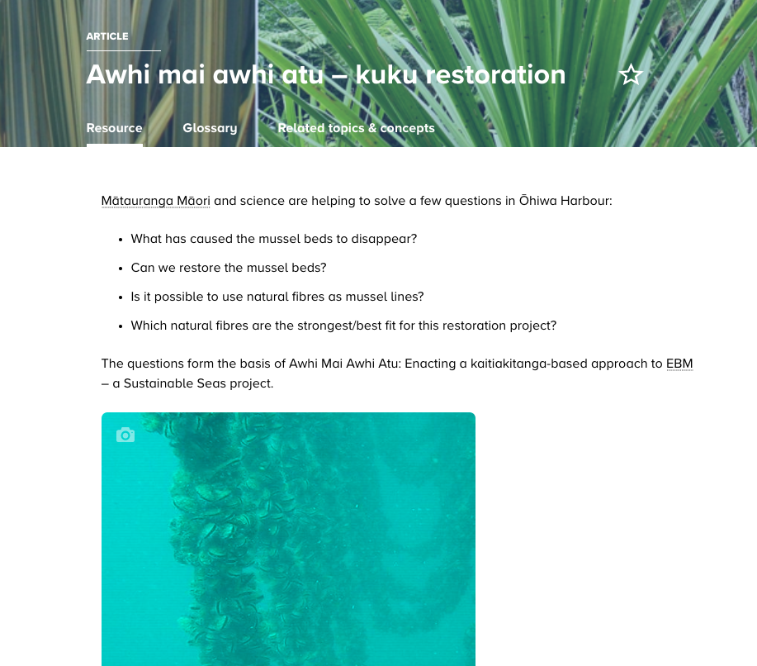
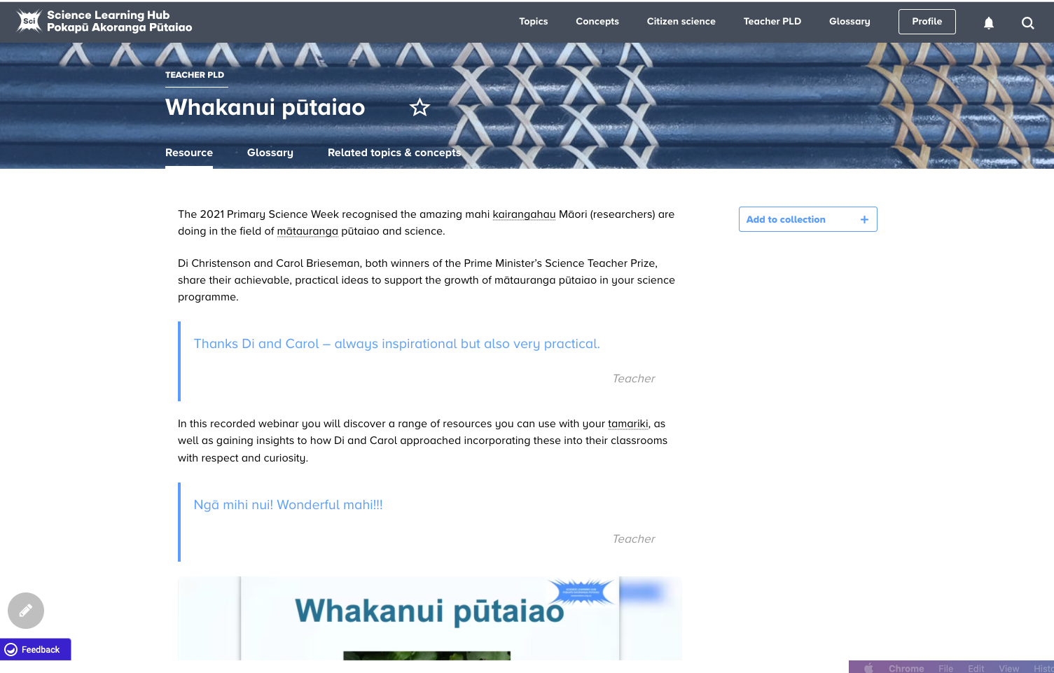
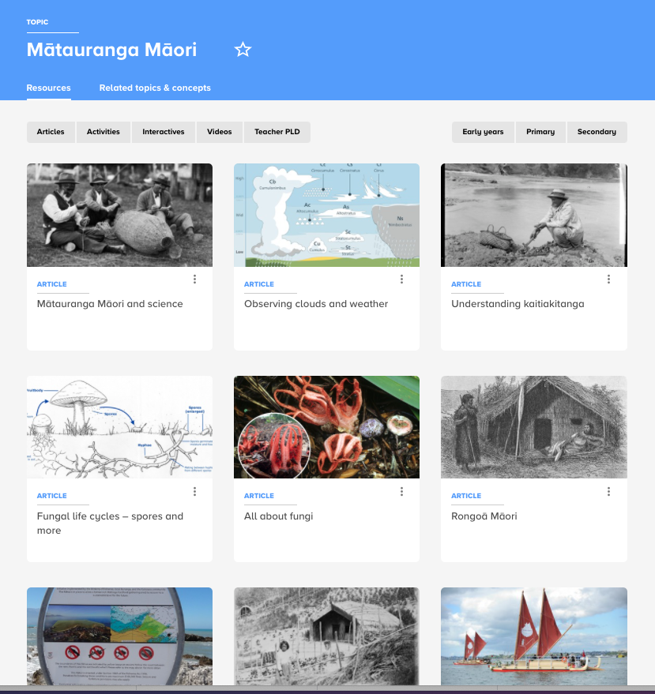
Resources
© Copyright. Science Learning Hub – Pokapū Akoranga Pūtaiao The University of Waikato Te Whare Wananga o Waikato.
All Rights Reserved | www.sciencelearn.org.nz. All images are copyrighted. For further information, please refer to enquiries@sciencelearn.org.nz
Notes:
https://www.sciencelearn.org.nz/resources/3102-awhi-mai-awhi-atu-kuku-restoration
https://www.sciencelearn.org.nz/resources/3049-whakanui-putaiao
Topic: https://www.sciencelearn.org.nz/topics/mātauranga-māori

Slide 34
Whakataukī
Poipoia te kākano kia puāwai
Nurture the seed and it will bloom
© Copyright. Science Learning Hub – Pokapū Akoranga Pūtaiao The University of Waikato Te Whare Wananga o Waikato.
All Rights Reserved | www.sciencelearn.org.nz. All images are copyrighted. For further information, please refer to enquiries@sciencelearn.org.nz

Slide 35





Thanks – want to keep in touch?
Email us on enquiries@sciencelearn.org.nz
https://twitter.com/NZScienceLearn
www.facebook.com/nzsciencelearn
https://nz.pinterest.com/nzsciencelearn
www.instagram.com/sciencelearninghubnz
Join us in our discussion channel on Slack (http://slh-talk.slack.com).
(Any problems accessing Slack, please contact us via our enquiries email, enquiries@sciencelearn.org.nz.)

