Slide 1
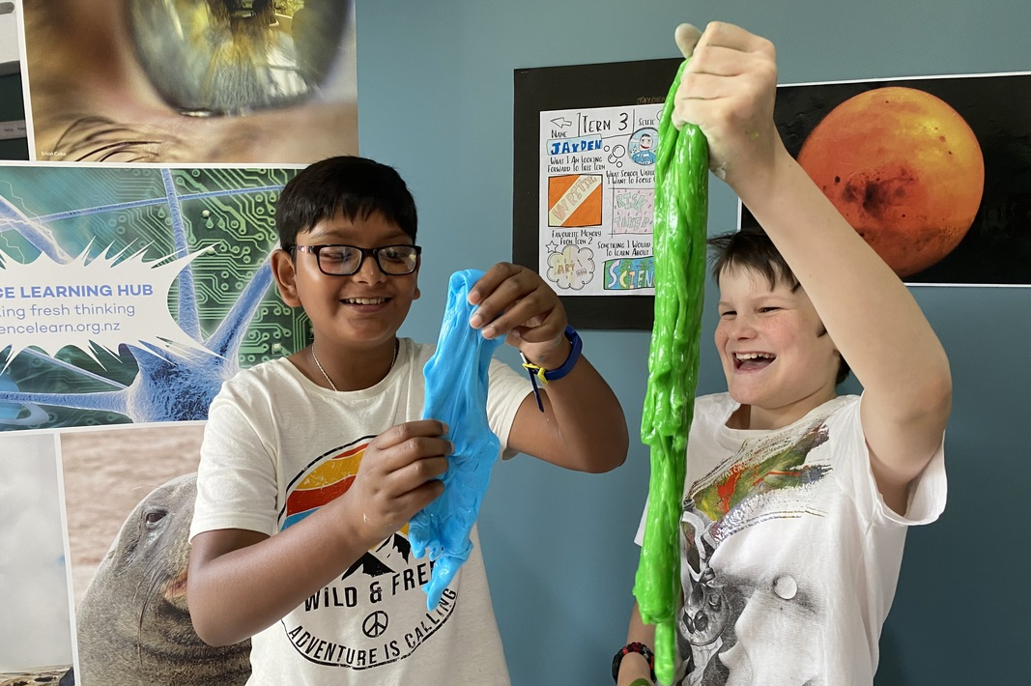
Get inspired about running Primary Science Week
Pete Monk Photography
4–4:45 pm Thursday
© Copyright. Science Learning Hub – Pokapū Akoranga Pūtaiao The University of Waikato Te Whare Wananga o Waikato.
All Rights Reserved | www.sciencelearn.org.nz. All images are copyrighted. For further information, please refer to enquiries@sciencelearn.org.nz

Slide 2
Index
Topic | Slideshow number(s ) | Video timecode
Welcome | 1 | 00:00
Index | 2 | 00:07
Introducing the Science Learning Hub | 3 | 00:17
Purpose | 4 | 00:43
NZAPSE – Sandy Jackson | 5 | 01:07
Carol Brieseman | 6–12 | 05:20
Di Christenson | 13 | 11:43
Anne Ryan | 14–17 | 14:23
John Marsh | 18–23 | 21:58
Sterling Cathman (Mr Science) | 24–32 | 28:29
SLH links, keep in touch and thanks | 33 | 34:31
© Copyright. The University of Waikato Te Whare Wananga o Waikato l Science Learning Hub – Pokapū Akoranga Pūtaiao. All Rights Reserved
All images are copyrighted. For further information, please refer to enquiries@sciencelearn.org.nz.

Slide 3
The Science Learning Hub
A trustworthy online resource – produced by educators and scientists
Based on world-class New Zealand science research
Supported by learning activities, information about the key science ideas and concepts, multimedia tools and other resources
Written for New Zealand teachers and students
© Copyright. Science Learning Hub – Pokapū Akoranga Pūtaiao The University of Waikato Te Whare Wananga o Waikato.
All Rights Reserved | www.sciencelearn.org.nz. All images are copyrighted. For further information, please refer to enquiries@sciencelearn.org.nz

Slide 4
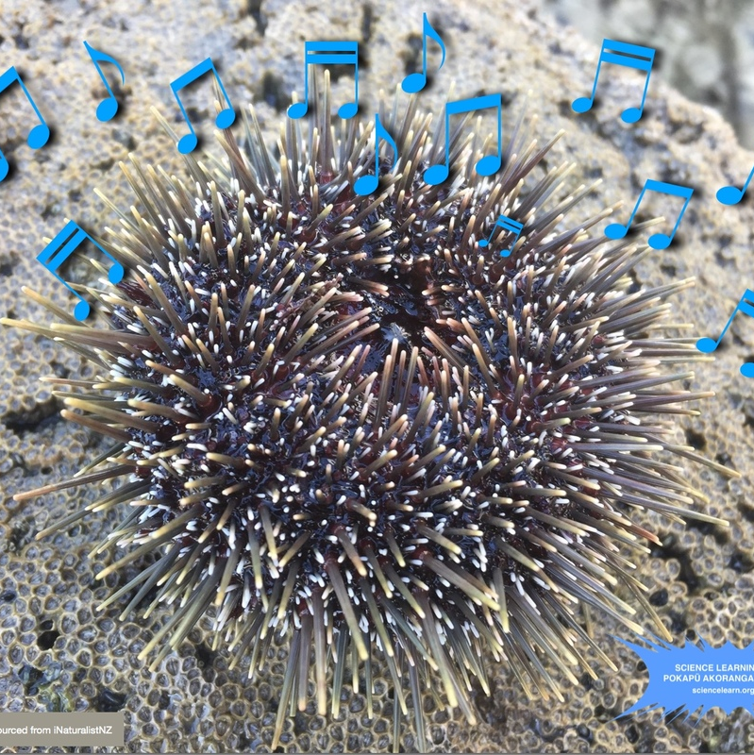
Purpose
Get you feeling inspired and supported to run a Primary science week
To let you know about NZAPSE and their mahi
Share ideas and answer your questions
© University of Waikato
© Copyright. Science Learning Hub – Pokapū Akoranga Pūtaiao The University of Waikato Te Whare Wananga o Waikato.
All Rights Reserved | www.sciencelearn.org.nz. All images are copyrighted. For further information, please refer to enquiries@sciencelearn.org.nz

Slide 5
NZAPSE
Sandy Jackson
nzapse.nzase.org.nz
© Copyright. Science Learning Hub – Pokapū Akoranga Pūtaiao The University of Waikato Te Whare Wananga o Waikato.
All Rights Reserved | www.sciencelearn.org.nz. All images are copyrighted. For further information, please refer to enquiries@sciencelearn.org.nz

Slide 6
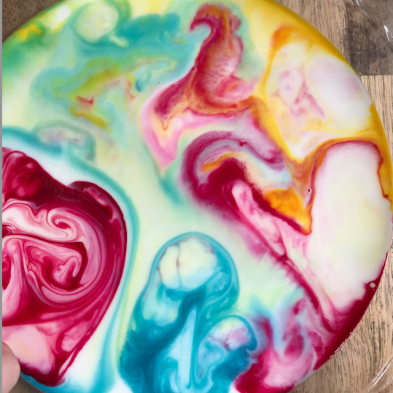
What’s worked?
Carol Brieseman & Di Christenson
© Private Collection
© Copyright. Science Learning Hub – Pokapū Akoranga Pūtaiao The University of Waikato Te Whare Wananga o Waikato.
All Rights Reserved | www.sciencelearn.org.nz. All images are copyrighted. For further information, please refer to enquiries@sciencelearn.org.nz

Slide 7
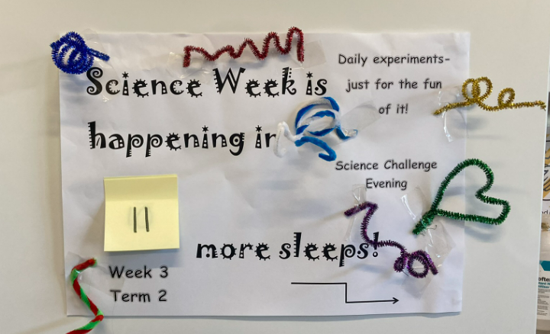
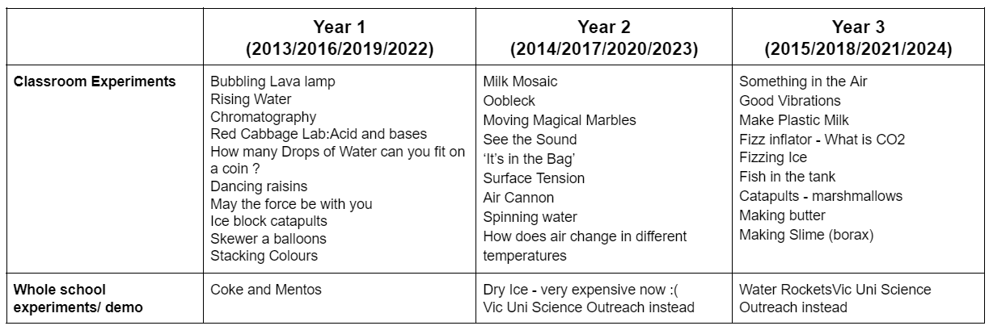
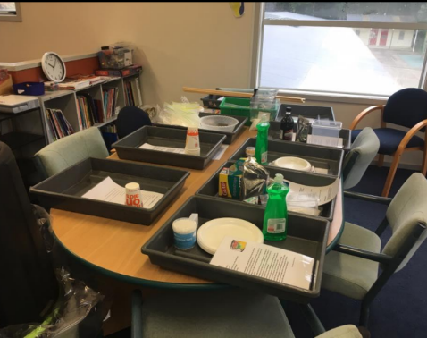
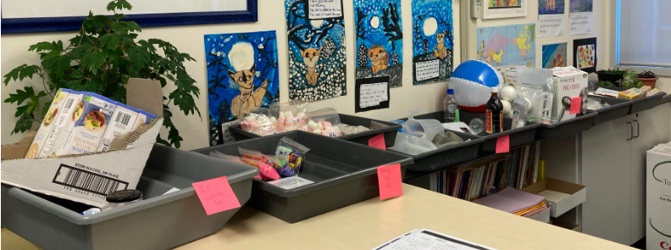
Countdown!
Set of experiments,
(3 year rotation)
© C Briesman, 2022
© C Briesman, 2022
© C Briesman, 2022
© Copyright. Science Learning Hub – Pokapū Akoranga Pūtaiao The University of Waikato Te Whare Wananga o Waikato.
All Rights Reserved | www.sciencelearn.org.nz. All images are copyrighted. For further information, please refer to enquiries@sciencelearn.org.nz

Slide 8
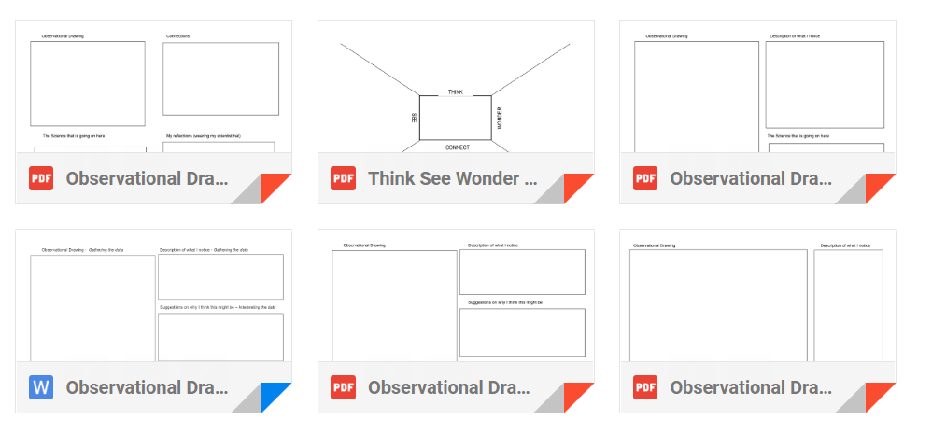
Writing templates
out
© Copyright. Science Learning Hub – Pokapū Akoranga Pūtaiao The University of Waikato Te Whare Wananga o Waikato.
All Rights Reserved | www.sciencelearn.org.nz. All images are copyrighted. For further information, please refer to enquiries@sciencelearn.org.nz

Slide 9
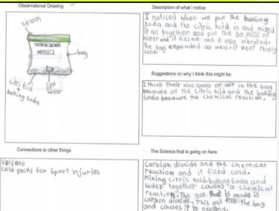
Writing templates
C Briesman, © Hampton Hill School, Tawa
© Copyright. Science Learning Hub – Pokapū Akoranga Pūtaiao The University of Waikato Te Whare Wananga o Waikato.
All Rights Reserved | www.sciencelearn.org.nz. All images are copyrighted. For further information, please refer to enquiries@sciencelearn.org.nz

Slide 10
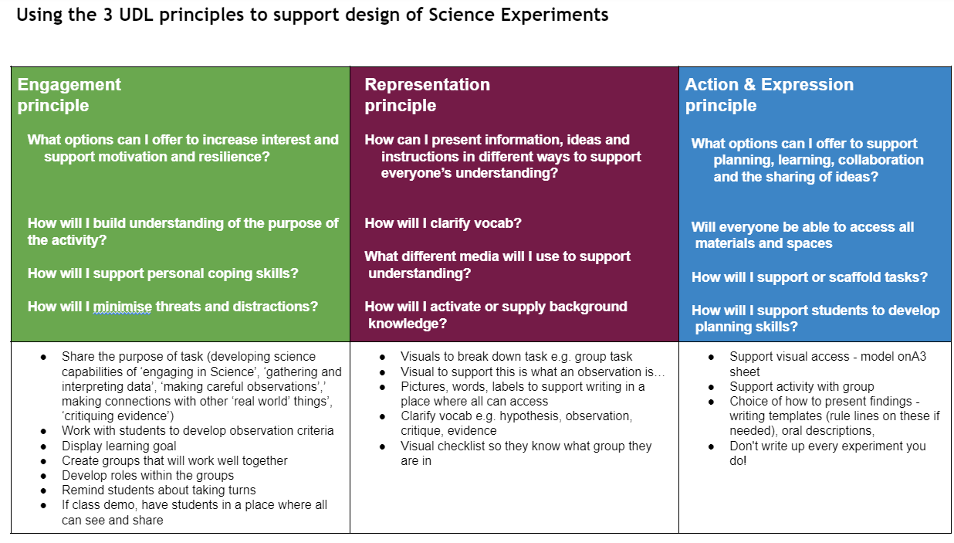
UDL support
© Copyright. Science Learning Hub – Pokapū Akoranga Pūtaiao The University of Waikato Te Whare Wananga o Waikato.
All Rights Reserved | www.sciencelearn.org.nz. All images are copyrighted. For further information, please refer to enquiries@sciencelearn.org.nz
Notes:
https://sites.google.com/hamptonhill.school.nz/sciencewithintawakahuiako/primary-science-week

Slide 11
Science challenge evenings
C Briesman, © Hampton Hill School, Tawa
© Copyright. Science Learning Hub – Pokapū Akoranga Pūtaiao The University of Waikato Te Whare Wananga o Waikato.
All Rights Reserved | www.sciencelearn.org.nz. All images are copyrighted. For further information, please refer to enquiries@sciencelearn.org.nz

Slide 12
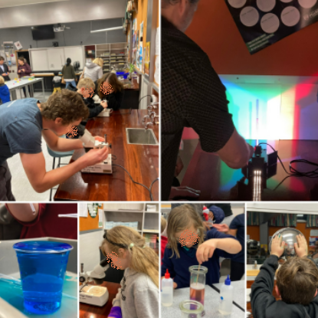
Tawa Kahui Ako Tawa College
Science Department Open Evening
© C. Briesman, 2022
© Copyright. Science Learning Hub – Pokapū Akoranga Pūtaiao The University of Waikato Te Whare Wananga o Waikato.
All Rights Reserved | www.sciencelearn.org.nz. All images are copyrighted. For further information, please refer to enquiries@sciencelearn.org.nz

Slide 13
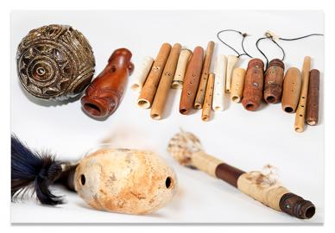
Cross-Curricular Learning
Primary Science Week 2020
Sounds of Aotearoa
Science of Sound
Mātauranga Māori
Technology
Music
© NZQA, CC BY 3.0 NZ
The tamariki were treated to a musical demonstration before having a go themselves. They experimented with making kōauau (a small flute), pūtātara (shell trumpet) and porotiti (disc spinner). This was an engaging and enriching experience, and it was fantastic to see them using their instruments around the school after working with Ariana Tikao and Sam Palmer.
© Copyright. Science Learning Hub – Pokapū Akoranga Pūtaiao The University of Waikato Te Whare Wananga o Waikato.
All Rights Reserved | www.sciencelearn.org.nz. All images are copyrighted. For further information, please refer to enquiries@sciencelearn.org.nz
Notes:
Can be either a short or long unit to support the science week kaupapa.
I focus my reading and writing around the kaupapa. For this unit it was a focus on instructions but could just as easily have been poetry, writing music or information reports.
Where possible I invite experts to support our learning and engage our students. I find Twitter a great place to find experts and often reach out to them this way to see if they are prepared to either zoom or come to kura.
Always follow up with thank you letters from the children.
Great link: https://otagomuseum.nz/athome/the-sounds-of-taoka-puoro
Image: https://www.nzqa.govt.nz/maori-and-pasifika/field-maori-assessment-support-materials/taonga-puoro/
Another option:https://en.wikipedia.org/wiki/K%C5%8Dauau#/media/File:Kooauau.png

Slide 14
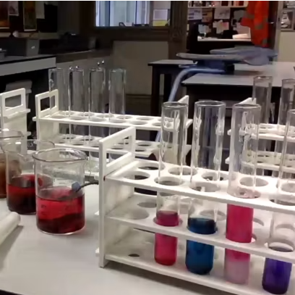
Teacher PLD
© Copyright. Science Learning Hub – Pokapū Akoranga Pūtaiao The University of Waikato Te Whare Wananga o Waikato.
All Rights Reserved | www.sciencelearn.org.nz. All images are copyrighted. For further information, please refer to enquiries@sciencelearn.org.nz

Slide 15
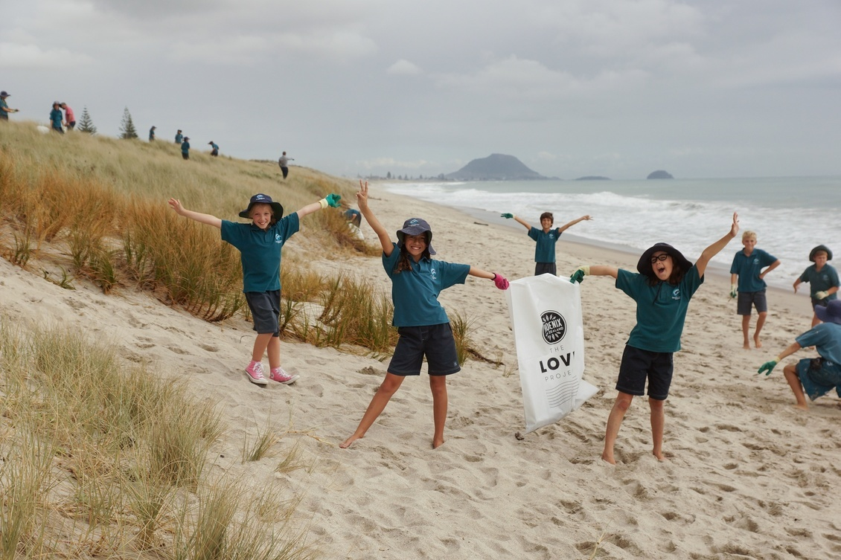
Community connection
Anne Ryan
Sustainable Coastlines, CC BY-NC 3.0 NZ
© Copyright. Science Learning Hub – Pokapū Akoranga Pūtaiao The University of Waikato Te Whare Wananga o Waikato.
All Rights Reserved | www.sciencelearn.org.nz. All images are copyrighted. For further information, please refer to enquiries@sciencelearn.org.nz

Slide 16
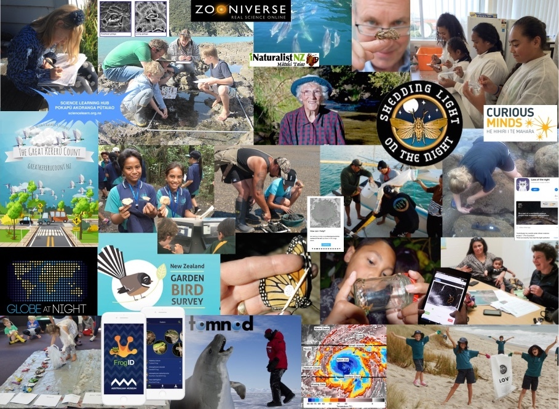
Invite the community in or go
out to the community
© University of Waikato
© Copyright. Science Learning Hub – Pokapū Akoranga Pūtaiao The University of Waikato Te Whare Wananga o Waikato.
All Rights Reserved | www.sciencelearn.org.nz. All images are copyrighted. For further information, please refer to enquiries@sciencelearn.org.nz

Slide 17
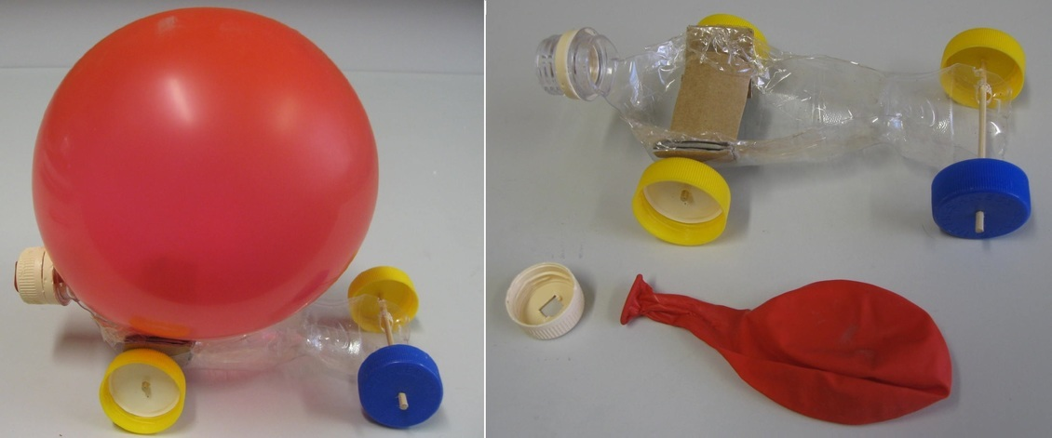
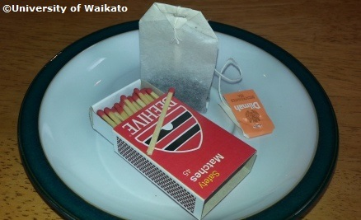
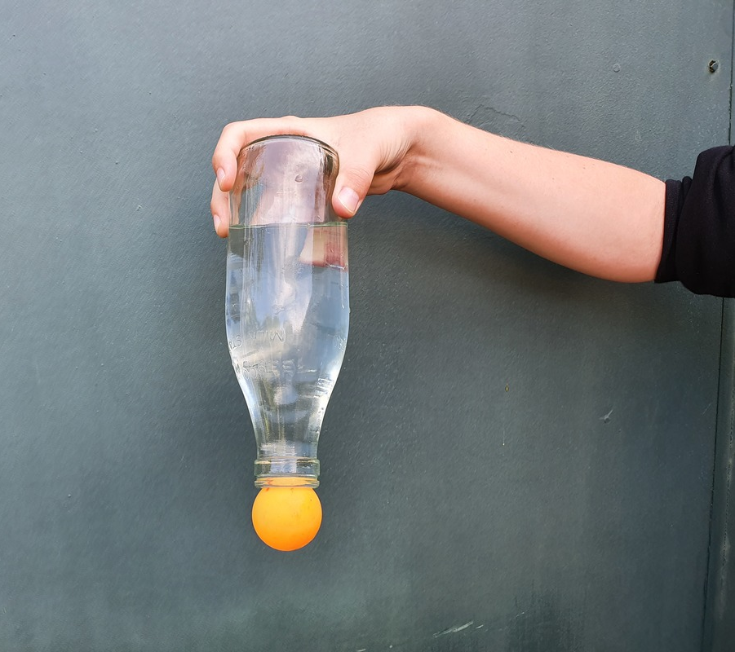
Showcase simple science ideas and discrepant events
https://huttscience.co.nz/home-experiments/
Indianapolis Public Library. Copyright © 2022
© Copyright. Science Learning Hub – Pokapū Akoranga Pūtaiao The University of Waikato Te Whare Wananga o Waikato.
All Rights Reserved | www.sciencelearn.org.nz. All images are copyrighted. For further information, please refer to enquiries@sciencelearn.org.nz
Notes:
Home Experiments » HuttScience

Slide 18
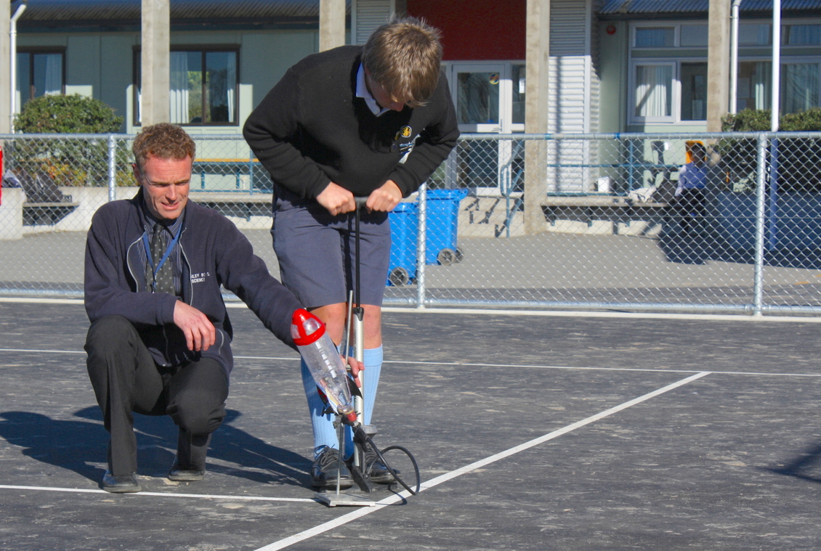
Rocket challenge
John Marsh
© Copyright. Science Learning Hub – Pokapū Akoranga Pūtaiao The University of Waikato Te Whare Wananga o Waikato.
All Rights Reserved | www.sciencelearn.org.nz. All images are copyrighted. For further information, please refer to enquiries@sciencelearn.org.nz
Notes:
https://www.sciencelearn.org.nz/images/3816-blast-off

Slide 19
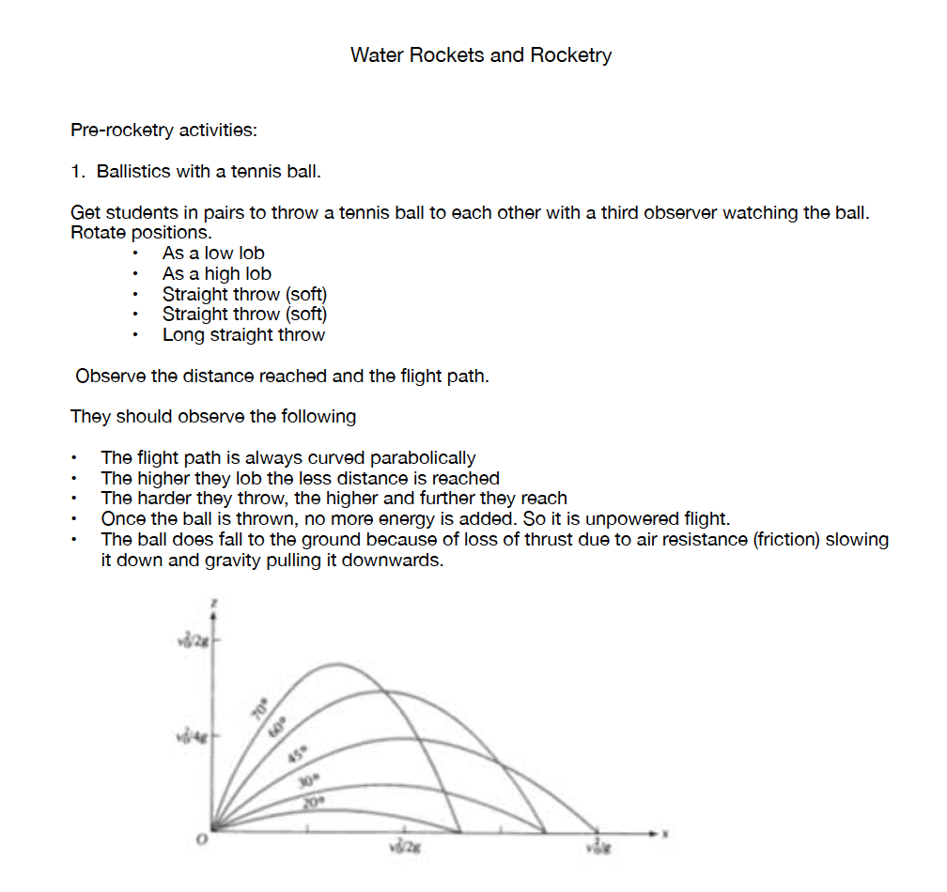
© John Marsh, Tauranga Intermediate School
© Copyright. Science Learning Hub – Pokapū Akoranga Pūtaiao The University of Waikato Te Whare Wananga o Waikato.
All Rights Reserved | www.sciencelearn.org.nz. All images are copyrighted. For further information, please refer to enquiries@sciencelearn.org.nz

Slide 20
© John Marsh, Tauranga Intermediate School
© Copyright. Science Learning Hub – Pokapū Akoranga Pūtaiao The University of Waikato Te Whare Wananga o Waikato.
All Rights Reserved | www.sciencelearn.org.nz. All images are copyrighted. For further information, please refer to enquiries@sciencelearn.org.nz

Slide 21
© John Marsh, Tauranga Intermediate School
© Copyright. Science Learning Hub – Pokapū Akoranga Pūtaiao The University of Waikato Te Whare Wananga o Waikato.
All Rights Reserved | www.sciencelearn.org.nz. All images are copyrighted. For further information, please refer to enquiries@sciencelearn.org.nz

Slide 22
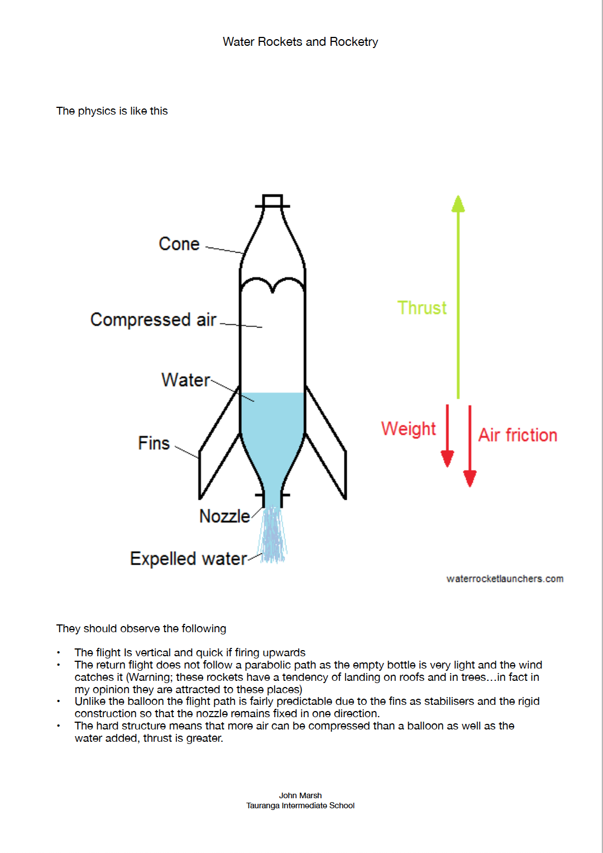
© John Marsh, Tauranga Intermediate School
© Copyright. Science Learning Hub – Pokapū Akoranga Pūtaiao The University of Waikato Te Whare Wananga o Waikato.
All Rights Reserved | www.sciencelearn.org.nz. All images are copyrighted. For further information, please refer to enquiries@sciencelearn.org.nz

Slide 23
© John Marsh, Tauranga Intermediate School
© Copyright. Science Learning Hub – Pokapū Akoranga Pūtaiao The University of Waikato Te Whare Wananga o Waikato.
All Rights Reserved | www.sciencelearn.org.nz. All images are copyrighted. For further information, please refer to enquiries@sciencelearn.org.nz

Slide 24
Safety and science week
https://scienceonline.tki.org.nz/Teaching-science/Science-equipment/Planning-for-science-programmes
You need to be familiar with this document available on TKI.
Page 45 has a section: How do we keep visitors/manuhiri safe during open days or nights?
The following activities include some that would be suitable for demonstration only.
Please be familiar with the Safe Method of Use (SMU) before doing any activity.
© Crown Copyright
© Copyright. Science Learning Hub – Pokapū Akoranga Pūtaiao The University of Waikato Te Whare Wananga o Waikato.
All Rights Reserved | www.sciencelearn.org.nz. All images are copyrighted. For further information, please refer to enquiries@sciencelearn.org.nz
Notes:
https://scienceonline.tki.org.nz/Teaching-science/Science-equipment/Planning-for-science-programmes Editorial fair use

Slide 25
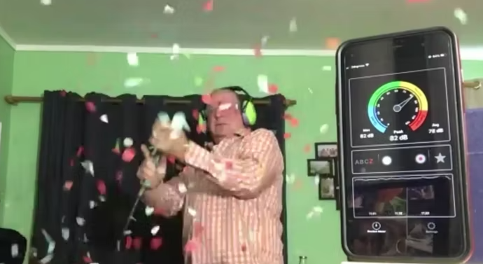
Engagement
Sterling Cathman
© Sterling Cathman
© Copyright. Science Learning Hub – Pokapū Akoranga Pūtaiao The University of Waikato Te Whare Wananga o Waikato.
All Rights Reserved | www.sciencelearn.org.nz. All images are copyrighted. For further information, please refer to enquiries@sciencelearn.org.nz
Notes:
Image still from: https://www.sciencelearn.org.nz/resources/2919-sounds-of-aotearoa

Slide 26
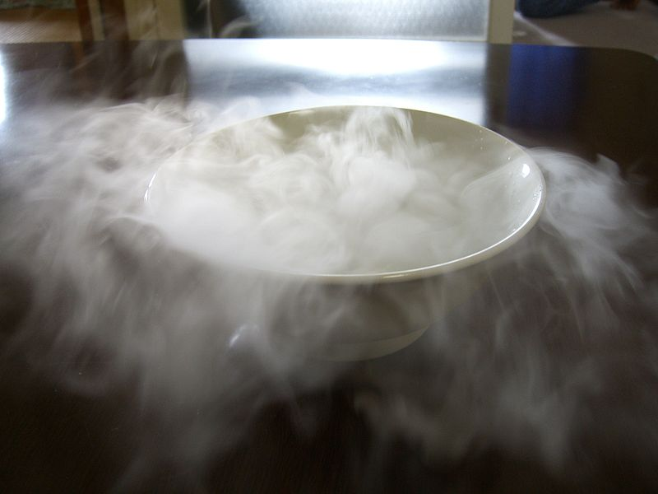
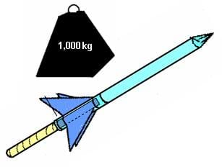
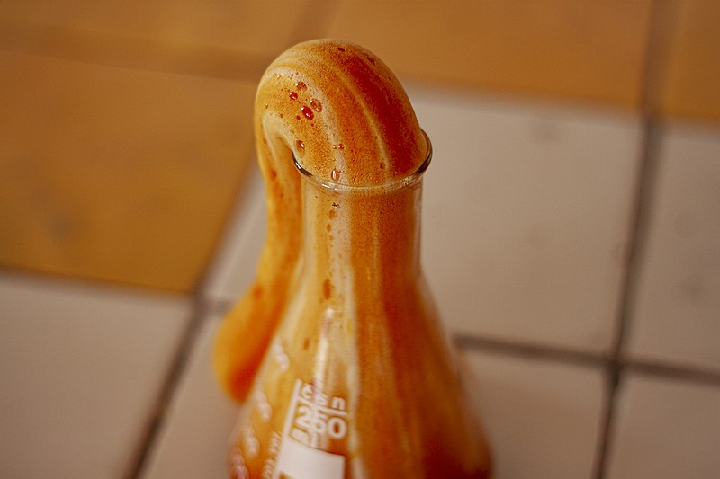
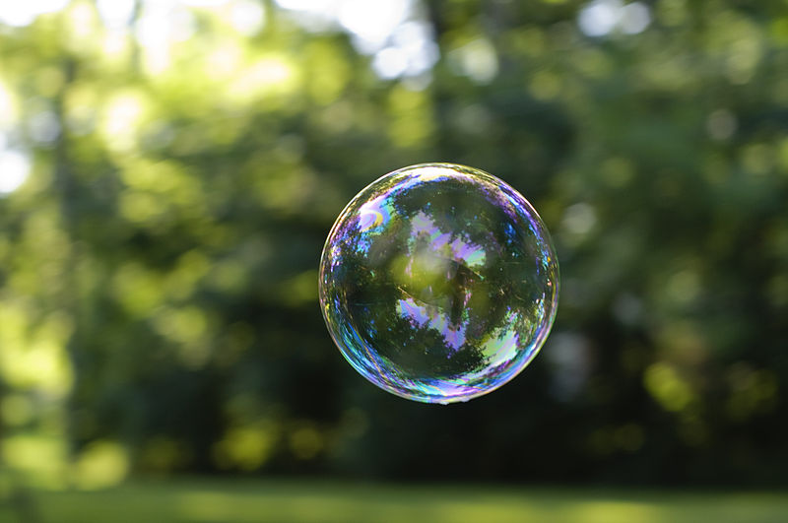
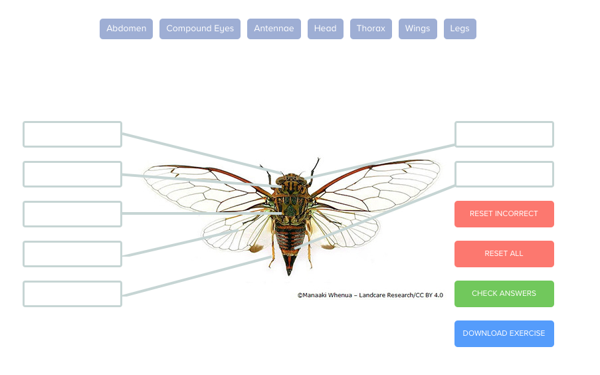
High engagement activities
Dry ice
Slimes
Straw rockets
Elephant’s toothpaste
Bubbles
Insect vs spider
© Copyright. Science Learning Hub – Pokapū Akoranga Pūtaiao The University of Waikato Te Whare Wananga o Waikato.
All Rights Reserved | www.sciencelearn.org.nz. All images are copyrighted. For further information, please refer to enquiries@sciencelearn.org.nz
Notes:
Image links in following slides

Slide 27
Dry Ice
Changing states of matter
Solid, liquid, gas
Delivered from BOC Gas
DANGER!!
Sarathtly
© Copyright. Science Learning Hub – Pokapū Akoranga Pūtaiao The University of Waikato Te Whare Wananga o Waikato.
All Rights Reserved | www.sciencelearn.org.nz. All images are copyrighted. For further information, please refer to enquiries@sciencelearn.org.nz
Notes:
Link to CC replacement image: https://commons.wikimedia.org/wiki/File:DryIceSublimation.JPG

Slide 28
Slimes
PVA
Guar gum
Borax
Messy!
© The University of Waikato Te Whare Wānanga o Waikato
© Copyright. Science Learning Hub – Pokapū Akoranga Pūtaiao The University of Waikato Te Whare Wananga o Waikato.
All Rights Reserved | www.sciencelearn.org.nz. All images are copyrighted. For further information, please refer to enquiries@sciencelearn.org.nz
Notes:
https://www.sciencelearn.org.nz/images/4834-hands-on-science

Slide 29
Straw rockets
Paper straws
Playdough
Targets
© Copyright. Science Learning Hub – Pokapū Akoranga Pūtaiao The University of Waikato Te Whare Wananga o Waikato.
All Rights Reserved | www.sciencelearn.org.nz. All images are copyrighted. For further information, please refer to enquiries@sciencelearn.org.nz
Notes:
https://www.teachengineering.org/policies/termsofuse
https://www.teachengineering.org/activities/view/cub_rockets_lesson03_activity2

Slide 30
Elephant’s toothpaste
Hydrogen peroxide
Yeast
DANGER!
© Copyright. Science Learning Hub – Pokapū Akoranga Pūtaiao The University of Waikato Te Whare Wananga o Waikato.
All Rights Reserved | www.sciencelearn.org.nz. All images are copyrighted. For further information, please refer to enquiries@sciencelearn.org.nz
Notes:
https://commons.wikimedia.org/wiki/File:Химический_опыт_МНОГО_ПЕНЫ_ИЗ_НИЧЕГО_part_VIII.jpg
https://sciencenotes.org/elephant-toothpaste-two-ways-to-make-it/

Slide 31
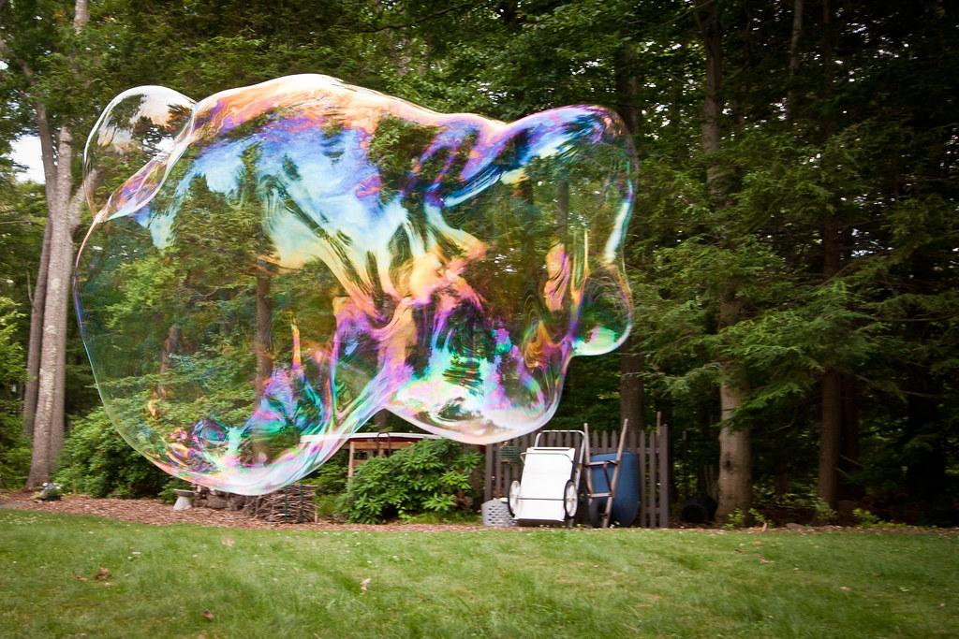
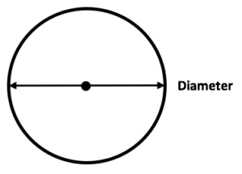
Bubbles
Floating
Bouncing
Table
Diameter
Monster
Fire
Serge Melki, CC-BY-2.0,
Andrew Malone, CC-BY-2.0,
© Copyright. Science Learning Hub – Pokapū Akoranga Pūtaiao The University of Waikato Te Whare Wananga o Waikato.
All Rights Reserved | www.sciencelearn.org.nz. All images are copyrighted. For further information, please refer to enquiries@sciencelearn.org.nz
Notes:
https://commons.wikimedia.org/wiki/File:First_Time_Bubble_(4718544475).jpg
https://www.flickr.com/photos/andrewmalone/5175463609
Booth CC BY 2.0

Slide 32
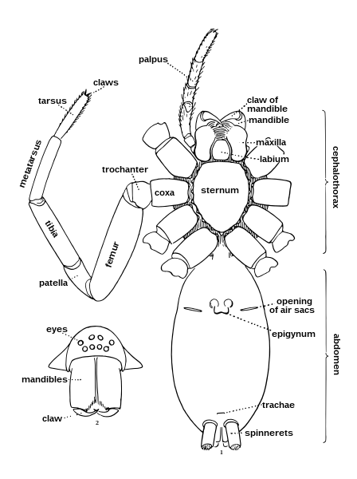
Insect v spider
Catch and release
© Copyright. Science Learning Hub – Pokapū Akoranga Pūtaiao The University of Waikato Te Whare Wananga o Waikato.
All Rights Reserved | www.sciencelearn.org.nz. All images are copyrighted. For further information, please refer to enquiries@sciencelearn.org.nz
Notes:
https://www.sciencelearn.org.nz/labelling_interactives/9-label-the-cicada
https://commons.wikimedia.org/wiki/File:Spider_external_anatomy.svg (Public domain)

Slide 33
Thanks – want to keep in touch?
Email us on enquiries@sciencelearn.org.nz
https://twitter.com/NZScienceLearn
www.facebook.com/nzsciencelearn
https://nz.pinterest.com/nzsciencelearn
www.instagram.com/sciencelearninghubnz
Join us in our discussion channel on Slack (http://slh-talk.slack.com).
(Any problems accessing Slack, please contact us via our enquiries email, enquiries@sciencelearn.org.nz.)

