Slide 1
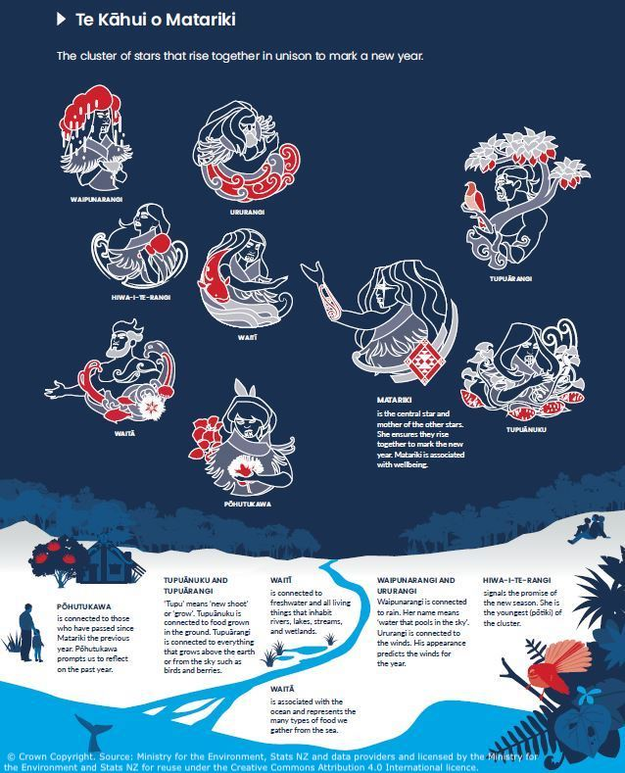
Te Kāhui o Matariki
and the environment
© Copyright. Science Learning Hub – Pokapū Akoranga Pūtaiao The University of Waikato Te Whare Wananga o Waikato.
All Rights Reserved | www.sciencelearn.org.nz. All images are copyrighted. For further information, please refer to enquiries@sciencelearn.org.nz
Notes:
https://www.sciencelearn.org.nz/images/4840-te-kahui-o-matariki

Slide 2
Index
Topic | Slideshow number(s) | Video timecode
Introducing the video and the Science Learning Hub presenters | 1 | 00:00
Index | 2 | 00:50
About the Science Learning Hub | 3 | 1:29
Purpose | 4 | 2:01
About the Environment Aotearoa 2022 report | 5 | 3:25
Whetū and their domains | 6 | 4:50
Mātauranga Māori and science | 7 | 6:22
Mauri, wellbeing and sustainability | 8 | 7:26
Looking at the resources | 9–11 | 8:31
Cross-curricular learning activities | 12–13 | 13:36
Local curriculum | 14 | 16:06
SLH links, keep in touch and thanks | 15 | 18:38
© Copyright. Science Learning Hub – Pokapū Akoranga Pūtaiao The University of Waikato Te Whare Wananga o Waikato.
All Rights Reserved | www.sciencelearn.org.nz. All images are copyrighted. For further information, please refer to enquiries@sciencelearn.org.nz

Slide 3

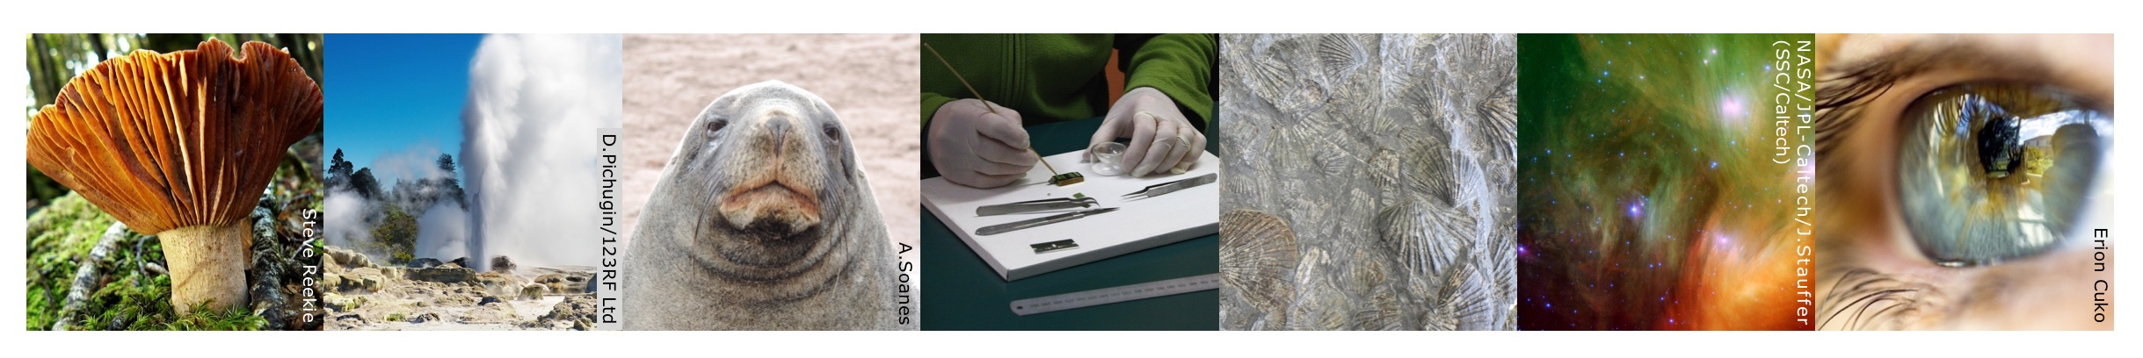
The Science Learning Hub
A trustworthy online resource – produced by educators and scientists
Based on world-class New Zealand science research
Supported by learning activities, information about the key science ideas and concepts, multimedia tools and other resources
Written for New Zealand teachers and students
Notes:
The Science Learning Hub is funded by the New Zealand government – MBIE Ministry of Business, Innovation and Employment – under the Curious Minds fund

Slide 4
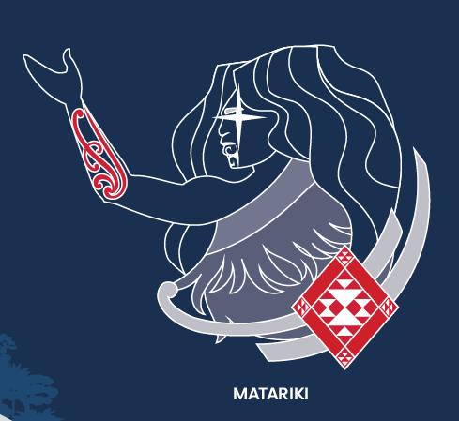
Purpose
To use Te Kāhui o Matariki as a framework for identifying:
environmental challenges
impacts on wellbeing
opportunities to take action.
To provide ideas on how to use the resources to support science and cross-curricular learning.
Rights: © Crown Copyright
© Copyright. Science Learning Hub – Pokapū Akoranga Pūtaiao The University of Waikato Te Whare Wananga o Waikato.
All Rights Reserved | www.sciencelearn.org.nz. All images are copyrighted. For further information, please refer to enquiries@sciencelearn.org.nz

Slide 5
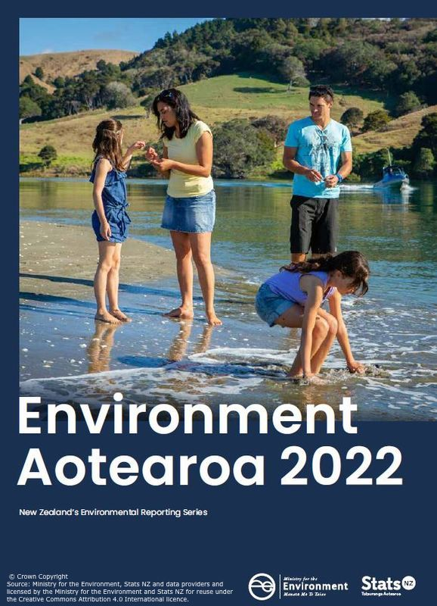
About Environment Aotearoa 2022
The report combines:
qualitative data
mātauranga Māori
scientific literature.
Interweaving different knowledge systems presents a richer and more relevant picture of the whole environment and the connections with people.
© Copyright. Science Learning Hub – Pokapū Akoranga Pūtaiao The University of Waikato Te Whare Wananga o Waikato.
All Rights Reserved | www.sciencelearn.org.nz. All images are copyrighted. For further information, please refer to enquiries@sciencelearn.org.nz
Notes:
https://www.sciencelearn.org.nz/images/4839-environment-aotearoa-2022-report-cover

Slide 6
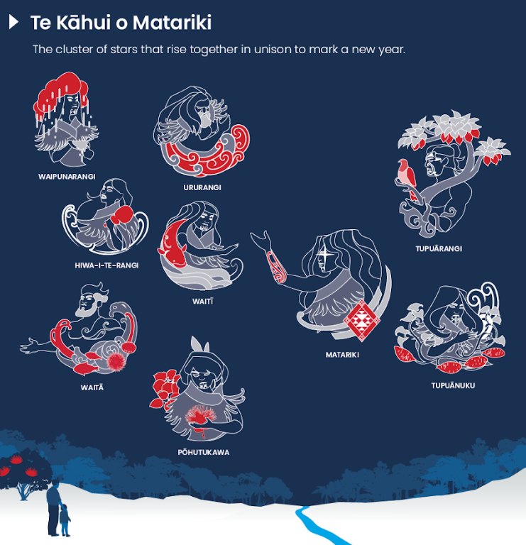
Whetū and their domains
Matariki – wellbeing
Pōhutukawa – pressures and loss
Tupuānuku – land and soil
Tupuārangi – land-based ecosystems
Waitī – freshwater environments
Waitā – marine conditions
Waipunarangi – rain and climate
Ururangi – winds and air quality
Hiwa-i-te-rangi – aspirations and action
Source: Ministry for the Environment. Licensed by the Ministry for the Environment and Stats NZ for reuse under the Creative Commons Attribution 4.0 International licence. © Crown Copyright.
© Copyright. Science Learning Hub – Pokapū Akoranga Pūtaiao The University of Waikato Te Whare Wananga o Waikato.
All Rights Reserved | www.sciencelearn.org.nz. All images are copyrighted. For further information, please refer to enquiries@sciencelearn.org.nz

Slide 7
Mātauranga Māori and science
“Mātauranga Māori and science are independent views of te taiao and use different methodologies to progressively add observations and knowledge over generations. Their relationship has been likened to a braided river with channels that cross and uncross on the journey downstream. When the ‘channels cross’ there is an opportunity for these knowledge systems to come together and provide new ways of thinking and alternate pathways to explore.”
Our Atmosphere and Climate 2020
Notes:
How can you weave this into your classroom? Beyond the report.
https://www.sciencelearn.org.nz/resources/2963-our-atmosphere-and-climate-introduction

Slide 8
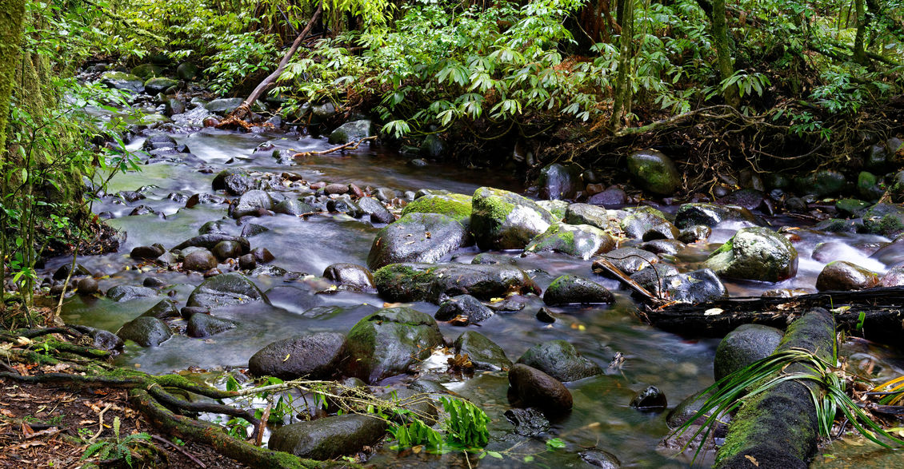
Mauri, wellbeing and sustainability
In te ao Māori, Matariki and wellbeing are closely connected with mauri – the health and vitality of living systems.
Mauri is often used by scientists to describe the state and sustainability of a particular environment.
Rights: Tristan Brynildsen
Notes:
https://www.sciencelearn.org.nz/images/4255-pirongia-forest-stream

Slide 9
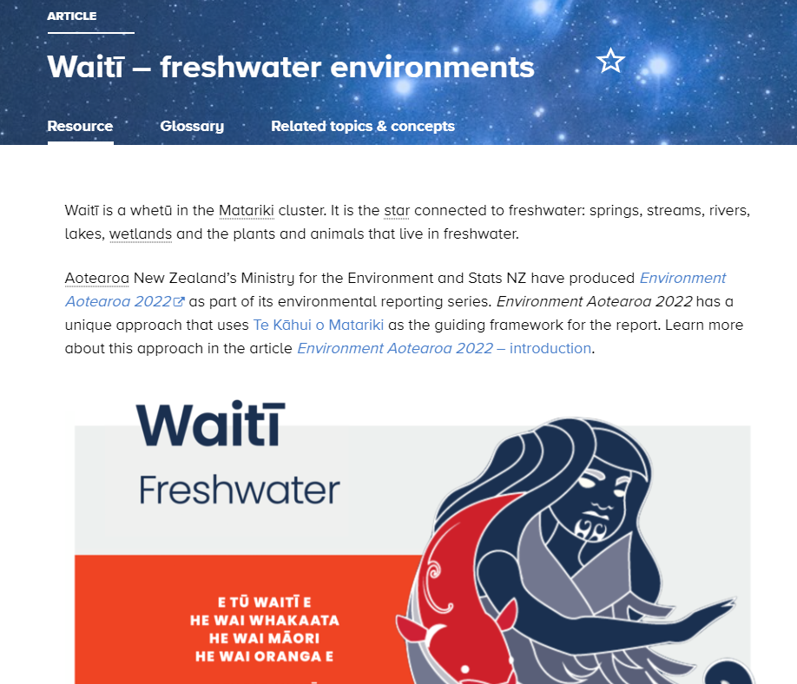
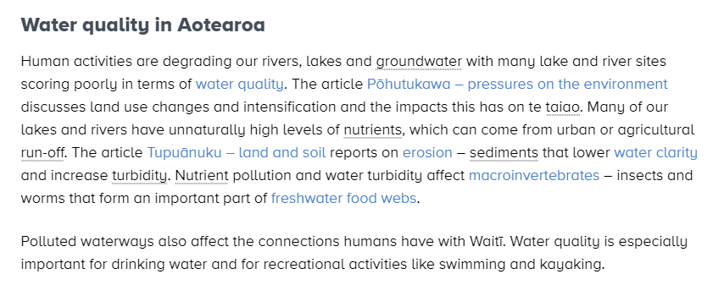
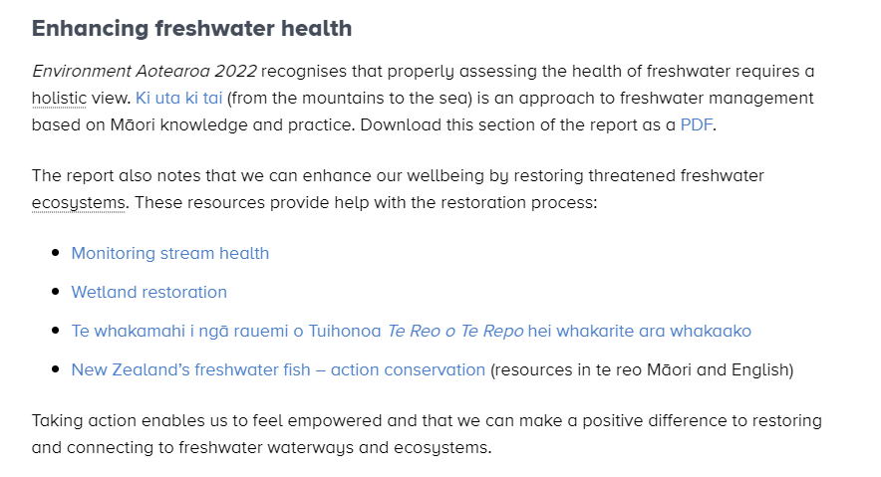
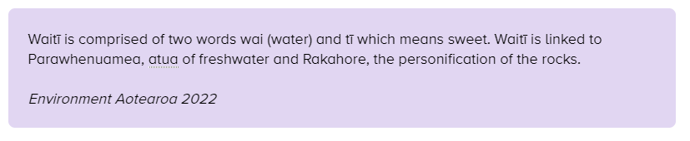
The articles: components
Source: Ministry for the Environment, Stats NZ and data providers. Licensed by the Ministry for the Environment and Stats NZ for reuse under the Creative Commons Attribution 4.0 International licence. © Crown Copyright.
© Copyright. Science Learning Hub – Pokapū Akoranga Pūtaiao The University of Waikato Te Whare Wananga o Waikato.
All Rights Reserved | www.sciencelearn.org.nz. All images are copyrighted. For further information, please refer to enquiries@sciencelearn.org.nz
Notes:
https://www.sciencelearn.org.nz/resources/3124-waiti-freshwater-environments

Slide 10
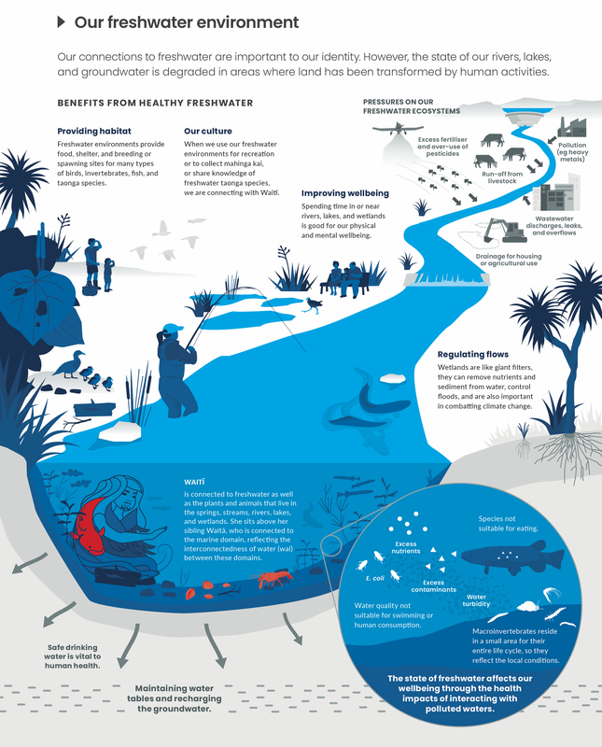
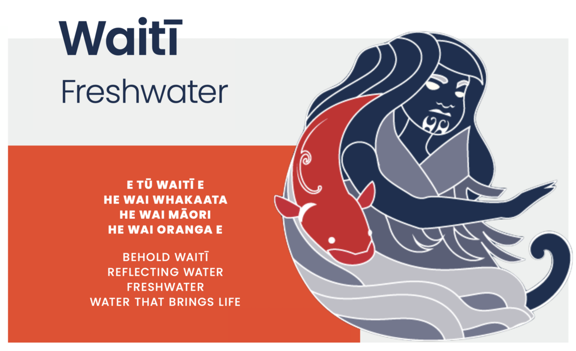
Images and infographics
Source: Ministry for the Environment, Stats NZ and data providers. Licensed by the Ministry for the Environment and Stats NZ for reuse under the Creative Commons Attribution 4.0 International licence. © Crown Copyright.
© Copyright. Science Learning Hub – Pokapū Akoranga Pūtaiao The University of Waikato Te Whare Wananga o Waikato.
All Rights Reserved | www.sciencelearn.org.nz. All images are copyrighted. For further information, please refer to enquiries@sciencelearn.org.nz
Notes:
https://www.sciencelearn.org.nz/images/4859-waiti-reflecting-on-our-freshwater-environment
https://www.sciencelearn.org.nz/images/4858-waiti

Slide 11
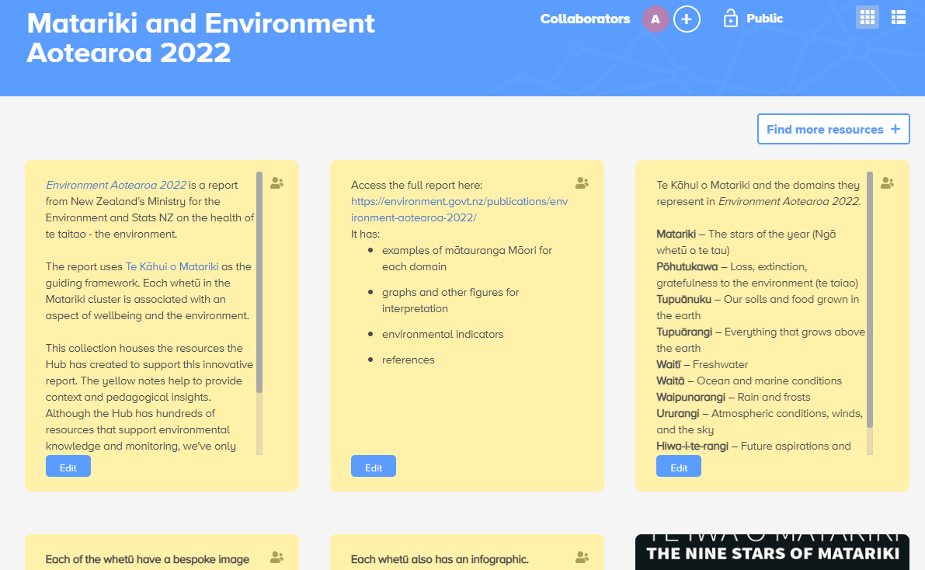
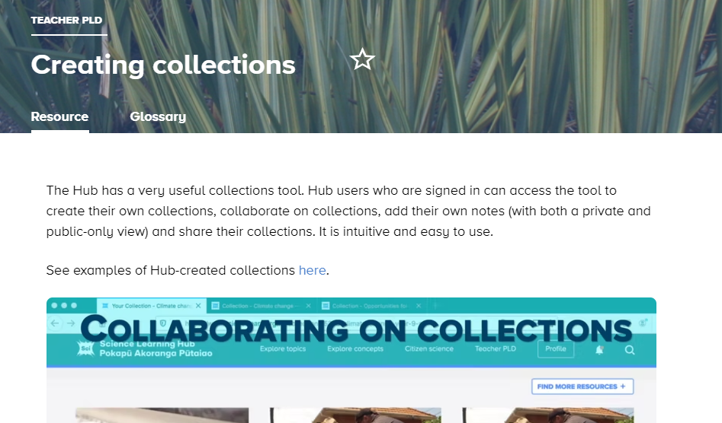
Using Te Kāhui o Matariki resources in
the classroom
Public collection
all resources in one place
pedagogical notes
related resources to deepen understanding.
© Copyright. Science Learning Hub – Pokapū Akoranga Pūtaiao The University of Waikato Te Whare Wananga o Waikato.
All Rights Reserved | www.sciencelearn.org.nz. All images are copyrighted. For further information, please refer to enquiries@sciencelearn.org.nz
Notes:
https://www.sciencelearn.org.nz/collections/8092-matariki-and-environment-aotearoa-2022
https://www.sciencelearn.org.nz/resources/2762-creating-collections

Slide 12
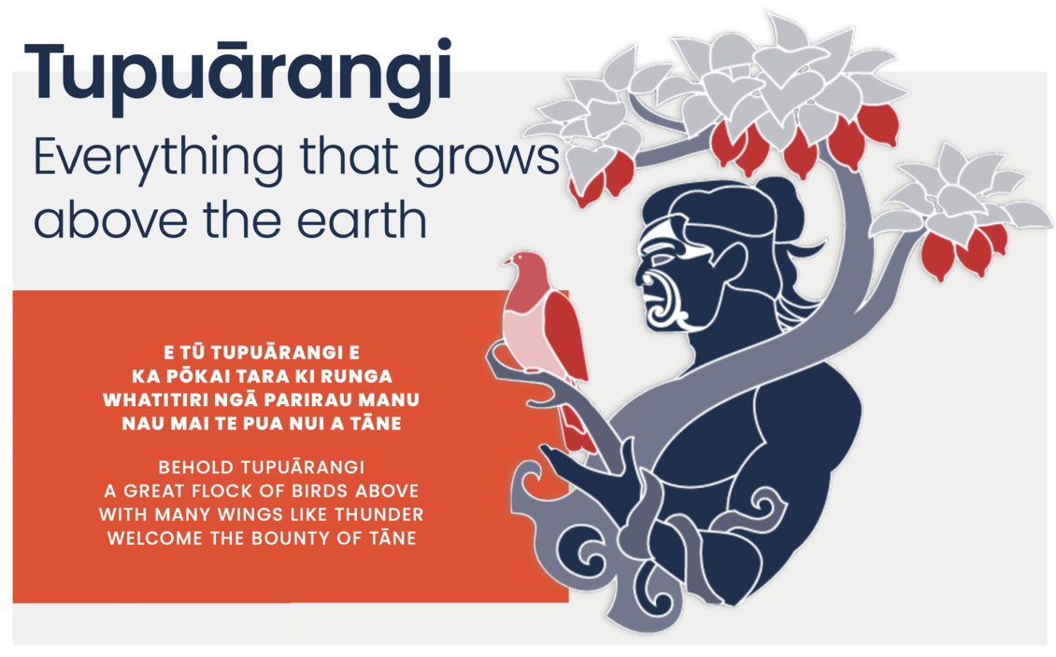
Cross-curricular learning activity:
Exploring the images and whakataukī connecting to Te Kāhui o Matariki
Explore written and visual literacies.
Create your own.
Source: Ministry for the Environment. Licensed by the Ministry for the Environment and Stats NZ for reuse under the Creative Commons Attribution 4.0 International licence. © Crown Copyright.
© Copyright. Science Learning Hub – Pokapū Akoranga Pūtaiao The University of Waikato Te Whare Wananga o Waikato.
All Rights Reserved | www.sciencelearn.org.nz. All images are copyrighted. For further information, please refer to enquiries@sciencelearn.org.nz
Notes:
https://www.sciencelearn.org.nz/images/4857-tupuarangi
https://www.sciencelearn.org.nz/images/4858-waiti

Slide 13
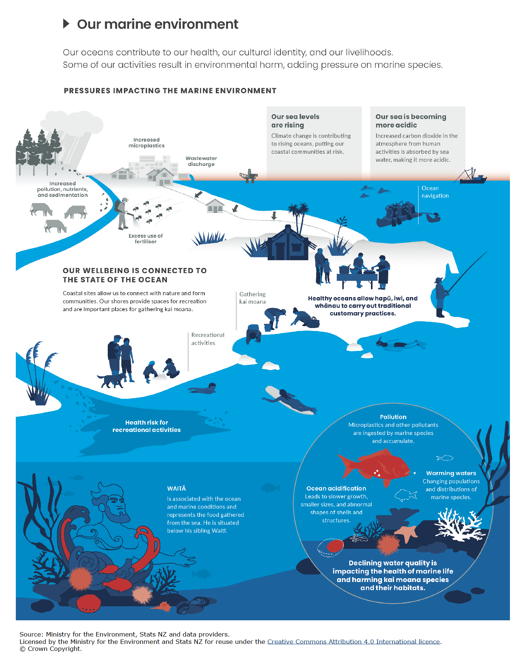
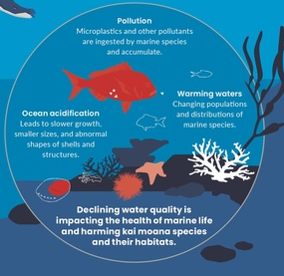
Interpret representations:
Te Kāhui o Matariki – interpreting infographics
Explore:
purpose
visual components
literacy components
framework to create your own
© Copyright. Science Learning Hub – Pokapū Akoranga Pūtaiao The University of Waikato Te Whare Wananga o Waikato.
All Rights Reserved | www.sciencelearn.org.nz. All images are copyrighted. For further information, please refer to enquiries@sciencelearn.org.nz
Notes:
https://www.sciencelearn.org.nz/images/4862-waita-and-our-marine-environment

Slide 14
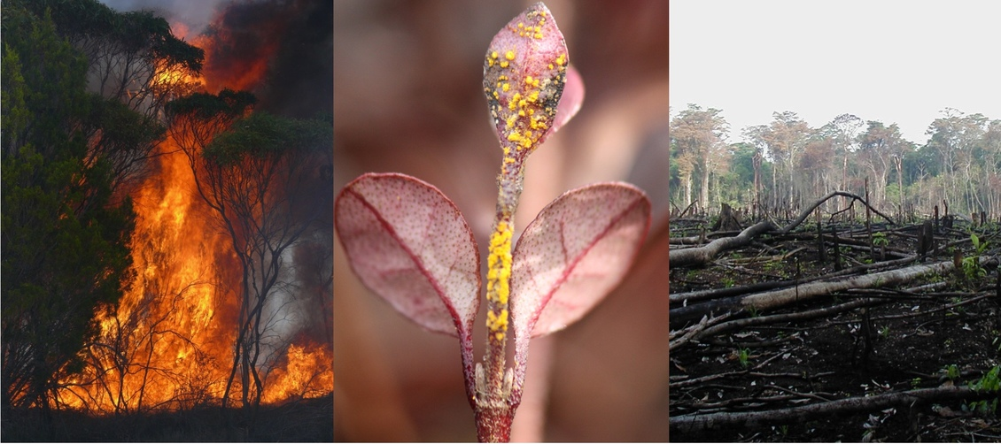
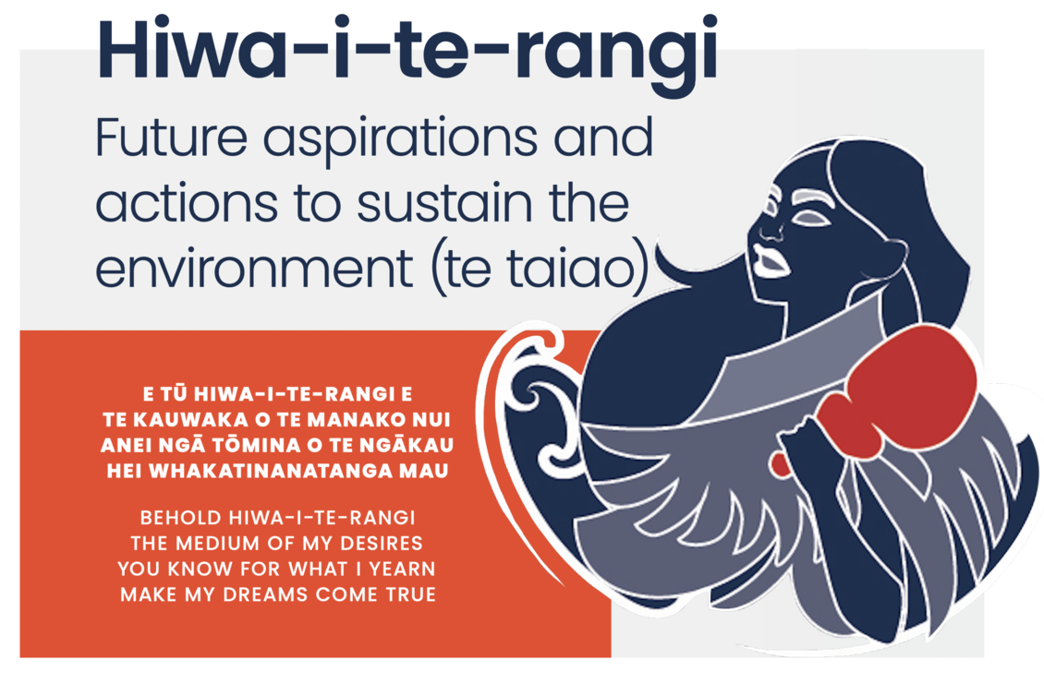
Local curriculum
Reporting on the state of te taiao can feel grim.
Build hope.
Wildfire image © Scion. Myrtle rust image © Ministry for Primary Industries/CC BY 4.0.
choose a domain of interest to your students
consider local mātauranga
consider opportunities to take action
Source: Ministry for the Environment. Licensed by the Ministry for the Environment and Stats NZ for reuse under the Creative Commons Attribution 4.0 International licence. © Crown Copyright.
© Copyright. Science Learning Hub – Pokapū Akoranga Pūtaiao The University of Waikato Te Whare Wananga o Waikato.
All Rights Reserved | www.sciencelearn.org.nz. All images are copyrighted. For further information, please refer to enquiries@sciencelearn.org.nz
Notes:
https://www.sciencelearn.org.nz/images/3846-threats-and-diseases
https://www.sciencelearn.org.nz/videos/2102-local-curriculum-matauranga-and-science

Slide 15





Thanks – want to keep in touch?
Email us on enquiries@sciencelearn.org.nz
https://twitter.com/NZScienceLearn
www.facebook.com/nzsciencelearn
https://nz.pinterest.com/nzsciencelearn
www.instagram.com/sciencelearninghubnz
Join us in our discussion channel on Slack (http://slh-talk.slack.com).
(Any problems accessing Slack, please contact us via our enquiries email, enquiries@sciencelearn.org.nz.)

