Slide 1
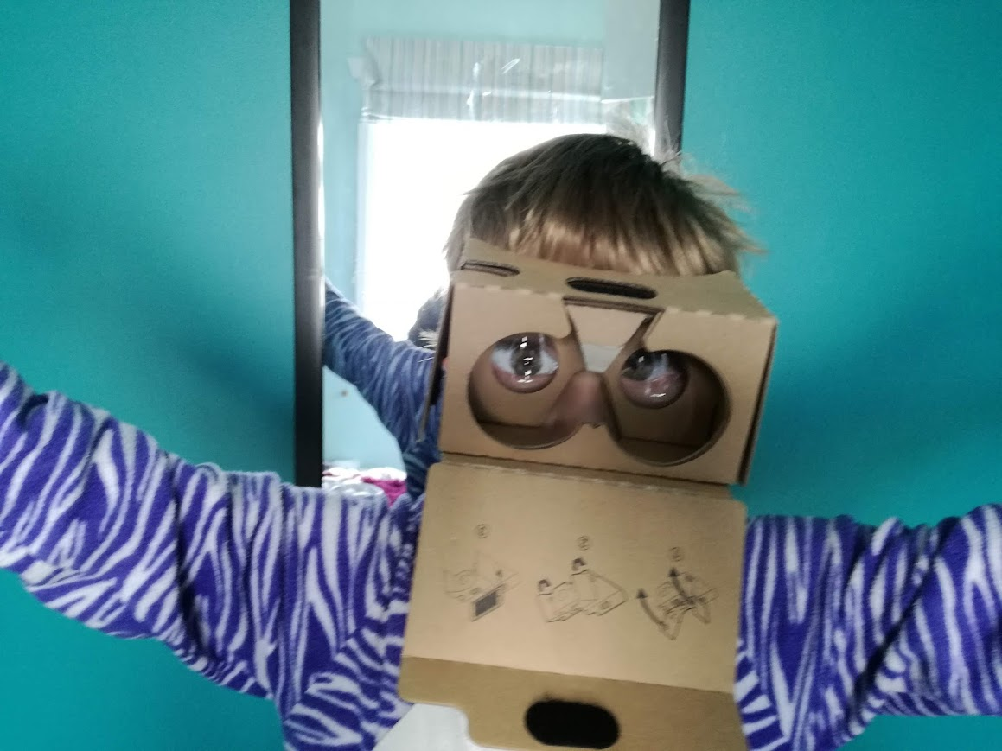
Understanding science through drama
© V.Bootham
4–4:40 pm Thursday 8 September
© Copyright. Science Learning Hub – Pokapū Akoranga Pūtaiao The University of Waikato Te Whare Wananga o Waikato.
All Rights Reserved | www.sciencelearn.org.nz. All images are copyrighted. For further information, please refer to enquiries@sciencelearn.org.nz
Notes:
Image: https://www.sciencelearn.org.nz/images/5007-science-and-drama

Slide 2
Index
Topic | Slideshow numbers | Video timecode
Introduction and index | 1–2 | 00:00
Introducing the Science Learning Hub and presenters | 3–4 | 00:15
Overview | 5 | 02:14
The value of drama in science teaching | 6–8 | 02:32
How can we use drama in science? | 9 | 17:15
Types of drama | 10–12 | 21:22
Eels of ANZAC Bridge | 13–20 | 25:16
Curriculum level ideas | 21 | 39:34
SLH links, keep in touch and thanks | 22–24 | 43:04
© Copyright. The University of Waikato Te Whare Wananga o Waikato l Science Learning Hub – Pokapū Akoranga Pūtaiao. All Rights Reserved
All images are copyrighted. For further information, please refer to enquiries@sciencelearn.org.nz.

Slide 3
Pokapū Akoranga Pūtaiao
A trustworthy online resource – produced by educators and scientists
Based on world-class New Zealand science research
Supported by learning activities, information about the key science ideas and concepts, multimedia tools and other resources
Written for New Zealand teachers and students
Notes:
The Science Learning Hub is funded by the New Zealand government – Ministry of Business, Innovation and Employment (MBIE) – under the Curious Minds fund.

Slide 4
Dr Carrie Swanson
Medical Laboratory Scientist (Microbiology)
Primary Teacher
Initial Teacher Education AUT
Fields of interest: Primary Science, Dramatic inquiry (Mantle of the Expert), integrated curriculum
Involved with the Dramatic Inquiry Network of Expertise
© C.Swanson

Slide 5
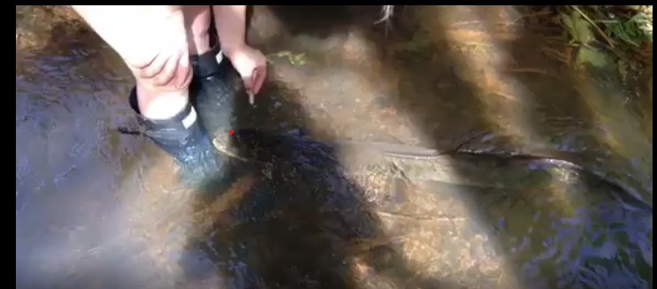
Overview
Why use drama in science?
How is it used?
Using the Eels of ANZAC Bridge as a provocation for a process drama in science.
© C.Swanson

Slide 6
What’s drama got to do
with science?
“Science and drama are natural bedfellows in education … both ‘are ways that we experience and make sense of the world’… Both have their roots in … curiosity [and] … play”
(O’Toole, 2021).
© V.Bootham
© Copyright. Science Learning Hub – Pokapū Akoranga Pūtaiao The University of Waikato Te Whare Wananga o Waikato.
All Rights Reserved | www.sciencelearn.org.nz. All images are copyrighted. For further information, please refer to enquiries@sciencelearn.org.nz
Notes:
Image: www.sciencelearn.org.nz/images/5007-science-and-drama

Slide 7
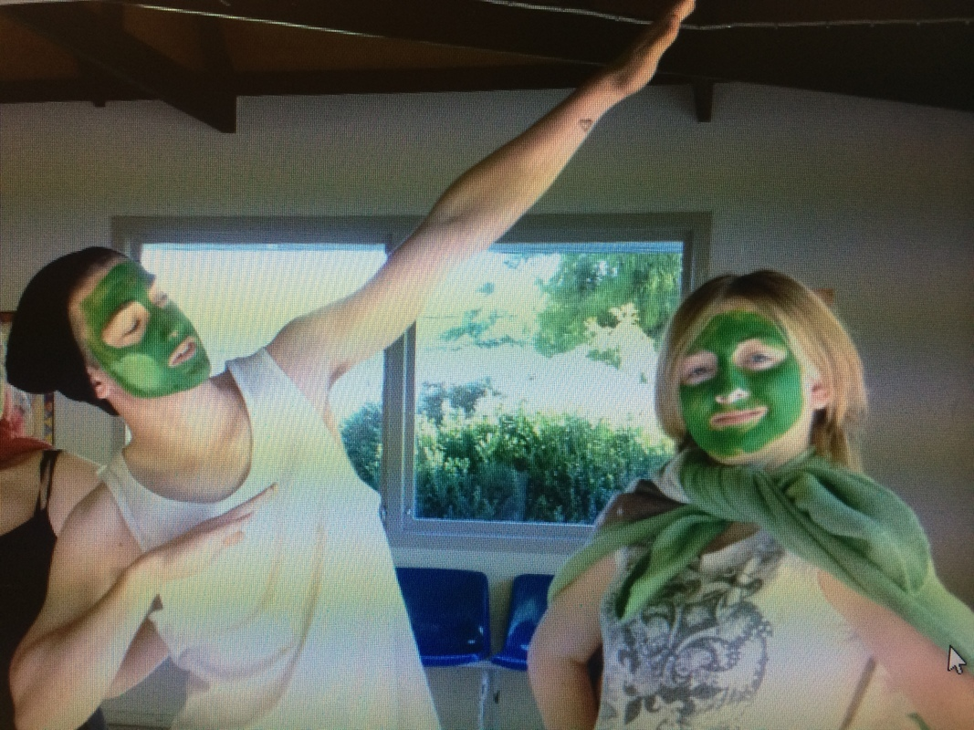
The value of using dramatic pedagogical approaches in science
Enjoyable
Embodied
Experiential learning
Ethical
Enlarges the learning space
Endorsed by Ministry of Education
Enhances understanding of science concepts, the Nature of Science, and science in society (McGregor et al., 2019; Swanson, 2016, 2019a).
© Andrea Soanes
© Copyright. Science Learning Hub – Pokapū Akoranga Pūtaiao The University of Waikato Te Whare Wananga o Waikato.
All Rights Reserved | www.sciencelearn.org.nz. All images are copyrighted. For further information, please refer to enquiries@sciencelearn.org.nz
Notes:
Image: www.sciencelearn.org.nz/images/4269-deciding-on-action

Slide 8
Why integrate science and drama?
Ideal for making connections across the learning areas – Future Focused Learning.
Useful means of integrated other curricular areas.
Enhances authenticity and possible connections to te ao Māori.
Curricular integration in STEM/STEAM is endorsed by MOE https://elearning.tki.org.nz/Teaching/Future-focused-learning/STEM-STEAM.
Theatre performances plays
Physical simulations
Role play
Variety of dramatic approaches
© Copyright. Science Learning Hub – Pokapū Akoranga Pūtaiao The University of Waikato Te Whare Wananga o Waikato.
All Rights Reserved | www.sciencelearn.org.nz. All images are copyrighted. For further information, please refer to enquiries@sciencelearn.org.nz

Slide 9
How can drama be used?
Theatre performances plays
Physical simulations
Role play
Variety of dramatic approaches
Dramatic role conventions such as
Teacher in role
Freeze frames
Role on the wall
Mapping
Conscious alley
© Copyright. Science Learning Hub – Pokapū Akoranga Pūtaiao The University of Waikato Te Whare Wananga o Waikato.
All Rights Reserved | www.sciencelearn.org.nz. All images are copyrighted. For further information, please refer to enquiries@sciencelearn.org.nz

Slide 10
Theatre performances in science
Watching theatre
Participating actively in theatre
Scripted science plays
Writing their own plays
Used to engage students, impart knowledge, construct knowledge and assess knowledge.
www.sciencelearn.org.nz/resources/191-drama-with-microbes

Slide 11
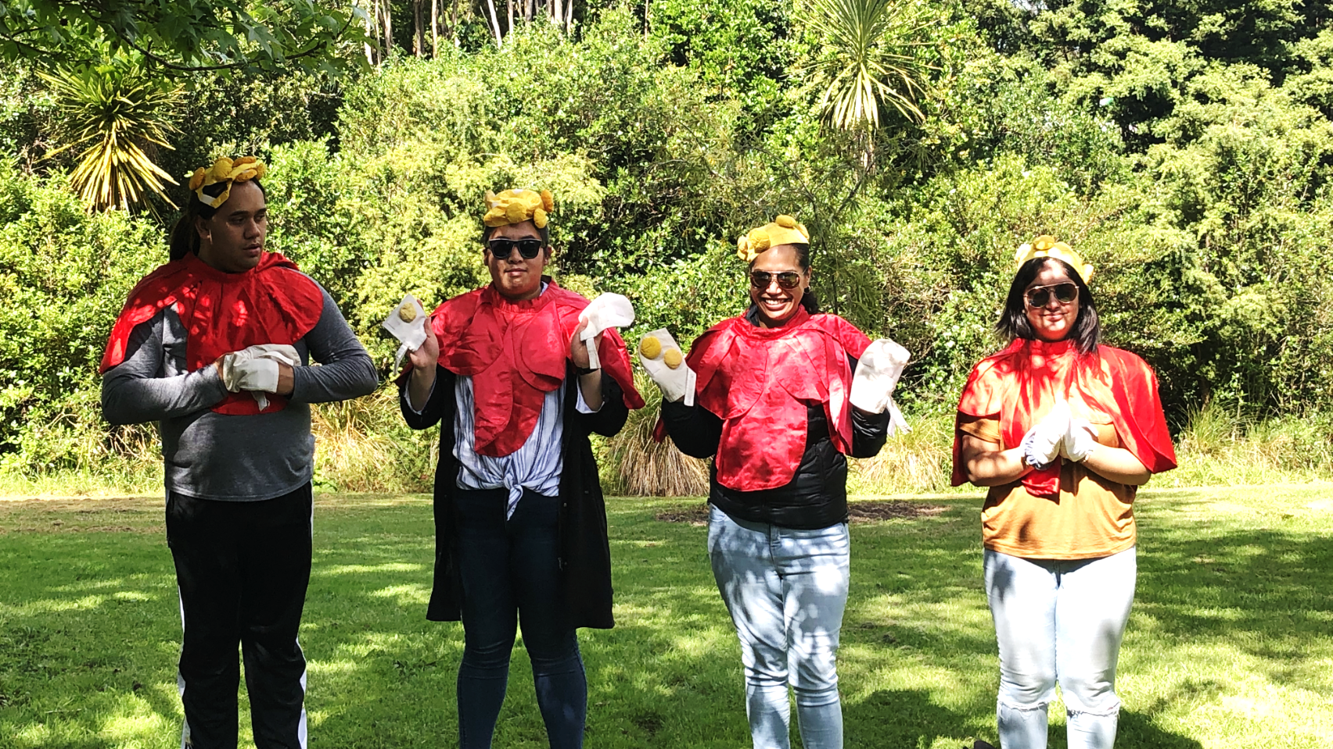
What types of drama can be used in science?
Physical simulations
Embodying the learning
Multimodal
Simulations – students simulating an aspect of science – for example, pollination.
www.sciencelearn.org.nz/resources/774-drama-in-the-microworld
www.sciencelearn.org.nz/resources/108-seed-dispersal-puppet-play
© Swanson, 2020

Slide 12
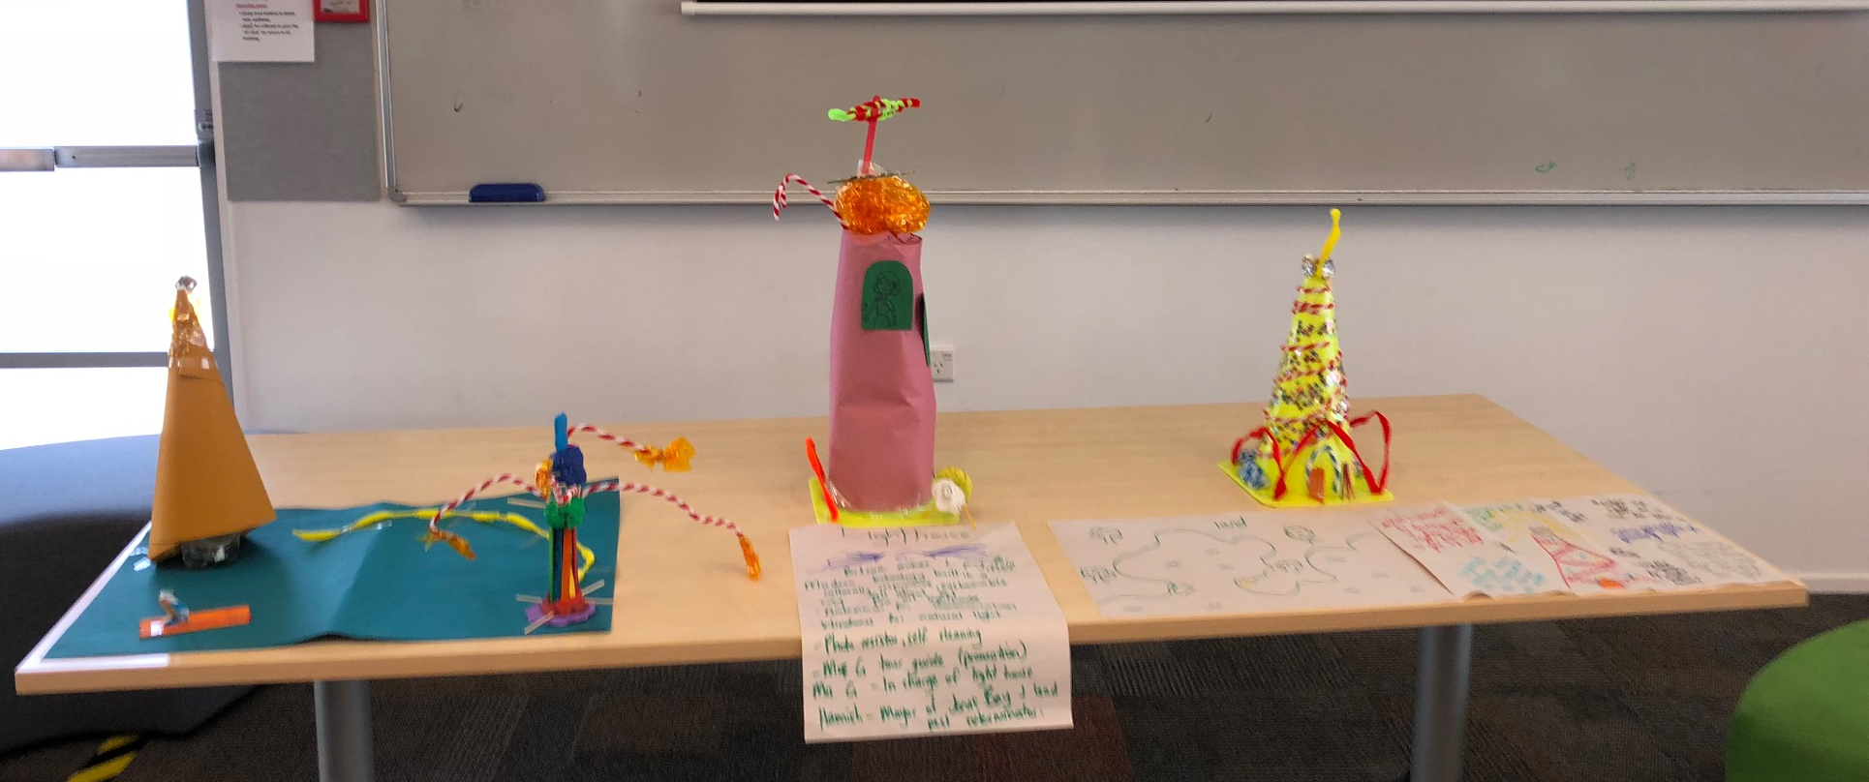
Role play used in science
Socio-cultural or process drama.
Can vary from one session – several sessions – entire term.
Used to deepen understanding of science concepts – taking on roles such as physicists, police.
Can support NOS, science concepts, science over time.
Can also support student’s achievements and attitudes towards science.
© C.Swanson

Slide 13
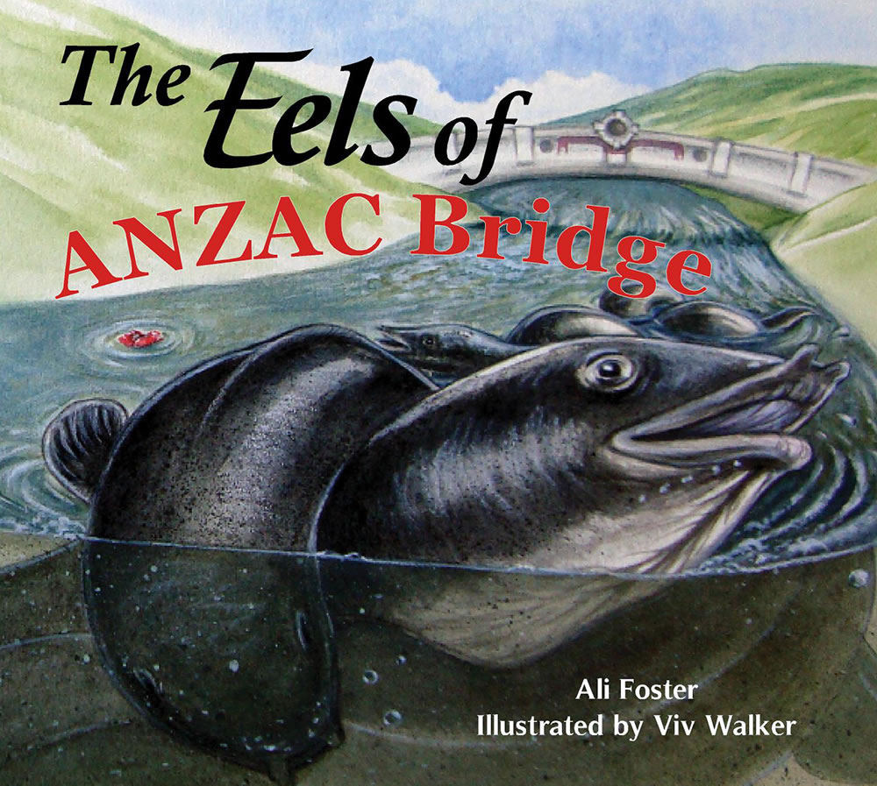
© Ali Foster
© Copyright. Science Learning Hub – Pokapū Akoranga Pūtaiao The University of Waikato Te Whare Wananga o Waikato.
All Rights Reserved | www.sciencelearn.org.nz. All images are copyrighted. For further information, please refer to enquiries@sciencelearn.org.nz

Slide 14
Pre-planning
Curricular links
Living World: Life processes
Living World: Ecology
Nature of Science: Understanding about science
Nature of Science: Participating and contributing
Drama: Developing ideas
Possible resources
Science Learning Hub www.sciencelearn.org.nz/search?term=eels
Department of Conservation www.doc.govt.nz/nature/native-animals/freshwater-fish/eels/
Wai care (Auckland Council). waicare.org.nz/Resources/forteachers.aspx
Tāmaki Paenga Hira Auckland War Museum Te awa o te Tuna River of Eels exhibit
Sina and the eel
© C.Swanson

Slide 15
Science conceptual knowledge
25-80 years head out to sea to spawn.
5000 km to South Pacific near Tonga to breed.
Adults die after spawning.
Eggs hatch to larvae – drift back to NZ over 15–17 months.
Larvae transform to glass eels – juvenile eels.
Once they enter estuaries – turn darker – elvers.
Swim upstream to find a suitable place to live.
© C.Swanson

Slide 16
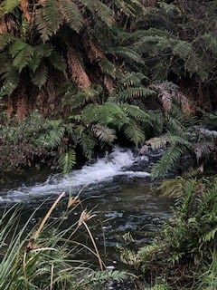
Set the scene
Poster of Tuna
Living Stream and Restoring Stream
Picture of the ANZAC bridge
Name – Tuna Kaitiaki
© C.Swanson
© Copyright. Science Learning Hub – Pokapū Akoranga Pūtaiao The University of Waikato Te Whare Wananga o Waikato.
All Rights Reserved | www.sciencelearn.org.nz. All images are copyrighted. For further information, please refer to enquiries@sciencelearn.org.nz

Slide 17
Knowledge building
If we are to be kaitiaki of tuna what do we need to know?
What do we need to do?
Perhaps we need to interview an expert?
You all have a slip of paper.
I am putting you in role as experts.
© Ali Foster
© Copyright. Science Learning Hub – Pokapū Akoranga Pūtaiao The University of Waikato Te Whare Wananga o Waikato.
All Rights Reserved | www.sciencelearn.org.nz. All images are copyrighted. For further information, please refer to enquiries@sciencelearn.org.nz

Slide 18
Using freeze frames to enhance empathy and desire for action about an issue.
My name is Albert. A long time ago I used to go eeling, drink the water and swim in the Mākākahi River. Now when I go to the river all I see the dirty water and rubbish, and signs saying, “Do not swim”. I wish we could go back to when I was a boy. (Foster, 2012)
© Ali Foster
“One hot summer’s afternoon in the tiny village of Kaiparoro, a small boy ran lickety split over a rickety bridge. Racing down the trusty track, he leapt into the river” (Foster, 2012, p.4,5).
© Copyright. Science Learning Hub – Pokapū Akoranga Pūtaiao The University of Waikato Te Whare Wananga o Waikato.
All Rights Reserved | www.sciencelearn.org.nz. All images are copyrighted. For further information, please refer to enquiries@sciencelearn.org.nz

Slide 19
Drama possibilities
How could we show the life cycle?
As kaitiaki how would we look after the habitat?
Why is looking after the environment important ?
Is there anyone we need to interview (in role) about the river/eels?
© C.Swanson

Slide 20
Showing our knowledge
How could you improve the health of the stream?
Can you do it by yourself?
Who would you consult to help?
Write a letter to a consultant who could help you improve the health of the stream in the role of a student from Kaiparoro school.
© C.Swanson
© Copyright. Science Learning Hub – Pokapū Akoranga Pūtaiao The University of Waikato Te Whare Wananga o Waikato.
All Rights Reserved | www.sciencelearn.org.nz. All images are copyrighted. For further information, please refer to enquiries@sciencelearn.org.nz

Slide 21
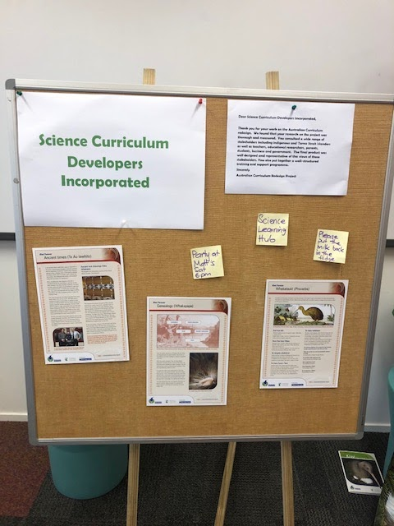
What curricular levels can drama be used at in science?
Junior class – Wild things – habitat
Middle – Animal Welfare Officers
Senior Primary – Dinosaur Hunters
Intermediate – Scientist
2017 Biolive Presentation Infection Busters – Level 1, 2, 3 and Biology – Influenza outbreak
Pre-service teachers – Curriculum developers
© C.Swanson

Slide 22
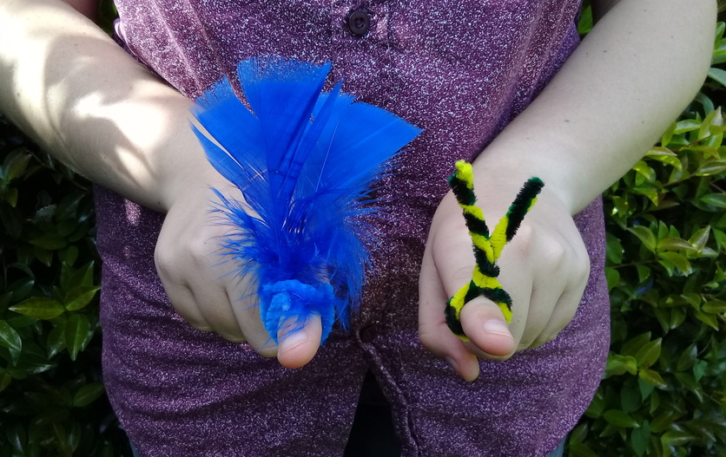
Activities from the Hub
Drama in the microworld
Water molecules in drama
Drama with microbes
Seed dispersal puppet play
Pollination role-plays
© Copyright. Science Learning Hub – Pokapū Akoranga Pūtaiao The University of Waikato Te Whare Wananga o Waikato.
All Rights Reserved | www.sciencelearn.org.nz. All images are copyrighted. For further information, please refer to enquiries@sciencelearn.org.nz
Notes:
Image from: www.sciencelearn.org.nz/images/3286-finger-puppet-pollinators

Slide 23
References
Davies, D., & McGregor, D. (2017). Teaching science creatively. (2nd ed., pp. 16-36) 16-36.
Routledge.
Foster, A. (2012). The eels of Anzac bridge. Fraser books.
McGregor, D., Baskerville, D., Anderson, D., Duggan, A. (2019). Examining the use of drama
to develop epistemological understanding about the nature of science: a collective case from
experience in New Zealand and England, International Journal of Science Education, Part
B, (9)2, 171-194 (2019), https://doi.org/10.1080/21548455.2019.1585994.
Skamp, K. (2015). Implementing the Australian curriculum: Science with a constructivist
mindset.In K. Skamp, & C. Preston. Teaching primary science constructively (5th ed., pp. 64-
71). Melbourne, Vic, Australia: Cengage.
Swanson, C. (2016). Positioned as expert scientists: Learning science through Mantle of the
Expert at years 7/8. [Doctoral thesis, The University of Waikato]. The University of Waikato
Research Commons. https://hdl.handle.net/10289/9974.
O’Toole, J. (2021). Foreword in P. White, K, Raphael., & K. van Cuylenburg. (Eds.). Science
and drama: Contemporary and creative approaches to Teaching and Learning. (pp. v-vii).
Springer.
Swanson, C. (2019). Working in multiple different worlds and positionings to reinvestigate the
science behind a national tragedy. Applied Theatre Research, 7(1), 107
-120. https://doi.org/10.1386/atr_00009_1.
© Copyright. Science Learning Hub – Pokapū Akoranga Pūtaiao The University of Waikato Te Whare Wananga o Waikato.
All Rights Reserved | www.sciencelearn.org.nz. All images are copyrighted. For further information, please refer to enquiries@sciencelearn.org.nz

Slide 24
Thanks – want to keep in touch?
Email us on enquiries@sciencelearn.org.nz
https://twitter.com/NZScienceLearn
www.facebook.com/nzsciencelearn
https://nz.pinterest.com/nzsciencelearn
www.instagram.com/sciencelearninghubnz
Join us in our discussion channel on Slack (http://slh-talk.slack.com).
(Any problems accessing Slack, please contact us via our enquiries email, enquiries@sciencelearn.org.nz.)

