Slide 1
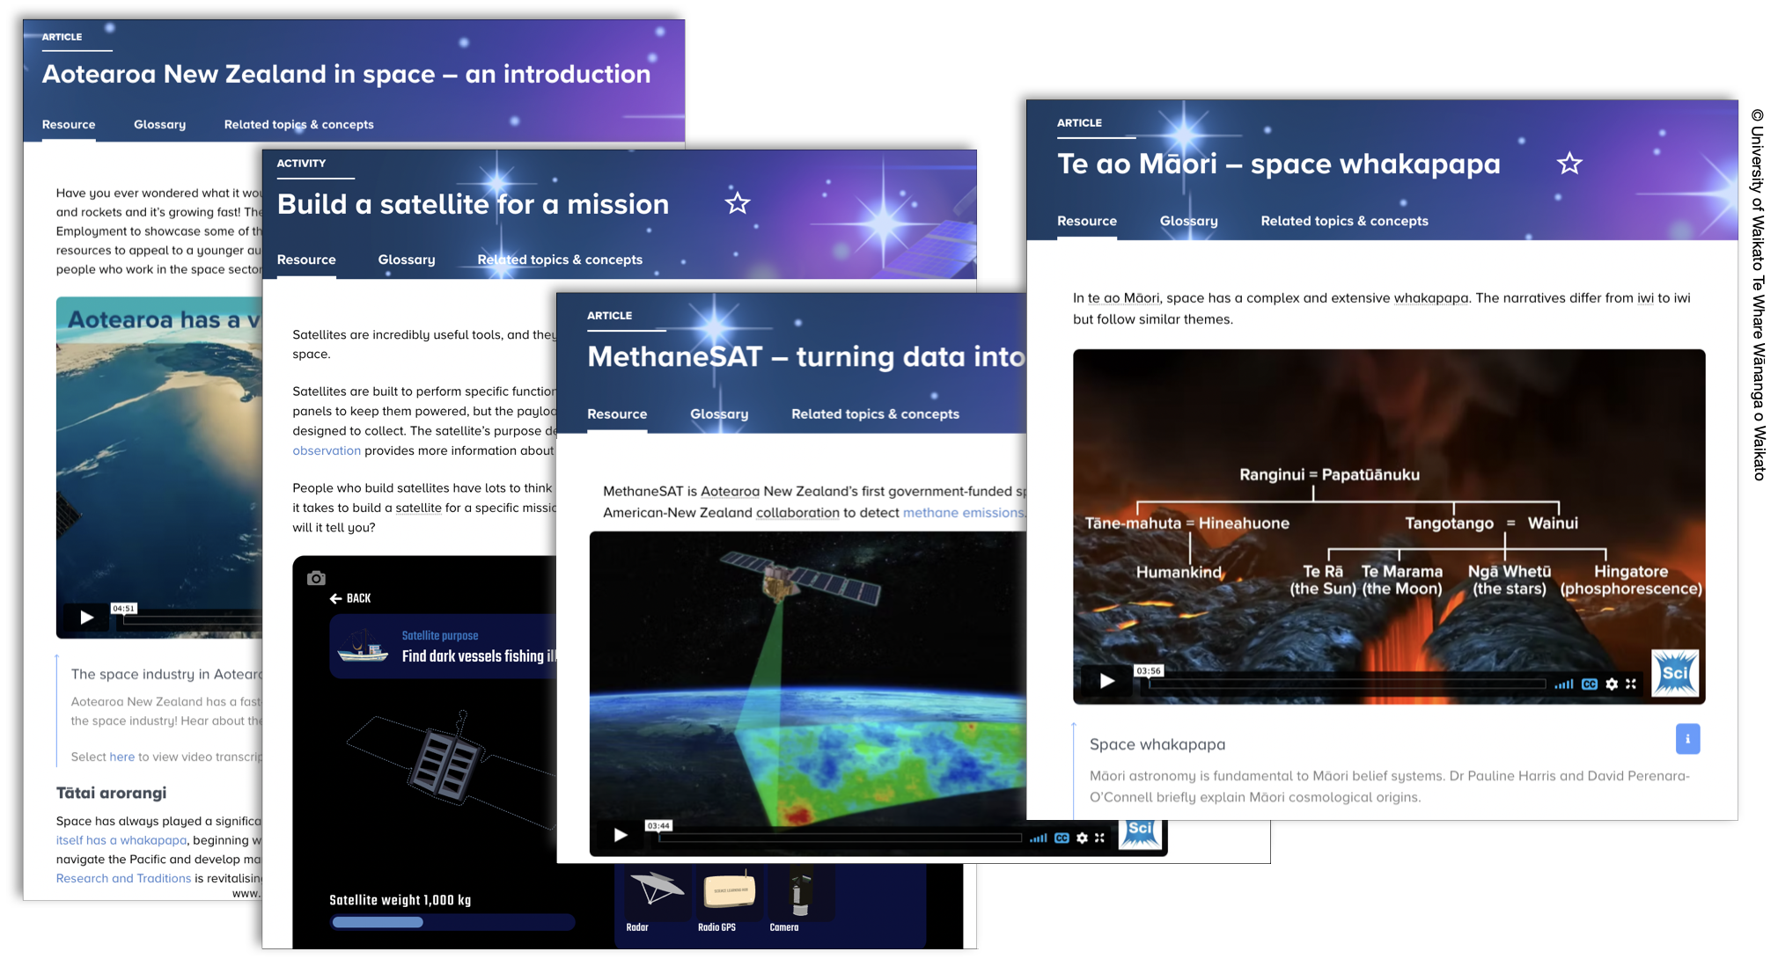
Aotearoa in space
4–4:45 pm Thursday 22 September
© Copyright. Science Learning Hub – Pokapū Akoranga Pūtaiao The University of Waikato Te Whare Wananga o Waikato.
All Rights Reserved | www.sciencelearn.org.nz. All images are copyrighted. For further information, please refer to enquiries@sciencelearn.org.nz
Notes:
Image: https://www.sciencelearn.org.nz/images/5008-resources-celebrating-aotearoa-in-space

Slide 2
Index
Topic | Slideshow numbers | Video timecode
Introduction and Index | 1–4 | 00:00
Purpose | 5 | 01:36
Aotearoa and space/Tūhura Tuarangi | 6–7 | 04:40
Where to start | 8–10 | 07:14
Wawata – seeing ourselves in space | 11–14 | 09:01
Tātai arorangi | 15–17 | 16:08
Satellites – Earth observation | 18 | 20:48
Build a satellite for a mission | 19–25 | 24:31
Innovation – ingenuity and sustainability | 26–31 | 34:26
SLH links, keep in touch and thanks | 32–34 | 40:46
© Copyright. The University of Waikato Te Whare Wananga o Waikato l Science Learning Hub – Pokapū Akoranga Pūtaiao. All Rights Reserved
All images are copyrighted. For further information, please refer to enquiries@sciencelearn.org.nz.

Slide 3
The Science Learning Hub
A trustworthy online resource – produced by educators and scientists
Based on world-class New Zealand science research
Supported by learning activities, information about the key science ideas and concepts, multimedia tools and other resources
Written for New Zealand teachers and students
Notes:
The Science Learning Hub is funded by the New Zealand government – Ministry of Business, Innovation and Employment (MBIE) – under the Curious Minds fund.

Slide 4
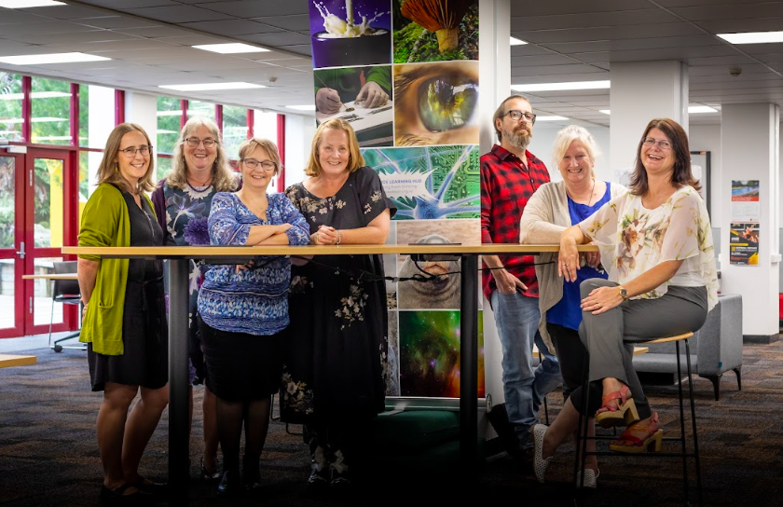
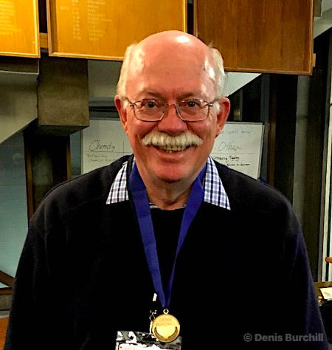
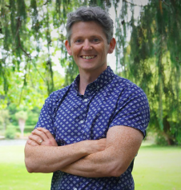
The Science Learning Hub team
© Copyright. Science Learning Hub – Pokapū Akoranga Pūtaiao The University of Waikato Te Whare Wananga o Waikato.
All Rights Reserved | www.sciencelearn.org.nz. All images are copyrighted. For further information, please refer to enquiries@sciencelearn.org.nz
Notes:
Introductions – who are we. The image of Stephen is copyright The University of Waikato Te Whare Wānanga o Waikato
https://www.sciencelearn.org.nz/pages/about
The image of Stephen is copyright The University of Waikato Te Whare Wānanga o Waikato

Slide 5
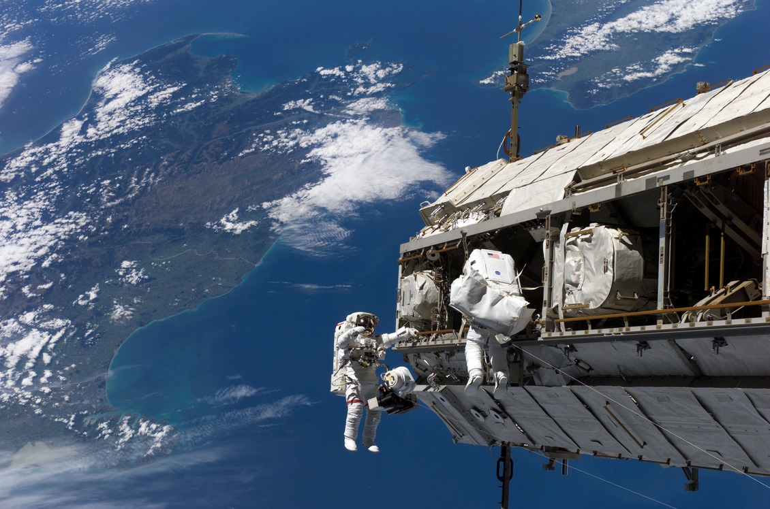
Purpose
Share our exciting new resources.
Inspire you to explore Aotearoa in space as a context for learning.
Answer your questions.
Support your students to see themselves in space!
Rights: NASA
© Copyright. Science Learning Hub – Pokapū Akoranga Pūtaiao The University of Waikato Te Whare Wananga o Waikato.
All Rights Reserved | www.sciencelearn.org.nz. All images are copyrighted. For further information, please refer to enquiries@sciencelearn.org.nz
Notes:
Image: https://www.sciencelearn.org.nz/images/1998-international-space-station-over-new-zealand

Slide 6
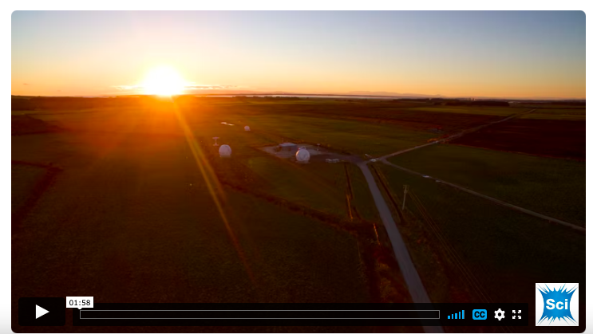
© Copyright. Science Learning Hub – Pokapū Akoranga Pūtaiao The University of Waikato Te Whare Wananga o Waikato.
All Rights Reserved | www.sciencelearn.org.nz. All images are copyrighted. For further information, please refer to enquiries@sciencelearn.org.nz
Notes:
Video: https://www.sciencelearn.org.nz/videos/2133-aotearoa-in-space

Slide 7
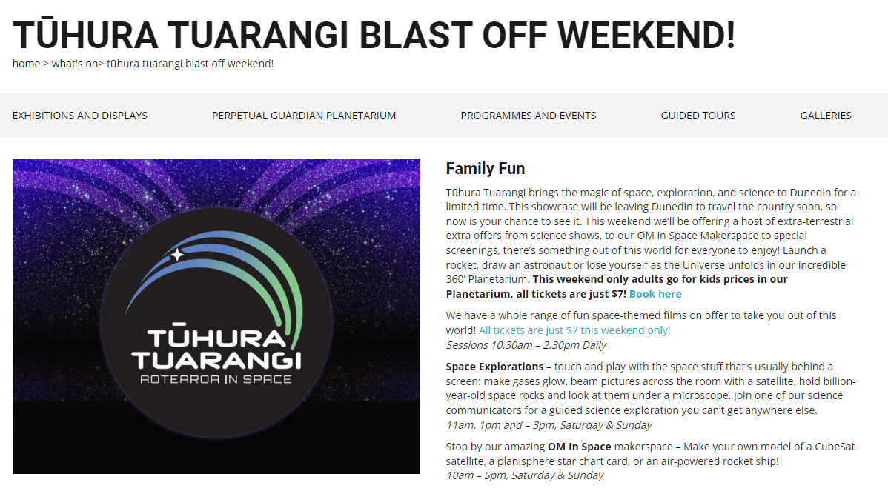
MethaneSAT
Notes:
Connecting with themes within the Otago exhibition https://otagomuseum.nz/whats-on/tuhura-tuarangi-blast-off-weekend
Event: https://www.sciencelearn.org.nz/events/2245-design-a-satellite-mission-competition

Slide 8
Aotearoa in space
19 Articles
27 Videos
12 Activities
38 Images
1 Build a Satellite Interactive
© Copyright. Science Learning Hub – Pokapū Akoranga Pūtaiao The University of Waikato Te Whare Wananga o Waikato.
All Rights Reserved | www.sciencelearn.org.nz. All images are copyrighted. For further information, please refer to enquiries@sciencelearn.org.nz

Slide 9
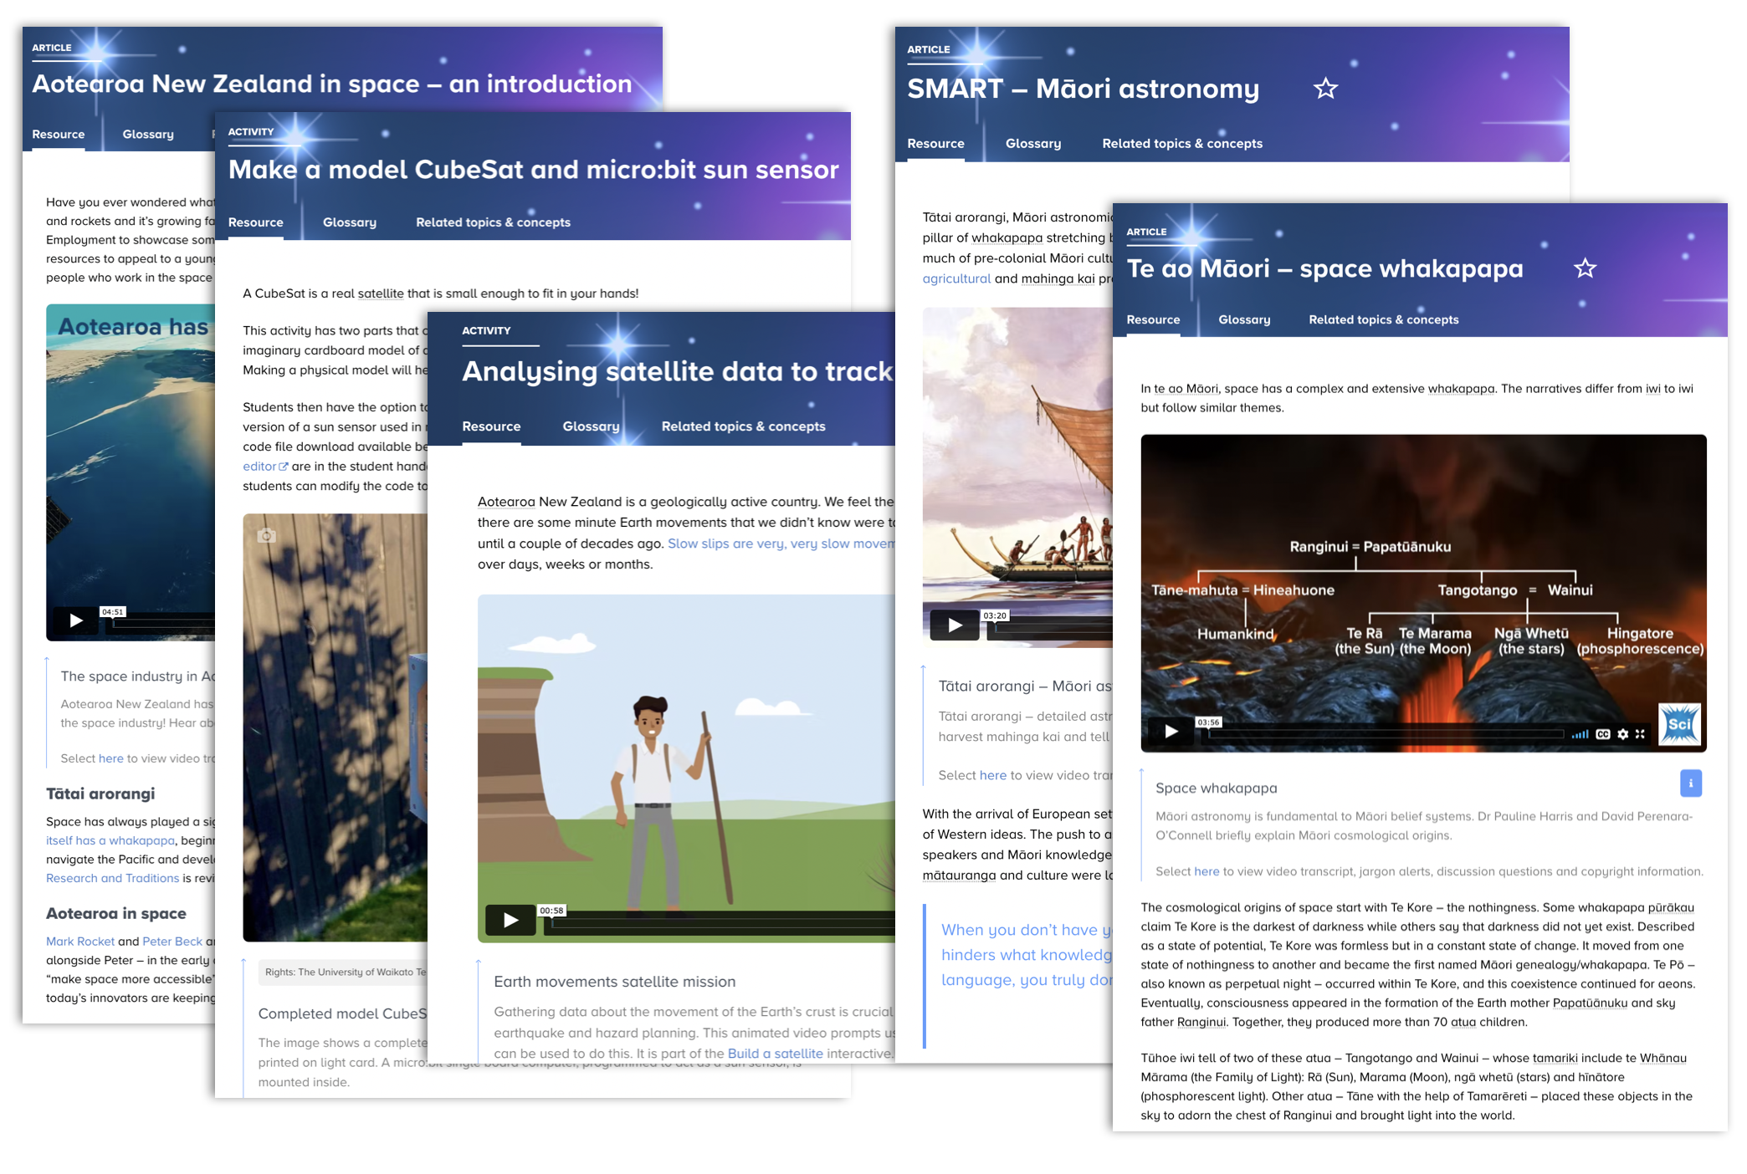
© Copyright. Science Learning Hub – Pokapū Akoranga Pūtaiao The University of Waikato Te Whare Wananga o Waikato.
All Rights Reserved | www.sciencelearn.org.nz. All images are copyrighted. For further information, please refer to enquiries@sciencelearn.org.nz
Notes:
Our expertise turned their passion enthusiasm and knowledge into accessible resources in the form of video, articles activities to engage and excite and inspire our next generation of space industry experts

Slide 10
Context for learning
© Copyright. Science Learning Hub – Pokapū Akoranga Pūtaiao The University of Waikato Te Whare Wananga o Waikato.
All Rights Reserved | www.sciencelearn.org.nz. All images are copyrighted. For further information, please refer to enquiries@sciencelearn.org.nz
Notes:
Articles:
https://www.sciencelearn.org.nz/resources/3159-aotearoa-new-zealand-in-space-an-introduction
https://www.sciencelearn.org.nz/resources/3162-aotearoa-in-space-a-context-for-learning

Slide 11
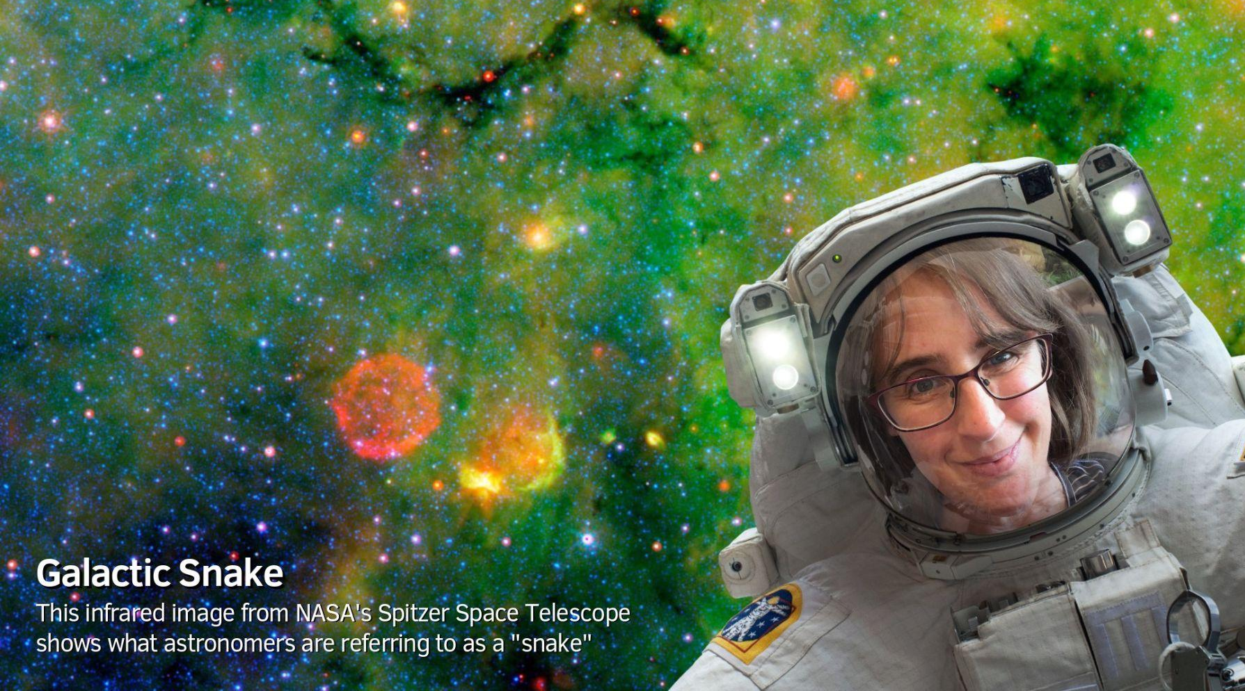
Wawata
Seeing ourselves in space
© Copyright. Science Learning Hub – Pokapū Akoranga Pūtaiao The University of Waikato Te Whare Wananga o Waikato.
All Rights Reserved | www.sciencelearn.org.nz. All images are copyrighted. For further information, please refer to enquiries@sciencelearn.org.nz

Slide 12
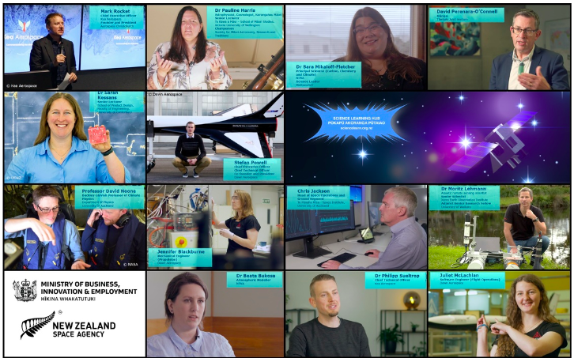
Seeing ourselves in space
© Copyright. Science Learning Hub – Pokapū Akoranga Pūtaiao The University of Waikato Te Whare Wananga o Waikato.
All Rights Reserved | www.sciencelearn.org.nz. All images are copyrighted. For further information, please refer to enquiries@sciencelearn.org.nz
Notes:
Image: https://www.sciencelearn.org.nz/images/5006-aotearoa-in-space-our-experts
See yourselves in space? Well these people did… by telling their purakau their stories with passion enthusiasm and expertise…

Slide 13
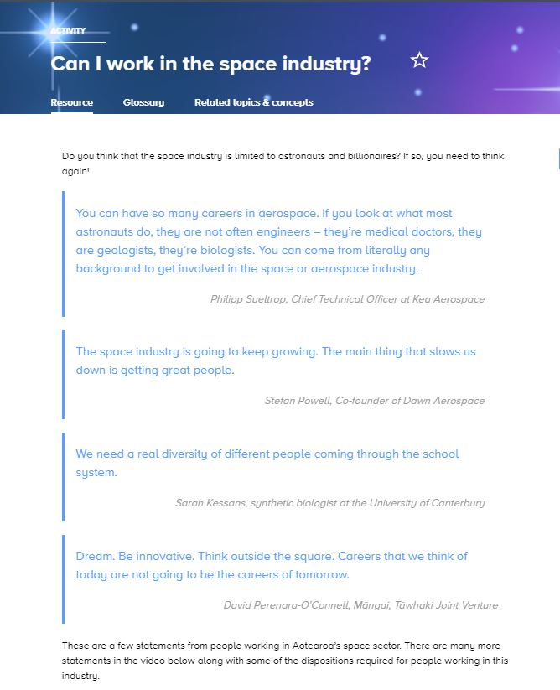
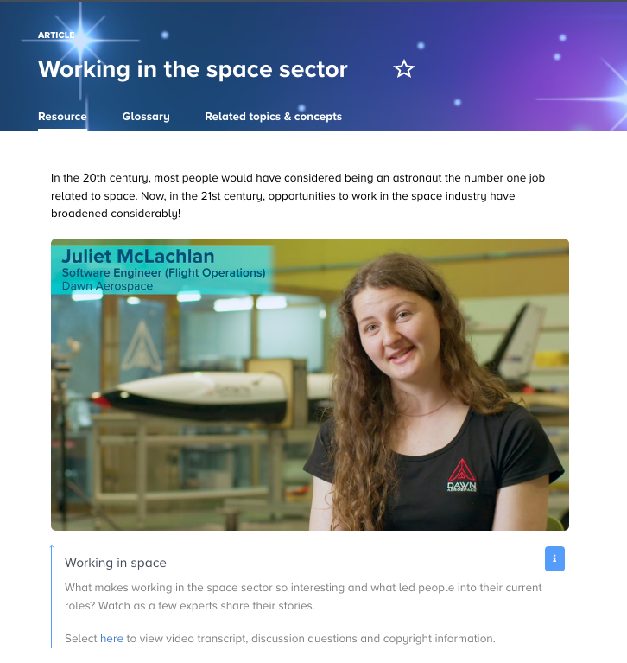
Seeing ourselves in space
“We need a real diversity of different people coming through the school system.”
Sarah Kessans, synthetic biologist at the University of Canterbury
© Copyright. Science Learning Hub – Pokapū Akoranga Pūtaiao The University of Waikato Te Whare Wananga o Waikato.
All Rights Reserved | www.sciencelearn.org.nz. All images are copyrighted. For further information, please refer to enquiries@sciencelearn.org.nz
Notes:
Article: https://www.sciencelearn.org.nz/resources/3158-working-in-the-space-sector
Activity: https://www.sciencelearn.org.nz/resources/3146-can-i-work-in-the-space-industry

Slide 14
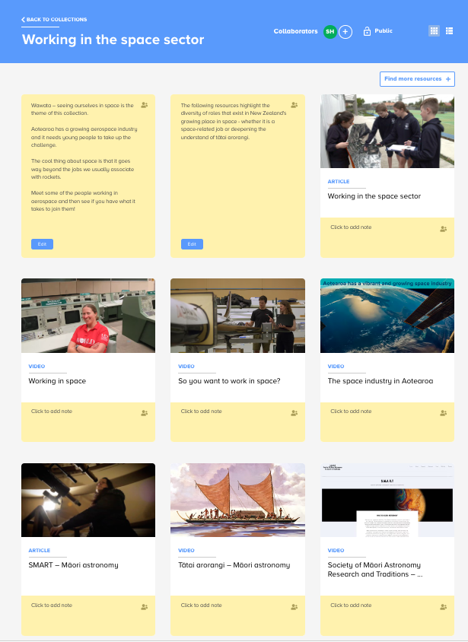
Working in the space sector collection
© Copyright. Science Learning Hub – Pokapū Akoranga Pūtaiao The University of Waikato Te Whare Wananga o Waikato.
All Rights Reserved | www.sciencelearn.org.nz. All images are copyrighted. For further information, please refer to enquiries@sciencelearn.org.nz
Notes:
Collection: https://www.sciencelearn.org.nz/collections/shared/1d638e8cf72c677986d3d1c10c46af83

Slide 15
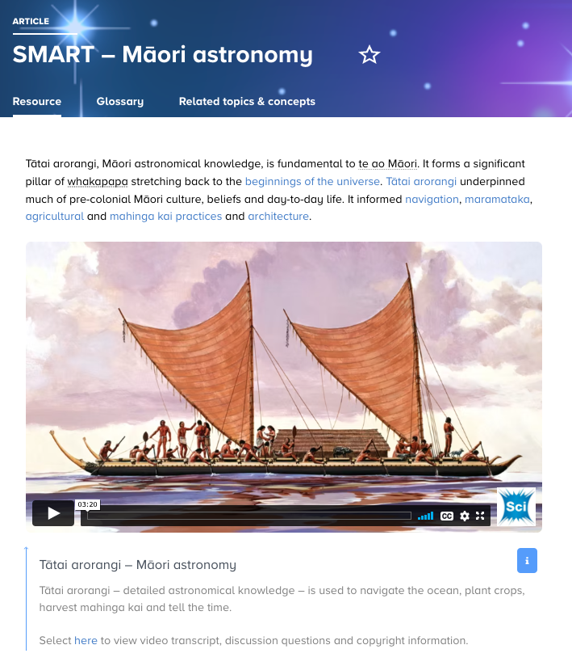
Tātai arorangi
Herb Kawainui Kāne Trust
© Copyright. Science Learning Hub – Pokapū Akoranga Pūtaiao The University of Waikato Te Whare Wananga o Waikato.
All Rights Reserved | www.sciencelearn.org.nz. All images are copyrighted. For further information, please refer to enquiries@sciencelearn.org.nz
Notes:
Videos /resources featuring mātauranga
Article: https://www.sciencelearn.org.nz/resources/3153-smart-maori-astronomy

Slide 16
Tātai arorangi
Taylor Animation
© Copyright. Science Learning Hub – Pokapū Akoranga Pūtaiao The University of Waikato Te Whare Wananga o Waikato.
All Rights Reserved | www.sciencelearn.org.nz. All images are copyrighted. For further information, please refer to enquiries@sciencelearn.org.nz
Notes:
Videos /resources featuring mātauranga
Video: https://www.sciencelearn.org.nz/videos/2111-space-whakapapa
Article: https://www.sciencelearn.org.nz/resources/3155-te-ao-maori-space-whakapapa

Slide 17
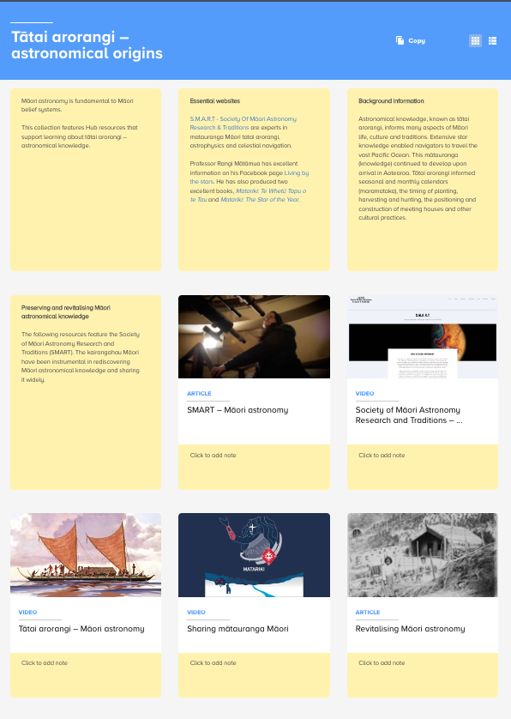
Tātai arorangi
collection
© Copyright. Science Learning Hub – Pokapū Akoranga Pūtaiao The University of Waikato Te Whare Wananga o Waikato.
All Rights Reserved | www.sciencelearn.org.nz. All images are copyrighted. For further information, please refer to enquiries@sciencelearn.org.nz
Notes:
Collection: https://www.sciencelearn.org.nz/collections/shared/ca41d7af864215e3c7cfc0d9f25d0c11

Slide 18
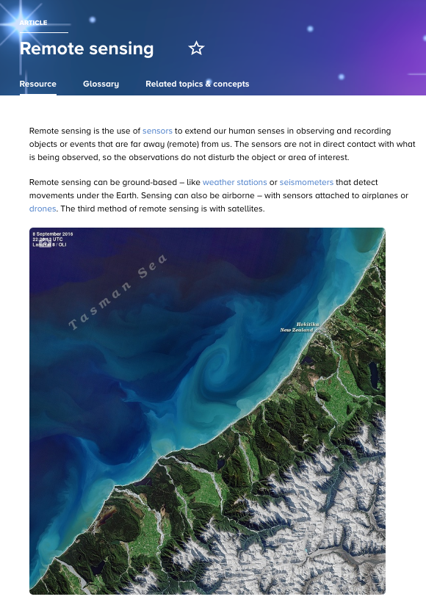
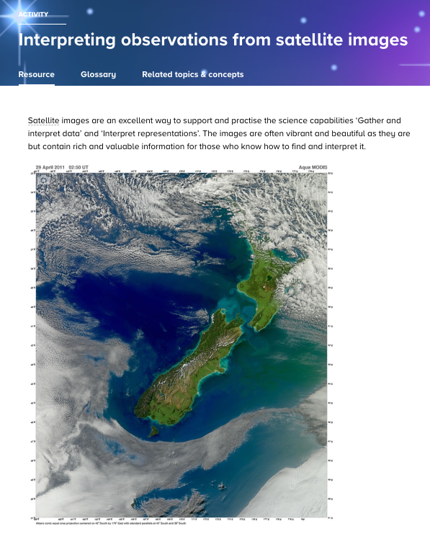
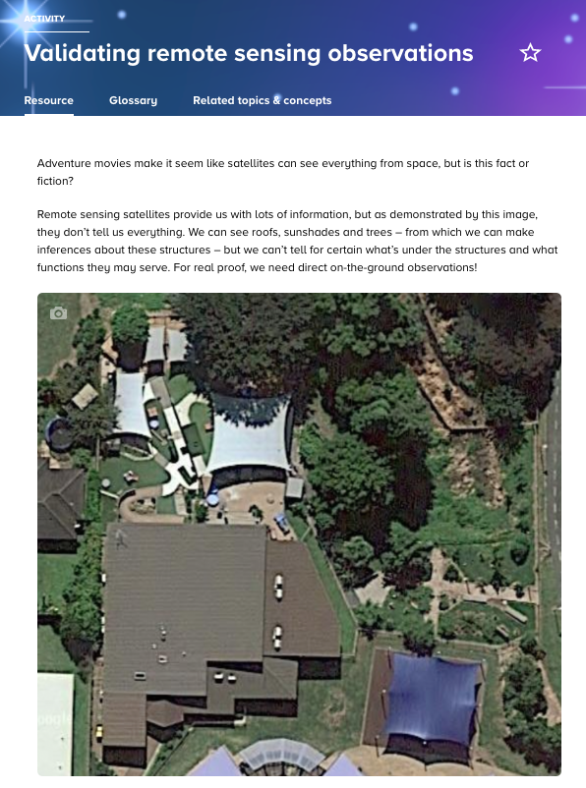
Satellites
Earth observation
© Copyright. Science Learning Hub – Pokapū Akoranga Pūtaiao The University of Waikato Te Whare Wananga o Waikato.
All Rights Reserved | www.sciencelearn.org.nz. All images are copyrighted. For further information, please refer to enquiries@sciencelearn.org.nz
Notes:
https://www.sciencelearn.org.nz/resources/3133-remote-sensing
https://www.sciencelearn.org.nz/resources/3142-interpreting-observations-from-satellite-images
https://www.sciencelearn.org.nz/resources/3145-validating-remote-sensing-observations

Slide 19
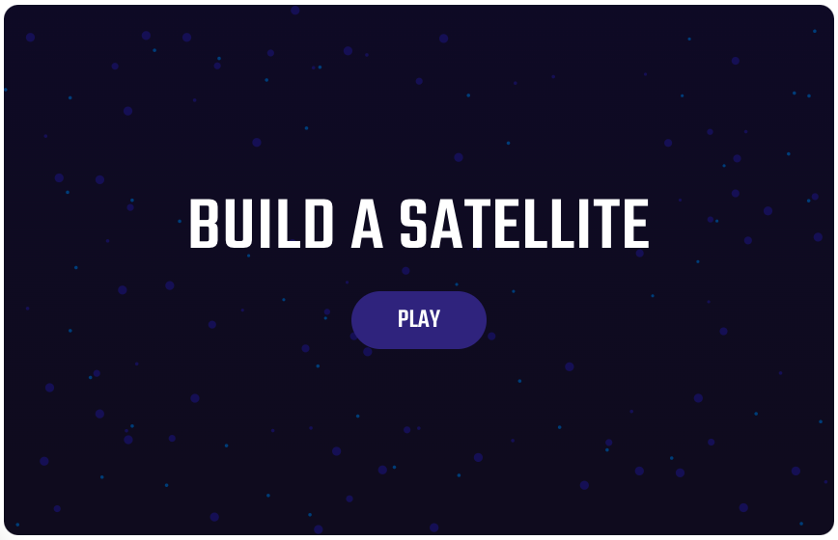
© Copyright. Science Learning Hub – Pokapū Akoranga Pūtaiao The University of Waikato Te Whare Wananga o Waikato.
All Rights Reserved | www.sciencelearn.org.nz. All images are copyrighted. For further information, please refer to enquiries@sciencelearn.org.nz
Notes:
Interactive: https://www.sciencelearn.org.nz/embeds/149-build-a-satellite
The thinking behind the resources we produced are embedded in strong pedagogical best practice. What are the learning outcomes for the SLH we have in mind for both teachers and students. In particular our hero resource is a game that linked building satellites to relevant real life scenarios – not just any game but an engaging learning tool from satellites to albatross, finding fishing vessels in vast oceans and how we gather data about the movement of land.
The ‘build a satellite’ game is not just a game but it has indepth learning built into it with wrap around support – satellites/scenario information/orbits/

Slide 20
© Copyright. Science Learning Hub – Pokapū Akoranga Pūtaiao The University of Waikato Te Whare Wananga o Waikato.
All Rights Reserved | www.sciencelearn.org.nz. All images are copyrighted. For further information, please refer to enquiries@sciencelearn.org.nz

Slide 21
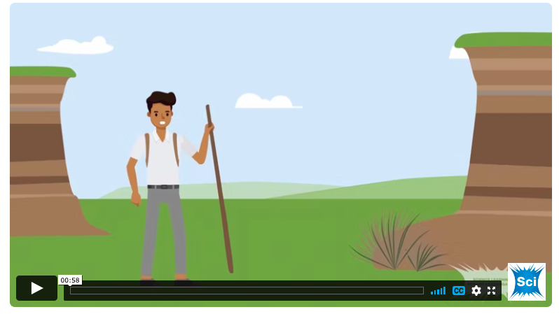
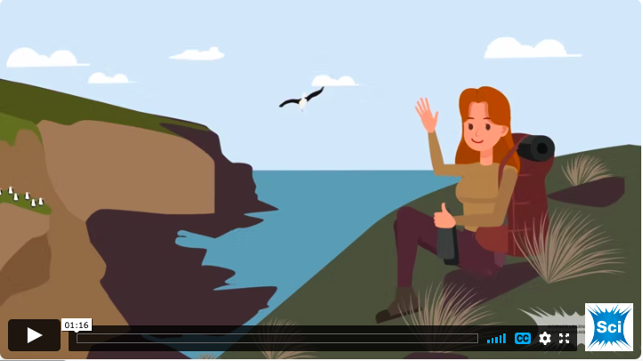
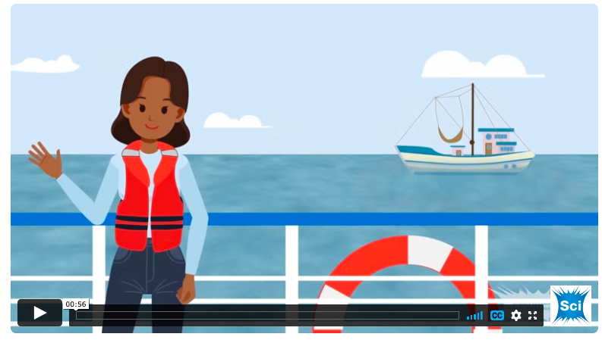
© Copyright. Science Learning Hub – Pokapū Akoranga Pūtaiao The University of Waikato Te Whare Wananga o Waikato.
All Rights Reserved | www.sciencelearn.org.nz. All images are copyrighted. For further information, please refer to enquiries@sciencelearn.org.nz
Notes:
First asked to help scientists to build a satellite for for purpose
Play videos:
https://www.sciencelearn.org.nz/videos/2107-albatross-satellite-mission
https://www.sciencelearn.org.nz/videos/2109-earth-movements-satellite-mission
https://www.sciencelearn.org.nz/videos/2108-dark-vessels-satellite-mission
On successful launch get data to analyze in an activity

Slide 22
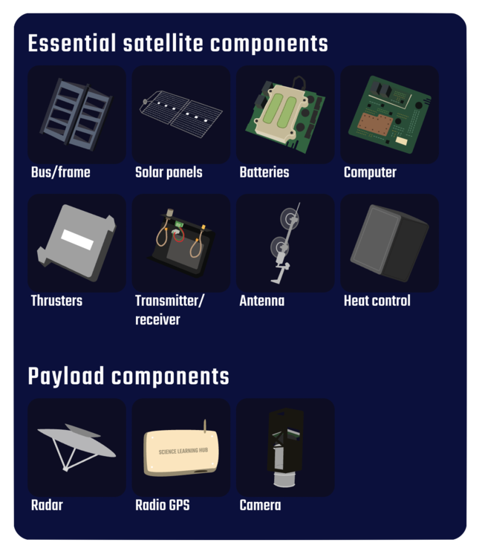
© Copyright. Science Learning Hub – Pokapū Akoranga Pūtaiao The University of Waikato Te Whare Wananga o Waikato.
All Rights Reserved | www.sciencelearn.org.nz. All images are copyrighted. For further information, please refer to enquiries@sciencelearn.org.nz
Notes:
https://www.sciencelearn.org.nz/images/4877-common-satellite-components

Slide 23
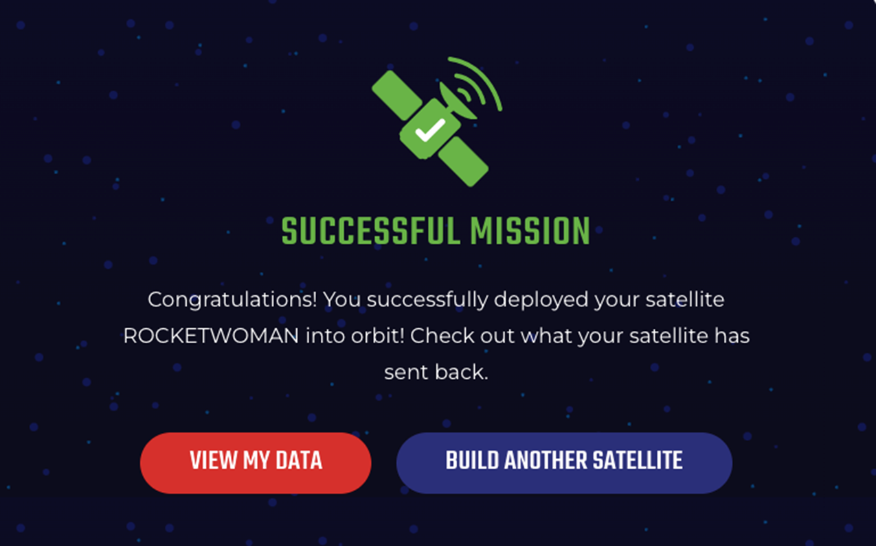
© Copyright. Science Learning Hub – Pokapū Akoranga Pūtaiao The University of Waikato Te Whare Wananga o Waikato.
All Rights Reserved | www.sciencelearn.org.nz. All images are copyrighted. For further information, please refer to enquiries@sciencelearn.org.nz

Slide 24
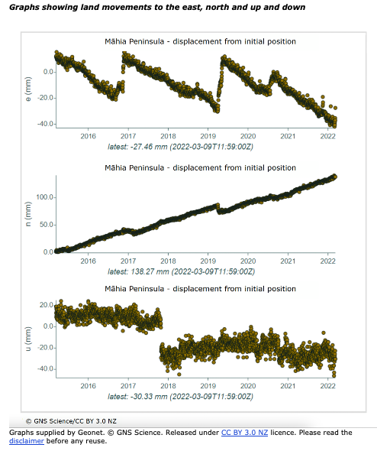
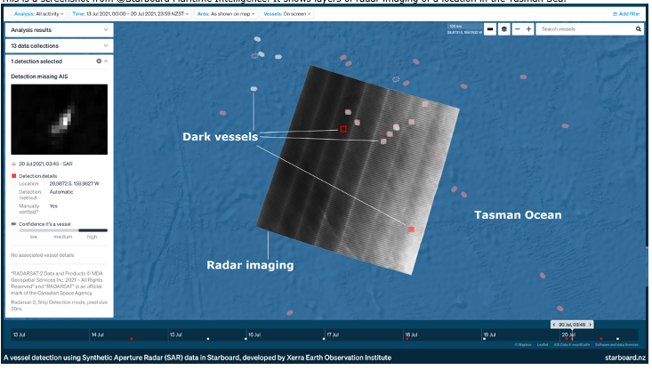
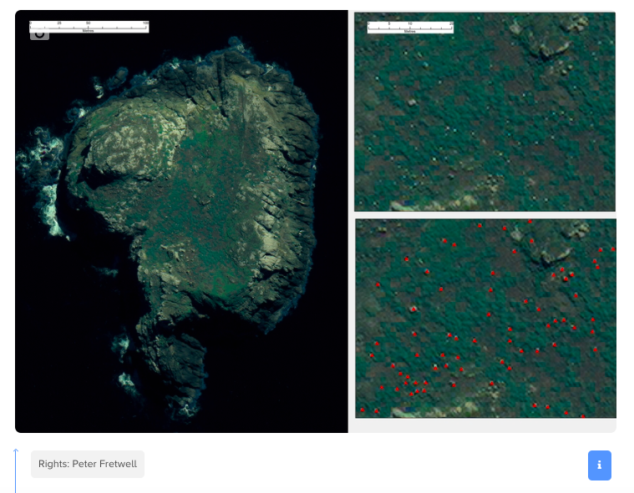
Real data
© Copyright. Science Learning Hub – Pokapū Akoranga Pūtaiao The University of Waikato Te Whare Wananga o Waikato.
All Rights Reserved | www.sciencelearn.org.nz. All images are copyrighted. For further information, please refer to enquiries@sciencelearn.org.nz
Notes:
Analyses real data sets

Slide 25
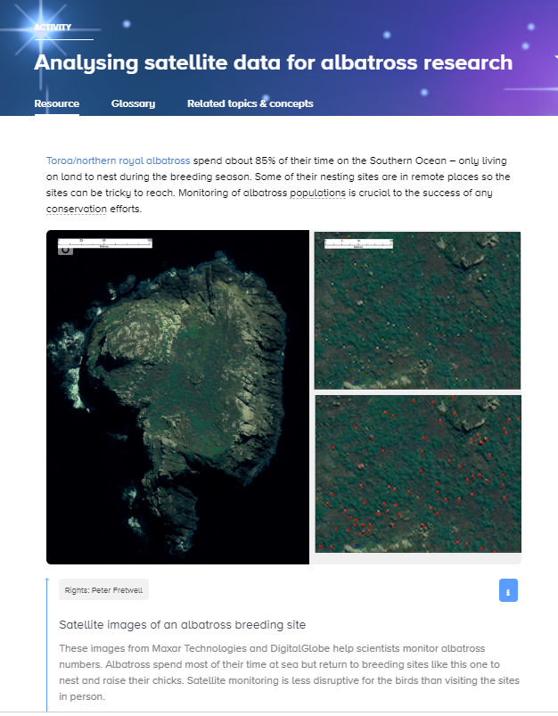
© Copyright. Science Learning Hub – Pokapū Akoranga Pūtaiao The University of Waikato Te Whare Wananga o Waikato.
All Rights Reserved | www.sciencelearn.org.nz. All images are copyrighted. For further information, please refer to enquiries@sciencelearn.org.nz
Notes:
Article: https://www.sciencelearn.org.nz/resources/3104-analysing-satellite-data-for-albatross-research

Slide 26
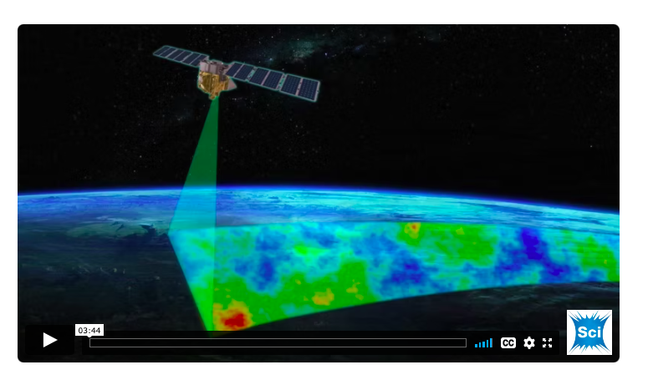
MethaneSAT – turning data into action
MethaneSAT
© Copyright. Science Learning Hub – Pokapū Akoranga Pūtaiao The University of Waikato Te Whare Wananga o Waikato.
All Rights Reserved | www.sciencelearn.org.nz. All images are copyrighted. For further information, please refer to enquiries@sciencelearn.org.nz
Notes:
The other hero is the MethaneSat project such an important project in many ways
https://www.sciencelearn.org.nz/videos/2122-methanesat-space-mission

Slide 27
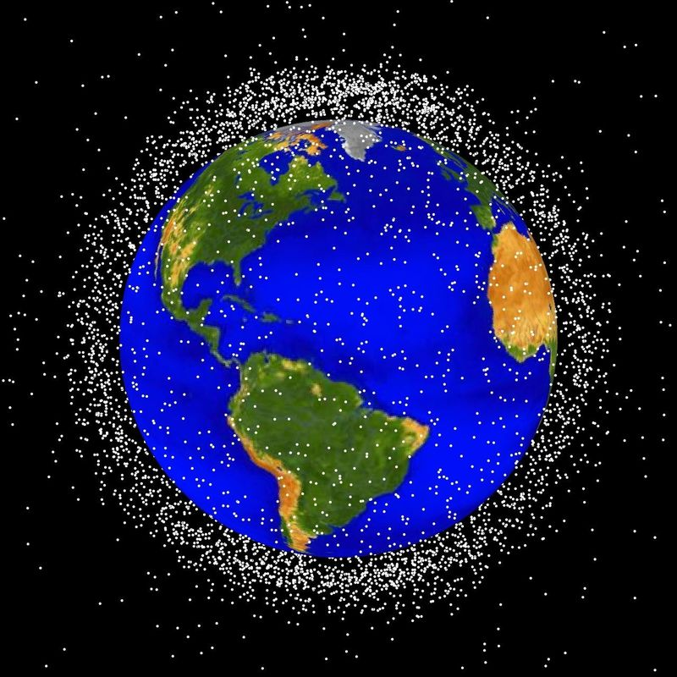
Innovation – ingenuity and sustainability
NASA
Notes:
Image: https://www.sciencelearn.org.nz/images/271-space-junk-concentrations

Slide 28
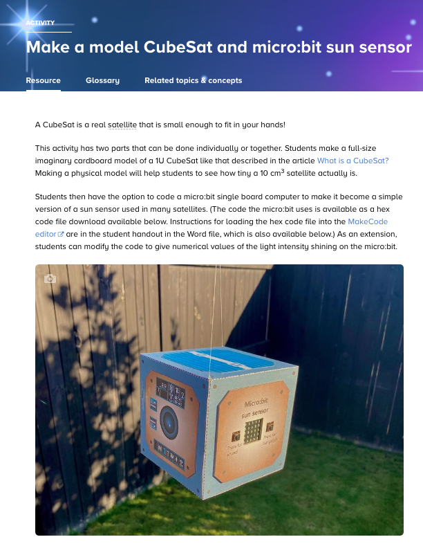
Engaging activities
© Copyright. Science Learning Hub – Pokapū Akoranga Pūtaiao The University of Waikato Te Whare Wananga o Waikato.
All Rights Reserved | www.sciencelearn.org.nz. All images are copyrighted. For further information, please refer to enquiries@sciencelearn.org.nz
Notes:
Activity: https://www.sciencelearn.org.nz/resources/3163-make-a-model-cubesat-and-micro-bit-sun-sensor
Images: https://www.sciencelearn.org.nz/images/4929-completed-model-cubesat

Slide 29
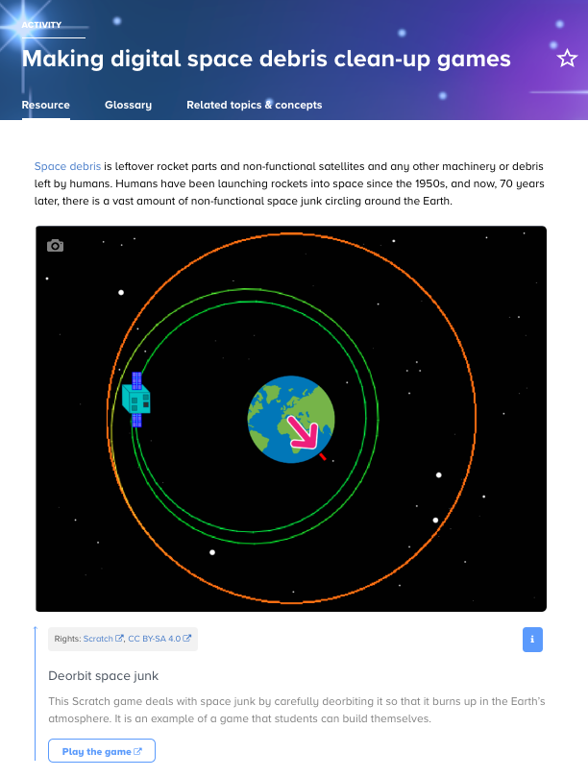
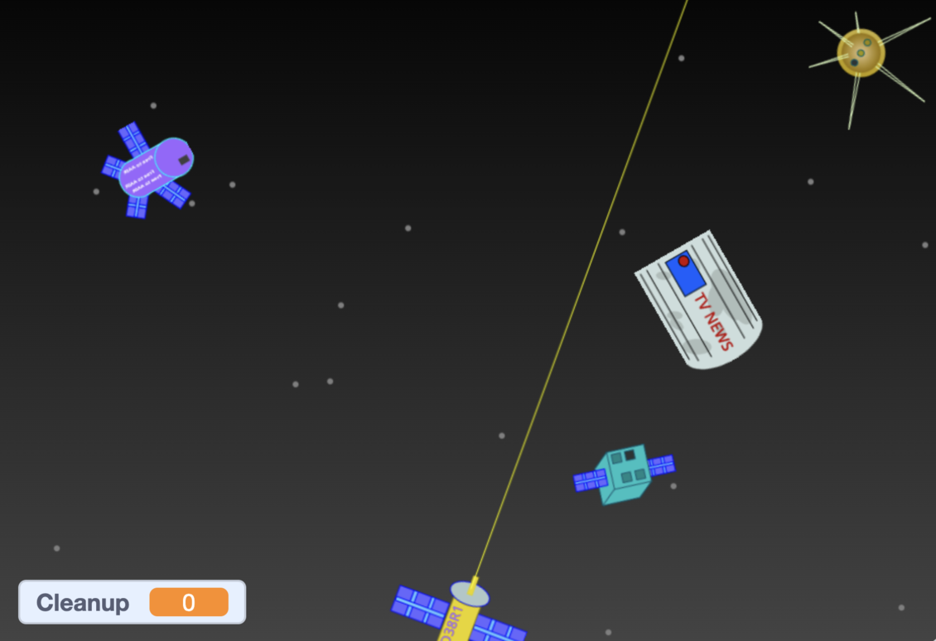
Engaging activities
© Copyright. Science Learning Hub – Pokapū Akoranga Pūtaiao The University of Waikato Te Whare Wananga o Waikato.
All Rights Reserved | www.sciencelearn.org.nz. All images are copyrighted. For further information, please refer to enquiries@sciencelearn.org.nz
Notes:
Activity: https://www.sciencelearn.org.nz/resources/3144-making-digital-space-debris-clean-up-games
Image: https://www.sciencelearn.org.nz/images/4890-cleaning-up-space

Slide 30
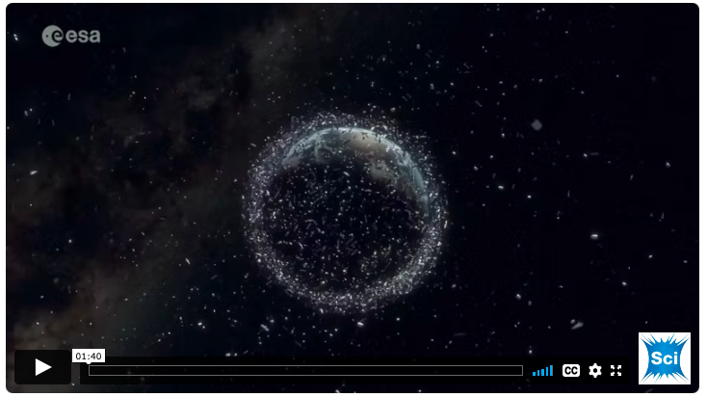
Space ethics
© Copyright. Science Learning Hub – Pokapū Akoranga Pūtaiao The University of Waikato Te Whare Wananga o Waikato.
All Rights Reserved | www.sciencelearn.org.nz. All images are copyrighted. For further information, please refer to enquiries@sciencelearn.org.nz
Notes:
Video: https://www.sciencelearn.org.nz/videos/2117-using-space-ethics-and-responsibilities

Slide 31
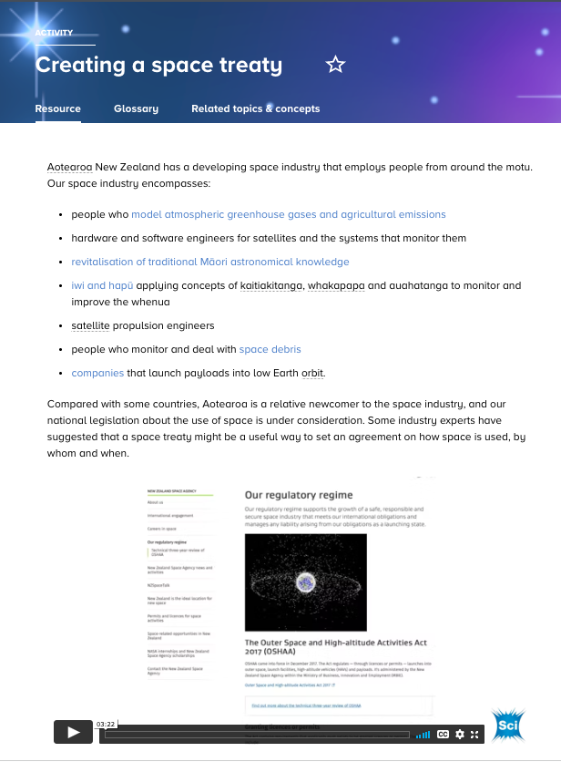
Space ethics
© Copyright. Science Learning Hub – Pokapū Akoranga Pūtaiao The University of Waikato Te Whare Wananga o Waikato.
All Rights Reserved | www.sciencelearn.org.nz. All images are copyrighted. For further information, please refer to enquiries@sciencelearn.org.nz
Notes:
Activity: https://www.sciencelearn.org.nz/resources/3143-creating-a-space-treaty

Slide 32
Supporting deep learning
© Copyright. Science Learning Hub – Pokapū Akoranga Pūtaiao The University of Waikato Te Whare Wananga o Waikato.
All Rights Reserved | www.sciencelearn.org.nz. All images are copyrighted. For further information, please refer to enquiries@sciencelearn.org.nz
Notes:
Getting the best from a video resource

Slide 33
Thanks – want to keep in touch?
Email us on enquiries@sciencelearn.org.nz
https://twitter.com/NZScienceLearn
www.facebook.com/nzsciencelearn
https://nz.pinterest.com/nzsciencelearn
www.instagram.com/sciencelearninghubnz
Join us in our discussion channel on Slack (http://slh-talk.slack.com).
(Any problems accessing Slack, please contact us via our enquiries email, enquiries@sciencelearn.org.nz.)

Slide 34
Ngā mihi nui
© Copyright. Science Learning Hub – Pokapū Akoranga Pūtaiao The University of Waikato Te Whare Wananga o Waikato.
All Rights Reserved | www.sciencelearn.org.nz. All images are copyrighted. For further information, please refer to enquiries@sciencelearn.org.nz
Notes:
https://www.sciencelearn.org.nz/images/5006-aotearoa-in-space-our-experts

