Slide 1
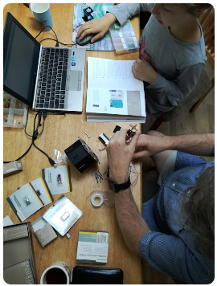
Digital tools for
science learning
4–4:45 pm Thursday 3 November 2022
© Copyright. Science Learning Hub – Pokapū Akoranga Pūtaiao The University of Waikato Te Whare Wananga o Waikato.
All Rights Reserved | www.sciencelearn.org.nz. All images are copyrighted. For further information, please refer to enquiries@sciencelearn.org.nz

Slide 2

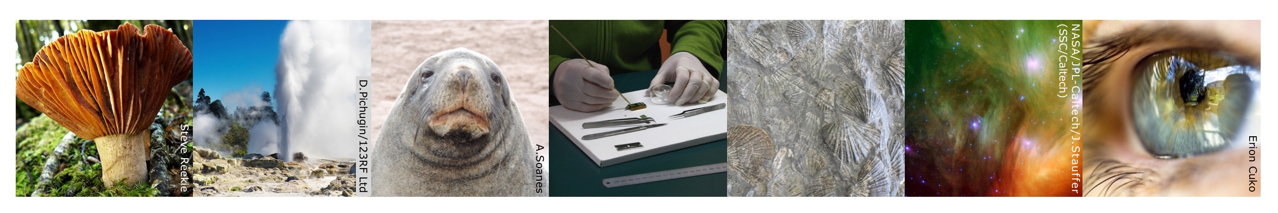
The Science Learning Hub
A trustworthy online resource – produced by educators and scientists
Based on world-class New Zealand science research
Supported by learning activities, information about the key science ideas and concepts, multimedia tools and other resources
Written for New Zealand teachers and students
Notes:
The Science Learning Hub is funded by the New Zealand government – Ministry of Business, Innovation and Employment (MBIE) – under the Curious Minds fund.

Slide 3
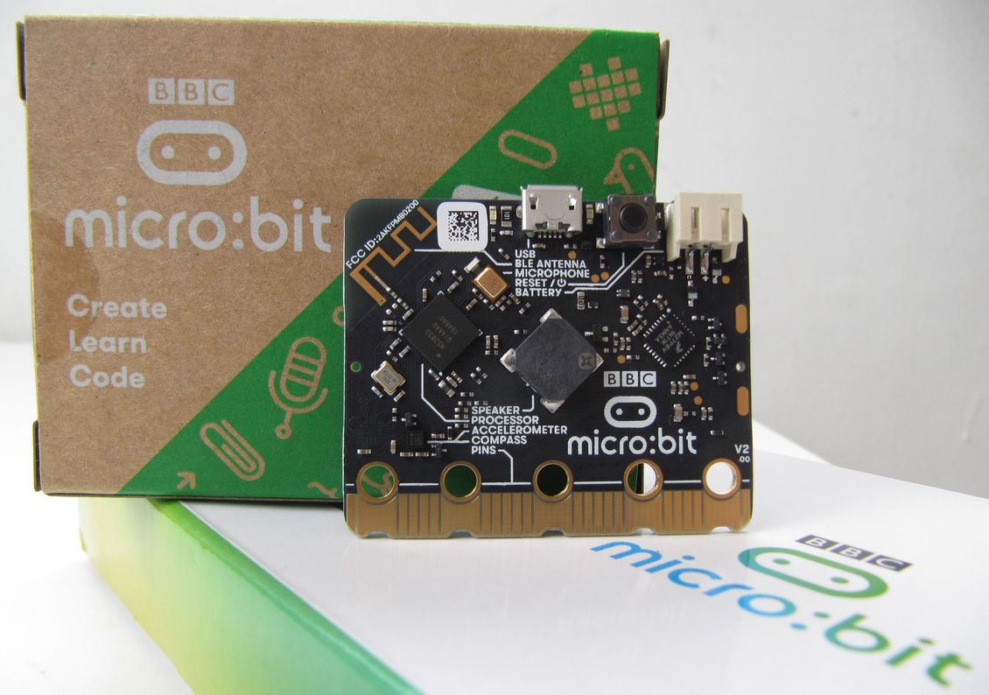
Purpose
What do we mean by digital tools?
How to use digital tools to develop science capabilities.
Public domain
© Copyright. Science Learning Hub – Pokapū Akoranga Pūtaiao The University of Waikato Te Whare Wananga o Waikato.
All Rights Reserved | www.sciencelearn.org.nz. All images are copyrighted. For further information, please refer to enquiries@sciencelearn.org.nz

Slide 4
Index
Topic | Slideshow number(s) | Video timecode
Introducing the Science Learning Hub and presenters | 1 | 00:00
Purpose and index | 2–3 | 00:27
What do we mean by digital tools? | 6–8 | 04:54
New Zealand curriculum links | 9–14 | 09:32
Arduino Science Journal | 15–18 | 16:50
Micro:bit | 19–23 | 29:41
Overview | 24–25 | 39:09
Links, keep in touch and thanks | 26–27 | 47:07
© Copyright. Science Learning Hub – Pokapū Akoranga Pūtaiao The University of Waikato Te Whare Wananga o Waikato.
All Rights Reserved | www.sciencelearn.org.nz. All images are copyrighted. For further information, please refer to enquiries@sciencelearn.org.nz

Slide 5

Nau mai haere mai
Ko Te Whare wananga o Waikato
Ko te Kura Toi Tangata
Tihei, Ko Te Whai Toi Tangata
Tihei mauri ora
I tipu ake ahau i raro i te maunga o Taranaki
Ko Ngati Pākehā tōku iwi
Kei Taupō nui a Tia ahau e noho ana
Kei raro i te maru o Tūwharetoa
Ko Glenda Coull rāua ko Malcolm Ross ōku mātua
Ko Stephen taku ingoa
Nō reira, tēnā tatou katoa
Nei rā te mihi manahau ki te tangata whenua,
ka mihi hoki ka tika ki ngā tohu o te rohe nei.
Nō reira tēnā koutou katoa.
© Copyright. Science Learning Hub – Pokapū Akoranga Pūtaiao The University of Waikato Te Whare Wananga o Waikato.
All Rights Reserved | www.sciencelearn.org.nz. All images are copyrighted. For further information, please refer to enquiries@sciencelearn.org.nz

Slide 6
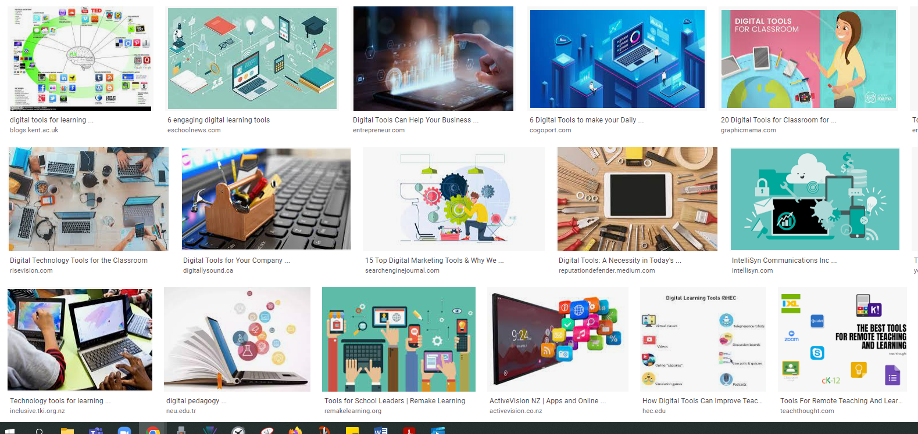
What do we mean by
digital tools?
© Copyright. Science Learning Hub – Pokapū Akoranga Pūtaiao The University of Waikato Te Whare Wananga o Waikato.
All Rights Reserved | www.sciencelearn.org.nz. All images are copyrighted. For further information, please refer to enquiries@sciencelearn.org.nz

Slide 7
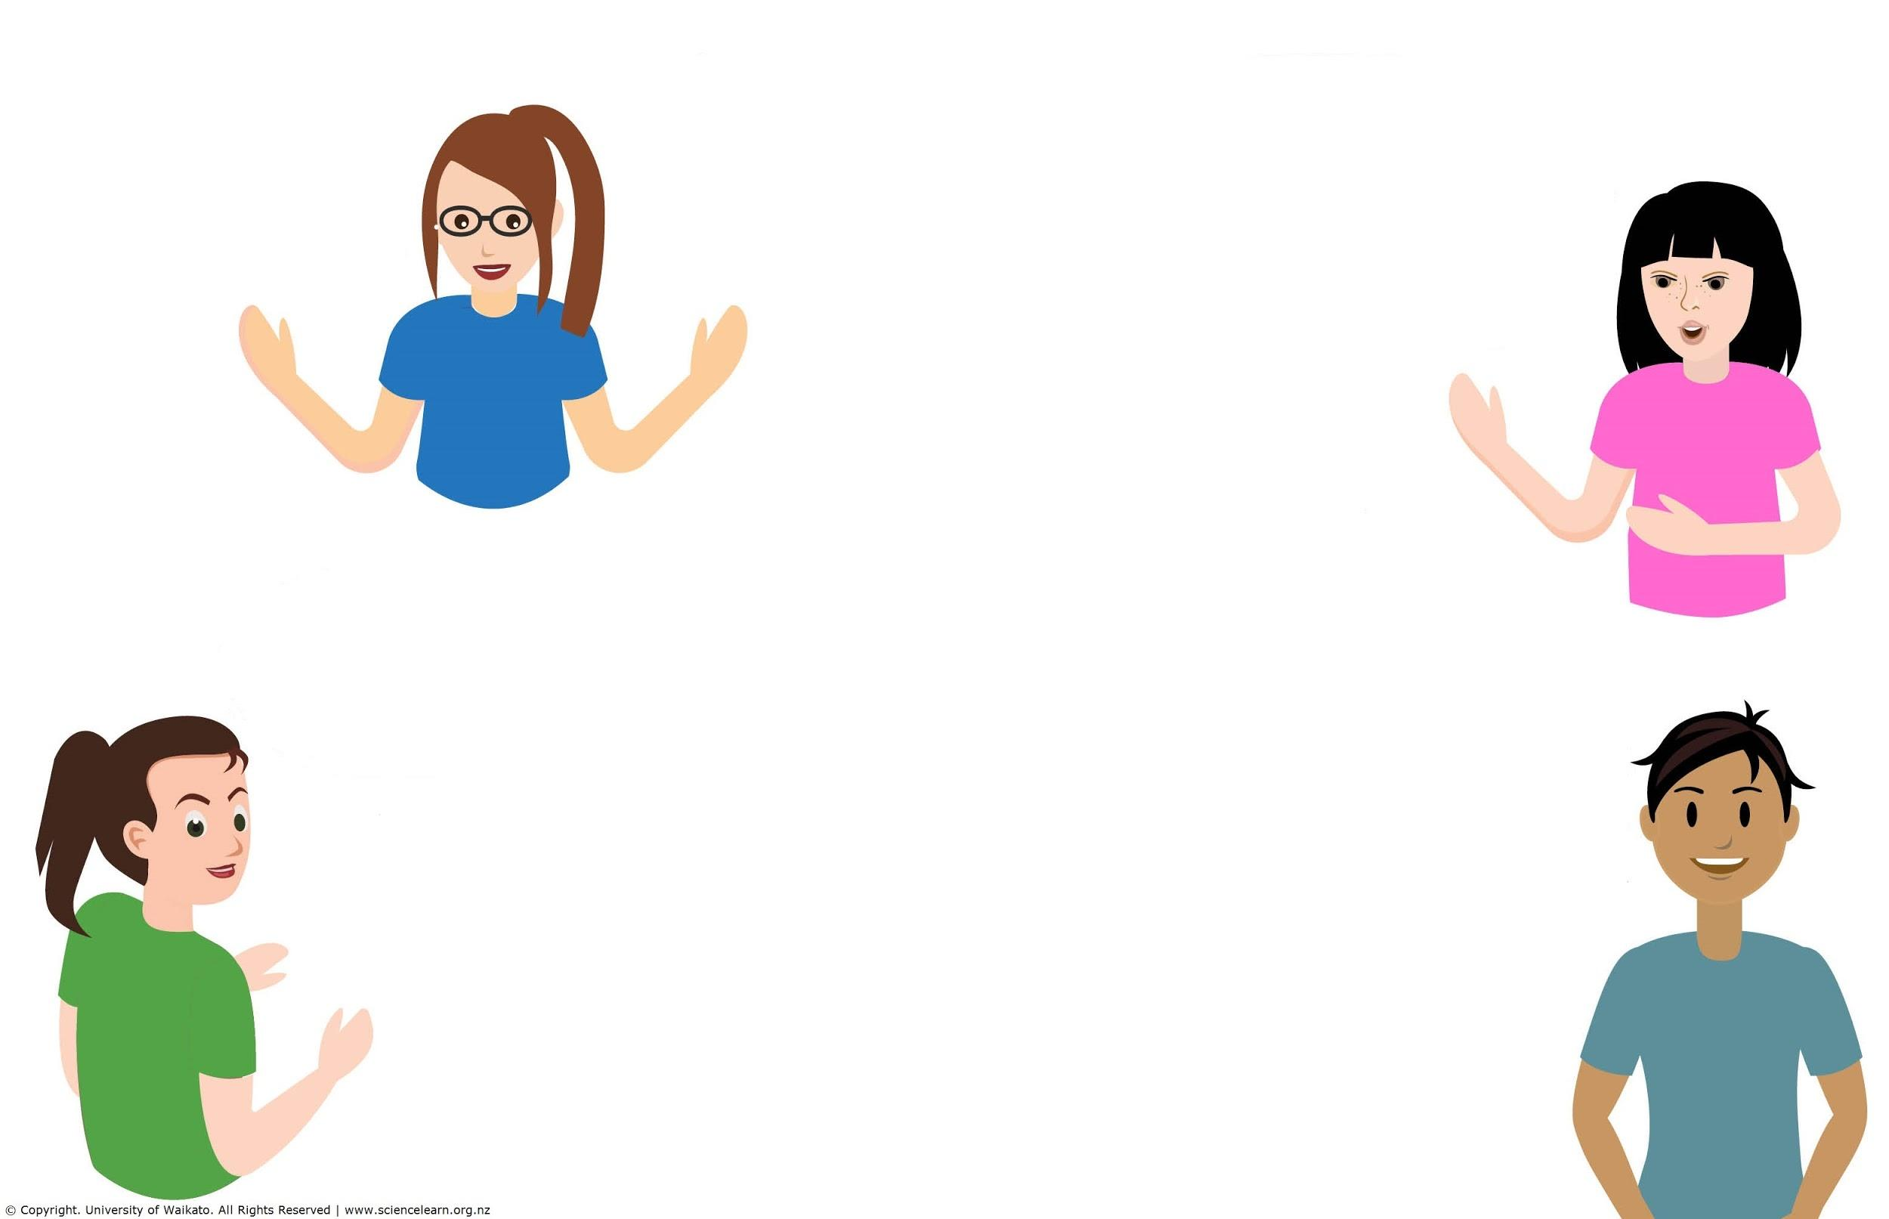
What digital tools do
you already use?
Phone apps for weather, recording or tuning guitar.
iNaturalist and Seek ID apps.
Digital thermometer for measuring temperature – change in state, scales for mass.
Zoom
A classroom smart/interactive board used for projecting visuals, videos, powerpoints, etc.
Chromebooks, iPods for students recording video and pictures, laptops, projector (daily for teaching).
© Copyright. Science Learning Hub – Pokapū Akoranga Pūtaiao The University of Waikato Te Whare Wananga o Waikato.
All Rights Reserved | www.sciencelearn.org.nz. All images are copyrighted. For further information, please refer to enquiries@sciencelearn.org.nz
Notes:
Science Learning Hub

Slide 8
Types of tools
Apps – programs that run on a mobile device e.g. Arduino Science Journal, iNaturalist, Pasco
Web based – programs that run in a browser as a website e.g. Google sheets, PhET simulations
Hardware – devices that have one or more specific purposes e.g. digital thermometer, motion sensor
© Copyright. Science Learning Hub – Pokapū Akoranga Pūtaiao The University of Waikato Te Whare Wananga o Waikato.
All Rights Reserved | www.sciencelearn.org.nz. All images are copyrighted. For further information, please refer to enquiries@sciencelearn.org.nz

Slide 9
Nature of science
Understanding about science: exploring science ideas, forming scientific explanations, science knowledge and the ways that science is done.
Investigating in science: student investigations, attitudes that support investigations, carrying out an investigation and interpreting observations.
Communicating in science: developing the vocabulary, numeric and symbol systems, and conventions of science, and using this knowledge to communicate about their own and others’ ideas.
Participating and contributing: using a scientific perspective to decisions and actions as appropriate.
“The nature of science strand is the overarching, unifying strand in the science learning area”
TKI Nature of science
© Copyright. Science Learning Hub – Pokapū Akoranga Pūtaiao The University of Waikato Te Whare Wananga o Waikato.
All Rights Reserved | www.sciencelearn.org.nz. All images are copyrighted. For further information, please refer to enquiries@sciencelearn.org.nz

Slide 10
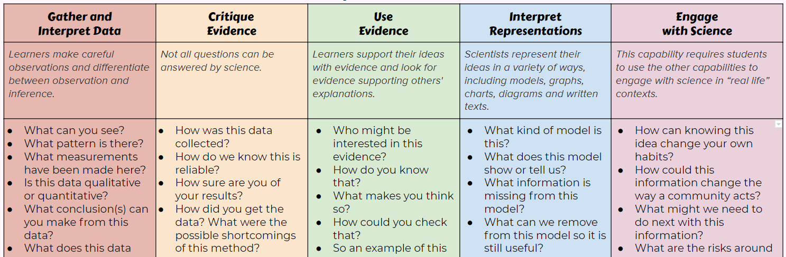

Science Capabilities:
Questioning
List of questions here – what could be added/changed?
Junior-friendly version here.
© Copyright. Science Learning Hub – Pokapū Akoranga Pūtaiao The University of Waikato Te Whare Wananga o Waikato.
All Rights Reserved | www.sciencelearn.org.nz. All images are copyrighted. For further information, please refer to enquiries@sciencelearn.org.nz

Slide 11
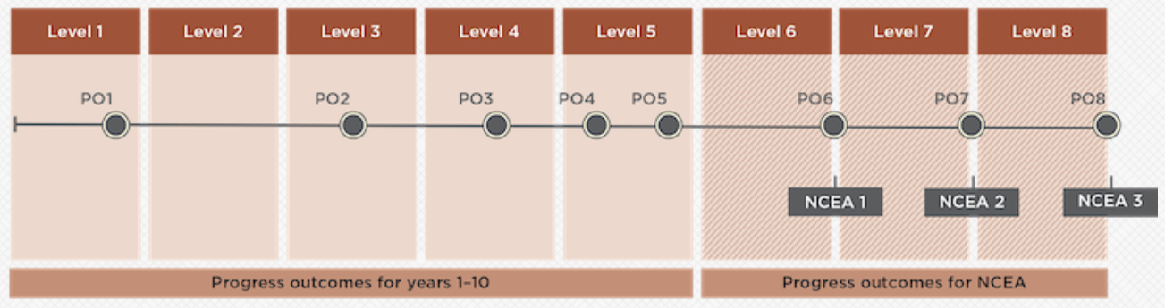
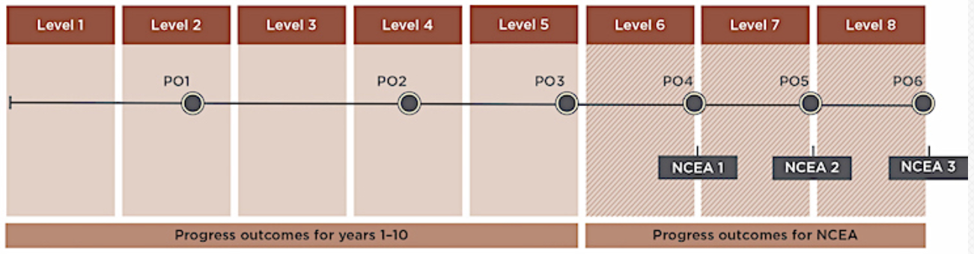
Digital Technologies: Progress Outcomes
Computational Thinking (CT)
CT exemplars here
© Crown copyright
Designing and Developing Digital Outcomes (DDDO)
DDDO exemplars here
© Crown copyright
© Copyright. Science Learning Hub – Pokapū Akoranga Pūtaiao The University of Waikato Te Whare Wananga o Waikato.
All Rights Reserved | www.sciencelearn.org.nz. All images are copyrighted. For further information, please refer to enquiries@sciencelearn.org.nz

Slide 12
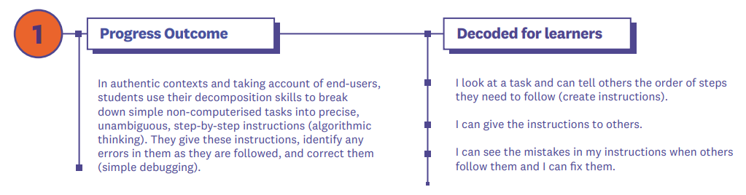

Progress Outcomes: student speak
Raranga Matihiko: Decoded for learners series click here.
Two separate PDFs for CT and DDDO
© Copyright. Science Learning Hub – Pokapū Akoranga Pūtaiao The University of Waikato Te Whare Wananga o Waikato.
All Rights Reserved | www.sciencelearn.org.nz. All images are copyrighted. For further information, please refer to enquiries@sciencelearn.org.nz
Notes:
https://uploads-ssl.webflow.com/5ee92d762d2ee25a917f4f9e/5eefcf9f0aad8980fae0f9f5_2.%20decoded%20for%20learners%20CT%2026Nov_Raranga-Matihiko_CT.pdf

Slide 13
CT and DDDO is about...
Digital Technologies Curriculum
Computational Thinking
Designing and Developing Digital Outcomes
Learners create instructions for others or devices to carry out.
Learners create digital media for others to interact with or consume.
© Copyright. Science Learning Hub – Pokapū Akoranga Pūtaiao The University of Waikato Te Whare Wananga o Waikato.
All Rights Reserved | www.sciencelearn.org.nz. All images are copyrighted. For further information, please refer to enquiries@sciencelearn.org.nz

Slide 14
DT and Nature of science
 |  | Understanding | Investigating | Communicating | Participating & Contributing
CT | create algorithms for computers or human? | Sequence the steps from a past scientific discovery | create methods or instructions | retell a process | how-to for taking action as a sequence of events
DDDO | create digital content or media? | photo diary, spreadsheet, tables/graphs in documents | spreadsheets, graphs, video showing how to carry out a process | spreadsheets, graphs, tables, vlog detailing process and inferences | videos, posters, animations, digital games
CT: Computational thinking
DDDO: Designing and developing digital outcomes
© Copyright. Science Learning Hub – Pokapū Akoranga Pūtaiao The University of Waikato Te Whare Wananga o Waikato.
All Rights Reserved | www.sciencelearn.org.nz. All images are copyrighted. For further information, please refer to enquiries@sciencelearn.org.nz

Slide 15

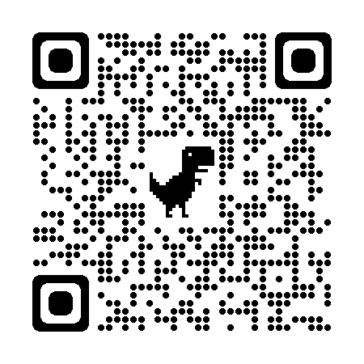
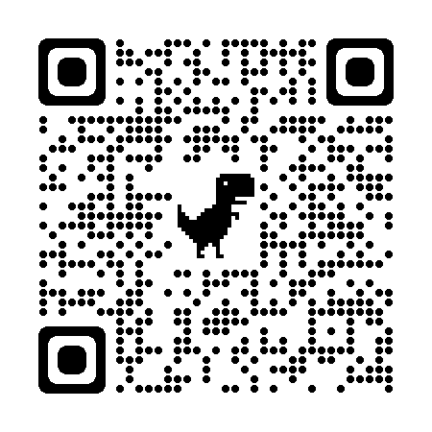
Install the Arduino Science Journal app on your mobile device
Android
iOs
© Copyright. Science Learning Hub – Pokapū Akoranga Pūtaiao The University of Waikato Te Whare Wananga o Waikato.
All Rights Reserved | www.sciencelearn.org.nz. All images are copyrighted. For further information, please refer to enquiries@sciencelearn.org.nz
Notes:
Android: https://play.google.com/store/apps/details?id=cc.arduino.sciencejournal
IOs: https://apps.apple.com/us/app/arduino-science-journal/id1518014927

Slide 16
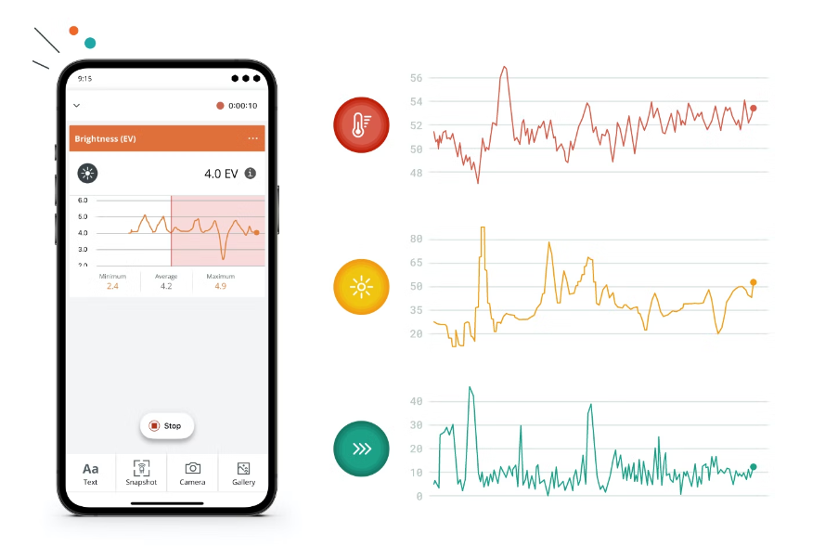
Arduino Science Journal
© Copyright. Science Learning Hub – Pokapū Akoranga Pūtaiao The University of Waikato Te Whare Wananga o Waikato.
All Rights Reserved | www.sciencelearn.org.nz. All images are copyrighted. For further information, please refer to enquiries@sciencelearn.org.nz

Slide 17
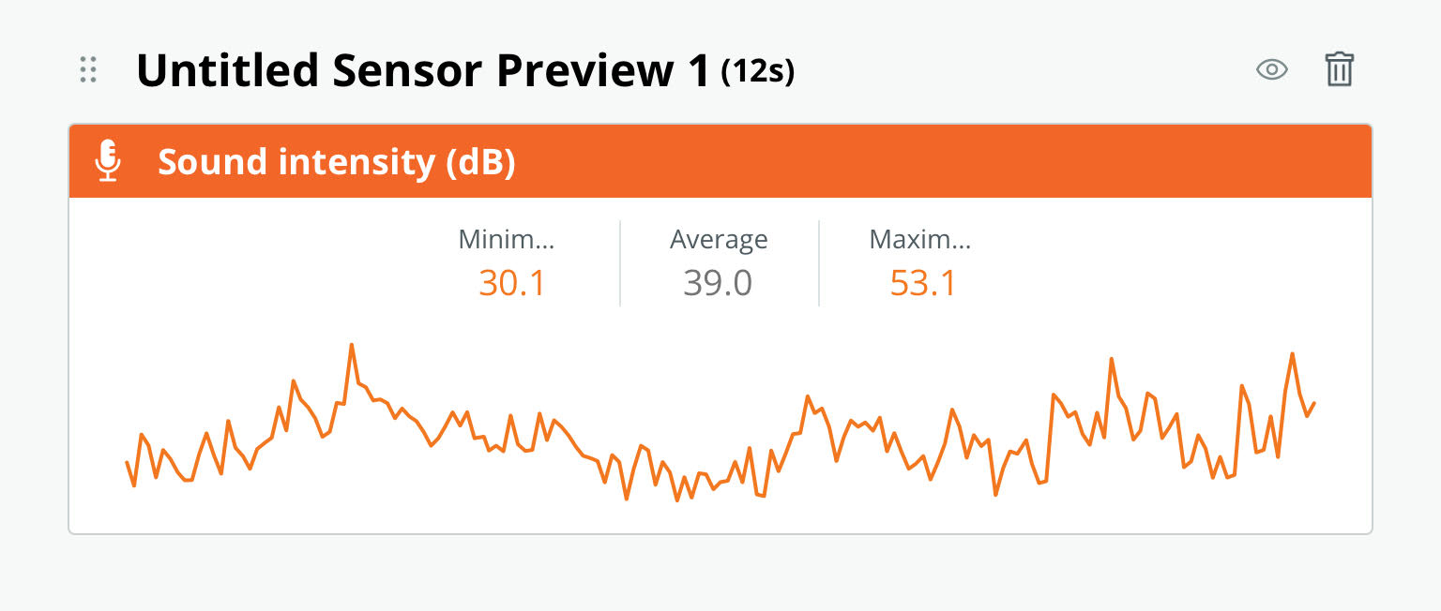
Instant graphs
The Arduino SJ app will record sensor data for a time and give you the minimum, maximum and average values for the session.
© Copyright. Science Learning Hub – Pokapū Akoranga Pūtaiao The University of Waikato Te Whare Wananga o Waikato.
All Rights Reserved | www.sciencelearn.org.nz. All images are copyrighted. For further information, please refer to enquiries@sciencelearn.org.nz

Slide 18
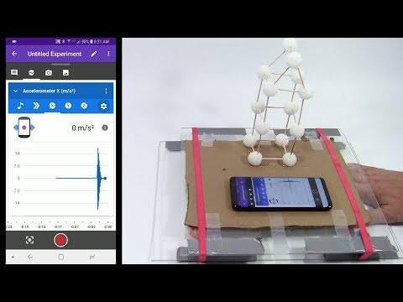
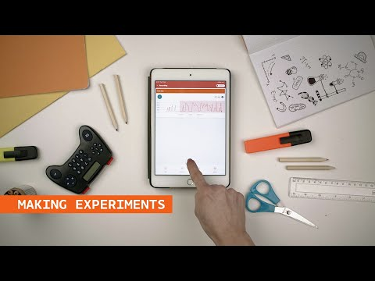
ASJ app resources
Official Arduino experiments with light, sound, electricity, and motion (some require extra peripherals for older learners).
Six physics investigations:
Fun activities that generate data to talk about: Arduino Science Journal Activities.
Short intro to using the app:
© Science buddies
© Arduino
© Copyright. Science Learning Hub – Pokapū Akoranga Pūtaiao The University of Waikato Te Whare Wananga o Waikato.
All Rights Reserved | www.sciencelearn.org.nz. All images are copyrighted. For further information, please refer to enquiries@sciencelearn.org.nz

Slide 19
Micro:bit
https://makecode.microbit.org
© Copyright. Science Learning Hub – Pokapū Akoranga Pūtaiao The University of Waikato Te Whare Wananga o Waikato.
All Rights Reserved | www.sciencelearn.org.nz. All images are copyrighted. For further information, please refer to enquiries@sciencelearn.org.nz
Notes:
https://makecode.microbit.org

Slide 20
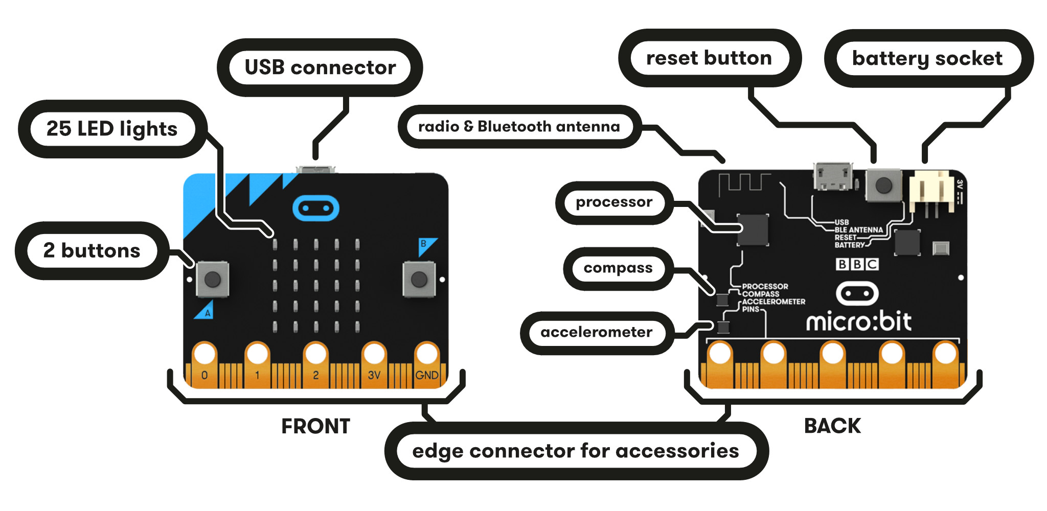
Micro:bit features
© Copyright. Science Learning Hub – Pokapū Akoranga Pūtaiao The University of Waikato Te Whare Wananga o Waikato.
All Rights Reserved | www.sciencelearn.org.nz. All images are copyrighted. For further information, please refer to enquiries@sciencelearn.org.nz

Slide 21
Micro:bit process
Code the Micro:bit in a browser of any device OR via a mobile app for iPad/Android.
Download the code to the Micro:bit via USB or Bluetooth.
© Copyright. Science Learning Hub – Pokapū Akoranga Pūtaiao The University of Waikato Te Whare Wananga o Waikato.
All Rights Reserved | www.sciencelearn.org.nz. All images are copyrighted. For further information, please refer to enquiries@sciencelearn.org.nz

Slide 22
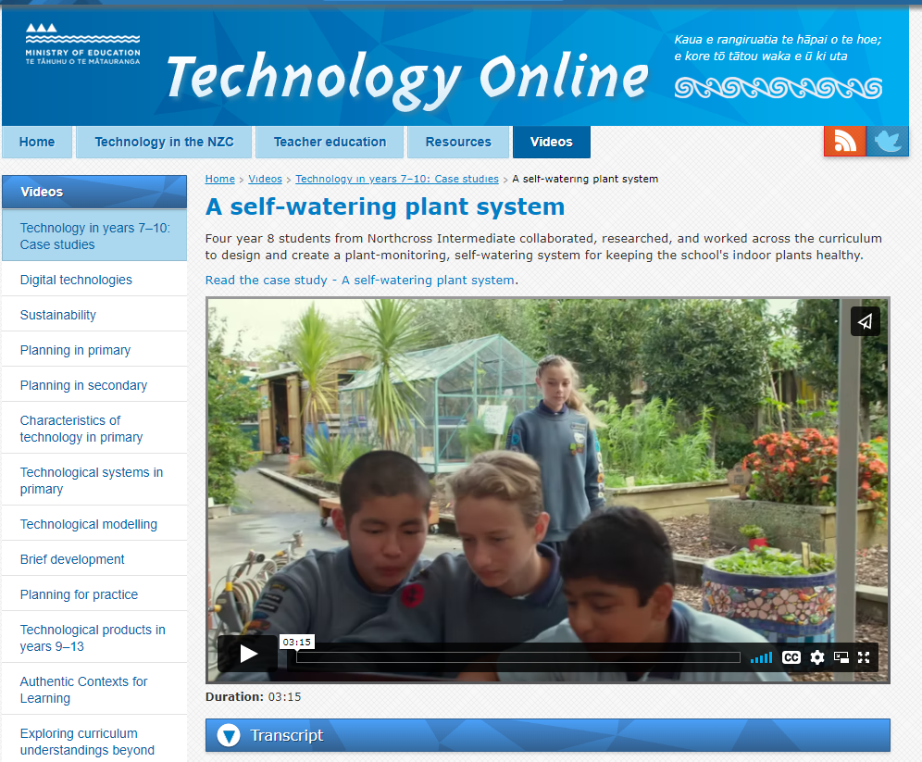
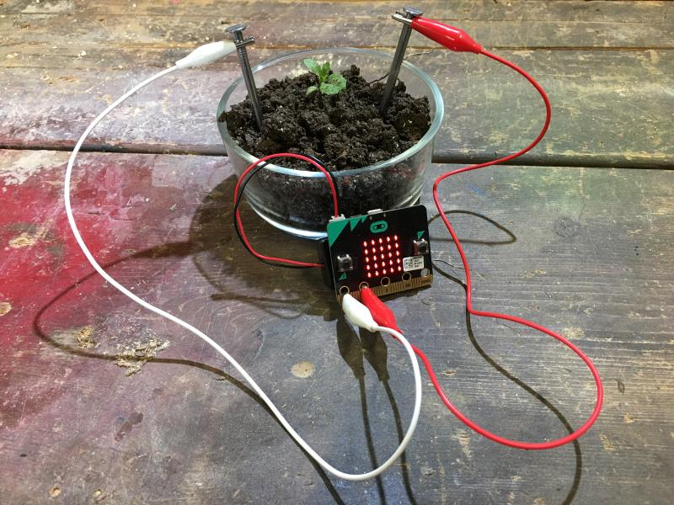
Science and DT: plant moisture
© Crown copyright
Soil moisture guide: click here.
© Crown copyright
© Copyright. Science Learning Hub – Pokapū Akoranga Pūtaiao The University of Waikato Te Whare Wananga o Waikato.
All Rights Reserved | www.sciencelearn.org.nz. All images are copyrighted. For further information, please refer to enquiries@sciencelearn.org.nz

Slide 23
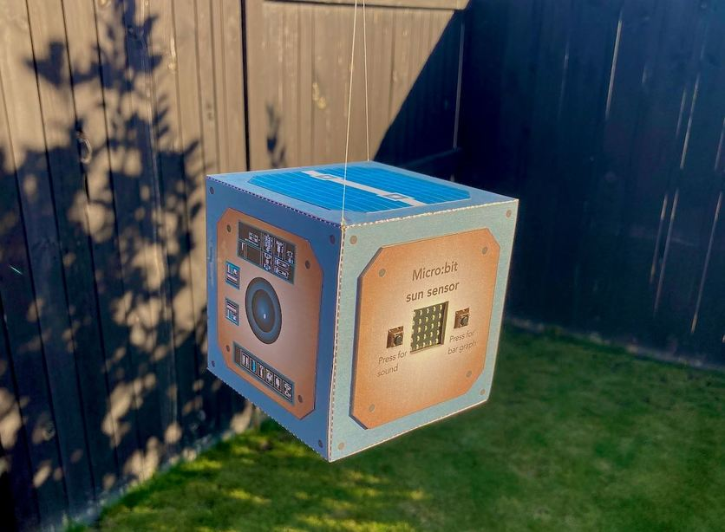
Make a model CubeSat
and micro:bit sun sensor
© Copyright. Science Learning Hub – Pokapū Akoranga Pūtaiao The University of Waikato Te Whare Wananga o Waikato.
All Rights Reserved | www.sciencelearn.org.nz. All images are copyrighted. For further information, please refer to enquiries@sciencelearn.org.nz
Notes:
Image: www.sciencelearn.org.nz/images/4929-completed-model-cubesat
Activity: www.sciencelearn.org.nz/resources/3163-make-a-model-cubesat-and-micro-bit-sun-sensor

Slide 24
Micro:bit and Arduino
Gathering and interpret evidence
Use evidence
Critique evidence
Interpret representations
Investigating
Communicating
© Copyright. Science Learning Hub – Pokapū Akoranga Pūtaiao The University of Waikato Te Whare Wananga o Waikato.
All Rights Reserved | www.sciencelearn.org.nz. All images are copyrighted. For further information, please refer to enquiries@sciencelearn.org.nz

Slide 25
DT and Nature of science
 |  | Understanding | Investigating | Communicating | Participating & Contributing
CT | create algorithms for computers or human? | Sequence the steps from a past scientific discovery | create methods or instructions | retell a process | how-to for taking action as a sequence of events
DDDO | create digital content or media? | photo diary, spreadsheet, tables/graphs in documents | spreadsheets, graphs, video showing how to carry out a process | spreadsheets, graphs, tables, vlog detailing process and inferences | videos, posters, animations, digital games
CT: Computational thinking
DDDO: Designing and developing digital outcomes
© Copyright. Science Learning Hub – Pokapū Akoranga Pūtaiao The University of Waikato Te Whare Wananga o Waikato.
All Rights Reserved | www.sciencelearn.org.nz. All images are copyrighted. For further information, please refer to enquiries@sciencelearn.org.nz

Slide 26





Stephen Ross
021 136 4912
stephen.ross@waikato.ac.nz
Connect with us:
Sign up for our newsletter
Explore our range
of workshops

Slide 27





Thanks – want to keep in touch?
Email us on enquiries@sciencelearn.org.nz
https://twitter.com/NZScienceLearn
www.facebook.com/nzsciencelearn
https://nz.pinterest.com/nzsciencelearn
www.instagram.com/sciencelearninghubnz
Join us in our discussion channel on Slack (http://slh-talk.slack.com).
(Any problems accessing Slack, please contact us via our enquiries email, enquiries@sciencelearn.org.nz.)
Notes:
Feedback/more of this?
Certificates

