Slide 1
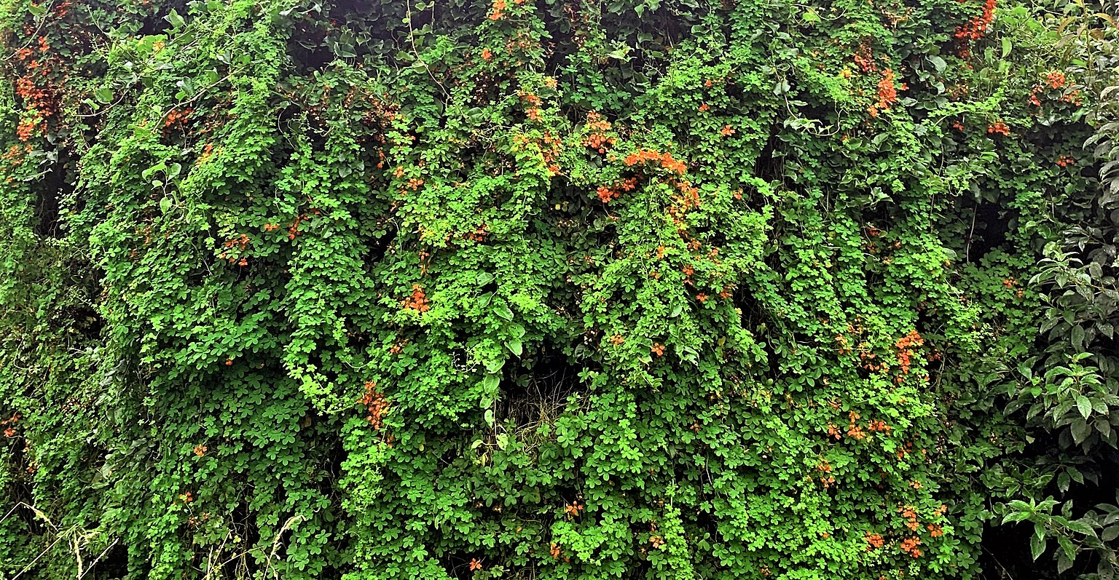

Weeds that threaten native ecosystems
Information in this slideshow is drawn from the Weedbusters website and from the Parliamentary Commissioner for the Environment’s 2021 report Space invaders: A review of how New Zealand manages weeds that threaten native ecosystems.

Slide 2
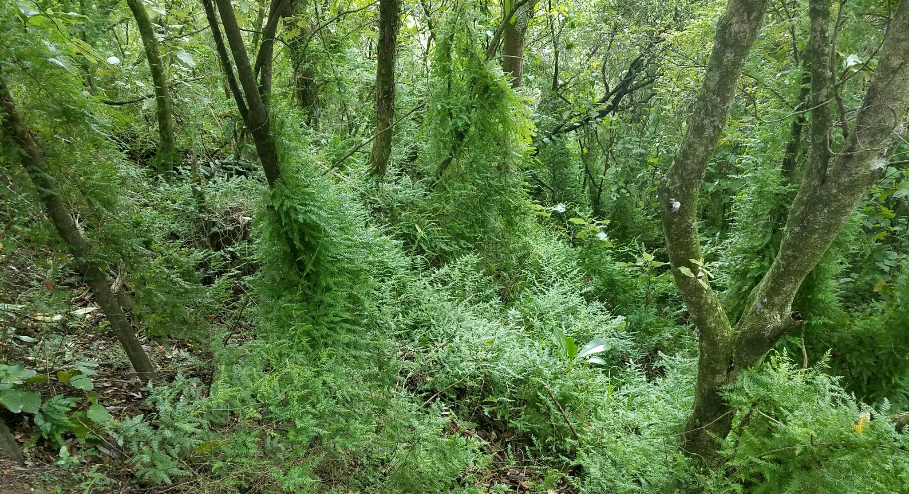
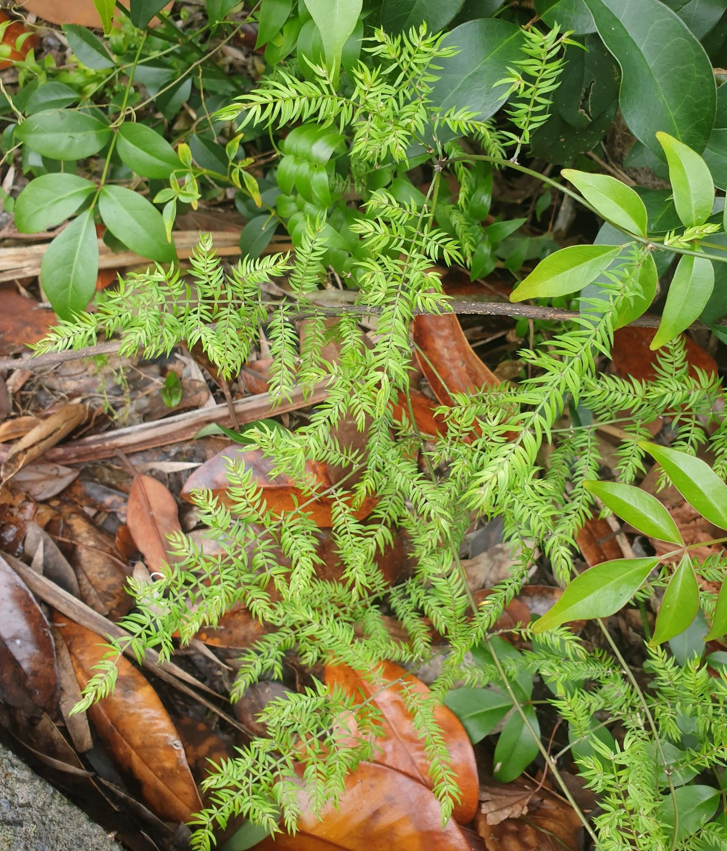
Image: hedley, CC BY-NC 4.0. Sourced from iNaturalistNZ.
Image: chrisc, CC BY-NC 4.0. Sourced from iNaturalistNZ.
Climbing asparagus (Asparagus scandens)
Why is it weedy?
Climbing asparagus can grow throughout the understorey of native forest, halting regeneration of native plants and scrambling up the trunks of trees and shrubs. When it has overwhelmed the canopy, it completely transforms the forest. It reproduces sexually through seeds and can also resprout from small fragments of plant (vegetative reproduction), making it a very successful invader. You can see the damage it can do in Northland where it dominates forests.

Slide 3
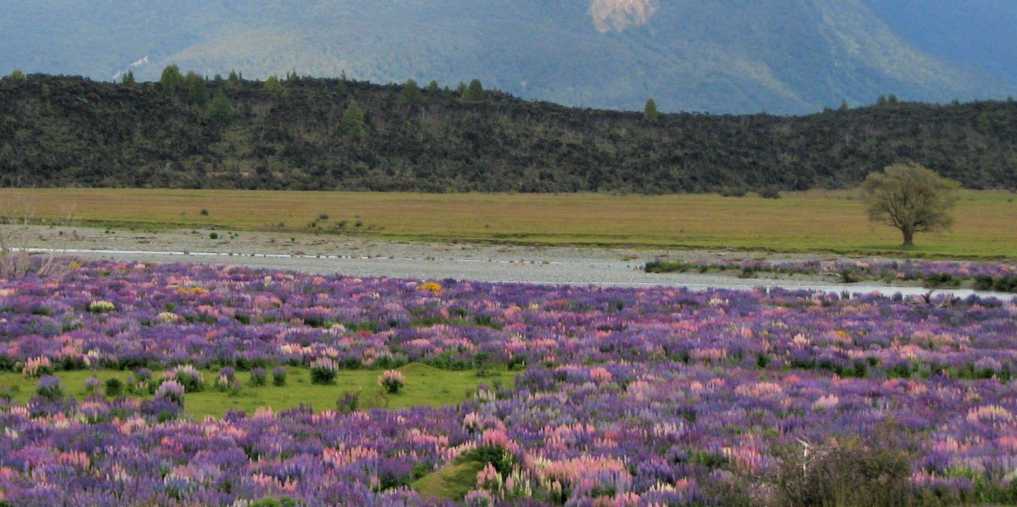
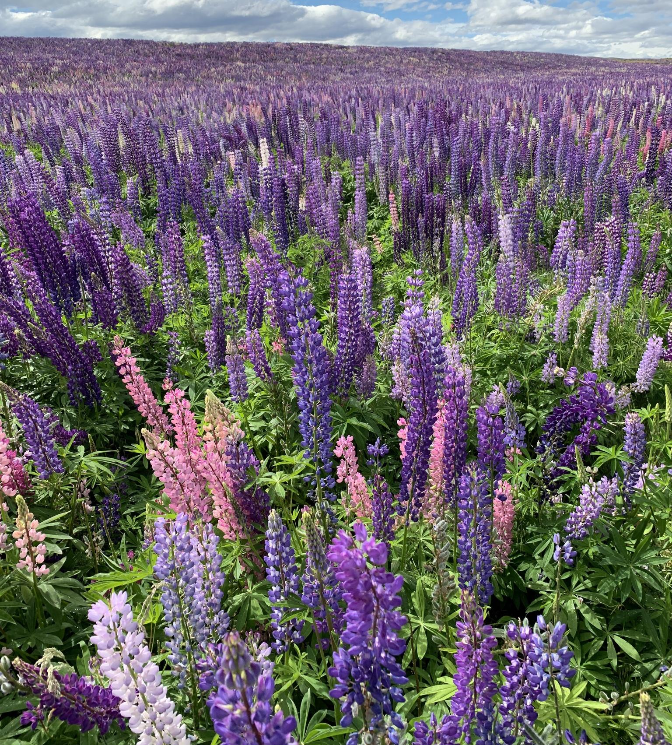
Image: Susan, CC BY-NC 4.0. Sourced from iNaturalistNZ.
Image: Anita Gould, Flickr. CC BY-NC 2.0.
Russell lupin (Lupinus polyphyllus)
Why is it weedy?
Russell lupins spread rapidly, forming dense stands in the gravel beds of braided riverbeds, creating problems for the native species that live there. The plants provide increased cover for predators and smother open nesting sites on the boulder banks. The dense infestations fundamentally alter river processes such as the way the braids and islands form as their roots stabilise riverbanks.
The plants produce large amounts of seed that are spread by water and by humans (often intentionally to encourage tourism).

Slide 4
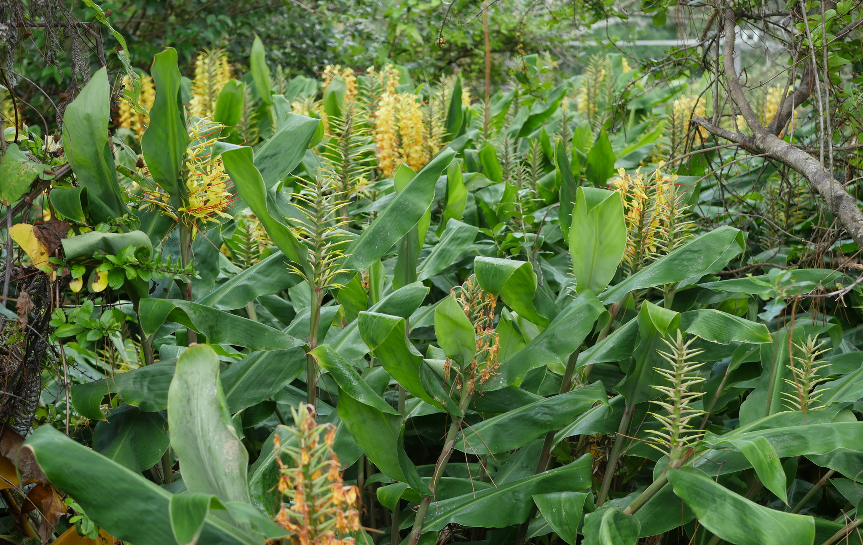
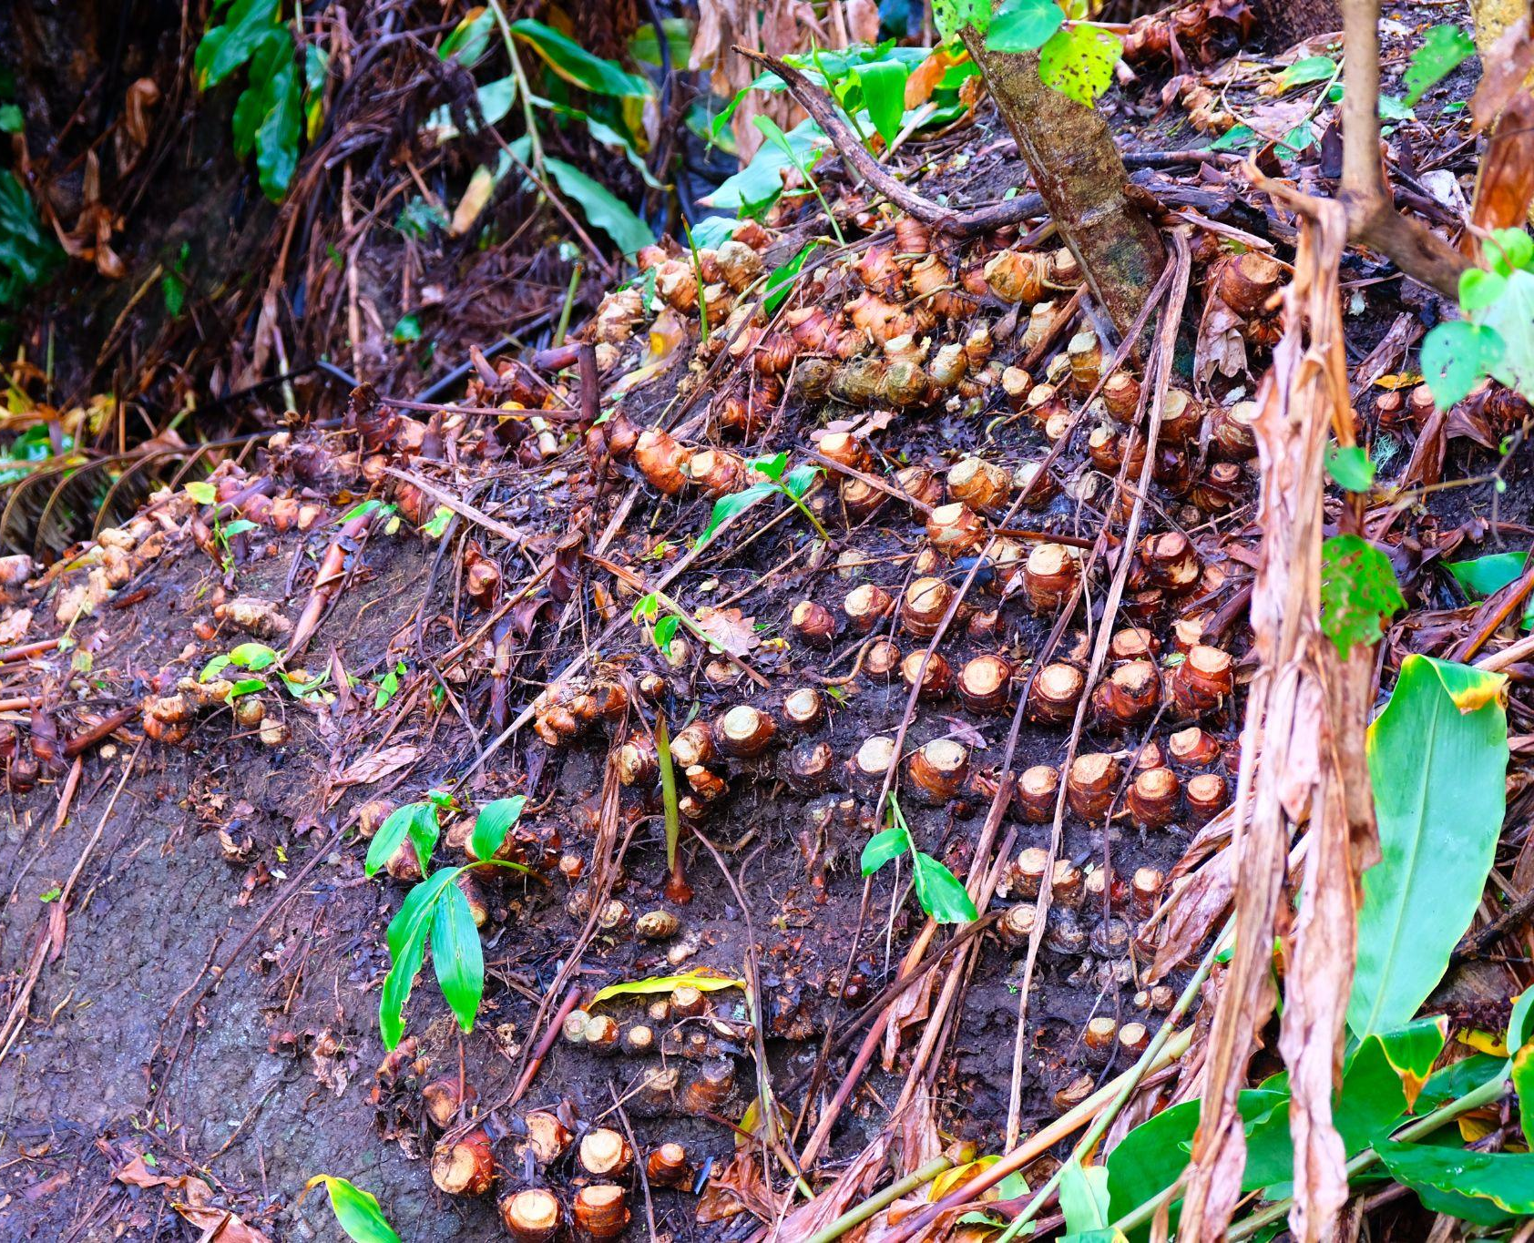
Rhizomes
Image: Bruce Calvert, CC BY 4.0. Sourced from iNaturalistNZ.
Wild ginger (Hedychium gardnerianum)
Why is it weedy?
Wild ginger can infiltrate intact forests, forming dense rhizome beds that exclude native species that are usually found growing in the understorey. Over time, these beds prevent native regeneration and cause the forest canopy to collapse. The plant can reproduce both vegetatively (via rhizomes) and sexually (via seeds), giving it more opportunities to spread to new sites. Rhizomes can survive immersion in the sea, crushing and years away from soil. The plant is dominant in warmer, northern regions.

Slide 5
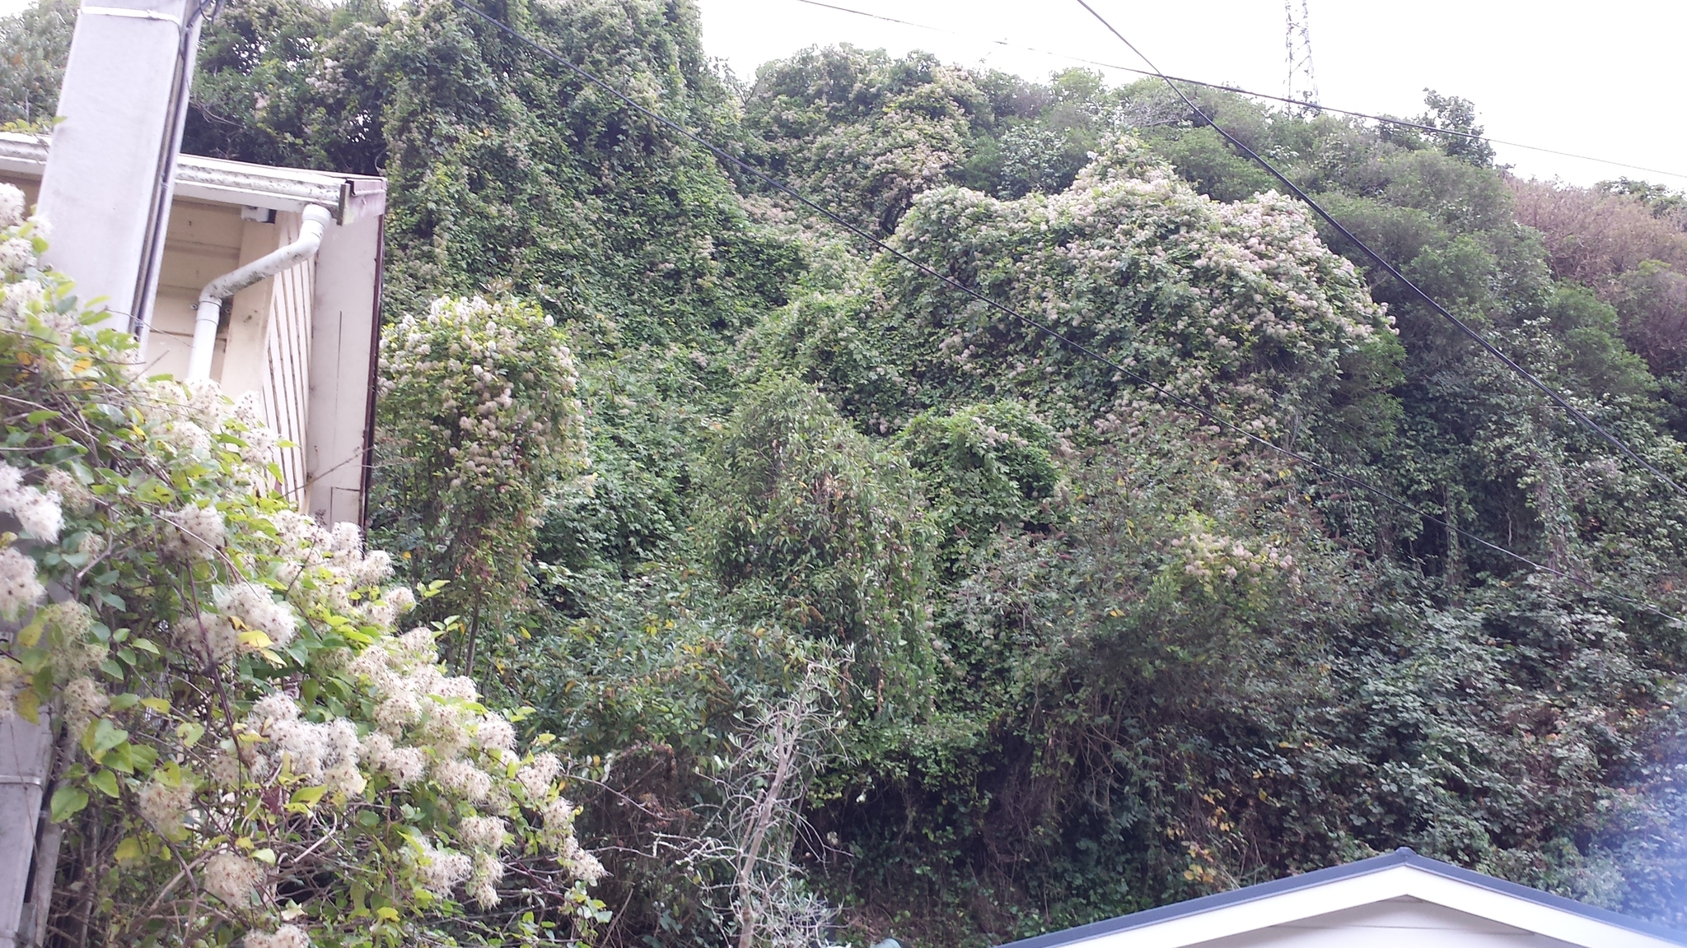
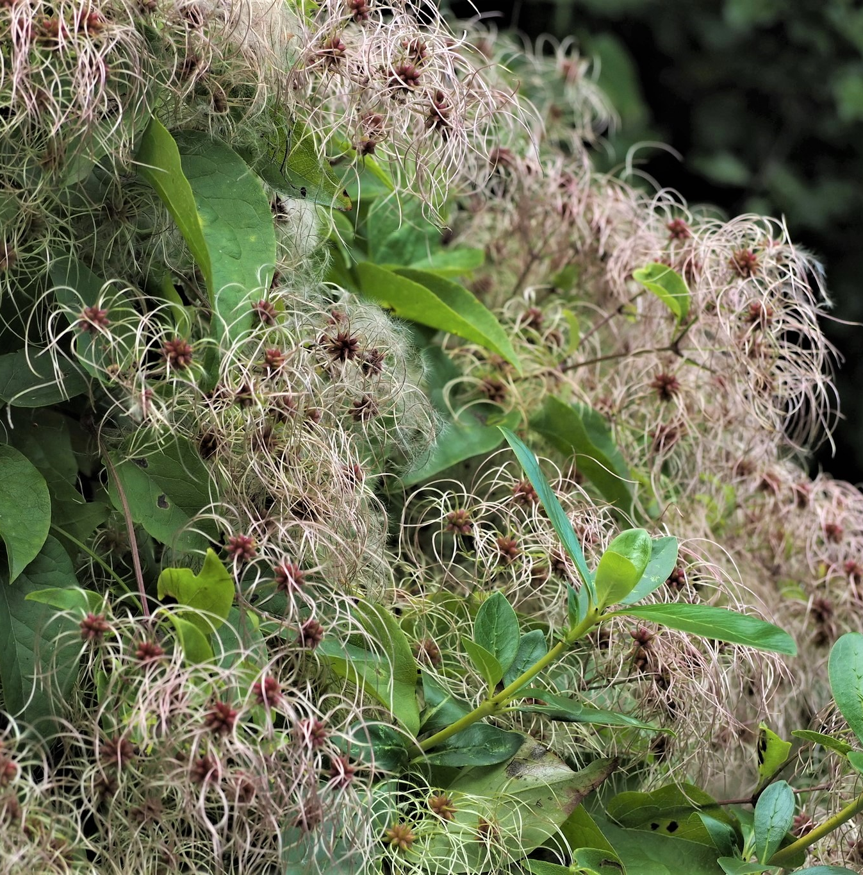
Image: Gordon Somerville, CC BY-NC 4.0. Sourced from iNaturalistNZ.
Image: emanon, CC BY-NC 4.0 . Sourced from iNaturalistNZ.
Old man’s beard (Clematis vitalba)
Why is it weedy?
Old man’s beard grows rapidly, forming dense, heavy masses that dominate canopies of any height. It smothers and kills all plants (in the most extreme situations causing the canopy to collapse) and prevents the establishment of native plant seedlings. It can produce over 35,000 seeds per square metre, and seeds can travel up to 100 metres on the air. Several community groups such as Old Man's Beard Free Wellington are dedicated to tackling the weed.

Slide 6
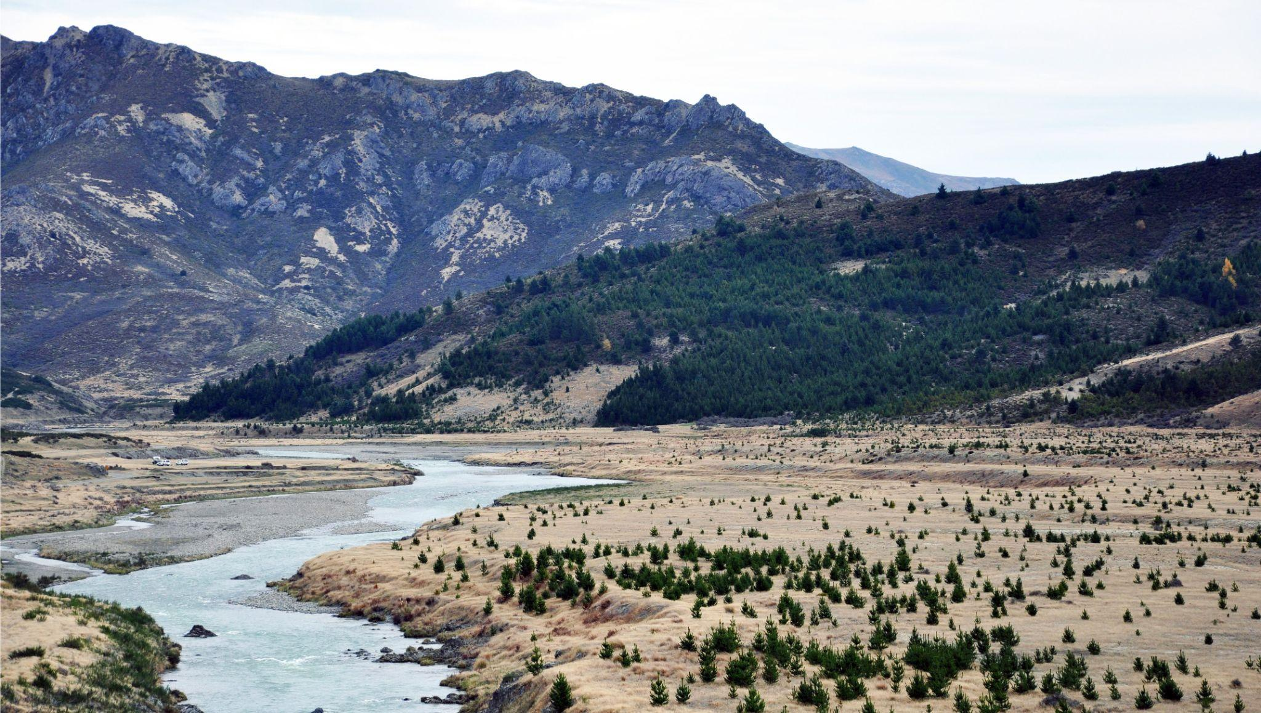
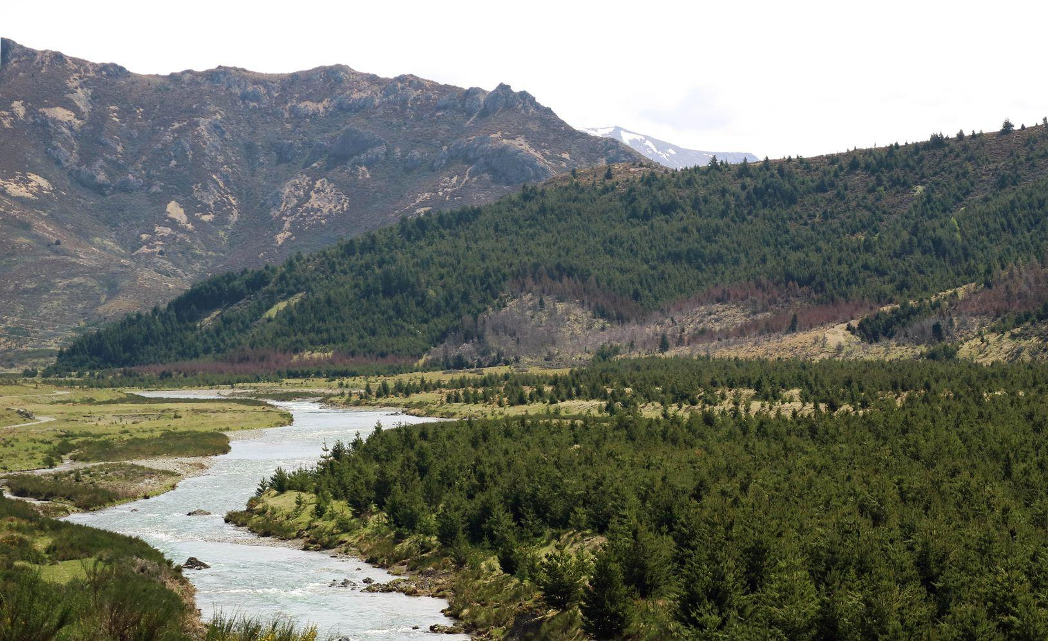
2014
2017
The speed with which wilding conifers can spread and grow can be seen in these two photos of the upper Waiau Toa/Clarence River taken just 3 years apart.
Images: Sherman Smith, Ministry for Primary Industries.
Wilding conifers – several species, including Douglas fir (Pseudotsuga menziesii) and Contorta pine (Pinus contorta)
Why are wilding conifers weedy?
Wilding conifers rapidly invade high country land and cost millions a year to control. They can change landscapes completely, threatening fragile grassland and herbfield ecosystems as they can grow above the existing tree line in mountainous areas. They can threaten landscape character and recreation value. They can produce up to 20,000 wind-spread seeds per tree every year, and seed can remain viable for years. The Ministry for Primary Industries has an extensive wilding conifer control programme.

Slide 7
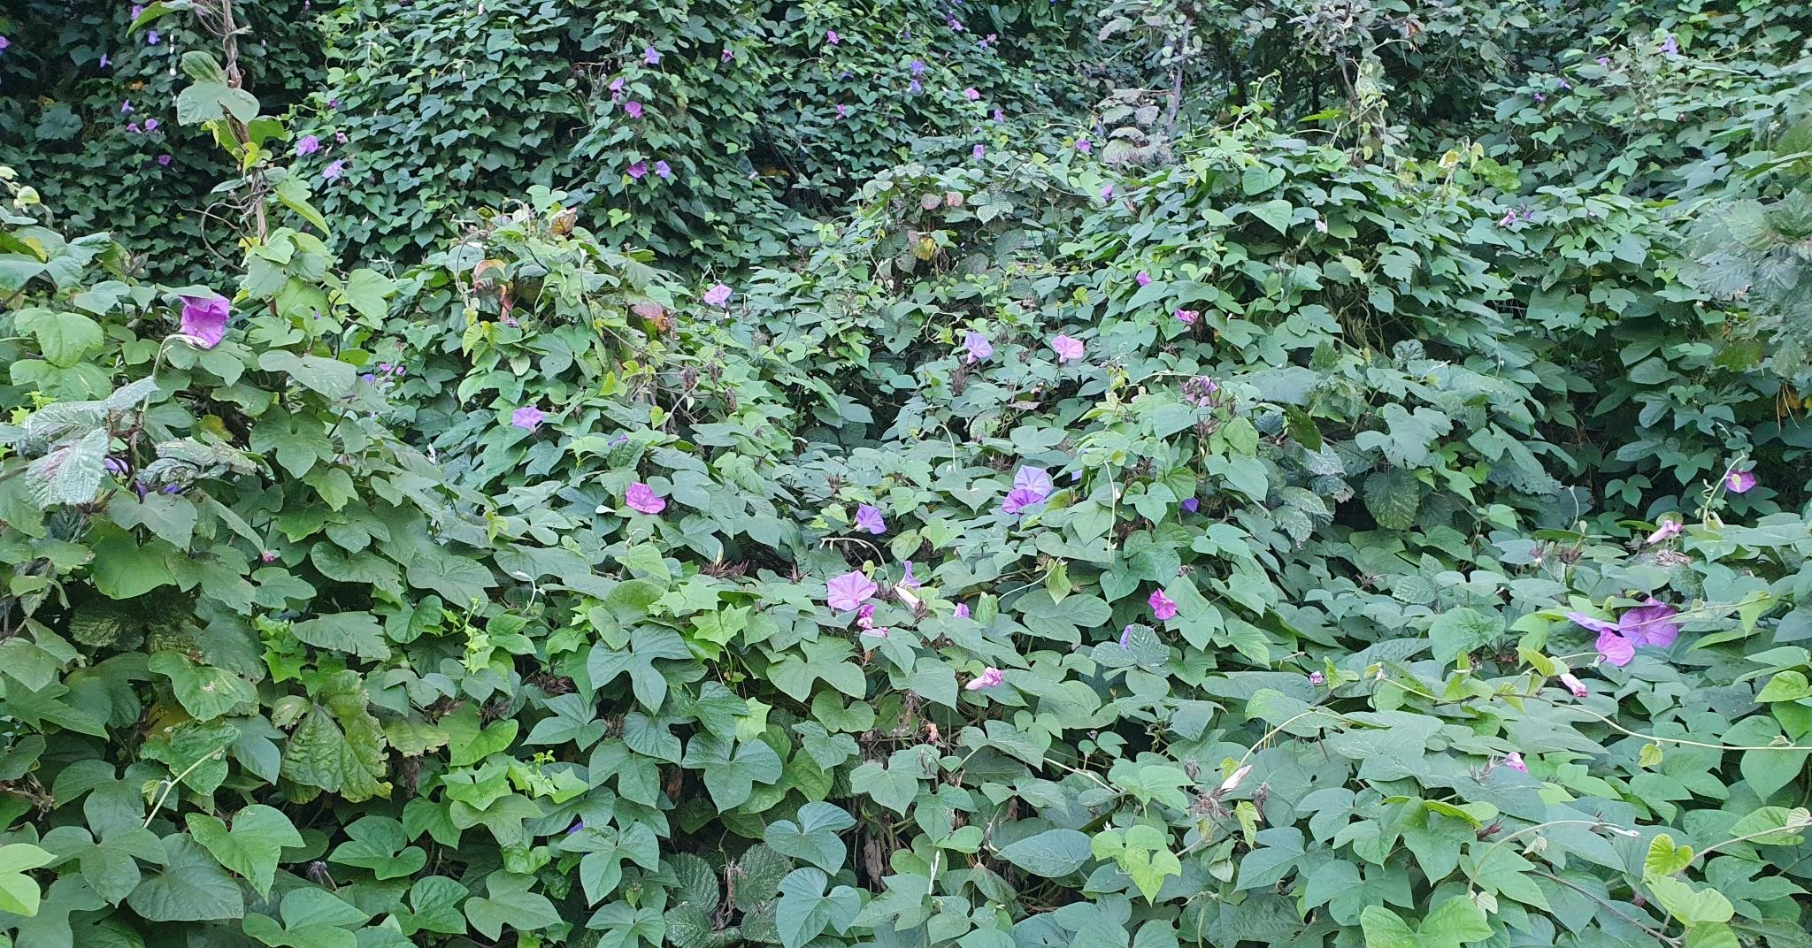
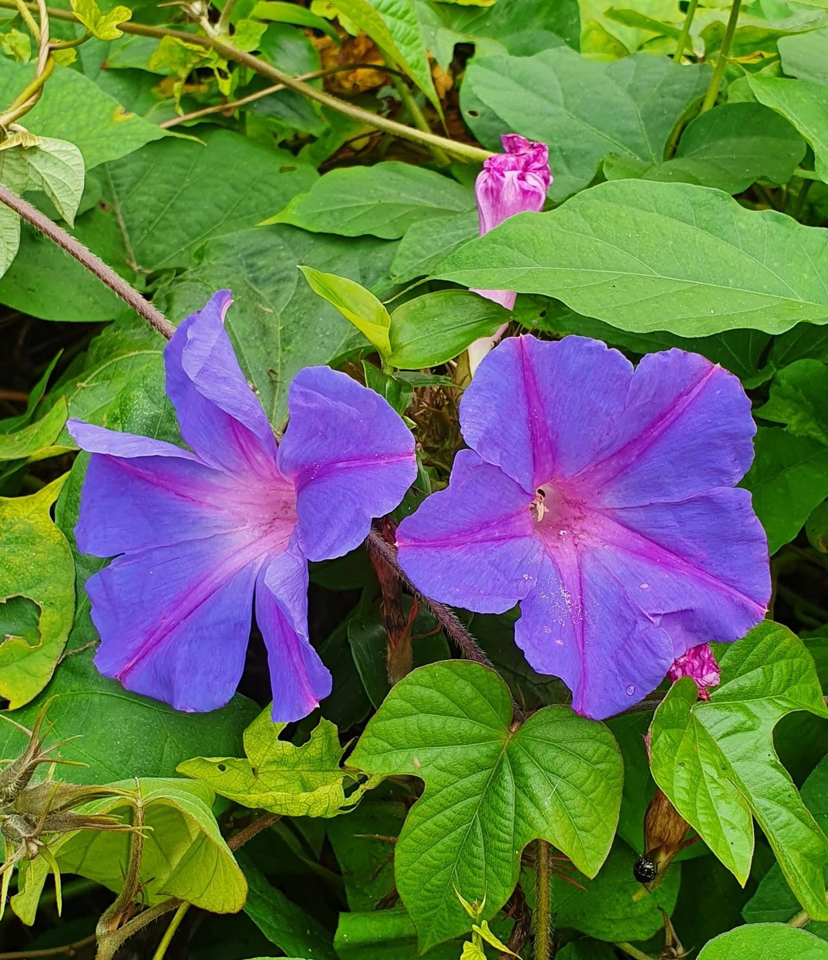
Image: Kate McAlpine, CC BY 4.0. Sourced from iNaturalistNZ.
Image: Clayson Howell, CC BY-NC 4.0. Sourced from iNaturalistNZ.
Blue morning glory (Ipomoea indica)
Why is it weedy?
Very fast growth rate, longevity, dense smothering habit and ability to climb to the top of high canopies makes this the dominant vine wherever it occurs. It tolerates hot to cool temperatures and damp to dry conditions. It climbs over all other species, ultimately killing them, and can replace forest with a low weedy blanket. It is the last species in many cases when a bush area totally succumbs to weeds.

Slide 8
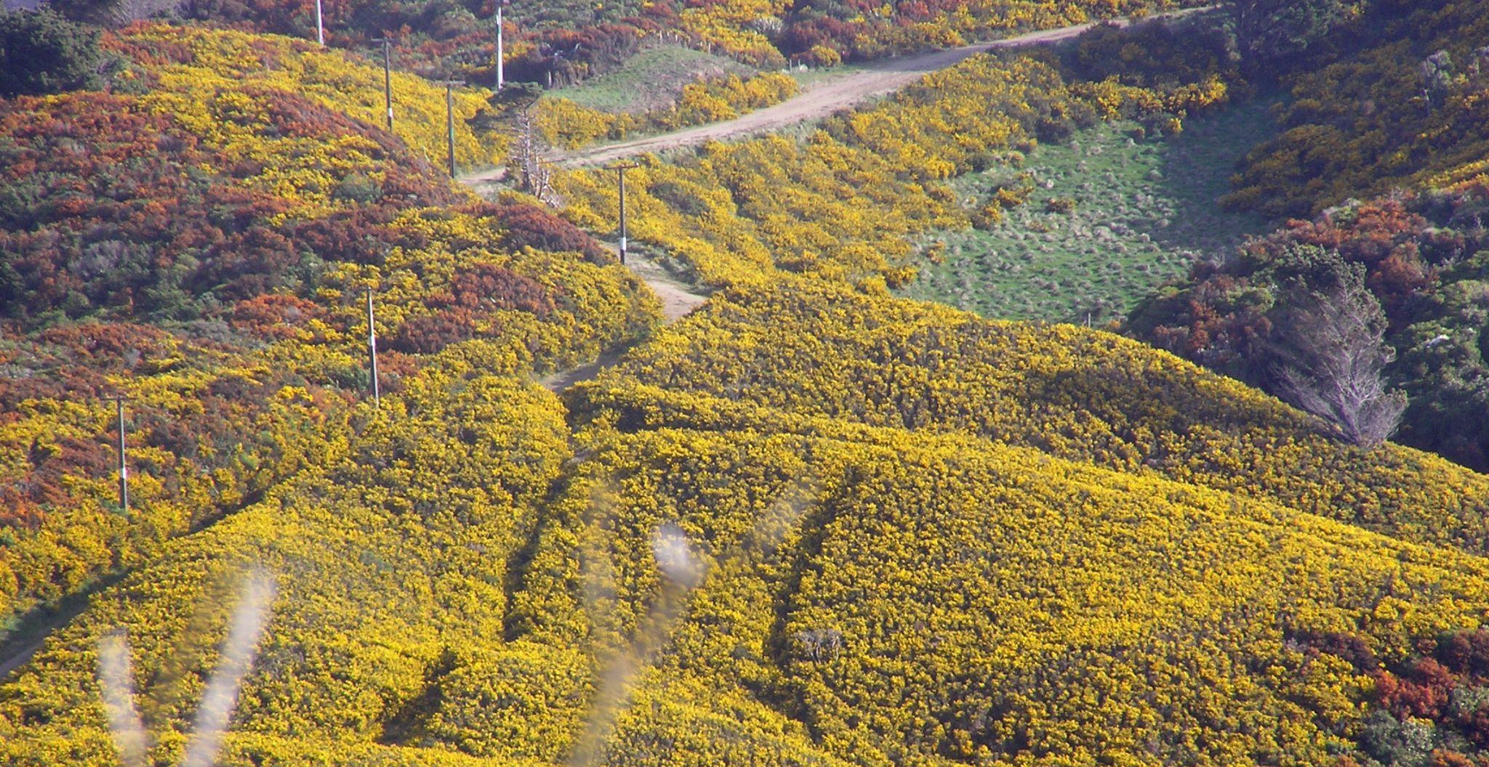
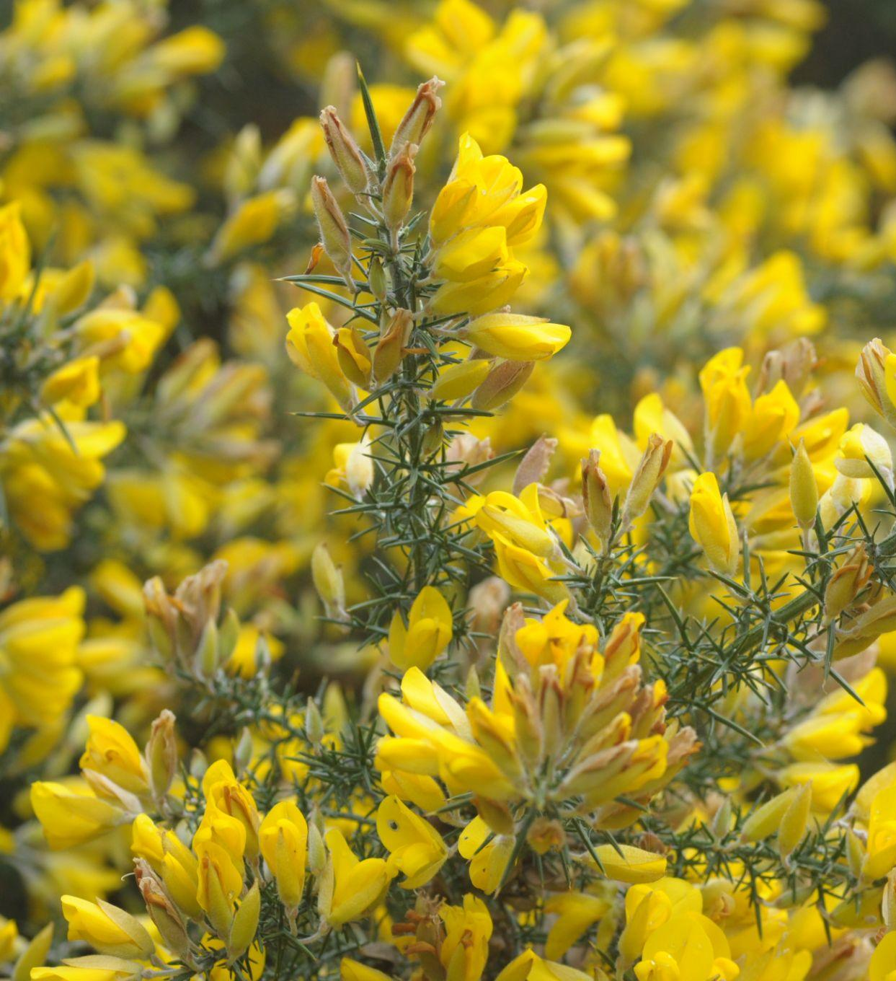
Image: Tony Mills, CC BY-SA 3.0.
Gorse (Ulex europaeus)
Why is it weedy?
Gorse was introduced by European settlers as a ‘living fence’ to stop stock from wandering. As early as 1854, gorse
fences were coming to be regarded as problematic. Today, gorse is still disliked by many landowners because of both
the way it encroaches on pasture and the fire risk it poses in drier climates. Nevertheless, in some conditions, it may serve
as a nursery for native seedlings where native forest or scrub is sparse but a native seed source is nearby. Gorse seeds may be able to germinate more than 90 years after burial in the soil.

Slide 9
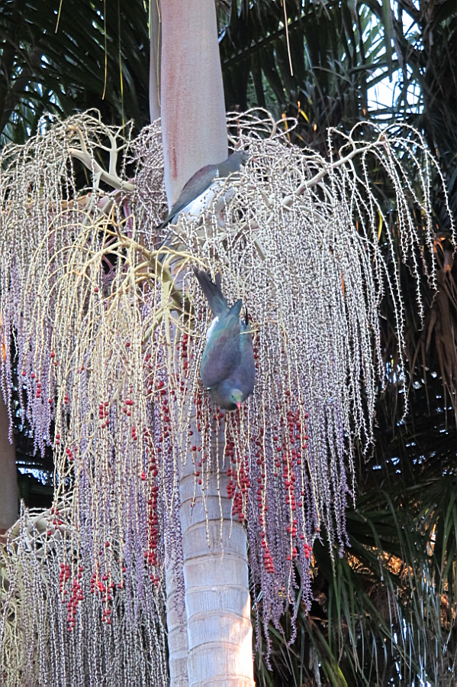
Bangalow palm (Archontophoenix cunninghamiana)
Why is it weedy?
Originally from Australia, this rainforest palm has the potential to establish in native plant habitats and has a similar habitat to nīkau such as gullies, stream banks and swampy areas.
Birds spread the seeds long distances. As the plants can produce up to 12,000 seeds per year, this creates a considerable problem. The seeds can also spread by water and gravity.
Lower rainfall in the northernmost tip of New Zealand may reduce the suitability of habitat there for bangalow palm by 2090.
Image: Northland Regional Council

Slide 10
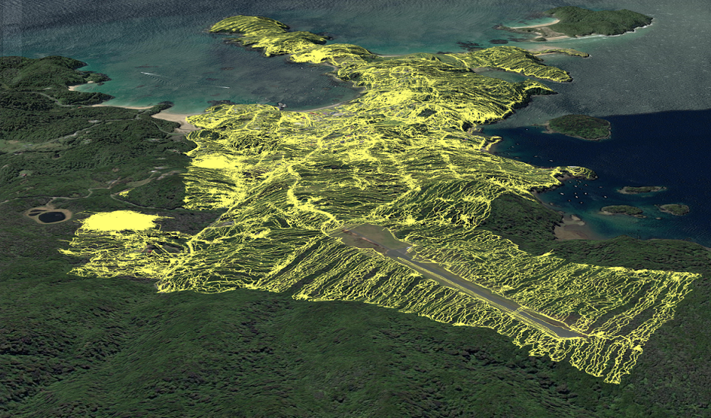
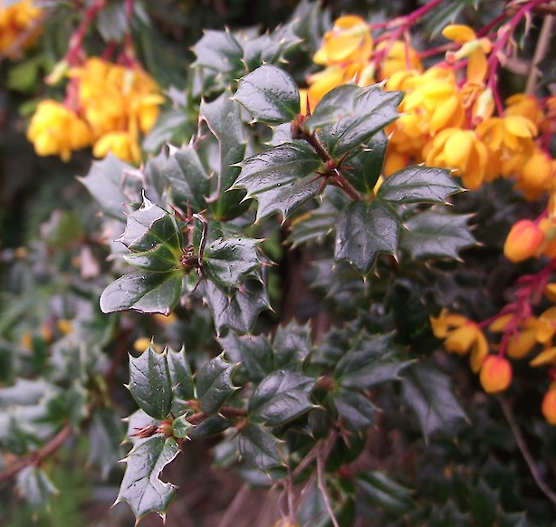
This screenshot from a GIS database shows the extent of searching (yellow tracks) by the Stewart Island/Rakiura Community & Environment Trust weed control staff between 2017 and 2020 around Oban township searching for Darwin’s barberry and other weeds.
Image: Carolyn Lewis, Weedbusters
Darwin’s barberry (Berberis darwinii)
Why is it weedy?
Darwin’s barberry tolerates moderate to cold temperatures, damp to dry conditions, high wind, salt, shade, damage, grazing (not browsed) and a range of soils. Scattered plants (occasionally dense stands) replace shrubland and regenerating forest, sometimes permanently in open habitats. A community conservation group on Rakiura have an extensive campaign to grid search and control the weed.

Slide 11
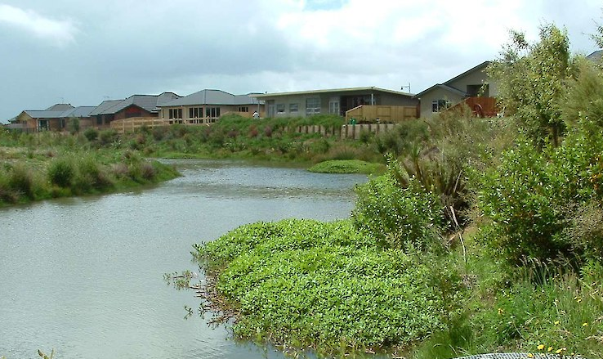
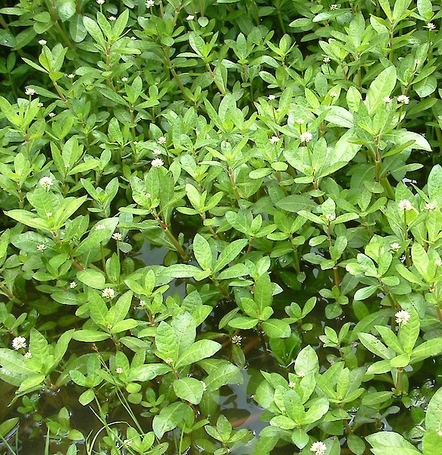
Images: Carolyn Lewis, Weedbusters
Alligator weed (Alternanthera philoxeroides)
Why is it weedy?
Alligator weed forms dense mats over water and riverine margins, with roots down to 2 m deep. This freshwater plant can tolerate 30% seawater, high temperatures, high pollutant levels, grazing and other damage but cannot tolerate frost. Alligator weed has been in Northland for over a century and has slowly been spreading southwards. In late March 2020, it was discovered by chance far from any other known population by a pest control officer from Taranaki Regional Council who happened to be walking past the Mangaone Stream in Palmerston North. Much of New Zealand’s weed surveillance is similarly serendipitous.

Slide 12
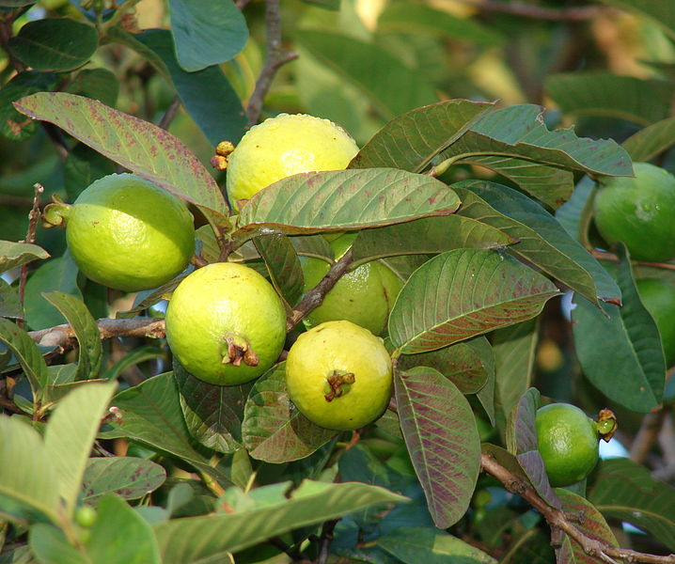
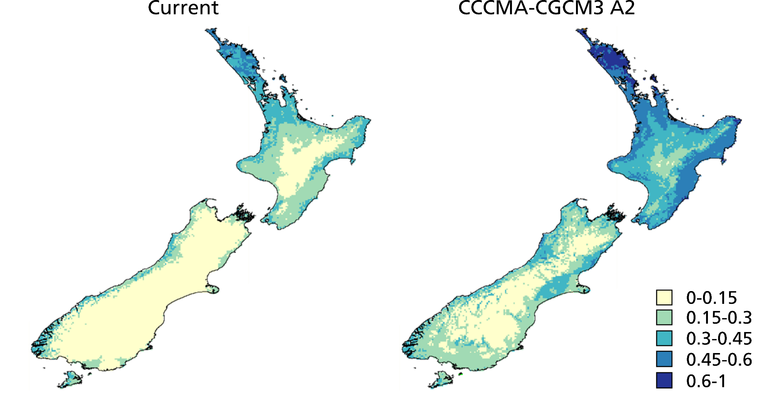
Current
2090
Image: Forest & Kim Starr, CC BY 3.0.
Common guava (Psidium guajava)
Possible range of the common guava now and in 2090 based on modelled climate change scenarios. Image: Space invaders
Why is it weedy?
It’s not – currently. But a warmer climate due to climate change is expected to enable many tropical and subtropical exotic plant species that are already naturalised in the north of New Zealand to extend their ranges southwards and upwards in elevation.
The potential distribution of common guava in New Zealand increases under all modelled climate change scenarios.
Above is the plant’s probability of being able to grow around
New Zealand in the current climate (left) and its potential future distribution in 2090 (right).

