Slide 1
Enduring competencies for designing science learning pathways
Part 1
Science Learning Hub webinar, 16 February 2023
Dr Rosemary Hipkins

Slide 2
Index
Topic | Slideshow number(s) | Video timecode
Part 1
Introducing Dr Rosemary Hipkins and the Science Learning Hub – Pokapū Akoranga Pūtaiao | 1 | 00:00
Index | 2–3 | 00:15
What did we want to achieve? | 4–8 | 02:14
So what are the competencies? | 9 | 13:56
Drawing on different knowledge systems | 10–13 | 14:18
Part 2
Enacting a range of science inquiry practices | 14–17 | 00:39
Working with literacy practices of science | 18–20 | 05:24
Using science for decision-making and action | 21–23 | 08:51
What now? | 24 | 13:44
SLH links, keep in touch and thanks | 25 | 21:56

Slide 3
The Science Learning Hub
A trustworthy online resource – produced by educators and scientists
Based on world-class New Zealand science research
Supported by learning activities, information about the key science ideas and concepts, multimedia tools and other resources
Written for New Zealand teachers and students
Notes:
The Science Learning Hub is funded by the New Zealand government – Ministry of Business, Innovation and Employment (MBIE) – under the Curious Minds fund.

Slide 4
Enduring competencies for designing science learning pathways
Part 1
Science Learning Hub webinar, 16 February 2023
Dr Rosemary Hipkins

Slide 6
Are the competencies
replacing the capabilities in the curriculum refresh?
To what extent is this idea
being applied in the NCEA science review and the
curriculum refresh?
What's the evidence?
Should we be assessing against these OR against the Nature of Science strands from the curriculum? Currently we report against the Nature of Science Strands but do you think it would be more meaningful/relevant to report against the enduring
competencies? Will these change again given we have already had the Science capabilities?

Slide 7
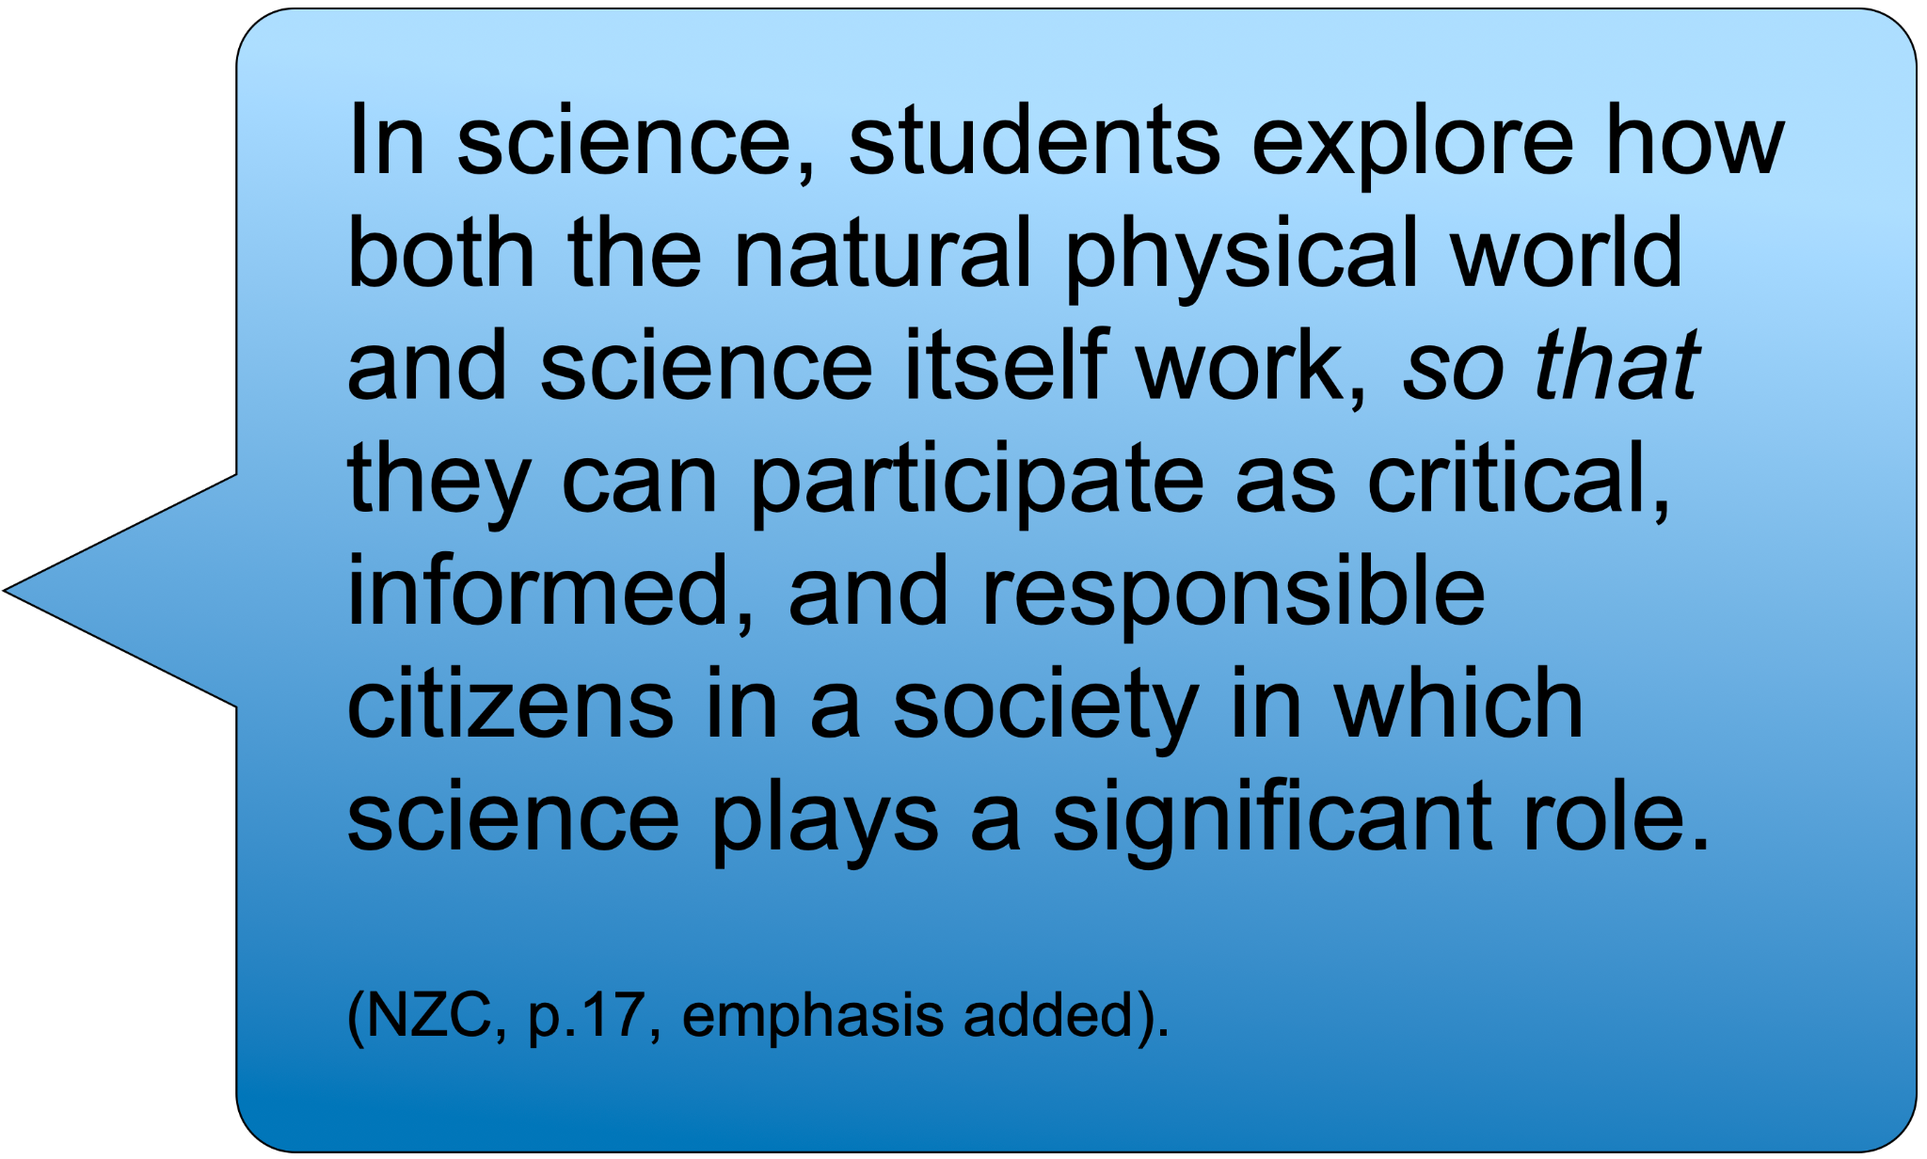
Enduring Competencies provide ideas for activating this vision. They are ideas to think with NOT content to be added.

Slide 8
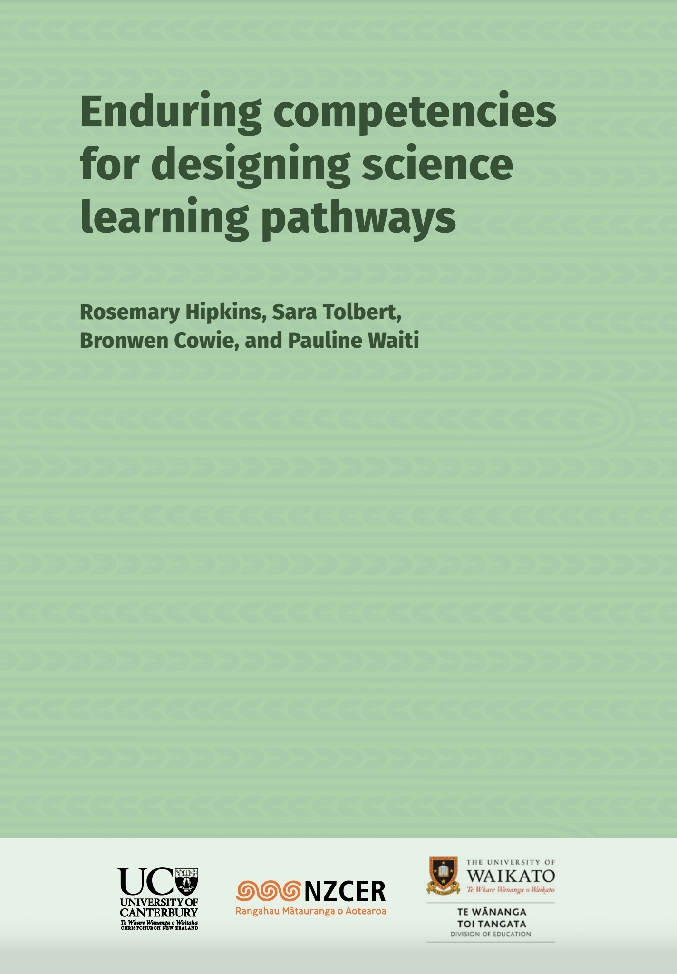
“Competencies” signal continuity from NZC initiatives (KCs/ science capabilities)
Not throwing the baby out with the bathwater
“Enduring” signals that learning will have value in
contexts beyond school or further learning
Taking the NZC purpose statement seriously
Supporting the Curriculum Refresh in science
Four competencies in total, each one unpacked as
multiple facets
More specific elaboration of NOS and associated
weaving challenges
Specific support for mana ōrite and inclusion of
mātauranga Māori in science learning contexts
© New Zealand Council for Educational Research

Slide 10
Drawing on different knowledge systems
Science as a knowledge system
Mātauranga Māori as a knowledge system
Science, as a knowledge system, is historically and socio-culturally embedded
Relationships between knowledge systems,
worldviews and identity

Slide 11
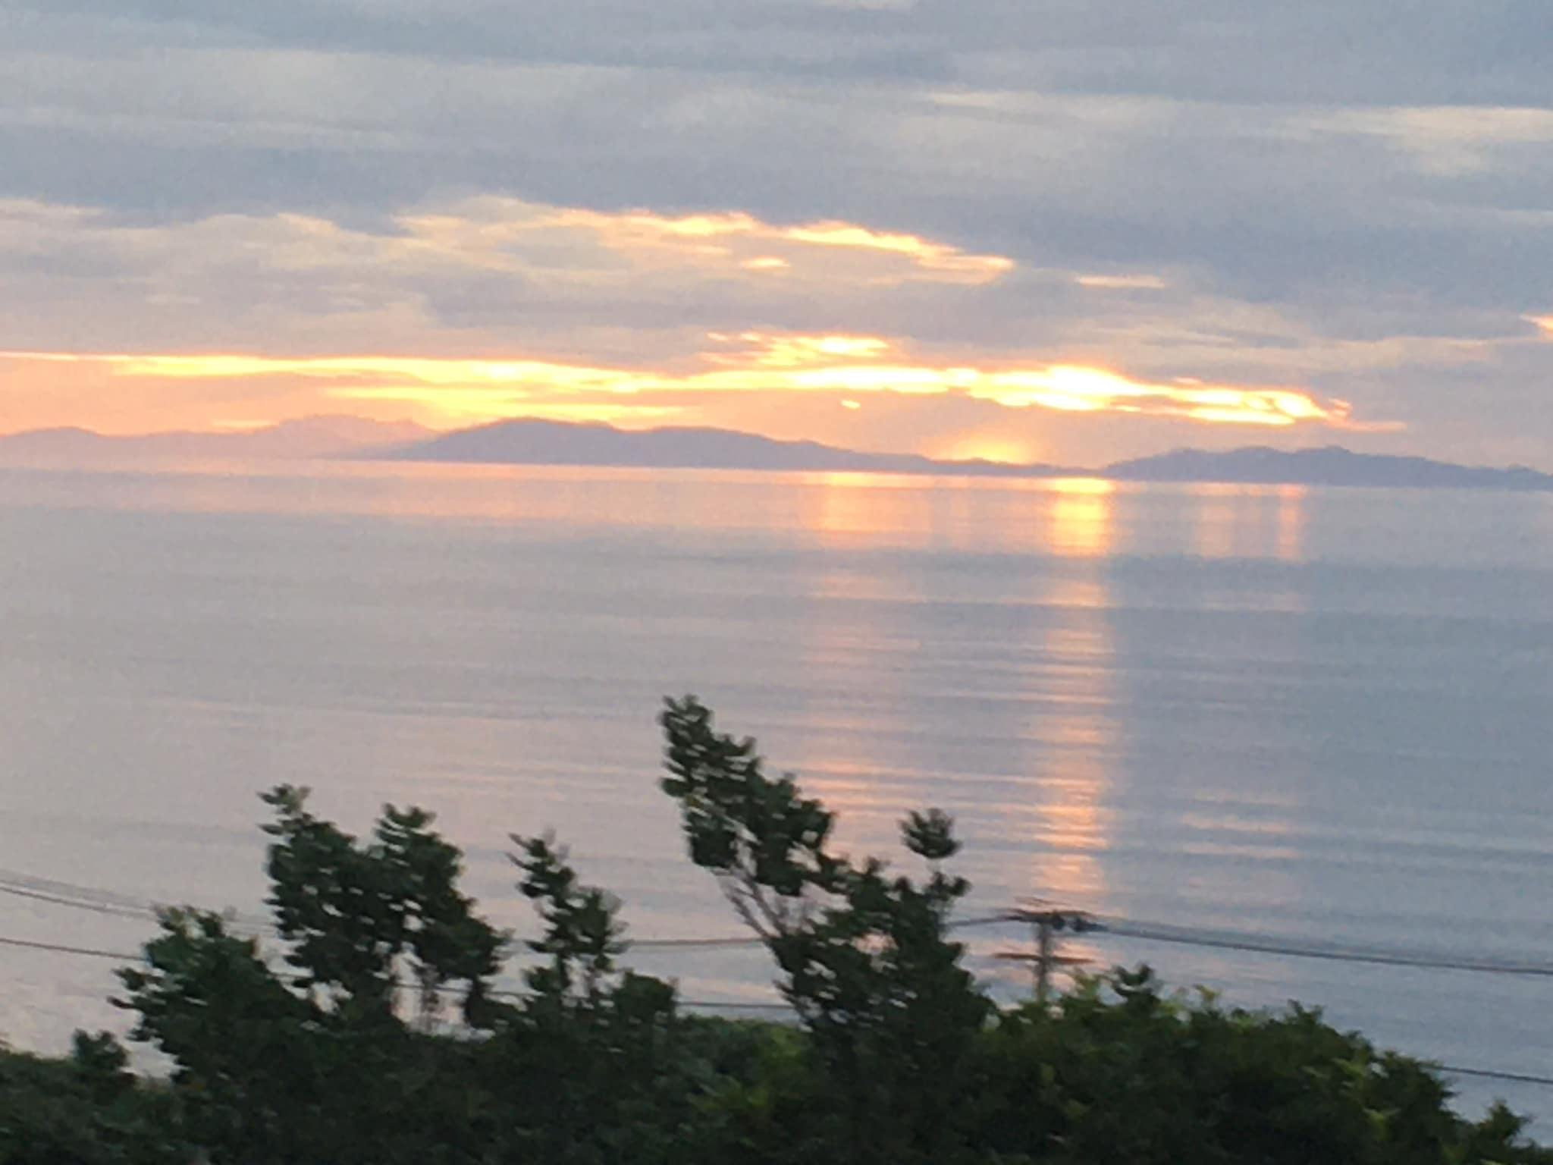
Continuity (and clarity): Meaningful NOS implementation
“A thing too familiar becomes invisible”
Catherynne M Valente

Slide 12
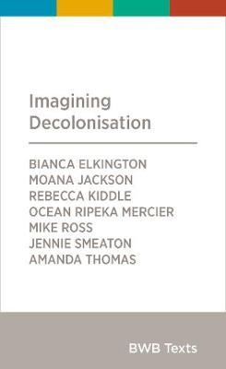
How can [EC] be used to weave in indigenous science knowledge ideas: mātauranga Māori knowledge
How to integrate mātauranga Māori in NCEA year 13 biology as well as junior science
© Bridget Williams Books
Taking care of our kupu - E-Tangata

Slide 13
Something new: appropriate inclusion of mātauranga Māori
Taking a knowledge system approach affords mana ōrite to mātaraunga Māori.
NOS features are arguably easier to recognise and come to understand when they are no longer what “just is”.

Slide 14
Enduring competencies for designing science learning pathways
Part 2
Science Learning Hub webinar, 16 February 2023
Dr Rosemary Hipkins

Slide 15
Enacting a range of science inquiry practices
The inquiry practices of science disciplines
The theory-building practices of science
The social nature of science practices
The thinking practices of science

Slide 16
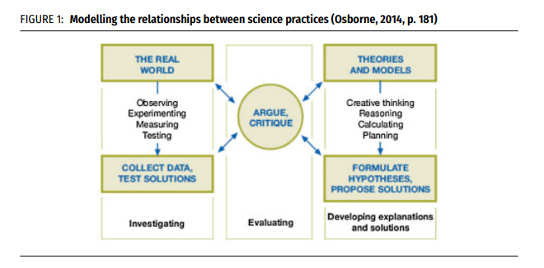
Continuity, with increased clarity from modelling the whole
Osborne, J. (2014). Teaching scientific practices: Meeting the challenge of change. Journal of Science Teacher Education, 25(2), 177–196. https://doi.org/10.1007/s10972-014-9384-1

Slide 17
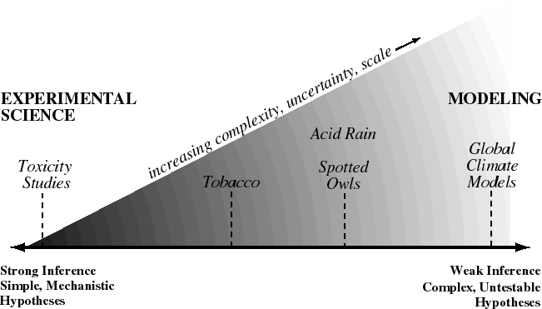
Something new: an explicit focus on uncertainty and complexity
Bradshaw, G. A. and J. G. Borchers. 2000. Uncertainty as information: narrowing the science-policy gap. Conservation Ecology 4(1): 7. [online] URL: http://www.consecol.org/vol4/iss1/art7
https://www.ecologyandsociety.org/vol4/iss1/art7/
Licensed under the Creative Commons Attribution 4.0 International License

Slide 18
Working with literacy practices of science
Science communications are characterised by protocols
Disinformation mimics these practices to confuse/obfuscate
Mātauranga Māori accounts of the natural world are communicated in different ways
Building awareness of how we, as individuals, make
sense of communications

Slide 19
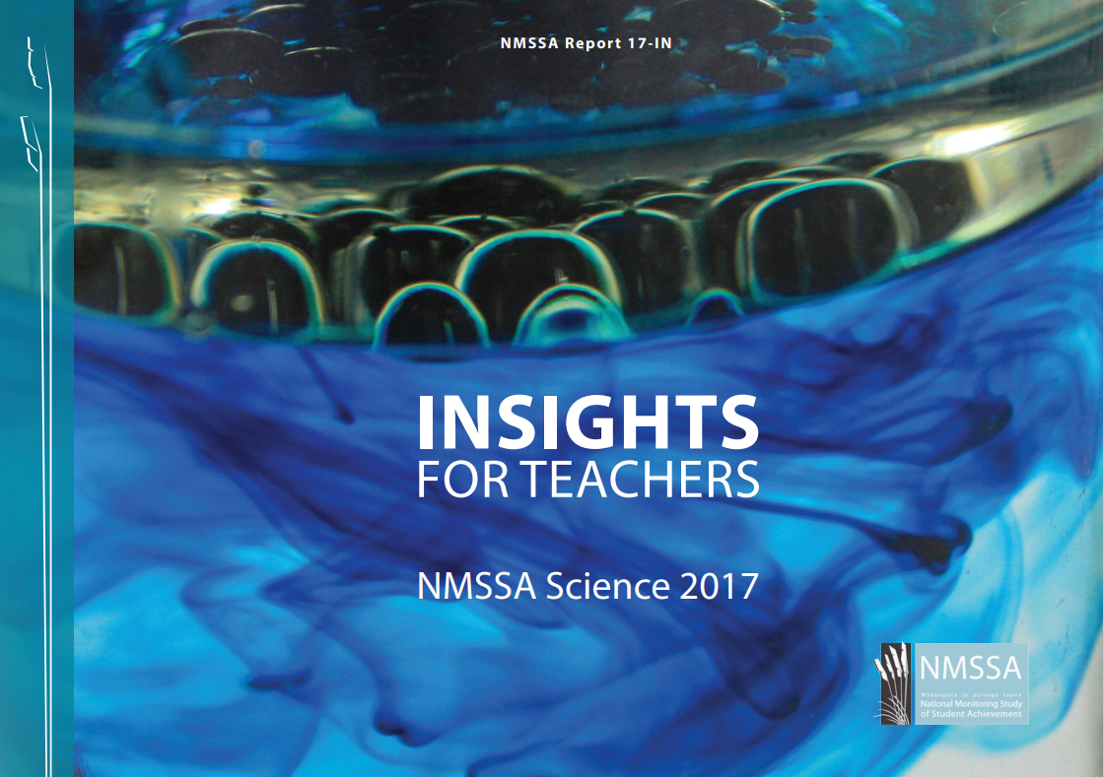
Continuity: Communicating in science is explicitly taught
NMSSA-INSIGHTS_Science_2017d.pdf (educationcounts.govt.nz)

Slide 20
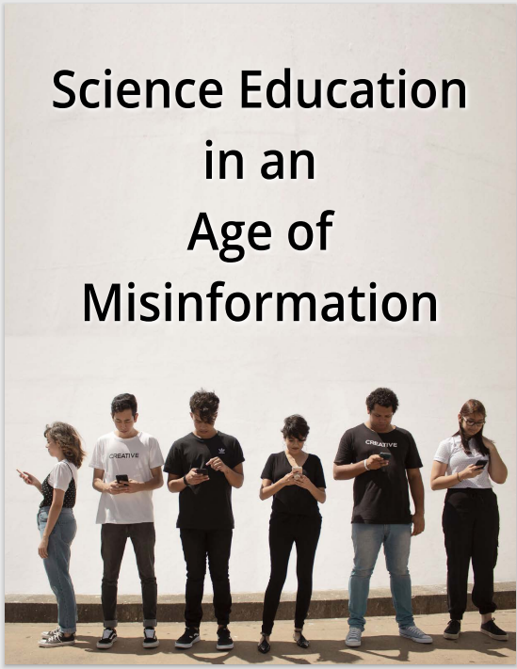
Something new: Supporting young people in an age of deliberate disinformation
This report highlights the social practices of science as a critical, if neglected, aspect of learning
(and has a number of practical teaching and learning suggestions)
Osborne, Jonathan & Pimentel, Daniel & Alberts, Bruce & Allchin, Douglas & Barzilai, Sarit & Bergstrom, Carl & Coffey, Janet & Donovan, Brian & Kivinen, Kari & Kozyreva, Anastasia & Wineburg, Sam. (2022). Science Education in an Age of Misinformation.
Science Education in an Age of Misinformation | Policy Commons

Slide 21
Using science for decision-making and action
Acting with an awareness of interconnectedness
Ethical thinking and doing for responsible action
Science and mātauranga Māori as tools for personal and collective decision-making and action
Science for innovation and problem solving

Slide 22
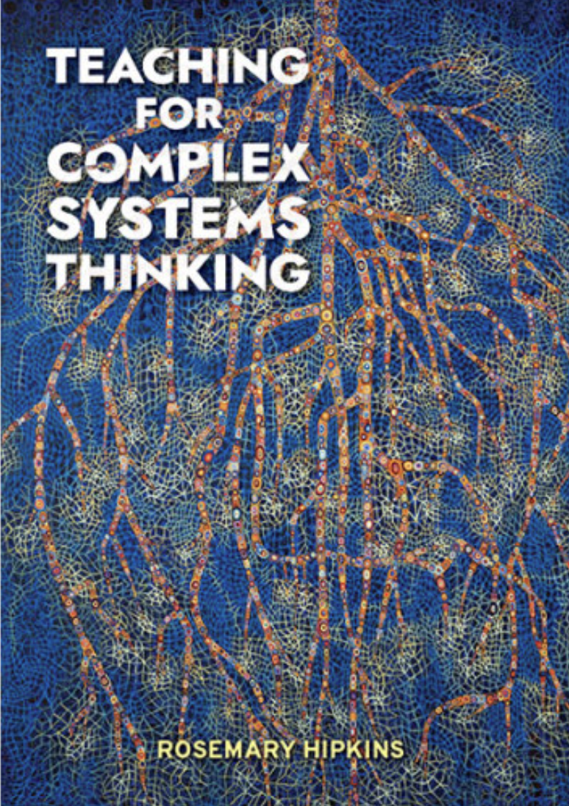
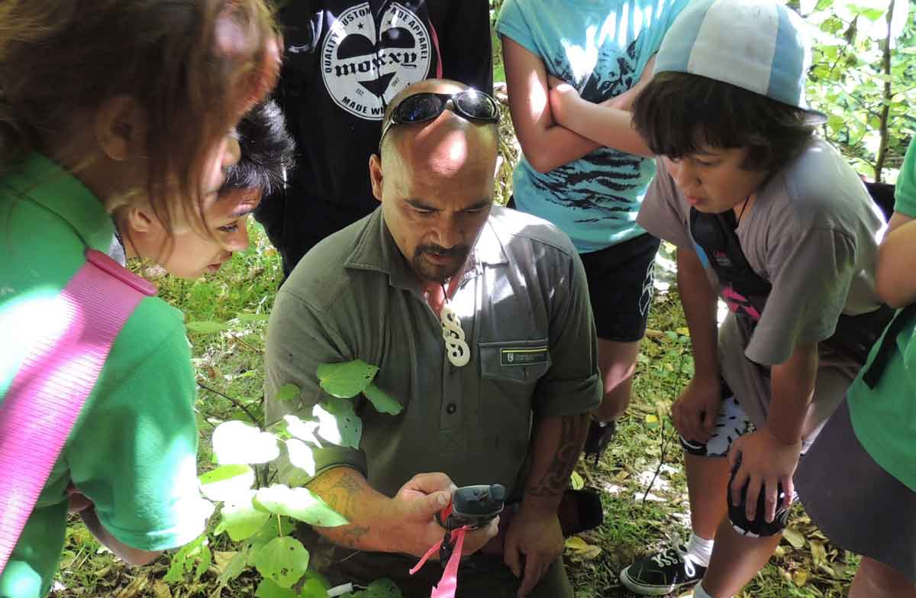
Continuity: extending and enriching traditional
field studies (local curriculum; place-based learning)
© New Zealand Council for Educational Research
© DOC, CC BY 4.0/Source

Slide 23
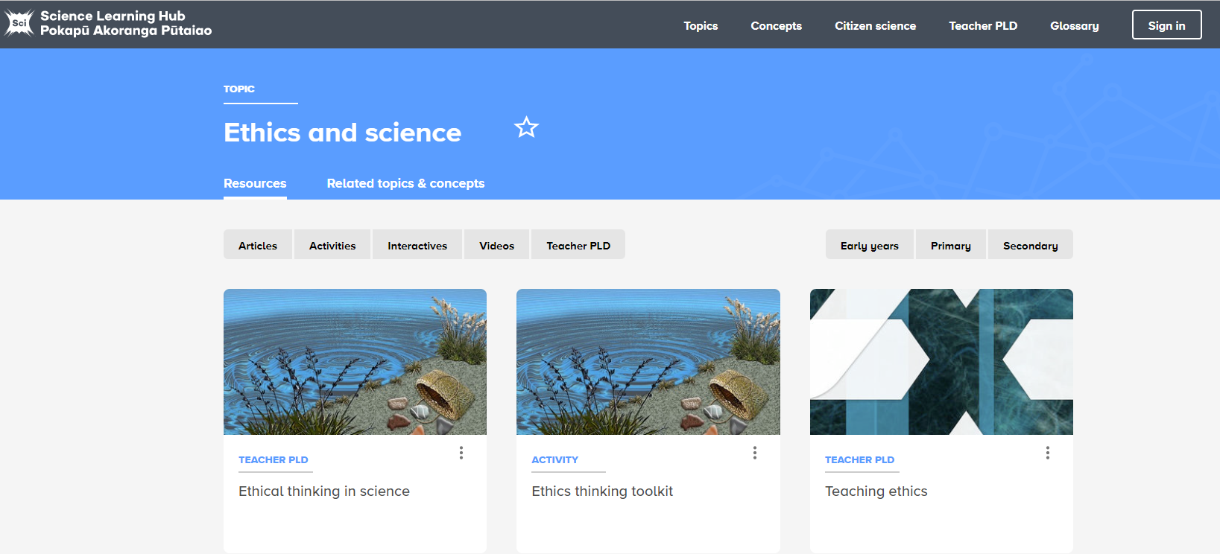
Something new: an explicit focus on ethics
© The University of Waikato Te Whare Wānanga o Waikato
Notes:
https://www.sciencelearn.org.nz/topics/ethics-and-science

Slide 24
What now?
Working on our own NOS insights
Building our awareness of our own intellectual inheritance / how it has shaped our identities
Building our awareness of mātauranga Māori (without ever claiming expertise for what belongs to others)

Slide 25
Thanks – want to keep in touch?
Email us on enquiries@sciencelearn.org.nz
https://twitter.com/NZScienceLearn
www.facebook.com/nzsciencelearn
https://nz.pinterest.com/nzsciencelearn
www.instagram.com/sciencelearninghubnz
Join us in our discussion channel on Slack (http://slh-talk.slack.com).
(Any problems accessing Slack, please contact us via our enquiries email, enquiries@sciencelearn.org.nz.)
Notes:
Feedback/more of this?
Certificates

