Slide 1
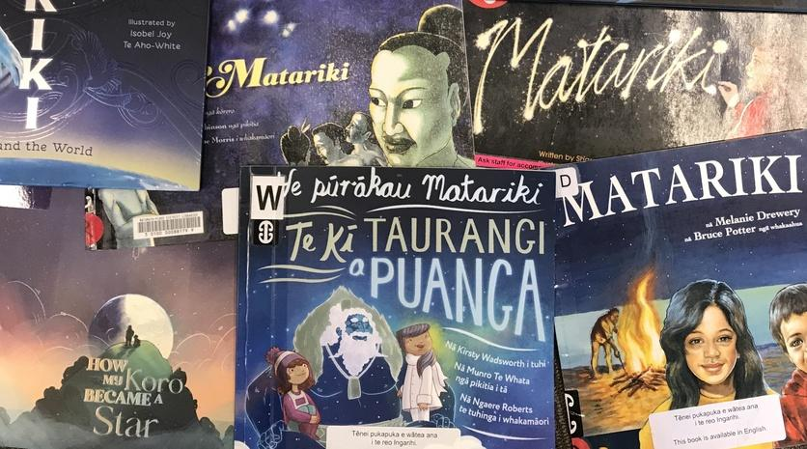
Picturebooks for Matariki
Associate Professor Nicola Daly
nicola.daly@waikato.ac.nz
@nicoladaly18
Thursday 25 May, 4pm
© Copyright. Science Learning Hub – Pokapū Akoranga Pūtaiao The University of Waikato Te Whare Wananga o Waikato.
All Rights Reserved | www.sciencelearn.org.nz. All images are copyrighted. For further information, please refer to enquiries@sciencelearn.org.nz

Slide 2
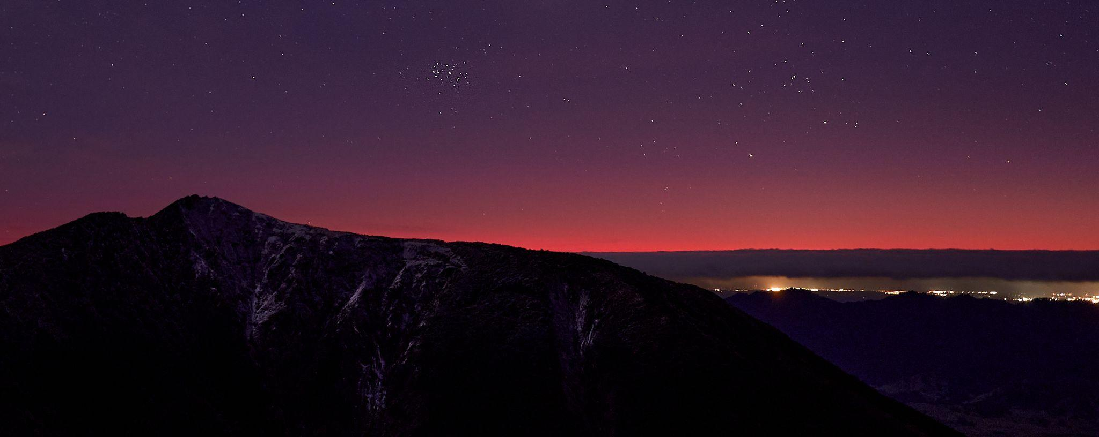
He Karakia mō Matariki
Geoff McKay/CC BY 2.0
© Copyright. Science Learning Hub – Pokapū Akoranga Pūtaiao The University of Waikato Te Whare Wananga o Waikato.
All Rights Reserved | www.sciencelearn.org.nz. All images are copyrighted. For further information, please refer to enquiries@sciencelearn.org.nz
Notes:
https://www.youtube.com/watch?v=BgO07wfIgXs
He Karakia mō Matariki
To celebrate Matariki the Māori New Year, Te Wharewaka o Poneke has gifted a moving karakia to Wellington. The karakia by Ben Ngaia speaks to resilience, generosity and bringing people together.
With special thanks to Johnny Hendrikus, The Art of Night - The Photography of Mark Gee, Richard Nunns and Bob Bickerson.

Slide 3
Matariki in the Waikato
Te Paki o Matariki – the coat of arms for the Kingitanga movement
Te kuaha o Māhinārangi – door of main wharenui at Tūrangawaewa.
Name of Kingitanga newspaper in Waikato (1892-1935)
Wooden carved door displaying the coat of arms for the Maori kings (Te Paki o Matariki) at the Maori meeting house Te Mahinarangi, Turanga-waewae Marae, Ngaruawahia. Houston, John, 1891-1962 : Papers. Ref: 1/2-025440-F. Alexander Turnbull Library, Wellington, New Zealand. /records/22904922
© Copyright. Science Learning Hub – Pokapū Akoranga Pūtaiao The University of Waikato Te Whare Wananga o Waikato.
All Rights Reserved | www.sciencelearn.org.nz. All images are copyrighted. For further information, please refer to enquiries@sciencelearn.org.nz
Notes:
https://teara.govt.nz/en/photograph/1736/te-paki-o-matariki

Slide 4
Index
Topic | Slideshow number(s) | Video timecode
Introduction, karakia and Matariki in the Waikato | 1–3 | 00:00
Index | 4 | 04:22
Part 1
What is a picturebook? | 5–7 | 05:18
Why I’m interested in bilingual picturebooks | 8–14 | 06:21
Part 2
Picturebooks about Matariki | 15 | 10:22
How they use te reo Māori and English and science links | 16–35 | 11:09
Part 3
He wero – a challenge | 36–37 | 38:58
SLH links, keep in touch and thanks | 38 | 40:49
Final karakia | 39 | 42:06
© Copyright. Science Learning Hub – Pokapū Akoranga Pūtaiao The University of Waikato Te Whare Wananga o Waikato.
All Rights Reserved | www.sciencelearn.org.nz. All images are copyrighted. For further information, please refer to enquiries@sciencelearn.org.nz

Slide 5
Part 1: What is a picturebook?
© Copyright. Science Learning Hub – Pokapū Akoranga Pūtaiao The University of Waikato Te Whare Wananga o Waikato.
All Rights Reserved | www.sciencelearn.org.nz. All images are copyrighted. For further information, please refer to enquiries@sciencelearn.org.nz

Slide 6
A picturebook
“A picturebook, unlike an illustrated book, is properly conceived of as a unit, a totality that integrates all the designated parts in a sequence in which the relationships among them – the cover, the endpapers, typography, pictures – are crucial to understanding the book”
(Marantz, 1977, p.3)
© Copyright. Science Learning Hub – Pokapū Akoranga Pūtaiao The University of Waikato Te Whare Wananga o Waikato.
All Rights Reserved | www.sciencelearn.org.nz. All images are copyrighted. For further information, please refer to enquiries@sciencelearn.org.nz

Slide 7
A picturebook
Bader (1976) defines a picturebook in the following way:
“A picturebook is a text, illustrations, total design, an item of manufacture and a commercial product, a social, cultural, historical document; and foremost an experience for a child. As an art form, it hinges on the interdependence of pictures and words, on the simultaneous display of two facing pages, and on the drama of turning the page.” (p.1)
© Copyright. Science Learning Hub – Pokapū Akoranga Pūtaiao The University of Waikato Te Whare Wananga o Waikato.
All Rights Reserved | www.sciencelearn.org.nz. All images are copyrighted. For further information, please refer to enquiries@sciencelearn.org.nz

Slide 8
Part 1 (cont): Why I’m interested
in picturebooks
© Copyright. Science Learning Hub – Pokapū Akoranga Pūtaiao The University of Waikato Te Whare Wananga o Waikato.
All Rights Reserved | www.sciencelearn.org.nz. All images are copyrighted. For further information, please refer to enquiries@sciencelearn.org.nz

Slide 9
New Zealand Picturebook Collection
(inspired by the European Picturebook Collection)
www.picturebooks.co.nz
© Copyright. Science Learning Hub – Pokapū Akoranga Pūtaiao The University of Waikato Te Whare Wananga o Waikato.
All Rights Reserved | www.sciencelearn.org.nz. All images are copyrighted. For further information, please refer to enquiries@sciencelearn.org.nz
Notes:
www.picturebooks.co.nz

Slide 10
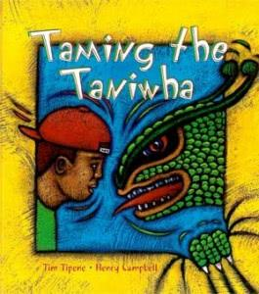
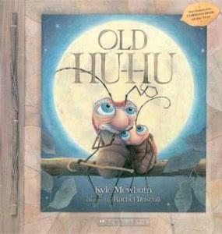
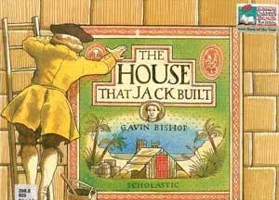
Five themes in NZPBC
Family
Environment
Tikanga Māori
Diversity
Language
© Copyright. Science Learning Hub – Pokapū Akoranga Pūtaiao The University of Waikato Te Whare Wananga o Waikato.
All Rights Reserved | www.sciencelearn.org.nz. All images are copyrighted. For further information, please refer to enquiries@sciencelearn.org.nz

Slide 11
Language
“It was night time when the first manuhiri came. They cried, talked and sang to Koro Jack. I saw whānau I hadn’t seen for ages, even my sister who was hapū. We went out to the wharekai and ate heaps.”
“The Kuia made mats to sit on and mats to sleep on. She made kits for kumara and kits for seafood.”
© Copyright. Science Learning Hub – Pokapū Akoranga Pūtaiao The University of Waikato Te Whare Wananga o Waikato.
All Rights Reserved | www.sciencelearn.org.nz. All images are copyrighted. For further information, please refer to enquiries@sciencelearn.org.nz

Slide 12
Translingual (interlingual)
Stories told in one language with words from another language woven in
“I saw whānau I hadn’t seen in ages. Even my sister who was hapū”
© Copyright. Science Learning Hub – Pokapū Akoranga Pūtaiao The University of Waikato Te Whare Wananga o Waikato.
All Rights Reserved | www.sciencelearn.org.nz. All images are copyrighted. For further information, please refer to enquiries@sciencelearn.org.nz

Slide 13
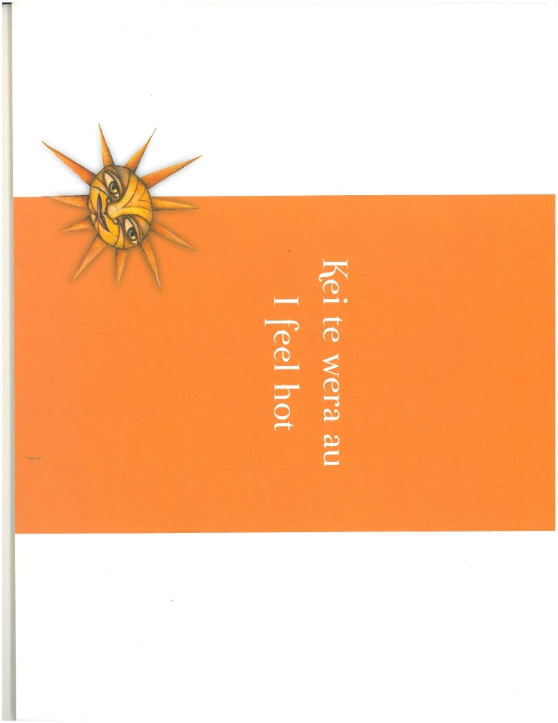
Bilingual/Multilingual
Stories told fully in two or more languages
© Copyright. Science Learning Hub – Pokapū Akoranga Pūtaiao The University of Waikato Te Whare Wananga o Waikato.
All Rights Reserved | www.sciencelearn.org.nz. All images are copyrighted. For further information, please refer to enquiries@sciencelearn.org.nz

Slide 14
Multiversion (Simultaneous or asynchronous)
© Copyright. Science Learning Hub – Pokapū Akoranga Pūtaiao The University of Waikato Te Whare Wananga o Waikato.
All Rights Reserved | www.sciencelearn.org.nz. All images are copyrighted. For further information, please refer to enquiries@sciencelearn.org.nz

Slide 15
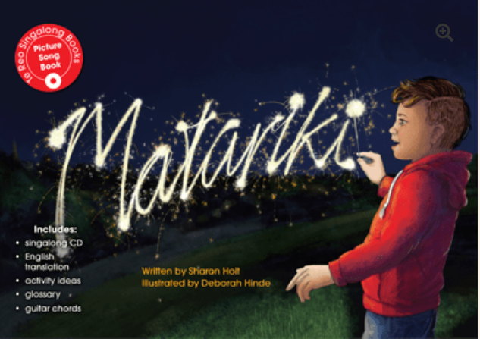
Part 2: Matariki picturebooks
Anthropomorphism
Contemporary
Traditional
© Copyright. Science Learning Hub – Pokapū Akoranga Pūtaiao The University of Waikato Te Whare Wananga o Waikato.
All Rights Reserved | www.sciencelearn.org.nz. All images are copyrighted. For further information, please refer to enquiries@sciencelearn.org.nz

Slide 16
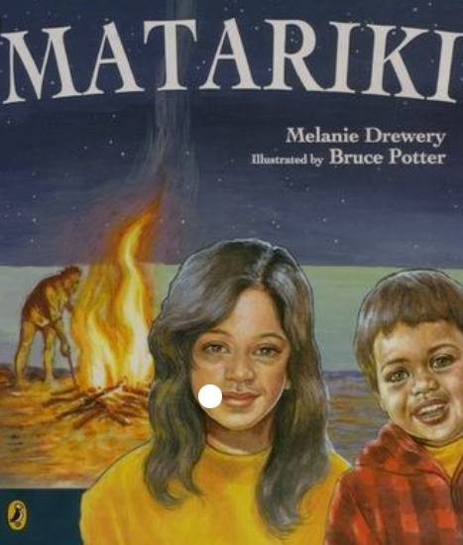
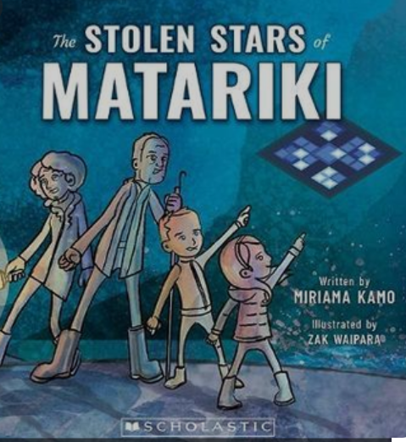
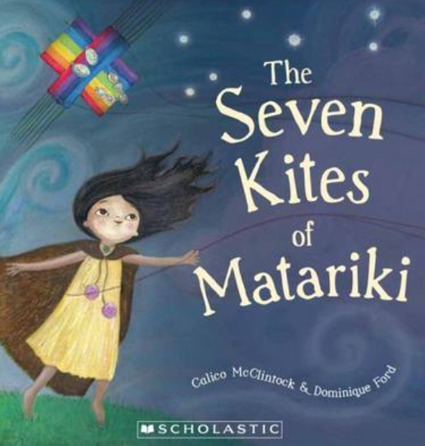
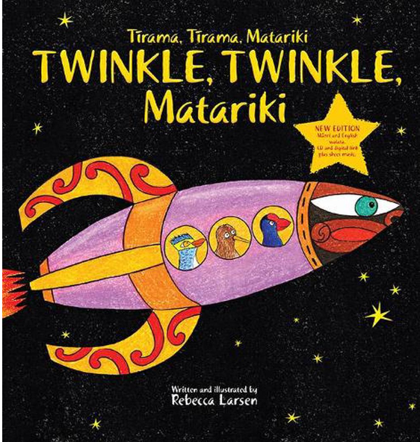
How is te reo Māori incorporated into picturebooks about Matariki?
© Copyright. Science Learning Hub – Pokapū Akoranga Pūtaiao The University of Waikato Te Whare Wananga o Waikato.
All Rights Reserved | www.sciencelearn.org.nz. All images are copyrighted. For further information, please refer to enquiries@sciencelearn.org.nz

Slide 17
Matariki
By Melanie Drewery and Bruce Potter (Penguin, 2003)
Translingual text
Kumara
Ae
Maori
Kai
Kia ora
Moko ma
Tane
Tirohia atu nei ka wheturangitia Matariki, te whetu o te tau
Behold Matariki the star of the year has made its appearance
© Copyright. Science Learning Hub – Pokapū Akoranga Pūtaiao The University of Waikato Te Whare Wananga o Waikato.
All Rights Reserved | www.sciencelearn.org.nz. All images are copyrighted. For further information, please refer to enquiries@sciencelearn.org.nz
Notes:
Read more: Melanie Drewery (1970–) Biography - Personal, Addresses, Career, Writings, Sidelights - Zealand, Auckland, Nanny, and Reed - JRank Articles https://biography.jrank.org/pages/1921/Drewery-Melanie-1970.html#ixzz7V83Qocf3
Greta to link to : https://www.sciencelearn.org.nz/resources/3058-science-through-picturebooks

Slide 18
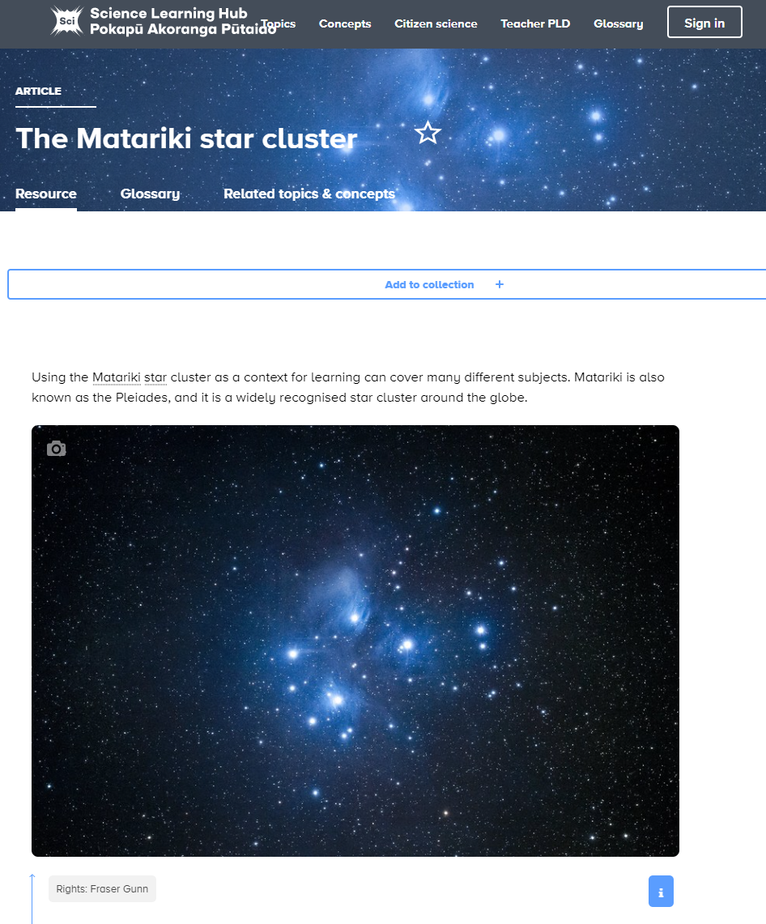
© Copyright. Science Learning Hub – Pokapū Akoranga Pūtaiao The University of Waikato Te Whare Wananga o Waikato.
All Rights Reserved | www.sciencelearn.org.nz. All images are copyrighted. For further information, please refer to enquiries@sciencelearn.org.nz
Notes:
https://www.sciencelearn.org.nz/resources/2322-the-matariki-star-cluster
Puanga and Matariki – what is the difference?
https://gazette.education.govt.nz/articles/puanga-and-matariki-what-is-the-difference/#:~:text=Puanga%20is%20about%20remembering%20those,earth%20both%20physically%20and%20spiritually.

Slide 19
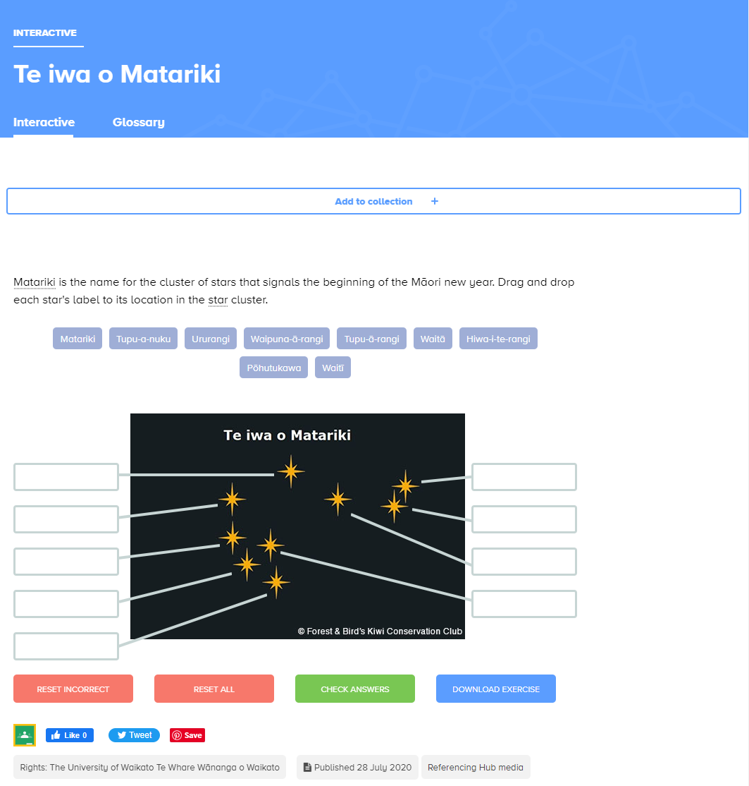
© Copyright. Science Learning Hub – Pokapū Akoranga Pūtaiao The University of Waikato Te Whare Wananga o Waikato.
All Rights Reserved | www.sciencelearn.org.nz. All images are copyrighted. For further information, please refer to enquiries@sciencelearn.org.nz
Notes:
https://www.sciencelearn.org.nz/labelling_interactives/10-te-iwa-o-matariki

Slide 20
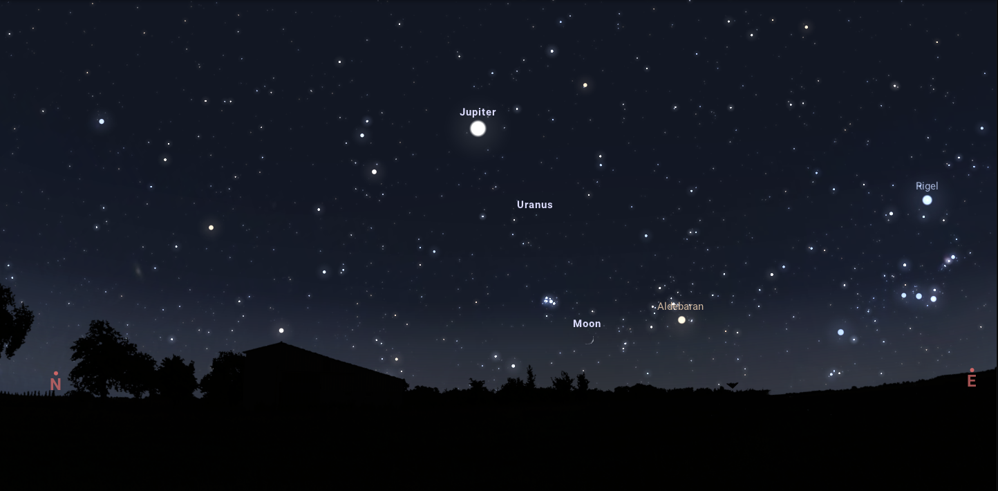
Finding Matariki
Matariki
Courtesy of Stellarium planetarium
Matariki on Friday, 14 July, 2023 from Te Aroha in the Waikato
© Copyright. Science Learning Hub – Pokapū Akoranga Pūtaiao The University of Waikato Te Whare Wananga o Waikato.
All Rights Reserved | www.sciencelearn.org.nz. All images are copyrighted. For further information, please refer to enquiries@sciencelearn.org.nz
Notes:
Stellarium: https://stellarium.org/
How to find the Matariki star cluster
https://www.youtube.com/watch?v=VN7MkI53Gl0

Slide 21
The Seven Stars of Matariki
by Toni Rolleston-Cummins and Nikki Slade Robinson (Huia, 2008)
Translingual text
Mītai | Whare
Maketū | Patupaiarehe
Tohunga | Kaimoana
Te Rāwhara | Tīwaiwaka
The god of the wind, Tāwhirimātea | Ngongotaha
Uenuku, the rainbow | Kererū
Pukemaire | Rongonui
Wāhine | Urutengangana god of the stars
www.youtube.com/watch?v=RKL6V69RLxo
© Copyright. Science Learning Hub – Pokapū Akoranga Pūtaiao The University of Waikato Te Whare Wananga o Waikato.
All Rights Reserved | www.sciencelearn.org.nz. All images are copyrighted. For further information, please refer to enquiries@sciencelearn.org.nz

Slide 22
The Seven Stars of Matariki by Toni Rolleston-Cummins and Nikki Slade Robinson (Huia, 2008)
Glossary
Kaimoana...seafood
Koroua...old man
Tīwaiwaka...fantail
Tohunga...tohunga
Wahine...woman
Wāhine...women
Whare...house
© Copyright. Science Learning Hub – Pokapū Akoranga Pūtaiao The University of Waikato Te Whare Wananga o Waikato.
All Rights Reserved | www.sciencelearn.org.nz. All images are copyrighted. For further information, please refer to enquiries@sciencelearn.org.nz

Slide 23
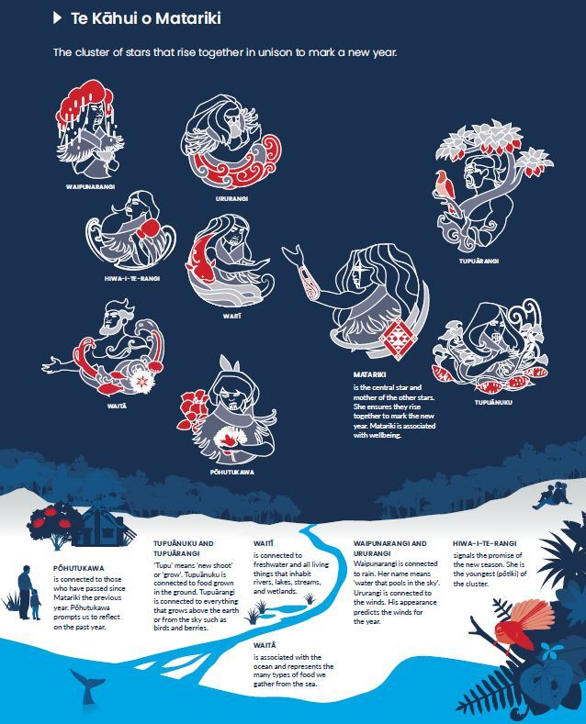
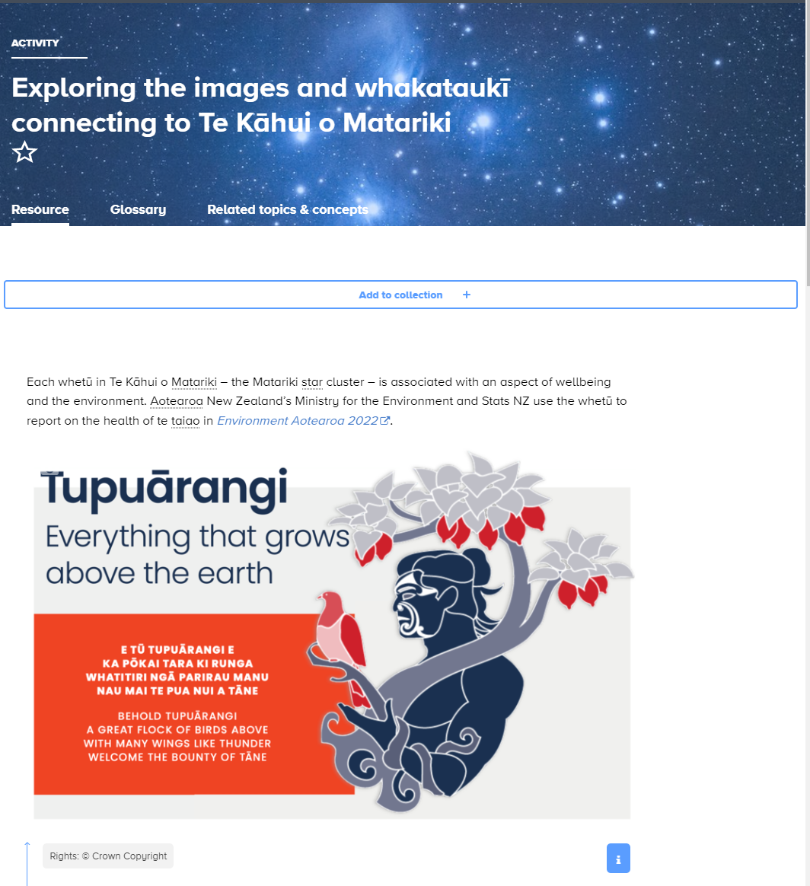
© Crown Copyright
© Copyright. Science Learning Hub – Pokapū Akoranga Pūtaiao The University of Waikato Te Whare Wananga o Waikato.
All Rights Reserved | www.sciencelearn.org.nz. All images are copyrighted. For further information, please refer to enquiries@sciencelearn.org.nz
Notes:
https://www.sciencelearn.org.nz/resources/3118-environment-aotearoa-2022-introduction
Images available here: https://www.sciencelearn.org.nz/resources/3137-exploring-the-images-and-whakatauki-connecting-to-te-kahui-o-matariki
Older students - knowledge systems, communicating in science

Slide 24
The Little Kiwi’s Matariki
by Nikki Slade Robinson (Duck Creek Press, 2016)
Translingual text
Auē!
Weka
Kāo, No, no little Kiwi
That’s just my puku tīarea, my empty tummy
Kia tere Weka. Hurry
That’s just my mokopuna, my grandchildren
Tūī
Katipō
Kia Tūpatō! Be careful little Kiwi!
That’s just Tāwhirimātea, god of the wind
Pushed through the pīngao
Macrons/Tohutō in place
www.youtube.com/watch?v=mmADkn3ldXI
© Copyright. Science Learning Hub – Pokapū Akoranga Pūtaiao The University of Waikato Te Whare Wananga o Waikato.
All Rights Reserved | www.sciencelearn.org.nz. All images are copyrighted. For further information, please refer to enquiries@sciencelearn.org.nz
Notes:
Inside Page
Previous
Next

Slide 25
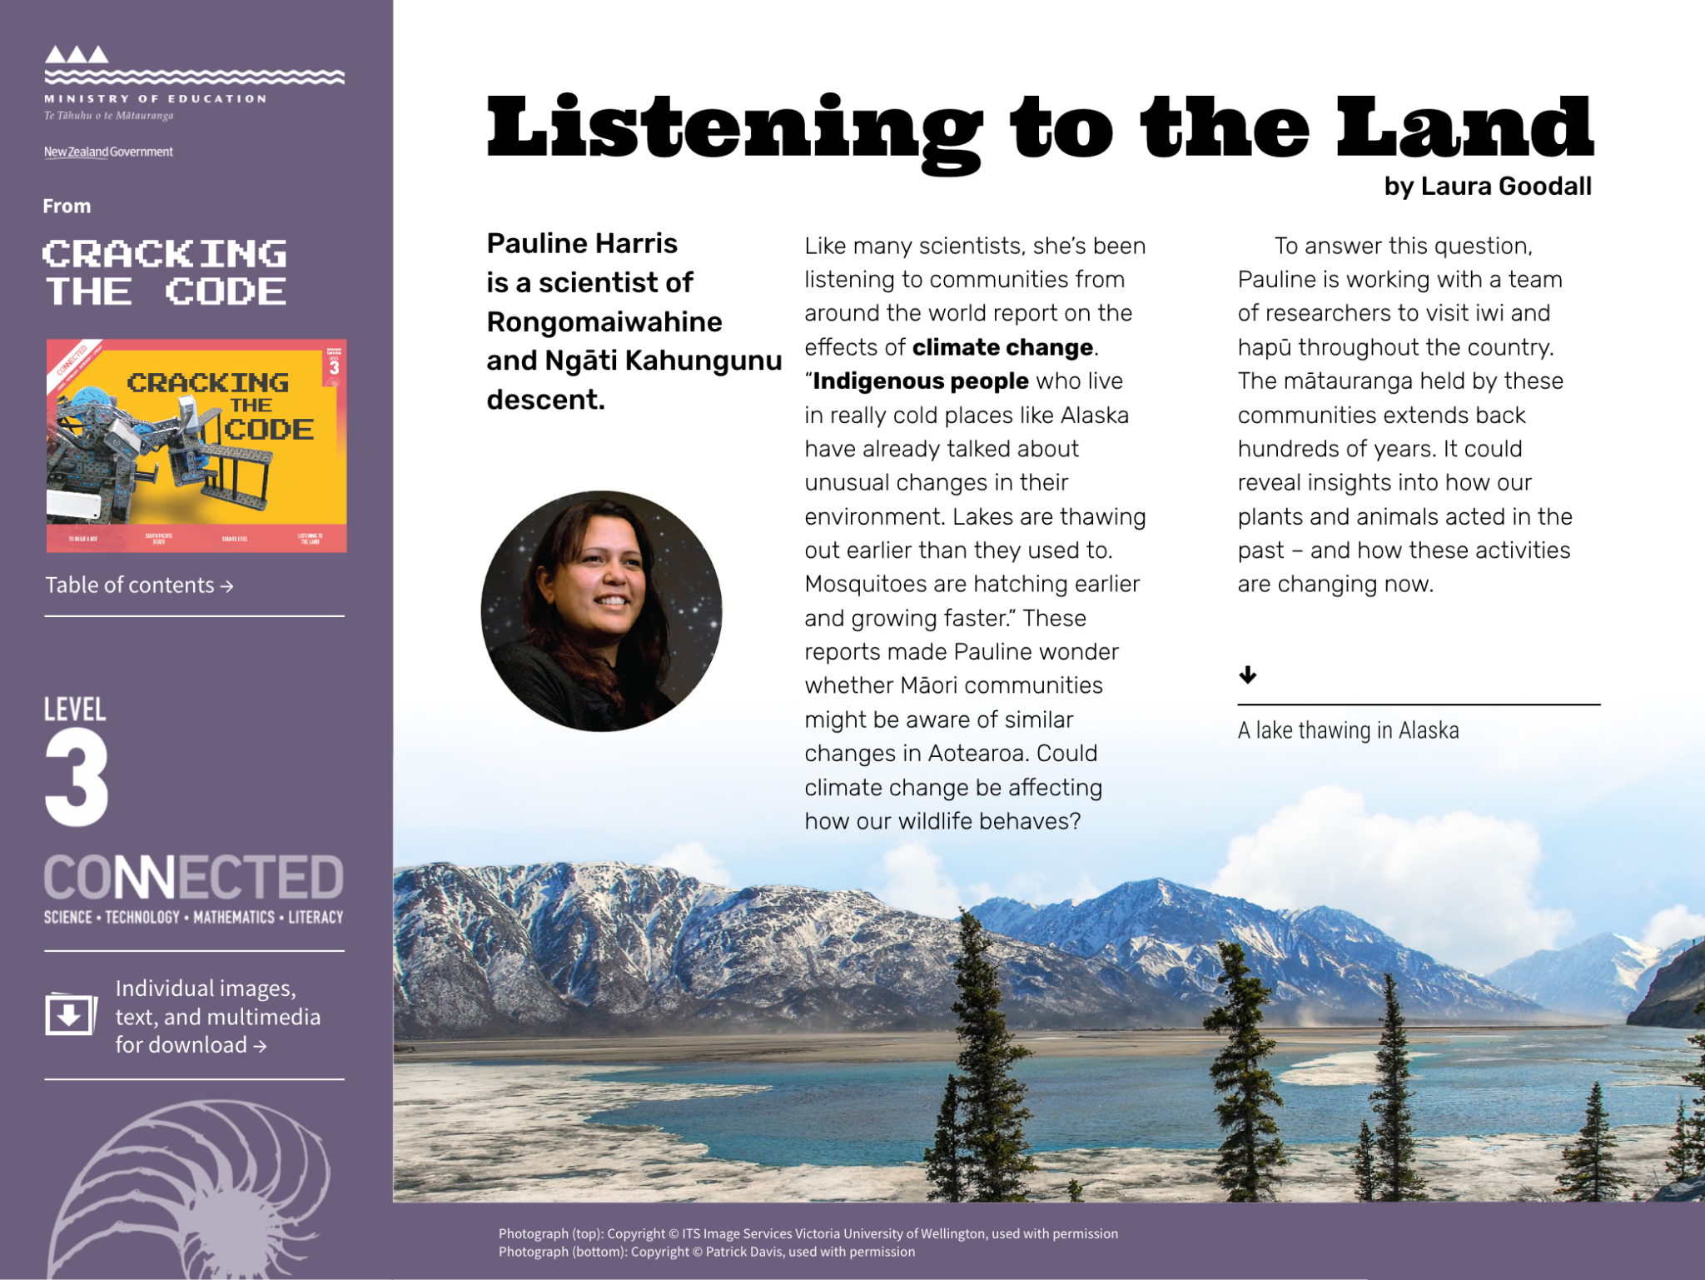
Listening to the land
Crown Copyright 2018
© Copyright. Science Learning Hub – Pokapū Akoranga Pūtaiao The University of Waikato Te Whare Wananga o Waikato.
All Rights Reserved | www.sciencelearn.org.nz. All images are copyrighted. For further information, please refer to enquiries@sciencelearn.org.nz
Notes:
https://www.sciencelearn.org.nz/resources/2961-maori-ways-of-knowing-weather-and-climate
https://www.sciencelearn.org.nz/resources/2940-listening-to-the-land

Slide 26
The Stolen Stars of Matariki
by Miriama Kamo and Zak Waipara (Scholastic, 2018)
Translingual text
Pōua
Te Mata Hāpuku, Birdlings Flat
Patupaiarehe (footnote: fairy folk)
Hāere tāua (footnote: let’s go)
Kākahu
Korowai
Oma (footnote: run)
Ka pai tō kōrua mahi (footnote: Good work you two)
www.youtube.com/watch?v=sWWcM0BWwwc
© Copyright. Science Learning Hub – Pokapū Akoranga Pūtaiao The University of Waikato Te Whare Wananga o Waikato.
All Rights Reserved | www.sciencelearn.org.nz. All images are copyrighted. For further information, please refer to enquiries@sciencelearn.org.nz
Notes:
https://www.youtube.com/watch?v=RIUBb3yiGG0

Slide 27
© Copyright. Science Learning Hub – Pokapū Akoranga Pūtaiao The University of Waikato Te Whare Wananga o Waikato.
All Rights Reserved | www.sciencelearn.org.nz. All images are copyrighted. For further information, please refer to enquiries@sciencelearn.org.nz
Notes:
https://www.sciencelearn.org.nz/resources/3174-mahinga-kai

Slide 28
Matariki
by Sharon Holt and Deborah Hinde (Te Reo Singalong, 2018)
Bilingual text
English guide in front pages
Body text in te reo Māori only – tohutō-macrons in place
Video introduces a third language
Macrons/Tohutō in place
www.youtube.com/watch?v=_QB9TahbqQY
© Copyright. Science Learning Hub – Pokapū Akoranga Pūtaiao The University of Waikato Te Whare Wananga o Waikato.
All Rights Reserved | www.sciencelearn.org.nz. All images are copyrighted. For further information, please refer to enquiries@sciencelearn.org.nz

Slide 29
© Crown Copyright
© Copyright. Science Learning Hub – Pokapū Akoranga Pūtaiao The University of Waikato Te Whare Wananga o Waikato.
All Rights Reserved | www.sciencelearn.org.nz. All images are copyrighted. For further information, please refer to enquiries@sciencelearn.org.nz
Notes:
https://www.sciencelearn.org.nz/resources/3128-hiwa-i-te-rangi-future-aspirations-and-actions
https://www.sciencelearn.org.nz/resources/2567-using-concept-cartoons-to-explore-students-scientific-thinking

Slide 30
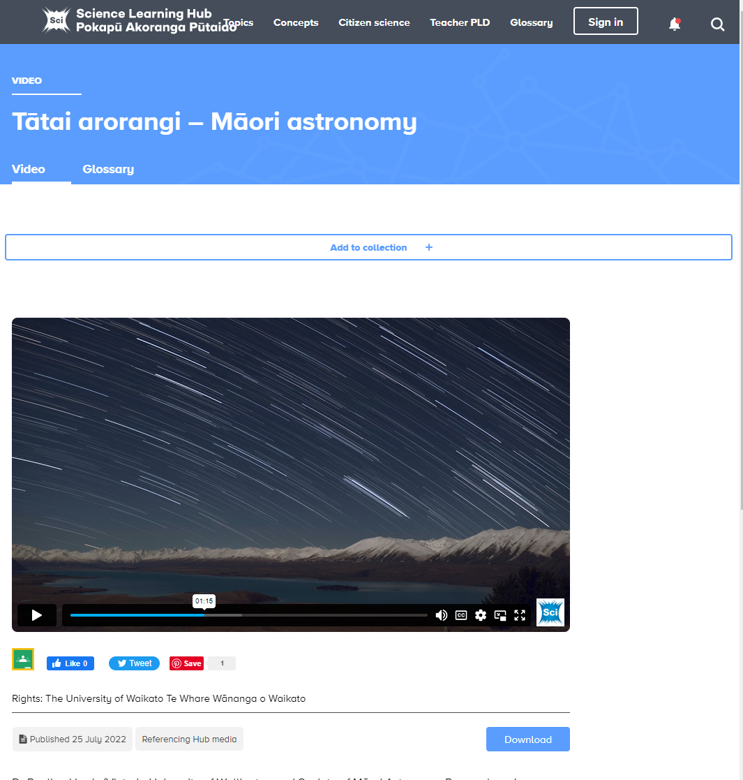
© Copyright. Science Learning Hub – Pokapū Akoranga Pūtaiao The University of Waikato Te Whare Wananga o Waikato.
All Rights Reserved | www.sciencelearn.org.nz. All images are copyrighted. For further information, please refer to enquiries@sciencelearn.org.nz
Notes:
https://www.sciencelearn.org.nz/videos/2112-tatai-arorangi-maori-astronomy

Slide 31
Tīrama, Tīrama, Matariki.
Twinkle Twinkle, Matariki
by Rebecca Larsen (Bateman books, 2019)
Bilingual text
English and Māori text same size and font
English to left, Māori to right
English on top, Māori underneath
Labels on illustrations, Māori first, Māori only for numbers and colours
Macrons/Tohutō in place
www.youtube.com/watch?v=A1Nm7BCUPcw
© Copyright. Science Learning Hub – Pokapū Akoranga Pūtaiao The University of Waikato Te Whare Wananga o Waikato.
All Rights Reserved | www.scie ncelearn.org.nz. All images are copyrighted. For further information, please refer to enquiries@sciencelearn.org.nz
Notes:
Inside Page
Previous
Next

Slide 32
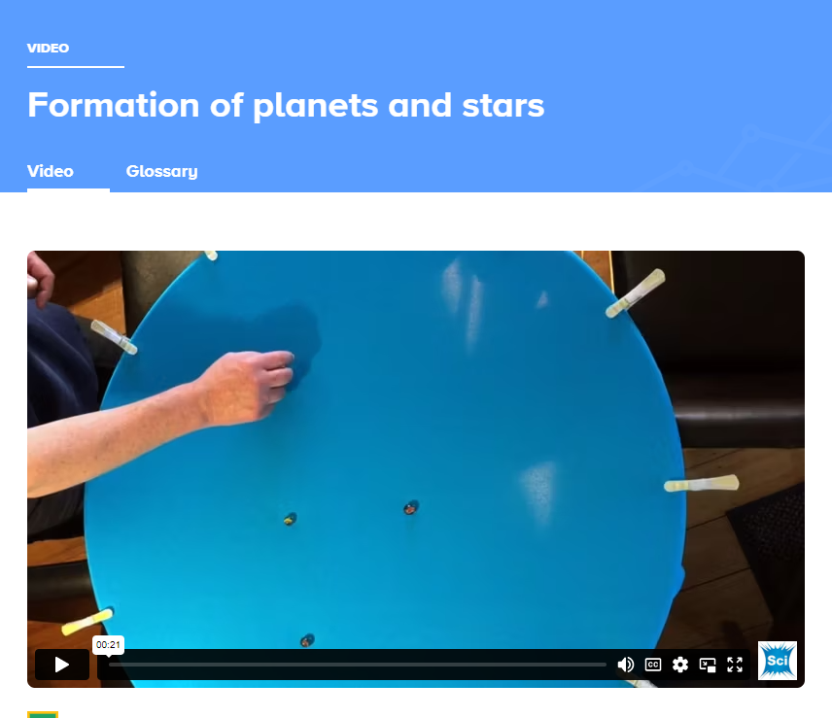
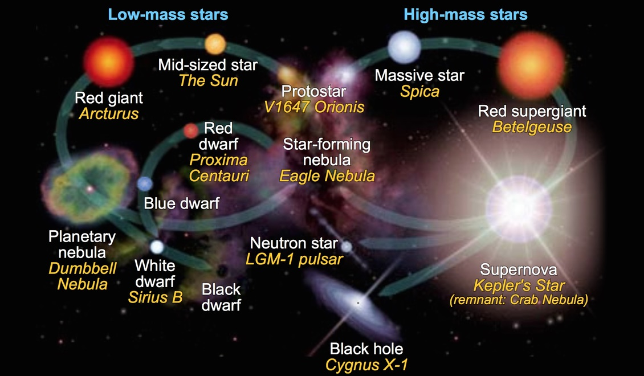
cmglee/NASA Goddard Space Flight Center. CC BY-SA 4.0
© Copyright. Science Learning Hub – Pokapū Akoranga Pūtaiao The University of Waikato Te Whare Wananga o Waikato.
All Rights Reserved | www.sciencelearn.org.nz. All images are copyrighted. For further information, please refer to enquiries@sciencelearn.org.nz
Notes:
Formation of planets and stars: https://www.sciencelearn.org.nz/videos/1883-formation-of-planets-and-stars
Navigating by the stars: https://www.sciencelearn.org.nz/resources/636-navigating-by-the-stars
Image: https://www.sciencelearn.org.nz/images/2755-the-stellar-evolution-of-stars from: https://www.sciencelearn.org.nz/resources/2208-how-a-solar-system-is-formed

Slide 33
How my Koro became a Star
by Brianne Te Paa and Story Hemi-Morehouse (Huia, 2022)
Translingual text
Lots of Māori kupu
Translanguaging
Macrons/Tohutō throughout
No glossing
No glossary
6 mins
www.youtube.com/watch?v=BfjRrZJX0YI
© Copyright. Science Learning Hub – Pokapū Akoranga Pūtaiao The University of Waikato Te Whare Wananga o Waikato.
All Rights Reserved | www.sciencelearn.org.nz. All images are copyrighted. For further information, please refer to enquiries@sciencelearn.org.nz

Slide 34
Project Mātauranga, Series 2 episode Tātai Arorangi, courtesy of Scottie Productions
© Copyright. Science Learning Hub – Pokapū Akoranga Pūtaiao The University of Waikato Te Whare Wananga o Waikato.
All Rights Reserved | www.sciencelearn.org.nz. All images are copyrighted. For further information, please refer to enquiries@sciencelearn.org.nz
Notes:
https://www.sciencelearn.org.nz/videos/563-tatai-arorangi

Slide 35
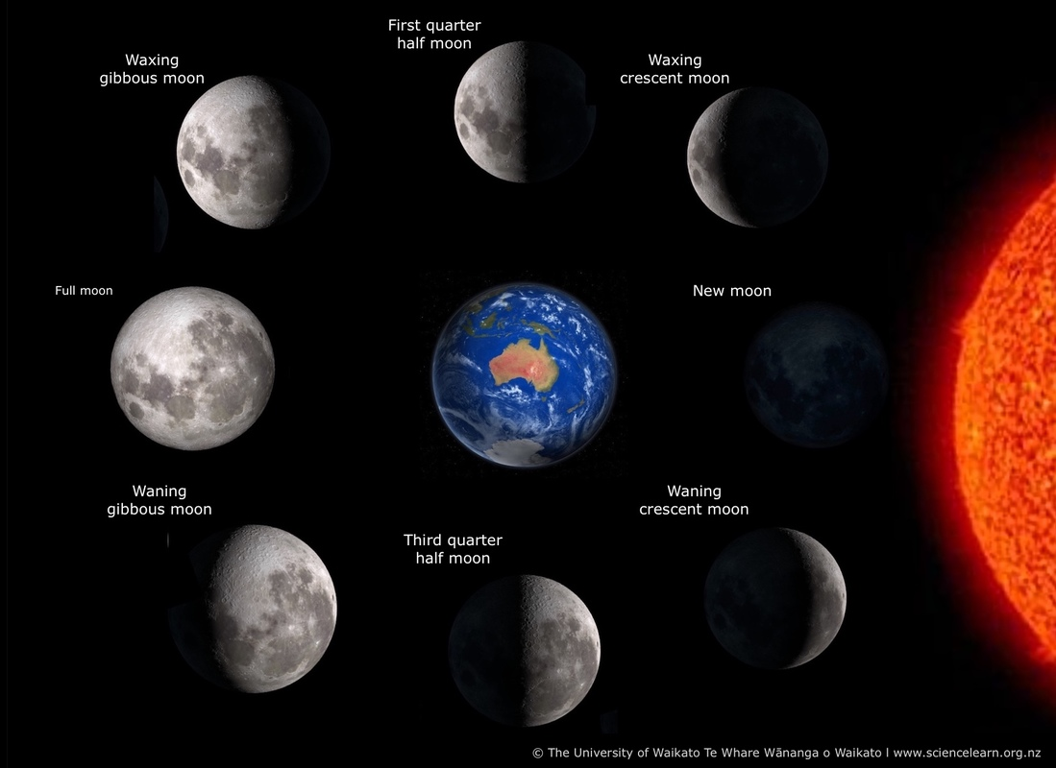
© Copyright. Science Learning Hub – Pokapū Akoranga Pūtaiao The University of Waikato Te Whare Wananga o Waikato.
All Rights Reserved | www.sciencelearn.org.nz. All images are copyrighted. For further information, please refer to enquiries@sciencelearn.org.nz
Notes:
https://www.sciencelearn.org.nz/resources/2466-the-moon-and-its-misconceptions

Slide 36
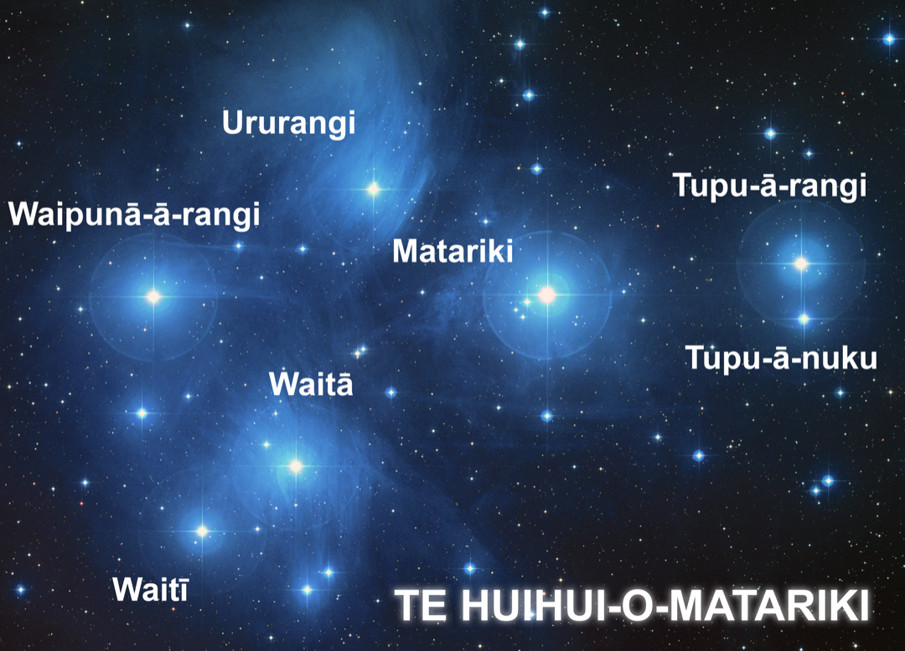
Part 3: He wero tā tātou mō
Matariki – A challenge for Matariki
Think about how te reo Māori words are used in English text
How are the two languages positioned?
Who is the audience?
How do the text and illustration support meaning making?
How does the use of te reo Māori in these books support the science curriculum
Background image courtesy of NASA. With text, Kim Martins, CC BY-NC-SA 4.0
© Copyright. Science Learning Hub – Pokapū Akoranga Pūtaiao The University of Waikato Te Whare Wananga o Waikato.
All Rights Reserved | www.sciencelearn.org.nz. All images are copyrighted. For further information, please refer to enquiries@sciencelearn.org.nz

Slide 37
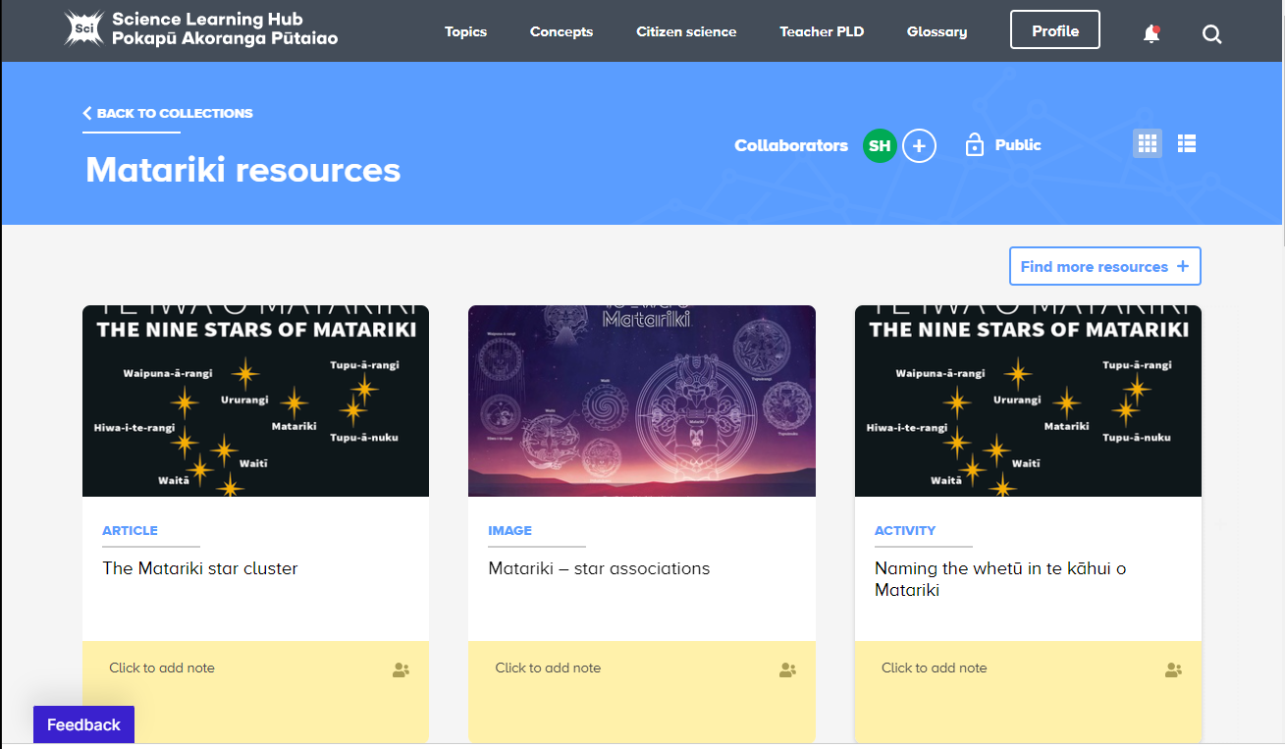
© Forest & Bird’s Kiwi Conservation Club
© Te Wānanga o Aotearoa
© Forest & Bird’s Kiwi Conservation Club
© Copyright. Science Learning Hub – Pokapū Akoranga Pūtaiao The University of Waikato Te Whare Wananga o Waikato.
All Rights Reserved | www.sciencelearn.org.nz. All images are copyrighted. For further information, please refer to enquiries@sciencelearn.org.nz
Notes:
Matariki and MfE: https://www.sciencelearn.org.nz/collections/shared/cc977bcbef82fb3d942eb3cd2e2eded3

Slide 38
Thanks – want to keep in touch?
Science Learning Hub
Email us on enquiries@sciencelearn.org.nz
https://twitter.com/NZScienceLearn
www.facebook.com/nzsciencelearn
https://nz.pinterest.com/nzsciencelearn
www.instagram.com/sciencelearninghubnz
Associate Professor Nicola Daly
nicola.daly@waikato.ac.nz
@nicoladaly18

Slide 39
He Karakia mō te Matariki
www.youtube.com/watch?v=BgO07wfIgXs
Geoff McKay/CC BY 2.0
© Copyright. Science Learning Hub – Pokapū Akoranga Pūtaiao The University of Waikato Te Whare Wananga o Waikato.
All Rights Reserved | www.sciencelearn.org.nz. All images are copyrighted. For further information, please refer to enquiries@sciencelearn.org.nz

