Slide 1
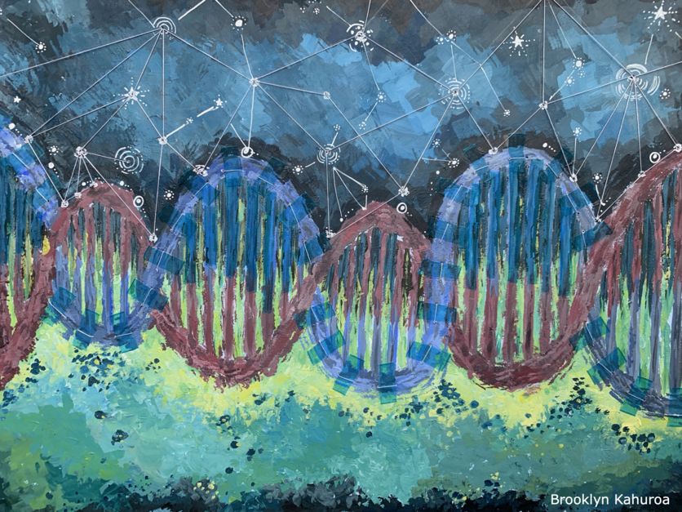
What is a knowledge system?
With Rosemary Hipkins and Pauline Waiti
4–5 pm Thursday 10 August 2023
© Copyright. Science Learning Hub – Pokapū Akoranga Pūtaiao The University of Waikato Te Whare Wananga o Waikato.
All Rights Reserved | www.sciencelearn.org.nz. All images are copyrighted. For further information, please refer to enquiries@sciencelearn.org.nz

Slide 2
The Science Learning Hub
A trustworthy online resource – produced by educators and scientists
Based on world-class New Zealand science research
Supported by learning activities, information about the key science ideas and concepts, multimedia tools and other resources
Written for New Zealand teachers and students
Notes:
The Science Learning Hub is funded by the New Zealand government – Ministry of Business, Innovation and Employment (MBIE) – under the Curious Minds fund.

Slide 3
Index
Topic | Slideshow number(s) | Video timecode
Introducing the Science Learning Hub and presenters | 1–2 | 00:00
Index | 3 | 00:29
Why ask the question “What is a knowledge system”? & definitions | 4–5 | 04:25
The CMP model applied to knowledge systems | 6 | 07:51
Unpacking knowledge systems – the Rena disaster | 7–11 | 11:00
Diffusion | 12 | 20:54
Cosmic phenomena | 13–14 | 25:17
Naming and grouping things | 15 | 27:56
Complex systems behaviour | 16 | 30:28
Emergence – fire | 17 | 31:37
Te reo o te Repo | 18 | 33:36
What “equal status” might (and might not) look like… | 19–20 | 37:00
Participant questions | 21 | 48:41
SLH links, keep in touch and thanks | 22 | 53:41

Slide 4
Why even ask this question?
Crown copyright ©/CC BY 3.0 NZ
The mana ōrite imperative appears to have originated in the NCEA change package.
Attention then turned to what it might mean for the curriculum refresh, including the refreshed science curriculum.
We had a think about how to support constructive change and came up with a “knowledge systems” approach.

Slide 5
“Knowledge systems include the practices, routines,
structures, mindsets, values and cultures affecting what
and how knowledge is produced and used, and by whom.”
(Fazey et al., 2020, p. 5)
“Formalised knowledge systems” are associated with
“universities, research institutes, non-government and
government organisations” (p. 5).
“…while current [formal] knowledge systems have led to
major advances, they have also generated phenomenal
capacity for humanity to create harm, such as by enabling
war and annihilation of biodiversity, cultures and languages”
(p. 6).
Transforming knowledge systems for life on Earth: Visions of future systems and how to get there - ScienceDirect

Slide 6
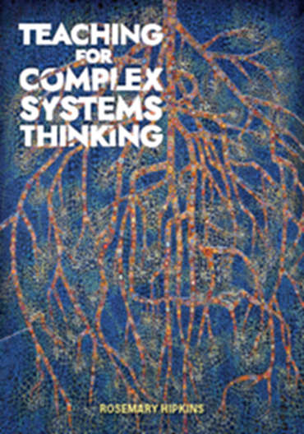
Knowledge systems are complex: the CMP model is one way to help learners make sense of them
 | How knowledge shows this feature
Phenomena | The things that happen – events in context – that ‘anchor’ knowledge to lived realities. [Organisational, operational and political contexts]
Mechanisms | Forms of logic and shared explanations that shape and inform ways that the components interact. [Generation, validation, communication and application of knowledge]
Components | Ideas, and experiences, captured in words and phrases, that can be shared and discussed. [Institutions, structures, assumptions, values, standards]
[ ] denote elements, functions, contexts of knowledge-generating systems, as per Fazey et al.

Slide 7
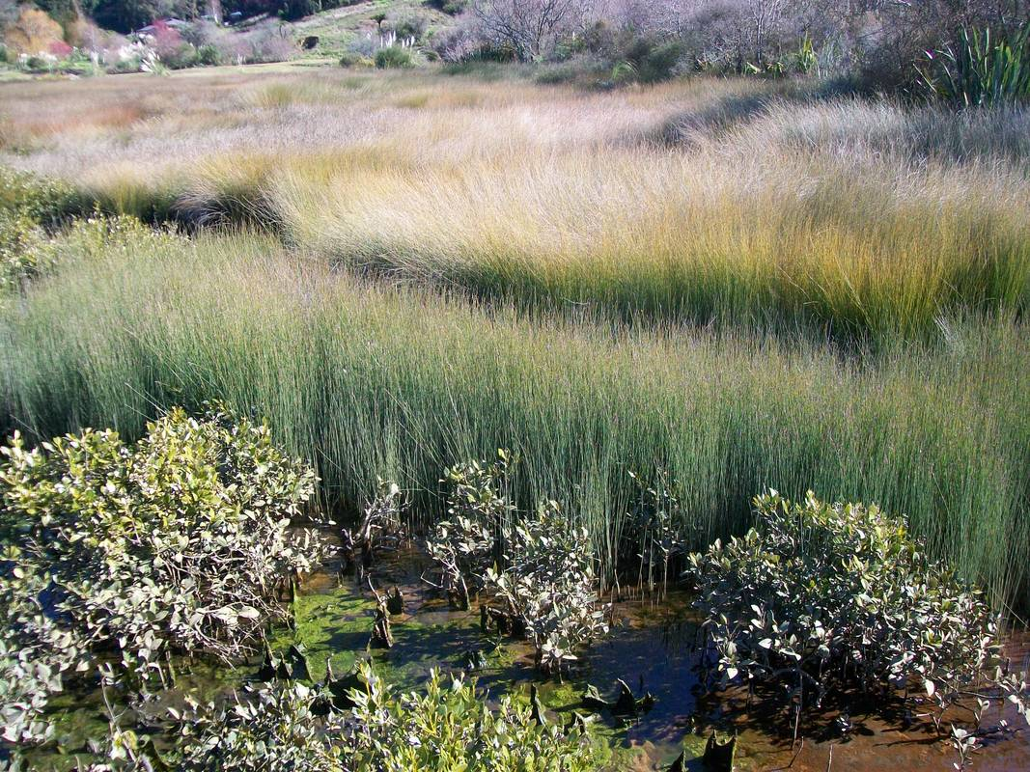
Unpacking knowledge systems by starting with a
phenomenon: The aftermath of the Rena disaster ….
© Rose Hendry
Notes:
Image: https://www.sciencelearn.org.nz/images/901-tauranga-estuary

Slide 8
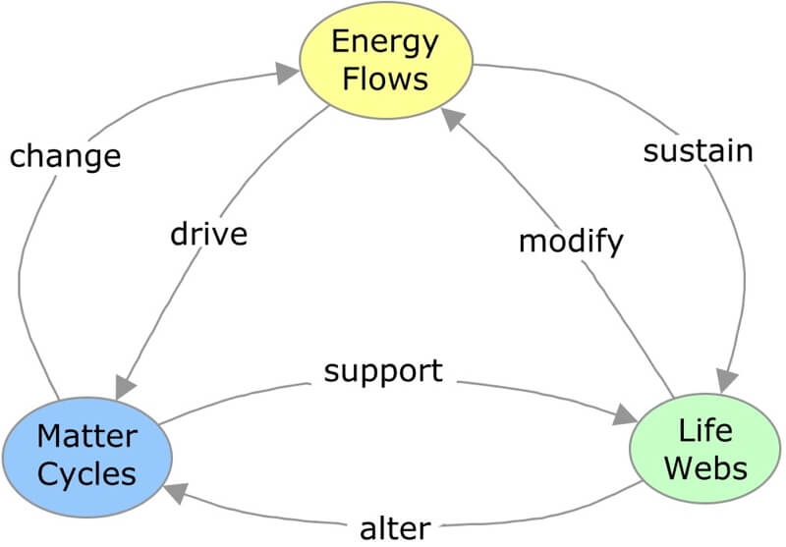
Science as a complex knowledge system:
Phenomenon: change to the coastal swamp ecosystem.
Components: science concepts that form interconnected webs. Mechanisms: connect the components (NB they are implicit)
Courtesy of Jodi Pickle
Source: Concept Mapping - Science Pickle

Slide 9
The same phenomenon from the perspective of
mātauranga Māori as a knowledge system.
“Dr Kepa Morgan’s mauri model presents mauri as a continuum or range between different extremes. The negative extreme is “Mauri moe, mauri noho” where the mauri is exhausted. At the other end, “Mauri tu, mauri ora” is where the mauri is vibrant and it has its fullest potential to support life.”
© Rose Hendry
© Copyright. Science Learning Hub – Pokapū Akoranga Pūtaiao The University of Waikato Te Whare Wananga o Waikato.
All Rights Reserved | www.sciencelearn.org.nz. All images are copyrighted. For further information, please refer to enquiries@sciencelearn.org.nz
Notes:
https://www.sciencelearn.org.nz/resources/809-restoring-mauri-after-the-rena-disaster

Slide 10
The concept of mauri belongs to the mātauranga Māori
knowledge system.
Concepts such as wairua, whakapapa and kaitiakitanga also belong to the mātauranga Māori knowledge system.
They do not have a direct equivalent within the science
knowledge system and should never be assimilated into it.
Many science groups are now consciously bringing knowledge systems together as they work on complex challenges such as ecological disasters.

Slide 11
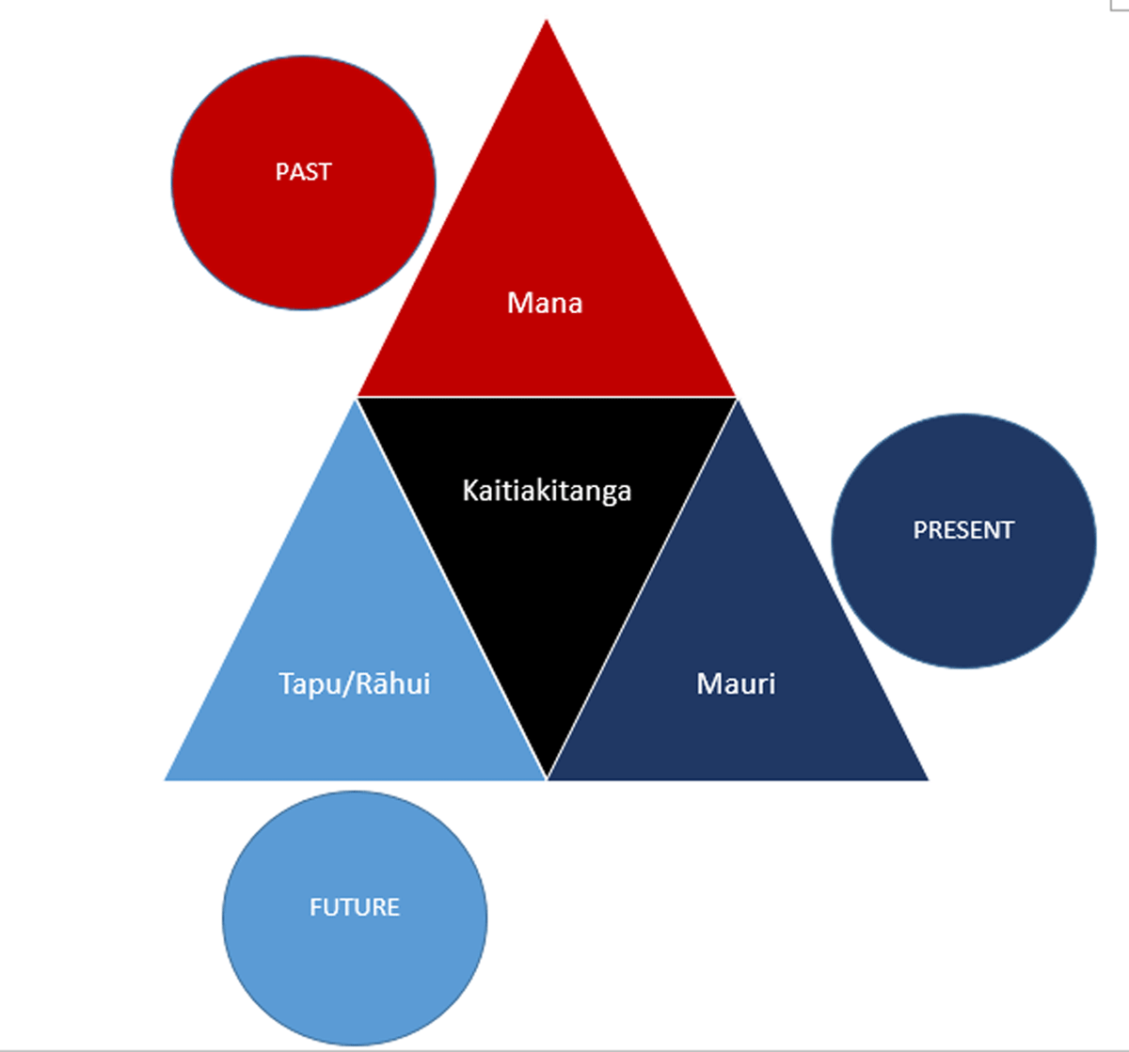
In both knowledge systems a single
concept/word can convey a complex
set of interconnections and/or
Mechanisms.
Including a temporal dimension
in conceptual models is a
characteristic feature of
indigenous knowledge systems
(and signals a non-linear view of time).
How does this diagram support
the warning that it is not
appropriate to assimilate words and
phrases from one knowledge system directly into another knowledge
system?
Kaitiakitanga: Utilising Māori Holistic Conservation in Heritage Institutions - Journal of Conservation and Museum Studies (jcms-journal.com). CC BY 4.0.

Slide 12
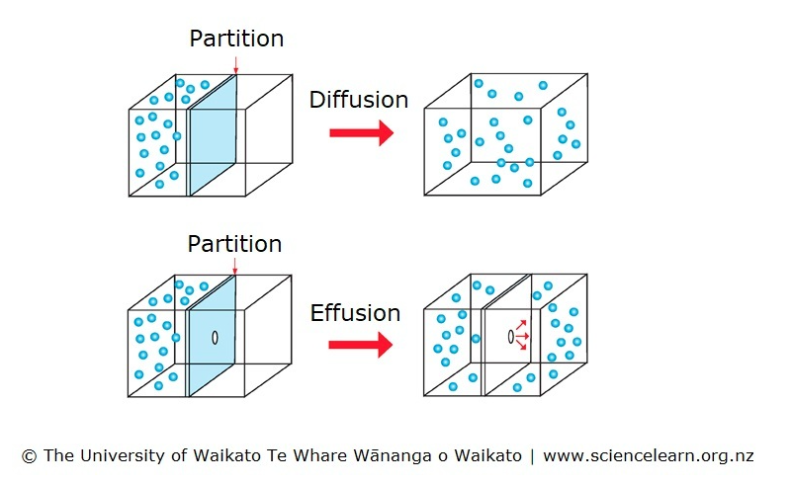
Nominalisation is one indicative feature of how mechanisms are expressed in a science knowledge system.
Stochastic phenomena are non-agentic.
© Copyright. Science Learning Hub – Pokapū Akoranga Pūtaiao The University of Waikato Te Whare Wananga o Waikato.
All Rights Reserved | www.sciencelearn.org.nz. All images are copyrighted. For further information, please refer to enquiries@sciencelearn.org.nz
Notes:
Image: https://www.sciencelearn.org.nz/images/4699-gaseous-diffusion-and-effusion

Slide 13
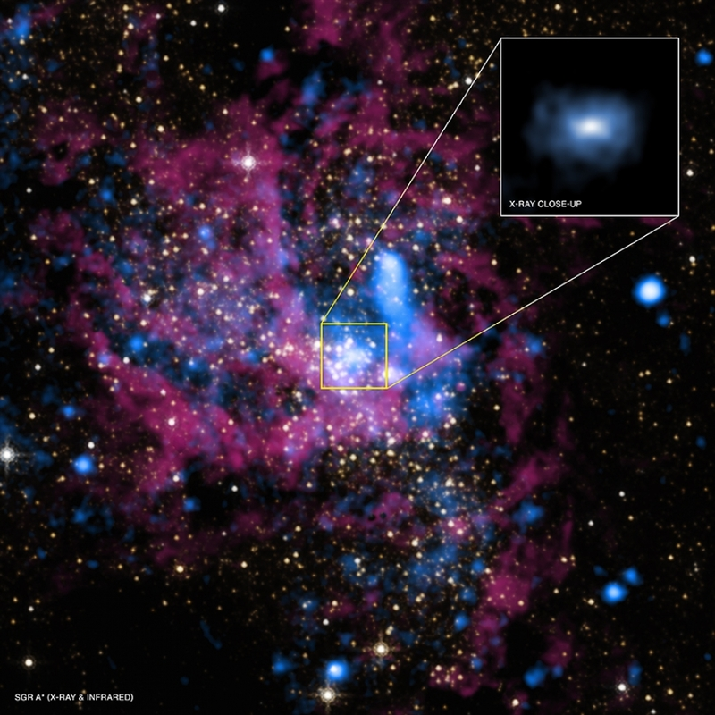
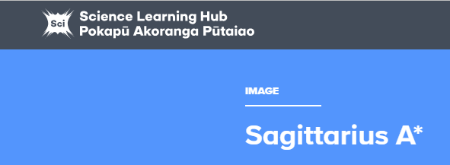
Sagittarius A* is the black hole at the centre of the Milky Way galaxy.
NASA/UMass/ D.Wang et al., IR: NASA/STScl
Now we illustrate some other features of the two knowledge systems,
using cosmic phenomena as our context …
© Copyright. Science Learning Hub – Pokapū Akoranga Pūtaiao The University of Waikato Te Whare Wananga o Waikato.
All Rights Reserved | www.sciencelearn.org.nz. All images are copyrighted. For further information, please refer to enquiries@sciencelearn.org.nz
Notes:
Image: https://www.sciencelearn.org.nz/images/2902-sagittarius-a

Slide 14
Many phenomena that exist at scales that are not directly observable
– both too vast and too small
NASA/UMass/ D.Wang et al., IR: NASA/STScl
In the science knowledge system cosmological phenomena create
challenges for empirical inquiry methods. New explanations emerge as new technologies enable different types of observations to be made.
The overall aim is to explain the phenomena.
In the mātauranga Māori knowledge system, mechanisms and relationships within the cosmos are expressed as narrative stories. All the observed
components have agency to act and personified names are often used.
The overall aim is to convey wisdom about how to live and be.
© Copyright. Science Learning Hub – Pokapū Akoranga Pūtaiao The University of Waikato Te Whare Wananga o Waikato.
All Rights Reserved | www.sciencelearn.org.nz. All images are copyrighted. For further information, please refer to enquiries@sciencelearn.org.nz

Slide 15
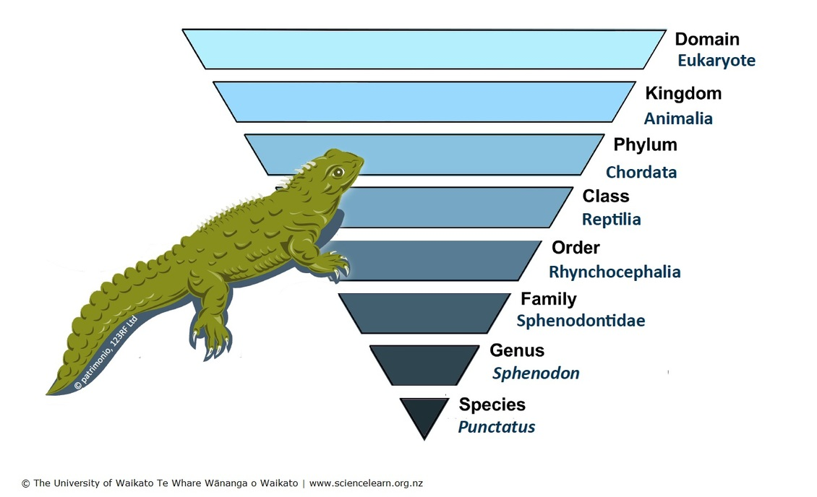
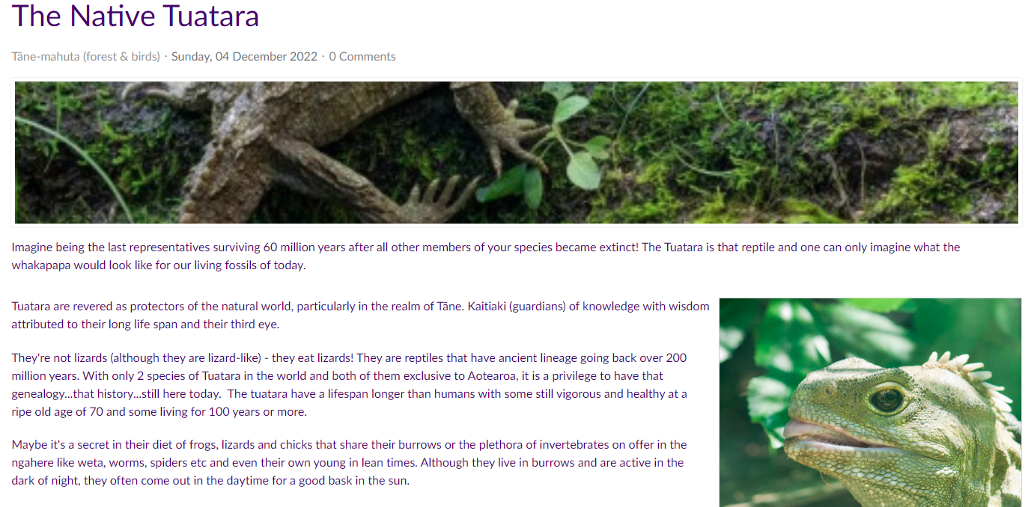
© 2023 by Tangata Whenua Network.
Where do names come from? Who decides how things get grouped?
In the science knowledge system, categories that group components are
organised around key science concepts and theories. Tuatara are seen as
“living fossils”, predicated on the theory of evolution.
In the mātauranga Māori knowledge system, categories that group components are organised around functional relationships. Tuatara are seen as “revered
protectors of the realm of Tāne”. They are kaitiaki of knowledge, with wisdom
attributed to their long life span and their third eye.
The Native Tuatara - Rangitaki (maorilandinfo.co.nz)
© Copyright. Science Learning Hub – Pokapū Akoranga Pūtaiao The University of Waikato Te Whare Wananga o Waikato.
All Rights Reserved | www.sciencelearn.org.nz. All images are copyrighted. For further information, please refer to enquiries@sciencelearn.org.nz
Notes:
https://www.sciencelearn.org.nz/images/4445-tuatara-classification

Slide 16
How complex systems behave
(their dynamics)
 | How knowledge shows this feature
Emergence | Components recombine in ways that allow new knowledge to emerge
Self-organisation | The structure of the whole emerges from more local interactions
Non-linearity | Small changes can have large and cascading effects
Feedback loops | Integration of new components prompts further exploration, questioning and idea improvement
Adaptation and evolution | Systems are dynamic – knowledge continually evolves and adapts

Slide 17
A paradigm shift signals emergence in the science knowledge system:
a new discovery or theory changes the way many concepts, relationships and mechanisms are understood – cascades of changes follow …
© Copyright. Science Learning Hub – Pokapū Akoranga Pūtaiao The University of Waikato Te Whare Wananga o Waikato.
All Rights Reserved | www.sciencelearn.org.nz. All images are copyrighted. For further information, please refer to enquiries@sciencelearn.org.nz
Notes:
https://www.sciencelearn.org.nz/resources/1596-fire-timeline

Slide 18
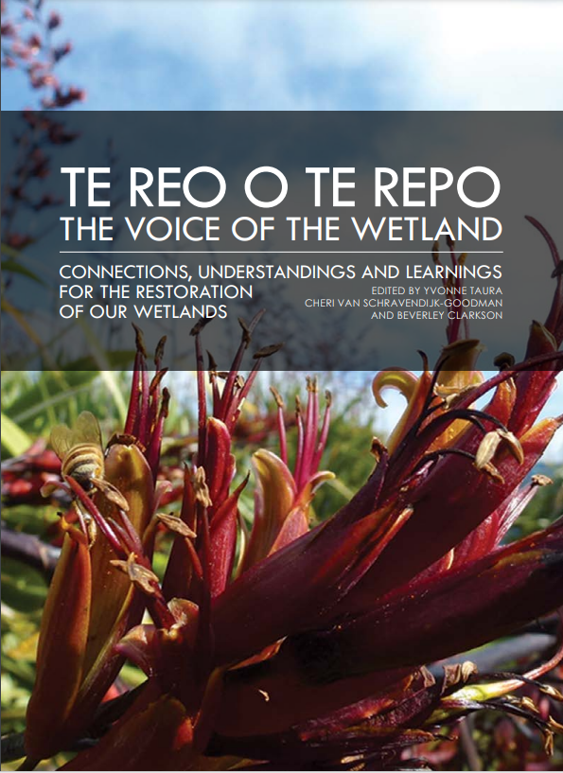
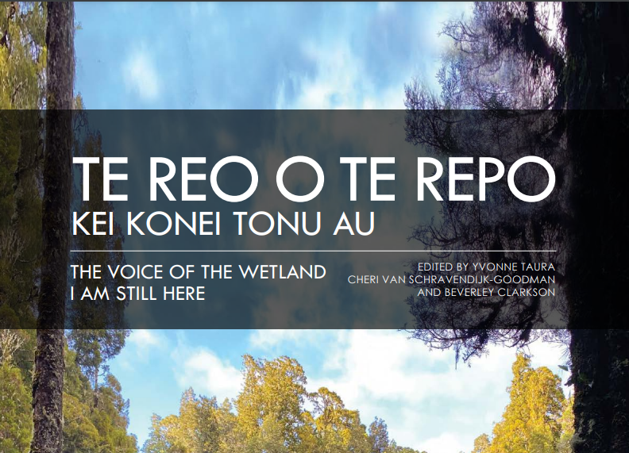
“Māori scholarship emphasizes the evolutionary nature of Indigenous knowledge
systems (Smith et. al, 2016). ‘Mātauranga Māori has a past, a present, and a
future’ – meaning that this Māori knowledge system is continually being used,
adapted, and incorporated into people’s lives. This allows for new, innovative
ideas and practices, including those evolving from fresh discoveries and research.”
(Varghese & Crawford, 2021, p. 5)
A cultural framework for Indigenous, Local, and Science knowledge systems in ecology and natural resource management - Varghese - 2021 - Ecological Monographs - Wiley Online Library

Slide 19
What “equal status” might (and might not) look like…
Each knowledge system is judged according to its own internal integrity and fitness for purpose.
Appropriation of distinctive features of one knowledge
system into the other is avoided (appropriation of
mātauranga Māori into the science knowledge system
is a form of recolonisation, no matter how well
intentioned).
Equal status does not necessarily imply equal time.
Knowledge systems are brought together when there is a constructive reason for doing so.

Slide 20
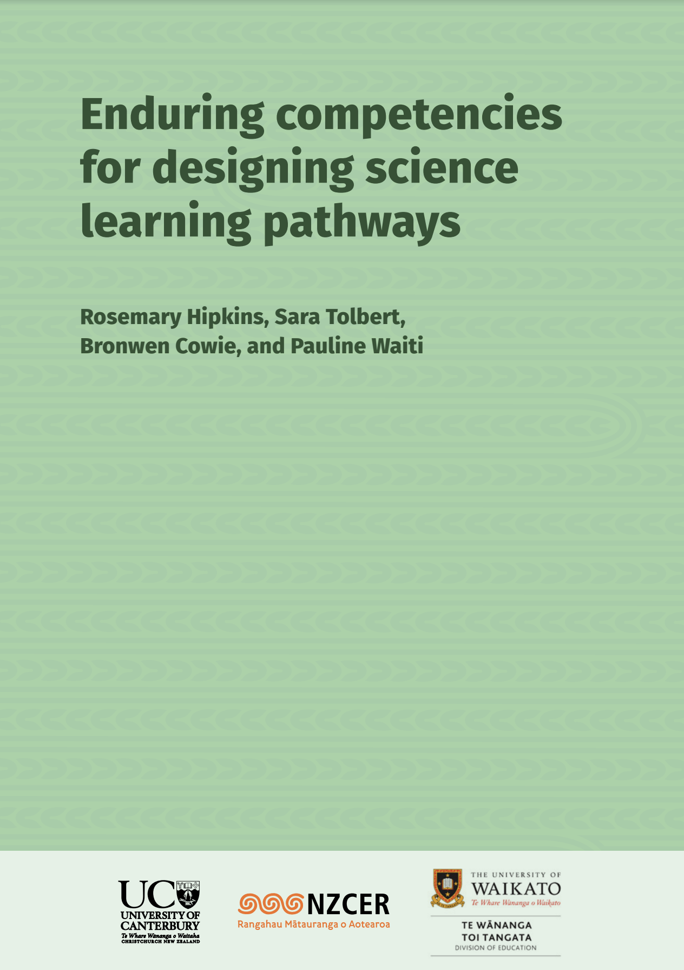
Having two knowledge systems to draw on is a tāonga that is potentially available to all the young people of Aotearoa
“As they take their learning out into the world, young people will be able to understand and interpret events and experiences through at least two different knowledge lenses: they will understand their place and identity in the natural world through the lens of science, and through the lens of mātauranga Māori, as well as other relevant cultural–historical knowledge systems. They will know how and when to draw on the contributions and strengths of science, mātauranga Māori, and other cultural–historical ways of knowing nature, to live as ethically and responsibly as possible”

Slide 21
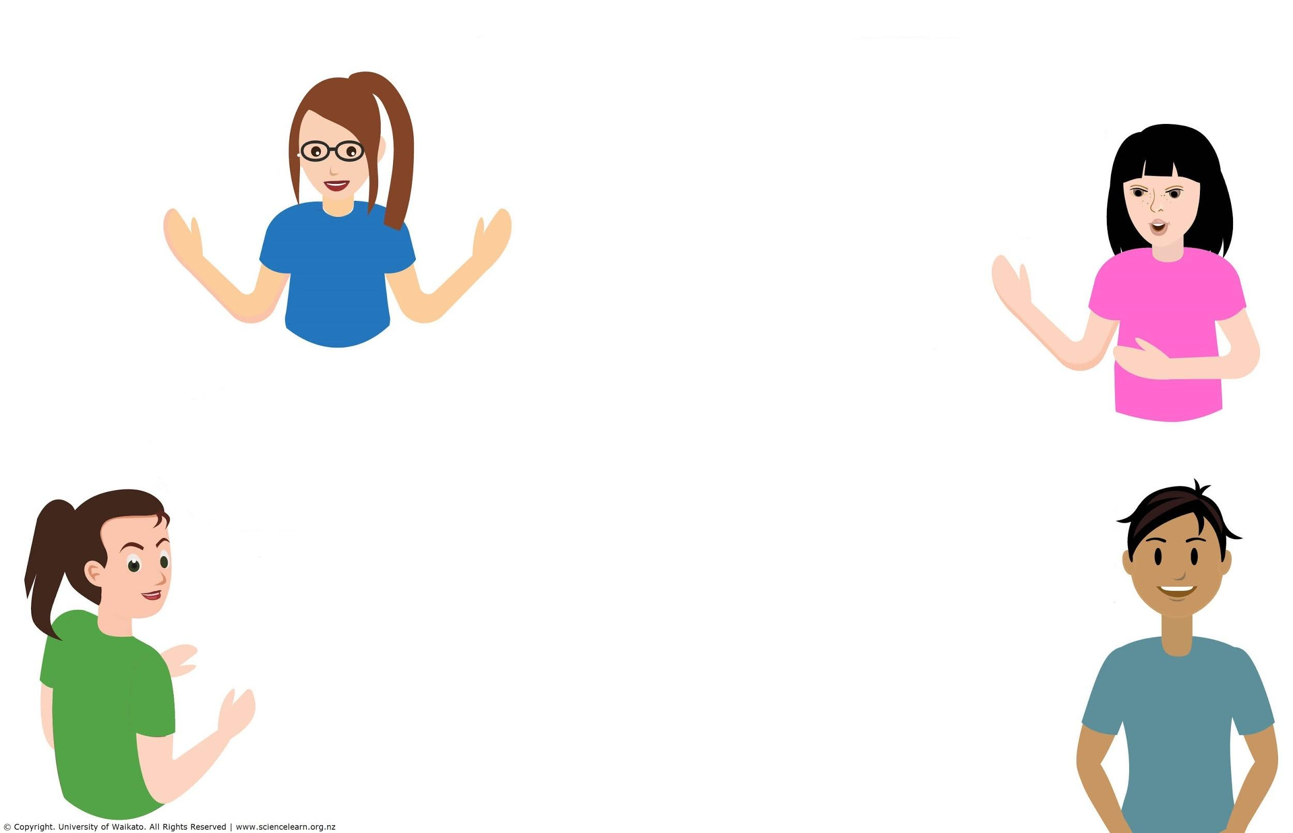
Participant
questions:

Slide 22
Thanks – want to keep in touch?
Email us on enquiries@sciencelearn.org.nz
https://twitter.com/NZScienceLearn
www.facebook.com/nzsciencelearn
https://nz.pinterest.com/nzsciencelearn
www.instagram.com/sciencelearninghubnz

