Slide 1
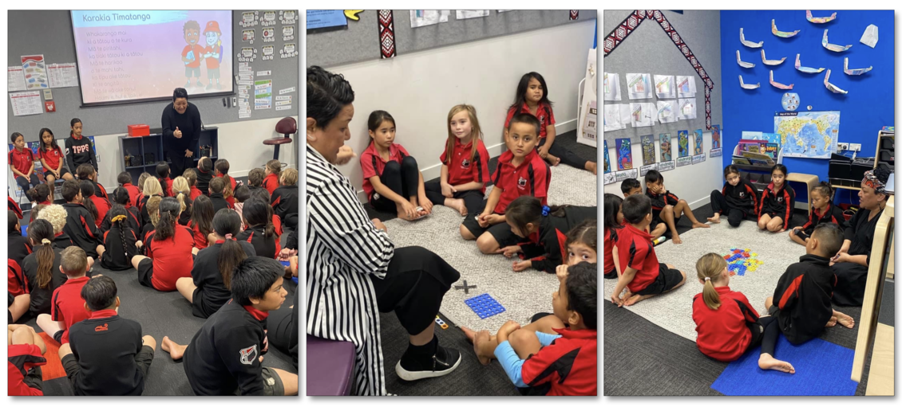
What does the hub look like in the classroom?
© S.Marsters
4–4:45 pm Thursday 14 September
© Copyright. Science Learning Hub – Pokapū Akoranga Pūtaiao The University of Waikato Te Whare Wananga o Waikato.
All Rights Reserved | www.sciencelearn.org.nz. All images are copyrighted. For further information, please refer to enquiries@sciencelearn.org.nz

Slide 2
The Science Learning Hub
A trustworthy online resource – produced by educators and scientists
Based on world-class New Zealand science research
Supported by learning activities, information about the key science ideas and concepts, multimedia tools and other resources
Written for New Zealand teachers and students
© Copyright. Science Learning Hub – Pokapū Akoranga Pūtaiao The University of Waikato Te Whare Wananga o Waikato.
All Rights Reserved | www.sciencelearn.org.nz. All images are copyrighted. For further information, please refer to enquiries@sciencelearn.org.nz

Slide 3
Index
Topic | Slideshow number(s) | Video timecode
Introducing the Science Learning Hub and today’s PLD | 1–2 | 00:00
Index | 3 | 00:28
Introducing Simone and opening karakia | 4–5 | 00:41
Purpose and some initial questions | 6–7 | 02:41
Science in the classroom: why the Hub? | 8–10 | 04:04
What Simone did | 11 | 09:07
The curriculum: Understand, Know, Do | 12–17 | 13:10
Example context: Honeybees | 18–24 | 19:28
Inquiry cycle | 25 | 31:33
Other examples | 26 | 34:00
Support for teachers | 27–30 | 34:43
SLH links, keep in touch and thanks | 31 | 37:28
© Copyright. Science Learning Hub – Pokapū Akoranga Pūtaiao The University of Waikato Te Whare Wananga o Waikato.
All Rights Reserved | www.sciencelearn.org.nz. All images are copyrighted. For further information, please refer to enquiries@sciencelearn.org.nz

Slide 4
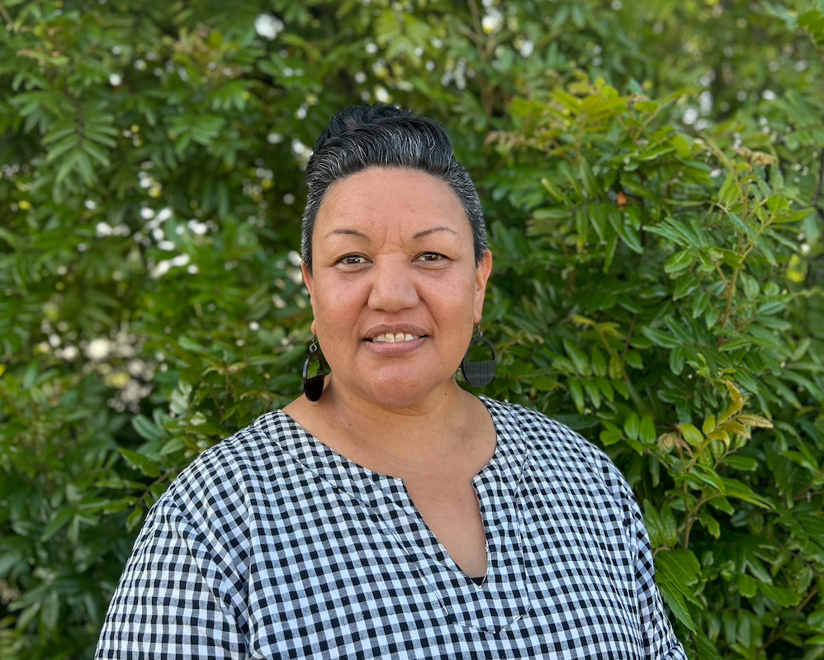
Simone Marsters
Ko Maungataniwha me Pāngaru ngā maunga
Ko Mataatua me Ngātokimatawhāorua ngā waka
Ko Tapapa me Hokianga ngā wai tapu
Ko Te Uri o Mahoe me Ngāti Kura ngā hapū
Ko Ngā Puhi te iwi
He uri ahau nō Te Taitokerau me Te Arawa hoki.
He hononga hoki ki te riu o Waikato, tōku ūkaipo me Gloucestershire, England.
Ko Tauranga moana tōku kainga noho i tēnei wā.
© S.Marsters
Kaihautū Māori/Content developer @ Te Pōkapu Akoranga Putaiao
13 years experience in the classroom years 0–8
Leaderships roles within and across schools
Advocate for mātaraunga Māori
Curiosity of the world we live in
© Copyright. Science Learning Hub – Pokapū Akoranga Pūtaiao The University of Waikato Te Whare Wananga o Waikato.
All Rights Reserved | www.sciencelearn.org.nz. All images are copyrighted. For further information, please refer to enquiries@sciencelearn.org.nz

Slide 5
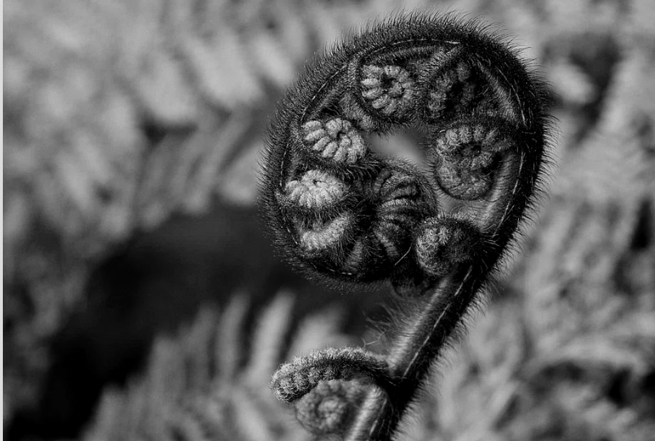
By believing and trusting
By having faith and hope
By looking and searching
By listening and hearing
By working and striving together
By sheer desire and determination
By all being done with compassion
We will succeed
Mā te whakapono
Mā te tūmanako
Mā te tītiro
Mā te whakarongo
Mā te mahi tahi
Mā te whakamomori
Mā te aroha
Ka taea e tātou
Fern background by Grapeman4, CC BY-SA 2.0

Slide 6
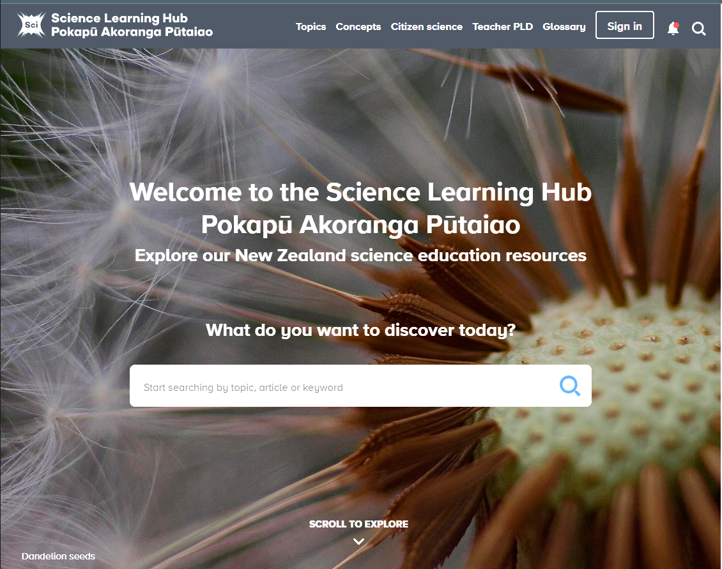
Purpose
Sharing
The steps we take when adapting a resource
Examples of resources to support common primary classroom topics
Opportunities for asking questions
Daniel Blunt, CC BY 2.0
© Copyright. Science Learning Hub – Pokapū Akoranga Pūtaiao The University of Waikato Te Whare Wananga o Waikato.
All Rights Reserved | www.sciencelearn.org.nz. All images are copyrighted. For further information, please refer to enquiries@sciencelearn.org.nz

Slide 7
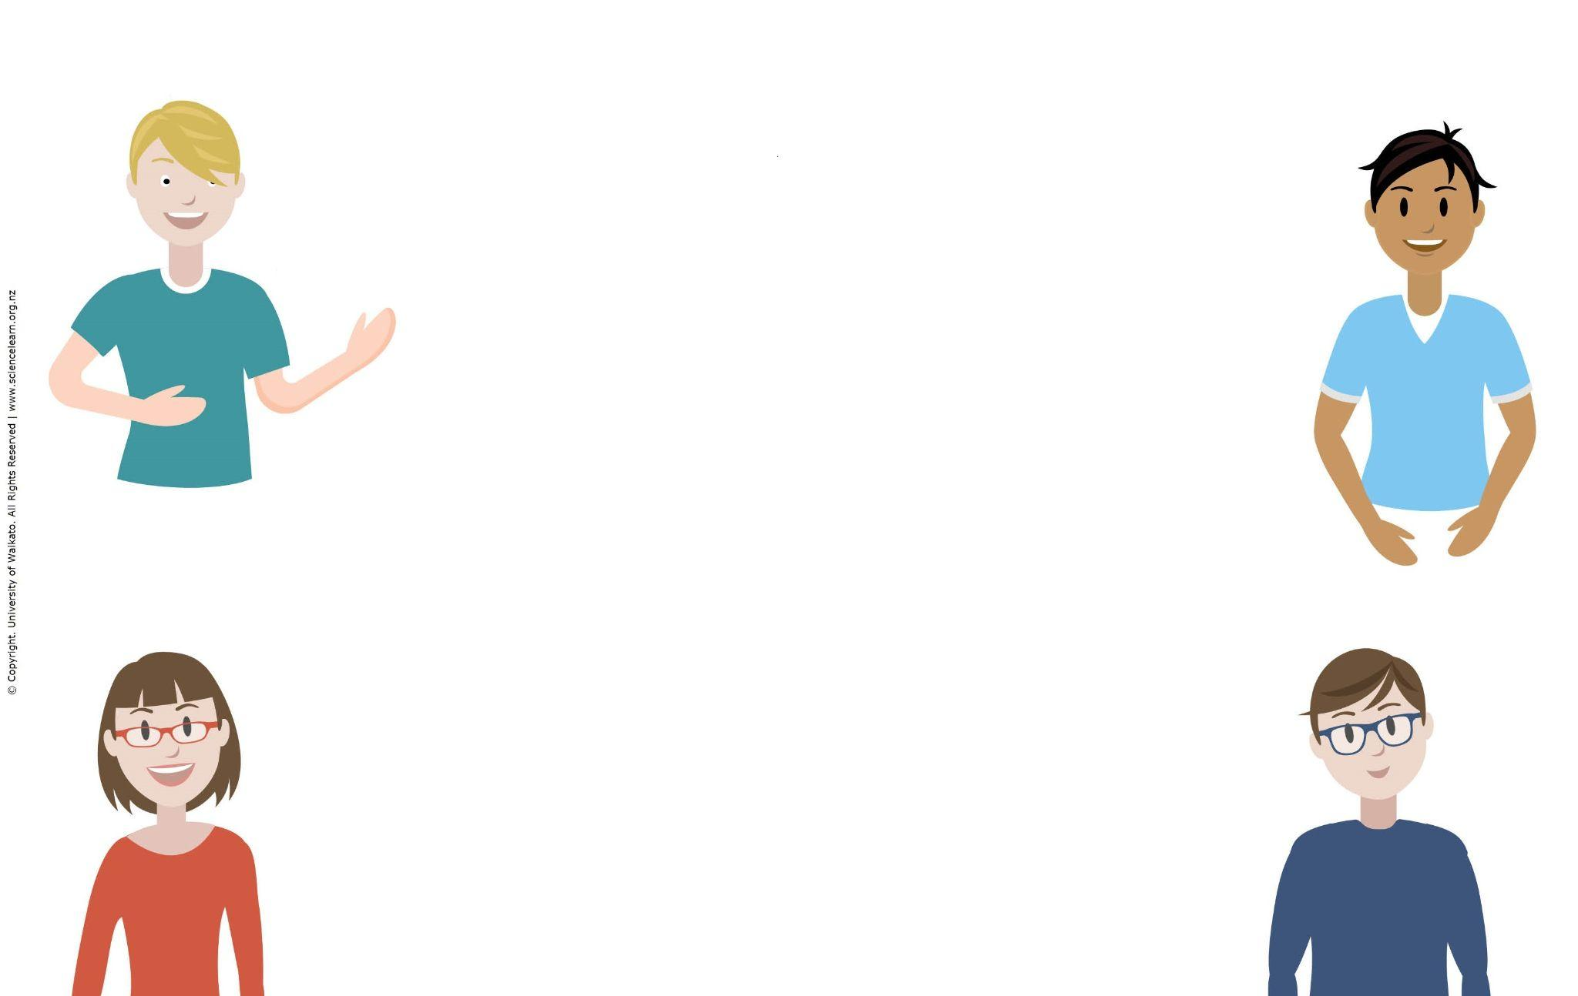
Participant questions
How to engage our youngest learners and equip them with the language they need to thrive with science.
Adapting for primary resources.
Finding what would be useful easily.
Where to start? I’ve never used the Science Learning Hub, so interested to see what it’s about and what resources are available.
Navigation – I find it hard to find my way back to things I have found before.
© Copyright. Science Learning Hub – Pokapū Akoranga Pūtaiao The University of Waikato Te Whare Wananga o Waikato.
All Rights Reserved | www.sciencelearn.org.nz. All images are copyrighted. For further information, please refer to enquiries@sciencelearn.org.nz

Slide 8
© Copyright. Science Learning Hub – Pokapū Akoranga Pūtaiao The University of Waikato Te Whare Wananga o Waikato.
All Rights Reserved | www.sciencelearn.org.nz. All images are copyrighted. For further information, please refer to enquiries@sciencelearn.org.nz

Slide 9
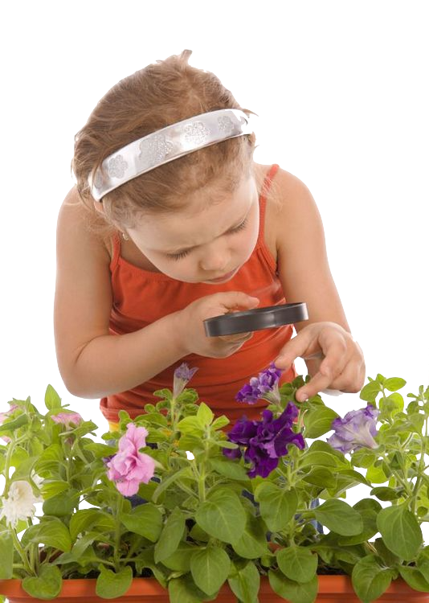
We are born scientists, we are curious about the physical environment from the moment we are born.
As tamariki we are naturally open to making meaning through exploration and communication with others.
As educators teaching and learning about science is introducing children to the ways scientists think about and investigate the physical world.
© Copyright. Science Learning Hub – Pokapū Akoranga Pūtaiao The University of Waikato Te Whare Wananga o Waikato.
All Rights Reserved | www.sciencelearn.org.nz. All images are copyrighted. For further information, please refer to enquiries@sciencelearn.org.nz

Slide 10
Why the hub?
Easily digestible information
Related content, concepts, topics
Hands-on activities
Editable resources
Multimedia content
Professional Learning Development (PLD)
© Copyright. Science Learning Hub – Pokapū Akoranga Pūtaiao The University of Waikato Te Whare Wananga o Waikato.
All Rights Reserved | www.sciencelearn.org.nz. All images are copyrighted. For further information, please refer to enquiries@sciencelearn.org.nz

Slide 11
What we did…
School/team kaupapa
Planning
Learning
Topic specific
Links to science curriculum
Science capabilities
Levels 1–4
Search resources
Ideas
Articles
Activities
Shared slides
Hands-on activities
Videos
© Copyright. Science Learning Hub – Pokapū Akoranga Pūtaiao The University of Waikato Te Whare Wananga o Waikato.
All Rights Reserved | www.sciencelearn.org.nz. All images are copyrighted. For further information, please refer to enquiries@sciencelearn.org.nz

Slide 12
Framing learning – The Understand, Know, Do
Understand: the big ideas
Know: rich contexts for exploring the big ideas
Do: practices that bring rigour to learning
“Learning that cannot left to chance”
© Copyright. Science Learning Hub – Pokapū Akoranga Pūtaiao The University of Waikato Te Whare Wananga o Waikato.
All Rights Reserved | www.sciencelearn.org.nz. All images are copyrighted. For further information, please refer to enquiries@sciencelearn.org.nz

Slide 13
What it looked like…
Science Curriculum Achievement Rubric Nature of Science: Investigating in Science (Overarching Strand) Strand: Material World (Contextual Strand): AO: Properties and Changes of Matter Level 1-2: Observe, describe and compare physical and chemical properties of common materials and changes that occur when materials are mixed, heated or cooled Level 3-4: Group materials in different ways based on the observations of measurements of the characteristic chemical and physical properties of a range of different materials
Progress indicators |  | Pre Level 1 | Early Level 1 | At Level 1 | Level 2 | Level 3 | Level 4
 |  |  |  |  | Early: Dipping into the curriculum level At: Completing MOST indicators independently MOST of the time
Nature of Science: Investigating in science (Overarching Strand) Experiment Test Classify Record |  | Does not understand, so cannot follow instructions (R4L assessment) | With support begin to follow simple instructions and use equipment to investigate With support begin to collect and record some evidence from observations (verbally) | Begin to follow simple instructions and use equipment to investigate Begin to record evidence from observations | With support plan and investigate Identify relevant variables - (what to keep the same, what to change) Carry out observations and collect evidence | Plan and carry out an investigation to gather evidence to test their theory/hypothesis/prediction (control variables if appropriate) Use precise observations and measurements and/or test and record findings | Select, justify, plan and carry out systematic investigations to gather evidence to test their inference / hypothesis / prediction controlling variables if appropriate. Choose an appropriate scientific method to observe and measure and / or test and record findings in a systematic way
At level 1
Begin to follow simple instructions and use equipment to investigate
Begin to record evidence from observations
© Copyright. Science Learning Hub – Pokapū Akoranga Pūtaiao The University of Waikato Te Whare Wananga o Waikato.
All Rights Reserved | www.sciencelearn.org.nz. All images are copyrighted. For further information, please refer to enquiries@sciencelearn.org.nz

Slide 14
Progress indicators |  | Pre Level 1 | Early Level 1 | At Level 1 | Level 2 | Level 3
 |  |  |  |  | Early: Dipping into the curriculum level At: Completing MOST indicators independently MOST of the time
Material World: (Contextual Strand) A.O: Properties and changes of matter (What the Specific Learning outcomes (SLO) will be) |  |  | Observe, describe and compare using our senses to find out about physical and chemical properties of common materials. Observe, describe and compare using our senses to find out about changes that occur when materials are mixed, heated or cooled Think about and share how we have answered our questions. | Observe, describe and compare using our senses to find out about physical and chemical properties of common materials. Observe, describe and compare using our senses to find out about changes that occur when materials are mixed, heated or cooled Think about and share how we have answered our questions. | Observe, describe and compare using our senses to find out about physical and chemical properties of common materials. Observe, describe and compare using our senses to find out about changes that occur when materials are mixed, heated or cooled Think about and share how we have answered our questions. | Group materials in different ways based on observations of measurements of the characteristic chemical and physical properties of a range of different materials. Compare chemical and physical changes. Make a plan to systematically gather information. Give reasons or evidence to explain our thinking. | . Group materials in different ways based on observations of measurements of the characteristic chemical and physical properties of a range of different materials. Compare (and record) chemical and physical changes. Make a plan to systematically gather information. Give reasons or evidence to explain our thinking

Slide 15
Science Capability (Tool - To guide teaching and learning) |  | Students are doing and talking, thinking and explaining. They work in everyday contexts to: |  |  |  | Students are testing their everyday knowledge. They work in a range of contexts, including some that are unfamiliar, to: | Students are building science knowledge. They often work in unfamiliar context to:
Capability 1 Gather and interpret Data |  | make observations using the five senses (see, hear, , smell, touch and taste) make a conclusion (inference) from their observation |  |  | make observations about events and objects using their senses use simple descriptive vocabulary write simple explanations using their observations ask simple questions about familiar contexts | make observations about events, objects and simple texts write simple but clear descriptions using some precise vocabulary write simple science explanations using direct observations and evidence from sources such as photographs ask simple questions that can be investigated notice and describe simple patterns involving differences use basic science investigatory practices, including systematic measurement | make observations about events, objects and formal science texts write descriptions using scientific vocabulary write a scientific explanation identify questions that can be investigated identify and describe complex patterns involving similarities and differences recognise why fair testing is important in gathering data

Slide 16
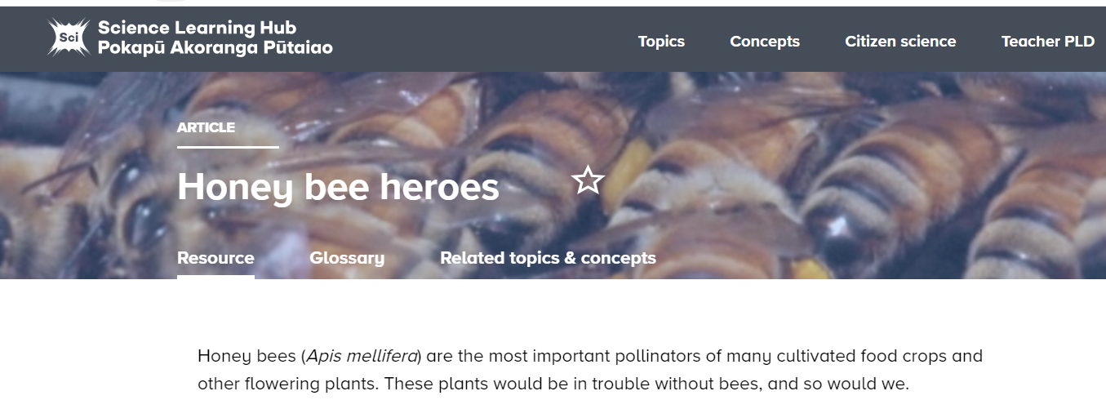
© Copyright. Science Learning Hub – Pokapū Akoranga Pūtaiao The University of Waikato Te Whare Wananga o Waikato.
All Rights Reserved | www.sciencelearn.org.nz. All images are copyrighted. For further information, please refer to enquiries@sciencelearn.org.nz
Notes:
Extend the learning – Related topics & concepts, Related Content and Useful links.
www.sciencelearn.org.nz/resources/83-honey-bee-heroes

Slide 17
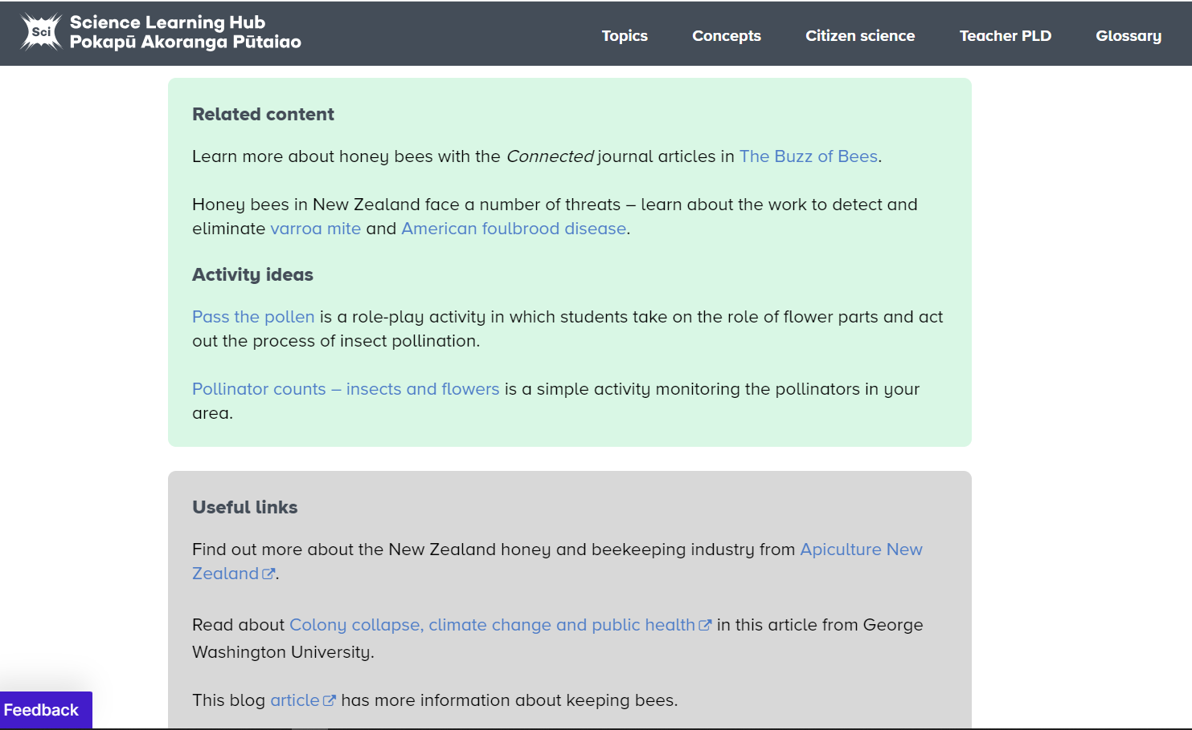
© Copyright. Science Learning Hub – Pokapū Akoranga Pūtaiao The University of Waikato Te Whare Wananga o Waikato.
All Rights Reserved | www.sciencelearn.org.nz. All images are copyrighted. For further information, please refer to enquiries@sciencelearn.org.nz

Slide 18
© Copyright. Science Learning Hub – Pokapū Akoranga Pūtaiao The University of Waikato Te Whare Wananga o Waikato.
All Rights Reserved | www.sciencelearn.org.nz. All images are copyrighted. For further information, please refer to enquiries@sciencelearn.org.nz

Slide 19
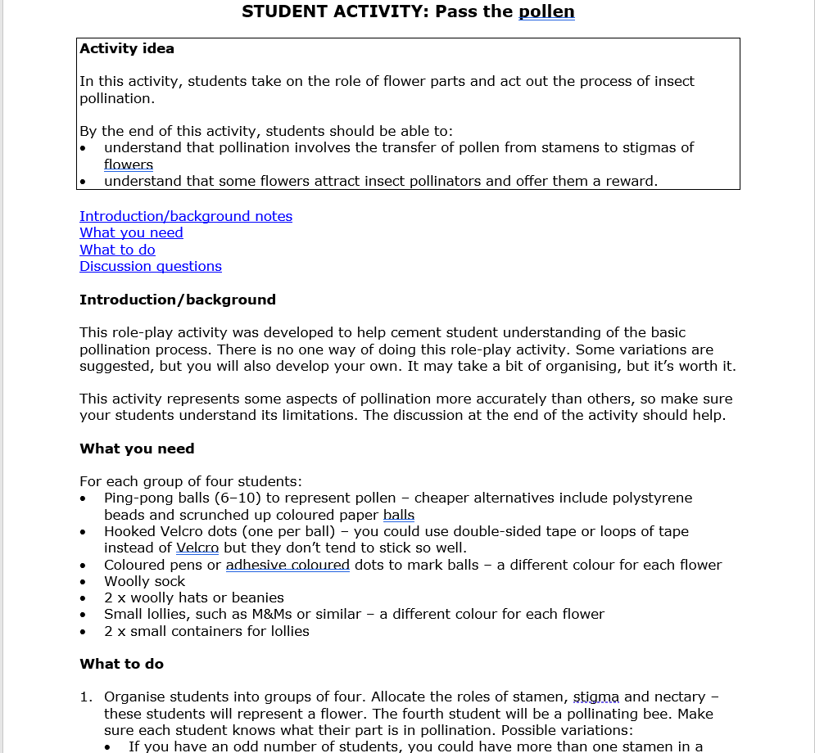
© Copyright. Science Learning Hub – Pokapū Akoranga Pūtaiao The University of Waikato Te Whare Wananga o Waikato.
All Rights Reserved | www.sciencelearn.org.nz. All images are copyrighted. For further information, please refer to enquiries@sciencelearn.org.nz
Notes:
Hands-on activities
www.sciencelearn.org.nz/resources/91-pass-the-pollen

Slide 20
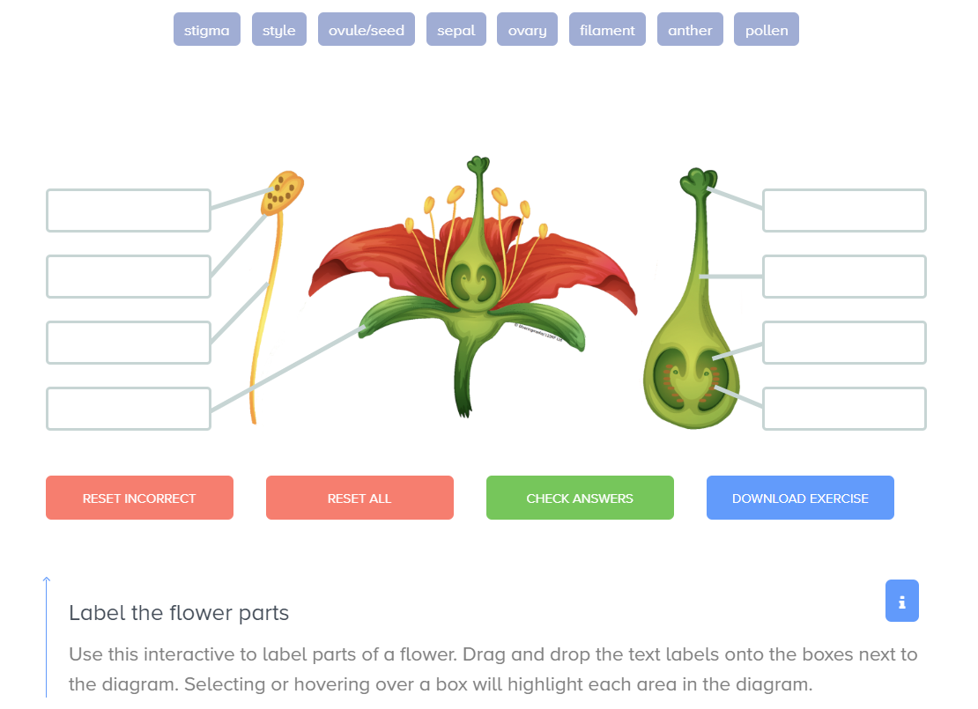
© Copyright. Science Learning Hub – Pokapū Akoranga Pūtaiao The University of Waikato Te Whare Wananga o Waikato.
All Rights Reserved | www.sciencelearn.org.nz. All images are copyrighted. For further information, please refer to enquiries@sciencelearn.org.nz
Notes:
www.sciencelearn.org.nz/resources/3199-labelling-the-parts-of-a-pua-flower

Slide 21
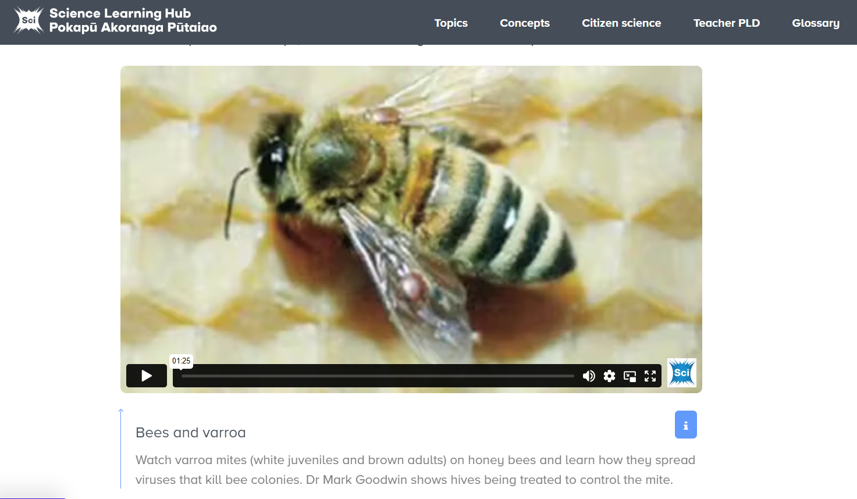
© Copyright. Science Learning Hub – Pokapū Akoranga Pūtaiao The University of Waikato Te Whare Wananga o Waikato.
All Rights Reserved | www.sciencelearn.org.nz. All images are copyrighted. For further information, please refer to enquiries@sciencelearn.org.nz
Notes:
www.sciencelearn.org.nz/videos/18-bees-and-varroa

Slide 22
Honey Bee heroes!
Honey bees (Apis mellifera) are the most important pollinators of many cultivated food crops and other flowering plants! These plants would be in trouble without bees, and so would we!!!

Slide 23
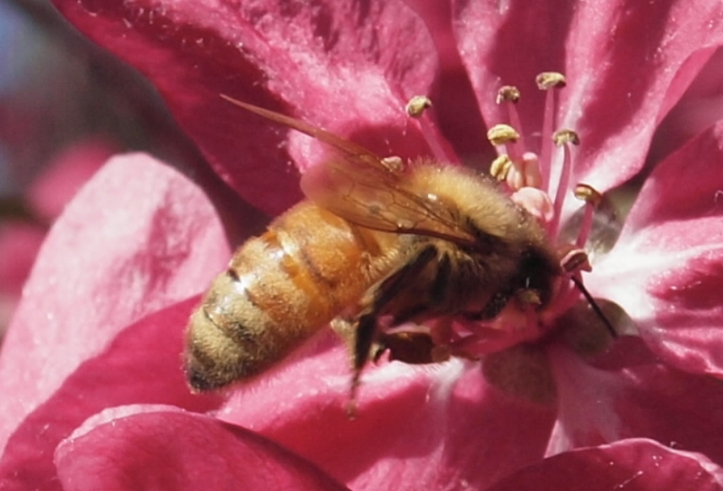
But how?
©Neville Gardner
This honey bee has pushed its head into a flower to search for nectar. Pollen from the stamens will rub off on its body and get carried to another flower.

Slide 24
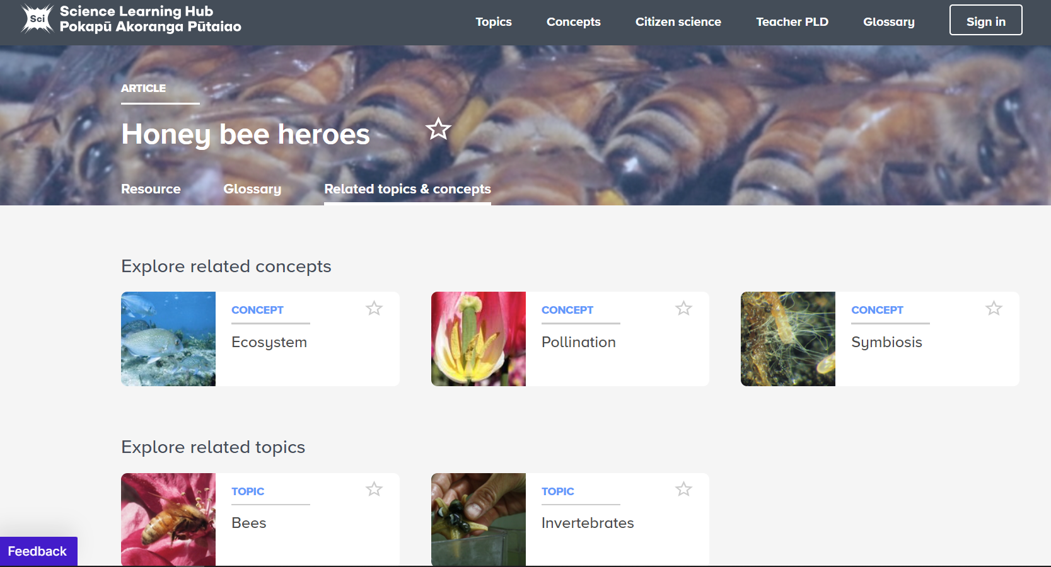
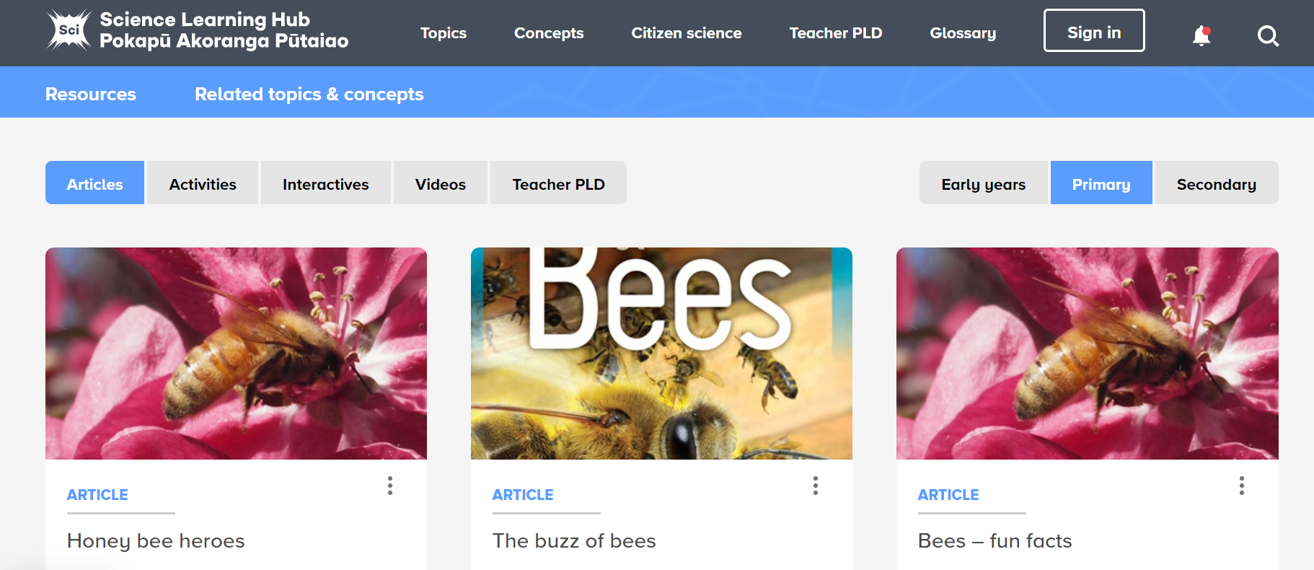
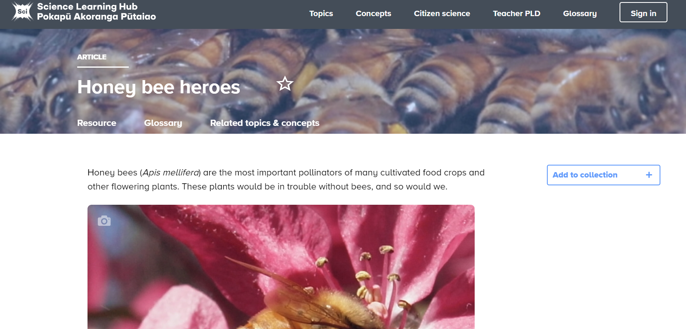
© Copyright. Science Learning Hub – Pokapū Akoranga Pūtaiao The University of Waikato Te Whare Wananga o Waikato.
All Rights Reserved | www.sciencelearn.org.nz. All images are copyrighted. For further information, please refer to enquiries@sciencelearn.org.nz

Slide 25
Great topics for primary science
Insects, birds or other living things
Rockets!
Light, colour and sound
Water
Soil, volcanoes, rocks or fossils
The human body
Food
© Copyright. Science Learning Hub – Pokapū Akoranga Pūtaiao The University of Waikato Te Whare Wananga o Waikato.
All Rights Reserved | www.sciencelearn.org.nz. All images are copyrighted. For further information, please refer to enquiries@sciencelearn.org.nz

Slide 26
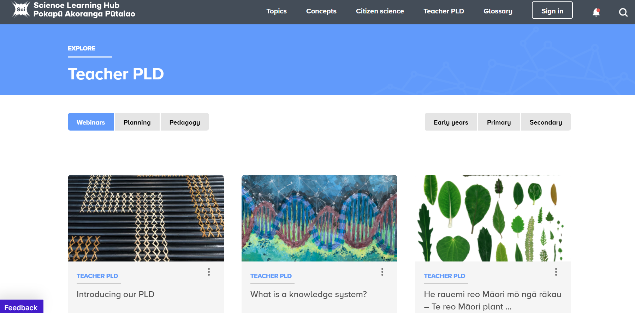
PLD
© Copyright. Science Learning Hub – Pokapū Akoranga Pūtaiao The University of Waikato Te Whare Wananga o Waikato.
All Rights Reserved | www.sciencelearn.org.nz. All images are copyrighted. For further information, please refer to enquiries@sciencelearn.org.nz
Notes:
www.sciencelearn.org.nz/teacher_pld

Slide 27
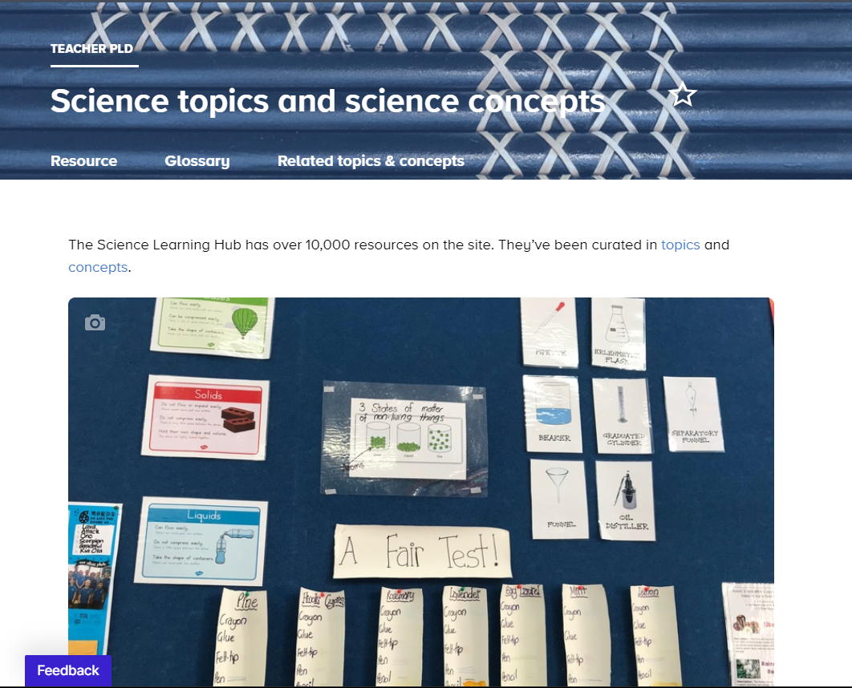
© Copyright. Science Learning Hub – Pokapū Akoranga Pūtaiao The University of Waikato Te Whare Wananga o Waikato.
All Rights Reserved | www.sciencelearn.org.nz. All images are copyrighted. For further information, please refer to enquiries@sciencelearn.org.nz
Notes:
Got a topic? What are the connected science ideas or concepts?
www.sciencelearn.org.nz/resources/3077-science-topics-and-science-concepts

Slide 28
© Copyright. Science Learning Hub – Pokapū Akoranga Pūtaiao The University of Waikato Te Whare Wananga o Waikato.
All Rights Reserved | www.sciencelearn.org.nz. All images are copyrighted. For further information, please refer to enquiries@sciencelearn.org.nz
Notes:
www.sciencelearn.org.nz/resources/3077-science-topics-and-science-concepts

Slide 29
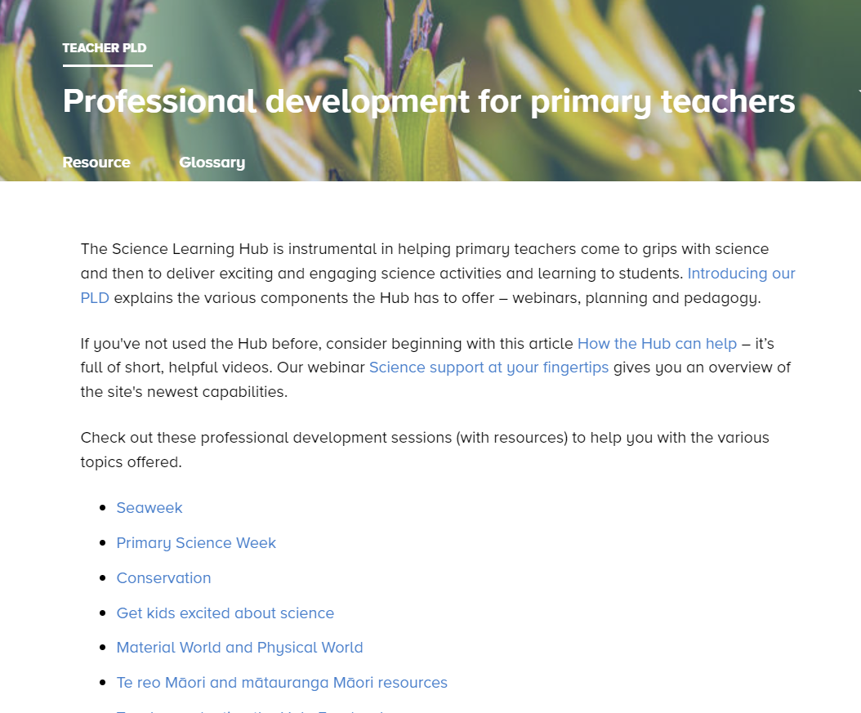
© Copyright. Science Learning Hub – Pokapū Akoranga Pūtaiao The University of Waikato Te Whare Wananga o Waikato.
All Rights Reserved | www.sciencelearn.org.nz. All images are copyrighted. For further information, please refer to enquiries@sciencelearn.org.nz
Notes:
www.sciencelearn.org.nz/resources/2251-junior-science
Recorded sessions:
www.sciencelearn.org.nz/resources/2246-science-for-juniors
www.sciencelearn.org.nz/resources/2267-professional-development-for-primary-teachers
www.sciencelearn.org.nz/resources/2927-how-the-hub-can-help
Professional development for primary teachers: https://www.sciencelearn.org.nz/search?term=primary&dFR%5Btype%5D%5B0%5D=Teacher%20PLD

Slide 30
Participant question
© Copyright. Science Learning Hub – Pokapū Akoranga Pūtaiao The University of Waikato Te Whare Wananga o Waikato.
All Rights Reserved | www.sciencelearn.org.nz. All images are copyrighted. For further information, please refer to enquiries@sciencelearn.org.nz

Slide 31
Adapting
earthworm resources
© Copyright. Science Learning Hub – Pokapū Akoranga Pūtaiao The University of Waikato Te Whare Wananga o Waikato.
All Rights Reserved | www.sciencelearn.org.nz. All images are copyrighted. For further information, please refer to enquiries@sciencelearn.org.nz
Notes:
www.sciencelearn.org.nz/image_maps/27-outside-of-an-earthworm

Slide 32
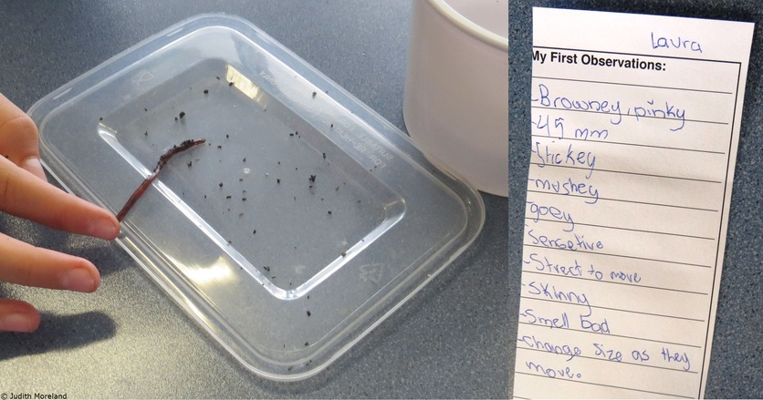
Adapting
earthworm resources
© Copyright. Science Learning Hub – Pokapū Akoranga Pūtaiao The University of Waikato Te Whare Wananga o Waikato.
All Rights Reserved | www.sciencelearn.org.nz. All images are copyrighted. For further information, please refer to enquiries@sciencelearn.org.nz
Notes:
www.sciencelearn.org.nz/resources/2397-adapting-slh-activities-altering-the-aims-and-learning-intentions
Image: www.sciencelearn.org.nz/images/3092-earthworm-observations

Slide 33
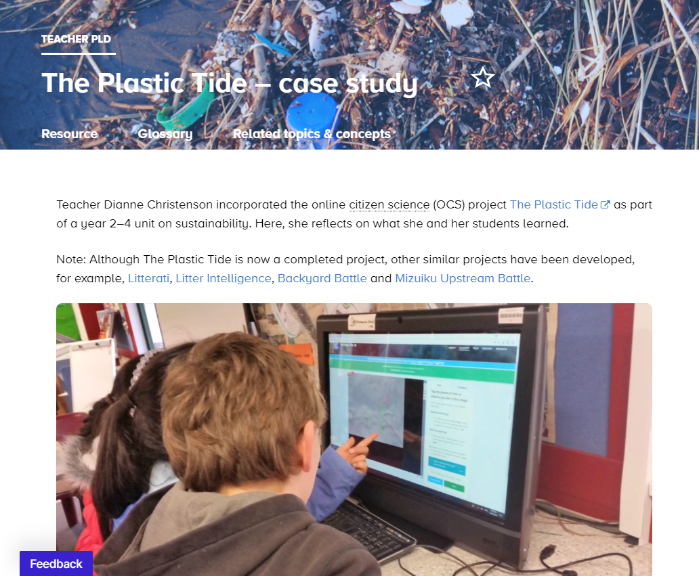
Citizen Science
© Koraunui School
© Copyright. Science Learning Hub – Pokapū Akoranga Pūtaiao The University of Waikato Te Whare Wananga o Waikato.
All Rights Reserved | www.sciencelearn.org.nz. All images are copyrighted. For further information, please refer to enquiries@sciencelearn.org.nz
Notes:
www.sciencelearn.org.nz/resources/2986-the-plastic-tide-case-study
Moe under www.sciencelearn.org.nz/citizen_science

Slide 34
Why the hub?
Easily digestible information
Related content, concepts, topics hands-on activities
Editable resources
Multimedia content
Professional Learning and Development (PLD)
© Copyright. Science Learning Hub – Pokapū Akoranga Pūtaiao The University of Waikato Te Whare Wananga o Waikato.
All Rights Reserved | www.sciencelearn.org.nz. All images are copyrighted. For further information, please refer to enquiries@sciencelearn.org.nz

Slide 35
Thanks – want to keep in touch?
Email us on enquiries@sciencelearn.org.nz
https://twitter.com/NZScienceLearn
www.facebook.com/nzsciencelearn
https://nz.pinterest.com/nzsciencelearn
www.instagram.com/sciencelearninghubnz
Notes:
Feedback/more of this?

