Slide 1
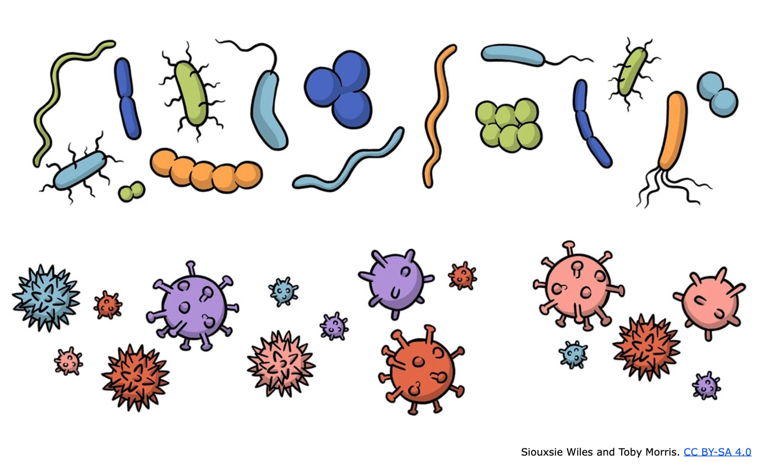
The science of superbugs
Teaching antimicrobial resistance awareness in Aotearoa
4–5 pm Thursday 26 October 2023
Collection: bit.ly/AMRresources
© Copyright. Science Learning Hub – Pokapū Akoranga Pūtaiao The University of Waikato Te Whare Wananga o Waikato.
All Rights Reserved | www.sciencelearn.org.nz. All images are copyrighted. For further information, please refer to enquiries@sciencelearn.org.nz
Notes:
Greta

Slide 2
Index
Topic | Slideshow number(s) | Video timecode
Welcome | 1 | 00:00
Index | 2 | 00:10
Introducing the Science Learning Hub and presenters | 3–5 | 00:22
What is antimicrobial resistance? | 6–18 | 02:00
How does antimicrobial resistance occur | 19–22 | 12:45
Antimicrobial resistance is a global issue | 23–25 | 21:05
Why should we care about antimicrobial resistance? | 26–27 | 24:55
Antimicrobial resistance in New Zealand | 28–31 | 28:27
What should we do? | 32–34 | 34:29
Antimicrobial resistance research | 35–37 | 35:51
SLH links, keep in touch and thanks | 38 | 37:07
© Copyright. Science Learning Hub – Pokapū Akoranga Pūtaiao The University of Waikato Te Whare Wananga o Waikato.
All Rights Reserved | www.sciencelearn.org.nz. All images are copyrighted. For further information, please refer to enquiries@sciencelearn.org.nz

Slide 3

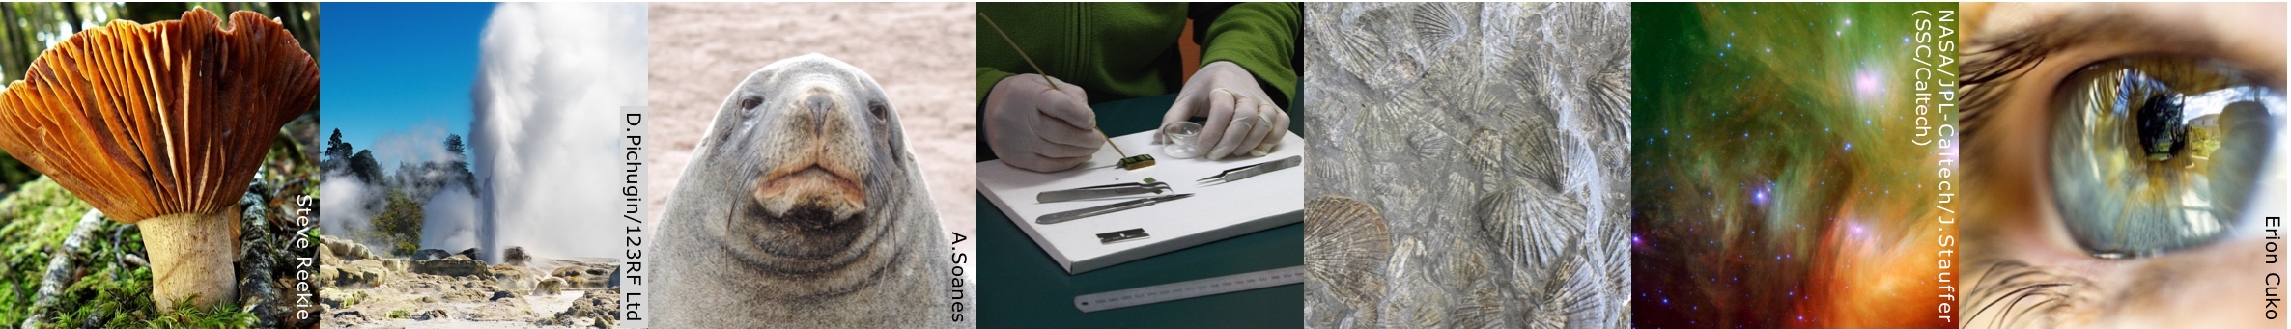
The Science Learning Hub
enquiries@sciencelearn.org.nz
A trustworthy online resource – produced by educators and scientists
Based on world-class New Zealand science research
Supported by learning activities, information about the key science ideas and concepts, multimedia tools and other resources
Written for New Zealand teachers and students
Notes:
Greta -
The Science Learning Hub is funded by the New Zealand government – Ministry of Business, Innovation and Employment (MBIE) – under the Curious Minds fund.

Slide 4





© Copyright. Science Learning Hub – Pokapū Akoranga Pūtaiao The University of Waikato Te Whare Wananga o Waikato.
All Rights Reserved | www.sciencelearn.org.nz. All images are copyrighted. For further information, please refer to enquiries@sciencelearn.org.nz
Notes:
Greta
Clare Possenniskie MOH
Lucy Johnston

Slide 5
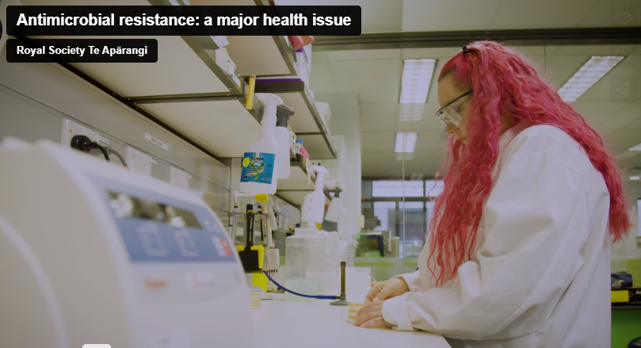
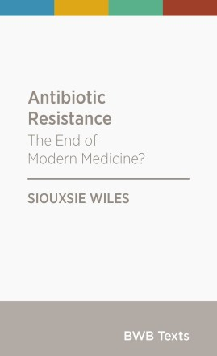
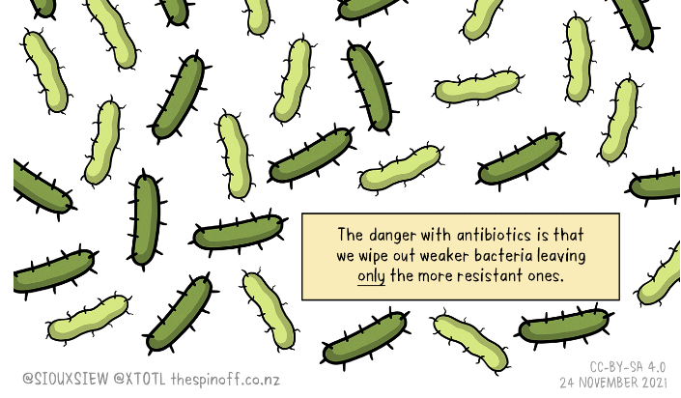
It is a zombie apocalypse …
© Copyright. Science Learning Hub – Pokapū Akoranga Pūtaiao The University of Waikato Te Whare Wananga o Waikato.
All Rights Reserved | www.sciencelearn.org.nz. All images are copyrighted. For further information, please refer to enquiries@sciencelearn.org.nz
Notes:
Greta introducing Siouxsie
http://bwb.co.nz/books/antibiotic-resistance
https://www.sciencelearn.org.nz/videos/1737-antimicrobial-resistance-a-major-health-issue

Slide 6
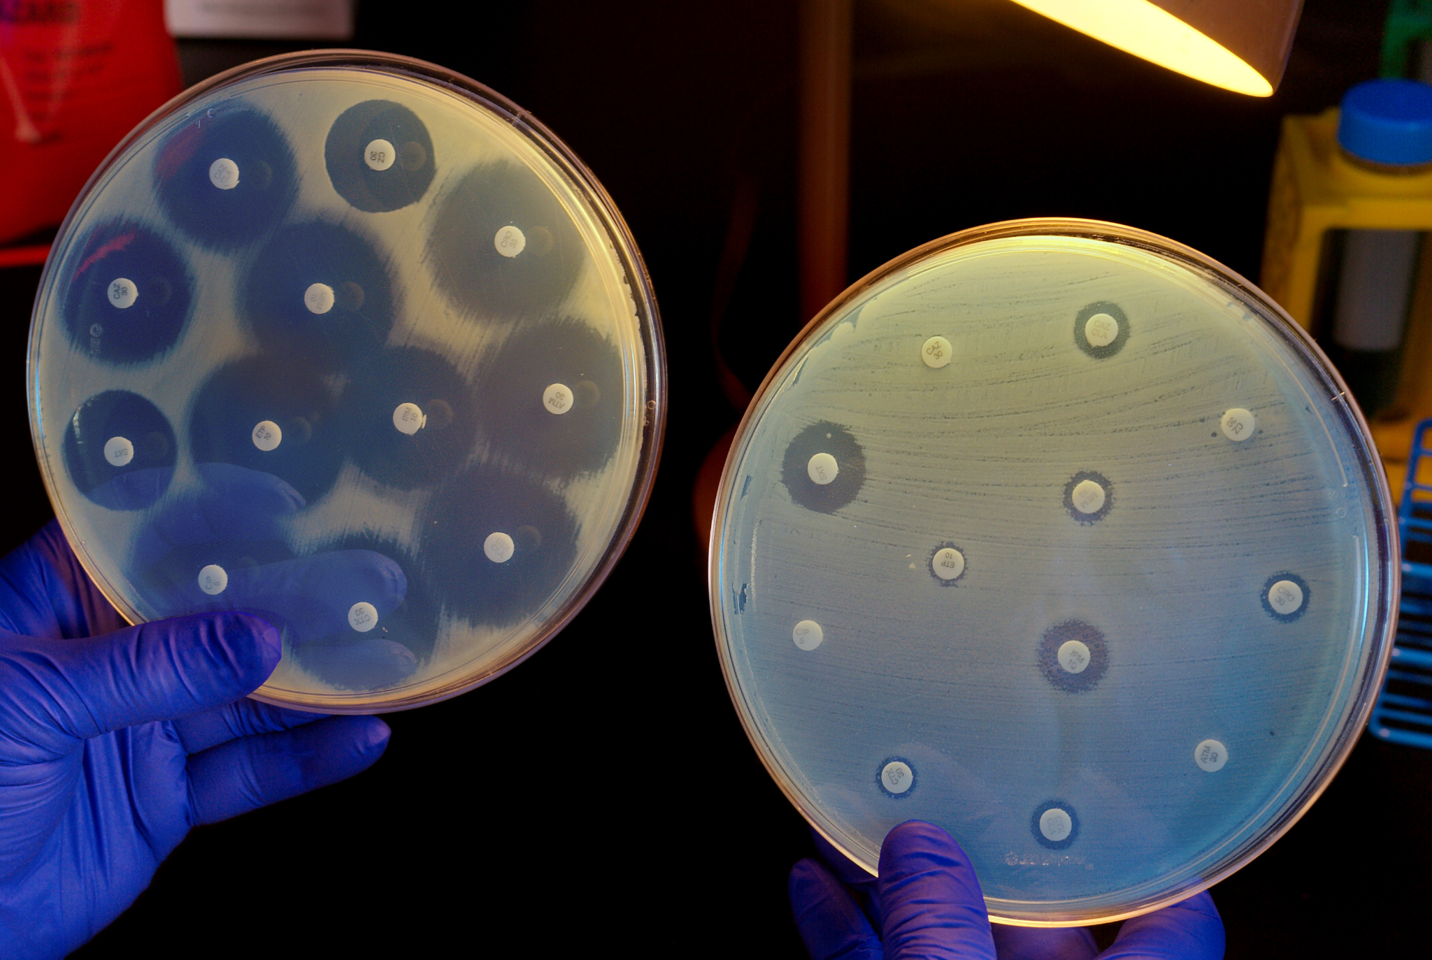
What is antimicrobial resistance?
© CDC/Melissa Dankel
© Copyright. Science Learning Hub – Pokapū Akoranga Pūtaiao The University of Waikato Te Whare Wananga o Waikato.
All Rights Reserved | www.sciencelearn.org.nz. All images are copyrighted. For further information, please refer to enquiries@sciencelearn.org.nz
Notes:
Siouxsie
Who gets the resistance (not the person!)
Terminology - biotics/microbials

Slide 7
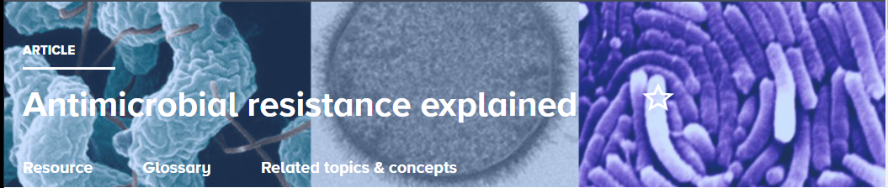
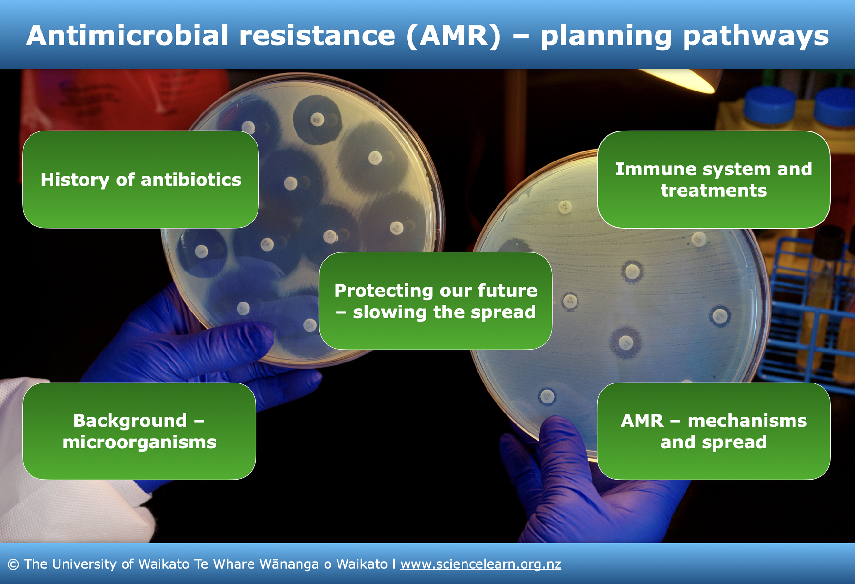
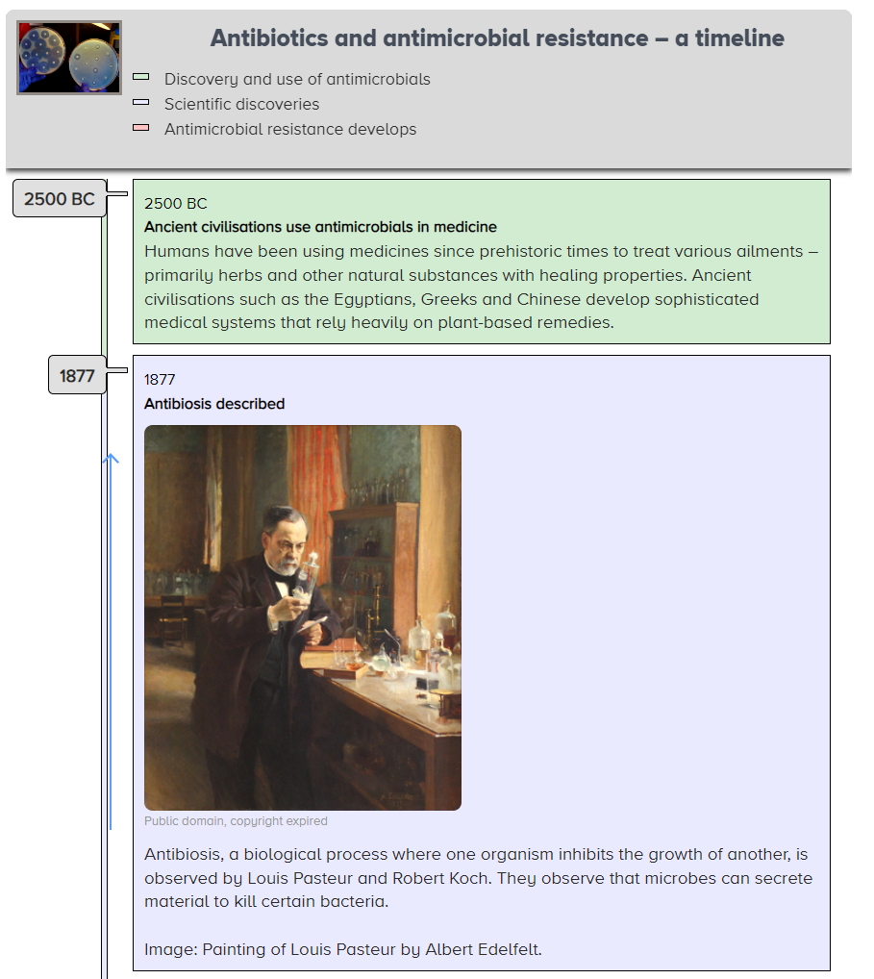

What is antimicrobial resistance?
Collection: bit.ly/AMRresources
© Copyright. Science Learning Hub – Pokapū Akoranga Pūtaiao The University of Waikato Te Whare Wananga o Waikato.
All Rights Reserved | www.sciencelearn.org.nz. All images are copyrighted. For further information, please refer to enquiries@sciencelearn.org.nz
Notes:
Greta - SLH resources
https://www.sciencelearn.org.nz/resources/3235-antimicrobial-resistance-a-context-for-learning
https://www.sciencelearn.org.nz/image_maps/127-antimicrobial-resistance-planning-pathways
https://www.sciencelearn.org.nz/resources/2513-antimicrobial-resistance-explained
https://www.sciencelearn.org.nz/resources/3236-the-history-of-antibiotics-and-antimicrobial-resistance

Slide 8
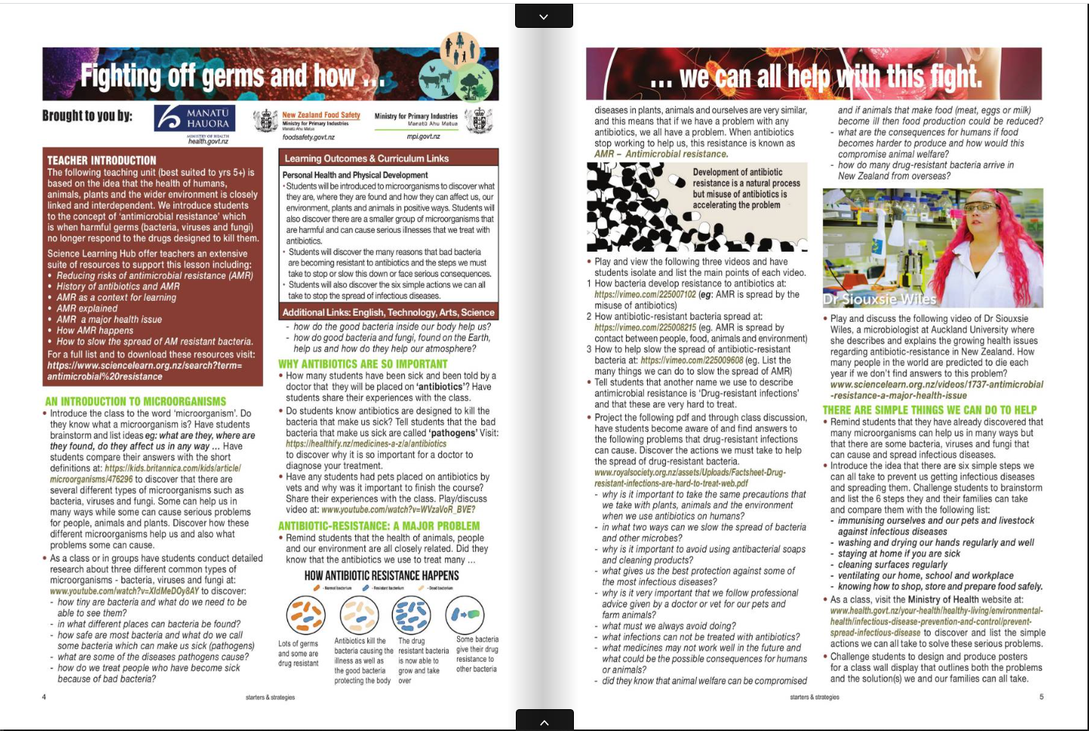
www.starters.co.nz
© Copyright 1991-2023 www.starters.co.nz is produced by Starters&Strategies – the New Zealand Teacher's Magazine.
Notes:
http://www.starters.co.nz/uploads/teachers-magazines/t3-2023-flip/

Slide 9
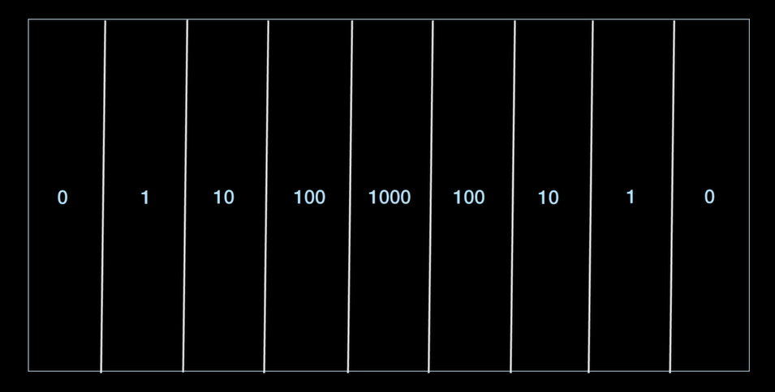
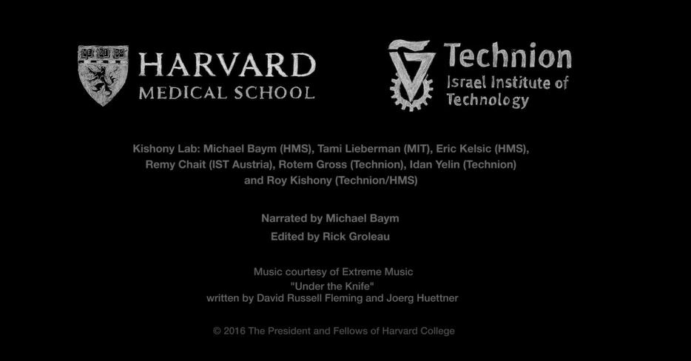
What is antimicrobial resistance?
© Copyright. Science Learning Hub – Pokapū Akoranga Pūtaiao The University of Waikato Te Whare Wananga o Waikato.
All Rights Reserved | www.sciencelearn.org.nz. All images are copyrighted. For further information, please refer to enquiries@sciencelearn.org.nz
Notes:
Siouxsie
https://vimeo.com/180908160

Slide 10
What is antimicrobial resistance?
© Copyright. Science Learning Hub – Pokapū Akoranga Pūtaiao The University of Waikato Te Whare Wananga o Waikato.
All Rights Reserved | www.sciencelearn.org.nz. All images are copyrighted. For further information, please refer to enquiries@sciencelearn.org.nz

Slide 11
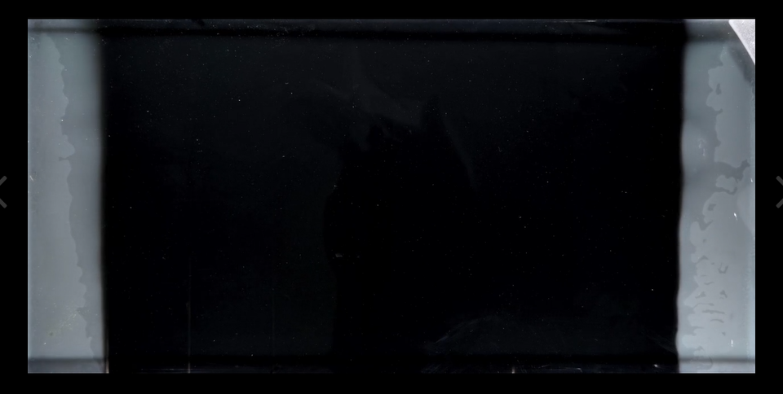
What is antimicrobial resistance?
© Copyright. Science Learning Hub – Pokapū Akoranga Pūtaiao The University of Waikato Te Whare Wananga o Waikato.
All Rights Reserved | www.sciencelearn.org.nz. All images are copyrighted. For further information, please refer to enquiries@sciencelearn.org.nz

Slide 12
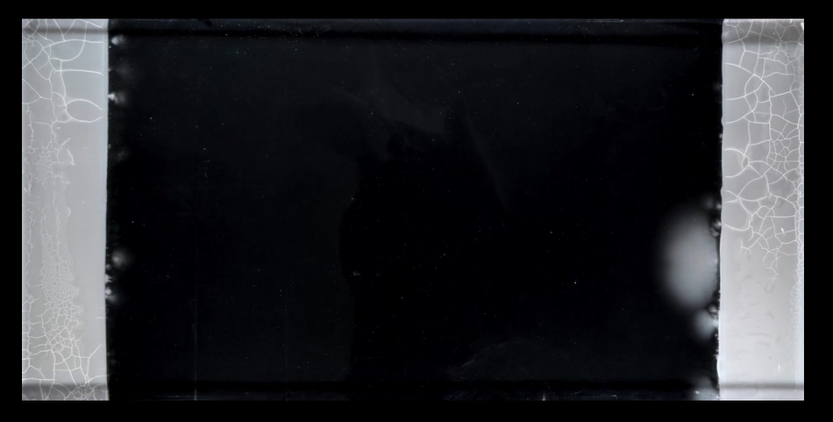
What is antimicrobial resistance?
© Copyright. Science Learning Hub – Pokapū Akoranga Pūtaiao The University of Waikato Te Whare Wananga o Waikato.
All Rights Reserved | www.sciencelearn.org.nz. All images are copyrighted. For further information, please refer to enquiries@sciencelearn.org.nz

Slide 13
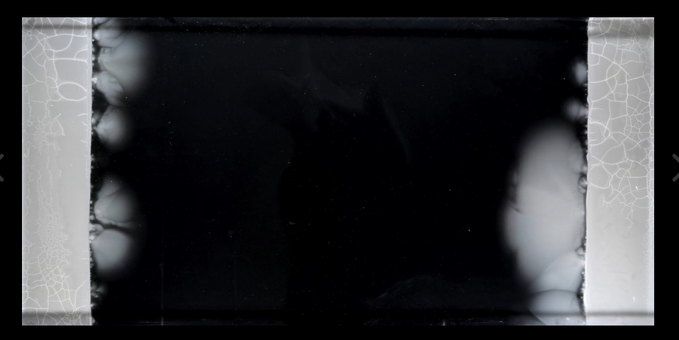
What is antimicrobial resistance?
© Copyright. Science Learning Hub – Pokapū Akoranga Pūtaiao The University of Waikato Te Whare Wananga o Waikato.
All Rights Reserved | www.sciencelearn.org.nz. All images are copyrighted. For further information, please refer to enquiries@sciencelearn.org.nz

Slide 14
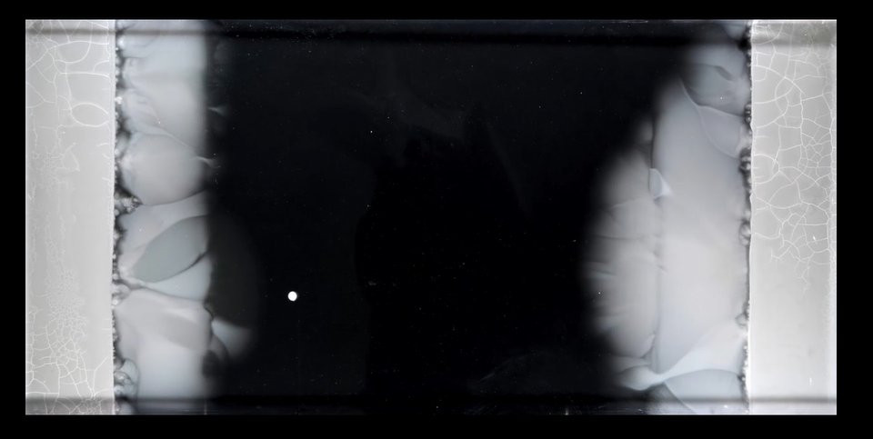
What is antimicrobial resistance?
© Copyright. Science Learning Hub – Pokapū Akoranga Pūtaiao The University of Waikato Te Whare Wananga o Waikato.
All Rights Reserved | www.sciencelearn.org.nz. All images are copyrighted. For further information, please refer to enquiries@sciencelearn.org.nz

Slide 15
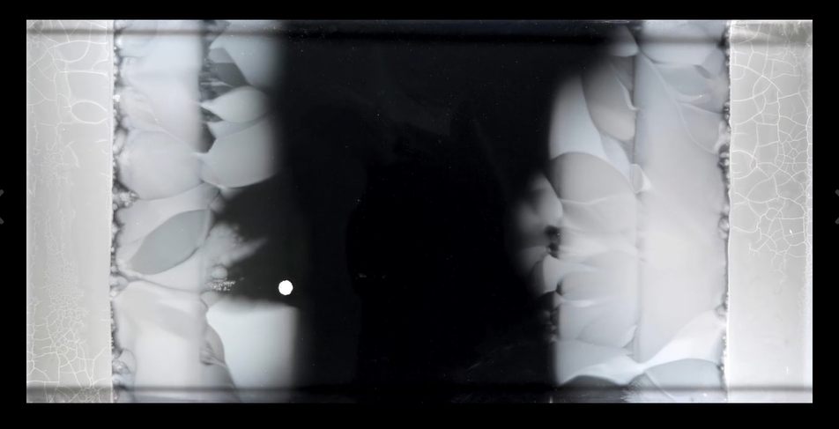
What is antimicrobial resistance?
© Copyright. Science Learning Hub – Pokapū Akoranga Pūtaiao The University of Waikato Te Whare Wananga o Waikato.
All Rights Reserved | www.sciencelearn.org.nz. All images are copyrighted. For further information, please refer to enquiries@sciencelearn.org.nz

Slide 16
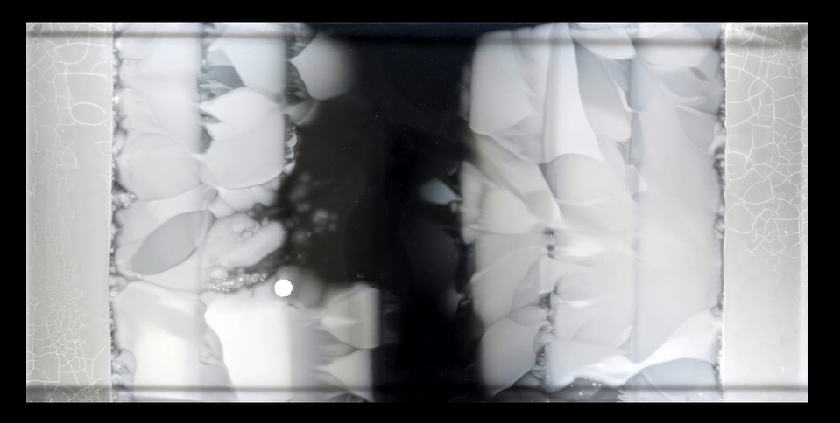
What is antimicrobial resistance?
© Copyright. Science Learning Hub – Pokapū Akoranga Pūtaiao The University of Waikato Te Whare Wananga o Waikato.
All Rights Reserved | www.sciencelearn.org.nz. All images are copyrighted. For further information, please refer to enquiries@sciencelearn.org.nz

Slide 17
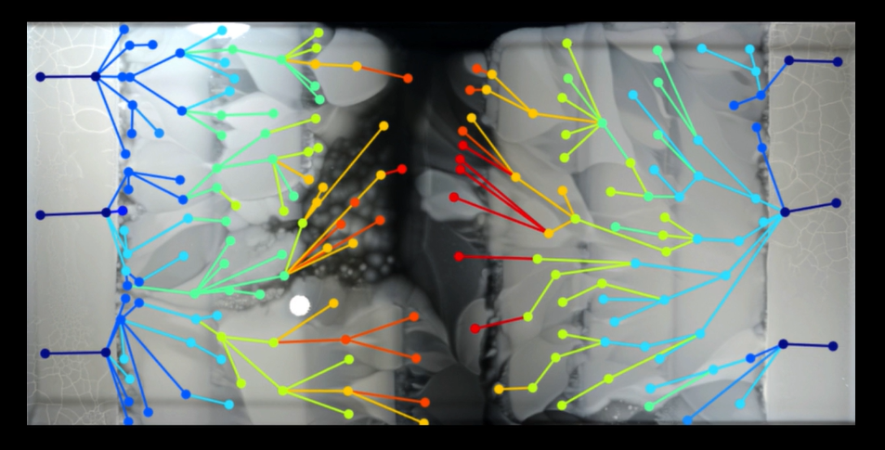
What is antimicrobial resistance?
© Copyright. Science Learning Hub – Pokapū Akoranga Pūtaiao The University of Waikato Te Whare Wananga o Waikato.
All Rights Reserved | www.sciencelearn.org.nz. All images are copyrighted. For further information, please refer to enquiries@sciencelearn.org.nz

Slide 18
What is antimicrobial resistance?
© Copyright. Science Learning Hub – Pokapū Akoranga Pūtaiao The University of Waikato Te Whare Wananga o Waikato.
All Rights Reserved | www.sciencelearn.org.nz. All images are copyrighted. For further information, please refer to enquiries@sciencelearn.org.nz

Slide 19
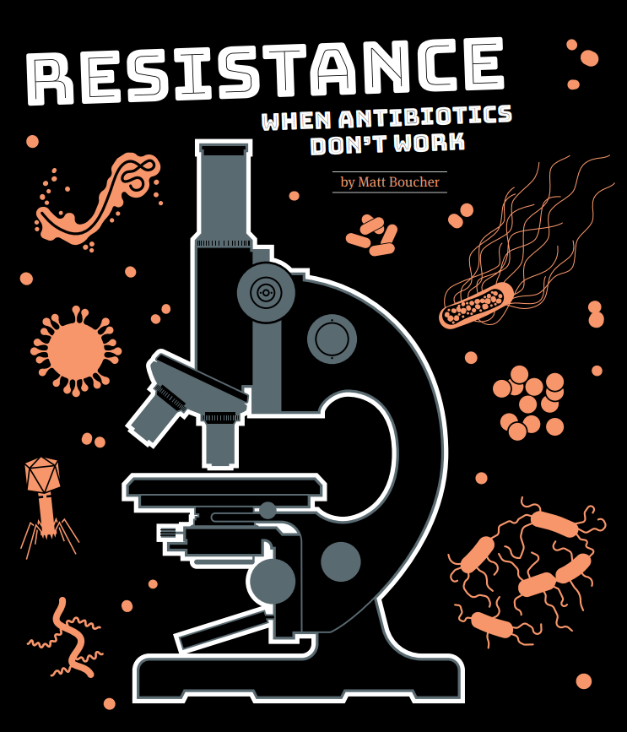
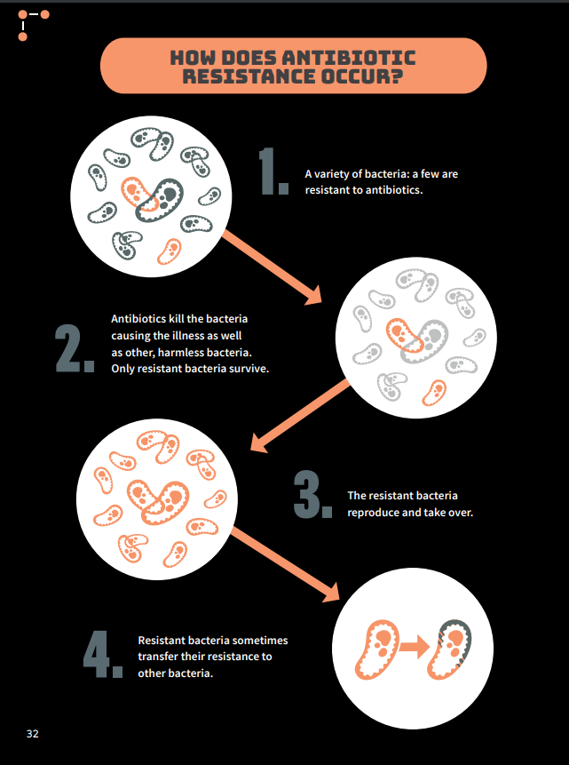
Copyright © Crown 2019. Illustrations by Ned Wenlock. School Journal Level 4 May 2019
Notes:
Siouxsie / Greta
Resistance: When Antibiotics Don’t Work: https://instructionalseries.tki.org.nz/Instructional-Series/School-Journal/School-Journal-Level-4-May-2019/Resistance-When-Antibiotics-Don-t-Work

Slide 20
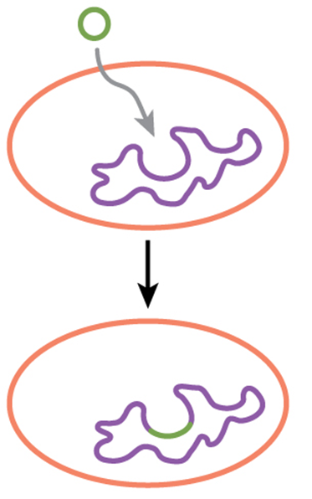
Horizontal gene transfer
Transformation
Taking up genetic material from their environment, e.g. plasmids.
© CNX OpenStax/CC BY 4.0
© Copyright. Science Learning Hub – Pokapū Akoranga Pūtaiao The University of Waikato Te Whare Wananga o Waikato.
All Rights Reserved | www.sciencelearn.org.nz. All images are copyrighted. For further information, please refer to enquiries@sciencelearn.org.nz
Notes:
Siouxsie
http://cnx.org/contents/GFy_h8cu@10.53:rZudN6XP@2/Introductionhttps://commons.wikimedia.org/w/index.php?curid=49931304

Slide 21
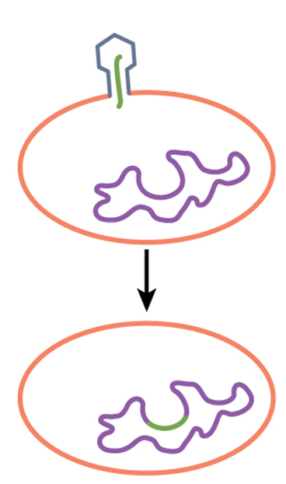
Horizontal gene transfer
Transduction
Receiving genetic material after infection with a virus.
© CNX OpenStax/CC BY 4.0
© Copyright. Science Learning Hub – Pokapū Akoranga Pūtaiao The University of Waikato Te Whare Wananga o Waikato.
All Rights Reserved | www.sciencelearn.org.nz. All images are copyrighted. For further information, please refer to enquiries@sciencelearn.org.nz
Notes:
Siouxsie
http://cnx.org/contents/GFy_h8cu@10.53:rZudN6XP@2/Introductionhttps://commons.wikimedia.org/w/index.php?curid=49931304

Slide 22
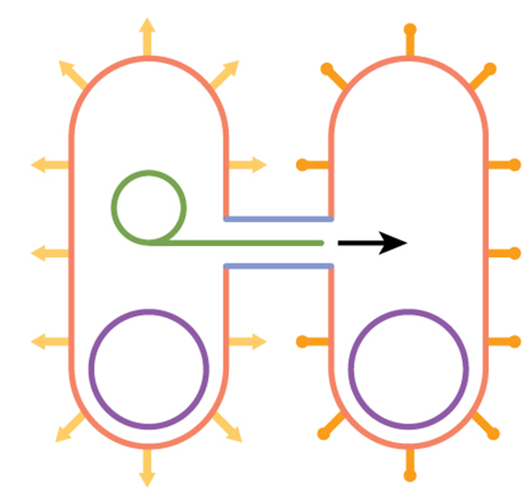
Horizontal gene transfer
Conjugation
Transfer of genetic material between bacterial cells of same or different species by direct cell-to-cell contact.
© CNX OpenStax/CC BY 4.0
© Copyright. Science Learning Hub – Pokapū Akoranga Pūtaiao The University of Waikato Te Whare Wananga o Waikato.
All Rights Reserved | www.sciencelearn.org.nz. All images are copyrighted. For further information, please refer to enquiries@sciencelearn.org.nz
Notes:
Siouxsie
http://cnx.org/contents/GFy_h8cu@10.53:rZudN6XP@2/Introductionhttps://commons.wikimedia.org/w/index.php?curid=49931304

Slide 23
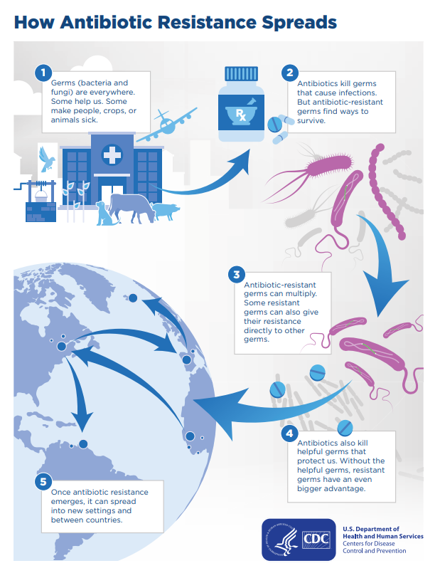
© Copyright. Science Learning Hub – Pokapū Akoranga Pūtaiao The University of Waikato Te Whare Wananga o Waikato.
All Rights Reserved | www.sciencelearn.org.nz. All images are copyrighted. For further information, please refer to enquiries@sciencelearn.org.nz
Notes:
https://www.sciencelearn.org.nz/images/5214-how-antimicrobial-resistance-happens

Slide 24
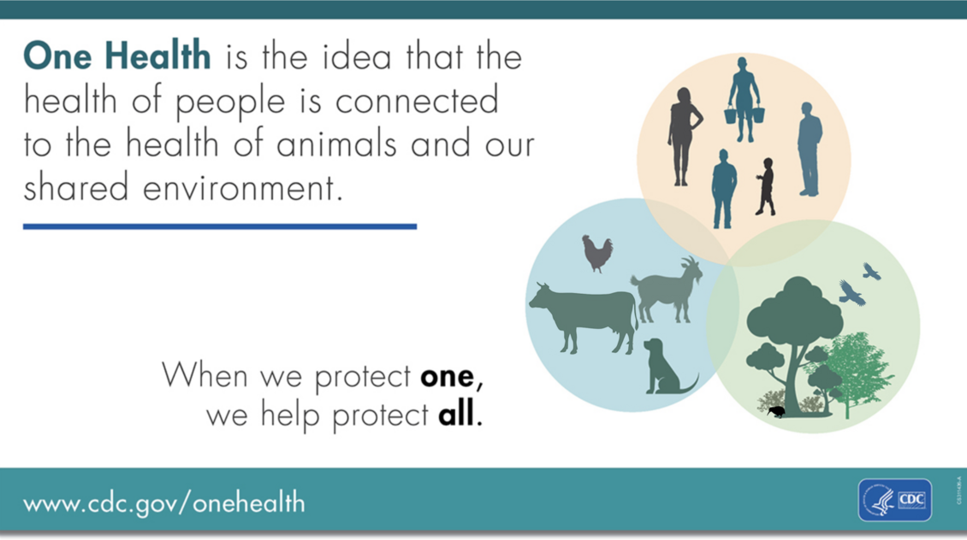
Notes:
Siouxsie
emphasise the One Health aspect to AMR- ie, that this is an issue that crosses over humans, animals, plants and the environment
MoH and MPI working together on this issue and that we jointly developed the AMR action plan.
Maybe we could also reference here World AMR Awareness Week and how we are trying to raise awareness of AMR and what people can do about it (ie, teaching kids!)
https://www.sciencelearn.org.nz/images/5213-one-health

Slide 25
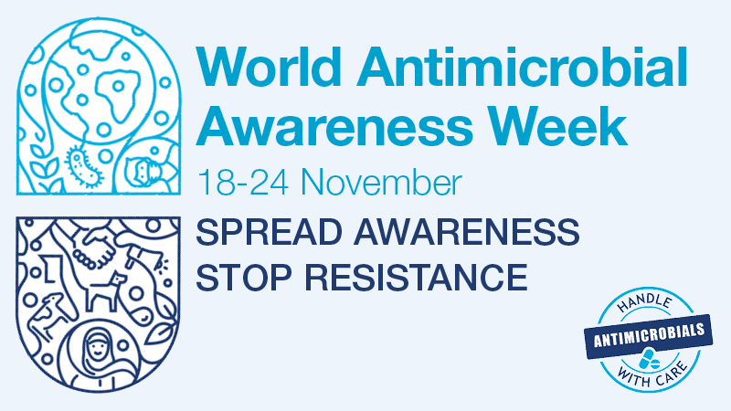
World Health Organisation/CC BY-NC-SA 3.0 IGO
© Copyright. Science Learning Hub – Pokapū Akoranga Pūtaiao The University of Waikato Te Whare Wananga o Waikato.
All Rights Reserved | www.sciencelearn.org.nz. All images are copyrighted. For further information, please refer to enquiries@sciencelearn.org.nz
Notes:
https://www.health.gov.au/news/world-antimicrobial-awareness-week-18-to-24-november-2021
https://www.sciencelearn.org.nz/events/2534-world-amr-awareness-week

Slide 26
Why should we care?
“the end of modern medicine
as we know it”
Dr Margaret Chan,
former Director General
World Health Organization
© Copyright. Science Learning Hub – Pokapū Akoranga Pūtaiao The University of Waikato Te Whare Wananga o Waikato.
All Rights Reserved | www.sciencelearn.org.nz. All images are copyrighted. For further information, please refer to enquiries@sciencelearn.org.nz
Notes:
Siouxsie

Slide 27
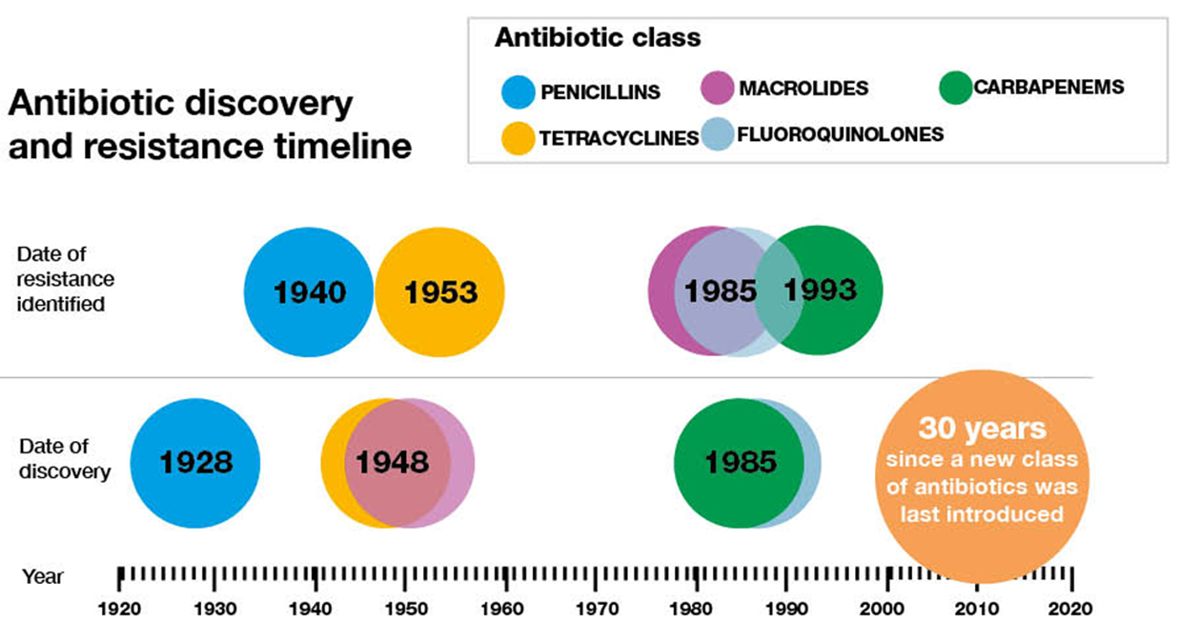
Why should we care?
Edwards, Matthew & Hamilton, Ross & Oliver, Nicola & Fitzgibbon, Sheridan & Samarasekera, Roshane. (2019). Antibiotic Resistance: Modelling the Impact on Mortality and Morbidity A report by the Antibiotic Resistance Working Party.
Notes:
Siouxsie
https://www.flickr.com/photos/diethylstilbestrol/24474659711

Slide 28
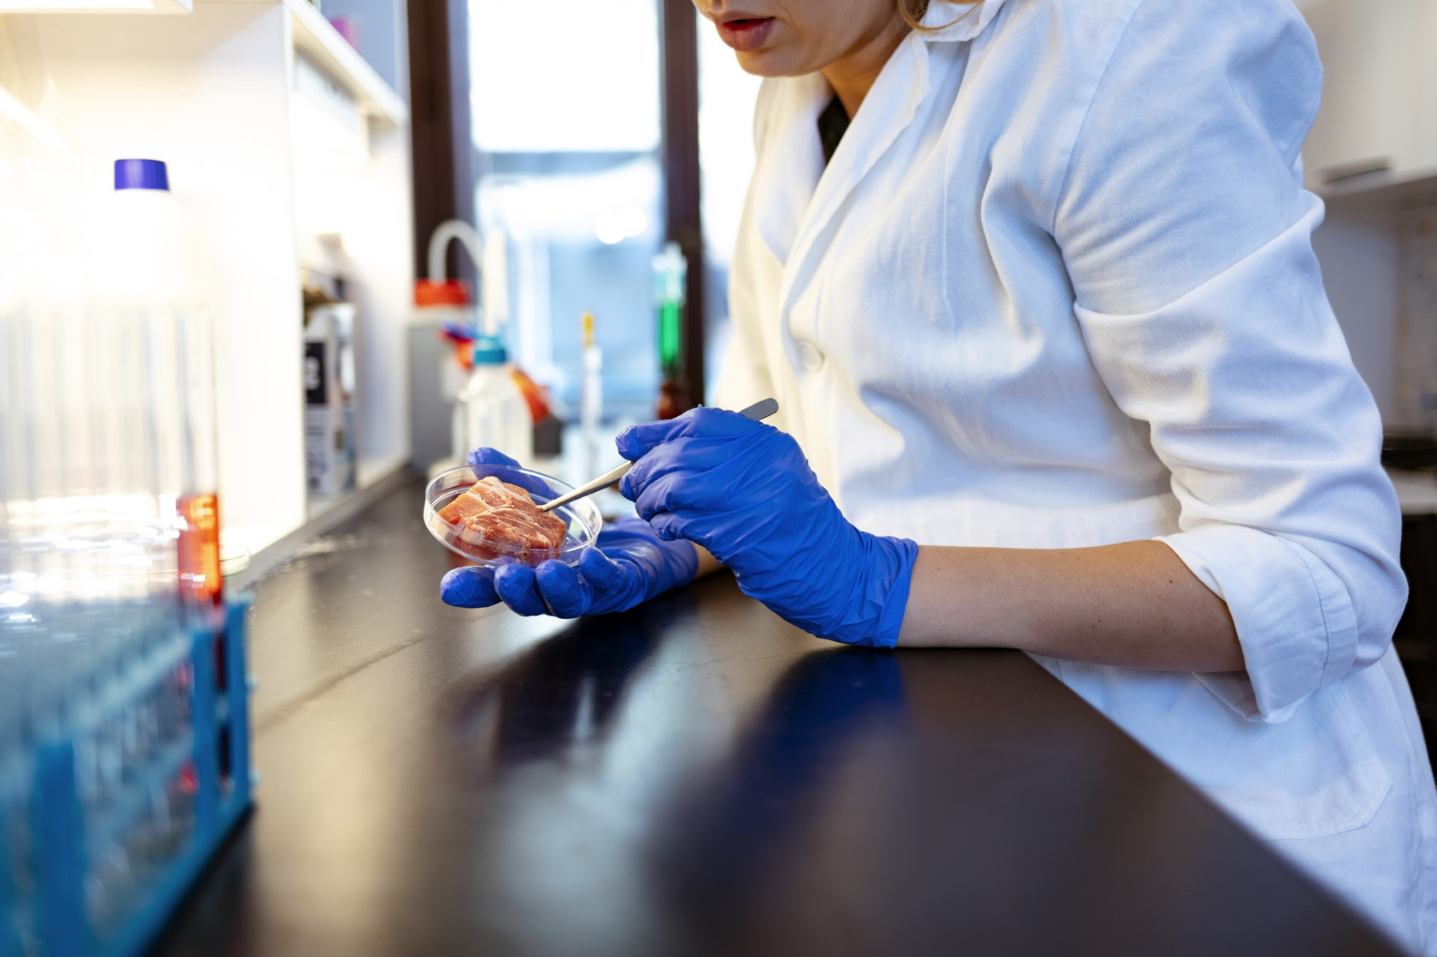
AMR in New Zealand
Getty Images
© Copyright. Science Learning Hub – Pokapū Akoranga Pūtaiao The University of Waikato Te Whare Wananga o Waikato.
All Rights Reserved | www.sciencelearn.org.nz. All images are copyrighted. For further information, please refer to enquiries@sciencelearn.org.nz
Notes:
Siouxsie
Animals
Getty image shared from MPI

Slide 29
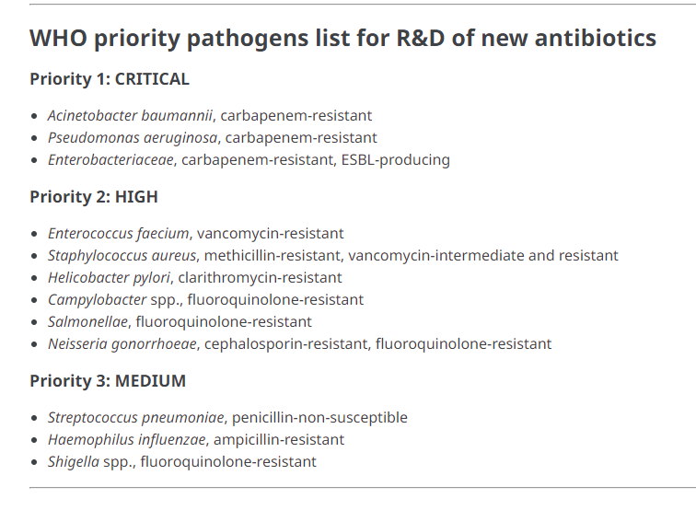
AMR in New Zealand
/CC BY-NC 4.0
© Copyright. Science Learning Hub – Pokapū Akoranga Pūtaiao The University of Waikato Te Whare Wananga o Waikato.
All Rights Reserved | www.sciencelearn.org.nz. All images are copyrighted. For further information, please refer to enquiries@sciencelearn.org.nz
Notes:
Siouxsie
WHO priority pathogens - all a threat to us. High rates of Staph infection
Antibiotic cream example - links to one health approach.
https://www.who.int/news/item/27-02-2017-who-publishes-list-of-bacteria-for-which-new-antibiotics-are-urgently-needed - this is an older publication (2017)
People
AMR - lots of different organisms. Dif ones in dif. countries
More info: https://www.who.int/publications/i/item/WHO-EMP-IAU-2017.12

Slide 30

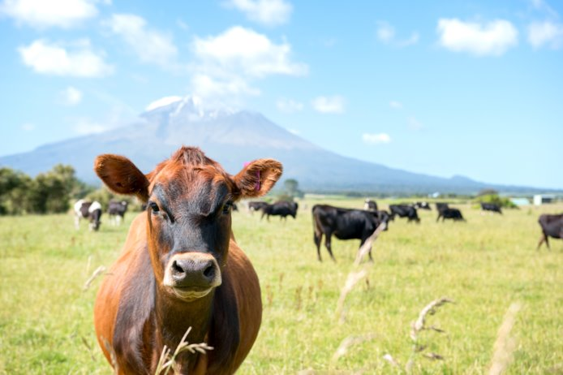
New Zealand is one of the world's lowest users of antibiotics in livestock production​.
MPI work with the New Zealand veterinary and horticultural sectors to promote careful use of antibiotics and encourage infection prevention strategies like good hygiene and vaccination​.
MPI undertakes surveillance for resistance in bacteria collected from animal samples.​
© Copyright. Science Learning Hub – Pokapū Akoranga Pūtaiao The University of Waikato Te Whare Wananga o Waikato.
All Rights Reserved | www.sciencelearn.org.nz. All images are copyrighted. For further information, please refer to enquiries@sciencelearn.org.nz
Notes:
Lucy: annual antibiotic sales reports show quantities of antibiotics used in animals have been declining for the last five years​
Animals
Animals can catch infections from humans.
Getty image shared from MPI

Slide 31
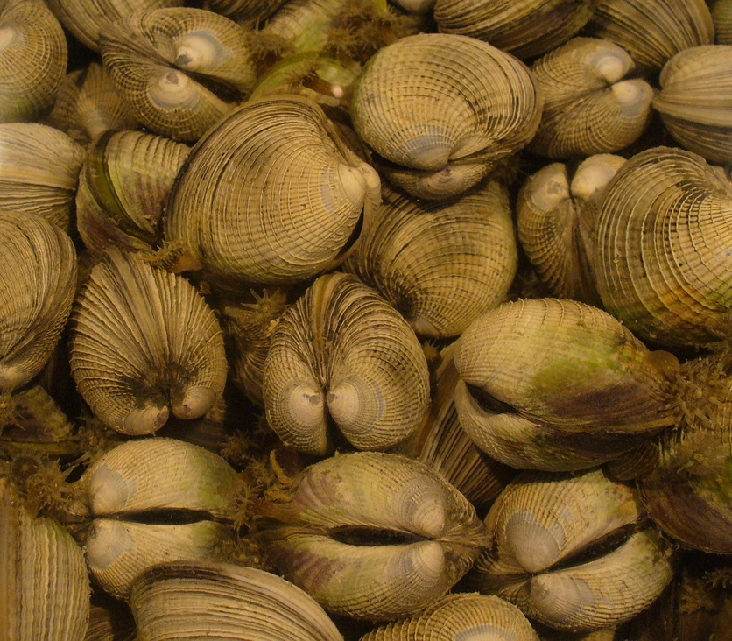
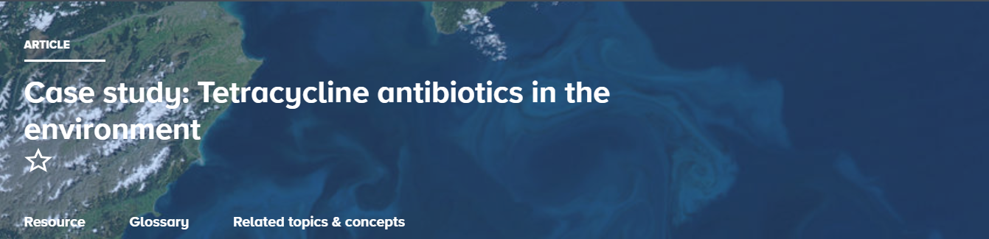
AMR in New Zealand
Mahinga/mahika kai
  E. coli on watercress and in mussels and cockles
Tetracyclines and beneficial soil bacteria
© Copyright. Science Learning Hub – Pokapū Akoranga Pūtaiao The University of Waikato Te Whare Wananga o Waikato.
All Rights Reserved | www.sciencelearn.org.nz. All images are copyrighted. For further information, please refer to enquiries@sciencelearn.org.nz
Notes:
Greta
Environment
https://theconversation.com/antibiotic-resistant-bacteria-in-nzs-wild-cockles-and-watercress-put-people-at-growing-risk-of-serious-illness-209845
https://www.sciencelearn.org.nz/resources/148-cockles
https://www.sciencelearn.org.nz/resources/3196-case-study-tetracycline-antibiotics-in-the-environment

Slide 32
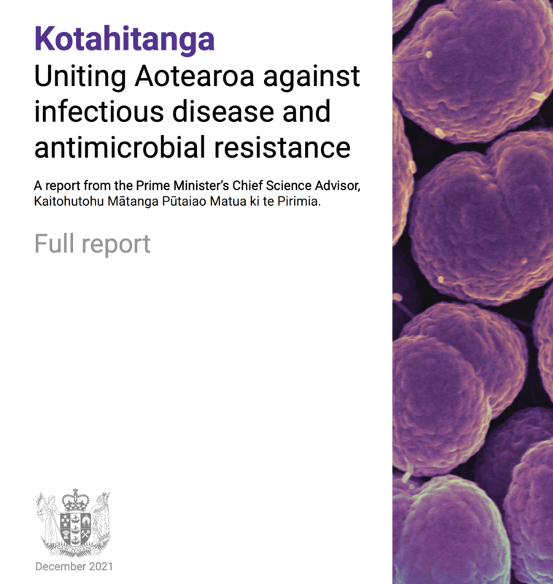
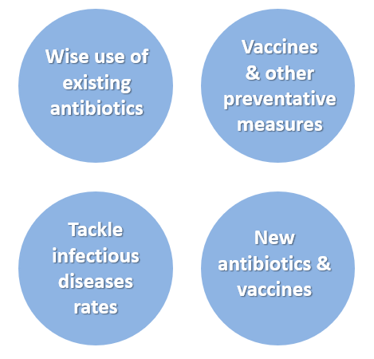
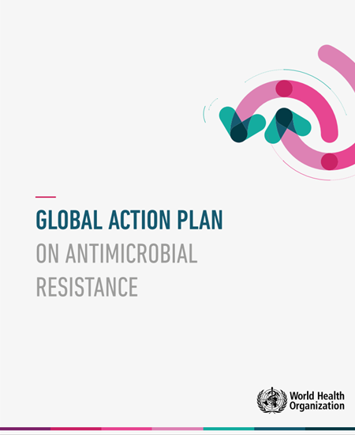

What should we do?
© Copyright. Science Learning Hub – Pokapū Akoranga Pūtaiao The University of Waikato Te Whare Wananga o Waikato.
All Rights Reserved | www.sciencelearn.org.nz. All images are copyrighted. For further information, please refer to enquiries@sciencelearn.org.nz
Notes:
Siouxsie
From Drs/patient perspectives
Vaccines
Kotahitanga: Uniting Aotearoa against infectious disease and antimicrobial resistance.
New Zealand Antimicrobial Resistance Action Plan
Global action plan on antimicrobial resistance
Image:
https://www.sciencelearn.org.nz/images/5082-opmcsa-cover

Slide 33

University of Oxford
Action
“Understand that antibiotics are a valuable resource that essentially becomes less effective if used excessively.”
Dr Joshua Freeman, Clinical Director Microbiology and Virology, Canterbury District Health Board, and Chair, New Zealand Antimicrobial Susceptibility Testing Committee (NZNAC).
© Copyright. Science Learning Hub – Pokapū Akoranga Pūtaiao The University of Waikato Te Whare Wananga o Waikato.
All Rights Reserved | www.sciencelearn.org.nz. All images are copyrighted. For further information, please refer to enquiries@sciencelearn.org.nz
Notes:
Greta
https://www.sciencelearn.org.nz/resources/3248-reducing-the-risks-of-antimicrobial-resistance
Quote from: https://www.sciencemediacentre.co.nz/2019/11/18/current-state-of-antimicrobial-resistance-in-new-zealand-expert-qa/

Slide 34
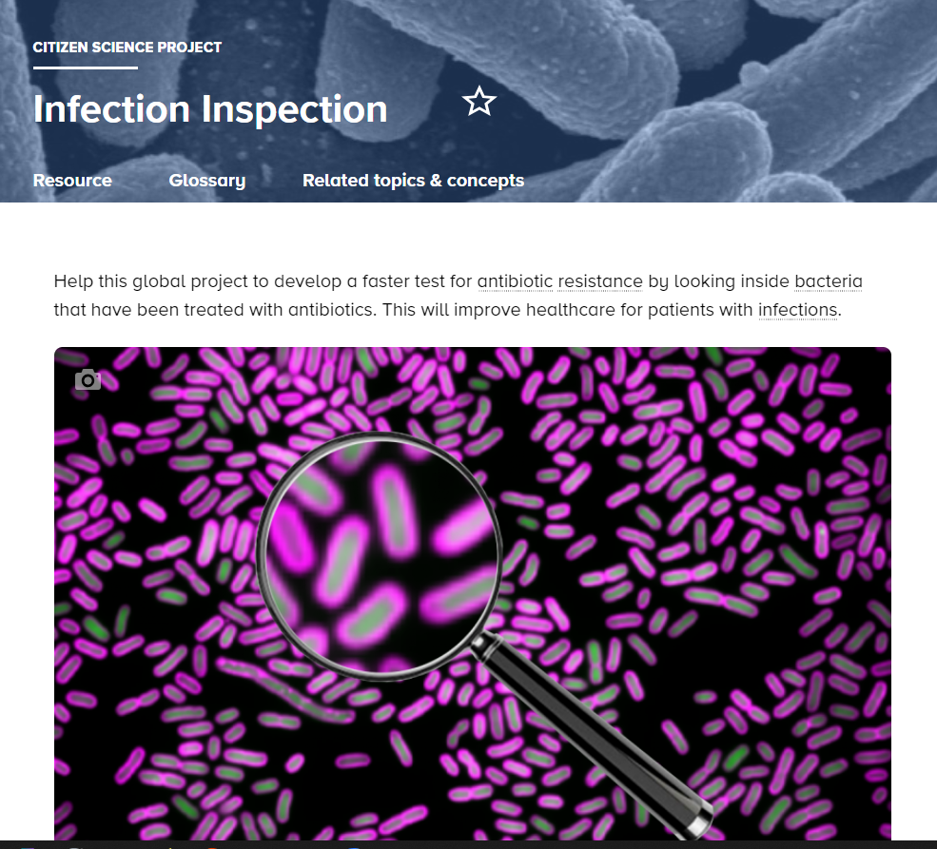
© University of Oxford
© Copyright. Science Learning Hub – Pokapū Akoranga Pūtaiao The University of Waikato Te Whare Wananga o Waikato.
All Rights Reserved | www.sciencelearn.org.nz. All images are copyrighted. For further information, please refer to enquiries@sciencelearn.org.nz
Notes:
Greta
https://www.sciencelearn.org.nz/resources/3229-infection-inspection

Slide 35
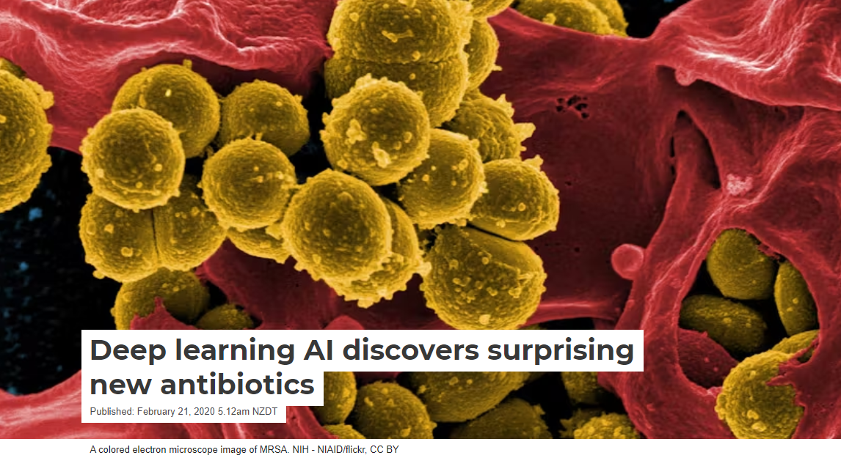
Research
Coloured electron micrograph MRSA. © NIAID/CC BY 2.0
© Copyright. Science Learning Hub – Pokapū Akoranga Pūtaiao The University of Waikato Te Whare Wananga o Waikato.
All Rights Reserved | www.sciencelearn.org.nz. All images are copyrighted. For further information, please refer to enquiries@sciencelearn.org.nz
Notes:
https://commons.wikimedia.org/wiki/File:Scanning_electron_micrograph_of_Methicillin-resistant_Staphylococcus_aureus_(MRSA)_and_a_dead_Human_neutrophil_-_NIAID.jpg
https://theconversation.com/deep-learning-ai-discovers-surprising-new-antibiotics-132059

Slide 36

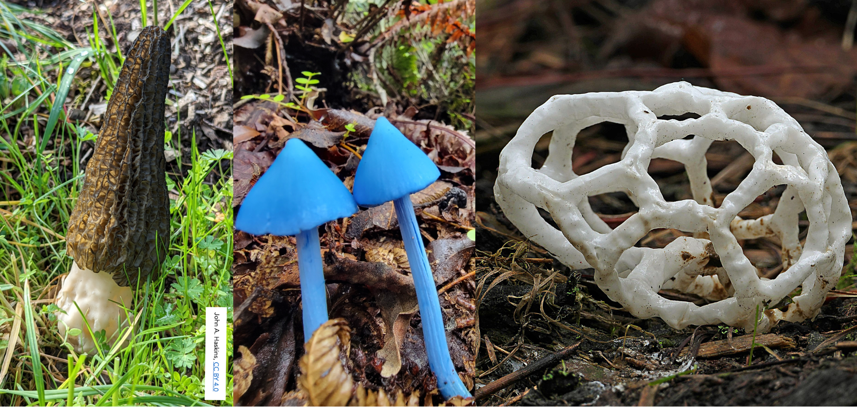
© Copyright. Science Learning Hub – Pokapū Akoranga Pūtaiao The University of Waikato Te Whare Wananga o Waikato.
All Rights Reserved | www.sciencelearn.org.nz. All images are copyrighted. For further information, please refer to enquiries@sciencelearn.org.nz
Notes:
Siouxsie
https://theconversation.com/the-world-is-desperate-for-new-antibiotics-and-new-zealands-unique-fungi-are-a-source-of-promising-compounds-167354

Slide 37
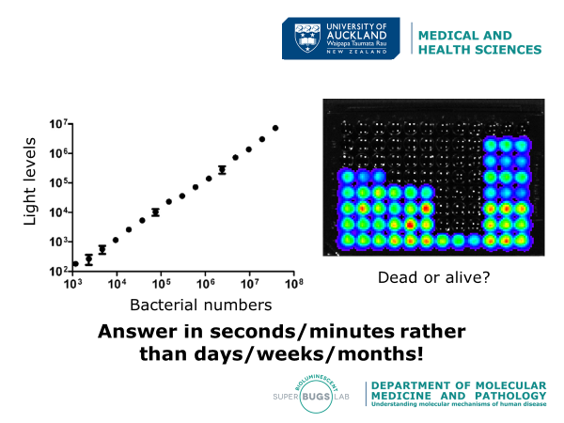
Research
Notes:
Siouxsie
https://www.youtube.com/watch?v=3LpnFM2I8Xo

Slide 38





Thanks – want to keep in touch?
Email us on enquiries@sciencelearn.org.nz
https://twitter.com/NZScienceLearn
www.facebook.com/nzsciencelearn
https://nz.pinterest.com/nzsciencelearn
www.instagram.com/sciencelearninghubnz
Collection: bit.ly/AMRresources
Notes:
Feedback/more of this?

