Slide 1
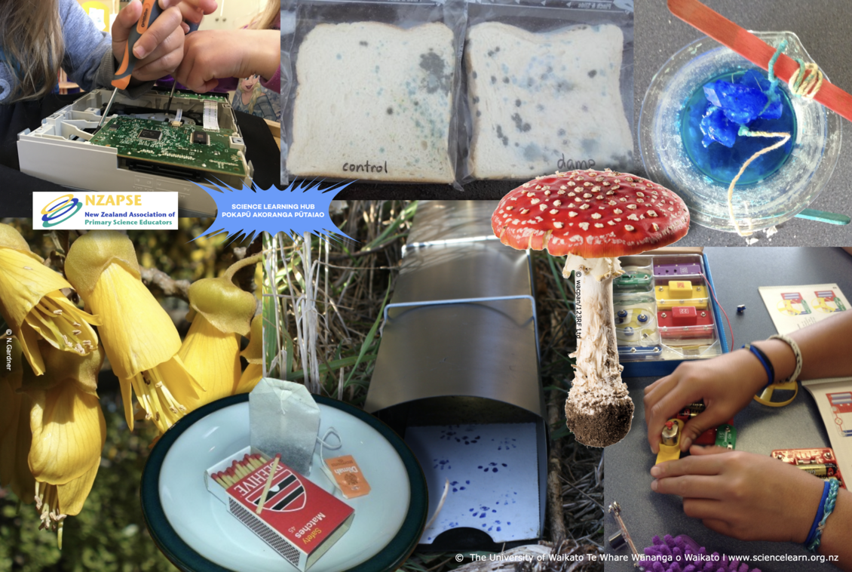
Fun and safety with
primary science
4–4:45 pm Thursday 4 April
© Copyright. Science Learning Hub – Pokapū Akoranga Pūtaiao The University of Waikato Te Whare Wananga o Waikato.
All Rights Reserved | www.sciencelearn.org.nz. All images are copyrighted. For further information, please refer to enquiries@sciencelearn.org.nz

Slide 2
The Science Learning Hub
A trustworthy online resource – produced by educators and scientists
Based on world-class New Zealand science research
Supported by learning activities, information about the key science ideas and concepts, multimedia tools and other resources
Written for New Zealand teachers and students
Notes:
The Science Learning Hub is funded by the New Zealand government – Ministry of Business, Innovation and Employment (MBIE) – under the Curious Minds fund.

Slide 3
Index
Topic | Slideshow number(s) | Video timecode
Introducing the Science Learning Hub | 1–2 | 00:00
Index | 3 | 00:40
Purpose | 4 | 00:47
New Zealand Association of Primary Science Educators (NZAPSE) | 5 | 01:17
Primary Science Week 2024 | 6–8 | 02:40
Safety documents | 9–15 | 09:12
Heather Goodey – I have the solution | 16 | 15:28
Steven Sexton – Straws and sounds | 17 | 21:50
Dianne Christenson – Trapping and tracking | 18–19 | 27:36
John Marsh – Chemical tests | 20 | 34:16
SLH links, keep in touch and thanks | 21 | 37:41
© Copyright. The University ofWaikato Te Whare Wananga o Waikato l Science Learning Hub – Pokapū Akoranga Pūtaiao. All Rights Reserved
All images are copyrighted. For further information, please refer to enquiries@sciencelearn.org.nz.

Slide 4
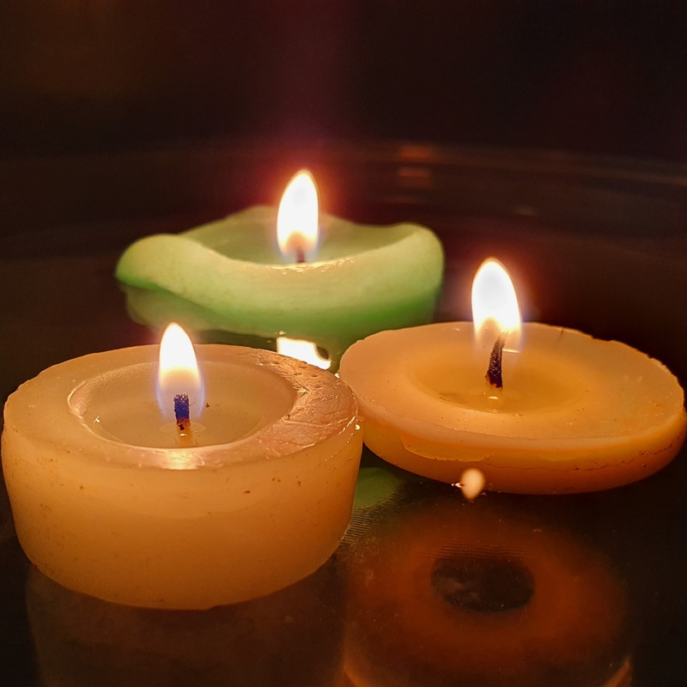
Purpose
To support primary teachers to teach science
To provide resources and examples of how to include fun, safe science in your programme
Rights: The University of Waikato
Te Whare Wānanga o Waikato
© Copyright. Science Learning Hub – Pokapū Akoranga Pūtaiao The University of Waikato Te Whare Wananga o Waikato.
All Rights Reserved | www.sciencelearn.org.nz. All images are copyrighted. For further information, please refer to enquiries@sciencelearn.org.nz
Notes:
https://www.sciencelearn.org.nz/images/5040-floating-candles

Slide 5
nzapse.nzase.org.nz
© Copyright. Science Learning Hub – Pokapū Akoranga Pūtaiao The University of Waikato Te Whare Wananga o Waikato.
All Rights Reserved | www.sciencelearn.org.nz. All images are copyrighted. For further information, please refer to enquiries@sciencelearn.org.nz
Notes:
NZAPSE (nzase.org.nz)

Slide 6
© Copyright. Science Learning Hub – Pokapū Akoranga Pūtaiao The University of Waikato Te Whare Wananga o Waikato.
All Rights Reserved | www.sciencelearn.org.nz. All images are copyrighted. For further information, please refer to enquiries@sciencelearn.org.nz

Slide 7
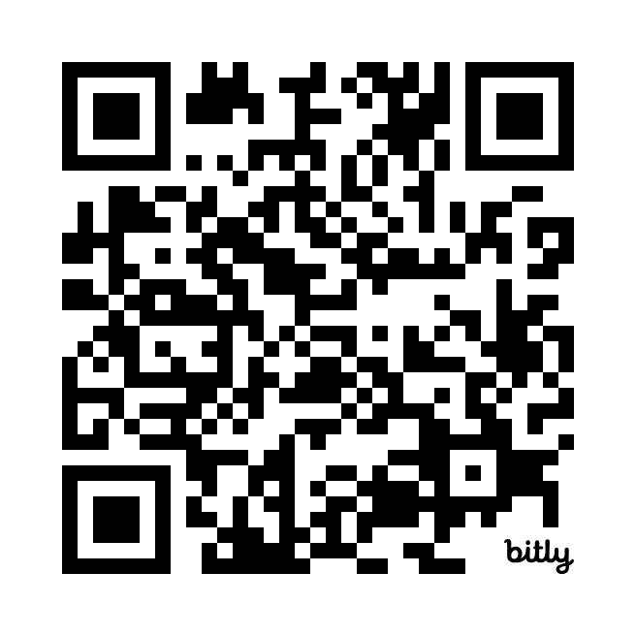
Competitions!
Enter Here:
https://bit.ly/3TIux6e
© Copyright. Science Learning Hub – Pokapū Akoranga Pūtaiao The University of Waikato Te Whare Wananga o Waikato.
All Rights Reserved | www.sciencelearn.org.nz. All images are copyrighted. For further information, please refer to enquiries@sciencelearn.org.nz

Slide 8
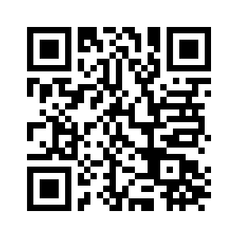
Q&A with Joel Rindelaub
Register
https://bit.ly/askascientist2024
© Copyright. Science Learning Hub – Pokapū Akoranga Pūtaiao The University of Waikato Te Whare Wananga o Waikato.
All Rights Reserved | www.sciencelearn.org.nz. All images are copyrighted. For further information, please refer to enquiries@sciencelearn.org.nz

Slide 9
Safety and Science/Pūtaiao: Guidance for Aotearoa New Zealand Schools and Kura
Crown copyright ©
© Copyright. Science Learning Hub – Pokapū Akoranga Pūtaiao The University of Waikato Te Whare Wananga o Waikato.
All Rights Reserved | www.sciencelearn.org.nz. All images are copyrighted. For further information, please refer to enquiries@sciencelearn.org.nz

Slide 10
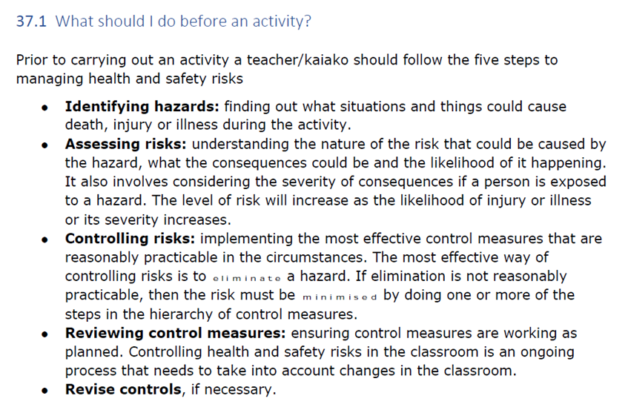
© Copyright. Science Learning Hub – Pokapū Akoranga Pūtaiao The University of Waikato Te Whare Wananga o Waikato.
All Rights Reserved | www.sciencelearn.org.nz. All images are copyrighted. For further information, please refer to enquiries@sciencelearn.org.nz

Slide 11
© Copyright. Science Learning Hub – Pokapū Akoranga Pūtaiao The University of Waikato Te Whare Wananga o Waikato.
All Rights Reserved | www.sciencelearn.org.nz. All images are copyrighted. For further information, please refer to enquiries@sciencelearn.org.nz

Slide 12
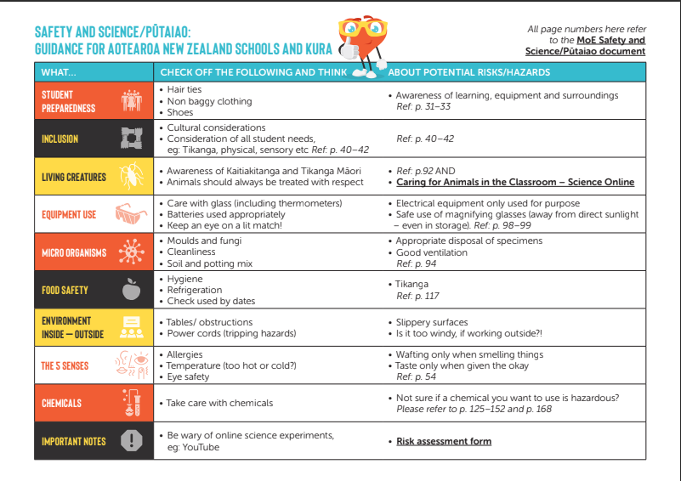
© House of Science
© Copyright. Science Learning Hub – Pokapū Akoranga Pūtaiao The University of Waikato Te Whare Wananga o Waikato.
All Rights Reserved | www.sciencelearn.org.nz. All images are copyrighted. For further information, please refer to enquiries@sciencelearn.org.nz

Slide 13
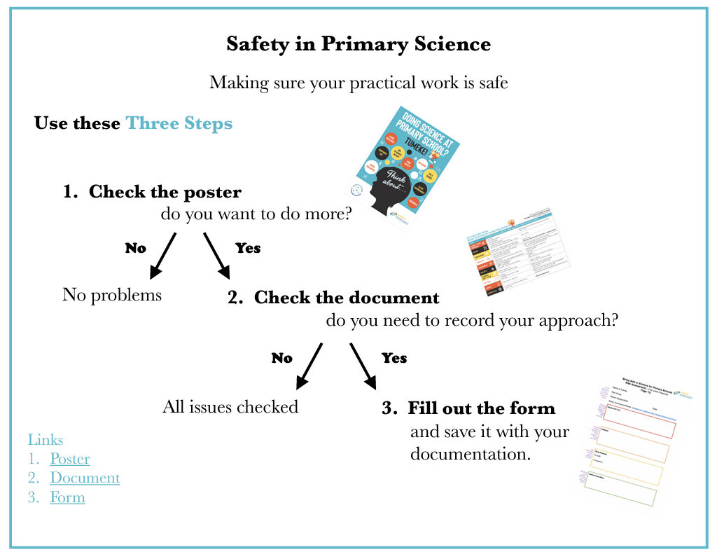
© Copyright. Science Learning Hub – Pokapū Akoranga Pūtaiao The University of Waikato Te Whare Wananga o Waikato.
All Rights Reserved | www.sciencelearn.org.nz. All images are copyrighted. For further information, please refer to enquiries@sciencelearn.org.nz
© House of Science

Slide 14
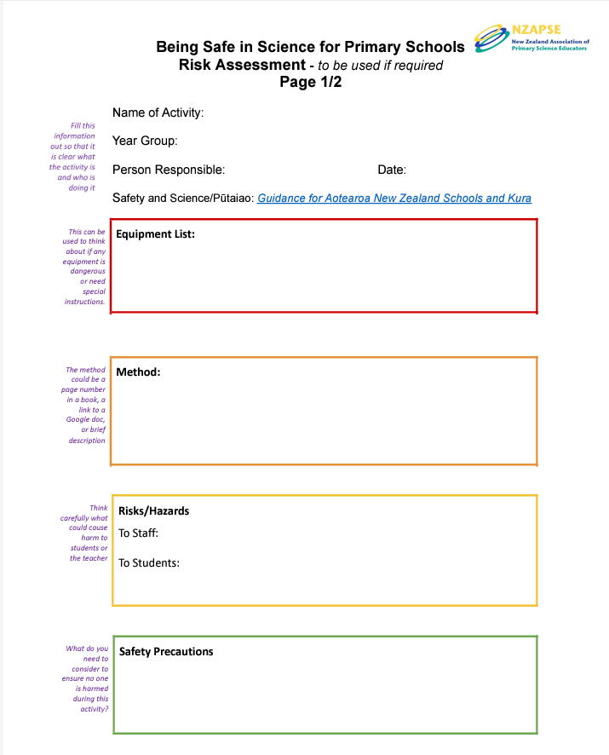
© Copyright. Science Learning Hub – Pokapū Akoranga Pūtaiao The University of Waikato Te Whare Wananga o Waikato.
All Rights Reserved | www.sciencelearn.org.nz. All images are copyrighted. For further information, please refer to enquiries@sciencelearn.org.nz

Slide 15
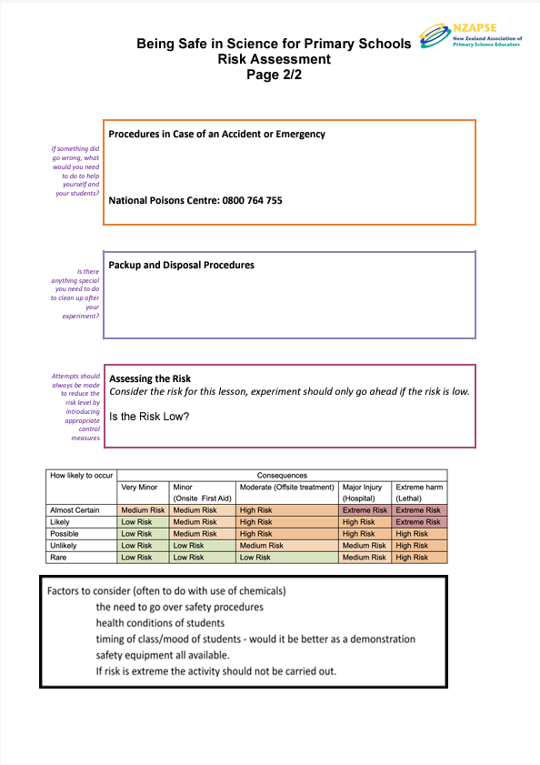
© Copyright. Science Learning Hub – Pokapū Akoranga Pūtaiao The University of Waikato Te Whare Wananga o Waikato.
All Rights Reserved | www.sciencelearn.org.nz. All images are copyrighted. For further information, please refer to enquiries@sciencelearn.org.nz

Slide 16
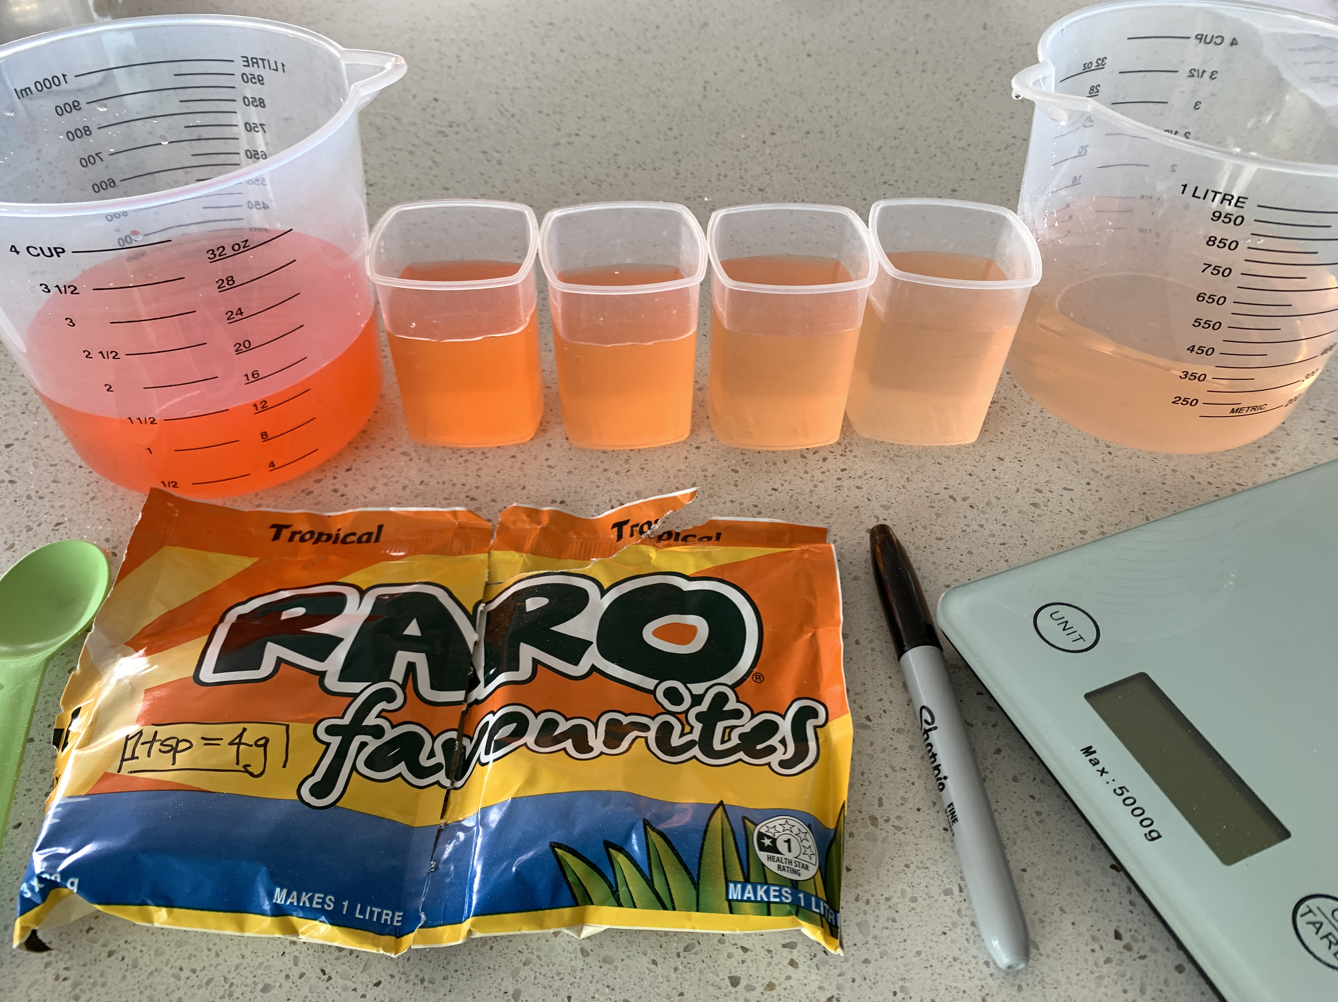
I have the solutions!
Making observations safely
© Heather/NZAPSE
© Copyright. Science Learning Hub – Pokapū Akoranga Pūtaiao The University of Waikato Te Whare Wananga o Waikato.
All Rights Reserved | www.sciencelearn.org.nz. All images are copyrighted. For further information, please refer to enquiries@sciencelearn.org.nz
Notes:
Heather
Image – place holder
https://www.sciencelearn.org.nz/images/1843-different-liquids

Slide 17
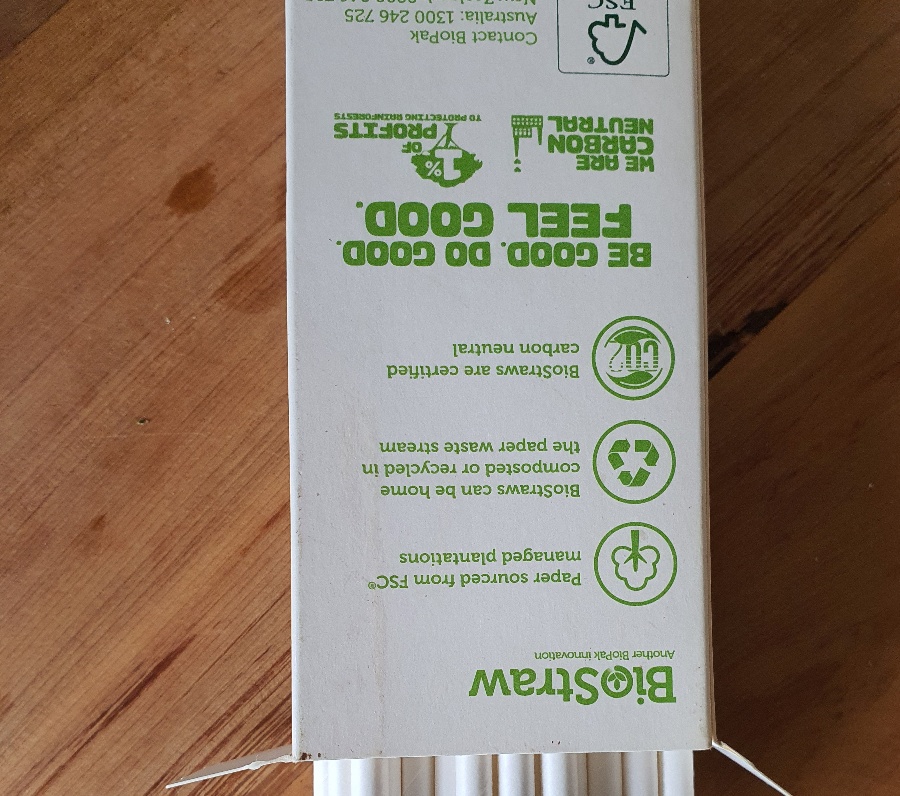
Sound and straws
© Copyright. Science Learning Hub – Pokapū Akoranga Pūtaiao The University of Waikato Te Whare Wananga o Waikato.
All Rights Reserved | www.sciencelearn.org.nz. All images are copyrighted. For further information, please refer to enquiries@sciencelearn.org.nz
Notes:
Steven
Image: https://www.sciencebuddies.org/stem-activities/make-musical-instrument

Slide 18
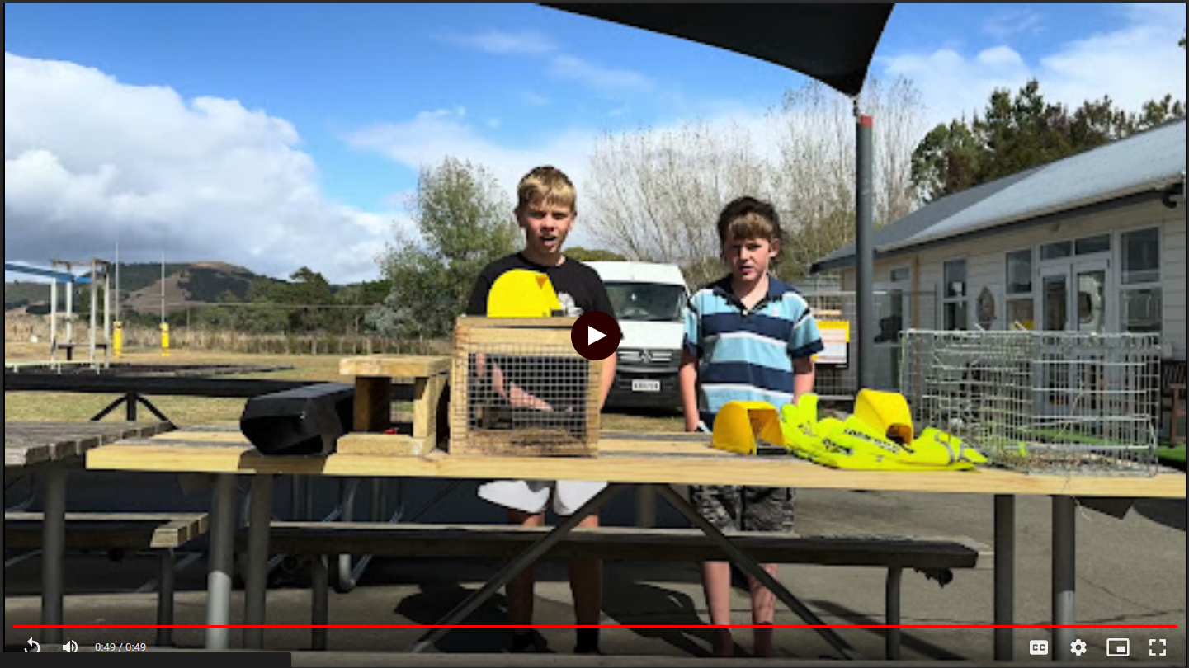
Trapping and tracking
© Dianne Christenson/Whareama School
© Copyright. Science Learning Hub – Pokapū Akoranga Pūtaiao The University of Waikato Te Whare Wananga o Waikato.
All Rights Reserved | www.sciencelearn.org.nz. All images are copyrighted. For further information, please refer to enquiries@sciencelearn.org.nz
Notes:
Dianne

Slide 19
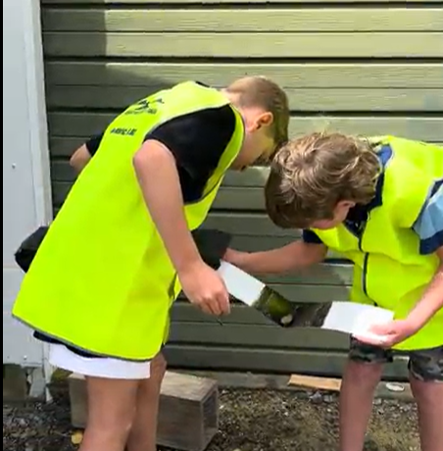
Trapping and tracking
Predatorfreenz.org/
toolkits/schools-toolkit/
© Dianne Christenson/Whareama School
© Copyright. Science Learning Hub – Pokapū Akoranga Pūtaiao The University of Waikato Te Whare Wananga o Waikato.
All Rights Reserved | www.sciencelearn.org.nz. All images are copyrighted. For further information, please refer to enquiries@sciencelearn.org.nz
Notes:
Dianne
Schools toolkit - Predator Free NZ Trust

Slide 20
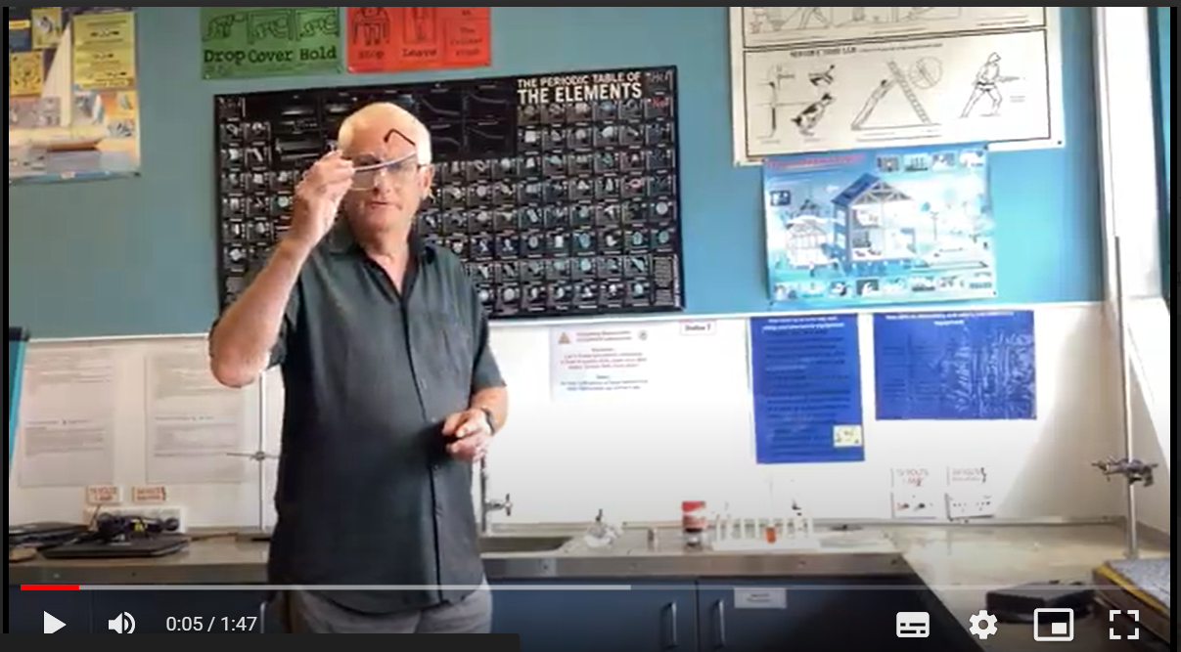
Chemical tests
© John Marsh/Tauranga Intermediate
© Copyright. Science Learning Hub – Pokapū Akoranga Pūtaiao The University of Waikato Te Whare Wananga o Waikato.
All Rights Reserved | www.sciencelearn.org.nz. All images are copyrighted. For further information, please refer to enquiries@sciencelearn.org.nz
Notes:
John

Slide 21
Thanks – want to keep in touch?
Email us on enquiries@sciencelearn.org.nz
https://twitter.com/NZScienceLearn
www.facebook.com/nzsciencelearn
https://nz.pinterest.com/nzsciencelearn
www.instagram.com/sciencelearninghubnz
Primary Science Week 13–17 May 2024
nzapse.nzase.org.nz​
Notes:
Greta Feedback/more of this?

