Slide 1
What do you notice?
Bird identification
Notes:
Learning outcomes for tauira in this activity:
Cultural Identity: Fostering a sense of cultural identity and pride in students' Māori heritage through the exploration of indigenous perspectives on science and the environment.
Whakapapa: Understanding the interconnectedness and relationships within the natural world, including genealogy, ecological systems and environmental sustainability.
Tikanga: Applying tikanga (protocols) and kaitiakitanga (guardianship) principles to science learning, including ethical considerations and responsibilities towards the environment.
Observation and Inquiry: Developing skills in observation, inquiry and investigation through hands-on experiences and culturally relevant contexts.

Slide 2
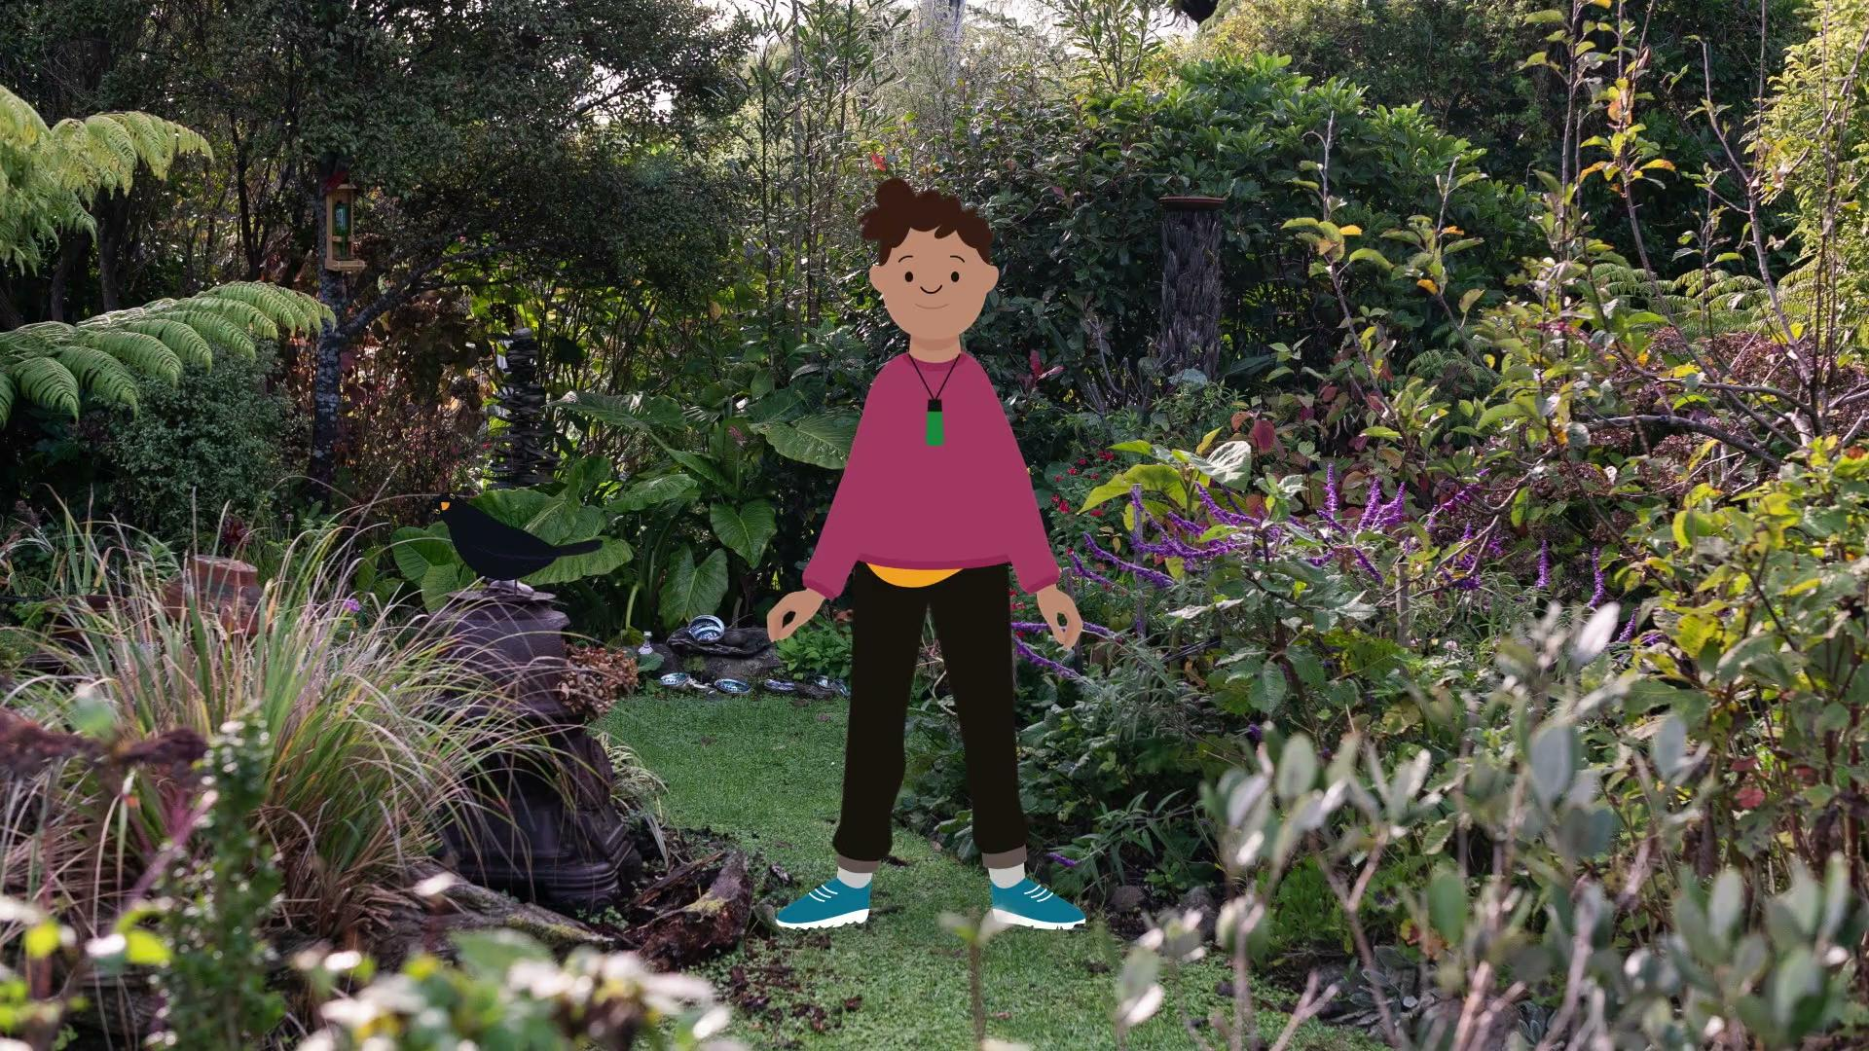
What do you notice? Bird identification
The video here is
Manu – identification.
© Manaaki Whenua – Landcare Research and The University of Waikato Te Whare Wānanga o Waikato | www.sciencelearn.org.nz
Notes:
Activity note:
In this video, Te Ariki asks if we know the different bird sounds in our garden.

Slide 3
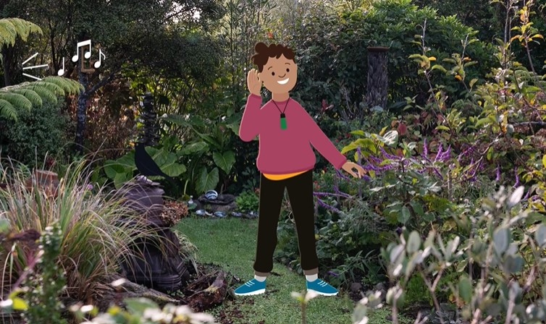
Learn bird songs and calls
When a bird sings, it tells you where it is and what it is.
When you first listen to a lot of birdsong, it can be overwhelming.
Just concentrate on one bird at a time and try different approaches!
© University of Waikato l www.sciencelearn.org.nz and Manaaki Whenua – Landcare Research
Notes:
Activity notes:
There are many different approaches in order to learn birds calls and songs.
Start with just a few – the ones provided in this slideshow and bird sounds of those that are seen the most times in your kura.
Use the Department of Conservation's Bird songs and calls to find more bird calls for your students, and yourselves to learn from.

Slide 4
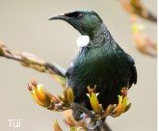
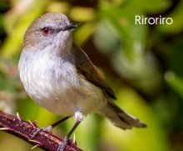
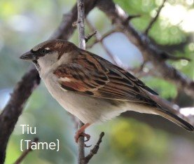
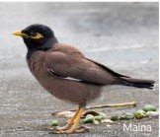
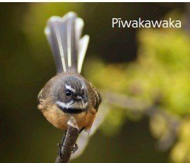
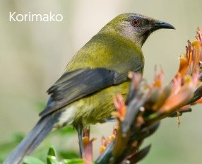
Can you hear what I hear?
Look at these images one at a time and listen to their calls.
When you use your eyes to help your ears, the connection will help it stick in your mind​!
© Manaaki Whenua – Landcare Research
Notes:
Activity notes:
Have children find themselves a comfortable space and really focus in on the bird calls they are about to hear.
Closing their eyes is helpful.
You might have audio equipment and headphones, which can be used in small groups.
Have them focus in on the sound – do they hear a repeated pattern?
Use the Department of Conservation's Bird songs and calls for more bird sounds – as children explore and want to learn more.
The images on this slide (including many others) are from Manaaki Whenua – Landcare Research's He aratohu mana māra poster.

Slide 5
Can you see what I see?
Notes:
Activity notes:
Print out copies of this poster in reo Māori or this poster in English for tamariki to have a closer look. ​(Alternatively load the PDF to devices for closer viewing.)
Supply magnifying glasses if you are able.
Spend some time really studying the poster of these manu with your tamariki. ​
Use prompting pātai from the poster to have tamariki focus on specific markings on feathers, beak and body shapes, legs and feet.

Slide 6
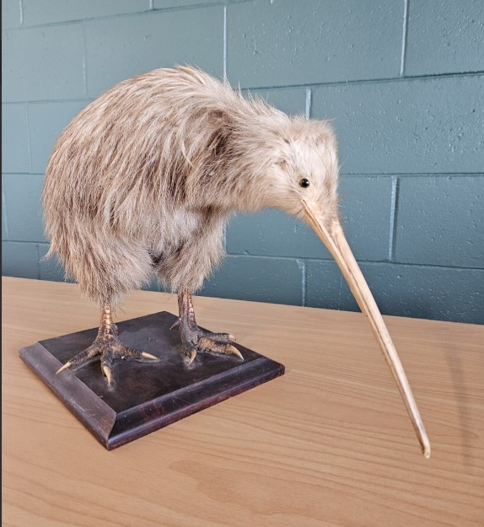
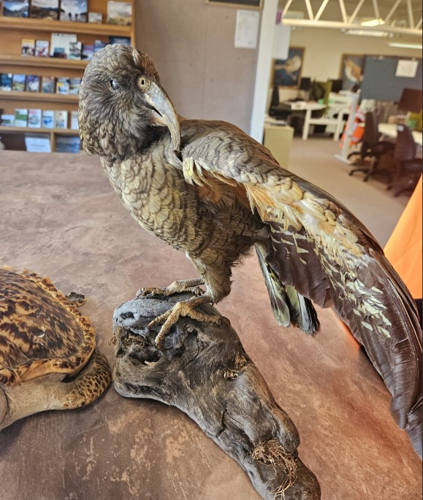
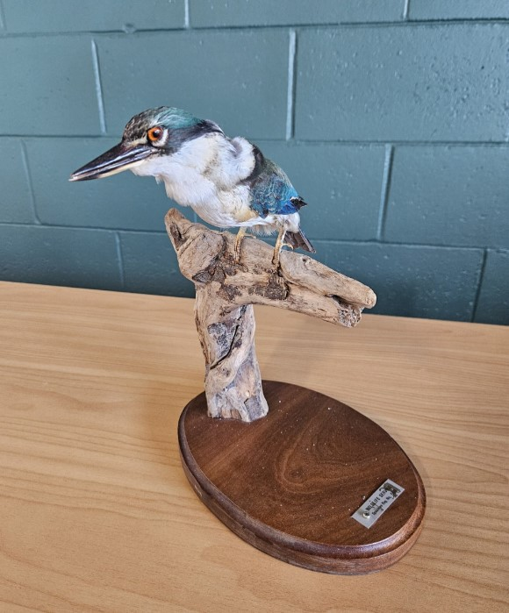
Can you see what I see?
Manu are hard to get close to and to have a really good look at. Here are some photographs of different manu, do you know what they are?
© Manaaki Whenua – Landcare Research
Notes:
Activity notes:
Using the posters and/or photographs, have the students focus on key features of the manu.
If possible have some feathers available for children to be able to touch and hold.
Taxidermy birds that can be used for further observation and exploration may be available from a local Department of Conservation office.
Educational disclosure: If you choose to use taxidermy animals for this activity, be mindful to have a discussion beforehand about the use of these animals for scientific purposes. A full explanation of how these animals died and how they came to be used in this manner can be sought from the Department of Conservation and given to students. Showing respect for these animals that were once living needs to be appreciated by everyone participating.

Slide 7
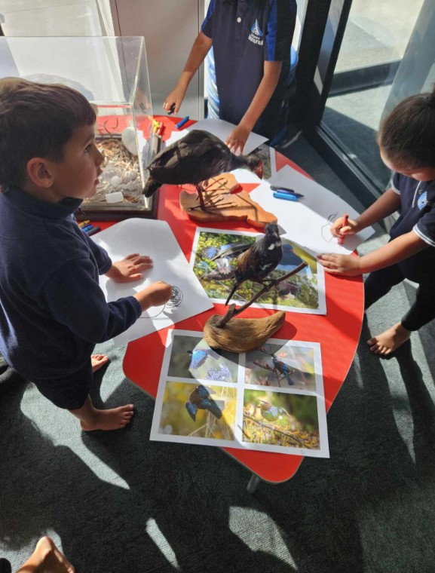
Can you see what I see?
Take a close look at their beak shape and colour, their body shape and features – what can you notice? ​
© Te Kura o Manunui
and Manaaki Whenua – Landcare Research

Slide 8
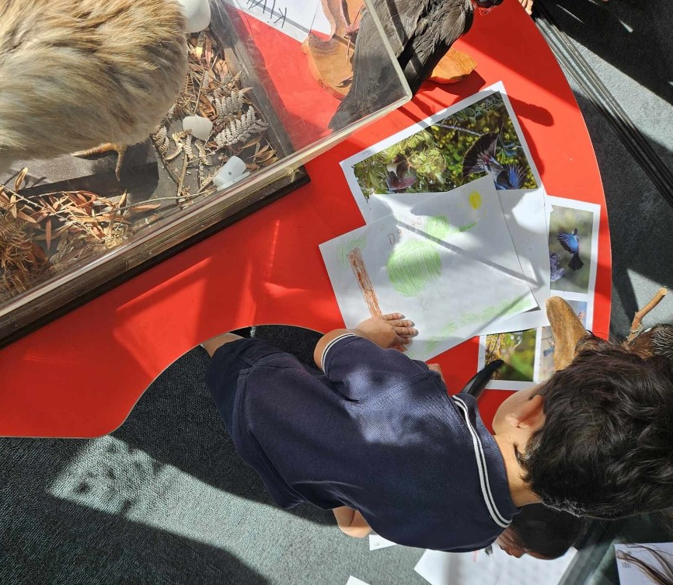
Can you see what I see?
Have a go at sketching your own manu and include all of their special features that you see.
© Te Kura o Manunui and Manaaki Whenua – Landcare Research

Slide 9
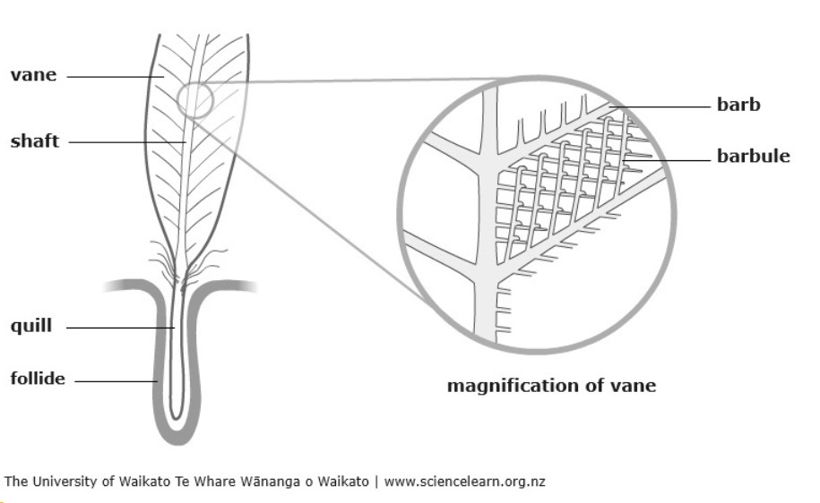
Feathers up close
Feathers are made of a tough and flexible material called keratin.
The spine down the middle, called the shaft, is hollow.
The vanes are on the two halves of the feather. They are made of thousands of branches called barbs.
Because there are many spaces between these barbs, a feather has as much air as matter.
Notes:
Activity notes:
Encourage an awareness of birds and their special abilities for flight.
This image is from the article Feathers and flight, which has lots more information about the design and function of feathers.

Slide 10
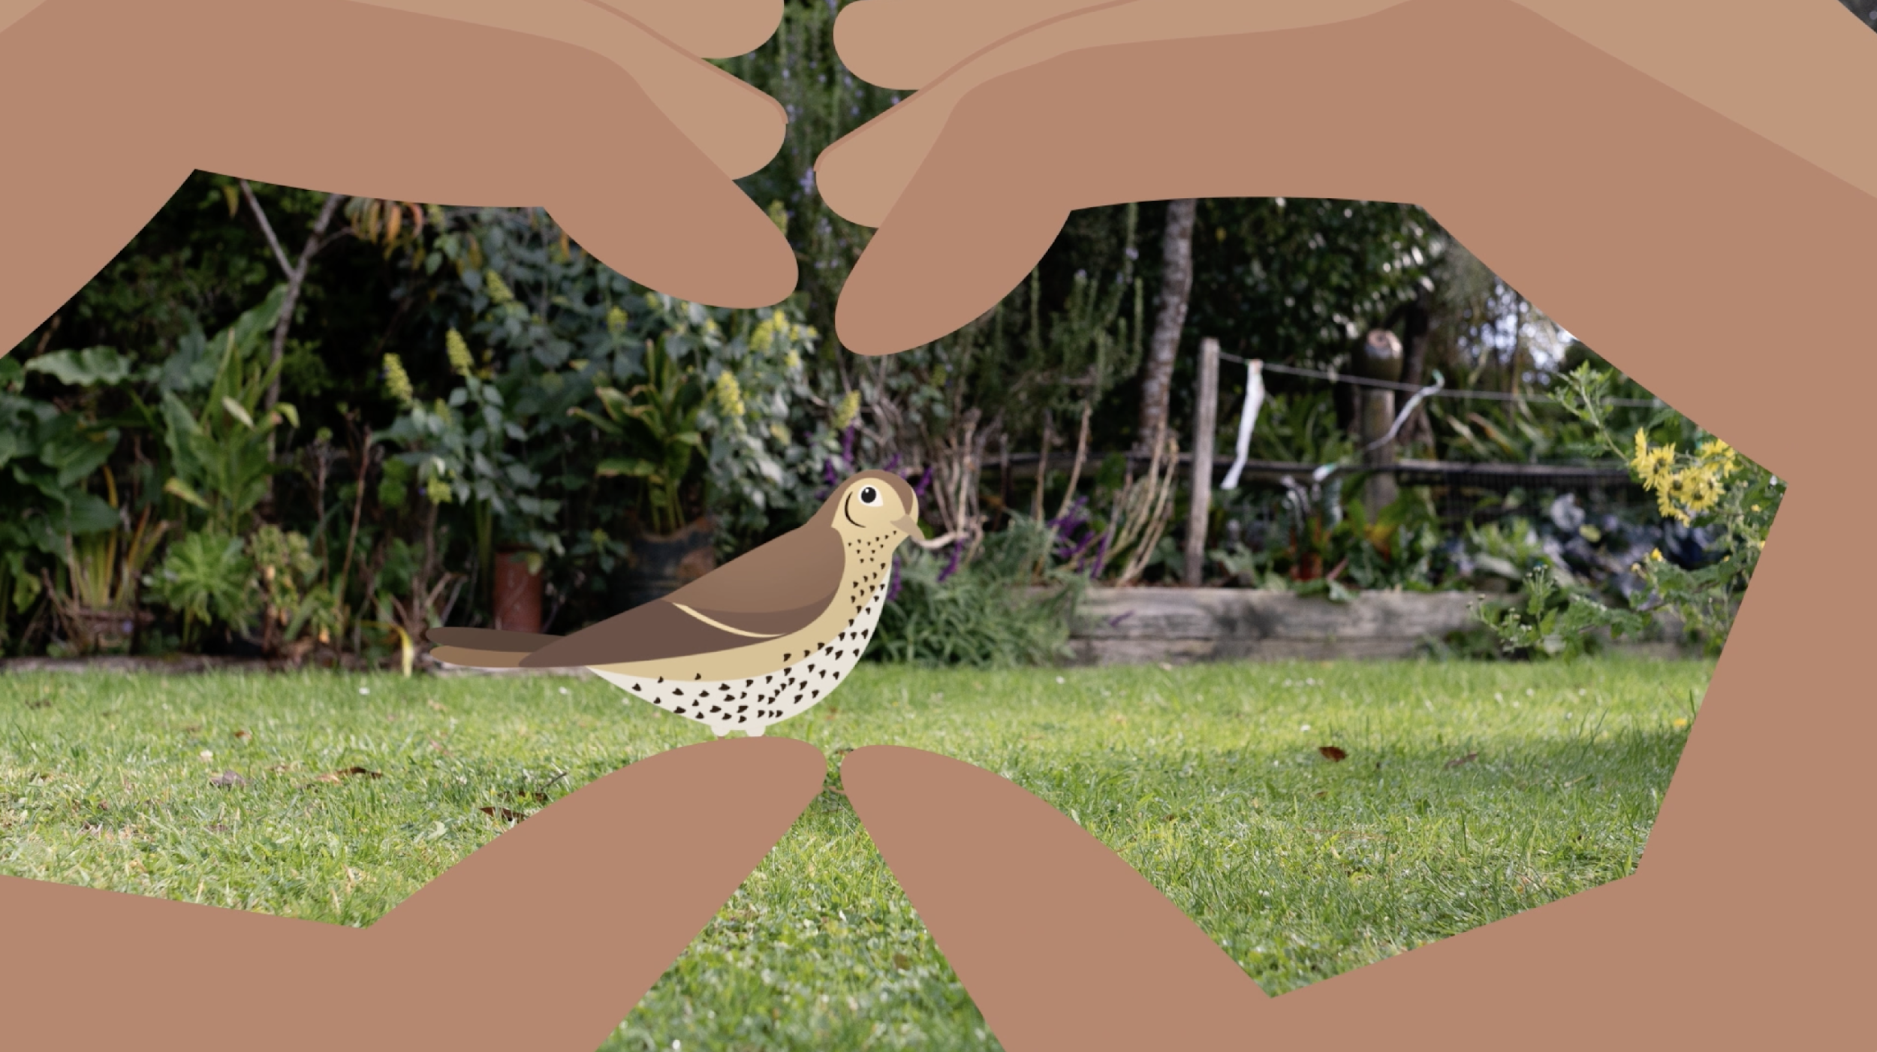
Your own observations
We learn so much just from observing and taking a critical look at the spaces and places around us. ​
Observation helps scientists understand how things work. By watching closely, they can discover new things about animals, plants, rocks or even stars in the sky.​
© University of Waikato l www.sciencelearn.org.nz and Manaaki Whenua – Landcare Research
Notes:
Activity notes:
The activity ​Titiro – observing my environment encourages tamariki to actively use all five senses to make observations in an outdoor school setting.

Slide 11
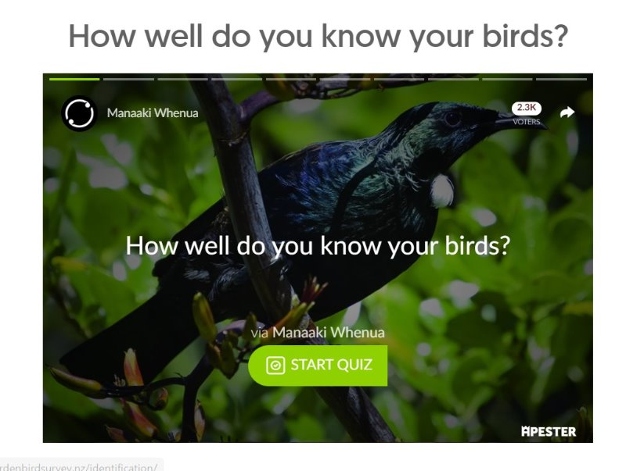
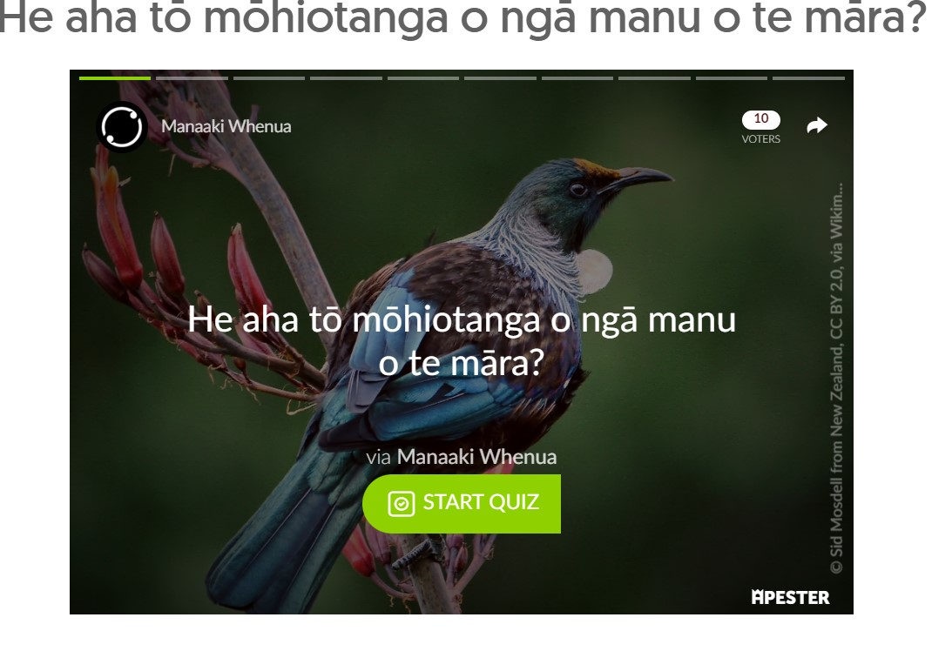
How well do you know your birds?
Click here to go to quizzes in
te reo or quizzes in English.
Notes:
Activity notes:
The quizzes from The Garden Bird Survey website feature images and questions with multi-choice answers.
The quizzes are self-marking with red and green responses.
He aha ēnei manu? – features quizzes in te reo Māori.
These quizzes are in English.

Slide 12
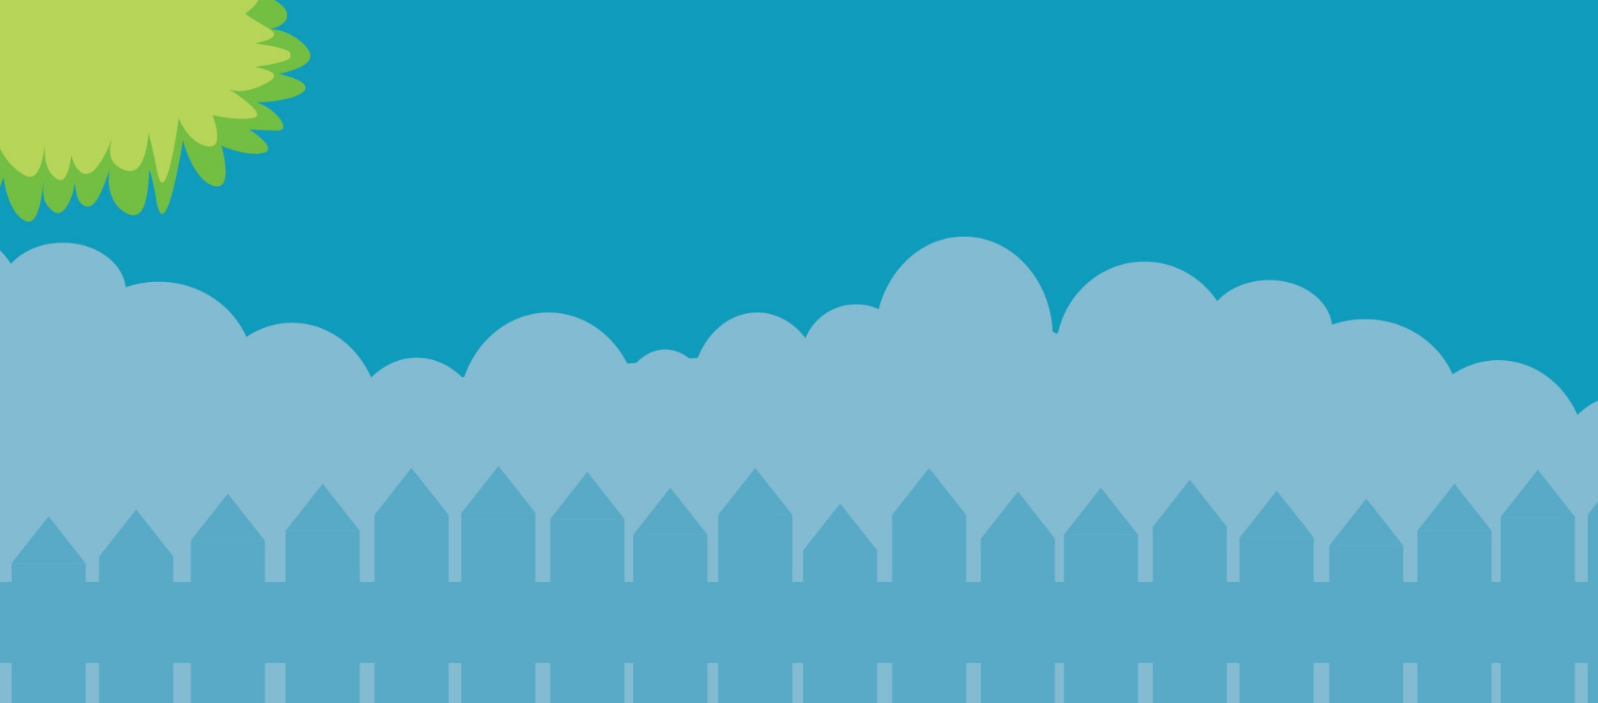
Help make our birds count
29 June – 7 July 2024
gardenbirdsurvey.nz

