Slide 1
Exploring data about
our manu
Notes:
Learning outcomes for tauira in this activity:
Cultural Identity: Fostering a sense of cultural identity and pride in students' Māori heritage through the exploration of indigenous perspectives on science and the environment.
Whakapapa: Understanding the interconnectedness and relationships within the natural world, including genealogy, ecological systems and environmental sustainability.
Tikanga: Applying tikanga (protocols) and kaitiakitanga (guardianship) principles to science learning, including ethical considerations and responsibilities towards the environment.
Observation and Inquiry: Developing skills in observation, inquiry and investigation through hands-on experiences and culturally relevant contexts.

Slide 2
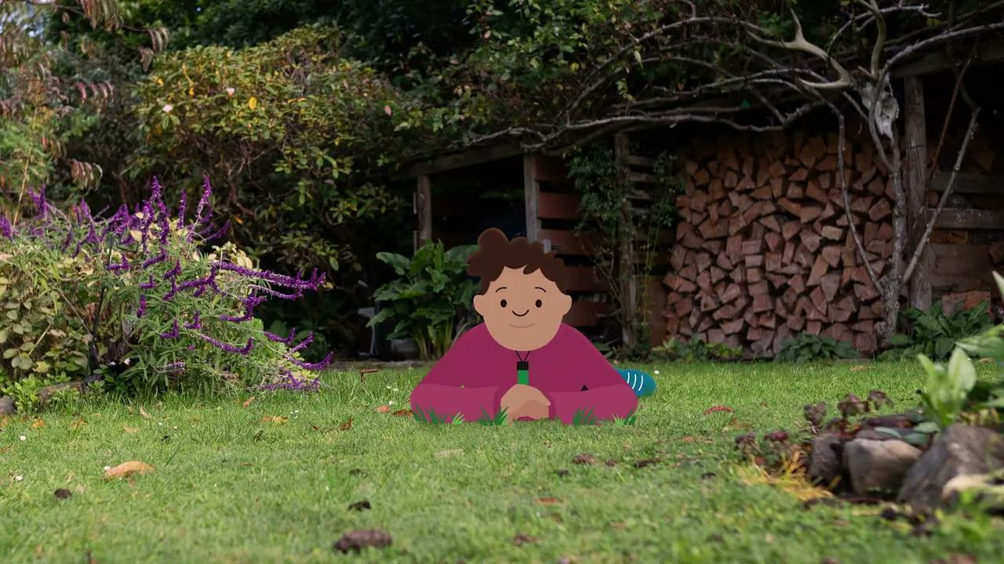
Collecting data about our manu
The video here is
Manu – exploring data.
© Manaaki Whenua – Landcare Research and The University of Waikato Te Whare Wānanga o Waikato | www.sciencelearn.org.nz
Notes:
Activity note:
In the video Manu – exploring data, Te Ariki encourages us to be scientists and explorers just like our tūpuna!

Slide 3
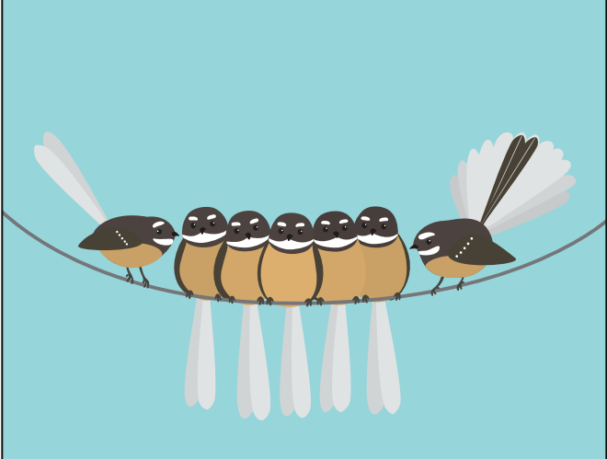
What is data?
The word data can mean many different things, what does it mean to you?
What do you think scientists mean when they talk about data?
© Manaaki Whenua – Landcare Research
Notes:
Activity notes:
Tamariki may be familiar with talking about data in relation to the internet – for example, running out of data or unlimited data. It is a good idea to highlight how the same word can have different meanings. In science we use the term data to mean a collection of information that we can sort and use to understand things – it can be expressed as numbers, text or symbols. This is an abstract idea so giving examples can help learners' understanding. As technology develops and more and more data is able to be collected, data scientists are needed to process it.
To explore the idea of data more deeply, read this article: Data and how we use it.

Slide 4
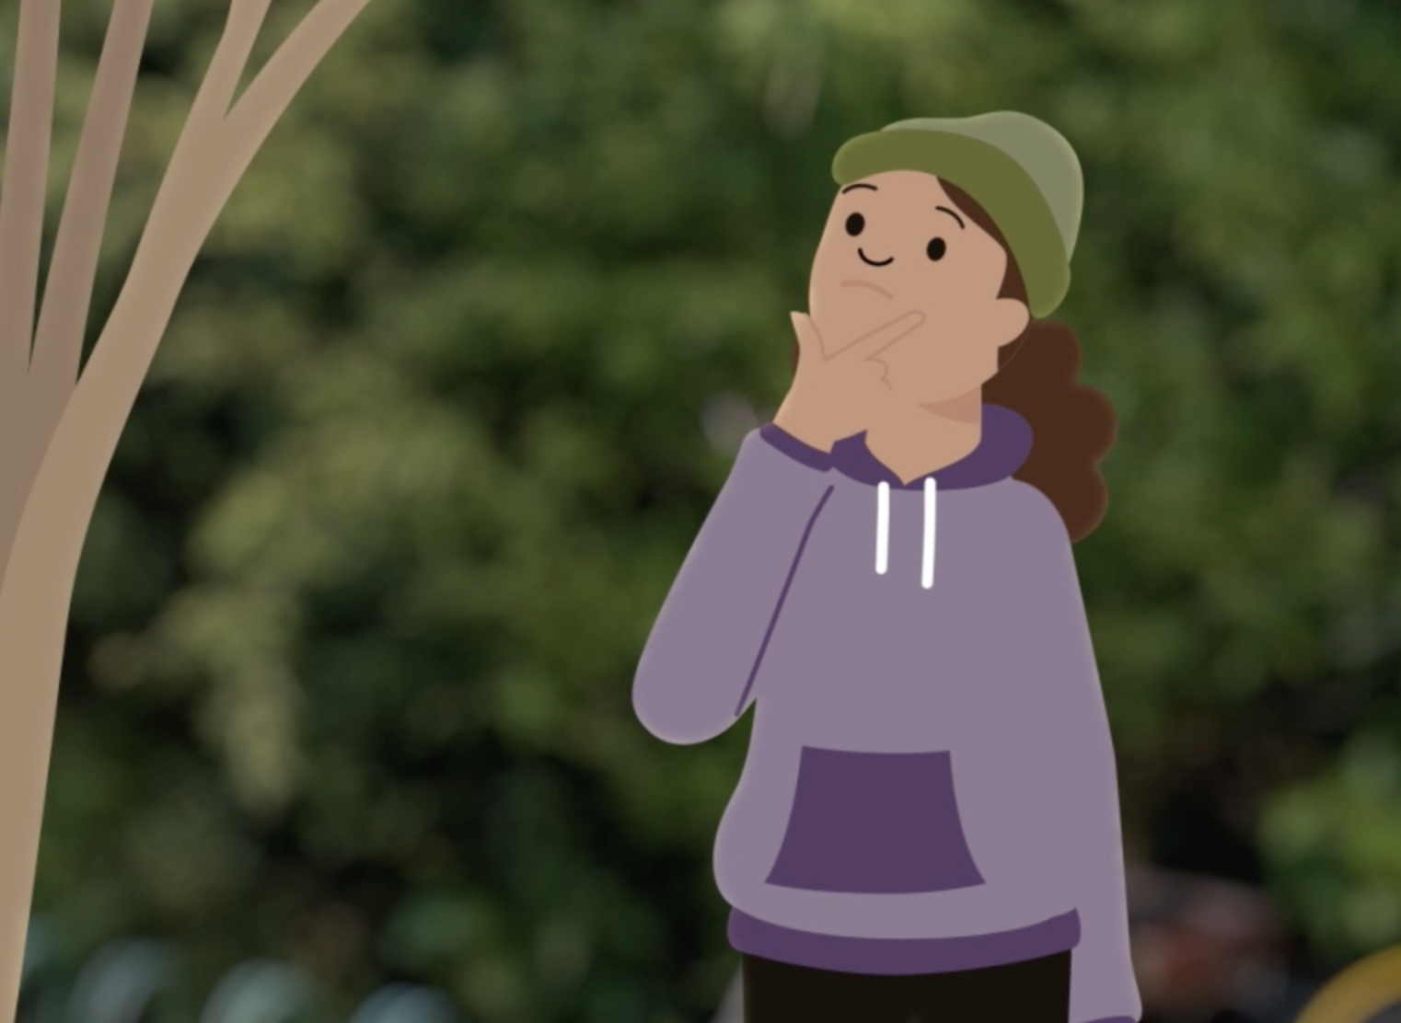
Data is useful
By collecting and processing data we can help find answers to our questions.
How do you use data?
© University of Waikato l www.sciencelearn.org.nz and Manaaki Whenua – Landcare Research
Notes:
Activity note:
Tamariki might use data to make decisions about what they eat, crossing the road or choices they make in a computer game.

Slide 5
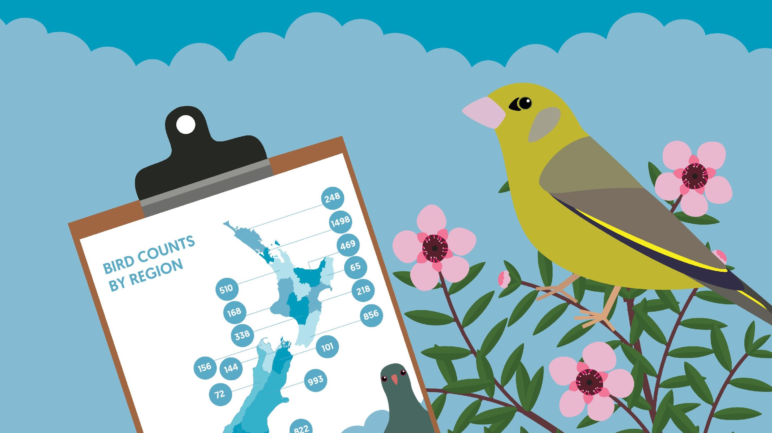
Exploring survey data
Scientists have lots of questions about the birds in Aotearoa.
The data from the Garden Bird Survey can help to answer these questions.
© Manaaki Whenua – Landcare Research
Notes:
Activity note:
Ask tamariki: What questions do you have?

Slide 6
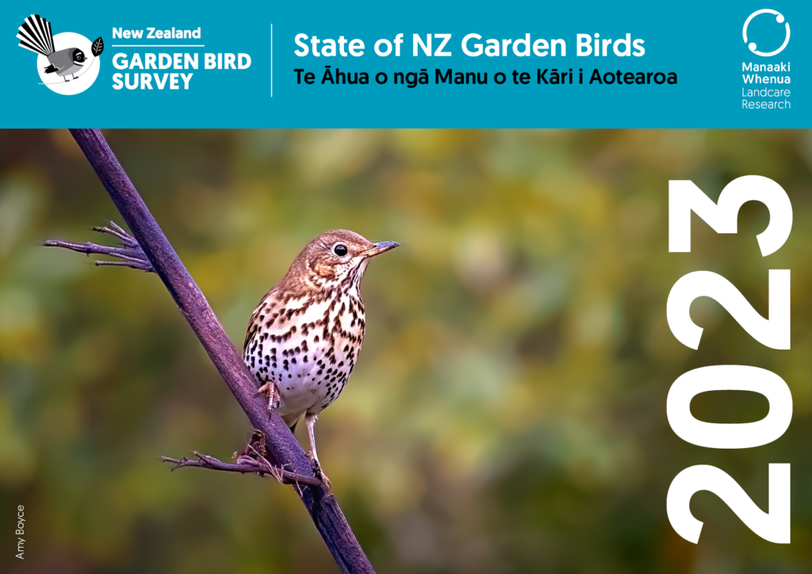
What do the survey results say?
Thanks to people like you there is lots of information about our garden birds.
Let's have a look at what it tells us!
Notes:
The New Zealand Garden Bird Survey website has a results page with survey results from previous years. The results are in text and infographic forms. They include reports from individual regions.

Slide 7
What does the survey say
about our birds?
Notes:
Activity notes:
There is a huge amount of information in the State of New Zealand Garden Birds report, which you can download from the New Zealand Garden Bird Survey website. Select one or two relevant graphs to unpack with your class.
For this slide, which shows the national results for the last 5 and 10 year periods, ask questions such as:
In the last 10 years (2013-2023), which birds have increased/decreased/stayed the same?
How do tamariki feel about this?
Does this data match their observations?
If local data is different, what might have caused the differences?

Slide 8
Notes:
Activity notes:
Unpack this image. What can we tell from the information available?
We are looking at data from the Bay of Plenty. You may want to show a map of the region in relation to Aotearoa so it is less abstract. For example, with Google maps.
We are looking at data on pīwakawaka.
The image shows data from the last 10 and 5-year periods.
The colours on the map tell us whether the numbers of fantails surveyed have gone up or down.
Discuss the blue area on the map. What is happening here?
This example shows the trends for the Bay of Plenty, find similar infographics for different regions and species on the New Zealand Garden Bird Survey website's results page.

Slide 9
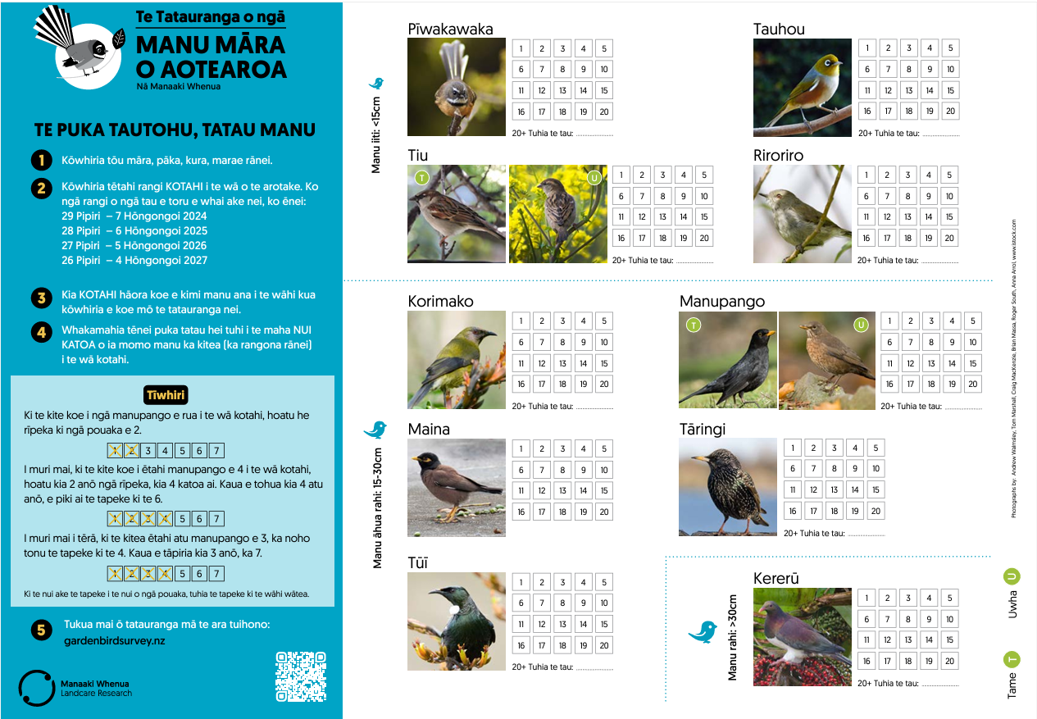
Let's look at the tally sheet
Notes:
Activity notes:
It would be good to have copies of the survey forms to hand out. One form between 2 tamariki works well.
Read through the information together.
Highlight how the survey asks for the biggest numbers of birds seen at one time – not the total number.
This slide shows the years 1–8 tally sheet. There is another, more detailed tally sheet for years 9+.
Both tally sheets and a video (in te reo Pākehā) on how to take part can be found on the New Zealand Garden Bird Survey website: Resources for teachers.

Slide 10
Exploring data
© Manaaki Whenua – Landcare Research
Notes:
Activity notes:
Go over how to record the birds.
Note it asks for the highest number of birds seen at one time.

Slide 11
What do you notice?
X
X
X
© Manaaki Whenua – Landcare Research
Notes:
Activity notes:
Te Ariki did the Garden Bird Survey last year. Here are some of his results.
Ask tamariki to explain what this tells us.

Slide 12
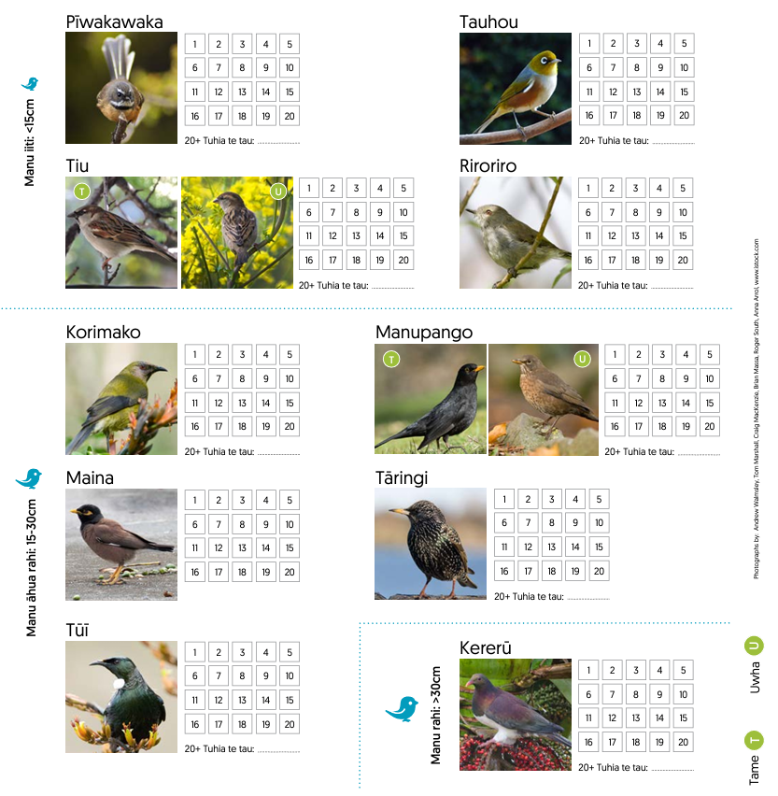
X X X
X X X X X
X X X X X
X
Have a look at this survey.
What do you notice?
X X X X
X X
© Manaaki Whenua – Landcare Research
Notes:
Activity notes:
Ask tamariki to make statements about the data that has been recorded.
What questions do they have?
Ask tamariki to put this data into another representation – for example, a bar graph.

Slide 13
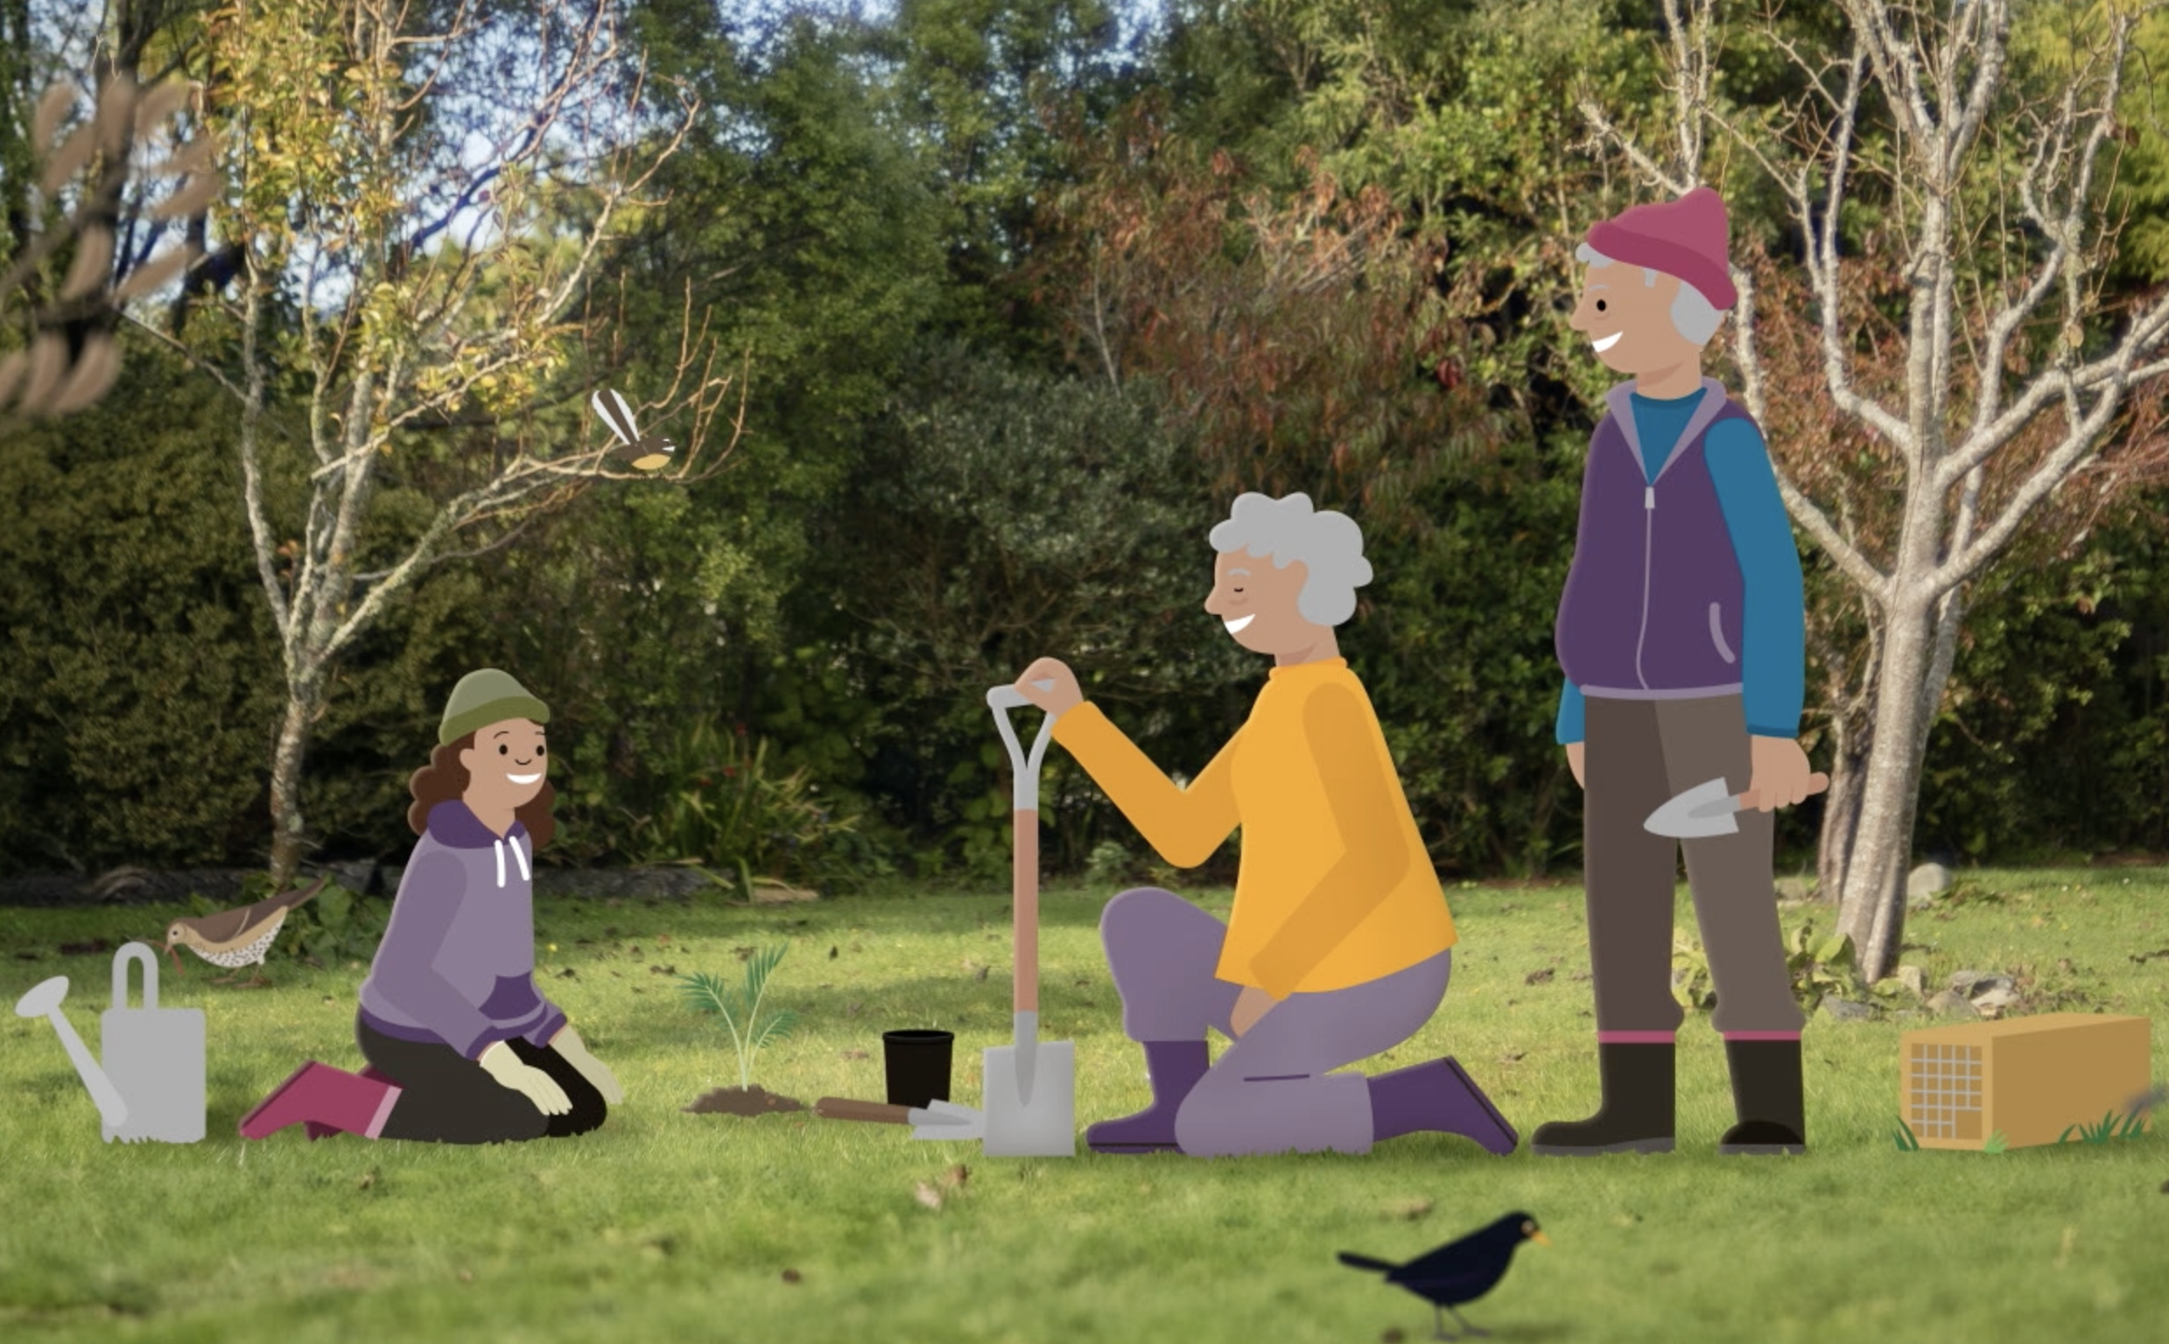
Have a go!
Just by observing and collecting data in your garden you can be a scientist and explorer just like your tūpuna.
The data you collect can help you and others learn to be better kaitiaki for our environment.
© University of Waikato l www.sciencelearn.org.nz and Manaaki Whenua – Landcare Research
Notes:
Activity note:
Practice doing the survey.

Slide 14
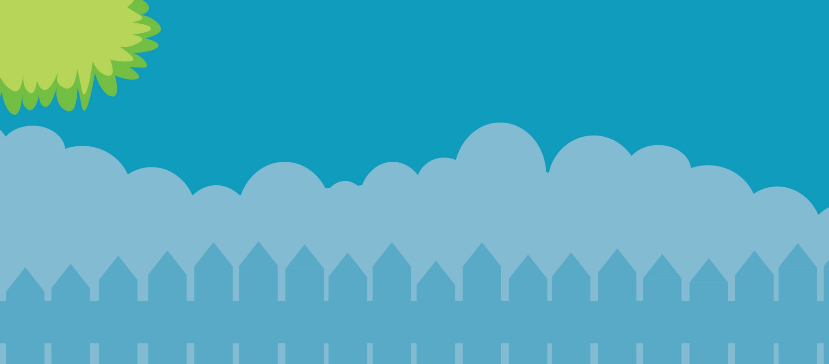
Help make our birds count
29 June – 7 July 2024
gardenbirdsurvey.nz

