Slide 1
Helping our manu
Notes:
Learning outcomes for tauira in this activity:
Cultural Identity: Fostering a sense of cultural identity and pride in students' Māori heritage through the exploration of indigenous perspectives on science and the environment.
Whakapapa: Understanding the interconnectedness and relationships within the natural world, including genealogy, ecological systems and environmental sustainability.
Tikanga: Applying tikanga (protocols) and kaitiakitanga (guardianship) principles to science learning, including ethical considerations and responsibilities towards the environment.
Observation and Inquiry: Developing skills in observation, inquiry and investigation through hands-on experiences and culturally relevant contexts.

Slide 2
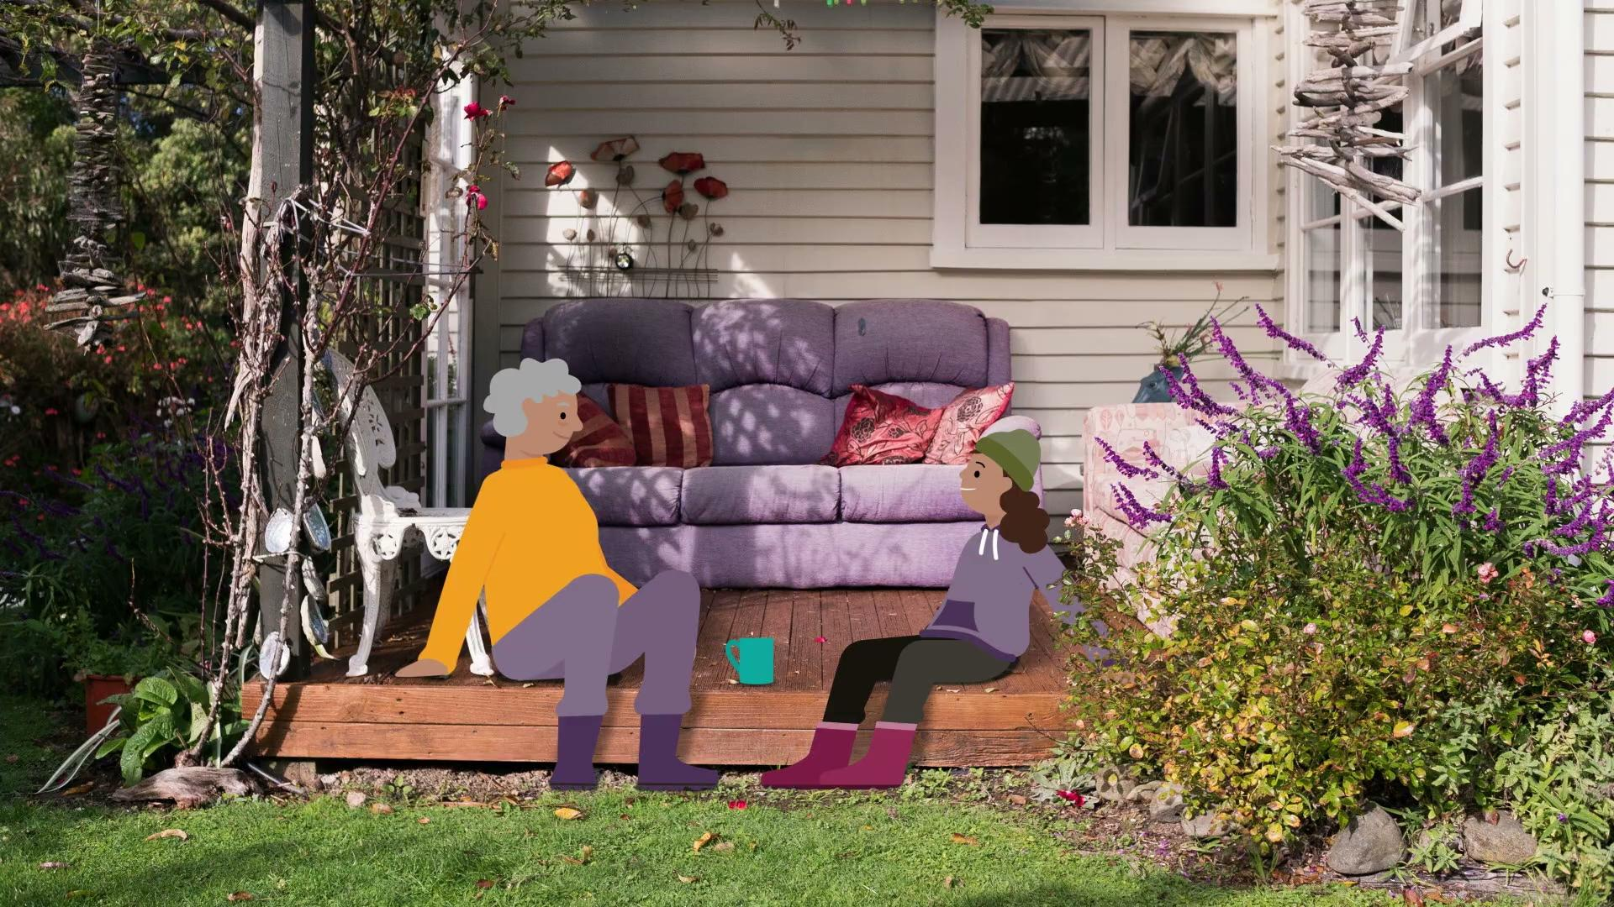
Helping our manu
The video here is
Manu – agency and action.
© Manaaki Whenua – Landcare Research and The University of Waikato Te Whare Wānanga o Waikato | www.sciencelearn.org.nz
Notes:
Activity note:
In this video, Te Ariki lays down a challenge to learn from our tūpuna and become kaitiaki of our local environment!
In this video, https://www.sciencelearn.org.nz/videos/2214-manu-agency-and-action Te Ariki lays down a challenge to learn from our tūpuna and become kaitiaki of our local environment!
Learning outcomes for tauira in this activity:
Cultural Identity: Fostering a sense of cultural identity and pride in students' Māori heritage through the exploration of indigenous perspectives on science and the environment.
Whakapapa: Understanding the interconnectedness and relationships within the natural world, including genealogy, ecological systems and environmental sustainability.
Tikanga: Applying tikanga (protocols) and kaitiakitanga (guardianship) principles to science learning, including ethical considerations and responsibilities towards the environment.
Observation and Inquiry: Developing skills in observation, inquiry and investigation through hands-on experiences and culturally relevant contexts.

Slide 3
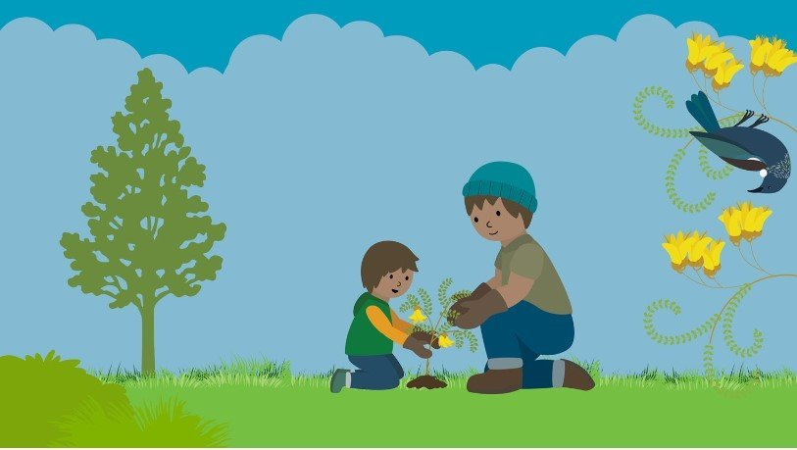
What can we do?
Native birds love eating from native plants
Make your garden appealing to birds with a range of plants that provide a year-round supply of food.
Different species of birds like different foods, so think about a variety of fruit, foliage and nectar.
You could include kōwhai, flax, kākābeak and tarata (lemonwood) for nectar; and wineberry, karamū and korokio (corokia) for fruit.
© Manaaki Whenua – Landcare Research
Notes:
Activity notes:
The New Zealand Garden Bird Survey website's Create a bird-friendly haven in your garden, school, or local park contains all the information you might need to start this initiative with your class.
This could also open opportunities to work alongside local conservation efforts and government offices like the Department of Conservation.

Slide 4
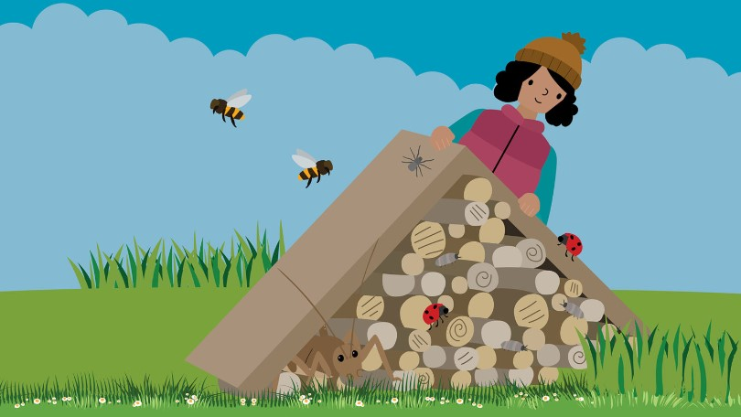
Creating a bug hotel
Protect and create habitat
Building a bug hotel can encourage all sorts of creatures into your garden and can provide a great food source for visiting birds.
There are no rules – old bricks, twigs, bamboo, wood chips, broken crockery, moss, sticks, mulch – the list is almost endless! Use your imagination and create different 'rooms' to accommodate different creatures.
The birds will thank you for the additional invertebrate food sources, and geckos and skinks will be delighted with their new lizard lounge!
© Manaaki Whenua – Landcare Research
Notes:
Activity notes:
You will need a few materials for the construction of the frame but the children can forage for materials to go into it.
Source cheap or free offcuts from local builders, whānau and friends. Untreated wooden pallets can come in handy.
Nails, hammers and saws – don't forget basic health and safety! Mind the fingers.
Assortment of materials to fill the hotel.
Instructions for making bug hotels are found on these websites:
Build a bug hotel in four easy steps – Topflite
Setting up a bug hotel – Kiwi Conservation Club

Slide 5
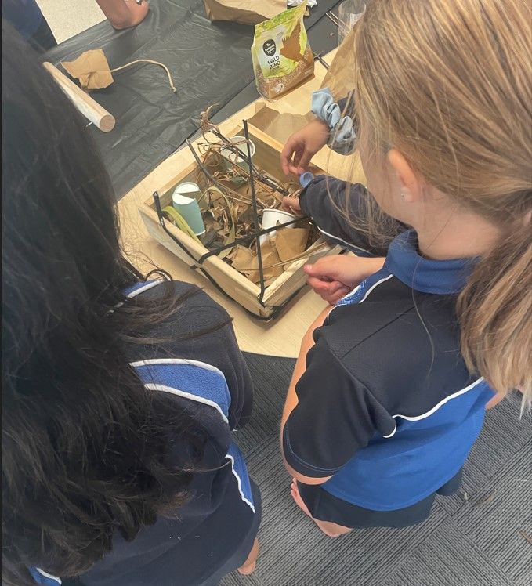
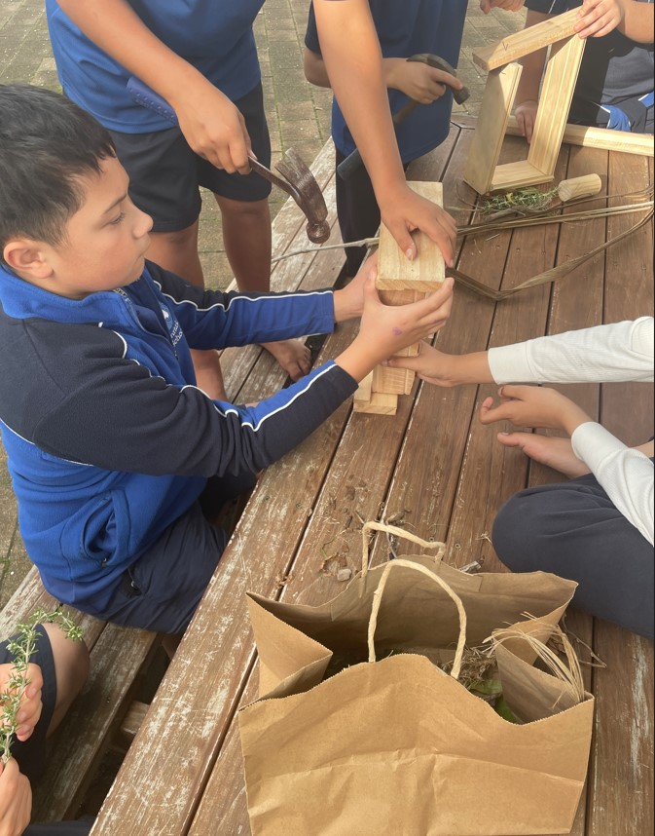
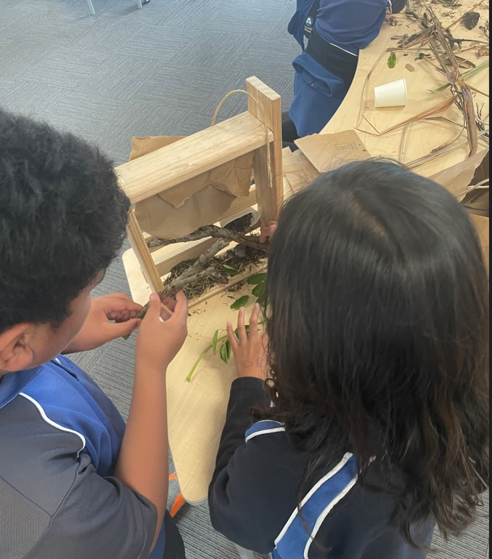
Creating a bug hotel
© Arataki School and University of Waikato Te Whare Wānanga o Waikato l www.sciencelearn.org.nz

Slide 6
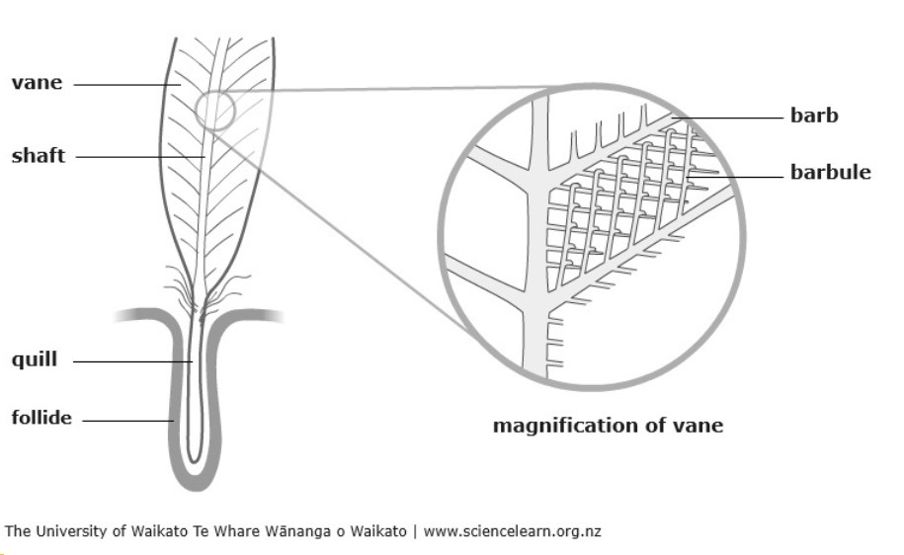
Feathers up close
Feathers are made of a tough and flexible material called keratin.
The spine down the middle, called the shaft, is hollow.
The vanes are on the two halves of the feather. They are made of thousands of branches called barbs.
Because there are many spaces between these barbs, a feather has as much air as matter.
Notes:
Activity notes:
Encourage an awareness of birds and their special abilities for flight.
This image is from the article Feathers and flight, which has lots more information about the design and function of feathers.

Slide 7
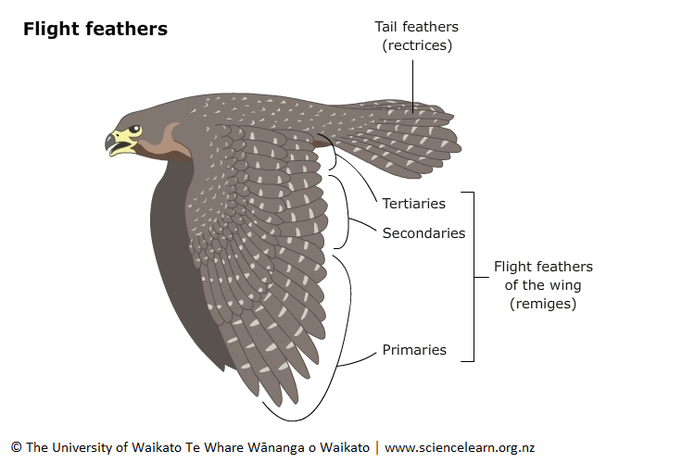
Feathers and flight
The flight feathers are known as remiges (wing feathers) and rectrices (tail feathers).
The wing feathers are made up of primary, secondary and tertiary feathers.
Notes:
This image is also from the article Feathers and flight.

Slide 8
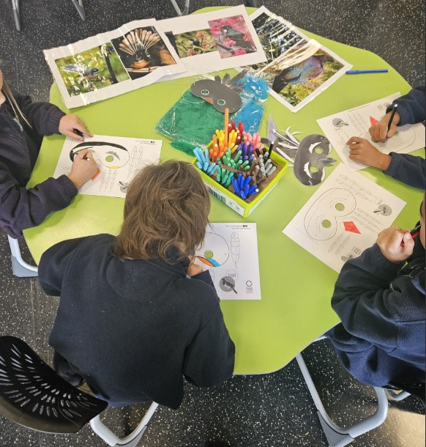
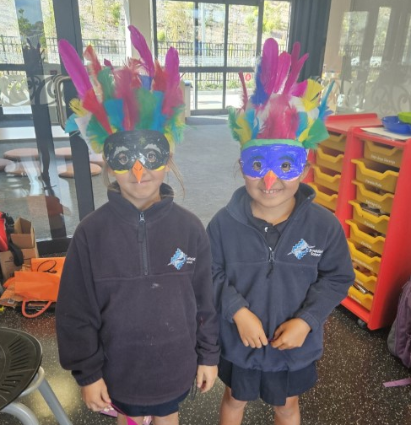
Make your own bird mask!
Be at one with the birds in your kura or māra and create your own bird mask!
© Te Kura o Manunui and Manaaki Whenua – Landcare Research
Notes:
Activity notes:
Encourage awareness of birds with a fun and creative activity using feathers.
Before starting the activity – spend time talking about the bird species first.
What species do they recognise?
What do they know about the birds?
Have they seen the bird species before? Where?
Why did they choose the bird species for making their mask?
The New Zealand Garden Bird Survey has templates to use as the base for students to create their own masks. Choose between black and white templates, which allow students to add their own colour, or colour templates, which imitate native birds' actual colours.
It would pay to have the templates precut for juniors. Sourcing real feathers from dollar or craft shops is also helpful as the feathers on the templates can be fiddly to cut out and attach. Real feathers also add colour and texture.
Set up the tables with an assortment of mask templates along with photos of the birds you are using (for colour matching and comparing).
Choose which medium students will use – crayons, colouring pencils or felts.

Slide 9
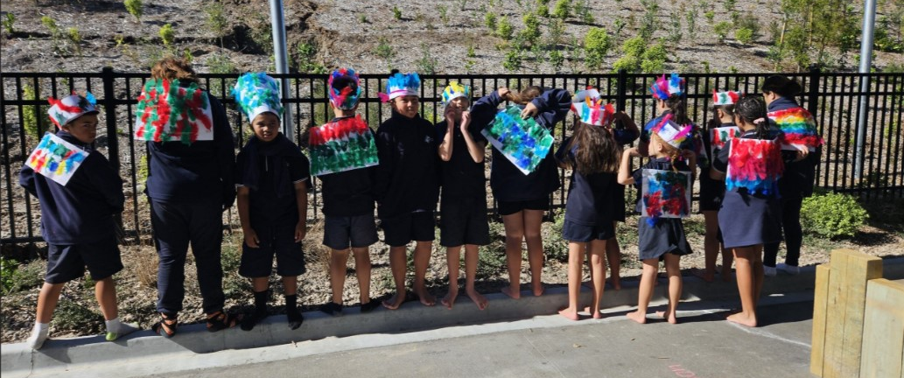
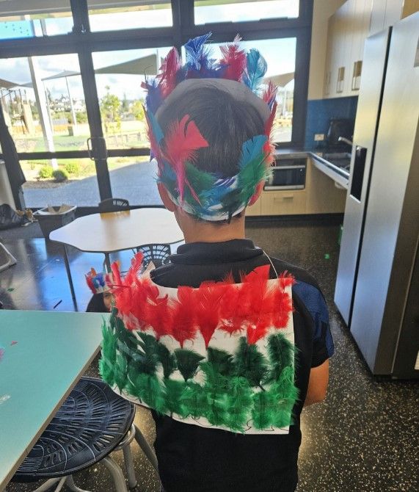
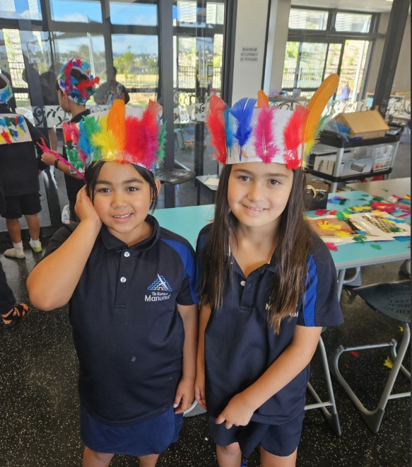
Kākahu huruhuru and tīpare
Create a kākahu or tīpare for a special occasion.
© Kura o Manunui and Manaaki Whenua – Landcare Research
Notes:
Activity notes:
Encourage awareness of birds with a fun and creative activity using feathers. This activity can support the learning of how introduced and native feathers are used in the making of traditional and contemporary kākahu huruhuru.
Use the start of the Museum of New Zealand Te Papa Tongarewa video He Paki Taonga i a Māui: Ko te Pakanga a ngā Manu | Battle of the Birds to show a traditional kākahu huruhuru – from about 00:50. If you can access a kākahu huruhuru, have one on hand for tamariki to get a close look at.
Either working in small groups or individually, students create a pattern of feathers for a tīpare and kākahu.

Slide 10
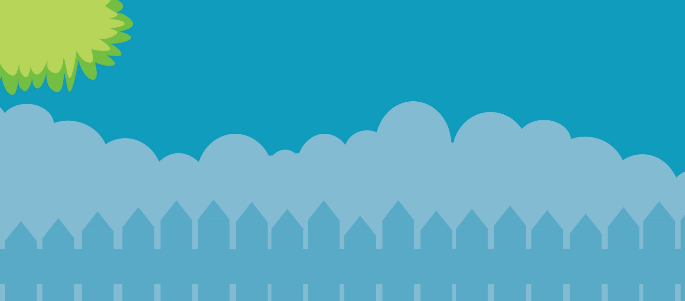
Help make our birds count
29 June – 7 July 2024
gardenbirdsurvey.nz

