Slide 1
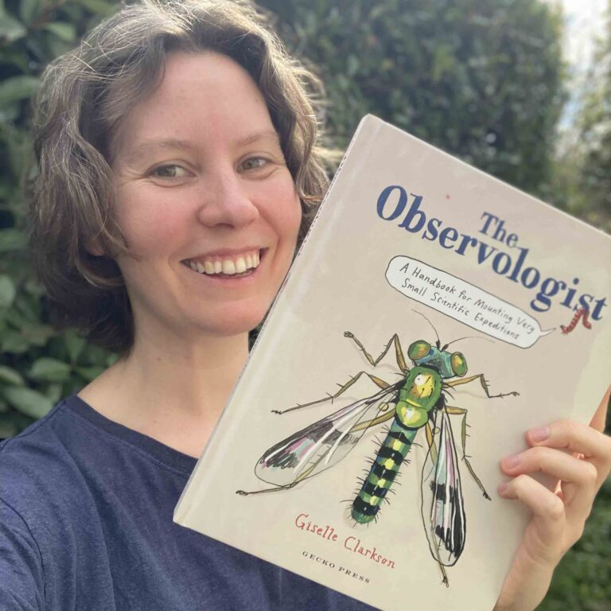
Observology
for the classroom
© Giselle Clarkson
4–4:45 pm Thursday 30 May

Slide 2
The Science Learning Hub
A trustworthy online resource – produced by educators and scientists
Based on world-class New Zealand science research
Supported by learning activities, information about the key science ideas and concepts, multimedia tools and other resources
Written for New Zealand teachers and students
Notes:
The Science Learning Hub is funded by the New Zealand government – Ministry of Business, Innovation and Employment (MBIE) – under the Curious Minds fund.

Slide 3
Index
Topic | Slideshow number(s ) | Video timecode
Welcome and introducing the Science Learning Hub | 1-2 | 00:00
Index and purpose | 3-4 | 00:37
Giselle Clarkson | 5-6 | 01:21
The Observologist | 7-8 | 06:25
Why use observology in your classroom? | 9-11 | 14:59
Drawing for observation | 12 | 17:41
Scale | 13 | 24:12
Tools for observation | 14 | 27:00
Taxonomy and scientific names | 15-17 | 30:31
Experiencing, connecting and conserving | 18-21 | 32:11
SLH links, keep in touch and thanks | 22 | 35:28

Slide 4
Purpose
Introduce you to observology
Share related big ideas including the science capabilities
Provide links to activities for use in the classroom
© Giselle Clarkson
Notes:
https://geckopress.com/giselle-clarksons-life-as-an-observologist/

Slide 5
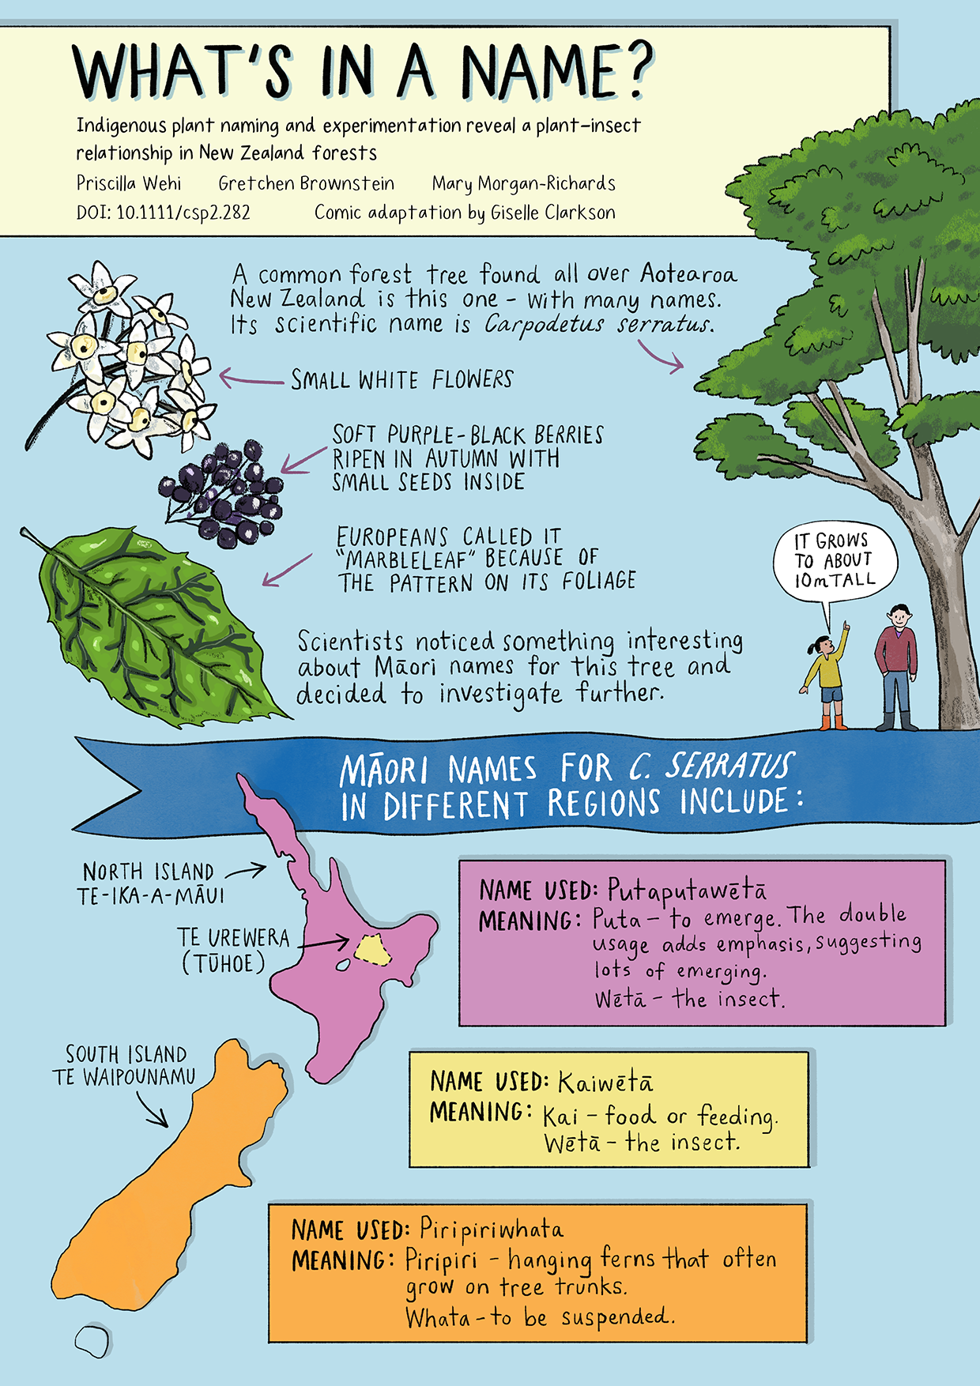
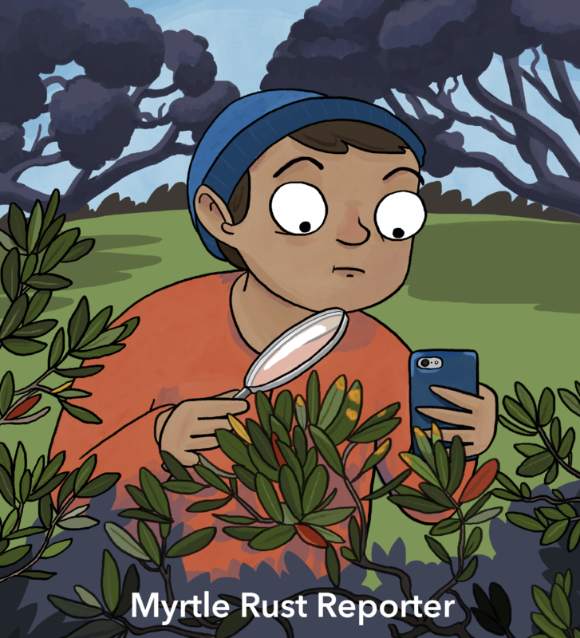
Giselle Clarkson
© Scion
Giselle Clarkson and Priscilla Wehi. What’s In a Name? Scientific Journeys website
© G.Clarkson/CC BY-SA 4.0
Notes:
https://www.sciencelearn.org.nz/images/4308-frog-facts
https://www.sciencelearn.org.nz/images/4703-myrtle-rust-reporter
https://www.priscillawehi.com/resources/plant-insect-relationship/plant-insect-download/
https://www.read-nz.org/writers-files/writer/clarkson-giselle - I have this book so I can take a pic if needed.
Leaf veined slug: https://en.wikipedia.org/wiki/Giselle_Clarkson#/media/File:COTW_Leaf-veined_Slug.png CC BY-SA 4.0
Links for Giselle profile: https://en.wikipedia.org/wiki/Giselle_Clarkson
https://geckopress.com/giselle-clarksons-life-as-an-observologist/

Slide 6
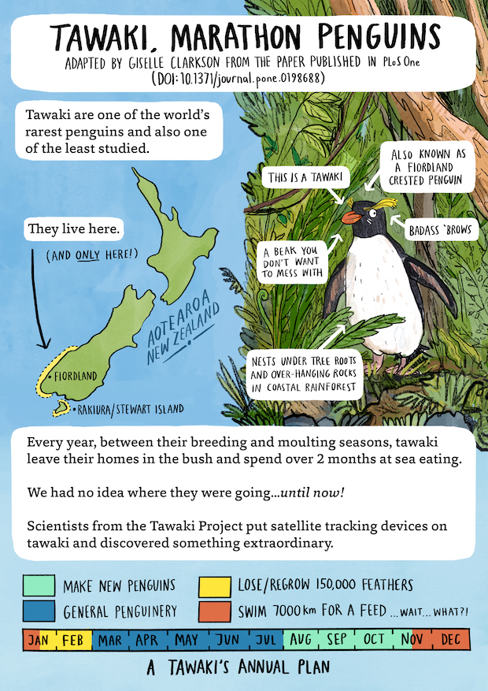
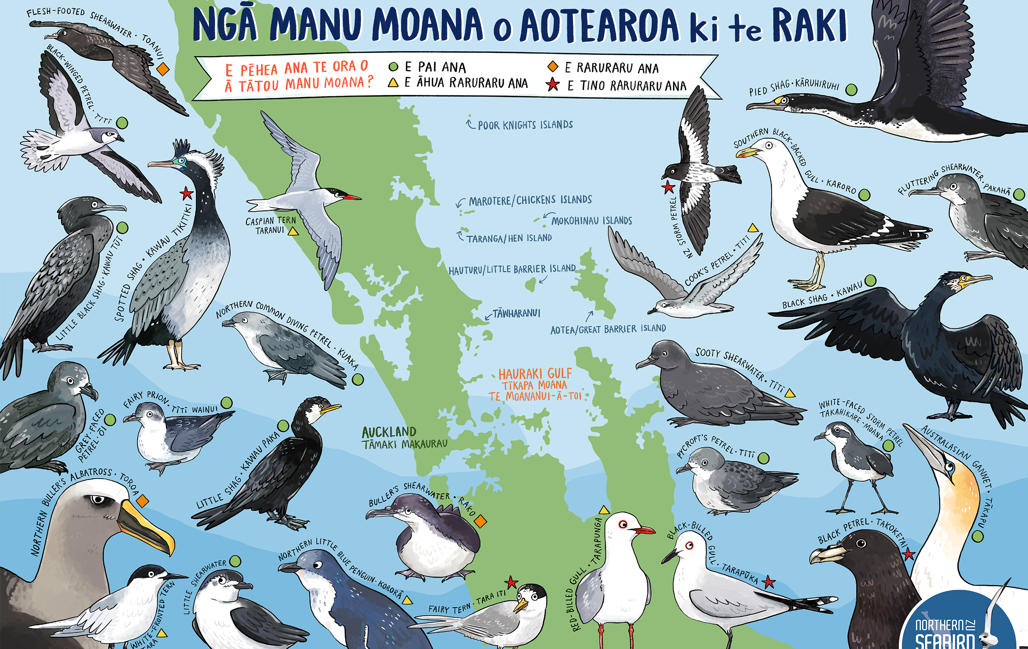
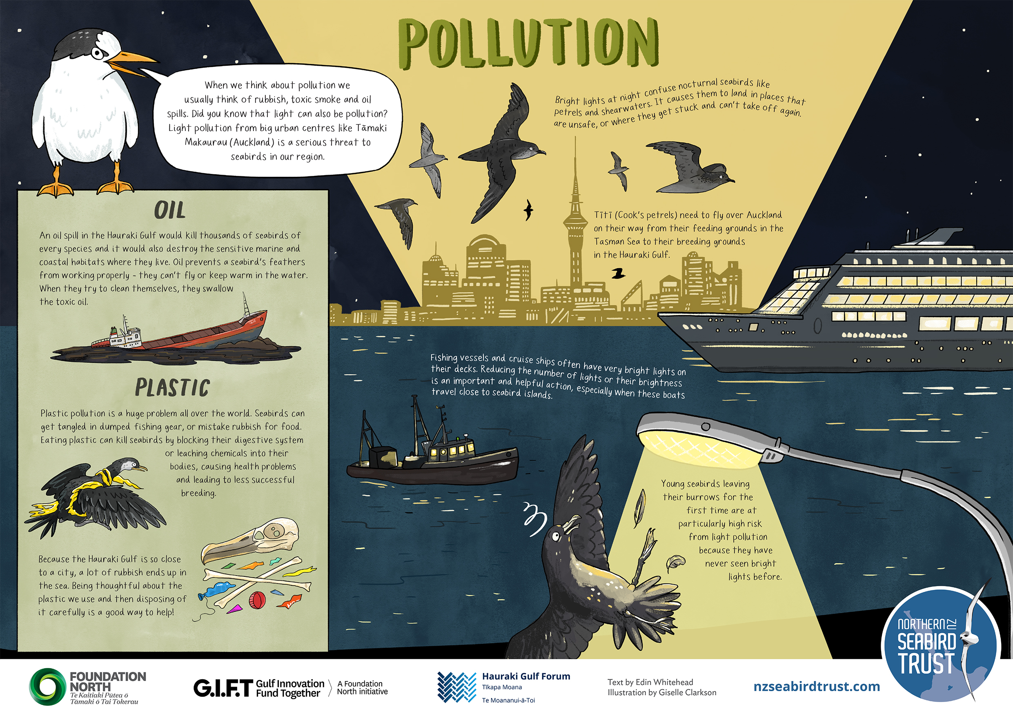
Giselle Clarkson
© The Tawaki Project
© 2024 Hauraki Gulf Forum. All Rights Reserved.
Notes:
https://www.giselledraws.com/portfolio/tawaki/
https://gulfjournal.org.nz/?post_type=poster

Slide 7
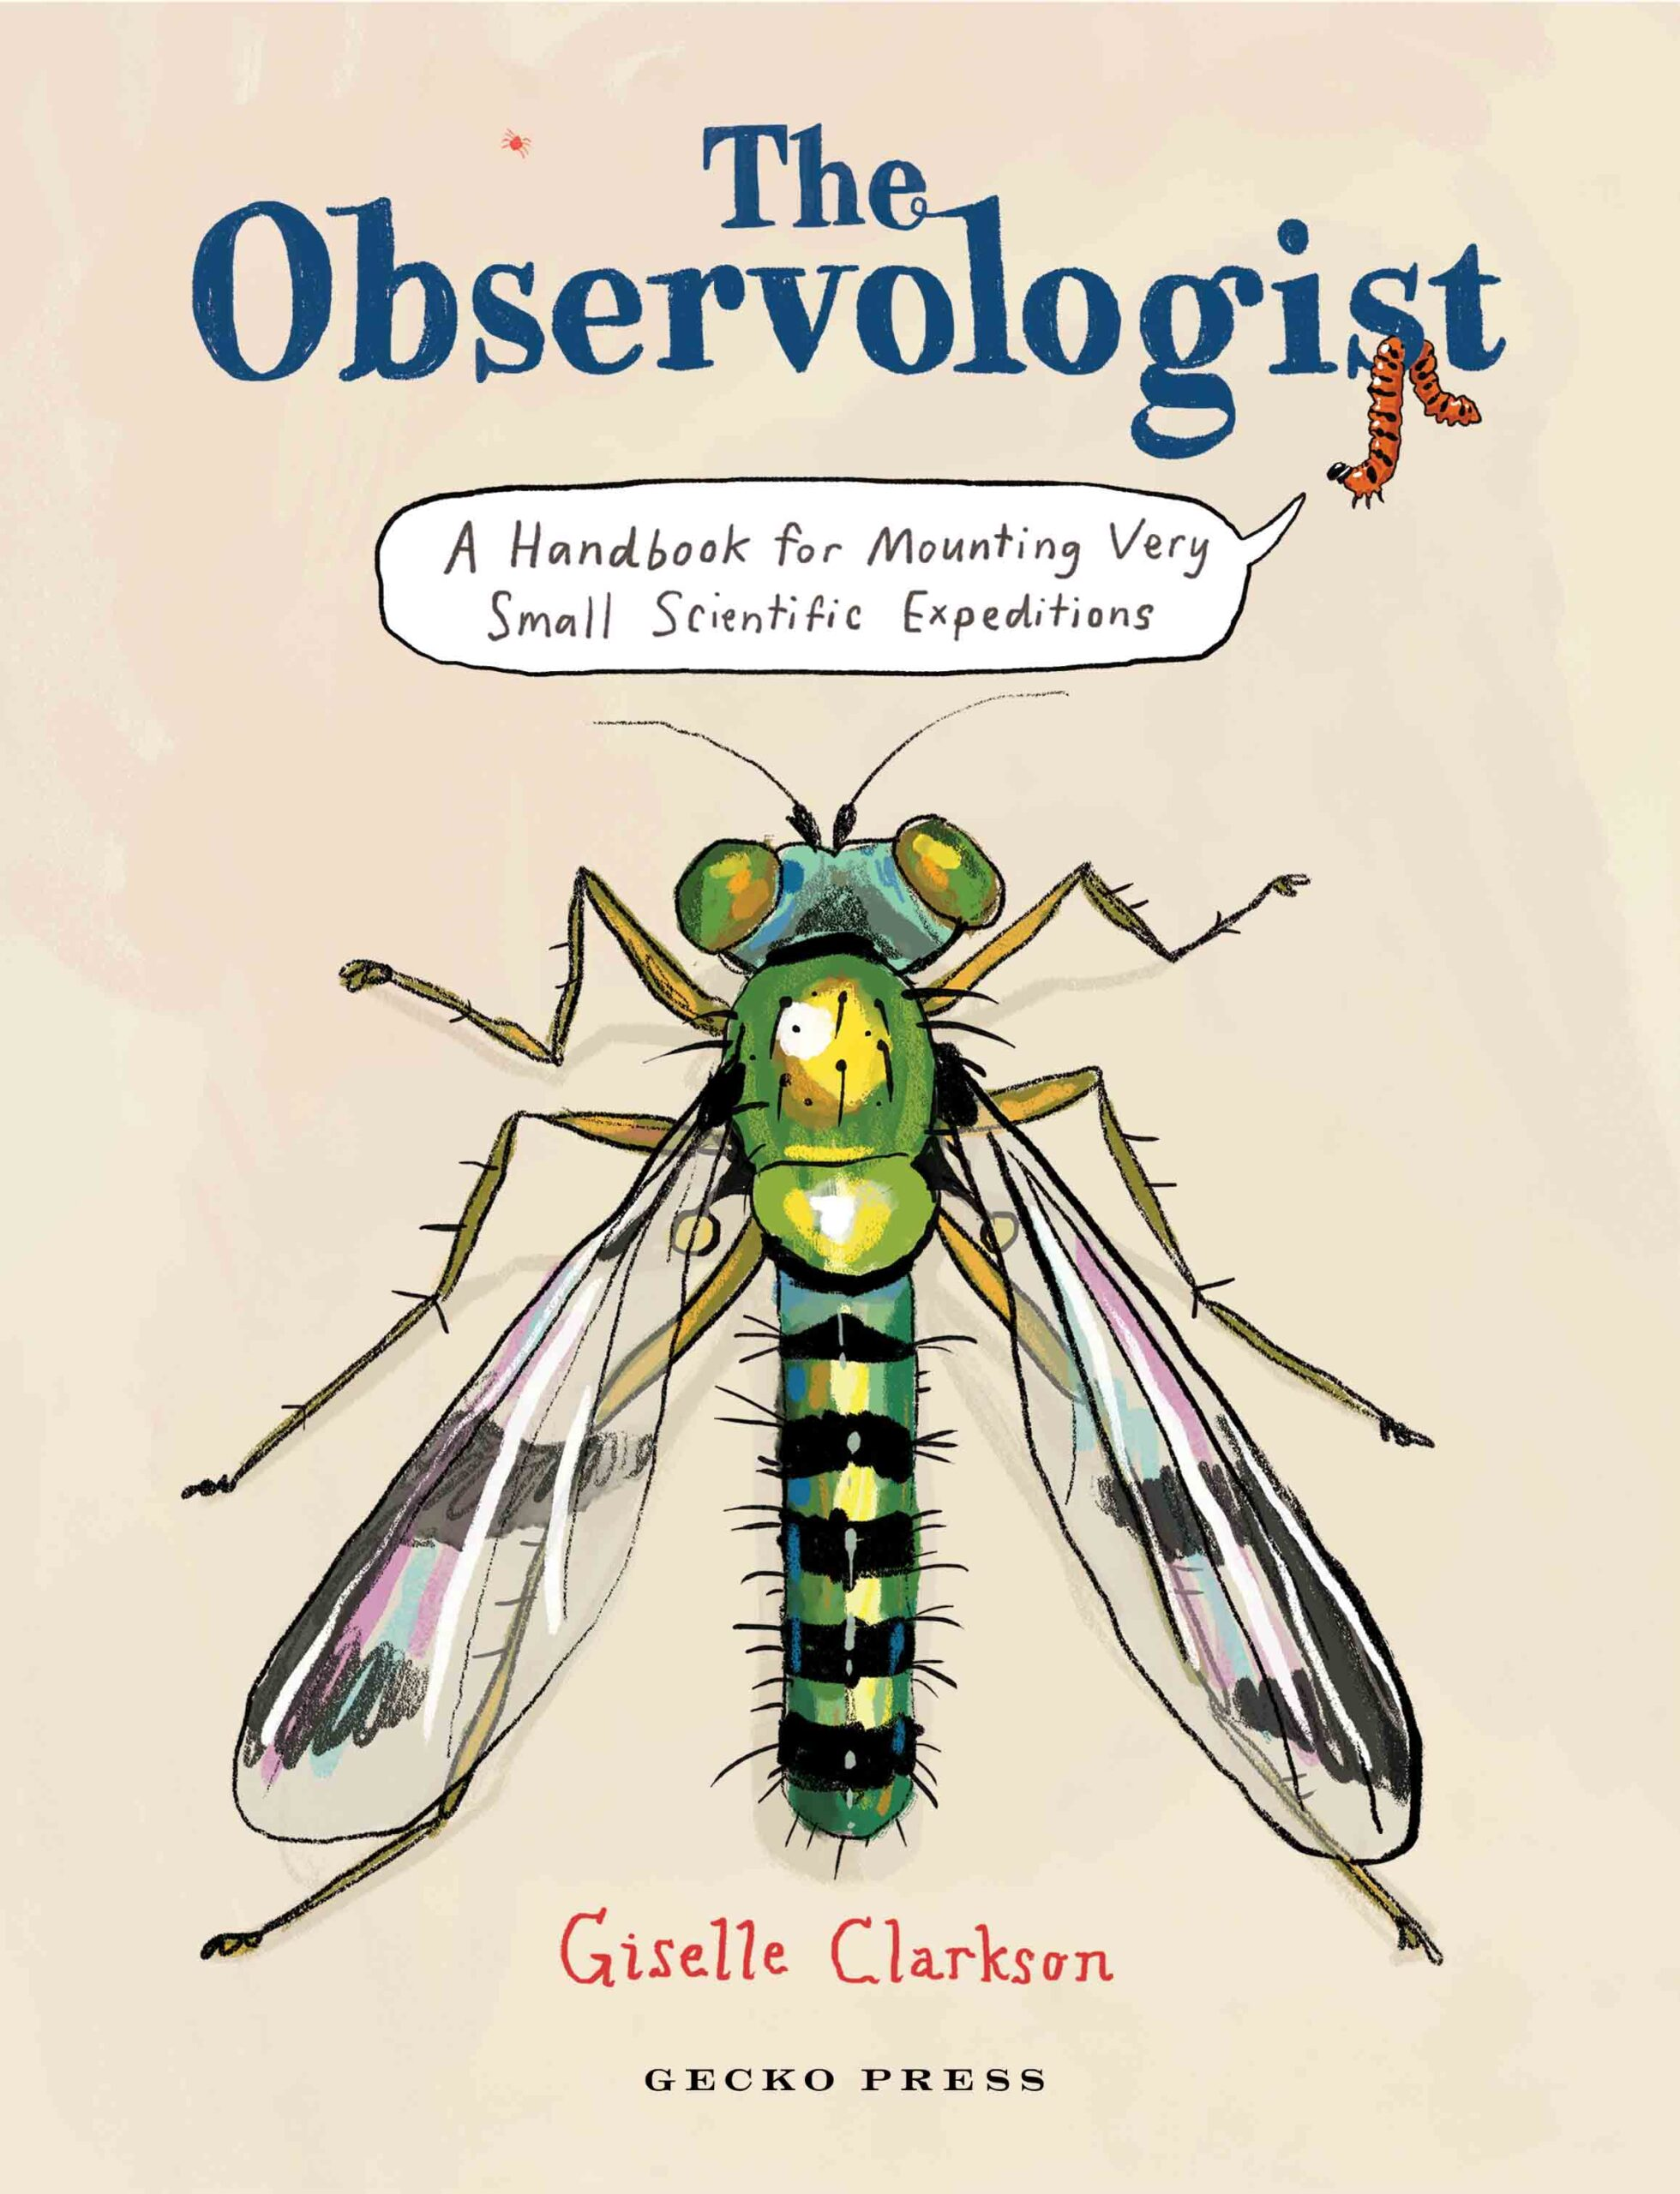
Giselle Clarkson
© Giselle Clarkson
Notes:
Image: https://geckopress.com/bookshop/the-observologist/

Slide 8
Observolo-what?
© Giselle Clarkson
Notes:
https://x.com/geckopress/status/1727136244529082497/photo/1
Other options
https://lernerbooks.com/shop/show/23118 or https://www.amazon.com.au/Observologist-Handbook-Mounting-Scientific-Expeditions/dp/1776575199 - need a better quality image

Slide 9
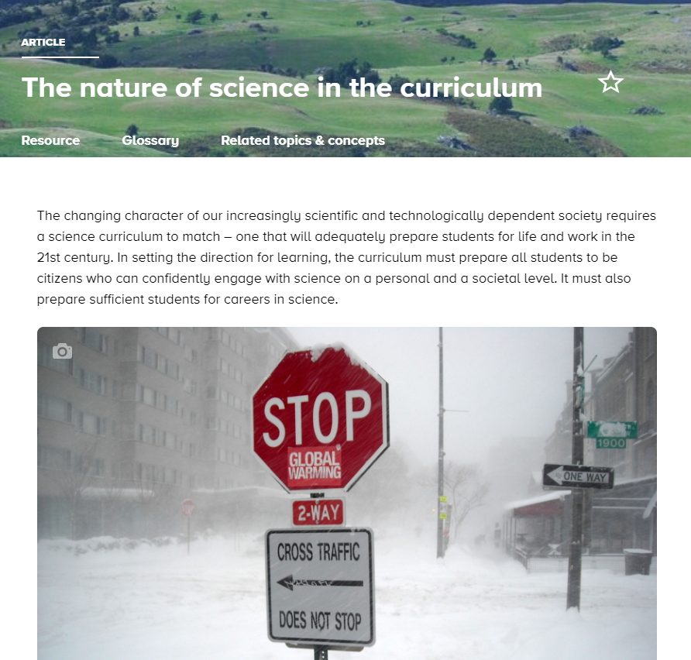
Why use observology
in your classroom?
© AgnosticPreachersKid, CC BY-SA 3.0
Notes:
https://www.sciencelearn.org.nz/resources/416-the-nature-of-science-in-the-curriculum

Slide 10
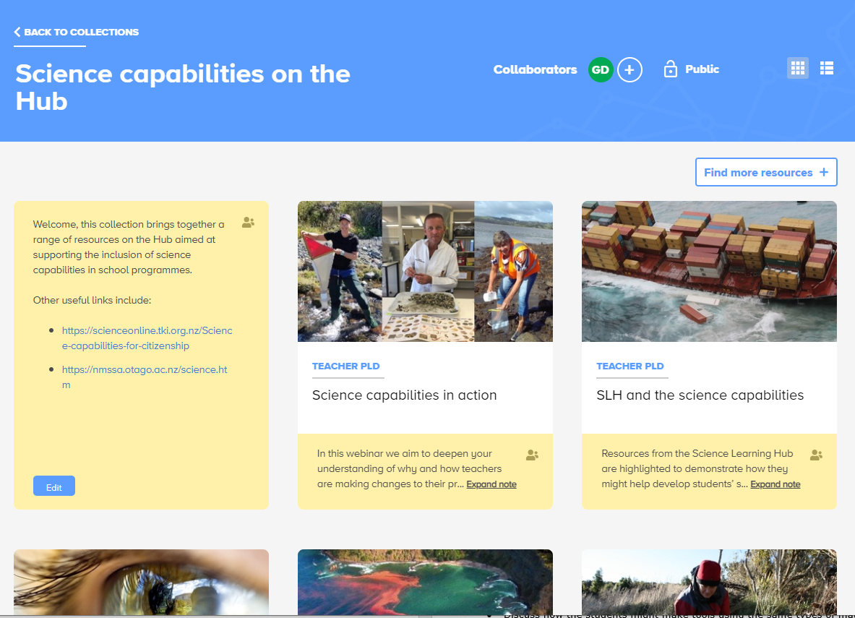
Why use observology
in your classroom?
© Maritime NZ
Notes:
https://www.sciencelearn.org.nz/collections/shared/4a2283a233bc879a89118d5d61e9bca4

Slide 11
Why use observology
in your classroom?
Notes:
https://www.sciencelearn.org.nz/image_maps/111-ways-of-investigating-in-science

Slide 12
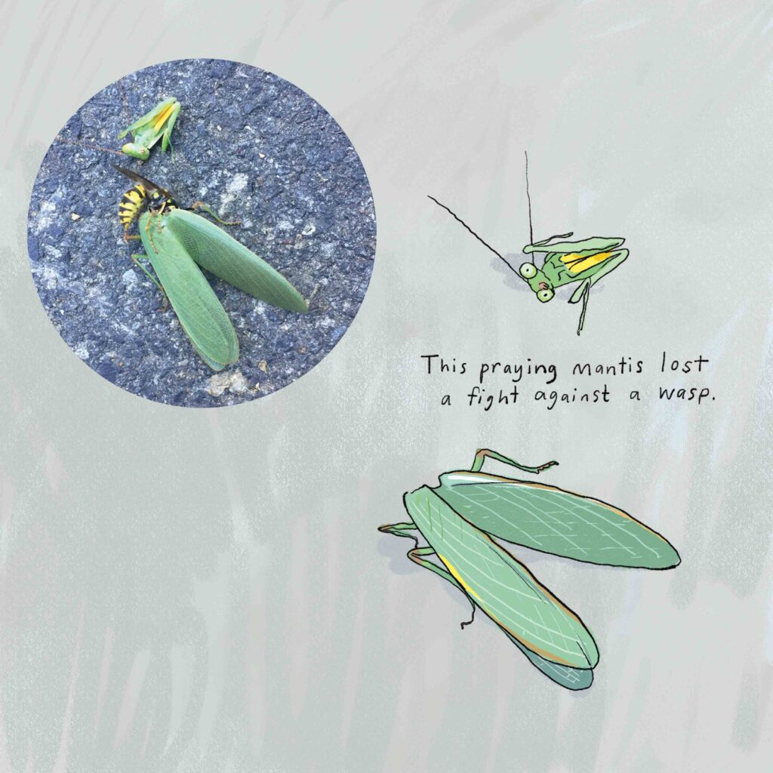
Drawing for observation
© Giselle Clarkson
Notes:
Image: https://geckopress.com/giselle-clarksons-life-as-an-observologist/
https://www.sciencelearn.org.nz/resources/2071-developing-observation-skills-in-younger-students

Slide 13
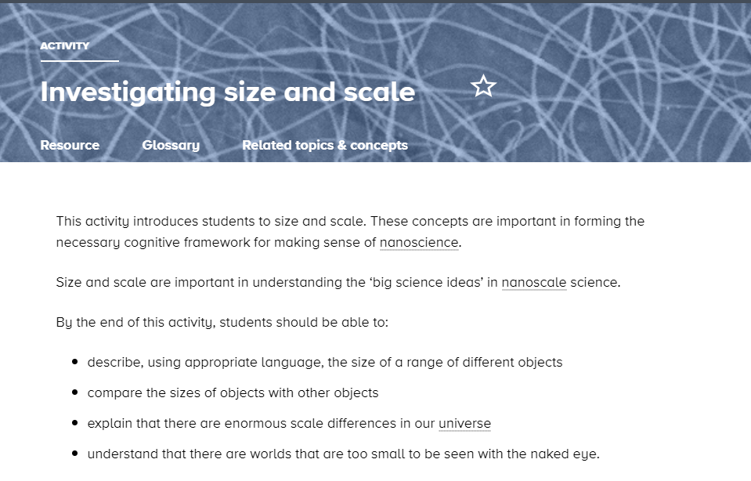
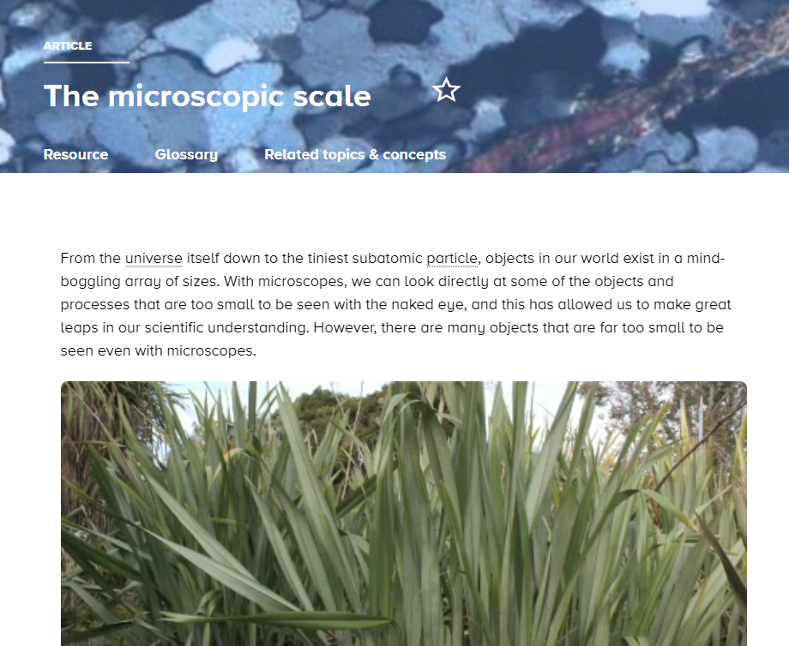
Scale
Notes:
https://www.sciencelearn.org.nz/resources/1681-investigating-size-and-scale
https://www.sciencelearn.org.nz/resources/497-the-microscopic-scale

Slide 14
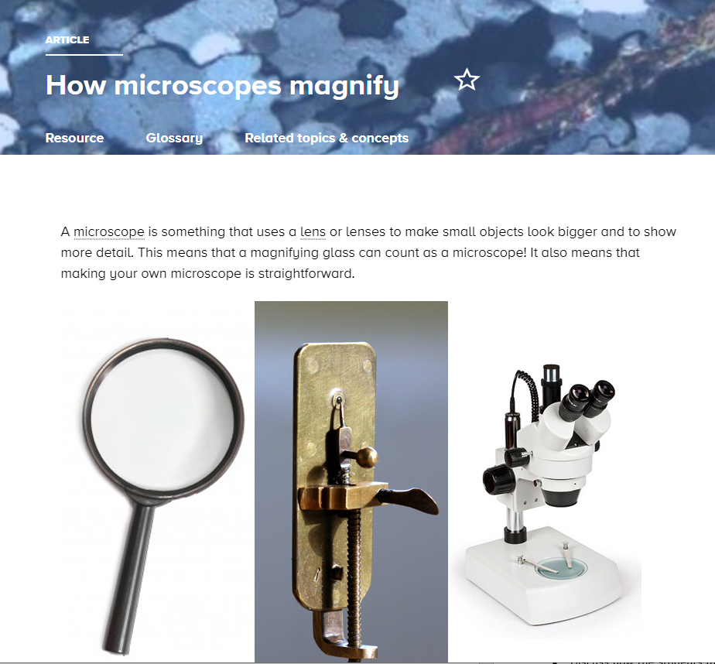
Tools for observation
Magnifying glass Image licensed through 123RF Ltd. Leeuwenhoek’s microscope courtesy of Jeroen Rouwkema/CC BY-SA 3.0. Modern microscope image courtesy of Dolbunov GNU Free Documentation License
Notes:
https://www.sciencelearn.org.nz/resources/496-how-microscopes-magnify

Slide 15
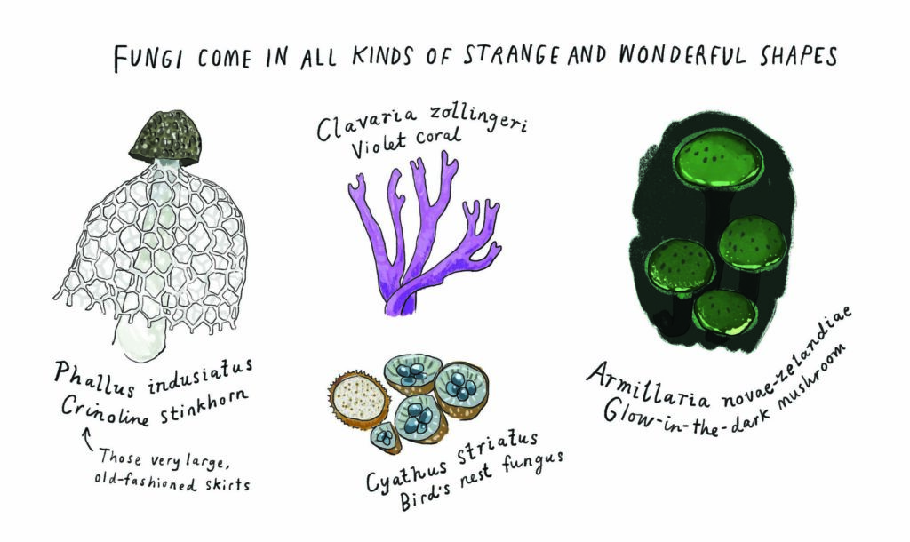
Taxonomy and
scientific names
© Giselle Clarkson
Notes:
https://geckopress.com/the-observologist-qa-with-giselle-clarkson/

Slide 16
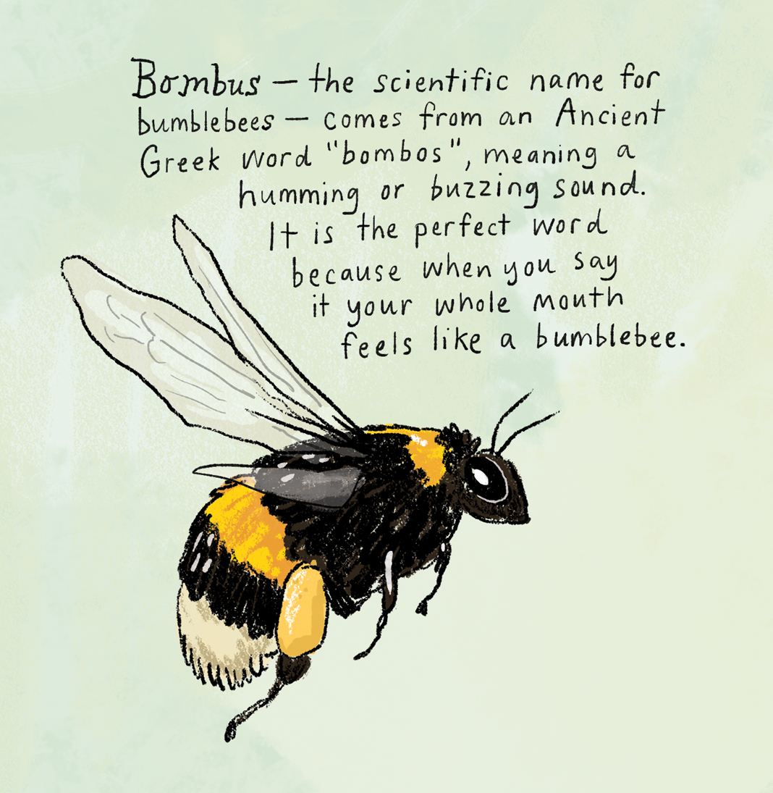
Taxonomy and
scientific names
© Giselle Clarkson
Notes:
https://www.facebook.com/photo/?fbid=846270277502877&set=pcb.846270380836200

Slide 17
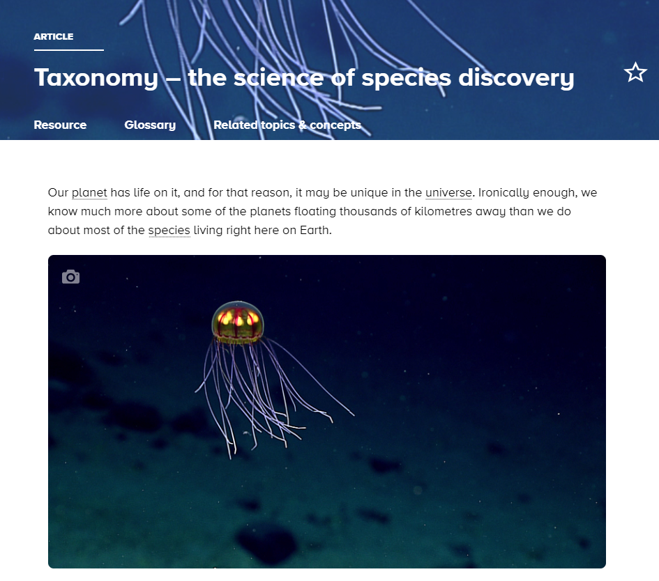
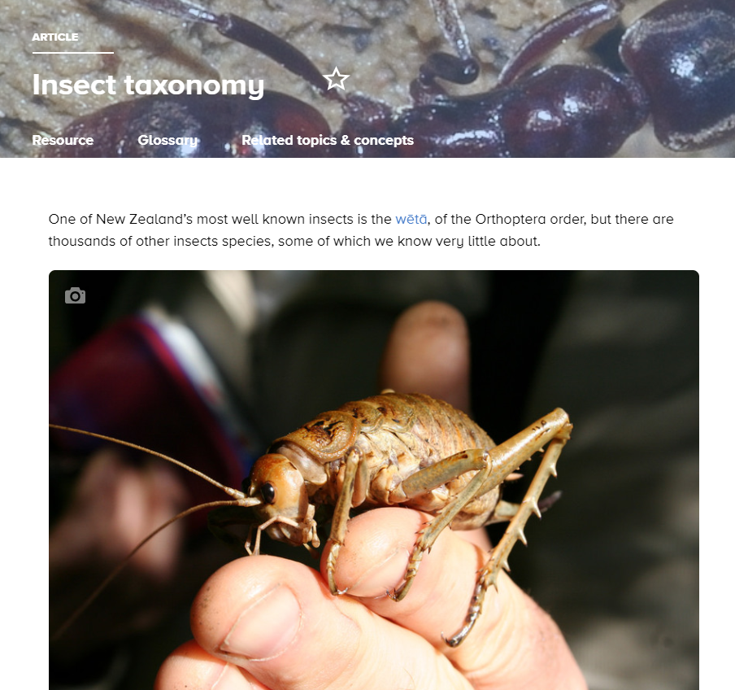
Taxonomy and
scientific names
© Tom Lynch
Private Collection
Notes:
https://www.sciencelearn.org.nz/resources/2829-taxonomy-the-science-of-species-discovery
https://www.sciencelearn.org.nz/resources/2840-insect-taxonomy

Slide 18
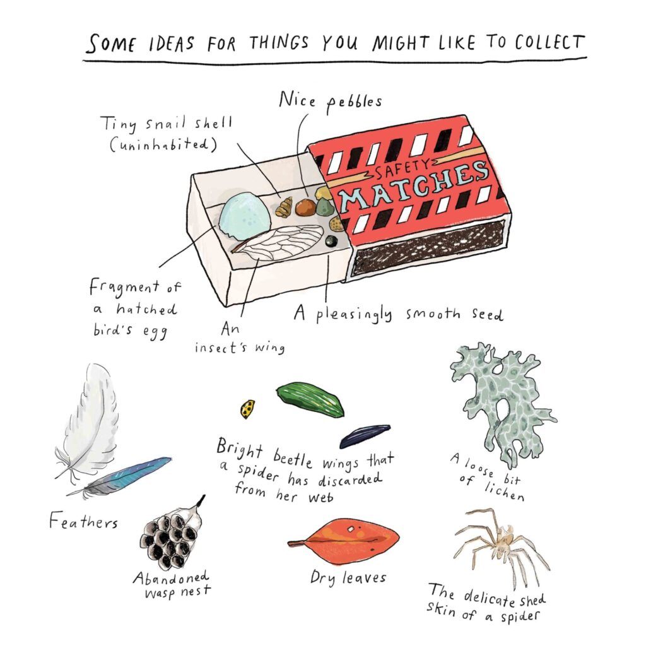
Nature tables and
libraries of experiences
© Giselle Clarkson
Notes:
https://geckopress.com/giselle-clarksons-life-as-an-observologist/
Embrace pellets! Poo files

Slide 19
Connecting and conserving
© Giselle Clarkson
Notes:
Image: https://www.amazon.com/Observologist-Handbook-Mounting-Scientific-Expeditions/dp/1776575199?
https://www.google.com/imgres?q=observologist&imgurl=https%3A%2F%2Fm.media-amazon.com%2Fimages%2FS%2Faplus-media-library-service-media%2F384a233f-735f-4595-a857-dcd618428b6f.__CR0%2C0%2C970%2C300_PT0_SX970_V1___.jpg&imgrefurl=https%3A%2F%2Fwww.amazon.com%2FObservologist-Handbook-Mounting-Scientific-Expeditions%2Fdp%2F1776575199&docid=i3c11J-tkpeymM&tbnid=CYl1dBLRG7N0nM&vet=12ahUKEwiu8r60sqKGAxUE1zgGHUuGBuUQM3oECHEQAA..i&w=970&h=300&hcb=2&itg=1&ved=2ahUKEwiu8r60sqKGAxUE1zgGHUuGBuUQM3oECHEQAA

Slide 20
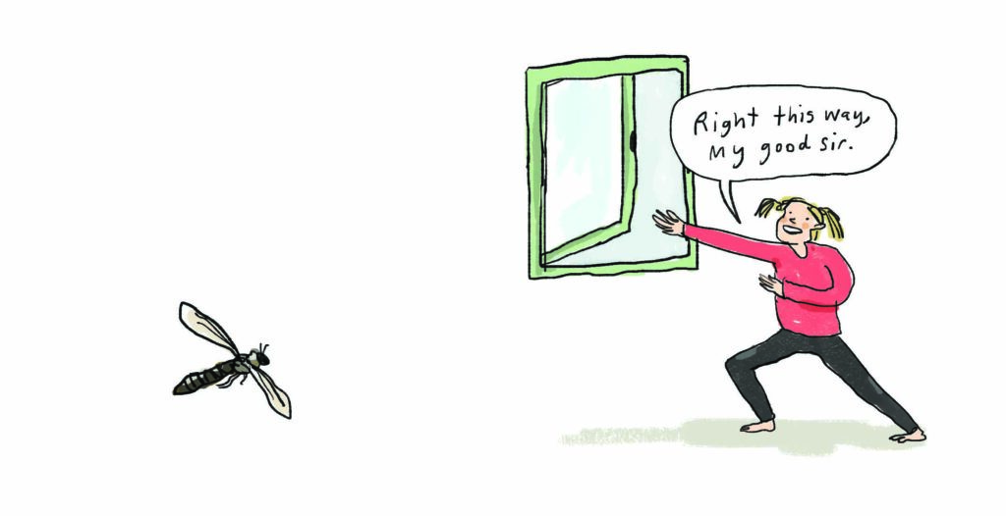
Connecting and conserving
© Giselle Clarkson
Notes:
Image: https://geckopress.com/the-observologist-qa-with-giselle-clarkson/

Slide 21
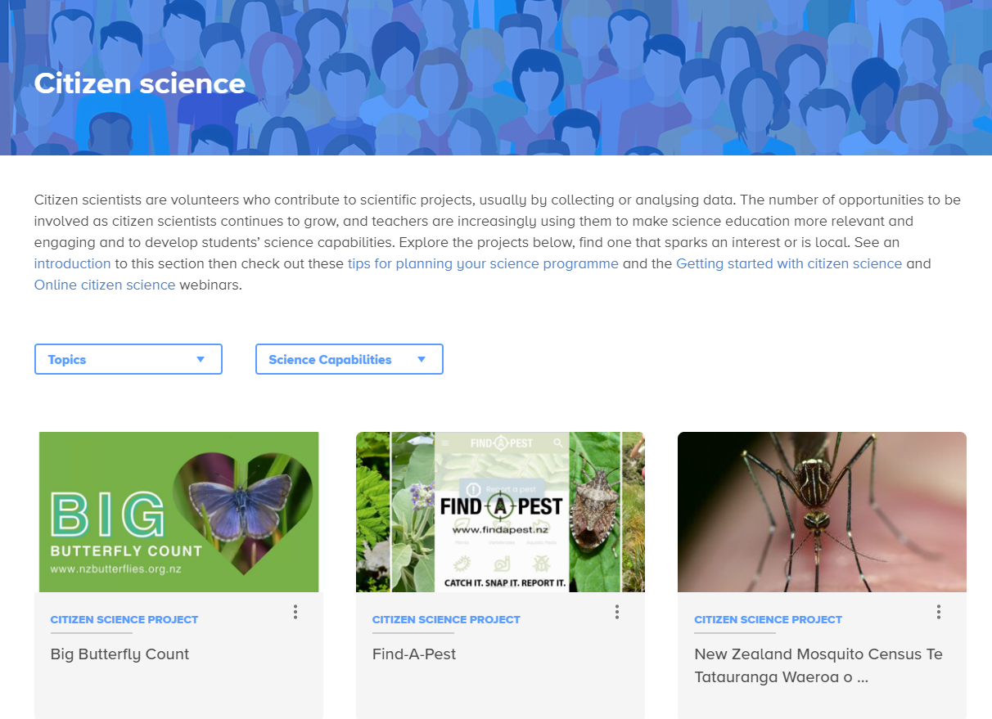
Connecting and conserving
Notes:
Image: https://www.sciencelearn.org.nz/citizen_science

Slide 22
Thanks – want to keep in touch?
Email us on enquiries@sciencelearn.org.nz
https://twitter.com/NZScienceLearn
www.facebook.com/nzsciencelearn
https://nz.pinterest.com/nzsciencelearn
www.instagram.com/sciencelearninghubnz
Notes:
Feedback/more of this?
Certificates

