Slide 1
Hei kaipūtaiao katoa tātou!
Notes:
Learning outcomes for tauira in this activity:
Cultural Identity: Fostering a sense of cultural identity and pride in students' Māori heritage through the exploration of indigenous perspectives on science and the environment.
Whakapapa: Understanding the interconnectedness and relationships within the natural world, including genealogy, ecological systems and environmental sustainability.
Tikanga: Applying tikanga (protocols) and kaitiakitanga (guardianship) principles to science learning, including ethical considerations and responsibilities towards the environment.
Observation and Inquiry: Developing skills in observation, inquiry and investigation through hands-on experiences and culturally relevant contexts.

Slide 2
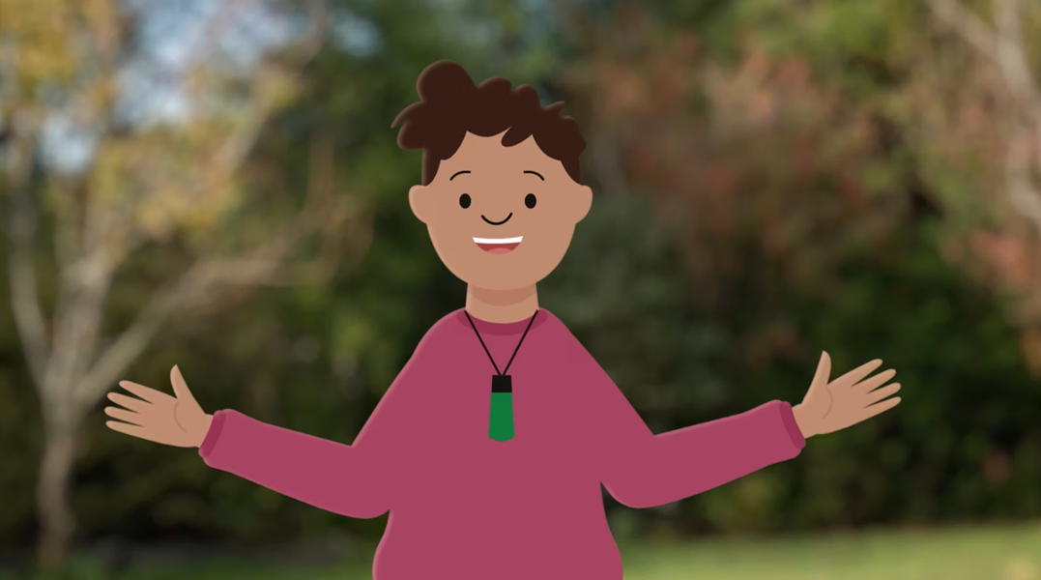
Hei kaipūtaiao katoa tātou!
Ko te kiriata o
Ngā kōrero o nehe a ngā manu kōnei.
© Manaaki Whenua – Landcare Research and The University of Waikato Te Whare Wānanga o Waikato | www.sciencelearn.org.nz
Notes:
Activity notes:
In this video, Te Ariki encourages us to learn more about birds – the descendants of Tāne Mahuta.
Learning outcomes for tauira in this activity:
Cultural Identity: Fostering a sense of cultural identity and pride in students' Māori heritage through the exploration of indigenous perspectives on science and the environment.
Whakapapa: Understanding the interconnectedness and relationships within the natural world, including genealogy, ecological systems and environmental sustainability.
Tikanga: Applying tikanga (protocols) and kaitiakitanga (guardianship) principles to science learning, including ethical considerations and responsibilities towards the environment.
Observation and Inquiry: Developing skills in observation, inquiry and investigation through hands-on experiences and culturally relevant contexts.

Slide 3
Titiro whakamuri, haere whakamua
Titiro whakamuri, haere whakamua. Ngā mahi tika, ngā mahi kāore e tika ana!
Kei te hiahia mōhio mātou he pēhea te āhua o tō mātou taiao i mua tonu tō whānautanga. Ka arataki koe i te rangahautanga mā te kōrero ki tētahi o te whānau, he kaiako, he kanohi nō te iwi e taea ai te whāngai mai ēnei kōrero ki a koe.
Notes:
Activity notes:
Use prompting pātai for tauira to engage in the learning prior to interviewing. Having them brainstorm what it is we need to know can really makes a difference.
What is your connection to the whenua?
What were some of the everyday activities you did with whānau and friends?
What were some of your fun or play activities?
Are there any stories that you remember being told about this rohe?
How different is this landscape to when you were growing up?
Did you notice the wildlife, birdlife much?
Was there anything special about particular birds?
Students could use a pictorial mapping exercise as shown in slide 9 to help understand how their kaumatua saw the space they grew up in.

Slide 4
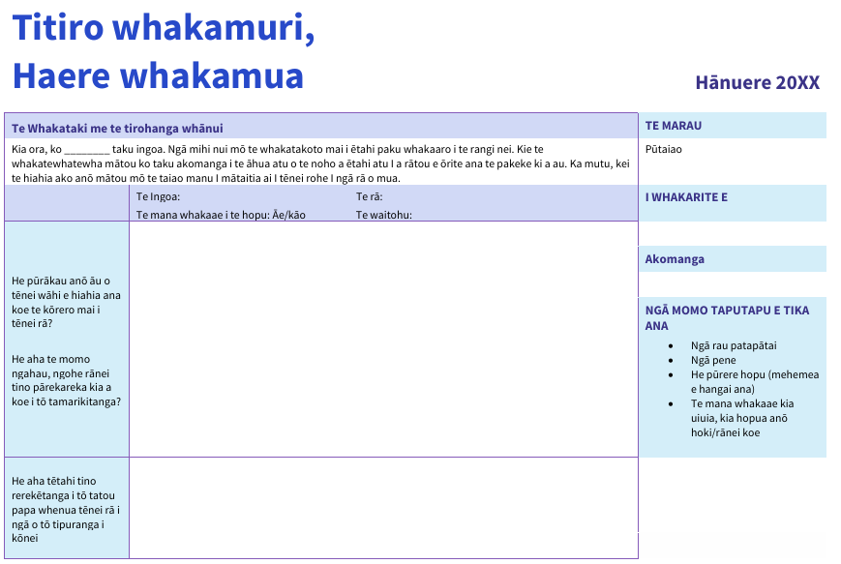
Ko te wā pātai! Whakamahia tēnei tātauira, hangaia rānei tō ake tātauira kia tīmata ai tēnei rangahau!
Tikiake te pātaitai
konei.
Notes:
Activity notes:
This can be done alongside or in place of the Ake ake exercise (slide 9).
The questionnaire can be edited to include pātai that have come from wānanga in class.
Engage whānau whānui by informing them of the kaupapa of this mahi so as to best set up your tamariki for success.
Set up times and spaces for tamariki to conduct interviews in class, teina could be supported by tuakana in group setting, taking turns to ask questions. Use a device to record the kōrero while encouraging tuakana to record interesting kōrero, key words and phrases.

Slide 5
Ngā manu me ō rātou ingoa
Kei te mōhio rānei koe 13 ngā ingoa rerekē o te tūī?
Tirohia te pae o Manaaki Whenua site mō ētahi atu ataata.
Notes:
Activity notes:
The Story of Tūī | Ngā Kōrero O Te Tūī from Manaaki Whenua – Landcare Research acknowledges the different names for manu in different rohe.
The video series The Story of Tūī | Ngā Kōrero O Te Tūī from Manaaki Whenua – Landcare Research explores the origin and significance of some of the different Māori and English names for tūī. The videos are in te reo Māori and English.

Slide 6
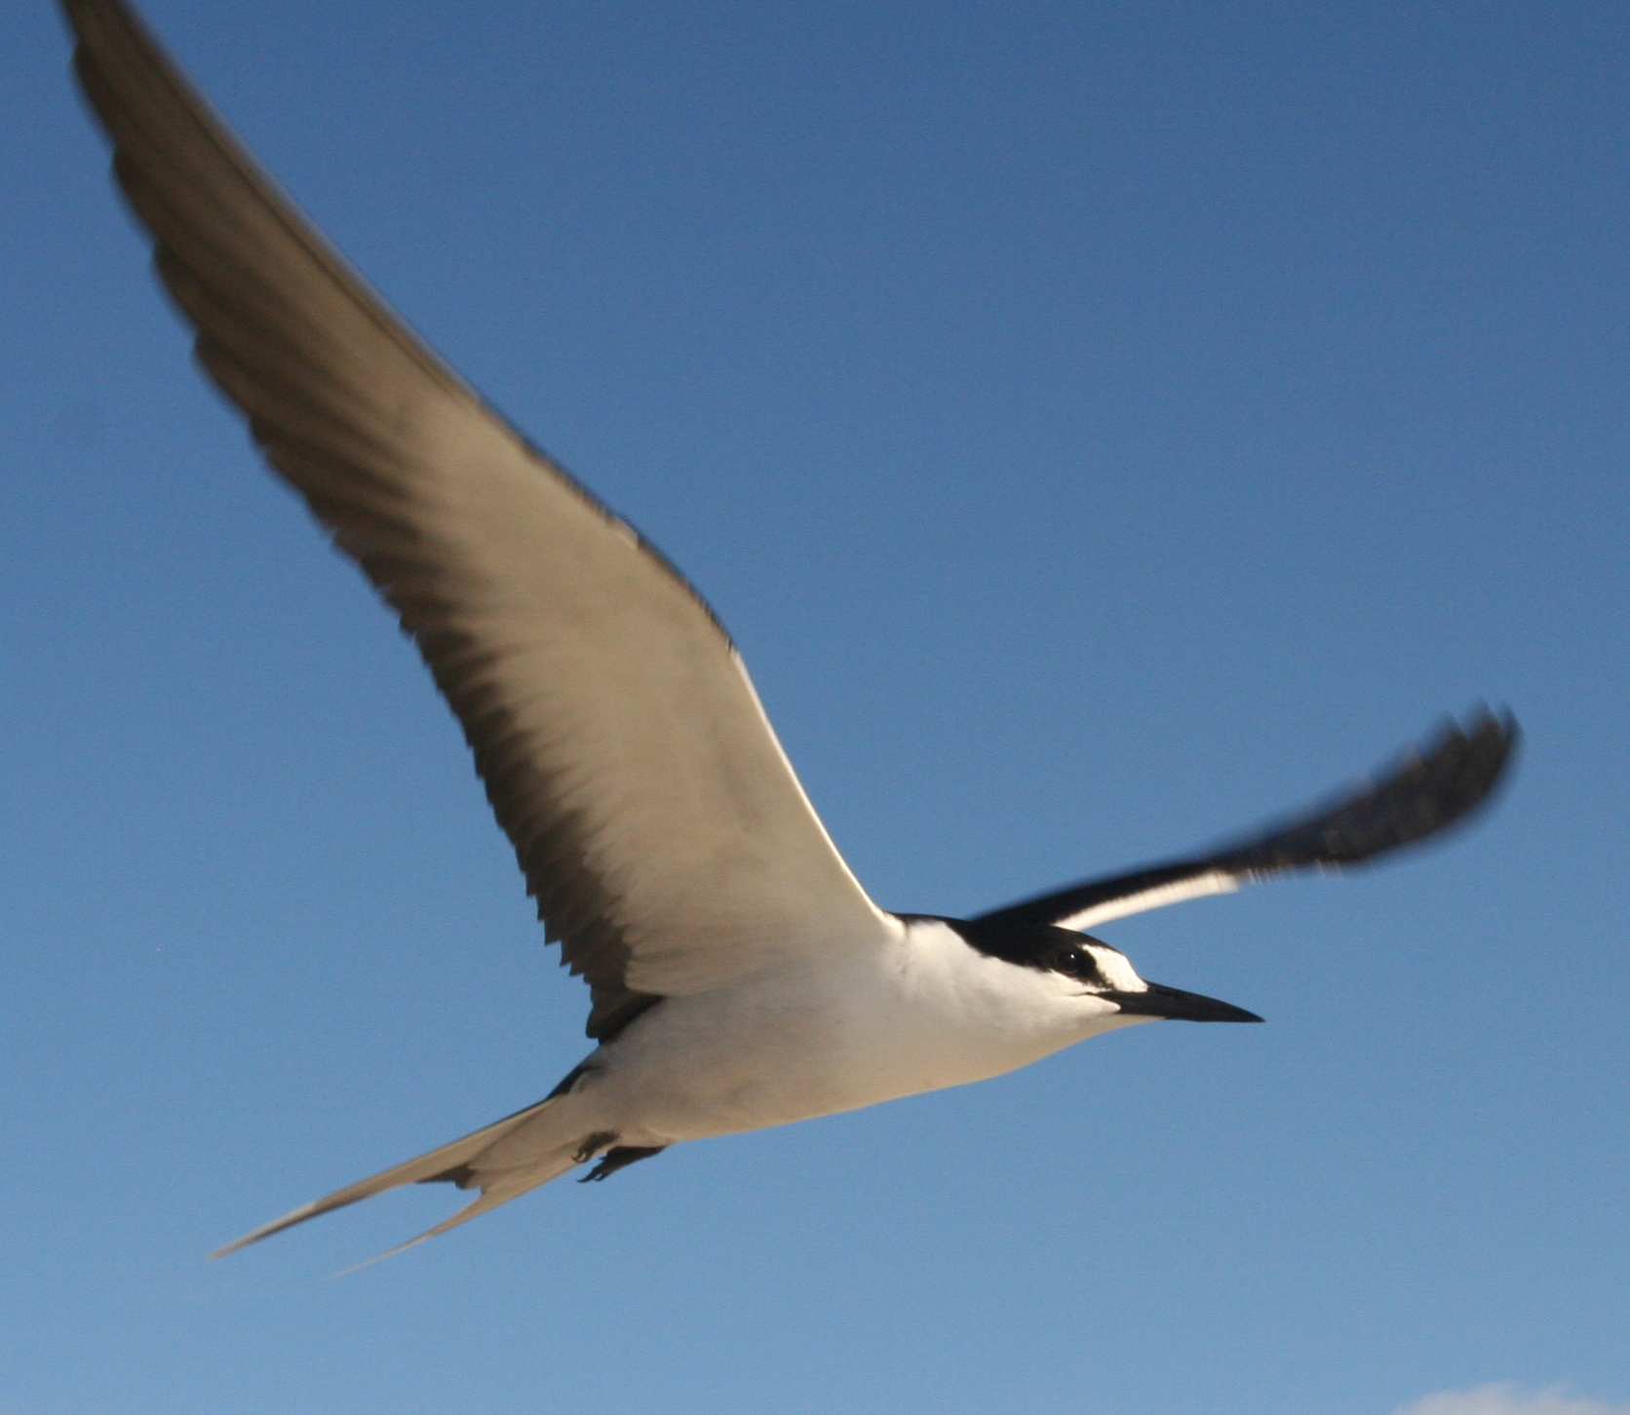
He mīharo te manu rere tai...
He nui whakaharahara ngā pūkenga rere a te manu rere tai, he manu rere tawhiti he rapu kai te mahi
He mōmona te tiko a te manu rere tai i te kaiao he mea whāngai te oneone ki ngā kai reka he pai anō te tipuranga o te tipu.
Ko ngā tūtohu ēnei o te oranga o tō tatou pūnaha rauropi.
He mea whakamatua I te pārurenga me ngā taupori kīrearea.
Notes:
Image source: https://commons.wikimedia.org/wiki/File:Sterna_fuscata_flight.JPG (Public domain)

Slide 7
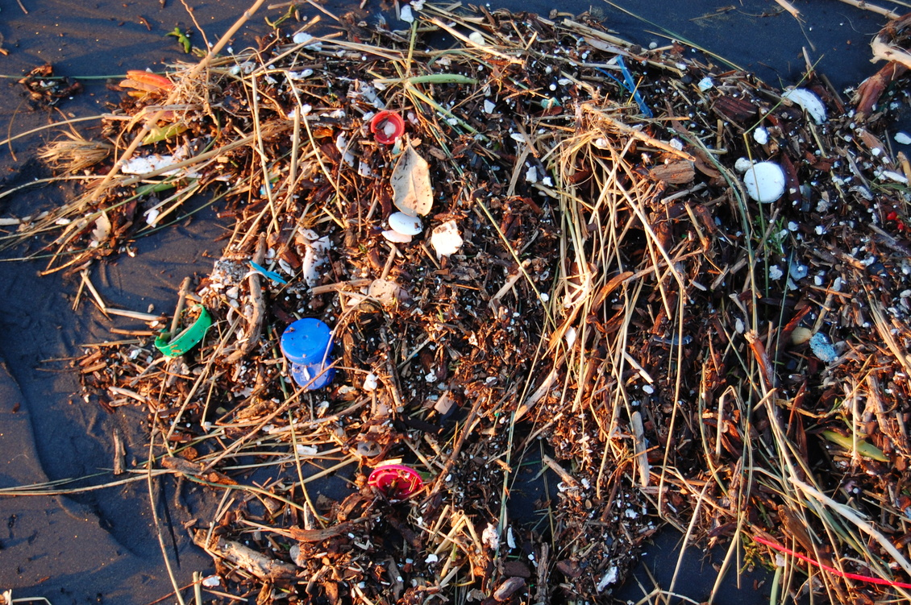
… engari kua mate haere ō tatou manu rere tai i te parahanga.
Kei te parakino haere te tangata I ngā moana mā te āhei ki te whiunga o ngā momo parahanga katoa, ka mutu, ko tōna otinga atu ko te moana!
© Kevin Krejci, CC BY 2.0

Slide 8
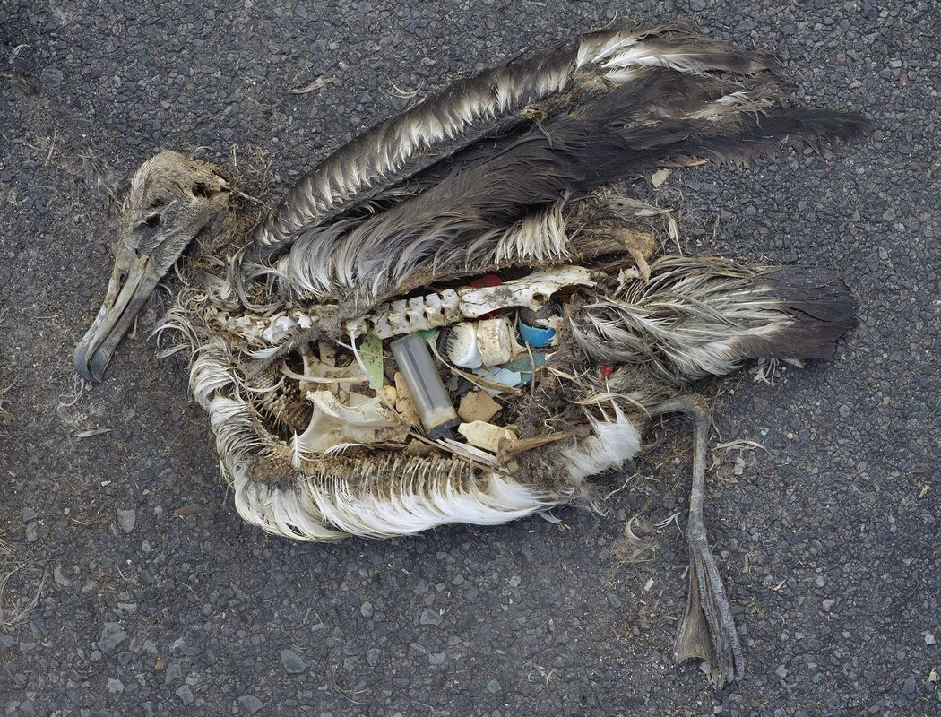
Ka aroha hoki te āhua o tēnei manu! Kua hia te nui o te parahanga kua kainga e ia i tana rapunga kai.
Photo by Chris Jordan for U.S. Fish and Wildlife Service Headquarters, CC BY 2.0
Notes:
Activity note:
Print this slide for use in the activity on slide 8.

Slide 9
Ko te wā whakamātautau!
Āta tirohia ngā ihirangi kei mua i a koe.
Hangaia ngā tapanga ka whakarārangitia ngā ihirangi ki ōna kāwai.
© Te Kura o Manunui, and Manaaki Whenua – Landcare Research
Notes:
Activity notes:
This activity has children closely examine items found grouped together at one location and then decide what is natural and what is man-made waste.
You will need an assortment of items, here are a few suggestions but let your imagination go!
Balloon remnants
Straws
Bottle tops
Pieces of smooth glass
Plastics – micro (fine bits of cut up ice cream containers) and macro (plastic spoon/fork)
Sand
Shells
Feathers
String
Fishing line
Sinkers
All of these placed in a bag ready to be emptied for examination.
As an alternative, you could collect random items 'found' in the playground. The idea being that birds are consuming man-made rubbish everywhere!
Also provide:
Shallow dish or flat board and a cloth underneath (for easy clean up)
Tweezers
Magnifying glasses
Sticky notes for sorting
Printed copies of the albatross on slide 7
Instructions for tamariki:
Carefully empty contents onto the tray or shallow dish.
Closely examine the contents and begin sorting them into categories.
Use the sticky notes to create labels.
Use the tweezers to pick up the contents to examine them more closely.
Prompting questions:
What details do you notice on closer examination of the items?
Why did the bird eat this? Was it intentional or by accident?
How do you think the rubbish has ended up in the ocean?
Who or what is impacting the pollution of our oceans?
How can we improve the situation?

Slide 10
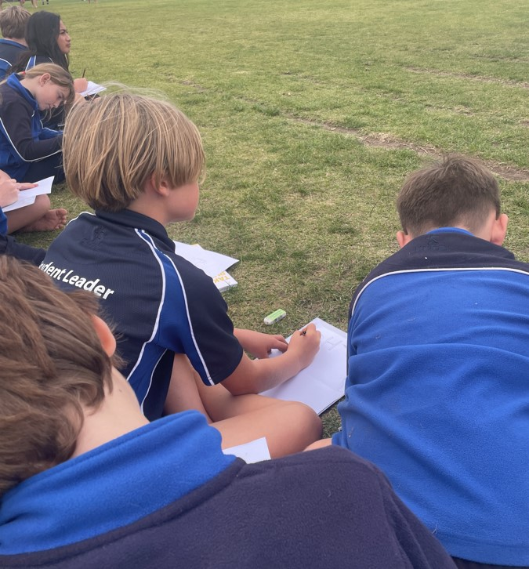
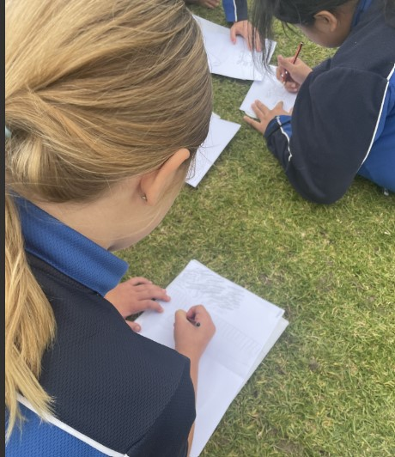
Ake…ake
Kimi tūnga i waho kia pai ai tō tirotiro haere i te whenua.
Kaua e tere rawa, kia āta haere kia tino Mārama ki a koe tāu i kite ai! Whai kia tau tō noho, kia mārire hoki koe kei pātata mai ngā manu ki a koe!
Me waituhi koe i tau i kite ai, āhua pārekareka rānei ki a koe.
© Arataki School and
University of Waikato Te Whare Wānanga o Waikato l www.sciencelearn.org.nz
Notes:
Activity notes:
This activity uses the Ake Ake – forever and ever model to explore changes in the local environment. You will need to provide photographs or picture maps showing how the local area you are using for this exercise – school, beach, park or marae – looked in the past.
Prompt thinking by asking children to closely examine the photographs or picture maps of the past.
What do you notice?
Do you recognise the area?
What can you say about how the area looks now?
Why do you think that has happened?
Do you think the wildlife, plant life is thriving? Why not?
What do we see now?
Choose an area in the school where the students could work mostly undisturbed.
Focus them on the view they have in front of them – they may go broad or they may want to focus in a particular area. Leave this up to them. The idea is for them to sketch from their perspective.
Set a time to have this completed in.
Use these prompting questions when you return to the classroom.
How would you see the area looking in the future?
What should we have in the space to make it better for everyone and everything?
How can we ensure the preservation of this space?
What action do you need to take to see this happen?
Come back together to explain what they have illustrated and why.

Slide 11
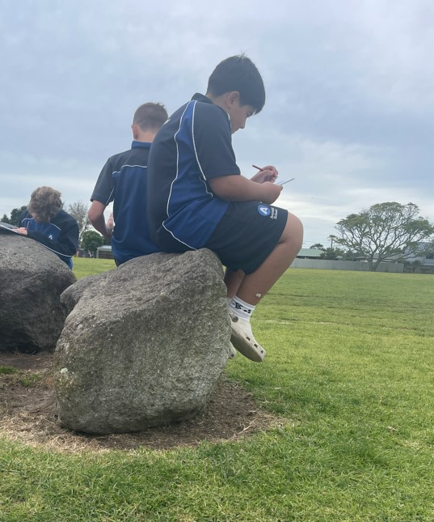
Ake…ake
Me waituhi koe i ngā whakaaro e aro ana ki tō wāhi o tua ake nei!
© Arataki School and
University of Waikato Te Whare Wānanga o Waikato l www.sciencelearn.org.nz

Slide 12
Ko te pakanga a ngā manu
© Te Papa
Anei te kiriata nō Te Papa Tongarewa Paki Taonga i a Māui: Ko te Pakanga a ngā Manu |Battle of the Birds
Notes:
Activity notes:
He Paki Taonga i a Māui: Ko te Pakanga a ngā Manu | Battle of the Birds – a video from Museum of New Zealand Te Papa Tongarewa – retells the battle between seabirds and landbirds for tasty kai.
There is so much in this video to observe and discuss!

Slide 13
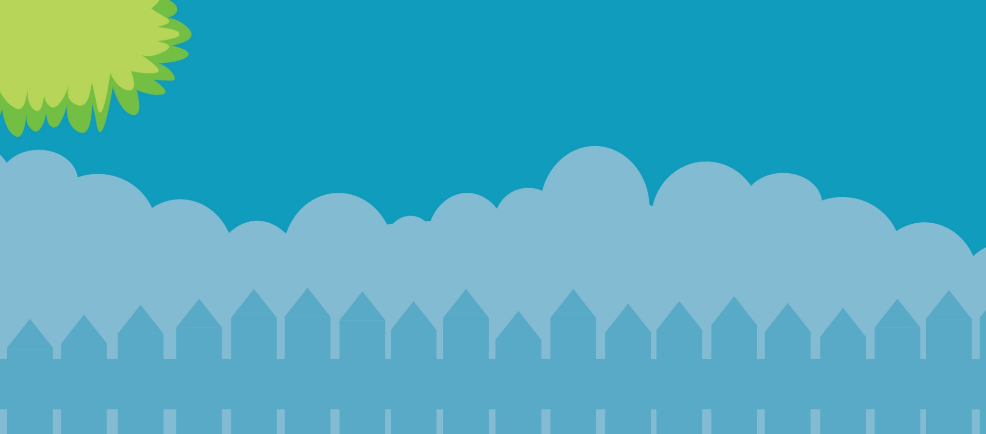
Āwhina mai kia whaihua a ngā manu
29 Hune ki te 7 Hūrae 2024
gardenbirdsurvey.nz

