Slide 1
He aha tāu i kite ai?
Te tautohu manu
Notes:
Learning outcomes for tauira in this activity:
Cultural Identity: Fostering a sense of cultural identity and pride in students' Māori heritage through the exploration of indigenous perspectives on science and the environment.
Whakapapa: Understanding the interconnectedness and relationships within the natural world, including genealogy, ecological systems and environmental sustainability.
Tikanga: Applying tikanga (protocols) and kaitiakitanga (guardianship) principles to science learning, including ethical considerations and responsibilities towards the environment.
Observation and Inquiry: Developing skills in observation, inquiry and investigation through hands-on experiences and culturally relevant contexts.

Slide 2
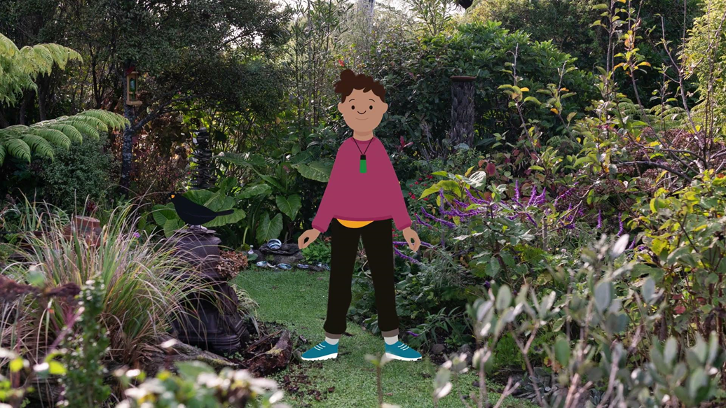
He aha tāu i kite ai? Te tautohu manu
Anei te kiriata
Tautohunga manu kōnei.
© Manaaki Whenua – Landcare Research and The University of Waikato Te Whare Wānanga o Waikato | www.sciencelearn.org.nz
Notes:
Activity note:
In this video, Te Ariki asks if we know the different bird sounds in our garden.

Slide 3
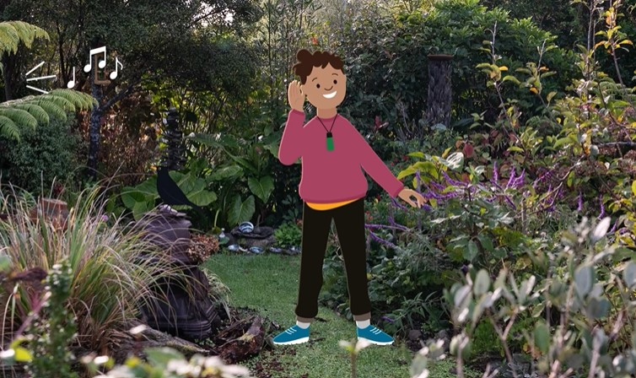
Ākonga ngā korihi me ngā tangi a ngā manu
Ka korihi mai te manu, kei te whāki atu ia kei hea ia, me tōna momo.
I te tuatahi ki te whakarongo koe ki ngā tini momo korihi rerekē a ngā manu, ka hēmanawa pea koe.
Me āta whakaronga noa iho koe ki tētahi manu i ia wā! Me whakamātau i ētahi momo ara rerekē.
© University of Waikato l www.sciencelearn.org.nz and Manaaki Whenua – Landcare Research
Notes:
Activity notes:
There are many different approaches in order to learn birds calls and songs.
Start with just a few – the ones provided in this slideshow and bird sounds of those that are seen the most times in your kura.
Use the Department of Conservation's Bird songs and calls to find more bird calls for your students, and yourselves to learn from.

Slide 4
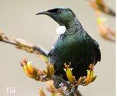
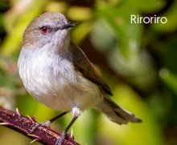
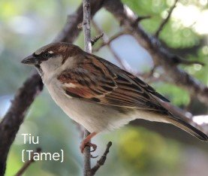
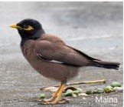
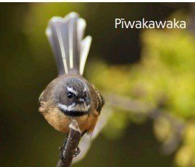
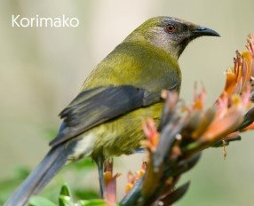
Kei te rongo koe i tāku i rongoa ai ?
Titiro ki ēnei whakaahua tētahi i ia wā me te whakarongo ki ō rātou momo tangi.
Ki te whakamahi koe i ō karu hei āwhina i tō taringa, mā te hononga e āwhina kia tuhia ki tō rae!
© Manaaki Whenua – Landcare Research
Notes:
Activity notes:
Have children find themselves a comfortable space and really focus in on the bird calls they are about to hear.
Closing their eyes is helpful.
You might have audio equipment and headphones, which can be used in small groups.
Have them focus in on the sound – do they hear a repeated pattern?
Use the Department of Conservation's Bird songs and calls for more bird sounds – as children explore and want to learn more.
The images on this slide (including many others) are from Manaaki Whenua – Landcare Research's He aratohu mana māra poster.

Slide 5
Kei te kite koe i tāku i kite ai ?
Notes:
Activity notes:
Print out copies of this poster in reo Māori or this poster in English for tamariki to have a closer look. ​(Alternatively load the PDF to devices for closer viewing.)
Supply magnifying glasses if you are able.
Spend some time really studying the poster of these manu with your tamariki. ​
Use prompting pātai from the poster to have tamariki focus on specific markings on feathers, beak and body shapes, legs and feet.

Slide 6
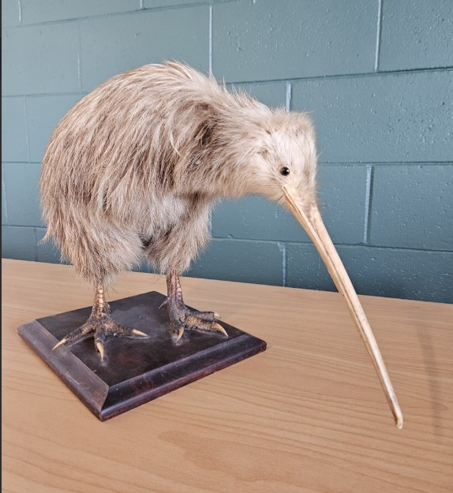
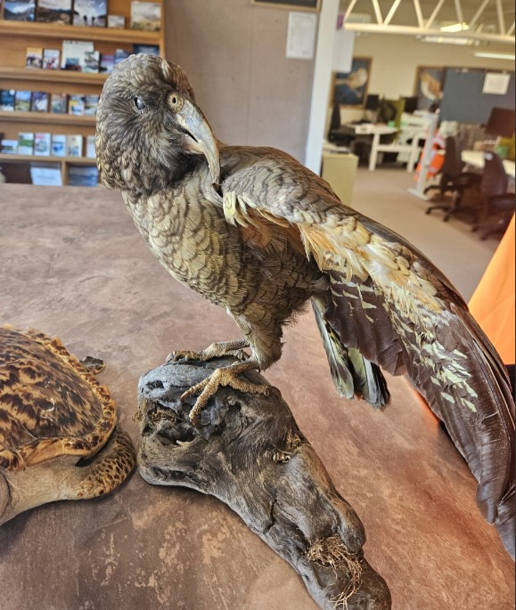
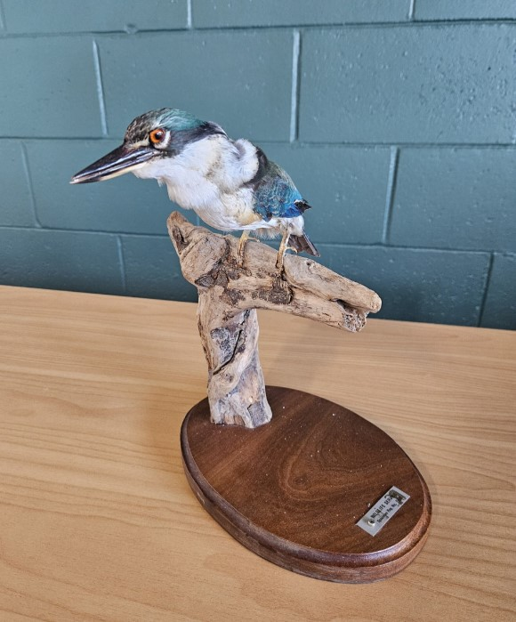
Kei te kite koe i tāku i kite ai ?
Me uaua te pātata atu ki te manu, kia āta tirohia ai. Anei ētahi whakaahua o ngā momo manu rerekē, kei te mōhio he aha ēnei?
© Manaaki Whenua – Landcare Research
Notes:
Activity notes:
Using the posters and/or photographs, have the students focus on key features of the manu.
If possible have some feathers available for children to be able to touch and hold.
Taxidermy birds that can be used for further observation and exploration may be available from a local Department of Conservation office.
Educational disclosure: If you choose to use taxidermy animals for this activity, be mindful to have a discussion beforehand about the use of these animals for scientific purposes. A full explanation of how these animals died and how they came to be used in this manner can be sought from the Department of Conservation and given to students. Showing respect for these animals that were once living needs to be appreciated by everyone participating.

Slide 7
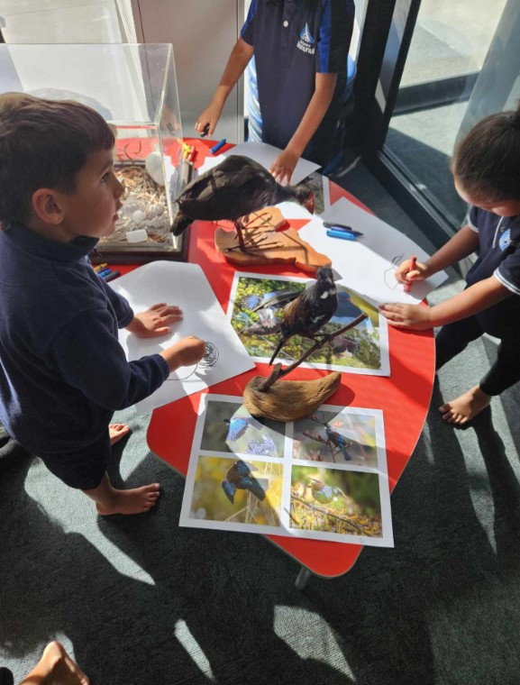
Kei te kite koe i tāku i kite ai ?
​
Kia āta tirohia te hanga o tō rātou ngutu, me te tae, te hanga o ō rātou tinana me ngā āhuahira – he aha tāu e kite atu ai?
© Te Kura o Manunui
and Manaaki Whenua – Landcare Research

Slide 8
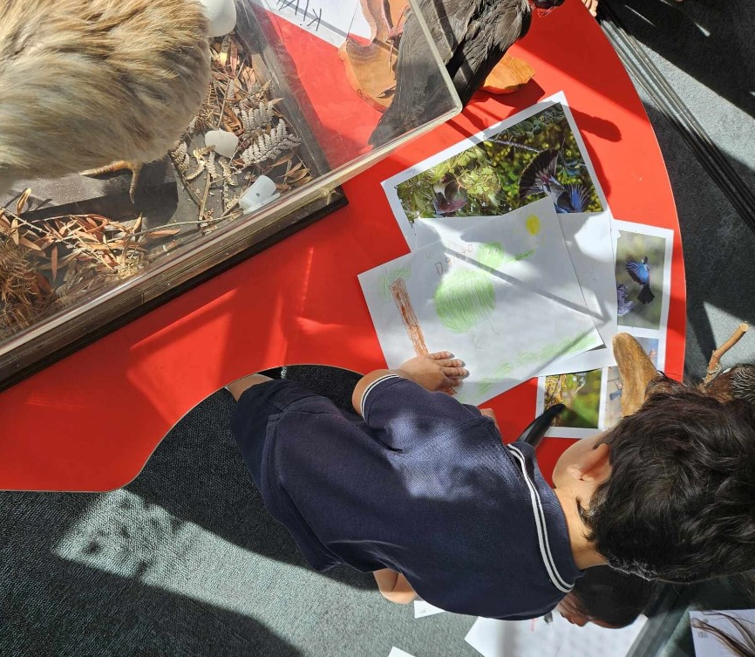
Kei te kite koe i tāku i kite ai?
Me whakamatau te waituhi i te manu me te whakauru mai i ō rātou āhuahira motuhake e kite ana koe!
© Te Kura o Manunui and Manaaki Whenua – Landcare Research

Slide 9
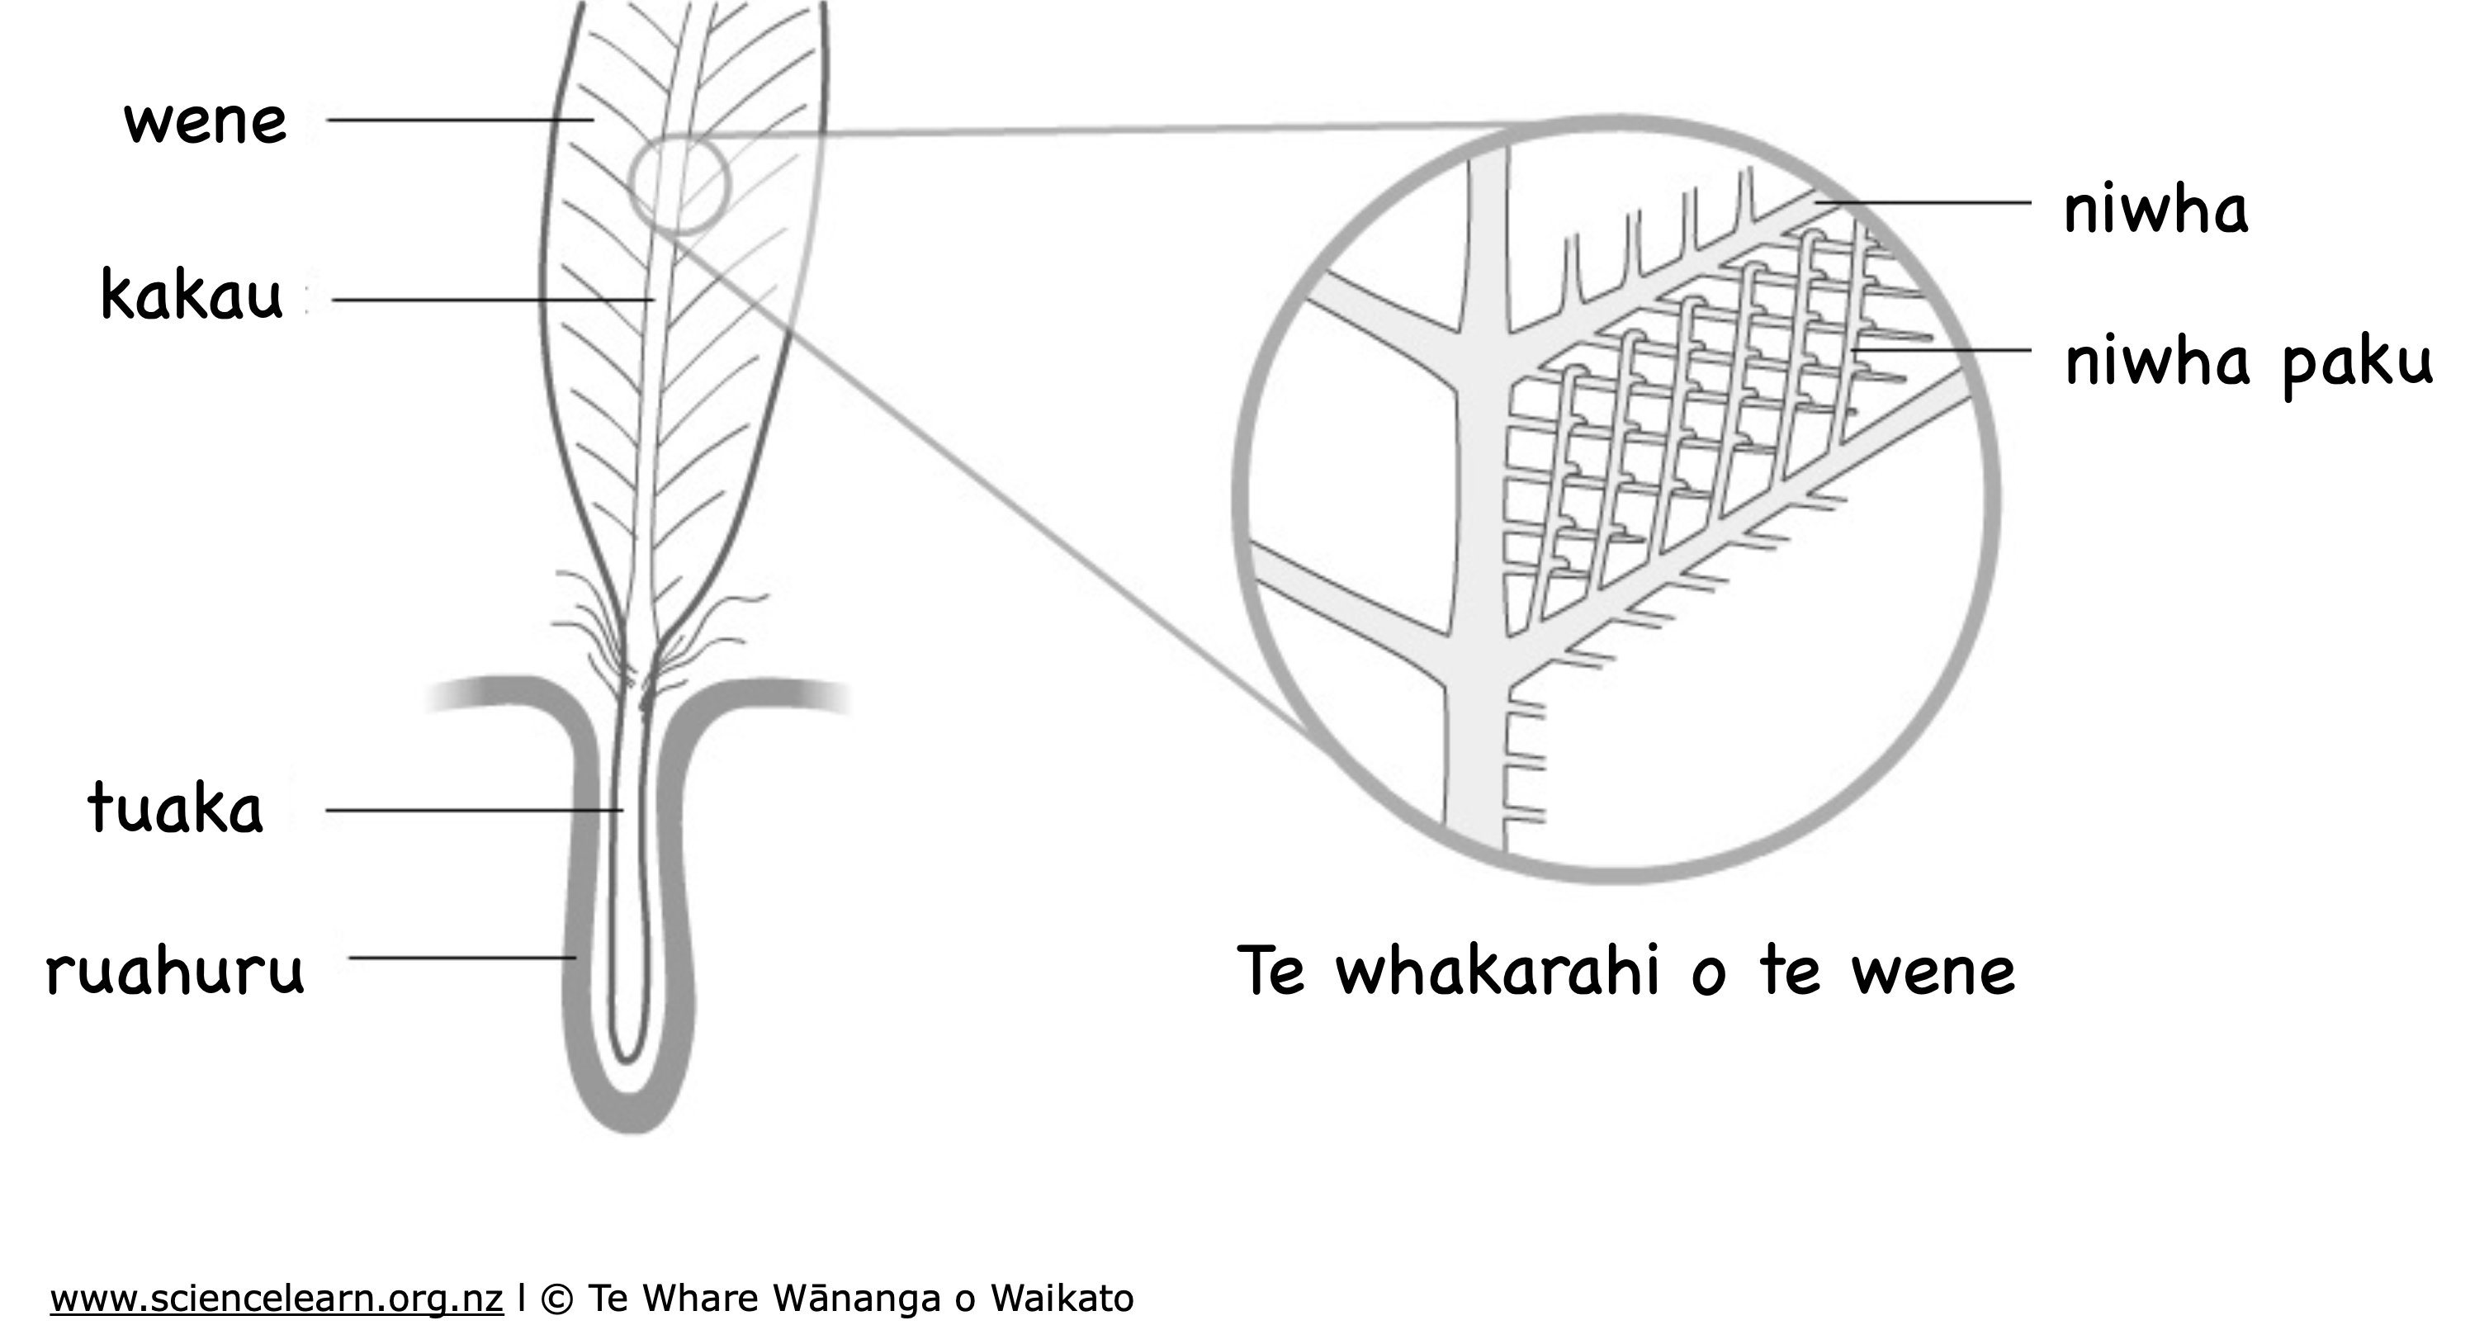
Te whakarahi a ngā huruhuru
E ahu mai ana ngā rau i te papanga taikaha me te hangore, e kiia nei ko te keratini.
Ko te tuarā kei waenganui, e kiia nei ko te kakau, he hahao.
Kei ngā haurua e rua o te rau, ngā wene. He mea hanga mai ēnei i te tini mano peka, e kiia ana ko ngā niwha.
Nā te mea he tini hoki ngā arearenga i waenga i ēnei niwha, he ōrite te hau o te rau ki te matū, te korakora.
Notes:
Activity notes:
Encourage an awareness of birds and their special abilities for flight.
This image is from the article Feathers and flight, which has lots more information about the design and function of feathers.

Slide 10
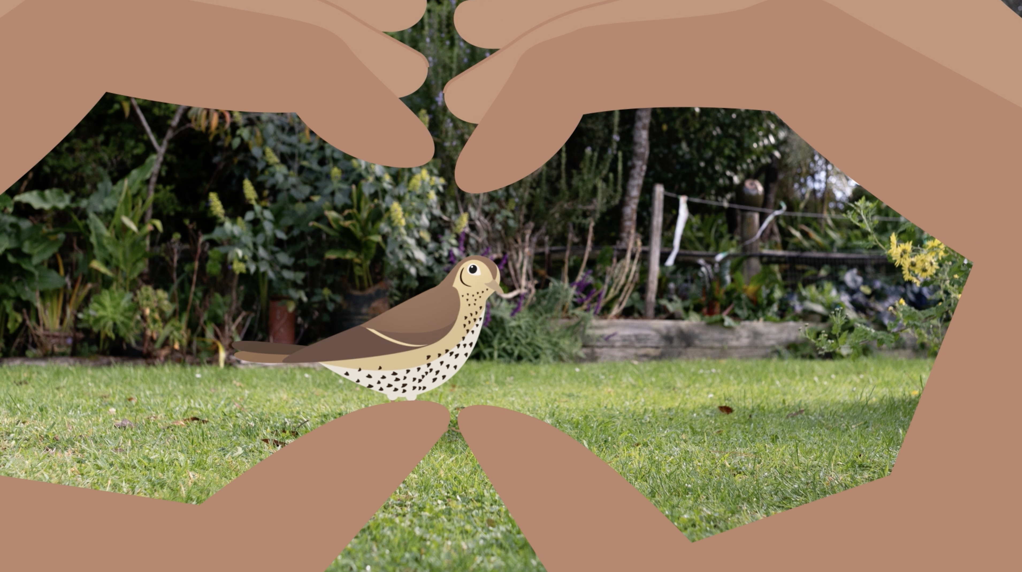
Ōu ake mātaitanga​
He nui te akoranga mai i te mātairanga me te āta tirotiro ki ngā ā tea me ngā wāhi karapoi ana i a tātou. ​
Mā te mātairanga e mārama ai ngā kaipūtaiao he pēhea te mahi i ngā momo hanga. Mā te āta mātaitai, e tūhura rātou i ngā kōrero hou mō ngā kararehe, ngā tipu, ngā toka, tae atu anō hoki ki ngā whetū i te rangi​.
© University of Waikato l www.sciencelearn.org.nz and Manaaki Whenua – Landcare Research
Notes:
Activity notes:
The activity Te mātaitanga o taku taiao encourages tamariki to actively use all five senses to make observations in an outdoor school setting.

Slide 11
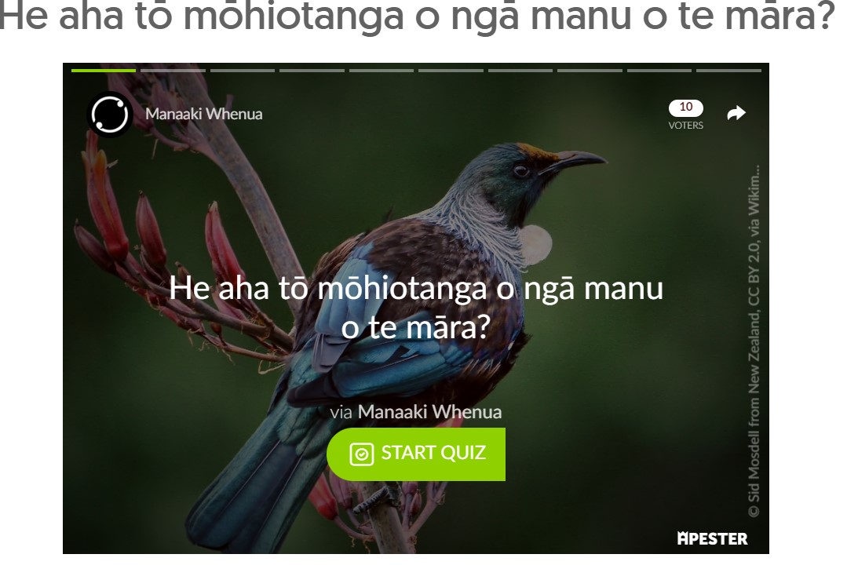
He aha tō mōhiotanga o ngā manu?
Pāwhiria kōnei mō ngā pātaitai reo Māori, ā reo Pākehā ranei.
Notes:
Activity notes:
The quizzes from The Garden Bird Survey website feature images and questions with multi-choice answers.
The quizzes are self-marking with red and green responses.
He aha ēnei manu? – features quizzes in te reo Māori.
These quizzes are in English.

Slide 12
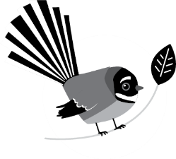
Āwhinatia kia whaihua ā tātou manu
29 Hune – 7 Hūrae 2024
gardenbirdsurvey.nz

