Slide 1
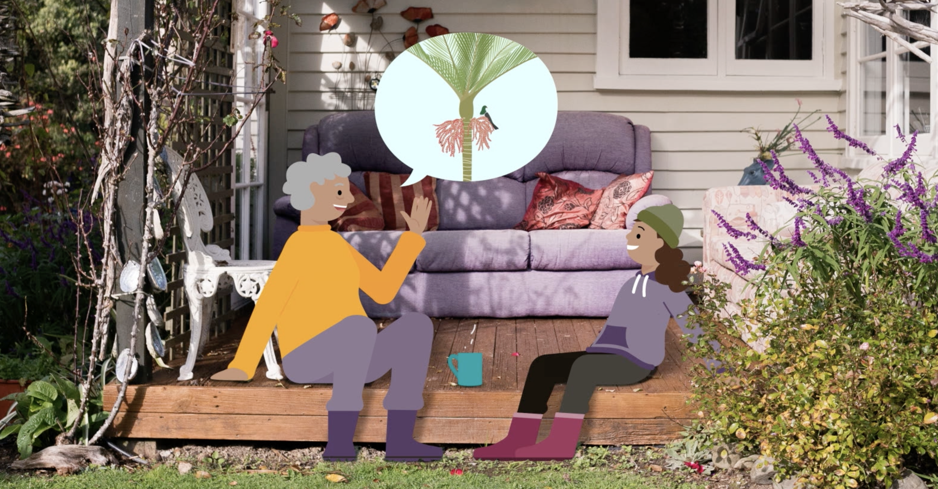
Āwhinatia ōu tātou manu
Notes:
Activity note:
In this video, Te Ariki lays down a challenge to learn from our tūpuna and become kaitiaki of our local environment!
Learning outcomes for tauira in this activity:
Cultural Identity: Fostering a sense of cultural identity and pride in students' Māori heritage through the exploration of indigenous perspectives on science and the environment.
Whakapapa: Understanding the interconnectedness and relationships within the natural world, including genealogy, ecological systems and environmental sustainability.
Tikanga: Applying tikanga (protocols) and kaitiakitanga (guardianship) principles to science learning, including ethical considerations and responsibilities towards the environment.
Observation and Inquiry: Developing skills in observation, inquiry and investigation through hands-on experiences and culturally relevant contexts.

Slide 2
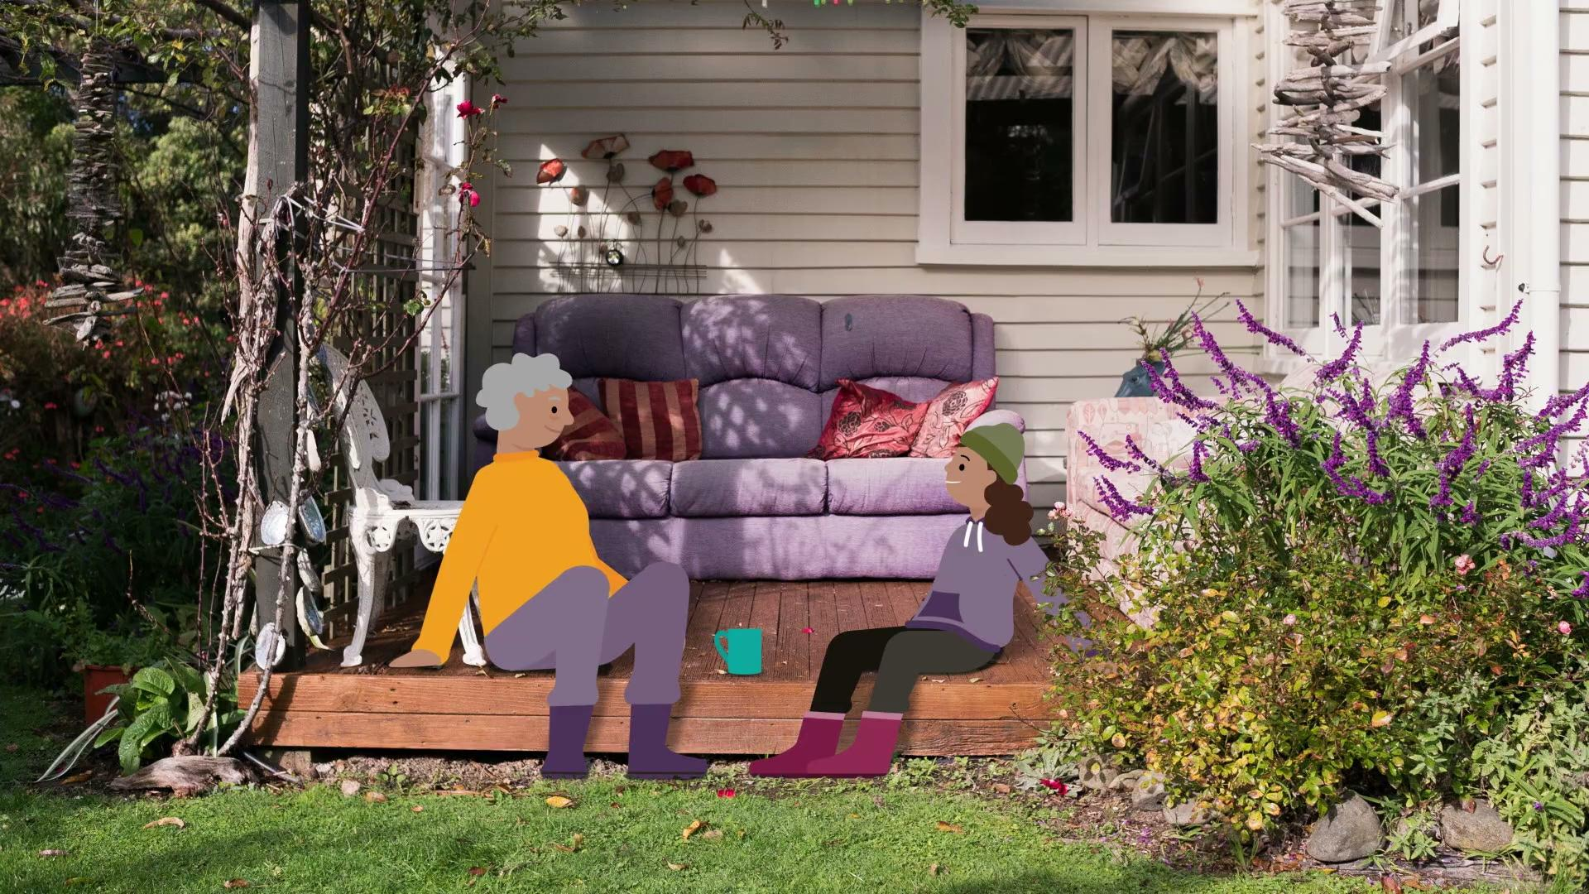
Āwhinatia ōu tātou manu
Anei te kiriata
Kahawhiri me te tohe tū a ngā manu kōnei.
© Manaaki Whenua – Landcare Research and The University of Waikato Te Whare Wānanga o Waikato | www.sciencelearn.org.nz
Notes:
Activity note:
In this video, Te Ariki lays down a challenge to learn from our tūpuna and become kaitiaki of our local environment!
In this video, https://www.sciencelearn.org.nz/videos/2214-manu-agency-and-action Te Ariki lays down a challenge to learn from our tūpuna and become kaitiaki of our local environment!
Learning outcomes for tauira in this activity:
Cultural Identity: Fostering a sense of cultural identity and pride in students' Māori heritage through the exploration of indigenous perspectives on science and the environment.
Whakapapa: Understanding the interconnectedness and relationships within the natural world, including genealogy, ecological systems and environmental sustainability.
Tikanga: Applying tikanga (protocols) and kaitiakitanga (guardianship) principles to science learning, including ethical considerations and responsibilities towards the environment.
Observation and Inquiry: Developing skills in observation, inquiry and investigation through hands-on experiences and culturally relevant contexts.

Slide 3
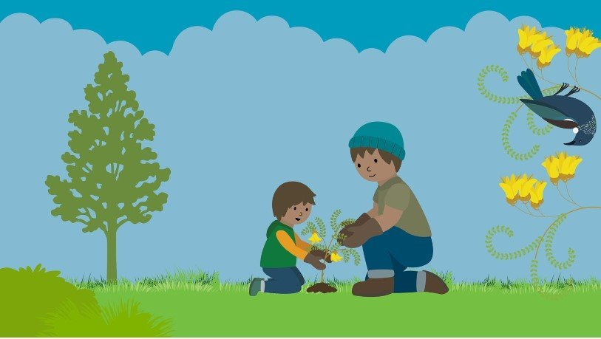
He aha e taea ai e tātou?
He pārekareka ki ngā manu Māori te kai mai i ngā tipu Māori.
Me whakapai i tō māra kia pārekareka anō ki ngā manu, me whai i ngā momo tipu e whakatipu i te kai huri noa i te tau.
He pai ki ngā momo manu rerekē ko ngā momo kai rerekē, nō reira whakaarohia ngā momo huarākau, te ururua, me te waihonga.
Ka taea te tāpiri mai te makomako, te karamū me te korokio mō te huarākau; te kōwhai, te harakeke, me te tarata mō te waihonga.
© Manaaki Whenua – Landcare Research
Notes:
Activity notes:
The New Zealand Garden Bird Survey website's Create a bird-friendly haven in your garden, school, or local park contains all the information you might need to start this initiative with your class.
This could also open opportunities to work alongside local conservation efforts and government offices like the Department of Conservation.

Slide 4
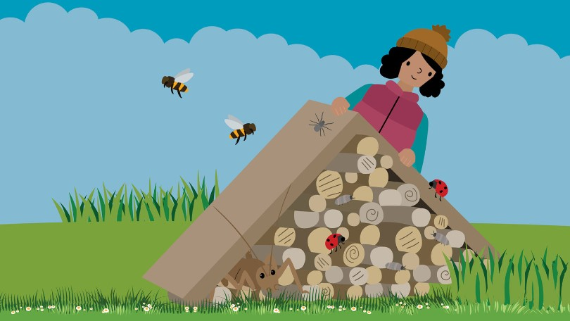
Hangaia te hōtēra ngārara
Whakamarutia me te hanga nōhonga.
Mā te hanga hōtēra ngārara e tō mai ai i ngā momo kīrehe katoa ki roto ki tō māra, ka noho hoki hei puna kai rawe hoki mō ngā manu torotoro.
Kāore he ture – he pereki tawhito, he rārā, he inanga, he maramara rākau, he okuoku pakaru, te rimurimu, ngā rākau, te whakamākūkū – he rārangi mutunga kore tonu.
Whakamahia ō pohewataga ki te hanga i ngā ‘rūma’rerek`e hei whakanoho i tēnā kararehe, i tēna kararehe.
© Manaaki Whenua – Landcare Research
Notes:
Activity notes:
You will need a few materials for the construction of the frame but the children can forage for materials to go into it.
Source cheap or free offcuts from local builders, whānau and friends. Untreated wooden pallets can come in handy.
Nails, hammers and saws – don't forget basic health and safety! Mind the fingers.
Assortment of materials to fill the hotel.
Instructions for making bug hotels are found on these websites:
Build a bug hotel in four easy steps – Topflite
Setting up a bug hotel – Kiwi Conservation Club

Slide 5
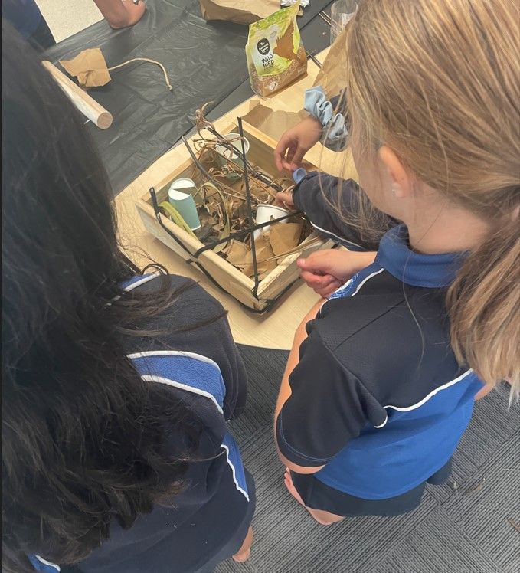
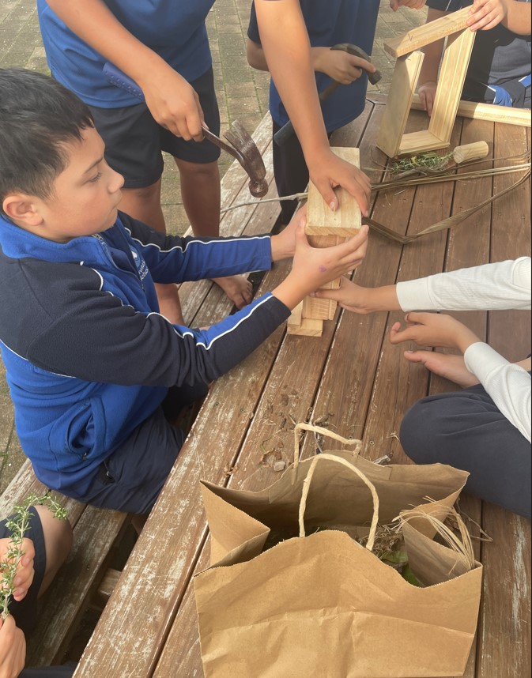
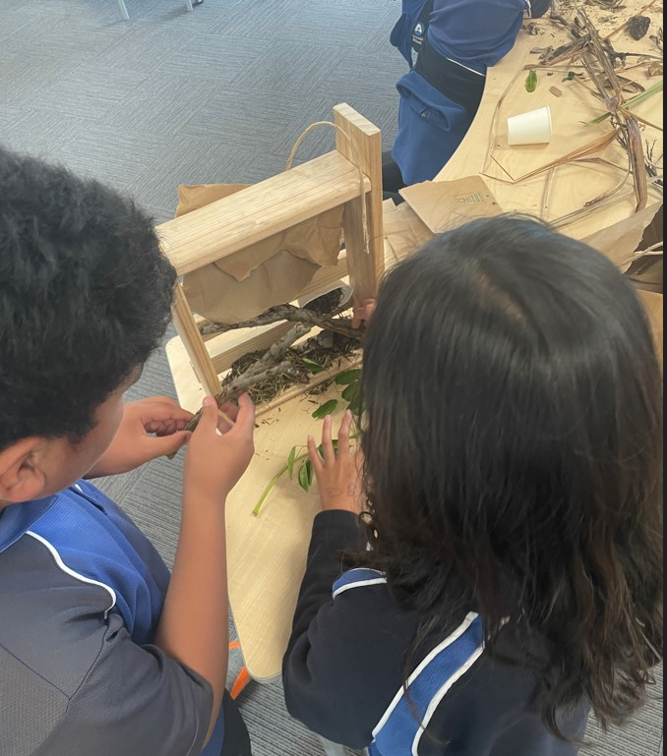
Hangia te hōtēra ngārara
© Arataki School and University of Waikato Te Whare Wānanga o Waikato l www.sciencelearn.org.nz

Slide 6
Te whakarahi a ngā huruhuru
E ahu mai ana ngā rau i te papanga taikaha me te hangore, e kiia ne ko te keratini.
Ko te tuarā kei waenganui, e kiia nei ko te kakau, he hahao.
Kei ngā haurua e rua o te rau, ngā wene. He mea hanga mai ēnei i te tini mano peka, e kiia ana ko ngā niwha.
Nā te mea he tini hoki ngā arearenga i waenga I ēnei niwha, he ōrite te hau o te rau ki te matū, te korakora.
Notes:
Activity notes:
Encourage an awareness of birds and their special abilities for flight.
This image is from the article Feathers and flight, which has lots more information about the design and function of feathers.

Slide 7
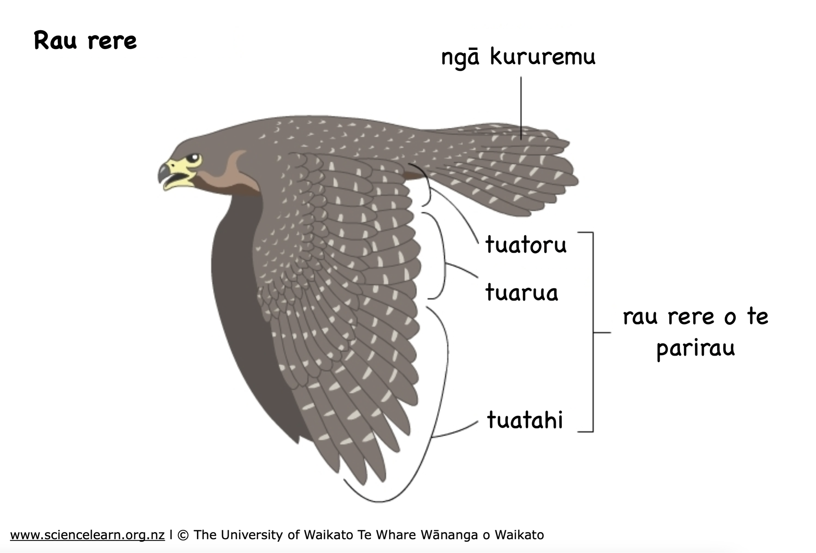
Ngā huruhuru me te rere
E kiia ana ngā rau rere hei pari rau (remiges), me ngā kururemu (rectrices).
He mea hanga ngā pari rau mai i ngā rau tuatahi, tuarua, tuatoru hoki.
Notes:
This image is also from the article Feathers and flight.

Slide 8
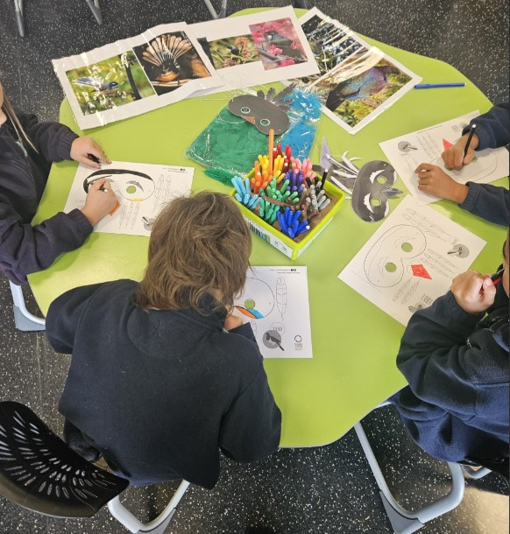
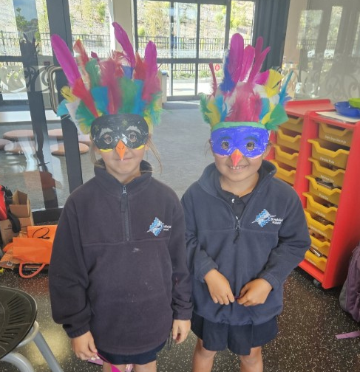
Hangaia tō ake mata-manu!
Kia kotahi ko ngā manu i tō kura, i tō māra rānei mā te hanga i tō ake mata-manu!
© Te Kura o Manunui and Manaaki Whenua – Landcare Research
Notes:
Activity notes:
Encourage awareness of birds with a fun and creative activity using feathers.
Before starting the activity – spend time talking about the bird species first.
What species do they recognise?
What do they know about the birds?
Have they seen the bird species before? Where?
Why did they choose the bird species for making their mask?
The New Zealand Garden Bird Survey has templates to use as the base for students to create their own masks. Choose between black and white templates, which allow students to add their own colour, or colour templates, which imitate native birds' actual colours.
It would pay to have the templates precut for juniors. Sourcing real feathers from dollar or craft shops is also helpful as the feathers on the templates can be fiddly to cut out and attach. Real feathers also add colour and texture.
Set up the tables with an assortment of mask templates along with photos of the birds you are using (for colour matching and comparing).
Choose which medium students will use – crayons, colouring pencils or felts.

Slide 9
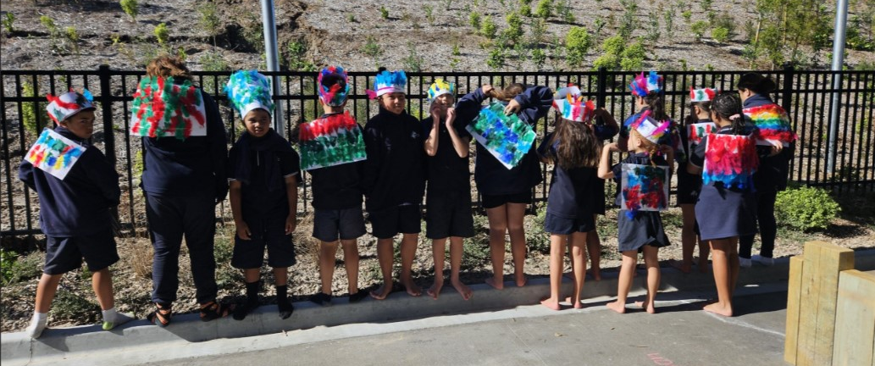
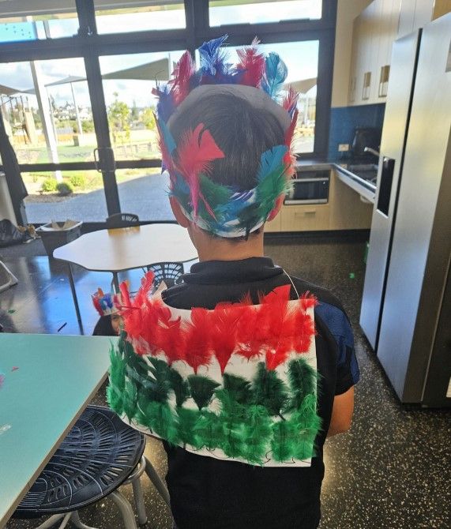
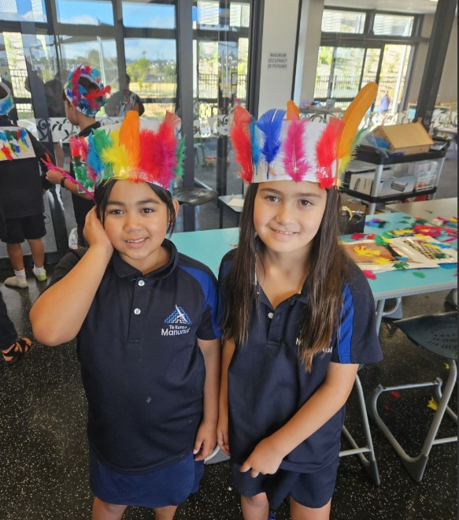
Ngā kākahu huruhuru me te tīpare
Hangaia he kākahu, he tīpare rānei mō tētahi wā motuhake.
© Kura o Manunui and Manaaki Whenua – Landcare Research
Notes:
Activity notes:
Encourage awareness of birds with a fun and creative activity using feathers. This activity can support the learning of how introduced and native feathers are used in the making of traditional and contemporary kākahu huruhuru.
Use the start of the Museum of New Zealand Te Papa Tongarewa video He Paki Taonga i a Māui: Ko te Pakanga a ngā Manu | Battle of the Birds to show a traditional kākahu huruhuru – from about 00:50. If you can access a kākahu huruhuru, have one on hand for tamariki to get a close look at.
Either working in small groups or individually, students create a pattern of feathers for a tīpare and kākahu.

Slide 10
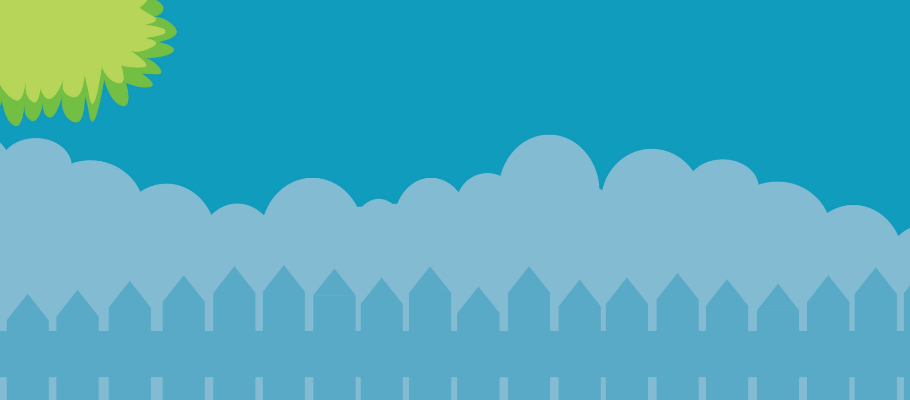
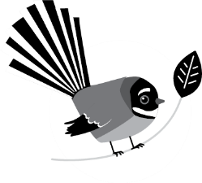
Āwhinatia kia whaihua ā tatou manu
29 Hune – 7 Hūrae 2024
gardenbirdsurvey.nz

