Slide 1
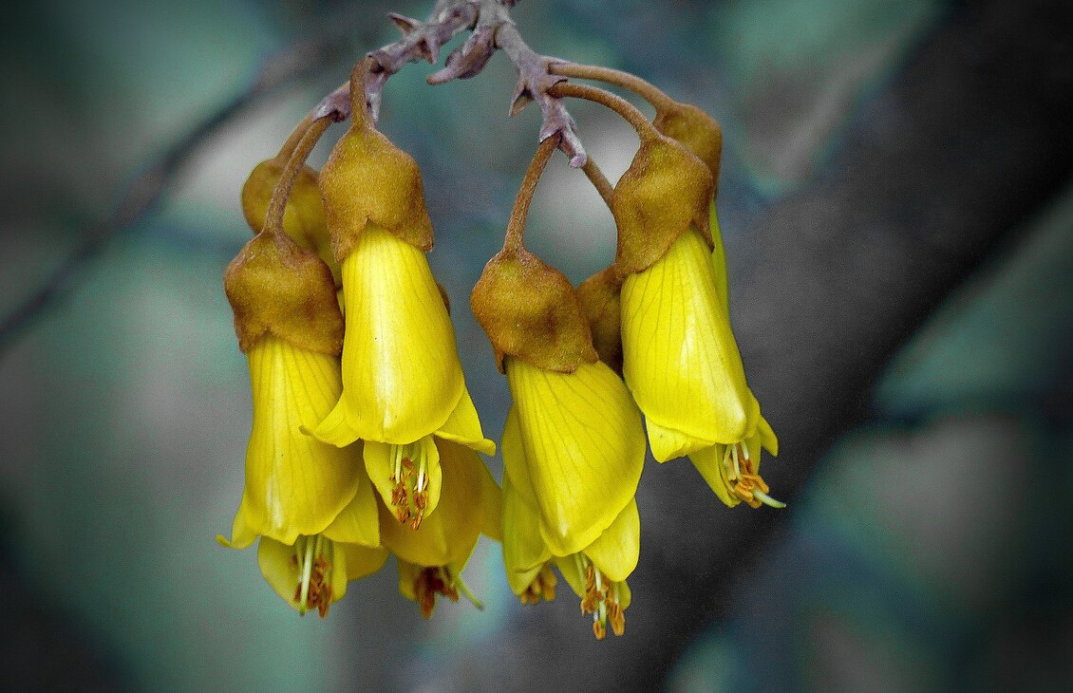
Exploring mātauranga
in the classroom
4–4:45 pm Thursday 1 August 2024
© Copyright. Science Learning Hub – Pokapū Akoranga Pūtaiao The University of Waikato Te Whare Wananga o Waikato.
All Rights Reserved | www.sciencelearn.org.nz. All images are copyrighted. For further information, please refer to enquiries@sciencelearn.org.nz

Slide 2
Pokapū Akoranga Pūtaiao
Science Learning Hub
A trustworthy online resource – produced by educators and scientists​
Based on world-class New Zealand science research​
Supported by learning activities, science ideas and concepts, multimedia tools and other resources​
Written for New Zealand teachers and students ​
© Copyright. Science Learning Hub – Pokapū Akoranga Pūtaiao The University of Waikato Te Whare Wananga o Waikato.
All Rights Reserved | www.sciencelearn.org.nz. All images are copyrighted. For further information, please refer to enquiries@sciencelearn.org.nz

Slide 3
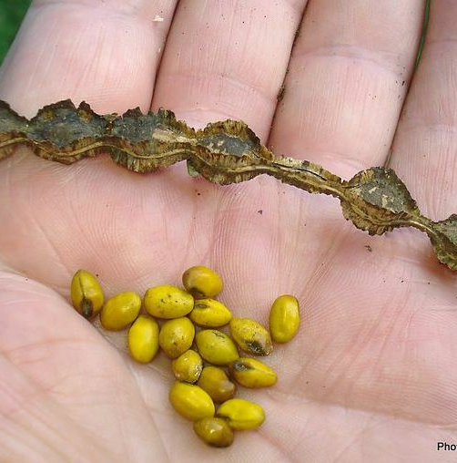
Purpose
Share our experiences exploring mātauranga in the classroom
Provide resources to support you
Answer your questions
© Phil Bendle
CC BY-NC-ND 3.0 NZ
© Copyright. Science Learning Hub – Pokapū Akoranga Pūtaiao The University of Waikato Te Whare Wananga o Waikato.
All Rights Reserved | www.sciencelearn.org.nz. All images are copyrighted. For further information, please refer to enquiries@sciencelearn.org.nz
Notes:
Image: https://www.sciencelearn.org.nz/images/5455-kowhai-seeds

Slide 4
Index
Topic | Slideshow number(s) | Video timecode
Introducing the Science Learning Hub and the purpose of the webinar | 1–3 | 00:00
Index | 4 | 01:24
Introducing the presenters | 5 | 01:37
Research background and resource links | 6–7 | 04:10
Poisonous plants awareness | 8 | 07:38
Introducing the kōwhai resources | 9 | 08:26
Mātauranga Māori of kōwhai | 10 | 12:02
Kōwhai activities | 11–18 | 20:45
Other well-resourced contexts to consider | 19–21 | 30:56
SLH links, keep in touch and thanks | 22 | 35:27
© Copyright. Science Learning Hub – Pokapū Akoranga Pūtaiao The University of Waikato Te Whare Wananga o Waikato.
All Rights Reserved | www.sciencelearn.org.nz. All images are copyrighted. For further information, please refer to enquiries@sciencelearn.org.nz

Slide 5
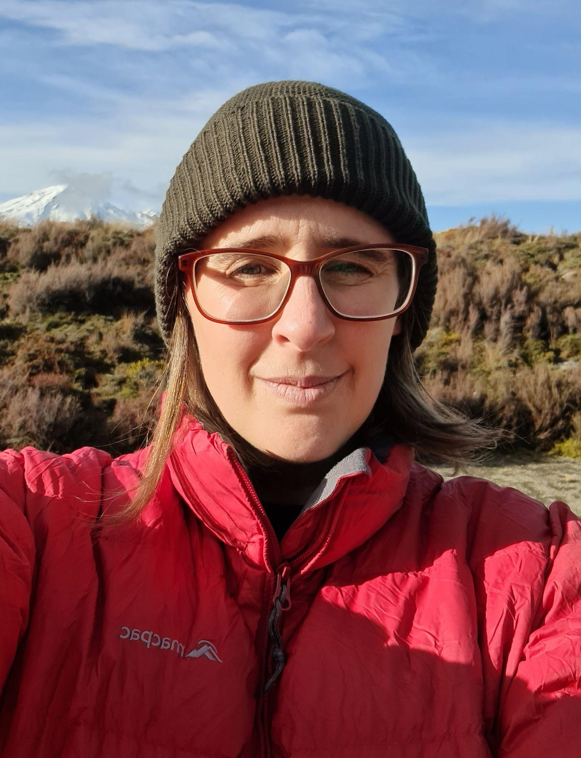
Introductions
© Private Collection
© Silverdale Normal School
© Copyright. Science Learning Hub – Pokapū Akoranga Pūtaiao The University of Waikato Te Whare Wananga o Waikato.
All Rights Reserved | www.sciencelearn.org.nz. All images are copyrighted. For further information, please refer to enquiries@sciencelearn.org.nz

Slide 6
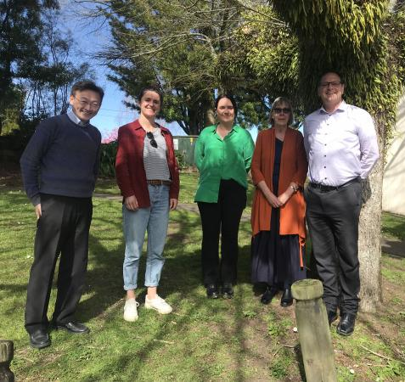
Envisioning student possible selves
in science: Addressing ‘plant blindness’ through place-based education.
© Maurice Cheng, University of Waikato Te Whare Wānanga o Waikato
Notes:
Teaching and Learning Research Initiative (TLRI) project
Students’ sense of place and science-related possible selves through local curriculum units on plants.
Researchers: Maurice M. W. Cheng and Bronwen Cowie from The University of Waikato.
http://www.tlri.org.nz/tlri-research/research-progress/school-sector/envisioning-student-possible-selves-science-addressing

Slide 7
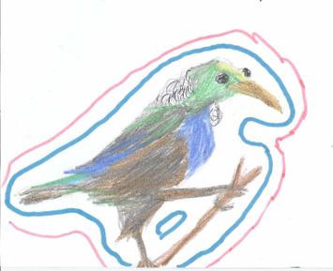
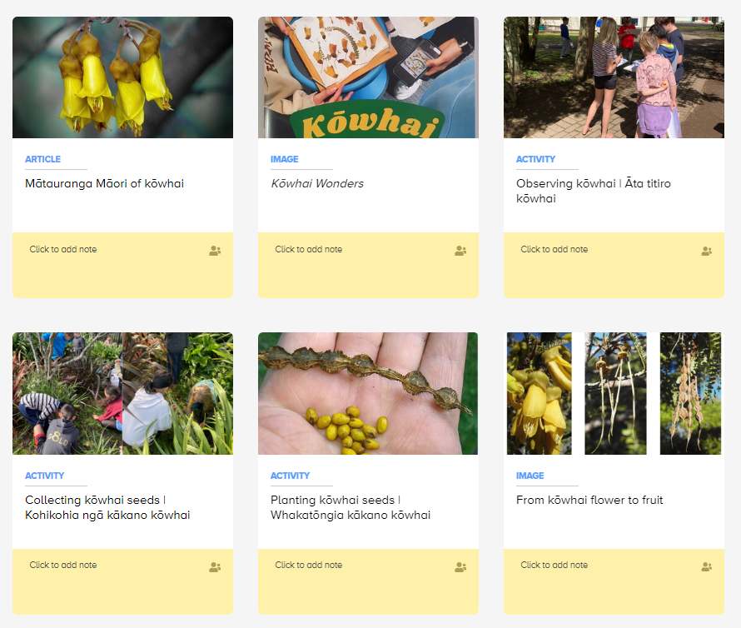
bit.ly/kōwhai
Notes:
https://bit.ly/kōwhai

Slide 8
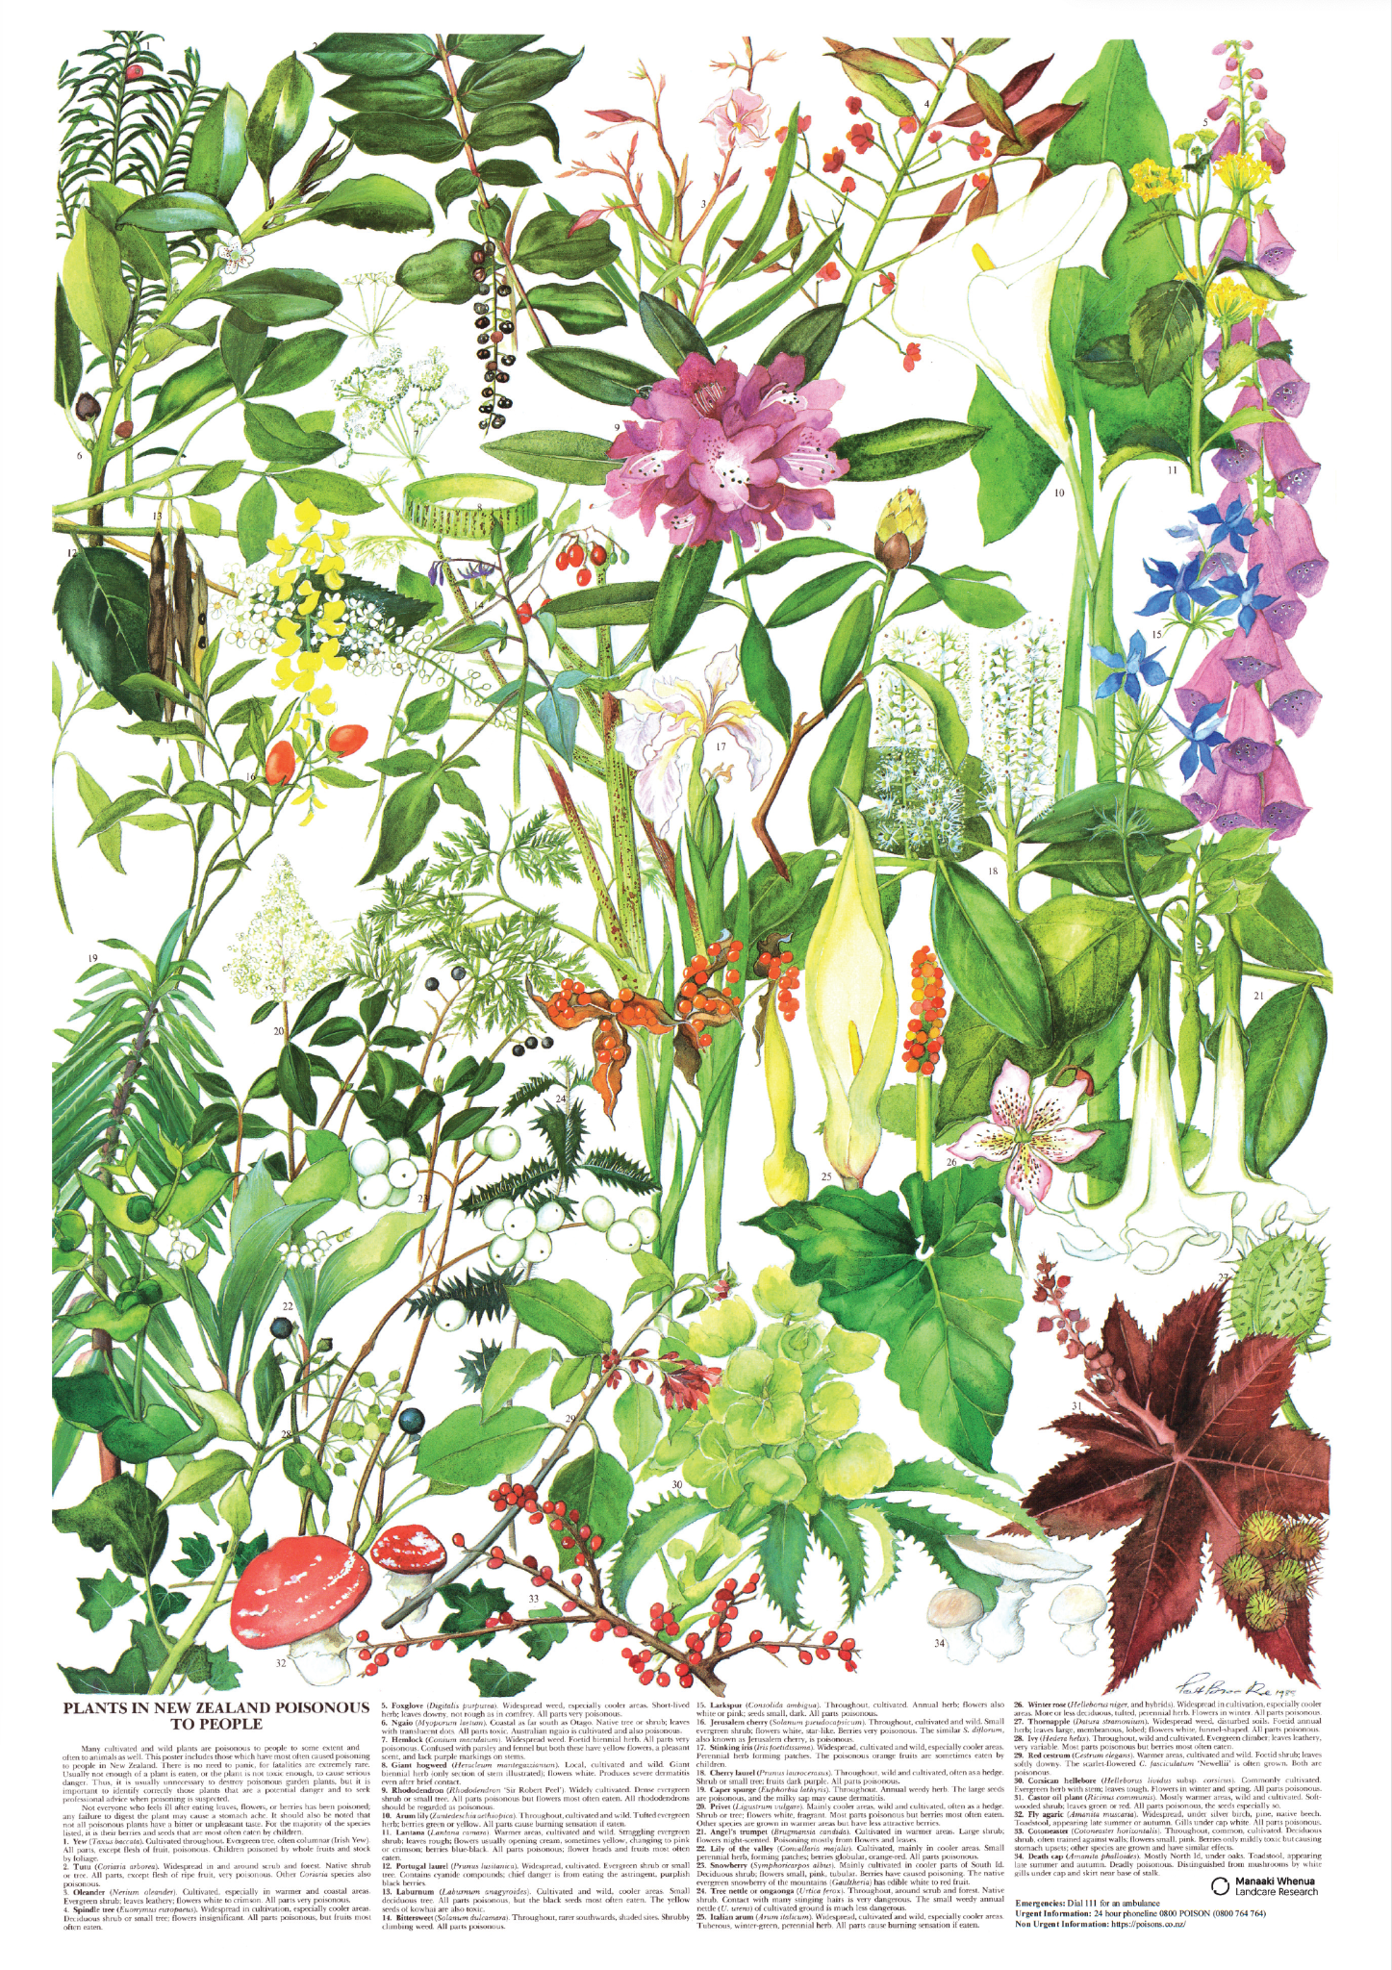
Plants poisonous to people, © Manaaki Whenua – Landcare Research
Notes:
https://www.landcareresearch.co.nz/publications/poisonous-plants/
https://poisons.co.nz/articles-and-info/common-poisons-around-the-garden/ 0800POISON
https://www.nzpcn.org.nz/flora/vascular/poisonous-natives/

Slide 9
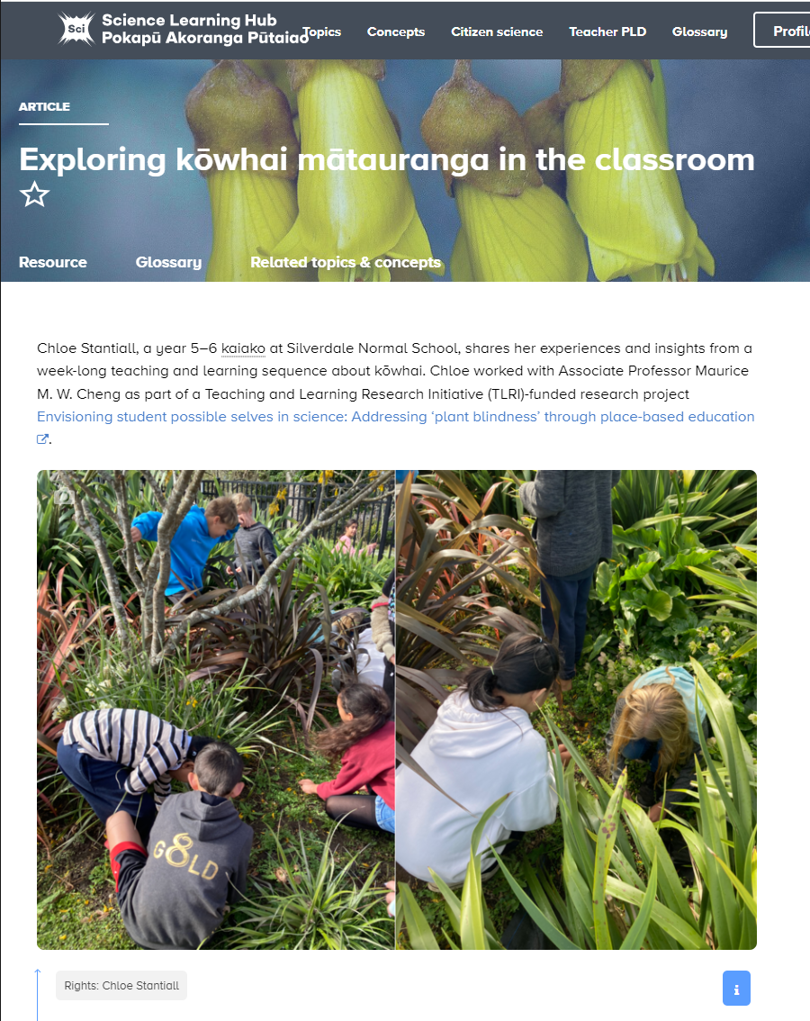
Notes:
https://www.sciencelearn.org.nz/resources/3337-exploring-kowhai-matauranga-in-the-classroom

Slide 10
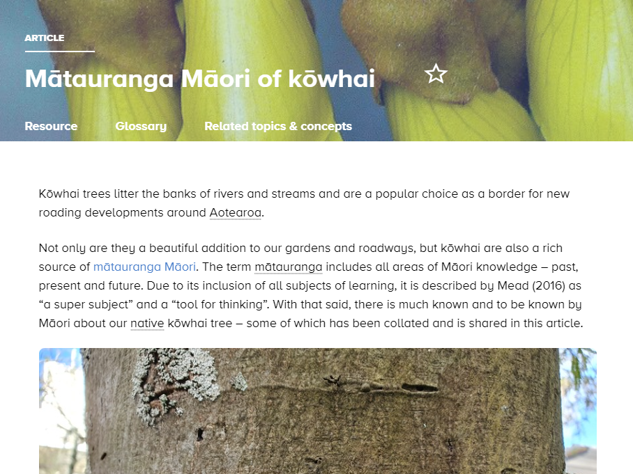
Notes:
https://www.sciencelearn.org.nz/resources/2801-matauranga-maori

Slide 11
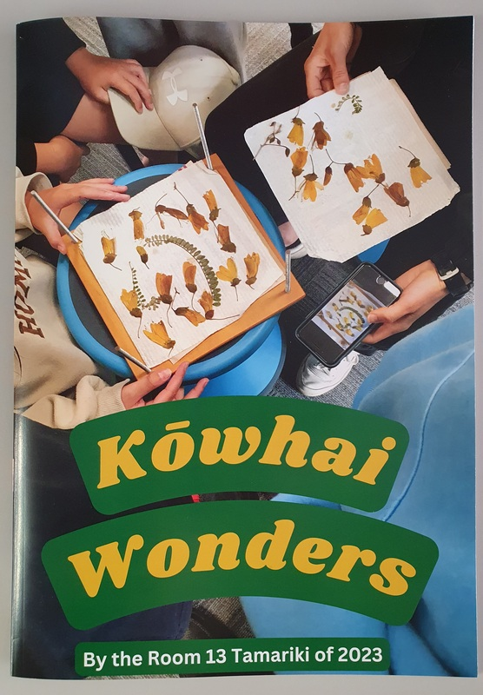
© Chloe Stantiall
Notes:
https://www.sciencelearn.org.nz/images/5449-kowhai-wonders

Slide 12
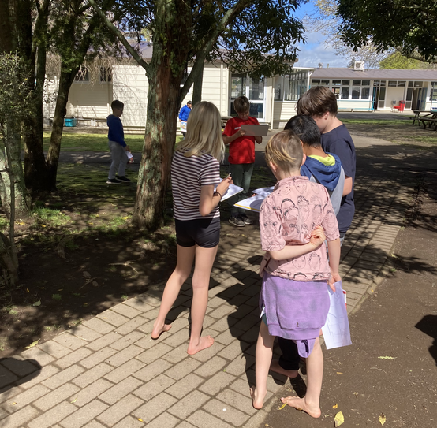
Observing kōwhai
Āta titiro kōwhai
… I taught/modelled the difference between sketching what you think you see, and what you can actually see.
© Chloe Stantiall

Slide 13
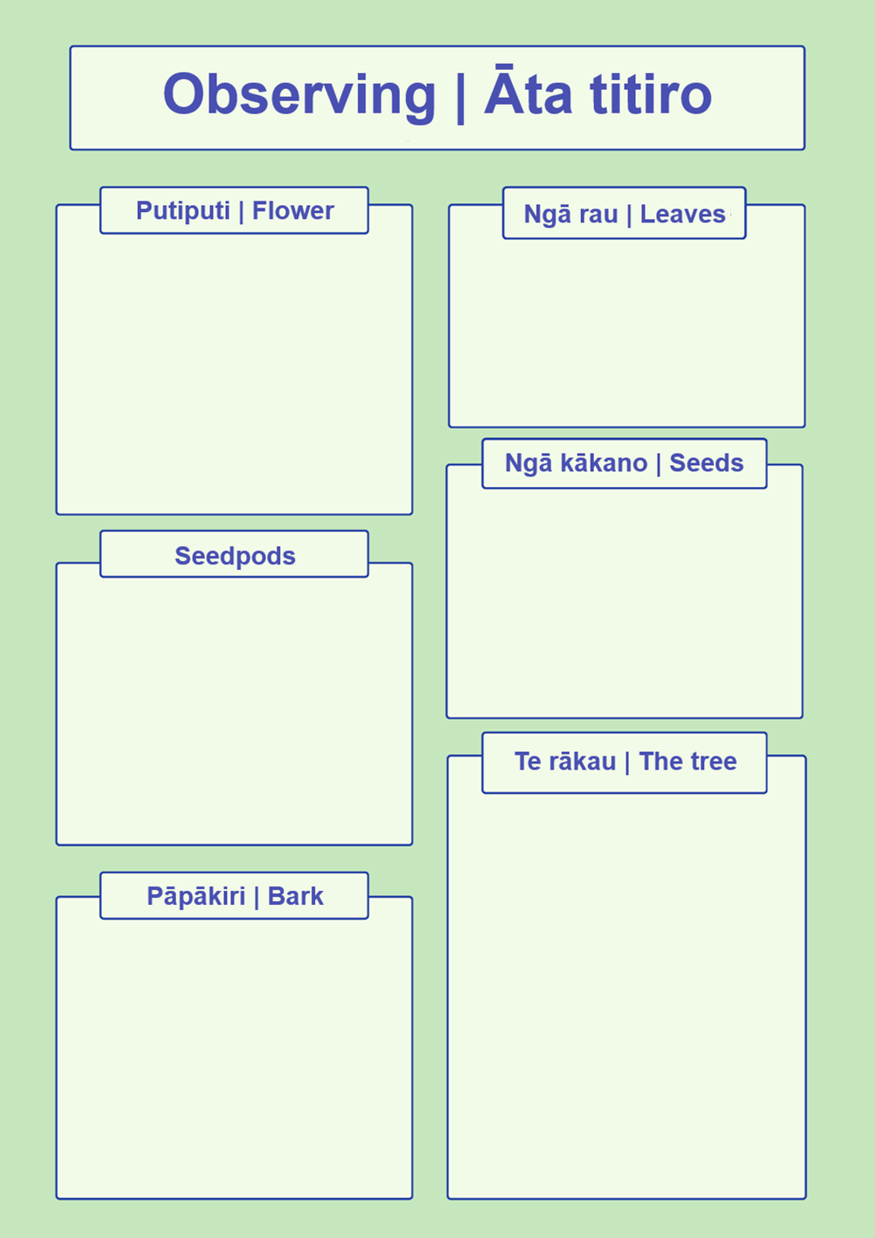
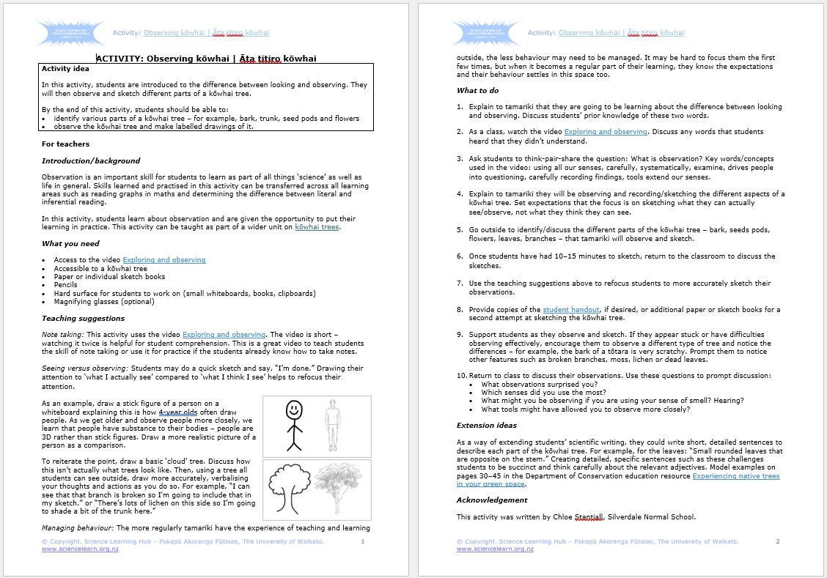
Notes:
https://www.sciencelearn.org.nz/resources/3340-observing-kowhai-ata-titiro-kowhai

Slide 14
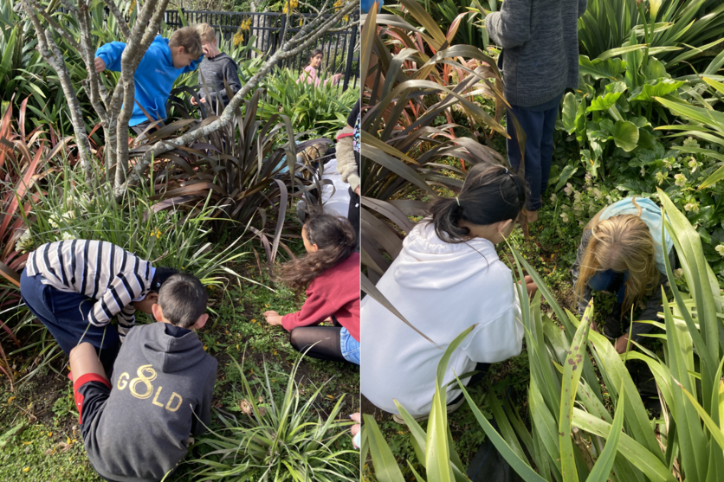
Collecting kōwhai seeds Kohikohia ngā kākano kōwhai
© Chloe Stantiall
Notes:
Image: https://www.sciencelearn.org.nz/images/5451-tamariki-collecting-kowhai-seeds

Slide 15
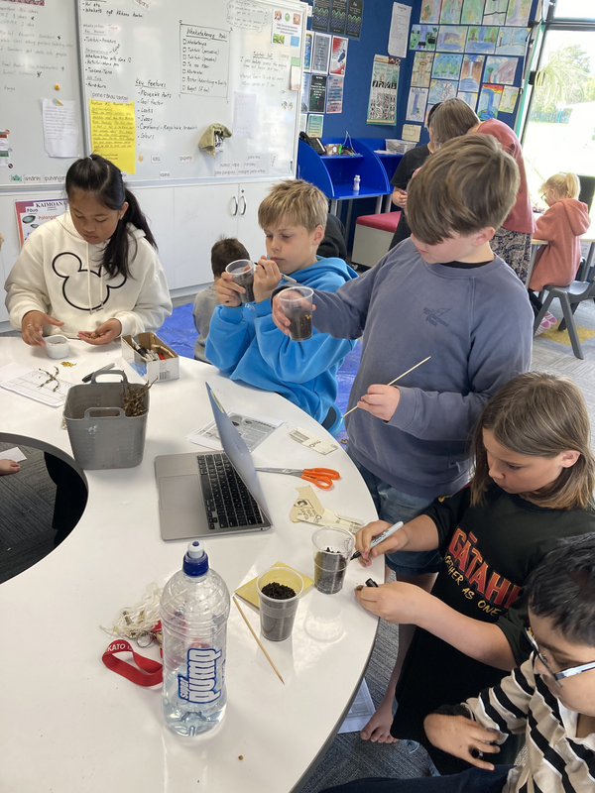
Planting kōwhai seeds Whakatōngia kākano kōwhai
… I found it quite hard not to interfere with the decisions students were making…
© Chloe Stantiall
Notes:
Image: https://www.sciencelearn.org.nz/images/5454-planting-kowhai-seeds

Slide 16
Botany resources
Kōwhai © Neville Gardner; kōtukutuku © Tony Wills, Creative Commons 2.5; kanono © bbi2, Creative Commons 4.0

Slide 17
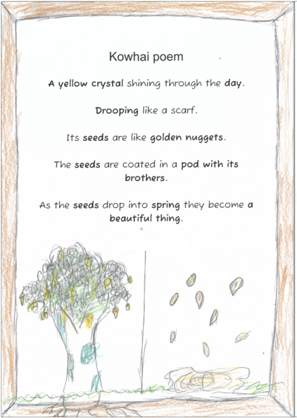
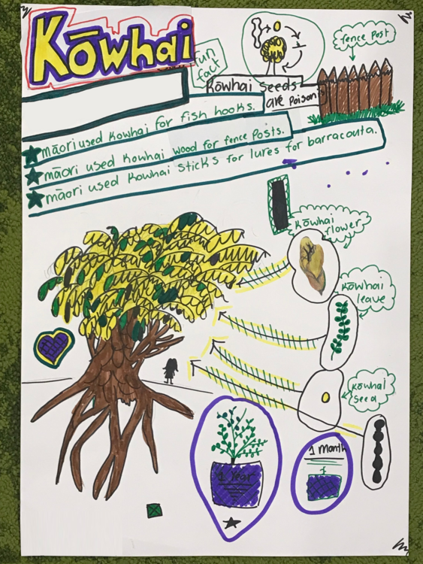
Communicating
© Chloe Stantiall
© Chloe Stantiall
Notes:
https://www.sciencelearn.org.nz/resources/3341-sharing-scientific-understanding-through-poetry
https://www.sciencelearn.org.nz/resources/3342-creating-kowhai-infographics

Slide 18
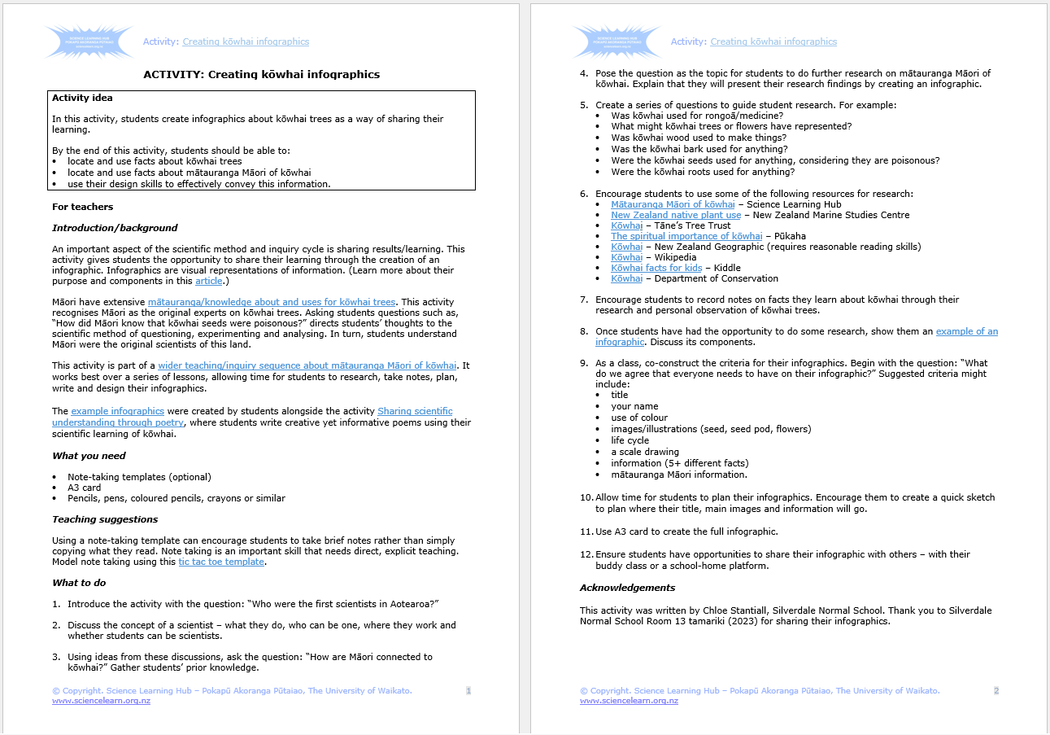
Notes:
https://www.sciencelearn.org.nz/resources/3342-creating-kowhai-infographics

Slide 19
Other contexts…
Video: www.sciencelearn.org.nz/resources/3116-local-curriculum-matauranga-and-science
Notes:
https://www.sciencelearn.org.nz/resources/3116-local-curriculum-matauranga-and-science

Slide 20
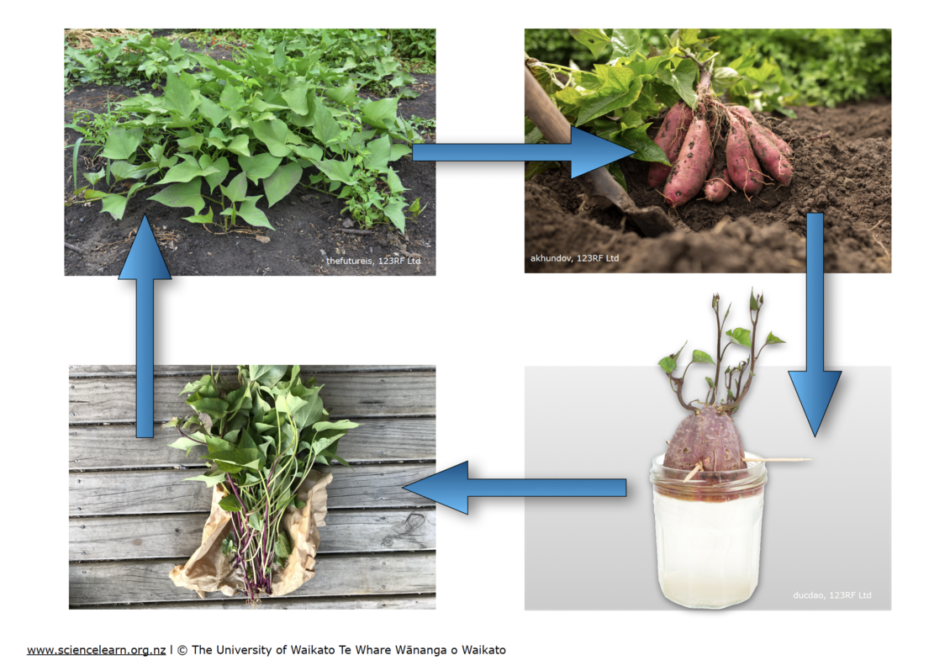
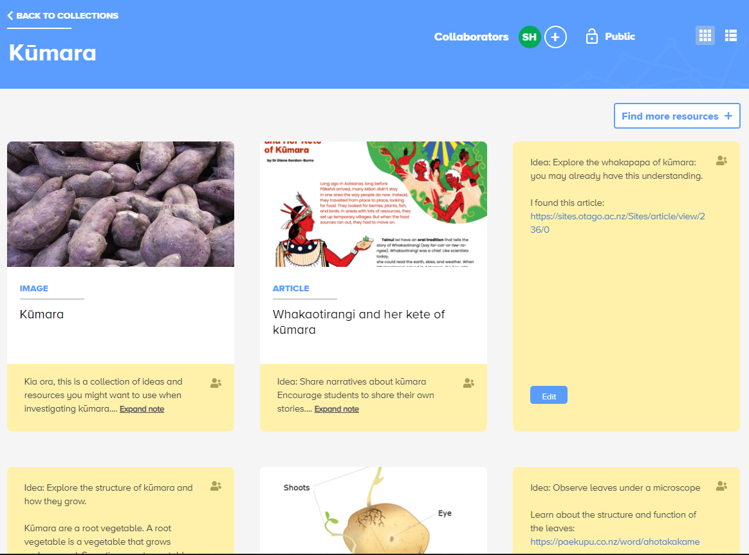
Kūmara
© Chris Dillion.
Illustrations by Taupuruariki Whakataka Brightwell. © Crown
See the Kūmara collection: https://bit.ly/3Obfca1
Notes:
https://bit.ly/3Obfca1

Slide 21
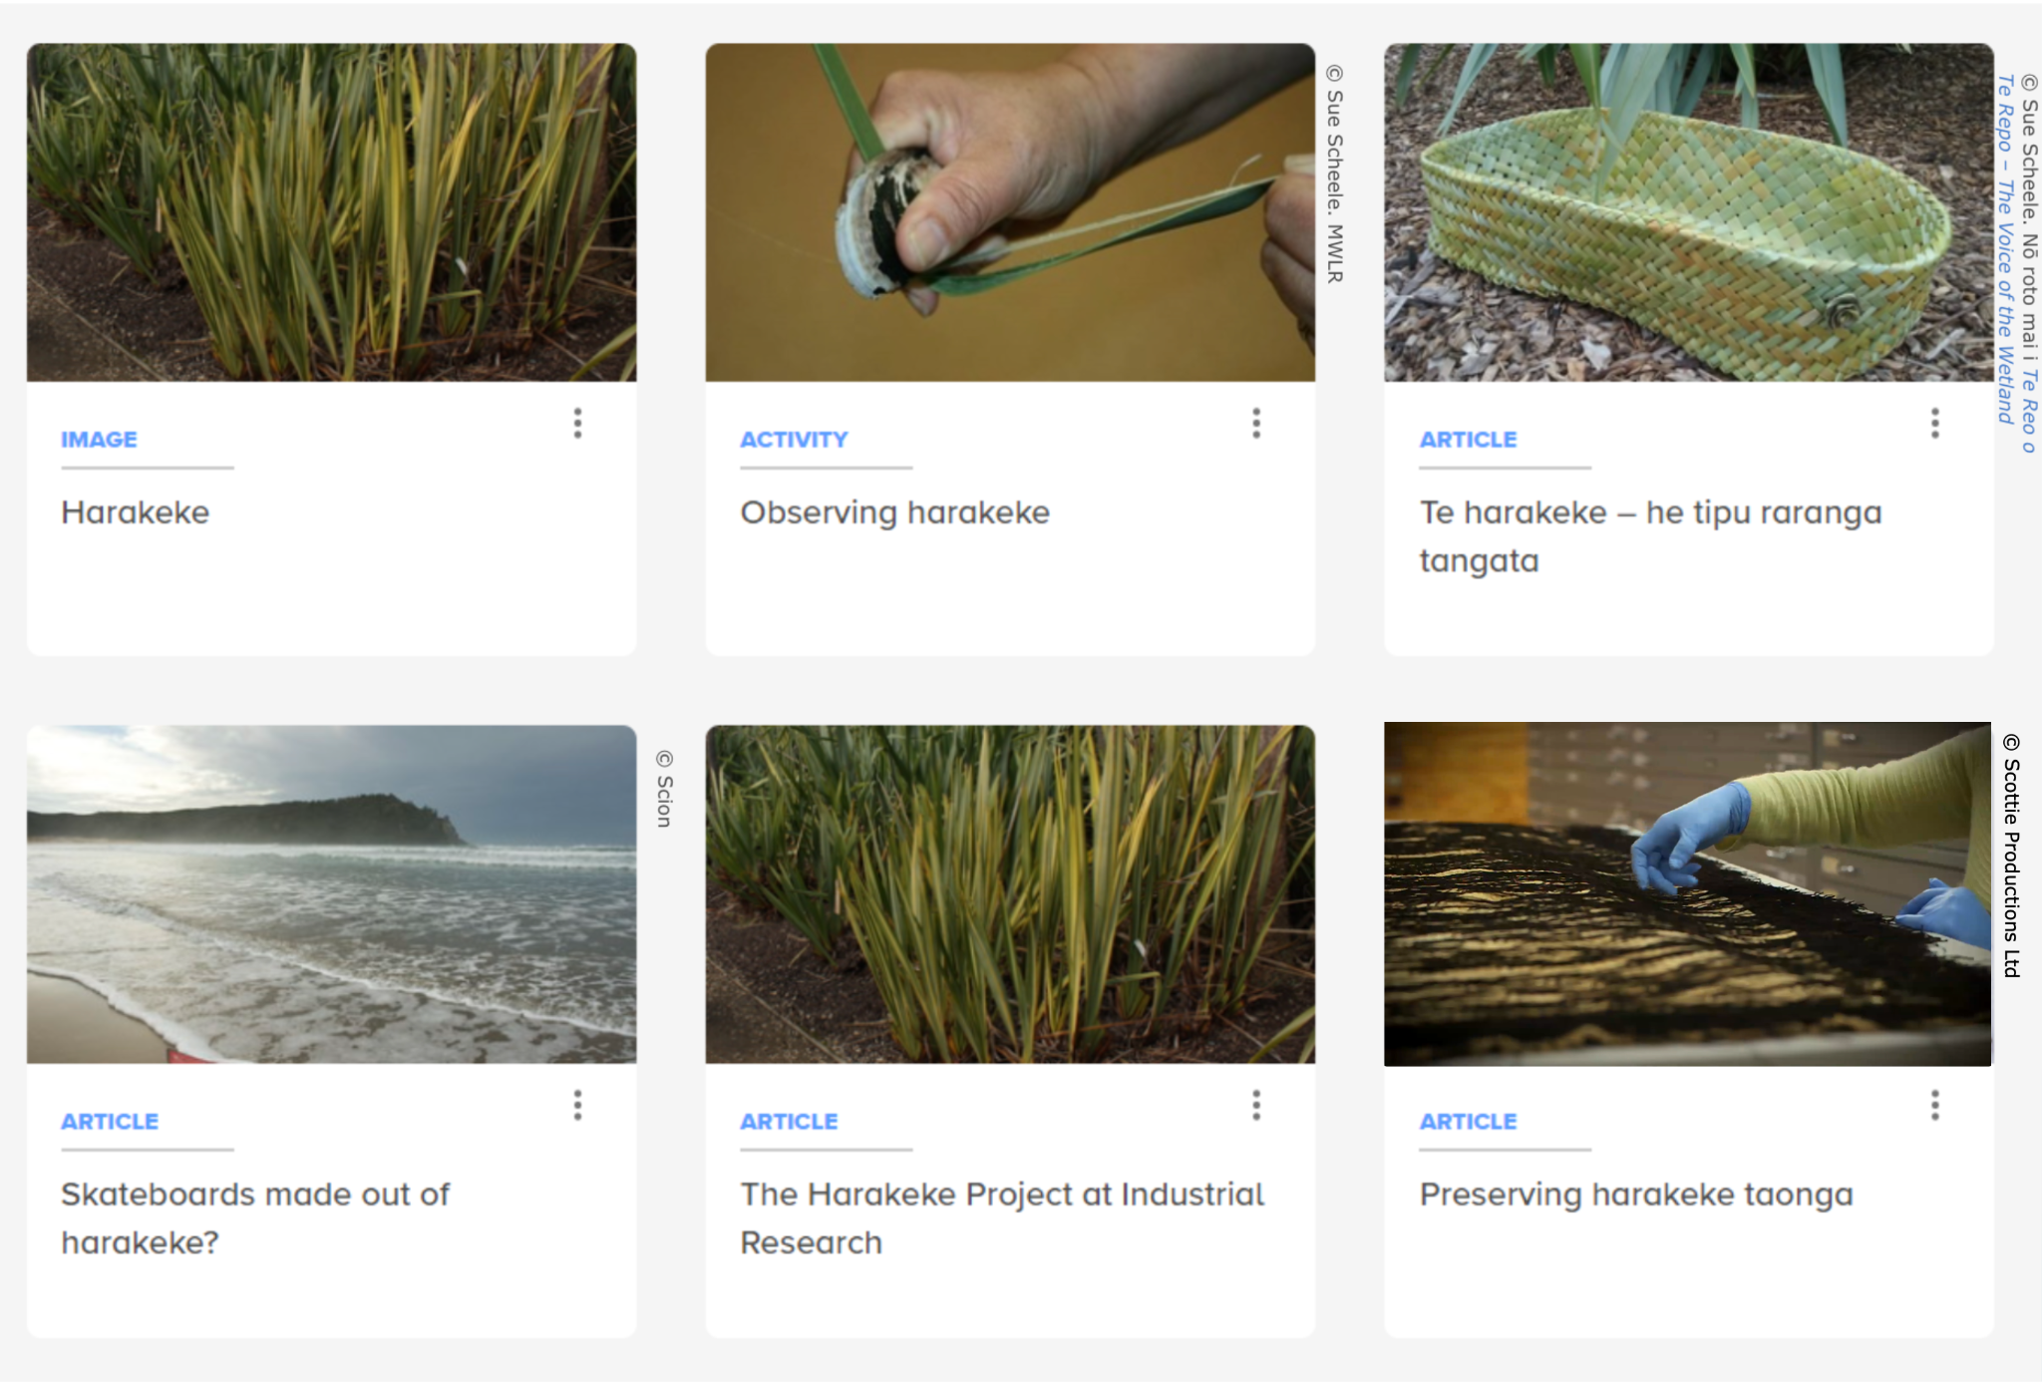
Harakeke
Notes:
https://www.sciencelearn.org.nz/search?term=harakeke

Slide 22
Thanks – want to keep in touch?
Email us on enquiries@sciencelearn.org.nz
https://x.com/NZScienceLearn
www.facebook.com/nzsciencelearn
https://nz.pinterest.com/nzsciencelearn
www.instagram.com/sciencelearninghubnz
Notes:
www.sciencelearn.org.nz/about/contact-us

