Slide 1
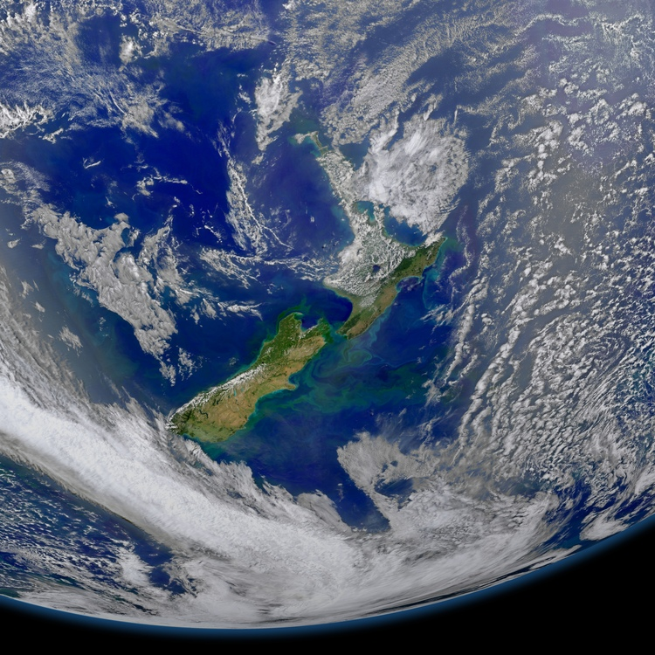
Understanding the
basics of climate change
Suomi NPP satellite, NASA Goddard Space Flight Center CC BY 2.0
Associate Professor Chris Eames​
School of Education​, University of Waikato​
© Copyright. Science Learning Hub – Pokapū Akoranga Pūtaiao The University of Waikato Te Whare Wananga o Waikato.
All Rights Reserved | www.sciencelearn.org.nz. All images are copyrighted. For further information, please refer to enquiries@sciencelearn.org.nz

Slide 2
Index
Topic | Slideshow number(s ) | Video timecode
Welcome | 1 | 00:00
Index | 2 | 00:22
Resource links | 3 | 00:43
Introducing the Science Learning Hub, NZASE and Dr Chris Eames | 4–8 | 01:13
What is climate change? | 9–12 | 04:27
Weather versus climate | 13 | 05:49
Key ideas for understanding climate change | 14 | 06:33
The Sun's light energy | 15–17 | 06:55
The greenhouse effect and greenhouse gases | 18–23 | 08:38
Where do carbon dioxide and methane come from? | 24-30 | 13:16
Global warming | 31–36 | 21:39
Summary and the role of climate change education | 37–39 | 30:19
SLH links, keep in touch and thanks | 40 | 36:49

Slide 3
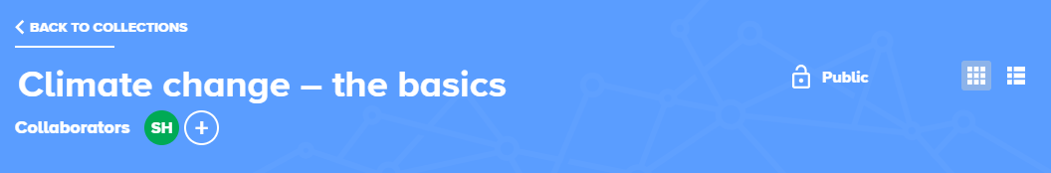
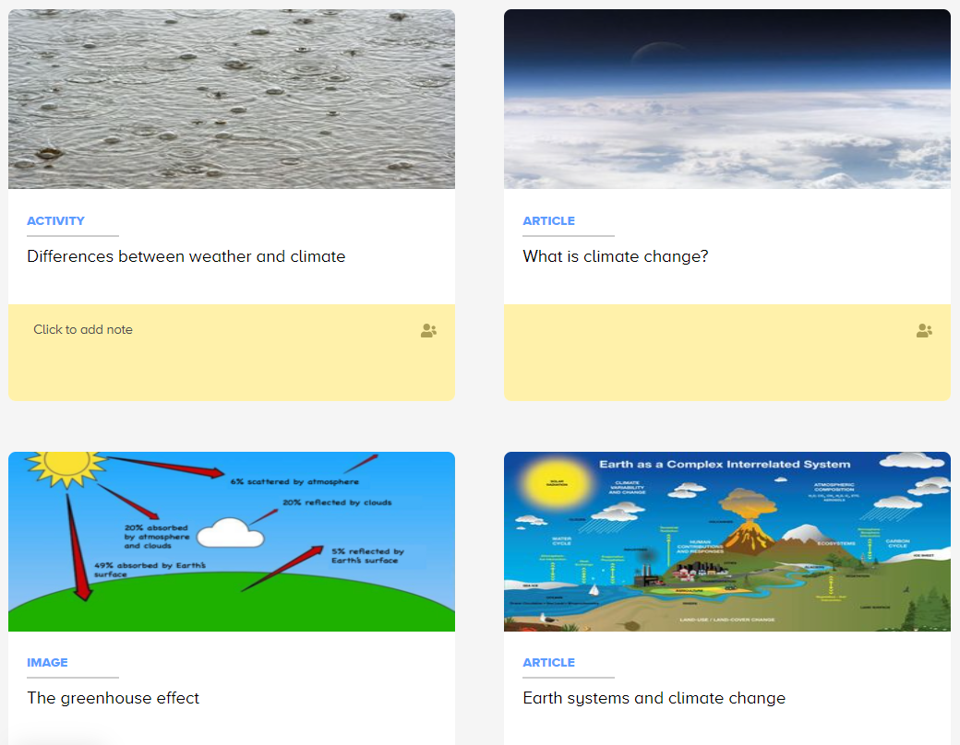
Links and resources
https://bit.ly/ClimateChangeBasics
© Copyright. Science Learning Hub – Pokapū Akoranga Pūtaiao The University of Waikato Te Whare Wananga o Waikato.
All Rights Reserved | www.sciencelearn.org.nz. All images are copyrighted. For further information, please refer to enquiries@sciencelearn.org.nz

Slide 4

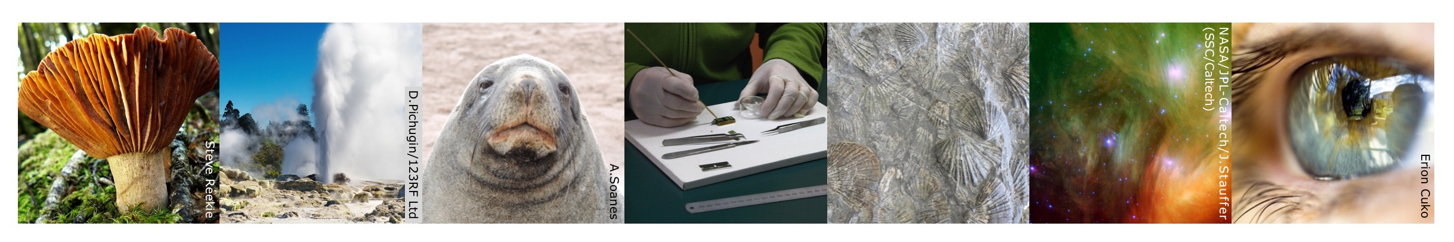
The Science Learning Hub
A trustworthy online resource – produced by educators and scientists
Based on world-class New Zealand science research
Supported by learning activities, information about the key science ideas and concepts, multimedia tools and other resources
Written for New Zealand teachers and students

Slide 5


nzase.org.nz
© Copyright. Science Learning Hub – Pokapū Akoranga Pūtaiao The University of Waikato Te Whare Wananga o Waikato.
All Rights Reserved | www.sciencelearn.org.nz. All images are copyrighted. For further information, please refer to enquiries@sciencelearn.org.nz
Notes:
.

Slide 6
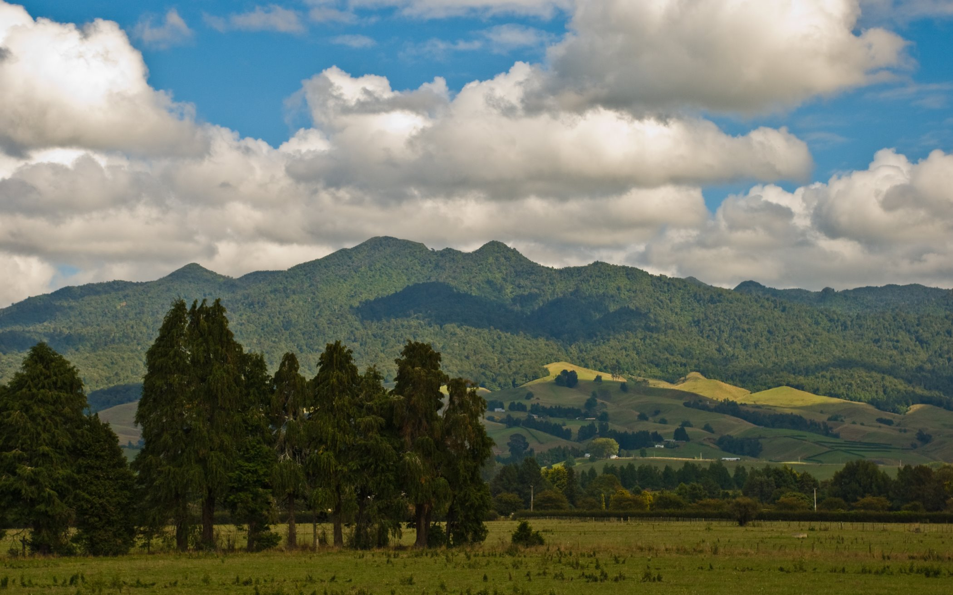
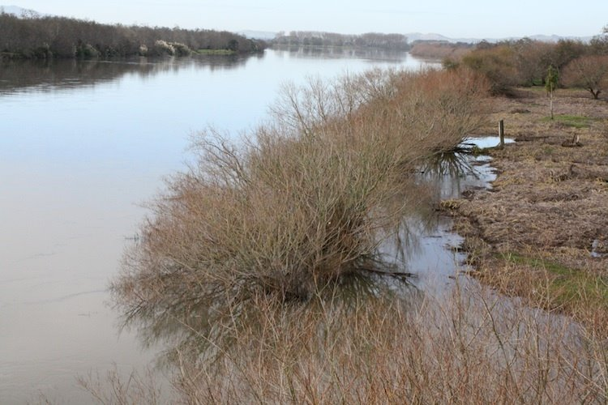
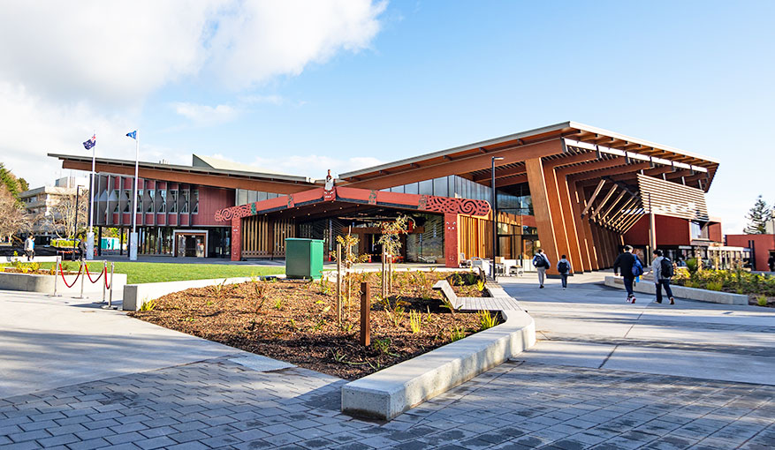
Pēpeha
Ko Pirongia te maunga e rū nei taku ngākau
Ko Waikato te awa e mahea nei taku māharahara
Kei te Whare Wānanga o Waikato e mahi ana
Ko Chris Eames toku ingoa
© Phillip Capper/CC BY 2.0​
^{Science Learning Hub,}
^{© The University of Waikato}
^{Te Whare Wānanga o Waikato}
© The University of Waikato Te Whare Wānanga o Waikato
© Copyright. Science Learning Hub – Pokapū Akoranga Pūtaiao The University of Waikato Te Whare Wananga o Waikato.
All Rights Reserved | www.sciencelearn.org.nz. All images are copyrighted. For further information, please refer to enquiries@sciencelearn.org.nz

Slide 7
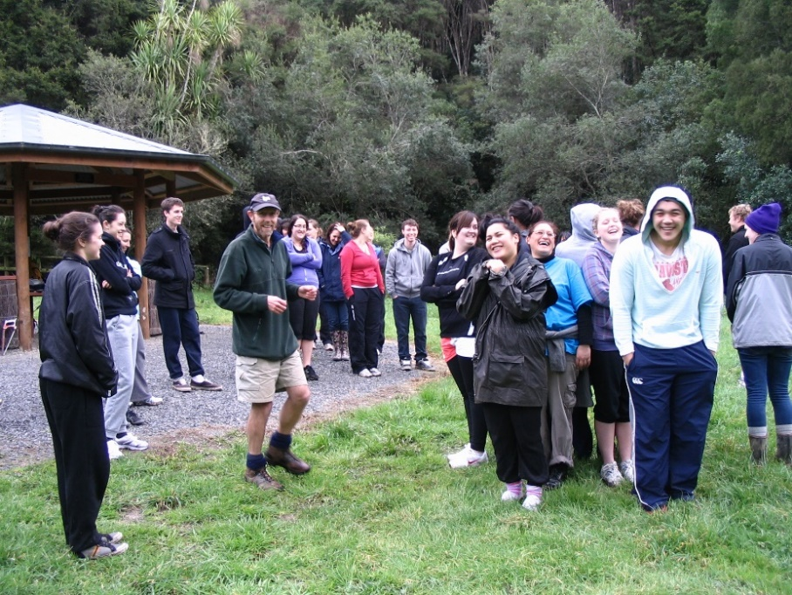
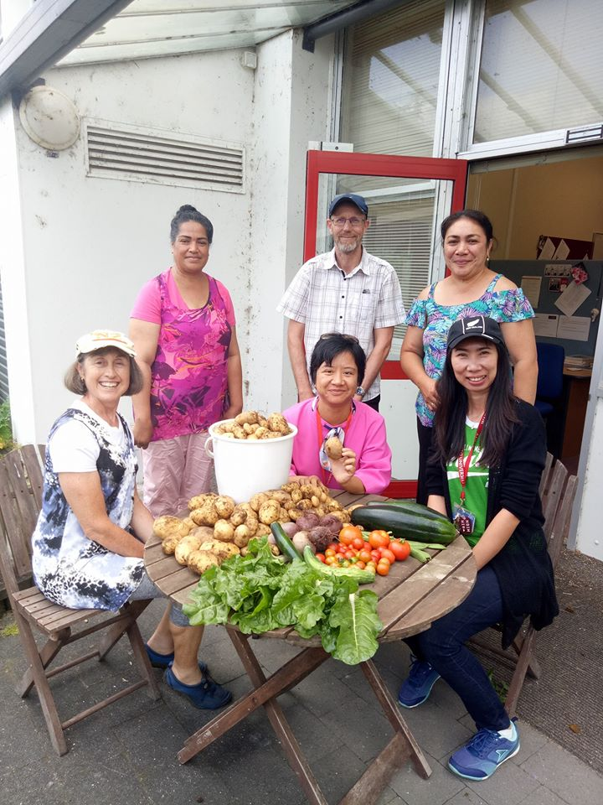
Ko wai au/ Who am I?
I am an environmental and sustainability educator at the University of Waikato
© Copyright. Science Learning Hub – Pokapū Akoranga Pūtaiao The University of Waikato Te Whare Wananga o Waikato.
All Rights Reserved | www.sciencelearn.org.nz. All images are copyrighted. For further information, please refer to enquiries@sciencelearn.org.nz

Slide 8





PISA framework:
Agency in the Anthropocene
Name | Organisation
Associate Professor Peta White | Deakin University, Australia
Professor Martha Monroe | University of Florida, USA
Associate Professor Chris Eames | University of Waikato, New Zealand
Associate Professor Nicole Ardoin | Stanford University, USA
© Copyright. Science Learning Hub – Pokapū Akoranga Pūtaiao The University of Waikato Te Whare Wananga o Waikato.
All Rights Reserved | www.sciencelearn.org.nz. All images are copyrighted. For further information, please refer to enquiries@sciencelearn.org.nz
Notes:
Chris
Greta – add link to PISA framework

Slide 9
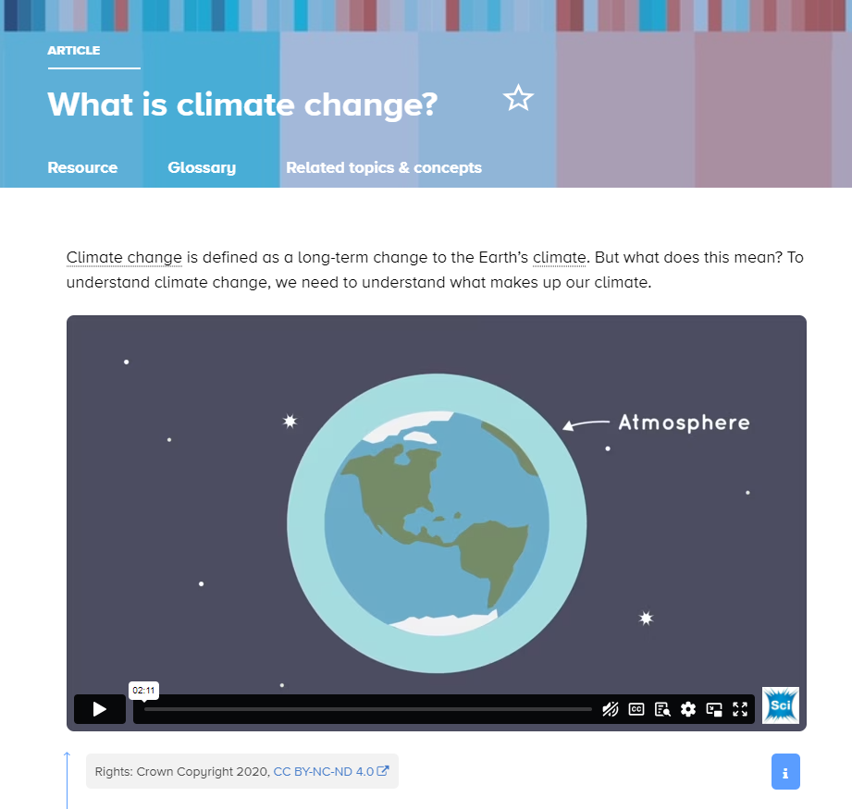
What is climate change?
a change in the pattern of overall weather
in a particular place
over a long time i.e. years
Notes:
Image: https://www.sciencelearn.org.nz/resources/2954-what-is-climate-change

Slide 10
What is climate change?
This change can be observed in temperature, wind, rainfall etc. over a long time period.
As these weather aspects interact with each other, a change in one can then lead to a change in another, i.e. warmer sea temperatures can create stronger winds.
© Copyright. Science Learning Hub – Pokapū Akoranga Pūtaiao The University of Waikato Te Whare Wananga o Waikato.
All Rights Reserved | www.sciencelearn.org.nz. All images are copyrighted. For further information, please refer to enquiries@sciencelearn.org.nz

Slide 11

What is climate change?
Climate change is complex.
We can make it easier to understand if we explore it in bite-sized chunks, while keeping in mind the bigger picture.
James Petts, CC BY-SA 2.0
© Copyright. Science Learning Hub – Pokapū Akoranga Pūtaiao The University of Waikato Te Whare Wananga o Waikato.
All Rights Reserved | www.sciencelearn.org.nz. All images are copyrighted. For further information, please refer to enquiries@sciencelearn.org.nz
Notes:
Image: https://commons.wikimedia.org/wiki/File:Jigsaw_puzzle_(detail)_(11919275515).jpg

Slide 12
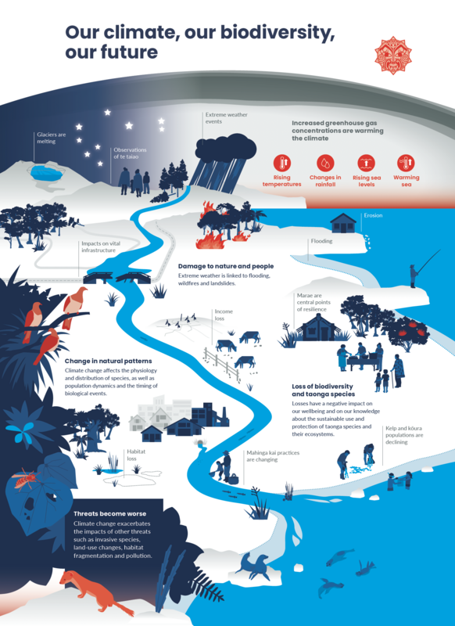
So what effects does climate have on Earth?
Our climate affects the fundamental needs that all living things have – including us.
Crown copyright ©, CC BY 4.0
© Copyright. Science Learning Hub – Pokapū Akoranga Pūtaiao The University of Waikato Te Whare Wananga o Waikato.
All Rights Reserved | www.sciencelearn.org.nz. All images are copyrighted. For further information, please refer to enquiries@sciencelearn.org.nz
Notes:
Image: https://www.sciencelearn.org.nz/images/5281-our-climate-our-biodiversity-infographic

Slide 13
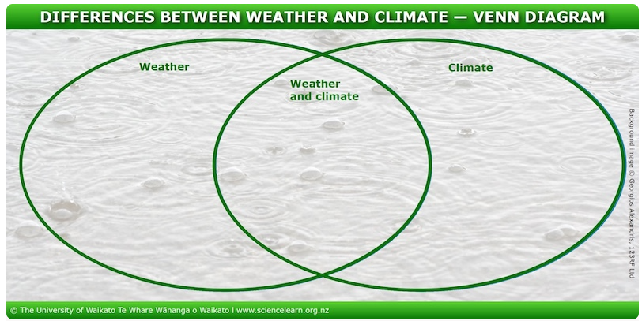
First, let’s ask – climate or weather?
Climate and weather are different. We have weather every day – sometimes many types of weather in one day!
Our climate is the longer term pattern of atmospheric conditions that has enduring effects.
© Copyright. Science Learning Hub – Pokapū Akoranga Pūtaiao The University of Waikato Te Whare Wananga o Waikato.
All Rights Reserved | www.sciencelearn.org.nz. All images are copyrighted. For further information, please refer to enquiries@sciencelearn.org.nz
Notes:
https://www.sciencelearn.org.nz/resources/2966-weather-and-climate

Slide 14
Second, we can start to understand climate change by exploring these ideas
Sun's light energy changes into heat energy.
The role of greenhouse gases.
The carbon cycle.
© Copyright. Science Learning Hub – Pokapū Akoranga Pūtaiao The University of Waikato Te Whare Wananga o Waikato.
All Rights Reserved | www.sciencelearn.org.nz. All images are copyrighted. For further information, please refer to enquiries@sciencelearn.org.nz

Slide 15
The Sun's light energy
When the Sun's light energy strikes an object, some of that energy may be absorbed, some will be reflected.
For objects such as buildings, rocks, water, etc. the Sun's light energy warms them, and then as they cool, they lose the energy as heat.
Plants use energy from sunlight to make food.
© Copyright. Science Learning Hub – Pokapū Akoranga Pūtaiao The University of Waikato Te Whare Wananga o Waikato.
All Rights Reserved | www.sciencelearn.org.nz. All images are copyrighted. For further information, please refer to enquiries@sciencelearn.org.nz

Slide 16
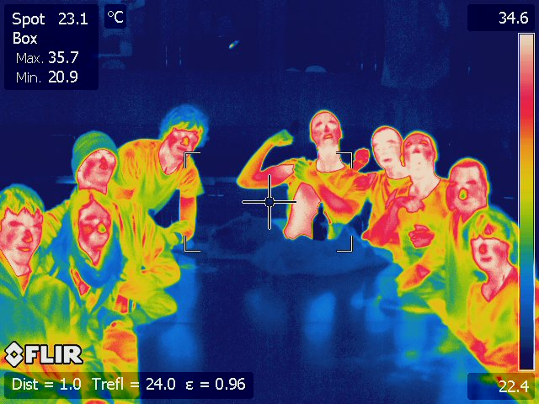
Using an infrared camera, we can see the heat energy being lost from a person
Human Body 37 °C
© Thomas Everth
© Copyright. Science Learning Hub – Pokapū Akoranga Pūtaiao The University of Waikato Te Whare Wananga o Waikato.
All Rights Reserved | www.sciencelearn.org.nz. All images are copyrighted. For further information, please refer to enquiries@sciencelearn.org.nz

Slide 17
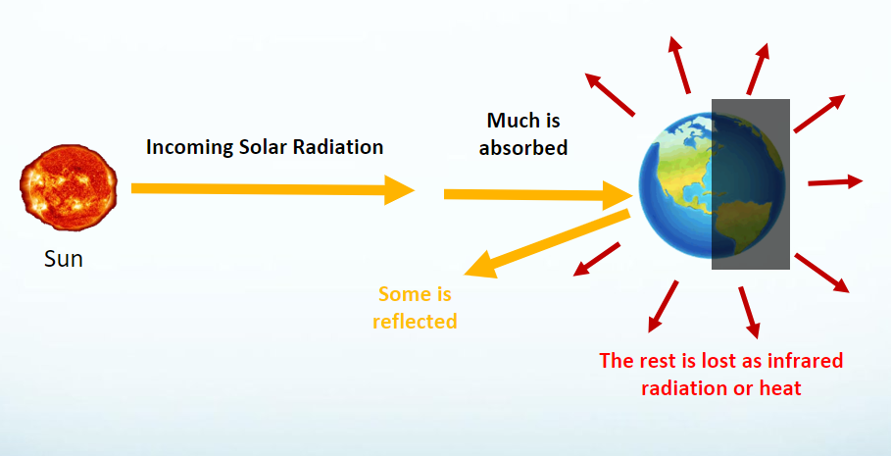
In the same way, as sunlight warms our planet
(land and water), when it cools, the energy is lost as heat to Space.
© Thomas Everth
© Copyright. Science Learning Hub – Pokapū Akoranga Pūtaiao The University of Waikato Te Whare Wananga o Waikato.
All Rights Reserved | www.sciencelearn.org.nz. All images are copyrighted. For further information, please refer to enquiries@sciencelearn.org.nz

Slide 18
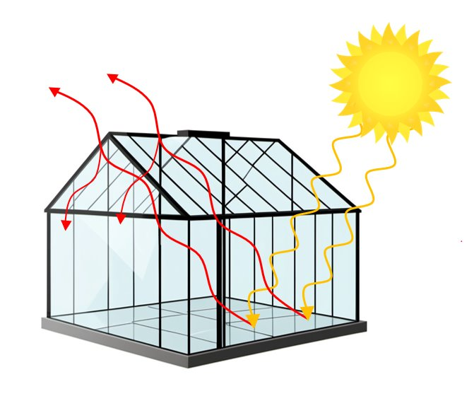
BUT, we live in a greenhouse!
© The University of Waikato Te Whare Wānanga o Waikato
© Copyright. Science Learning Hub – Pokapū Akoranga Pūtaiao The University of Waikato Te Whare Wananga o Waikato.
All Rights Reserved | www.sciencelearn.org.nz. All images are copyrighted. For further information, please refer to enquiries@sciencelearn.org.nz

Slide 19
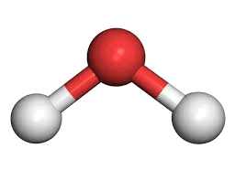

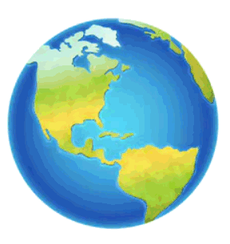
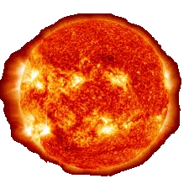
The greenhouse effect
Like the glass roof of a greenhouse, greenhouse gases in the atmosphere absorb and then re-emit infrared radiation.
This hinders cooling of the Earth by radiation to Space, keeping the Earth warm.
© Thomas Everth
© Copyright. Science Learning Hub – Pokapū Akoranga Pūtaiao The University of Waikato Te Whare Wananga o Waikato.
All Rights Reserved | www.sciencelearn.org.nz. All images are copyrighted. For further information, please refer to enquiries@sciencelearn.org.nz

Slide 20
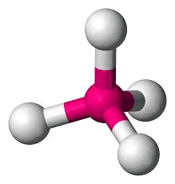
So what are the greenhouse gases?
The major ones are:
Carbon dioxide (CO₂)
1 carbon connected to 2 oxygen atoms
Methane (CH₄, natural gas)
1 carbon connected to 4 hydrogen atoms
© Copyright. Science Learning Hub – Pokapū Akoranga Pūtaiao The University of Waikato Te Whare Wananga o Waikato.
All Rights Reserved | www.sciencelearn.org.nz. All images are copyrighted. For further information, please refer to enquiries@sciencelearn.org.nz

Slide 21
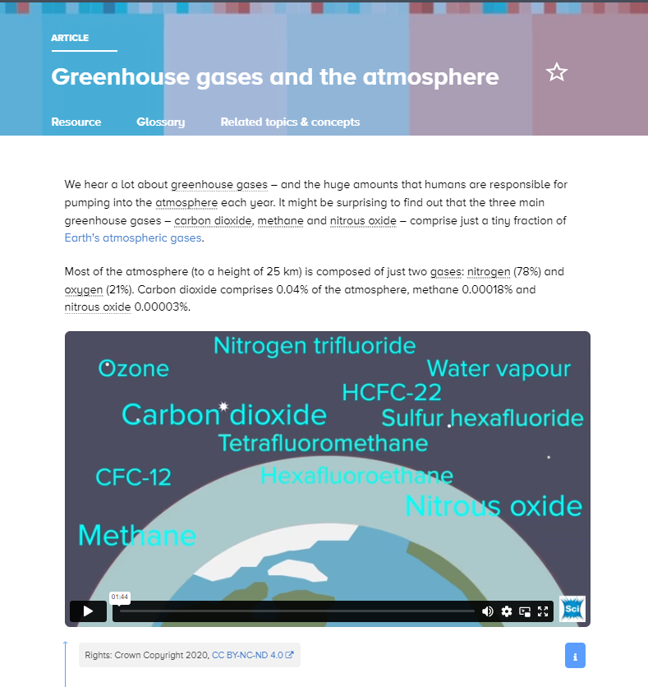
© Copyright. Science Learning Hub – Pokapū Akoranga Pūtaiao The University of Waikato Te Whare Wananga o Waikato.
All Rights Reserved | www.sciencelearn.org.nz. All images are copyrighted. For further information, please refer to enquiries@sciencelearn.org.nz
Notes:
https://www.sciencelearn.org.nz/resources/2959-greenhouse-gases-and-the-atmosphere

Slide 22
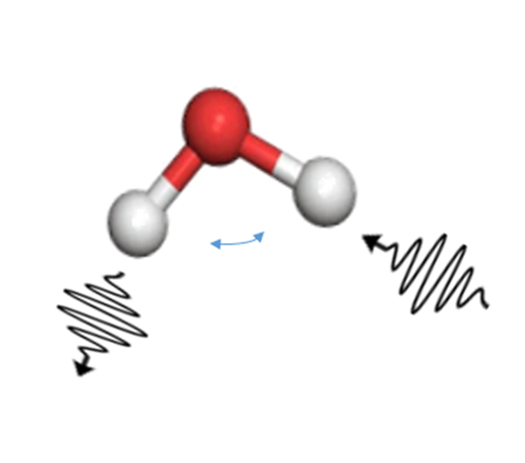
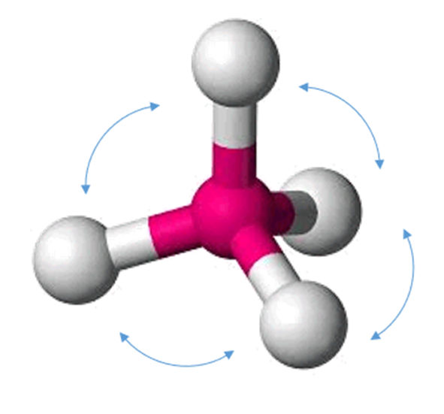
So how do the greenhouse gases trap heat?
Carbon Dioxide (CO₂)
The molecules of greenhouse gases can vibrate like “tuning forks”.
Their vibration frequencies coincide with the frequency of infrared radiation (heat) emitted by Earth.
These gases are highly efficient absorbers of infrared radiation.
These gases then re-emit the energy as heat, back towards Earth
Infrared light
Methane (CH₄)
© Copyright. Science Learning Hub – Pokapū Akoranga Pūtaiao The University of Waikato Te Whare Wananga o Waikato.
All Rights Reserved | www.sciencelearn.org.nz. All images are copyrighted. For further information, please refer to enquiries@sciencelearn.org.nz

Slide 23
The right amount of greenhouse gases is good, but too much is not!
They provide the atmospheric blanket that keeps us warm.
But if we have too much greenhouse gas in the atmosphere, it traps too much warmth!
© Copyright. Science Learning Hub – Pokapū Akoranga Pūtaiao The University of Waikato Te Whare Wananga o Waikato.
All Rights Reserved | www.sciencelearn.org.nz. All images are copyrighted. For further information, please refer to enquiries@sciencelearn.org.nz

Slide 24
Where do these greenhouse gases come from?
And has the amount of greenhouse gas changed over time?
Let’s start with carbon dioxide.
© Copyright. Science Learning Hub – Pokapū Akoranga Pūtaiao The University of Waikato Te Whare Wananga o Waikato.
All Rights Reserved | www.sciencelearn.org.nz. All images are copyrighted. For further information, please refer to enquiries@sciencelearn.org.nz
Notes:
Link: https://www.sciencelearn.org.nz/resources/684-carbon-dioxide-in-the-atmosphere

Slide 25
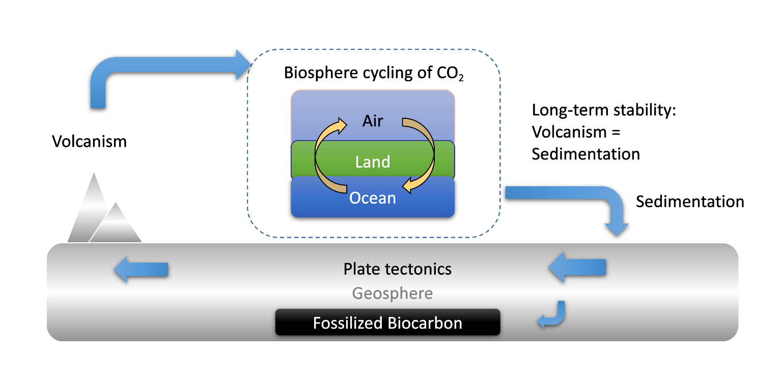
Natural flow of CO₂ through the biosphere
© Copyright. Science Learning Hub – Pokapū Akoranga Pūtaiao The University of Waikato Te Whare Wananga o Waikato.
All Rights Reserved | www.sciencelearn.org.nz. All images are copyrighted. For further information, please refer to enquiries@sciencelearn.org.nz

Slide 26
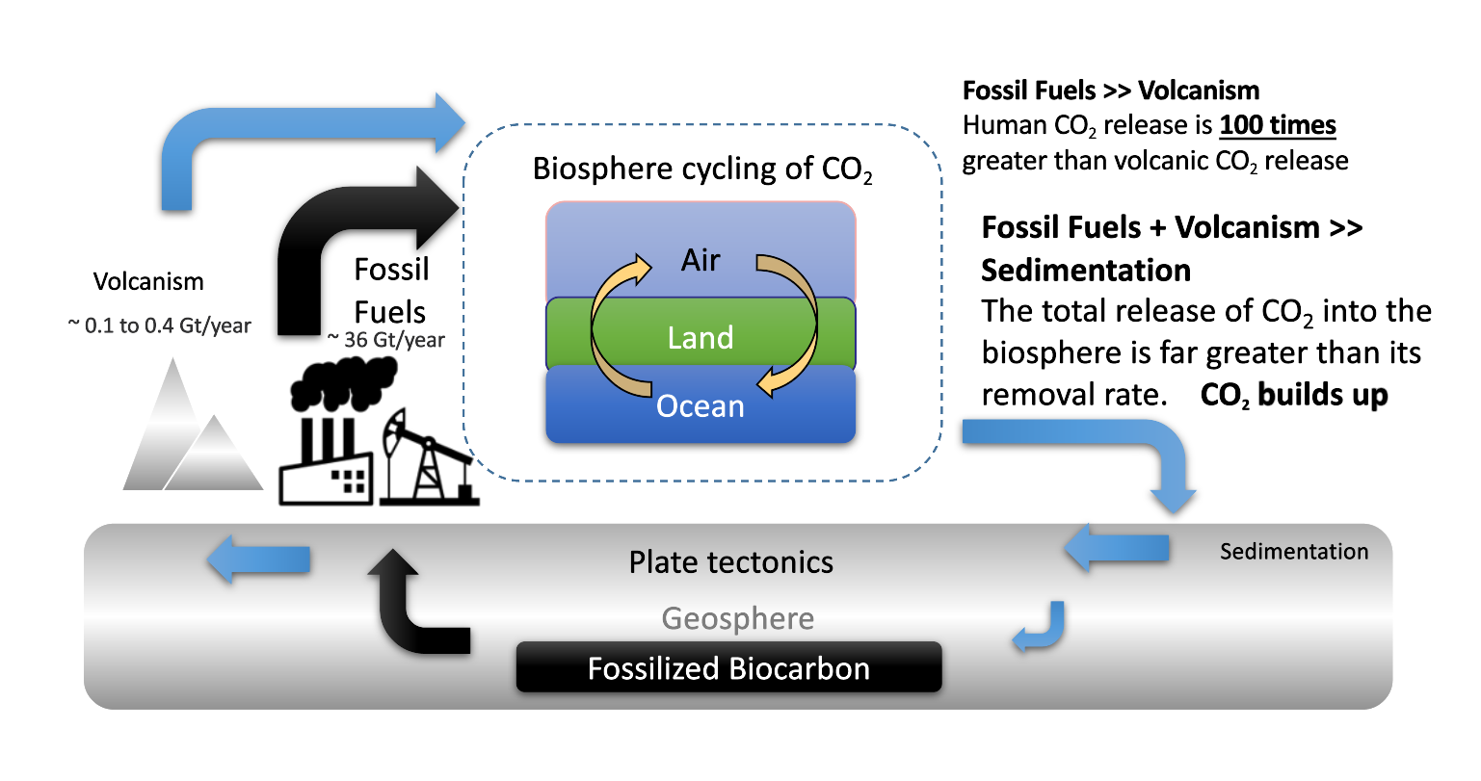
Human activity adds significantly to the CO₂ flow
© Copyright. Science Learning Hub – Pokapū Akoranga Pūtaiao The University of Waikato Te Whare Wananga o Waikato.
All Rights Reserved | www.sciencelearn.org.nz. All images are copyrighted. For further information, please refer to enquiries@sciencelearn.org.nz

Slide 27
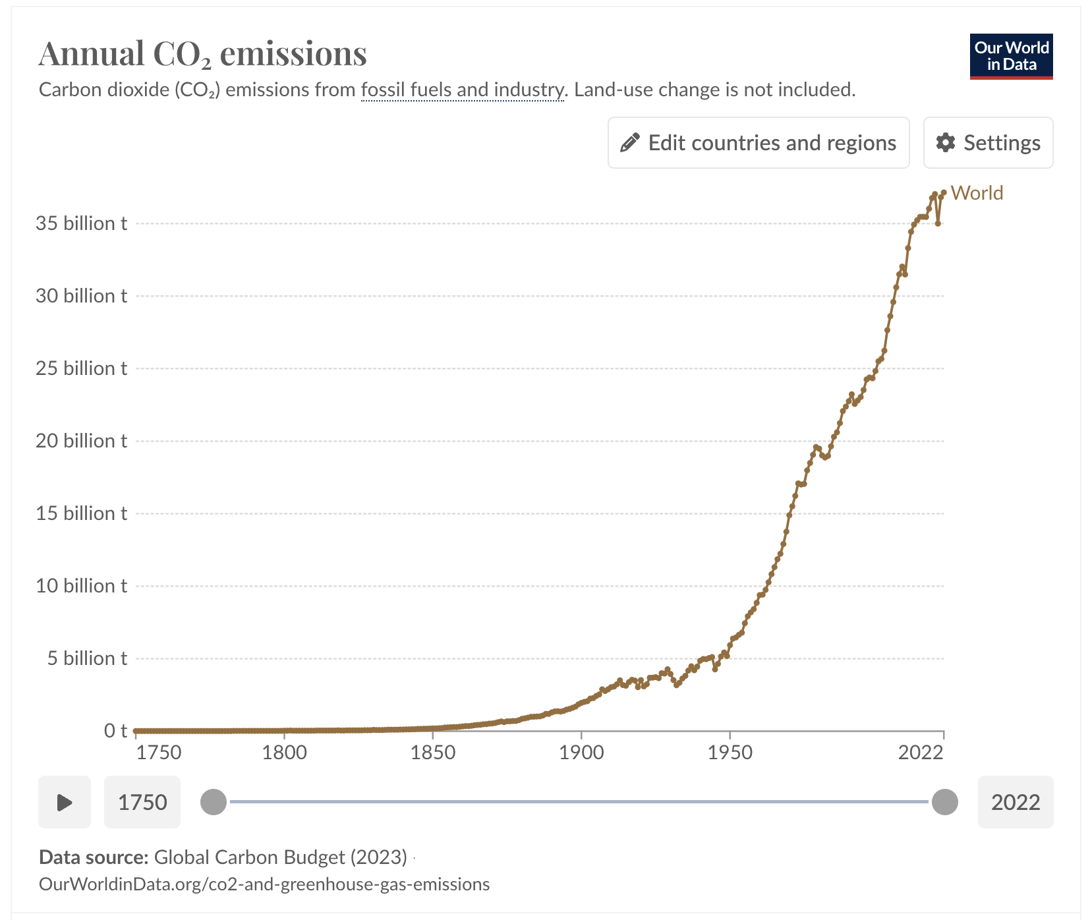
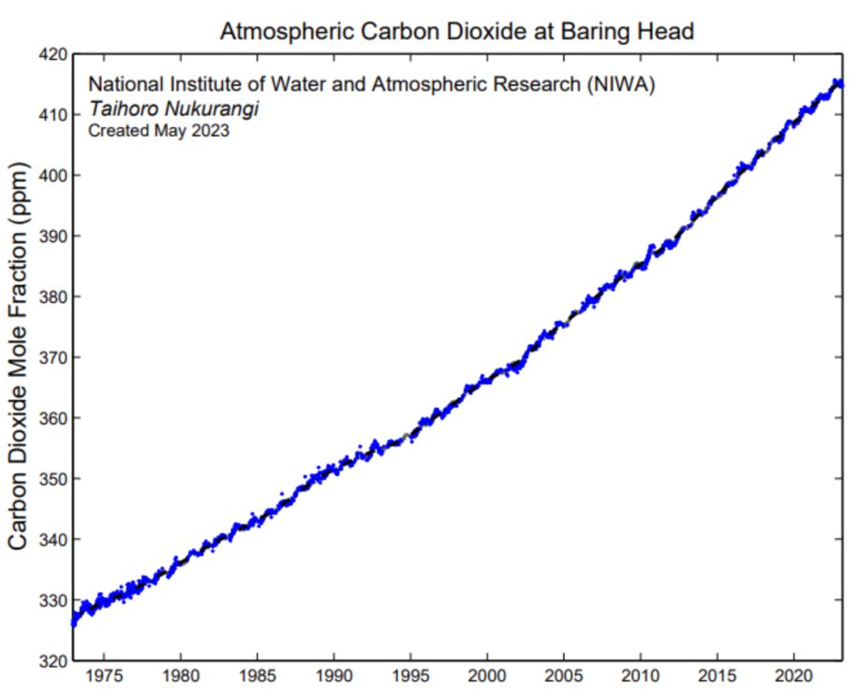
Recent history of the CO₂ concentration
    © NIWA, CC BY 4.0
© Copyright. Science Learning Hub – Pokapū Akoranga Pūtaiao The University of Waikato Te Whare Wananga o Waikato.
All Rights Reserved | www.sciencelearn.org.nz. All images are copyrighted. For further information, please refer to enquiries@sciencelearn.org.nz
Notes:
Image: NIWA: https://niwa.co.nz/atmosphere/carbon-dioxide
Terms of use: https://niwa.co.nz/about-niwa/terms

Slide 28
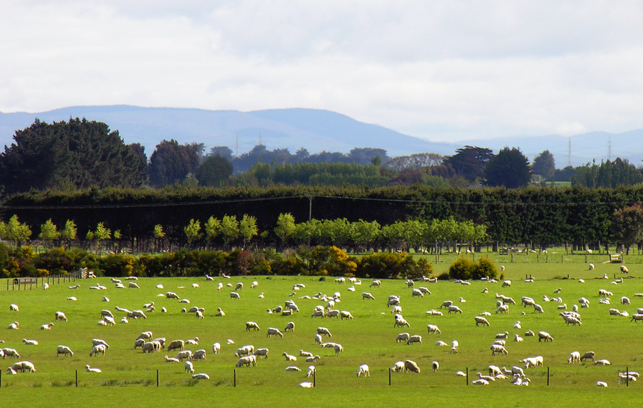
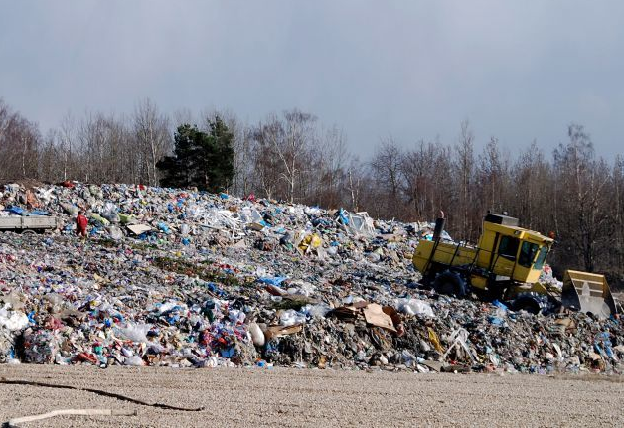
A look at methane (CH₄)
It is important for New Zealand!
Methane is added naturally to the biosphere from the decay of bio-matter and ruminant animal digestion.
Methane is removed by decay into CO₂ in the atmosphere, 12 years half-life.
Molecule for molecule, methane is 80 times more effective as a greenhouse gas than CO₂!
Today, methane is added in large amounts to the biosphere from leaks in gas wells, landfills and massive increase in ruminant animals. The amount of methane has increased rapidly due to human impacts.
© Phillip Capper, CC BY 2.0
© 123RF Ltd
© Copyright. Science Learning Hub – Pokapū Akoranga Pūtaiao The University of Waikato Te Whare Wananga o Waikato.
All Rights Reserved | www.sciencelearn.org.nz. All images are copyrighted. For further information, please refer to enquiries@sciencelearn.org.nz
Notes:
Link: https://www.sciencelearn.org.nz/resources/3132-methane-a-greenhouse-gas

Slide 29
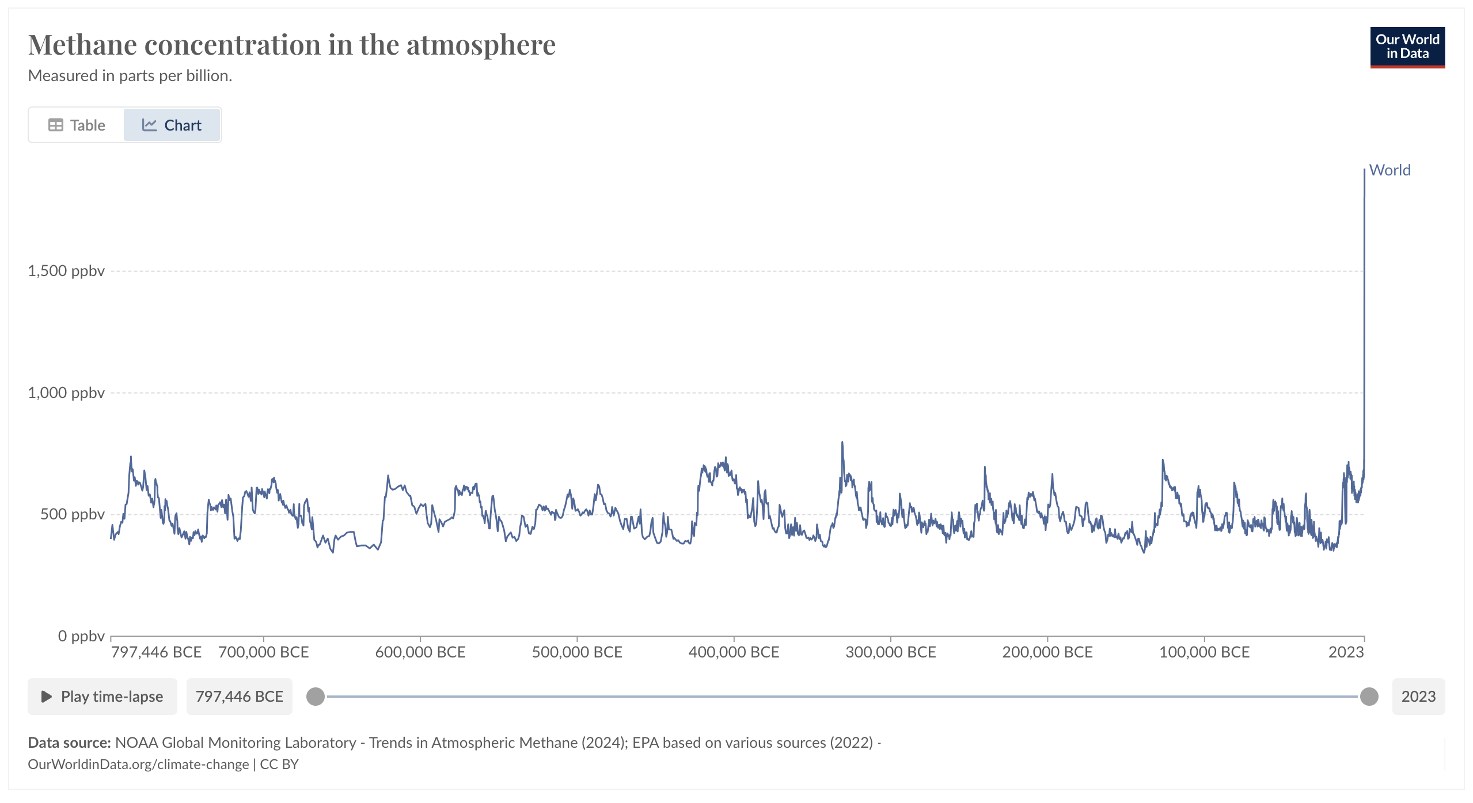
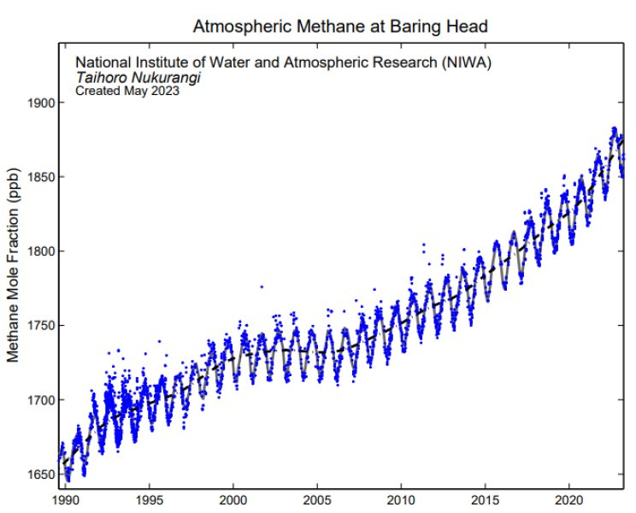
Methane concentration history
© NIWA, CC BY 4.0
© Copyright. Science Learning Hub – Pokapū Akoranga Pūtaiao The University of Waikato Te Whare Wananga o Waikato.
All Rights Reserved | www.sciencelearn.org.nz. All images are copyrighted. For further information, please refer to enquiries@sciencelearn.org.nz
Notes:
Previous option:
NIWA: https://niwa.co.nz/atmosphere/methane
Terms of use: https://niwa.co.nz/about-niwa/terms

Slide 30


Increasing the greenhouse gas concentration leads to warming
© Copyright. Science Learning Hub – Pokapū Akoranga Pūtaiao The University of Waikato Te Whare Wananga o Waikato.​
All Rights Reserved | www.sciencelearn.org.nz. All images are copyrighted. For further information, please refer to enquiries@sciencelearn.org.nz​
Notes:
https://www.sciencelearn.org.nz/videos/2001-greenhouse-gases-and-the-atmosphere

Slide 31
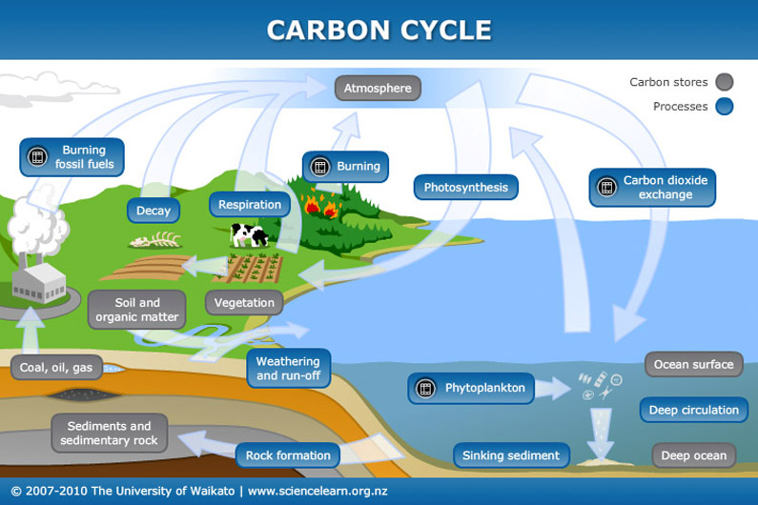
Carbon cycles through
Earth systems
Notes:
Link: https://www.sciencelearn.org.nz/resources/1569-carbon-cycle/ https://www.sciencelearn.org.nz/resources/689-the-ocean-and-the-carbon-cycle/https://www.sciencelearn.org.nz/resources/684-carbon-dioxide-in-the-atmosphere

Slide 32
Greenhouse gas increases lead to global warming
As the amount of these gases in the atmosphere increases, so too does the capacity to heat the Earth.
90% of the retained heat is stored in the oceans.
© Copyright. Science Learning Hub – Pokapū Akoranga Pūtaiao The University of Waikato Te Whare Wananga o Waikato.
All Rights Reserved | www.sciencelearn.org.nz. All images are copyrighted. For further information, please refer to enquiries@sciencelearn.org.nz

Slide 33
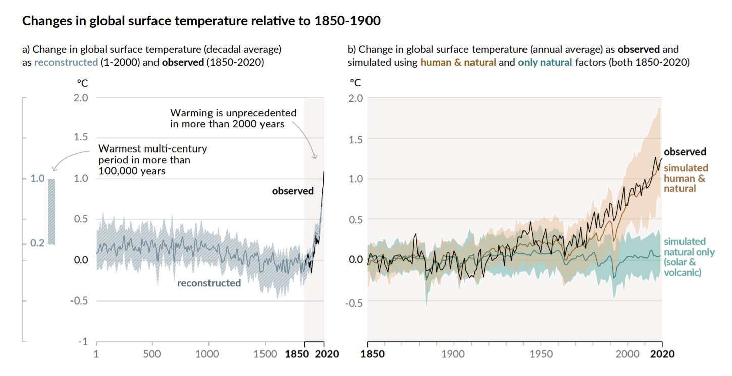
Global surface warming
IPCC AR6 2021
© Copyright. Science Learning Hub – Pokapū Akoranga Pūtaiao The University of Waikato Te Whare Wananga o Waikato.
All Rights Reserved | www.sciencelearn.org.nz. All images are copyrighted. For further information, please refer to enquiries@sciencelearn.org.nz

Slide 34
How does global warming affect our climate?
There are significant system and energy effects. Warmer land and water temperatures affect Earth and Human systems by:
Melting of glaciers and polar ice caps
Changing ocean circulation patterns
Changing weather patterns
Acceleration of the water cycle and increase in drought and flooding
Impacts on plants and animals, and broader ecosystems
Impacts on human health
© Copyright. Science Learning Hub – Pokapū Akoranga Pūtaiao The University of Waikato Te Whare Wananga o Waikato.
All Rights Reserved | www.sciencelearn.org.nz. All images are copyrighted. For further information, please refer to enquiries@sciencelearn.org.nz

Slide 35
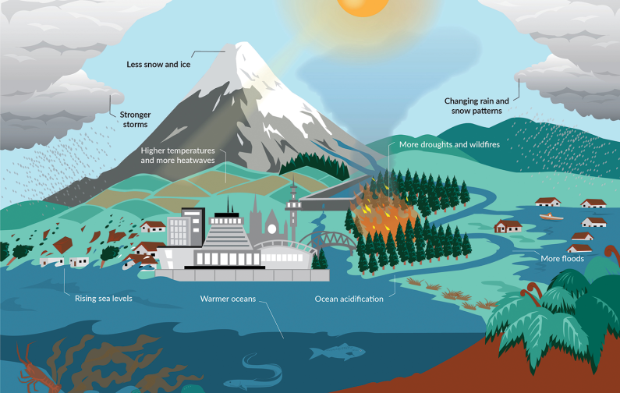
From global warming to climate change
Crown copyright © 2022.
Source: Aotearoa New Zealand’s first national adaptation plan. Wellington. Ministry for the Environment. 2022.
Notes:
Image: https://environment.govt.nz/publications/aotearoa-new-zealands-first-national-adaptation-plan/adapting-to-climate-change-our-long-term-strategy/

Slide 36
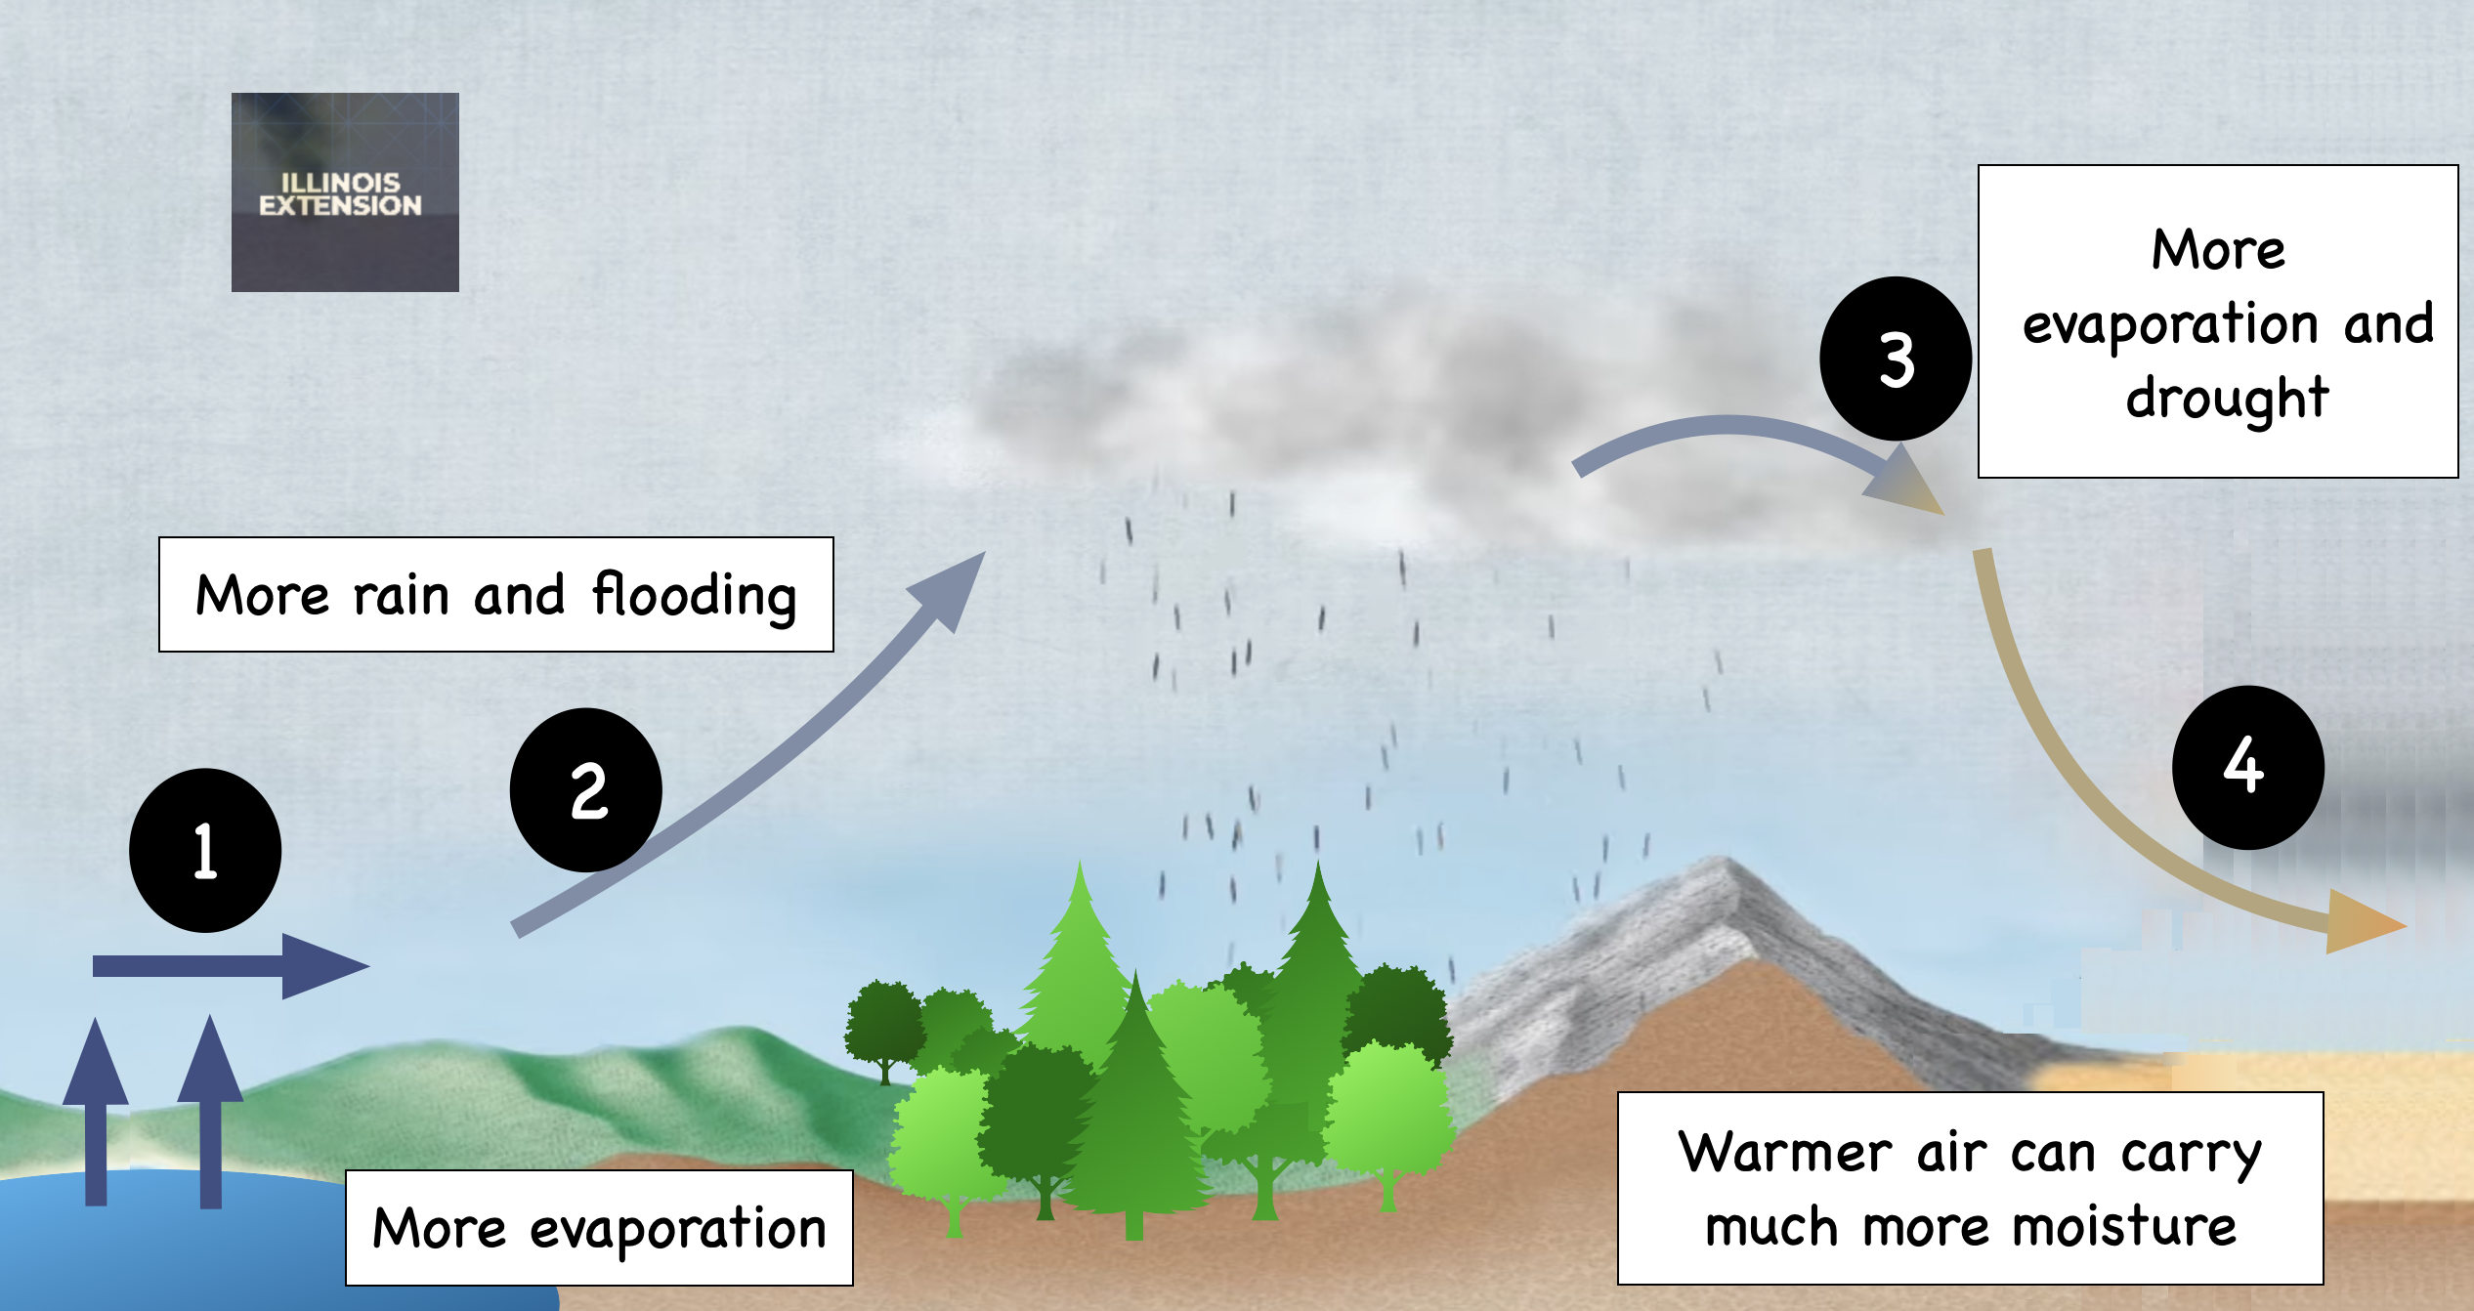
Changes to the water cycle: too much or too little
Regions that were wet already are getting wetter. Regions that were already dry are getting dryer.
© Copyright. Science Learning Hub – Pokapū Akoranga Pūtaiao The University of Waikato Te Whare Wananga o Waikato.
All Rights Reserved | www.sciencelearn.org.nz. All images are copyrighted. For further information, please refer to enquiries@sciencelearn.org.nz
Notes:
Image: https://www.sciencefocus.com/planet-earth/how-do-deserts-form/

Slide 37
Summary – we can start to understand climate change by exploring these ideas
Sun's light energy changes into heat energy
The role of greenhouse gases
The carbon cycle
© Copyright. Science Learning Hub – Pokapū Akoranga Pūtaiao The University of Waikato Te Whare Wananga o Waikato.
All Rights Reserved | www.sciencelearn.org.nz. All images are copyrighted. For further information, please refer to enquiries@sciencelearn.org.nz

Slide 38
Climate change requires us to change what we do
Mitigation – we must significantly reduce our emissions to slow, and eventually stop, temperature rise to slow climate change.
Adaptation – as greenhouse gas levels continue to rise, and will do so for some time, we must prepare to adapt to climate change.
© Copyright. Science Learning Hub – Pokapū Akoranga Pūtaiao The University of Waikato Te Whare Wananga o Waikato.
All Rights Reserved | www.sciencelearn.org.nz. All images are copyrighted. For further information, please refer to enquiries@sciencelearn.org.nz

Slide 39
So, what is the role of education in climate change?
Climate change education involves:
  developing knowledge about what climate change is and what impacts it has
  considering your own values and attitudes (and those of others) about climate change
  acting to mitigate (and if necessary, adapt to) climate change.
Education can help us learn how to act and empower us to do so!
© Copyright. Science Learning Hub – Pokapū Akoranga Pūtaiao The University of Waikato Te Whare Wananga o Waikato.
All Rights Reserved | www.sciencelearn.org.nz. All images are copyrighted. For further information, please refer to enquiries@sciencelearn.org.nz

Slide 40




Thanks – want to keep in touch?
Email us on enquiries@sciencelearn.org.nz
www.facebook.com/nzsciencelearn
https://nz.pinterest.com/nzsciencelearn
www.instagram.com/sciencelearninghubnz

