Slide 1
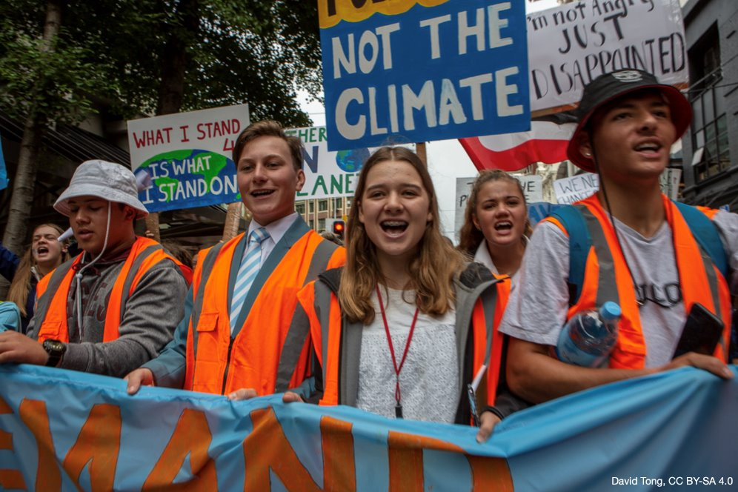
Exploring climate change education in primary schools
Associate Professor Chris Eames​
School of Education​, University of Waikato​
© Copyright. Science Learning Hub – Pokapū Akoranga Pūtaiao The University of Waikato Te Whare Wananga o Waikato.
All Rights Reserved | www.sciencelearn.org.nz. All images are copyrighted. For further information, please refer to enquiries@sciencelearn.org.nz

Slide 2
Index
Topic | Slideshow number(s ) | Video timecode
Welcome and index | 1–2 | 00:00
Introducing the Science Learning Hub, NZASE and Dr Chris Eames | 3–8 | 00:48
What is climate change education? | 9–11 | 04:13
Building blocks: years 1–3, 4–6 and 7–8 | 12–18 | 07:38
Pedagogy for climate change | 19 | 20:14
Nature connection, Mātauranga Māori, and Systems and critical thinking | 20–25 | 20:59
Solutions and hope | 26–30 | 28:43
Decision making and action taking | 31–34 | 33:05
Teacher and student wellbeing | 35–37 | 36:43
Teaching towards climate change | 38–39 | 40:00
Resources | 40–42 | 41:45
SLH links, keep in touch and thanks | 43 | 43:16

Slide 3
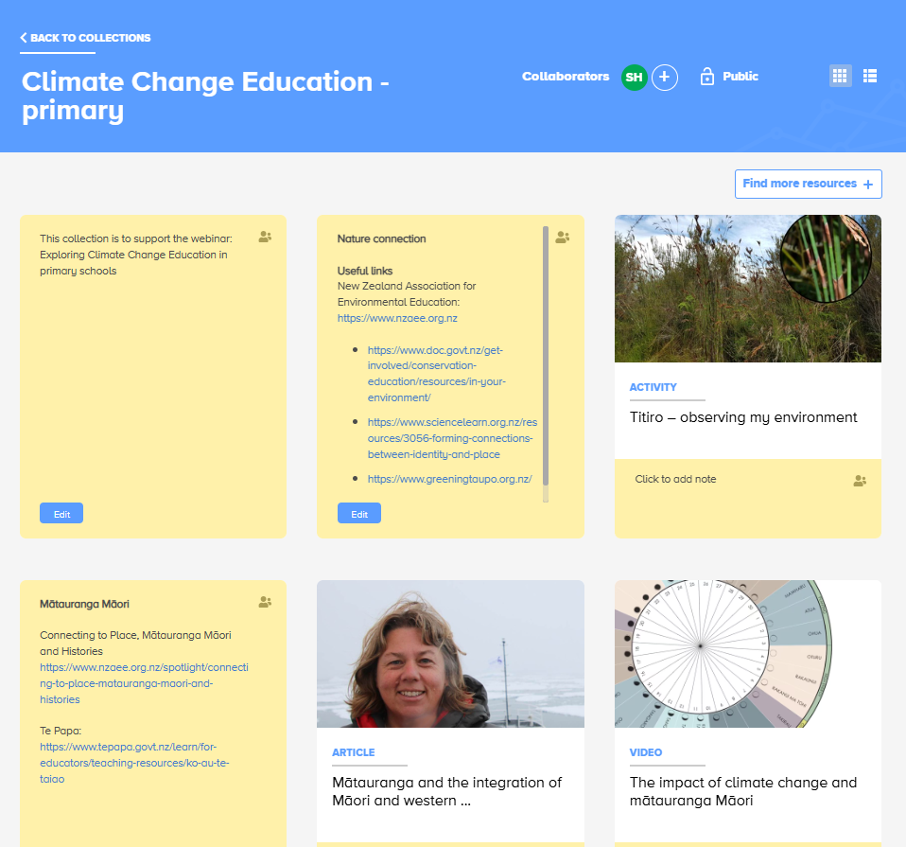
Links and resources
https://bit.ly/CCEprimary
© Copyright. Science Learning Hub – Pokapū Akoranga Pūtaiao The University of Waikato Te Whare Wananga o Waikato.
All Rights Reserved | www.sciencelearn.org.nz. All images are copyrighted. For further information, please refer to enquiries@sciencelearn.org.nz

Slide 4

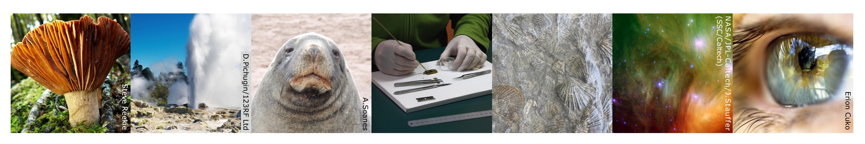
The Science Learning Hub
A trustworthy online resource – produced by educators and scientists
Based on world-class New Zealand science research
Supported by learning activities, information about the key science ideas and concepts, multimedia tools and other resources
Written for New Zealand teachers and students

Slide 5


© Copyright. Science Learning Hub – Pokapū Akoranga Pūtaiao The University of Waikato Te Whare Wananga o Waikato.
All Rights Reserved | www.sciencelearn.org.nz. All images are copyrighted. For further information, please refer to enquiries@sciencelearn.org.nz

Slide 6
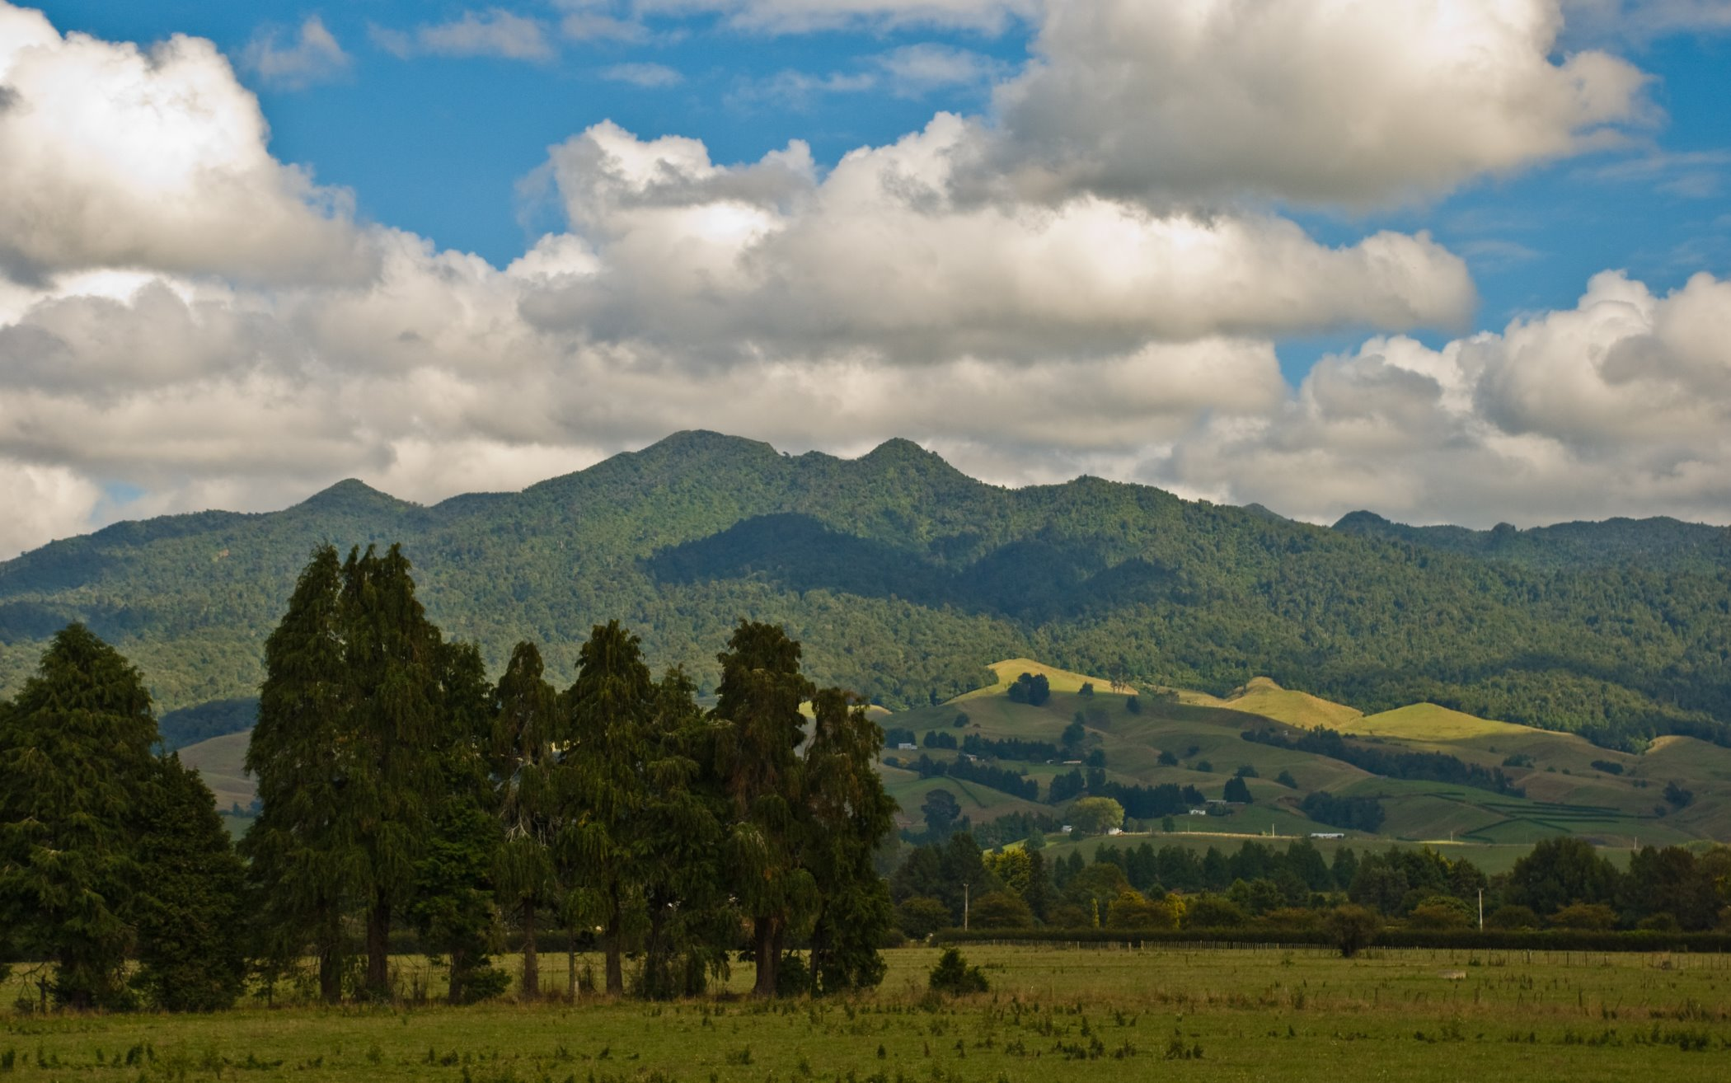
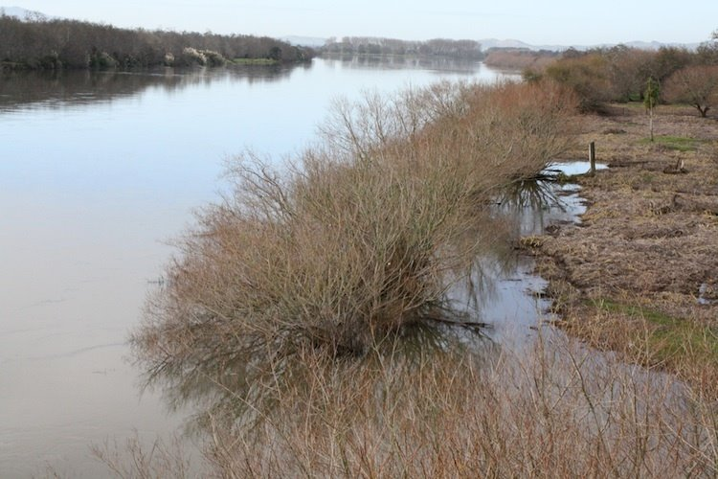
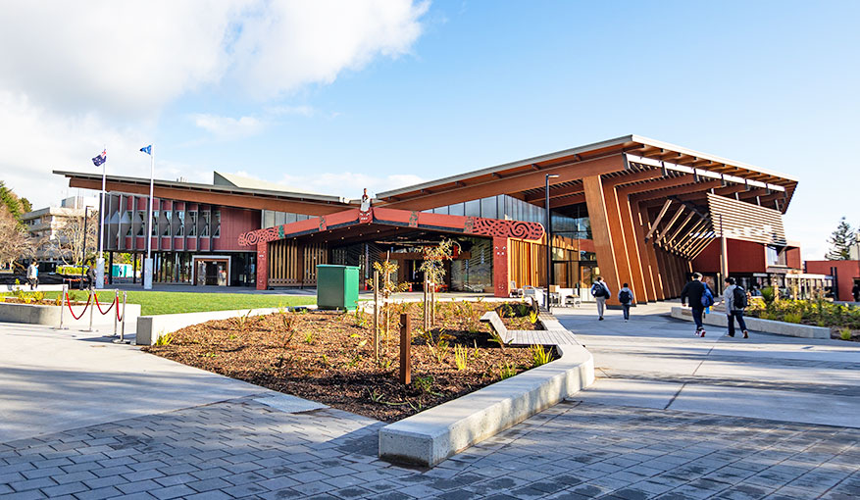
Pēpeha
Ko Pirongia te maunga e rū nei taku ngākau
Ko Waikato te awa e mahea nei taku māharahara
Kei te Whare Wānanga o Waikato e mahi ana
Ko Chris Eames toku ingoa
© Phillip Capper/CC BY 2.0​
^{Science Learning Hub,}
^{© The University of Waikato}
^{Te Whare Wānanga o Waikato}
© The University of Waikato Te Whare Wānanga o Waikato

Slide 7
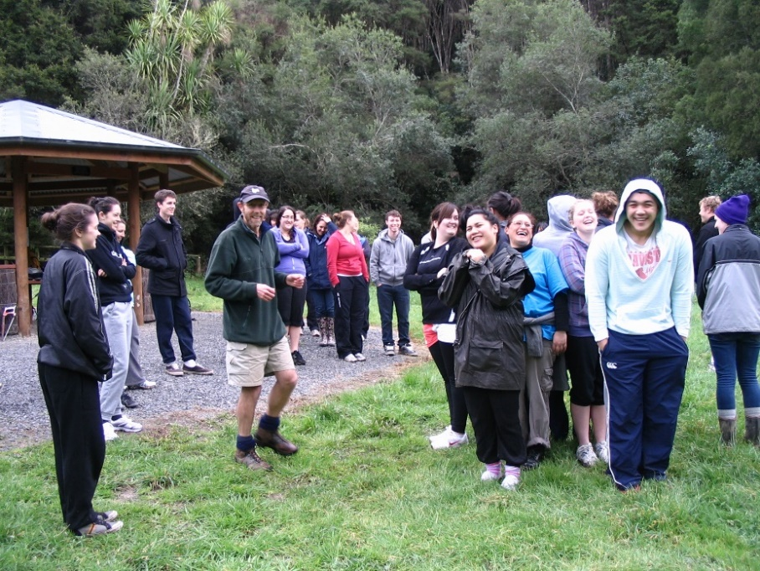
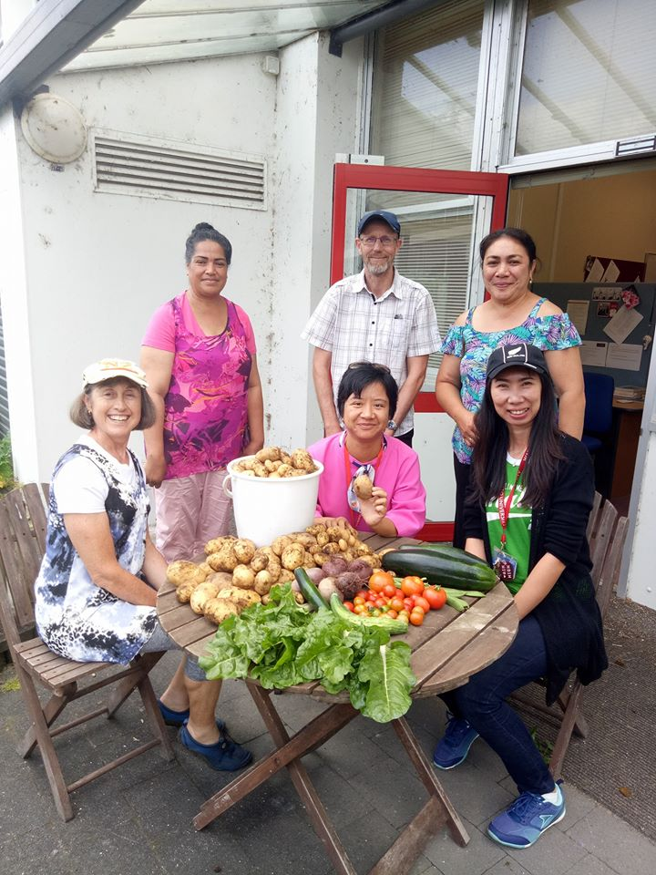
Ko wai au/ Who am I?
I am an environmental and sustainability educator at the University of Waikato
© THE UNIVERSITY OF WAIKATO • TE WHARE WANANGA O WAIKATO

Slide 8

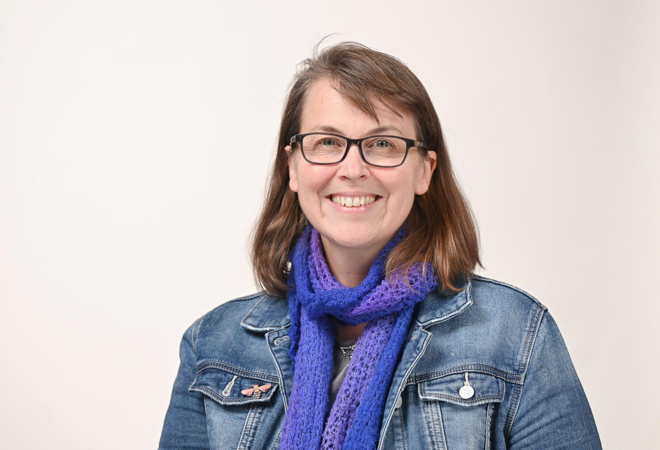



PISA framework:
Agency in the Anthropocene
Name | Organisation
Associate Professor Peta White | Deakin University, Australia
Professor Martha Monroe | University of Florida, USA
Associate Professor Chris Eames | University of Waikato, New Zealand
Associate Professor Nicole Ardoin | Stanford University, USA
© THE UNIVERSITY OF WAIKATO • TE WHARE WANANGA O WAIKATO

Slide 9
Recap from last week's webinar
Three key ideas from climate science:
  Sun's light energy changes into heat energy
  The role of greenhouse gases
  The carbon cycle
Responses to climate change are mitigation and adaptation
Education is crucial for both
© Copyright. Science Learning Hub – Pokapū Akoranga Pūtaiao The University of Waikato Te Whare Wananga o Waikato.
All Rights Reserved | www.sciencelearn.org.nz. All images are copyrighted. For further information, please refer to enquiries@sciencelearn.org.nz

Slide 10
Our plan this afternoon
Climate change curriculum
Climate change pedagogy
Resources to help you

Slide 11
What is climate change education?
Climate change education aims to develop climate literacy by:
  Developing understanding of how the climate system works, how human actions influence climate, and the impacts of climate change.
  Considering diverse value systems, ways of knowing and evidence about climate change
  Making informed and just decisions to act to mitigate (and, if necessary, adapt to) climate change.
Therefore, science is key, but so are other learning areas.
© Copyright. Science Learning Hub – Pokapū Akoranga Pūtaiao The University of Waikato Te Whare Wananga o Waikato.
All Rights Reserved | www.sciencelearn.org.nz. All images are copyrighted. For further information, please refer to enquiries@sciencelearn.org.nz

Slide 12
In primary school, let's not start with climate change!
Learning about climate change in early primary years is very challenging, so let's not do it.
Instead, we can focus on the building blocks that will prepare students for understanding and acting for climate change.
But you may need to be prepared in case a younger student brings it up in your class.
So, what building blocks can we work on?

Slide 13
Years 1–3
Me and my environment
Science remains key to underpinning learning
Explore a variety of common life forms and their needs for life in their habitat L1/2
Understand where natural resources come from L2
Understand weather and what causes it L2/3
Develop science capabilities – see https://newzealandcurriculum.tahurangi.education.govt.nz/five-science-capabilities/5637164183.p

Slide 14
Years 1–3
Me and my environment
Other learning areas are also important. Some examples:
Social sciences
  Understand roles and responsibilities L2
  Understand people make choices about wants and needs L2
Understand interactions between technology and society L2
Explore attitudes, values and actions which contribute to healthy physical and social environments L2

Slide 15
Years 4–6
Carbon, Human impact and Justice
Explore the carbon cycle, including sources and sinks of carbon dioxide and methane L3/4
Understand how matter changes between solid, liquid and gas L3/4
Understand the water cycle and the difference between weather and climate L3
Examine human impacts on living things and their habitats L3/4
Explore sources and forms of energy L3/4

Slide 16
Years 4–6
Carbon, Human impact and Justice
Social sciences
  Explore ideas of equity and justice L3/4
  Understand that events have causes and effects L4
  Make decisions about access to and use of resources e.g. food, water L3
  Understand how people view and use places differently L3
  Understand how commerce works L3/4
Technology
  Understand the process of innovation L4
Health
  Explore factors that contribute to wellbeing L4

Slide 17
Years 7–8
Greenhouse gases, global warming and action
Explore how certain gases contribute to a greenhouse effect in the atmosphere L4
Understand that light energy transforms to heat energy L4
Investigate how heat is distributed around the Earth L5
Begin to think about ecosystems and interdependence L5

Slide 18
Years 7–8
Greenhouse gases, global warming and action
Social sciences
  Understand how people participate individually and collectively in response to community challenges L4
  Understand how economic decisions impact communities L5
Technology
  Understand how technology draws on a number of disciplines and perspectives L4
Health
  Investigate aspects of school and environment that affect people's wellbeing and take action to enhance these L5

Slide 19
Pedagogy for climate change
There are typical approaches that teachers use such as experimental/experiential and inquiry/project work, but we would like to emphasise these six aspects as well:
  Nature connection
  Mātauranga Māori
  Systems and critical thinking
  Solutions focus and hope
  Decision making and action taking
  Teacher and student wellbeing

Slide 20
Nature connection
Why is this important?
  Many socio-ecological challenges, such as climate change, are caused, or at least contributed to, by a disconnect between people and nature
  People ARE part of nature – it is us and we are it!
How can it be done?
  Spending time in nature is an important start
  Knowledge about nature (plants, animals, weather, seasons) builds understanding
  Connecting emotionally to create value positions
  In Aotearoa, the importance of te ao Māori
See Nature Connection at https://www.nzaee.org.nz/resources

Slide 21
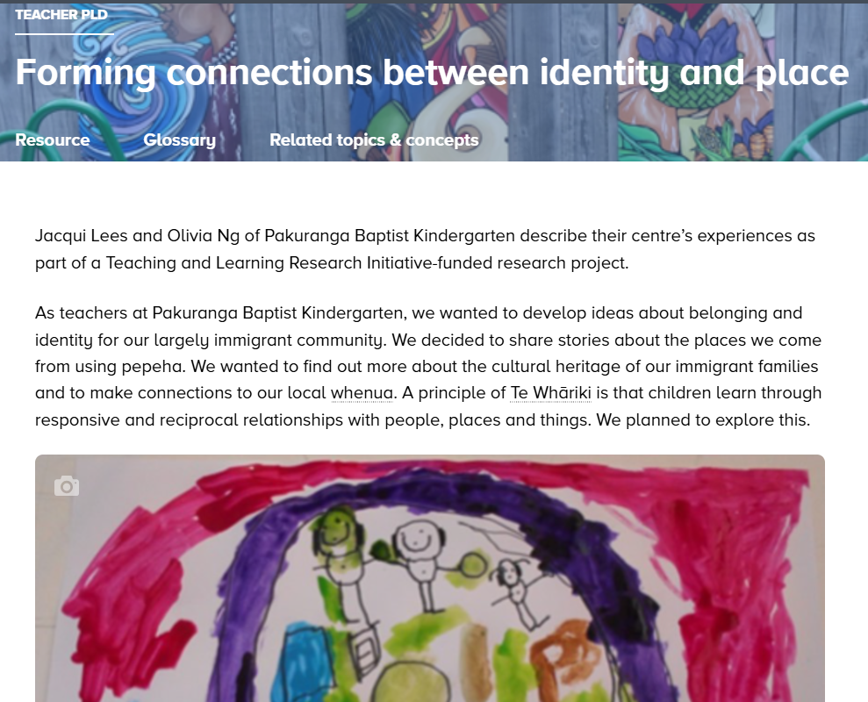
Connecting to nature
https://www.sciencelearn.org.nz/resources/3056-forming-connections-between-identity-and-place ​
© Copyright. Science Learning Hub – Pokapū Akoranga Pūtaiao The University of Waikato Te Whare Wananga o Waikato.
All Rights Reserved | www.sciencelearn.org.nz. All images are copyrighted. For further information, please refer to enquiries@sciencelearn.org.nz
Notes:
https://www.sciencelearn.org.nz/resources/3056-forming-connections-between-identity-and-place

Slide 22
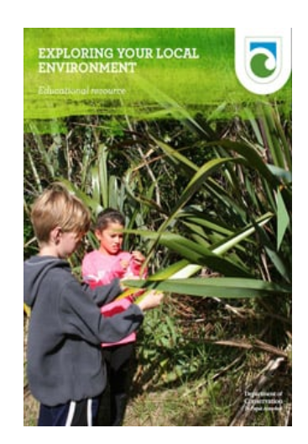
Connecting to nature
https://www.doc.govt.nz/get-involved/conservation-education/resources/in-your-environment/
© Copyright. Science Learning Hub – Pokapū Akoranga Pūtaiao The University of Waikato Te Whare Wananga o Waikato.
All Rights Reserved | www.sciencelearn.org.nz. All images are copyrighted. For further information, please refer to enquiries@sciencelearn.org.nz

Slide 23
Mātauranga Māori
Why is this important?
  Honouring Te Tiriti o Waitangi
  An alternative way of knowing which can change perspectives and engage learners
  A sustainable view of ecosystems and natural resource use e.g. rahui, tapu
How can it be done?
  Connect to place through local iwi/hapū
  May include pūrākau and story telling
  Complements 'Western' science
See https://www.nzaee.org.nz/spotlight/connecting-to-place-matauranga-maori-and-histories
https://www.sciencelearn.org.nz/resources/2858-matauranga-and-the-integration-of-maori-and-western-knowledge

Slide 24
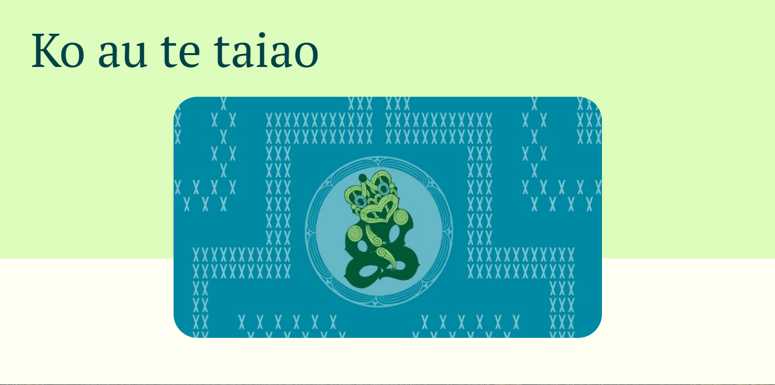
Ko au te taiao: Recognising that we are nature through mātauranga Māori values and the collections at Te Papa
https://www.nzaee.org.nz/resources/ko-au-te-taiao

Slide 25
Systems and critical thinking
Why is this important?
  Learning can sometimes just show parts of systems
  Parts of systems are connected and affect each other
  Human systems impact Earth systems
  Causes of these impacts can be considered in senior primary.
How can it be done?
  Role plays and simulations/games can help visualise systems
  Mind maps can assist seeing connections.

Slide 26
Solutions and hope
Why is this important?
  Tamariki will confront problems in their lives
  A solution focus fosters hope and agency.
How can it be done?
  Students explore the causes of local environmental problems
  Inquire into possible solutions and discuss their pros and cons
  Underpin teaching and learning with hope for the future.

Slide 27
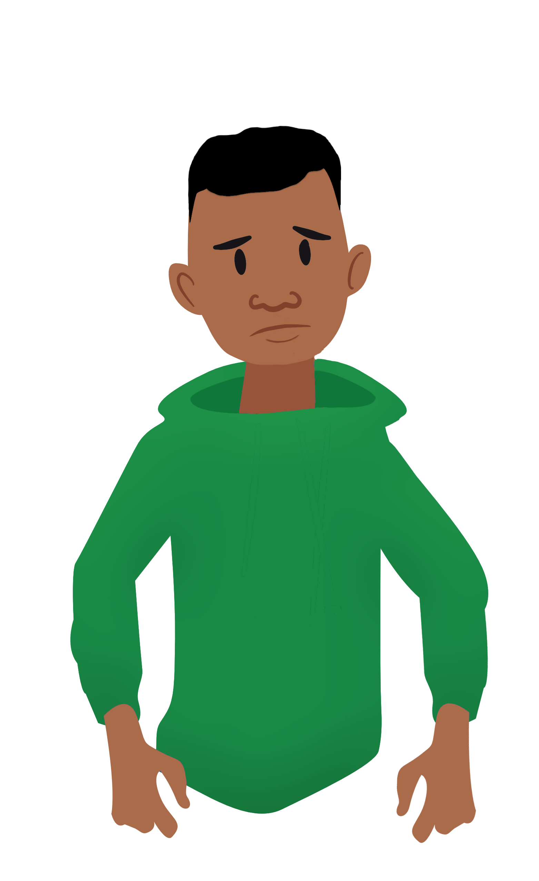

As teachers, we must not burden young people
Yes, heavy rain may cause your house to flood again and there is nothing we can do about it.
I am worried when it rains that we may have to leave our house again.
Anxiety
Adapted from Professor Niki Harre, University of Auckland

Slide 28
As teachers, we can be passive
There are lots of adults concerned about flooding. They have it all under control. No need for you to worry because soon we will have the technology to solve these problems.
I am worried when it rains that we may have to leave our house again.
Complacent
hope
Adapted from Professor Niki Harre, University of Auckland

Slide 29
We need to motivate with hope
There are lots of people working very hard on solutions to flooding. In Aotearoa scientists, engineers, teachers, community leaders are getting together. People have solved really hard problems before. You can help too.
I am worried when it rains that we may have to leave our house again.
Motivational
hope
Adapted from Professor Niki Harre, University of Auckland

Slide 30
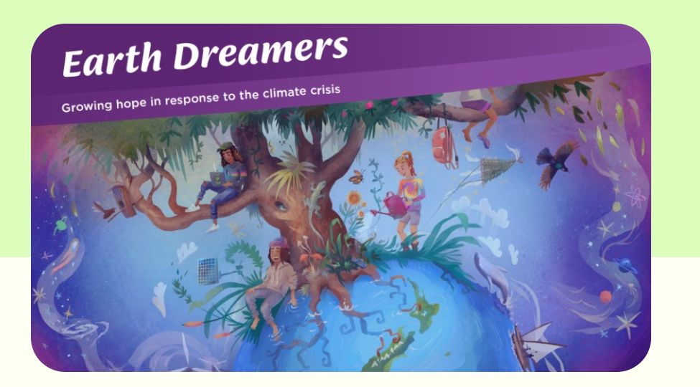
Earth Dreamers: Growing hope in response to the climate crisis
Earth Dreamers is designed to support the social sciences curriculum for teachers of years 7–8 ākonga and encourages teachers and ākonga to explore the complex global issue of the climate crisis within their local contexts in ways that foster joy and agency, curiosity, and hope.
https://newzealandcurriculum.tahurangi.education.govt.nz/earth-dreamers/5637221089.p
Notes:
https://newzealandcurriculum.tahurangi.education.govt.nz/earth-dreamers/5637221089.p

Slide 31
Decision making and action taking
Why is this important?
  Young people will be the decision-makers of the future
  It is part of the key competency of participating and contributing
  Change is needed and action must therefore be taken.
How can it be done?
  Learn the processes of decision-making
  Practice decision-making through debates, role plays
  Plan for action on local issues, take action, reflect on action
  Individual action AND collective action.

Slide 32
We can distinguish activity from action by focus and input
 | No student input | Student input in deciding what to do
Activity focused on a symptom of climate change | ACTIVITY | ACTIVITY
Activity targeted at the cause of climate change | ACTIVITY | ACTION
See McLean, T. (2003) Environmental education in Otago primary schools: Education for the environment? Set, 1, 4-9.

Slide 33
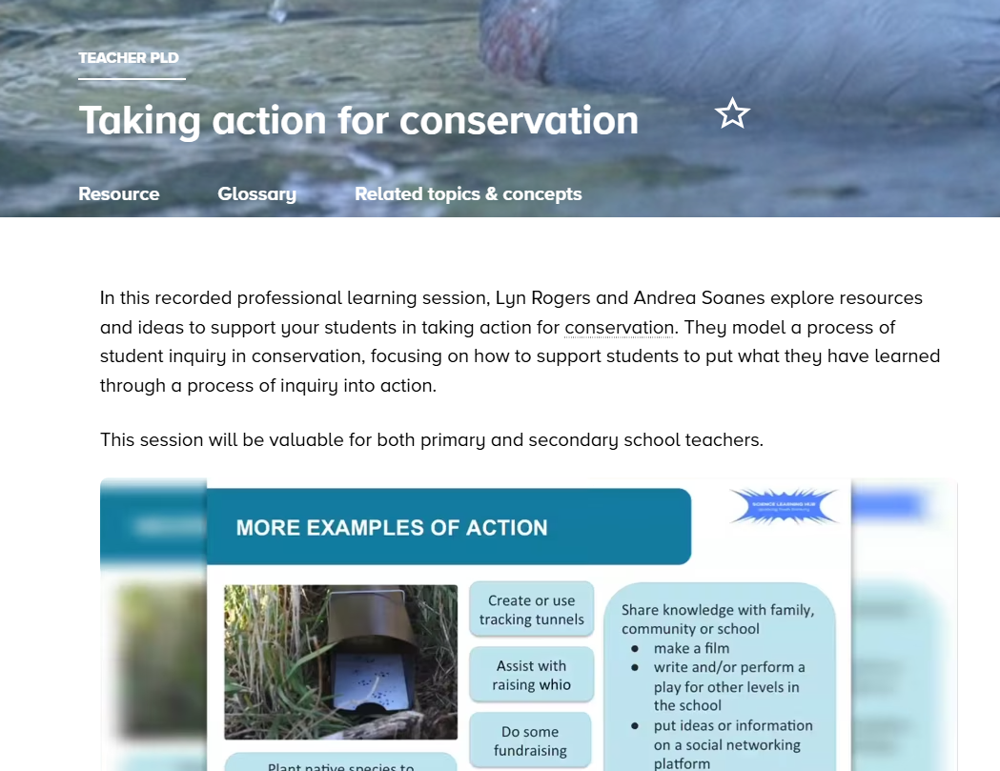
Agency and action
© Copyright. Science Learning Hub – Pokapū Akoranga Pūtaiao The University of Waikato Te Whare Wananga o Waikato.
All Rights Reserved | www.sciencelearn.org.nz. All images are copyrighted. For further information, please refer to enquiries@sciencelearn.org.nz
Notes:
https://www.sciencelearn.org.nz/resources/2385-taking-action-for-conservation

Slide 34
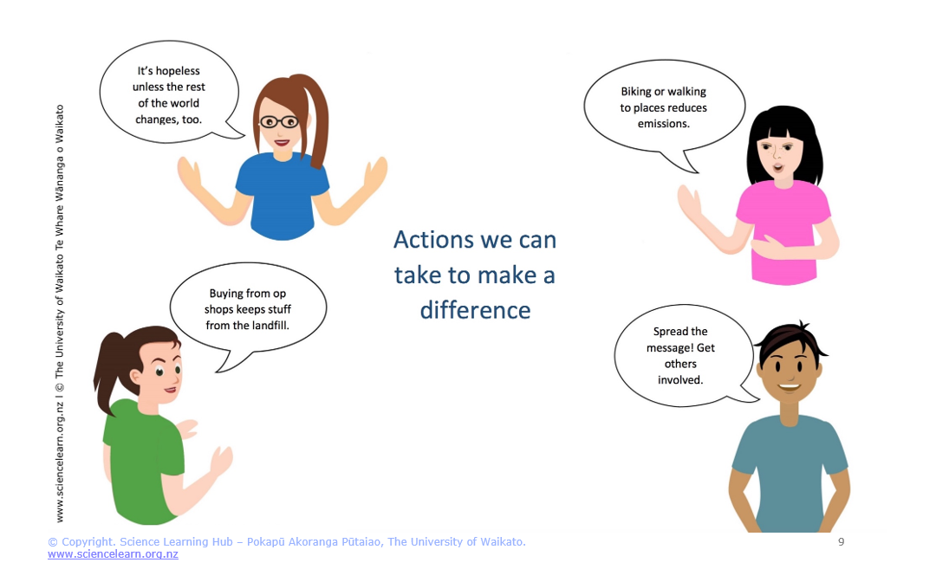
Concept cartoons
© Copyright. Science Learning Hub – Pokapū Akoranga Pūtaiao The University of Waikato Te Whare Wananga o Waikato.
All Rights Reserved | www.sciencelearn.org.nz. All images are copyrighted. For further information, please refer to enquiries@sciencelearn.org.nz
Notes:
https://www.sciencelearn.org.nz/resources/2971-climate-change-challenging-conversations

Slide 35
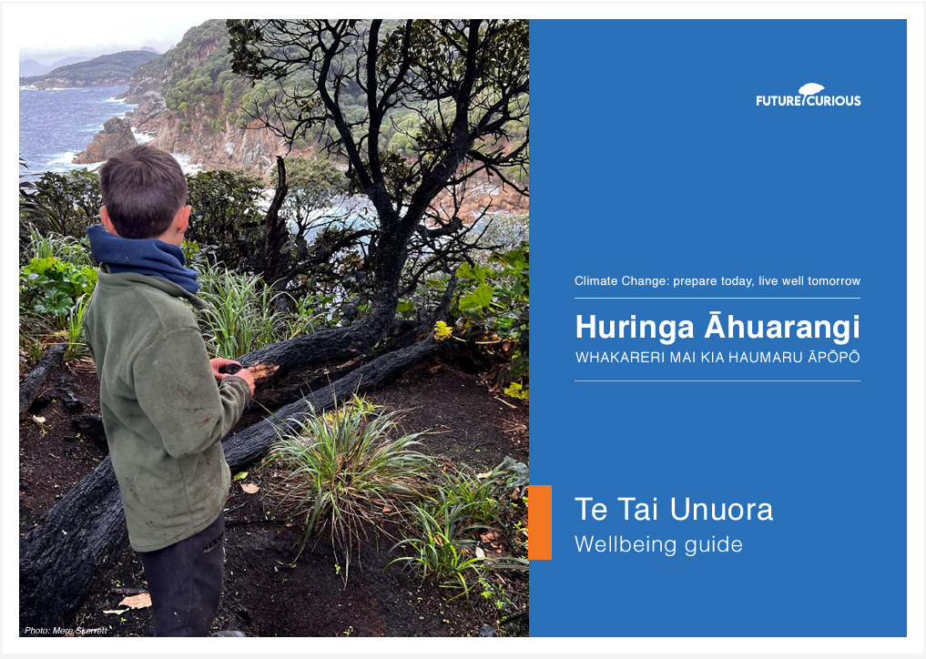
Teacher wellbeing
Why is this important?
  we can feel conflicted about teaching for a future that could be quite challenging
  we can struggle with the complexity of climate change and whether we are teaching it well
  we may experience apathy or even resistance from colleagues, leadership and parents.
© NZAEE
https://www.nzaee.org.nz/resources/climate-change-learning-programme
© Copyright. Science Learning Hub – Pokapū Akoranga Pūtaiao The University of Waikato Te Whare Wananga o Waikato.
All Rights Reserved | www.sciencelearn.org.nz. All images are copyrighted. For further information, please refer to enquiries@sciencelearn.org.nz
Notes:
Student and teacher wellbeing
Link to Sian's guide: https://www.nzaee.org.nz/resources/climate-change-learning-programme
Image: https://global-uploads.webflow.com/61b2ca7b222b886bdf7e6a01/63378017fbac72c8a70aea3d_CC%20Wellbeing%20Guide%20FINAL.pdf

Slide 36
Teacher wellbeing
How can it be done?
  we need to first look after ourselves
  beware of algorithms of gloom
  seek peer support.
© NZAEE
https://www.nzaee.org.nz/resources/climate-change-learning-programme
© Copyright. Science Learning Hub – Pokapū Akoranga Pūtaiao The University of Waikato Te Whare Wananga o Waikato.
All Rights Reserved | www.sciencelearn.org.nz. All images are copyrighted. For further information, please refer to enquiries@sciencelearn.org.nz
Notes:
Student and teacher wellbeing
Link to Sian's guide: https://www.nzaee.org.nz/resources/climate-change-learning-programme
Image: https://global-uploads.webflow.com/61b2ca7b222b886bdf7e6a01/63378017fbac72c8a70aea3d_CC%20Wellbeing%20Guide%20FINAL.pdf

Slide 37
Student wellbeing
Why is this important?
  climate anxiety is real
  anxiety stifles hope and action.
How can it be done?
  provide motivational hope, manage anxiety
  provide examples of what others are already doing to address climate change
  be open about the challenges and be alert to student responses
  specifically consider Māori and Pacific student wellbeing
  use avenues of wellbeing support that are available.
© NZAEE
https://www.nzaee.org.nz/resources/climate-change-learning-programme
© Copyright. Science Learning Hub – Pokapū Akoranga Pūtaiao The University of Waikato Te Whare Wananga o Waikato.
All Rights Reserved | www.sciencelearn.org.nz. All images are copyrighted. For further information, please refer to enquiries@sciencelearn.org.nz
Notes:
Student and teacher wellbeing
Link to Sian's guide: https://www.nzaee.org.nz/resources/climate-change-learning-programme
Image: https://global-uploads.webflow.com/61b2ca7b222b886bdf7e6a01/63378017fbac72c8a70aea3d_CC%20Wellbeing%20Guide%20FINAL.pdf

Slide 38
Teaching towards climate change
An example of teaching towards climate change at year 3, involving science, social sciences and health.
Students undertake teacher-guided inquiry into the patterns of weather in their local region.
Students explore the variety of natural and human built environments in that region.
Students share their thoughts and feelings about how weather patterns may affect these environments, plants and animals (including people) within them eg sports, farming, rivers.
Students consider what might happen/has happened in their region if extreme weather events like floods, drought, heatwaves occur.

Slide 39
Teaching towards climate change
An example of teaching towards climate change at Year 6, involving science, social sciences and technology
Students undertake teacher-guided inquiry into harvesting of wind energy in their local region
Students explore how the region is suited to wind energy generation
Students explore the technology and economics behind wind energy generation
Students investigate the feelings of local residents about having a wind farm on their local hillsides
Students debate the pros ann cons of having a wind farm in their community

Slide 40
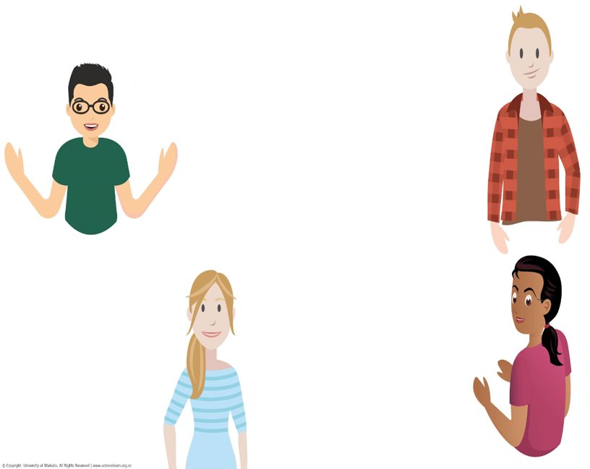
Resources
There are many resources available to help you!
www.thinksustainably.co.nz there are a number of sustainability resources on this site that leverage off the school journals to get kids to think sustainably, inclusive of Climate change.
I love the NIWA games about sea level rise.
World's Largest Lesson – great resource for ownership/agency
House of Science has a climate change kit & Science Alive has related lessons
https://shsenvironmental.blogspot.com/search?q=climate
This is some of our previous learning. I took a year off teaching Climate Change explicitly. Previously found the unit put out by the MOE a great mix of digital and hands on learning that integrated science, literacy, numeracy and health aspects well.
Climate Change Learning Programme on NZAEE, various research and resources also available on NZAEE.
Notes:
Ideas from participants
https://www.thinksustainably.co.nz/
https://niwa.co.nz/about-niwa/resources-teachers
https://worldslargestlesson.globalgoals.org/
https://shsenvironmental.blogspot.com/search?q=climate
https://www.nzaee.org.nz/resources/climate-change-learning-programme
https://houseofscience.nz/
https://www.sciencealive.co.nz/

Slide 41
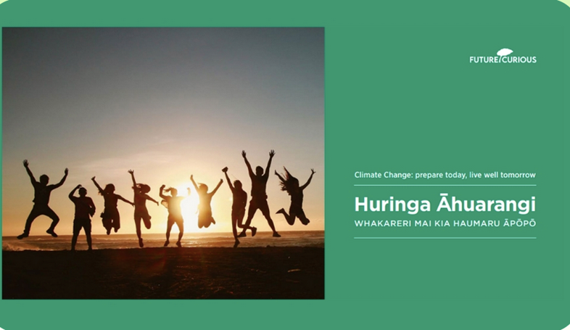
Climate Change Learning Programme
For learners aged 10–14 years
Development led by Future Curious
Continuously reviewed and updated
Aotearoa contexts and Mātauranga Māori
Consists of:
User Guide
Eight learning modules
Te Tai Unuora (Wellbeing Guide)
Registration process needed to access full resource – free for teachers
© NZAEE
https://www.nzaee.org.nz/resources/climate-change-learning-programme
© Copyright. Science Learning Hub – Pokapū Akoranga Pūtaiao The University of Waikato Te Whare Wananga o Waikato.
All Rights Reserved | www.sciencelearn.org.nz. All images are copyrighted. For further information, please refer to enquiries@sciencelearn.org.nz

Slide 42
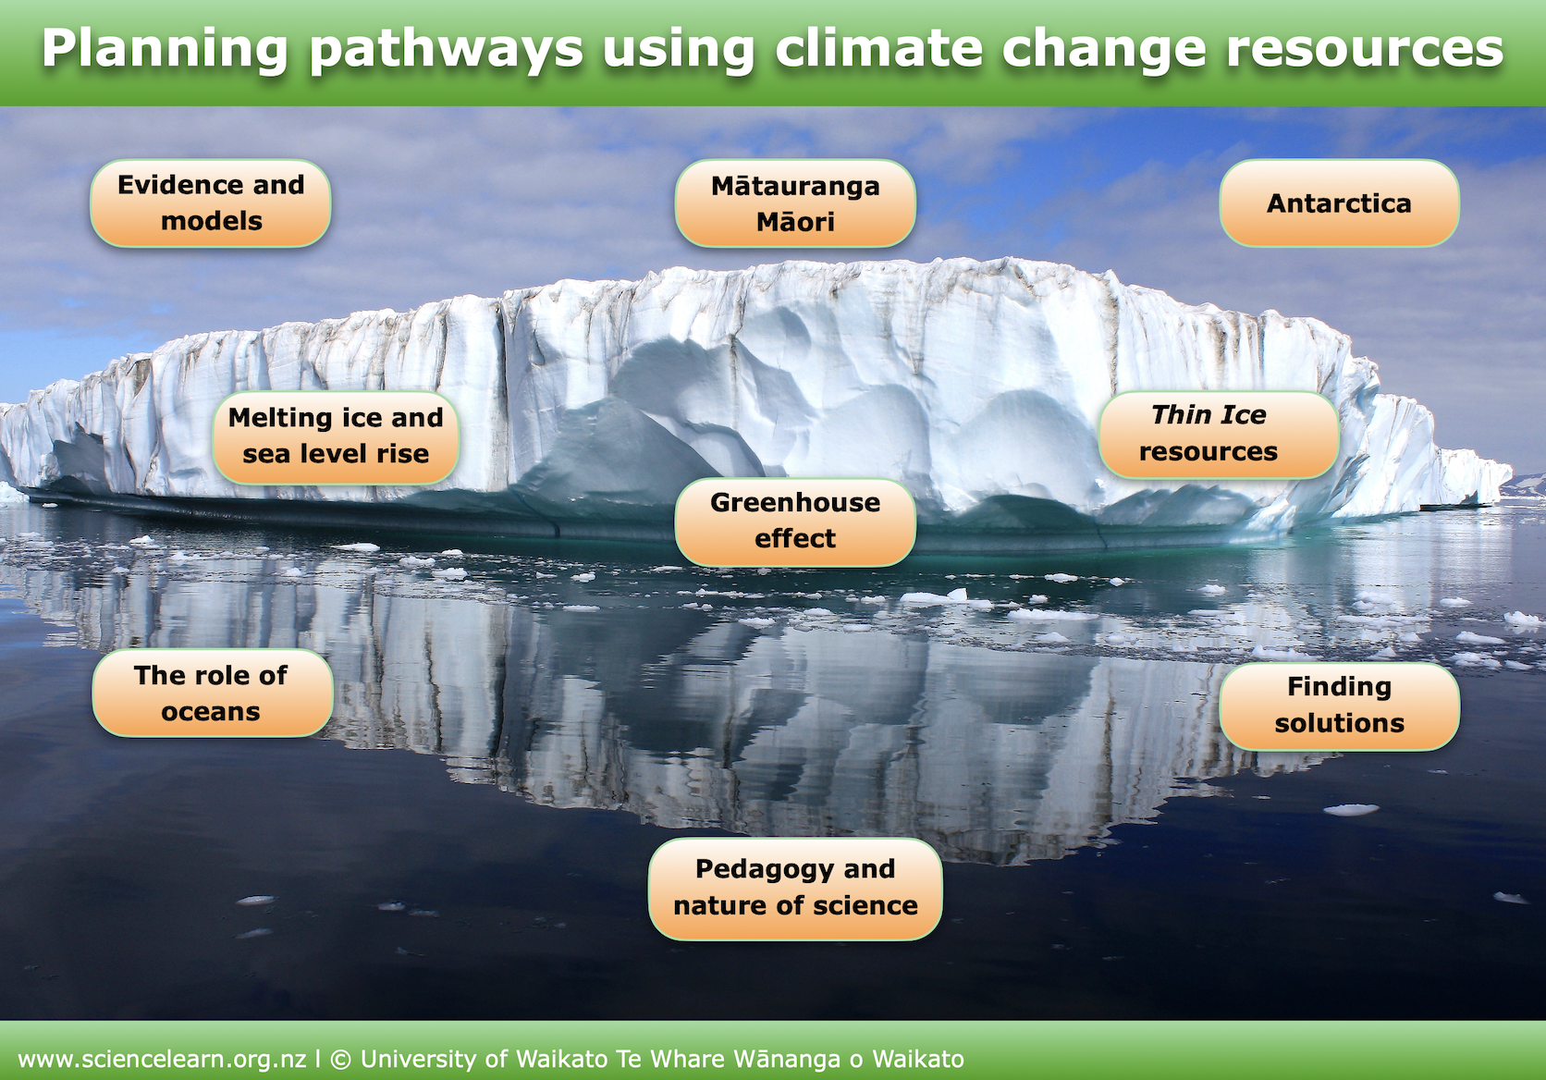
Science Learning Hub resources
www.sciencelearn.org.nz/resources/2639-climate-change-resources-planning-pathways
Notes:
https://www.sciencelearn.org.nz/resources/2639-climate-change-resources-planning-pathways

Slide 43




Thank you – stay connected
 | Email us on: enquiries@sciencelearn.org.nz
 | www.facebook.com/nzsciencelearn
 | https://nz.pinterest.com/nzsciencelearn
 | www.instagram.com/sciencelearninghubnz

