Slide 1
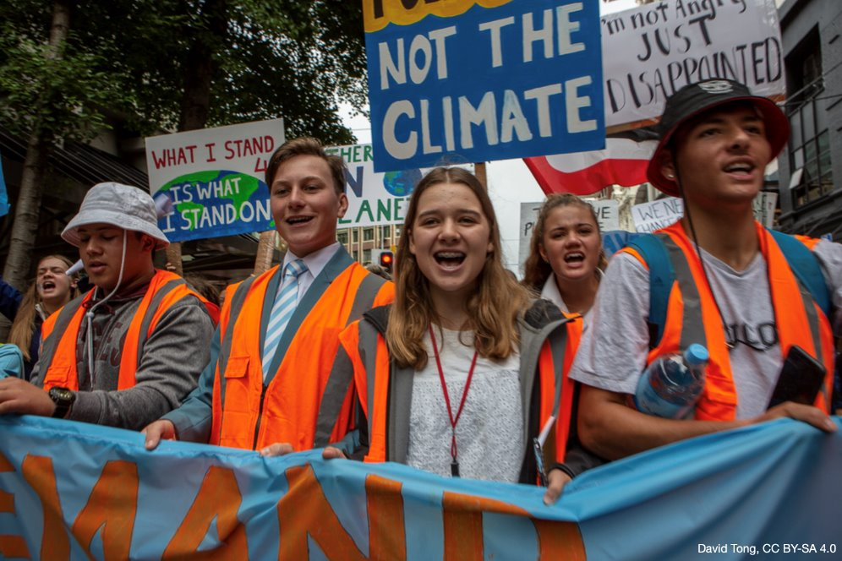
Exploring climate change education in secondary schools
Associate Professor Chris Eames​
School of Education​, University of Waikato​
© Copyright. Science Learning Hub – Pokapū Akoranga Pūtaiao The University of Waikato Te Whare Wananga o Waikato.
All Rights Reserved | www.sciencelearn.org.nz. All images are copyrighted. For further information, please refer to enquiries@sciencelearn.org.nz

Slide 2
Index
Topic | Slideshow number(s ) | Video timecode
Welcome and index | 1–2 | 00:00
Introducing the Science Learning Hub, NZASE and Dr Chris Eames | 3–8 | 00:49
What is climate change education? | 9–11 | 03:32
Starting with the science: curriculum connections – Biology, Chemistry, Physics, and Earth and Space Science | 12–16 | 06:16
Pedagogy for climate change | 17 | 10:56
Nature connection, Mātauranga Māori, and Systems and critical thinking | 18–20 | 11:45
Solutions and hope | 21–24 | 19:56
Decision making and action taking | 25–26 | 25:57
Teacher and student wellbeing | 27–29 | 29:13
Integration | 30–33 | 32:23
Resources | 34–37 | 37:31
SLH links, keep in touch and thanks | 38 | 40:16

Slide 3
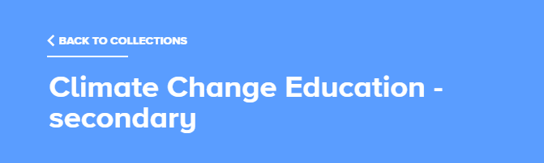
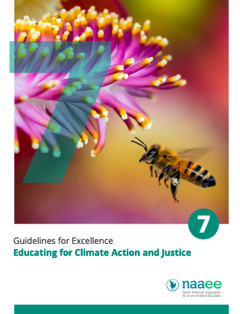
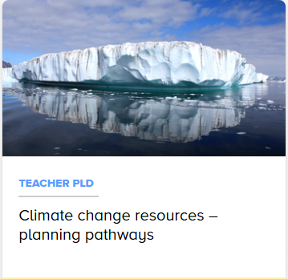
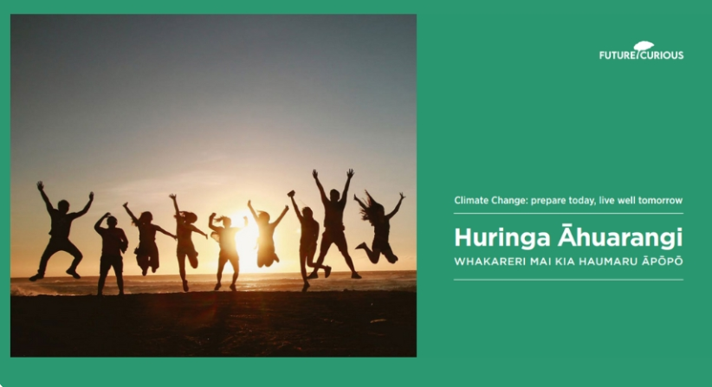
Links and resources
https://bit.ly/CCEsecondary
© North American Association for Environmental Education
© Copyright. Science Learning Hub – Pokapū Akoranga Pūtaiao The University of Waikato Te Whare Wananga o Waikato.
All Rights Reserved | www.sciencelearn.org.nz. All images are copyrighted. For further information, please refer to enquiries@sciencelearn.org.nz

Slide 4

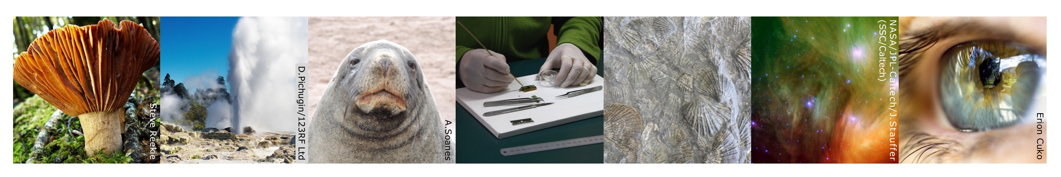
The Science Learning Hub
A trustworthy online resource – produced by educators and scientists
Based on world-class New Zealand science research
Supported by learning activities, information about the key science ideas and concepts, multimedia tools and other resources
Written for New Zealand teachers and students

Slide 5


© Copyright. Science Learning Hub – Pokapū Akoranga Pūtaiao The University of Waikato Te Whare Wananga o Waikato.
All Rights Reserved | www.sciencelearn.org.nz. All images are copyrighted. For further information, please refer to enquiries@sciencelearn.org.nz

Slide 6
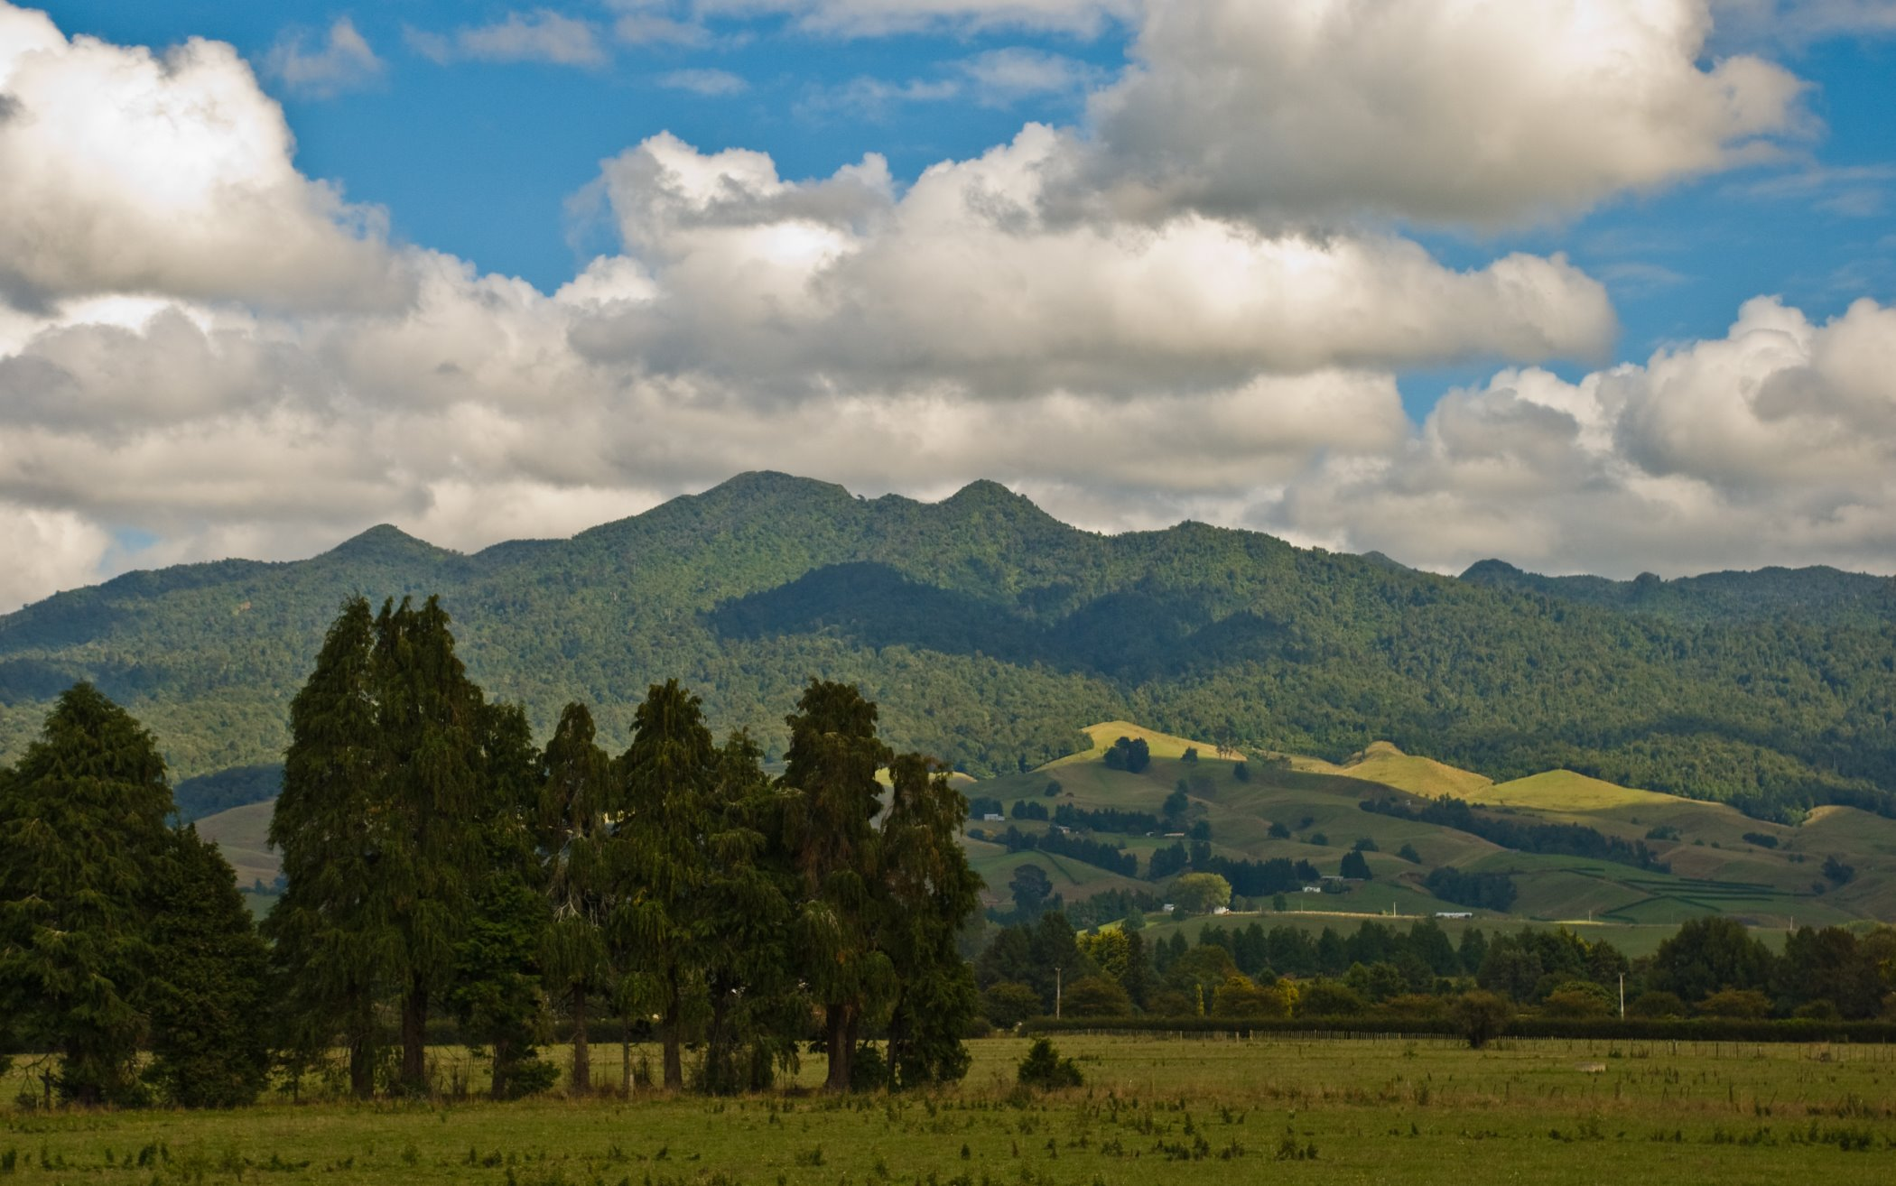
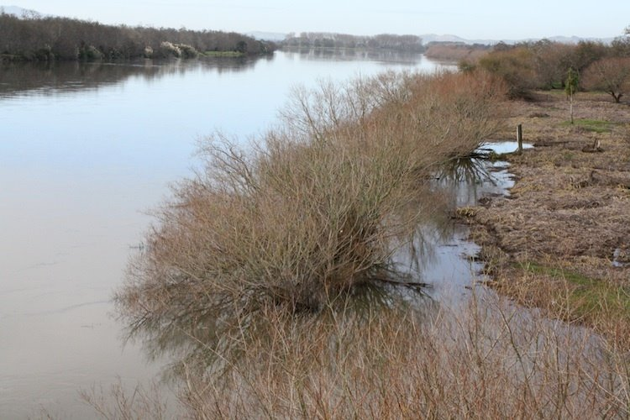
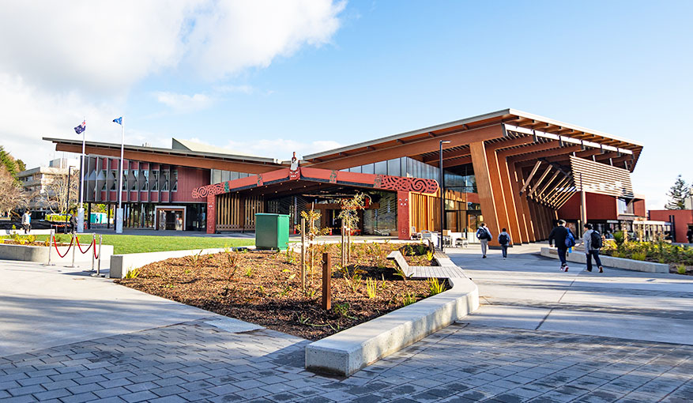
Pēpeha
Ko Pirongia te maunga e rū nei taku ngākau
Ko Waikato te awa e mahea nei taku māharahara
Kei te Whare Wānanga o Waikato e mahi ana
Ko Chris Eames toku ingoa
© Phillip Caper/CC BY 2.0​
^{Science Learning Hub,}
^{© The University of Waikato}
^{Te Whare Wānanga o Waikato}
© The University of Waikato Te Whare Wānanga o Waikato

Slide 7
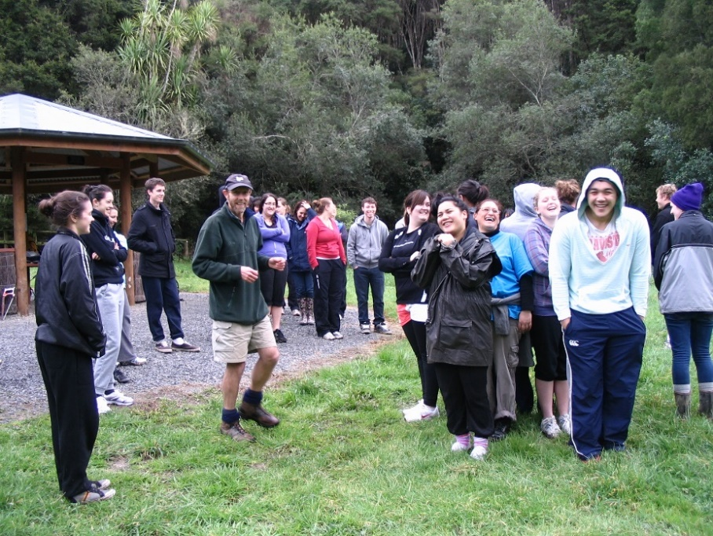
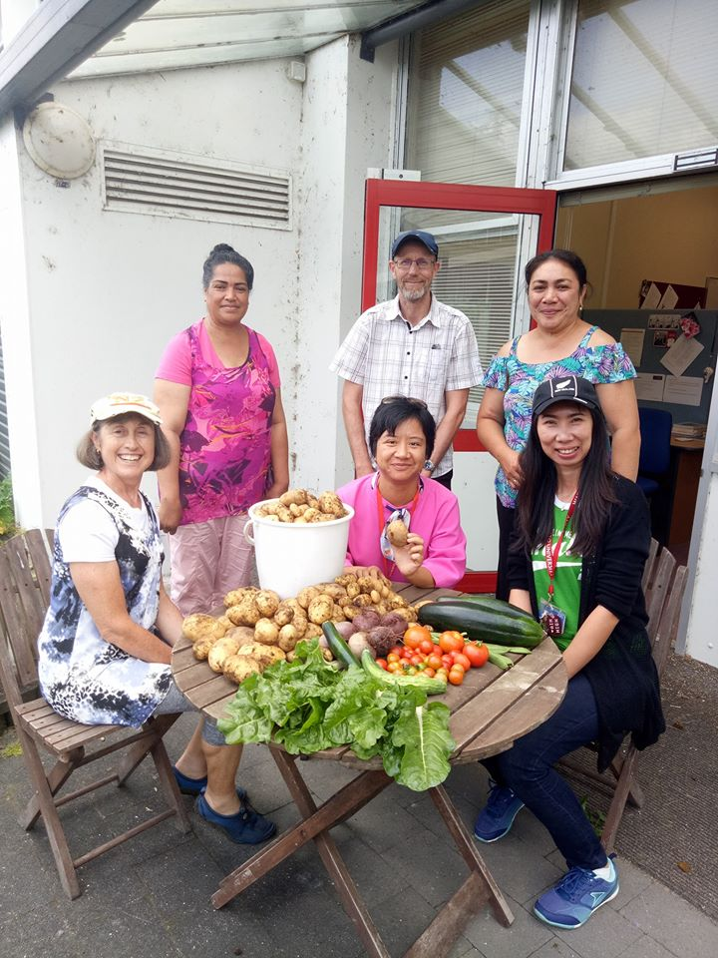
Ko wai au/ Who am I?
I am an environmental and sustainability educator at the University of Waikato
© THE UNIVERSITY OF WAIKATO • TE WHARE WANANGA O WAIKATO

Slide 8

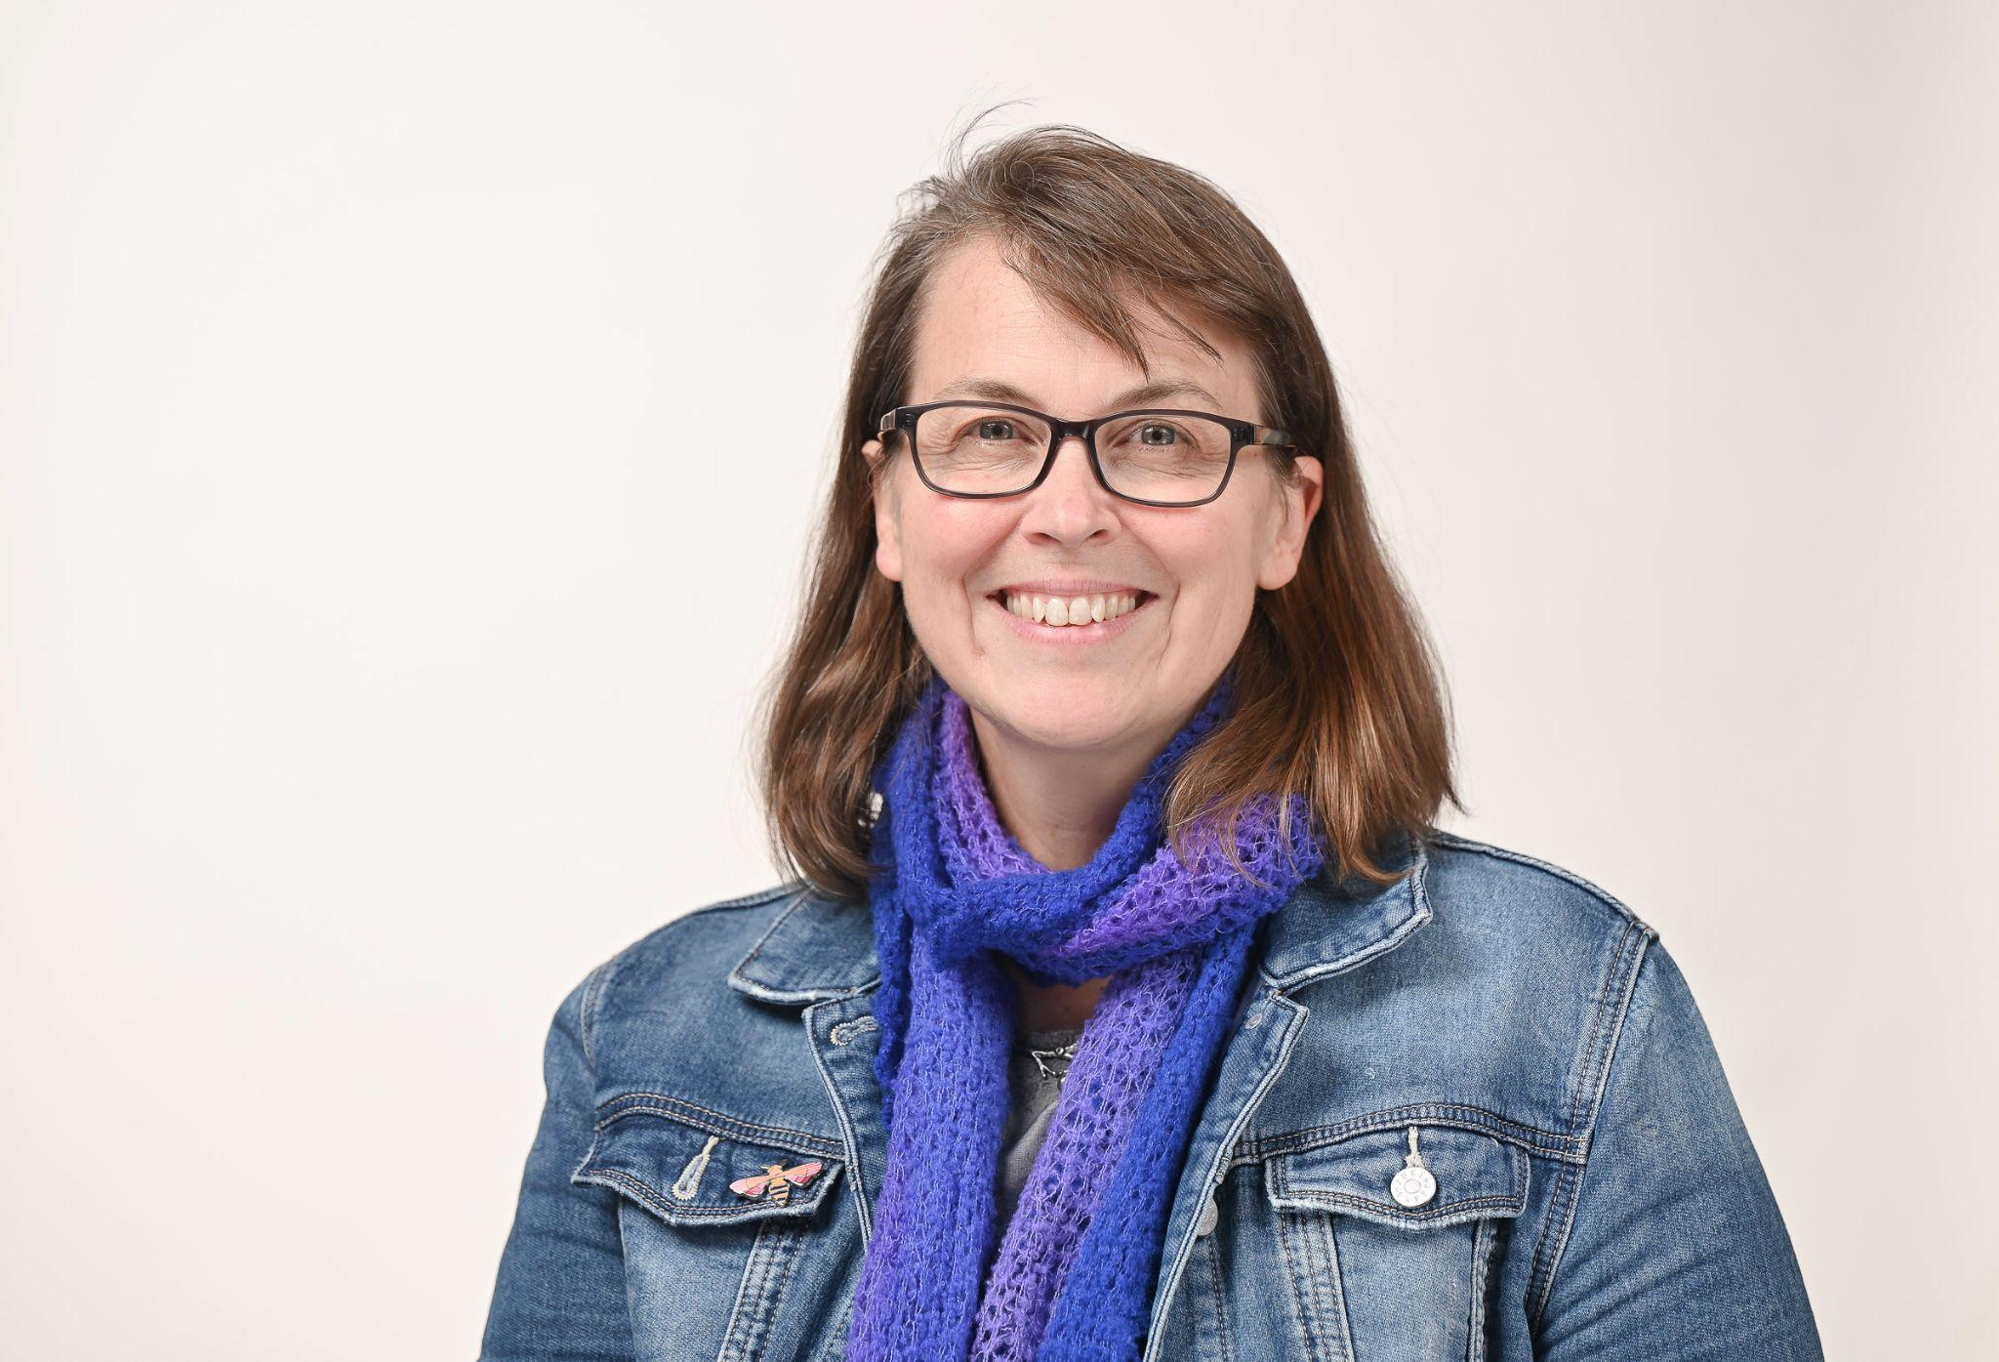



PISA framework:
Agency in the Anthropocene
Name | Organisation
Associate Professor Peta White | Deakin University, Australia
Professor Martha Monroe | University of Florida, USA
Associate Professor Chris Eames | University of Waikato, New Zealand
Associate Professor Nicole Ardoin | Stanford University, USA
© THE UNIVERSITY OF WAIKATO • TE WHARE WANANGA O WAIKATO

Slide 9
Recap from last week's webinar
Three key ideas from climate science:
  Sun's light energy changes into heat energy
  The role of greenhouse gases
  The carbon cycle
Responses to climate change are mitigation and adaptation
Education is crucial for both
© Copyright. Science Learning Hub – Pokapū Akoranga Pūtaiao The University of Waikato Te Whare Wananga o Waikato.
All Rights Reserved | www.sciencelearn.org.nz. All images are copyrighted. For further information, please refer to enquiries@sciencelearn.org.nz

Slide 10
What is climate change education?
Climate change education aims to develop climate literacy by:
  Developing understanding of how the climate system works, how human actions influence climate, and the impacts of climate change.
  Considering diverse value systems, ways of knowing and evidence about climate change.
  Making informed and just decisions to act to mitigate (and, if necessary, adapt to) climate change.
Therefore, science is key, but so are other learning areas.
© Copyright. Science Learning Hub – Pokapū Akoranga Pūtaiao The University of Waikato Te Whare Wananga o Waikato.
All Rights Reserved | www.sciencelearn.org.nz. All images are copyrighted. For further information, please refer to enquiries@sciencelearn.org.nz

Slide 11
Our plan this afternoon
Climate change curriculum
Climate change pedagogy
Cross-curricular or integrated learning
Resources to help you

Slide 12
Science is key, so let's start there!
Concepts from within biology, chemistry, physics and Earth and space science are all important.
Climate change does not currently feature as such in the NZC, and the refresh is now paused again.
Therefore, what we are offering as climate change curriculum is tentative at this stage!

Slide 13
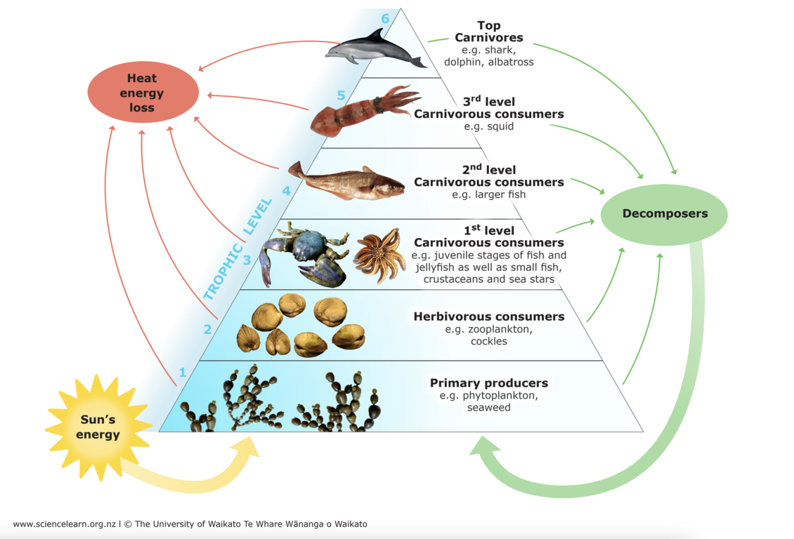
Biology in climate change
Existing AOs at L4 and L5 focus on habitats and interdependence and humans influence these, including through warming land and seas, changes in precipitation etc.
Opportunities in senior biology include examining specific interactions, adaptations and distribution patterns in relation to a changing climate.
Notes:
Image: https://www.sciencelearn.org.nz/resources/143-marine-food-webs

Slide 14
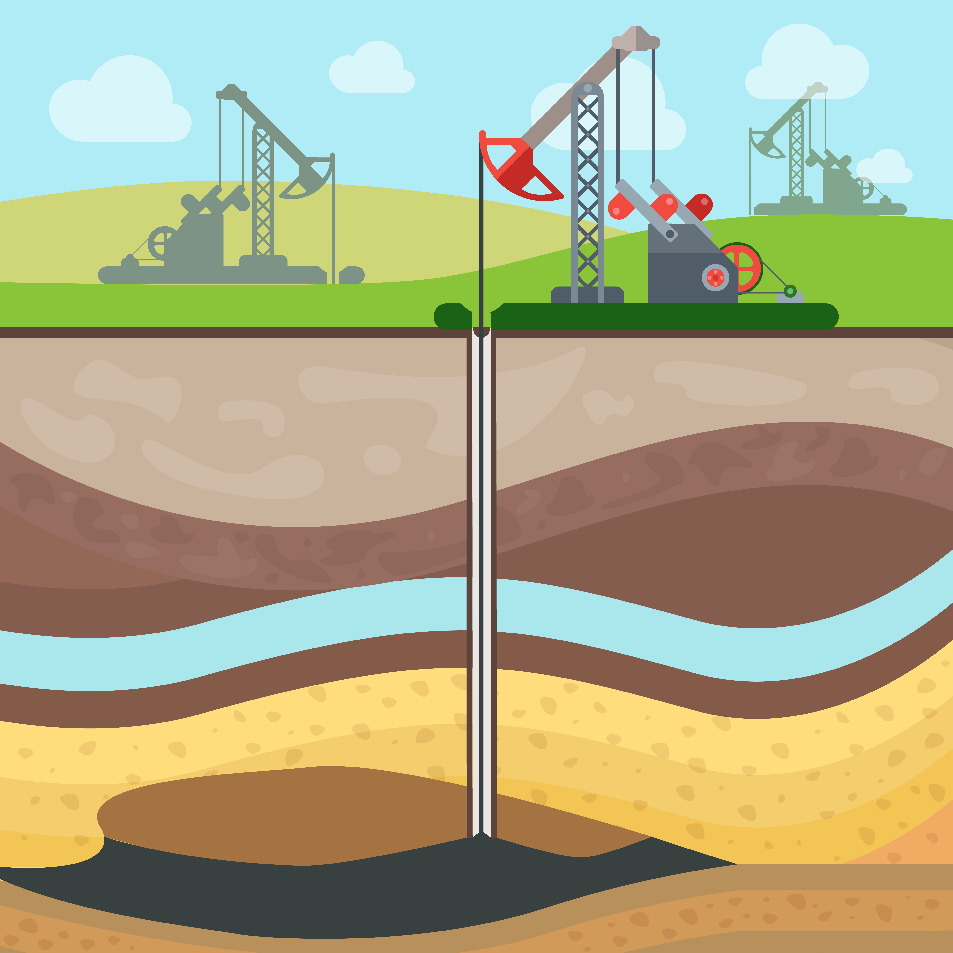
Chemistry in climate change
Existing AOs at L4 and L5 focus on the chemical and physical properties of greenhouse gases, and their emissions from various sources, including human-induced.
Opportunities in senior chemistry include examining reaction properties of hydrocarbons (fossil fuels) and carbon capture technologies.
© sentavio, Shutterstock.com

Slide 15
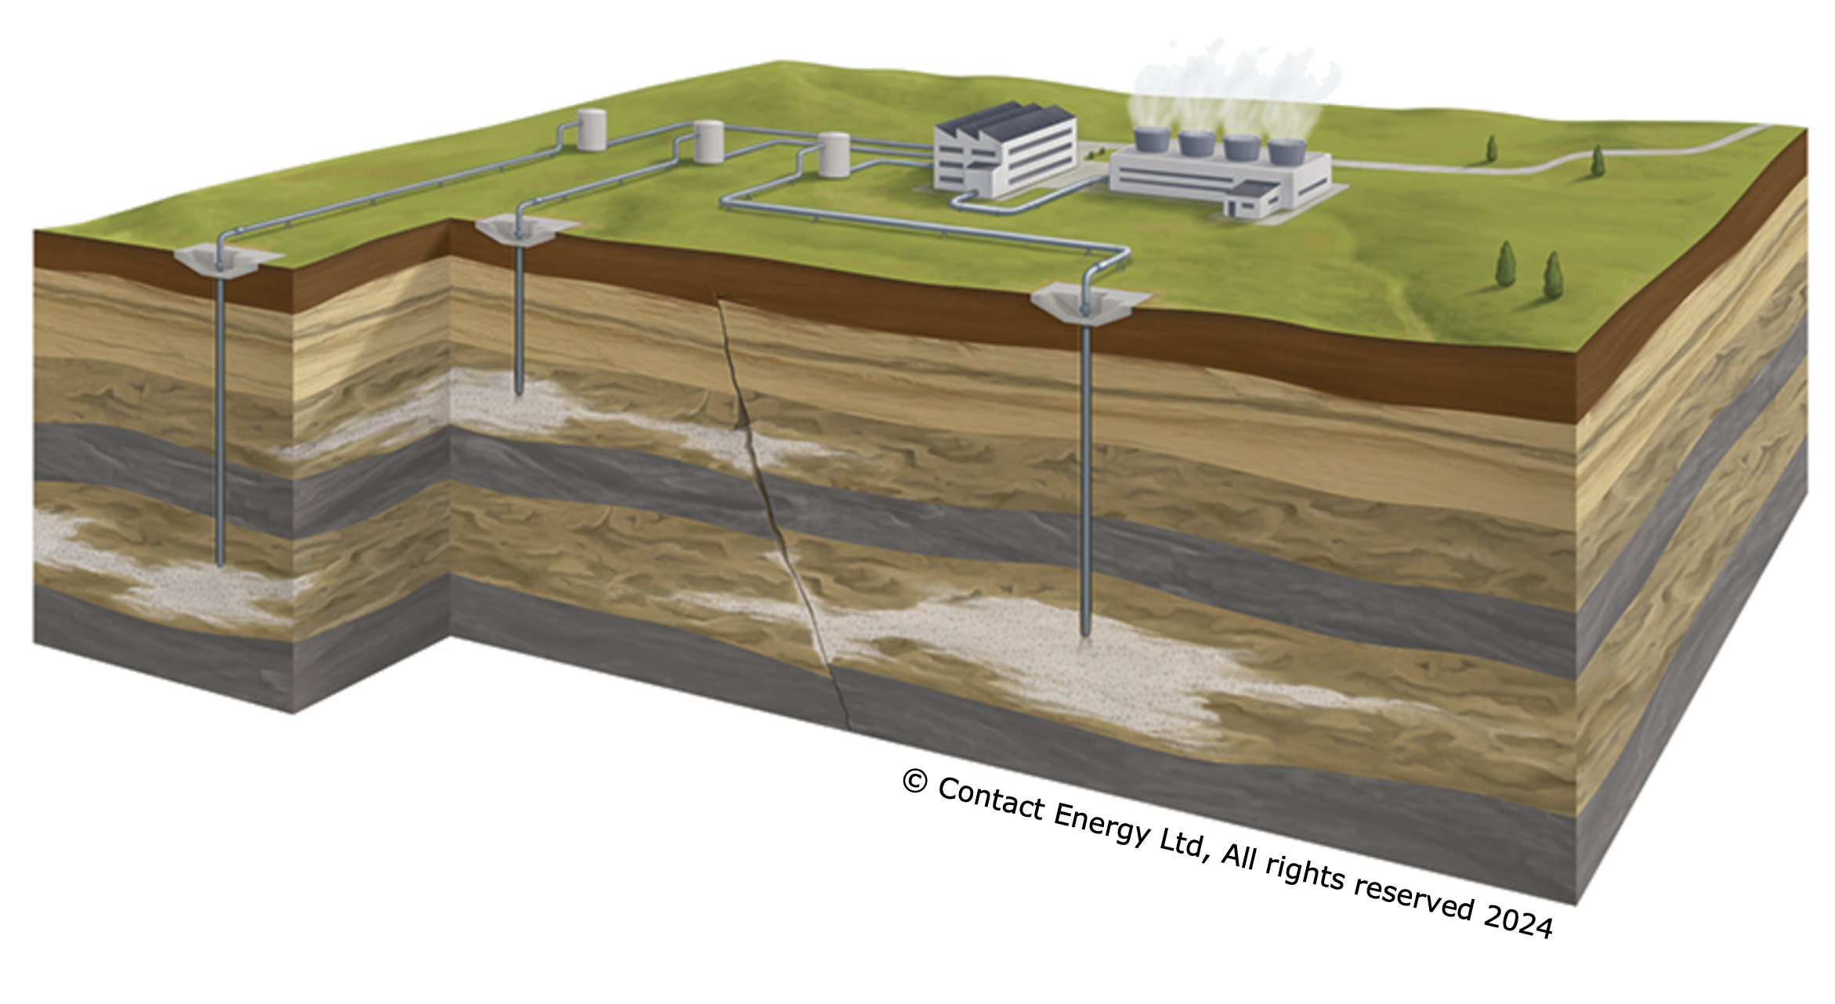
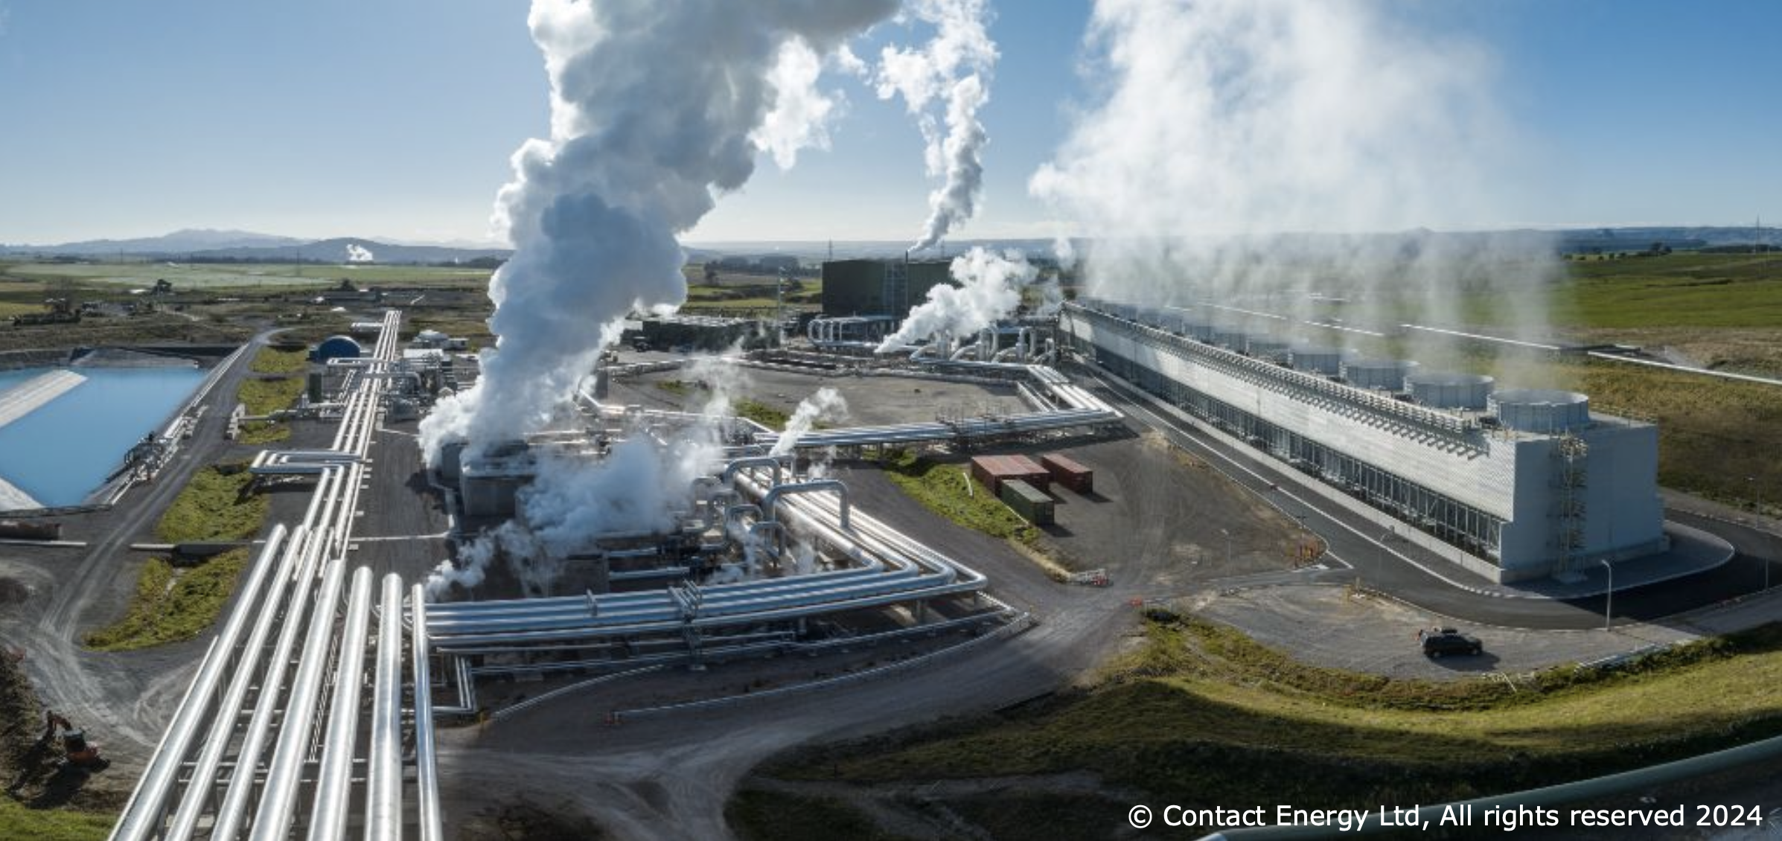
Physics in climate change
Existing AOs at L4 and L5 focus on energy transformations and applications such as renewable energy generation.
Opportunities in senior physics include modelling radiative forcings and analysing climate models.

Slide 16
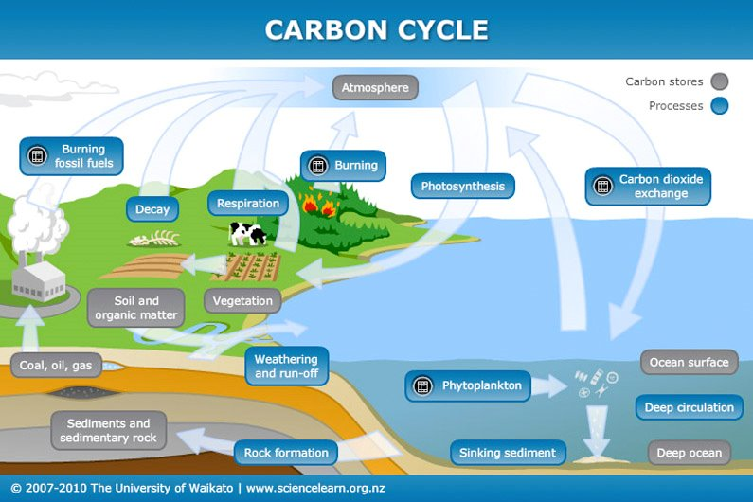
Earth and Space Science in climate change
Existing AOs at L4 and L5 focus on Earth's systems and water cycle changes due to global warming.
Opportunities in senior ESS include examining system cycling of carbon and human impacts on the climate system.

Slide 17
Pedagogy for climate change
There are typical approaches that science teachers use such as experimental/experiential and project work, but we would like to emphasise these six aspects as well:
  Nature connection
  Mātauranga Māori
  Systems and critical thinking
  Solutions focus and hope
  Decision making and action taking
  Teacher and student wellbeing

Slide 18
Nature connection
Why is this important?
  Many of socio-ecological challenges, such as climate change, are caused, or at least contributed to, by a disconnect between people and nature
  People ARE part of nature – it is us!
How can it be done?
  Spending time in nature is necessary but not sufficient
  Knowledge about nature and our place within it is important
  Connecting emotionally to create value positions
  In Aotearoa, the importance of te ao Māori
See Nature Connection at https://www.nzaee.org.nz/resources

Slide 19
Mātauranga Māori
Why is this important?
  Honouring Te Tiriti o Waitangi
  An alternative way of knowing which can change perspectives
  A sustainable view of ecosystems and natural resource use e.g. rāhui, tapu
How can it be done?
  Connect to place through local iwi/hapū
  May include pūrākau
  Complements 'Western' science
See https://www.nzaee.org.nz/spotlight/connecting-to-place-matauranga-maori-and-histories
https://www.sciencelearn.org.nz/resources/2858-matauranga-and-the-integration-of-maori-and-western-knowledge

Slide 20
Systems and critical thinking
Why is this important?
  Science can sometimes just show parts of systems
  Parts of systems are connected and affect each other
  Human systems impact Earth systems
  Causes of these impacts need to be addressed
How can it be done?
  Role plays and simulations can help visualise systems
  Mind maps can assist seeing connections
  Inquiry into structures which lead to impacts i.e. policy, resource use, economic models
Notes:
Link to Planetary boundaries resource: https://applets.kcvs.ca/PlanetaryBoundaries/index.html?showPage=connections

Slide 21
Solutions and hope
Why is this important?
  Solutions exist now to mitigate and adapt to climate change
  Solutions have opportunities and costs
  Systems thinking can be used to explore these
  Solutions foster hope.
How can it be done?
  Students explore the causes of climate change impacts
  Inquire into solutions being worked on and the science behind them
  Underpin teaching and learning with hope for the future.

Slide 22
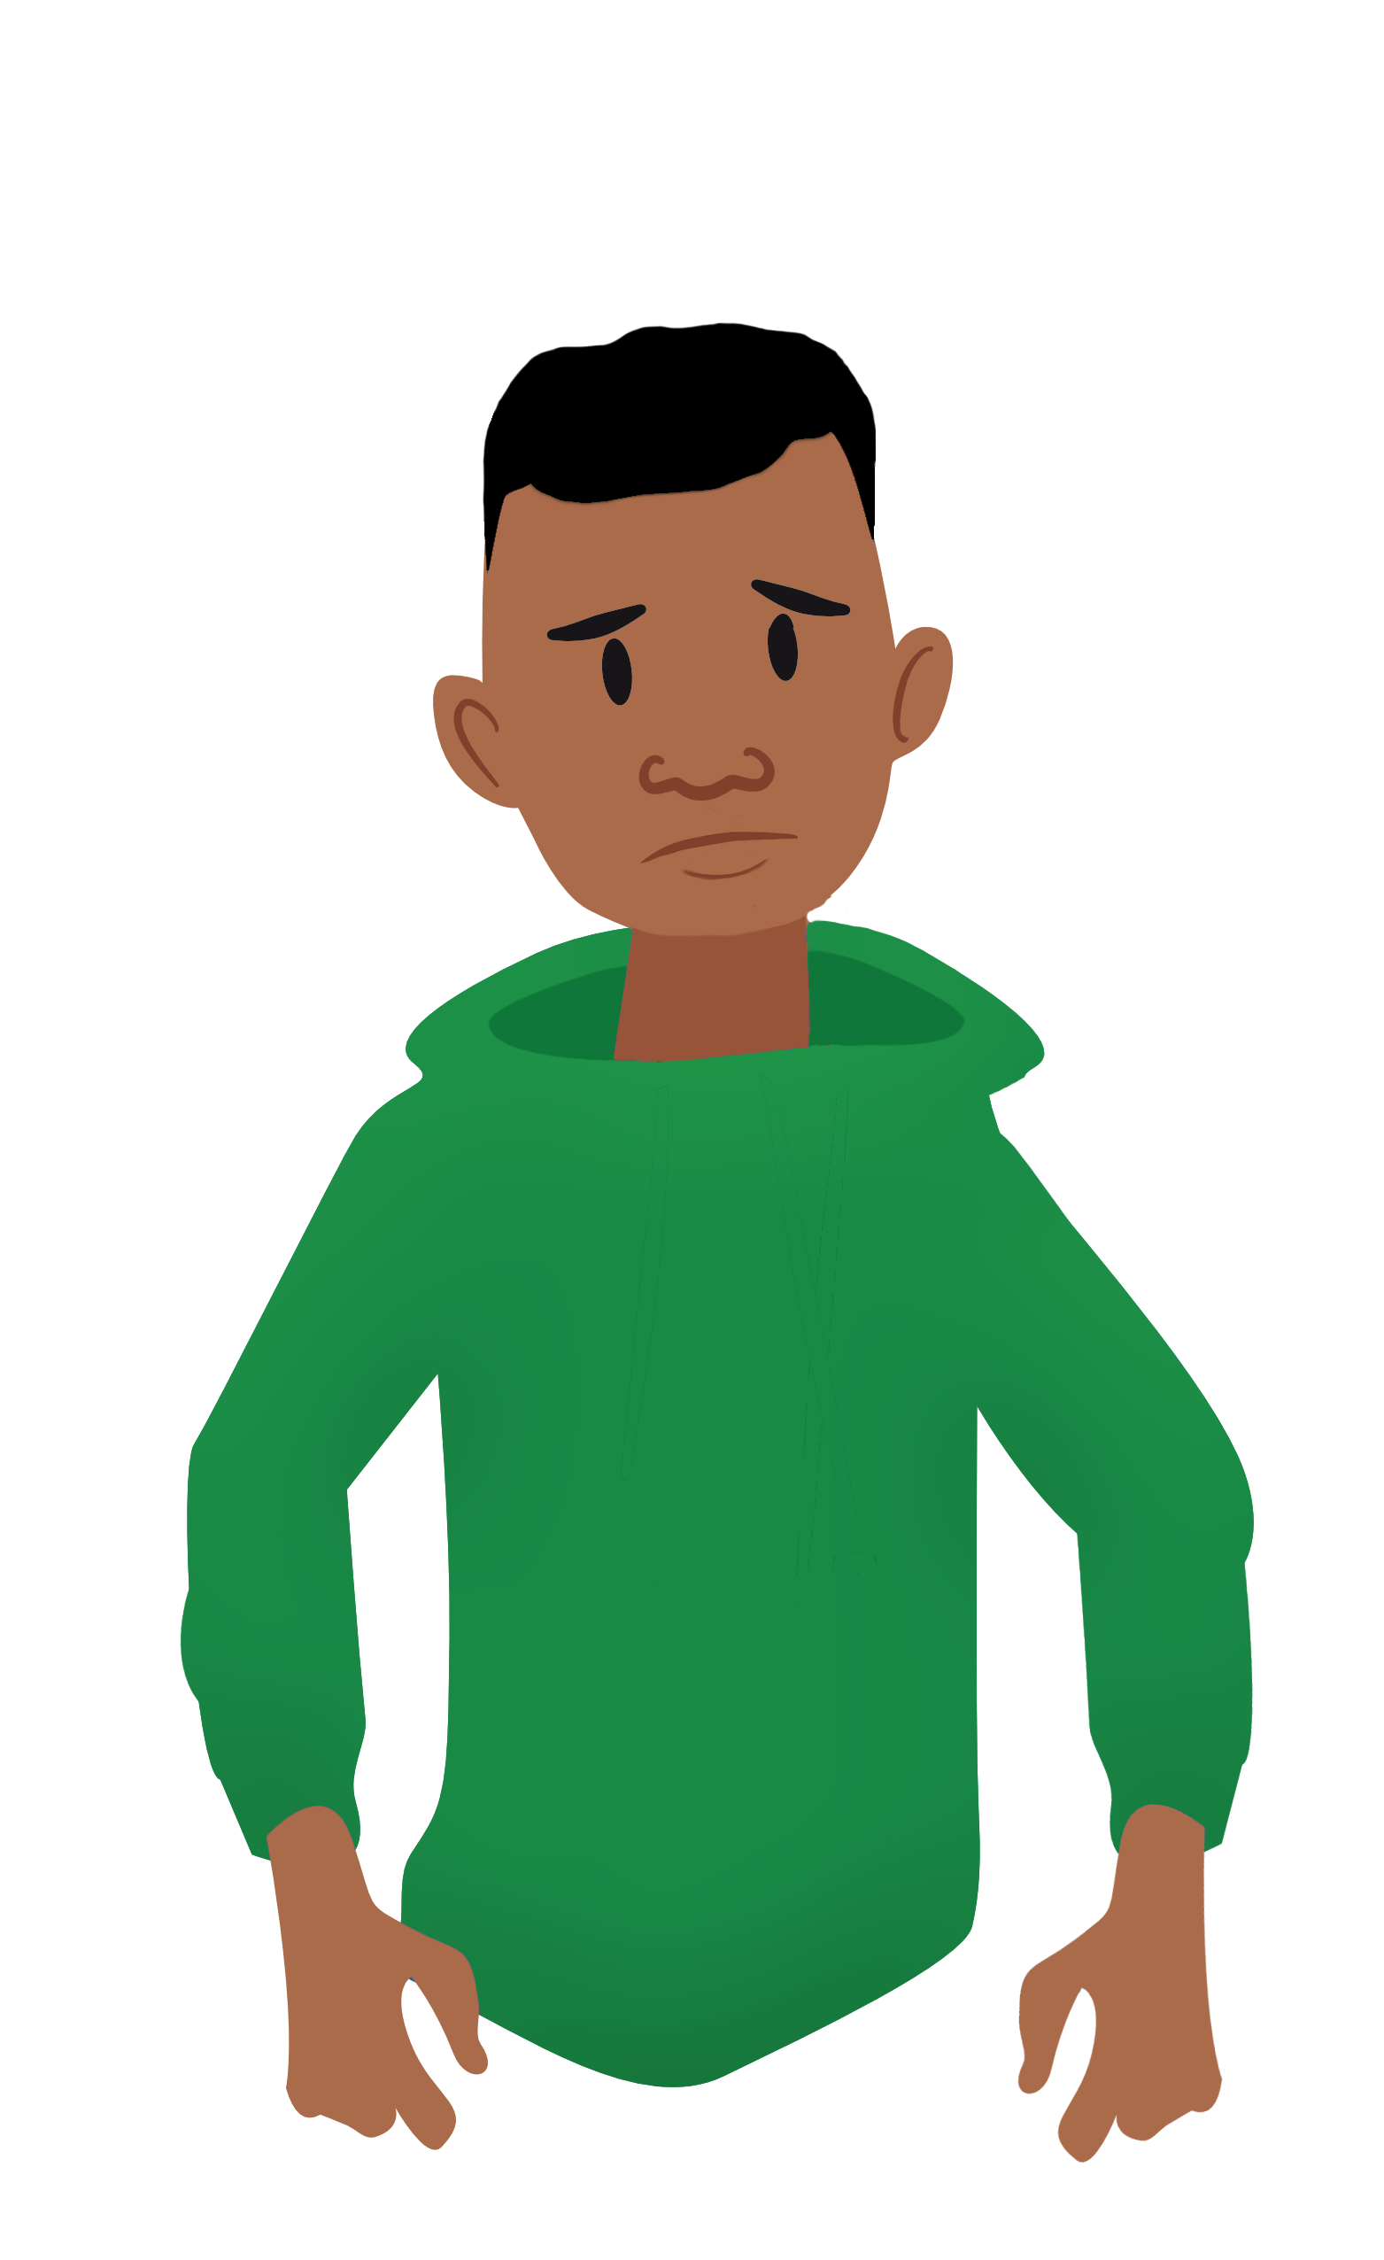

As teachers, we must not burden young people
Because of climate change I might not get to be an adult. If I am still alive in ten years, I won’t have a job or anywhere to live and I can never have children.
Yes, you are right. We are in a terrible situation and no one is doing anything about it. You should try and save the world! Do it now or all will be lost!
Anxiety
Adapted from Professor Niki Harre, University of Auckland

Slide 23
As teachers, we can be passive
There are lots of adults concerned about climate change. They have it all under control. No need for you to worry because soon we will have the technology to solve these problems.
Because of climate change I might not get to be an adult. If I am still alive in ten years, I won’t have a job or anywhere to live and I can never have children.
Complacent
hope
Adapted from Professor Niki Harre, University of Auckland

Slide 24
We need to motivate with hope
There are lots of people working very hard on solutions to climate change. All over the world scientists, engineers, teachers, community leaders are getting together. People have solved really hard problems before. You can help too.
Because of climate change I might not get to be an adult. If I am still alive in ten years, I won’t have a job or anywhere to live and I can never have children.
Motivational
hope
Adapted from Professor Niki Harre, University of Auckland

Slide 25
Decision making and action taking
Why is this important?
  Young people will be the decision-makers of the future
  It is part of the key competency of participating and contributing
  Change is needed and action must therefore be taken.
How can it be done?
  Consider who makes decisions and how
  Learn the processes of decision-making
  Practice decision-making through debates, role plays
  Plan for action, take action, reflect on action
  Individual action AND collective action.

Slide 26
We can distinguish activity from action by focus and input
 | No student input | Student input in deciding what to do
Activity focused on a symptom of climate change | ACTIVITY | ACTIVITY
Activity targeted at the cause of climate change | ACTIVITY | ACTION
See McLean, T. (2003) Environmental education in Otago primary schools: Education for the environment? Set, 1, 4-9.

Slide 27
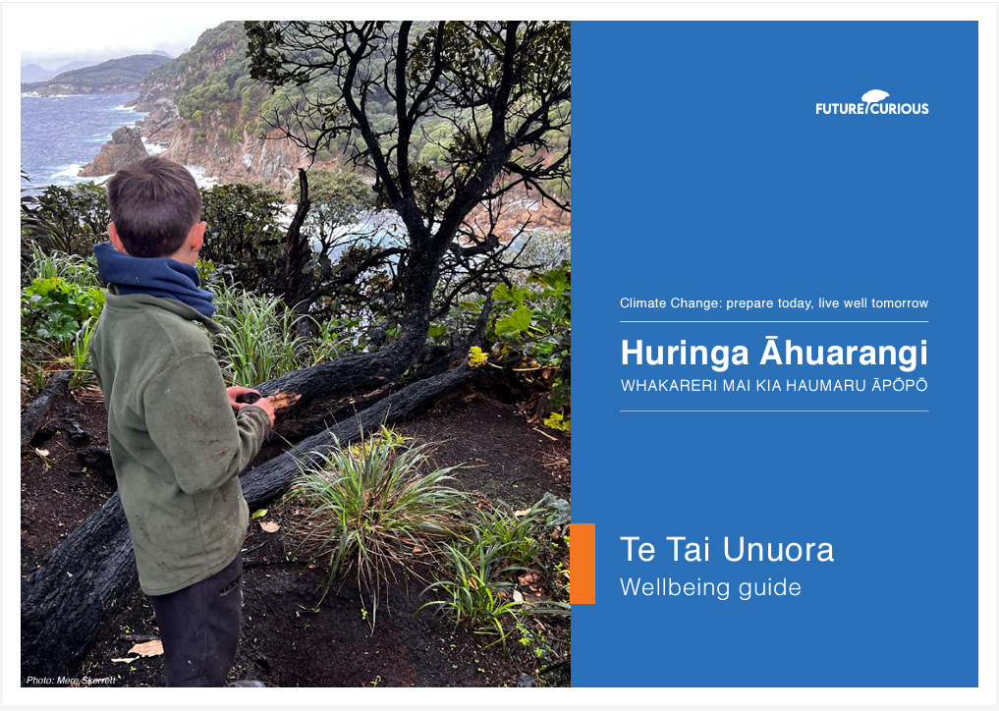
Teacher wellbeing
Why is this important?
  we can feel conflicted about teaching for a future that could be quite challenging
  we can struggle with the complexity of climate change and whether we are teaching it well
  we may experience apathy or even resistance from colleagues, leadership and parents.
© NZAEE
https://www.nzaee.org.nz/resources/climate-change-learning-programme
© Copyright. Science Learning Hub – Pokapū Akoranga Pūtaiao The University of Waikato Te Whare Wananga o Waikato.
All Rights Reserved | www.sciencelearn.org.nz. All images are copyrighted. For further information, please refer to enquiries@sciencelearn.org.nz
Notes:
Student and teacher wellbeing
Link to Sian's guide: https://www.nzaee.org.nz/resources/climate-change-learning-programme
Image: https://global-uploads.webflow.com/61b2ca7b222b886bdf7e6a01/63378017fbac72c8a70aea3d_CC%20Wellbeing%20Guide%20FINAL.pdf

Slide 28
Teacher wellbeing
How can it be done?
  we need to first look after ourselves
  beware of algorithms of gloom
  seek peer support.
© NZAEE
https://www.nzaee.org.nz/resources/climate-change-learning-programme
© Copyright. Science Learning Hub – Pokapū Akoranga Pūtaiao The University of Waikato Te Whare Wananga o Waikato.
All Rights Reserved | www.sciencelearn.org.nz. All images are copyrighted. For further information, please refer to enquiries@sciencelearn.org.nz
Notes:
Student and teacher wellbeing
Link to Sian's guide: https://www.nzaee.org.nz/resources/climate-change-learning-programme
Image: https://global-uploads.webflow.com/61b2ca7b222b886bdf7e6a01/63378017fbac72c8a70aea3d_CC%20Wellbeing%20Guide%20FINAL.pdf

Slide 29
Student wellbeing
Why is this important?
  climate anxiety is real
  anxiety stifles hope and action.
How can it be done?
  provide motivational hope, manage anxiety
  provide examples of what others are already doing to address climate change
  be open about the challenges and be alert to student responses
  specifically consider Māori and Pacific student wellbeing
  use avenues of wellbeing support that are available.
© NZAEE
https://www.nzaee.org.nz/resources/climate-change-learning-programme
© Copyright. Science Learning Hub – Pokapū Akoranga Pūtaiao The University of Waikato Te Whare Wananga o Waikato.
All Rights Reserved | www.sciencelearn.org.nz. All images are copyrighted. For further information, please refer to enquiries@sciencelearn.org.nz
Notes:
Student and teacher wellbeing
Link to Sian's guide: https://www.nzaee.org.nz/resources/climate-change-learning-programme
Image: https://global-uploads.webflow.com/61b2ca7b222b886bdf7e6a01/63378017fbac72c8a70aea3d_CC%20Wellbeing%20Guide%20FINAL.pdf

Slide 30
Integration
Science is needed to address climate change but is not sufficient
All learning areas play an important role
Therefore, interdisciplinary or integrative teaching is important
Such teaching can be challenging in secondary schools
Discipline knowledge must be maintained but connections between knowledge must also be made
Time is needed for planning

Slide 31
Integration
Options to integrate:
  Within a learning area e.g. between subjects such as biology and chemistry
  Across learning areas e.g. between science and social science
  Paired teaching e.g. course with teachers from different subjects or learning areas
  Thematic teaching in a webbed structure e.g. themes could be renewable energy, sea level rise etc.

Slide 32
Cross subject integration – one example
An example of teaching climate change at year 10, involving science and social sciences
Students undertake teacher-guided inquiry into the causes and impacts of climate change in their area, which is prone to flooding in intense rainstorms
Students visit sites that are affected by flooding and access modelling data that shows flood risks
Students share their thoughts and feelings about how flooding may affect their future, and consider their hopes about this challenge
Students plan and undertake action projects, individually or collectively, to raise awareness of flooding risk, plant areas with water-absorbing vegetation, or work with local authorities and landowners to flood-protect their property

Slide 33
Cross subject integration – a senior school example
Music – activism and environmental awareness through the Arts
History – links through historical skills and analysis tools to critically examine events/concepts
Chemistry – greenhouse gases and carbon footprints
Digital technology – analysis of climate models and using tools to create unit outputs

Slide 34
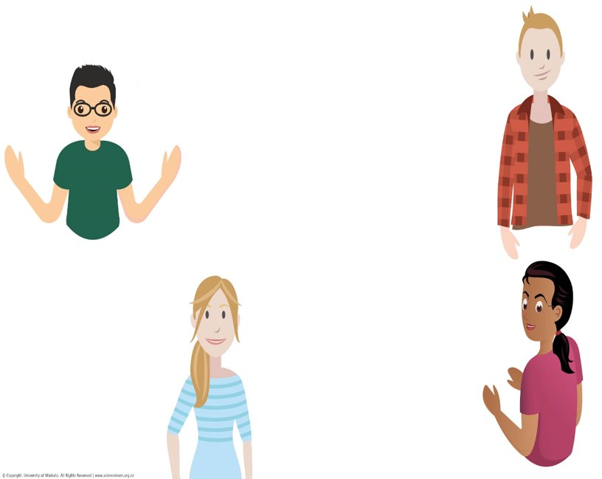
Resources
There are many resources available to help you!
www.thinksustainably.co.nz there are a number of sustainability resources on this site that leverage off the school journals to get kids to think sustainably, inclusive of Climate change.
Mountains to Sea, Carbon Watch, the Ministry for the Environment and The Royal Society.
I like the NIWA online games.
I found the NZ SeaRise programme, but ran out of time to learn about it, however it has lots of potential. Also, the climate central maps for predicting flooding, these would be some good modelling activities and the GNS information.
Climate Change Learning Programme on NZAEE, various research and resources also available on NZAEE.
Notes:
Ideas from participants
https://www.thinksustainably.co.nz/
https://www.mountainstoseawellington.org/
https://niwa.co.nz/atmosphere/carbonwatch-nz
https://environment.govt.nz/facts-and-science/climate-change/
https://niwa.co.nz/about-niwa/resources-teachers
https://worldslargestlesson.globalgoals.org/
https://shsenvironmental.blogspot.com/search?q=climate
https://www.nzaee.org.nz/resources/climate-change-learning-programme
https://www.searise.nz/
https://sealevel.climatecentral.org/maps/
https://www.gns.cri.nz/

Slide 35
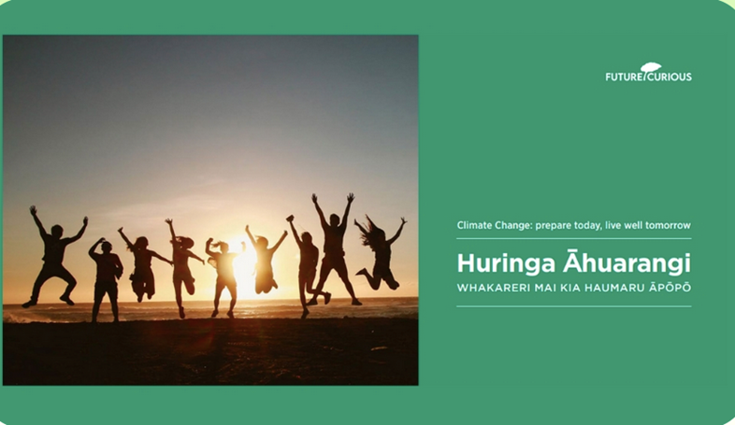
Climate Change Learning Programme
For learners aged 10–14 years
Development led by Future Curious
Continuously reviewed and updated
Aotearoa contexts and Mātauranga Māori
Consists of:
User Guide
Eight learning modules
Te Tai Unuora (Wellbeing Guide)
Registration process needed to access full resource – free for teachers
© NZAEE
https://www.nzaee.org.nz/resources/climate-change-learning-programme
© Copyright. Science Learning Hub – Pokapū Akoranga Pūtaiao The University of Waikato Te Whare Wananga o Waikato.
All Rights Reserved | www.sciencelearn.org.nz. All images are copyrighted. For further information, please refer to enquiries@sciencelearn.org.nz

Slide 36
Educating for Climate
Action and Justice – Guidelines for Excellence
Provide recommendations and resources.
Solutions-focused.
Fosters action.
Understanding and centring on climate justice as well as a willingness to work towards solutions that address the impacts of climate change.
Contains links to resources, definitions and case studies of effective practice at different levels/sectors.
© North American Association for Environmental Education
https://eepro.naaee.org/sites/default/files/2024-09/Guidelines-%237-Educating-for-Climate-Action-and-Justice-Accessible-Compressed.pdf

Slide 37
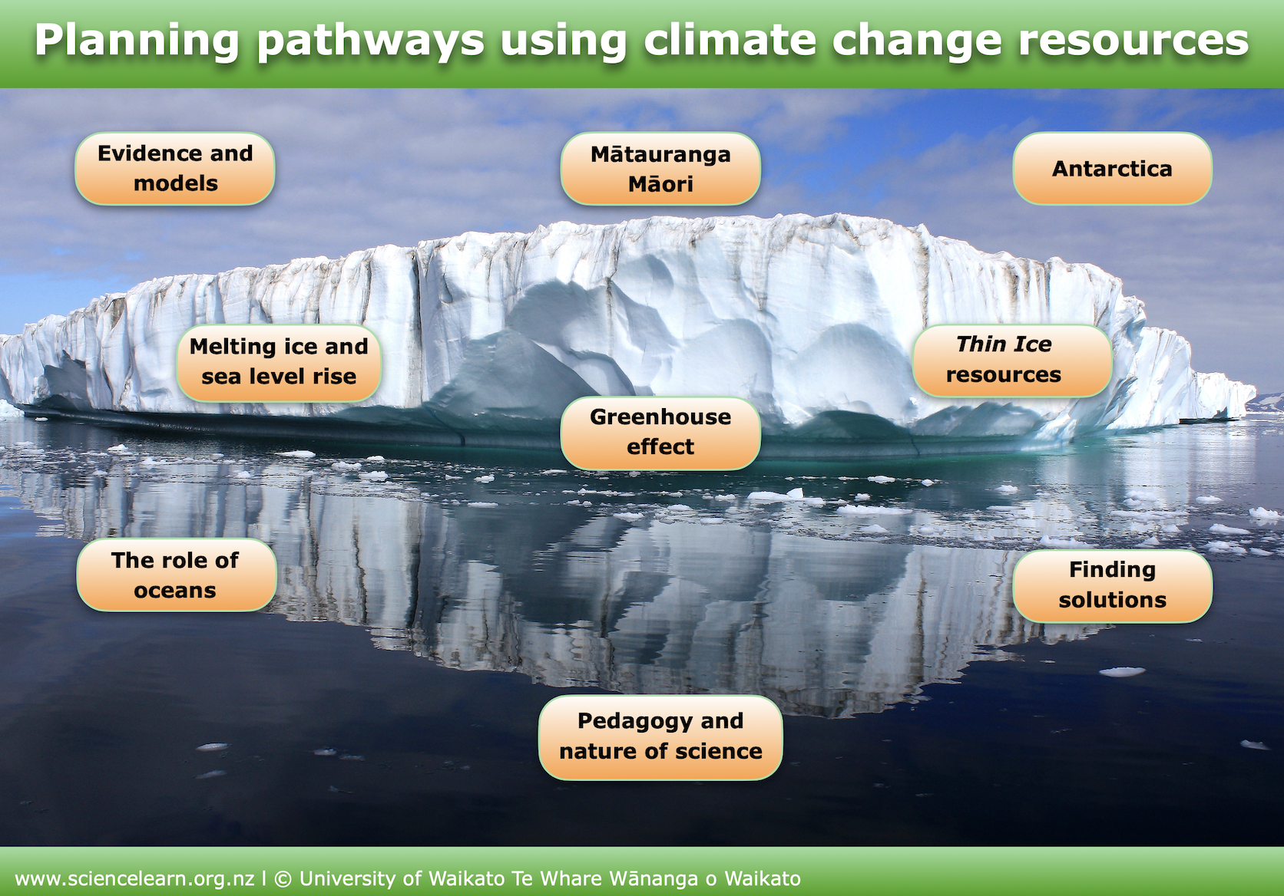
Science Learning Hub resources
www.sciencelearn.org.nz/resources/2639-climate-change-resources-planning-pathways ​
Notes:
https://www.sciencelearn.org.nz/resources/2639-climate-change-resources-planning-pathways

Slide 38




Thank you – stay connected
 | Email us on: enquiries@sciencelearn.org.nz
 | www.facebook.com/nzsciencelearn
 | https://nz.pinterest.com/nzsciencelearn
 | www.instagram.com/sciencelearninghubnz

