Slide 1
Index
Topic | Slideshow number(s) | Video timecode
Introducing the Science Learning Hub and presenters | 1 | 00:00
Index | 2 | 00:17
Introducing the presenters | 3–5 | 01:08
Context and focus of the webinar | 6–9 | 08:23
Lian Soh: Where did I start? | 10–19 | 14:56
Clarify your why | 20 | 22:06
Lian Soh: Where did I go next? | 21–27 | 24:06
Key ideas | 28–30 | 33:35
Local context inspiration | 31 | 39:18
Links, keep in touch and thanks | 32–33 | 40:20

Slide 2
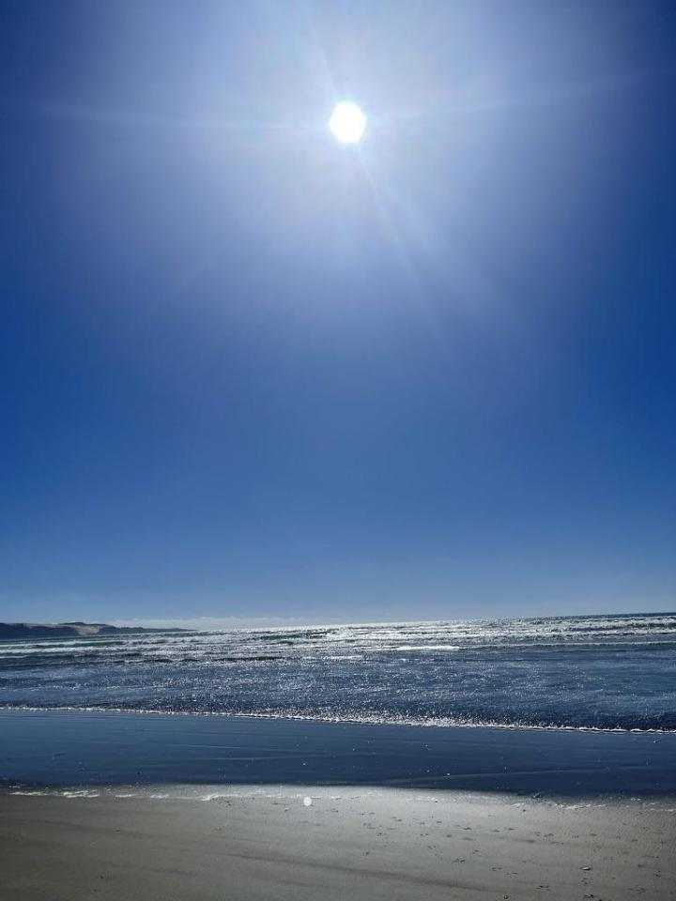
He uri ahau nō Muriwhenua
Ko āku karangatanga maha …
Ko Whakakoro, ko Whangatauatia ngā maunga
Ko Te Awaroa, ko te Wairoa me te Wainui ngā awa
Ko te wahapu o Whangape, ko Kāririkura, ko Te Oneroa
a Tohe ngā moana
Ko Te Kōtahitanga, ko Roma, ko Wainui ngā marae
Ko Ngāti Haua, ko Te Rōkeka, ko Ngāti Moetonga
ngā hapū
Ka noho hau kāinga i Ahipara
Ko Te Rarawa te iwi
Ko Pauline Waiti tōku ingoa
E mihi atu tēnei ki a koutou
© Pauline Waiti

Slide 3
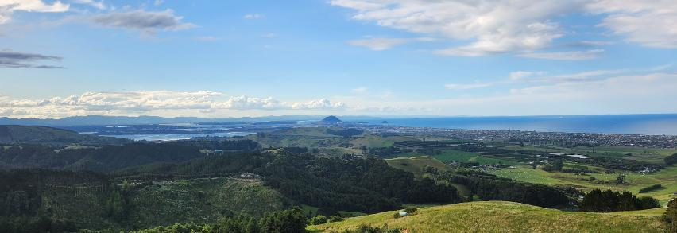
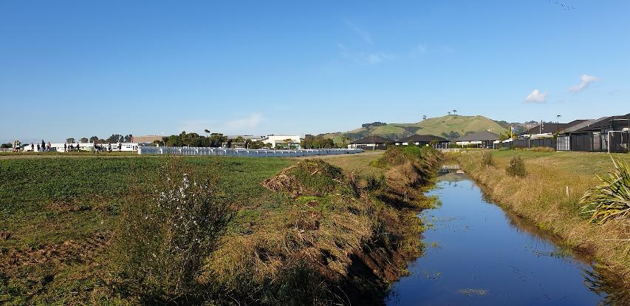
Ko Lian Soh tōku ingoa.
I whānau au ki Singapore.
I tupu ake au ki Tāmaki Makaurau.
Kei Pāpāmoa tōku kāinga.
Kei te mihi ai ki nga iwi Māori
© Lian Soh
© Lian Soh
Images from personal collection.

Slide 4
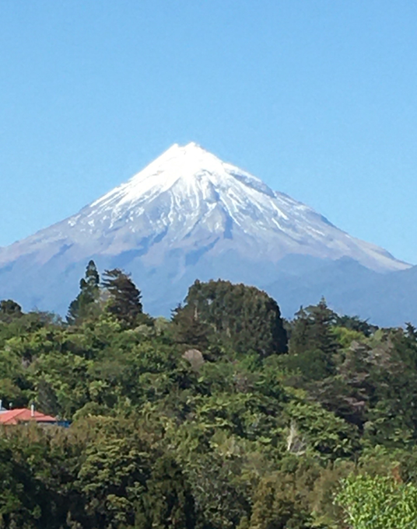
I whānau mai au i Waitara, i roto i te rohe o Te Atiawa
Nō Kōtarana ōku tūpuna
Ko au te Kaihautū Rangahau ki te
Rangahau Mātaraunga o Aotearoa
Ko Rosemary Hipkins tōku ingoa
© Rosemary Hipkins

Slide 5
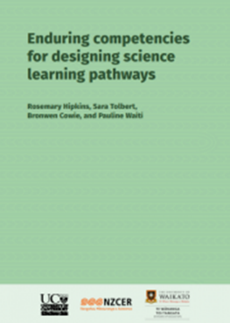
The context for change
NCEA Review: Mana ōrite imperative
Curriculum Refresh: honouring Te Tiriti
A ‘knowledge systems’ approach to align the two workstreams
The focus has shifted but the challenge and the learning benefits have not gone away!
Notes:
The initiative Mana ōrite mō te Mātauranga Māori supports equal status, support and resourcing for mātauranga Māori in NCEA.

Slide 6
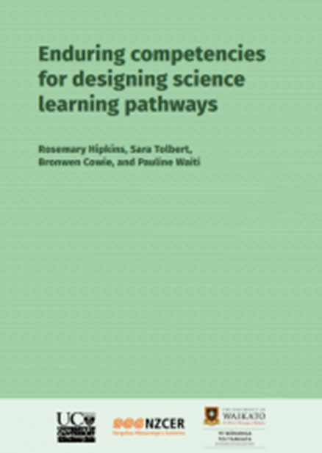
Drawing on different knowledge systems
“As they take their learning out into the world, young people
will be able to understand and interpret events and
experiences through at least two different knowledge lenses:
they will understand their place and identity in the natural
world through the lens of science, and through the lens of
mātauranga Māori, as well as other relevant cultural–historical knowledge systems.
They will know how and when to draw on the contributions and strengths of science, mātauranga Māori, and other
cultural–historical ways of knowing nature, to live as ethically
and responsibly as possible.”
Notes:
Enduring competencies for designing science learning pathways by Rosemary Hipkins, Sara Tolbert, Bronwen Cowie and Pauline Waiti

Slide 7
Some of the challenges that can be anticipated
Building personal professional knowledge
Not assimilating other knowledge systems into Eurocentric subjects
Finding resources that model ways to juxtapose knowledge systems respectfully
Building appropriate and sustainable interactions with local iwi and hapu
Knowing your ‘why’

Slide 8
The focus of this webinar
Do: Clarify your purpose for including mātauranga Māori in your teaching programme
Do: Build a clear personal focus for changes to practice
Do: Use local contexts
Do: Enjoy the learning opportunity

Slide 9
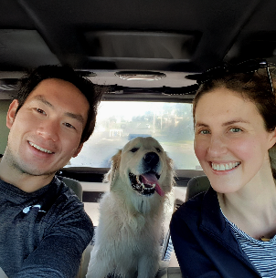
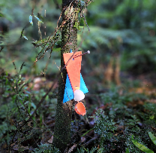
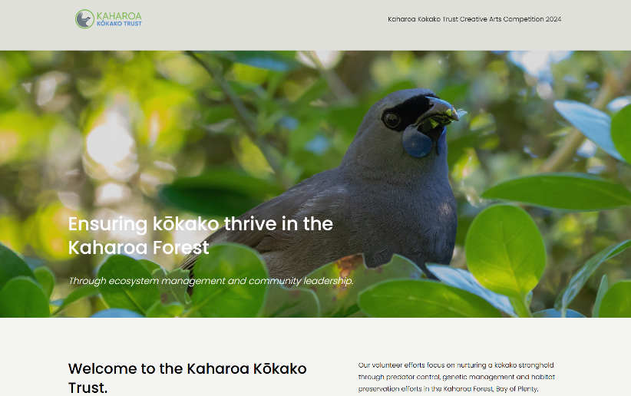
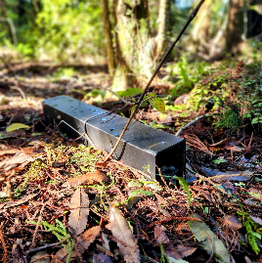
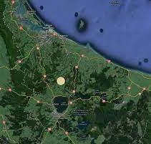
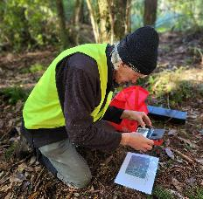
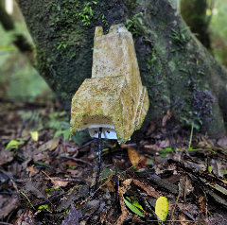
DO
Build a clear personal focus for changes. Clarify your purpose for including mātauranga Māori in your teaching programme.
Source: https://www.kokako.org.nz/
Map of Bay of Plenty © 2025 Google Maps. Image of laptop licensed via Adobe Stock.
Screenshot of website © Kaharoa Kōkako Trust. All other images from private collection.
PS: Vote Kōkako for bird of the year, donate a trap at https://giveatrap.org.nz/ and sign up as a volunteer at your local conservation group at https://www.doc.govt.nz/get-involved/volunteer/groups/

Slide 10
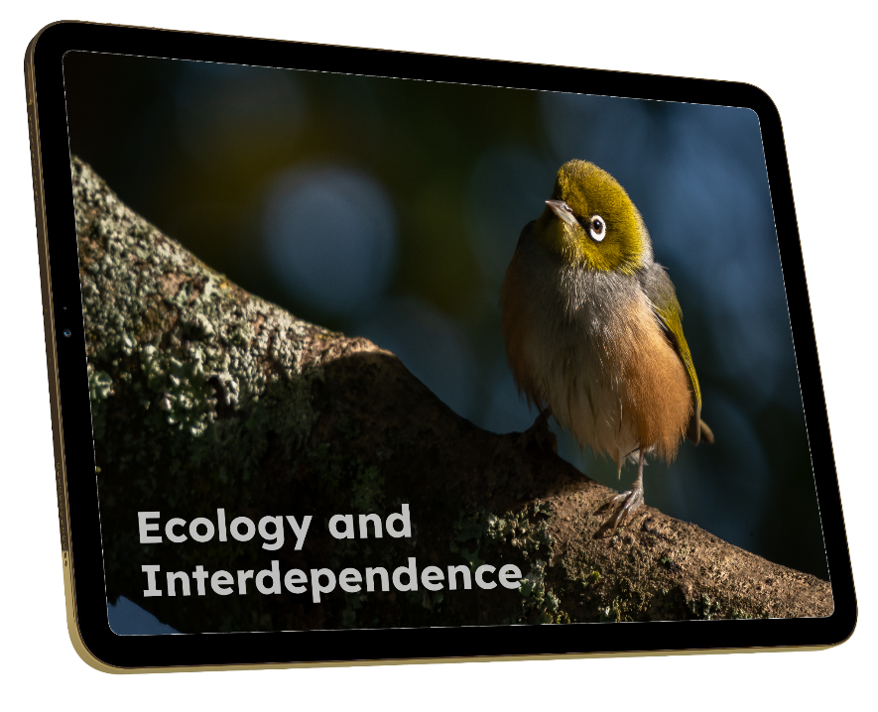
Where do did I start?
All images licensed via Adobe Stock unless otherwise indicated. Monthly pest kill data courtesy of Predator Free Bay of Plenty.

Slide 11
Where do did I start?
BIG IDEAS
- Living things’ specific structures have particular functions that contribute to their individual survival.
- Relationships between structure and function evolve over many generations in response to the challenges of survival in the environment of the time.
BIG IDEAS
- Living things’ specific structures have particular functions that contribute to their individual survival.
- Relationships between structure and function evolve over many generations in response to the challenges of survival in the environment of the time.
Example from Building Science Concepts by MoE
All images licensed via Adobe Stock unless otherwise indicated. Monthly pest kill data courtesy of Predator Free Bay of Plenty.

Slide 12
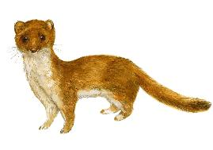
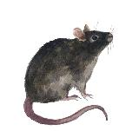
Where do did I start?
BIG IDEAS
- Living things’ specific structures have particular functions that contribute to their individual survival.
- Relationships between structure and function evolve over many generations in response to the challenges of survival in the environment of the time.
Concept: behavioural adaptations
The Wider World
Construct an explanation that predicts patterns of interactions among organisms across multiple ecosystems.
Resource Availability
Analyse and interpret data to provide evidence for the effects of resource availability on organisms and populations of organisms in an ecosystem.
Resource Availability
Evaluate competing design solutions for maintaining biodiversity and ecosystem services.
Selection Pressures
Construct an argument supported by empirical evidence that changes to physical or biological components of an ecosystem affect populations.
Implications and Solutions
Make a claim about the merit of a solution to a problem caused when the environment changes and the types of plants and animals that live there may change.
Natural Selection
Construct an argument with evidence that in a particular habitat some organisms can survive well, some survive less well, and some cannot survive at all.
Implications and Solutions
Construct an argument supported by evidence for how plants and animals can change the environment to meet their needs.
Habitats
Use a model to represent the relationship between the needs of different plants and animals and the places they live.
Sampled from NSTA 9.7
Adaptations
Use observations to describe patterns of what plants and animals need to survive.
All images licensed via Adobe Stock unless otherwise indicated. Monthly pest kill data courtesy of Predator Free Bay of Plenty. Willard, T. (2020). The NSTA atlas of the three dimensions. National Science Teaching Association.
Ministry of Education. (2000). Birds – Structure, function and adaptation. Learning Media Limited.

Slide 13
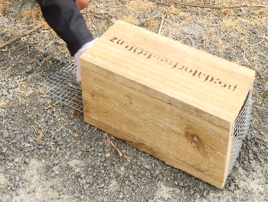
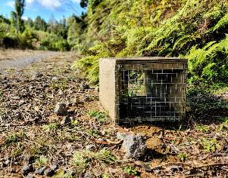
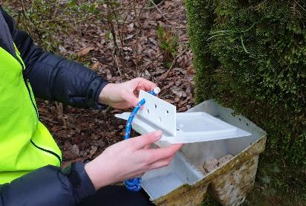
Where do did I start?
BIG IDEAS
- Living things’ specific structures have particular functions that contribute to their individual survival.
- Relationships between structure and function evolve over many generations in response to the challenges of survival in the environment of the time.
Concept: behavioural adaptations
Kaharoa Conservation Area
Resource Availability
Analyse and interpret data to provide evidence for the effects of resource availability on organisms and populations of organisms in an ecosystem.
Pāpāmoa College Science
The Wider World
Construct an explanation that predicts patterns of interactions among organisms across multiple ecosystems.
Resource Availability
Evaluate competing design solutions for maintaining biodiversity and ecosystem services.
Kaharoa Conservation Area
Selection Pressures
Construct an argument supported by empirical evidence that changes to physical or biological components of an ecosystem affect populations.
Implications and Solutions
Make a claim about the merit of a solution to a problem caused when the environment changes and the types of plants and animals that live there may change.
Natural Selection
Construct an argument with evidence that in a particular habitat some organisms can survive well, some survive less well, and some cannot survive at all.
Implications and Solutions
Construct an argument supported by evidence for how plants and animals can change the environment to meet their needs.
Habitats
Use a model to represent the relationship between the needs of different plants and animals and the places they live.
Sampled from NSTA 9.7
Adaptations
Use observations to describe patterns of what plants and animals need to survive.
All images licensed via Adobe Stock unless otherwise indicated. Monthly pest kill data courtesy of Predator Free Bay of Plenty. Willard, T. (2020). The NSTA atlas of the three dimensions. National Science Teaching Association.
Ministry of Education. (2000). Birds – Structure, function and adaptation. Learning Media Limited.

Slide 14
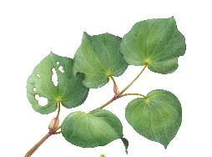
Where do did I start?
BIG IDEAS
- Living things’ specific structures have particular functions that contribute to their individual survival.
- Relationships between structure and function evolve over many generations in response to the challenges of survival in the environment of the time.
Concept: behavioural adaptations
Kaharoa Conservation Area
Resource Availability
Analyse and interpret data to provide evidence for the effects of resource availability on organisms and populations of organisms in an ecosystem.
Pāpāmoa College Science
The Wider World
Construct an explanation that predicts patterns of interactions among organisms across multiple ecosystems.
Resource Availability
Evaluate competing design solutions for maintaining biodiversity and ecosystem services.
Kaharoa Conservation Area
Nature of Science: Investigating in science
Selection Pressures
Construct an argument supported by empirical evidence that changes to physical or biological components of an ecosystem affect populations.
Implications and Solutions
Make a claim about the merit of a solution to a problem caused when the environment changes and the types of plants and animals that live there may change.
Natural Selection
Construct an argument with evidence that in a particular habitat some organisms can survive well, some survive less well, and some cannot survive at all.
Implications and Solutions
Construct an argument supported by evidence for how plants and animals can change the environment to meet their needs.
Habitats
Use a model to represent the relationship between the needs of different plants and animals and the places they live.
Sampled from NSTA 9.7
Adaptations
Use observations to describe patterns of what plants and animals need to survive.
All images licensed via Adobe Stock unless otherwise indicated. Monthly pest kill data courtesy of Predator Free Bay of Plenty. Willard, T. (2020). The NSTA atlas of the three dimensions. National Science Teaching Association.
Ministry of Education. (2000). Birds – Structure, function and adaptation. Learning Media Limited.

Slide 15
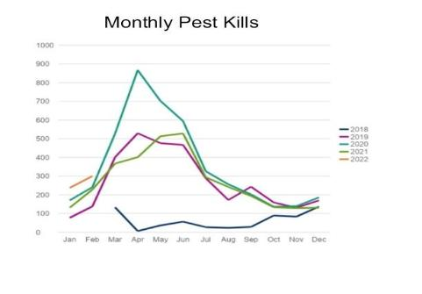
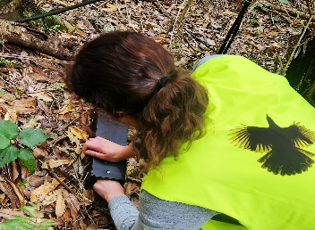
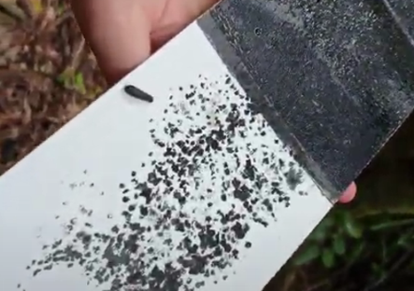
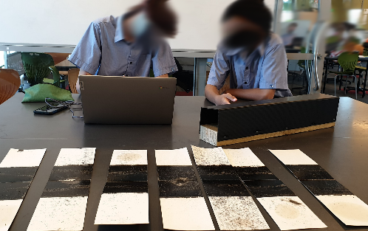
Where do did I start?
BIG IDEAS
- Living things’ specific structures have particular functions that contribute to their individual survival.
- Relationships between structure and function evolve over many generations in response to the challenges of survival in the environment of the time.
Concept: behavioural adaptations
Kaharoa Conservation Area
Resource Availability
Analyse and interpret data to provide evidence for the effects of resource availability on organisms and populations of organisms in an ecosystem.
Pāpāmoa College Science
The Wider World
Construct an explanation that predicts patterns of interactions among organisms across multiple ecosystems.
Nature of Science: Investigating in science
Resource Availability
Evaluate competing design solutions for maintaining biodiversity and ecosystem services.
Nature of Science: Investigating in science
Kaharoa Conservation Area
Selection Pressures
Construct an argument supported by empirical evidence that changes to physical or biological components of an ecosystem affect populations.
Kaharoa Conservation Area
Implications and Solutions
Make a claim about the merit of a solution to a problem caused when the environment changes and the types of plants and animals that live there may change.
Natural Selection
Construct an argument with evidence that in a particular habitat some organisms can survive well, some survive less well, and some cannot survive at all.
Data from Predator Free BOP
Kaharoa Conservation Area
Pāpāmoa College Science
Implications and Solutions
Construct an argument supported by evidence for how plants and animals can change the environment to meet their needs.
Habitats
Use a model to represent the relationship between the needs of different plants and animals and the places they live.
Sampled from NSTA 9.7
Adaptations
Use observations to describe patterns of what plants and animals need to survive.
All images licensed via Adobe Stock unless otherwise indicated. Monthly pest kill data courtesy of Predator Free Bay of Plenty. Willard, T. (2020). The NSTA atlas of the three dimensions. National Science Teaching Association.
Ministry of Education. (2000). Birds – Structure, function and adaptation. Learning Media Limited.

Slide 16
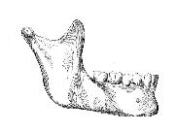
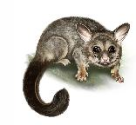
Where do did I start?
BIG IDEAS
- Living things’ specific structures have particular functions that contribute to their individual survival.
- Relationships between structure and function evolve over many generations in response to the challenges of survival in the environment of the time.
Concept: behavioural adaptations
Kaharoa Conservation Area
Resource Availability
Analyse and interpret data to provide evidence for the effects of resource availability on organisms and populations of organisms in an ecosystem.
Pāpāmoa College Science
The Wider World
Construct an explanation that predicts patterns of interactions among organisms across multiple ecosystems.
Nature of Science: Investigating in science
Resource Availability
Evaluate competing design solutions for maintaining biodiversity and ecosystem services.
Nature of Science: Investigating in science
Kaharoa Conservation Area
Selection Pressures
Construct an argument supported by empirical evidence that changes to physical or biological components of an ecosystem affect populations.
Kaharoa Conservation Area
Implications and Solutions
Make a claim about the merit of a solution to a problem caused when the environment changes and the types of plants and animals that live there may change.
Natural Selection
Construct an argument with evidence that in a particular habitat some organisms can survive well, some survive less well, and some cannot survive at all.
Data from Predator Free BOP
Kaharoa Conservation Area
Pāpāmoa College Science
Implications and Solutions
Construct an argument supported by evidence for how plants and animals can change the environment to meet their needs.
Concept - dentition / types of teeth, structure and function
Habitats
Use a model to represent the relationship between the needs of different plants and animals and the places they live.
Sampled from NSTA 9.7
Adaptations
Use observations to describe patterns of what plants and animals need to survive.
All images licensed via Adobe Stock unless otherwise indicated. Monthly pest kill data courtesy of Predator Free Bay of Plenty. Willard, T. (2020). The NSTA atlas of the three dimensions. National Science Teaching Association.
Ministry of Education. (2000). Birds – Structure, function and adaptation. Learning Media Limited.

Slide 17
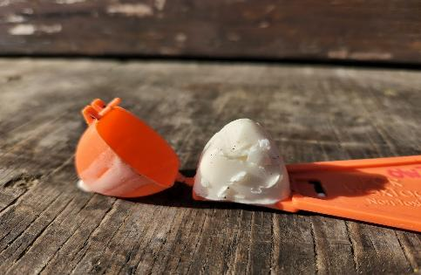
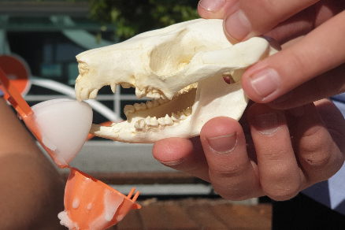
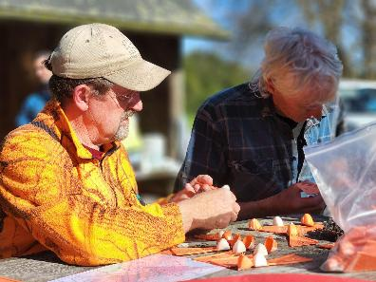
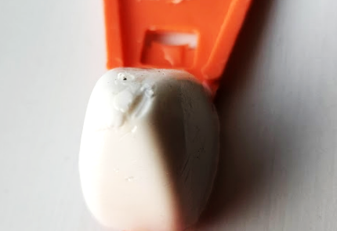
Where do did I start?
BIG IDEAS
- Living things’ specific structures have particular functions that contribute to their individual survival.
- Relationships between structure and function evolve over many generations in response to the challenges of survival in the environment of the time.
Concept: behavioural adaptations
Kaharoa Conservation Area
Resource Availability
Analyse and interpret data to provide evidence for the effects of resource availability on organisms and populations of organisms in an ecosystem.
Pāpāmoa College Science
The Wider World
Construct an explanation that predicts patterns of interactions among organisms across multiple ecosystems.
Resource Availability
Evaluate competing design solutions for maintaining biodiversity and ecosystem services.
Nature of Science: Investigating in science
Kaharoa Conservation Area
Selection Pressures
Construct an argument supported by empirical evidence that changes to physical or biological components of an ecosystem affect populations.
Kaharoa Conservation Area
Implications and Solutions
Make a claim about the merit of a solution to a problem caused when the environment changes and the types of plants and animals that live there may change.
Natural Selection
Construct an argument with evidence that in a particular habitat some organisms can survive well, some survive less well, and some cannot survive at all.
Data from Predator Free BOP
Kaharoa Conservation Area
Pāpāmoa College Science
Implications and Solutions
Construct an argument supported by evidence for how plants and animals can change the environment to meet their needs.
Concept - dentition / types of teeth, structure and function
Habitats
Use a model to represent the relationship between the needs of different plants and animals and the places they live.
Sampled from NSTA 9.7
Kaharoa Conservation Area
Adaptations
Use observations to describe patterns of what plants and animals need to survive.
Pāpāmoa College Science
Kaharoa Conservation Area
All images licensed via Adobe Stock unless otherwise indicated. Monthly pest kill data courtesy of Predator Free Bay of Plenty. Willard, T. (2020). The NSTA atlas of the three dimensions. National Science Teaching Association.
Ministry of Education. (2000). Birds – Structure, function and adaptation. Learning Media Limited.
Pāpāmoa College Science

Slide 18
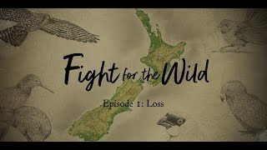
Where do did I start?
We talk about Mātauranga, the Māori worldview, or Māori knowledge. It is completely integrated with and within nature. The Earth, Te Taiao, is our older brother; it is all that we are. If we don’t look after it, it won’t look after us.
Our customs and ceremonies draw from the actions and behaviours of these species. If we have any hope of carrying that way of knowing and being and going forward from our generation into future generations, if we can’t do that, we’re going to be the ones that dropped the ball.
Jan Hania
If we lose biodiversity, we lose language and traditional environmental knowledge that’s connected to that plant or that animal. We lose all of the messages we’re supposed to pick up about how to conduct ourselves as humans.
Tina Ngata
Dr Ihirangi Heke
Source: https://www.rnz.co.nz/programmes/fight-for-the-wild
RNZ. (2021). Fight for the wild [Documentary series]. https://www.rnz.co.nz/programmes/fight-for-the-wild
All other images licensed via Adobe Stock.
Notes:
RNZ. (2021). Fight for the wild [Documentary series]. https://www.rnz.co.nz/programmes/fight-for-the-wild

Slide 19
Clarify your “why”
A mātauranga Māori perspective can help with:
Building deeper knowledge and connections to a specific place (not just ‘once and done’)
Choosing a rich context that can help learners to see where the ‘bits’ of knowledge fit in once you start to unpack science concepts (not just a pile of bricks)
Exploring the interconnectedness of everything, including different areas of science (not sticking to traditional silos)
Adding value-based dimensions such as an ethic of care (which ‘objective’ science rules out of scope)

Slide 20
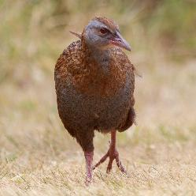
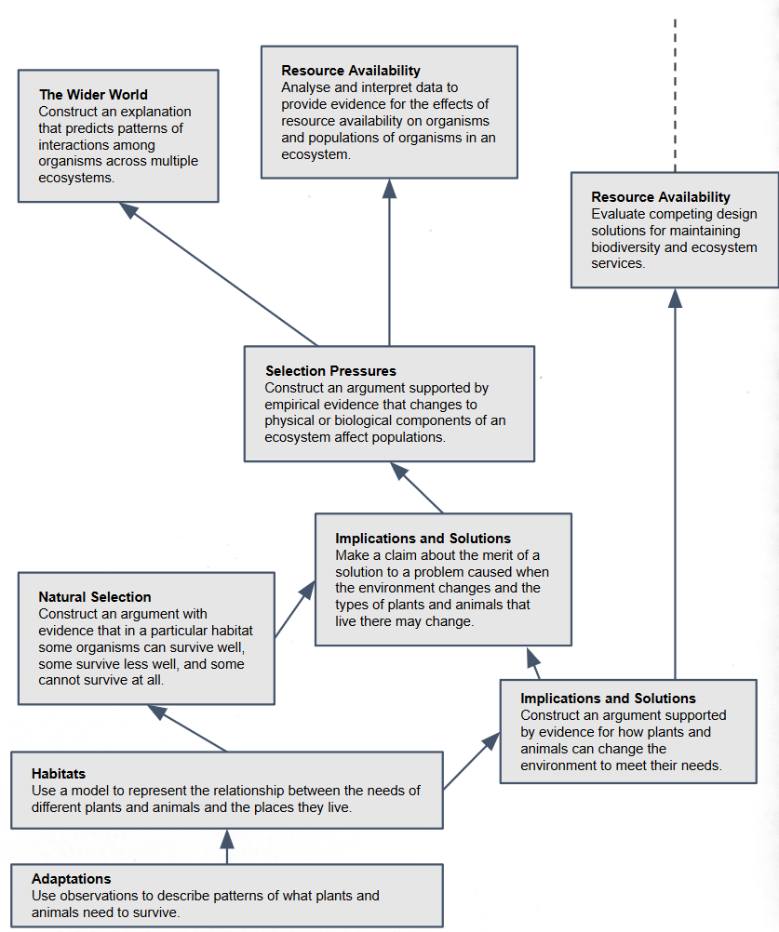
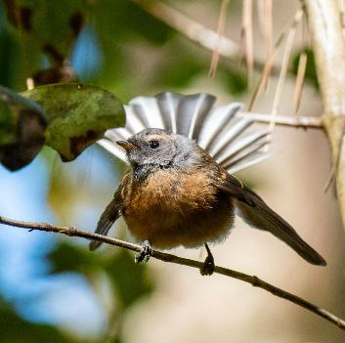
Where do did I go next?
BIG IDEAS
- Living things’ specific structures have particular functions that contribute to their individual survival.
- Relationships between structure and function evolve over many generations in response to the challenges of survival in the environment of the time.
Te Reo
Image of moa bones: personal collection
All other images licensed via Adobe Stock.

Slide 21
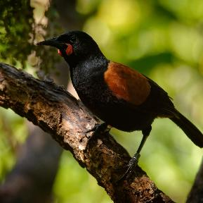
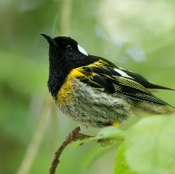
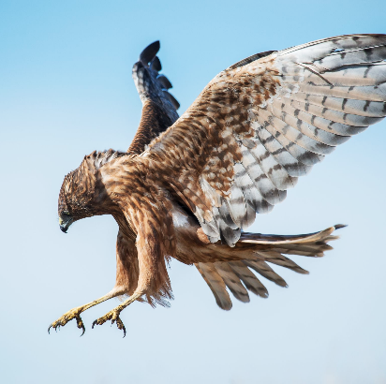
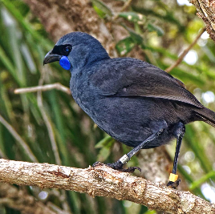
Where do did I go next?
BIG IDEAS
- Living things’ specific structures have particular functions that contribute to their individual survival.
- Relationships between structure and function evolve over many generations in response to the challenges of survival in the environment of the time.
Te Reo
Pūrākau
All other images licensed via Adobe Stock.

Slide 22
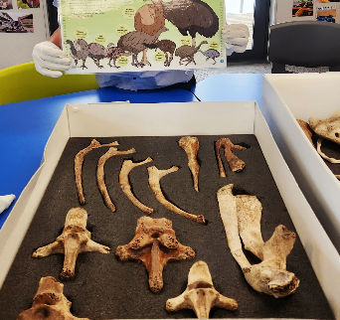
Where do did I go next?
BIG IDEAS
- Living things’ specific structures have particular functions that contribute to their individual survival.
- Relationships between structure and function evolve over many generations in response to the challenges of survival in the environment of the time.
Nature of Science
Te Reo
Pūrākau
Moa Bones from Hands on Tauranga
Taking care of our kupu. (n.d.). E-Tangata. https://e-tangata.co.nz/reo/taking-care-of-our-kupu/
Image of moa bones: personal collection
All other images licensed via Adobe Stock.
Notes:
Taking care of our kupu. (n.d.). E-Tangata. https://e-tangata.co.nz/reo/taking-care-of-our-kupu/

Slide 23
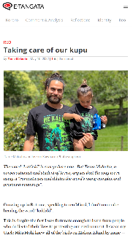
Where do did I go next?
BIG IDEAS
- Living things’ specific structures have particular functions that contribute to their individual survival.
- Relationships between structure and function evolve over many generations in response to the challenges of survival in the environment of the time.
Nature of Science
Te Reo
Our Obligations
Pūrākau
Moa Bones from Hands on Tauranga
Taking care of our kupu. (n.d.). E-Tangata. https://e-tangata.co.nz/reo/taking-care-of-our-kupu/
Image of moa bones: personal collection
All other images licensed via Adobe Stock.

Slide 24
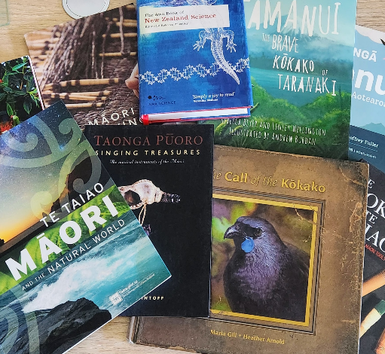
Where do did I go next?
Te Taiao: Māori and the Natural World. Museum of New Zealand Te Papa Tongarewa / Te Papa Press, 2023.
Flintoff, B. (2014). Taonga pūoro: Singing treasures. Nelson, New Zealand: Potton & Burton. Priestley, R. (Ed.). (2008). The Awa book of New Zealand science. Wellington, New Zealand: Awa Press.
Gill, M. (2011). The call of the kōkako. New Zealand: New Holland Publishers (NZ) Ltd. Fugill, C. (2016). Te toki me te whao: The story and use of Māori tools. New Zealand: Oratia. Beyer, R., & Wellington, L. (2015). Tamanui: The brave kōkako of Taranaki. Wellington, New Zealand: Huia Publishers. Fuller, G. (2022). He kōrero mō ngā manu o Aotearoa. Auckland, New Zealand: Scholastic New Zealand Ltd. Puketapu-Hetet, E. (2016). Māori weaving: The art of creating Māori textiles. Wellington, New Zealand: Huia Publishers. Tipa, C. (2020). Treasures of Tāne: Plants of Ngāi Tahu. Wellington, New Zealand: Huia Publishers.
Rauika Māngai. (2020). A Guide to Vision Mātauranga: Lessons from Māori Voices in the New Zealand Science Sector. Wellington, NZ: Rauika Māngai. Elkington. B, Jackson. M, Kiddle. R, Mercier. O, Ross. M, Smeaton. J, Thomas. A (2020). Imagining decolonisation. Bridget Williams Books. Amoamo. M, Kawharu. M, Katharina. (2023). He pou hiringa: Grounding science and technology in te ao Māori. Bridget Williams Books. Predator Free Bay of Plenty. (n.d.). Predator Free BOP teacher resource [PDF]. https://www.predatorfreebop.nz/resources Bay Conservation Alliance. (n.d.). Bay Conservation Alliance website. https://www.bayconservation.nz/ Hands On Tauranga. (n.d.). Moa bones (HC1501-14). https://www.handsontauranga.co.nz
All other images licensed via Adobe Stock.

Slide 25
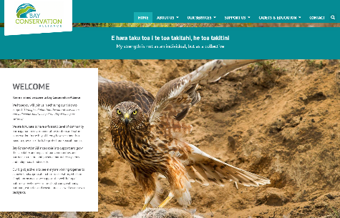
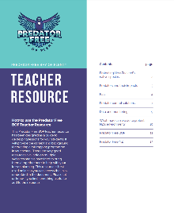
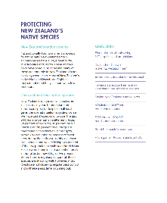
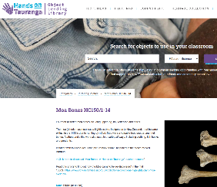
Where do did I go next?
Te Taiao: Māori and the Natural World. Museum of New Zealand Te Papa Tongarewa / Te Papa Press, 2023.
Flintoff, B. (2014). Taonga pūoro: Singing treasures. Nelson, New Zealand: Potton & Burton. Priestley, R. (Ed.). (2008). The Awa book of New Zealand science. Wellington, New Zealand: Awa Press.
Gill, M. (2011). The call of the kōkako. New Zealand: New Holland Publishers (NZ) Ltd. Fugill, C. (2016). Te toki me te whao: The story and use of Māori tools. New Zealand: Oratia. Beyer, R., & Wellington, L. (2015). Tamanui: The brave kōkako of Taranaki. Wellington, New Zealand: Huia Publishers. Fuller, G. (2022). He kōrero mō ngā manu o Aotearoa. Auckland, New Zealand: Scholastic New Zealand Ltd. Puketapu-Hetet, E. (2016). Māori weaving: The art of creating Māori textiles. Wellington, New Zealand: Huia Publishers. Tipa, C. (2020). Treasures of Tāne: Plants of Ngāi Tahu. Wellington, New Zealand: Huia Publishers.
Rauika Māngai. (2020). A Guide to Vision Mātauranga: Lessons from Māori Voices in the New Zealand Science Sector. Wellington, NZ: Rauika Māngai. Elkington. B, Jackson. M, Kiddle. R, Mercier. O, Ross. M, Smeaton. J, Thomas. A (2020). Imagining decolonisation. Bridget Williams Books. Amoamo. M, Kawharu. M, Katharina. (2023). He pou hiringa: Grounding science and technology in te ao Māori. Bridget Williams Books. Predator Free Bay of Plenty. (n.d.). Predator Free BOP teacher resource [PDF]. https://www.predatorfreebop.nz/resources Bay Conservation Alliance. (n.d.). Bay Conservation Alliance website. https://www.bayconservation.nz/ Hands On Tauranga. (n.d.). Moa bones (HC1501-14). https://www.handsontauranga.co.nz
All other images licensed via Adobe Stock.

Slide 26
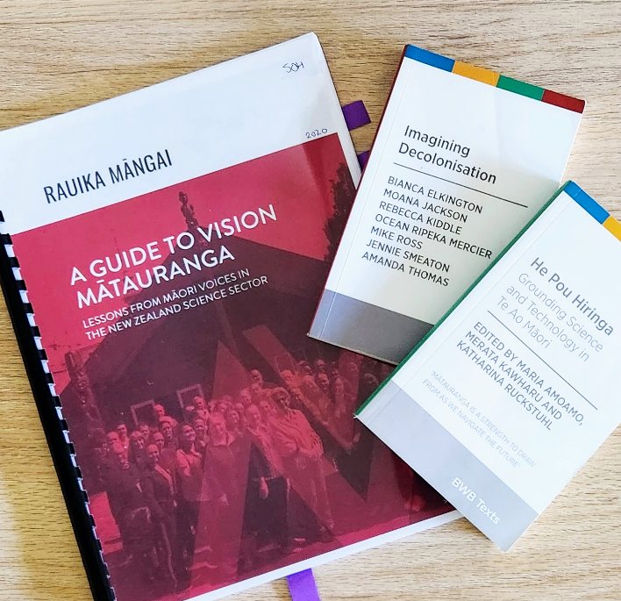
Where do did I go next?
Te Taiao: Māori and the Natural World. Museum of New Zealand Te Papa Tongarewa / Te Papa Press, 2023.
Flintoff, B. (2014). Taonga pūoro: Singing treasures. Nelson, New Zealand: Potton & Burton. Priestley, R. (Ed.). (2008). The Awa book of New Zealand science. Wellington, New Zealand: Awa Press.
Gill, M. (2011). The call of the kōkako. New Zealand: New Holland Publishers (NZ) Ltd. Fugill, C. (2016). Te toki me te whao: The story and use of Māori tools. New Zealand: Oratia. Beyer, R., & Wellington, L. (2015). Tamanui: The brave kōkako of Taranaki. Wellington, New Zealand: Huia Publishers. Fuller, G. (2022). He kōrero mō ngā manu o Aotearoa. Auckland, New Zealand: Scholastic New Zealand Ltd. Puketapu-Hetet, E. (2016). Māori weaving: The art of creating Māori textiles. Wellington, New Zealand: Huia Publishers. Tipa, C. (2020). Treasures of Tāne: Plants of Ngāi Tahu. Wellington, New Zealand: Huia Publishers.
Rauika Māngai. (2020). A Guide to Vision Mātauranga: Lessons from Māori Voices in the New Zealand Science Sector. Wellington, NZ: Rauika Māngai. Elkington. B, Jackson. M, Kiddle. R, Mercier. O, Ross. M, Smeaton. J, Thomas. A (2020). Imagining decolonisation. Bridget Williams Books. Amoamo. M, Kawharu. M, Katharina. (2023). He pou hiringa: Grounding science and technology in te ao Māori. Bridget Williams Books. Predator Free Bay of Plenty. (n.d.). Predator Free BOP teacher resource [PDF]. https://www.predatorfreebop.nz/resources Bay Conservation Alliance. (n.d.). Bay Conservation Alliance website. https://www.bayconservation.nz/ Hands On Tauranga. (n.d.). Moa bones (HC1501-14). https://www.handsontauranga.co.nz
All other images licensed via Adobe Stock.

Slide 27
Why do I love the Knowledge Systems approach?
Bringing values into play
More than one way of knowing; adds richness to how we make sense of the world
World view - examining another can inform your own (making the invisible visible)
A different way of ‘being’ in the world

Slide 28
Do: Enjoy the learning opportunity
Work out why this matters to you, and why it matters to include in your teaching programme
You are not expected to know all things mātauranga Māori, a good start will be to consider what a Māori world view might look like
Mātauranga Māori is very discoverable, all Iwi have websites

Slide 29
Do: Enjoy the learning opportunity
Contd
Do your own research as you would for any other knowledge & understanding you are seeking
Be humble with the knowledge and understandings you are developing, acknowledge the knowledge and understandings your Māori students may or may not have
Build on the knowledge you have over time, acknowledging how you know this, and having an awareness of what you may not yet know, check your understandings with others
As with all that we teach our students…it must be worth knowing

Slide 30
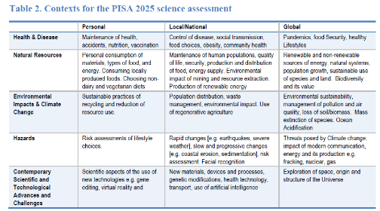
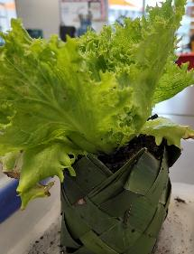
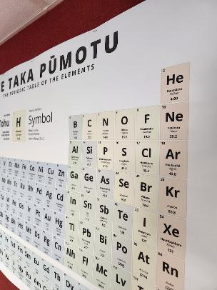
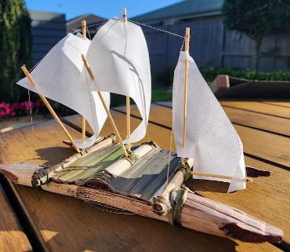
DO
Use local contexts
Organisation for Economic Co-operation and Development. (2023). Agency in the Anthropocene. https://doi.org/10.1787/8d3b6cfa-en Private collection of photographs from Te Ara o Wairakei stormwater reserve, Pāpāmoa College learning spaces, Kaituna River, Ōtūmoetai, Pāpāmoa Hills Regional Park Further acknowledgements: Trap boxes by Pāpāmoa College Technology Department, Trees 4 Survival

Slide 31
Published papers
Tolbert, S., Hipkins, R., Cowie, B. & Waiti, P. (2024)
Epistemic agency, Indigenous knowledge, and
the school science curriculum: Reflections from
Aotearoa New Zealand. International Journal of Science Education, https://doi.org/10.1080/09500693.2024.2356229
Hipkins, R., Cowie, B., Tolbert, S. & Waiti, P. (2023)
Designing for empowering curriculum implementation: The potential of “enduring competencies”. The New Zealand Annual Review of Education, 28:38-48.
DOI: 10.26686/nzaroe.v28.8273
Hipkins, R. (2024). From key competencies to science capabilities and on to enduring competencies. Tracing the trajectory of an idea.
set: Research Information for Teachers, 1, 20-27,
https://doi.org/10.18296/set.1547
Find more here….
Notes:
Published papers:
Tolbert, S., Hipkins, R., Cowie, B. & Waiti, P. (2024)
Epistemic agency, Indigenous knowledge, and
the school science curriculum: Reflections from
Aotearoa New Zealand. International Journal of Science Education, https://doi.org/10.1080/09500693.2024.2356229
Hipkins, R., Cowie, B., Tolbert, S. & Waiti, P. (2023)
Designing for empowering curriculum implementation: The potential of “enduring competencies”. The New Zealand Annual Review of Education, 28:38-48.
DOI: 10.26686/nzaroe.v28.8273
Hipkins, R. (2024). From key competencies to science capabilities and on to enduring competencies. Tracing the trajectory of an idea.
set: Research Information for Teachers, 1, 20-27,
https://doi.org/10.18296/set.1547

