Slide 1
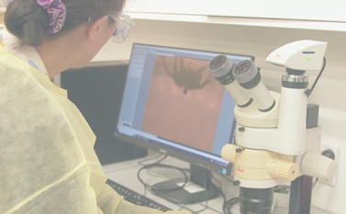
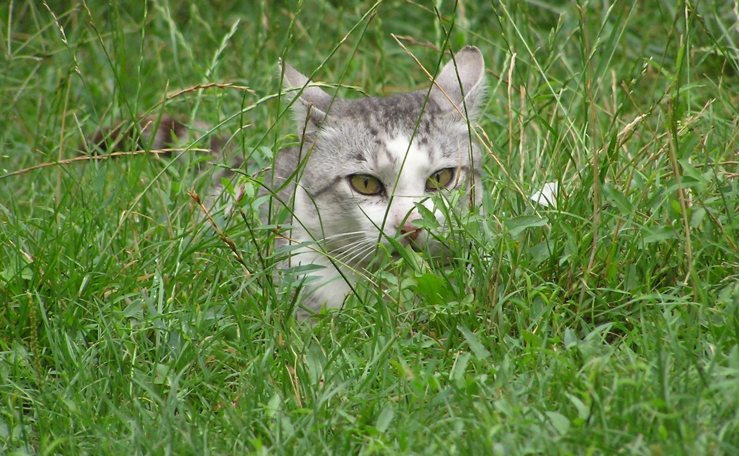
Māori knowledge in science education:
He Mana Ōrite, He Awa Whiria
Georgina Tuari Stewart
Te Kura Mātauranga School of Education, AUT
Sally Birdsall
Faculty of Arts & Education, University of Auckland
Webinar 12 June 2025, hosted by Science Learning Hub
© The University of Waikato Te Whare Wānanga o Waikato and ANZCCART New Zealand

Slide 2
Index
Topic | Slideshow number(s) | Video timecode
Introduction | 1 | 00:00
Index | 2 | 00:20
Mātauranga Māori is ... | 3 | 00:51
Māori knowledge in science education? | 4–8 | 03:03
Example: Science and Māori knowledge of kiore | 9–11 | 11:08
What does ‘mana ōrite’ mean? | 12–15 | 15:13
Putting both knowledge systems to work – animal knowledge and ethics | 16–18 | 20:03
Māori Concepts | 19–21 | 25:21
Potential benefits of including Māori concepts | 22 | 28:14
Q&A, SLH links, keep in touch and thanks | 23 | 30:58

Slide 3
Mātauranga Māori is . . .
Māori knowledge in the widest sense
Not divided into disciplines
Māori concepts, values and perspectives
All aspects of Māori culture and identity
Includes the knowledge lost since colonisation
Also the Western knowledge that Māori people have borrowed
The knowledge that Māori students bring into the classroom
Holistic, undefined, dynamic, potentially includes all knowledge
Mead, H. M. (2012). Understanding Mātauranga Māori. In D. Bean, T. Black, W. Collings, & W. Nuku (Eds.), Conversations on mātauranga Māori (pp. 9-14). NZQA & Haemata Ltd.
Mead. H. M. & e-tangata. (2022). Understanding Mātauranga Māori. https://e-tangata.co.nz/comment-and-analysis/understanding-matauranga-maori/

Slide 4
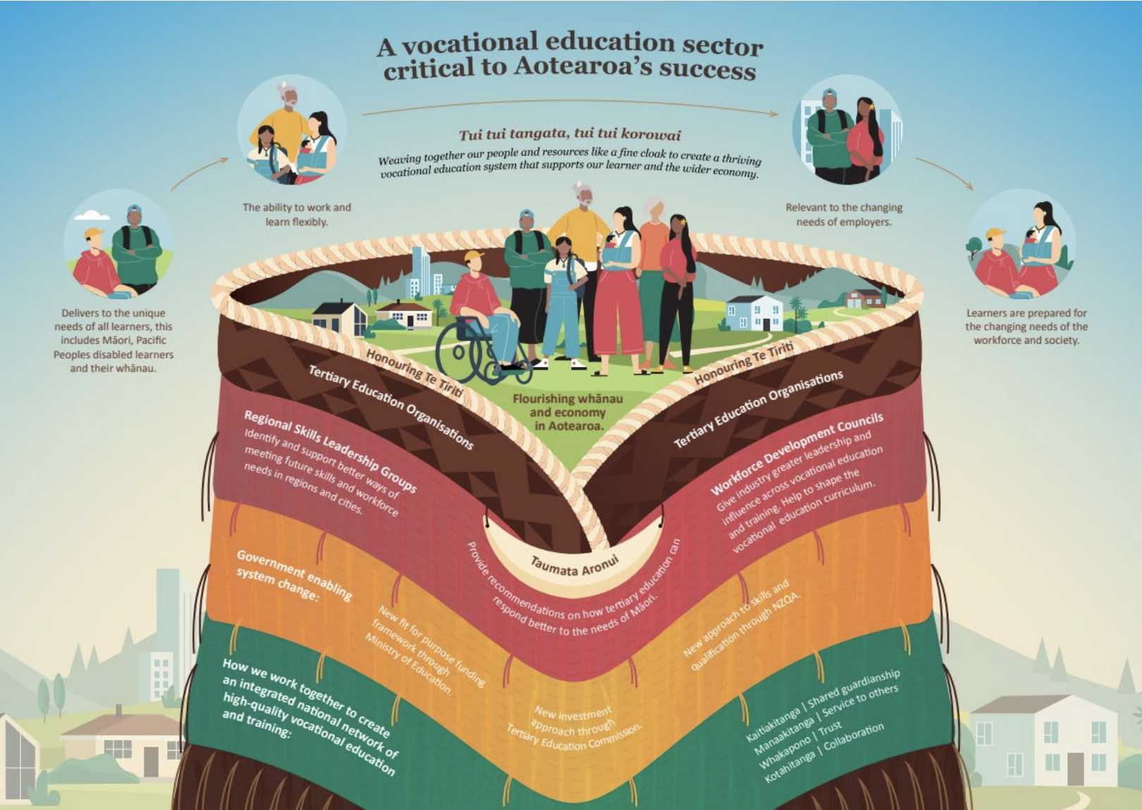
Māori knowledge in science education?
Until recently, it was assumed that mātauranga Māori had no place in science classrooms.
Now, it is assumed that mātauranga Māori can be, and is being, included in all science classrooms and programmes.
The logic seems to be:
  Science teachers are expected to teach mātauranga Māori
  Mātauranga Māori includes all knowledge
  Therefore, in teaching science we are teaching mātauranga Māori
  Mātauranga Māori is placed ‘around’ the science content
Catching the Knowledge Wave (Gilbert, 2005) and many
others advocate for a knowledge systems approach
© Tertiary Education Commission

Slide 5
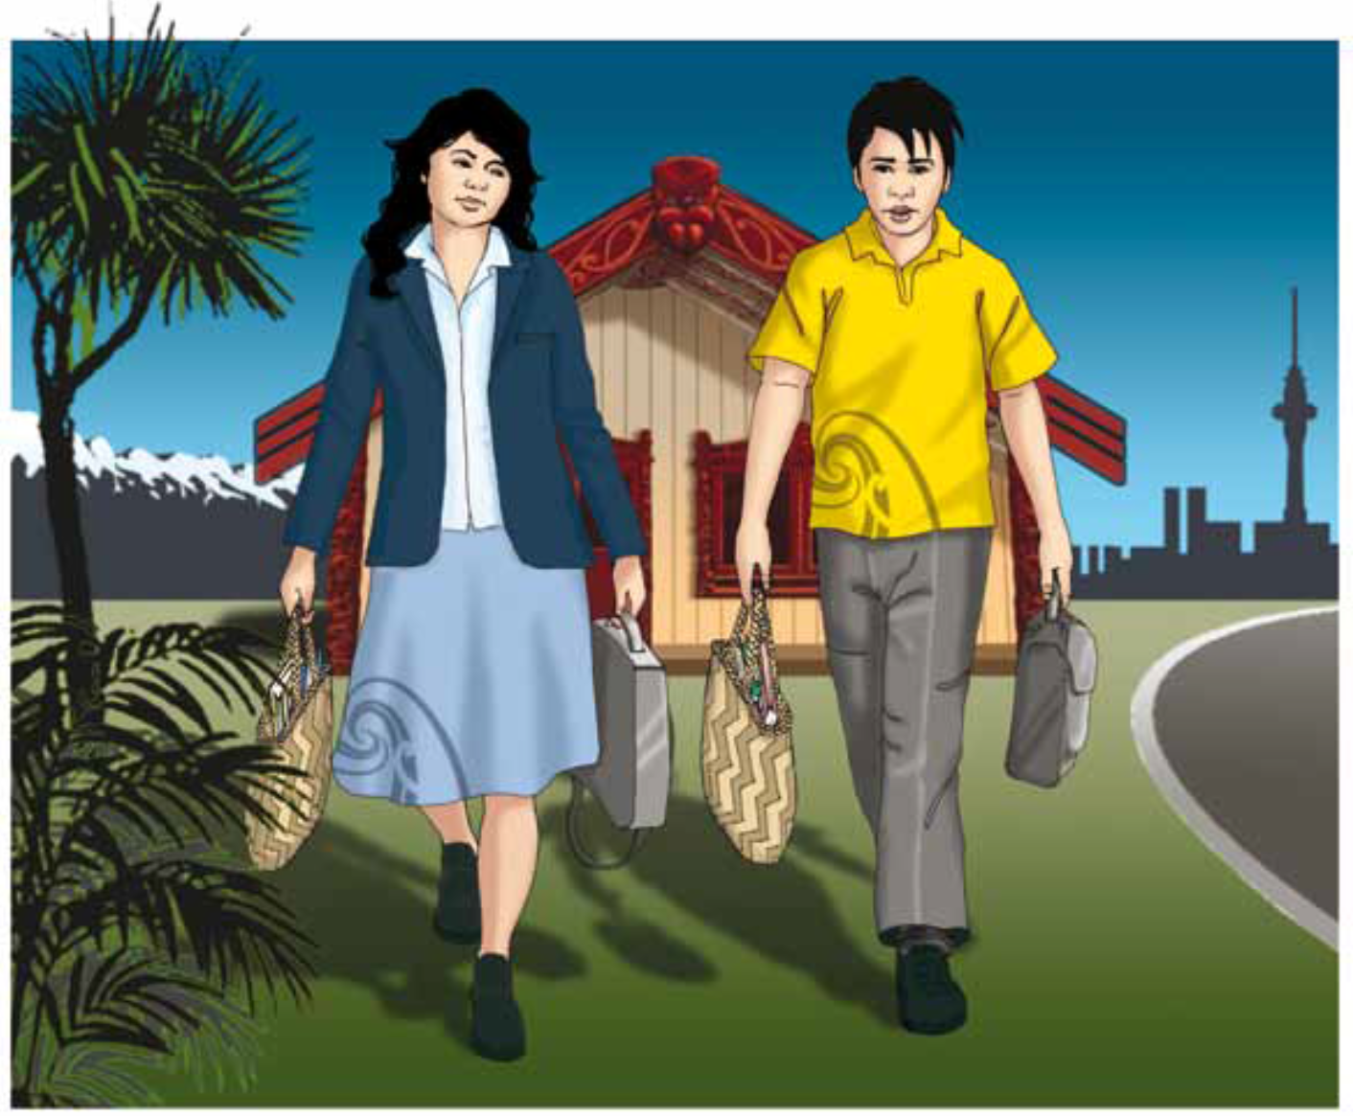
1. Questions of mātauranga Māori don’t just apply to Science but all curriculum areas.
2. Metaphors like ‘he awa whiria’ and ‘two-eyed seeing’ are implied by the following terms and concepts:
Worldview
Incommensurability
Knowledge systems
Ways of knowing
Epistemologies
Sciences
Crown Copyright ©

Slide 6

He Awa Whiria
“Acknowledging the mana and integrity of both knowledge streams”
- Angus Macfarlane
Macfarlane, A., Derby, M., & Macfarlane, S. (2024). He Awa Whiria: Braiding the knowledge streams in research, policy and practice. Canterbury University Press. https://doi.org/10.26021/14970
Chapter topics include:
  Behaviour management
  Literacy
  Psychology
  Planning
  Community work
  River science
  Data science
  Research methodology
  Volcanology in science ed
Geoff Leeming, CC BY-NC 2.0, via Flickr

Slide 7
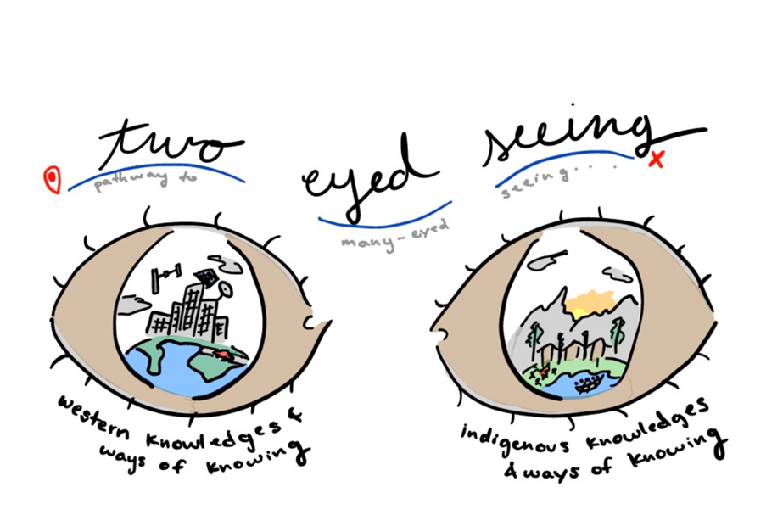
Two-Eyed Seeing
An appropriated traditional concept from First Nations people of Canada.
‘Etuaptmumk’ - a Mi'kmaq word meaning “the gift of multiple perspectives”
Bartlett, C., Marshall, M., & Marshall, A. (2012). Two-Eyed Seeing and other lessons learned within a co-learning journey of bringing together indigenous and mainstream knowledges and ways of knowing. Journal of Environmental Studies and Sciences, 2(4), 331-340. https://doi.org/10.1007/s13412-012-0086-8
Illustration by Anna Socha, based on the Etuaptmumk/Two-Eyed Seeing teachings shared by Mi'kmaw Elder Dr. Albert Marshall during a live online dialogue hosted by Reconciling Ways of Knowing, Canada. © Dr. Albert Marshall.

Slide 8
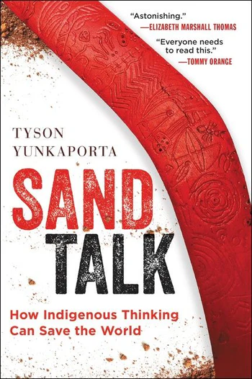
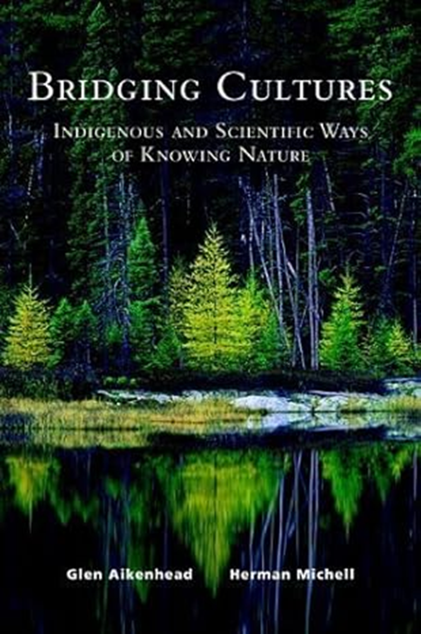
Center for Braiding Indigenous Knowledges and Science (CBIKS) – research hub NSF 2023 (US$30 million for first 5 years)
Braiding Sweetgrass: Indigenous Wisdom, Scientific Knowledge, and the Teachings of Plants by Professor Robin Wall Kimmerer – a botanist and Native American (Potawatomi Nation)
Science teachers as culture brokers
Integrative Science
Bridging Cultures
Sand Talk
and many more books and articles

Slide 9
Example: Science & Māori knowledge of kiore
Haami, B. (1993). Cultural knowledge and traditions relating to the kiore rat in Aotearoa Part I: A Māori perspective. In E. McKinley & P. Waiti (Eds.), SAMEpapers 1993 (pp. 5-22). CSMER Publications.
Roberts, M. (1993). Scientific knowledge and cultural traditions Part II: A Pakeha view of the kiore rat in New Zealand. In E. McKinley & P. Waiti (Eds.), SAMEpapers 1993 (pp. 23-45). CSMER Publications.
Rattus exulans – the smallest species in the Rattus genus – spread with people throughout the Pacific

Slide 10
Mere Roberts:
  Rodent phylogeny
  Dispersal (see diagram)
  Cultural significance of rodents to
  Europeans
  Biology
    scientific names
    distinguishing characteristics
    ecological impact
    etc
  Current status in New Zealand
    DOC aim to 100% eradicate the kiore
Diagram: page 28, Roberts (1993)

Slide 11
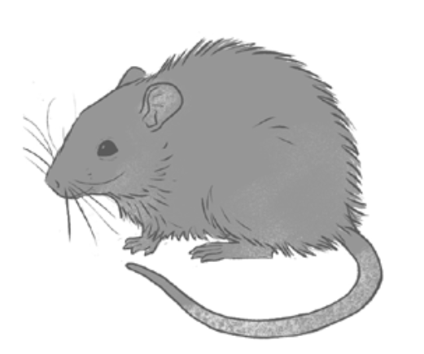
Brad Haami: The kiore is part of tikanga and mātauranga, not as a nuisance, but something of considerable value. Māori participants in his research shed tears of joy when they found out that populations of kiore still survived on some offshore islands.
Kiore were brought to Aotearoa purposefully as a food source and managed in rāhui kiore. Detailed knowledge of their biology/ecology
Harvesting and preparation (detailed practical knowledge)
Hua kiore (rats preserved under fat in gourds) – exchange value
Whakapapa – kinship with humans
Narratives, Whakataukī, Waiata (oral repositories)
Iconography
Metaphoric value – co-travellers with Māori
© G. T. Stewart and S. Birdsall

Slide 12
What does ‘mana ōrite’ mean?
As a result of history, Māori have had no option but to be bicultural
“The relational intent of the Treaty of Waitangi was understood by many iwi as mana ōrite. This, as a metaphor for interdependent relationships, brings responsibilities to both groups to maintain the mana of the other, and understand the mana of both as ōrite.”
Berryman, M., Lawrence, D., & Lamont, R. (2018). Cultural relationships for responsive pedagogy: A bicultural mana ōrite perspective. Set: Research information for teachers, 2018(1), 3-10. https://doi.org/10.18296/set.0096

Slide 13
Mana ōrite mō te mātauranga Māori
One of 7 changes in the NCEA change programme mandated in February 2020
In April 2024, following the change of government, the NCEA change programme was delayed, since the curriculum is still under review
Rapid changes in direction for updating the curriculum cast doubt over the future of this principle
But what does this principle really mean?
Poorly understood, superficially interpreted
Challenging for science teachers
Has led to objections from scientists

Slide 14
Mana is an attribute of persons
The ancient Indigenous concept of mana is an attribute of people, not of knowledges
To apply the notion of ‘mana ōrite’ to knowledge is a metaphor; the meaning of ‘mana ōrite mō te mātauranga Māori’ is thus metaphorical
So it does NOT mean ‘teaching equal amounts’ of mātauranga Māori and science in science classrooms
The principle of ‘mana ōrite mō te mātauranga Māori’ makes sense in terms of living relationships between people, not for making comparisons between different forms of knowledge
The call for equal mana aims to re-balance the weight of history, when Māori knowledge was ignored and denigrated in knowledge systems of New Zealand including school curricula and science

Slide 15
Mana ōrite means respectful relations
In this sense, the concept of mana ōrite means ‘respectful relations’
Calls for an end to unthinking dismissal of Māori knowledge
How Māori knowledge has been used in jokes, myths and legends, and insulting ideas like ‘the warrior gene’
Mātauranga Māori or its global equivalent, Indigenous knowledge, did not cause the problems humans face, and cannot solve them
A reminder that science has limits
The need for humility and respect are among the gifts of this idea

Slide 16
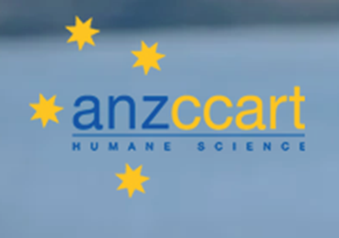
Putting both knowledge systems to work
One of ANZCCART’s strategic aims is to support education about the care of animals in research, testing and teaching
We researched Māori knowledge relevant to animal ethics, with the aim of producing classroom resources
The Three Rs (Replace, Reduce, Refine) are best practice principles of animal ethics for more humane use of animals

Slide 17
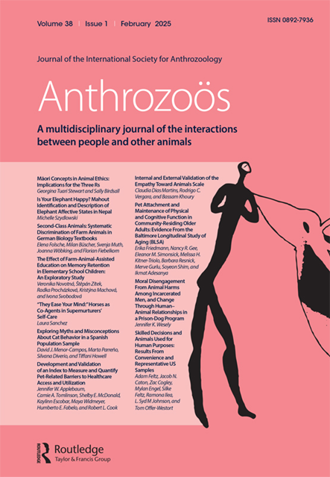
Developing research-based resources
1. Two research articles
Stewart, G. T. (2024). Animals of Aotearoa: Kaupapa Māori Summaries. Anthrozoös, 37(1), 1-17.
Stewart, G. T. & Birdsall, S. (2025).
Māori Concepts in Animal Ethics: Implications for the Three Rs. Anthrozoös, 38(1), 1-16.
2. Two source texts + 6 profiles 2a. Translation-ready texts
Junior (Yr7-10) on Māori knowledge of animals Translator: Te Ahunui Donovan Farnham
Senior (Yr11+) on Māori concepts for animal ethics Junior, senior, and the six expert profiles
Plus 6 short profiles of the experts we interviewed
3. Science Learning Hub digital resources 3a. Te Reo Māori booklets
119 items: 18 articles, 59 images, Pdf downloads from Science Learning Hub
14 activities, 5 pdfs, 8 videos Student booklet + teacher guide
www.sciencelearn.org.nz Sets of 10 student booklets sent to 89 Wharekura
Published on behalf of the International Society for Society for Anthrozoology. © Routledge, Taylor & Francis Group

Slide 18
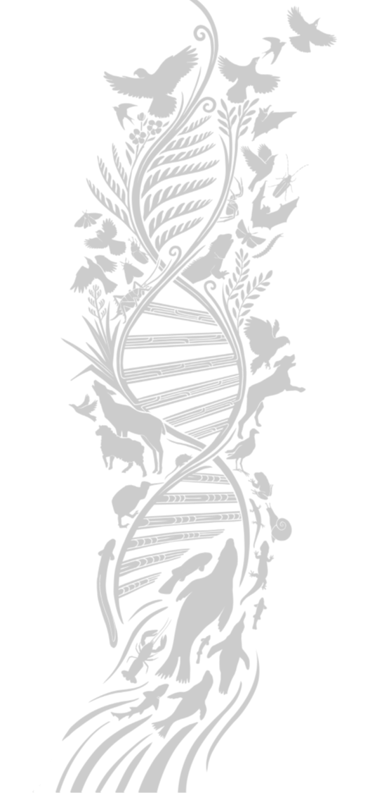
Māori Concepts for Animal Ethics
Whakapapa - keystone concept of Māori philosophy - explains kin relationships between humans and animals, since all descend from Ngā Atua Māori.
So, in Māori thinking, all animals are ethically significant. All animals have mana so are deserving of respect.
Thus, Māori concepts give rise to Relate and Respect as logical underpinnings of the Three Rs.
These ideas justify enacting the Three Rs in support of being a good citizen of the natural world.
© G.Tuari Stewart and S.Birdsall

Slide 19
Unpacking the nature of Māori concepts
Māori concepts are often treated as separate entities, like scientific concepts.
Invalid since Māori concepts are multi-layered and inter-connected, and can be both facts and values at the same time.
Manaakitanga and kaitiakitanga - two Māori concepts prominent in efforts to incorporate Māori knowledge into education.
© G.Tuari Stewart and S.Birdsall

Slide 20
Manaakitanga
Usually interpreted to mean ‘hospitality’
Manaaki + tanga = the quality of manaaki
Mana + aki = to encourage mana
Mana is often translated as personal prestige or power
But mana is a central concept of Māori philosophy: it means the ability to keep the forces of creation in balance
Manaakitanga means acting with integrity, supporting the mana of others, and caring for animals and nature
© G.Tuari Stewart and S.Birdsall

Slide 21
Kaitiakitanga
Usually interpreted to mean ‘conservation’
Kaitiaki + tanga = the quality of a kaitiaki
Kai + tiaki = the entity that guards or protects a natural resource, feature or location
Today, people often call themselves kaitiaki
Traditionally, kaitiaki are spiritual entities – either ngā atua or their intermediaries, often animals
Kaitiakitanga calls to whakapapa and taking seriously the idea of kinship through whakapapa to other species
© G.Tuari Stewart and S.Birdsall

Slide 22
Potential benefits of including Māori concepts
For Māori, weaving mātauranga Māori and science together can suggest another way of doing science and perhaps a better understanding of science.
For non-Māori, it provides an opportunity to consider other ways of seeing that enhance one’s perspective and attitude to the world.
For everyone, it places value on mātauranga Māori.
Other knowledge systems have potential to help us to see what might be invisible to us: a standpoint of critique, which counters the view that science is the one and only “true” way of thinking about the natural world.

Slide 23







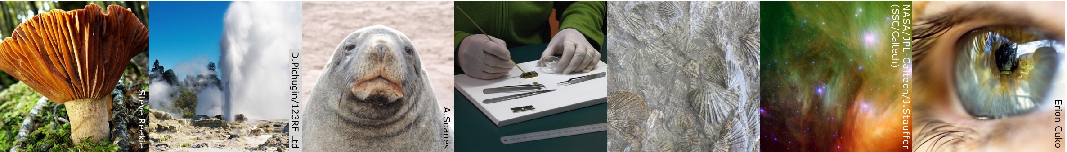
Thanks – want to keep in touch?
Email us on enquiries@sciencelearn.org.nz
facebook.com/nzsciencelearn
instagram.com/sciencelearninghubnz
bit.ly/slhnz_li
youtube.com/@ScienceLearningHubNZ
pinterest.com/nzsciencelearn

