Slide 1
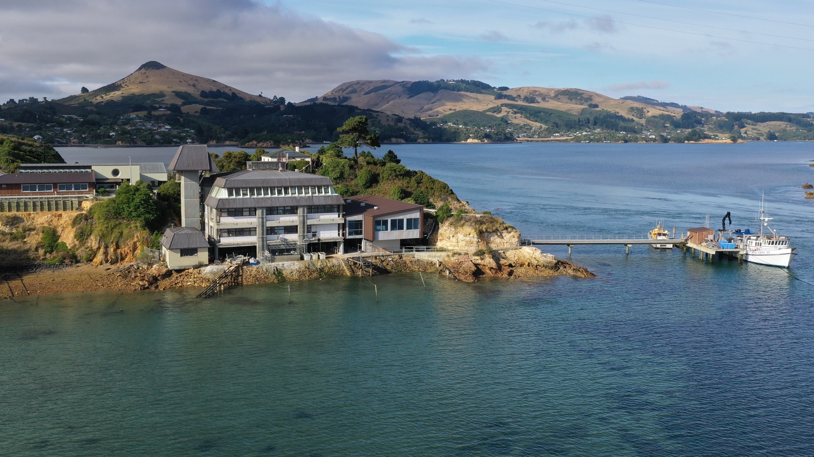


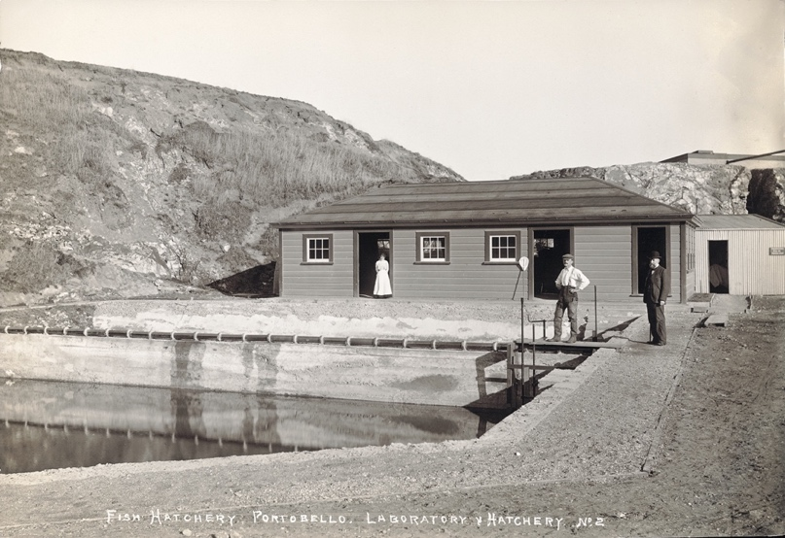
Sally Carson, NZMSC Director
Sally.carson@Otago.ac.nz
Portobello Marine Laboratory
RV Polaris
© NZMSC
Monitoring the Moana
– Participatory Science Methods
www.marine.ac.nz
www.mm2.net.nz

Slide 2

Index
Topic | Slideshow number(s) | Video timecode
Introducing Sally Carson and index | 1–3 | 00:00
Why should we care? | 4–9 | 02:21
Measuring conditions: temperature, salinity and clarity | 10–14 | 08:05
Monitoring biological communities: Marine Metre2 Photogrammetry Plankton Settlement plates Subtidal underwater cameras | 15–22 | 15:32
How to get started and moving beyond data donation | 23–24 | 24:17
Next steps… | 25 | 27:40
Can we grow environmental citizens? | 26 | 29:43
Keep in touch and thanks! | 27 | 37:40
© Copyright. Science Learning Hub Pokapū Akoranga Pūtaiao The University of Waikato Te Whare Wananga o Waikato.
All Rights Reserved | www.sciencelearn.org.nz. All images are copyrighted. For further information, please refer to enquiries@sciencelearn.org.nz

Slide 3
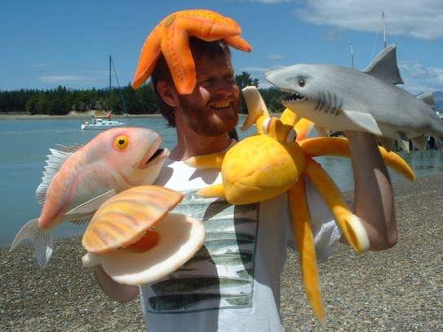

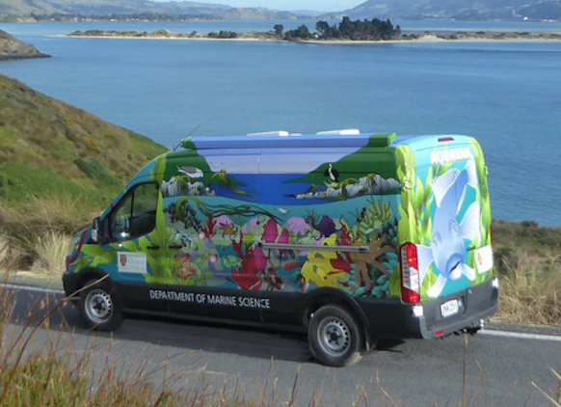
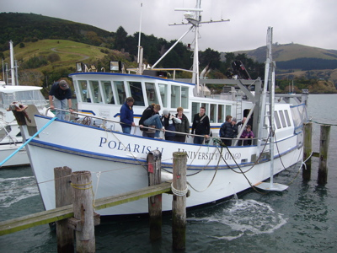
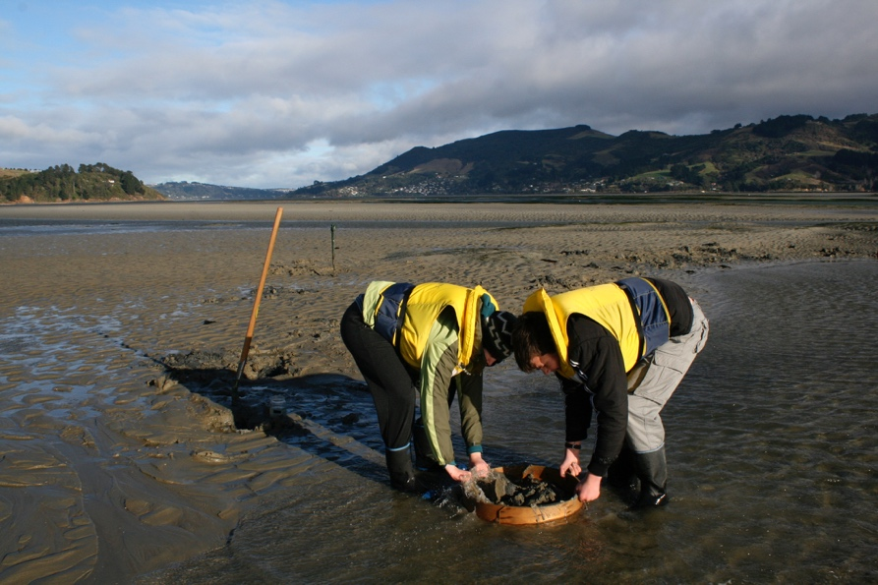
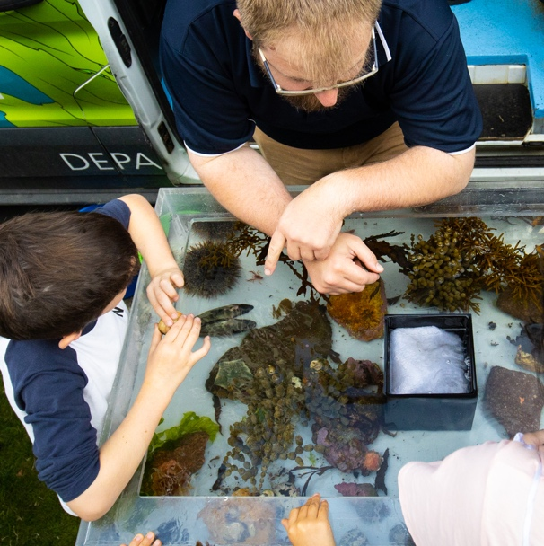
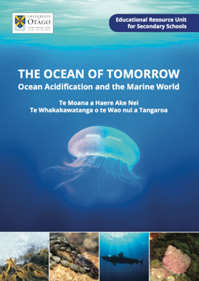
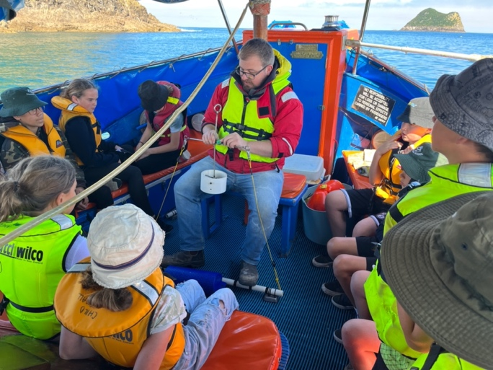
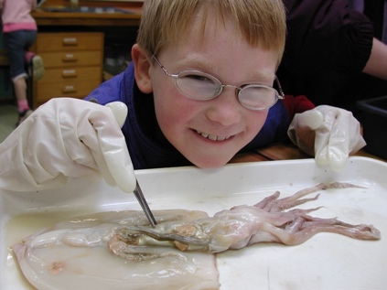
Hands-on science
Place-based
Enriching Local Curriculum
© NZMSC
Field and laboratory
www.marine.ac.nz
Authentic science

Slide 4

Monitoring the Moana
– Participatory Science Methods
Why should we care about the moana?
What can we do to care for our moana?
Measure environmental conditions
Monitor biological communities
How to get started?
© Marine metre2

Slide 5
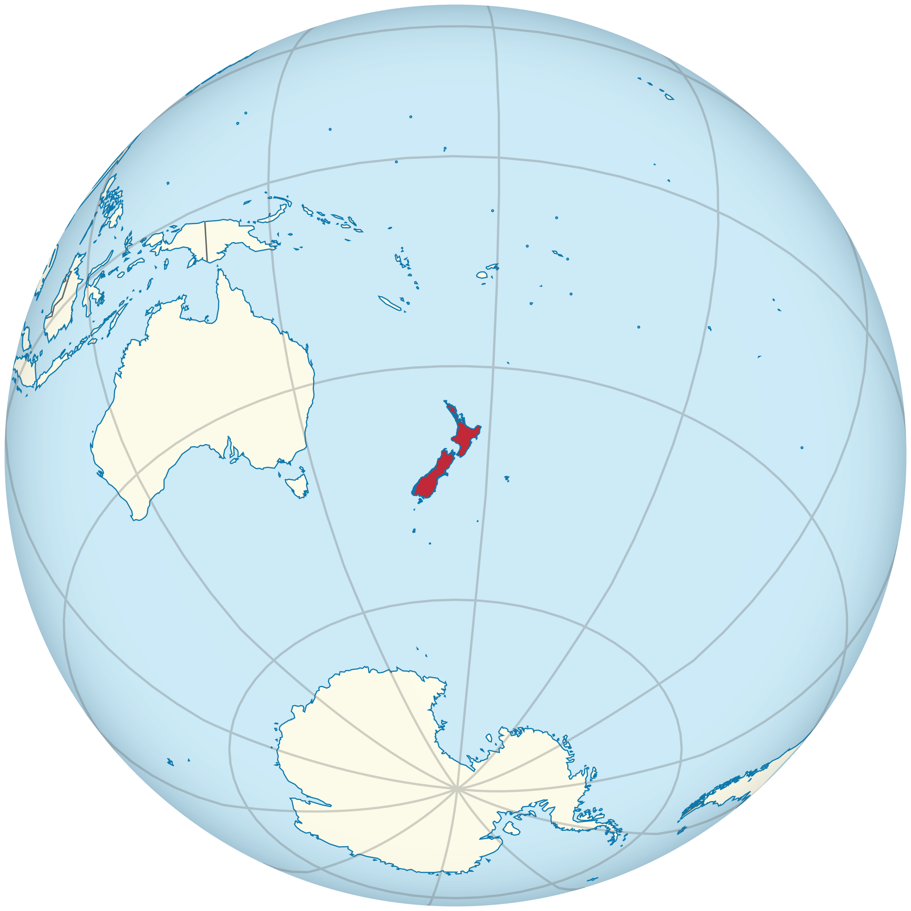
Our Planet is Blue…
The ocean influences our climate, history, culture, economy and our daily lives!
~70% of the world’s population live within 60 km of the coastline.
Some 1 billion people rely on the sea as a major source of protein.
© TUBS, CC BY-SA 3.0

Slide 6
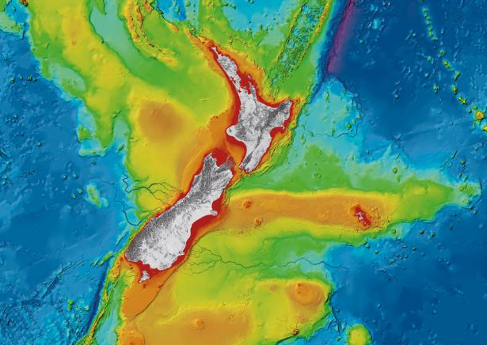
New Zealand’s ocean is big!
NZ has > 15,000 km of coastline
NZ’s marine territory is one of largest in the world
Subtropical to subantarctic
Sheltered harbours to deep canyons
<1% protected
Celebrate our coastal environment and actively care for it!
© NIWA, CC BY 4.0
Notes:
NIWA Bathymetric Chart of New Zealand – to order go to https://niwa.co.nz/coasts/charts
NZ Exclusive Economic Zone (EEZ)– 200 nautical miles from NZ islands, 15 x the land area of NZ
> 60% of the world’s marine ecosystems are degraded
We all have a role to protect it

Slide 7
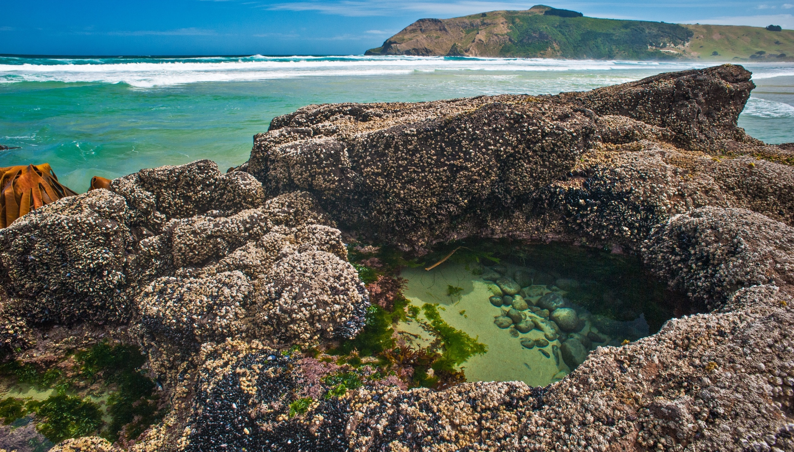
Photo credit: Rod Morris
17,000 marine species
10% global marine biodiversity
Half only found in NZ waters
Over 4,000 still undescribed
Build environmental awareness
(e.g. record local species)

Slide 8
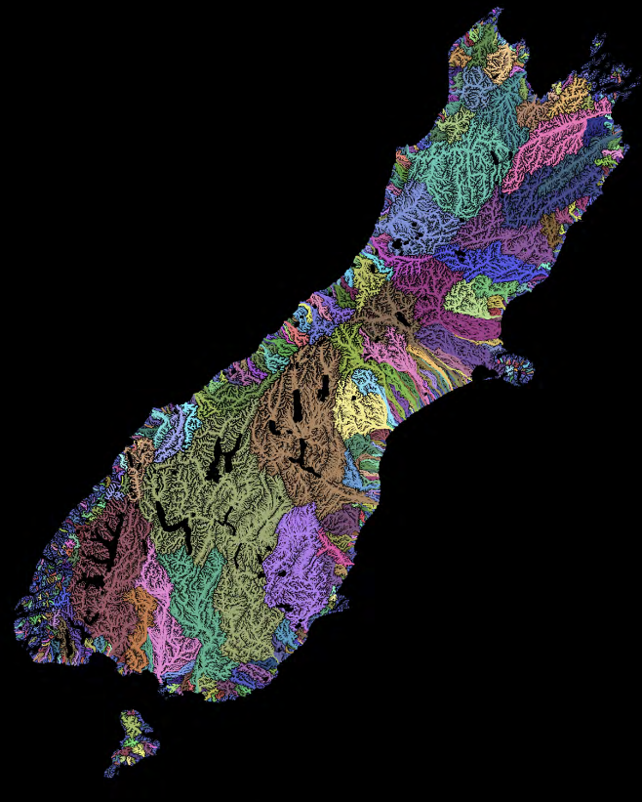
Coastal connection…
Duane Wilkins of Toitū Te Whenua Land Information NZ, CC BY 4.0
Our waterways are connected
Schools community / iwi have local knowledge and understanding
Our Ocean environment is changing
We all have a role as kaitiaki for the coastal environment
© Environment Canterbury
Mountains to Sea
Ki uta ki tai
Notes:
https://drive.google.com/drive/folders/1w3Jn62BeqZspeoYU6rlU8up3UCQ7SYWe?fbclid=IwAR1lYYct0vFUfaFM6rSk7lmXPzQ3NW-OMQ7ZCM4ufnG_eiPwW7xd5Hk4NZQ

Slide 9

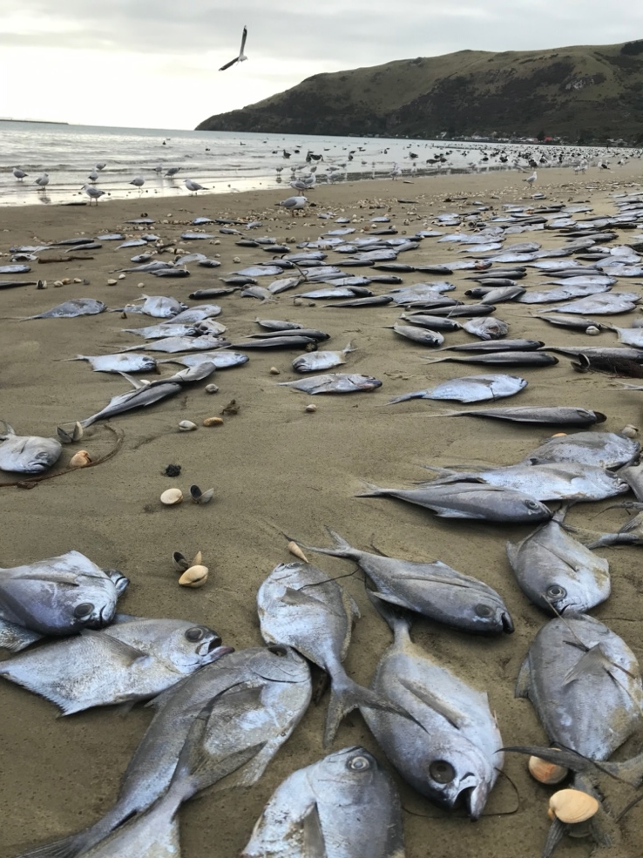
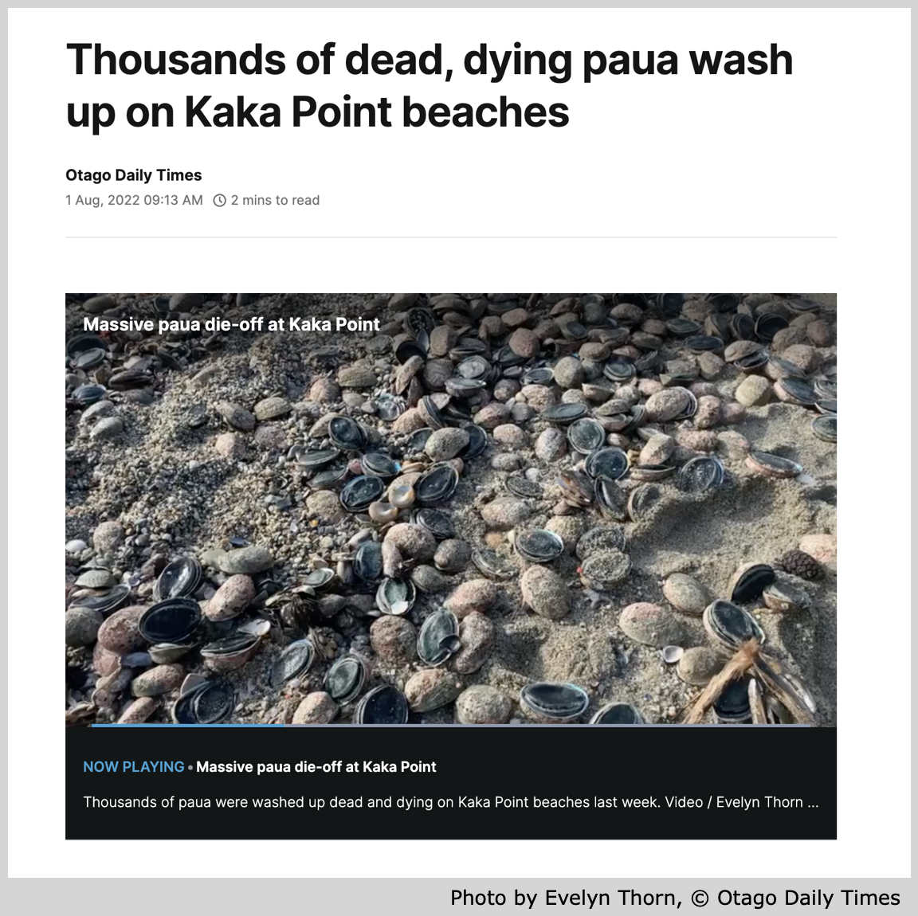
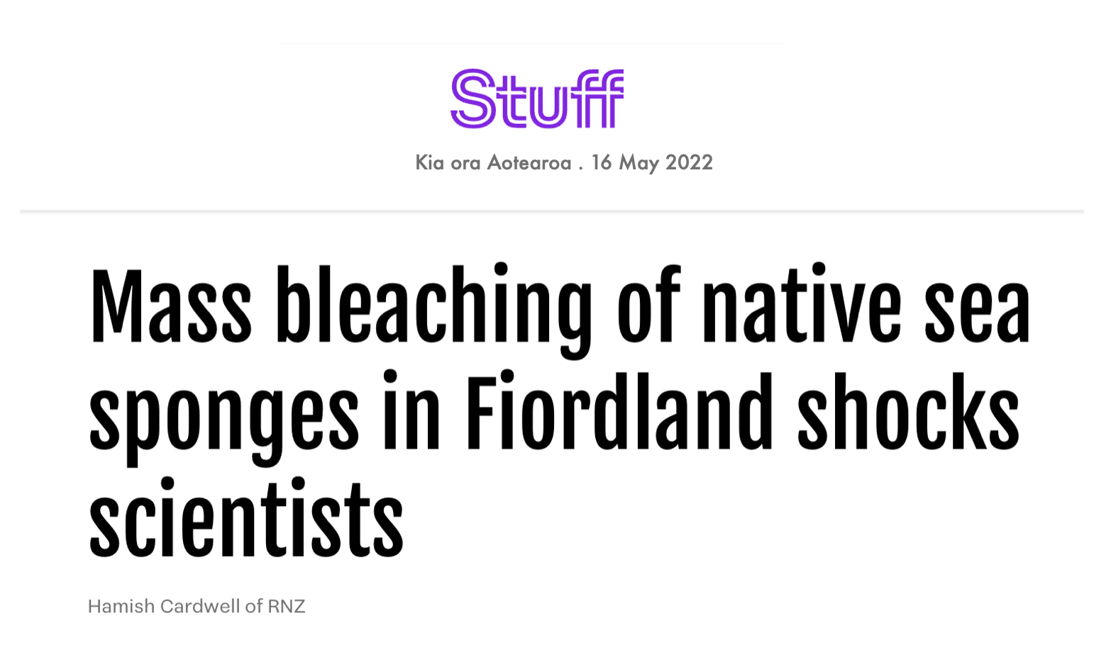
Our ocean is changing….
Sea level is rising
Sea is becoming more acidic
Average temperature is rising, Heatwaves more extreme
Storm events increasing (waves, sediment input, etc.)
© Sally Carson
Ray’s Bream – May 2022
Environmental monitoring (e.g. record change)

Slide 10
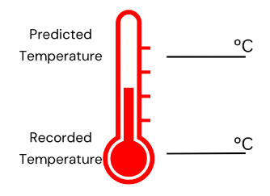
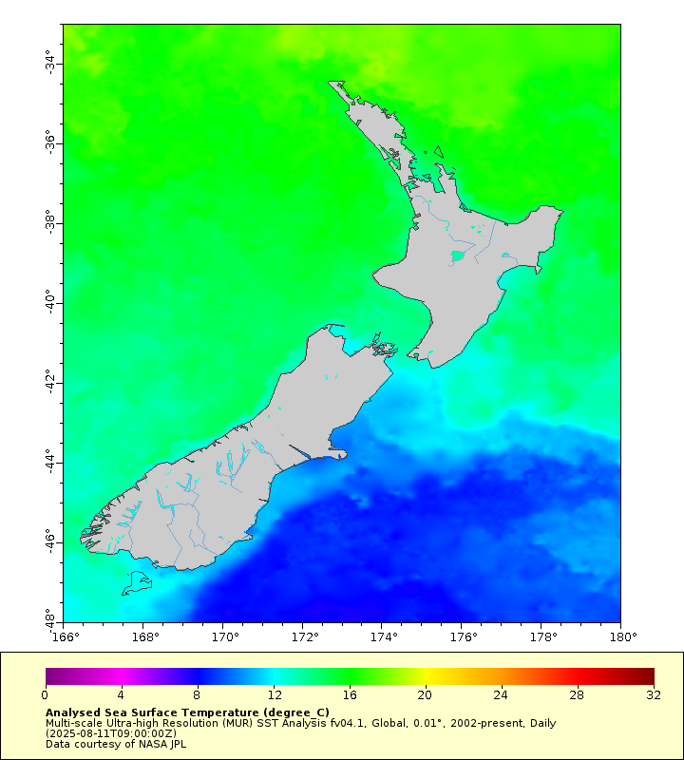
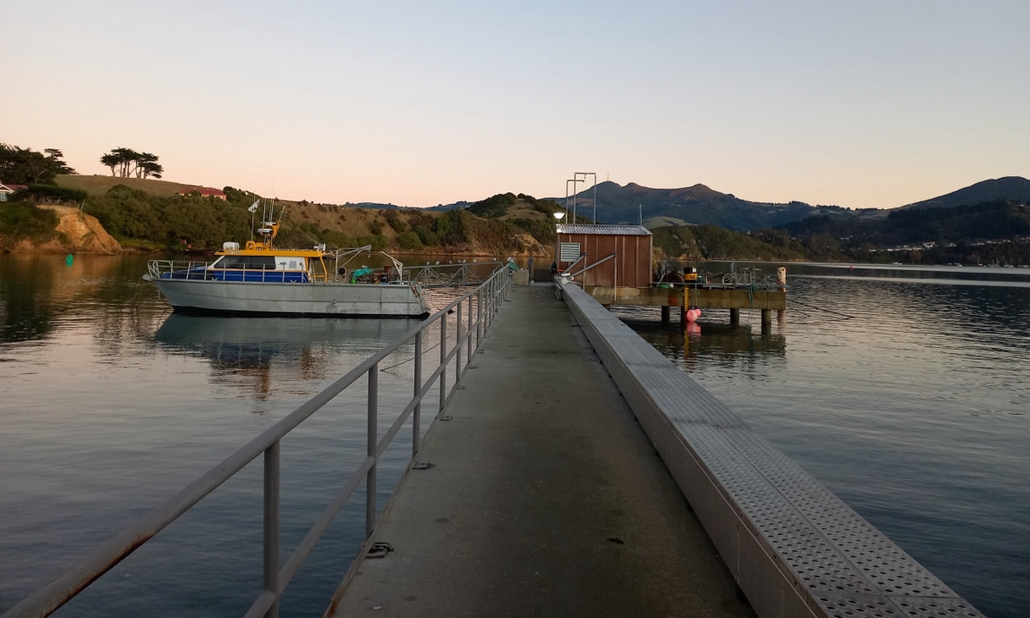
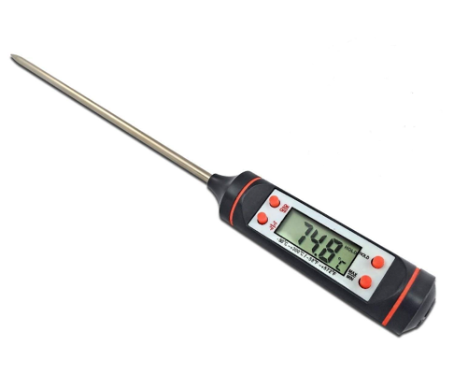
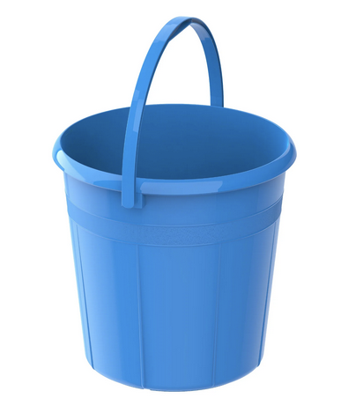
Measuring Environmental Conditions – Temperature (ºC)
Sea surface temperature
(Satellite Data – 11 August 2025)
© NZMSC
https://coastwatch.pfeg.noaa.gov/erddap/index.html

Slide 11
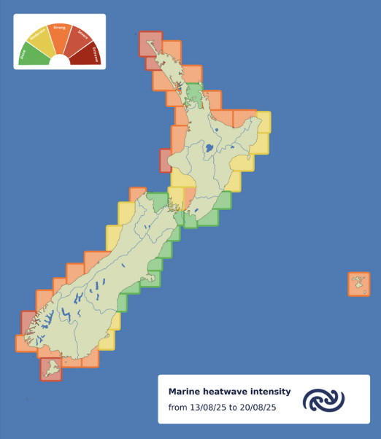
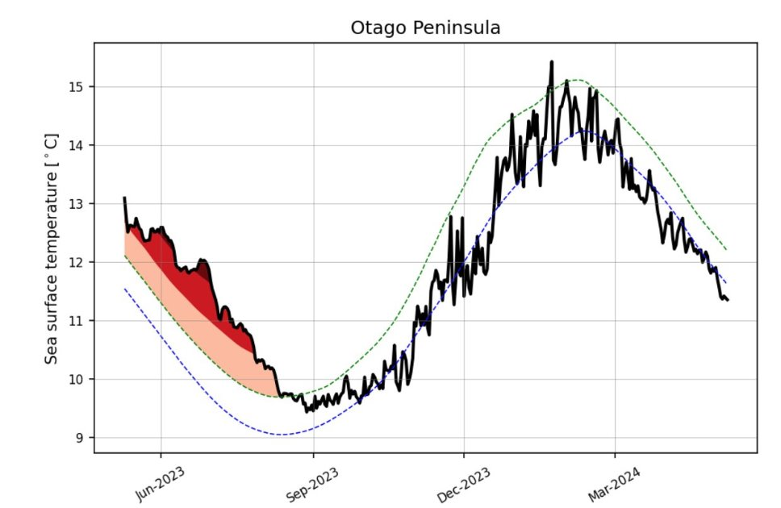

Temperature naturally change with the seasons. But Aotearoa’s ocean is warming.
Forecast from regional data (>2 m depth)
© Moana Project, CC BY-NC-SA 4.0
Image sourced from the Moana Project, www.moanaproject.org, funded by the New Zealand Ministry of Business Innovation and Employment, contract number METO1801.
Extreme warming events (marine heatwaves) can affect:
health and distribution of fish, seaweeds other species
traditional mahinga kai practices
https://www.moanaproject.org/marine-heatwave-forecast
Notes:
Moana Project www.moanaproject.org – marine heatwave forecast

Slide 12
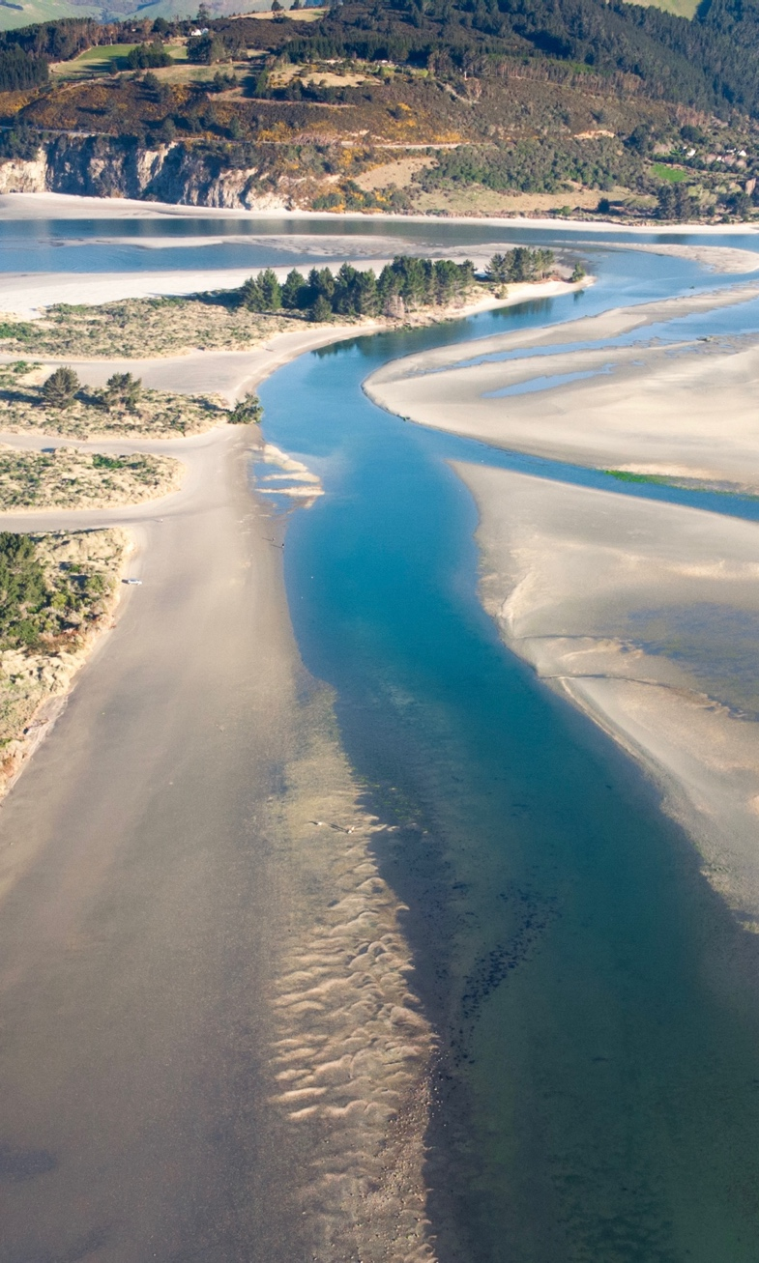
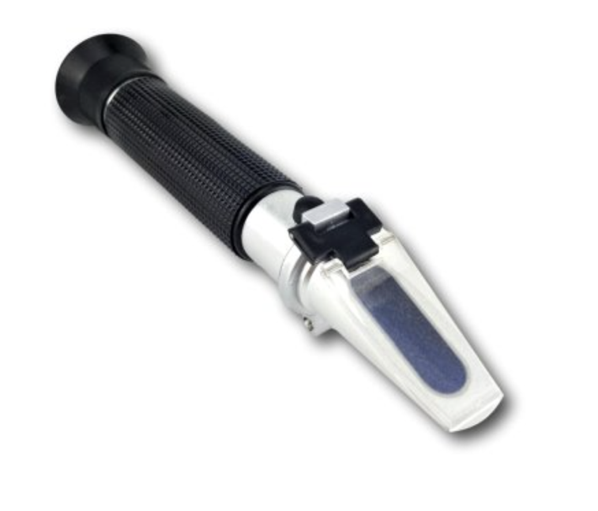
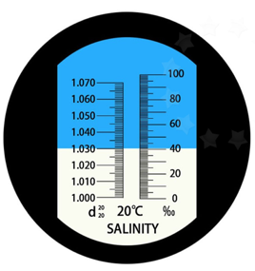
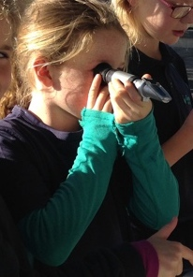
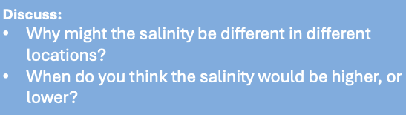
Measuring Environmental Conditions – Salinity (ppt)
Refractometer
© NZMSC
Taste test – predict which is saltier?
River – 0 ppt
Ocean – 35 to 37 ppt

Slide 13
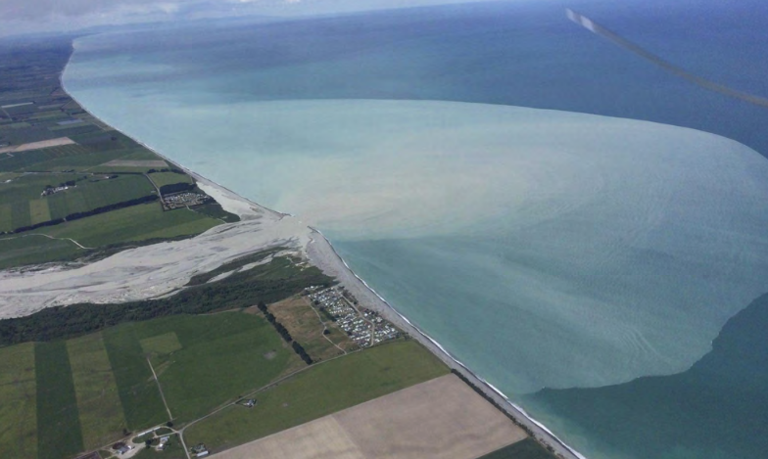
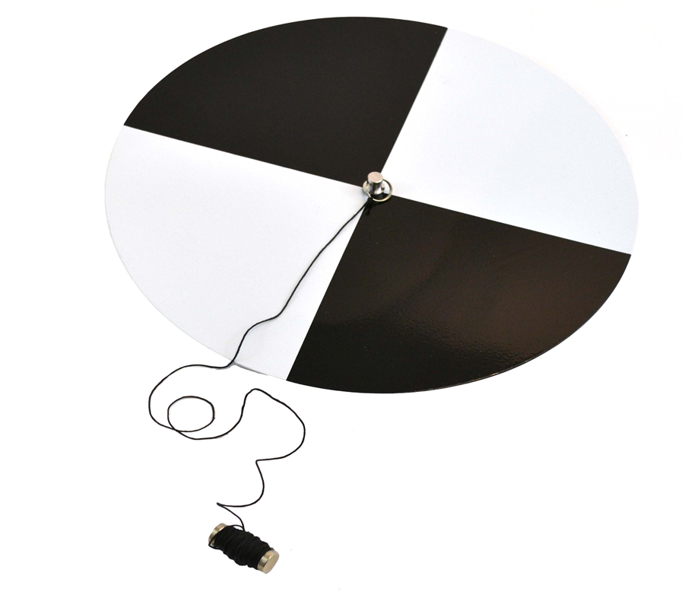
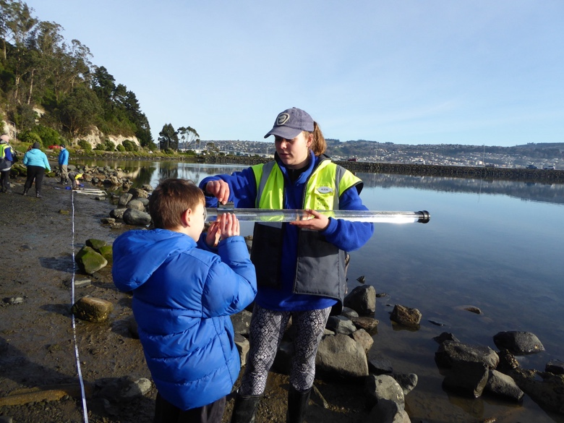
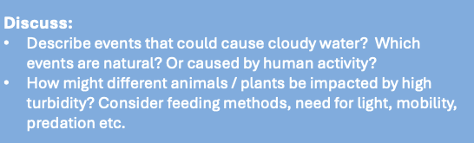
Measuring Environmental Conditions – Clarity (cm)
Secchi Disk
Clarity tube used for shallow water
© NZMSC
Notes:
Related game
https://www.otago.ac.nz/__data/assets/pdf_file/0017/324413/big-fish-little-fish-survival-in-the-estuary-dual-language-0245959.pdf

Slide 14
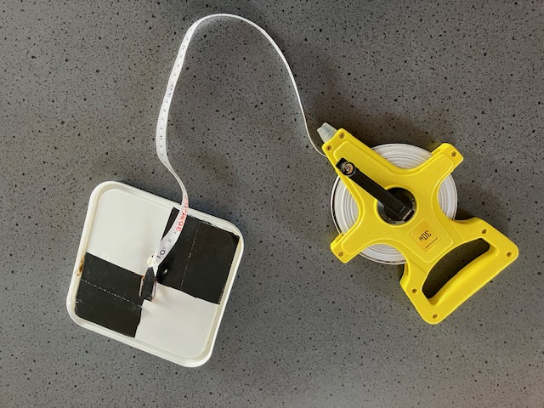
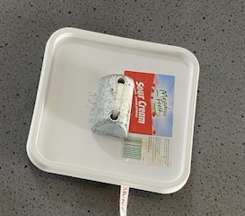
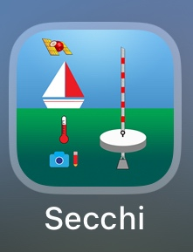
Make your own seechi disc
ice cream container lid
black paint or duct tape
measured line or rope
weight
© NZMSC
Secchi App (http://www.secchidisk.org/ )

Slide 15
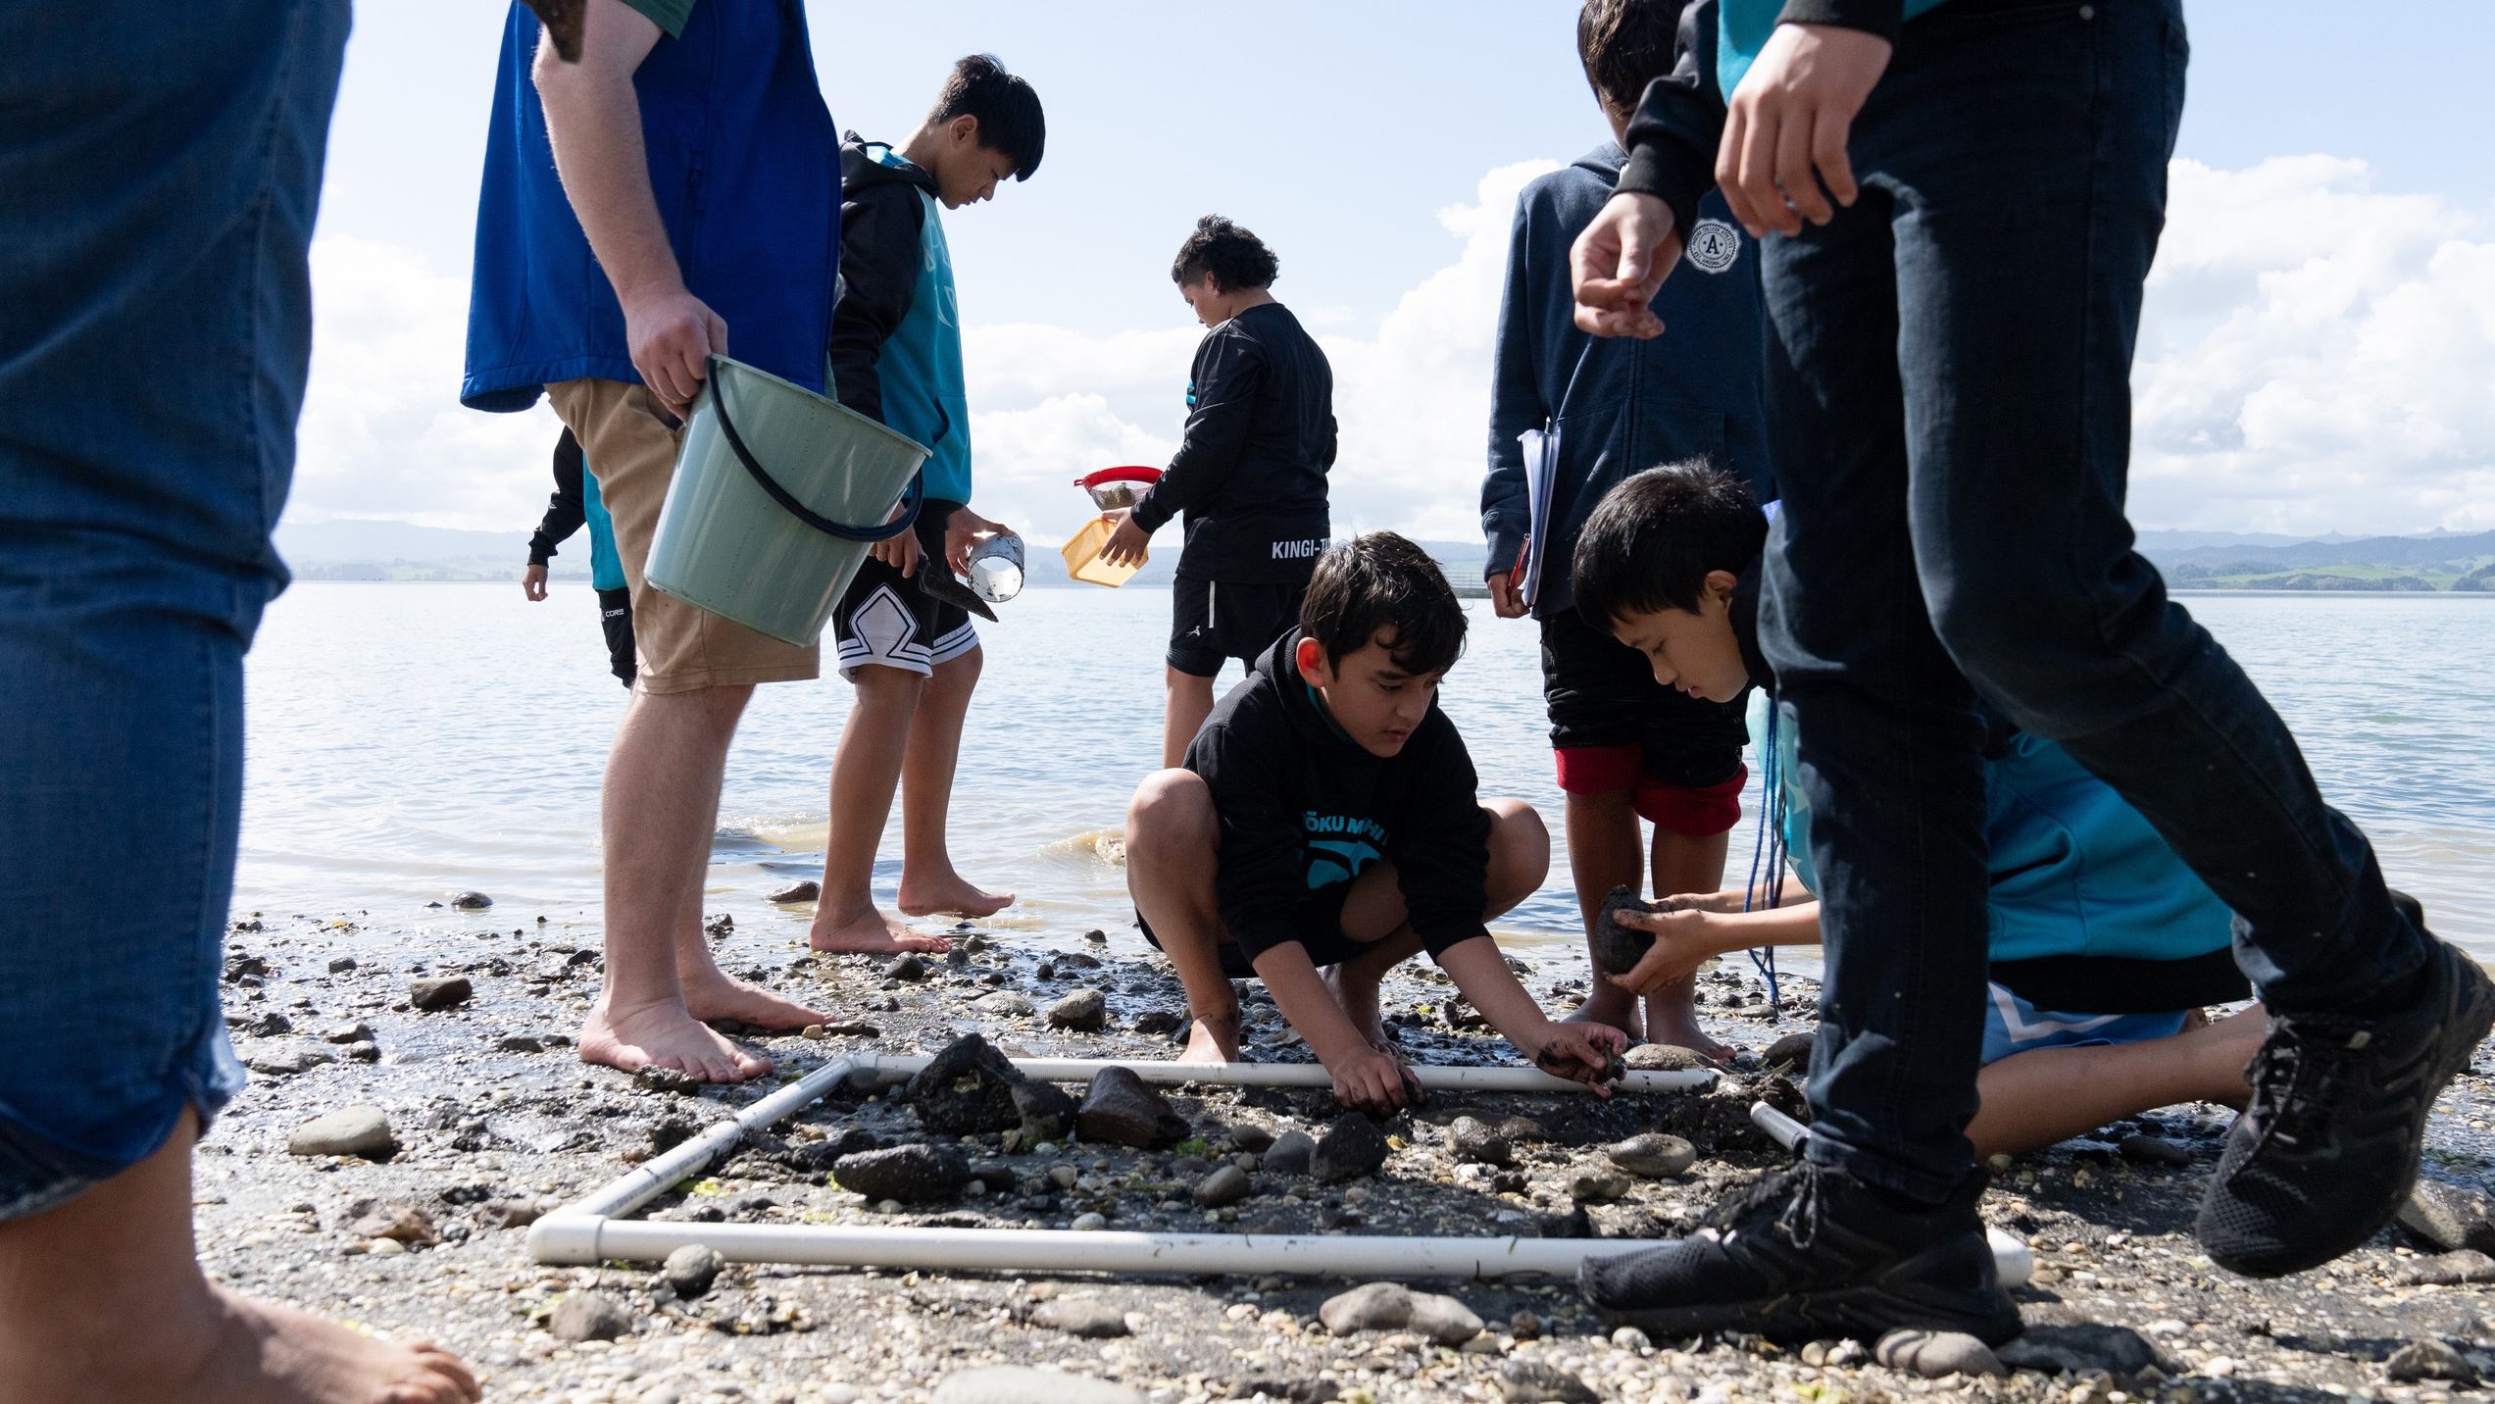
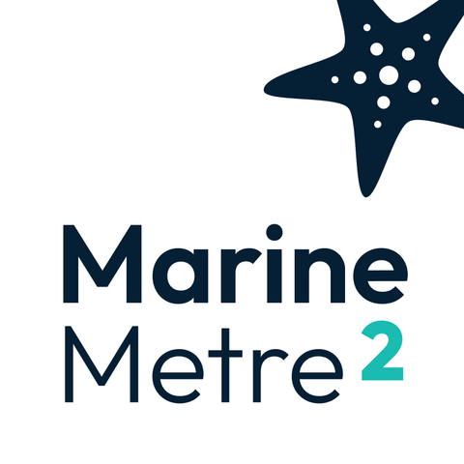
Monitoring Biological Communities – Seashore
www.marine.ac.nz
Notes:
MM2 is a citizen science initiative designed to involve schools and the community in coastal monitoring – opportunity for us all to get to know our coastal neighbours.
Established more than 10 years ago, it has evolved into a robust, nation-wide project.

Slide 16
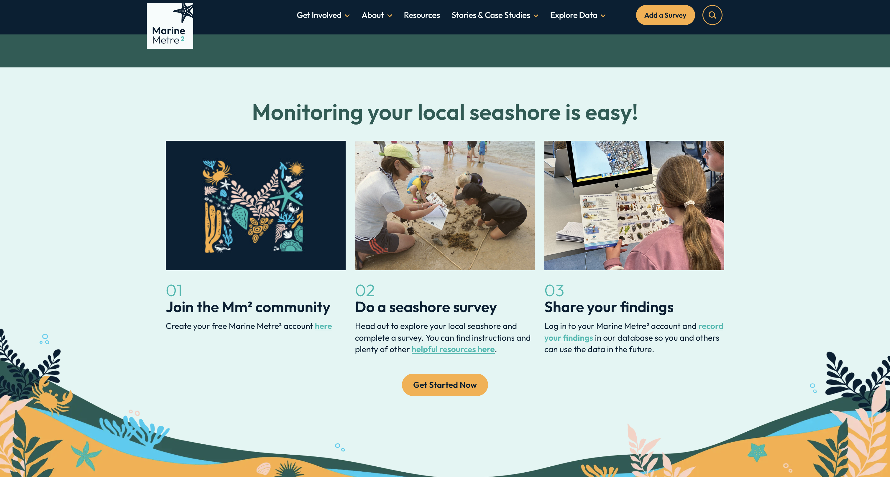
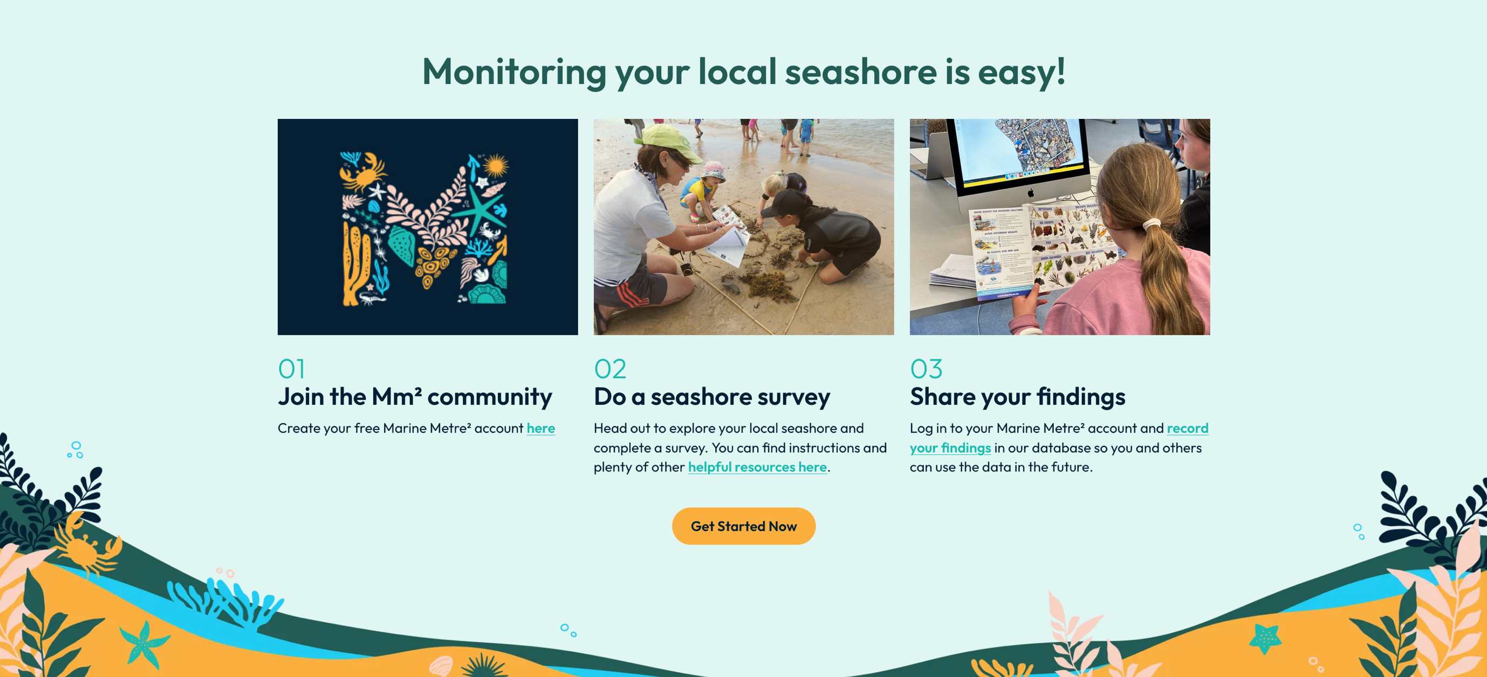

Slide 17
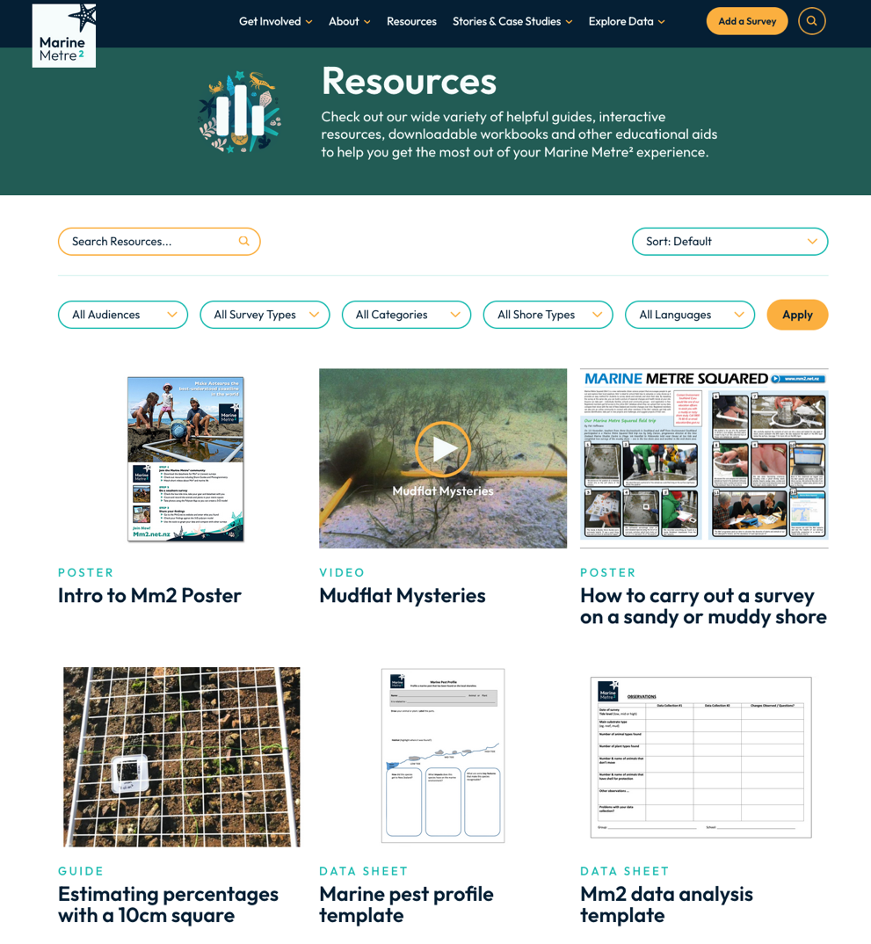
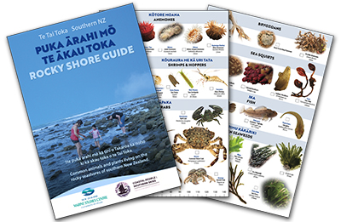
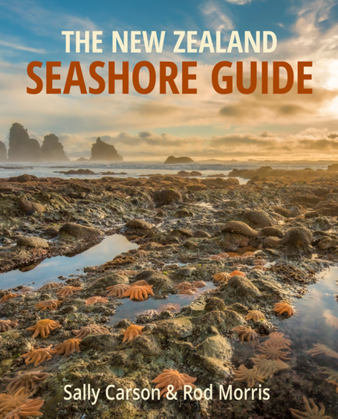
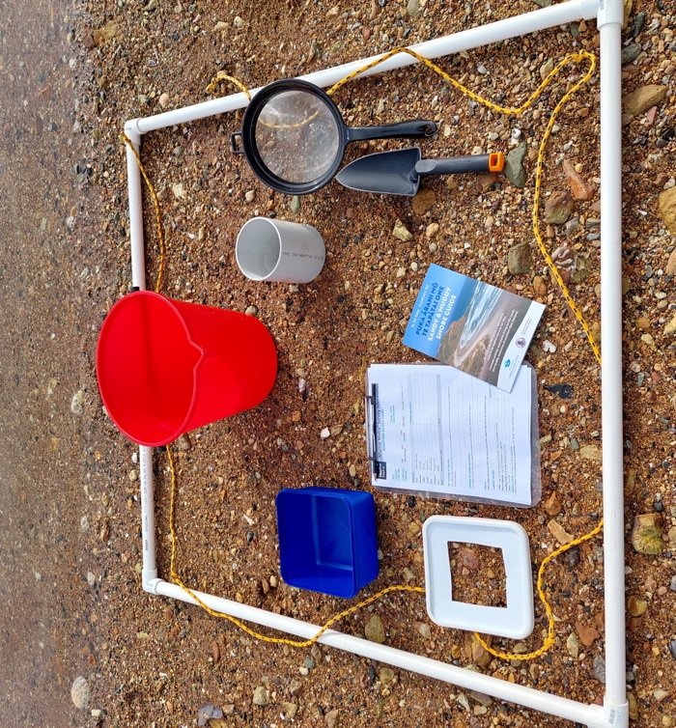

Resources available…
Experiencing Marine Reserves
Simple methods
minimal equipment
suitable for any shore
different levels (Mm2 or transect)
NEW website www.mm2.net.nz
Instructions
resources / stories
data storage
data visualization tools
© NZMSC

Slide 18
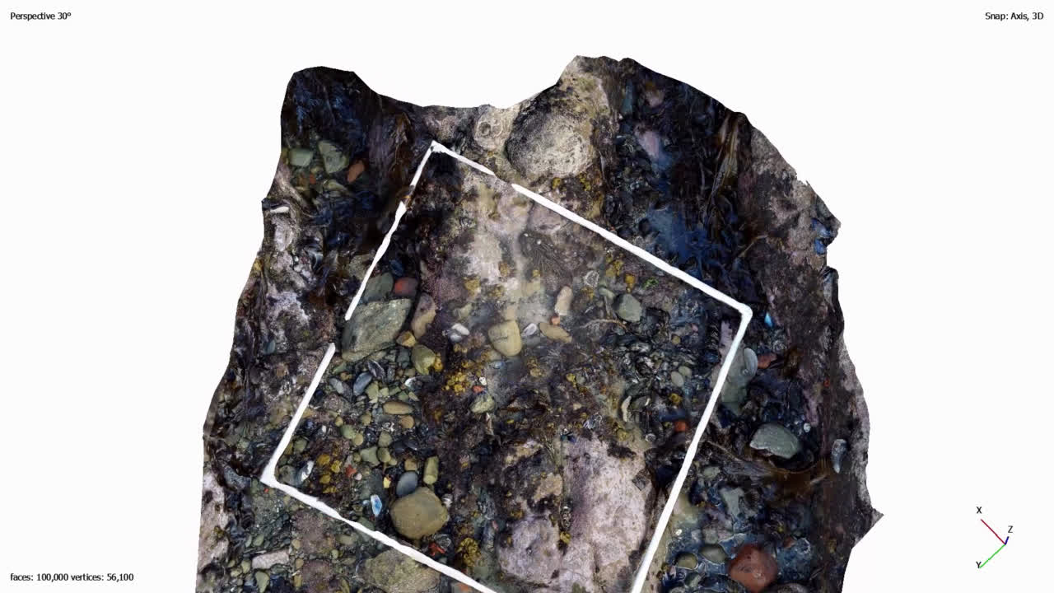
Photogrammetry - Mapping our shoreline one square metre at a time
© NZMSC, https://poly.cam/
Notes:
https://mm2.net.nz/resource/photogrammetry - link to instructions to use

Slide 19
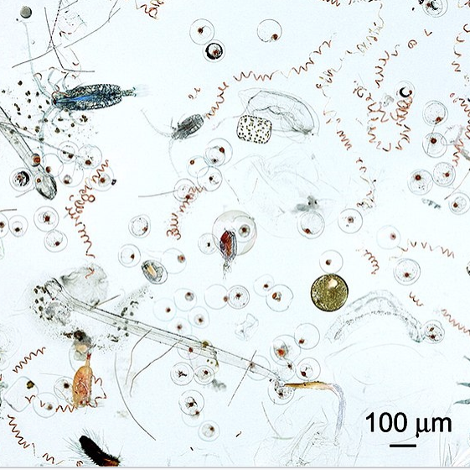
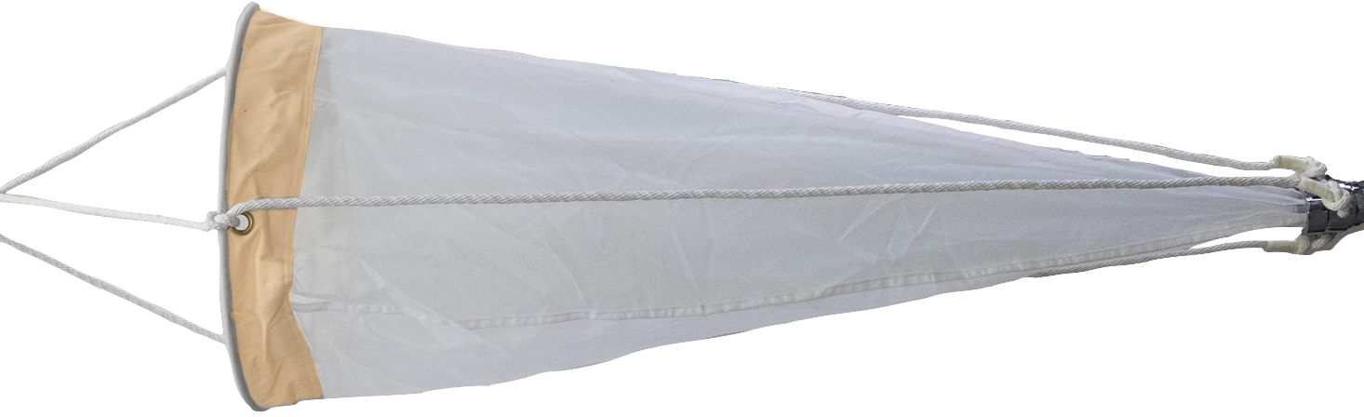
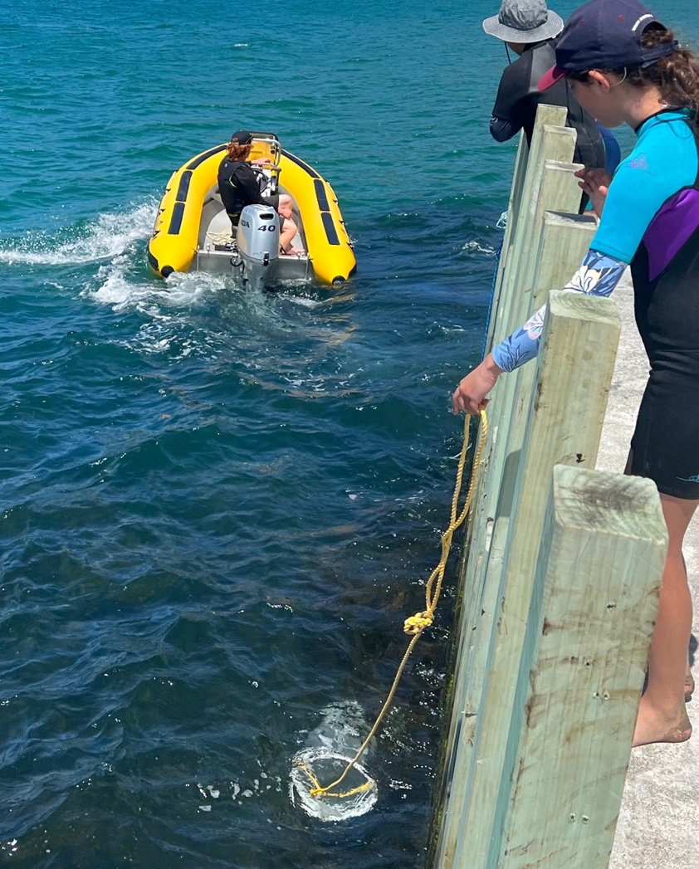
Monitoring Biological Communities – Plankton
Drifters of the sea
Warichrb29, CC BY-SA 4.0
Phytoplankton (plant-like)
Zooplankton
(animal)
©Yachting NZ
Permanent plankton (e.g. krill copepod)
Temporary plankton (e.g. larvae of fish / invertebrates)

Slide 20
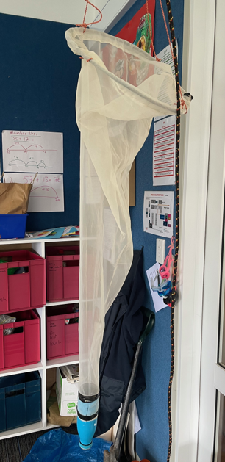
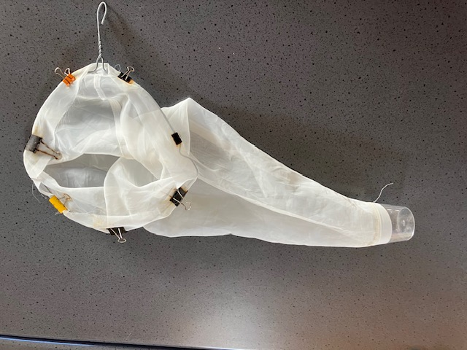


Make your own plankton net
© Ben Offner, Stanley Bay School
Metal hanger
Screen printing cloth
Bull dog clips
Plastic pottle
© Stanley Bay School
© NZMSC
Coscinodiscus sp

Slide 21




Settlement Plates
© NZMSC

Slide 22




Monitoring Biological Communities – Subtidal
Baited Underwater Camera (Go Pro in case)
© NZMSC
© NZMSC
© Crown Copyright

Slide 23
How to get started…
Hone observations skills / science skills (classroom activities)
Plan field trip to seashore / river (H&S, tides)
Organise equipment (make, borrow, purchase)
Collect baseline data (field trip)
Graph and compare data (investigate changes over time and between regions)
What does the data tell you?
Monitoring is environmental action!!

Slide 24


Moving beyond data donation…
Asking questions of local relevance…

Slide 25




Next Steps…
Explore partnerships and collaboration (e.g. NZMSC, Yachting NZ Moanamana Programme, White Bait Connections / EMR)
Connect with local experts and share data (e.g. science organizations, local councils & citizen science projects)
Engage with community events (e.g. catchment group planting days)
Raise awareness – share your stories (e.g. newspaper, social media)
© RNZ
https://www.rnz.co.nz/news/national/519486/primary-pupils-on-quest-to-protect-marine-area-around-worser-bay-boating-club

Slide 26

Can we grow Environmental Citizens?
Collective purpose
Shared questions / interest provides motivation for further monitoring
Facilitation supports local application of tools
Place-based
Project provides a reason to engage with their local environment
Local relevance increases motivation to engage in environmental citizenship behaviours.
Networks for learning and questioning
Connecting data with larger environmental issues
opportunity for participants to extend and grow involvement
Students understand the value of a healthy ecosystem and how they can participate in conservation action!
© Marine metre2

Slide 27

Get in touch...
marine.ac.nz
mm2.net.nz
cpss.org.nz
sally.carson@otago.ac.nz
© NZMSC

