Slide 1
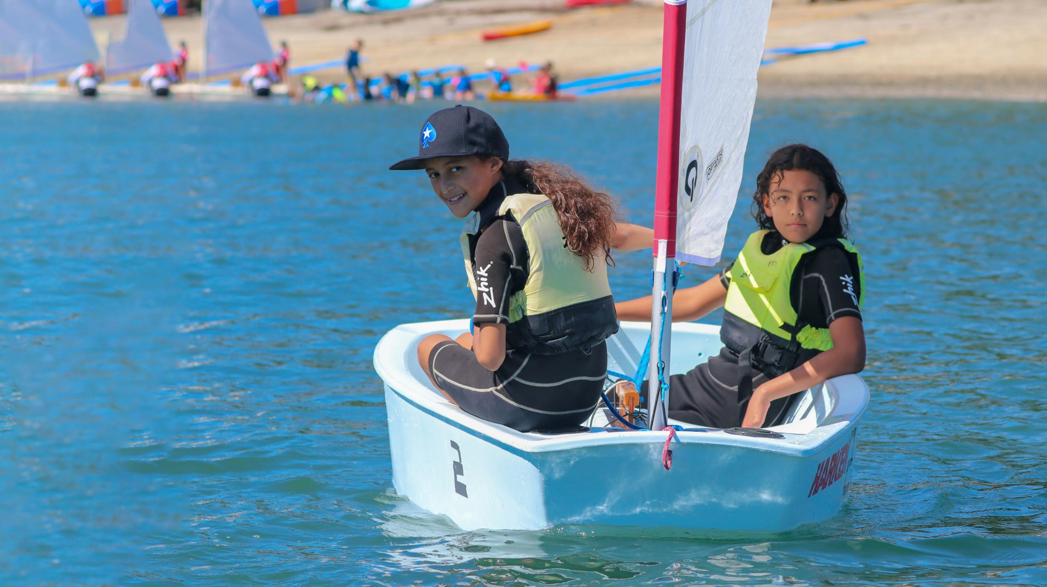


A School & Community Engagement Programme

Slide 2

Index
Topic | Slideshow number(s) | Video timecode
Introducing the webinar and presenters | 1 | 00:04
Index | 2 | 02:19
Introducing RŪNĀ | 3–8 | 02:30
The Worser Bay NZL Blue Belt site | 9–13 | 09:12
Penguin Hotel | 14 | 15:23
Kelp forest | 15 | 16:47
Pāua nursery | 16 | 18:09
Underwater art | 17 | 21:10
Anemone Garden | 18 | 22:46
The Moanamana App | 19–20 | 24:48
Te kahu moana | 21 | 28:19
Links, keep in touch and thanks | 22 | 35:52

Slide 3
RŪNĀ is Yachting New Zealand’s innovative framework designed to engage school students to learn through sport.
The name RŪNĀ, meaning ‘to steer’ in Māori, represents a journey of learning that combines historical insights with modern technology, guiding students to navigate towards a sustainable future.
The programme blends online educational resources with practical sailing club experiences, structured into three modules, each presenting a unique challenge for students to solve.

Slide 4
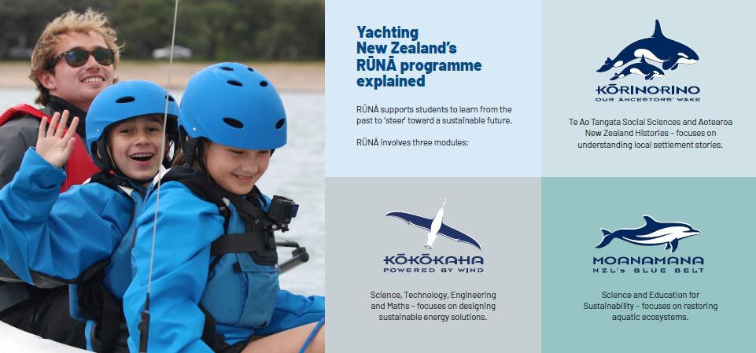

Slide 5
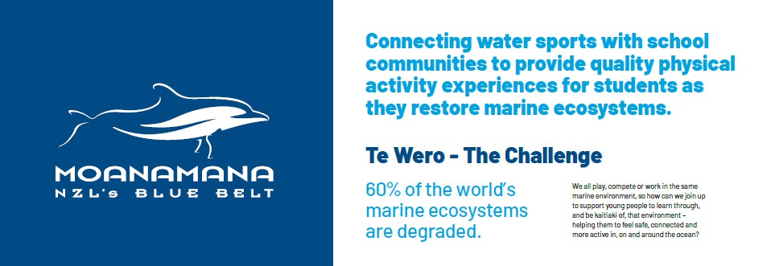
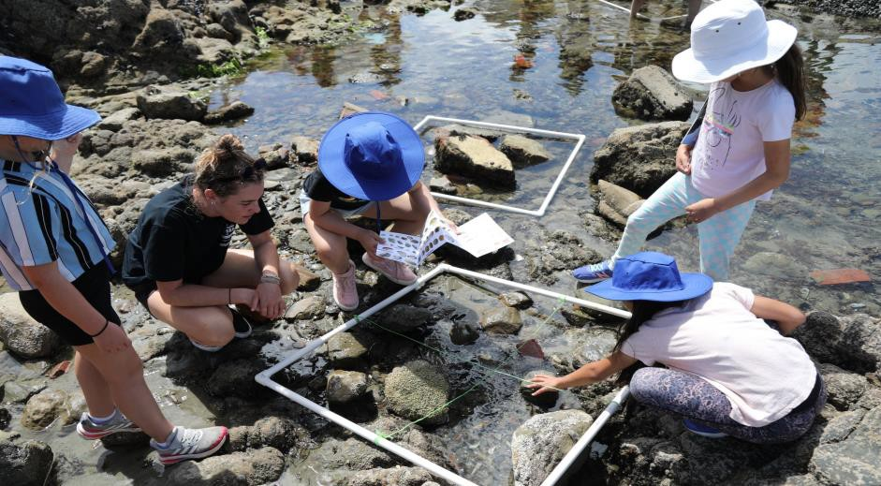


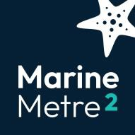
We all play, compete or work in the same marine environment, so how can we join up to support young people to learn through, and be kaitiaki of, that environment – helping them to feel safe, connected and more active in, on and around the ocean?
The Moanamana Project
Students research the impact of pollution, climate change and overfishing on marine ecosystems and take a lead role as citizen scientists, helping to establish NZL Blue Belt sites to protect marine biodiversity and restore low stocks of marine life in their area.
Clubs partner with schools to employ scientific tools and methods, activating students and the community to participate in restoring marine ecosystems in their local waterways.
Yachting New Zealand's aspiration is there will be a network of NZL Blue Belt sites around the country that will become the marine environment equivalent of Predator Free New Zealand, helping to restore the mana of moana.

Slide 6
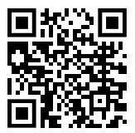
RŪNĀ WEBSITE
How it Works: Teacher information
Learning Experiences: Student tasks
Introduction:
  Challenge
  Setting the Scene
  Building NZL’s Blue Belt
Class work:
  Classroom (Prior tasks)
  Club Visit
  Data Processing
  Moana Activity Library (Research)
Take Action: Assessment
Project Proposal
Development
Action
Monitoring
https://www.runa-yachtingnz.org.nz/

Slide 7
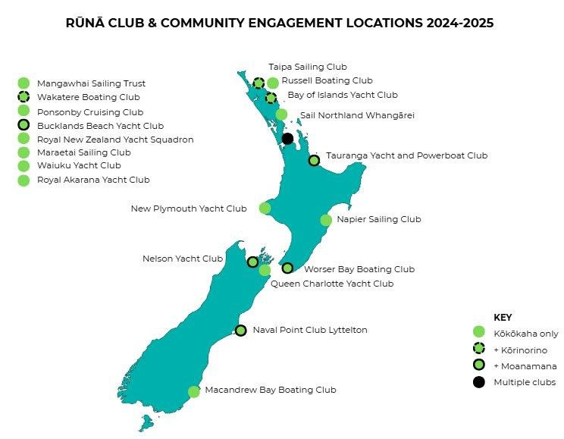

Slide 8
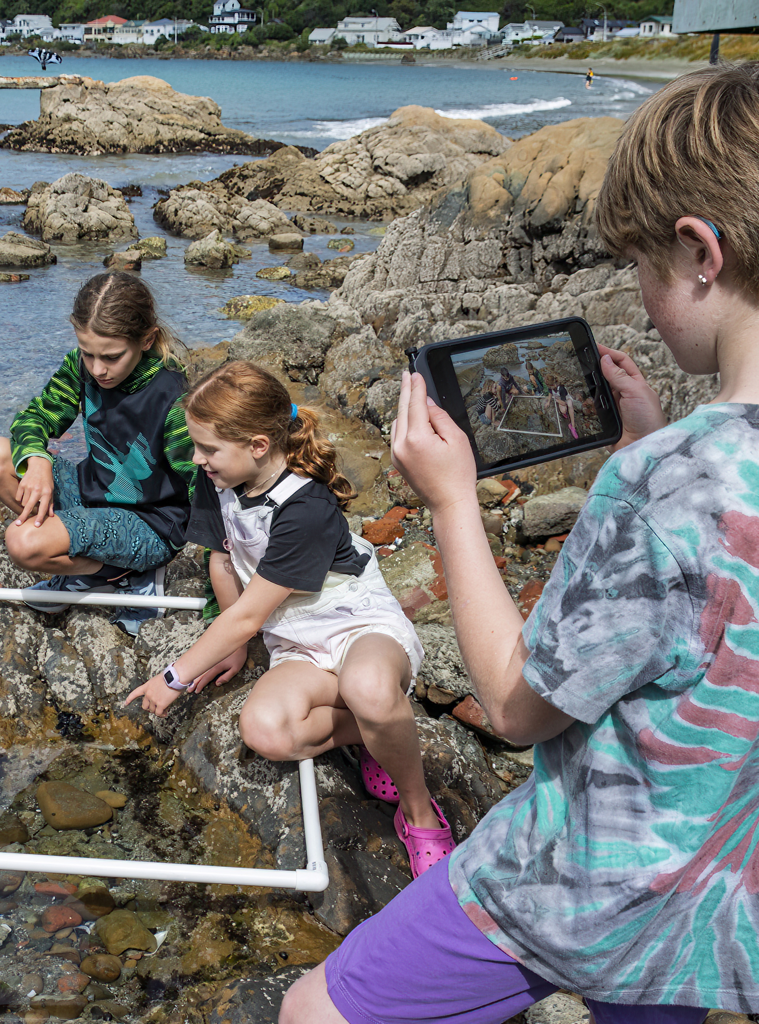
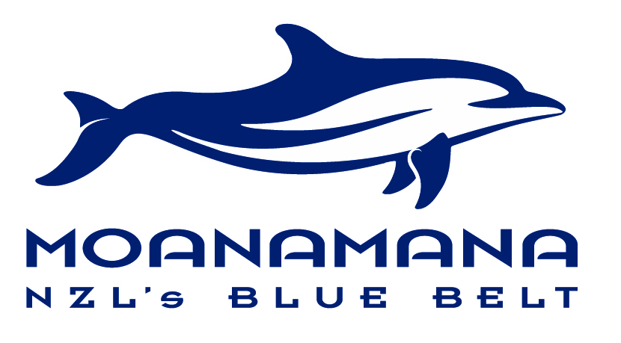
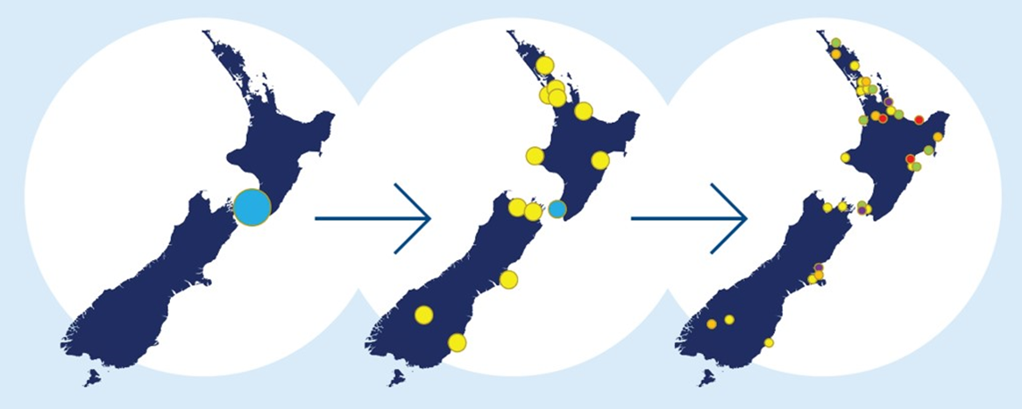
Moanamana
The vision is that clubs will establish NZL Blue Belt sites and use a consistent set of tools to monitor the impact of community efforts to restore marine ecosystems. By 2028 the aspiration is to have over 30 NZL Blue Belt sites in place, involving 40% of communities across the country.
Establish
Expand
Embed
Copyright. RŪNĀ/Yachting New Zealand. All Rights Reserved. All images are copyrighted. For further information, please refer to enquiries@sciencelearn.org.nz

Slide 9



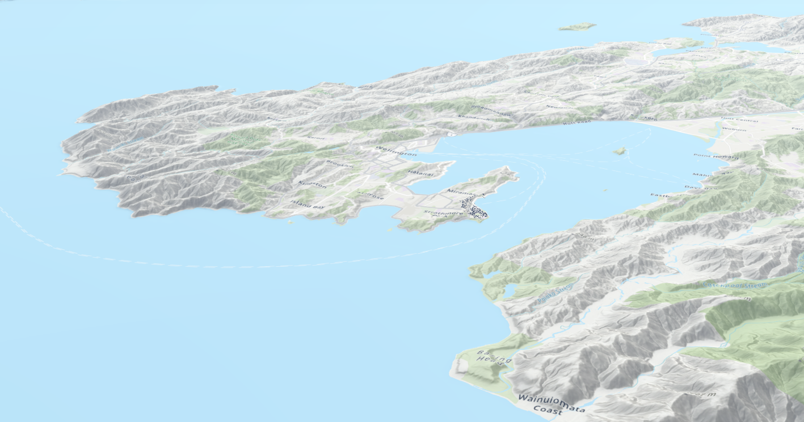
NZL BLUE BELT SITE
Worser Bay
NZL Blue Belt Site
© Copyright. RŪNĀ/Yachting New Zealand. All Rights Reserved
All images are copyrighted. For further information, please refer to enquiries@sciencelearn.org.nz

Slide 10
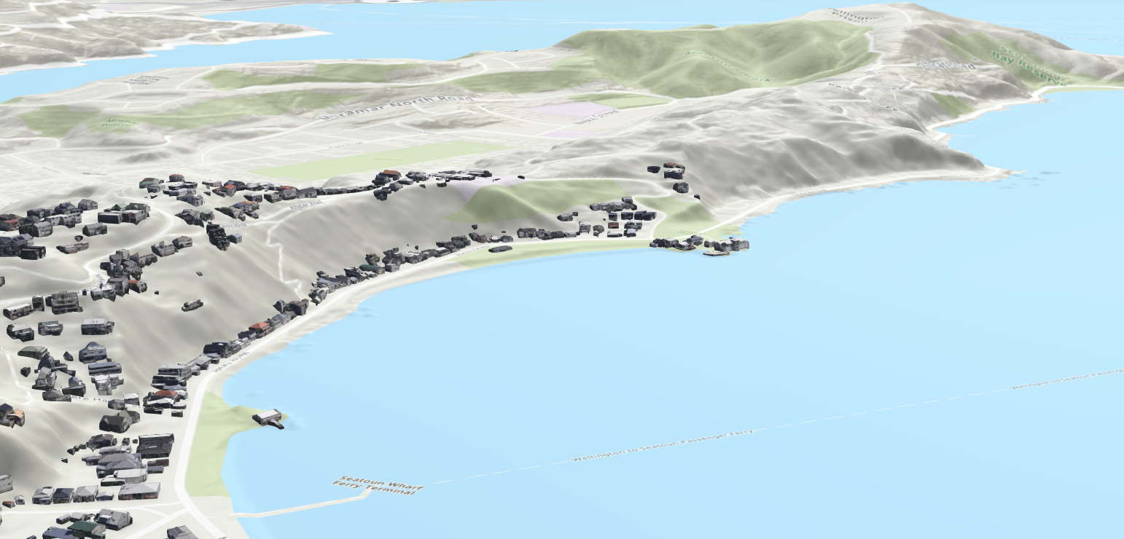
NZL BLUE BELT SITE
Site
Boundary
© Copyright. RŪNĀ/Yachting New Zealand. All Rights Reserved. All images are copyrighted. For further information, please refer to enquiries@sciencelearn.org.nz

Slide 11
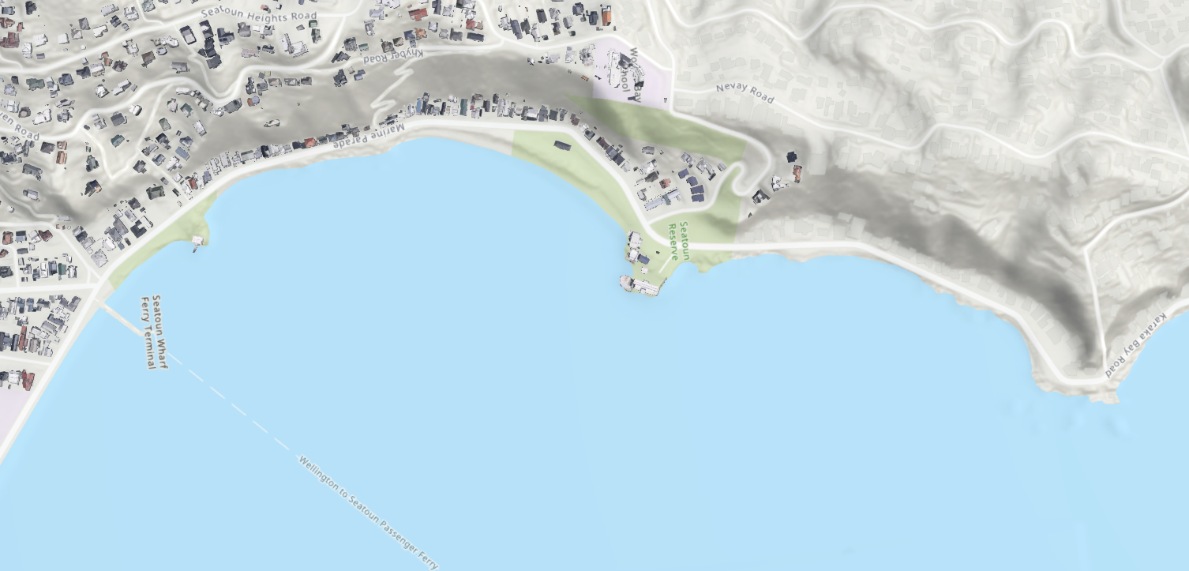
NZL BLUE BELT SITE
© Copyright. RŪNĀ/Yachting New Zealand. All Rights Reserved . All images are copyrighted. For further information, please refer to enquiries@sciencelearn.org.nz
Marine Metre Squared (MM2)
Proposed ‘No Take’ community initiated marine management area
Baited Remote Underwater Video (BRUV)
Plankton

Slide 12
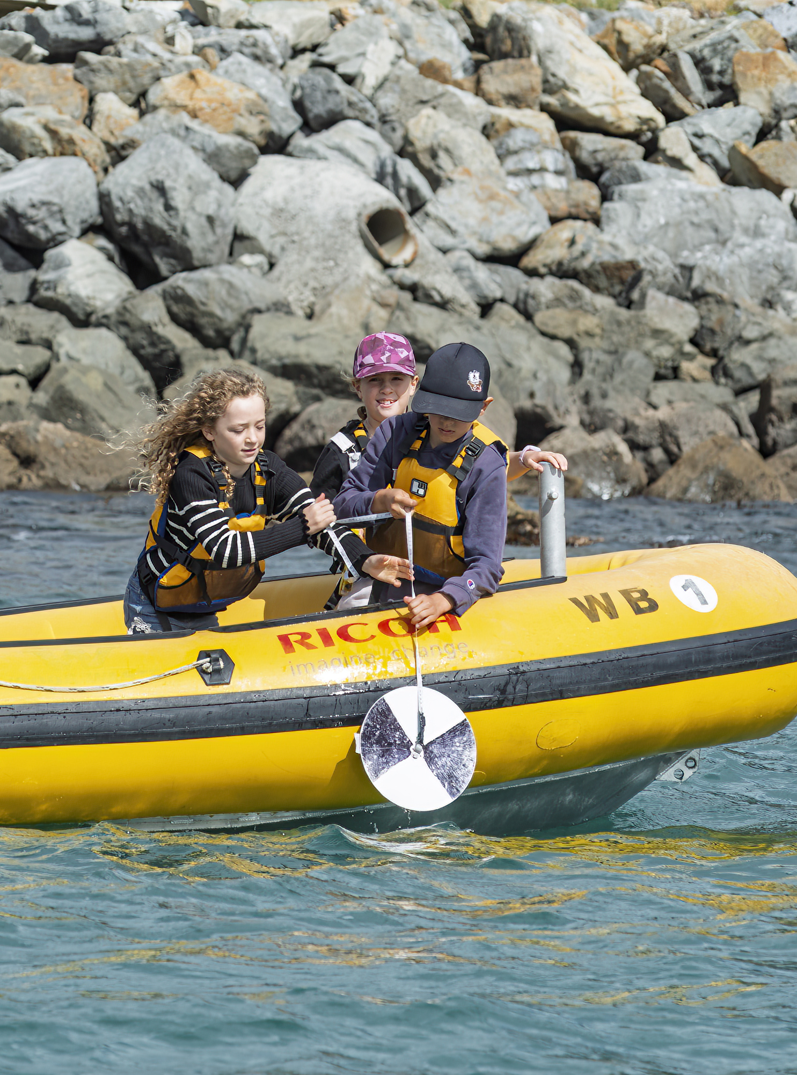
Blue Belt tools
Environmental conditions measurements to record temperature, salinity and clarity of coastal water in relation to weather events.
Marine Metre Squared surveys to monitor biodiversity in intertidal areas.
Photogrammetry models to create digital 3D representations of the shoreline.
Underwater transect surveys to record species along designated marine zones.
Plankton surveys to monitor diversity of microscopic marine life.
Baited remote underwater video (BRUV) surveys to monitor subtidal marine species communities.
Settlement plate surveys to monitor settlement of marine larvae over time.
© Copyright. RŪNĀ/Yachting New Zealand. All Rights Reserved . All images are copyrighted. For further information, please refer to enquiries@sciencelearn.org.nz

Slide 13
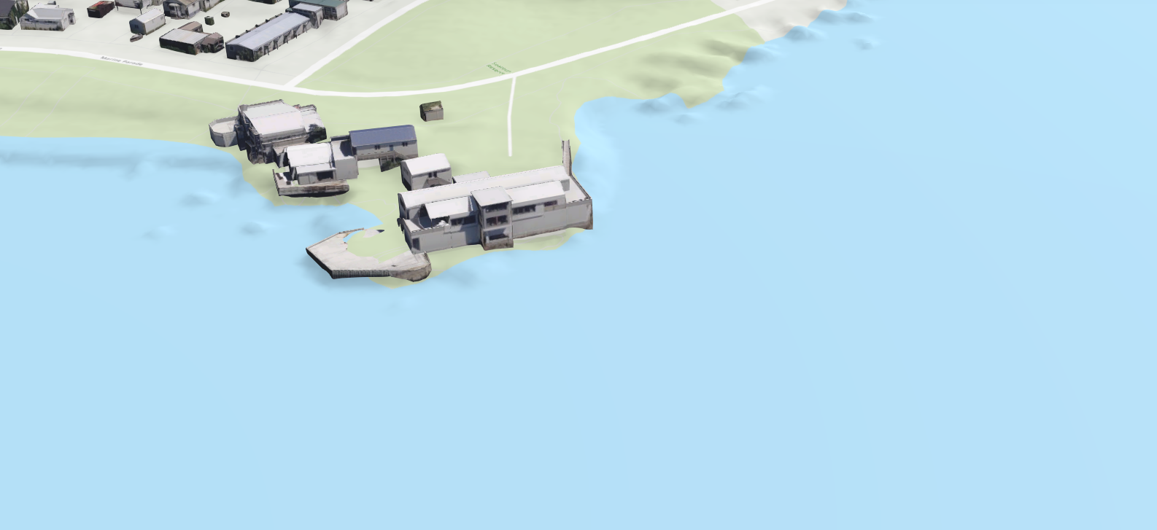
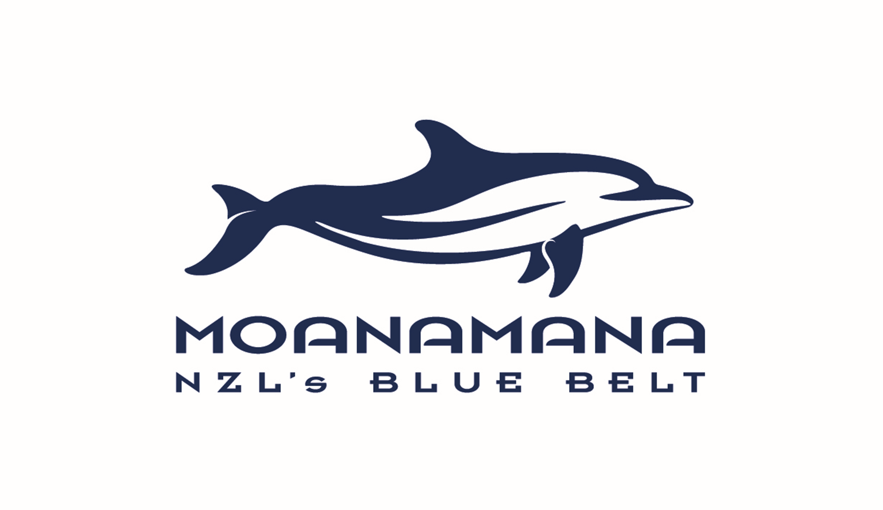
NZL BLUE BELT SITE
Aquaculture
Tanks
Kelp
Forest
Anemone
Garden
Underwater
Art Trail
Penguin
Hotel
Paua
Hatchery
Crayfish
Nursery
© Copyright. RŪNĀ/Yachting New Zealand. All Rights Reserved . All images are copyrighted. For further information, please refer to enquiries@sciencelearn.org.nz

Slide 14
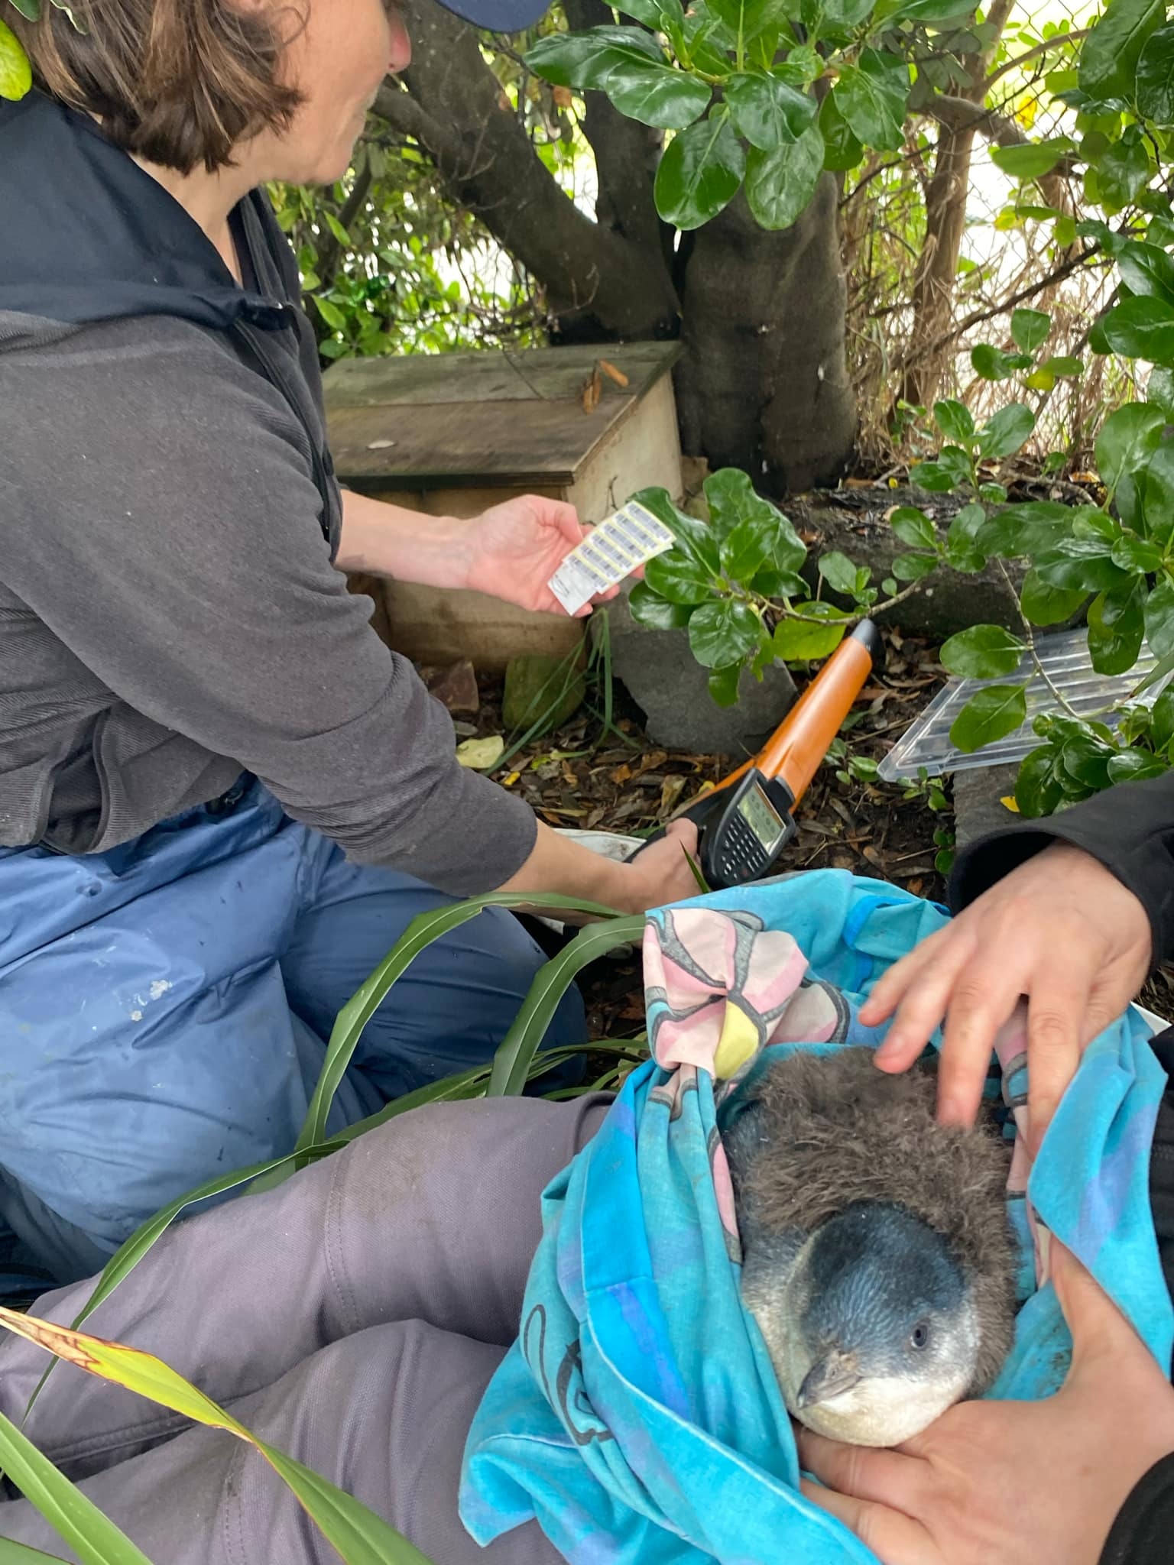
Penguin Hotel
Students from Wellington High School designed a fenced off area adjacent to the carpark at Worser Bay with a tunnel through the rock revetment to the high tide zone. In the fenced off area they installed penguin nests and planted vegetation to encourage kororā to nest.
In 2024 the first guests checked into the student’s penguin hotel! Two mating pairs set up a nest in two of the nesting boxes and three kororā chicks were successfully hatched and fledged. The kororā were tagged and are now part of the NIWA monitoring programme.
© Copyright. RŪNĀ/Yachting New Zealand. All Rights Reserved ​
All images are copyrighted. For further information, please refer to enquiries@sciencelearn.org.nz

Slide 15
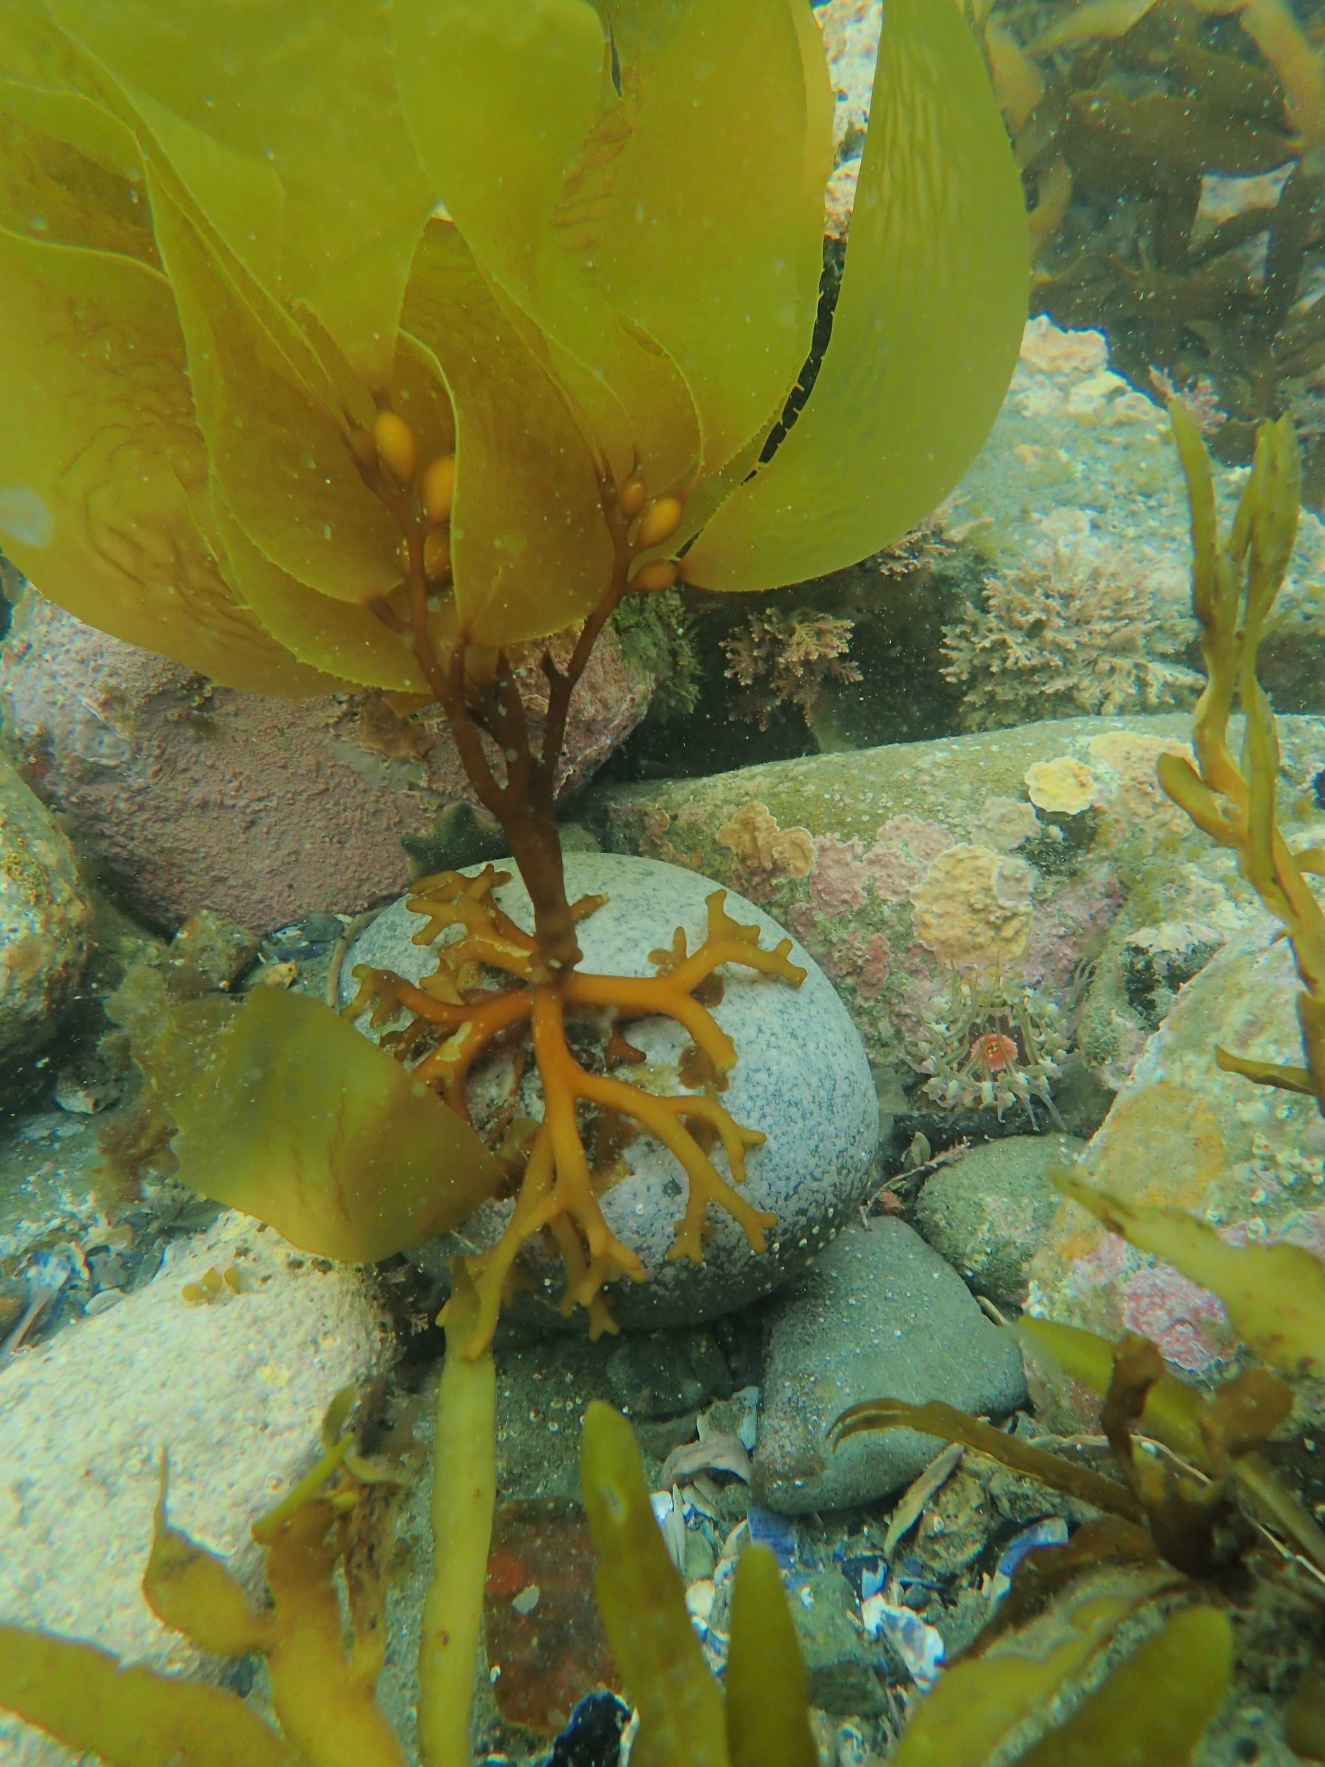
Kelp Forest
Through their Love Rimurimu project, Mountains to Sea Wellington are carrying out seaweed regeneration around the Miramar peninsula and have identified Worser Bay as a site where the local kura would lead seaweed restoration.
They are working with Te Kura Kaupapa Māori o Ngā Mokopuna to trial a range of different regeneration methods at Worser Bay to help identify the best way to restore seaweed across Wellington harbour.
Mountains to Sea and the Kura are entering their third season of ‘kelp-ling’ plant-outs and are monitoring the Worser Bay kelp forest regularly.
© Copyright. RŪNĀ/Yachting New Zealand. All Rights Reserved. All images are copyrighted. For further information, please refer to enquiries@sciencelearn.org.nz

Slide 16
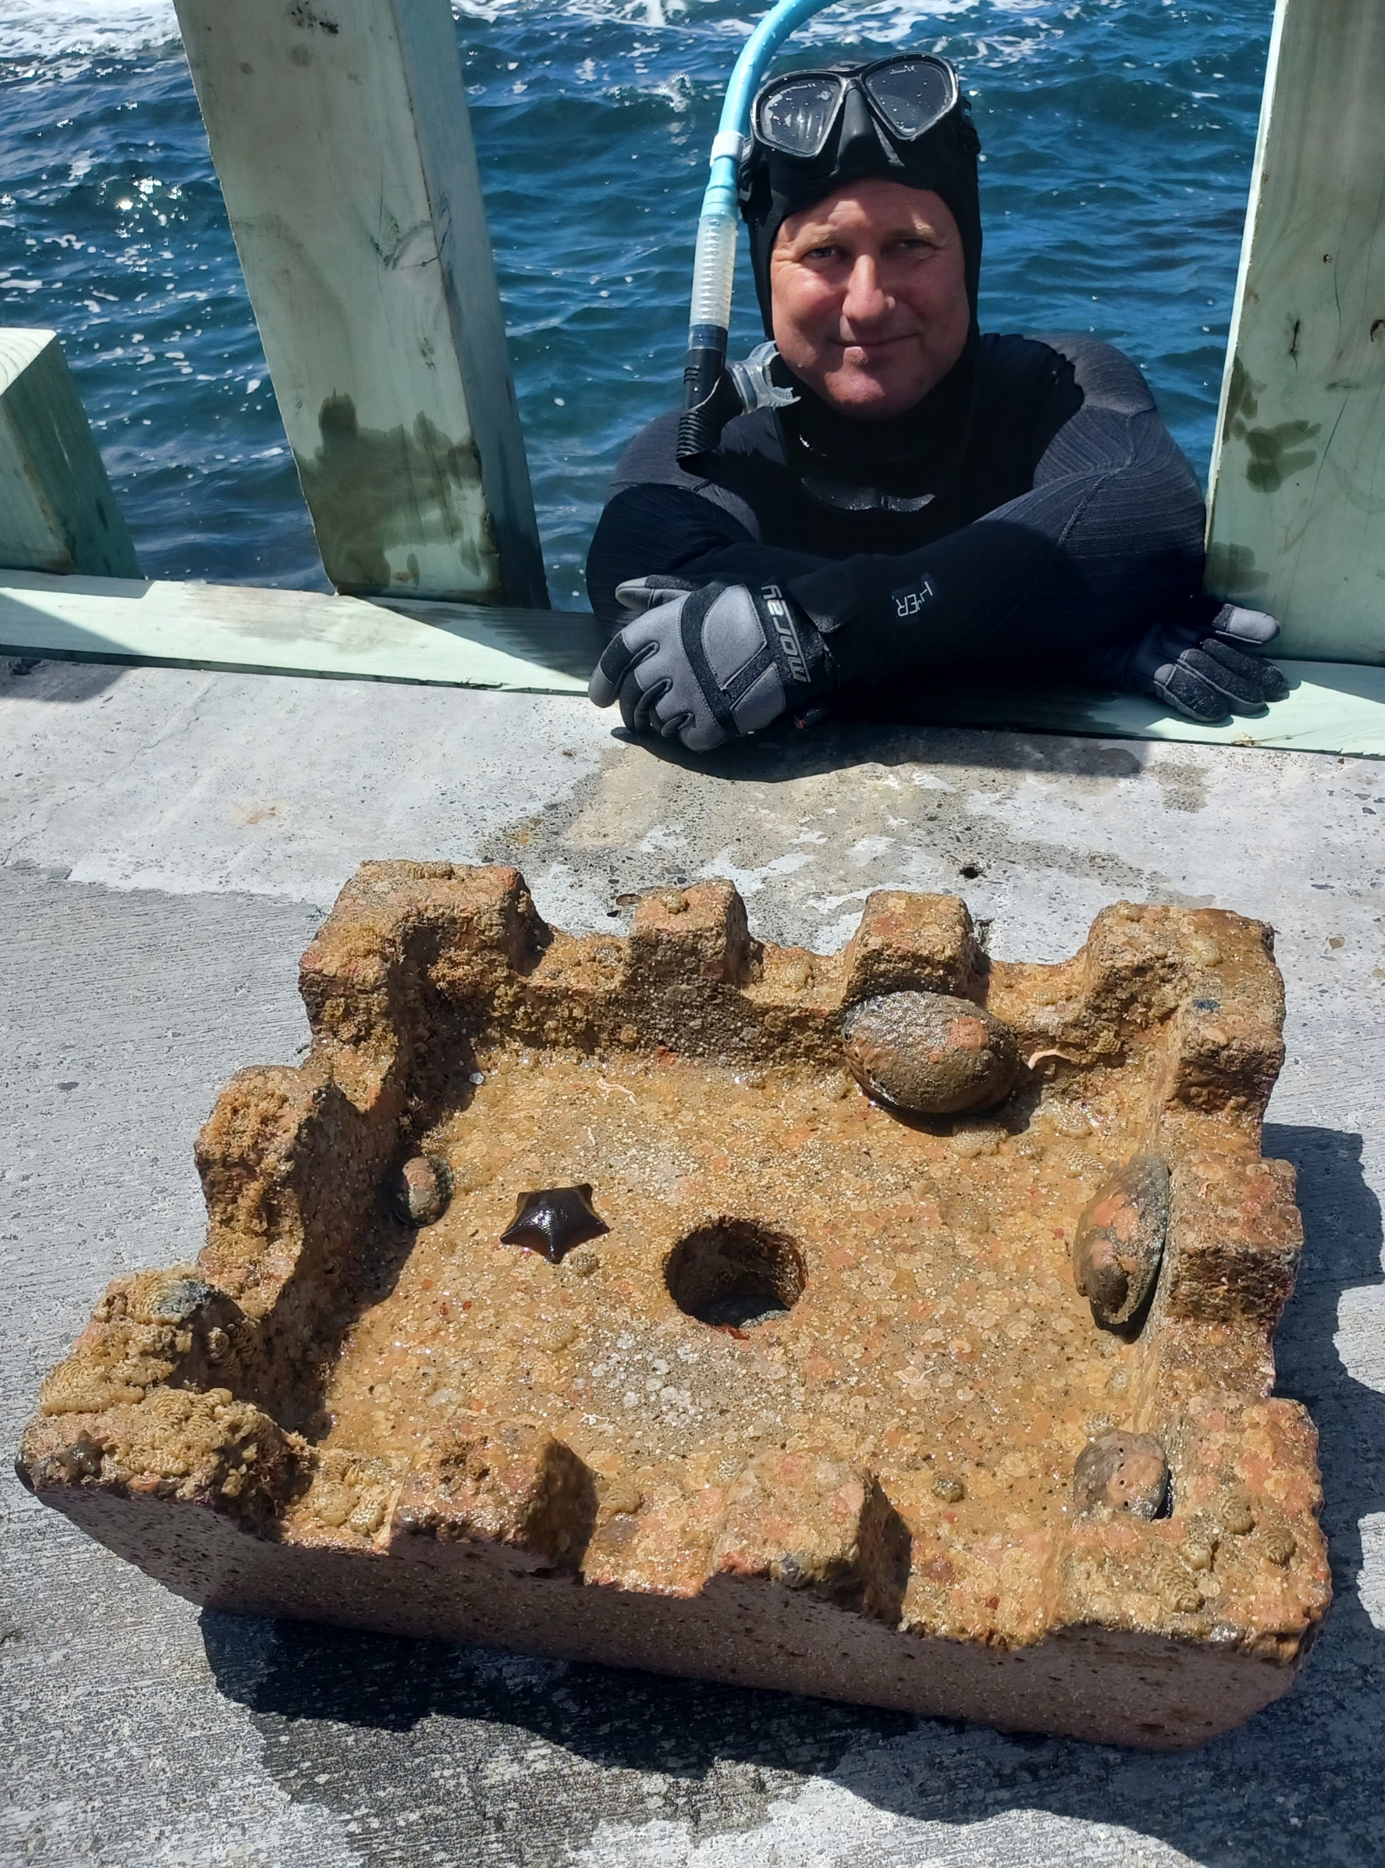
Pāua Nursery
In 2023, students from Wellington East Girls College began investigating the pāua population at Worser Bay.
In 2024, the next group of students from East investigated ways in which pāua could be helped to flourish at Worser Bay. After discussions with scientists at NIWA they began testing pāua pods as a mechanism for giving juvenile pāua shelter to help them become established, and found this to be successful.
The next step is to work with the Worser Bay community to establish a voluntary no-take zone in Worser Bay, and to get the necessary consents to trial using the pods to increase the pāua populations at other reef sites around Worser Bay.
© Copyright. RŪNĀ/Yachting New Zealand. All Rights Reserved.​
All images are copyrighted. For further information, please refer to enquiries@sciencelearn.org.nz

Slide 17
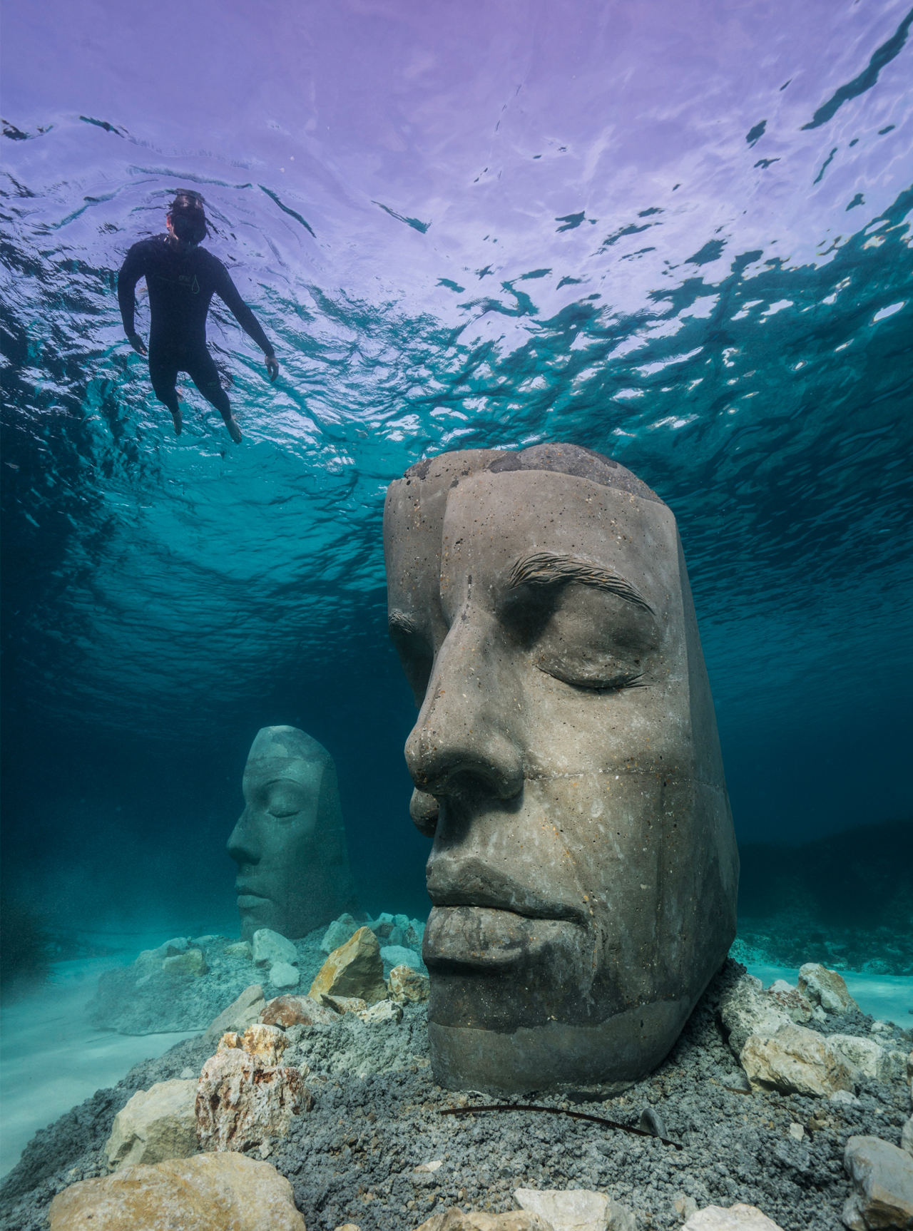
Underwater Art
The underwater art gallery will act as a snorkel trail and be part of the no-take zone within the Worser Bay Marine Management Area. The aspiration is for a high quality art installation that becomes a recreation attraction for Wellingtonians, tourists and other visitors to our city.
The project includes: establishing a baseline of what life exists in the area now; working out the size and path for the snorkel trail; researching materials to be used and methods for anchoring the sculptures; working with mana/tangata whenua to identify pūrākau that could help inform the design; and, engaging with artists to establish the initial designs for the sculptures.
© Copyright. RŪNĀ/Yachting New Zealand. All Rights Reserved. ​
All images are copyrighted. For further information, please refer to enquiries@sciencelearn.org.nz

Slide 18
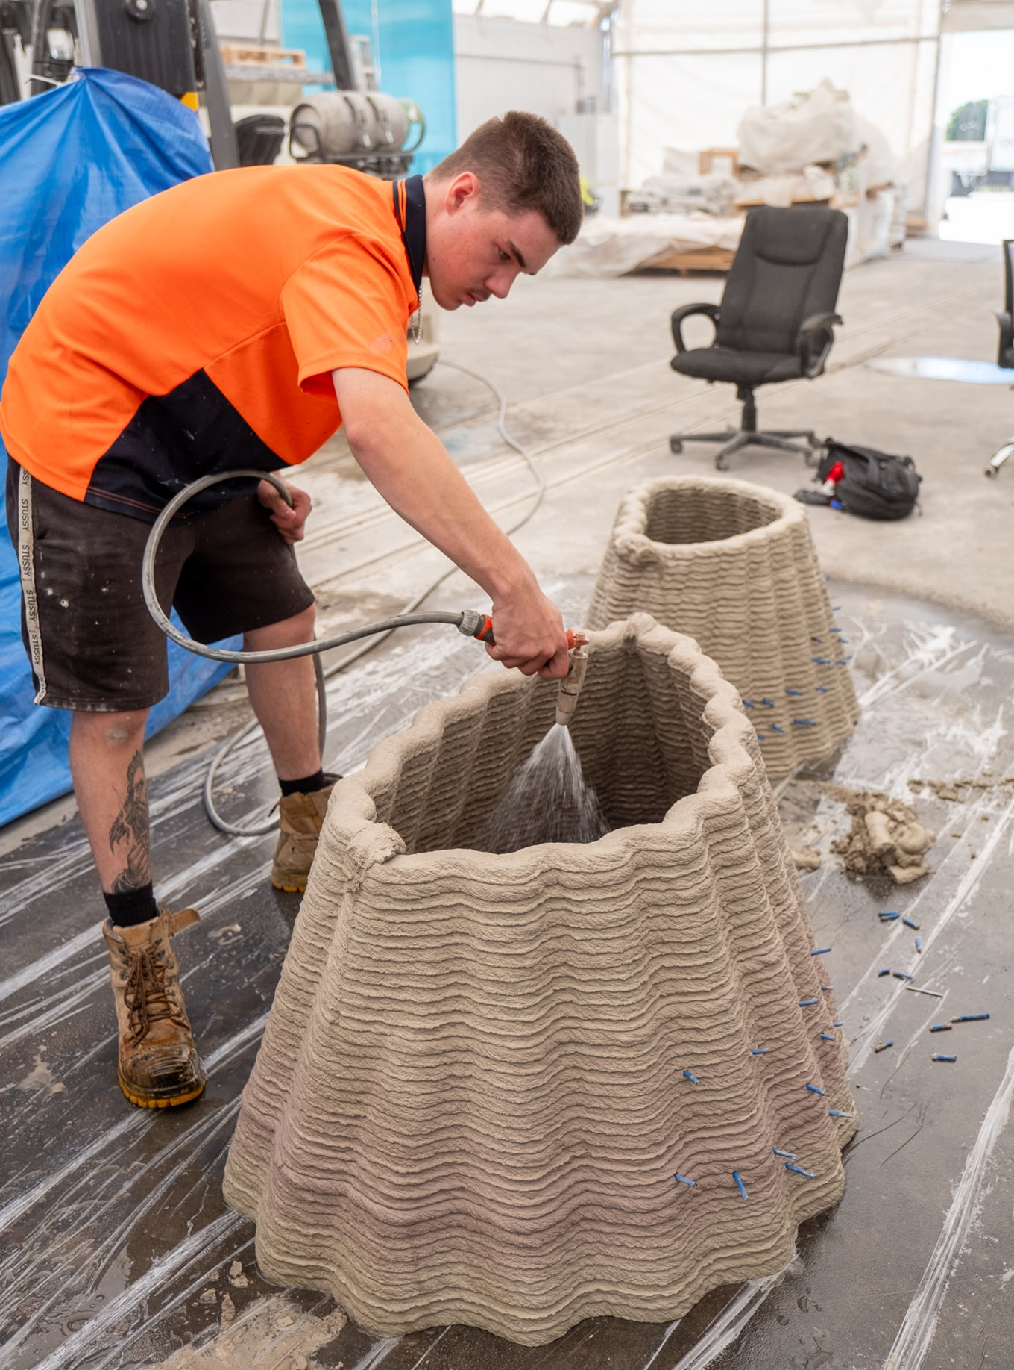
Anemone Garden
Students from Worser Bay and Seatoun Schools are working to establish an artificial reef structure called the Anemone Garden in the intertidal zone between the Worser Bay Boating Club launching ramp, the diving board and the beach.
During 2025 they will create a design for the area that uses 3D printed marine modules as a way of creating better habitats for sea life.
It is envisaged that some of the modules will be permanently submerged underwater, while others will lie fully exposed at low tide. A set of bathyscope underwater viewers will be publicly available to encourage people to ‘just look and not take’ once the Anemone Garden is in place.
© Copyright. RŪNĀ/Yachting New Zealand. All Rights Reserved.​
All images are copyrighted. For further information, please refer to enquiries@sciencelearn.org.nz

Slide 19
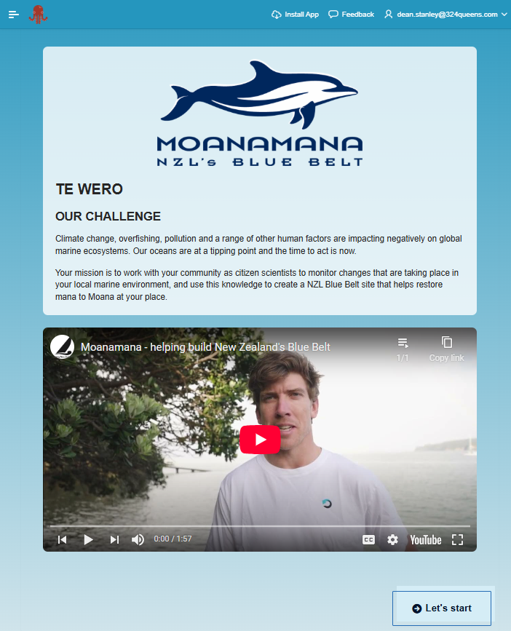







Moanamana App
© Copyright. RŪNĀ/Yachting New Zealand. All Rights Reserved. ​
All images are copyrighted. For further information, please refer to enquiries@sciencelearn.org.nz

Slide 20
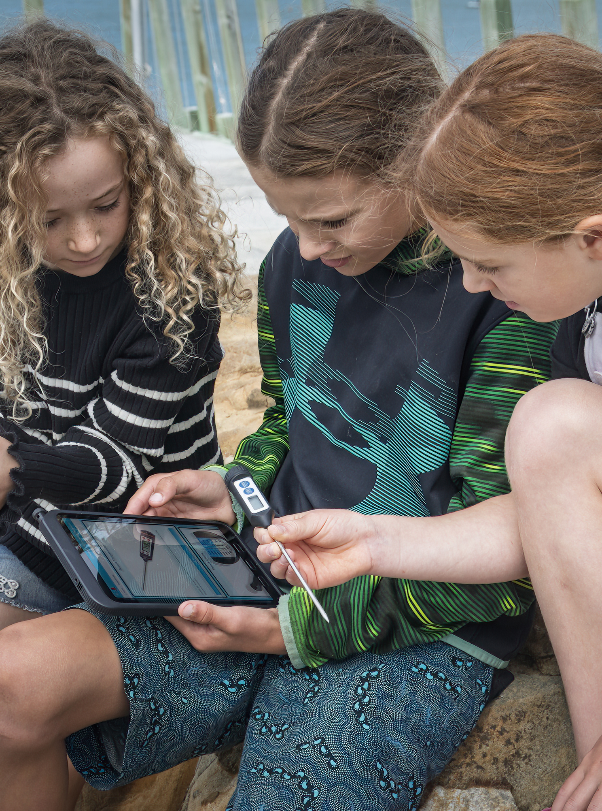
Test and refine the Moanamana App
Team CLOUD, with support from Oracle, have created The Moanamana App, which we are testing throughout 2025.
Ākonga will use the Moanamana App to collect baseline biodiversity data about the proposed marine management area at Worser Bay.
Once we have tested the Moanamana App at Worser Bay it will be updated before being made available to other NZL Blue Belt sites around the country.
© Copyright. RŪNĀ/Yachting New Zealand. All Rights Reserved. ​
All images are copyrighted. For further information, please refer to enquiries@sciencelearn.org.nz

Slide 21
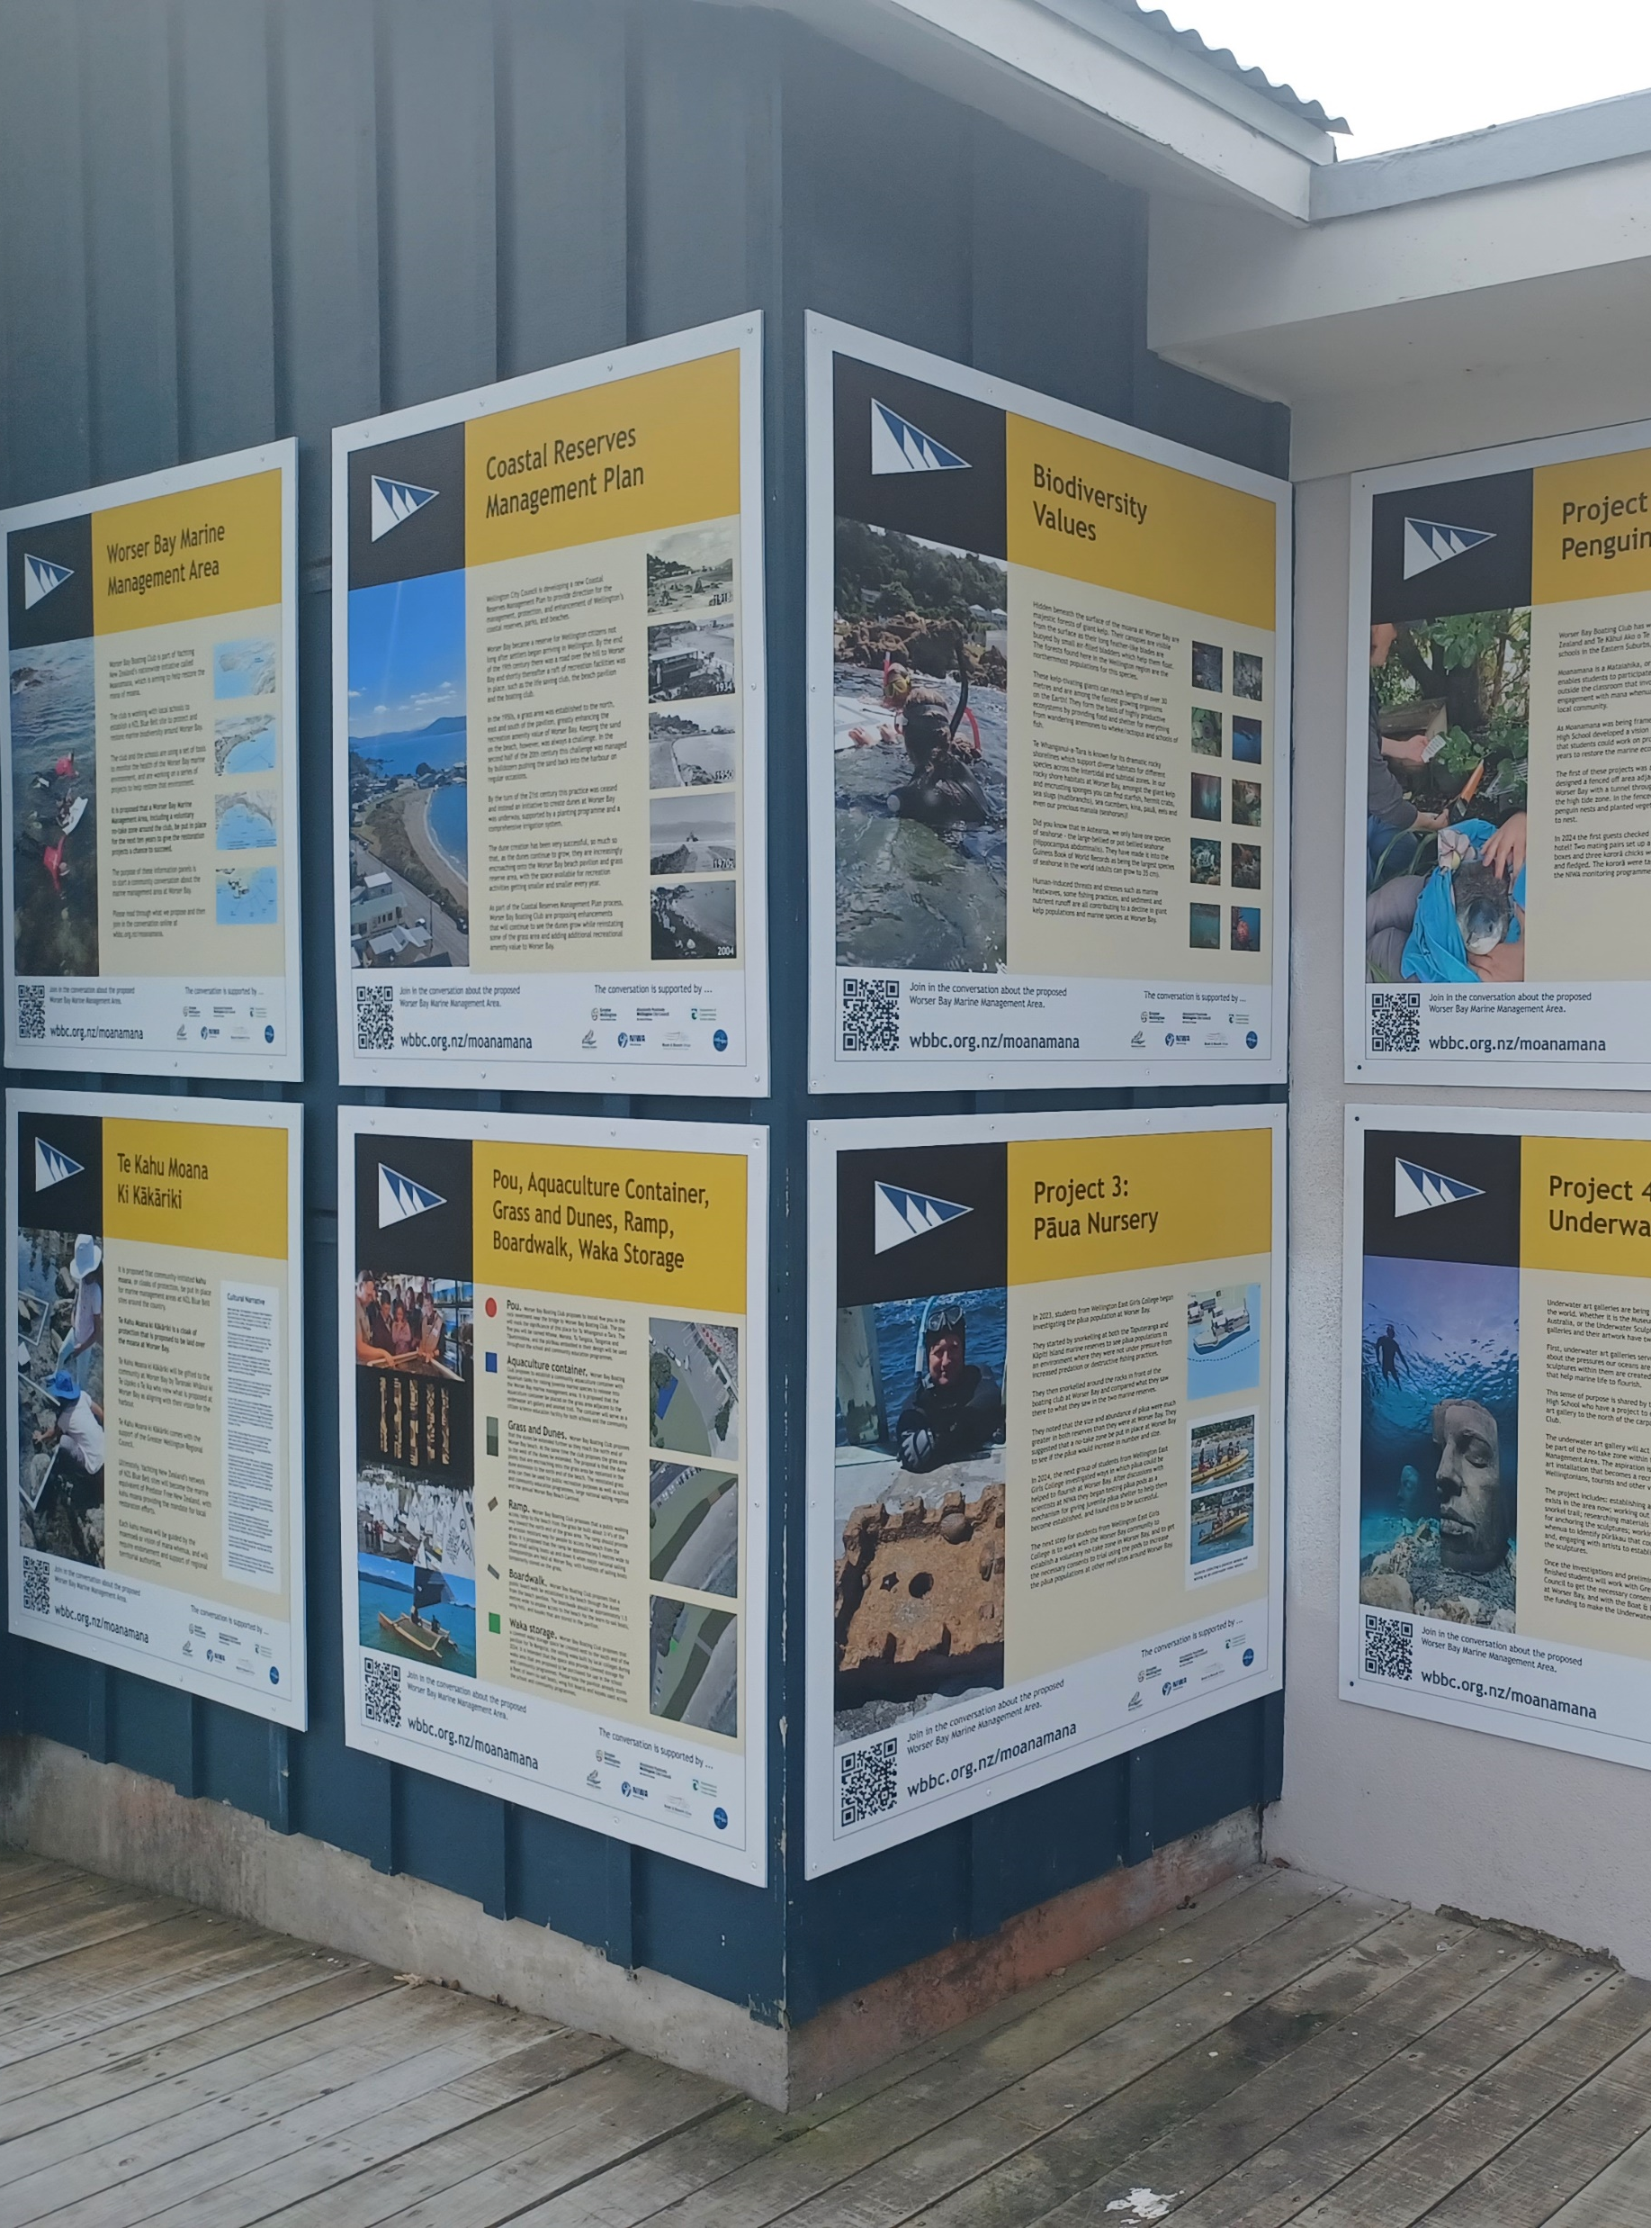
Te kahu moana
It is proposed that community-initiated kahu moana, or cloaks of protection, be put in place for marine management areas at NZL Blue Belt sites around the country.
Te Kahu Moana ki Kākāriki is a cloak of protection that is proposed to be laid over the moana at Worser Bay, with support from Greater Wellington Regional Council and Taranaki Whānui.
Ākonga are helping collect, analyse and present community feedback on a proposal for a voluntary no-take zone and coastal reserves amenity enhancements at Worser Bay.
© Copyright. RŪNĀ/Yachting New Zealand. All Rights Reserved. ​
All images are copyrighted. For further information, please refer to enquiries@sciencelearn.org.nz

Slide 22






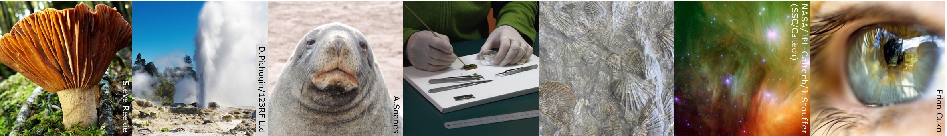
Thanks – want to keep in touch?
Email us on enquiries@sciencelearn.org.nz
facebook.com/nzsciencelearn
instagram.com/sciencelearninghubnz
bit.ly/slhnz_li
youtube.com/@ScienceLearningHubNZ
pinterest.com/nzsciencelearn

