Slide 1
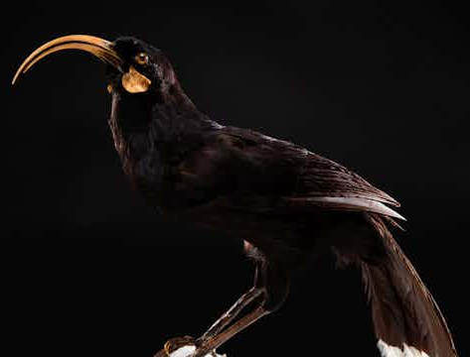
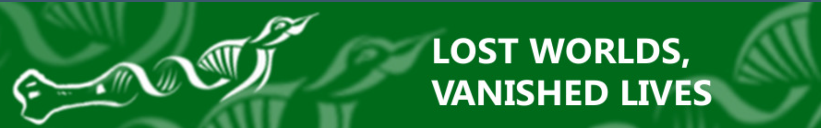


MythBusting de-extinction to sort fact from fiction
Assoc Prof Nic Rawlence
Otago Palaeogenetics Lab
Department of Zoology
University of Otago, Dunedin
nic.rawlence@otago.ac.nz
© Auckland Museum Collections, CC BY 2.0
https://blogs.otago.ac.nz/lost-worlds/
https://theconversation.com/profiles/nic-rawlence-392371/articles
All images are copyrighted. For further information, please refer to enquiries@sciencelearn.org.nz
© shutter2you, 123RF Ltd

Slide 2

Index
Topic | Slideshow number(s) | Video timecode
Introduction | 1 | 00:00
Index | 2 | 00:22
History of extinction | 3–4 | 01:43
De-extinction in the headlines | 5–6 | 03:30
De-extinction and gene technology | 7–15 | 04:59
Functional de-extinction | 16–17 | 16:54
Technological limits | 18–20 | 19:25
Ecological concerns | 21– 26 | 22:09
De-extinction in Aotearoa | 27–28 | 29:54
Using de-extinction tech for conservation | 29–30 | 30:29
De-extinction and sci comm | 31 | 31:51
Conclusions and thanks | 32-33 | 32:31
© Copyright. Science Learning Hub Pokapū Akoranga Pūtaiao The University of Waikato Te Whare Wananga o Waikato.
All Rights Reserved | www.sciencelearn.org.nz. All images are copyrighted. For further information, please refer to enquiries@sciencelearn.org.nz

Slide 3
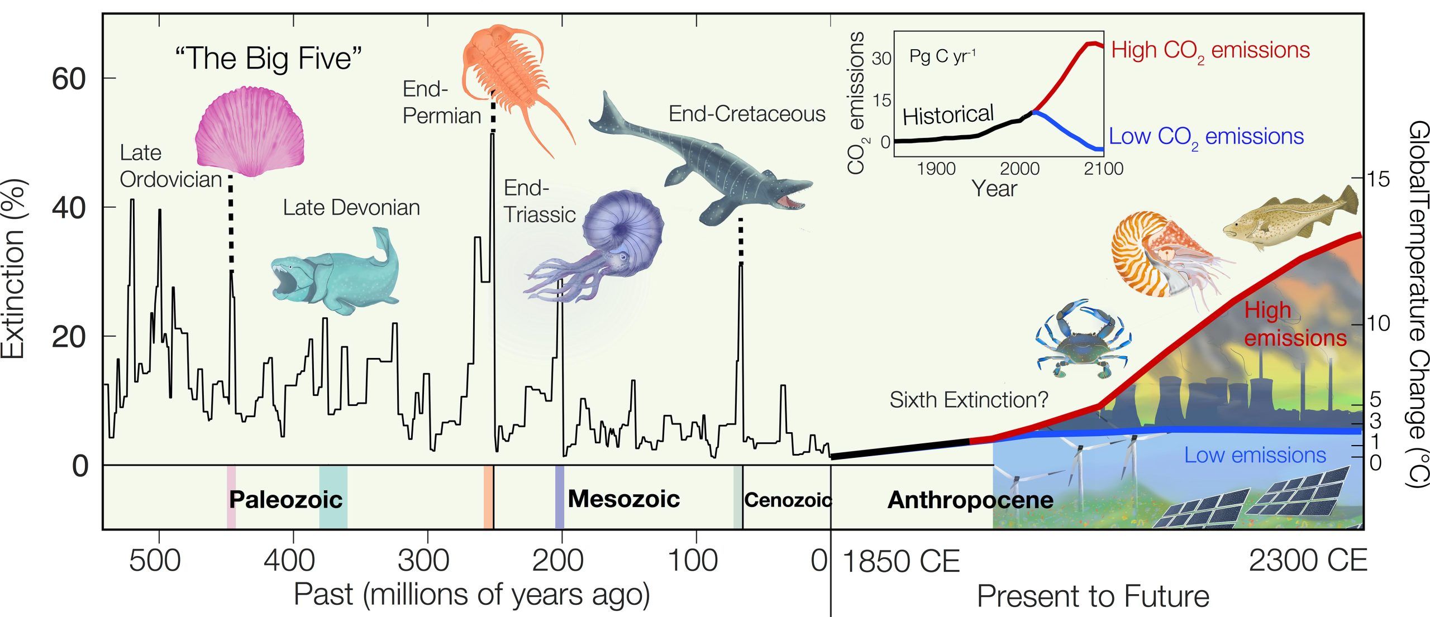
Mass extinctions
Data by Justin Penn and Curtis Deutsch with illustrations by Yesenia Román
© All images are copyrighted. For further information, please refer to enquiries@sciencelearn.org.nz

Slide 4
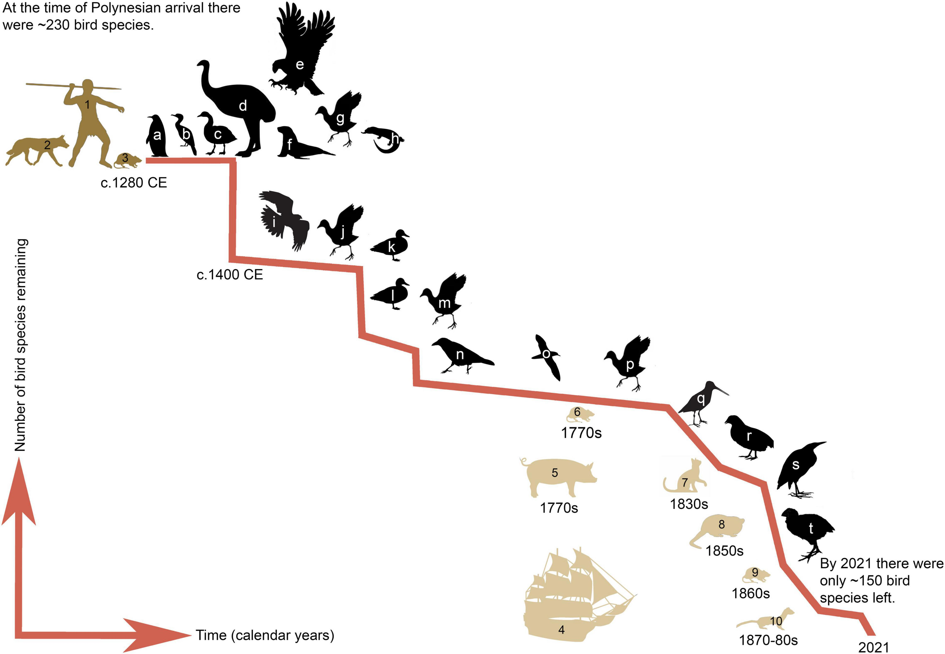
Human driven extinctions in Aotearoa NZ
Greig K and Rawlence NJ (2021) The Contribution of Kurī (Polynesian Dog) to the Ecological Impacts of the Human Settlement of Aotearoa New Zealand. Front. Ecol. Evol. 9:757988. Doi: 10.3389/fevo.2021.757988.
© All images are copyrighted. For further information, please refer to enquiries@sciencelearn.org.nz

Slide 5
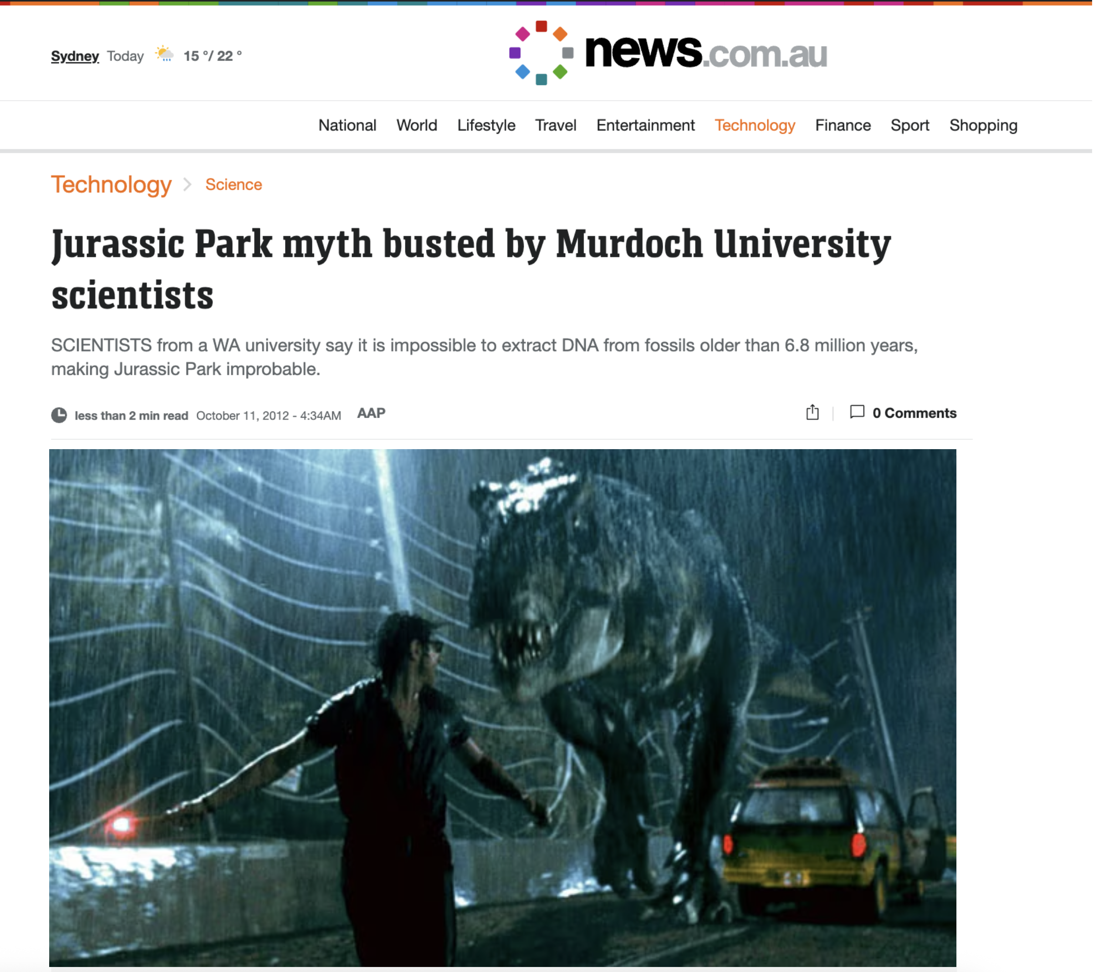
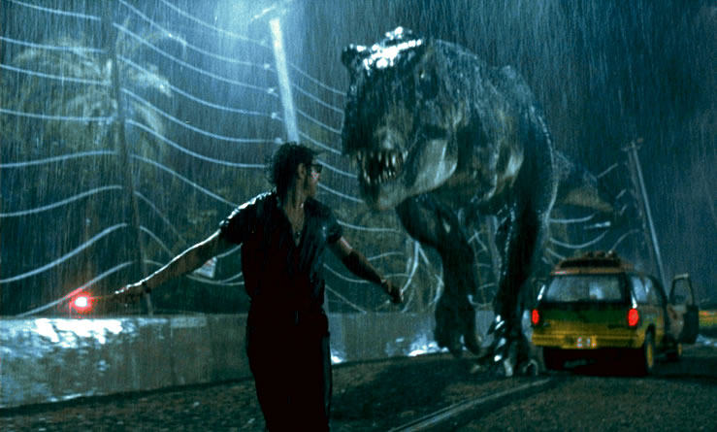
Jurassic Park and de-extinction…busted
© News.com.au
© All images are copyrighted. For further information, please refer to enquiries@sciencelearn.org.nz

Slide 6
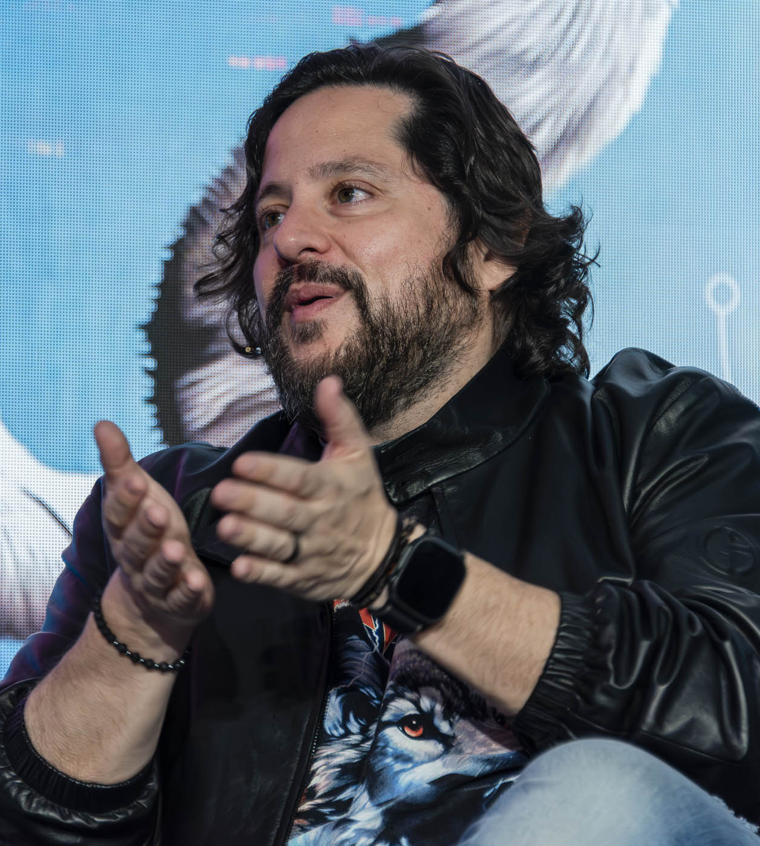
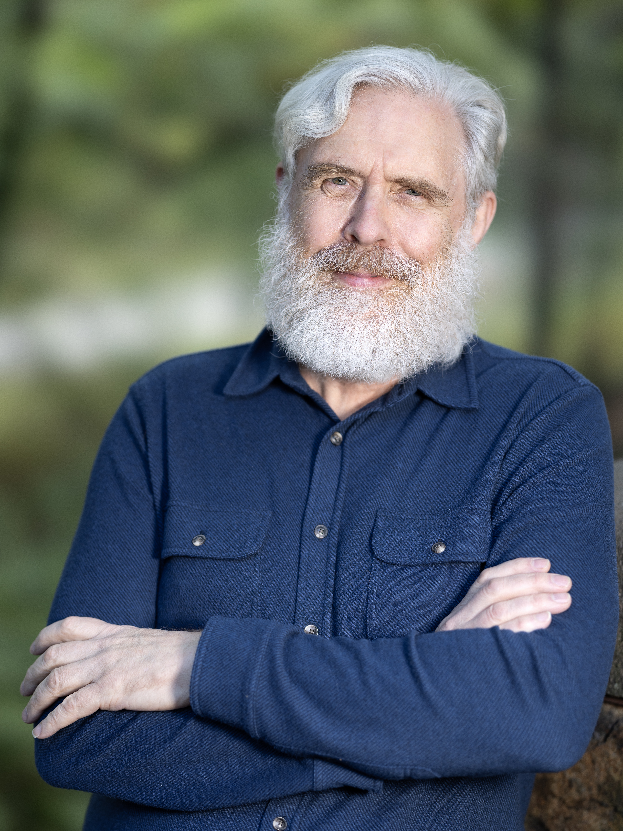
Colossal Biosciences
© Christopher Michel, CC BY-SA 4.0
© Duk3L1xon, CC BY-SA 4.0
https://colossal.com/
© All images are copyrighted. For further information, please refer to enquiries@sciencelearn.org.nz

Slide 7
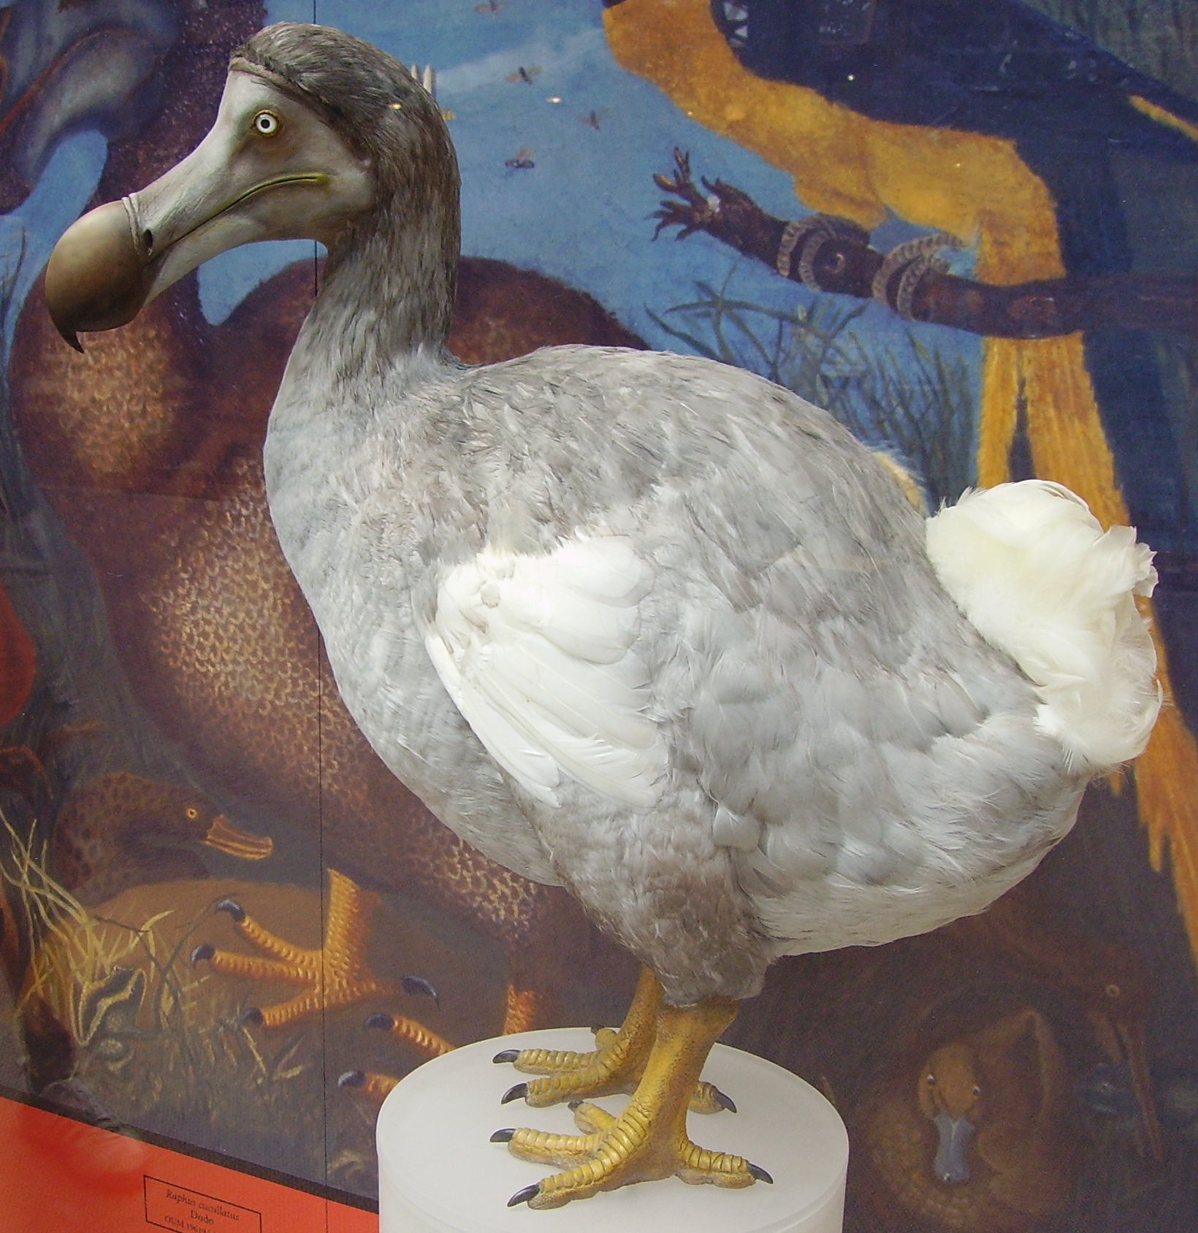
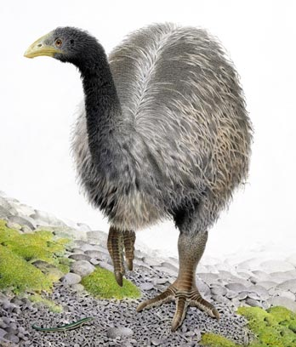
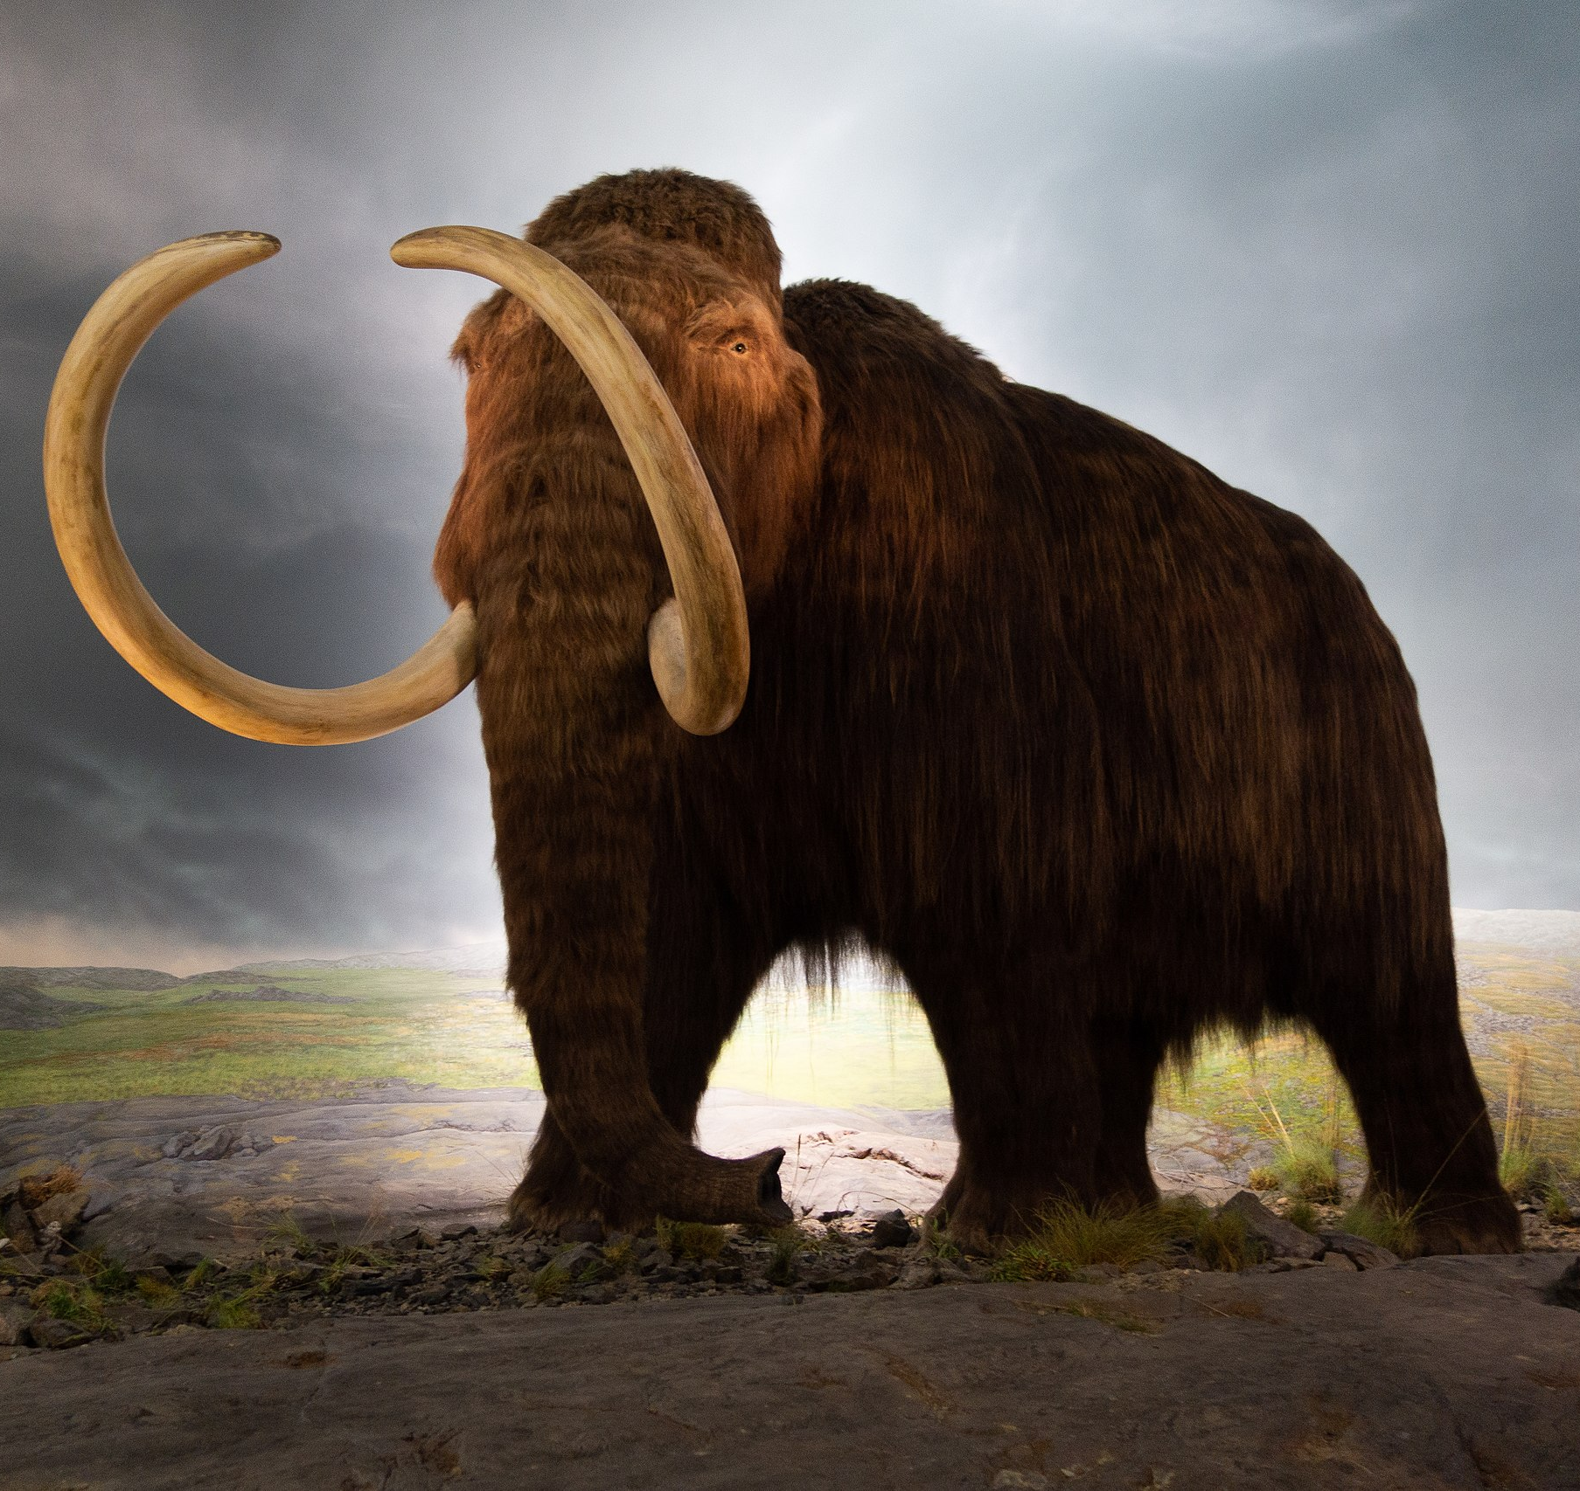
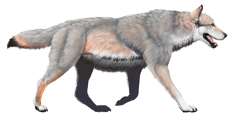
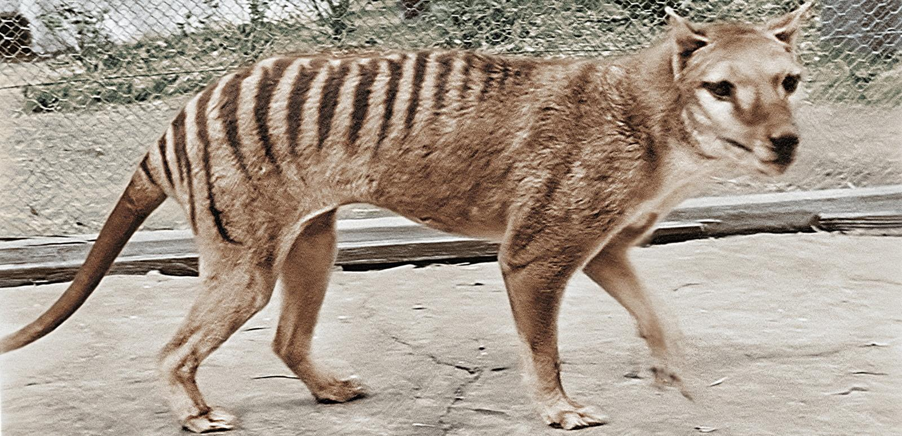
De-extinction candidates…
© Ballista, CC BY-SA 3.0
Illustration for National Park Service (USA) by Benji Paysnoe
© Thomas Quine, CC BY 2.0
Heavy-footed Moa. Pachyornis elephantopus. From the series: Extinct Birds of New Zealand., 2005, Masterton, by Paul Martinson. Purchased 2006.
© Te Papa. CC BY-NC-ND 4.0. Te Papa (2006-0010-1/20)
Courtesy of the National Film and Sound Archive, Australia. From Colourised footage of last Tasmanian tiger
All images are copyrighted. For further information, please refer to enquiries@sciencelearn.org.nz

Slide 8
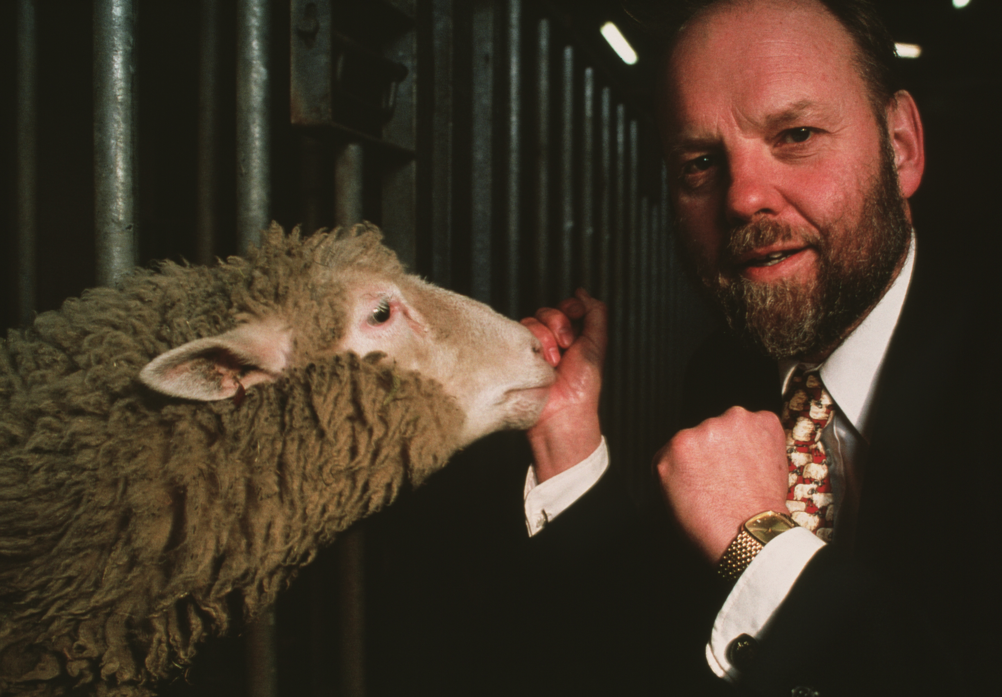
Cloning Dolly the sheep
Photo by Philippe Plailly, © Science Photo Library
All images are copyrighted. For further information, please refer to enquiries@sciencelearn.org.nz

Slide 9
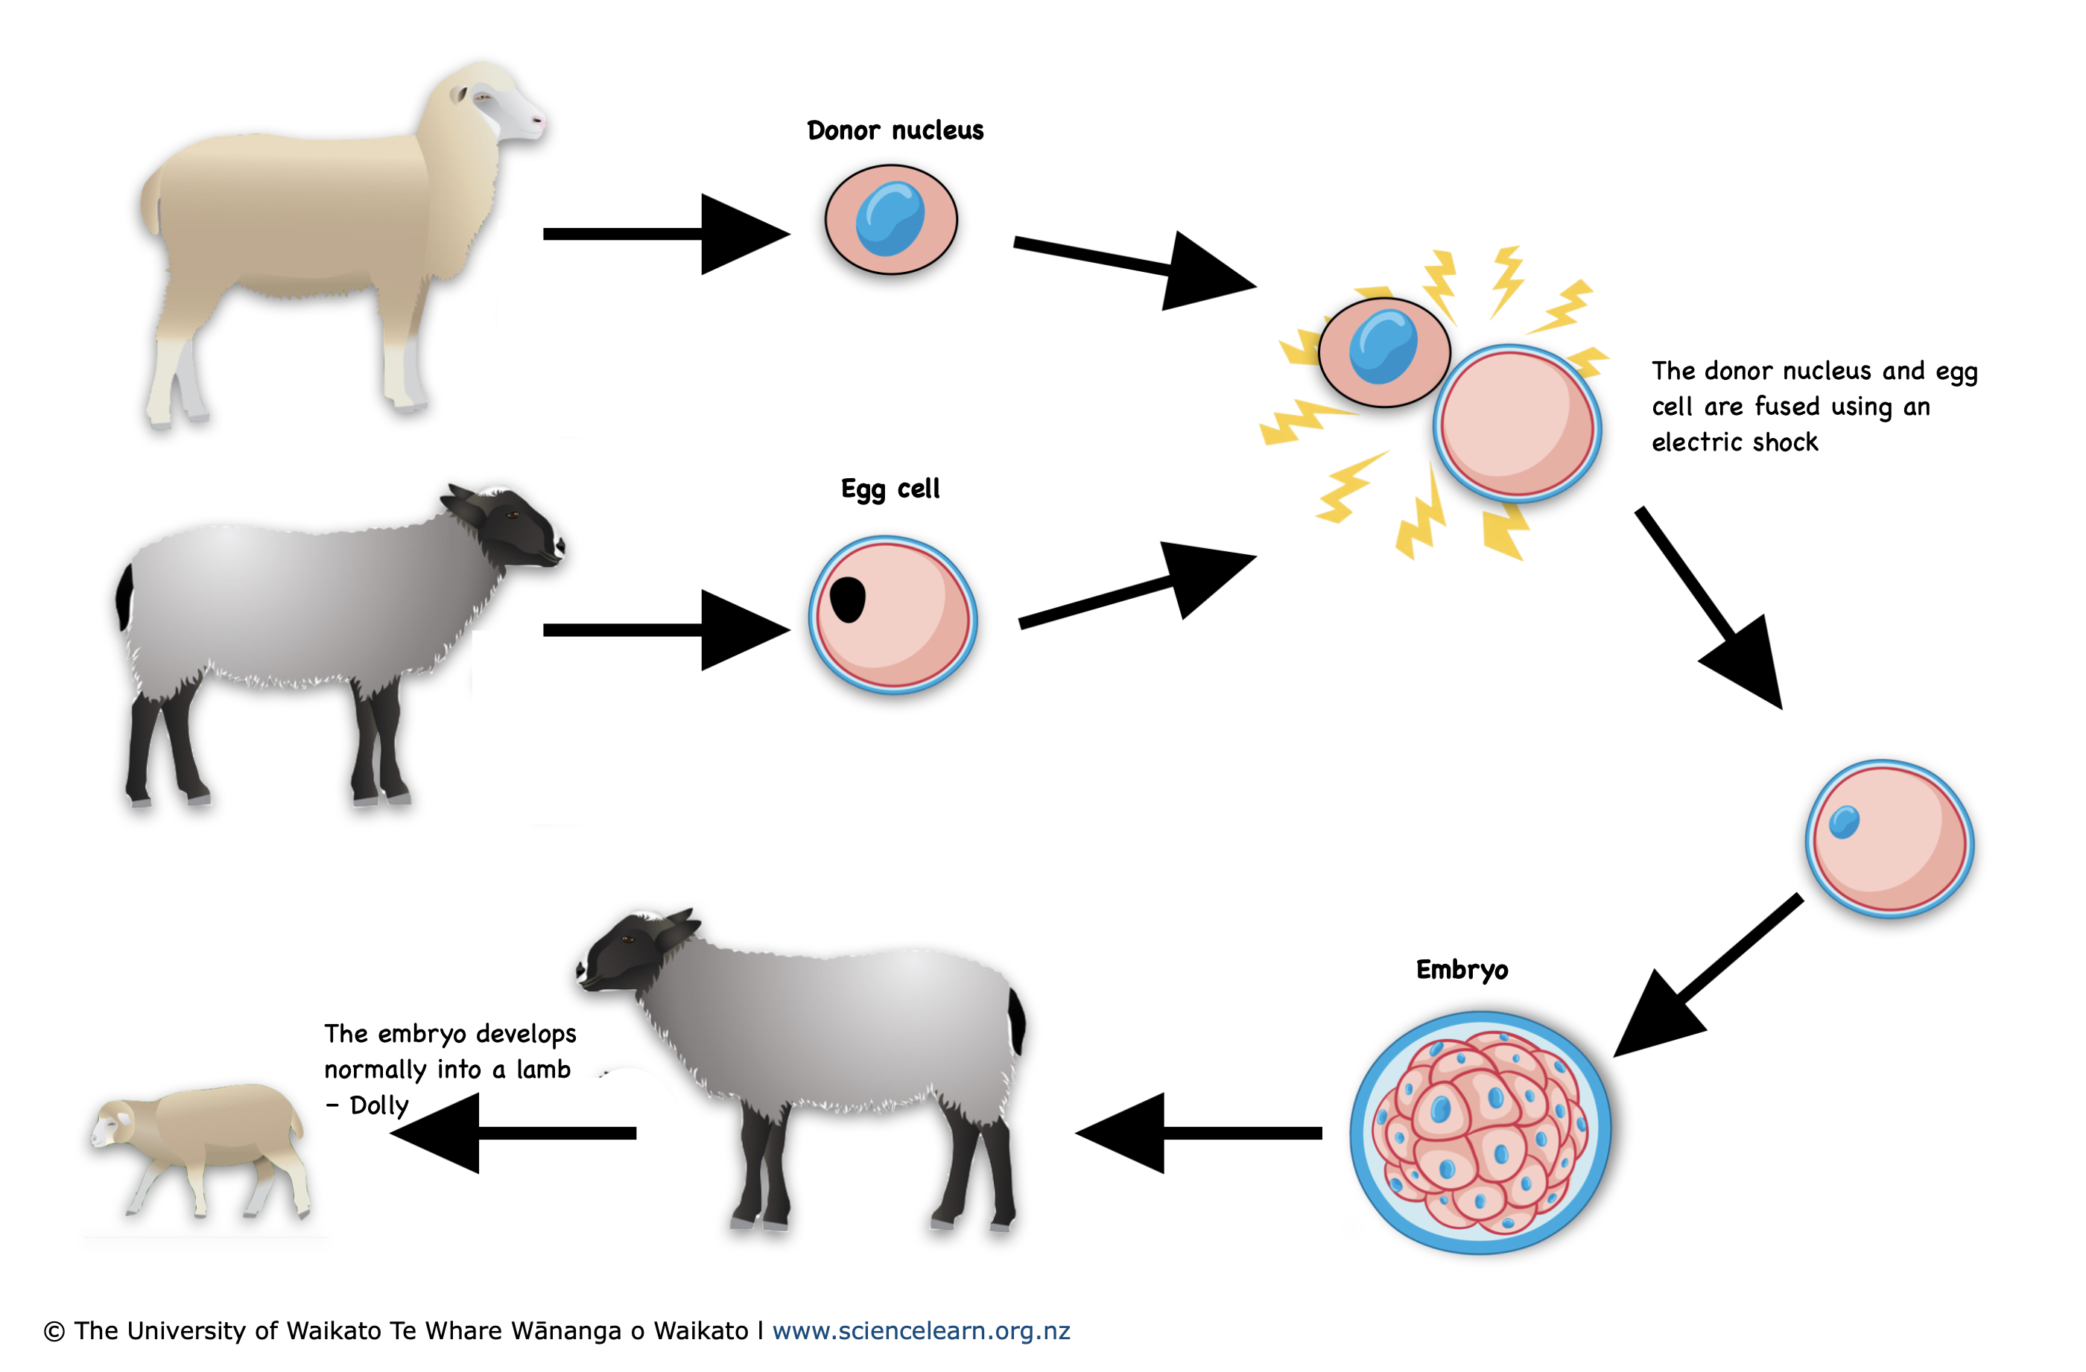
Cloning (somatic cell nuclear transfer)
Diagram adapted from: Armstrong, Lyle & Lako, Majlinda & Dean, Wendy & Stojkovic, Miodrag. (2006). Epigenetic Modification Is Central to Genome Reprogramming in Somatic Cell Nuclear Transfer. Stem cells (Dayton, Ohio). 24. 805-14.10.1634/stemcells.2005-0350.
All images are copyrighted. For further information, please refer to enquiries@sciencelearn.org.nz

Slide 10
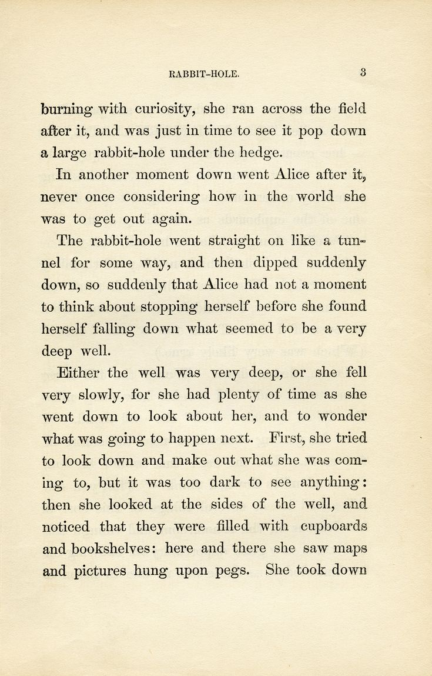
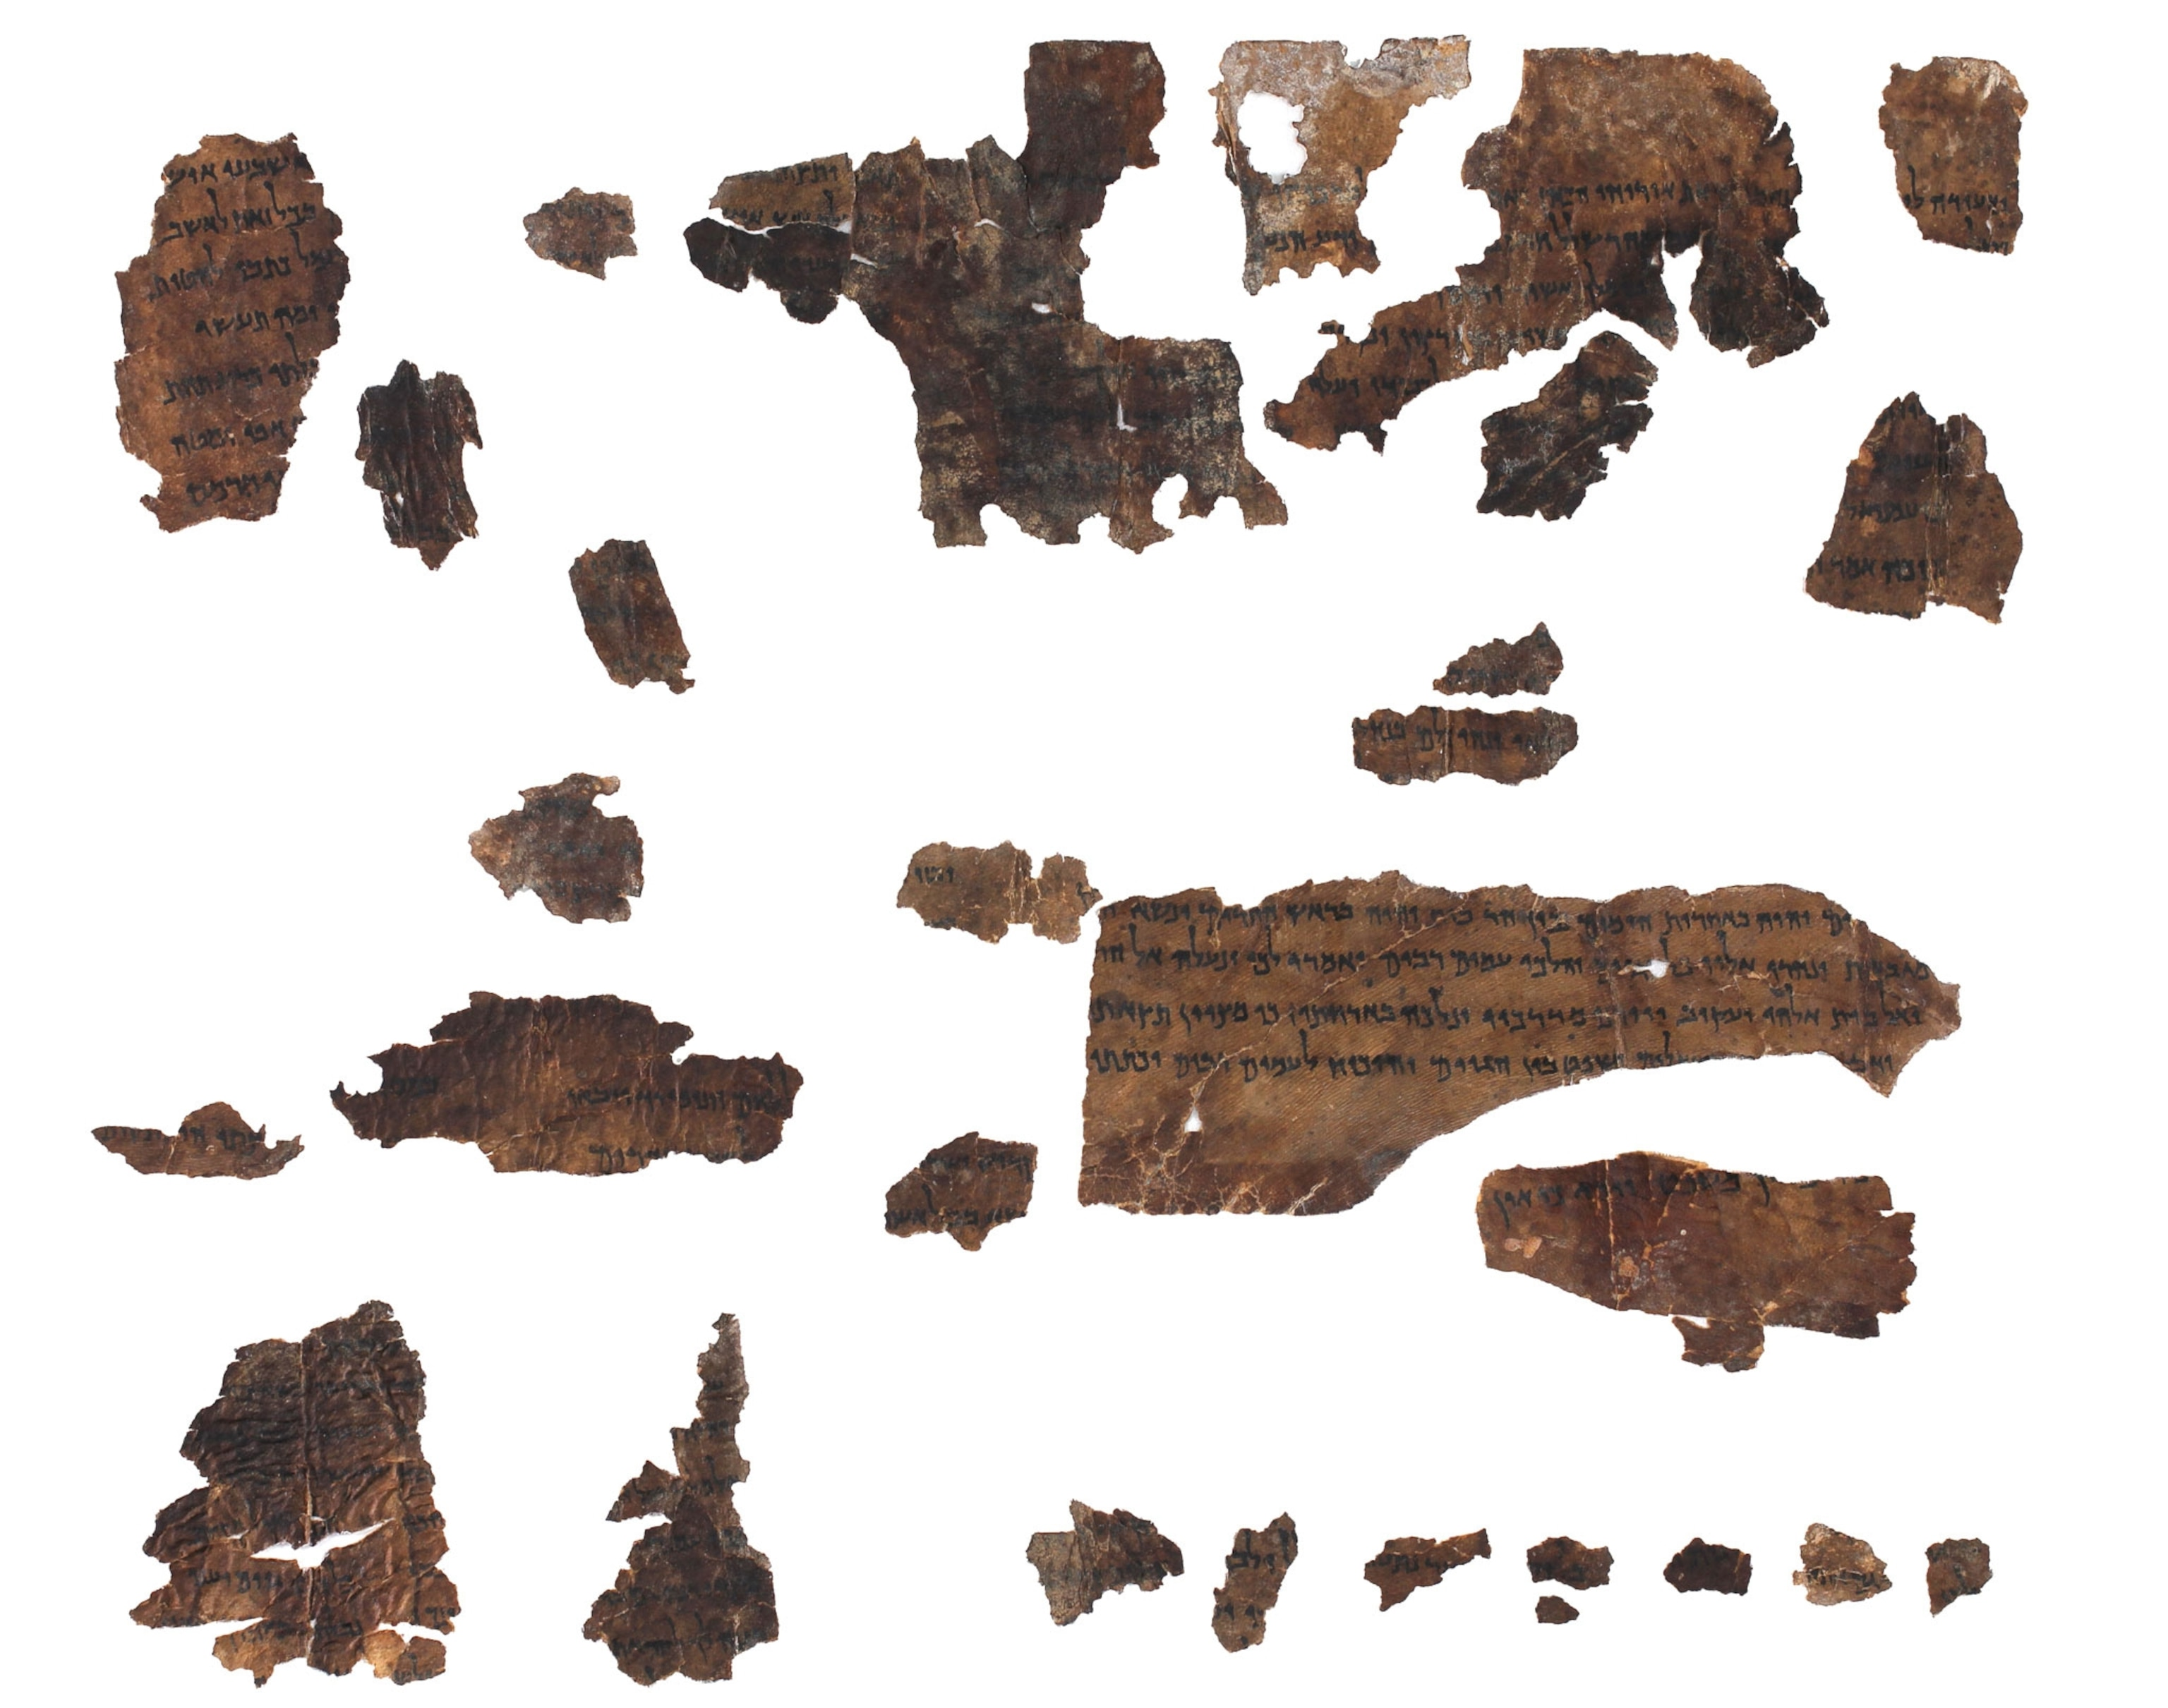
Ancient DNA preservation
Wikisource, CC BY-SA 2.0
Photo by Shai Halevi, © The Israel Antiquities Authority
All images are copyrighted. For further information, please refer to enquiries@sciencelearn.org.nz

Slide 11
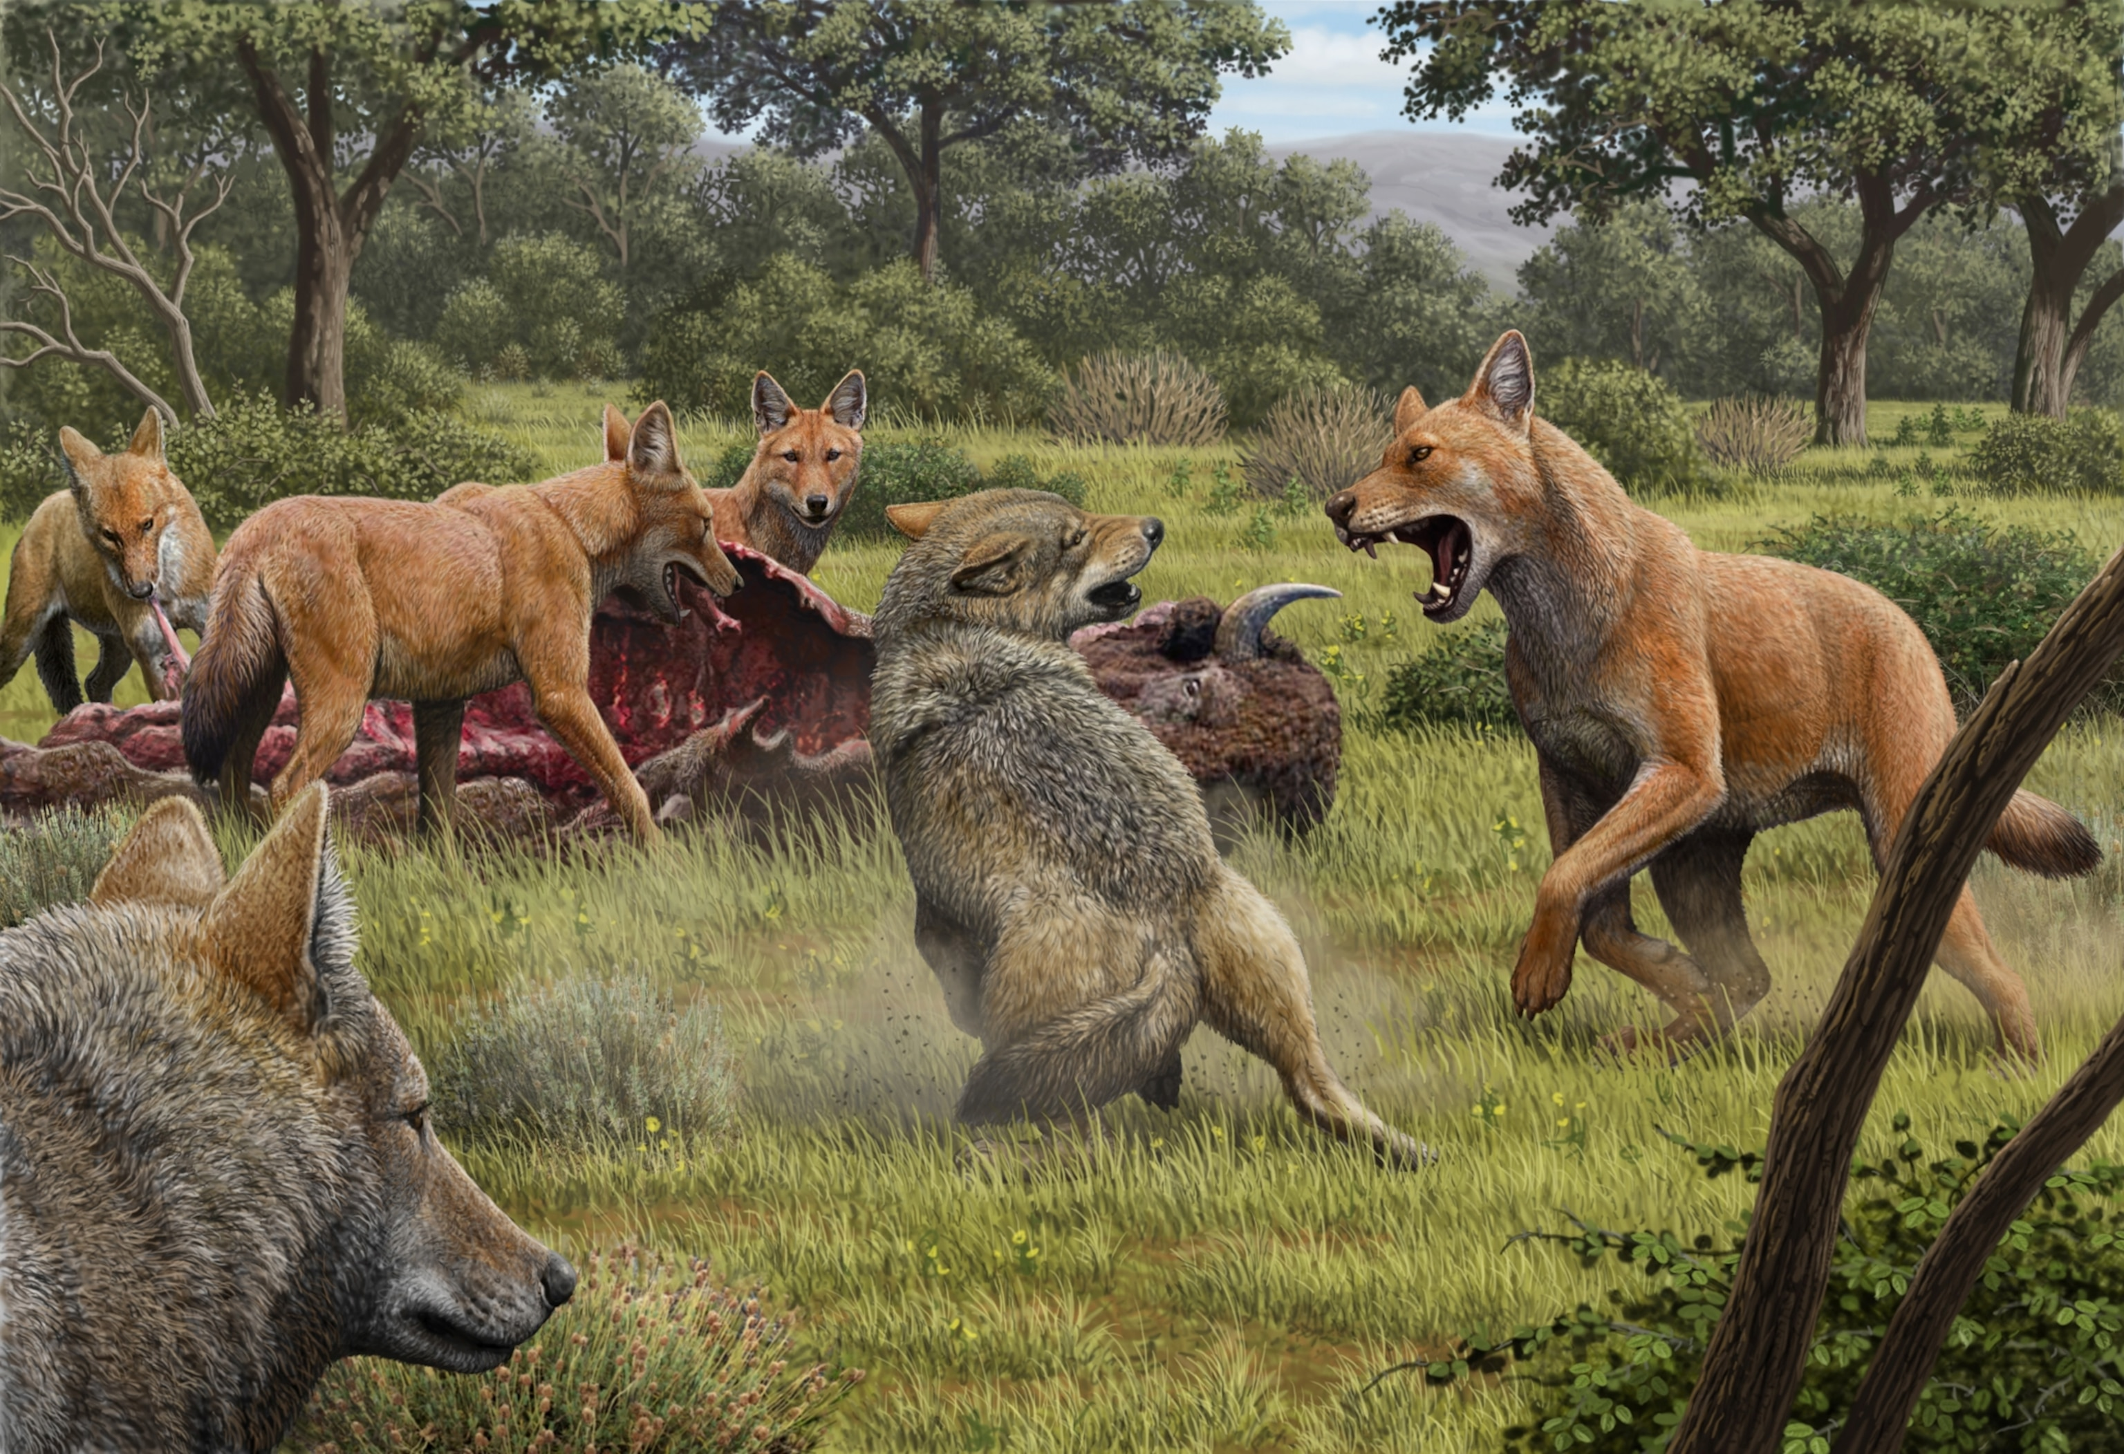
The picture on the puzzle box: scaffold reference genomes
Art by Mauricio Antón
All images are copyrighted. For further information, please refer to enquiries@sciencelearn.org.nz​

Slide 12
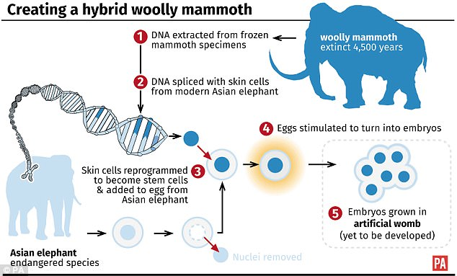
Genome engineering an extinct species
All images are copyrighted. For further information, please refer to enquiries@sciencelearn.org.nz​

Slide 13
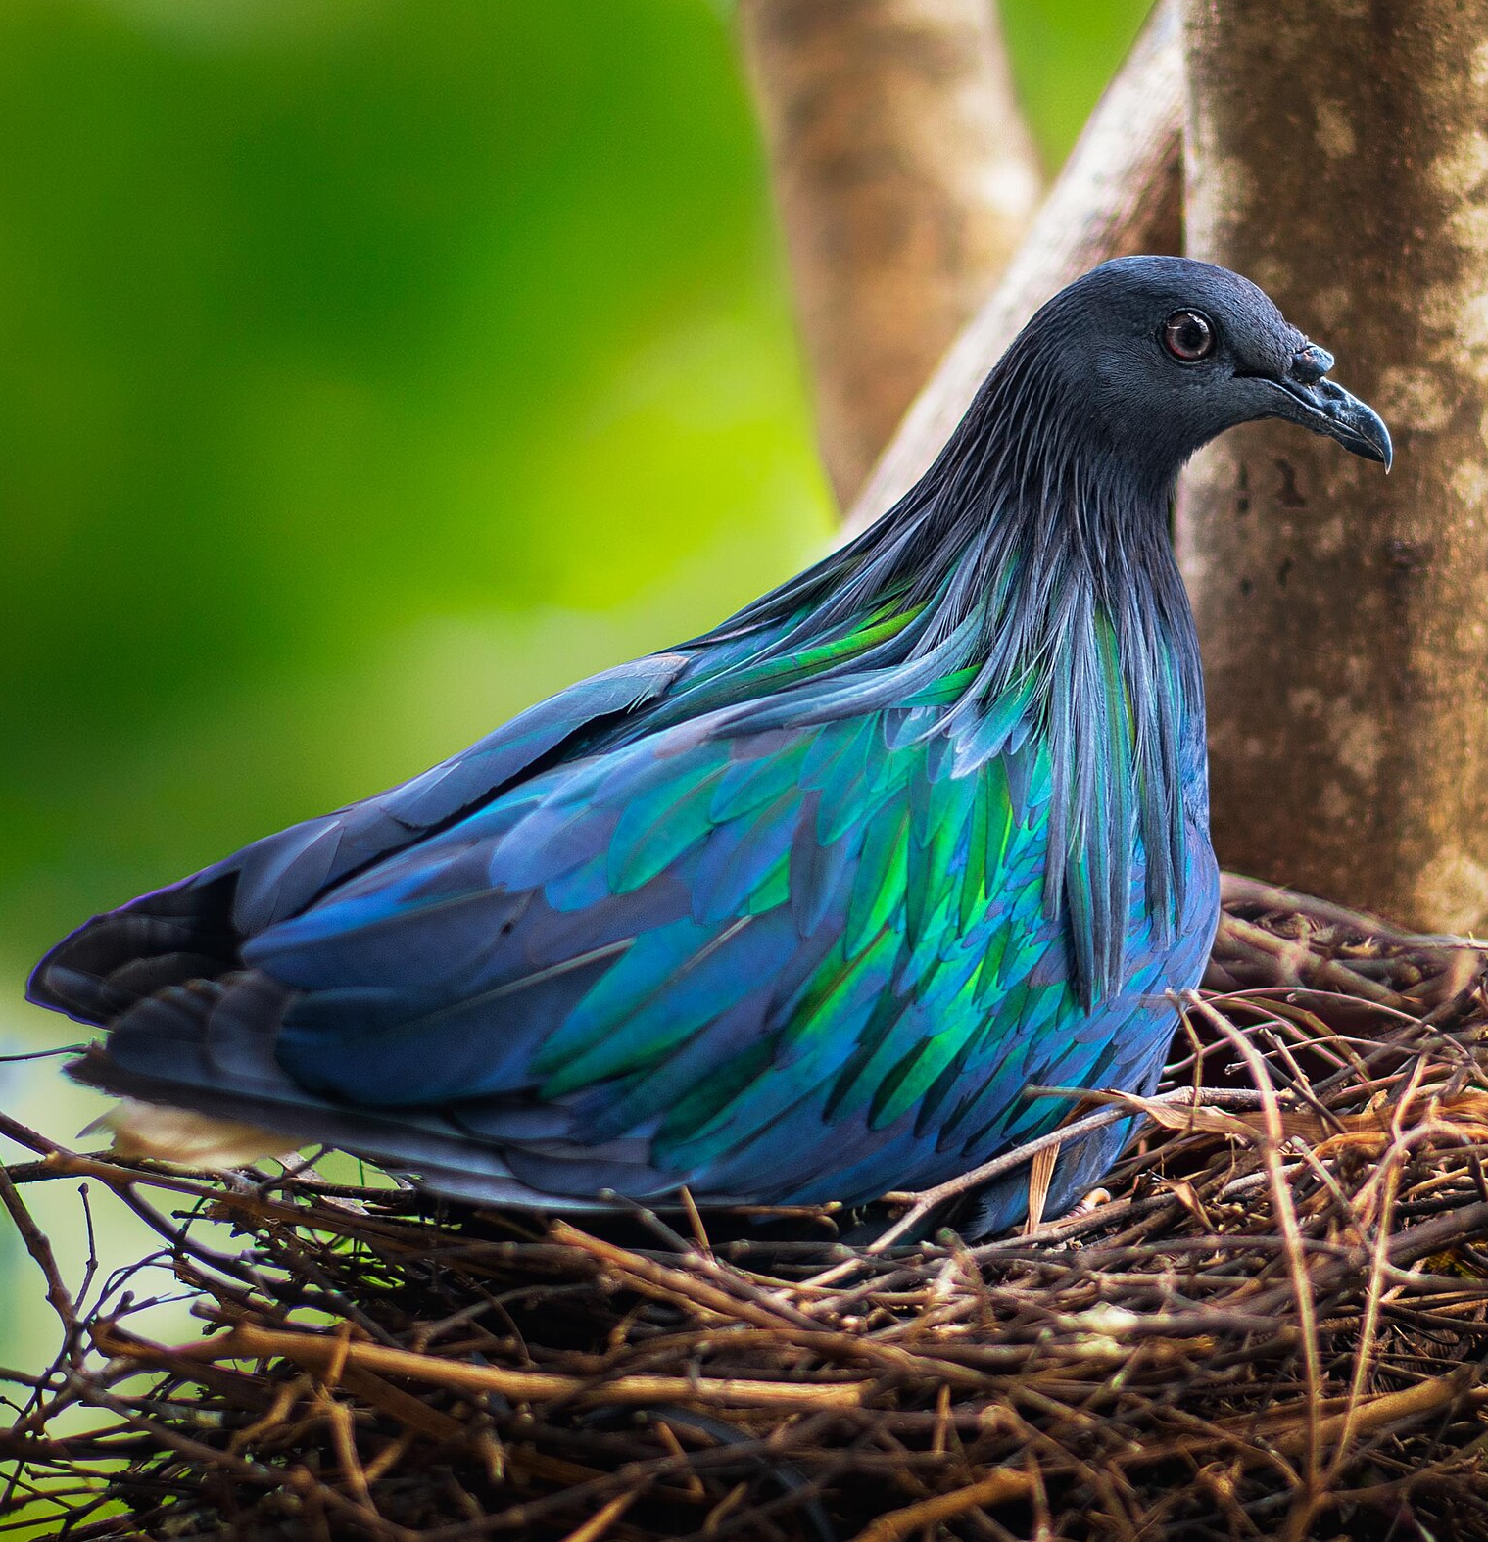
Nicobar pigeon Dodo
© Kirkamon Guapo Cabello, CC BY-SA 4.0
© Ballista, CC BY-SA 3.0
All images are copyrighted. For further information, please refer to enquiries@sciencelearn.org.nz​

Slide 14
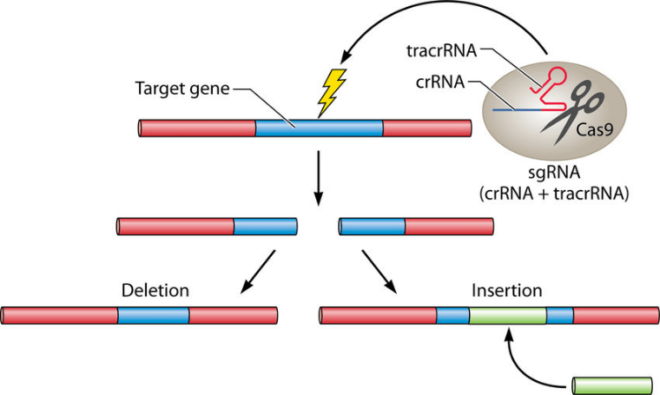
Molecular scissors: Crispr-Cas9
Ishino, Yoshizumi & Krupovic, Mart & Forterre, Patrick. (2018). History of CRISPR-Cas from Encounter with a Mysterious Repeated Sequence to Genome Editing Technology. Journal of Bacteriology. 200. JB.00580-17. 10.1128/JB.00580-17.
All images are copyrighted. For further information, please refer to enquiries@sciencelearn.org.nz​

Slide 15
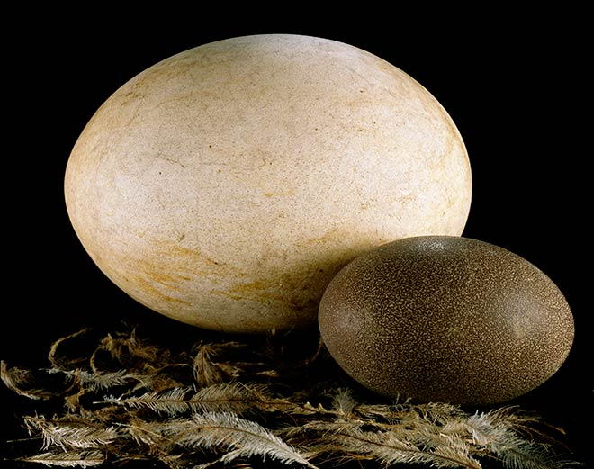
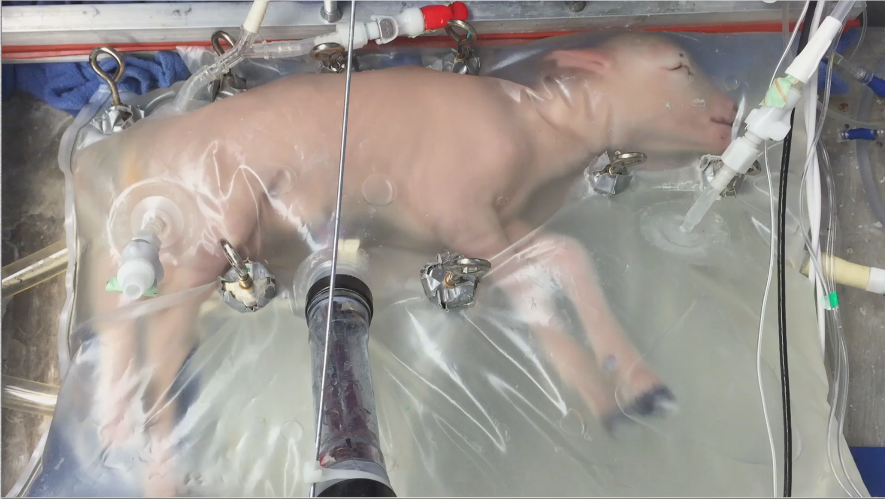
When surrogates are not enough
© E. A. Partridge et al./Nature. CC BY 4.0
© Te Papa. MA_B.021408
All images are copyrighted. For further information, please refer to enquiries@sciencelearn.org.nz​

Slide 16
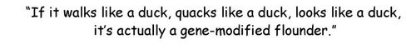
Functional ‘de-extinction’
Chris Wildt (cartoonist)
All images are copyrighted. For further information, please refer to enquiries@sciencelearn.org.nz​

Slide 17
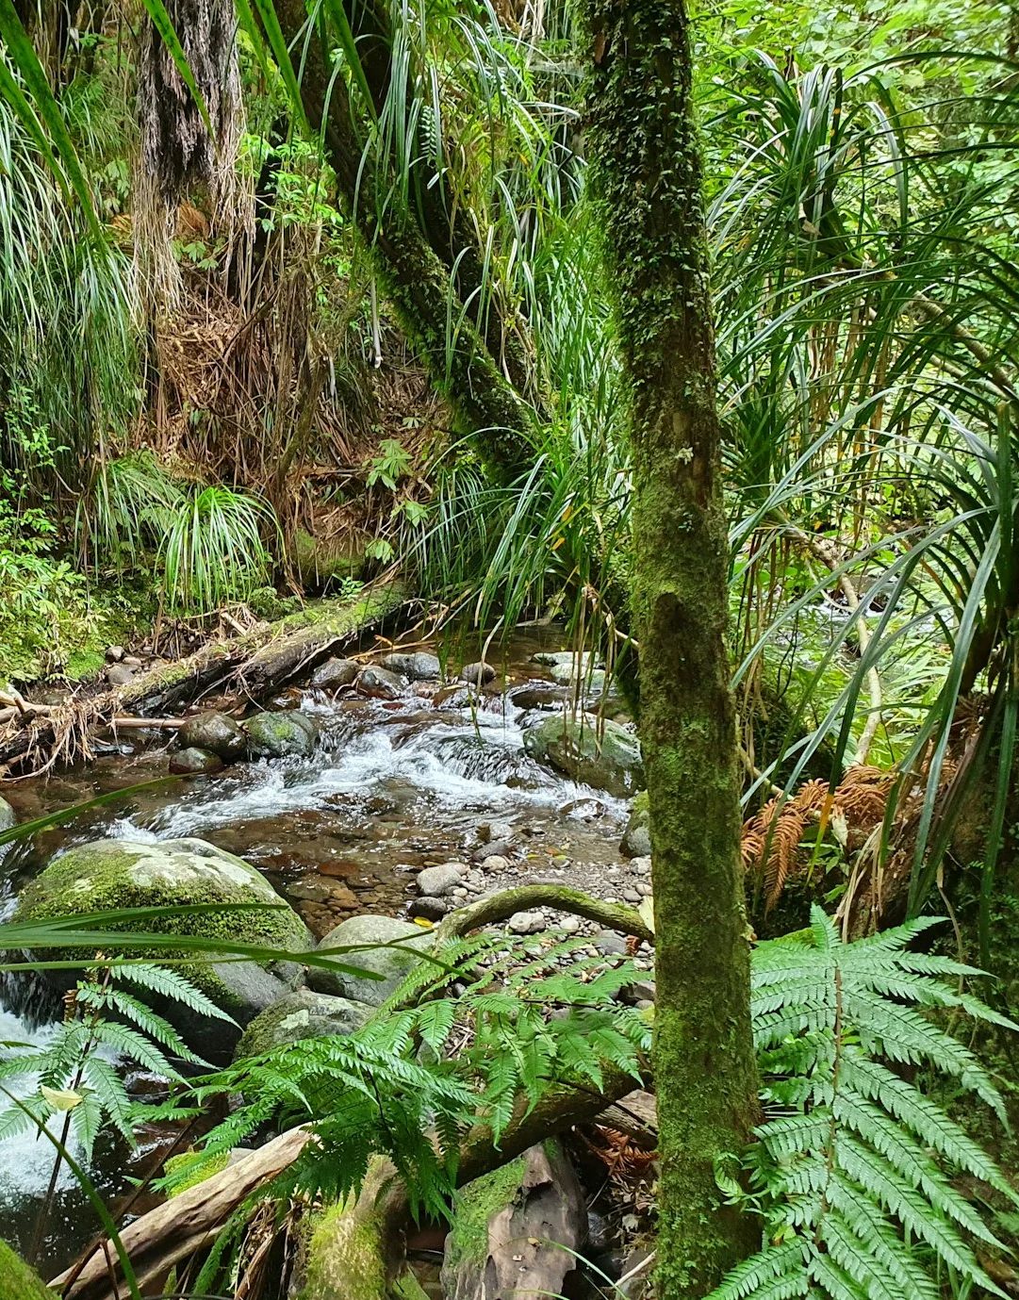
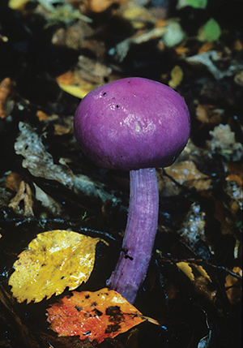
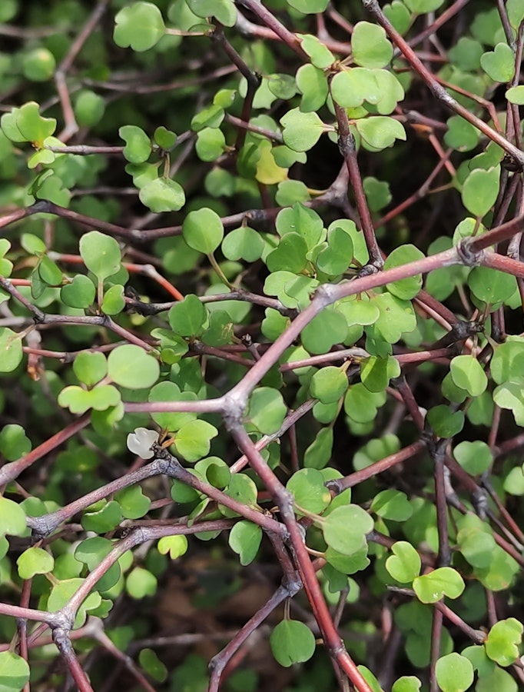
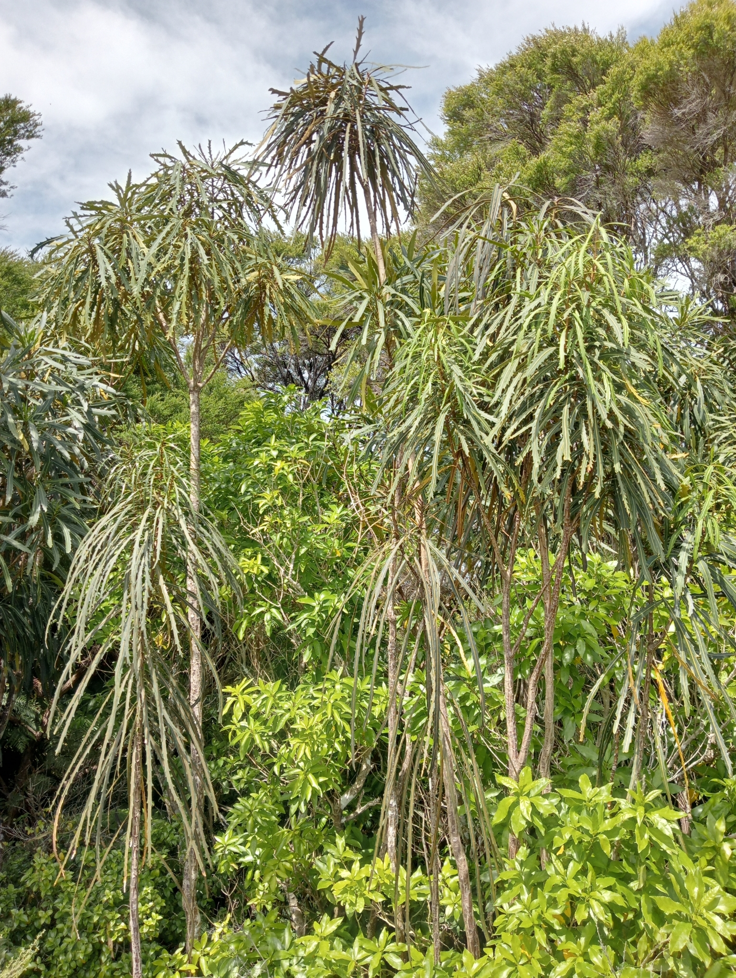
The often quoted argument for ‘de-extinction’
© The University of Waikato Te Whare Wānanga o Waikato
© Manaaki Whenua – Landcare Research
© Jenny Saito, CC BY-NC 4.0. Sourced from iNaturalistNZ.
© John Barkla, CC BY 4.0
All images are copyrighted. For further information, please refer to enquiries@sciencelearn.org.nz​

Slide 18
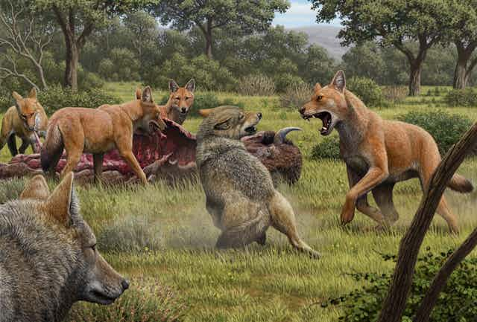
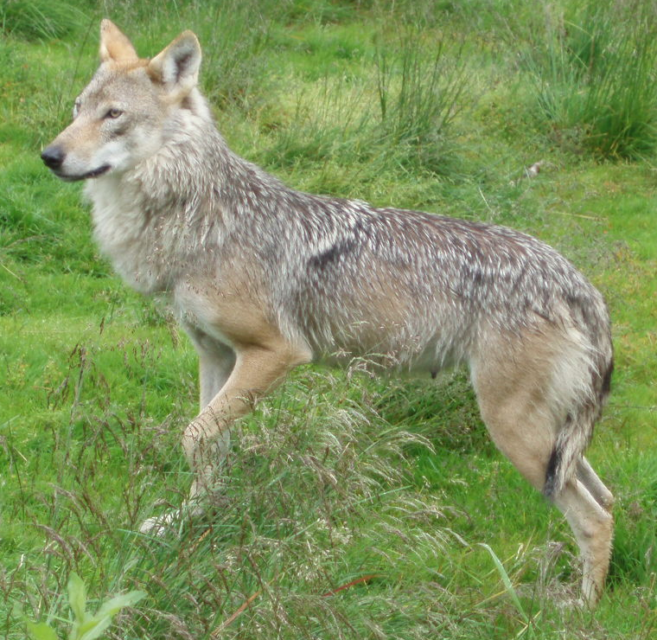
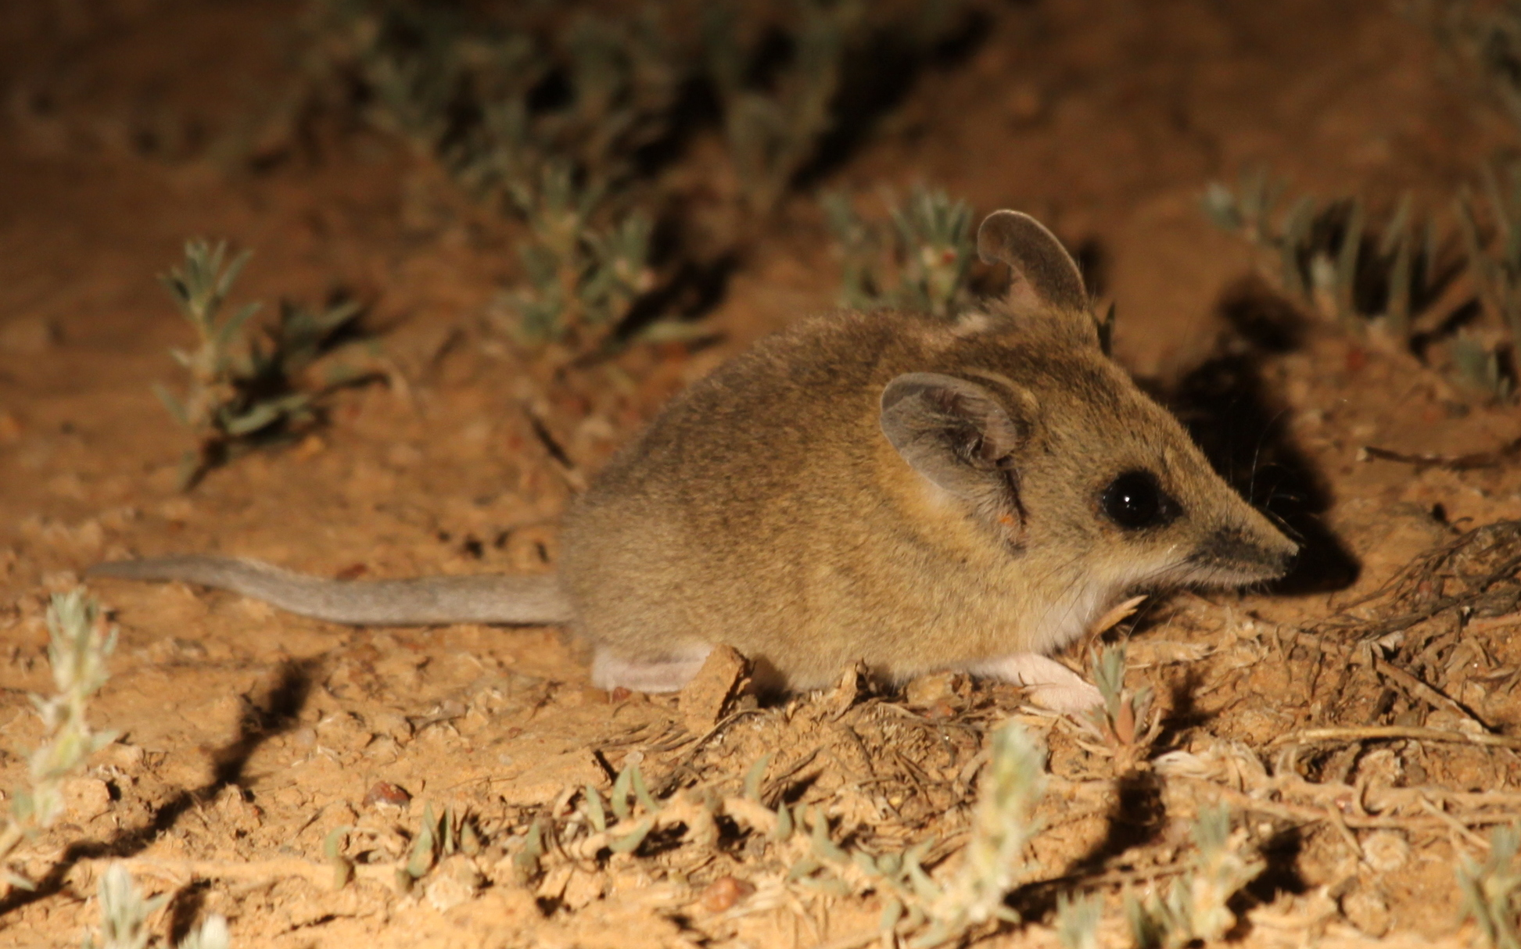
Technological limits: genomic differences
Art by Mauricio Antón
© Petter Fjeld, CC BY-SA 2.5
All images are copyrighted. For further information, please refer to enquiries@sciencelearn.org.nz​
Courtesy of the National Film and Sound Archive, Australia.
From Colourised footage of last Tasmanian tiger
Photo by Richard Fuller, released into public domain. Sourced from iNaturalist

Slide 19
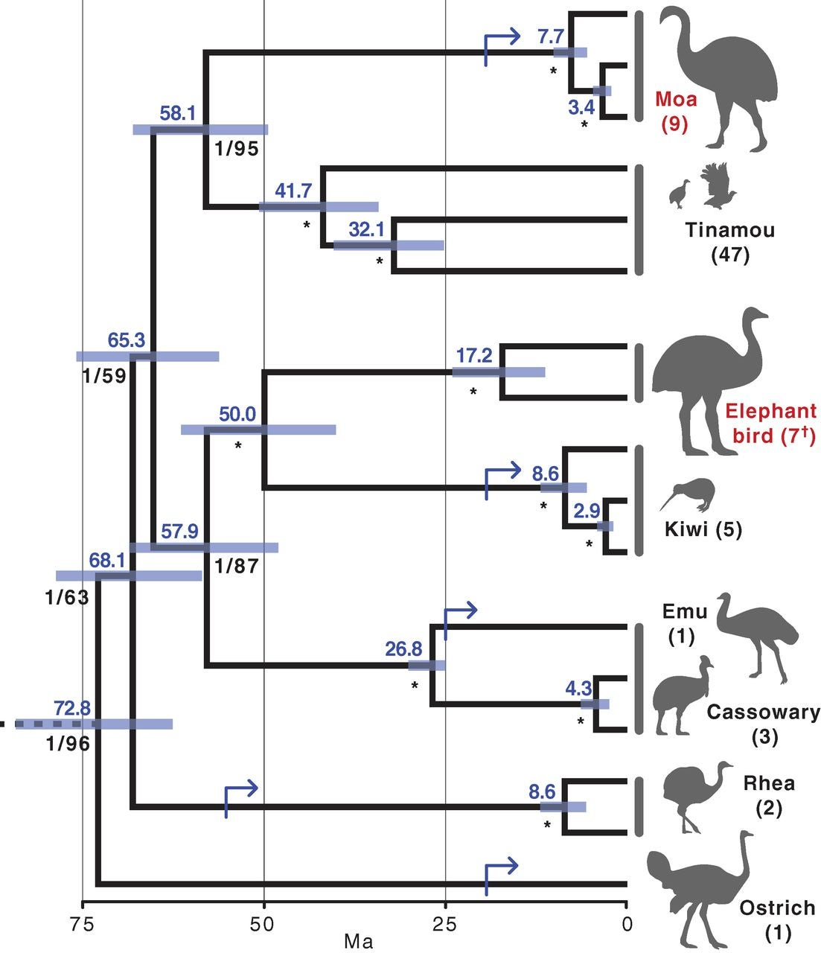
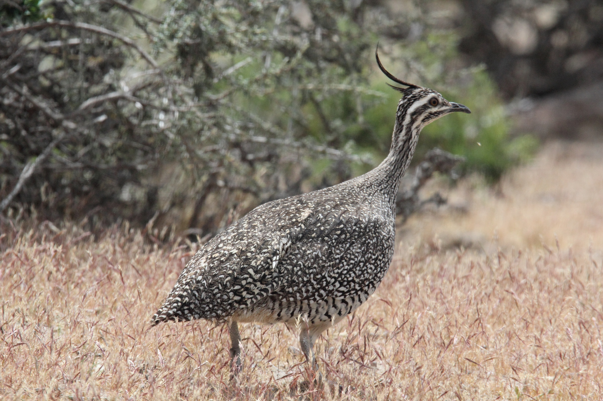
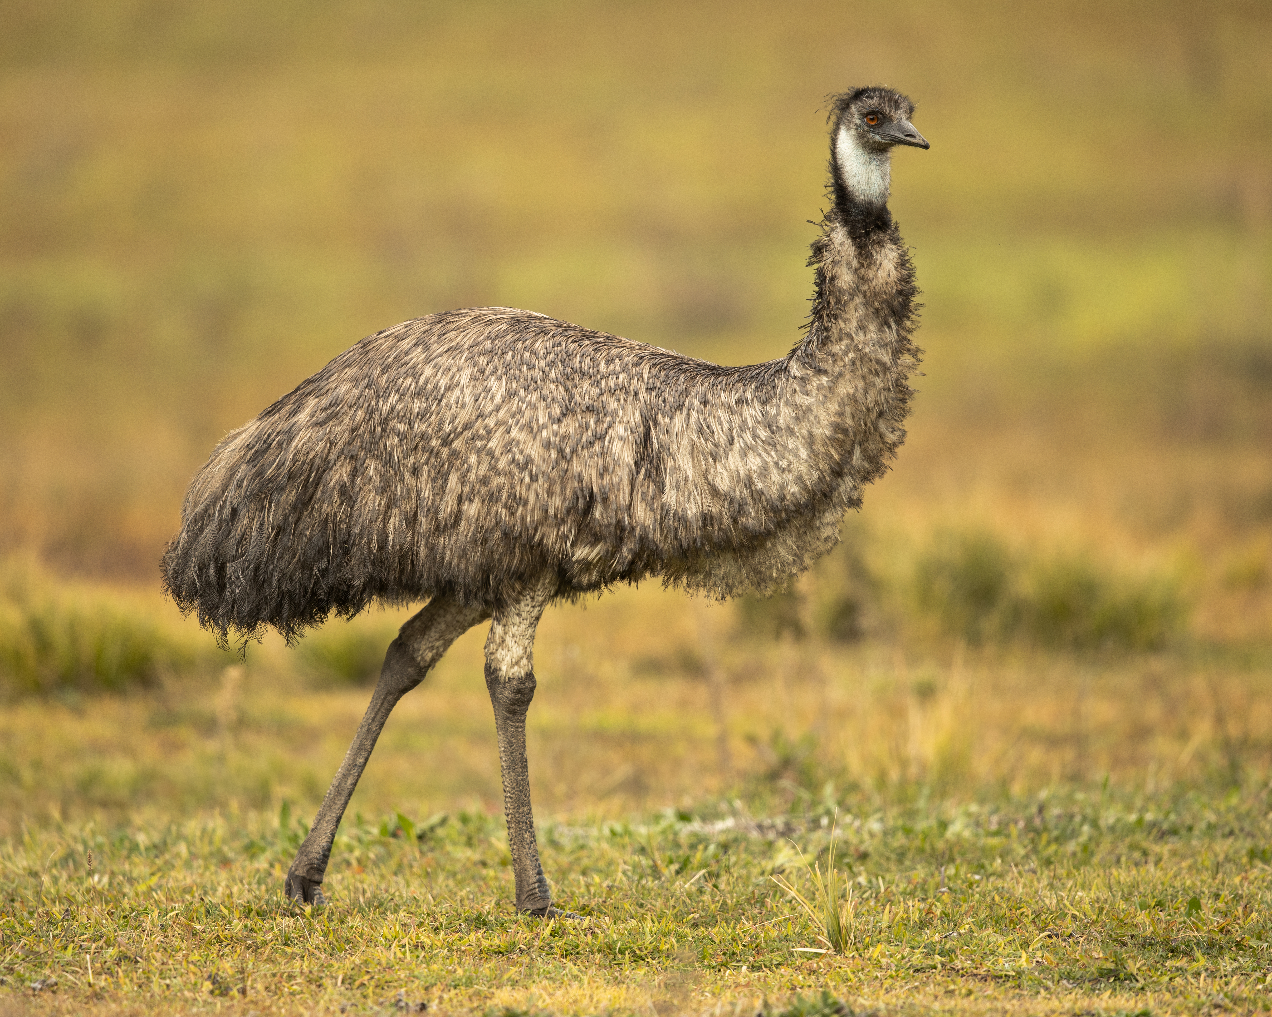
Technological limits: genomic differences
© Dominic Sherony, CC BY-SA 2.0
All images are copyrighted. For further information, please refer to enquiries@sciencelearn.org.nz​
Kieren J. Mitchell et al. Ancient DNA reveals elephant birds and kiwi are sister taxa and clarifies ratite bird evolution. Science 344,898-900(2014).DOI:10.1126/science.1251981
© JJ Harrison, CC BY-SA 4.0
Notes:
Bulk of DNA between animals is very similar but that small percentage of difference has a big difference.

Slide 20
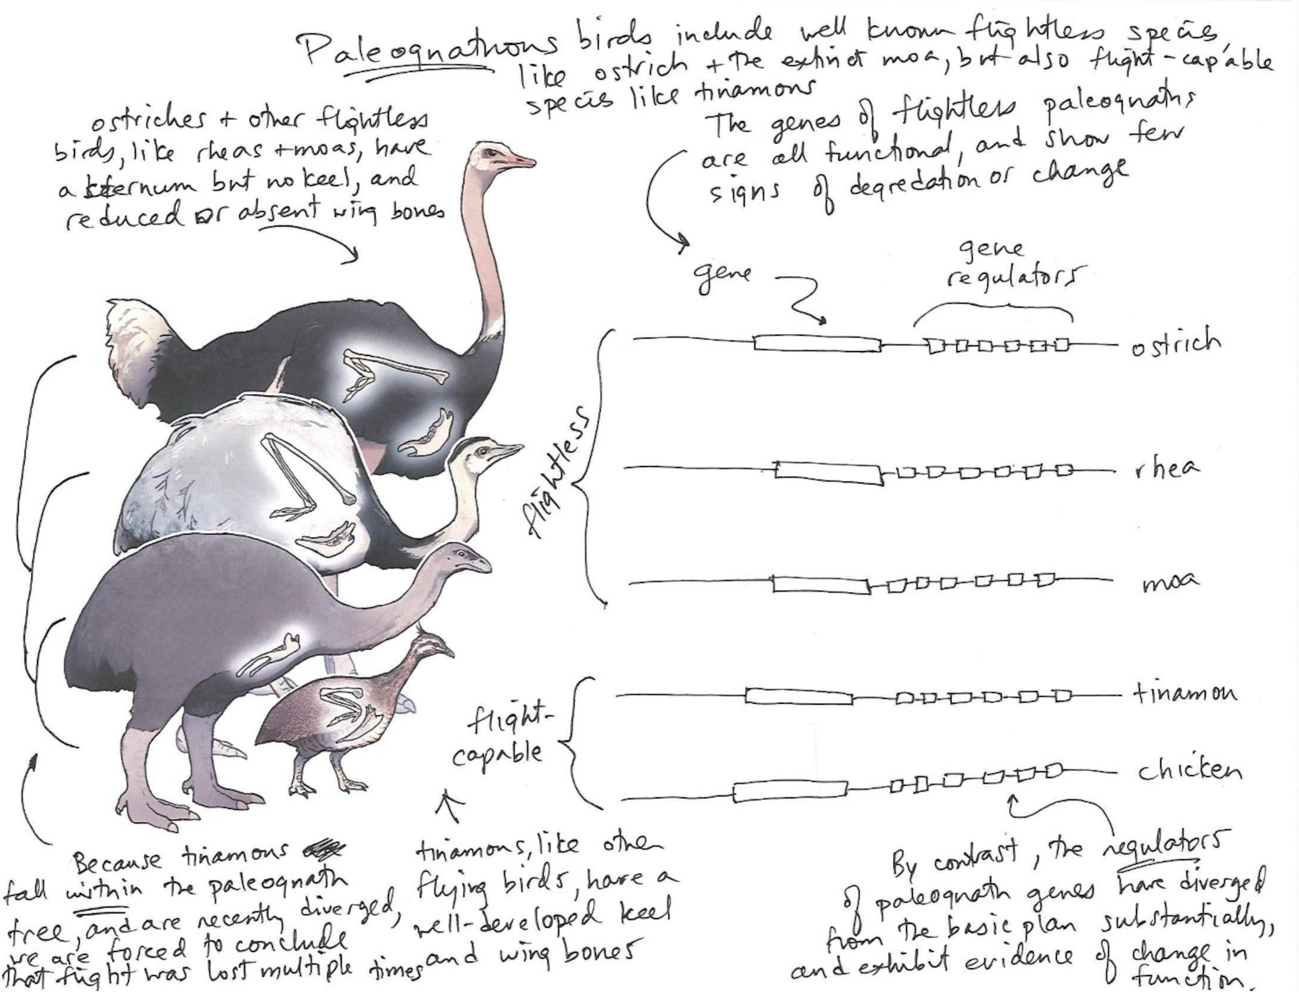
Technological limits: genes don’t hold all the answers
All images are copyrighted. For further information, please refer to enquiries@sciencelearn.org.nz​
Illustration by Wren Lu with annotations by Professor Scott V Edwards based on: Scott V. Edwards et al., A nuclear genome assembly of an extinct flightless bird, the little bush moa. Sci. Adv.10,eadj6823(2024). DOI:10.1126/sciadv.adj6823

Slide 21
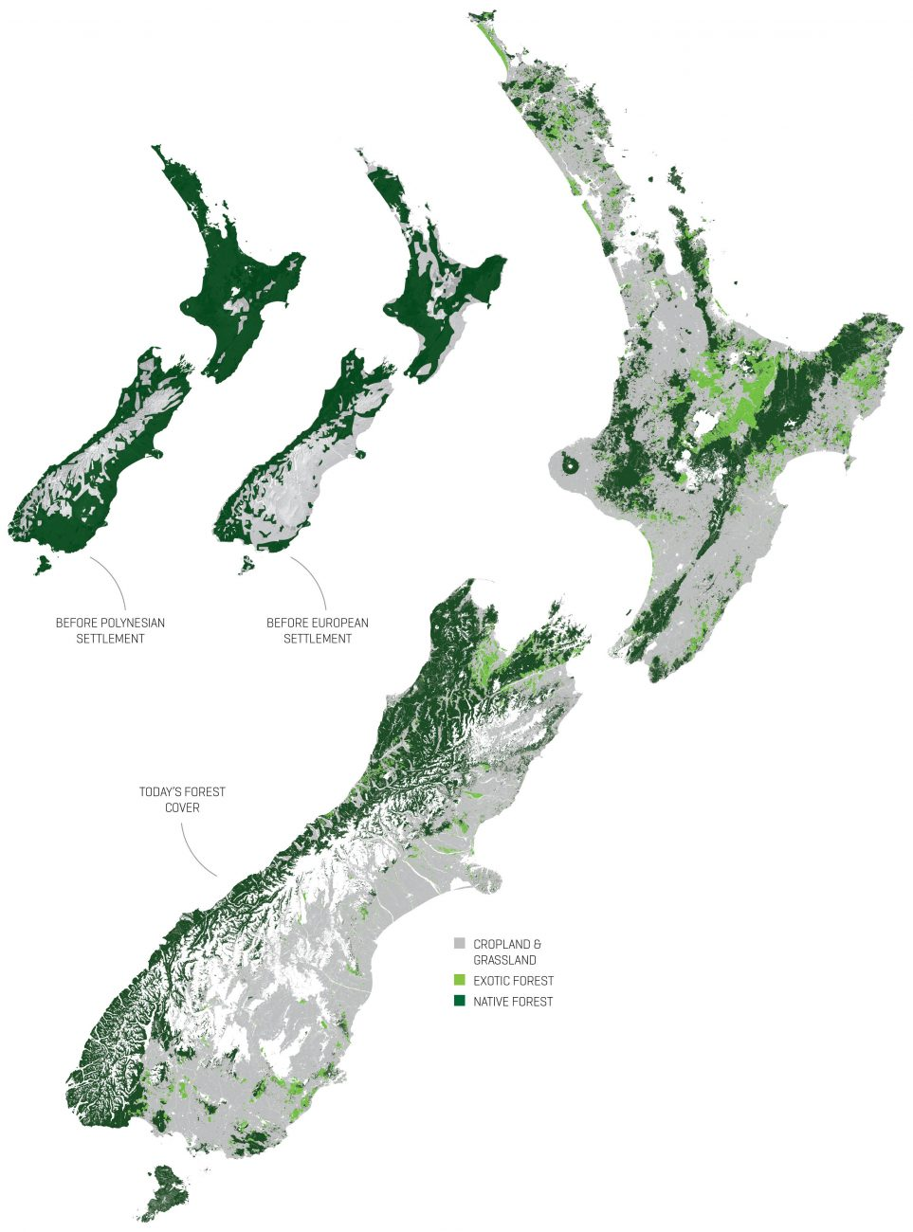
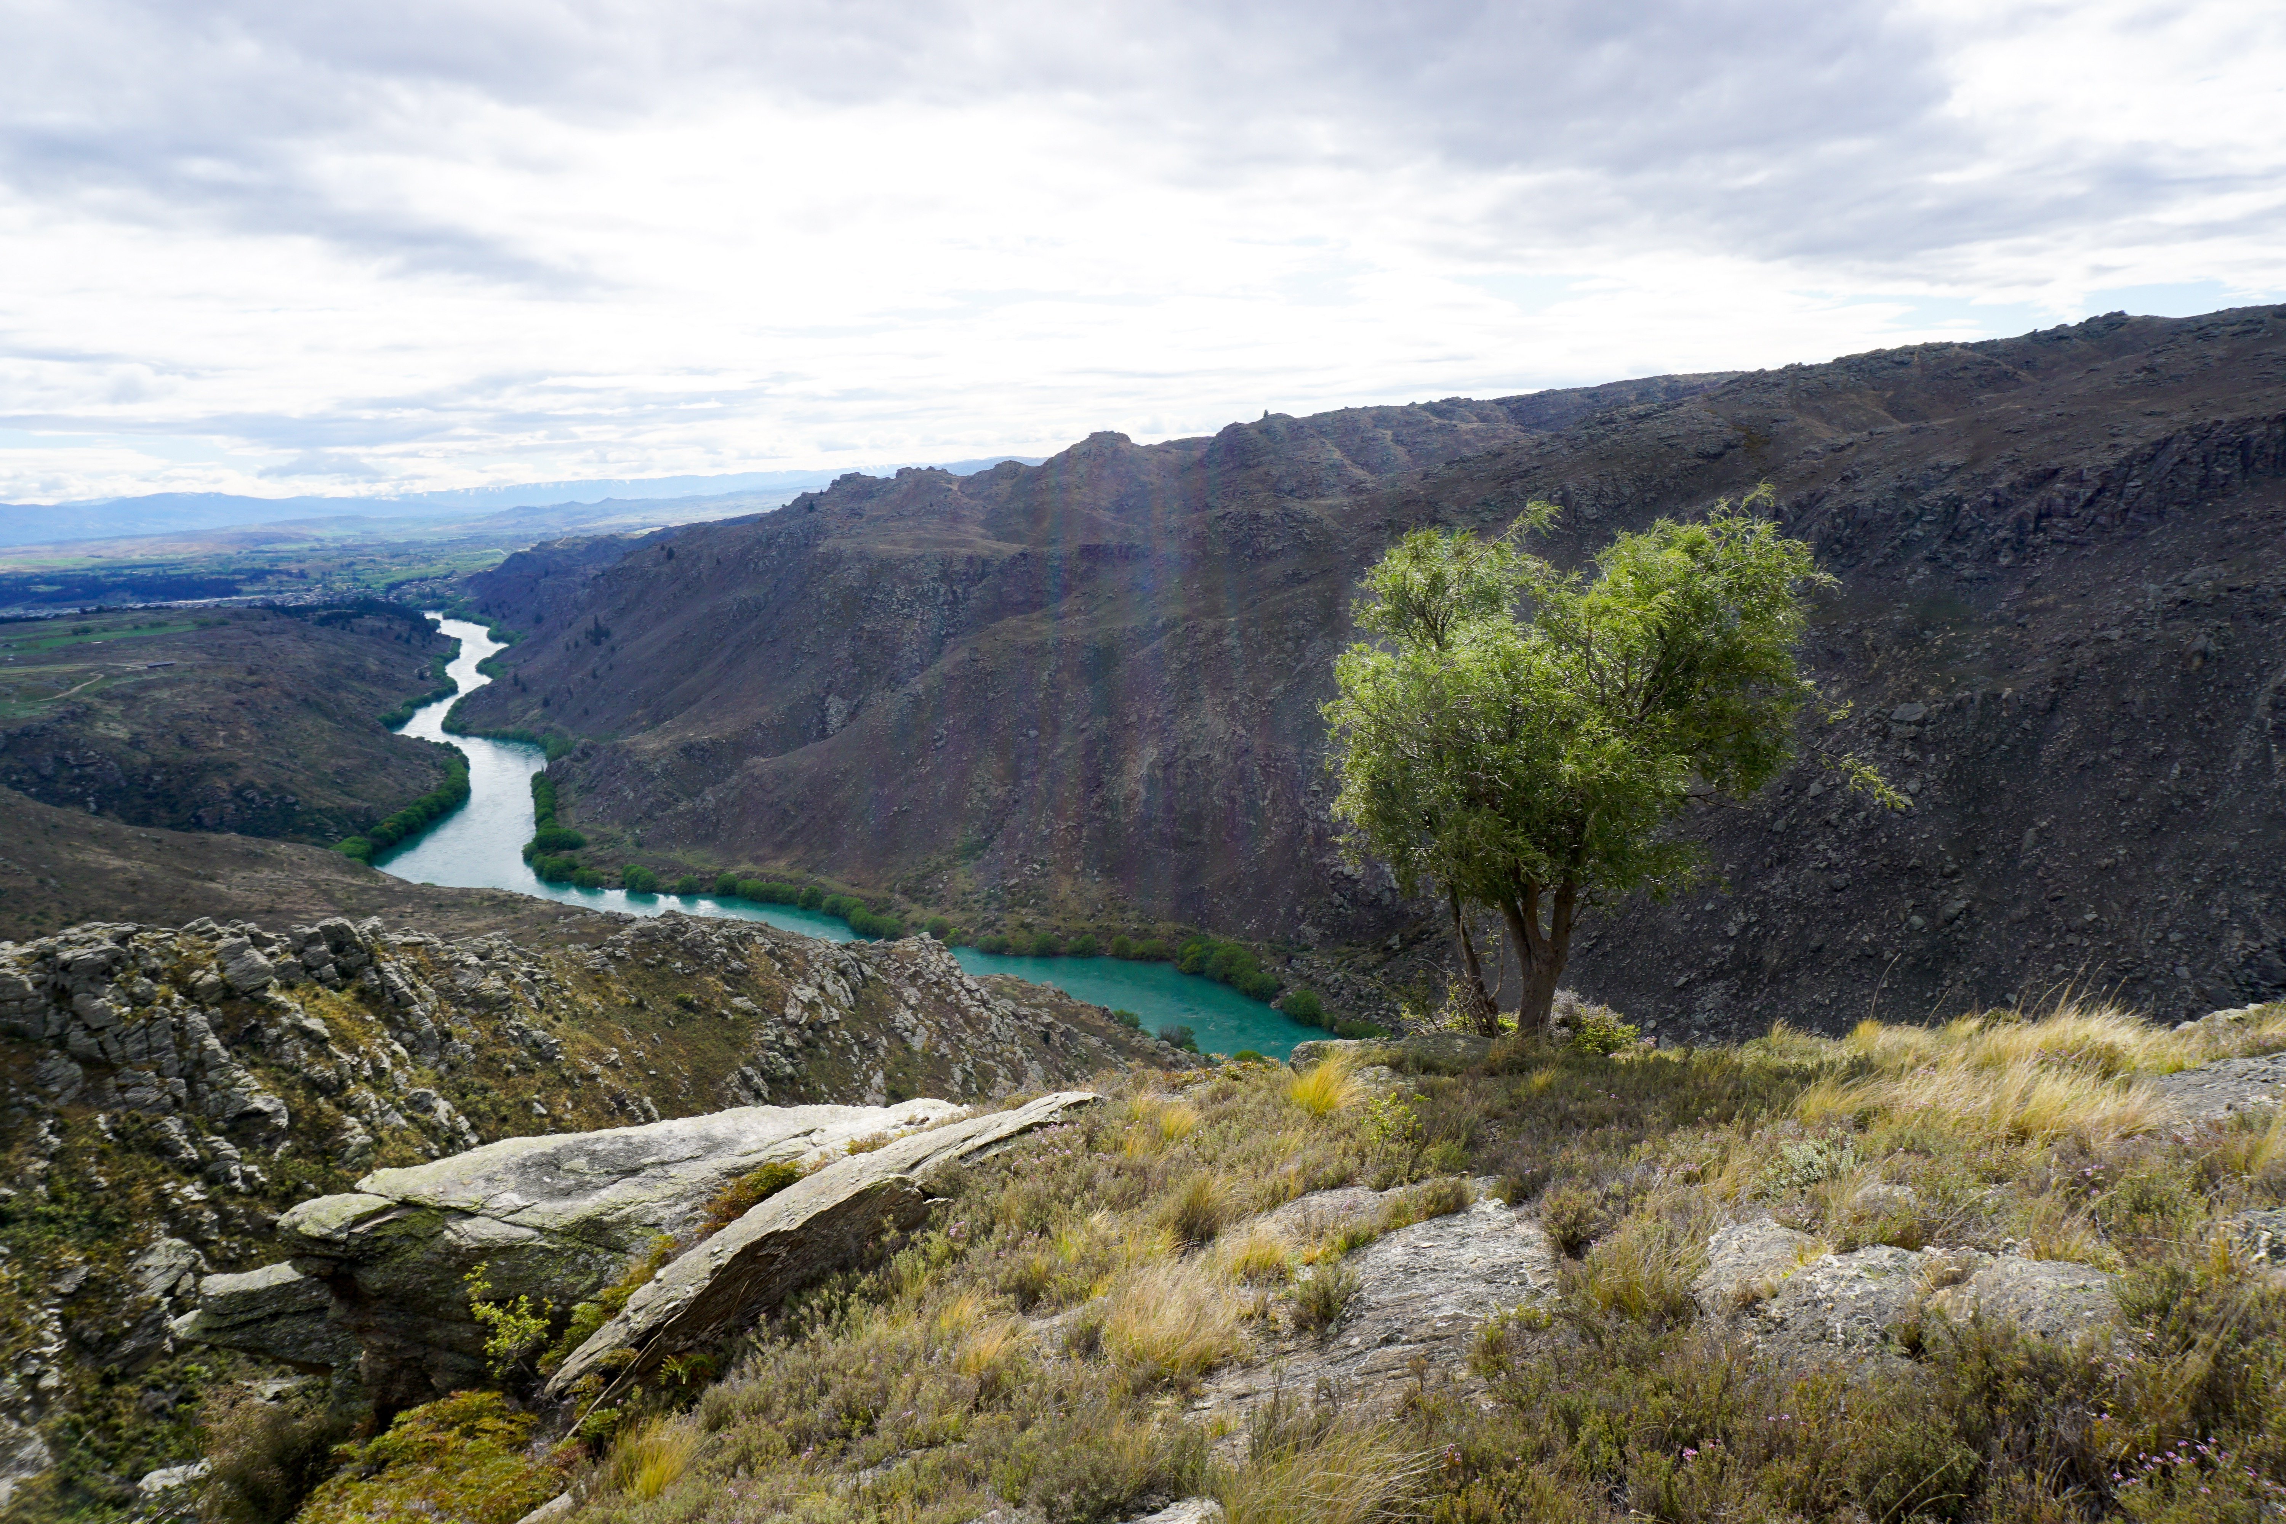
Ecological concerns: loss of habitat
All images are copyrighted. For further information, please refer to enquiries@sciencelearn.org.nz​
© Anna Yeoman
Pole, Mike. 2022. A vanished ecosystem: Sophora microphylla (Kōwhai) dominated forest recorded in mid-late Holocene rock shelters in Central Otago, New Zealand. Palaeontologia Electronica, 25(1):a1. https://doi.org/10.26879/1169.
Copyright: January 2022 Paleontological Society. CC BY-NC-SA 4.0.

Slide 22
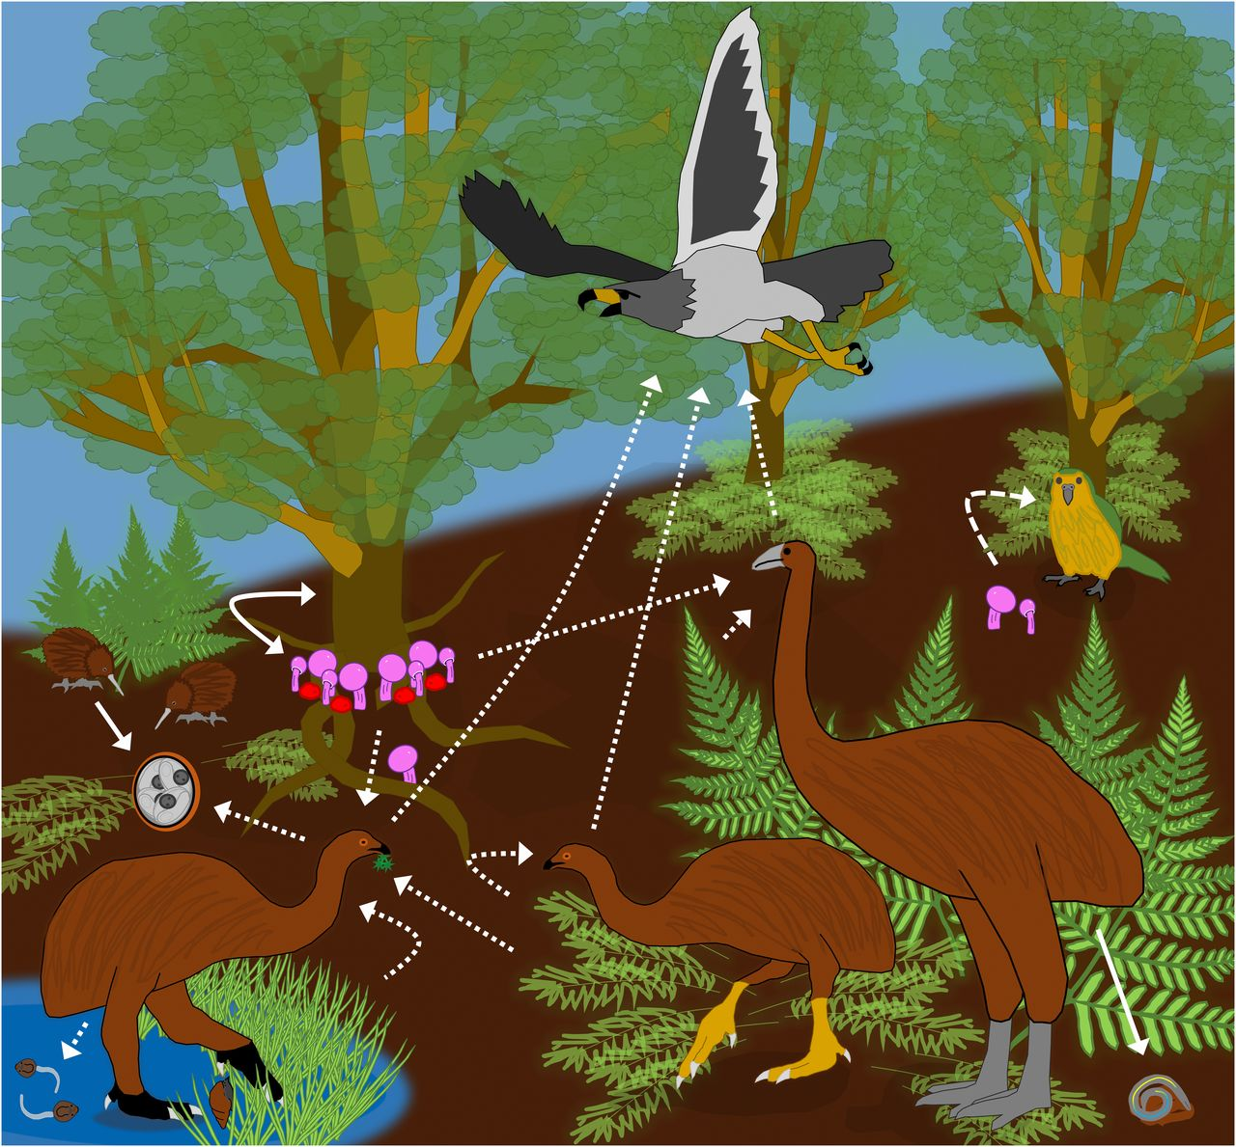
Ecological concerns: gut microflora
© The University of Waikato Te Whare Wānanga o Waikato
© Manaaki Whenua – Landcare Research
K.D. Lafferty, & S.R. Hopkins, Unique parasite aDNA in moa coprolites from New Zealand suggests mass parasite extinctions followed human-induced megafauna extinctions, Proc. Natl. Acad. Sci. U.S.A. 115 (7) 1411-1413, doi.org/10.1073/pnas.1722598115 (2018).
All images are copyrighted. For further information, please refer to enquiries@sciencelearn.org.nz​

Slide 23
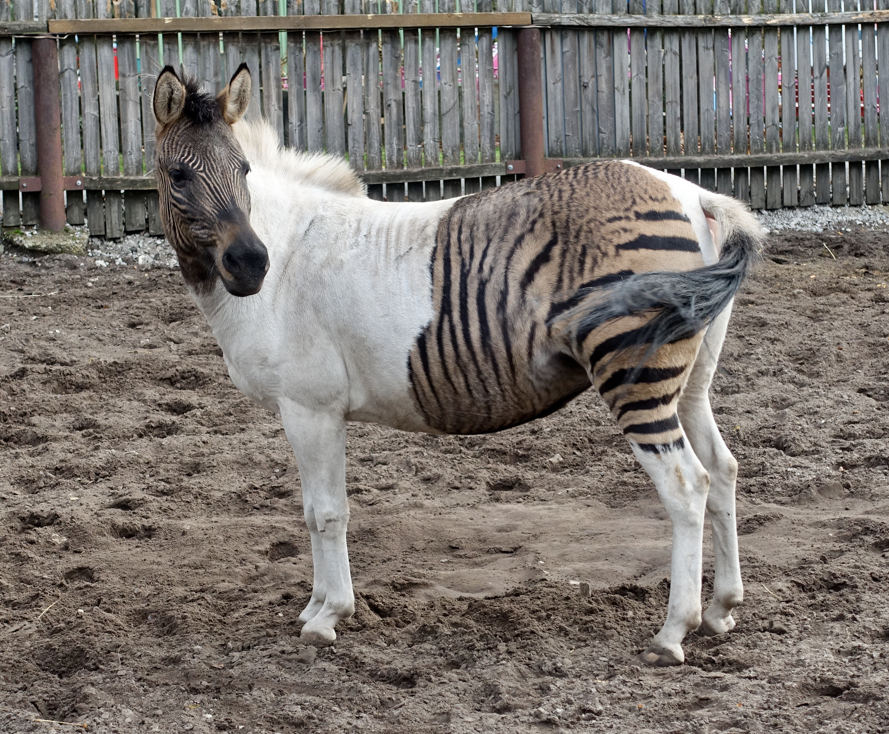
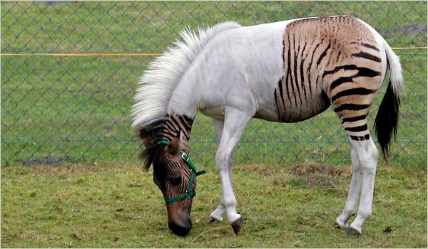
Ecological concerns: mal- or hyper-adapted
© Fährtenleser, CC BY-SA 4.0
All images are copyrighted. For further information, please refer to enquiries@sciencelearn.org.nz​

Slide 24
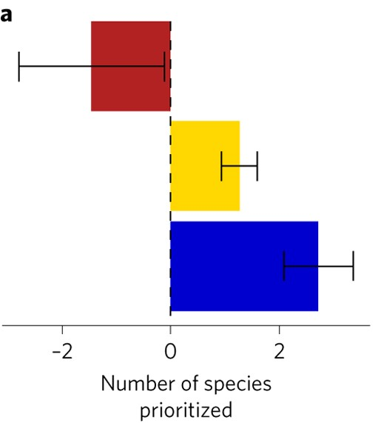
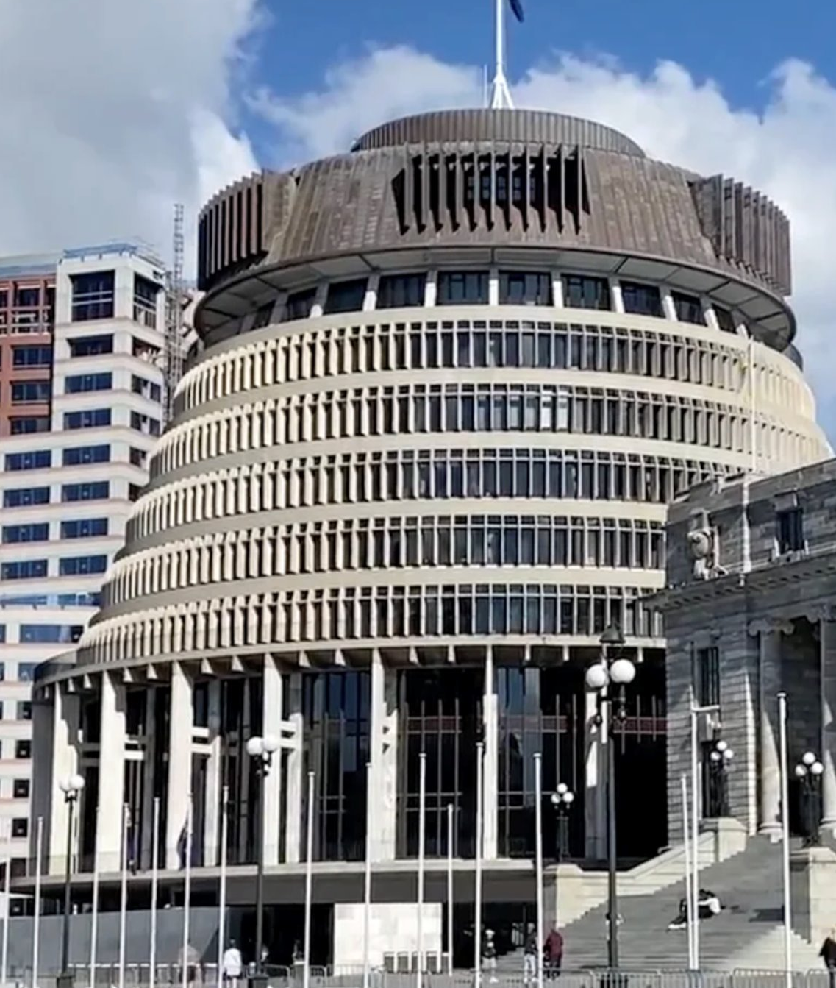
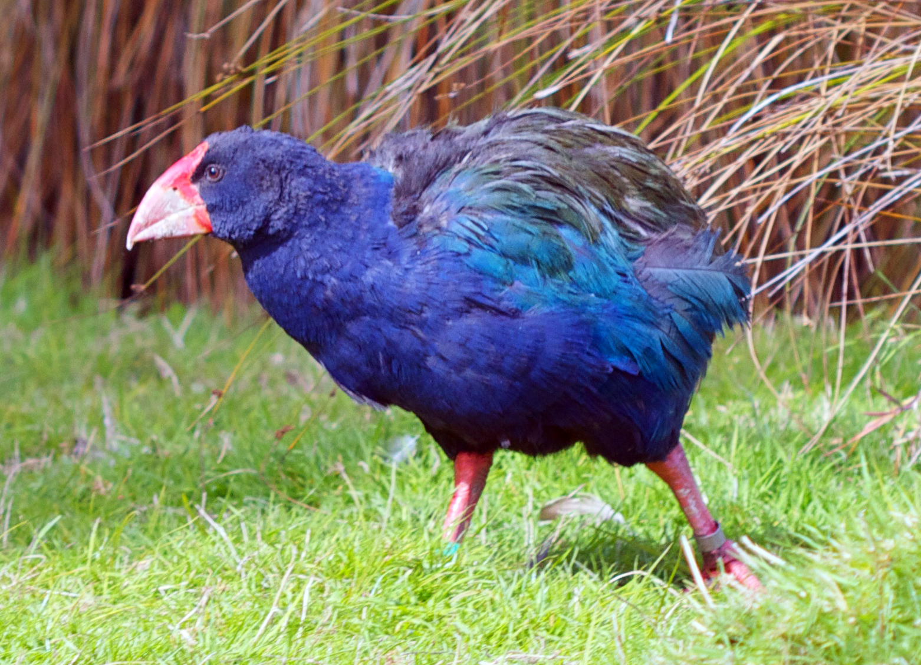
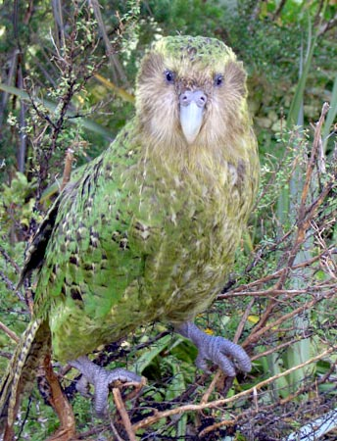
Ecological concerns: opportunity costs
Heavy-footed Moa. Pachyornis elephantopus. From the series: Extinct Birds of New Zealand., 2005, Masterton, by Paul Martinson. Purchased 2006. ​© Te Papa. CC BY-NC-ND 4.0. Te Papa (2006-0010-1/20)
© UOW
Colossal Bioscience
Bennett, J., Maloney, R., Steeves, T. et al. Spending limited resources on de-extinction could lead to net biodiversity loss. Nat Ecol Evol 1, 0053 (2017). doi.org/10.1038/s41559-016-0053.
© Harald Selke, CC BY-SA 2.0
Photo by Mike Bodie, © DOC, CC BY 2.0
All images are copyrighted. For further information, please refer to enquiries@sciencelearn.org.nz​

Slide 25
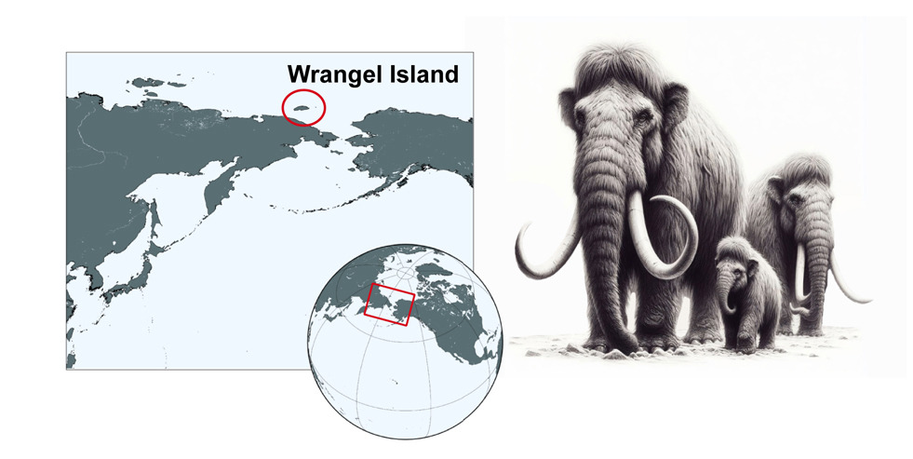
Ecological (ethical) concerns: inbreeding
Temporal dynamics of woolly mammoth genome erosion prior to extinction
Dehasque, Marianne et al. Cell, Volume 187, Issue 14, 3531 - 3540.e13. CC BY 4.0
All images are copyrighted. For further information, please refer to enquiries@sciencelearn.org.nz

Slide 26
Ecological (ethical) concerns: inbreeding
Population size
Temporal dynamics of woolly mammoth genome erosion prior to extinction
Dehasque, Marianne et al. Cell, Volume 187, Issue 14, 3531 - 3540.e13. CC BY 4.0
All images are copyrighted. For further information, please refer to enquiries@sciencelearn.org.nz​

Slide 27
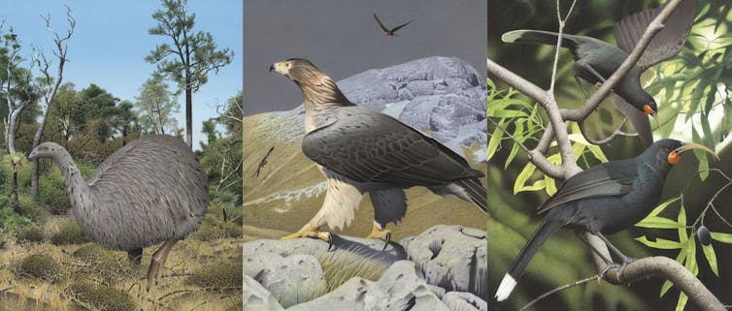
‘De-extinction’ in Aotearoa
Eastern moa|Moa mōmona Image 2006-0010-1/23 from the series 'Extinct birds of New Zealand'.
Masterton, December 2004. Image © Purchased 2006. © Te Papa by Paul Martinson.
Haast’s eagle (Harpagornis moorei). Image 2006-0010-1/37 from the series 'Extinct birds of New Zealand'.
Masterton, December 2004. Image © Purchased 2006. © Te Papa by Paul Martinson.
Huia. Image 2006-0010-1/11 from the series 'Extinct birds of New Zealand'. Masterton, January 2005. Image © Purchased 2006. © Te Papa by Paul Martinson.
All images are copyrighted. For further information, please refer to enquiries@sciencelearn.org.nz​

Slide 28
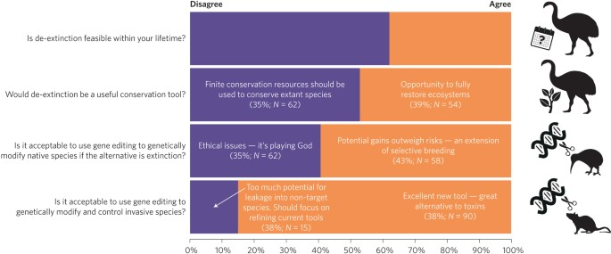
Perceptions of genetic engineering for conservation
Taylor SA, Larson EL. Insights from genomes into the evolutionary importance and prevalence of hybridization in nature. Nat Ecol Evol. 2019 Feb;3(2):170-177. doi: 10.1038/s41559-018-0777-y. Epub 2019 Jan 29. PMID: 30697003.
All images are copyrighted. For further information, please refer to enquiries@sciencelearn.org.nz​

Slide 29
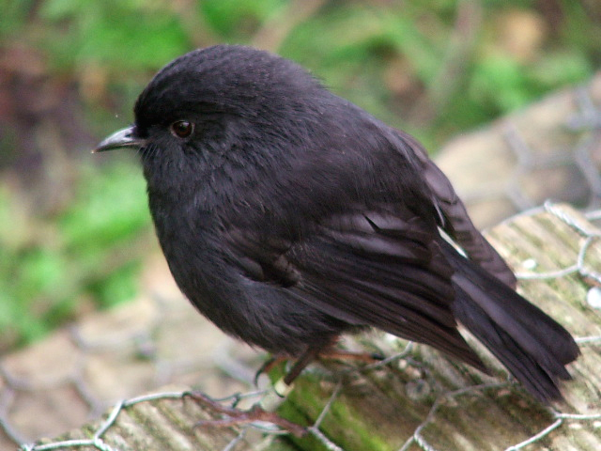
Using ‘de-extinction’ tech for conservation
© Harald Selke, CC BY-SA 2.0
© Francis Schmechel, CC BY-SA 2.0
Photo by Mike Bodie, © DOC, CC BY 2.0
All images are copyrighted. For further information, please refer to enquiries@sciencelearn.org.nz​

Slide 30
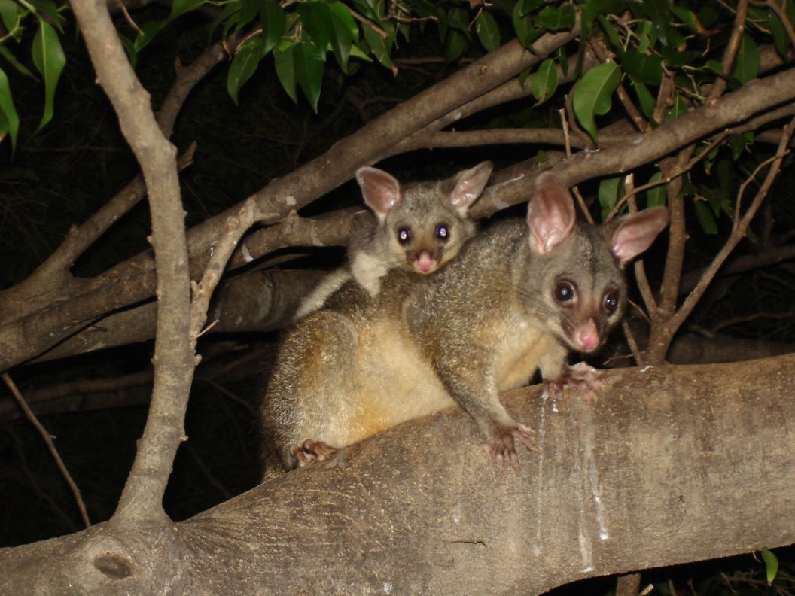
Using ‘de-extinction’ tech for conservation​
All images are copyrighted. For further information, please refer to enquiries@sciencelearn.org.nz​

Slide 31
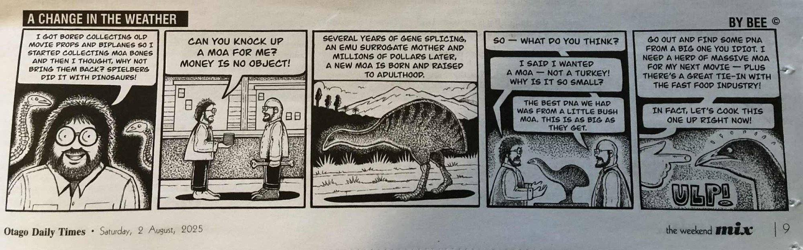


Assessing different forms of sci comm
All images are copyrighted. For further information, please refer to enquiries@sciencelearn.org.nz​

Slide 32
MythBusting de-extinction to sort fact from fiction
© Auckland Museum Collections, CC BY-SA 4.0
https://blogs.otago.ac.nz/lost-worlds/
https://theconversation.com/profiles/nic-rawlence-392371/articles
All images are copyrighted. For further information, please refer to enquiries@sciencelearn.org.nz​
© shutter2you, 123RF Ltd
Notes:
Interest in connecting with kura, and Maori iwi, hapu, runanga, and trusts.

Slide 33








Thanks – want to keep in touch?
Email us on enquiries@sciencelearn.org.nz
Facebook.com/nzsciencelearn
instagram.com/sciencelearninghubnz
bit.ly/slhnz_li
youtube.com/@ScienceLearningHubNZ
pinterest.com/nzsciencelearn
All images are copyrighted. For further information, please refer to enquiries@sciencelearn.org.nz​
Notes:
Greta

